Slide 1
libcxxgpu
GPU Acceleration for the C++ STL

Slide 2
libcxxgpu
C++ STL provides algorithms over data structures
Thrust provides GPU versions of these algorithms
GPU version will always win in some cases
Automatically use the GPU
Implemented as a set of GPU algorithms and utilities
Mostly separate from STL code to allow painless implementation in different versions of the STL
Notes:
Attempts to minimize the number of code modifications in each implementation of the STL
Multiple implementations of the STL
libstdc++ coupled to gcc version

Slide 3
Algorithm Code Modifications
template <typename Iterator>
void sort( Iterator first, Iterator last){
if(first != last){
#ifdef STL_ENABLE_GPU
if( should_use_gpu( 16, last – first, sizeof(T) ) ){
gpu_sort(first, last);
}else{
#endif
… Sequential sorting method …
STL_GPU_END
}
}
Notes:
A compiler flag allows the user to enable or disable GPU acceleration on a per program basis
Uses heuristics to decide which device to execute with and then uses that device

Slide 4
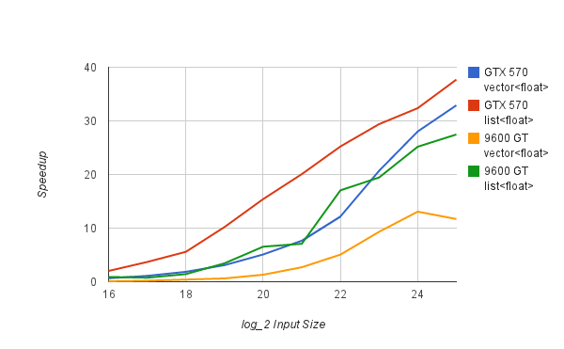
Sorting
Notes:
GTX 570 produces larger speedups because of increased bandwidth (factor of 2.5x) and increased core count (about 10x)
In both cases, list sort produces a larger speedup because random access sort is more heavily optimized on the CPU than list sort

Slide 5
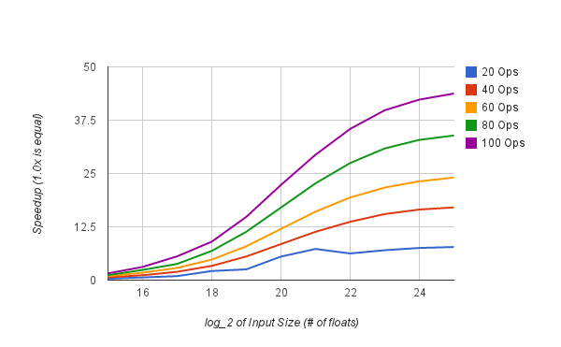
Transform
Notes:
Transform accepts a user-defined function, which allowed us to experiment with how many operations were necessary to make GPU acceleration beneficial
In this case, measured transform with a function of N floating-point additions
As the number of operations increases, the speedup increases for all input sizes
From this data, it is clear that the CPU runtime is more affected than the GPU by the number of instructions per input element

Slide 6
Heuristics
Goal: Never decrease performance by choosing the GPU when the CPU would perform better
Goal: Avoid increase in CPU runtime due to computing heuristics
instruction_factor = Size * Instructions per Element
Instructions per Element is approximated through experiments
CPU is more affected by the amount of computation done per element of data
bandwidth_factor = Elem_Size * GPU_factor
GPU_factor = Constants * bandwidth * cores * clock
GPU is more affected by total amount of data
Due to kernel startup costs and data transfer overheads
If instruction_factor > bandwidth_factor, use the GPU
Notes:
First goal: Be conservative about using the GPU so to not accidentally harm performance by choosing to use the GPU when the CPU would have been better
Second goal: Don’t use heuristics that hurt the runtime of CPU execution
- Example: Checking current GPU utilization may be beneficial, but takes too much time to query the device on each STL function call
GPU_factor gives a rough estimate of the computational capabilities of the target GPU as compared to the GTX 570

Slide 7
Heuristics
Early cutoffs
Don’t want to waste time computing and comparing both factors in cases where the CPU will be faster
Cutoff 1:
Instructions per Element < Minimum Instructions
Cutoff 2:
instruction_factor < Minimum Total Instructions

Slide 8
Future Work
libcxxparallel
Combine vectorization, multi-core, and GPU acceleration
MCSTL provides multi-core STL implementation
Vectorized STL implementation also explored
Performance evaluation on more hardware platforms
Make sure heuristics do not “overfit” evaluated systems

Slide 9
Thank you!
Questions?

Slide 11
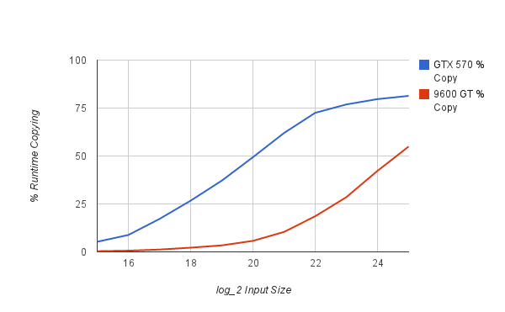
Copying
Notes:
As input_size increases, % of runtime devoted to copying increases
But, runtime for copying to GPU compared to runtime for CPU execution remains nearly constant
And CPU execution time greatly increases faster with input_size than GPU does
Motivates system-on-a-chip designs

Slide 12
5
3
1
4
6
2
5
3
1
4
6
2
thrust::sort
1
2
3
4
5
6
1
2
3
4
5
6

