Slide 1
Python Review

Slide 2
Table of content
Pycharm
Variables
Lists
Read from file

Slide 3
Pycharm

Slide 4
Variables
print('Hello World’)
Hello = ‘Hello World’
x=3 y = 5 z = x + y print(z)

Slide 5
Lists
#Empty string
empty = [] empty = list() zero = [0] * 9 print('Zero:',zero) empty.append(3) print('Emtpy:',empty) print('Length of empty:',len(empty))

Slide 6
List Indexing
list_range = range(8) another_list = [6,0,2,4,10,8,3] print('list_range:',list_range) print('another_list:', another_list) print('Index 5 of list_range:', list_range[5]) print(another_list[3:6])

Slide 7
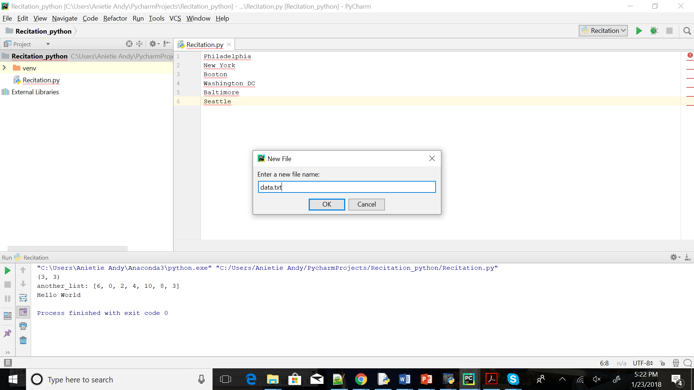
Reading from a file

Slide 8
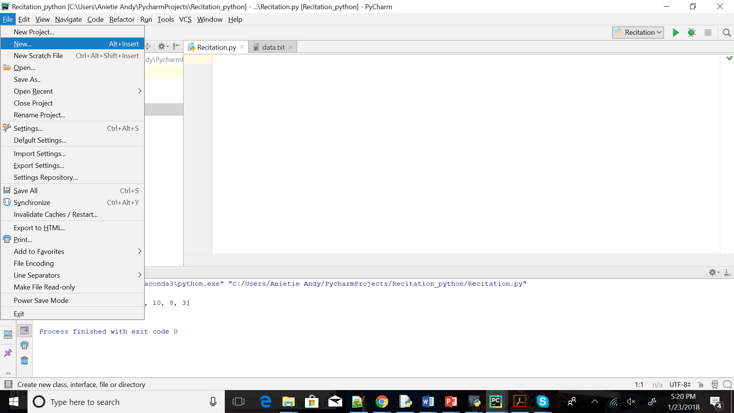
Reading from a file

Slide 9
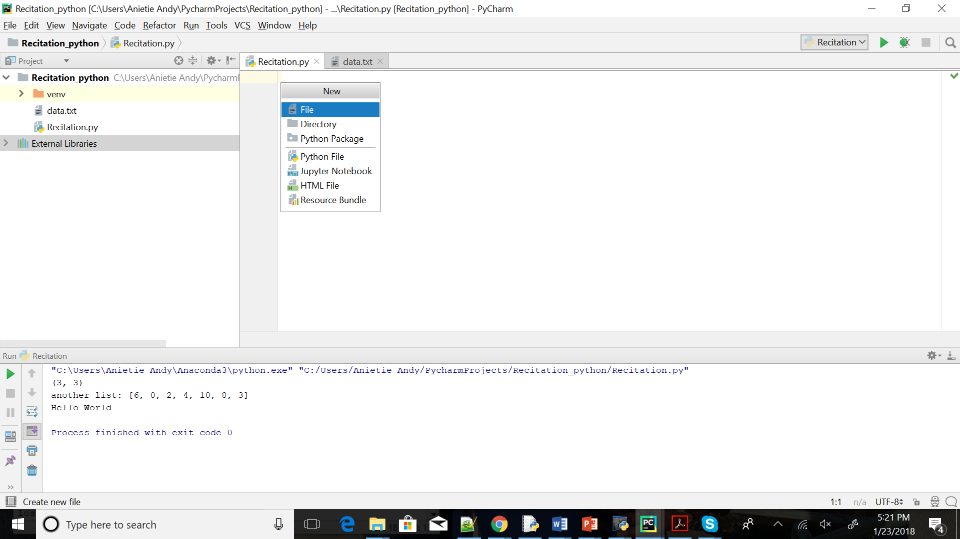
Reading from a file

Slide 10
Reading from a file
Create text file , data.txt
Philadelphia
New York
Boston
Washington DC
Baltimore
Seattle

Slide 11
Reading from a file
#Read from a file data=[] with open('data.txt') as myfile: for line in myfile: data.append(line) print('data:',data)

Slide 12
Reading from file
#Remove end of line character
data=[] with open('data.txt') as myfile: for line in myfile: data.append(line.rstrip()) print('data',data)

Slide 13
Matrixes and Vectors: Numpy
A scientific computing package for Python
$M=\left|\begin{matrix}1 & 2 & 3 \\ 4 & 5 & 6 \\ 7 & 8 & 9\end{matrix}\right| v=\left|\begin{aligned}1 \\ 2 \\ 3\end{aligned}\right|$
import numpy M = np.array([[1, 2, 3], [4, 5, 6], [7, 8, 9]]) v = np.array([[1],[2],[3]])

Slide 14
Matrixes and Vectors: Numpy
print(M.shape)
(3, 3) print(v.shape)
(3, 1) print(v+v)
[[2]
[4]
[6]]

Slide 15
Other ways of creating Matrices and Vectors
a = np.zeros((2,2)) #Create an array of all zeros print(a)
[[ 0. 0.]
[ 0. 0.]]
[[ 1. 1.]]
b = np.ones((1,2)) #Create an array of all ones print(b)

Slide 16
c = np.full((2,2), 7) #Create a constant array
print( c )
[[ 7. 7.]
[ 7. 7.]]
d = np.eye(2) #Create a 2x2 identity matrix
print(d)
[[ 1. 0.]
[ 0. 1.]]

Slide 17
e = np.random.random((2,2)) #Create an array with random values
print(e)
[[ 0.96285848 0.34266397]
[ 0.89280528 0.58975698]]

Slide 18
Element-wise Multiplication
$M=\left|\begin{matrix}1 & 2 & 3 \\ 4 & 5 & 6 \\ 7 & 8 & 9\end{matrix}\right| v=\left|\begin{aligned}1 \\ 2 \\ 3\end{aligned}\right|$
print(np.multiply(M,v))
[[ 1 2 3]
[ 8 10 12]
[21 24 27]]
print(np.multiply(v,v))
[[1]
[4]
[9]]

Slide 19
Transpose
print(M)
[[1 2 3]
[4 5 6]
[7 8 9]]
print(M.T)
[[1 4 7]
[2 5 8]
[3 6 9]]

Slide 20
print(v)
[[1]
[2]
[3]]
print(v.T)
[[1 2 3]]

Slide 21
Stochastic Gradient Descent
from sklearn.linear_model import SGDClassifier
X = [[0., 0.], [1., 1.]]
y = [0, 1]
clf = SGDClassifier(loss="hinge", penalty="l2")
clf.fit(X, y)
Predict new values
clf.predict([[2., 2.]]

Slide 22
End

Slide 24
Dictionaries
#Empty dictionary empty_dict=dict() another_empty_dict = {} #Adding values to the dictionary non_empty_dict = {1:'CIS', 2:'419/519'} #printing values of the dictionary print('empty_dict:',empty_dict) print('non_empty_dict:', non_empty_dict[1] + non_empty_dict[2])

Slide 25
Dictionaries (continued)
print('non_empty_dict:', non_empty_dict.keys()) print('non_empty_dict:', non_empty_dict.values()) #Adding a value to an existing dictionary non_empty_dict[3] = 'Recitation'

Slide 26
Dictionaries (continued)
#Print dictionary print('non_empty_dict:', non_empty_dict) #Deleting from a dictionary del non_empty_dict[3] print('non_empty_dict:',non_empty_dict)

