Slide 1
libcxxgpu
GPU Acceleration for the C++ STL

Slide 2
libcxxgpu
C++ STL provides algorithms over data structures
Thrust provides GPU versions of these algorithms
GPU version will always win in some cases
Automatically use the GPU
Plan: Implement over LLVM libcxx
Compatibility issues with linux/thrust
Implementing over libstdc++
And libcxx if time allows

Slide 3
5
3
1
4
6
2
5
3
1
4
6
2
thrust::sort
1
2
3
4
5
6
1
2
3
4
5
6

Slide 4
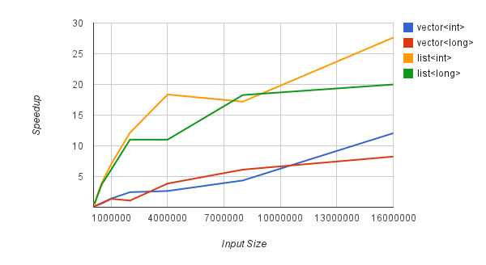
CPU vs. GPU Sort

Slide 5
Data Structure Flexibility
list<int> vs. vector<int>
vector sort runtime < list sort runtime
CPU: 6.9x average, 14.4x maximum
GPU: 1.6x average, 3.8x maximum
list<long> vs. vector<long>
CPU: 6.2x average, 15.1x maximum
GPU: 1.3x average, 2.5x maximum
Choose the appropriate data structure
Less need to choose based on sorting speed

Slide 6
Challenges: O(n) Algorithms
std::find
O(n) worst-case runtime
O(n) just to copy data to the GPU
Though maybe more practical with more bandwidth
9600 GT: 57.6 GB/s vs. GTX 480: 177.4 GB/s
Possible solutions
Lazy operations
Rewrite with sort and binary_search

Slide 7
Challenges: Heuristics
When should we execute on the GPU?
Choose based on multiple factors:
Number of elements
Element size
GPU generation
Compile-time or Run-time choice

