Slide 1

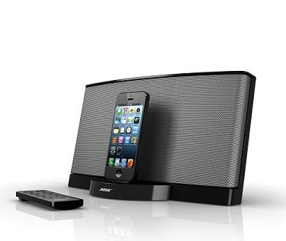
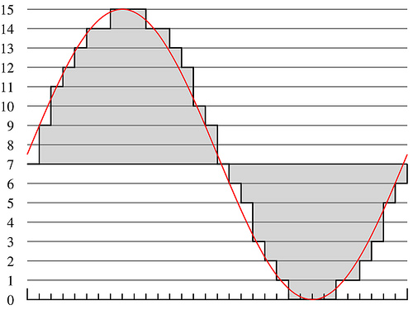
Lecture #9 – Operating Systems (OS)
ESE 150 –
Digital Audio Basics

Slide 2
Preclass 1
What things can your phone do while you are listening to an MP3?

Slide 3
Observation
We want our devices (including our phones) to do many things at once.

Slide 4
Multiple tasks
We could…
  Dedicate a separate processor for every task we want to perform
How many would we need?
Maybe
  Need dozen processors for our Phone

Slide 5
But….
MP3 Play
  44,000 samples per second decoded
  500 cycles to decode a sample
  How many instructions per second require?
What fraction of a 10⁹ instruction per second processor does this use?

Slide 6
Observation
If we dedicate a processor to MP3 decoding
  It will sit idle most of the time
MP3 decoding (and many other things) do not consume the processor
Maybe we can share the processor among tasks?

Slide 7
Outline
Setup Need / Opportunity
Where are we
Role of Operating System
Virtualization

Slide 8
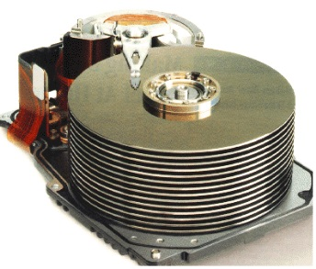

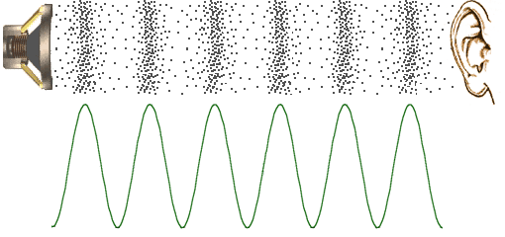




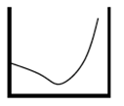



Course Map
7,8,9
10101001101
MIC
CPU
File-
System
A/D
10
10101001101
NIC
Music
1
domain
conversion
5,6
Numbers correspond to course weeks
compress
sample
freq
pyscho-
acoustics
3
2
4
13
11
EULA
----------------click
OK
D/A
NIC
speaker
MP3 Player / iPhone / Droid
12

Slide 9
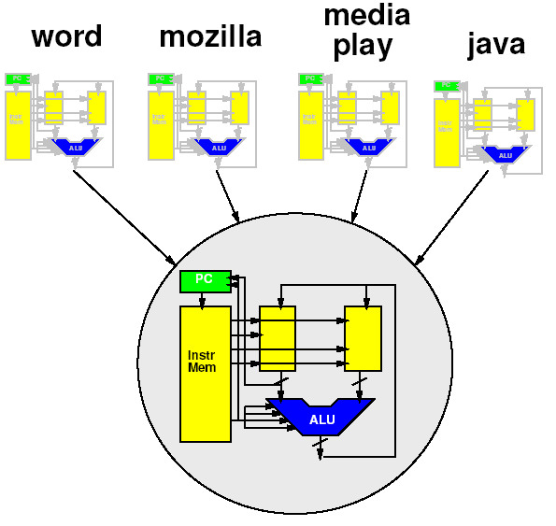
Course Map – Week 10
MIC
A/D
Music
1
domain
conversion
5,6
Numbers correspond to course weeks
compress
sample
freq
pyscho-
acoustics
3
2
4
EULA
----------------click
OK
D/A
10101001101
speaker
MP3 Player / iPhone / Droid

Slide 10
“Stored-Program” Processor
By filling in memory, can program to perform any computation

Slide 11
Role of Operating System

Slide 12
Programming the Processor
How can we change the program/app?
  How do we gets the bits into memory?
  What if had to reboot machine… for every application?
  Change flash card
  Download over USB

Slide 13
More than one Program?
How could we have multiple applications?
  (just run one at a time for now)

Slide 14
Multiple Running Programs?
How can multiple applications run simultaneously on this?

Slide 15
Coordination?
Does every program need to
know about every other
program?
  Implications?
Where acceptable?
  Proprietary system with small
  set of applications all developed
  in-house.
Where unworkable?
  Any upgradeable platform (e.g. laptop, iPhone)
  Any platform integrating non-source applications from variety of sources

Slide 16
Role of Operating System
Higher-level, shared support for all programs
  Could put it in program, but most programs need it!
  Needs to be abstracted from program
Resource sharing
  Processor, memory, “devices” (net, printer, audio)
Polite sharing
  Isolation and protection
  Fences make Good Neighbors – R. Frost
Idea: Expensive/limited resources can be shared in time – OS manages this sharing

Slide 17
Shared Support
What software support do most programs need?
Examples:
  Memory allocation/deallocation
  Handle I/O: keyboard/screen
  Draw pretty boxes/menus/selections

Slide 18
Devices
Displays
Input (keyboard, mouse)
Storage (hard drive, USB drive, CDROM)
Network (ethernet, wifi, bluetooth)
Microphone, speakers
GPS
Printer

Slide 19
Device Coordination
Coordinate among multiple users
  Don’t want programs accessing hardware directly ignorant of other users
Exclusively allocate to one application at a time?
  Speaker
  Printer
  Screen? (portion of screen?)
Allow interleaved use?
  Network
  Hard disk

Slide 20
Virtualization

Slide 21
Virtualization
Providing an abstract view separate from the physical view
Hides physical view
Provides abstract view to software
  Abstract from physical resource limits

Slide 22
Idea
Virtualize the processor
  Make it look like we have multiple processors
  With each program running on its own processor
Abstraction
  Programs see hardware as simple blocks
    Ex: USB/Display/I/O all seen as a “file”
    Programmer View:
      calls function: “FGETC()” to read character from keyboard
    OS View:
      Transfers data along databus from keyboard into memory
      Loads data from memory to regfile, returns to user
      Programmer/User never knows how complex things are!

Slide 23
Terminology: Process
Process
  A virtualization of the physical processor
    an instance of a program in execution
  Virtual processor

Slide 24
What does our program see?
Physically
  One processor
    One PC
    One data memory
    One instruction memory
  These are its state
    Terminology: context

Slide 25
Executing the Program
To execute program
  Keep track of state of machine
    Value of counter
    Contents of instruction memory
    Contents of data memory
(Program counter)

Slide 26
Execution Exercise
Simulate one of the 2 cases (as indicated on your worksheet) for the 12 cycles shown.
Work in pairs
  in part so can use 2 worksheets to see both sides
  …but really to check each other…

Slide 27
Execution: Getting Started
0
5
35
255
66
1
5
35
0
66
2
5
1
0
66

Slide 28
Execution Exercise
What is the state for the +12 cycle? (A, B)
What is the state for the +6 cycle? (A, B)

Slide 29
One Processor, One Program
On the physical machine, can only run one program
  Why?
    One PC
    One memory

Slide 30
Virtualization
Make it look like we have multiple resources
  Multiple processors
Provide abstraction of large* number of processors
  Each program gets its own processor
    Each program gets its own machine state
  * “large” enough to approximate infinite

Slide 31
Virtualization

Slide 32
Key Idea
Can capture state of a processor
  All the information that defines the current point in the computation

Slide 33
Executing the Program
What is the state of the processor?
  Value of Program Counter (PC)
  Contents of instruction memory
  Contents of data memory

Slide 34
Key Idea
Can capture state of a processor
  All the information that defines the current point in the computation
  i.e. program counter, data and instruction memory
Can save that in memory
  A different memory from what the process sees
  (could be different range of addresses)
Fully represents the running program
Can restore that from memory to the processor
Can save/restore without affecting the functional behavior of the program

Slide 35
State in Memory

Slide 36
Sharing Processor
Now that we can save/restore the state
Can share processor among processes
  (Restore state; run for time; save state)
Isolation: none of the processes need to know about each other
  Each thinks it has the a whole machine

Slide 37
Memory?
“save all of memory” ?
  Must have more memory
  Enough to hold all the memory of all the running programs == all the processes
Each program has view that it owns machine
  Each may put program in same place?
  Shouldn’t have to know about other programs, where they use memory

Slide 38
Saving Memory?
Each program has view that it owns machine
  Each may put program in same place?
  Shouldn’t have to know about other programs, where their stacks are…
Could:
  Have programs operate 0…max_process_mem
  Copy data in and out of this range
  Keep elsewhere
    more memory not visible to program
    On disk

Slide 39
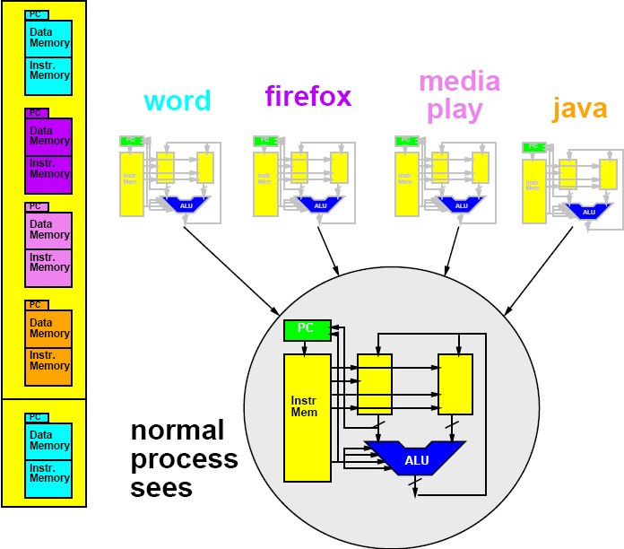
Memory Save/Restore
Memory Save/Restore

Slide 40
Memory Save/Restore
Memory Save/Restore
Save

Slide 41
Memory Save/Restore

Slide 42
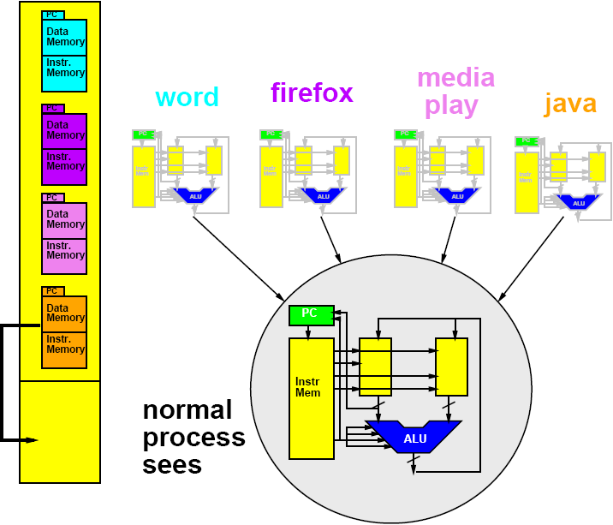
Memory Save/Restore
Restore

Slide 43
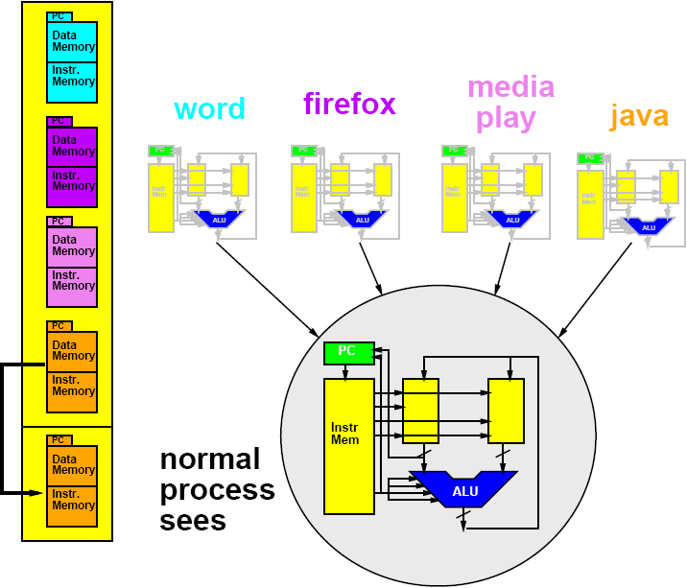
Memory Save/Restore
Restore

Slide 44
Saving Memory?
Each program has view of it owns machine
  Each may put program in same place
  Shouldn’t have to know about other programs…
    where their stacks are…etc.
Can do better
  Avoid copying
  Virtualizing Memory as well
    Translate processor addresses

Slide 45
Management Program
Need another program → process
  Manage swap of running processes
  Decide what to run next
  Decide when to stop a process
…process manager/scheduler

Slide 46
Time-Sliced Sharing
Simplest version:
  Run each process for 10,000 cycles
  Then swap to next process
  Looks like each process runs on a processor 1/n-th the speed of the real processor
More sophisticated:
  Assign uneven time to processes
  Also change when process…
    waits for input
  What are cases where this is
    appropriate?

Slide 47
Time Switch Exercise
Write down the +6 cycle state from the opposite case
  This is your “swap back in” of task

Slide 48
Time Switch Exercise
Simulate from +6 cycles
What is the state for the +12 cycle?
Compare earlier solutions

Slide 49
Time Switch Exercise Demo
Simulating a case:
Processor runs A for 6 cycles
  Then stores off to memory.
Processor runs B for 6 cycles
  Then stores off to memory
Processor reads A state from memory and runs for another 6 cycles
Processor reads B state from memory and runs for another 6 cycles

Slide 50
Device Virtualization
Similar concept
  Identify state of device
  Save/restore state as use “virtual” device
Window as virtualization for screen
  May not even be visible (e.g. minimized)

Slide 51
Review: Key Idea
Can capture state of a processor
  All the information that defines the current point in the computation
  i.e. program counter, data and instruction memory…
Can save that in memory
  A different memory from what the process sees
  (could be different range of addresses)
Fully represents the running program
Can restore that from memory to the processor
Can save/restore without affecting the functional behavior of the program

Slide 52
Upcoming Lab
Explore linux and processes on linux
Monday after next (4/9)
This Monday (4/2) – Processor Lab
  Lab now out, yet … but should be soon…

Slide 53
Big Ideas
Virtualize hardware
  Identify state; save/restore from memory
Program view: owns complete machine
Allows programs to share limited physical hardware (e.g. processor)
  Provide illusion of unlimited hardware
Operating System is the program that manages this sharing

Slide 54
Learn More
CIS380 – Operating Systems

