Slide 1
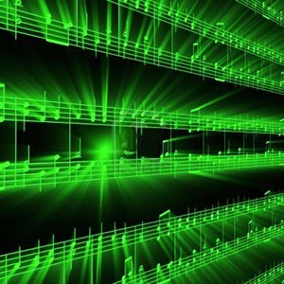
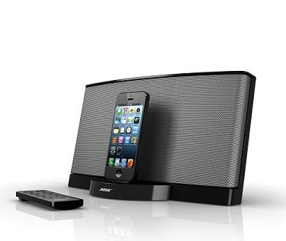
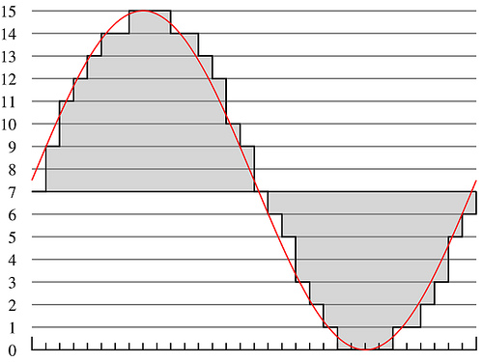
Lecture #10 – Psychoacoustics: Masking
ESE 150 –
Digital Audio Basics

Slide 2
Lecture Topics
Where are we on course map?
Psychoacoustics
  Review
  Masking
References

Slide 3
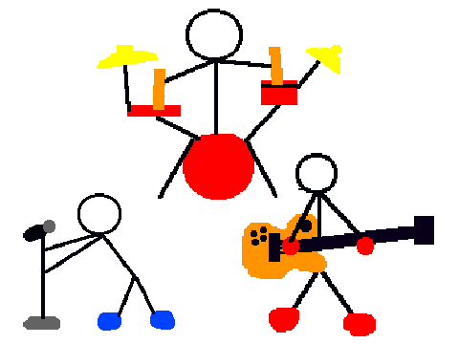
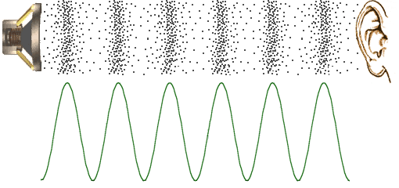
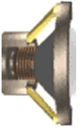

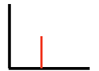
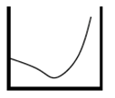
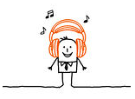

Course Map – Week 6
MIC
A/D
10101001101
Music
1
domain
conversion
5
Numbers correspond to course weeks
compress
sample
freq
pyscho-
acoustics
3
2
4
D/A
10101001101
speaker
MP3 Player / iPhone / Droid

Slide 4
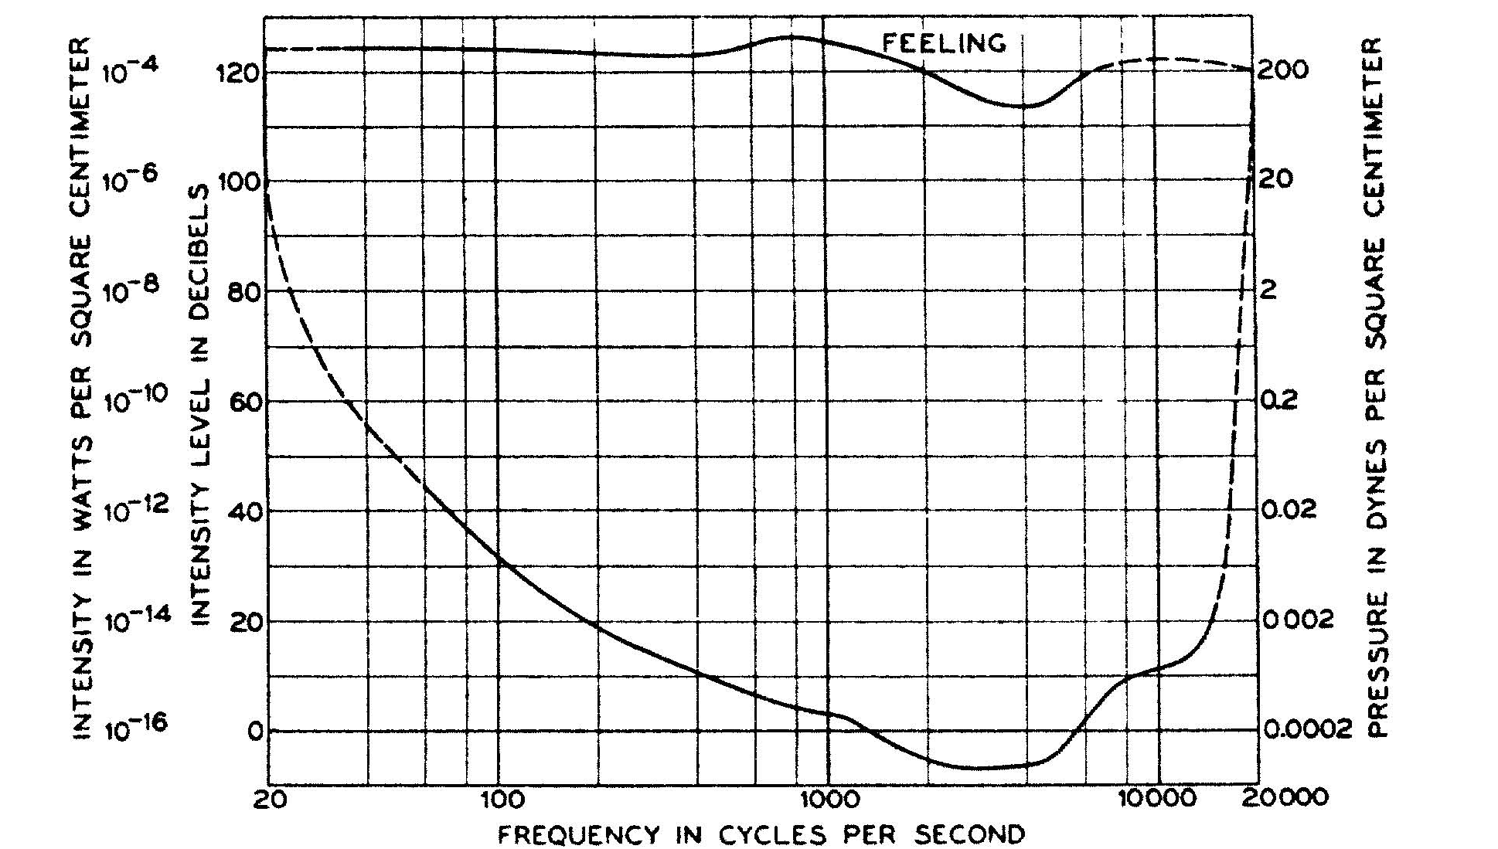
Lab 5: Measured own Fletcher Curve

Slide 5
Lab 5: Measured Masking
Saw (heard) that loud tones could mask softer, nearby frequencies.

Slide 6
Psychoacoustics

Slide 7
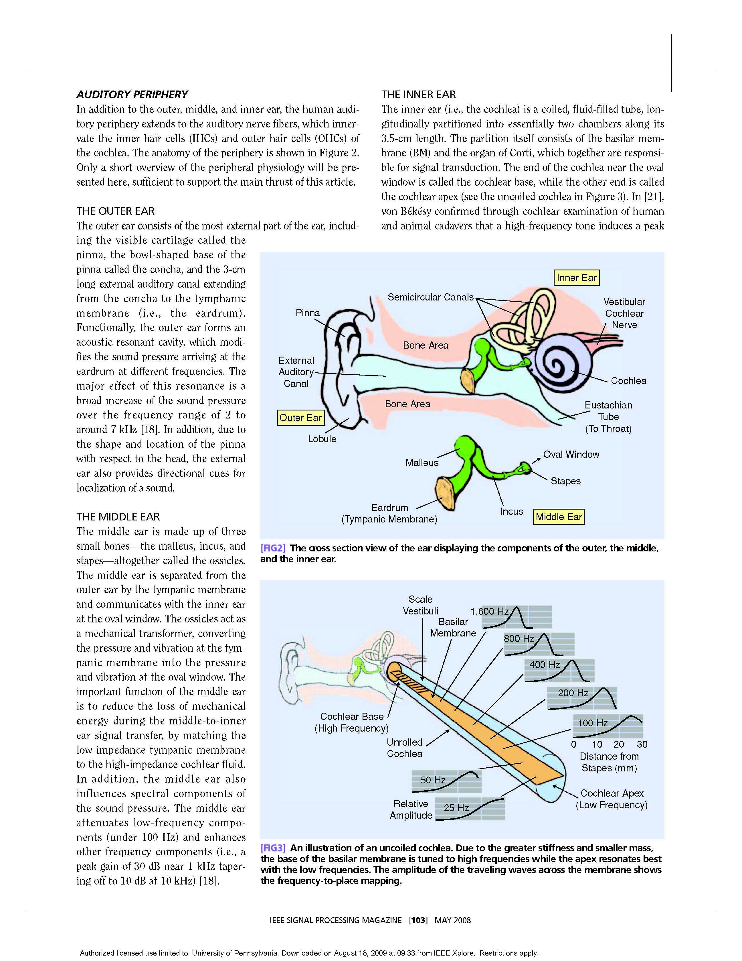
The Physical Ear – Take-away
Cochlea
  directly senses frequencies
  Captures frequency domain
  …not time domain
Frequency sensitive locations
  activated by sound waves
Neurons sense activation
Picture above – uncoiled cochlea…
-- different stereovilli (Hairs) resonate at different frequencies
-- our ear performs Fourier Transform!
Notes:
Snail shell is latin translation

Slide 8
Physical Ear to Engineering Model
Limits of Human Hearing…easy to see from Cochlea
  Cochlea only so long…
    lowest frequencies: 20 Hz
    Highest frequencies: 20 kHz
Also helps us understand ‘selectivity’
  Our brain can choose to ‘listen’ to output of various filters
  Example: At a party, but you can concentrate on conversation!
Notes:
Average length of choclea: 31.5mm long!

Slide 9
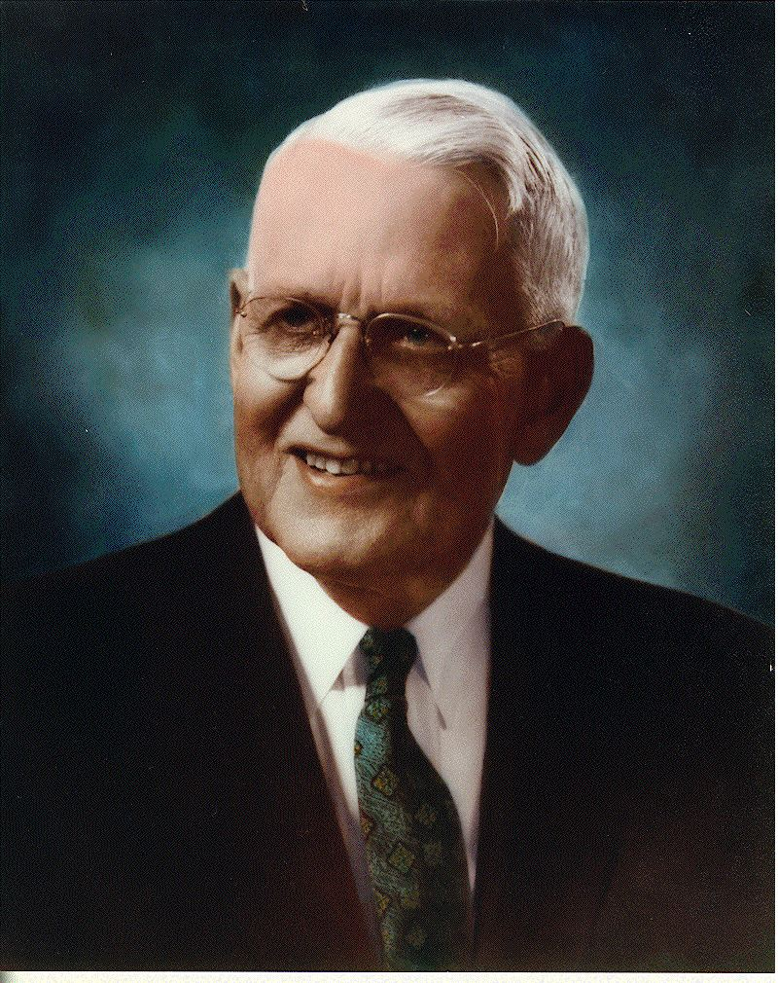
Auditory Thresholds – Measured by Fletcher
Low frequency & very high frequency sounds
must be intense for us to interpret them as
“loud” as sounds with frequencies in 1k to 5k range

Slide 10
Auditory Masking

Slide 11
Masking
Auditory Masking
  When the perception of one sound is affected by the presence of another
    Remember…perception
Two types:
  Frequency Domain Based:
    Frequency Masking, simultaneous masking, spectral masking
  Time Domain Based:
    Temporal Masking / non-simultaneous masking

Slide 12
Frequency Domain Masking
Masking illustrates the limits of ear selectivity
  In fact, we measure ear selectivity using masking!
Vocabulary:
  Masker – The noise ‘masking’ the maskee
  Maskee – The signal being ‘masked’ by masker

Slide 13
On-Frequency Masking
Greatest/worst form of frequency masking
  Occurs when maskee & masker are the same frequency

Slide 14
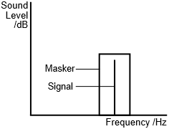
On-Frequency Masking
Greatest/worst form of frequency masking
  Occurs when maskee & masker are the same frequency
  Also strong when masker and signal are within same auditory band (filter)

Slide 15
On-Frequency Masking
Greatest/worst form of frequency masking
  Occurs when maskee & masker are the same frequency
  Also strong when masker and signal are within same auditory filter
  Think about Cochlea vibrating:
Nearby hair cells vibrating
will cause some vibration.
Interpreted by brain as caused
by large vibration, not a separate
frequency.

Slide 16
On-Frequency Masking
Greatest/worst form of frequency masking
  Occurs when maskee & masker are the same frequency
  Also strong when masker and signal are within same auditory filter
  Think about Cochlea vibrating:
  Listener cannot distinguish between
  them, perceived as one sound
  Preclass 1: audience noise masks
  movie line

Slide 17
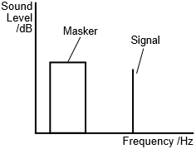
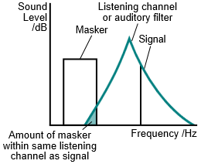
Off-Frequency Masking
Off-frequency masking
  Masker has different frequency than signal
  Masker still has effect…
    …if it’s in same auditory filter band as signal

Slide 18
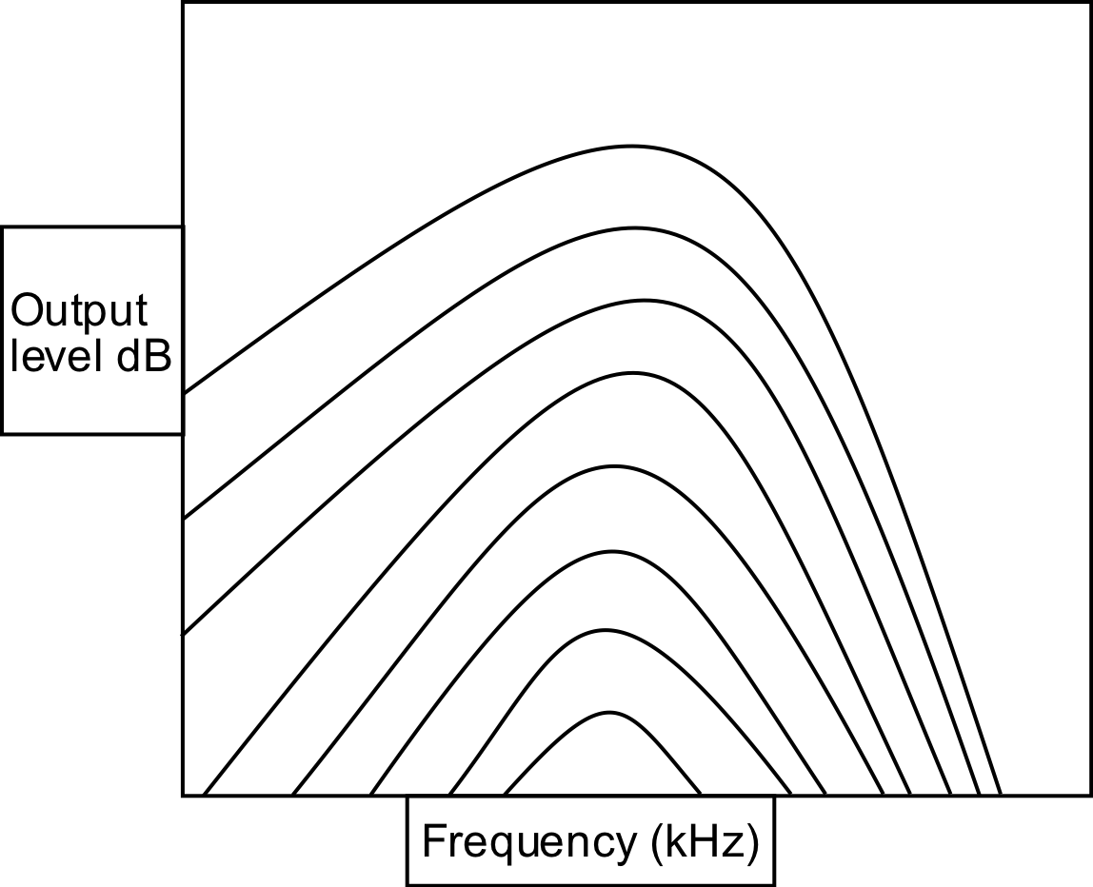
Frequency Masking
Given a signal at a frequency
How strong must a signal (or noise) at a difference frequency be in order to be heard?
General trend:
  Larger the frequency difference
  The less strong it must be (the less masking)
https://commons.wikimedia.org/wiki/File:OutputlevelMoore.svg

Slide 19
Frequency Masking Example
1000
2000
4000
80
Freq (Hz) | Strength (dB)
1000 | 80
2000 | 70
4000 | 20
70
20
https://commons.wikimedia.org/wiki/File:OutputlevelMoore.svg

Slide 20

Demonstration
Generate 900 Hz Tone (left channel) (maskee)
  Turn gain all the way down (-36 dB)
Generate 1000 Hz Tone (right channel) (masker)
  Keep gain at 0 dB
Play sound…
  Bring intensity of 900 Hz tone up so we can hear both tones
  Mute masker and play it again…
    Maskee was always there, just couldn’t hear it
    Even though it was at different frequency of masker
Notes:
Used audacity for these demos

Slide 21
Demonstration
Generate 1000 Hz Tone (masker) [band 9]
Sweep frequency 700Hz to 1600 Hz (masked)
  About 20% of level of masker
  Bands 7--11
Both constant loudness
Reference without Masker
Play sound…
  When hear second signal?
See diminished masking effects as frequencies get further apart
Notes:
Used audacity for these demos

Slide 22
Frequency Masking Example
1000
2000
4000
80
Freq | Strength
1000 | 80
2000 | 70
4000 | 20
70
20
https://commons.wikimedia.org/wiki/File:OutputlevelMoore.svg

Slide 23
Frequency Masking Example
1000
2000
4000
80
Freq | Strength
1000 | 80
2000 | 70
4000 | 20
70
20
Which of A, B, C are masked?
https://commons.wikimedia.org/wiki/File:OutputlevelMoore.svg

Slide 24
Preclass 2
Which frequencies should we keep?

Slide 25
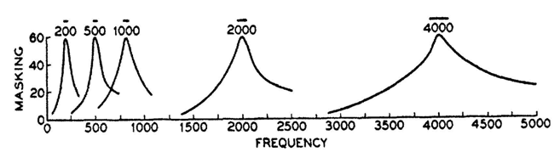
Frequency Masking @ Higher Frequencies
Plots of masking at several different frequencies:
  Effect of masking is ‘worse’ at higher frequencies
  Masking band gets wider at higher frequencies

Slide 26
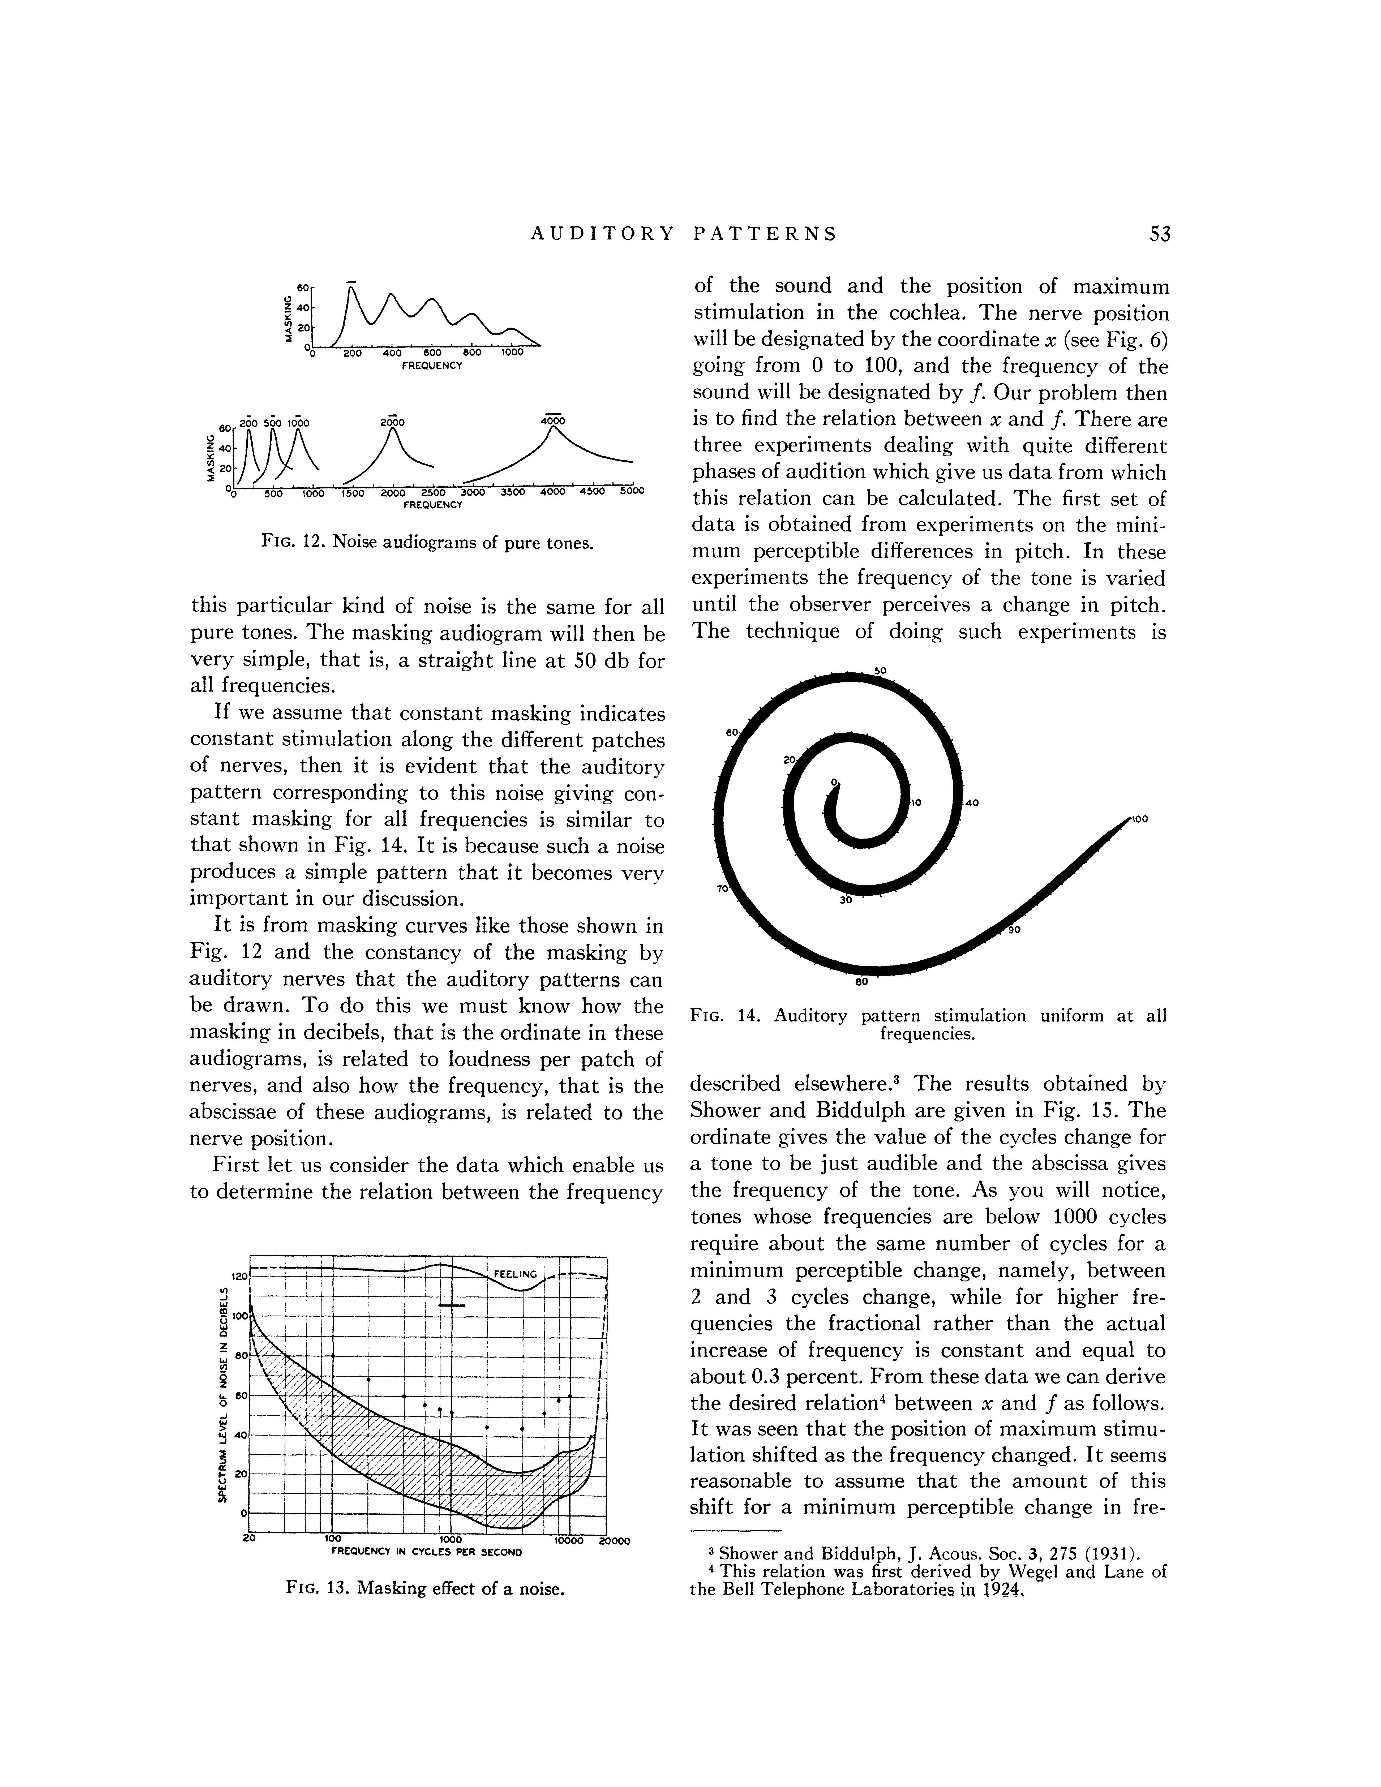
Frequency Masking and Harmonics
Masking can also occur at the harmonics of masker…
  Example has a masker at 200 Hz
  While effect of masker is greatest at 200 Hz…
    Also effects harmonics of masker signal!

Slide 27
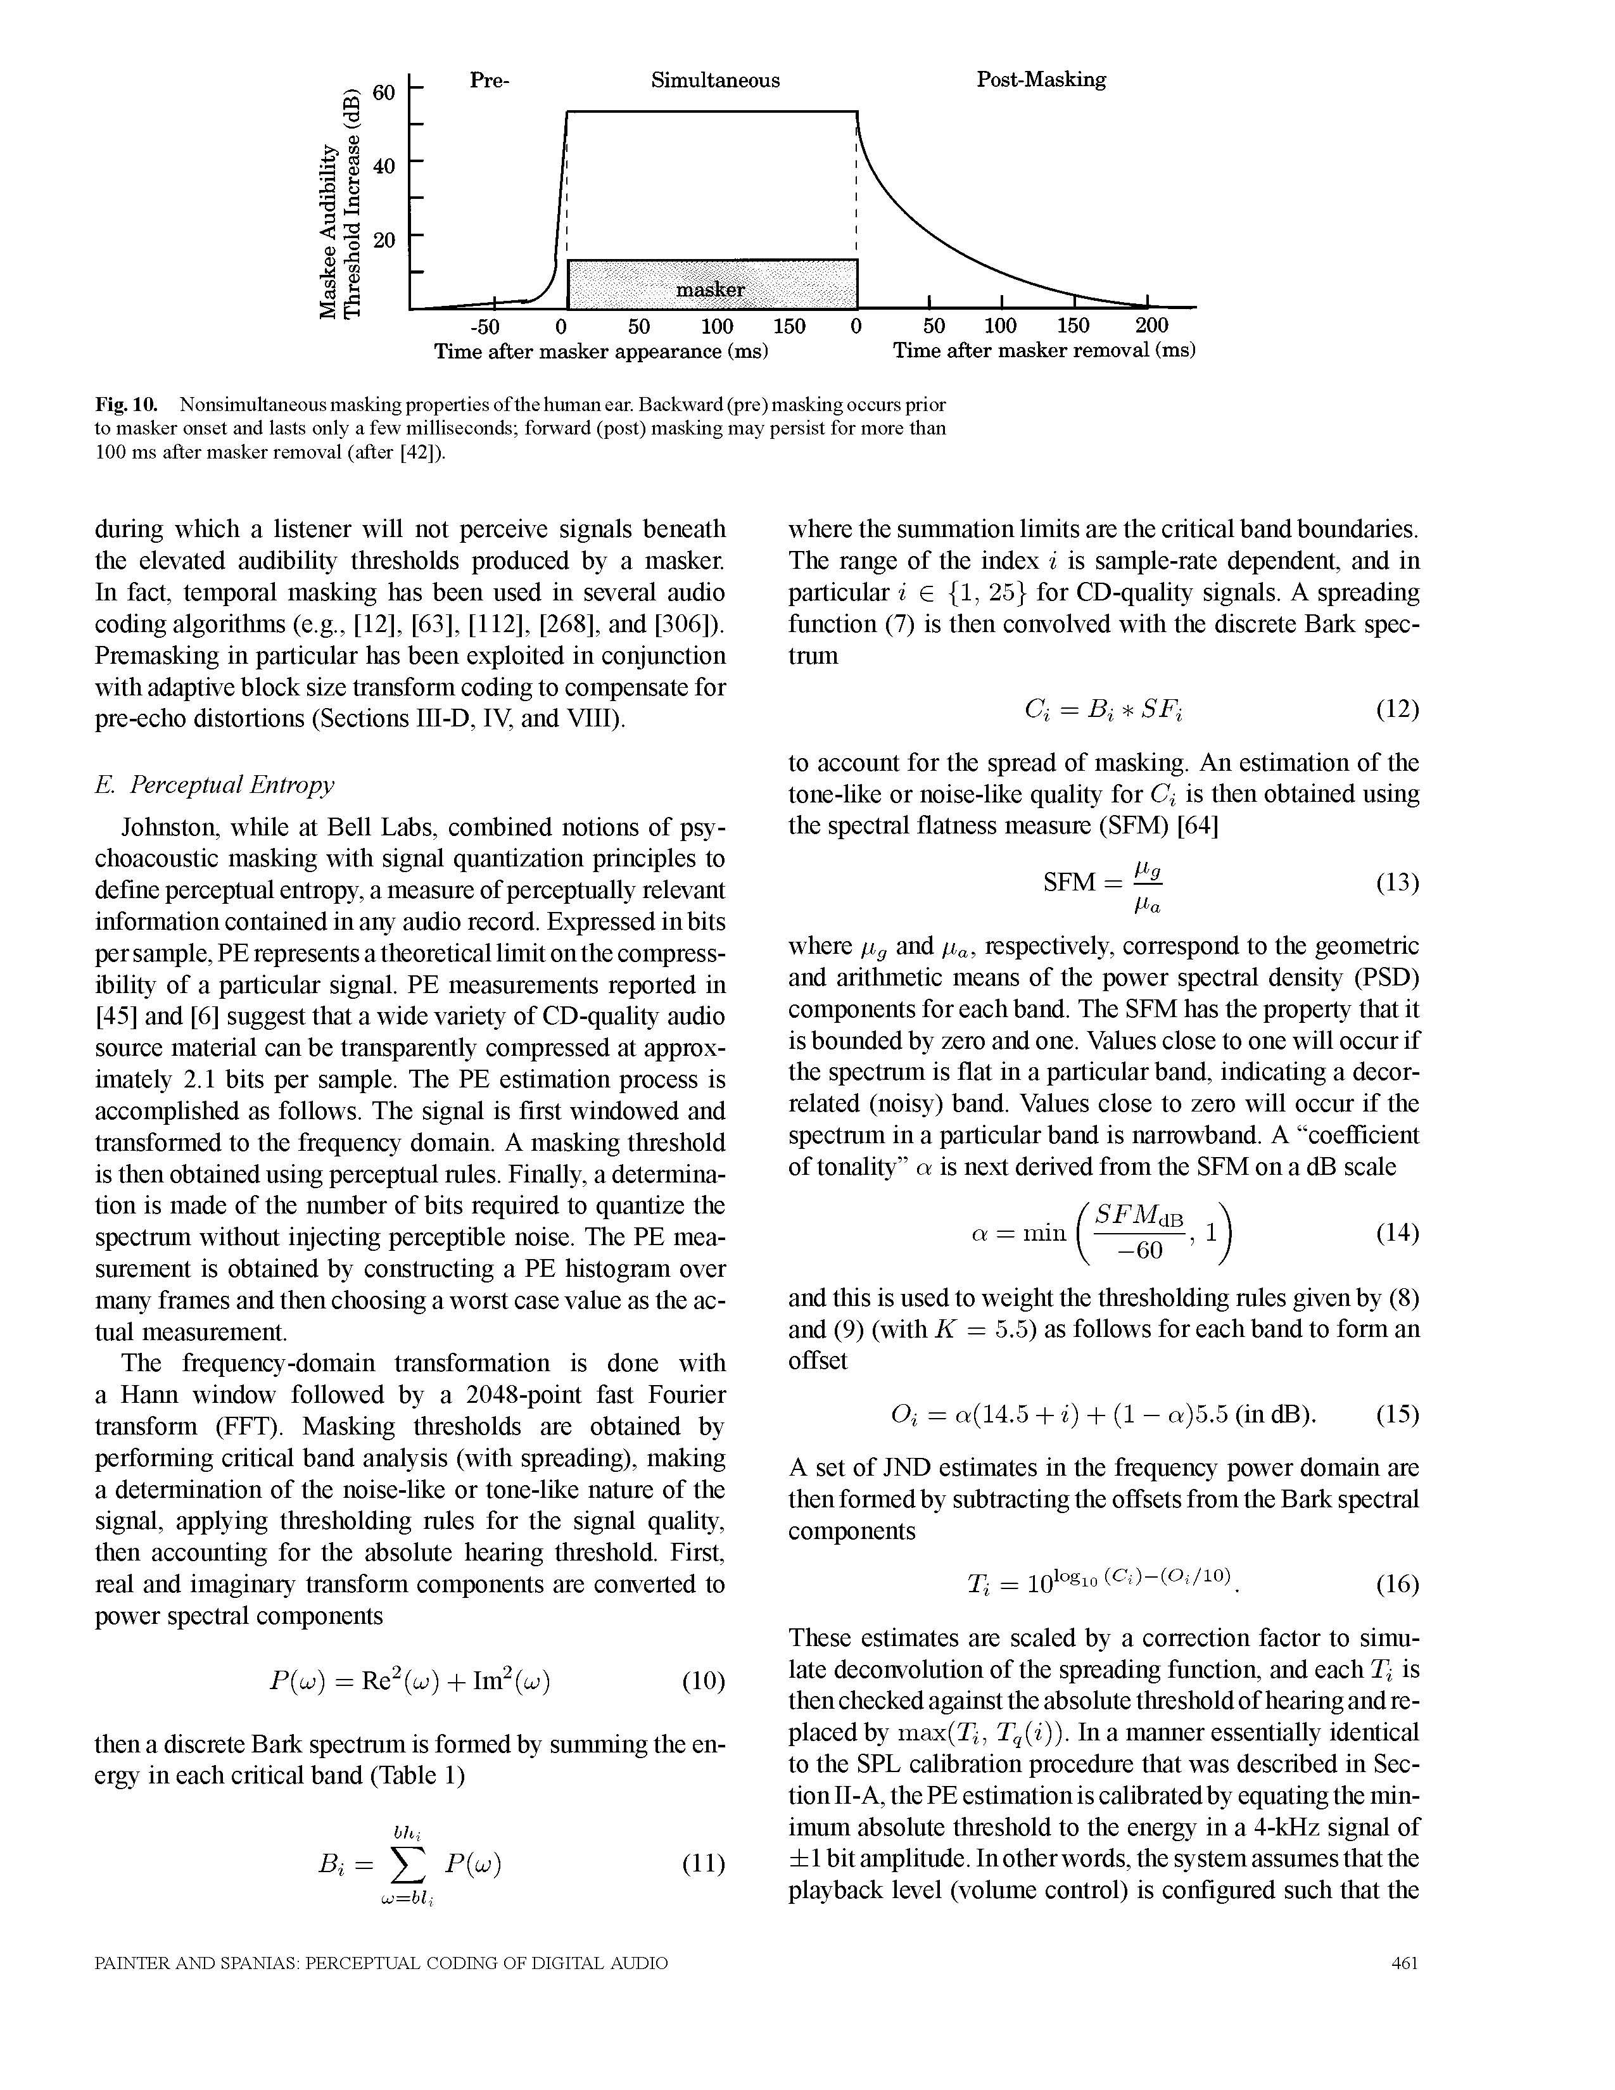
Time-Domain Masking (Temporal)
Two types:
  pre-masking (backwards)
  post-masking (forwards)

Slide 28
Temporal Masking - Forwards
Easier to understand…
  A sudden masker noise…
    Makes inaudible other sounds following noise…for up to 200ms
      Physical: hair cells in Cochlea don’t stop vibrating instantly
        Brain accounts for the fact their vibration will decay over time after incident sound goes away
      (imagine the compression possibilities!)

Slide 29
Temporal Masking - Backwards
Not as intuitive an explanation…
  A sudden masker noise…
    Makes inaudible other sounds preceding noise!
    Why does this happen?
      One thought: takes time for your brain to interpret sound
      Think of it like a buffer…
      Throws out contents of buffer when a loud sound comes in
        to concentrate on only the loud sound (masker in this case)
      Also, hair vibrations likely take time to come up to full amplitude

Slide 30
Using Psychoacoustics in Digital Audio

Slide 31
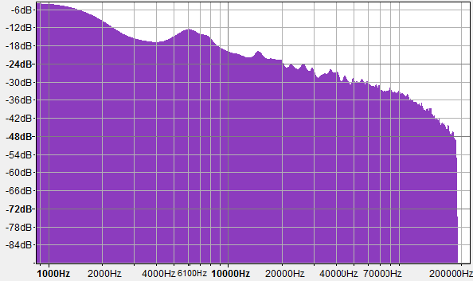
How do we use psychoacoustics in digital music compression? (range)

Slide 32
How do we use psychoacoustics in digital music compression? (masking)
120
dB
100
80
60
40
20
Masked
0
Frequency
193 194 196 197 198 199 201 202 203 204 206 207 208

Slide 33
How do we use psychoacoustics in digital music compression? (masking)
120
dB
100
80
60
40
20
0
Frequency
193 194 196 197 198 199 201 202 203 204 206 207 208

Slide 34
Preclass 3
Same A, B, C, D, E from preclass 2
  With same masking effects
8b per frequency, 10 frequencies → bits?
Non-zero, non-masked frequencies?
Lossless encode Bits?
  Encode 0s/masked with 1-bit
  Encode keep/non-0 with 9-bit

Slide 35
Basic Freq/masking Compression Idea
Convert to frequency domain
If few frequencies
  Cheaper to only represent those
Masking means can drop frequencies that are present, but not dominant
  Save by leaving those out

Slide 36
Big Ideas
Human hearing mechanism directly encodes frequency
  By position on Cochlea
Differential sensitivity by frequency
  Hear some frequencies louder than others
Frequency Masking
  Limit to what we can simultaneously perceive in critical bands – loud frequencies can hide others
Temporal Masking
  Loud signals can hide sounds that come after (or before) them

Slide 37
Learn More
BIBB417 – Visual Processing
  Same kind of look at physiology, but for vision
LING520 – Phonetics 1
  Focus on speech, includes both hearing and production

Slide 38
Midterm – Online Quiz
Open book, open notes
Calculators allowed
2 hours
Anytime between 9am and 11pm EST Wed. 3/3
5% of grade
  prepare for final
Last 3 year’s midterm and answers
  on 2018, 2019, 2020 syllabus
  Were all in-person, closed book
  2020 final was Online Quiz, also on syllabus
Post “rules” for exam before Friday
Topics
Data representation in bits
Sounds waves
Sampling
Quantization
Nyquist
Lossy/lossless compression
Common case
Frequency domain
Psychoacoustics
Perceptual coding

Slide 39
Coming up
Feedback – including Lab 5
Next Lecture
  Put this together to compress audio
  Start deriving key features of MP3 (finish next Friday)
Lab 5 report this Friday as usual
Lab 6 on Monday – start of big, formal lab
  Lab now posted
Midterm next Wednesday
  No lecture
No lab report next Friday

Slide 40
References
Physical Ear:
  R. Munkong and B.-H. Juang. IEEE Sig. Proc. Mag., 25(3):98–117, 2008
Filter Bank:
  http://www.ugr.es/~atv/web_ci_SIM/en/seccion_4_en.htm
Bark Scale:
  [E. Zwicker. J. Acoust. Soc.Am., 33(2):248, February 1961]
DB Chart:
  http://www.dspguide.com/ch22/1.htm
Masking Discussion:
  Wikipedia: PsychoAcoustics Article

