Slide 1
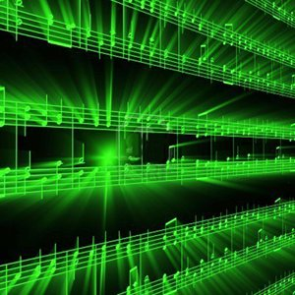
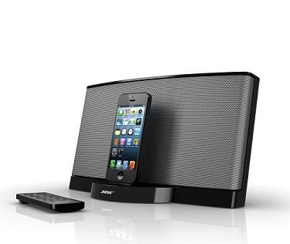
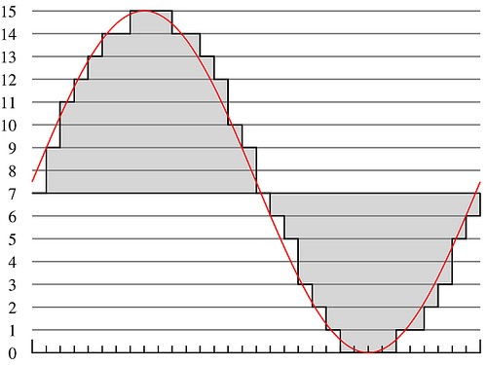
Lecture #08 – Psychoacoustics
ESE 1500 – Digital Audio Basics

Slide 2
Teaser – Dog Whistle
What is special about a dog whistle?
https://www.youtube.com/watch?v=dk0HsvQ7m_E

Slide 3
Teaser – Rodent Deterent
How do these work?
https://www.amazon.com/Ultrasonic-Repelling-Electronic-Repellent-Squirrels/dp/B081F5WL6W/ref=sr_1_20?dchild=1&keywords=ultrasonic+rodent+repeller&qid=1613513635&sr=8-20

Slide 4
Hearing Range
https://commons.wikimedia.org/wiki/File:Animal_hearing_frequency_range.svg

Slide 5
Observe
There are sounds we cannot hear
Depends on frequency

Slide 6
Lecture Topics
Part 1
Motivation: hearing range
Where are we on course map?
Psychoacoustics: basics
Structure of Human Ear / encoding signals to brain
Part 2: psychoacoustics model and implications
Engineering Model
Human Hearing Limits
Critical Bands (Frequency bins)
Next Lab
References

Slide 7
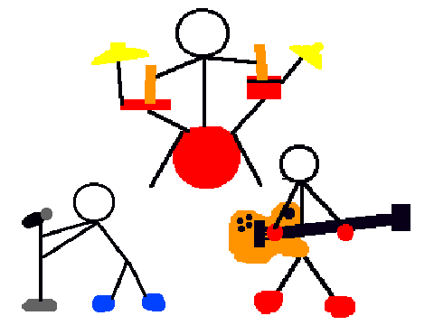
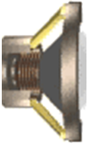
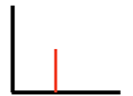
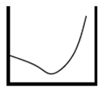
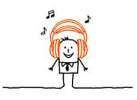
Course Map – Week 6
MIC
A/D
10101001101
Music
1
domain
conversion
5
Numbers correspond to course weeks
compress
sample
freq
pyscho-
acoustics
3
2
4
D/A
10101001101
speaker
MP3 Player / iPhone / Droid

Slide 8
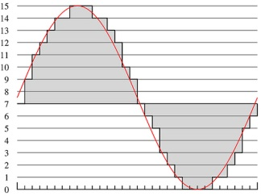
What we did in Lab…
Analog
input
ADC
Digital
Output
compress
Week 1: Converted Sound to analog voltage signal
a “pressure wave” that changes air molecules w/ respect to time
a “voltage wave” that changes amplitude w/ respect to time
Week 2: Sampled voltage, then quantized it to digital sig.
Sample: Break up independent variable, take discrete ‘samples’
Quantize: Break up dependent variable into n-levels (need 2^{n} bits to digitize)
Week 3: Compress digital signal
Use even less bits without using sound quality!
Week 4: Frequency Domain Transform before we compress…
Put our ‘digital’ data into another form…BEFORE we compress…less stuff to compress!

Slide 9
Psychoacoustics

Slide 10
What is Psychoacoustics?
Scientific study of sound perception
Branch of science studying the psychological and physiological responses associated with sound
Also, considered a branch of: psychophysics
Human physical (and neurological) mechanism for sound perception
Why study sound & human perception?
Example: FREQUENCY vs. PITCH
Frequency of sound: “how often” air particles vibrate (Hz)
Pitch of sound: the sensation of frequency
How our brains “interpret” the frequency of a sound
Things may “sound” one way…
…but be interpreted by our brains very differently!

Slide 11
Psychoacoustics & Digital Music
How does psychoacoustics relate to MP3?
The “consumer” of an MP3 is the human ear…
Knowing more about brain’s interpretation of sound…
…helps us remove things human’s can’t hear anyway
We’ve used some of this in our system already:
Limit of human perception of sound: 20 Hz to 20,000 Hz
We put an anti-aliasing filter limiting incoming audio
Fixes our sampling rate, less data to store as a result!

Slide 12
Our study of Psychoacoustics
Structure of Human Ear / encoding signals to brain
Human Hearing Limits
Critical Bands
Frequency Bins
Masking (Spatial vs. Temporal) [two week]
Applied Psychoacoustics [following week]
Using all of the above to build...the “Psychoacoustical Model”
Perceptual Coding in MP3 (using the model to compress MP3s)

Slide 13
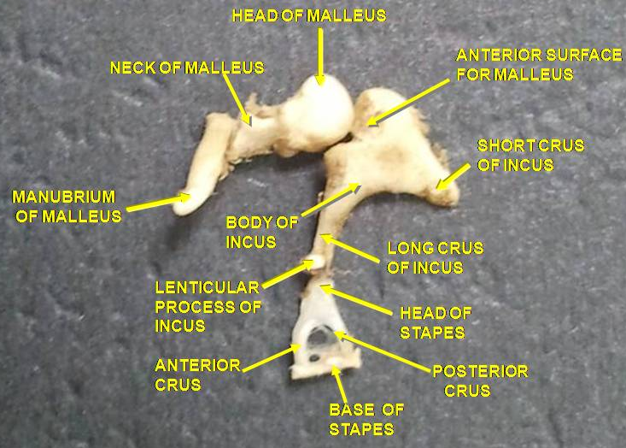
The Physical Ear
Outer Ear
Guides sound waves into ‘auditory canal’
Middle Ear
Ear Drum – transmits sound from air to 3 bones in inner ear: ossicles (hammer, anvil, stirrup)
Inner Ear
Ossicles – transmit sound from air to fluid-filled “chochlea”
Converts vibrations in air (sound) into
mechanical motion in the middle-ear!
Notes:
Ossicles – group of 3 bones: malleus (hammer) the incus (anvil), and the stapes (stirrup) of the middle ear. Smallest bones in body

Slide 14
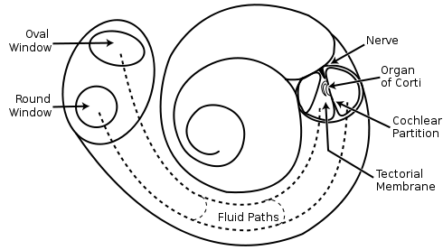
The Physical Ear – “Cochlea”
Cochlea – “snail shell”
Fluid-filled “labyrinth”
Located in: “inner-ear”
Spiral Shaped (snail shell)
Hair inside cochlea ‘resonates’ according to incoming vibrations in the liquid
Stereovilli (name of hair)
Hairs convert vibration into nerve impulses
Picture above – uncoiled cochlea…
-- different stereovilli (Hairs) resonate at different frequencies
-- our ear sense in Frequency Domain!
http://www.youtube.com/watch?v=zeg4qTnYOpw
Notes:
Snail shell is latin translation

Slide 15
Cochlea Animation
https://www.youtube.com/watch?v=dyenMluFaUw

Slide 16
The Physical Ear – Take-away
Cochlea
directly senses frequencies
Captures frequency domain
…not time domain
Frequency sensitive locations
activated by sound waves
Neurons sense activation
Picture above – uncoiled cochlea…
-- different stereovilli (Hairs) resonate at different frequencies
-- our ear performs Fourier Transform!
Notes:
Snail shell is latin translation

Slide 17
Take-away
Our ear works in the frequency domain.
We could consider devices that
Directly recorded frequencies
Collection of resonators?
Directly produced frequencies
Collection of vibrators
Tuning forks
Strings
Pipes
…sound familiar?

Slide 18
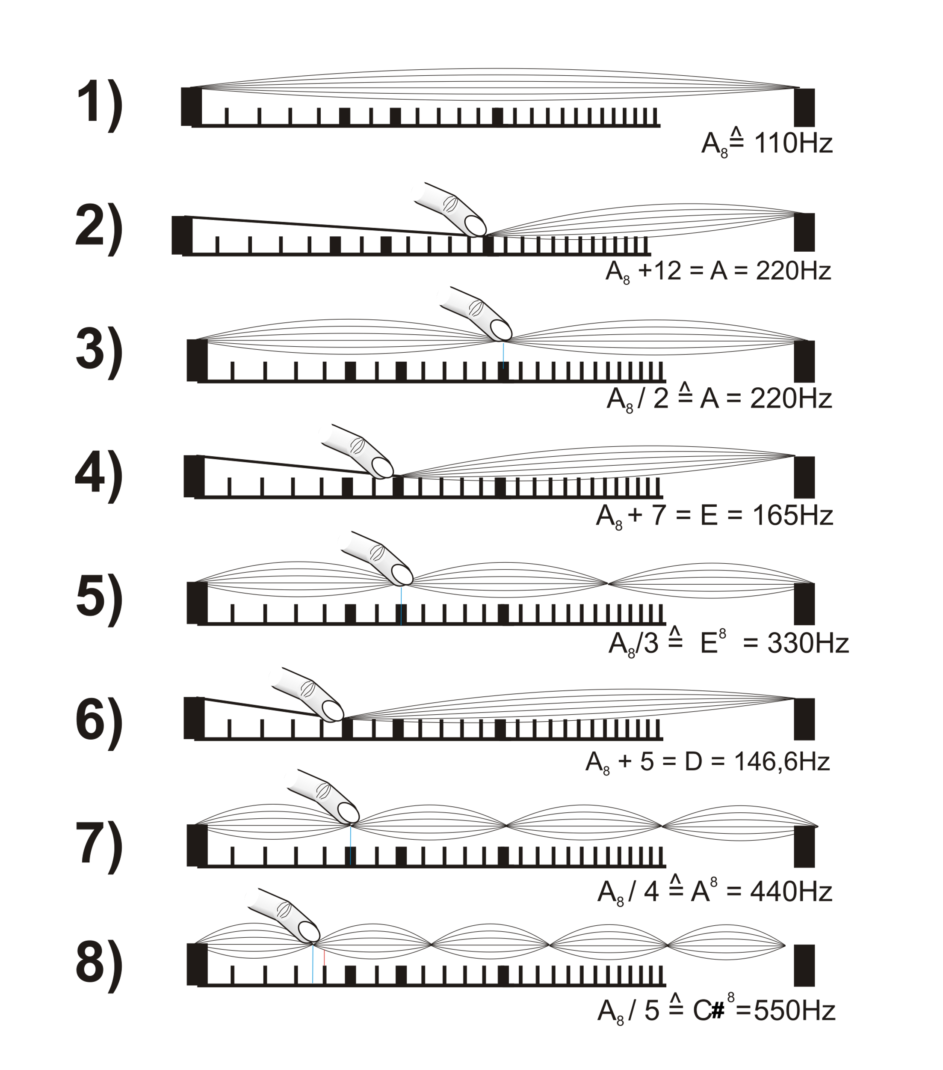
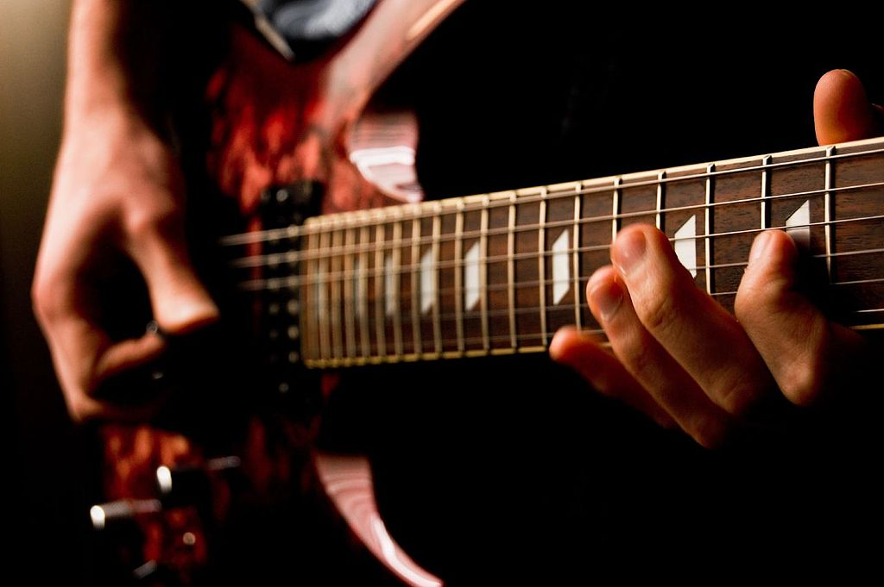
Direct Frequency Generation
All traditional musical instruments work that way!
Piano, guitar, violin – vibrating strings
Feliciano Guimarães from Guimarães, Portugal / CC BY
(https://creativecommons.org/licenses/by/2.0)
By user:Mjchael - made by me (Corel-Draw), CC BY-SA 2.5,
https://commons.wikimedia.org/w/index.php?curid=1251597
More: Lhttps://www.zmescience.com/science/physics/guitar-strings-vibrate/

Slide 19
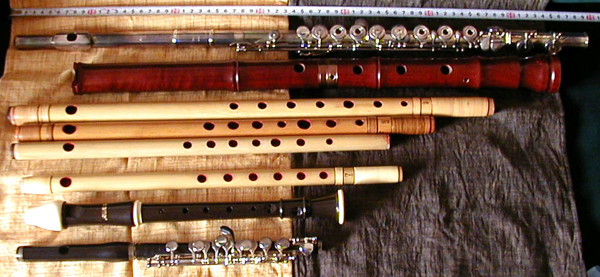
Direct Frequency Generation
All traditional musical instruments work that way!
Piano, guitar, violin – vibrating strings
Flute, trumpet, pipe organ – pipes
http://newt.phys.unsw.edu.au/jw/woodwind.html
http://newt.phys.unsw.edu.au/jw/fluteacoustics.html (below, right)
By Photo by Yasuhiko Sano, Nov 2005 - http://homepage2.nifty.com/iwatake/,
Public Domain, https://commons.wikimedia.org/w/index.php?curid=435915

Slide 20
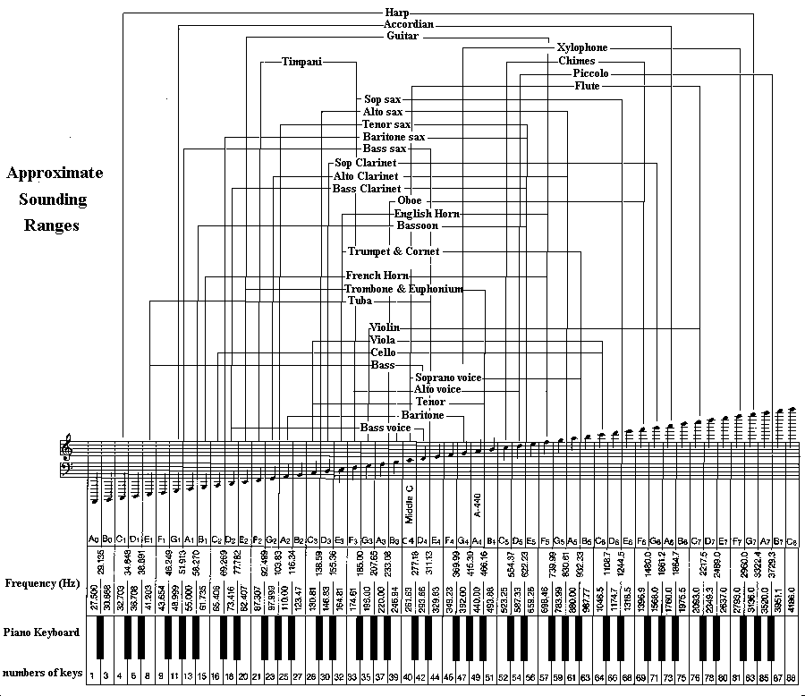
Time Domain Advantage?
Larry Solomn: http://solomonsmusic.net/insrange.htm

Slide 21
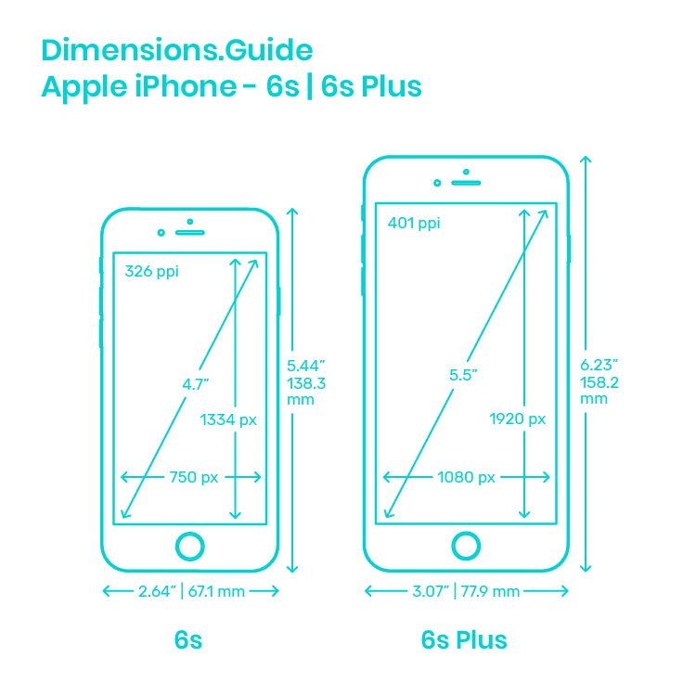
Time Domain Advantage?
1.5m x 2.4m
0.07m x 0.14m
http://www.bluebookofpianos.com/types.html
https://www.dimensions.guide/element/apple-iphone-6s-6s-plus

Slide 22
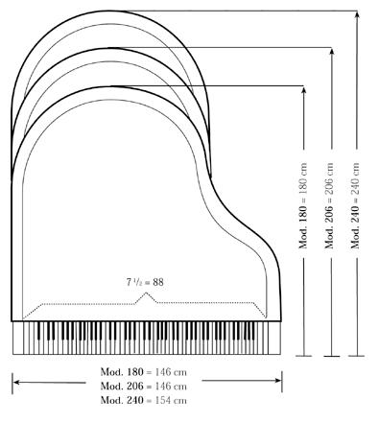
Time Domain Advantage?
Can produce (receive) many frequencies
Without large number of strings (vibrators, pipes)
Without large footprint for strings and resonant cavities
Smaller/cheaper
Exploiting cheap processing from Moore’s Law
http://www.bluebookofpianos.com/types.html
https://www.dimensions.guide/element/apple-iphone-6s-6s-plus

Slide 23
Part 2

Slide 24
Physical Ear to Engineering Model
With knowledge of structure/function of ear:
We can model cochlea’s behavior as bank of filters / bandpass filters
Cochlea breaks down auditory input into frequency ranges
Sends different frequencies down different nerve pathways!
Each physical region responsible for a range of frequencies.
Each Frequency
encoded independently
on the auditory nerve
Brain ultimately
“interprets” these
Encoded signals
as sound
Bundle
Of
Neurons

Slide 25
We know how to avoid aliasing…
Recall -- Day 5 -- filter
What is a filter you ask?
Imagine a coffee filter…
Signals ranging
in frequencies
from 20Hz to 40kHz
(100KHz, …)
go into filter
Water,
Ground coffee
beans go into
Filter…
WATER
grinds
grinds
Electronic
Filter
Called a “low pass” filter
Has a “cutoff” frequency
of 20 kHz
Coffee Filter
COFFEE
Only “delicious”
signals ranging
from 20Hz to 20kHz
pass through filter
(aka Audio Signals)
Only delicious
coffee passes
through filter…
“grinds” cannot pass

Slide 26
Filters
For anti-aliasing saw low-pass filter
Only allow low frequencies to pass through
General, can develop filters that select a range of signals
Band-pass filter
Only allow frequencies in a ”band”
Between some low cutoff frequency and high cutoff

Slide 27
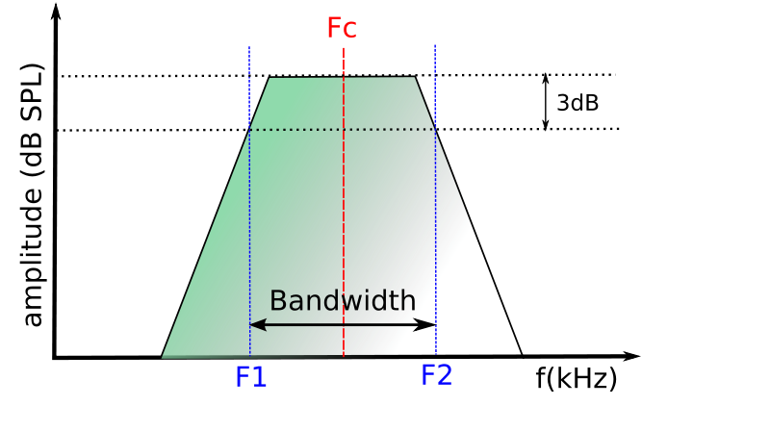
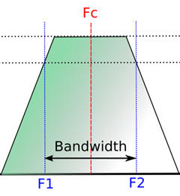
Physical Ear – Limits of Human Perception
Critical Frequency Bands
Refers to ‘frequency bandwidth’ of each regions in the ear
A ‘sharply tuned’ filter has good frequency resolution
Allows frequencies in band pass well, but not others
Brain can then ‘resolve’ different frequencies

Slide 28
Critical Frequency Bands – How many?
Number | Center Freq. (Hz) | Cut-off Freq. (Hz) | Bandwidth (Hz)
 |  | 20
1 | 50 | 100 | 80
2 | 150 | 200 | 100
3 | 250 | 300 | 100
4 | 350 | 400 | 100
5 | 450 | 510 | 110
6 | 570 | 630 | 120
7 | 700 | 770 | 140
8 | 840 | 920 | 150
9 | 1000 | 1080 | 160
10 | 1170 | 1270 | 190
11 | 1370 | 1480 | 210
12 | 1600 | 1720 | 240
Number | Center Freq. (Hz) | Cut-off Freq. (Hz) | Bandwidth (Hz)
13 | 1850 | 2000 | 280
14 | 2150 | 2320 | 320
15 | 2500 | 2700 | 380
16 | 2900 | 3150 | 450
17 | 3400 | 3700 | 550
18 | 4000 | 4400 | 700
19 | 4800 | 5300 | 900
20 | 5800 | 6400 | 1100
21 | 7000 | 7700 | 1300
22 | 8500 | 9500 | 1800
23 | 10500 | 12000 | 2500
24 | 13500 | 15500 | 3500
“Bark” scale –
Maps frequency intervals into their respective critical band number

Slide 29
Critical Frequency Bands – How many?
Number | Center Freq. (Hz) | Cut-off Freq. (Hz) | Bandwidth (Hz)
 |  | 20
1 | 50 | 100 | 80
2 | 150 | 200 | 100
3 | 250 | 300 | 100
4 | 350 | 400 | 100
5 | 450 | 510 | 110
6 | 570 | 630 | 120
7 | 700 | 770 | 140
8 | 840 | 920 | 150
9 | 1000 | 1080 | 160
10 | 1170 | 1270 | 190
11 | 1370 | 1480 | 210
12 | 1600 | 1720 | 240
Number | Center Freq. (Hz) | Cut-off Freq. (Hz) | Bandwidth (Hz)
13 | 1850 | 2000 | 280
14 | 2150 | 2320 | 320
15 | 2500 | 2700 | 380
16 | 2900 | 3150 | 450
17 | 3400 | 3700 | 550
18 | 4000 | 4400 | 700
19 | 4800 | 5300 | 900
20 | 5800 | 6400 | 1100
21 | 7000 | 7700 | 1300
22 | 8500 | 9500 | 1800
23 | 10500 | 12000 | 2500
24 | 13500 | 15500 | 3500
“Bark” scale –
Maps frequency intervals into their respective critical band number
24 frequency bins (or “barks”), get wider as frequency increases!

Slide 30
OK, now…some tests…
How well can you hear? (range)
20 Hz to 20kHz – frequency increasing over 20 seconds
Can you hear tone the entire time, or do is it appear to go silent at some point?
Tells you how high (and maybe how low) of frequencies you can hear
Probably need to switch to audacity on laptop to see when still playing…
(or mouse over sound to see playbar)
Notes:
1) Used audacity (free download) for class demo: generate a chirp from 20 Hz to 20kHz for 20 seconds
2) Put 400 Hz on left channel put 1000 Hz on right channel
3) Generate a 1500 Hz tone, then a 1502 Hz tone…play separately…can’t hear difference
---but, play them at the same time and we can ‘perceive’ beats

Slide 31
OK, now…some tests…
Can you hear two frequencies at once? (selectivity)
Let’s try: 400 Hz and 1000 Hz
First independent references
Then together
Notes:
1) Used audacity (free download) for class demo: generate a chirp from 20 Hz to 20kHz for 20 seconds
2) Put 400 Hz on left channel put 1000 Hz on right channel
3) Generate a 1500 Hz tone, then a 1502 Hz tone…play separately…can’t hear difference
---but, play them at the same time and we can ‘perceive’ beats

Slide 32
Different Bands
Number | Center Freq. (Hz) | Cut-off Freq. (Hz) | Bandwidth (Hz)
 |  | 20
1 | 50 | 100 | 80
2 | 150 | 200 | 100
3 | 250 | 300 | 100
4 | 350 | 400 | 100
5 | 450 | 510 | 110
6 | 570 | 630 | 120
7 | 700 | 770 | 140
8 | 840 | 920 | 150
9 | 1000 | 1080 | 160
10 | 1170 | 1270 | 190
11 | 1370 | 1480 | 210
12 | 1600 | 1720 | 240
Number | Center Freq. (Hz) | Cut-off Freq. (Hz) | Bandwidth (Hz)
13 | 1850 | 2000 | 280
14 | 2150 | 2320 | 320
15 | 2500 | 2700 | 380
16 | 2900 | 3150 | 450
17 | 3400 | 3700 | 550
18 | 4000 | 4400 | 700
19 | 4800 | 5300 | 900
20 | 5800 | 6400 | 1100
21 | 7000 | 7700 | 1300
22 | 8500 | 9500 | 1800
23 | 10500 | 12000 | 2500
24 | 13500 | 15500 | 3500
Bands
400Hz
1000Hz

Slide 33
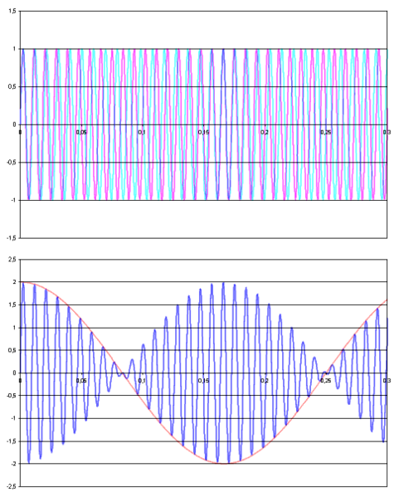
OK, now…some tests…
Frequency Resolution…(bands)
In 1000 Hz to 2000 Hz octave…
Brain can’t perceive changes in frequency
smaller than 3.6 Hz
Plays 1500Hz tone then 1502Hz
Aside from maybe a click in the middle, can you tell difference between tones?
Keep same tones, but add a 1500Hz tone on second track playing whole time.
Now hear interference demonstrating that first track did change tones.
Notes:
1) Used audacity (free download) for class demo: generate a chirp from 20 Hz to 20kHz for 20 seconds
2) Put 400 Hz on left channel put 1000 Hz on right channel
3) Generate a 1500 Hz tone, then a 1502 Hz tone…play separately…can’t hear difference
---but, play them at the same time and we can ‘perceive’ beats

Slide 34
Frequency Quantization
Frequency Resolution…(bands)
In 1000 Hz to 2000 Hz octave…
Brain can’t perceive changes in frequency
smaller than 3.6 Hz
What does this tell us about frequency quantization?
Notes:
1) Used audacity (free download) for class demo: generate a chirp from 20 Hz to 20kHz for 20 seconds
2) Put 400 Hz on left channel put 1000 Hz on right channel
3) Generate a 1500 Hz tone, then a 1502 Hz tone…play separately…can’t hear difference
---but, play them at the same time and we can ‘perceive’ beats

Slide 35
Physical Ear to Engineering Model
Limits of Human Hearing…easy to see from Cochlea
Cochlea only so long…
lowest frequencies: 20 Hz
Highest frequencies: 20 kHz
Also helps us understand ‘selectivity’
Our brain can choose to ‘listen’ to output of various filters
Example: At a party, but you can concentrate on conversation!
Notes:
Average length of choclea: 31.5mm long!

Slide 36
Sound Intensity & Loudness

Slide 37
Sound Intensity – “Loudness”
But first, we must discuss: deci-Bels (dB)
Logarithmic unit in engineering: compare levels (fractions)
Compare two physical quantities: power, intensity, etc
Often compare quantity to a reference value
Sound and (dB)
Sound is compression/expansion of air
We use (dB) to compare two air pressures in acoustics:
Lowest limit of human ear sensitivity: 20 $μ$Pascals ($μ$Pa)
We compare all sounds to this lower limit (reference sound pres.)
(unitless)
(unitless)
Loudness-Sound Pressure Level (L_{SPL}) = $20∗\log_{10}\left(\frac{Sound pressure }{Reference Sound pressure}\right)$ in dB
(unitless)

Slide 38
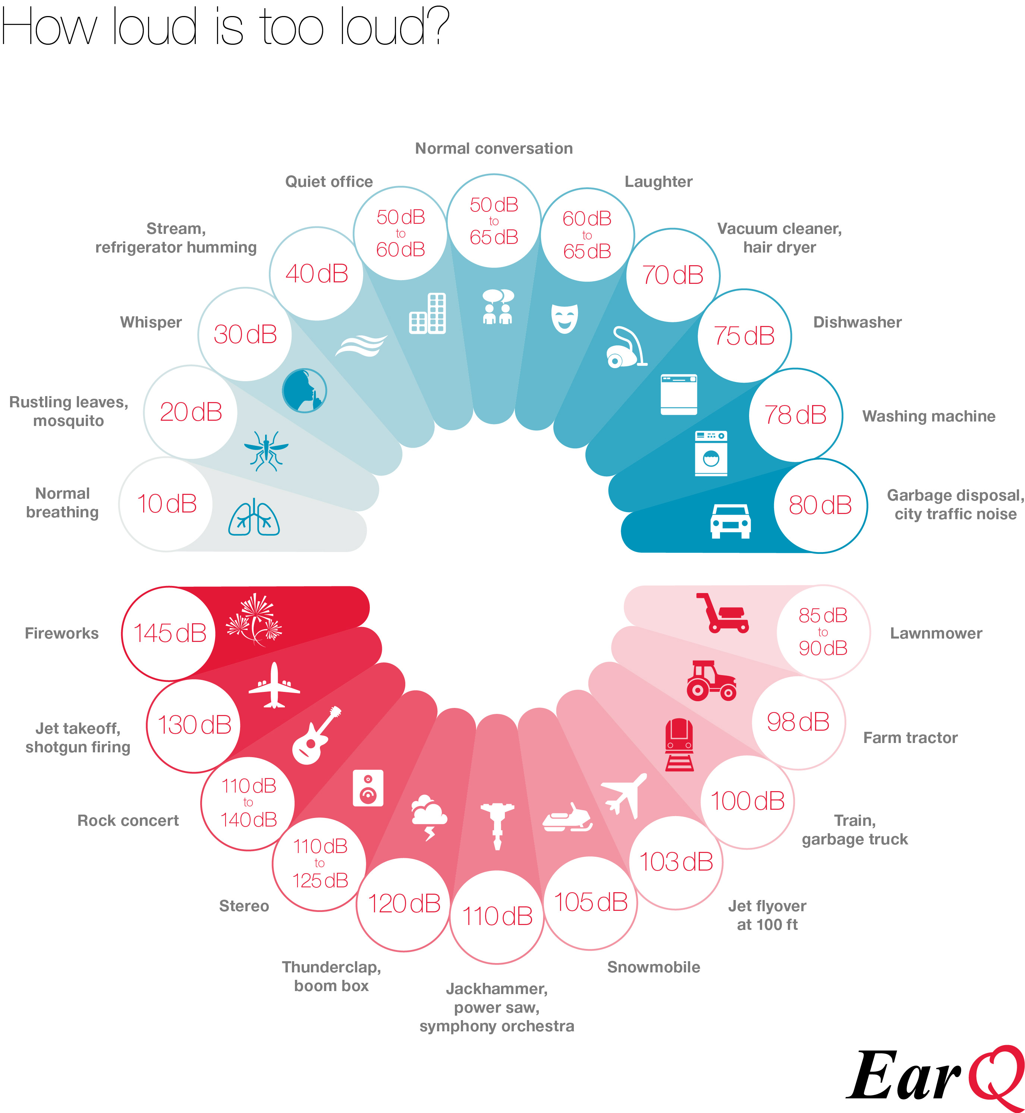
Sound Intensity in (dB) – “Loudness”
Preclass 2:
Pressure (Pa) | Intensity (dB)
2x10⁻⁵
2x10⁻⁴
2x10²
Preclass 3: Ratio of pressure between 20dB and 140dB?
Notes:
Could also calculate actual value of sound pressure. dB in this context is an absolute

Slide 39
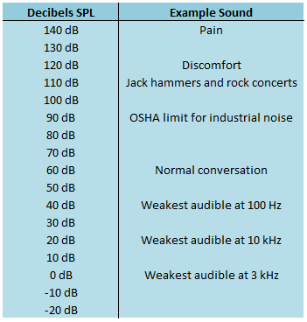
Sound Intensity in (dB) – “Loudness”
If sound intensity level is:
140 dB 20 dB
Divide both sides by 20:
Sound with intensity of 140dB:
has a sound pressure 1 million times greater than the quietist sound we can hear (which is 20 uPa) -- OUCH!
$$20log\left(\frac{P2}{P0}\right)=140dB$$
$$20log\left(\frac{P1}{P0}\right)=20dB$$
$$\log\left(\frac{P2}{P0}\right)=7$$
$$\log\left(\frac{P1}{P0}\right)=1$$
$$\frac{P2}{P0}={10}^{7}$$
$$\frac{P1}{P0}={10}^{1}$$
$$\frac{P2}{P1}=1,000,000$$
Notes:
Could also calculate actual value of sound pressure. dB in this context is an absolute

Slide 40
Sound Intensity in (dB) – “Loudness”
Loudness –
subjective perception of intensity of sound
Intensity –
Sound power per unit area
Does loudness change with frequency?
Yes! Scientist: Harvey Fletcher (1940)
Measured loudness vs. frequency (Auditory Thresholds)
Same ‘amplitude’ sound can sound very quiet or really loud
All depends on its frequency
Turns out…
We are very sensitive to frequencies from 1kHz to 5kHz
They don’t have to be ‘intense’ for us to hear them…why??

Slide 41
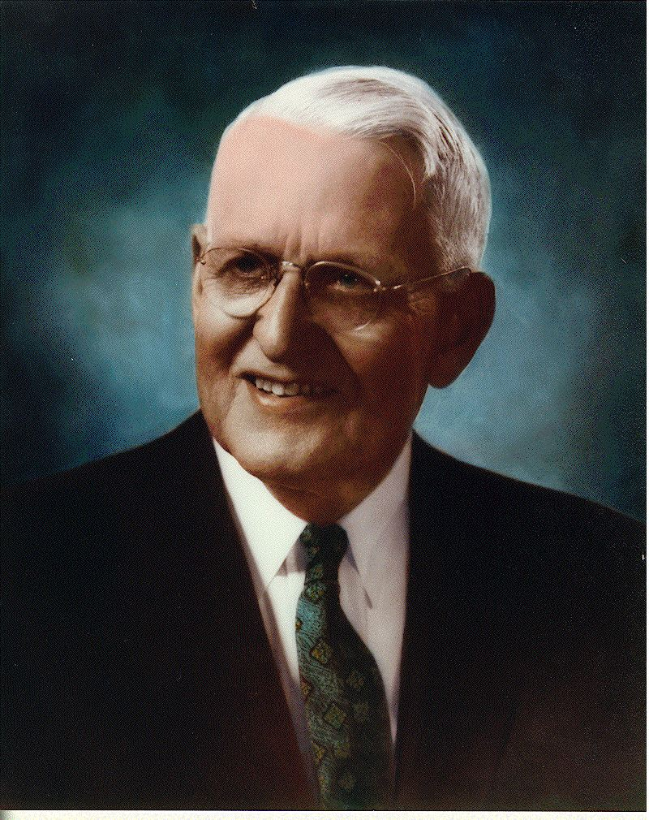
Auditory Thresholds – Measured by Fletcher
Low frequency & very high frequency sounds
must be intense for us to interpret them as
“loud” as sounds with frequencies in 1k to 5k range

Slide 42
Demonstration
Same demo as before: 20 Hz to 20kHz
Instead of thinking about frequency cutoff (range)
Think instead about how “loud” the sounds at different frequencies are…
Which ‘band’ sounds ‘loudest’ to you?
Note: they are all at same amplitude, so equally intense
But we perceive sounds in 1 kHz to 5 kHz to be louder!

Slide 43
Auditory Thresholds – Measured by Fletcher

Slide 44
Quantization and Auditory Thresholds
What does this tell us about amplitude quantization?
How much need?
Where may need lower or higher quantization?

Slide 45
Big Ideas
Human hearing mechanism directly encodes frequency
By position on Cochlea
Frequency domain representation is the natural one
Differential sensitivity by frequency
Hear some frequencies louder than others
Useful to work with frequency representation to determine
What’s important to keep
What can discard

Slide 46
Learn More
PSYC3320 – Neural Systems and Behavior
Includes visual, audio, olfactory
LING2210 – Phonetics 1
Focus on speech, includes both hearing and production

Slide 47
Admin/Coming up
Feedback (including lab from Monday)
Monday:
No Lecture
Will be a lab – Convert to Frequency Domain
Wednesday
No lecture
Next Lecture: Monday 2/20, Fourier Transform

Slide 48
References
Physical Ear:
R. Munkong and B.-H. Juang. IEEE Sig. Proc. Mag., 25(3):98–117, 2008
Filter Bank:
http://www.ugr.es/~atv/web_ci_SIM/en/seccion_4_en.htm
Bark Scale:
[E. Zwicker. J. Acoust. Soc.Am., 33(2):248, February 1961]
DB Chart:
http://www.dspguide.com/ch22/1.htm

