Slide 1
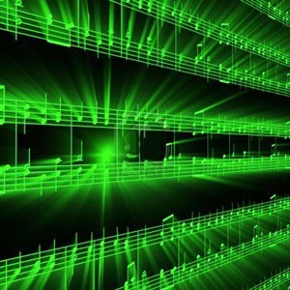
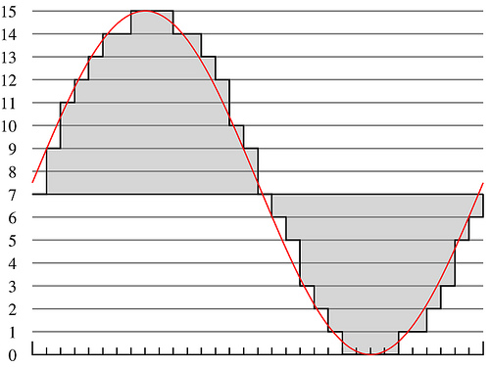
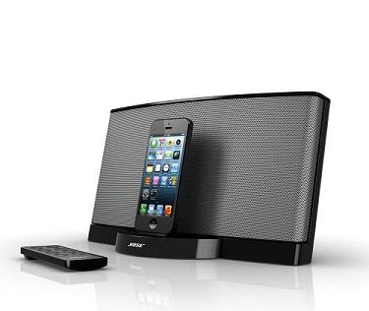

Lecture #24 – Intellectual Property
ESE 1500 –
Digital Audio Basics
Slides 2018--2023 DeHon

Slide 2
Preclass
Cost to develop and write a book?
  200 days @ $500/day
Cost per book (assume $1 to print book)
  Total volume 1
  Total volume 10,000
  Total volume 1 million
Book sells $10
  Value added by writer?
  Copies sold for author to break even at $2/copy to writer?

Slide 3
Economic Terms
Production cost – expense to produce
Price – what consume will pay for it
  Value to consumer
Profit = Price – cost

Slide 4
Observe
Creative / Intellectual work produces most of value
At least in volume, physical costs of reproduction is small part of product price

Slide 5
Preclass Continued
Cost to photocopy 200 page book at $0.05/page?
Cost to scan book at 10page/minute?
Cost to perform a 10s copy onto flash drive?
Cost of portion of flash drive used
  $4 for 32GB drive, 0.5MB file

Slide 6
Observe
With digital representation
  Cost of “physical” reproduction trends to 0

Slide 7
Past
Much of value in physical construction of objects
  Bridge, house, car, screwdriver
Expensive to reproduce / copy
Reproductions imperfect
  5th generation analog recording
  4th generation photocopy of text
Inherent barrier to making copies
  Value to buying original

Slide 8
Digital representation
Can represent perfectly in bits
  Including sound, words
Can make perfect copies
Bits are cheap…and getting cheaper
  Copying “free”
Intellectual value disconnected from physical reproduction

Slide 9
What else has this property?
Digital Intellectual Property | Physical IP Renderer
Novel | eReader
Song (MP3) | MP3 Player
JPEG Photo
 | Video Player
Video Game
 | Arduino or Personal Computer
Verilog digital circuit
STL (3D CAD drawing)
DNA Sequence | DNA Printer

Slide 10
Intellectual Property
Intangible creations of human intellect
Have value
Don’t necessarily have physical embodiment on their own

Slide 11
Intellectual Property Creators
As Engineers
  Program, develop algorithms, design circuits
Almost everything we create will have this property
  Value added is intellectual
  Can be represented digitally in bits
  Can (increasingly) be copied/reproduced cheaply
Easy to have impact
  Our solutions can reach millions, billions
  Decreasing physical barriers to propagation of solutions
Challenge to protect and reward IP creators

Slide 12
Outline
Setup Need / Opportunity – What is IP
Where are we
Rationale for IP Protection – Why Protect
How protect?
  Patents
  Copyrights
  Open Source
  NDA
  Licensing

Slide 13
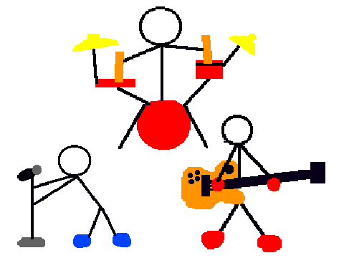
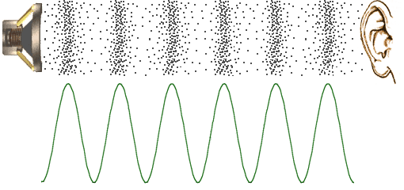
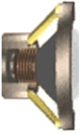


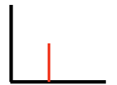
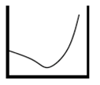



Course Map
7,8,9
10101001101
MIC
CPU
A/D
10101001101
NIC
Music
1
domain
conversion
6
10
Numbers correspond to course weeks
compress
sample
freq
pyscho-
acoustics
3
2,5
4
14
EULA
----------------click
OK
D/A
NIC
11
speaker
MP3 Player / iPhone / Droid
13

Slide 14
Rationale
Part 2

Slide 15
Pricing challenge
When cost of copying → 0
  Inventor/author must recover development cost
    Price must include develop cost + copy cost
  Copier does not have development cost
    Price = copy cost + epsilon
    Competition of copiers will drive epsilon down near 0
  Inventor/author not compensated for development
    Remove incentive/reward for development
Demand: developers need way to exclude others from copying to incentivize creation

Slide 16
Arrow’s Information Paradox
Customer not know how to value information until see information (see details of product)
  Enough information to decide to buy
  Enough information to decide what will pay for it
Once show customer information, sufficient detail, they have enough information to reproduce
  Could walk away and produce their own without paying for it
Disclosure of what effectively transfers technology
Demand: protection for developer
Arrow, Kenneth J. Economic Welfare and the Allocation of Resources for Invention, in The Rate and Direction of Inventive Activity, 609 (Nat’l Bureau of Econ. Research ed. 1962).

Slide 17
Balance Individual and Societal good
Individual should benefit form their own effort
Society advances with the accumulation of knowledge

Slide 18
Before copying was an issue
Concern that new developments/ideas would be lost when inventor die
  Techniques could remain secret for decades!
Incentive to make inventions known
  Advance the general welfare

Slide 19
US Constitution
Article 1, Section 8, Clause 8:
  To promote the Progress of Science and useful Arts, by securing for limited Times to Authors and Inventors the exclusive Right to their respective Writings and Discoveries

Slide 20
Mechanisms (To support)
Patents
  Cover inventions
  E.g., Flying Machine (US 821,393),
  ENIAC (US 3,120,606),
Copyrights
  Creative expression
  E.g., novel, song, movie

Slide 21
Mechanisms for Protection
Messy and imperfect
Haven’t kept up with technology
Likely need (and will need) innovation and refinement

Slide 22
Interlude: NIL
Nikolai Ivanovich Lobachevsky
https://www.youtube.com/watch?v=gXlfXirQF3A
Notes:
https://www.youtube.com/watch?v=gXlfXirQF3A

Slide 23
Mechanisms
Part 3

Slide 24
Patent
Inventions
Non-obvious to one “ordinary skill in art”
Reduced to practice
Cannot patent
  Abstract ideas
  Laws of nature
US: First to file
  (prior to 2013 was first to invent)
Exclusive rights 20 years from filing

Slide 25
What might be tricky / non-satisfying?
First to file? (even invent?)
20 year term?

Slide 26
Patent
Identification of problem is part of invention
Claims
  Define the invention
  Technical coverage
Requires disclosure
  If really believe no one else will figure it out…or can copy it, may be better to keep as a trade secret
License to litigate
  Recover damages through litigation
  Establish violation
  Validity of many patents overturned in litigation

Slide 27
Patent Process
US have one year from first-public disclosure to file
  Many places – public disclosure prevents patent
  https://www.uspto.gov/web/offices/pac/mpep/s2153.html
May file provisional patent to get filing date
File patent with claims
Reviewed by examiner
Examiner reports on what may be allowable
  As-is
  With tighter qualifications
  Not-at-all
  On a per-claim basis
Typically requires several iterations
Often year(s) before patent issues
Filing costs thousands of dollars
  With lawyer/legal fees tens to hundreds of thousands

Slide 32
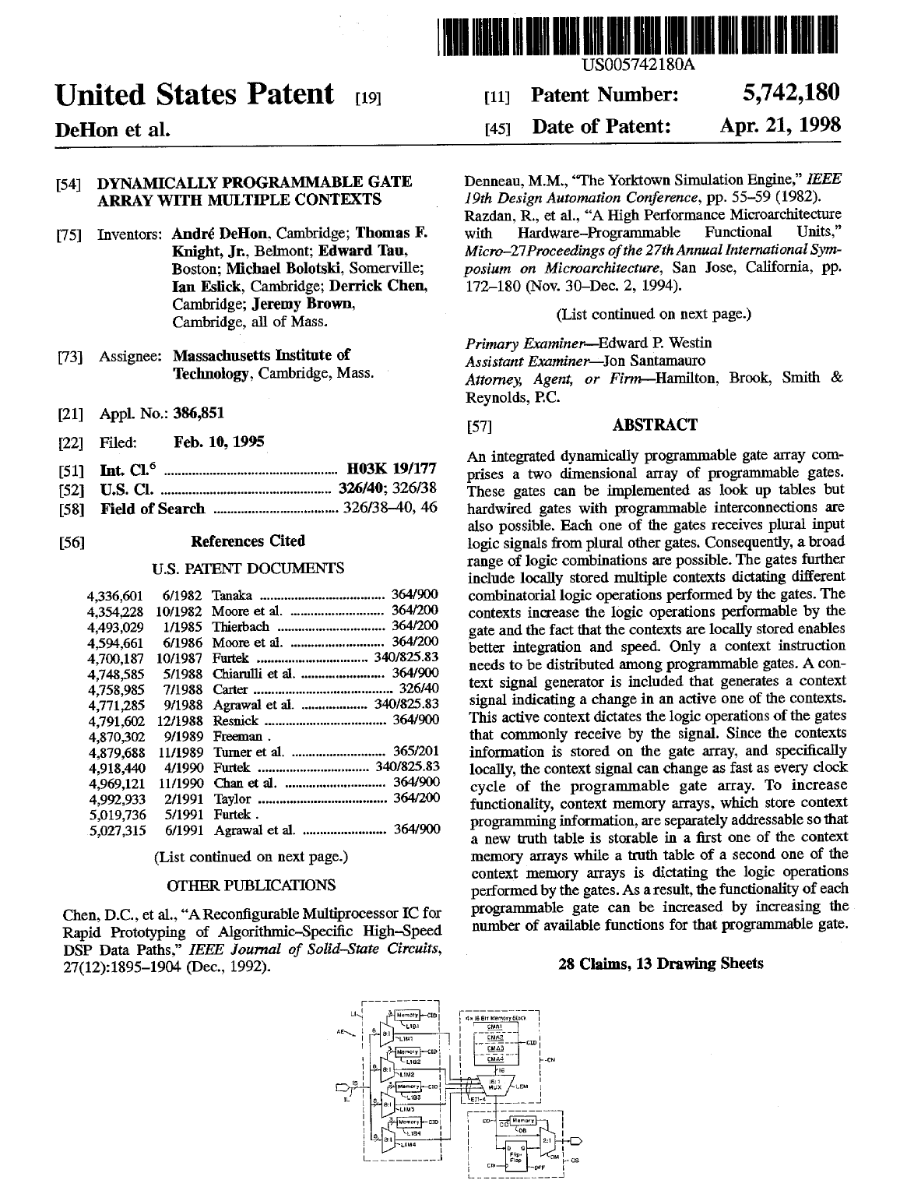

Slide 33
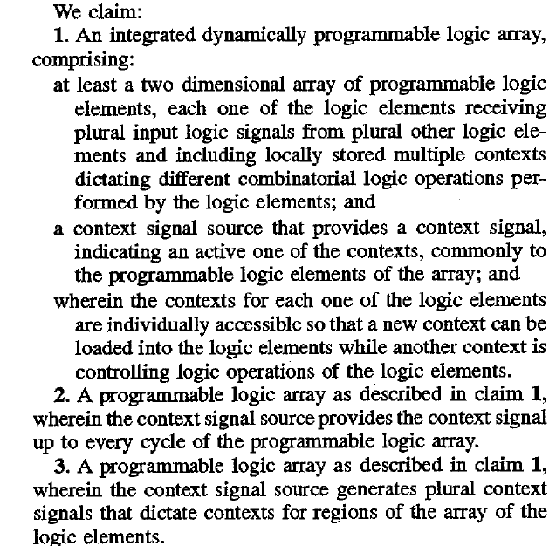
Claims

Slide 34
Xilinx FPGA US 4,870,302
https://patents.google.com/patent/US4870302A/en?oq=us+4870302

Slide 35
ENIAC US 3,120,606
1. MEANS FOR PRODUCING ELECTRIC PULSES IN SEQUENCE, ELECTRONIC MEANS FOR ALTERNATELY TRANSMITTING CERTAIN ONES OF SAID PULSES AS RECURRENT DIFFERENTIATED GROUPS, ELECTRONIC MEANS FOR SELECTING PARTICULAR PULSES FROM ONE OF SAID DIFFERENTIATED GROUPS TO REPRESENT QUANTITATIVE VALUES, ELECTRONIC MEANS FOR SELECTING PARTICULAR PULSES FROM ANOTHER OF SAID DIFFERENTIATED GROUPS TO REPRESENT CERTAIN QUALITATIVE VALUES, READING MEANS RESPONSIVE TO PULSES REPRESENTING BOTH THE QUALITATIVE AND QUANTITATIVE VALUES FOR READING DATA TO BE PROCESSED UPON COMMAND OF AT LEAST ONE OF SAID QUALITATIVE PULSES, STORING THE DATA THUS READ, AND MAKING THE DATA AVAILABLE IN THE FORM OF DATA PULSES IN RESPONSE TO AT LEAST ONE OTHER OF SAID QUALITATIVE PULSES, AND ELECTRONIC MEANS FOR RECEIVING SAID DATA PULSES AND RESPONSIVE THERETO FOR PERFORMING ELECTRICAL SWITCHING OPERATIONS OF A NATURE DETERMINED BY SELECTED ONES OF SAID QUALITATIVE VALUES AND OF A DEGREE DETERMINED BY SELECTED ONES OF SAID QUANTITATIVE VALUES.
https://www.computerhistory.org/revolution/birth-of-the-computer/4/99/387

Slide 36
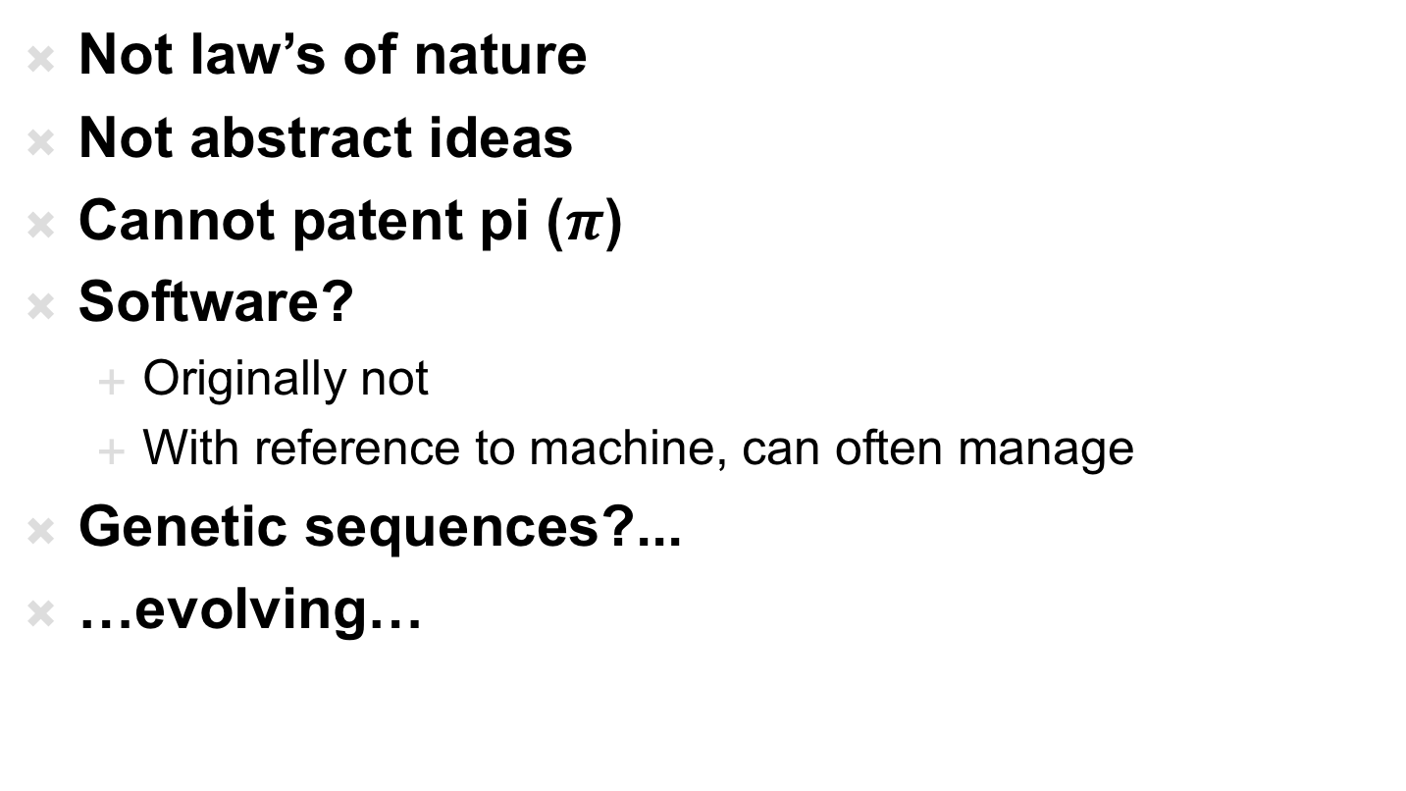
What’s Patentable
Not law’s of nature
Not abstract ideas
Cannot patent pi ($π$)
Software?
  Originally not
  With reference to machine, can often manage
Genetic sequences?...
…evolving…

Slide 37
Copyright

Slide 38
Copyright
Cover particular, original expression
  Including software
Technically don’t need to register
  But should…
  Must register before sue for infringement
  $45
    https://www.copyright.gov/about/fees.html
  No review, just registration
Life of author + 70 years
Work for hire: 95 years from publication

Slide 39
Licensing

Slide 40
Licenses
How get right to use
  Something patented, copyrighted by someone else
Between companies
  Get IP need to build a product
To consumers
  Technically, most software is licensed, not sold
  …shrink-wrap/click-through licensing agreements…
Define terms of use
  What you are paying for (one copy, many, resale…)
  What uses (dis)allowed

Slide 41
Open Source / Creative Commons

Slide 42
Sharing
Sometimes we want to share
  Isn’t it great doesn’t cost us anything to give away digital products?
  Isn’t it great can build on work of others without necessary cost?
  Cooperation on standards create opportunities for everyone, for an industry

Slide 43
Challenge
Patents cost money
Business (people making money) will spend money to patent things
  …and typically incentivized to patent everything they can
Company (individual) could patent something and grant free license
How does individual, non-profit, etc.
  Create something and protect right to share?
Variety of Open-Source/Public Domain licenses

Slide 44
Creative Commons
Framework and set of licenses for clearly expressing intent
Issues
  Attribution
  Share-Alike
  (Non-)commercial
  (No)Derivatives
Apps to choose, logos to show, legal backing to define precisely
https://creativecommons.org/share-your-work/licensing-types-examples/

Slide 45
Non-Disclosure Agreement (NDA)

Slide 46
NDA
Tool for protecting IP
Legal agreement that you won’t disclose information shared with you
  Prevent loss of IP
Typical for collaborating companies
Typical for employers
In part to make sure sharing with you doesn’t count as “disclosure” to preclude patents
Define scope of disclosure

Slide 47
Who Owns IP?

Slide 50
Work Scenarios
Hired/paid by company to invent
  Belongs to company
Invent on side on free time
  …may depend on employment agreement
  …whether or not subject matter overlaps with company
Consultant
  By default yours, but consulting agreement may define

Slide 51
University
Based on grant funds and resources
  Typically goes to university and funding source
  Right of first refusal…won’t always pursue
Undergraduate
  Invent in class, senior-design → yours
Graduate students paid RA from grant
  Typically funded by grant and go to University
Undergraduate paid research (employee)
  Typically funded by grant and go to University
Graduate students in class, using class resources
  Goes to University

Slide 52
Learn More
EAS 5070 – IP and Business Law for Engineers
EAS 5450 – Engineering Entrepreneurship
  Has sections on IP

Slide 53
Big Ideas
We (engineers…particularly in computing space) are knowledge workers, producing IP
IP carries great value
  That is less and less tied to physical objects
Need to equitably reward and encourage IP creation
Patents, Copyrights…two of the things that
  Attempts to provide framework for IP ownership, sharing, monetization
  …probably not the final answer, particularly as technology landscape continues to evolve.

Slide 54
Remember
Feedback
Lab 11 due today
Lab 12 today
  Bring lab kits
Last lecture on Wednesday

