Slide 1
ESE370: Circuit-Level Modeling, Design, and Optimization for Digital Systems
Lec 11: September 29, 2021
Layout and Area

Slide 2
Today
Layout
Transistors
Gates
Design rules
Standard cells
Notes:
2

Slide 3
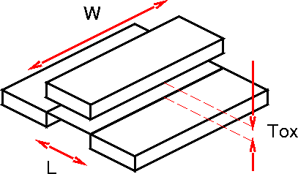
Transistor
Side view
Perspective view
Notes:
3

Slide 4
Layout
Sizing & positioning of transistors
Designer controls W, L
t_{ox} fixed for process
Sometimes thick/thin oxide “flavors”
Notes:
4

Slide 5
NMOS Geometry
L
W
Top view
Perspective view
Notes:
5

Slide 6
NMOS Geometry
Color scheme
Red: gate (polysilicon material)
Green: source and drain areas (n type diffusion)
L
S
G
D
W
Top view
Notes:
6

Slide 7
NMOS vs PMOS
NMOS built on p substrate
PMOS built on n substrate
Needs an N-well
Rabaey text, Fig 2.1
Notes:
7

Slide 8
PMOS Geometry
Color scheme
Red: gate
Orange: source and drain areas (p type)
Green: n well
NMOS built on p wafer
Must add n well material to build PMOS
L
S
G
D
W
n well
Notes:
8

Slide 9
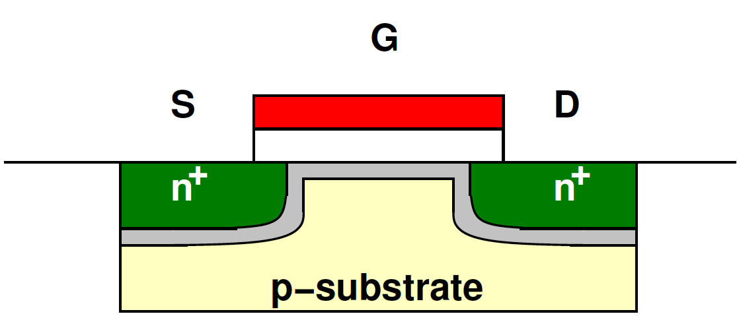
Body Contact
“Fourth terminal”
Needed to set voltage around device
PMOS: V_{b} = V_{dd}
NMOS: V_{b} = GND
At right: PMOS (orange) with bulk contact (dark green)
D
G
B
S
Notes:
9

Slide 10
Body Contact
Needed to set voltage around device
PMOS: V_{b} = V_{dd}
NMOS: V_{b} = GND
What happens if NMOS body contact is V_{dd}?
D
G
B
S
Notes:
10

Slide 11
Body Contact
Needed to set voltage around device
PMOS: V_{b} = V_{dd}
NMOS: V_{b} = GND
What happens if NMOS body contact is V_{dd}?
Polarity of field wrong
Won’t invert channel
D
G
B
S
Notes:
11

Slide 12
Transistor Geometry

Slide 13
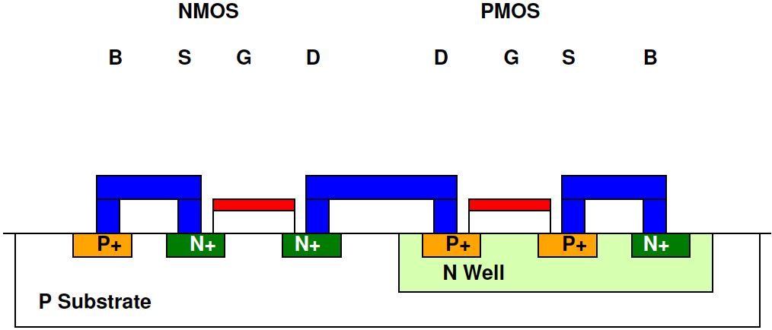
Interconnect
Connect transistors
Different layers of metal
“Contact” - metal to transistor
“Via” - metal to metal
Notes:
13

Slide 14
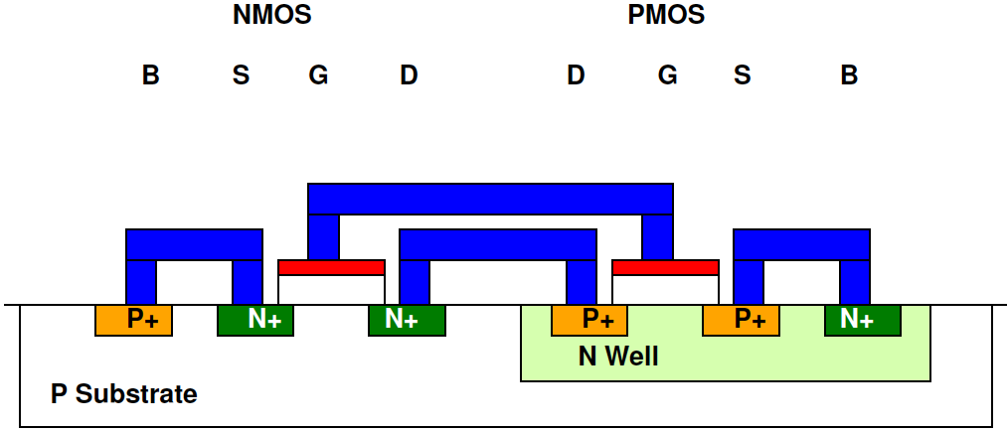
Interconnect
Connect transistors
Different layers of metal
“Contact” - metal to transistor
“Via” - metal to metal
Notes:
14

Slide 15
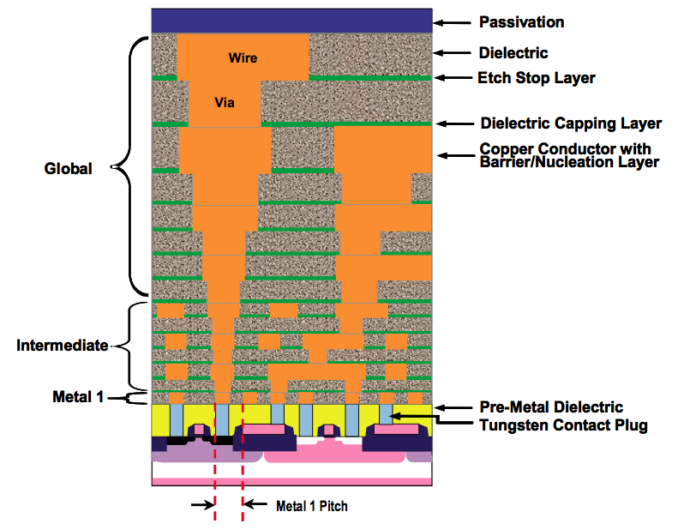
Interconnect Cross Section
ITRS 2007
Notes:
15

Slide 16
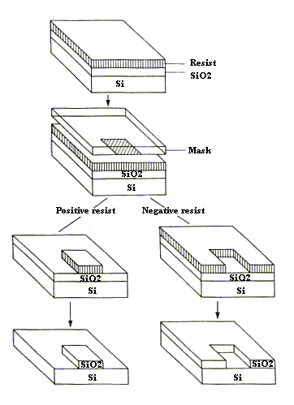
Masks
Define areas want to see in layer
Think of “stencil” for material deposition
Use photoresist (PR) to form the “stencil”
Grow PR over entire wafer
Expose PR through mask
PR dissolves in exposed areas
Material is deposited/etched
Only “sticks” in area w/ dissolved PR
Notes:
16

Slide 17
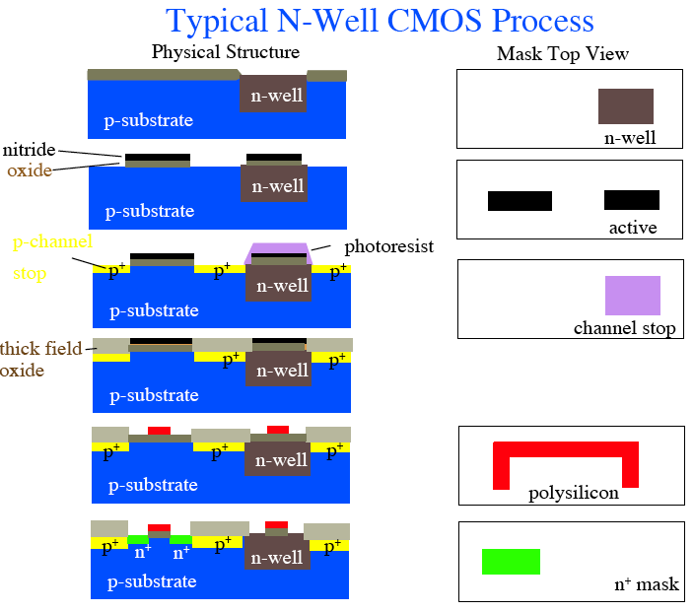
Typical N-Well CMOS Process

Slide 18
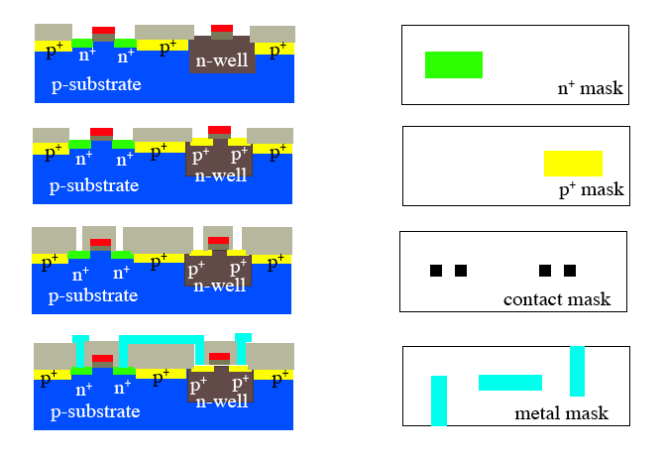
Typical N-Well CMOS Process

Slide 19
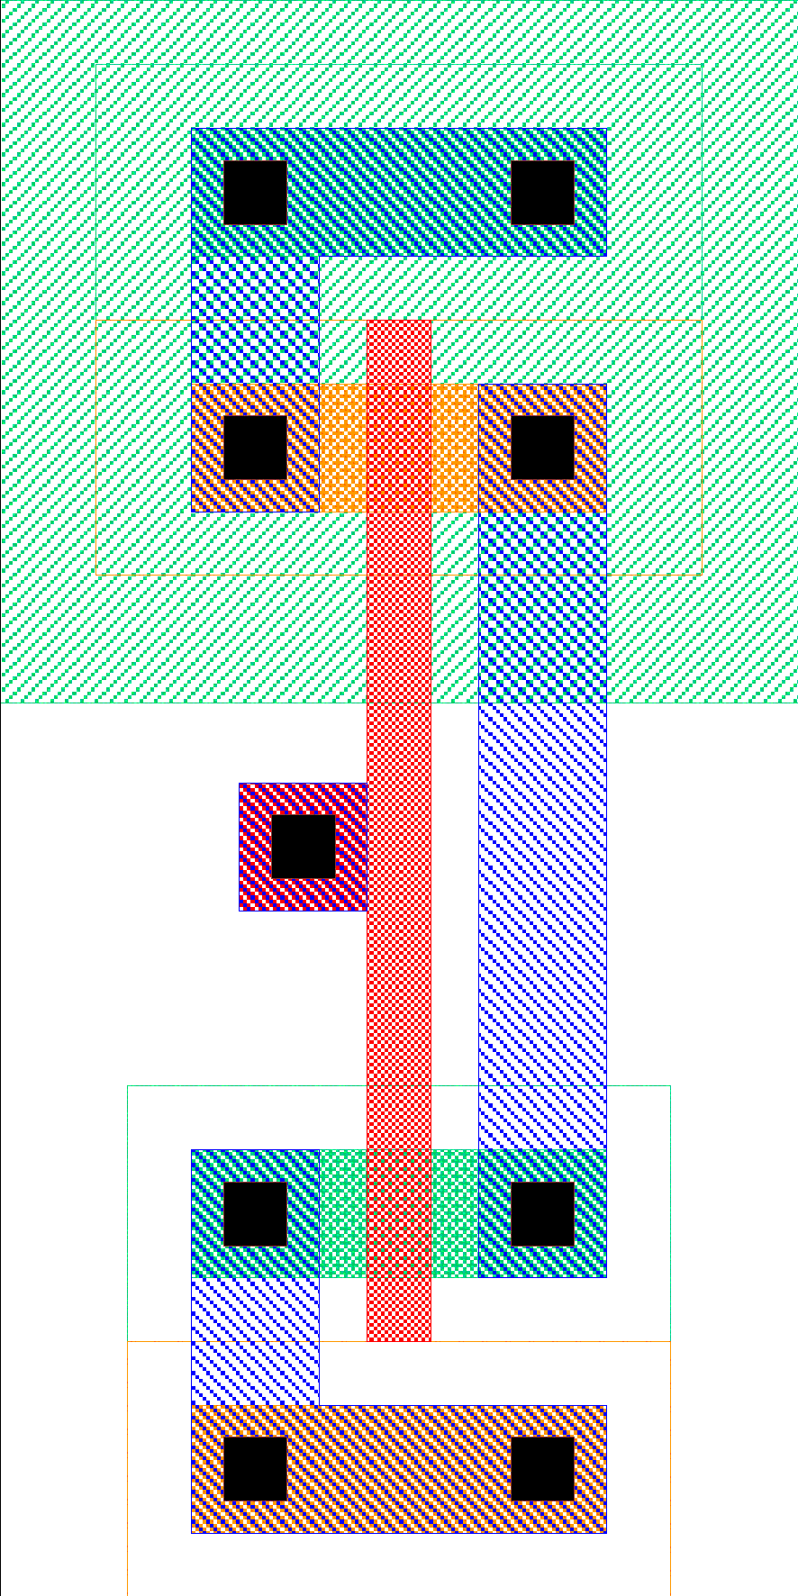
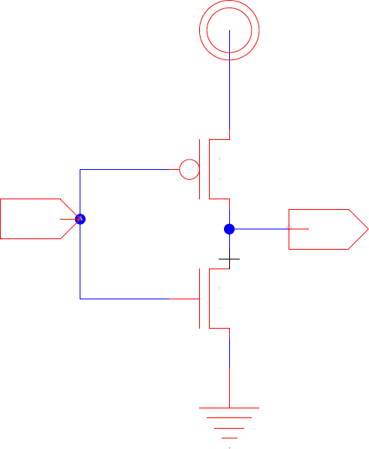
Reverse Engineer Inverter Layout (Preclass 1)
Notes:
19

Slide 20
Layout Revisited
How to “decode” circuit from layout?
Notes:
20

Slide 21
Reverse Engineer Inverter Layout
Power (Vdd)
GND
Notes:
21

Slide 22
Reverse Engineer Inverter Layout
Where is PMOS transistor?
NMOS?
Power (Vdd)
GND
Notes:
22

Slide 23
Layout to Circuit
1. Identify transistors
Notes:
23

Slide 24
Inverter Layout
Where is Input?
Notes:
24

Slide 25
Inverter Layout
Where is Input?
Notes:
25

Slide 26
Inverter Layout
Where is Output?
Notes:
26

Slide 27
Inverter Layout
Where is Output?
Notes:
27

Slide 28
Layout to Circuit
2. Add connections
Drain connection
Notes:
28

Slide 29
Layout to Circuit
2. Add connections
Gate connection
Notes:
29

Slide 30
Layout to Circuit
2. Add connections
pMOS-source to VDD
Notes:
30

Slide 31
Layout to Circuit
2. Add connections
nMOS source to GND
Notes:
31

Slide 32
Design Rules
Why not adjacent transistors?
Plenty of empty space
If area is money, pack in as much as possible
Shortens connections
Recall: processing is imprecise
Margin of error for process variation
Notes:
32

Slide 33
Design Rules
Contract between process engineer & designer
Minimum width/spacing
Can be (often are) process specific
Lambda rules: scalable design rules
In terms of λ = 0.5 L_{min} (L_{drawn})
Can migrate designs from similar process with lambda factor
Notes:
33

Slide 34
Design Rules: Some Examples
2λ
λ
λ
2λ
3λ
2λ
1.5λ
6λ
6λ
Legend
contact
n doping
metal 1
gate
via
p doping
metal 2

Slide 35
Potential Consequences of Design Rule Violations
Inter-Layer Design Rule Origins
Catastrophic Error – Unintended misalignment cause Source-Drain short circuit
Intended Transistor
Intended Unrelated Poly & Diffusion
Catastrophic Error – Unintended overlap cause fabrication of a parasitic Transistor

Slide 36
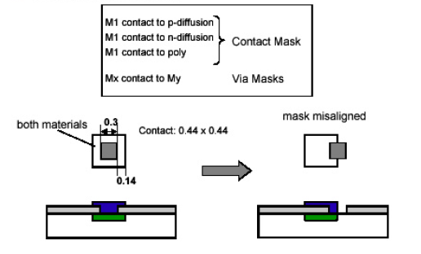
Potential Consequences of Design Rule Violations
Inter-Layer Design Rule Origins
Contact and Via Masks
M1 contact to n-diffusion
M1 contact to p-diffusion -> Contact Mask
M1 contact to poly
Mn contact to Mn-1 for n = 2, 3,.. -> Via Mask
Both Metal 1 & Diffusion
Mask misalignment
Both Metal 1 & Diffusion
Intended Contact Alignment
Error – Unintended misalignment cause poor contact

Slide 37
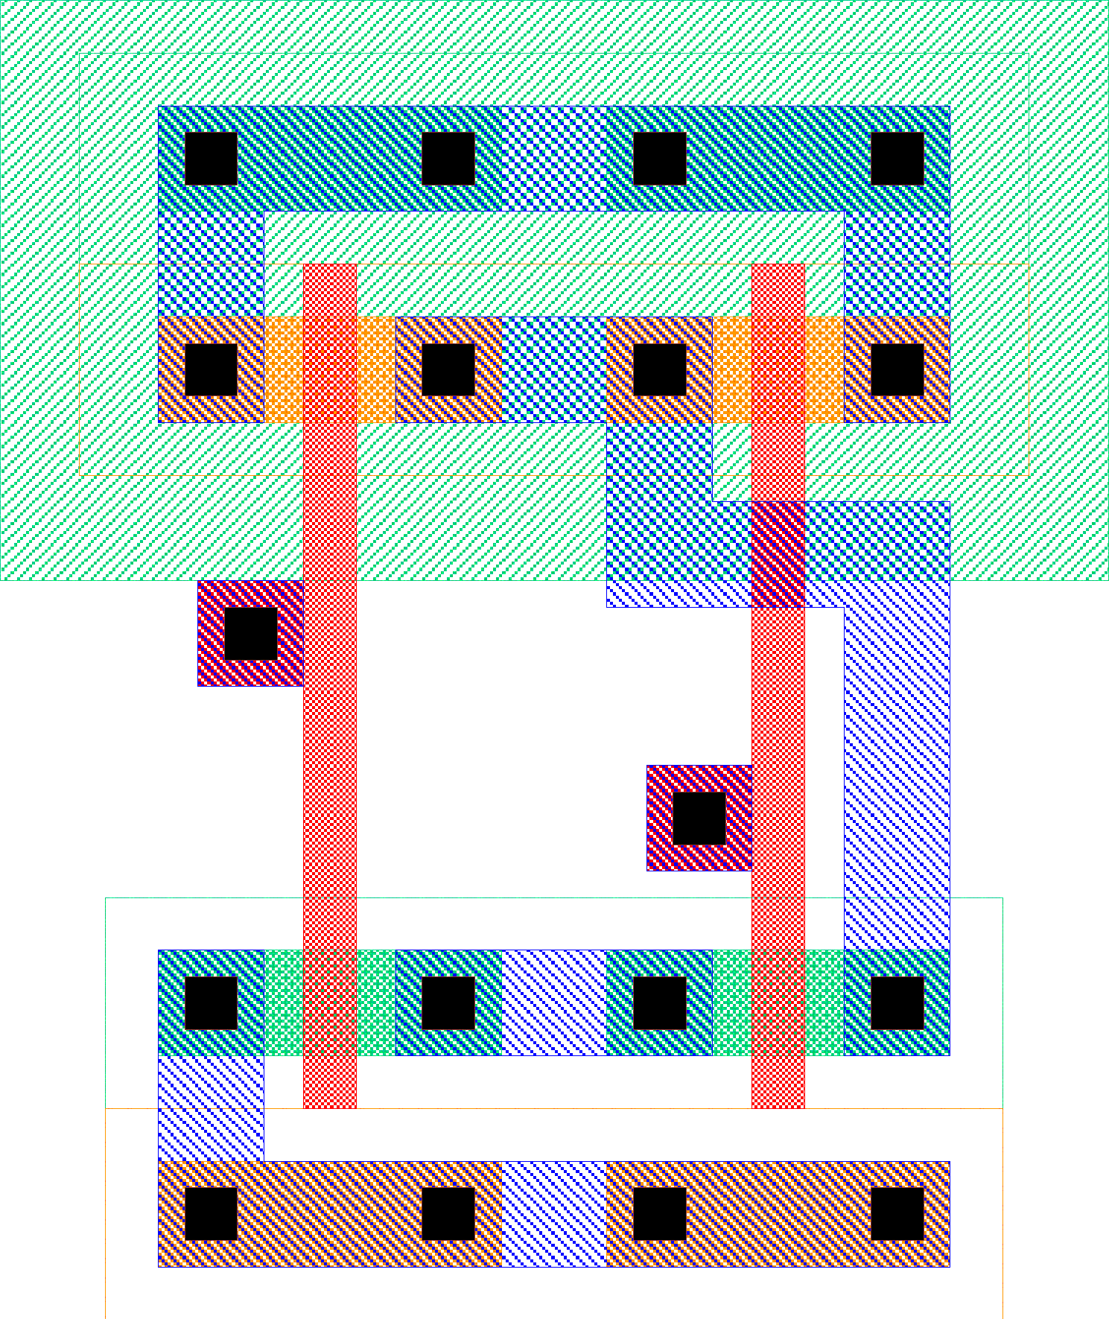
Layout #2 (preclass 2)
Notes:
37

Slide 38
Layout #2 (preclass 2)
How many transistors?
PMOS?
NMOS?
How connected?
PMOS, NMOS?
Inputs connected how?
Outputs?
What is it?
Notes:
38

Slide 39
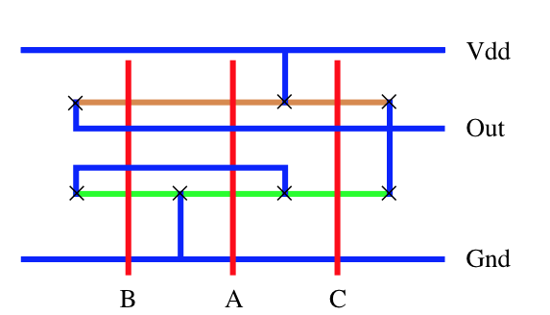
Symbolic Layout
Stick diagrams capture spatial relationships, but abstract away design rules
What is the gate function?
How many NMOS? PMOS? D/S connections?
Draw schematic
×

Slide 40
Standard Cells
Lay out gates so that heights match
Rows of adjacent cells
Standardized sizing of gate heights
Motivation: automated place and route
EDA tools convert HDL to layout
Notes:
40

Slide 41
Standard Cells

Slide 42
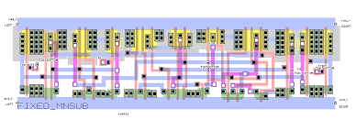
Standard Cell Layout Example

Slide 43
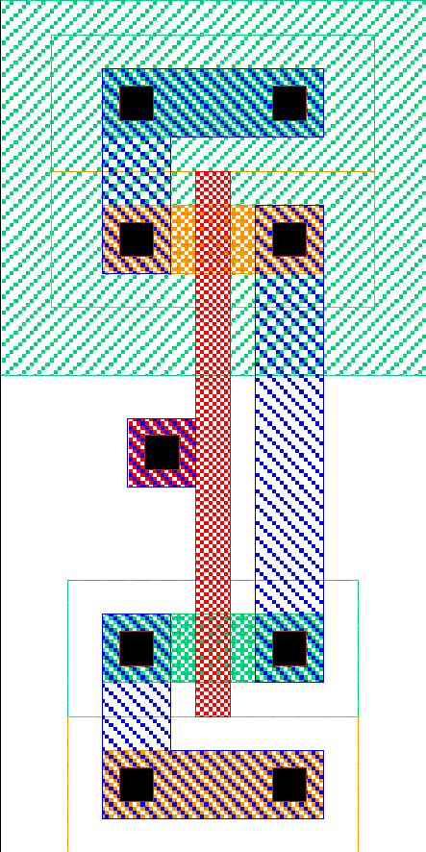
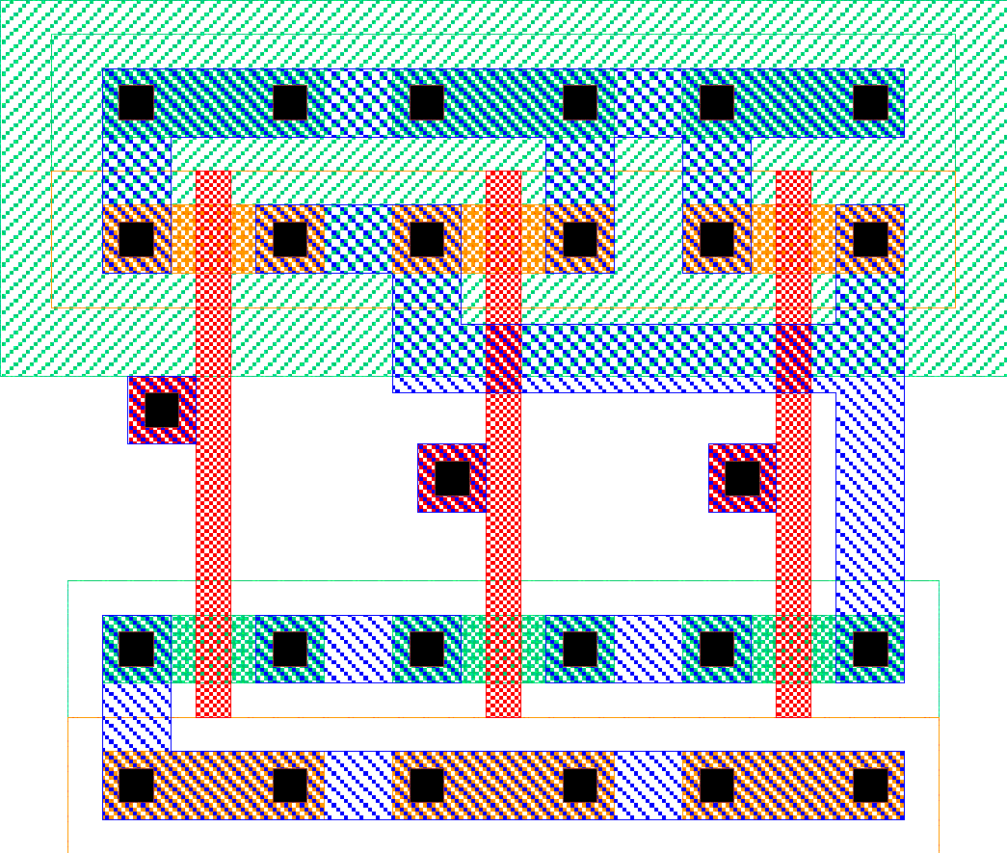
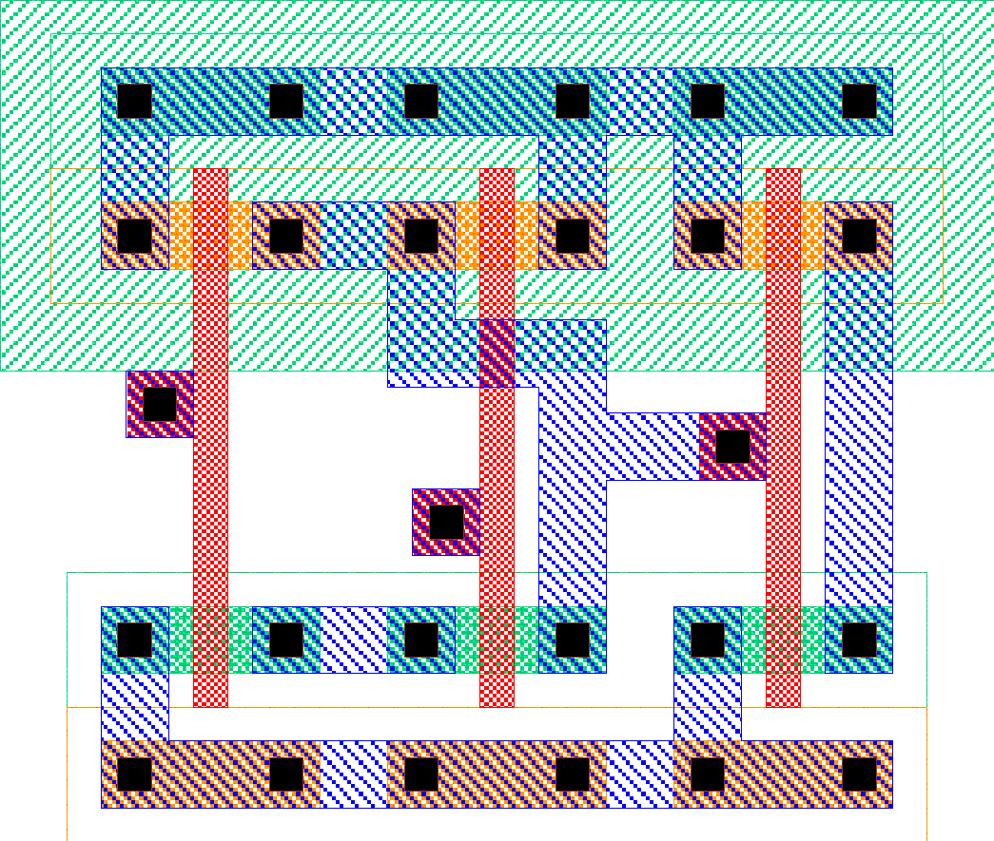
Standard Cell Area
inv
nand3
All cells
uniform
height
Width of
channel
determined
by routing
Cell area

Slide 44
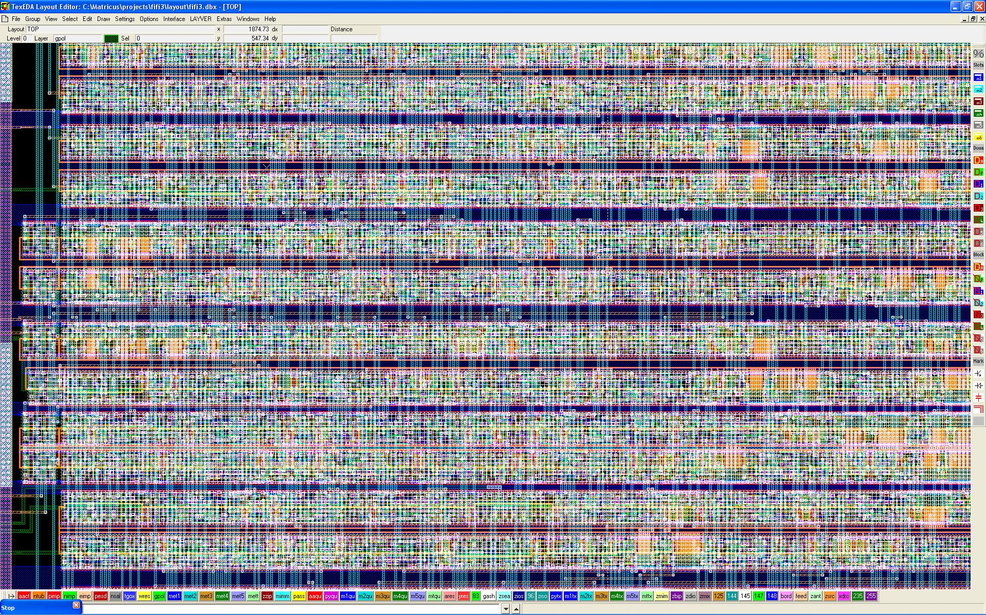
Standard Cell Layout Example
http://www.laytools.com/images/StandardCells.jpg

Slide 45
Standard Cell Layout Example
http://www.laytools.com/images/StandardCells.jpg

Slide 46
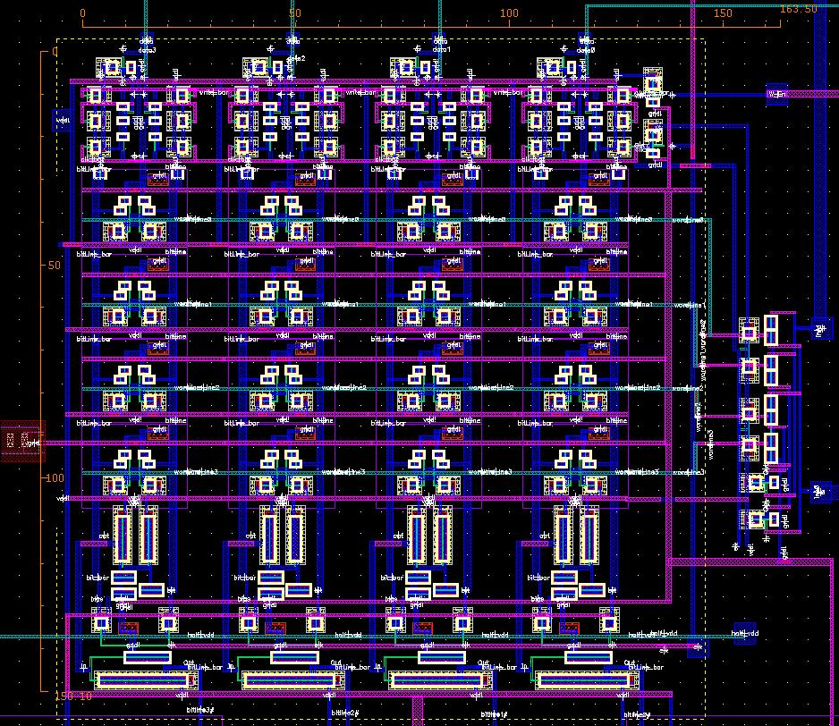
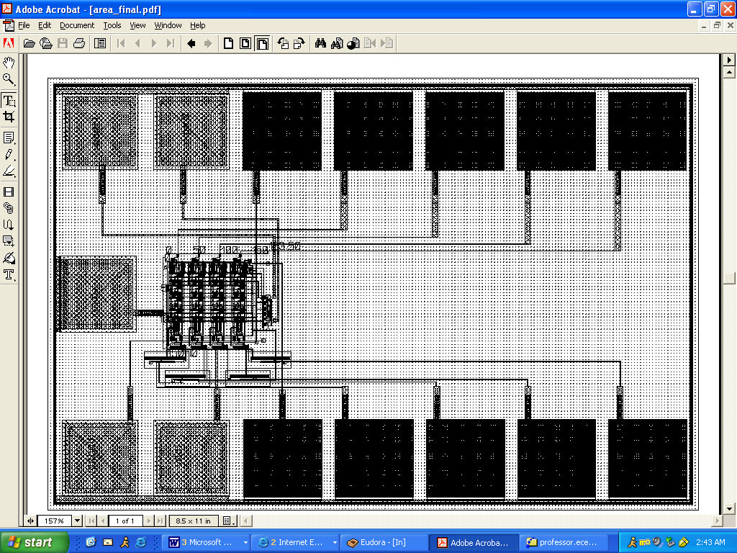
4x4 6T SRAM Memory

Slide 47
Circuit Extraction
Circuit extraction extracts a schematic representation of a layout, including transistors, wires, and possibly wire and device resistance and capacitance.
Circuit extraction is used for LVS, and for spice simulation of layouts

Slide 48
Circuit Extraction

Slide 49
Circuit Extraction

Slide 50
Big Idea
Layouts are physical realization of circuit
Geometry tradeoff
Can decrease spacing at the cost of yield
Design rules
Can go from circuit to stick diagram/layout or stick diagram/layout to circuit by inspection
Notes:
50

Slide 51
Admin
Midterm 1 Friday 10/1
7-9pm in Towne 309
No Lecture, virtual office hours
Use Tania OH link on Piazza
Virtual review session on Wednesday, will be recorded
See Piazza for updates
HW 4 posted Friday 10/1 after midterm
Due following Friday 10/8 @midnight

