Slide 1
ESE370: Circuit-Level Modeling, Design, and Optimization for Digital Systems
Lec 19: October 22, 2021
Design Space Exploration (con’t)
Pass Transistor Logic

Slide 2
Design Space Exploration

Slide 3
Design Problem
Function: Identify equivalence of two 32bit inputs
Optimize: Minimize total energy
Assumptions: Match case uncommon
Ie. Most of the time, the inputs won’t be matched
Deliberately focus on Energy to complement project
…but will still talk about delay

Slide 4
Design Space Dimensions
Topology
(A) Gate choice, logical optimization
(B) Fanin, fanout,
(C) Serial vs. parallel
Chain vs. tree
Gate style / logic family
(D) CMOS, Ratioed (N load, P load), Pass (coming soon)
(E) Transistor Sizing
(F) Vdd
(G) Vth

Slide 5
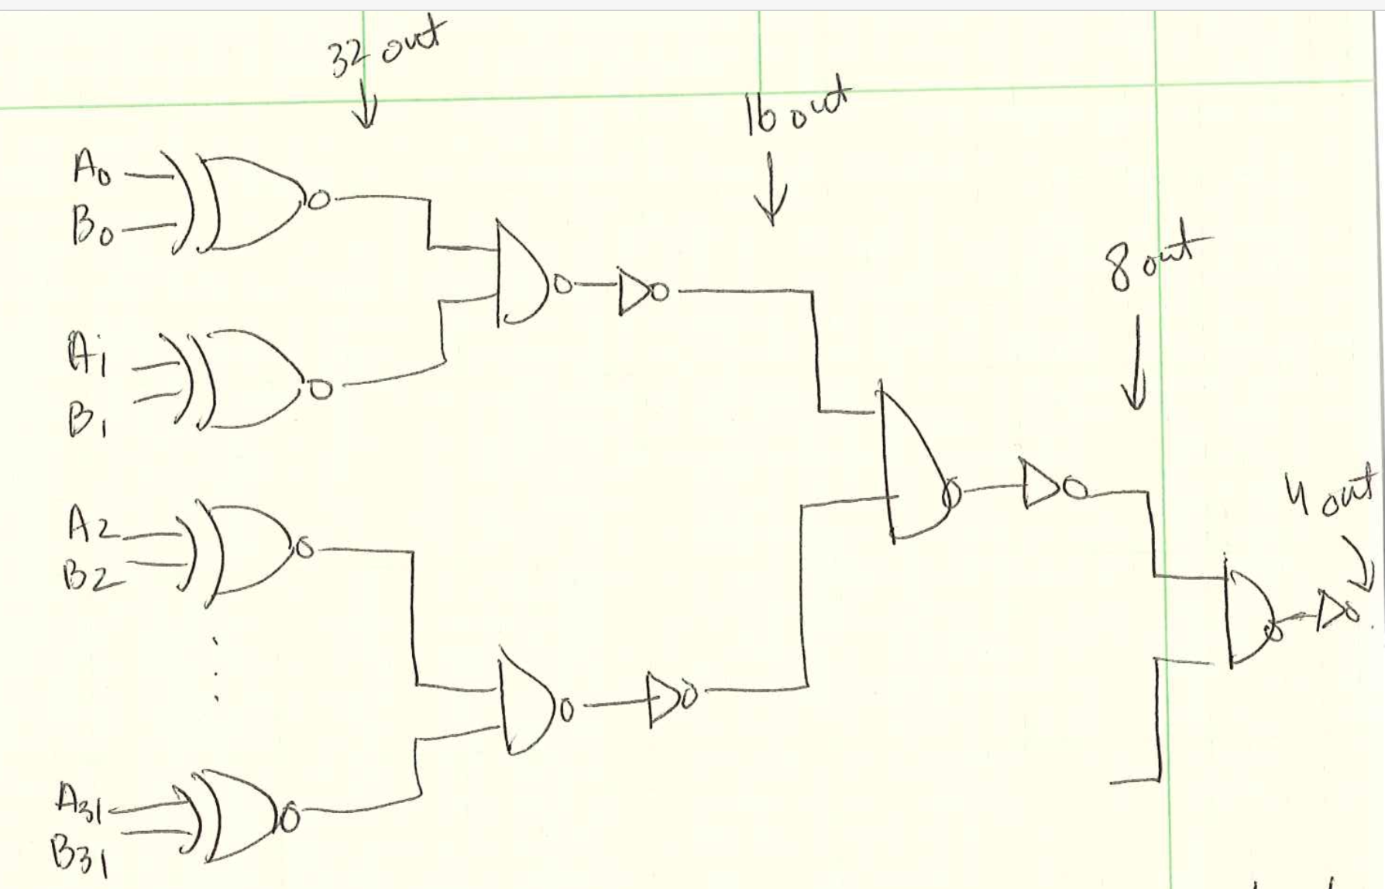
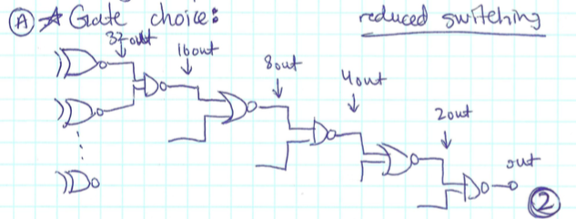
Gate Choice
(A) What gates might we build?

Slide 6
Gate Choice
(A) What gates might we build?

Slide 7
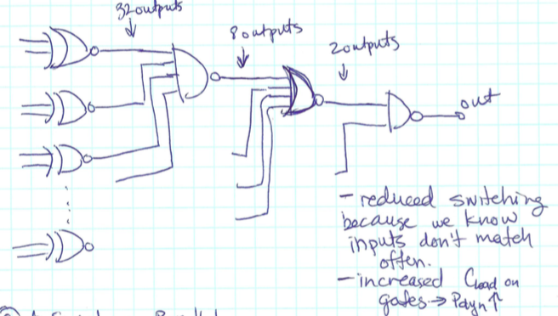
Gate Fan-in
(B) High fan-in?

Slide 8
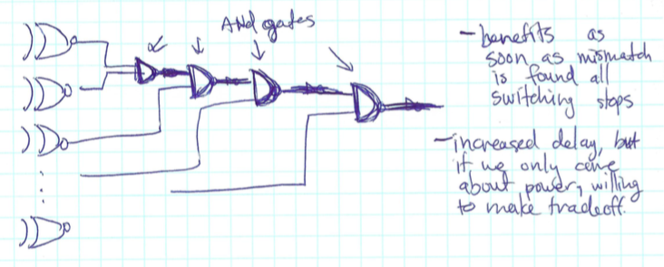
Gate Topology
(C) Serial-Parallel?

Slide 9
(D) Logic Family
Considerations for each logic family?
CMOS
Ratioed with PMOS load
Ratioed with NMOS load
Ratioed Logic
Reduced C_{loads} result in lower switching power (P_{dyn} ⬇)
Increased static power

Slide 10
(E) Sizing
How do we want to size gates?
Sizing transistors up will reduce delay →
Reduces short circuit power
Increases dynamic power

Slide 11
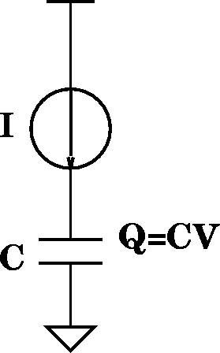
(F) Reduce Vdd
What happens as reduce V?
Energy?
Dynamic ⬇
Static ⬇
Switching Delay? ⬆
τ_{gd}=Q/I=(CV)/I
I_{d}=(μC_{OX}/2)(W/L)(V_{gs}-V_{TH})²
τ_{gd} impact?
τ_{gd} α 1/V
Limit on Vdd?

Slide 12
(G) Increase V_{th}?
What is impact of increasing threshold on
Dynamic Energy? ⬇
Leakage Energy? ⬇
Delay? ⬆
τ_{gd}=Q/I=(CV)/I
I_{ds}=(ν_{sat}C_{OX})(W)(V_{gs}-V_{TH}-V_{DSAT}/2)

Slide 13
Ideas
We know many things we can do to our circuits
Design space is large
Systematically identify dimensions
Identify continuum (trends) tuning when possible
Watch tradeoffs
…don’t over-tune

Slide 14
Pass Transistor Logic

Slide 15
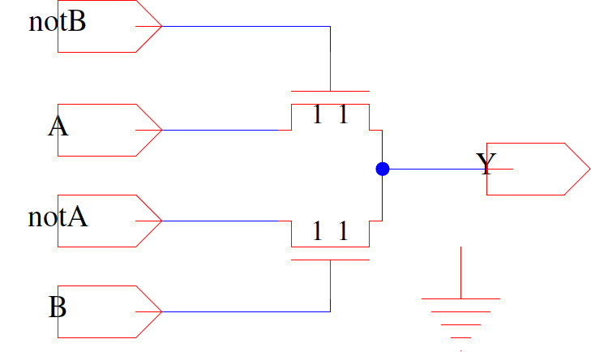
Pass Transistor Logic (Preclass 1)
What does this do?
A | B | Y
0 | 0
0 | 1
1 | 0
1 | 1

Slide 16
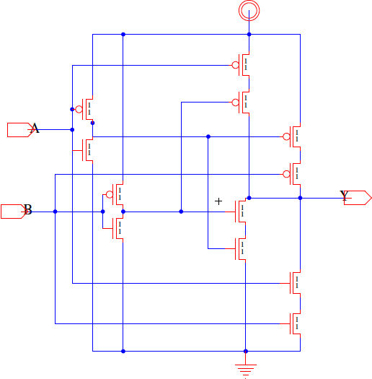
Identify Function (Preclass 2)
What function is this?

Slide 17
Area
Compare PT with CMOS circuit?

Slide 18
Output
Is this a regenerating/restoring gate?
A | B | Y
0 | 0 | 0
0 | 1 | 1
1 | 0 | 1
1 | 1 | 0

Slide 19
Output
What does output look like (DC transfer)?
(B=1, notB=0, sweep A, notA=CMOS inv(A))

Slide 20
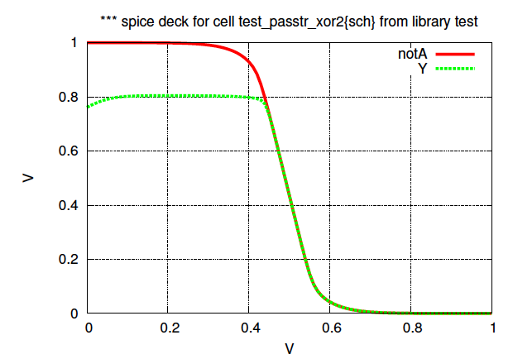
Pass TR transfer (B=1)
Sweep A

Slide 21
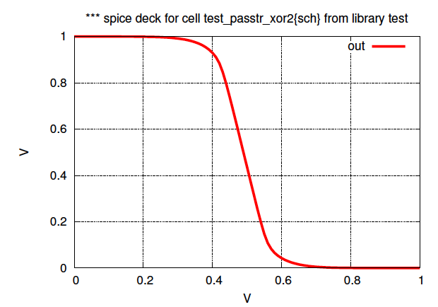
XOR Output
Reasonable Input to CMOS Inverter?

Slide 22
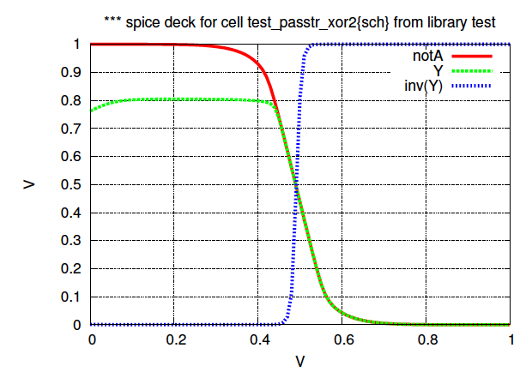
Pass Transistor xor2 with inv restore

Slide 23
Required to use?
What should we add to make suitable comparison with CMOS?

Slide 24
Restore Output
What should we add to make suitable comparison with CMOS?

Slide 25
Restore Output
Area? (compare to CMOS)

Slide 26
Chain Together

Slide 27
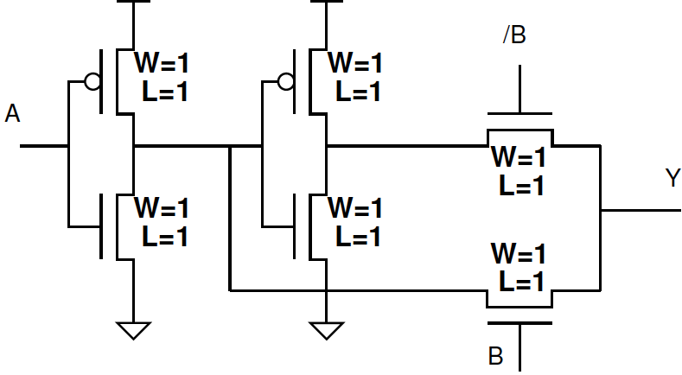
Analyze Stage

Slide 28
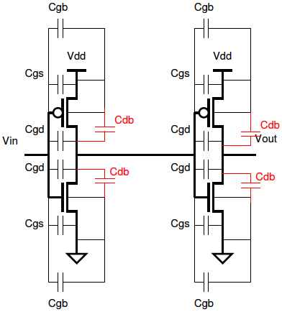
Impact of Capacitance
C_{GS}=C_{GCS}+C_{GSO}
C_{GD}=C_{GCD}+C_{GDO}
C_{GB}=C_{GCB}
C_{SB}=C_{diff}
C_{DB}=C_{diff}

Slide 29
Contact/Diffusion Capacitance
C_{j} – diffusion depletion
C_{jsw} – sidewall capacitance
L_{S} – length of diffusion
Define:
L_{S}

Slide 30
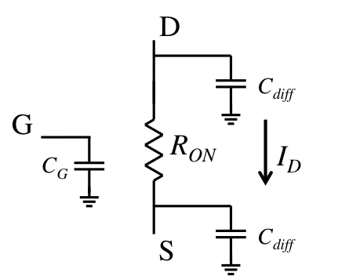
First Order Model
C_{diff0}
R₀
C₀
C_{diff0}
Switch
Loads all terminals capacitively
Draw no steady-state current for a CMOS gate
Does not impact steady-state output voltage
Impacts Settling time/Delay
Has finite drive strength
Could form voltage divider with resistive load
Impacts Settling time/Delay
Penn ESE370 Fall2021 – Khanna

Slide 31
First Order Delay
R₀ = Resistance of minimum size NMOS device
C₀ = gate capacitance of minimum size NMOS device
C_{diff0} = diffusion capacitance on minimum size NMOS
C_{diff0} =γC₀
R_{drive} = R₀/W
C_{g} = WC₀
C_{diff} = WC_{diff0} = γWC₀

Slide 32
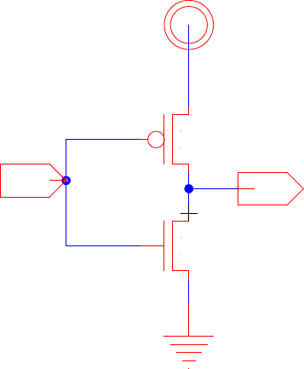
Inverter Delay
Delay driving another (min size) inverter?
Include C_{diff}=γC_{g}=γWC₀
W=1

Slide 33
Delay A=1, B=0, C_{diff0}=γC₀? (Preclass 3)
2C₀

Slide 34
Delay A=1, B=0, C_{diff0}=γC₀? (Preclass 3)
What’s the equivalent RC circuit?
2C₀

Slide 35
Delay A=1, B=0, C_{diff0}=γC₀? (Preclass 3)
What’s the equivalent RC circuit?
2C₀

Slide 36
Delay A=1, B=1, C_{diff0}=γC₀? (Preclass 3)
2C₀

Slide 37
Delay A=1, B=1, C_{diff0}=γC₀? (Preclass 3)
What’s the equivalent RC circuit?
2C₀

Slide 38
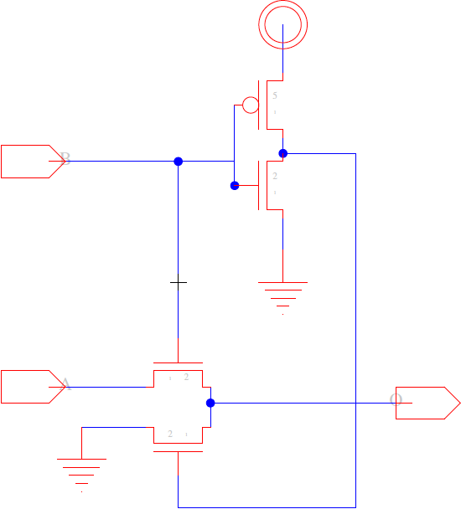
Bonus
What does this do?
A | B | Y
0 | 0
0 | 1
1 | 0
1 | 1
B
A

Slide 39
Idea
There are other circuit disciplines
Can use pass transistors for logic
Sometimes gives area or delay win

Slide 40
Admin
Project 1
Milestone due tonight @midnight
Will get feedback by Sunday morning
Can’t pass the class if you don’t turn in projects
Can’t do project last minute
Really should be into exploring optimizations for baseline

