Slide 1
ESE370: Circuit-Level Modeling, Design, and Optimization for Digital Systems
Lec 30: November 19, 2021
Inductive Noise

Slide 2
Today
Inductive Responses
Calculating L
Where inductances show up
Impact of inductance on digital circuits
How to address inductive noise

Slide 3
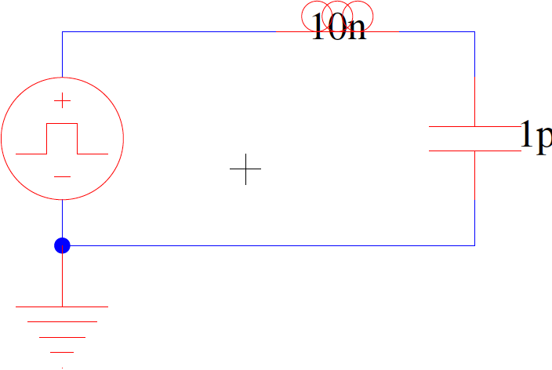
LC Response (preclass 1)
What happens here?
V₂

Slide 4
LC Response
What happens here?
V₂

Slide 5
LC Response
What happens here?
V₂

Slide 6
LC Response
What happens here?
V₂

Slide 7
LC Response
What happens here?
V₂

Slide 8
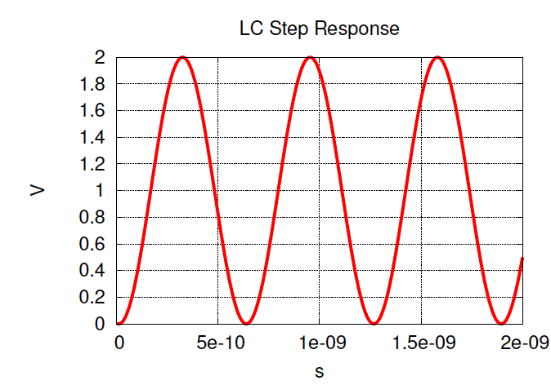
LC Response

Slide 9
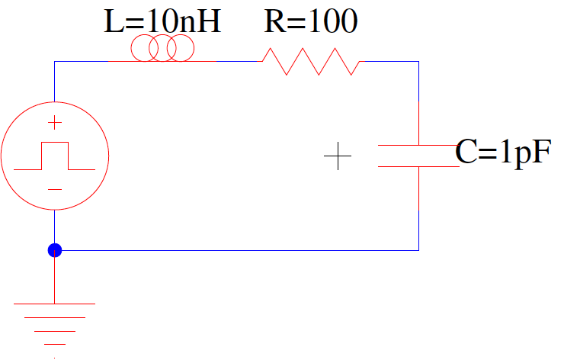
Response? (preclass 1)
V₂

Slide 10
RLC Response
V₂

Slide 11
RLC Response
V₂

Slide 12
RLC Response
V₂

Slide 13
RLC Response
V₂

Slide 14
RLC Response
V₂

Slide 15
RLC Response
V₂

Slide 16
RLC Response
V₂

Slide 17
RLC Response
V₂
For what R does this circuit oscillate?

Slide 18
RLC Response
V₂
For what R does this circuit oscillate?

Slide 19
RLC Response
Decay
Oscillation
V₂
For what R does this circuit oscillate?

Slide 20
When Oscillate
For what R does this particular circuit oscillate?

Slide 21
When Oscillate
For what R does this particular circuit oscillate?

Slide 22
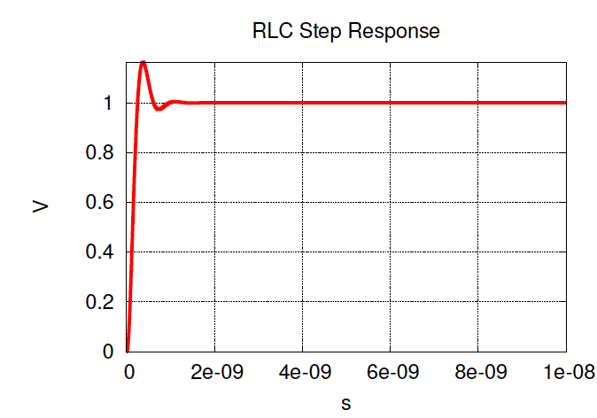
RLC Response (R=100)

Slide 23
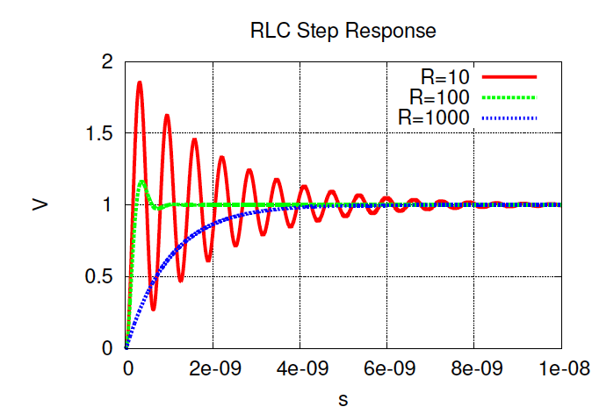
RLC Response

Slide 24
Inductance of Wire

Slide 25
Isolated Wire RC
B
B
4 m
4 m
0.1 mm
0.2 mm
A
0.2 mm
A
0.1 mm
dielectric material
0.1 mm
metal plate
Penn ESE370 Fall2018 – Khanna

Slide 26
Inductance: Wire over Ground Plane

Slide 27
Inductance: Wire over Ground Plane

Slide 28
Inductance: Wire over Ground Plane
C’ and L’ per unit length

Slide 29
On Chip Inductance
C_{wire} = 0.16 pF (for the 1mm)
C_{wire =} 0.16nF/m
Permeability μ₀≈ μ_{Si02}=12.6×10⁻⁷H/m
Permitivity ε_{ox}=3.5×10⁻¹¹F/m

Slide 30
On Chip Inductance
C_{wire} = 0.16 pF (for the 1mm)
C_{wire =} 0.16nF/m
Permeability μ₀≈ μ_{Si02}=12.6×10⁻⁷H/m
Permitivity ε_{ox}=3.5×10⁻¹¹F/m
276 pH (for 1 mm)

Slide 31
PCB Trace Inductance (preclass 2)
Inductance per cm of PCB trace with h=3mil, w=5mil (1mil = .001 inch)
𝞵₀ = 1.26 x 10⁻⁶
𝞵_{r} = 1

Slide 32
Comparisons
5mil trace on PCB
7.56nH/cm
Breadboard wires (0.6mm diameter)
About 7nH/cm
On chip wire
0.28nH/mm = 2.8nH/cm

Slide 33
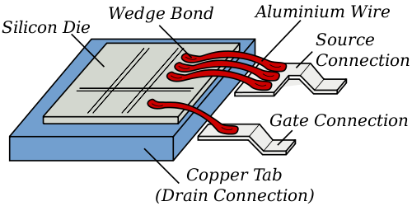
Inductors
Bond pads
Chip leads
Long wire runs
Cables
Src: http://en.wikipedia.org/wiki/File:Wirebonding2.svg

Slide 34
Where Inductance Arises
In our digital systems

Slide 35
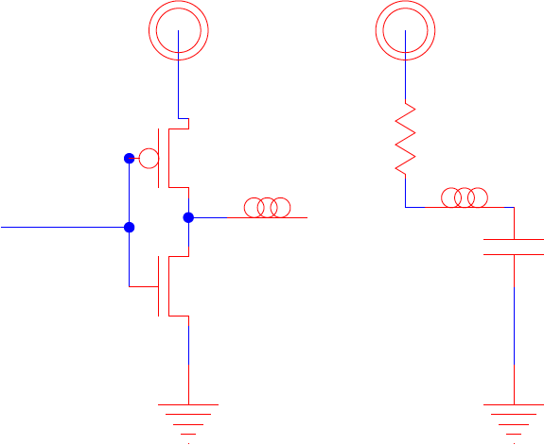
Signal Path

Slide 36
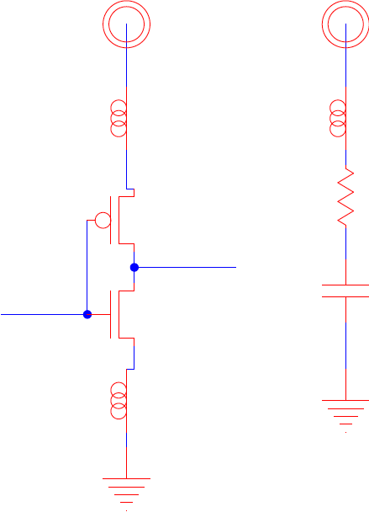
Power Ground

Slide 37
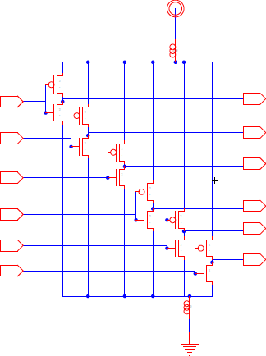
Shared Power/Ground Example: 74x04

Slide 38
Estimate
R_{eq}, C_{eq} for gates in parallel
R₀ = 25K Ω
C₀ = 0.01 fF
say 10C₀=0.1fF for typical load
250 gates switching at clock
Decay
Oscillation

Slide 39
Estimate
R_{eq}, C_{eq} for gates in parallel
R₀ = 25K Ω
C₀ = 0.01 fF
say 10C₀=0.1fF for typical load
250 gates switching at clock
R_{eq} = 100Ω C_{eq}=25fF
Assume L=1nH
How long to settle? Oscillation freq?
Decay
Oscillation

Slide 40
Power Ground

Slide 41
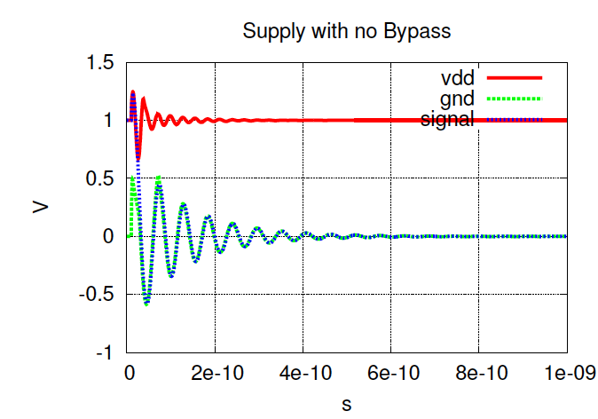
RLC Response

Slide 42
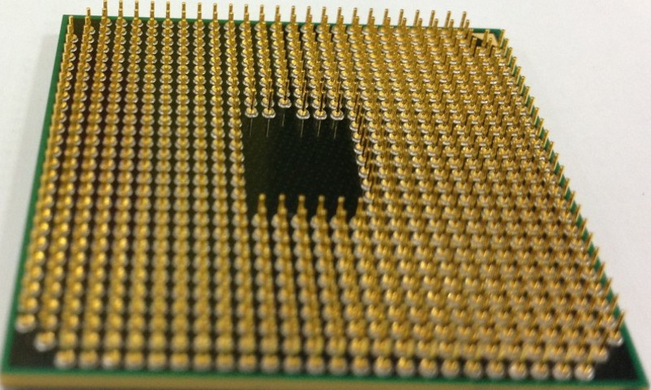
Today’s chips: Multiple Power/Ground Pins
Use many power/ground pins
Divide switching gates by pins
To get effective load on each pin

Slide 43
Improve Performance

Slide 44
Minimize the L
Make wires short
Use power and ground planes
Think of power plane as a very wide wire

Slide 45
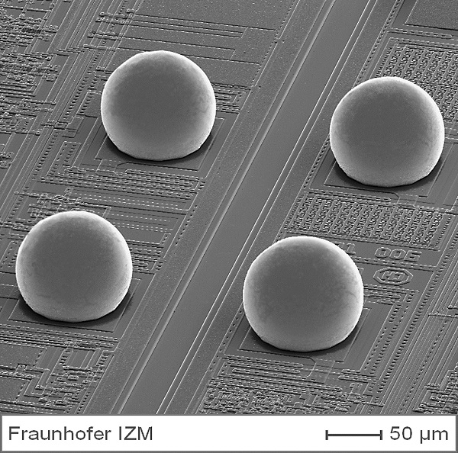
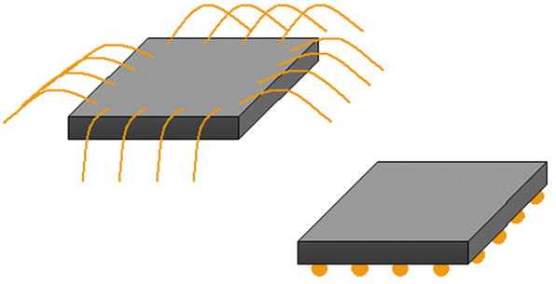
Flip Chip, Area IO
http://www.izm.fraunhofer.de/en/abteilungen/high_density_interconnectwaferlevelpackaging/arbeitsgebiete/arbeitsgebiet1.html

Slide 46
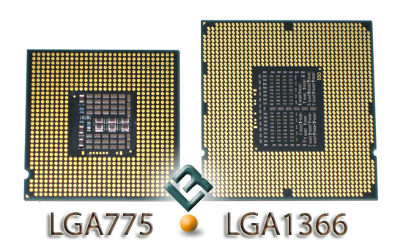
Add Good C’s
Bypass Capacitors – inside the inductances
On board
On package
On chip

Slide 47
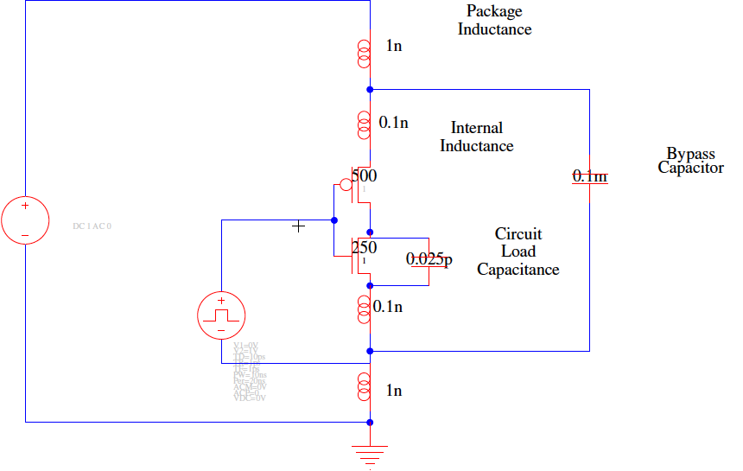
Bypass Capacitor Example

Slide 48
Bypass Capacitor Example
No bypass cap
No package inductance
package inductance w/ bypass cap

Slide 49
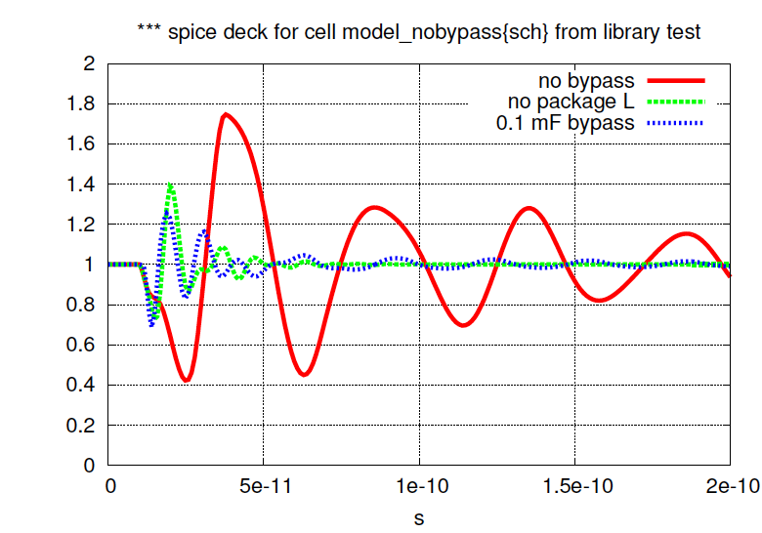
Bypassed Supplies (@ transistor)

Slide 50
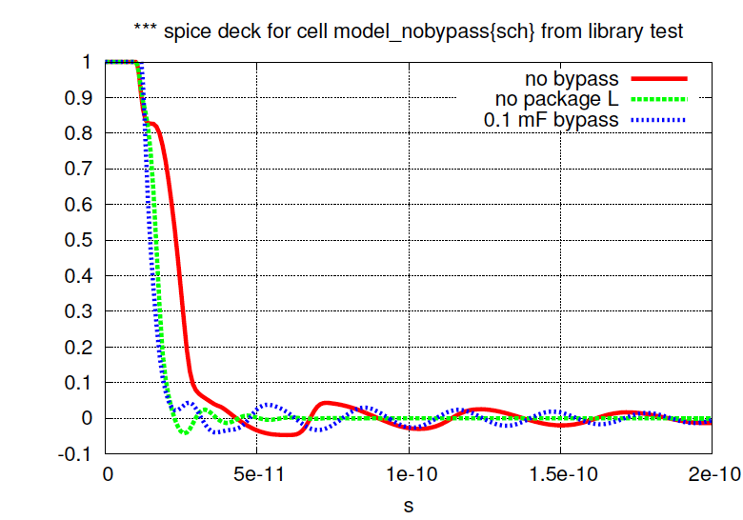
Bypassed Output

Slide 51
Idea
Long wires are inductive
Avoid them
Especially on power supplies
Bypass capacitors help
Decay
Oscillation

Slide 52
Admin
Project 2
Milestone due Monday
Feedback by Wednesday
Final due Friday 12/3

