Slide 1
ESE370: Circuit-Level Modeling, Design, and Optimization for Digital Systems
Lec 7: September 20, 2021
MOS Transistor Operating Regions
Part 1
Penn ESE370 Fall2021 – Khanna
1

Slide 2
Today
MOS Transistor Topology
Threshold
Operating Regions
  Resistive
  Saturation
  Subthreshold (next class)
  Velocity Saturation (next class)
Penn ESE370 Fall2021 – Khanna

Slide 3
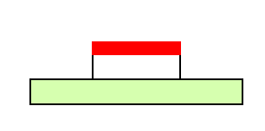
Last Time – MOS model
gate
drain
source
semiconductor
V_{gs} positive
Conducts
V_{gs} negative
Conducts
+ + + + +
- - - - - -
- - - - - -
- -
- -
+ + + + +
- -
- -
- -
+ + + + + + + + + + +
PMOS
NMOS
PMOS
Penn ESE370 Fall2021 – Khanna

Slide 4
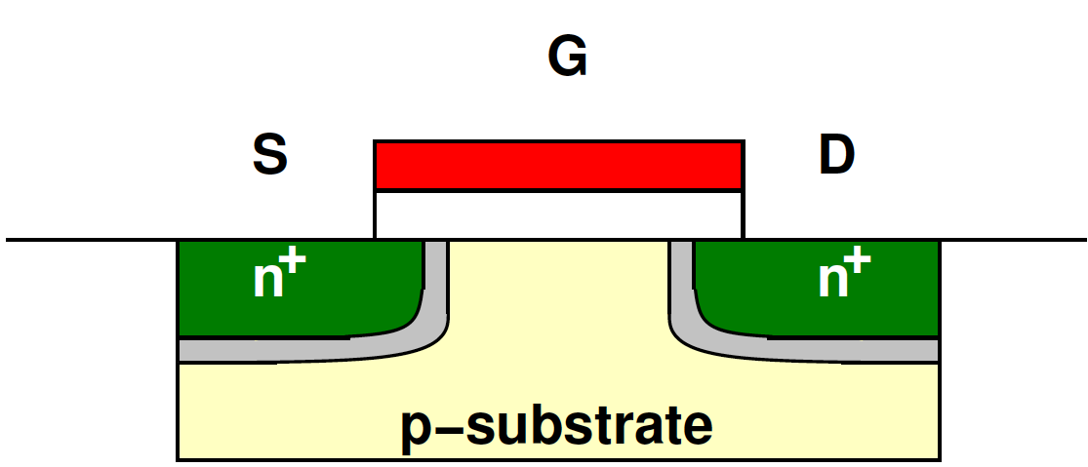
Refinement
Depletion region around D/S→ excess carriers depleted
Penn ESE370 Fall2021 – Khanna

Slide 5
Bulk/Body Contact
MOS actually has four contacts
Also effects fields
Ideally substrate and source connected
  Settle for substrate being <= source
  Gnd for nmos (V_{dd} for pmos)
D
G
B
S
B
Penn ESE370 Fall2021 – Khanna

Slide 6
No Field
V_{GS}=0, V_{DS}=0
Penn ESE370 Fall2021 – Khanna

Slide 7
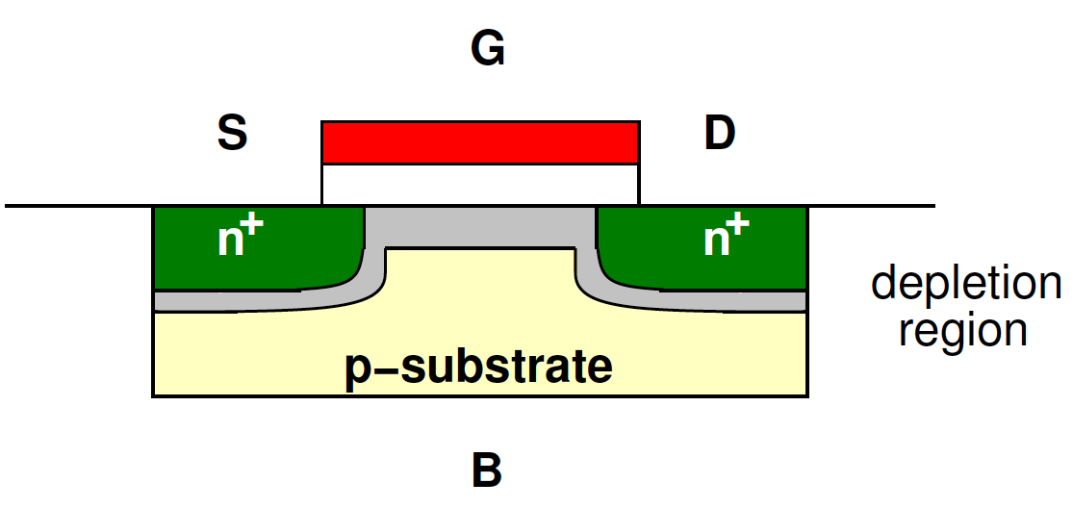
Apply V_{GS}>0
Deplete excess positive charge under oxide
Left with negative charge
  Repel holes
Penn ESE370 Fall2021 – Khanna

Slide 8
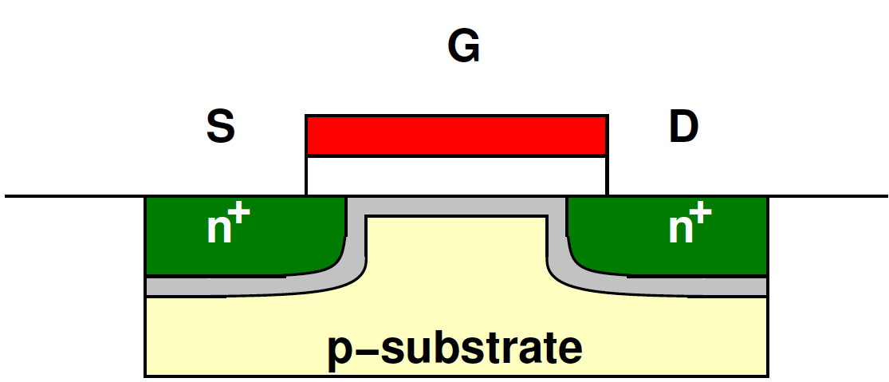
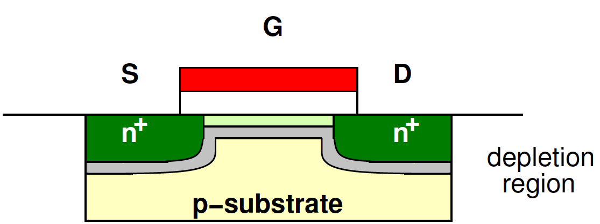
Channel Evolution -- Increasing Vgs
depletion region
depletion region
inversion layer
Penn ESE370 Fall2021 – Khanna

Slide 9
Inversion
Surface builds electrons
  Inverts to n-type
  Draws electrons from n⁺ source terminal
Penn ESE370 Fall2021 – Khanna

Slide 10
Threshold
Voltage where strong inversion occurs → threshold voltage
  V_{th} ~= 2ϕ_{F}
Penn ESE370 Fall2021 – Khanna

Slide 11
Threshold
Voltage where strong inversion occurs → threshold voltage
  V_{th} ~= 2ϕ_{F}
  Engineer by controlling doping (N_{A})
Penn ESE370 Fall2021 – Khanna

Slide 12
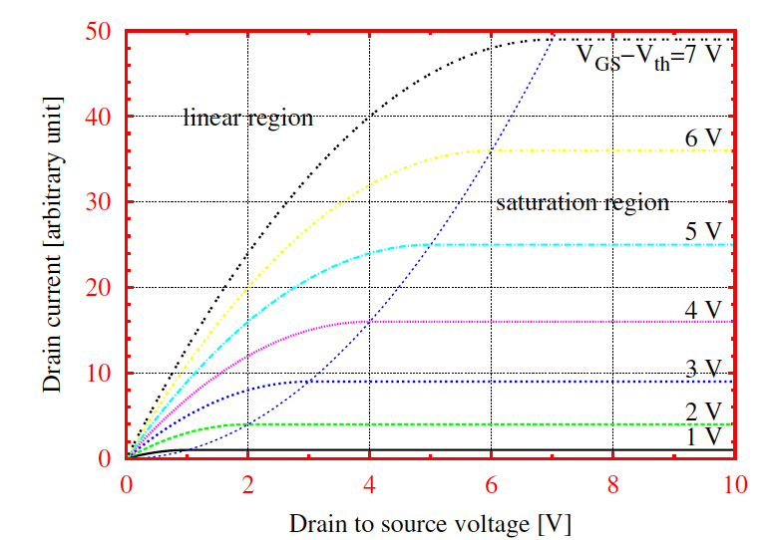
MOSFET – IV Characteristics
V_{DS} <V_{GS} -V_{TH}
V_{GS} -V_{th}
I_{DS}
V_{DS} ≥V_{GS} -V_{TH}
V_{DS}
Penn ESE370 Fall2021 – Khanna

Slide 13
Linear Region
V_{GS}>V_{th} and V_{DS} small
Penn ESE370 Fall2021 – Khanna

Slide 14
Linear Region
V_{GS}>V_{th} and V_{DS} small
V_{GS} fixed → looks like resistor
  Current linear in V_{DS}
Penn ESE370 Fall2021 – Khanna

Slide 15
Linear Region
V_{GS}>V_{th} and V_{DS} small
V_{GS} fixed → looks like resistor
  Current linear in V_{DS}
~0
Penn ESE370 Fall2021 – Khanna

Slide 16
MOSFET – IV Characteristics
V_{DS} <V_{GS} -V_{TH}
V_{GS} -V_{th}
I_{DS}
V_{DS} ≥V_{GS} -V_{TH}
V_{DS}
Penn ESE370 Fall2021 – Khanna

Slide 17
Preclass 1
Reference: I_{ds} for single transistor with Vgs and Vds bias
Penn ESE370 Fall2021 – Khanna

Slide 18
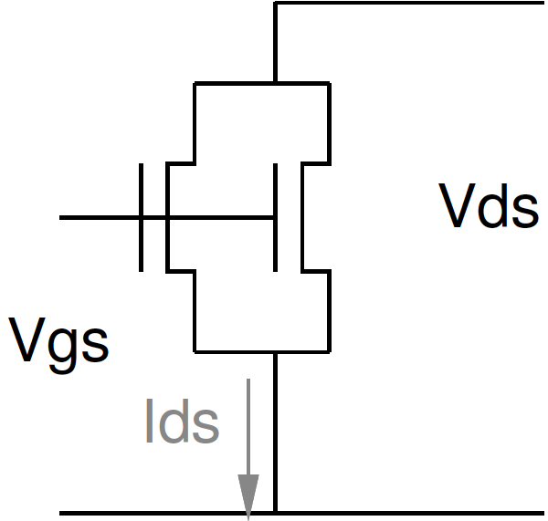
Preclass 1
I_{ds} for identical transistors in parallel?
Reference:
Penn ESE370 Fall2021 – Khanna

Slide 19
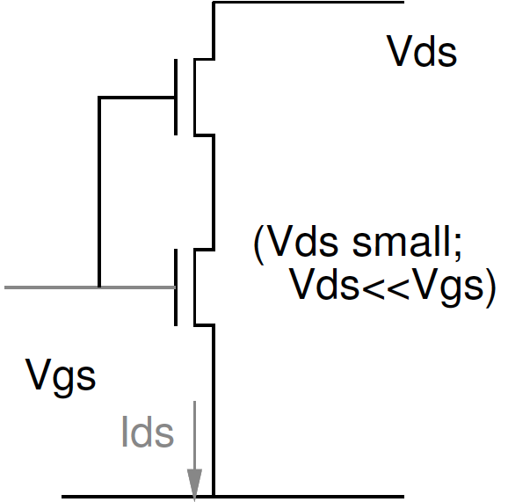
Preclass 1
I_{ds} for identical transistors in series?
  (Vds small)
Reference:
Penn ESE370 Fall2021 – Khanna

Slide 20
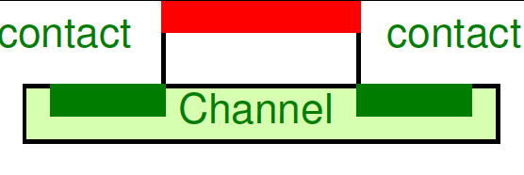
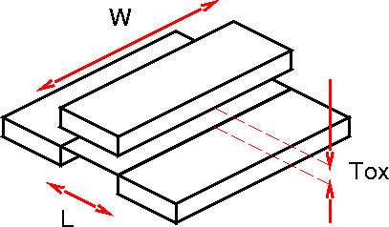
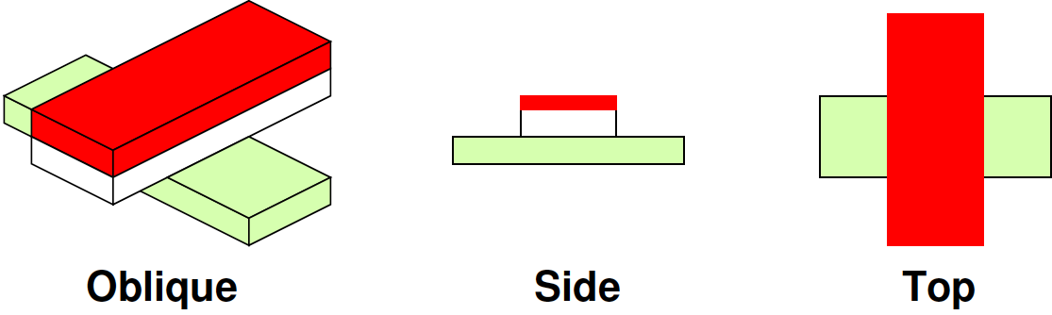
Dimensions
Channel Length (L)
Channel Width (W)
Oxide Thickness (T_{ox})
Penn ESE370 Fall2021 – Khanna

Slide 21
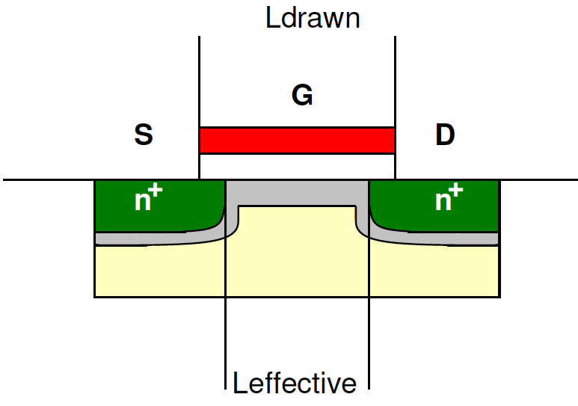
L_{drawn} vs. L_{effective}
Doping not perfectly straight
Spreads under gate
Effective L smaller than draw gate width
Penn ESE370 Fall2021 – Khanna

Slide 22
Transistor Strength (W/L)
Penn ESE370 Fall2021 – Khanna

Slide 23
Transistor Strength (W/L)
Shape dependence match Resistance intuition
  Wider = parallel resistors → decrease R
  Longer = series resistors → increase R
Penn ESE370 Fall2021 – Khanna

Slide 24

Channel Voltage
Think of channel as resistor
Voltage varies along channel
Penn ESE370 Fall2021 – Khanna

Slide 25
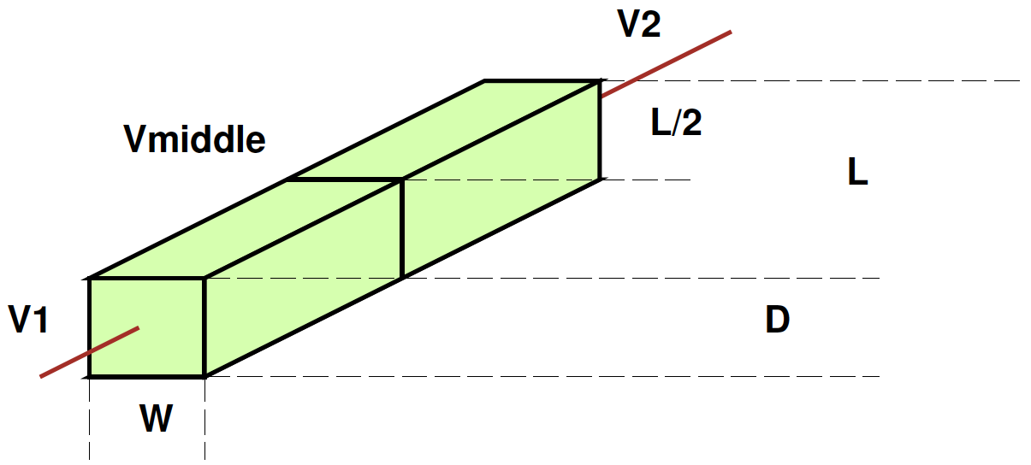
Preclass 2
What is voltage in the middle of a resistive medium?
  Relative to V1 and V2
  halfway between terminals
Penn ESE370 Fall2021 – Khanna

Slide 26
Channel Voltage
Think of channel as resistor
Voltage varies along channel
  Serves as a voltage divider between V_{S} and V_{D}
Penn ESE370 Fall2021 – Khanna

Slide 27
Voltage along Channel
What does voltage along the channel look like?
x=0
x=L
V(x)
x
Penn ESE370 Fall2021 – Khanna

Slide 28
Voltage along Channel
What does voltage along the channel look like?
x=0
x=L
Vd
V(x)
Vs
x
Penn ESE370 Fall2021 – Khanna

Slide 29

Voltage along Channel
What does voltage along the channel look like?
x=0
x=L
Vd
V(x)
Vs
$${=V}_{GS}−\frac{V_{DS}}{L}x$$
x
Penn ESE370 Fall2021 – Khanna

Slide 30

Channel Field
When voltage gap V_{G}-V_{x} drops below V_{th}, drops out of inversion
V_{x}
Penn ESE370 Fall2021 – Khanna

Slide 31
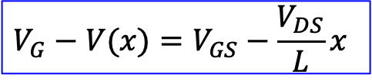
Channel Field
When voltage gap V_{G}-V_{x} drops below V_{th}, drops out of inversion
  Saturation Edge: V_{DS} = V_{GS} – V_{th} →V_{G} – V_{X}(@ D) = ?
V_{x}
$${V_{G}−V(x)=V}_{GS}−\frac{V_{DS}}{L}x$$
Penn ESE370 Fall2021 – Khanna

Slide 32
Channel Field
When voltage gap V_{G}-V_{x} drops below V_{th}, drops out of inversion
  Deep Saturation: V_{DS} > V_{GS} – V_{th} →V_{G} – V_{X}(@ D) = ?
V_{x}
Penn ESE370 Fall2021 – Khanna

Slide 33
Channel Field
When voltage gap V_{G}-V_{x} drops below V_{th}, drops out of inversion
  Deep Saturation: V_{DS} > V_{GS} – V_{th} →V_{G} – V_{X}(@ D) < V_{th} Upper limit on current, channel is “pinched off”
V_{x}
Penn ESE370 Fall2021 – Khanna

Slide 34
Channel Field
When voltage gap V_{G}-V_{x} drops below V_{th}, drops out of inversion
  What if V_{DS} > V_{GS} – V_{th}?
    Upper limit on current, channel is “pinched off”
    For what x, is V_{G}-V(x)=V_{T}?
V_{x}
Penn ESE370 Fall2021 – Khanna

Slide 35
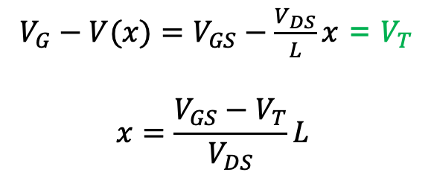
Channel Field
When voltage gap V_{G}-V_{x} drops below V_{th}, drops out of inversion
  What if V_{DS} > V_{GS} – V_{th}?
    Upper limit on current, channel is “pinched off”
    For what x, is V_{G}-V(x)=V_{T}?
${V_{G}−V(x)=V}_{GS}−\frac{V_{DS}}{L}x$ = $V_{T}$
$$x=\frac{V_{GS}−V_{T}}{V_{DS}}L$$
V_{x}
Penn ESE370 Fall2021 – Khanna

Slide 36
Pinch Off
When voltage along the channel drops below V_{th}, the channel drops out of inversion
  Occurs when: V_{G} – V_{X}(@ D) < V_{th} → V_{DS} > V_{GS} – V_{th}
Conclusion:
  current cannot increase with V_{DS} once V_{DS} > V_{GS}-V_{T}
    Not true! More later…
Penn ESE370 Fall2021 – Khanna

Slide 37
Saturation
At edge of saturation, V_{DS}= V_{GS}-V_{T}
Becomes:
Penn ESE370 Fall2021 – Khanna

Slide 38
MOSFET – IV Characteristics
V_{DS} <V_{GS} -V_{TH}
V_{GS} -V_{th}
I_{DS}
V_{DS} ≥V_{GS} -V_{TH}
V_{DS}
Penn ESE370 Fall2021 – Khanna

Slide 39
Channel Length Modulation

Slide 40
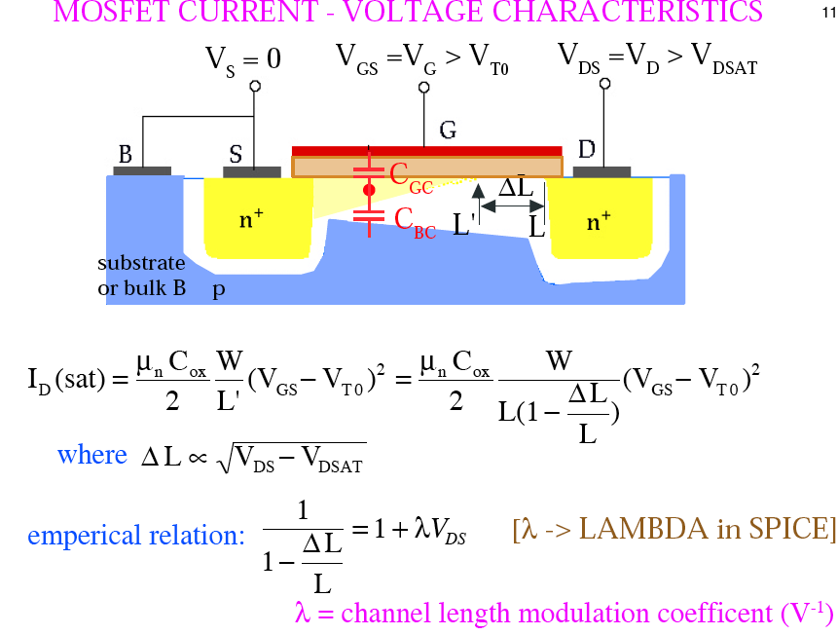

MOSFET IV Characteristics - Saturation
V_{GS} > V_{T0}
V_{DS} > V_{GS} – V_{T0}
V_{x}
n⁺
n⁺
$$I_{DS}$$

Slide 41
MOSFET IV Characteristics - Saturation
V_{GS} > V_{T0}
V_{DS} > V_{GS} – V_{T0}
V_{x}
n⁺
n⁺
$$I_{DS}$$

Slide 42


MOSFET IV Characteristics - Saturation
V_{GS} > V_{T0}
V_{DS} > V_{GS} – V_{T0}
V_{x}
n⁺
n⁺
$$I_{DS}$$
empirically
$$ΔL∝\sqrt{V_{DS}−{(V}_{GS}−V_{T0})}$$

Slide 43

MOSFET IV Characteristics - Saturation
V_{GS} > V_{T0}
V_{DS} > V_{GS} – V_{T0}
V_{x}
n⁺
n⁺
$$I_{DS}$$
empirically
$$ΔL∝\sqrt{V_{DS}−{(V}_{GS}−V_{T0})}$$
If λ•V_{DS}<<1,

Slide 44

MOSFET IV Characteristics - Saturation
$$I_{DS}$$

Slide 45
MOSFET IV Characteristics - Saturation
$$I_{DS}$$

Slide 46
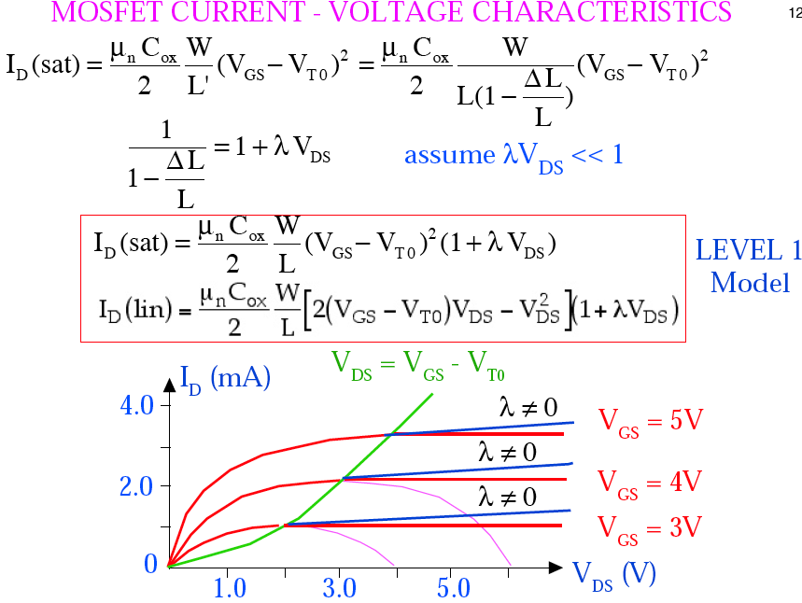
MOSFET IV Characteristics
Linear Region:
Saturation Region:
λ≠0
λ=0

Slide 47
MOSFET IV Characteristics
Linear Region:
Saturation Region:
DISCONTINUOUS! @ V_{DS} = V_{GS}-V_{T}
λ≠0
λ=0

Slide 48
MOSFET IV Characteristics
Linear Region:
Saturation Region:
DISCONTINUOUS! @ V_{DS} = V_{GS}-V_{T}
λ≠0
λ=0

Slide 49
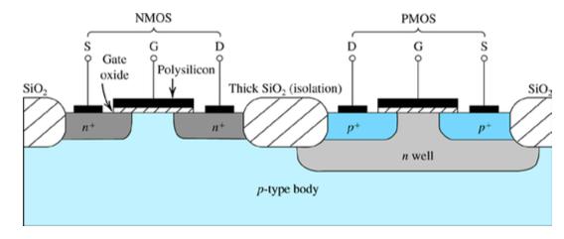
pMOS Device
Analagous phenomena to NMOS
Opposite polarity
  Negative V_{th,} λ
Reason based on oppositely charged carriers
Penn ESE370 Fall2021 – Khanna

Slide 50
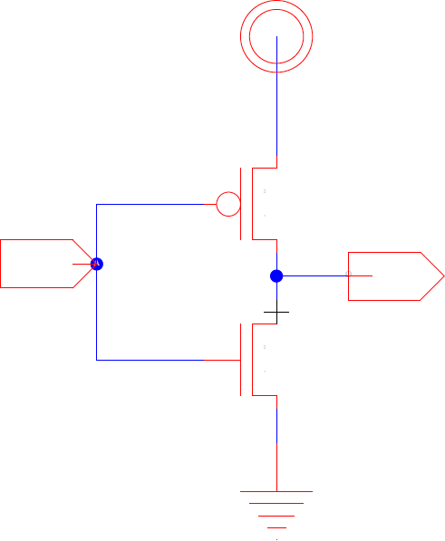
Approach
Identify Region
Drives governing equations
  See preclass reference (pg 2)
Use region and equations to understand operation
Penn ESE370 Fall2021 – Khanna

Slide 51
Big Idea
3 Regions of operation for MOSFET
  Linear
  Saturation
    With channel length modulation
  Subthreshold (next class)
Penn ESE370 Fall2021 – Khanna

Slide 52
Admin
Text 3.3.2 – highly recommend read!!
  Second half on Wednesday
HW2 due tonight
HW3 out
  Get started now
  Long and time-consuming
Penn ESE370 Fall2021 – Khanna

