Slide 1

ESE5320:
System-on-a-Chip Architecture
Day 8: September 28, 2022
Spatial Computations

Slide 2
Today
Accelerator Pipelines (Part 1)
FPGAs (Part 2)
Computational Capacity (Part 3)
  Zynq

Slide 3
Message
Custom accelerators efficient for large computations
  Exploit Instruction-level parallelism
  Run many low-level operations in parallel
Field-Programmable Gate Arrays (FPGAs)
  Allow post-fabrication configuration of custom accelerator pipelines
  Can offer high computational capacity

Slide 4
Accelerator Datapaths

Slide 5
Pipeline Graph
Last time: pipelined simple loop

Slide 6
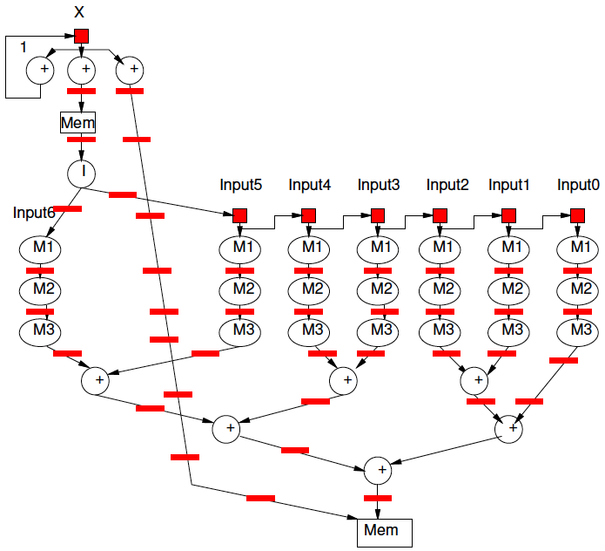
Pipeline for Unrolled Loop

Slide 7
Preclass 1
For fully unrolled loop shown,
how many instructions per pipeline cycle?
  Add
  Mpy
  Load
  Store

Slide 8
Spatial Pipeline
Can compute equivalent of tens of “instructions” in a cycle
Wire up primitive operators
  No indirection through register file, memory
Pipeline for operator latencies
Any dataflow graph of computational operations

Slide 9
Operators
Can assemble any custom operators
  Ones may not have in generic processor
Processor
  Add, bitwise-xor/and/or
  Maybe: floating-point add, multiply
Less likely
  Square-root, exponent, cosine, encryption (AES) step, polynomial evaluate,
  log-number-system

Slide 10
Accelerators
Compression/decompression
Encryption/decryption
Encoding (ECC, Checksum)
Discrete Cosine Transform (DCT)
Sorter
Taylor Series Approximation of function
Transistor evaluator
Tensor or Neural Network evaluator

Slide 11
Streaming Dataflow
Replace operator with custom accelerator
Stream data to/from it

Slide 12
Streaming Dataflow Example

Slide 13
Application-Specific SoCs
For dedicated applications
may build custom hardware for accelerators
  Layout VLSI, fab unique chips
  ESE3700, 5700
Video-encoder – include custom DCT, motion-estimation engines

Slide 14
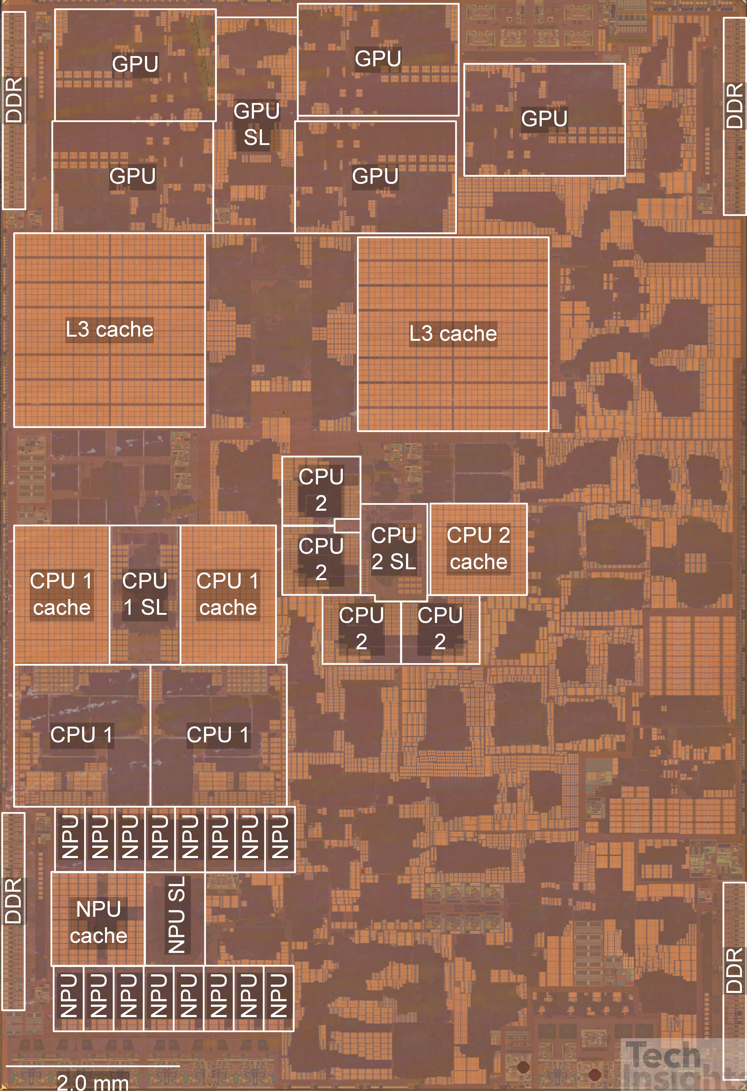
Apple A15 Bionic
108mm², 5nm
15 Billion Tr.
iPhone 13
6 ARM cores
  2 fast (3.2GHz)
  4 low energy (2GHz)
5 custom GPUs
16 Neural Engines
  11 Trillion ops/s?
Image from https://semianalysis.com/apple-a15-die-shot-and-annotation-ip-block-area-analysis/
https://www.anandtech.com/show/16983/the-apple-a15-soc-performance-review-faster-more-efficient

Slide 15
Customizable Accelerators
With post-fabrication configurability
can exploit without unique fabrication
Need programmable substrate that allows us to wire-up computations

Slide 16
Field-Programmable
Gate Arrays
FPGAs
Part 2

Slide 17
FPGA
Idea: Can wire up programmable gates in the “field”
  After fabrication
  At your desk
  When part “boots”
Like a “Gate Array”
  But not hardwired

Slide 18
Gate Array
Idea: Provide a collection of uncommitted gates
Create your “custom” logic by wiring together the gates
Less layout, fewer masks than full custom
  Since only wiring together pre-fab gates
  → lower cost (fewer masks)
  → lower manufacturing delay

Slide 19
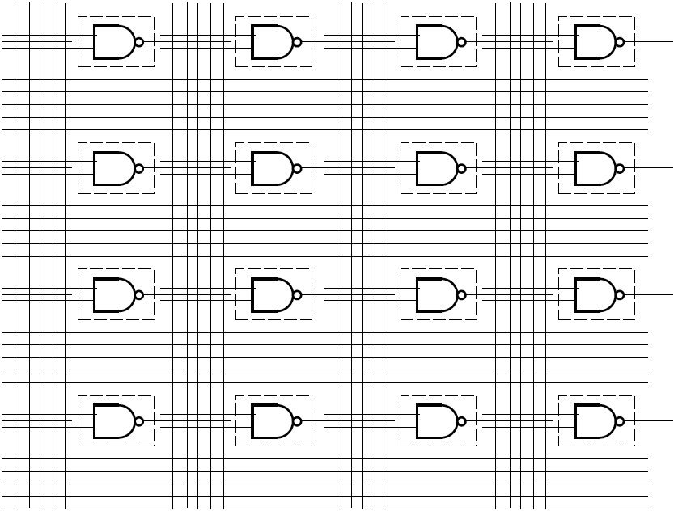
Gate Array

Slide 20
GA→FPGA
Remove the need to even fabricate the wiring mask
Make “customization” soft
Key trick:
  Use reprogrammable configuration bits
  Typically: static-RAM bits
    Like SRAM cells or latches in memory
    Hold a configuration value

Slide 21

Multiplexer Gate
MUX
  When S=0, output=i0
  When S=1, output=i1
  Out = /s*i0 + s*i1

Slide 22
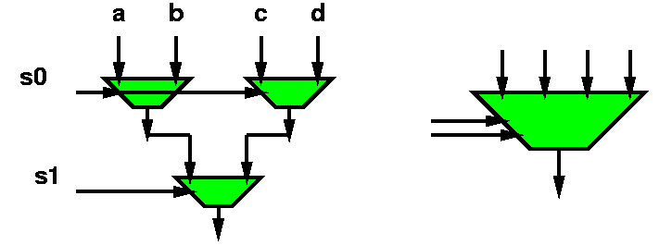
Mux with configuration bits
= programmable gate

Slide 23
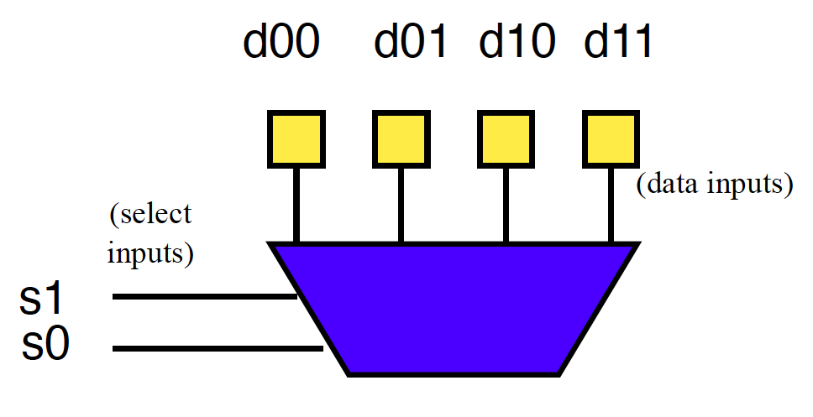
Preclass 4a
How do we program to behave as and2?

Slide 24
Preclass 4b
How do we program to behave as xor2?

Slide 25
Mux as Logic
Just by “configuring” data into this mux4,
  Can select any two input function

Slide 26
LUT – LookUp Table
When use a mux as programmable gate
  Call it a LookUp Table (LUT)
  Implementing the Truth Table for small # of inputs
    # of inputs =k (need mux-2^{k})
  Just lookup the output result in the table

Slide 27
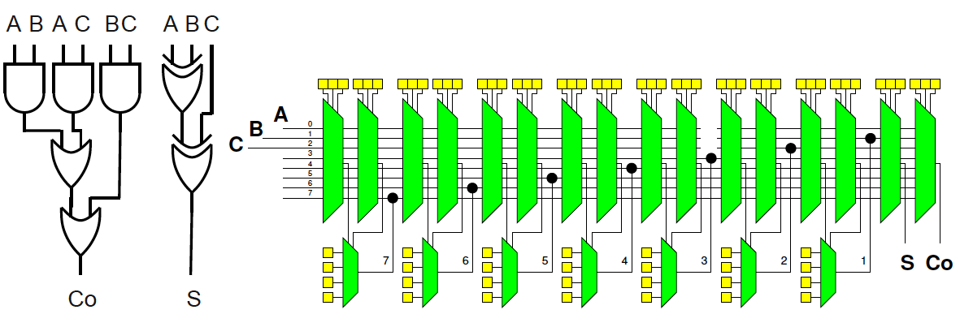
Preclass 6
How do we program full adder?

Slide 28
FPGA
Programmable gates + wiring
  (both built from muxes w/ config. bits)
Can wire up any collection of gates
  Like a gate array

Slide 29
Simplistic FPGA
(illustrate possibility)
Every LUT input has a mux
Every such mux has m=(N+I) inputs
  An input for each LUT output (N 2-LUTs)
  An input for each Circuit Input (I Circuit inputs)
Each Circuit Output has an m-input mux

Slide 30
Simplistic FPGA
(illustrate possibility)
N 2-LUTs, I Circuit Inputs, O Circuit Outputs
2N+O muxes to connect
Can build any combinational logic circuit that doesn’t need more than N 2-input gates, I inputs, O outputs

Slide 31
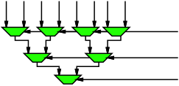
Preclass 3
How big is an m-input mux?
In terms of 2-input muxes?
  Warmup: how many for 4-input (Preclass 2)
  Warmup: how many for 8-input (below)
m inputs – what we are selecting from
log₂(m) bits
to select
which input
routed to
output

Slide 32
Math: Series Sums
A₀(1+r+r²+r³+r⁴+…)
A₀(1+r+r²+r³+r⁴+…)*(1-r)
=A₀+ A₀ r+ A₀ r²+ A₀ r³+ A₀ r⁴+…
- A₀ r - A₀ r² - A₀ r³ - A₀ r⁴-…
= A₀ (when r<1)
A₀(1+r+r²+r³+r⁴+…)*(1-r)=A₀
A₀(1+r+r²+r³+r⁴+…)=A₀/(1-r)

Slide 33
Receding Sum

Slide 34
Preclass 3
How big is an m-input mux?
M-input mux will require m-1 2-input muxes
m inputs – what we are selecting from
log₂(m) bits
to select
which input
routed to
output

Slide 35
Simplistic FPGA
(illustrate possibility…and expense)
2N+O m-input muxs; m=N+I
Each m-input mux is m-1 2-input muxes
Requires: (2N+O)*(N+I-1) 2-input muxes
Mux area grows as ~N²
  when gate (LUT) area grows as N

Slide 36
Interconnect
Fully connected mux input is too expensive, growing as N²
  …and not necessary
Want
  To be able to wire up gates
  Economical with wires and muxes
    …and configuration bits
  Exploit locality (keep wires short)

Slide 37
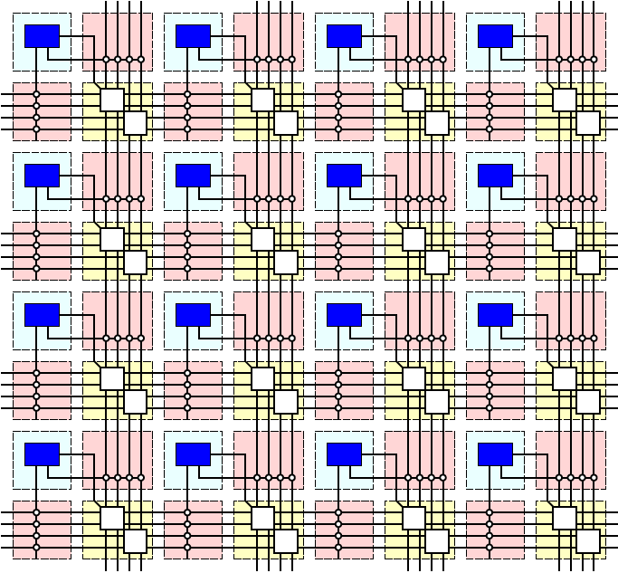
Simple FPGA

Slide 38
Register
Want to be able to pipeline logic
…and generally hold state
  E.g. implement hold Input-N in preclass 1
Add optional register on each gate

Slide 39
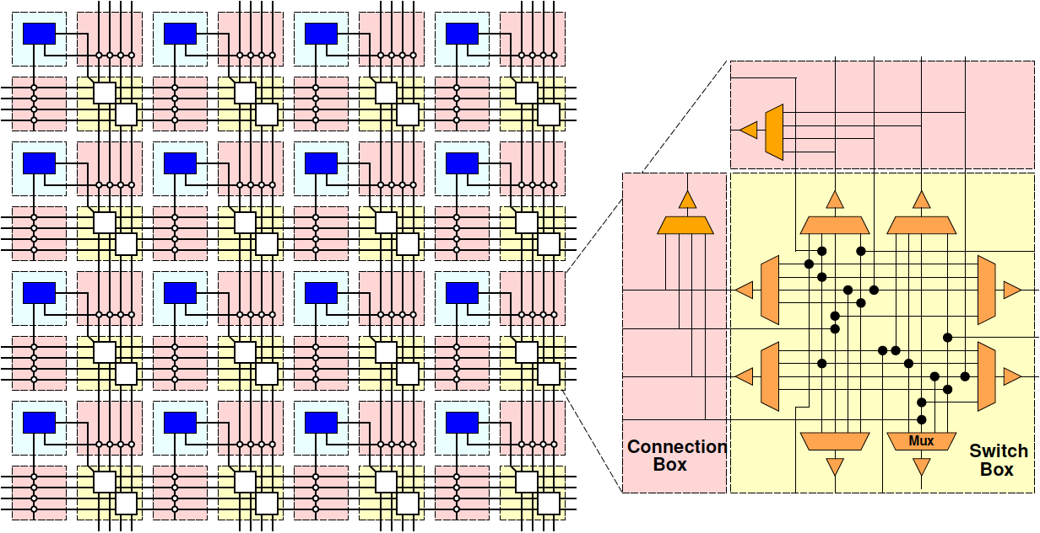
Simple FPGA

Slide 40
Simple FPGA

Slide 41
FPGA Design
Raises many architectural design questions
  How big (many inputs) should the gates have?
    Are LUTs really the right thing…
  How rich is the interconnect?
    Wires/channel
    Wire length
    Switching options

Slide 42
Modern FPGAs
Logic Blocks
  hardwired fast-carry logic
    Can implement adder bit in single “LUT”
  Speed optimized: 6-LUTs
  Energy, Cost optimization: 4-LUTs
  Clusters many LUTs into a tile
Interconnect
  Mesh, segments of length 4 and longer

Slide 43
More than LUTs
Should there be more than LUTs in the “array” fabric?
What else might we want?

Slide 44
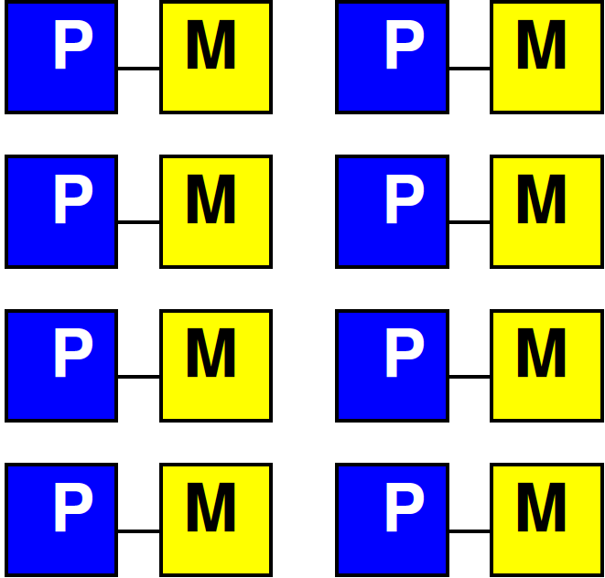
Embedded Memory
One flip-flop per LUT doesn’t store state densely
Want memory close to logic

Slide 45
Embed Memory in Array
Replace logic clusters
Convenient to replace columns
  Since area of memory may not match area of logic cluster

Slide 46
Embedded Memory in FPGA
Logic
Cluster
Memory
Bank
Memory
Frequency
Memory banks on Xilinx called BRAMs (Block RAMs)

Slide 47
Hardwired Multipliers
Can build multipliers out of LUTs
  Just as can implement multiplies on processor out of adds
But, custom multiplier is smaller than LUT-configured multiplier
  …and multipliers common in signal processing, scientific/engineering compute

Slide 48
Multiplier Integration
Integrate like memories
  Replace columns

Slide 49
More FPGA Architecture Design Questions
Size of Memories? Multipliers?
Mix of LUTs, Memories, Multipliers?
Add processors? Floating-point?
Other hardwired blocks?
How manage configuration?

Slide 50
Midterm (10/5 – next Wed.)
From Code
Forms of Parallelism
Dataflow, SIMD, hardware pipeline, threads
Pipelining/Retiming
Map/schedule task graph to (multiple) target substrates
Memory assignment and movement
Area-time points
Analysis
  Bottleneck
  Amdhal’s Law Speedup
  Computational requirements
  Resource Bounds
  Critical Path
  Latency/throughput/II
Will be calculating/estimating runtimes

Slide 51
Midterm
In-class exam
Closed book, notes, etc.
Calculators allowed (encouraged)
Read midterm details posted on web
Last six midterms, finals online
  Both without answers (for practice)
  …and with answers (check yourself)
  Check syllabus for previous terms
  (but note 2020 year online, open-book)
Midterm comes earlier last few years

Slide 52
Zynq MPSoC
Part 3

Slide 53
Programmable SoC
UG1085
Xilinx
UltraScale
Zynq
TRM
(p27)

Slide 54
ZU3EG (Ultra96)
6-LUTs: 70,560
DSP Blocks: 360
  18x27 multiply, 48b accumulate
Block RAMs (BRAMs): 216
  36Kb
  Dual port
  Up to 72b wide (512x72)

Slide 55
DSP48
Xilinx UG579 UltraScale DSP Slice User’s Guide

Slide 56
Preclass 5
Approximating | Resources | Cycle | Per second
Zynq LUTs | 70,000 adder bits | 0.5 GHz
4x ARM Scalar | 4x2x64 adder bits | 1.2 GHz
4x ARM Neon | 4x1x64 adder bits | 1.2 GHz
Zynq DSP | 360 multiply-accumulates | 0.5 GHz
4x ARM Scalar | 4x(1 mpy+1add) | 1.2 GHz
4x ARM Neon | 4x1x4 multiply-accumulates | 1.2 GHz
How compare between ARM scalar, ARM NEON and FPGA array?
  Adder-bits/second?
  Multiply-accumulators/second?

Slide 57
Capacity → Density
Says Zynq has high computational capacity in FPGA
More broadly
  FPGA can have more compute/area than processor
    E.g., more adder bits in some fixed area
  SIMD can have more compute/area than processor (Day 6)
    How wide SIMD can you exploit?

Slide 58
FPGA Potential
FPGA Array has high raw capacity
Exploitable when computation has high regularity
  Uses the same computation over-and-over
  High throughput on a computation
  Build customized accelerator pipeline to match the computation
Low-hanging fruit
  Operator/function takes most of the compute time

Slide 59
90/10 Rule
Observation that code is not used uniformly
90% of the time is spent in 10% of the code
Knuth: 50% of the time in 2% of the code
Opportunity
  Build custom datapath in FPGA (hardware) for that 10% (or 2%) of the code

Slide 60
Big Ideas
Custom accelerators efficient for large computations
  Exploit Instruction-level parallelism
  Run many low-level operations in parallel
Field Programmable Gate Arrays (FPGAs)
  Allow post-fabrication configuration of custom accelerator pipelines
  Can offer high computational capacity

Slide 61
Admin
Reading for Day 9 on canvas
HW4 due on Friday
Midterm on Wednesday
  No assignment due on Friday (10/7)
  Previous midterms (with solutions) on web syllabus of previous years
HW5 not out, yet (early next week)
  Heavier – start early…have more than week
  Vivado HLS synthesis slow (plan for it)
  Due Fri. 10/14

