Slide 1
ESE535: Electronic Design Automation
Day 2: January 21, 2015
Heterogeneous Multicontext Computing Array
Work Preclass

Slide 2
Today
Behavioral
(C, MATLAB, …)
Arch. Select
Schedule
RTL
Motivation
Energy in programmable architectures
Gate Evaluation Model
Rent’s Rule and VLSI Complexity
Central Processor
Spatial Locality
Heterogeneous multicontext
Issues and Concerns
Project overview
FSM assign
Two-level,
Multilevel opt.
Covering
Retiming
Gate Netlist
Placement
Routing
Layout
Masks

Slide 3
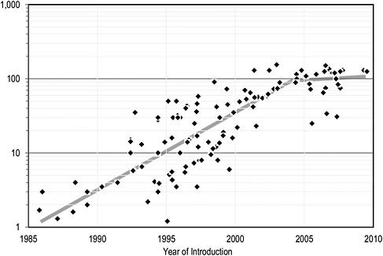
Question
What should an energy-efficient programmable substrate look like?
Importance:
Computation/chip limited by energy-density not transistor capacity → dark silicon
Energy efficiency determines battery life
W/cm²
The Future of Computing Performance: Game Over or Next Level?
National Academy Press, 2011

Slide 4
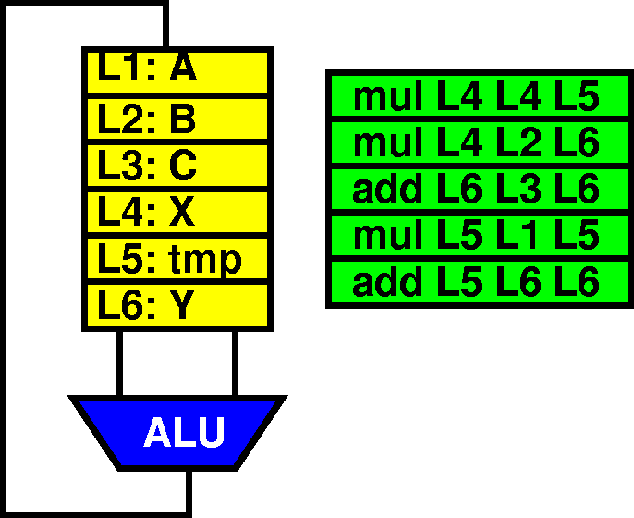
Question
Is it better to build compact computations
And read instructions and data from memory
Avoid sending data on long wires
Or to build spatially distributed computations
And send data from producers to consumers
Avoid spending energy on large memories

Slide 5
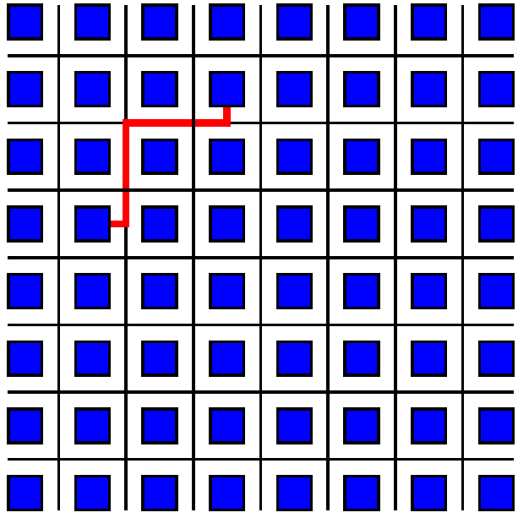
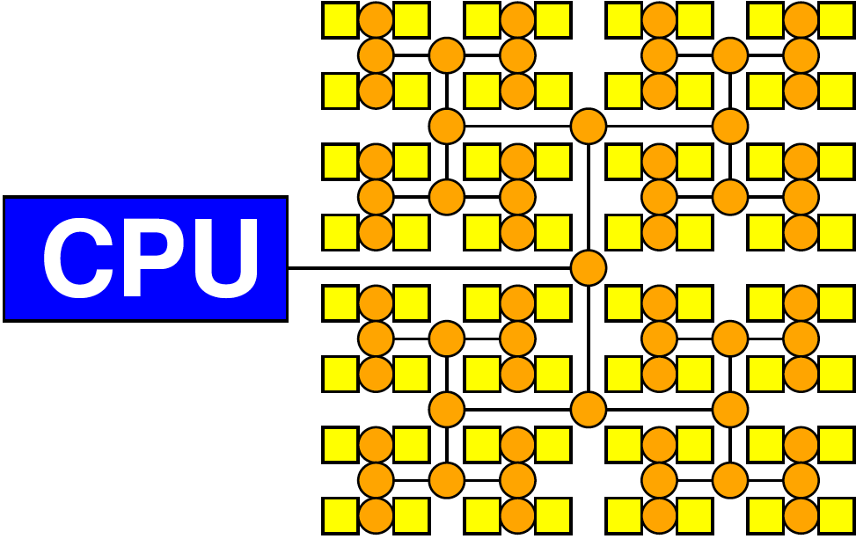
Intuition
Given a good spatial layout
It is cheaper to transmit the result of a gate to its well-placed consumers
average wire length O(N^{p-0.5}) ≤O(N^{0.5})
O(1) for p<0.5
Than to
Fetch inputs from a large central memory
O(N^{0.5})

Slide 6
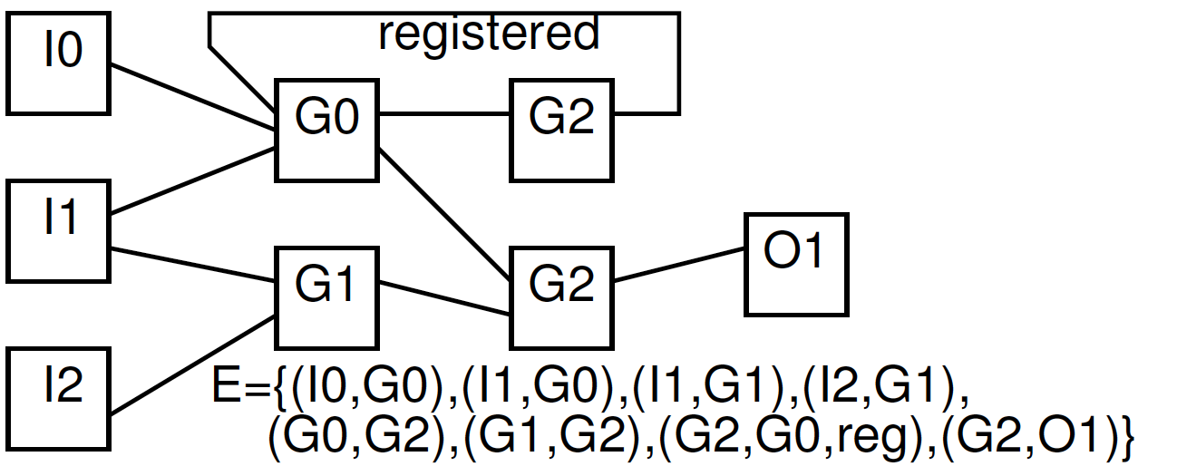
Gate Array Evaluation Model
For each “circuit”
Evaluate N k-input gates (k constant, e.g. 4)
Assume
Must evaluate every gate every time
Every gate active (may switch)

Slide 7
Bisection Width
Partition design into two equal size halves
Minimize wires (nets) with ends in both halves
Number of wires crossing is bisection width
lower bw = more locality
N/2
bisection
width
N/2

Slide 8
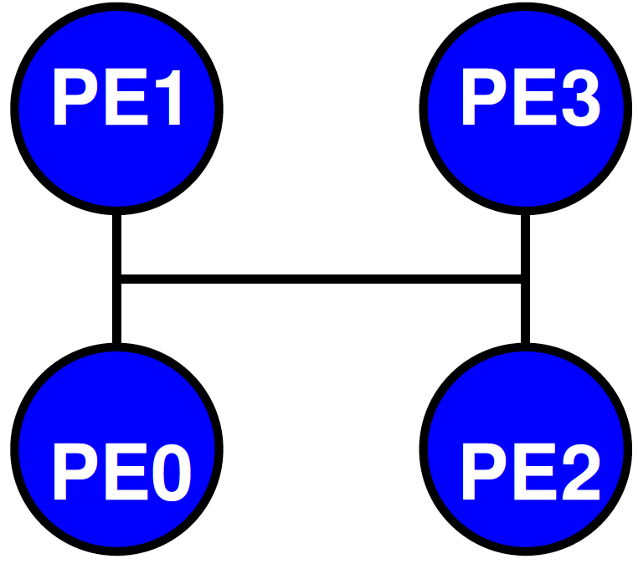
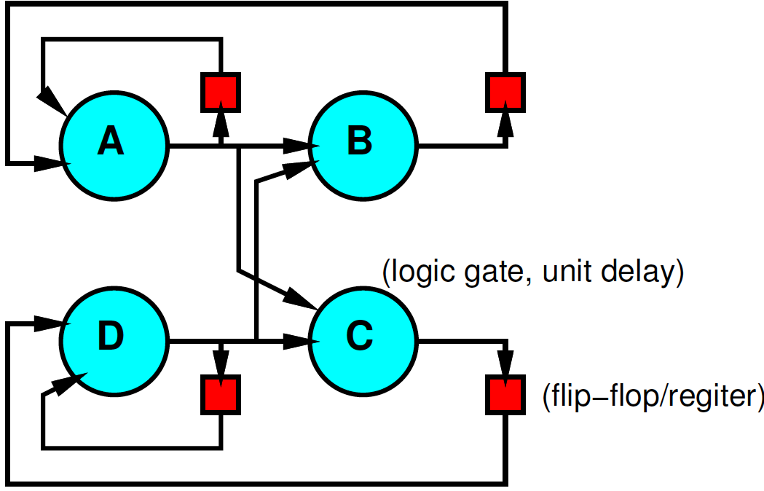
Preclass
3a: What is bisection cut when:
0:D, 1:A, 2: C, 3: B

Slide 9
Preclass
4a: What is bisection cut when:
0:A, 1:B, 2: D, 3: C

Slide 10
Minimum Bisection?
Is there a better assignment?
One that achieves a smaller bisection cut?

Slide 11
Bisection Width
Partition design into two equal size halves
Minimize wires (nets) with ends in both halves
Number of wires crossing is bisection width
lower bw = more locality
N/2
bisection
width
N/2

Slide 12
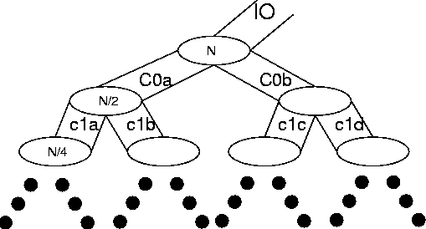
Rent’s Rule
If we recursively bisect a graph, attempting to minimize the cut size, we typically get:
BW=IO = c N^{p}
0≤p≤1
p≤1 means many inputs come from within a partition
[Landman and Russo,
IEEE TR Computers p1469, 1971]

Slide 13
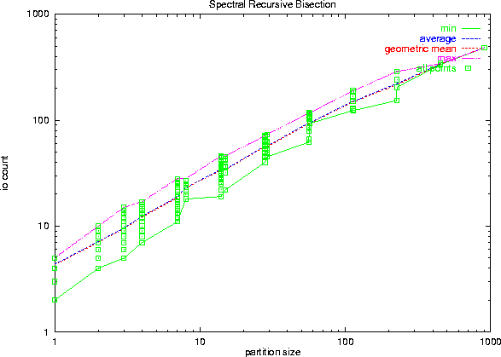
Rent’s Rule Bisection Data
IO = c N^{p}
Log-log plot → straight lines represent geometric growth

Slide 14
Rent and Locality
Rent and IO quantifying locality
local consumption
local fanout
IO = c N^{p}

Slide 15
VLSI Interconnect Area
Bisection width is lower-bound on IC width
When wire dominated, may be tight bound
(recursively)
Rent’s Rule tells us how big our chip must be

Slide 16
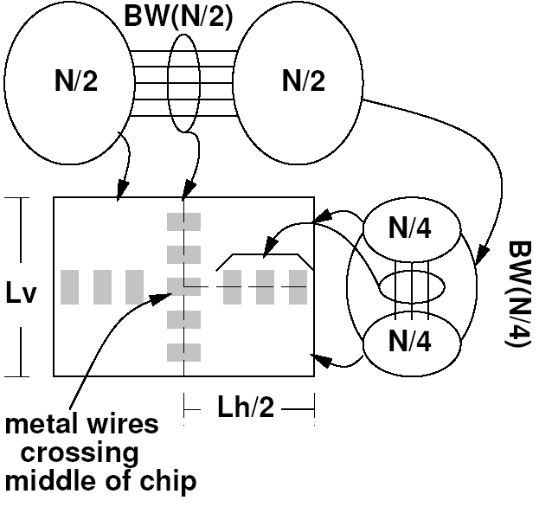
As a function of Bisection
A_{chip} ≥ N × A_{gate}
A_{chip} ≥ N_{horizontal} W_{wire} × N_{vertical} W_{wire}
N_{horizontal} = N_{vertical} = BW = cN^{p}
A_{chip} ≥ (cN)^{2p}
If p<0.5
A_{chip} ∝ N
If p>0.5
A_{chip} ∝ N^{2p}
Interconnect dominates

Slide 17
Outline
Gate Evaluation Model
Rent’s Rule and VLSI Complexity
Central Processor
Instruction Sharing
Spatial Locality
Description
Data
Instruction
Wire sharing

Slide 18
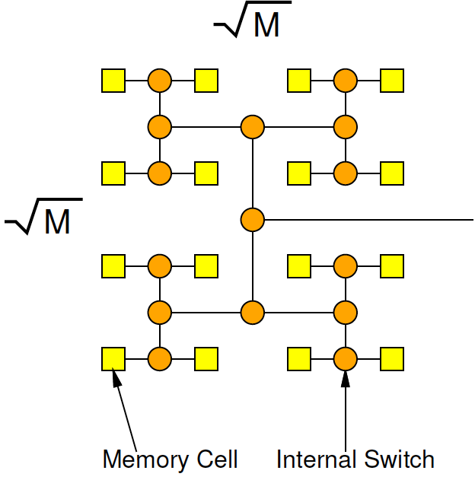
Fully Banked Memory
Only activate path to leaf
O(M^{0.5}) wire length
Random access must send address
O(M^{0.5}log(M))
Sequential access avoid address per bit
O(M^{0.5}) per bit

Slide 19
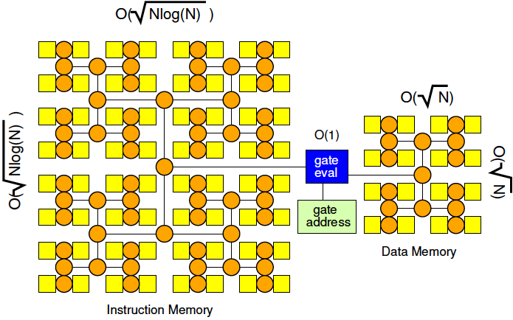
Central Processor
Each instruction specifies source nodes so is O(log(N)) long
O(N^{1.5}log^{1.5}(N))
Read/write O(N) bits
O(N^{1.5}log(N))

Slide 20
Central Processor
Each instruction specifies source nodes so is O(log(N)) long
O(N^{1.5}log^{1.5}(N))
Read/write O(N) bits
O(N^{1.5}log(N))

Slide 21
Problem 1: Description Locality
Assumption: Each instruction specifies source nodes so is O(log(N)) long
Challenge: Costs O(N log(N)) for description since can assume any input comes from anywhere
Opportunity: exploit Rent locality

Slide 22
Spatial Locality
If we place a circuit well,
Most of the inputs can be “close”
Use Rent’s Rule recursive bisection
IO = c N^{p}
p≤1 means many inputs come from within a partition

Slide 23
Description Lemma
If p<1.0, can describe computation with O(N) memory.
If something close by, only need to use bits proportional to subtree height

Slide 24
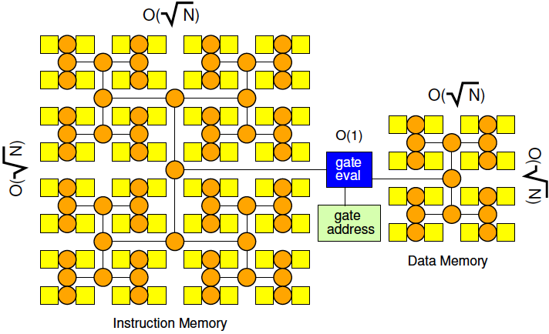
Central Processor with Description Locality
p<1.0, total instruction bits are O(N)
O(N^{1.5})
Read/write O(N) bits
O(N^{1.5}log(N))

Slide 25
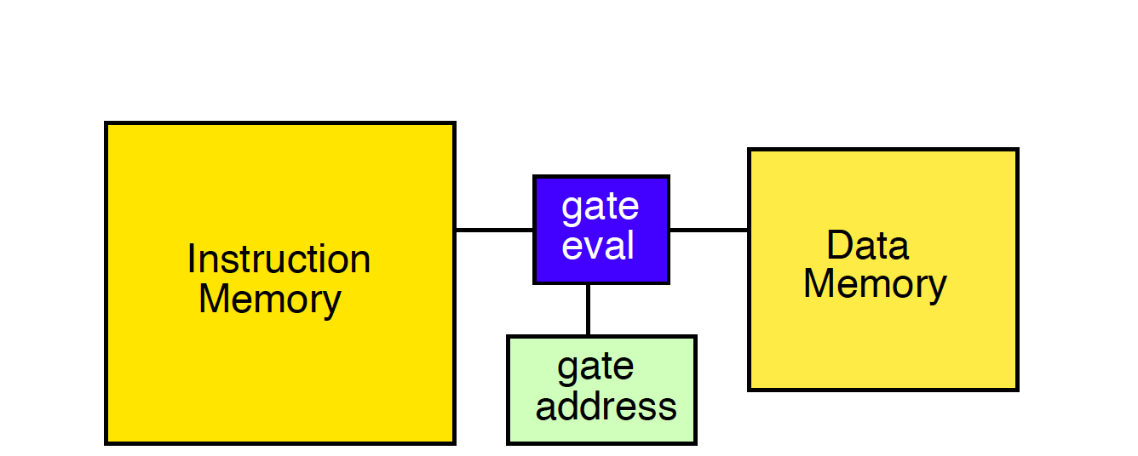
Central Processor
Total instruction bits
Read I_{bits}
From memory of size I_{bits}
Read/write bits
5 N bits (for 4-LUT)
From memory of size N

Slide 26
Central Processor
Total instruction bits
Read I_{bits}
I_{bits}-bit Memory
p=0.7 ➔ ~N×(16+27)
Read/write O(N) bits
5 N
N-bit memory
Imem 43× larger
43/5~8× more reads

Slide 27
Problem 2: Instruction Sharing
Problem: absolutely, instruction energy dominates data energy
Assumption: every bit operator needs its own unique instruction
Opportunity: share instructions across operators

Slide 28
Looping
Reuse—share—instructions across different data
Instructions not necessarily grow as N
Example: Image or Graph
Fixed work per node
Variable number of nodes
Let I = number of unique instructions

Slide 29
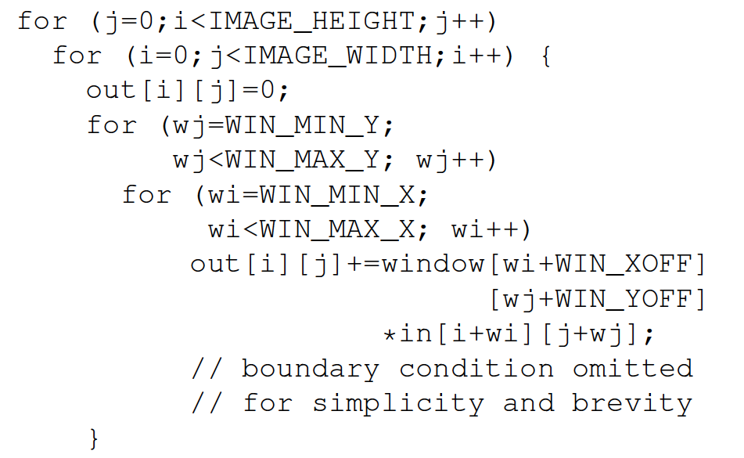
Image Processing Example

Slide 30
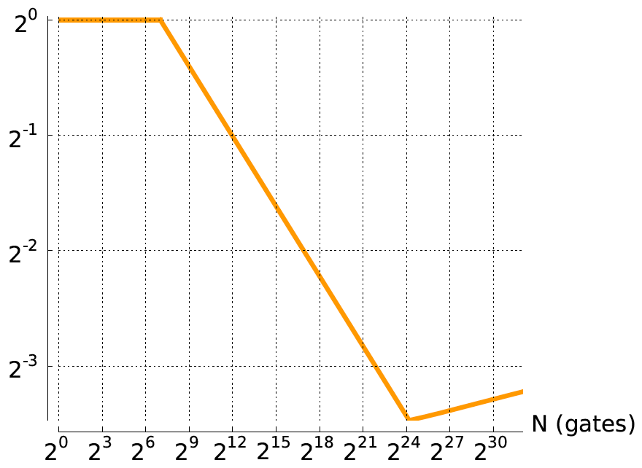
Impact of Looping (I) (p=0.7)
Energy Ratio to Processor W=1, I=N
Processor I≤128

Slide 31
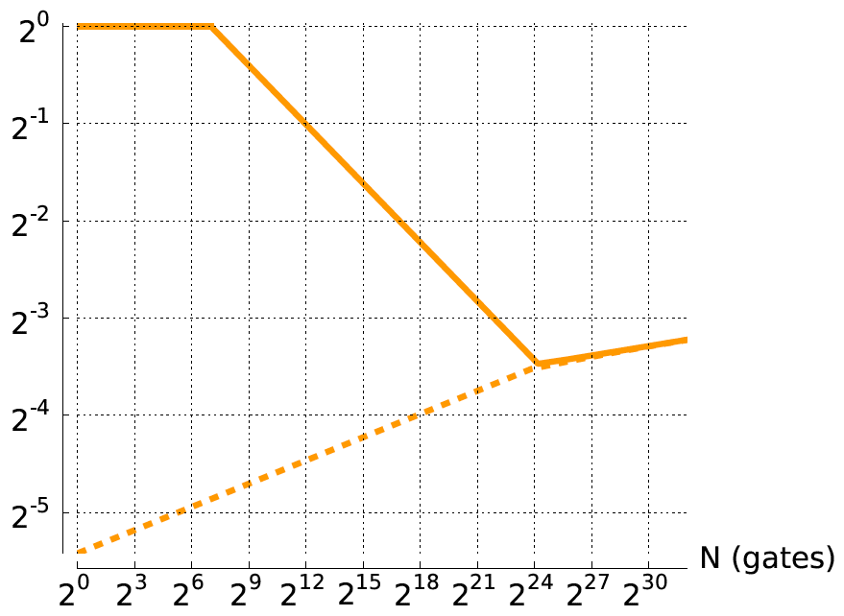
Impact of Looping (I) (p=0.7)
Energy Ratio to Processor W=1, I=N
Processor I≤128
Data energy only

Slide 32
Word Width
Use same instruction across a set of bits
Let W=SIMD Word width
E.g., 4b add
Share instruction bits
Share source/destination address bits
Instructions

Slide 33
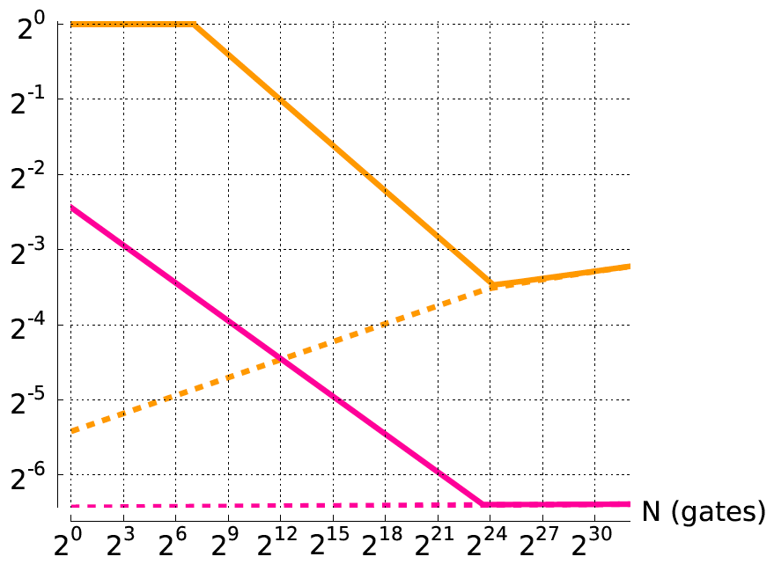
Impact of I and W (p=0.7)
Energy Ratio to Processor W=1, I=N
Processor W=1, I≤128
Processor W=64, I≤128

Slide 34
Problem 3: Data Locality
Problem: Must pay O(N^{0.5}) for every read since data must be moved in and out of memory.
Opportunity: compute local to data

Slide 35
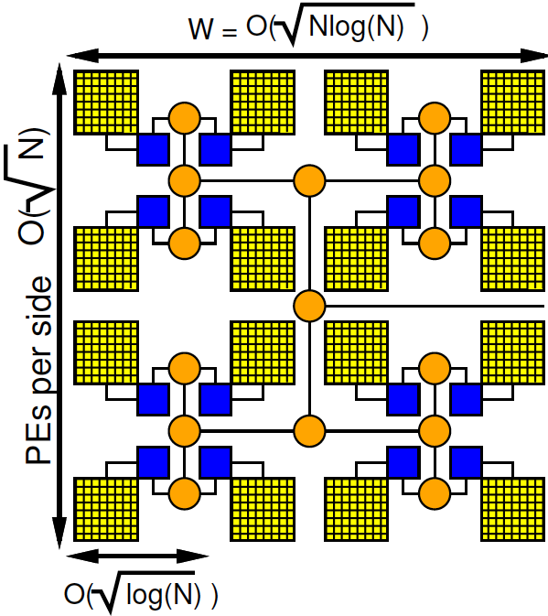
Sequential with Data Locality
Place for locality --Rent Partitions
Store data at endpoints
Send through network from producer to consumer
Store location at leaves – O(log(N))
Build H-Tree to keep area to O(Nlog(N))

Slide 36
Sequential with Data Locality
Area = O(Nlog(N))
Sending addresses log(N) bits at top
Signals lower O(1)
Only send a few over top O(N^{p})
O((log^{1.5}N)N^{p+0.5}) for p>0.5
Cheaper to send where needed than to central location.

Slide 37
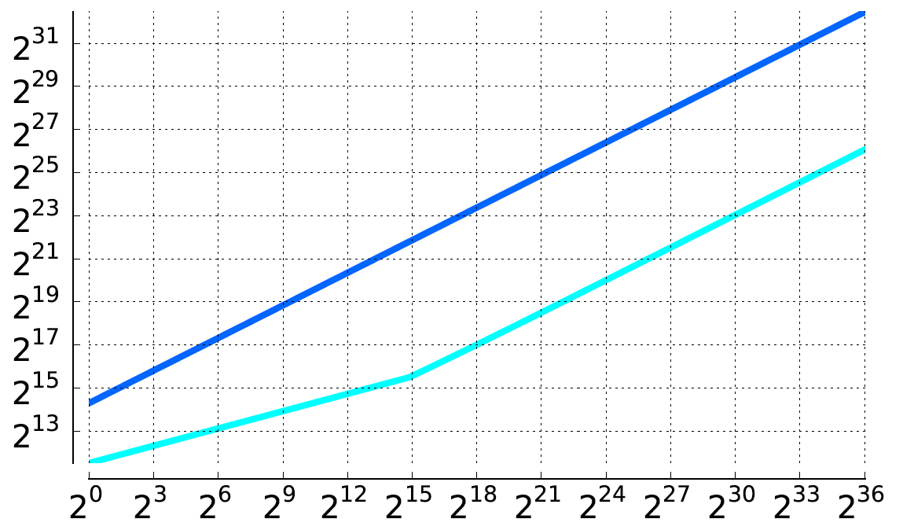
Data Local Compare (p=0.7)
Energy
Processor W=64
Processor W=1
Gates (N)

Slide 38
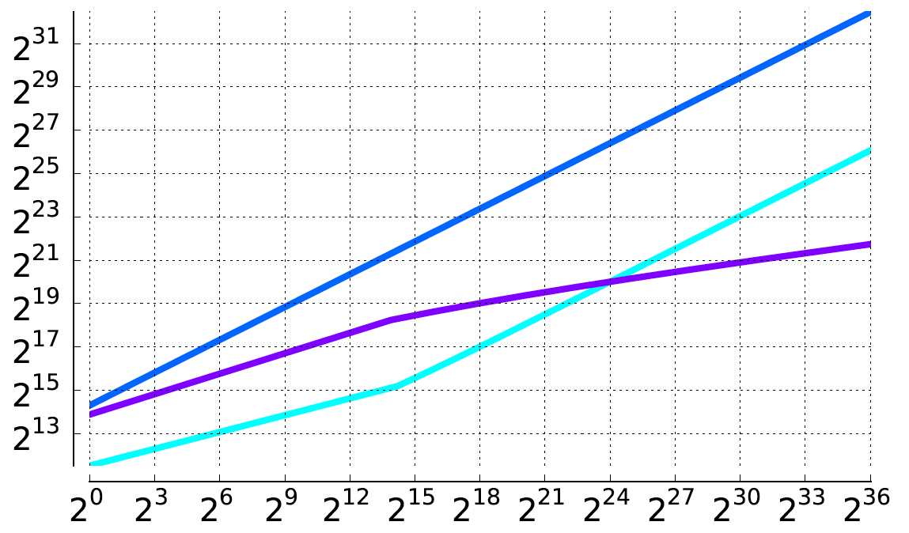
Data Local Compare (p=0.7)
Energy
Processor W=64
Processor W=1
Data W=1
Gates (N)

Slide 39
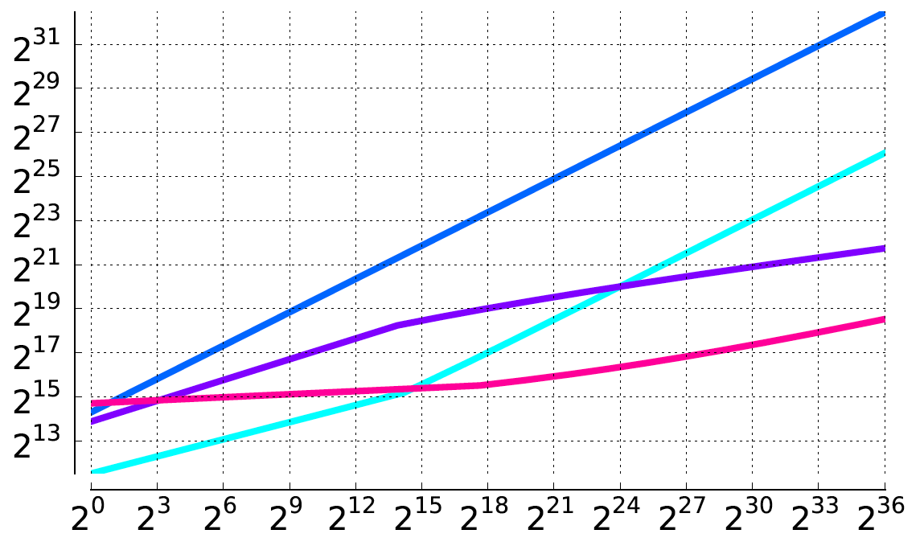
Data Local Compare (p=0.7)
Energy
Processor W=64
Processor W=1
Data W=1
Data W=64
Gates (N)

Slide 40
Problem 4:
Problem: Multiply energy by O(log(N)) to send an address up the tree
Opportunity: store instructions local to switches
In tree

Slide 41
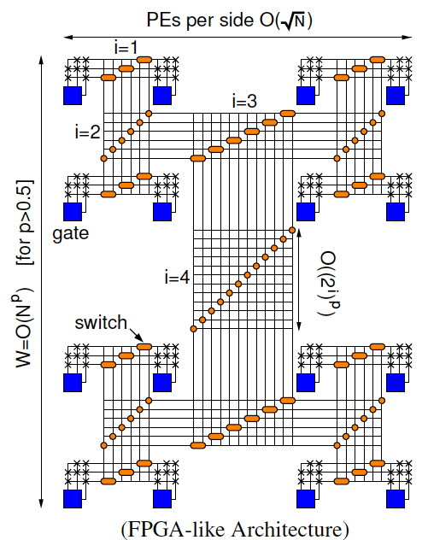
Fully Spatial (FPGA)
Like an FPGA
Each signal gets own wire
No addresses
Configuration local
Area grows as O(N^{2p}) for p>0.5
Energy O(N^{2p}) for p>0.5
Θ(N) for p<0.5

Slide 42
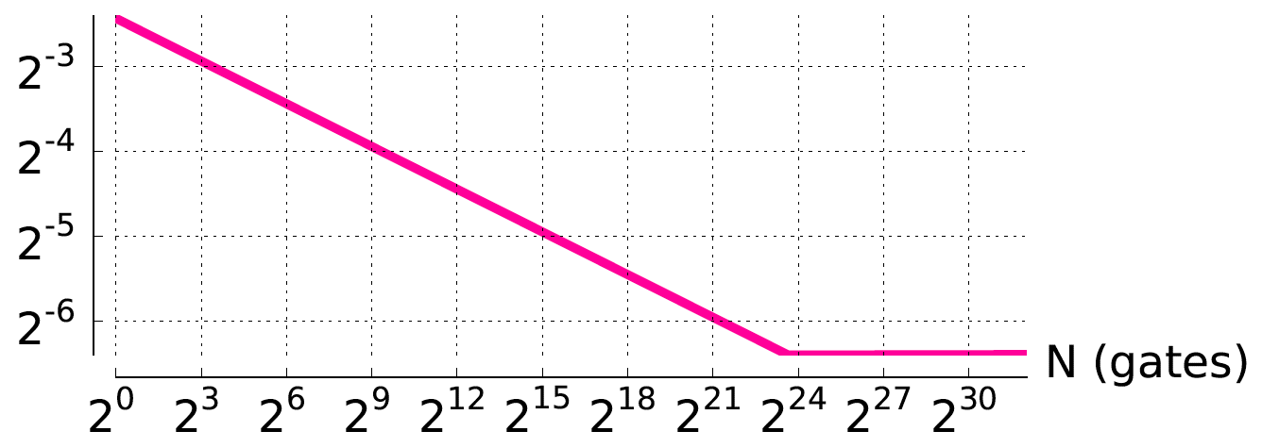
p=0.7 Compare to Processor
Energy Ratio to Processor W=1, I=N
Processor W=64, I≤128

Slide 43
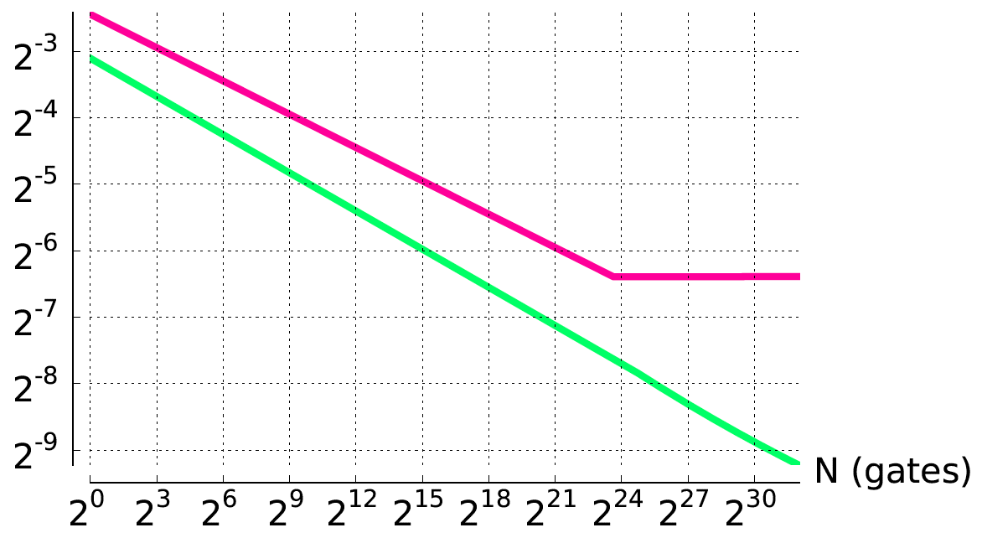
p=0.7 Compare to Processor
Energy Ratio to Processor W=1, I=N
Processor W=64, I≤128
FPGA

Slide 44
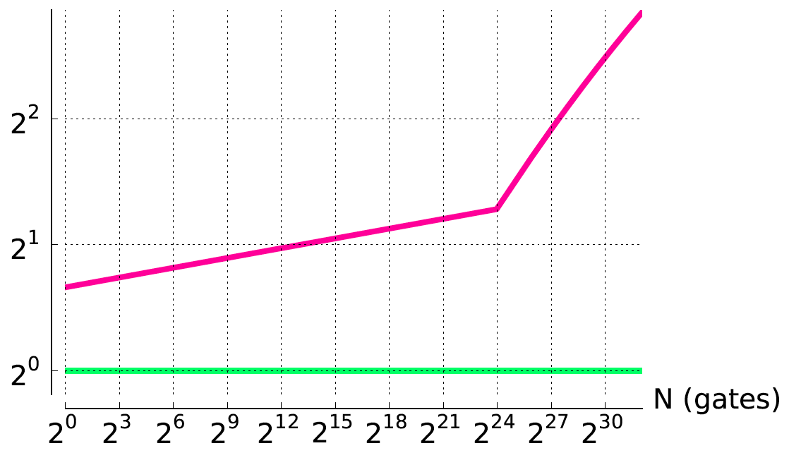
p=0.7 Compare to FPGA
Energy Processor/FPGA
Processor W=64, I≤128
FPGA

Slide 45
Asymptotic Energy
Org | Any p | p<1.0 |  | 1>p>0.5 |  | p=0.5 | p<0.5
Processor | O(N^{1.5}log^{1.5}N) | O(N^{1.5}logN) Description Locality
FPGA 2-metal |  |  | O(N^{2p}) |  | O(Nlog²N) |  | Θ(N)
Note break at p=0.75

Slide 46
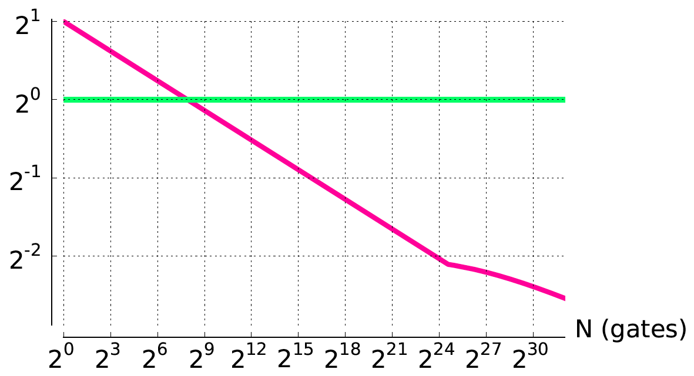
p=0.8 Compare to FPGA
Energy Processor/FPGA
FPGA
Processor W=64, I≤128

Slide 47
Compare around p=0.75
Breakpoint at p=0.75
Energy Processor/FPGA
Processor W=64, I≤128
FPGA
p=0.7
p=0.8

Slide 48
Intuition
Given a good spatial layout
It is cheaper to transmit the result of a gate to its well-placed consumers
Fixed metal layers: average wire length
p<0.5: O(1)
p<0.75: O(N^{2p-1}) < O(N^{0.5})
p>0.75: O(N^{2p-1}) > O(N^{0.5})
Than to
Fetch inputs from a large central memory
O(N^{0.5})

Slide 49
Problem 5: Wiring Dominates
Problem: When p>0.5 wiring dominates area → force longer wires
Opportunity: Share wires
But also, keep instructions local to switches

Slide 50
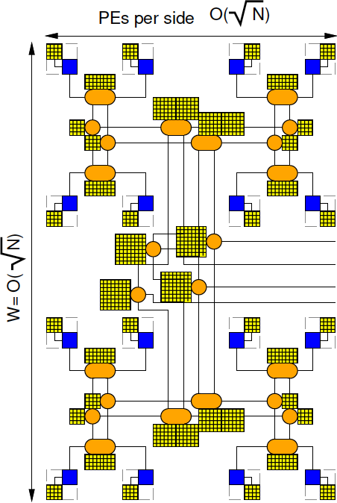
Instructions Local to Switches
Constant metal
Build p<0.5 tree
Store bits local to each tree level
Read out of memory there
Bits/switch differs with tree level
Signal on wire dominates reads
O(N^{p+0.5}) for p>0.5

Slide 51
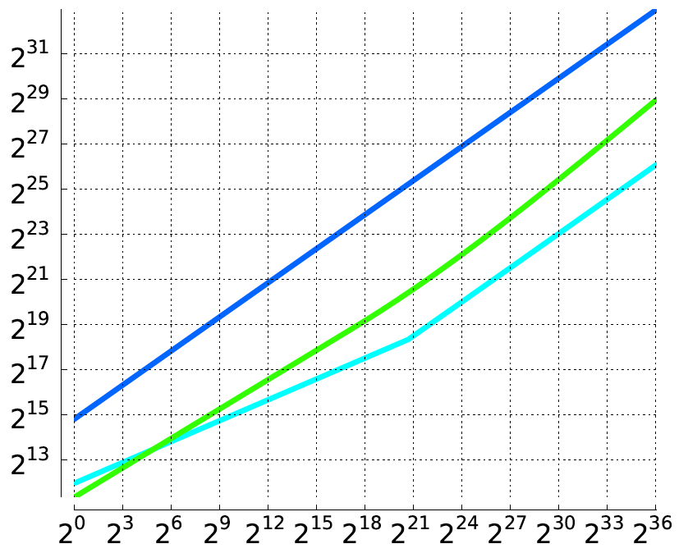
Instructions Local (p=0.8)
Energy
Processor W=1
FPGA
Processor W=64
Gates (N)

Slide 52
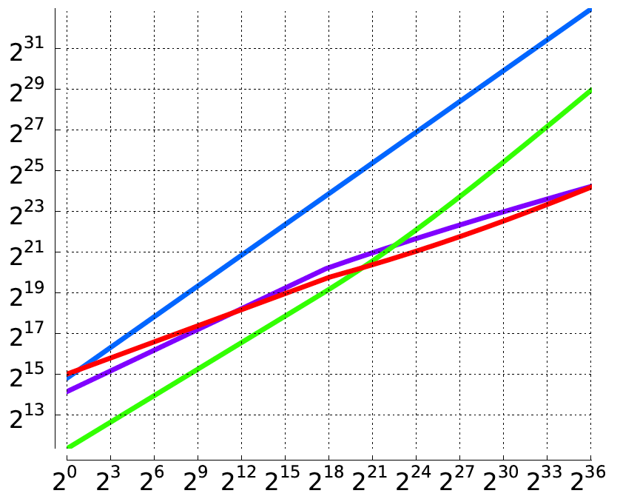
Instructions Local (p=0.8)
Energy
Processor W=1
FPGA
Data W=1
Multicontext W=1
Gates (N)

Slide 53
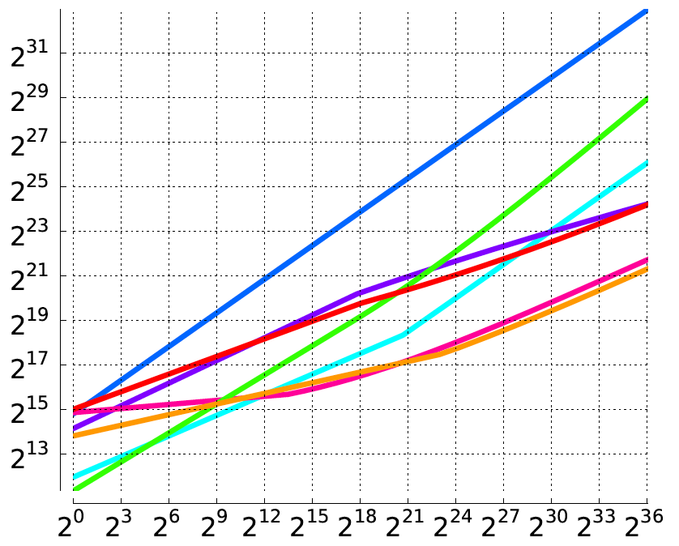
Instructions Local (p=0.8)
Energy
Processor W=1
FPGA
Processor W=64
Data W=1
Multicontext W=1
Data W=64
Multicontext W=64
Gates (N)

Slide 54
Results: Energy
Org | Any p | p<1.0 |  | 1>p>0.5 |  | p=0.5 | p<0.5
Processor | O(N^{1.5}log^{1.5}N) | O(N^{1.5}logN) Description Locality
Data Locality (Packet Switch) |  |  | O(N^{p+0.5}log^{1.5}N) |  | O(Nlog^{2.5}N) |  | O(Nlog^{1.5}N)
FPGA 2-metal |  |  | O(N^{2p}) |  | O(Nlog²N) |  | Θ(N)
Multicontext |  |  | O(N^{p+0.5}) |  | O(NlogN) |  | Θ(N)

Slide 55
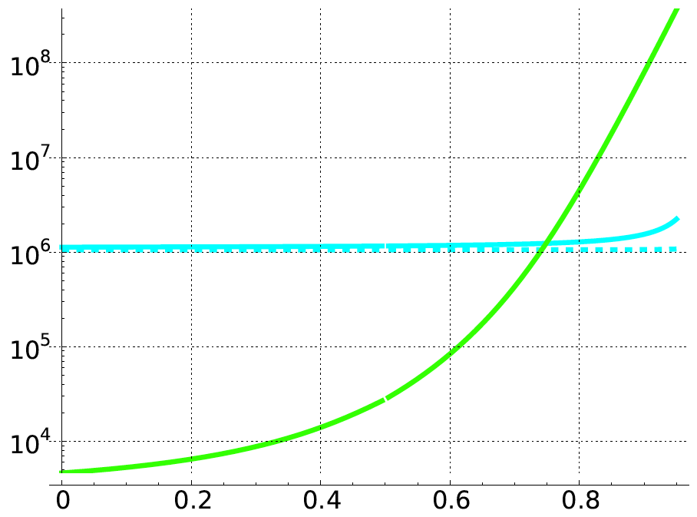
Compare vs. p, W=64, N=2²⁴
Energy
FPGA
Processor
Rent p

Slide 56
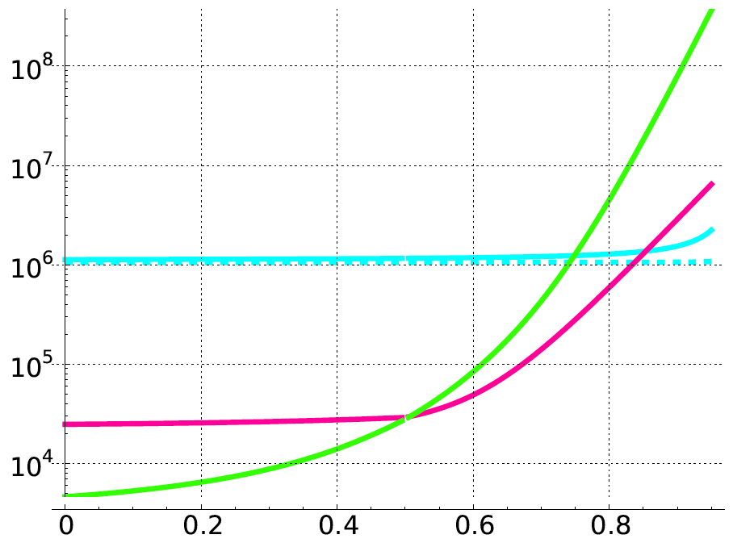
Compare vs. p, W=64, N=2²⁴
Energy
FPGA
Processor
Data
Rent p

Slide 57
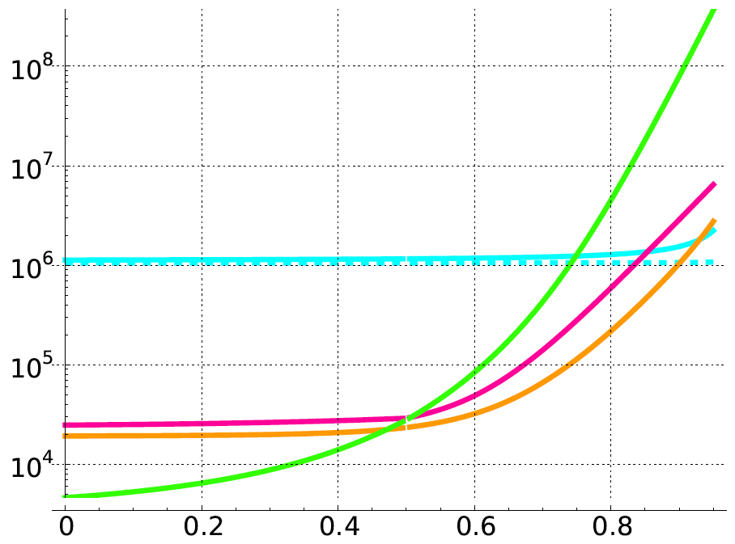
Compare vs. p, W=64, N=2²⁴
Energy
FPGA
Processor
Data
Multicontext
Rent p

Slide 58
Location¹, Location², Location³
To minimize asymptotic energy, essential to exploit spatial locality to:
Reduce size of description
Minimize data movement energy
Argues against centralized processor
Reduce or eliminate instruction energy
Argues for configuration
Local to the resources controlled

Slide 59
Absolute Energy
To minimize absolute energy, essential to share:
Instructions to reduce instruction energy
Wires to avoid size growth when p>0.5

Slide 60
Heterogeneous Multicontext
Heterogeneous:
Bits/switch differs with tree level
More wire sharing higher in the tree

Slide 61
Preclass
1: What are the levels on the wires?
(ASAP scheduling for when can route outputs)

Slide 62
ASAP Schedule As Soon As Possible (ASAP)
For each input
mark input on successor
if successor has all inputs marked, put in visit queue
While visit queue not empty
pick node
update time-slot based on latest input
Time-slot = max(time-slot-of-inputs)+1
mark inputs of all successors, adding to visit queue when all inputs marked

Slide 63
ASAP Example
Work
Example

Slide 64
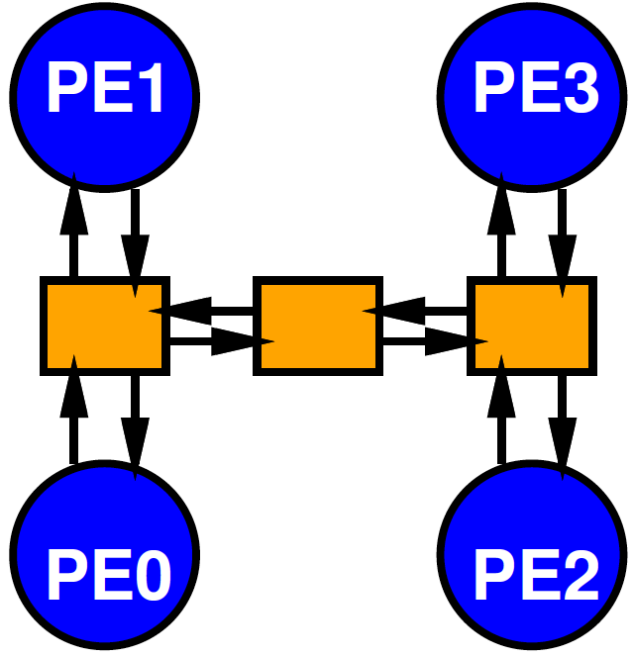
Interconnect and Levels
Why relevant to interconnect?

Slide 65
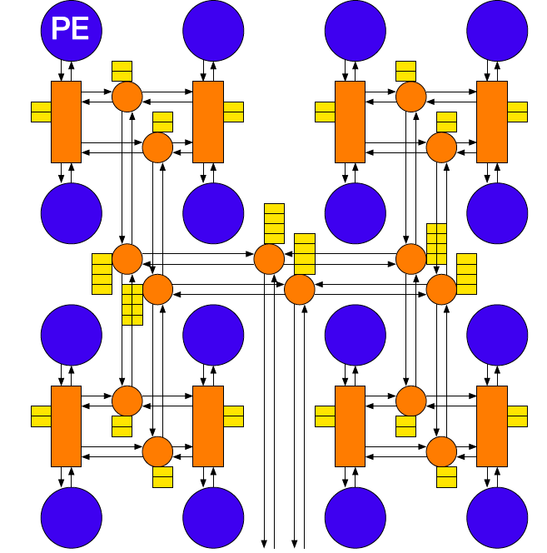
Heterogeneous Multicontext
PEs:
4-LUT
Data memory
Tree network
Sequentially route by levels

Slide 66
Preclass
3b: What is bisection cut per level when:
0:D, 1:A, 2: C, 3: B

Slide 67
Preclass
4b: What is bisection cut per level when:
0:A, 1:B, 2: D, 3: C

Slide 68
Challenges
Place to minimize wire lengths
Reduce bisection
Track worst-case wiring across levels
Minimize bisection in worst-case level
Schedule
Minimize bisection in worst-case level

Slide 69
Project: Develop Mapping Tools
Cost functions (2)
Partitioning (3-6)
Scheduling/Routing (7-8)
Open project to improve

Slide 70
Today’s Big Ideas
Energy in communication
Wires and memories
Save energy by exploiting locality
Exploit freedom in placement
Must be careful about wire growth
Energy benefit to wire sharing for designs with low locality (p>0.5)
Avoid bottlenecks:
Level with large bisection requirement
Placement, scheduling?

Slide 71
Administrivia
Assignment 1 due Thursday (tomorrow)
Assignment 2 out
Reading for Monday in canvas

