Slide 1
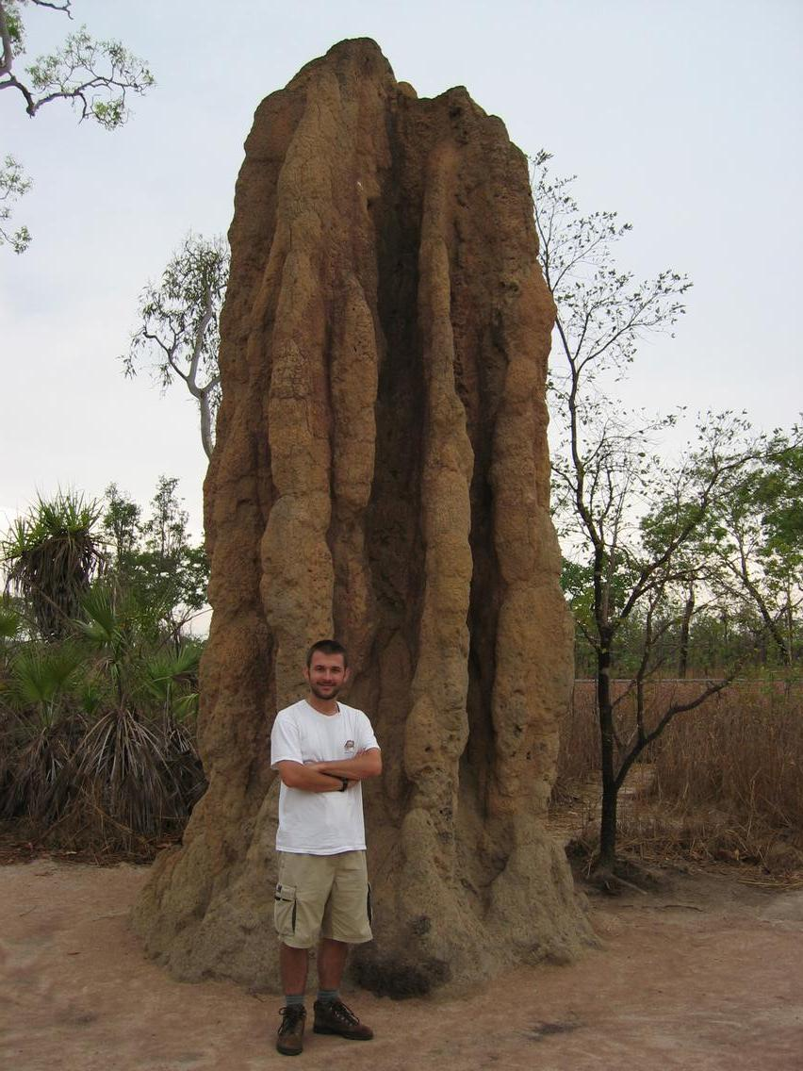
Termite Mounds: Swarm-based Construction David Skelly Yale University

Slide 2
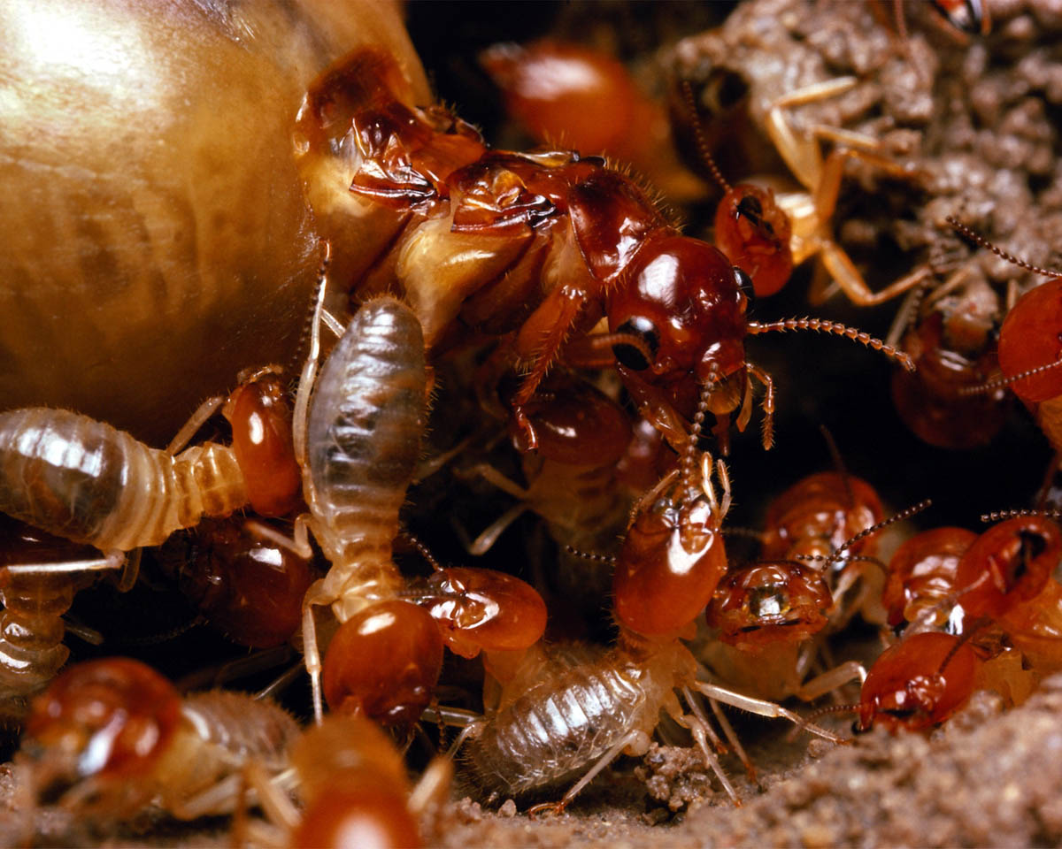
Large Eusocial Colonies

Slide 3
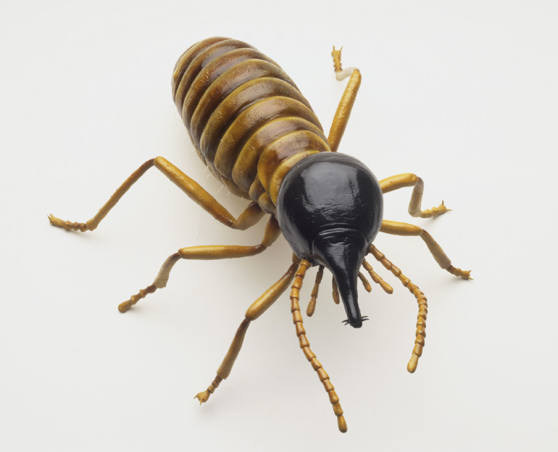
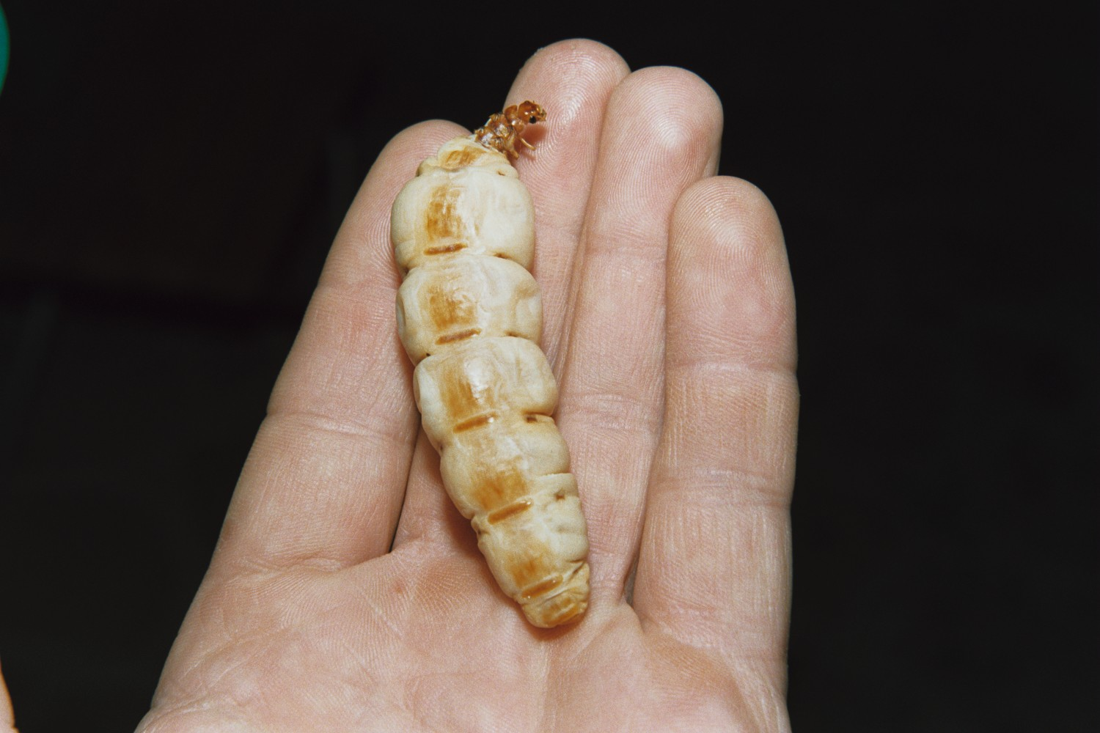
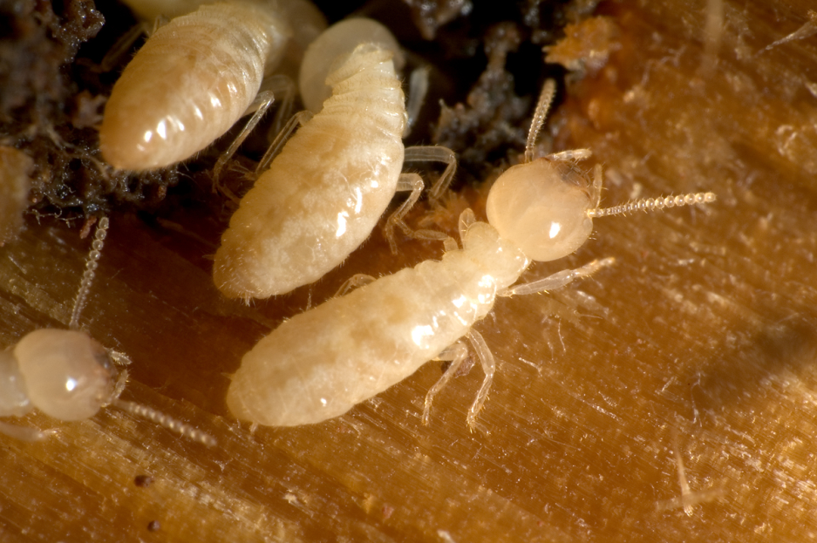
Polymorphic: Castes

Slide 4
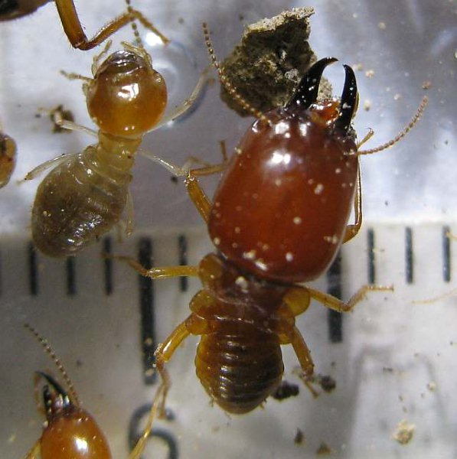
Polymorphic: Castes

Slide 5
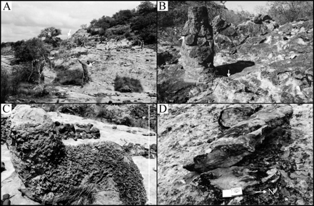
Jurassic Termite Mounds
Notes:
Early Jurassic Fossil Mounds, sandstone, Southern Africa Clarens Formation, Tuli Basin

Slide 6
Jurassic Termite Mounds
Notes:
Early Jurassic Fossil Mounds, sandstone, Southern Africa Clarens Formation, Tuli Basin

Slide 7
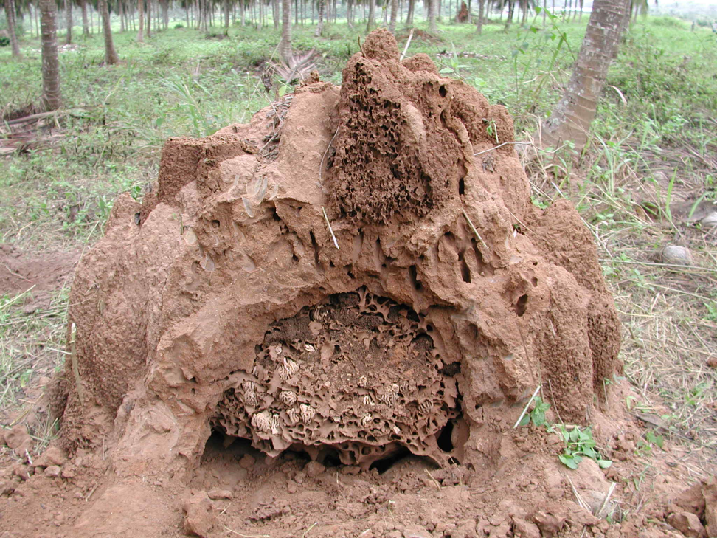
Complex Mounds

Slide 8
Complex Mounds
outer walls
brood chambers
base with cooling vanes
royal chamber
fungus gardens
galleries

Slide 9
Stigmergy
Indirect coordinated action among individuals where a trace left in the environment by an action stimulates subsequent actions by individuals.

Slide 10
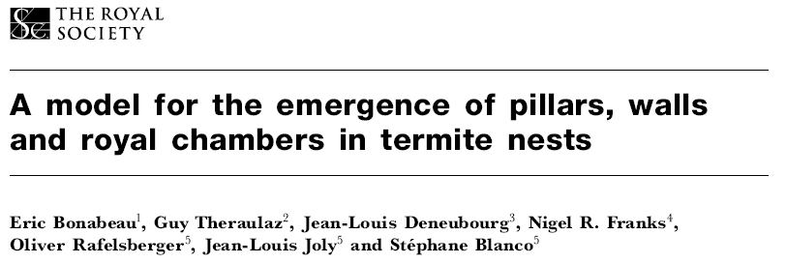
cement pheromone
trail pheromone
queen pheromone
convective air currents
net directional movement
Notes:
Termites most impressive builders in nature – nests 4 or 5 orders of magnitude larger than a worker

Slide 11
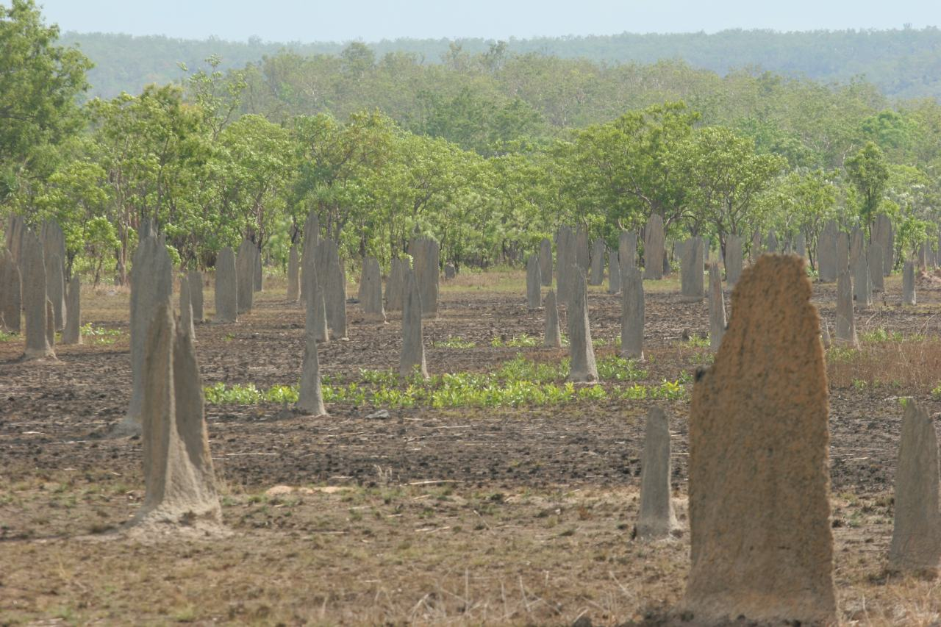
Magnetic Termite Mounds
Tropical Australia
Two Species
Flooding Dependent?
Notes:
N-S orientation. Termites stay on cooler side during morning and afternoon. Experimental E-W orientation raises temp by 6 C in nest. May be related to propensity for flooding – termites have to stay in nest above ground through summer where it floods.

Slide 12
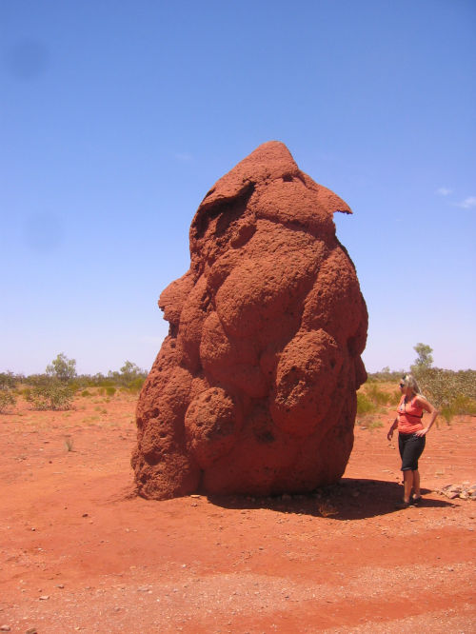
Termite Mounds: Take Home
Large numbers of individuals
Limited information
Limited Capabilities
Stigmergy
Strongly condition Dependent
Notes:
N-S orientation. Termites stay on cooler side during morning and afternoon. Experimental E-W orientation raises temp by 6 C in nest. May be related to propensity for flooding – termites have to stay in nest above ground through summer where it floods.

Slide 13
Robotic Construction of a Truss Structure with Distributed Coverage
Seungkook Yun, Mac Schwager, Daniela Rus
Computer Science and Artificial Intelligence Laboratory
MIT
Notes:
13
In this work, a lot of modular robots cooperate to build a self-assembled structure with rigid bars, in a distributed and a locally optimal way.

Slide 14
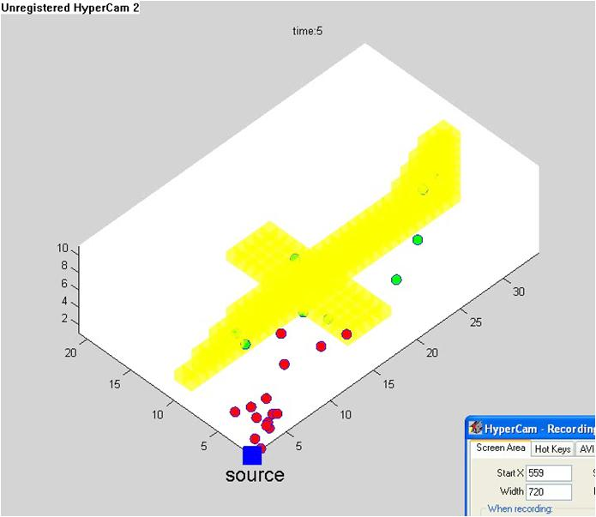
Robotic construction with Distributed Coverage
Robots with roles
Assembly
Delivery of parts
Target structure is given by a density function
Part location known, quantities unknown
Decentralized control to identify the allocation of robots to sub-assemblies
Decentralized control for parts delivery
Notes:
14

Slide 15
Main Control Flow
Deploy the assembly robots in the target area
Place the robots at optimal task location in Q
Delivery robot: carry parts
Assembly robot: assemble the parts
No more parts
Sub structure
is done
End
Notes:
15

