Slide 1
Data Citation: Giving Credit Where Credit is Due
Yinjun Wu, Abdussalam Alawini, Susan B. Davidson, Gianmaria Silvello
Notes:
Hello! This is Yinjun. I am excited to present our work on automating data citation.

Slide 2
Publication in the Digital Era
More and more scientific databases
Published online
Curated by large communities
Complex, structured, and evolving
Contributors need to be acknowledged
How should data extracted from a database be cited?
Notes:
Currently, in biological and medical domain, more scientific datasets are published on the web, which are curated by large scientific community.
//features of those datasets
Those datasets are complex, evolving fast and structured as relational or graph database. In those databases, the contributors’ work should be acknowledged when the data is cited, which can encourage their continuous contribution to the database. Typical examples are Reactome, IUPHAR and eagle-I. But how should we generate citations to the cited data appropriately?

Slide 3
Outline
State of the art in Data Citation
Model: Citation views
Implementing Citation views
Conclusions
Notes:
How presentation will benefit audience: Adult learners are more interested in a subject if they know how or why it is important to them.
Presenter’s level of expertise in the subject: Briefly state your credentials in this area, or explain why participants should listen to you.
I DON’T REALLY LIKE THIS OUTLINE, PERHAPS IT SHOULD BE DIFFERENT
STATE OF THE ART IN DATA CITATION
OUR APPROACH: CITATION VIEWS
IMPLEMENTING CITATION VIEWS
CONCLUSIONS

Slide 4
Outline
State of the art in Data Citation
Model: Citation views
Implementing Citation views
Conclusions
Notes:
How presentation will benefit audience: Adult learners are more interested in a subject if they know how or why it is important to them.
Presenter’s level of expertise in the subject: Briefly state your credentials in this area, or explain why participants should listen to you.

Slide 5
Traditional citations
Southan, Christopher, Joanna L. Sharman, Helen E. Benson, Elena Faccenda, Adam J. Pawson, Stephen PH Alexander, O. Peter Buneman et al. "The IUPHAR/BPS Guide to PHARMACOLOGY in 2016: towards curated quantitative interactions between 1300 protein targets and 6000 ligands." Nucleic acids research 44, no. D1 (2015): D1054-D1068.
Traditional citations:
Composed of “snippets” of information: authors, title, date, etc.
Used to recognize authors’ work
Why current citations in scientific databases are not enough:
Only database owner and main curators are mentioned
Citation depends on the data retrieved by a query
Notes:
//current datasets cited as whole
We all know how to cite an article, which is well known for decades. Those traditional citations are composed of authors, title, etc., which are used to recognize authors’ work in those publications. So most scientific datasets mimic traditional citations to achieve the same goal, which cite the entire database as a whole.
//traditional citations to database: weakness
But the traditional citations are not enough for scientific databases, since it only includes the names of PIs and important people, which ignores other contributors who take a lot of effort to upload and curate the database.
The citations should depend on user query since data retrieved by different queries might be curated by different people.

Slide 6
Digital Libraries community
A number of organizations recognize the importance of data citation, and propose principles and standards.
E.g. Force 11, DataCite, etc.
We build on principles proposed by the digital libraries community
Notes:
Some organizations from digital library have realized the importance of this issue and they provide some guidelines and principles to data citations.
We believe that data citation is a computationally important problem and we will justify this point using one typical database, i.e. IUPHAR database.

Slide 7
State of the art in data citation: the IUPHAR database
The IUPHAR Guide to Pharmacology is a database of information about drug targets and prescription medicines
Drug targets are arranged into groups called “families”
Some families have a detailed “introduction” page
Different families and introduction pages have different citations
Notes:
IUPHAR is the best database for tackling data citation currently.
//content in IUPHAR:
Which stores information about drug targets in human and medicines that act on them.
//family and introduction page:
The drug targets are arranged into groups called “families” and some families have detailed introduction page, which are contributed by different groups of contributors. So each family page and introduction page need citations to recognize the contributors’ work.

Slide 8
Notes:
Let’s look at a use case in IUPHAR.
//landing page
This is the landing page of IUPHAR, by which

Slide 9
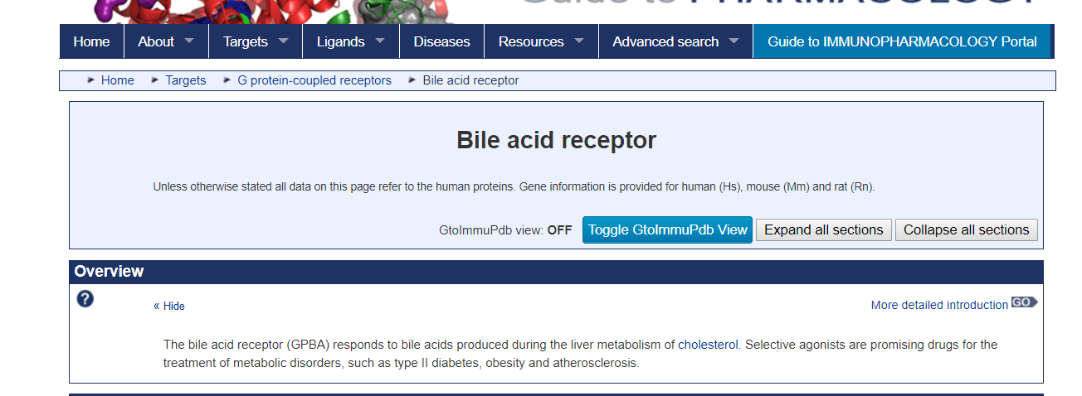
Notes:
users can navigate through the database and come to one specific family page called bile-acid receptor. The navigation process is actually a query against this database.

Slide 10
Citation 1:
Anthony P. Davenport, Tom I. Bonner, Janet J. Maguire, Rebecca Hills, Edward Rosser. Bile acid receptor. Accessed on 03/05/2018. IUPHAR/BPS Guide to PHARMACOLOGY, http://www.guidetopharmacology.org/GRAC/FamilyDisplayForward?familyId=8.
Notes:
In this webpage, two types of citations are provided. One is the fine-grained citation including all the contributors for this family page.
//query included in the citation
Note that, the query retrieving this family page, i.e. this http address is also included in this citation.
IUPHAR wins over other dbs by providing such fine-grained citations

Slide 11
IUPHAR Guide to Pharmacology is a database of information about drug targets, and the prescription medicines and experimental drugs that act on them.
Contents of the database are generated by hundreds of experts who, in small groups, contribute to portions of the database. Thus the authorship depends on what part of the database is being cited.
Citation 2:
Alexander SPH, Kelly E, Marrion NV, Peters JA, Faccenda E, Harding SD, Pawson AJ, Sharman JL, Southan C, Buneman OP, Cidlowski JA, Christopoulos A, Davenport AP, Fabbro D, Spedding M, Striessnig J, Davies JA; CGTP Collaborators. (2017) The Concise Guide to PHARMACOLOGY 2017/18. Br J Pharmacol. 174 (Suppl 1): S1-S446.
Notes:
The other one is coarse-grained, which is a traditional journal citation to the IUPHAR database as a whole.

Slide 12
Citations in IUPHAR
Coarse-grained citations
E.g. Traditional journal citation to database as a whole
Fine-grained citations
E.g. Citation to an individual family page
Both are
Hard-coded in web-pages and manually specified
Used in practice
General user queries need to be supported.
Notes:
NOT CLEAR WHAT USE BOTH OR USE ONE MEANS
As we can see, for some part of data in IUPHAR database, there exist two types of citations, i.e. fine-grained citation and coarse-grained citation.
//hard-coded
Note that both the coarse-grained and fine-grained citations are hard-coded and manually specified by DBAs. Both of them are encouraged to be used, which are called alternative use.
//others
Comparing to other typical scientific datasets, IUPHAR wins by owning fine-grained citations to include most specific contributors for the cited data.
//general query
However, this solution is still not enough since in IUPHAR database, only limited queries are associated with citations, like the query to each individual family. The DBAs hope that citations for general queries can be supported in the future.

Slide 13
Why hard-coded citations are not enough
The number of general queries can be infinite.
We need to automatically generate citations as the data is extracted.
It is a computational challenge
Notes:
However, the number of general user queries can be infinite, it’s impossible to manually attach citations to each user query.
//goal
So we need to figure out how to automatically generate citations for the cited data.

Slide 14
Outline
State of the art in Data Citation
Model: Citation views
Implementing Citation views
Conclusions
Notes:
We designed a model which based on one concept, citation views

Slide 15
Model: citation views
A citation view consists of
View query
Citation query
Citation function
Notes:
We defined a model for it, which centers around a concept called “citation views”, which consists of view query, citation query and citation function.

Slide 16
View query
Conjunctive, can be parameterized
Specifies what portion of data is being cited
E.g. IUPHAR has citations for each Family page
λ FID. V1(FID, Fname, Type) :- Family(FID, FName, Type)
V2(FID, Fname, Type) :- Family(FID, FName, Type)
Notes:
//view query:
The first component is view query, which is to specify the portion of data being cited. The view query is conjunctive and possibly parameterized query. For example, for each family page, we can define two view queries over family relation. One is parameterized while the other one is unparameterized.

Slide 17
View query
Conjunctive, can be parameterized
Specifies what portion of data is being cited
E.g. IUPHAR has citations for each Family page
λ FID. V1(FID, Fname, Type) :- Family(FID, FName, Type)
V2(FID, Fname, Type) :- Family(FID, FName, Type)
Parameterized
Notes:
//view query:
The first component is view query, which is to specify the portion of data being cited. The view query is conjunctive and possibly parameterized query. For example, for each family page, we can define two view queries over family relation. One is parameterized while the other one is unparameterized.

Slide 18
View definition
Parameterized views
Unparameterized views
FID | FName | Type
1 | Glucagen receptor… | GPCR
2 | CLR (calcitonin receptor-like receptor) … | GPCR
3 | Peptidases and proteinases… | Kinase
4 | A multifunctional molecule, adenosine… | Kinase
5 | Chromatin modifying enzymes… | Kinase
Parameterized views define a family of views, one for each value of the parameter.
λ FID. V1(FID, Fname, Type) :- Family(FID, FName, Type)
V2(FID, Fname, Type) :- Family(FID, FName, Type)
“Instantiated views”:
V1(F, N, Ty)(1)
V1(F, N, Ty)(2)
1 | Glucagen receptor… | GPCR
2 | CLR (calcitonin receptor-like receptor) … | GPCR
Notes:
//relation
In order to show the differences between parameterized and unparameterized views, we use family relation from IUPHAR database, which includes information like ID, name and type of all families together.
For the unparameterized view V2, its instance includes all the tuples in Family relation. It represents the coarse-grained citation in the previous example, which is same across different family tuples. For V1, which is parameterized by FID, it can be instantiated by plugging in some FID value. Each instantiated view represents each family page and the fine-grained citation, which is most specific and different across different family tuples.

Slide 19
Citation query and function
λ FID. V1(FID, Fname, Type) :- Family(FID, FName, Type)
Citation query: defines snippets of information to be included in the citation
E.g. Citation query to V1
λ FID. C_{V1}(FN, LN) :- Family(FID, FName, Type), Contributor2Family(FID, FN, SN)
Citation function: specifies how to construct the citation using snippets of information
E.g. JSON-formatted citations:
[contributor: {‘Anthony P. Davenport’, ‘Tom I. Bonner’, ‘Janet J. Maguire’, ‘Rebecca Hills’, ‘Edward Rosser’}, database: ‘IUPHAR’]
Notes:
//citation query
The second component is citation query, which is used to retrieve snippets of information from the database used for citation. For example, given view V1, we can define a citation query which returns the contributors to each individual family page.
//citation function
The last component is the citation function, which is to organize the snippets of information to construct a formatted citation for users.

Slide 20
How can citations for general queries be generated automatically using pre-defined citation views?
Notes:
//solutions
Then here is a question, how can the citations to general queries automatically be generated using those predefined citation views?

Slide 21
How can citations for general queries be generated automatically using pre-defined citation views?
Query rewriting using views ?
Notes:
This problem sounds very similar to query rewriting using views, right? But in fact, this research problem is not exactly same as query rewriting using views problem. Here is why.

Slide 22
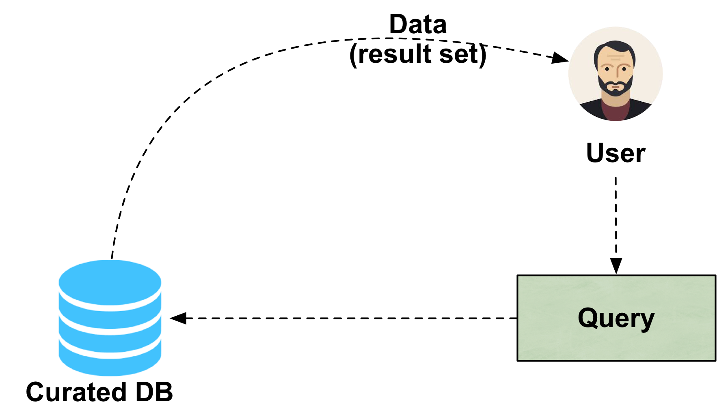
Need for tuple-level reasoning
Return the ‘gpcr’ drugs in the IUPHAR database
Notes:
//query example
In IUPHAR database, a user submits a query to return the drug targets whose type is ‘GPCR’

Slide 23
Need for tuple-level reasoning
Q(FID, N, Ty) :- Family(FID, N, Ty), Ty = ‘gpcr’
Notes:
//datalog query
This query can be formalized as a datalog query like this

Slide 24
Need for tuple-level reasoning
FID | N | Ty
1 | 5-HT | gpcr
2 | muscarinic | gpcr
3 | Adenosine | gpcr
Notes:
Then the query result is presented to this user.

Slide 25
Need for tuple-level reasoning
FID | N | Ty
1 | 5-HT | gpcr
2 | muscarinic | gpcr
3 | Adenosine | gpcr
What’s the citation for the last tuple?
Notes:
After seeing the query result, only the last tuple captures users’ interests. Since the user might not be an SQL expert, the user may just want to manually select that tuple. The citation for that tuple instead of the entire query result should be generated.

Slide 26
Need for tuple-level reasoning
FID | N | Ty
1 | 5-HT | gpcr
2 | muscarinic | gpcr
3 | Adenosine | gpcr
What’s the citation for the last tuple?
This goes beyond query rewriting using views.
Notes:
After seeing the query result, only the last tuple captures users’ interests. Since the user might not be an SQL expert, the user may just want to manually select that tuple. The citation for that tuple instead of the entire query result should be generated.

Slide 27
Outline
State of the art in Data Citation
Model: Citation views
Implementing Citation views
Conclusions
Notes:
How presentation will benefit audience: Adult learners are more interested in a subject if they know how or why it is important to them.
Presenter’s level of expertise in the subject: Briefly state your credentials in this area, or explain why participants should listen to you.

Slide 28
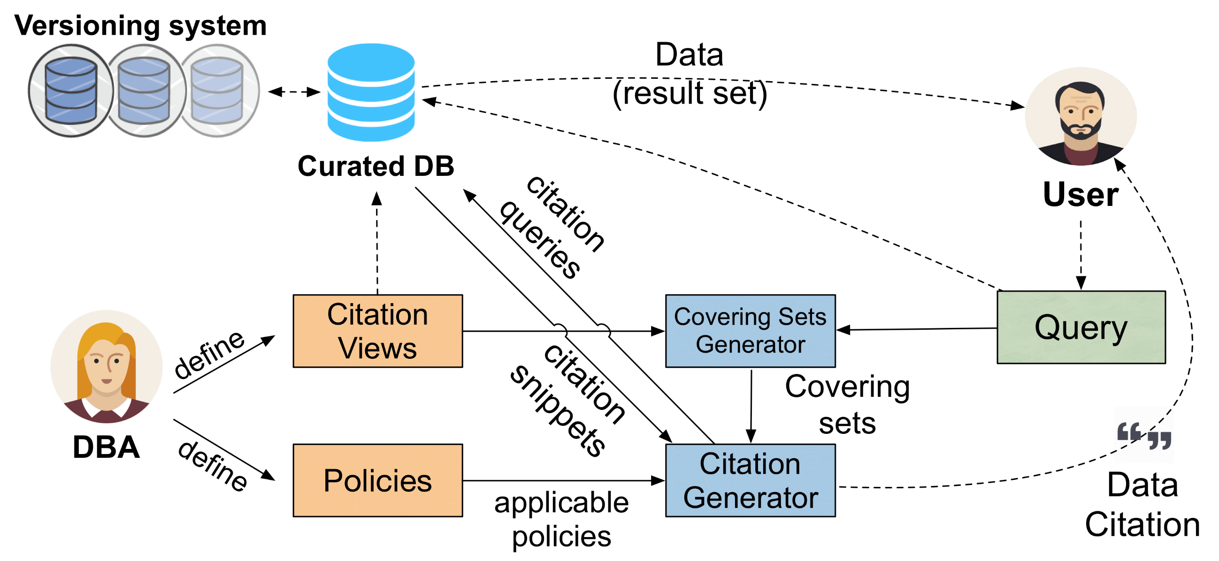
Data Citation Architecture
Notes:
Just to give you a high-level idea on how our system works, I will only talk about the role of citation views and policies in the citation generation process. You can find details in our paper.
Quickly walk through our Data citation system. First, the DBAs define citation views and policies, which I will explain in the next few slides.
A user submits a query, which will be executed right away. At the same time, our citation system will take the user query and try to figure out what citation view to be used to generate citations for the query result.

Slide 29
Intuition
If a view tuple is visible in the query result, then the query tuple carries the view tuple’s citation annotation.
Notes:
In order to generate citations for each tuple, we should use citations from pre-defined citation views.

Slide 30
Strategies
Tuple-level reasoning
Schema-level reasoning
Schema level approach (SLA)
(Pure schema-level reasoning)
Notes:
For a certain query tuple, we should determine which views are usable. Here is the intuition, i.e., view tuples should be visible in certain query tuple.

Slide 31
Strategies
Tuple-level reasoning
Schema-level reasoning
Schema level approach (SLA)
(Pure schema-level reasoning)
Notes:
To capture this intuition, we designed three approaches, in which the amount of reasoning progressively shifts from tuple level to schema level.
//SLA
The first one is schema-level approach, which only reasons the citations in the schema level

Slide 32
Strategies
Tuple-level reasoning
Schema-level reasoning
Tuple level approach (TLA)
(Tuple-level reasoning
+ schema-level reasoning)
Schema level approach (SLA)
(Pure schema-level reasoning)
Notes:
At the other end of this spectrum, it is the Tuple-level approach

Slide 33
Strategies
Semi-schema level approach (SSLA)
(Tuple-level reasoning
+ schema-level reasoning)
Tuple-level reasoning
Schema-level reasoning
Tuple level approach (TLA)
(Tuple-level reasoning
+ schema-level reasoning)
Schema level approach (SLA)
(Pure schema-level reasoning)
Notes:
At the other end of this spectrum, it is the Tuple-level approach

Slide 34
Strategies
Semi-schema level approach (SSLA)
(Tuple-level reasoning
+ schema-level reasoning)
Tuple-level reasoning
Schema-level reasoning
Tuple level approach (TLA)
(Tuple-level reasoning
+ schema-level reasoning)
Schema level approach (SLA)
(Pure schema-level reasoning)
Notes:
Somewhere in-between is the semi-schema level approach. The last two approaches reason citations at both tuple-level and schema-level.
Due to the time limit, let’s focus on tuple-level approach in this presentation

Slide 35
Tuple-level approach
Views definition:
λ FID. V1(FID, N, Ty) :- Family(FID, N, Ty), FID <= 2
λ FID. V2(FID, Tx) :- FamilyIntro(FID2, Tx)
Family
FamilyIntro
FID | N | Ty
1 | 5-HT | gpcr | V1(1)
2 | muscarinic | vgic | V1(2)
3 | Adenosine | gpcr
4 | Adreno | lgic
FID | Text
1 | Histamine… | V2(1)
2 | 5-HT… | V2(2)
3 | Histamine… | V2(3)
Notes:
//annotation step
Tuple-level approach starts by annotating tuples in the base relations with views. During annotation step, we want to capture visibility early, which is achieved by taking care of the predicates.
For example, there are two parameterized views defined over family and familyintro relation respectively. Only the first two tuples in Family relation are annotated with V1 since it has a predicate FID <= 2 while all the tuples in relation FamilyIntro are annotated by V2 which has no predicates. The annotation in each tuple is instantiated by plugging FID values, which represents most specific citations to every tuple.

Slide 36
Tuple-level approach
Views definition:
λ FID. V1(FID, N, Ty) :- Family(FID, N, Ty), FID <= 2
λ FID. V2(FID, Tx) :- FamilyIntro(FID2, Tx)
Family
FamilyIntro
FID | N | Ty
1 | 5-HT | gpcr | V1(1)
2 | muscarinic | vgic | V1(2)
3 | Adenosine | gpcr
4 | Adreno | lgic
FID | Text
1 | Histamine… | V2(1)
2 | 5-HT… | V2(2)
3 | Histamine… | V2(3)
Joint-use
Alternative-use
Aggregated-use
Notes:
//joint-use claim
There are three possible ways to construct citations for query tuples using those annotations, i.e. joint-use, alternative-use and aggregated-use. First, let’s look at the joint-use of citations.

Slide 37
Joint-use of citations
Views definition:
λ FID. V1(FID, N, Ty) :- Family(FID, N, Ty), FID <= 2
λ FID. V2(FID, Tx) :- FamilyIntro(FID2, Tx)
Query: Return the id, type and text of families with introduction page
Q(FID1, Type, Text) :- Family(FID1, FName, Type), FamilyIntro(FID2, Text), FID1 = FID2
Q(D)
FID1 | Type | Text
1 | gpcr | Histamine… | V1(1) | V2(1)
2 | vgic | 5-HT… | V1(2) | V2(2)
3 | gpcr | Histamine… |  | V2(3)
Notes:
Suppose a user query comes, which is to return the id, type and text of a family with introduction page. This is a join query between family and familyinto relation, which brings
annotations from the two relations to the query result..

Slide 38
Joint-use of citations
Q(D)
FID1 | Type | Text
1 | gpcr | Histamine… | V1(1) | V2(1)
2 | vgic | 5-HT… | V1(2) | V2(2)
3 | gpcr | Histamine… |  | V2(3)
Joint use of citations (Join):
Citation for V1(1): {contributor: [‘Mark’], db_name: ‘IUPHAR’}
Citation for V2(1): {contributor: [‘Hay’], db_name: ‘IUPHAR’}
Resulting citation: {contributor: [‘Mark’, ‘Hay’], db_name: ‘IUPHAR’}
Notes:
In this case, we can jointly use the citations of the annotations from the two relations to construct citations for each query tuple. For example, we can jointly use the citations of V1(1) and V2(1) for the first query tuple.
//apply policy
There are many possible policies for joint-use. For example, the jointly use can be defined as join, which joins the citations of the two annotations like the natural join in SQL.

Slide 39
Alternative-use of citations
Views definition:
λ FID. V1(FID, N, Ty) :- Family(FID, N, Ty), FID <= 2
V3(FID, N, Ty) :- Family(FID, N, Ty)
Family
FID | N | Ty
1 | 5-HT | gpcr | V1(1), V3
2 | muscarinic | vgic | V1(2), V3
3 | Adenosine | gpcr | V3
4 | Adreno | lgic | V3
Notes:
The second case is the alternative use of citations. In this example, we have two views over family relation. One is parameterized while the other one is unparameterized.
After the annotation step, there is a user query against the family relation.

Slide 40
Alternative-use of citations
Views definition:
λ FID. V1(FID, N, Ty) :- Family(FID, N, Ty), FID <= 2
V3(FID, N, Ty) :- Family(FID, N, Ty)
Query: Return the id and type of the first family
Q’(FID, Type) :- Family(FID, FName, Type), FID = 1
Family
Q’(D)
FID | N | Ty
1 | 5-HT | gpcr | V1(1), V3
2 | muscarinic | vgic | V1(2), V3
3 | Adenosine | gpcr | V3
4 | Adreno | lgic | V3
FID | Type
1 | gpcr | V1(1), V3
Notes:
Two annotations exist in the query tuple. Since they come from same base relation, we consider alternatively using their citations.

Slide 41
Alternative-use of citations
Q’(D)
FID | Type
1 | gpcr | V1(1), V3
Alternative use of citations (Union):
Citation for V1(1): {contributor: [‘Mark’], db_name: ‘IUPHAR’}
Citation for V3: {contributor: [‘Andrew’], db_name: ‘IUPHAR’}
Resulting citation: {{contributor: [‘Mark’], db_name: ‘IUPHAR’}, {contributor: [‘Andrew’], db_name: ‘IUPHAR’}}
41
Notes:
We can union the two citations as a whole.
Cost function for paper

Slide 42
Aggregated use of citations
Views definition:
λ FID. V1(FID, N, Ty) :- Family(FID, N, Ty), FID <= 2
Family
FID | N | Ty
1 | 5-HT | gpcr | V1(1)
2 | muscarinic | vgic | V1(2)
3 | Adenosine | gpcr
4 | Adreno | lgic
Notes:
The third case is the aggregated use in which we want to generate citations for multiple tuples.
After the annotation step

Slide 43
Aggregated use of citations
Views definition:
λ FID. V1(FID, N, Ty) :- Family(FID, N, Ty), FID <= 2
Query: Return the id and type of the first three families
Q’’(FID, Type) :- Family(FID, FName, Type), FID <= 3
Family
Q’’(D)
FID | N | Ty
1 | 5-HT | gpcr | V1(1)
2 | muscarinic | vgic | V1(2)
3 | Adenosine | gpcr
4 | Adreno | lgic
FID1 | Type
1 | gpcr | V1(1)
2 | vgic | V1(2)
3 | gpcr
Notes:
The user query generates three tuples. But the user may simply select the first two tuples.

Slide 44
Aggregated use of citations
Q’’(D)
FID1 | Type
1 | gpcr | V1(1)
2 | vgic | V1(2)
3 | gpcr
Aggregated use of citations:
Citation for V1(1): {contributor: [‘Mark’], db_name: ‘IUPHAR’}
Citation for V1(2): {contributor: [‘Robert’], db_name: ‘IUPHAR’}
Aggregated citation: {{contributor: [‘Mark’, ‘Robert’], db_name: ‘IUPHAR’}}
Notes:
In this case, we need to aggregate the citation information from the annotations from each selected tuple.

Slide 45
Data Citation Architecture
Notes:
To put everything together, let’s use the architecture figure and walk through an example to explain the citation generation process.

Slide 46
Data Citation Architecture
λ FID. V1(N, Ty) :- Family(FID, N, Ty), FID <= 2
Notes:
To put everything together, let’s use the architecture figure and walk through an example to explain the citation generation process.

Slide 47
Data Citation Architecture
λ FID. V1(N, Ty) :- Family(FID, N, Ty), FID <= 2
Joint use: Join
Alternative use: Union
Aggregated use
Notes:
To put everything together, let’s use the architecture figure and walk through an example to explain the citation generation process.

Slide 48
Data Citation Architecture
Q(FID, N, Ty): - Family(FID, N, Ty), FID <= 3
λ FID. V1(N, Ty) :- Family(FID, N, Ty), FID <= 2
Joint use: Join
Alternative use: Union
Aggregated use
Notes:
To put everything together, let’s use the architecture figure and walk through an example to explain the citation generation process.

Slide 49
Data Citation Architecture
Q(FID, N, Ty): - Family(FID, N, Ty), FID <= 3
λ FID. V1(N, Ty) :- Family(FID, N, Ty), FID <= 2
FID | N | Ty
1 | 5-HT | gpcr | V1(1)
2 | muscarinic | vgic | V1(2)
3 | Adenosine | gpcr
Joint use: Join
Alternative use: Union
Aggregated use
49
Notes:
To put everything together, let’s use the architecture figure and walk through an example to explain the citation generation process.

Slide 50
Data Citation Architecture
Q(FID, N, Ty): - Family(FID, N, Ty), FID <= 3
λ FID. V1(N, Ty) :- Family(FID, N, Ty), FID <= 2
FID | N | Ty
1 | 5-HT | gpcr | V1(1)
2 | muscarinic | vgic | V1(2)
3 | Adenosine | gpcr
FID | N | Ty
1 | 5-HT | gpcr | V1(1)
2 | muscarinic | vgic | V1(2)
3 | Adenosine | gpcr
Joint use: Join
Alternative use: Union
Aggregated use
{{contributor: [‘Mark’, ‘Robert’], db_name: ‘IUPHAR’}}
Notes:
To put everything together, let’s use the architecture figure and walk through an example to explain the citation generation process.

Slide 51
Experiments
Time performance is important
Experiments on both synthetic and realistic scenarios
Database engine: PostgreSQL
Deployed on a single Linux machine

Slide 52
Performance on realistic queries
Query | Execution time for Tuple-level approach (seconds)
Q0 | 0.83
Q1 | 0.60
Q2 | 0.63
Q3 | 0.56
Q4 | 0.73
Q5 | 0.53
Q6 | 0.53
Q7 | 0.57
Notes:
As you can imagine, users don’t want to wait too long for the citations, which means that our system should be an interactive tool. To test the performance, we have done a bunch of experiments on synthetic and realistic cases. This is the performance for realistic queries against IUPHAR database. We test the total execution time for tuple-level approach and schema-level approach and calculate the ratio between them.
The result indicates that the tuple-level approach is only slightly worse than schema-level reasoning although it needs more reasoning steps in the tuple level.

Slide 53
Performance on realistic queries
Query | Execution time for Tuple-level approach (seconds)
Q0 | 0.83
Q1 | 0.60
Q2 | 0.63
Q3 | 0.56
Q4 | 0.73
Q5 | 0.53
Q6 | 0.53
Q7 | 0.57
Query result size: 8868
# of Relations: 3
Notes:
Some of those realistic queries are very large. For example, Q0 is a join between 3 relations, which generates up to 8000 tuples

Slide 54
Outline
State of the art in Data Citation
Model: Citation views
Implementing Citation views
Conclusions
Notes:
How presentation will benefit audience: Adult learners are more interested in a subject if they know how or why it is important to them.
Presenter’s level of expertise in the subject: Briefly state your credentials in this area, or explain why participants should listen to you.

Slide 55
Summary
Automating fine-grained citations to general queries is an interesting computational challenge
Future work
Explore the connections between data citation and provenance
Enable bibliometrics (e.g. h-indexes) for curators, giving credits as Google Scholar does.
Support versioning database
Notes:
To conclude, in this paper, we explore solutions to automating fine-grained citations to general queries
In terms of future work, since the annotation in tuple-level approach is similar to provenance, we will explore the connections between data citation and provenance. We will also explore how to enable bibliometrics for data citation and support database versioning.

Slide 56
Thanks!

Slide 57
For more information:
http://l.ead.me/baulYk

