Slide 1
ProvCite: Provenance-based Data Citation
Yinjun Wu*, Abdussalam Alawini*, Daniel Deutch**,
Tova Milo**, Susan B. Davidson*
*University of Pennsylvania
** Tel Aviv University
Notes:
University names in this slide

Slide 2
Why Data citation?
Reactome: https://reactome.org/
IUPHAR: http://www.guidetopharmacology.org/
Eagle-i: https://www.eagle-i.net/

Slide 3
Large communities involved
Curators1
Table 2
Table 1
Curators2
Pis, Managers
PI1, PI2, Manager1, Manager2,…; Article about the database.

Slide 4
Outline
Prior work and need for aggregation
Provenance-based model (PBM)
From traditional query rewriting using views with aggregation
Motivation for using provenance
Implementation – ProvCite and Evaluations

Slide 5
Prior work: Rewriting-based Model
R
S
Conjunctive view queries: Data with citations
A | B
1 | 2
2 | 3
3 | 1
4 | 2
C | D
1 | 2
2 | 3
λA V1(A, B) :- R(A, B), A <= 3
V2(C, D) :- S(C, D)
V1(D)
V2(D)
A | B
1 | 2 | [{Person:[‘Lee’]}]
C | D
1 | 2 | [{Person:[‘Dan’]}]
2 | 3 | [{Person:[‘Dan’]}]
2 | 3 | [{Person:[‘Liu’]}]
3 | 1 | [{Person:[‘Bob’]}]
Q(D)
Query rewriting using views ?
Conjunctive user queries:
A | C
1 | 2
3 | 1
4 | 2
Q(A, C) :- R(A, B), S(C, D), A = C
Q1(A, C) :- R(A, B), S(C, D), A = C, A <= 3
{V1, V2}
Q2(A, C) :- R(A, B), S(C, D), A = C, A > 3
Partially rewrite
{V2}
Notes:
Different portions different citations.
The query cannot match the views.
Fine-grain level citations
Figure out which views to use at the fine grain level
Predicates v1 not valid for every query tuple

Slide 6
Prior work: Rewriting-based Model
R
S
Conjunctive view queries: Data with citations
A | B
1 | 2
2 | 3
3 | 1
4 | 2
C | D
1 | 2
2 | 3
λA V1(A, B) :- R(A, B), A <= 3
V2(C, D) :- S(C, D)
V1(D)
V2(D)
A | B
1 | 2 | [{Person:[‘Lee’]}]
2 | 3 | [{Person:[‘Liu’]}]
3 | 1 | [{Person:[‘Bob’]}]
C | D
1 | 2 | [{Person:[‘Dan’]}]
2 | 3 | [{Person:[‘Dan’]}]
Q(D)
Rewriting-Based Model (RBM) [Alawini, VLDB2017] [Wu, SIGMOD2018]
Conjunctive user queries:
A | C
1 | 2 | [{Person:[‘Lee’, ‘Joe’]}]
3 | 1 | [{Person:[‘Liu’, ‘Dan’]}]
4 | 2 | [{Person:[‘Joe’]}]
Q(A, C) :- R(A, B), S(C, D), A = C

Slide 7
Summary of our prior work
Goal
Automatically generate fine-grained citations for general conjunctive query results
Solution – Rewriting-based model
Use modifications of traditional query rewriting using views techniques to determine valid views at fine-grain level

Slide 8
Can we go beyond conjunctive queries and views to handle more complicated cases, e.g. aggregate queries and views?

Slide 9
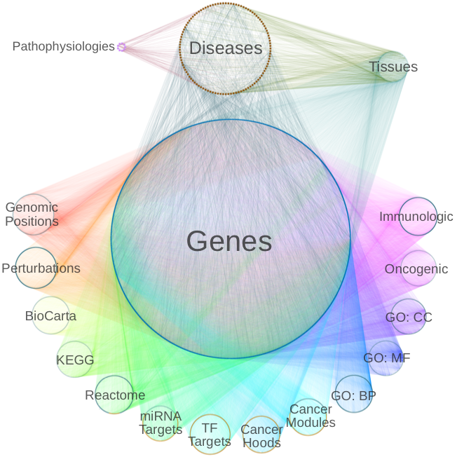
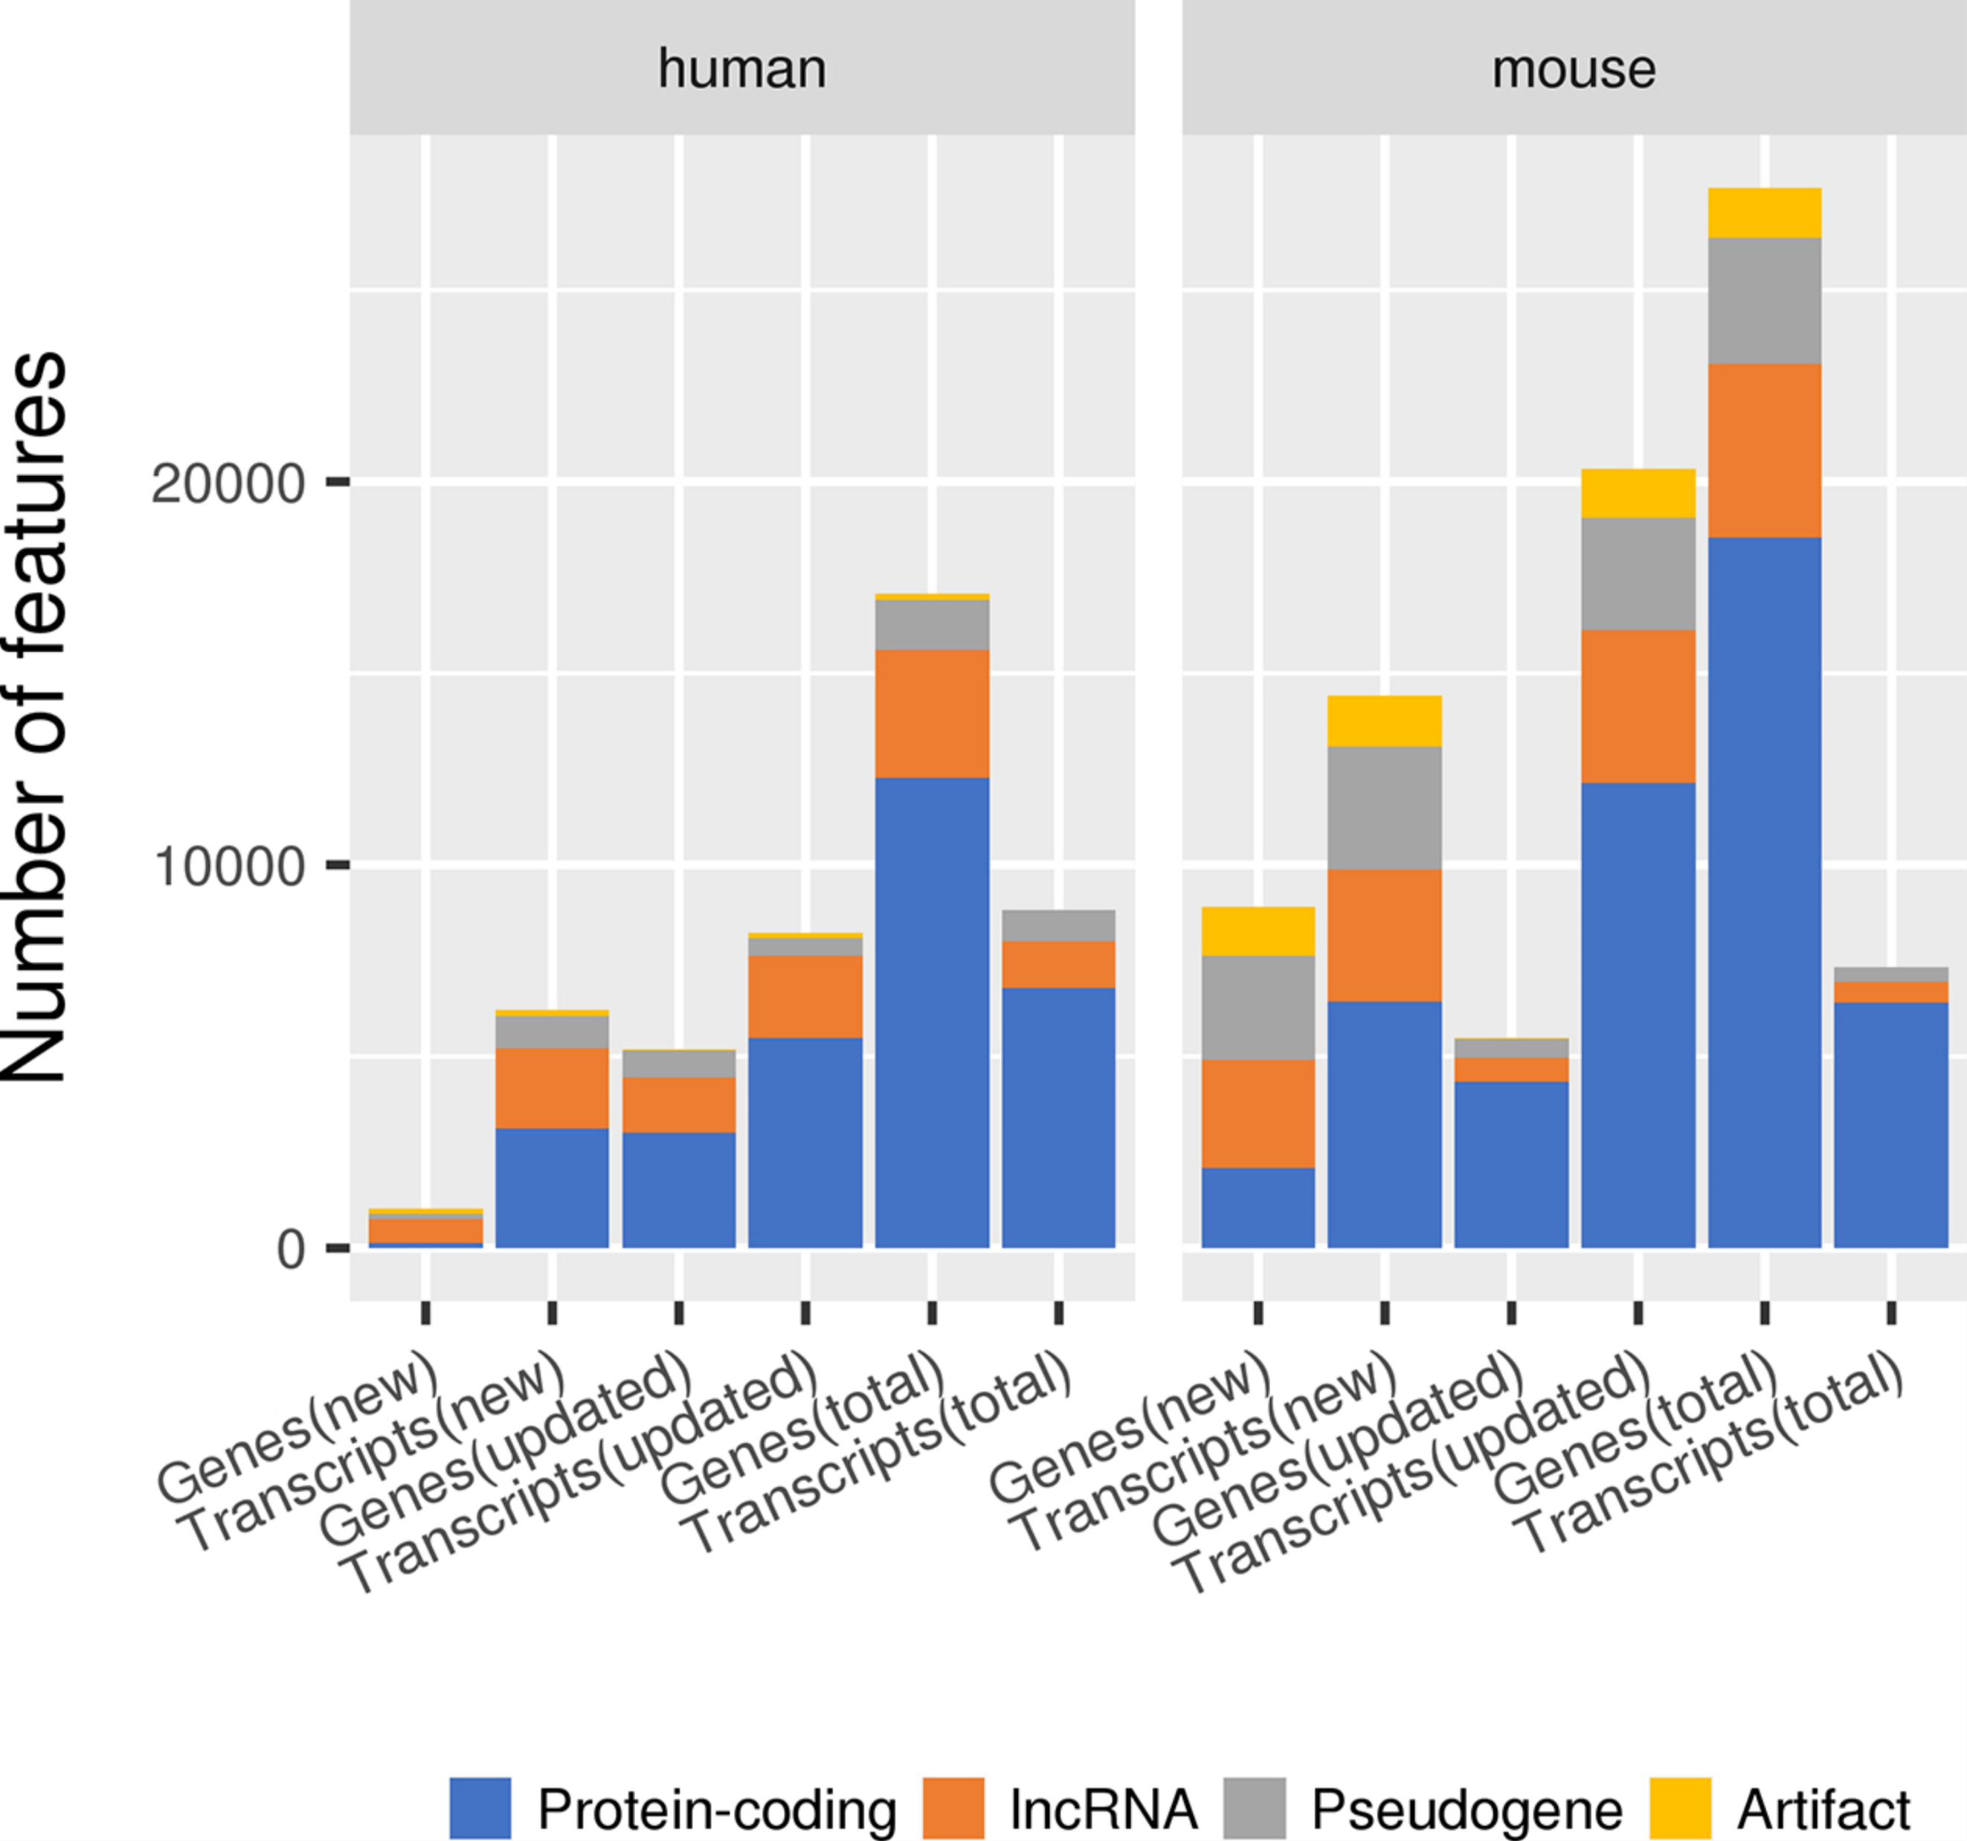
Can we go beyond conjunctive queries and views to handle more complicated cases, e.g. aggregate queries and views?
Hetionet [Himmelstein, Elife 2017]:
count connections between curated objects
GENCODE [Frankish, 2018]:
statistics on Genes, Transcripts and Exons
Query
(Conjunctive queries + aggregate queries)
View definitions
(Conjunctive queries + aggregate queries)

Slide 10
The goal of our current work
Automatically generate fine-grained citations for an arbitrary subset of a general query result in the context of aggregate queries and aggregate views

Slide 11
Contributions
Provenance-base model (PBM) automatically generates fine-grained citations to the results of aggregate queries with aggregate views
Aggregates may be general aggregate functions
Query rewriting using views with aggregation is generalized at fine-grained level with how-provenance.
An efficient implementation of PBM (ProvCite) is provided
Various optimization strategies can be applied
Extensive experimental study shows the feasibility of ProvCite

Slide 12
Running example - GENCODE
Gene(GID, Name, Type)
Transcript(TID, Name, Type, GID) GID references Gene
Exon(EID, Level, TID), TID references Transcript
Notes:
This is very complicated, do we need it all? Can it be simplified?

Slide 13
Outline
Prior work and need for aggregation
Provenance-based model (PBM)
From traditional query rewriting using views with aggregation
Motivation for using provenance
Implementation – ProvCite and Evaluations

Slide 14
Outline
Prior work and need for aggregation
Provenance-based model (PBM)
From traditional query rewriting using views with aggregation
Motivation for using provenance
Implementation – ProvCite and Evaluations

Slide 15
Running example – queries and views
V1(Ty, G, COUNT(T)) :- Transcript(T, N, Ty, G)
Q1(Ty, COUNT(T)) :- Transcript(T, N, Ty, G)
Count(G1) + Count(G2) = Count ({G1, G2})
V1 has finer granularity than Q1
V1’(Ty, COUNT(T)) :- Transcript(T, N, Ty, G)
Q1’(Ty, COUNT(T)) :- Transcript(T, N, Ty, G)
V1’ has the same granularity as Q1’

Slide 16
Running example – queries and views
V2(Ty, G, AVG(T)) :- Transcript(T, N, Ty, G)
Q2(Ty, AVG(T)) :- Transcript(T, N, Ty, G)
Not invertible!!
[Cohen, 2006]
V2 has finer granularity than Q2
V2’(Ty, AVG(T)) :- Transcript(T, N, Ty, G)
Q2’(Ty, AVG(T)) :- Transcript(T, N, Ty, G)
V2’ has the same granularity as Q2’

Slide 17
Outline
Prior work and need for aggregation
Provenance-based model (PBM)
From traditional query rewriting using views with aggregation
Motivation for using provenance
Implementation – ProvCite and Evaluations

Slide 18
Running example – queries and views
V1(Ty, G, COUNT(T)) :- Transcript(T, N, Ty, G) , G <= 2
Q1(Ty, COUNT(T)) :- Transcript(T, N, Ty, G), T <= ‘T6’
Query rewriting using views

Slide 19
Running example – queries and views
V1(Ty, G, COUNT(T)) :- Transcript(T, N, Ty, G) , G <= 2
Q1(Ty, COUNT(T)) :- Transcript(T, N, Ty, G), T <= ‘T6’
V1(D)
Transcript
Ty | G | COUNT(T)
rRNA | 1 | 2
rRNA | 2 | 1
mRNA | 2 | 2
TID | Name | Type | GID
T1 | N1 | rRNA | 1
T2 | N2 | rRNA | 1
T3 | N3 | mRNA | 2
T4 | N4 | mRNA | 2
T5 | N5 | rRNA | 2
T6 | N5 | rRNA | 3
T7 | N7 | mRNA | 3
Rewriting based model ?
Q1(D)
Q1’(Ty, COUNT(T)) :- Transcript(T, N, Ty, G) , T <= ‘T6’, G <= 2 ?
Ty | COUNT(T)
rRNA | 4
mRNA | 2
Ty | COUNT(T)
rRNA | 3

Slide 20
Running example – queries and views
V1(Ty, G, COUNT(T)) :- Transcript(T, N, Ty, G) , G <= 2
Q1(Ty, COUNT(T)) :- Transcript(T, N, Ty, G), T <= ‘T6’
V1(D)
Transcript
Ty | G | COUNT(T)
rRNA | 1 | 2
rRNA | 2 | 1
mRNA | 2 | 2
TID | Name | Type | GID
T1 | N1 | rRNA | 1
T2 | N2 | rRNA | 1
T3 | N3 | mRNA | 2
T4 | N4 | mRNA | 2
T5 | N5 | rRNA | 2
T6 | N5 | rRNA | 3
T7 | N7 | mRNA | 3
Q1(D)
Ty | COUNT(T)
rRNA | 4
mRNA | 2

Slide 21
Running example – queries and views
V1(Ty, G, COUNT(T)) :- Transcript(T, N, Ty, G) , G <= 2
Q1(Ty, COUNT(T)) :- Transcript(T, N, Ty, G), T <= ‘T6’
V1(D)
Transcript
Ty | G | COUNT(T)
rRNA | 1 | 2 | p1+p2
rRNA | 2 | 1 | p5
mRNA | 2 | 2 | p3+p4
TID | Name | Type | GID
T1 | N1 | rRNA | 1 | p1
T2 | N2 | rRNA | 1 | p2
T3 | N3 | mRNA | 2 | p3
T4 | N4 | mRNA | 2 | p4
T5 | N5 | rRNA | 2 | p5
T6 | N5 | rRNA | 3 | p6
T7 | N7 | mRNA | 3 | p7
Intuition 2: How-Provenance [Green, 2007] is essential for fine-grained citation reasoning for aggregate queries and views
Q1(D)
Ty | COUNT(T)
rRNA | 4 | p1+p2+p5+p6
mRNA | 2 | p3+p4
Notes:
Policy decision. Everything needed for the computation result in the query tuple.

Slide 22
Provenance-based model (PBM)
Schema-level conditions
Proper granularity between Q and V
Proper aggregate functions between Q and V
For a query tuple t in Q
Tuple-level conditions
a set of view tuples in V(D) should share the same set of provenance with t

Slide 23
Outline
Prior work and need for aggregation
Provenance-based model (PBM)
From traditional query rewriting using views with aggregation
Motivation for using provenance
Implementation – ProvCite and Evaluations

Slide 24
Architecture
Provenance-enabled Database
Query
Provenance of views
Provenance of Query
“ ”
Reasoning with provenance to determine valid views
Request the citation to the first 10 tuples
Constructing rewritings and citations

Slide 25
Optimizations 1
Provenance-enabled Database
Query
Materialize view provenance (Eager strategy) VS keep view provenance virtual (Lazy strategy)
Parallelize reasoning steps for each view
Build index over query provenance for speed-ups
Provenance of views
Provenance of Query
“ ”
Reasoning with provenance to determine valid views
Request the citation to the first 10 tuples
Constructing rewritings and citations

Slide 26
Effectiveness of Optimizations 1
Provenance-enabled Database
Query
Materialize view provenance (Eager strategy) VS keep view provenance virtual (Lazy strategy)
Parallelize reasoning steps for each view
Build index over query provenance for speed-ups
Provenance of views
Provenance of Query
2x Speed-ups
“ ”
Reasoning with provenance to determine valid views
Request the citation to the first 10 tuples
Constructing rewritings and citations

Slide 27
Optimizations 2
Provenance-enabled Database
Query
Provenance of views
Provenance of Query
“ ”
Use bit arrays and clustering algorithms to efficiently remove redundant “rewritings”
Reasoning with provenance to determine valid view tuples
Request the citation to the first 10 tuples
Constructing rewritings and citations

Slide 28
Effectiveness of Optimizations 2
Provenance-enabled Database
Query
Provenance of views
Provenance of Query
“ ”
10x speed-ups
Use bit arrays and clustering algorithms to efficiently remove redundant “rewritings”
Reasoning with provenance to determine valid view tuples
Request the citation to the first 10 tuples
Constructing rewritings and citations

Slide 29
Summary
The Provenance-Based Model (PBM) uses how-provenance to provide fine-grained citations in the context of aggregate queries and views
How-provenance may be useful for other rewriting-based problems in which query instance is available
Various optimization strategies were designed to improve performance
Future work:
Combine existing work into larger citation ecosystem
Explore the data citation for more complicated computations, e.g. Machine learning algorithms

Slide 30
Q&A

Slide 31
References
[Davidson, CIDR2017] Davidson, Susan B., Daniel Deutch, Tova Milo, and Gianmaria Silvello. "A Model for Fine-Grained Data Citation." In CIDR. 2017.
[Himmelstein, Elife 2017] Himmelstein, Daniel Scott, Antoine Lizee, Christine Hessler, Leo Brueggeman, Sabrina L. Chen, Dexter Hadley, Ari Green, Pouya Khankhanian, and Sergio E. Baranzini. "Systematic integration of biomedical knowledge prioritizes drugs for repurposing." Elife 6 (2017): e26726.
[Frankish, 2018] Frankish, Adam, Mark Diekhans, Anne-Maud Ferreira, Rory Johnson, Irwin Jungreis, Jane Loveland, Jonathan M. Mudge et al. "GENCODE reference annotation for the human and mouse genomes." Nucleic acids research 47, no. D1 (2018): D766-D773.

Slide 32
References – cont.
[Alawini, VLDB2017] Alawini, Abdussalam, Susan B. Davidson, Wei Hu, and Yinjun Wu. "Automating data citation in CiteDB." Proceedings of the VLDB Endowment 10, no. 12 (2017): 1881-1884.
[Wu, SIGMOD2018] Wu, Yinjun, Abdussalam Alawini, Susan B. Davidson, and Gianmaria Silvello. "Data citation: giving credit where credit is due." In Proceedings of the 2018 International Conference on Management of Data, pp. 99-114. ACM, 2018.
[Cohen, 2006] Cohen, Sara. "User-defined aggregate functions: bridging theory and practice." In Proceedings of the 2006 ACM SIGMOD international conference on Management of data, pp. 49-60. ACM, 2006.
[Green, 2007] Green, Todd J., Grigoris Karvounarakis, and Val Tannen. "Provenance semirings." In Proceedings of the twenty-sixth ACM SIGMOD-SIGACT-SIGART symposium on Principles of database systems, pp. 31-40. ACM, 2007.

Slide 33
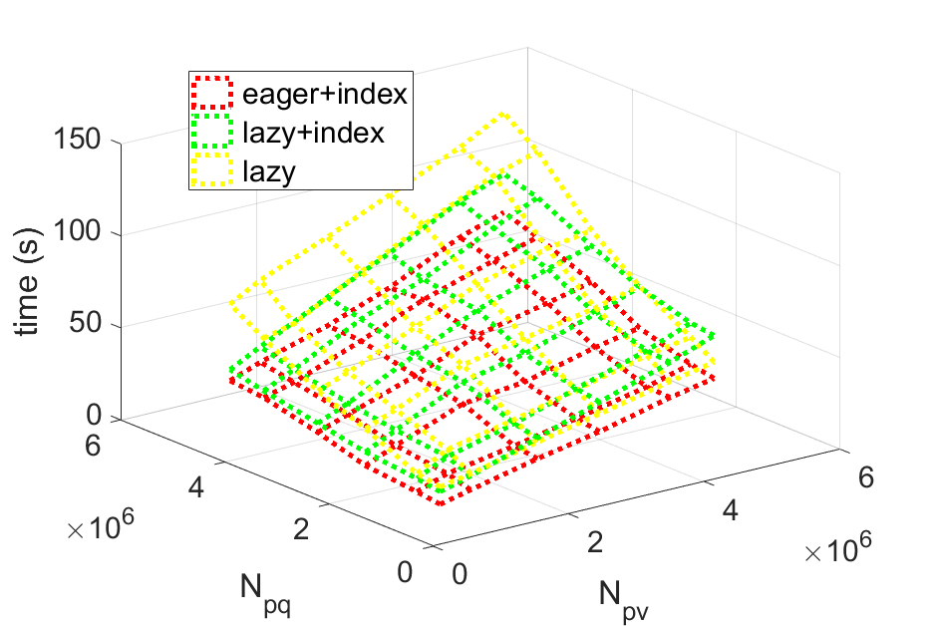
Effectiveness of Optimizations 1
Size of provenance in the query instance
Size of provenance in the view instance

Slide 34
Effectiveness of Optimizations 1
Eager strategy reduces the overhead by ~1.5x in the case of large view provenance
Size of provenance in the query instance
Size of provenance in the view instance

Slide 35
Effectiveness of Optimizations 1
Indexes achieve ~1.8x speed-ups in the case of large query provenance
Size of provenance in the query instance
Size of provenance in the view instance

Slide 36
Running example – queries and views
V3(Ty, G, SUM(L), COUNT(L)) :- Transcript(T, N, Ty, G)
Q3(Ty, AVG(T)) :- Transcript(T, N, Ty, G)
V3 has finer granularity than Q3
V3’(Ty, SUM(L), COUNT(L)) :- Transcript(T, N, Ty, G)
Q3’(Ty, AVG(T)) :- Transcript(T, N, Ty, G)
V3’ has the same granularity as Q3’
Computation rule [Cohen, 2006]:
SUM, COUNT -> AVG
Intuition 1: Reasoning over both the query and view schemas (general aggregate function and granularity) is needed

