Slide 1
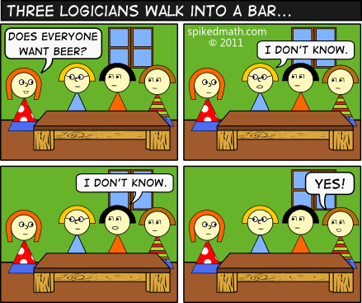
Spikedmath.com (some of their jokes are NSFW)

Slide 2
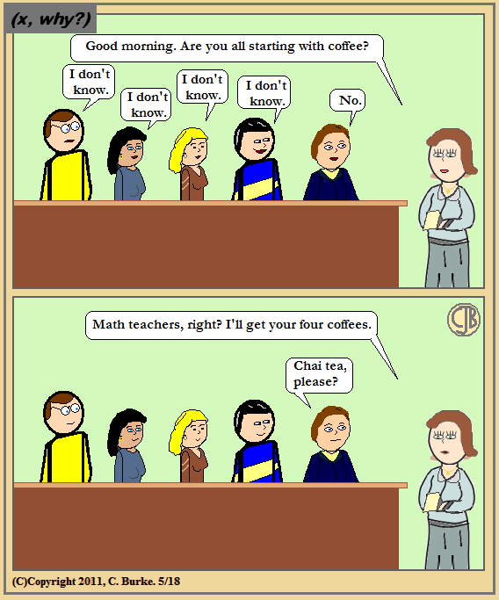
http://mrburkemath.blogspot.com

