Slide 1
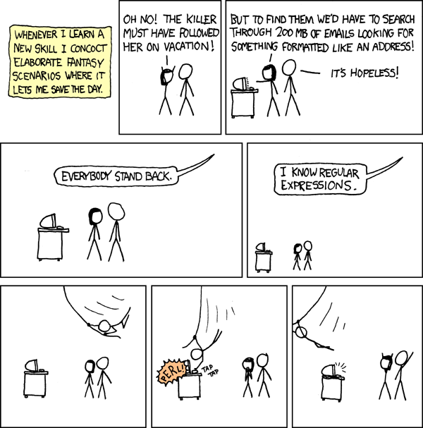
Courtesy xkcd

Slide 2

Programming assignment number 1
Programming in a theory course … is this gonna work out?

Slide 3
Few points about HW3
It is a direct copy of http://ezekiel.vancouver.wsu.edu/~cs317/archive/projects/grep/grep.pdf
But we have fewer things we are asking you to implement
Assumes knowledge of Postfix notation
2 weeks to do the program
TAs will have a special session (extra office hours/tutorial) on how to tackle this on next Wednesday
  Please read the specs and the code structure before attending the session

Slide 4
Postfix notation (Reverse Polish)
Put the operator at the end
5 + ((1 + 2) * 4) − 3 is what we call infix, with the operator in the middle
5 1 2 + 4 * + 3 -
Why postfix? – the operator order is no longer ambiguous. You are always operating on the most recent two operands

Slide 5
Postfix for regular expression (regex)
We will use ‘|’ for the union and ‘&’ for the concatenation
Also remember that * is a unary operation
ab|*a&

Slide 6
Final deliverable
Your program should be able to make an NFA that recognizes postfix regular expressions
We are fine with you limiting yourself to the command line results that are posted in HW3 (check out the main function)
Highly encouraged to have fun with the regex finder

Slide 7
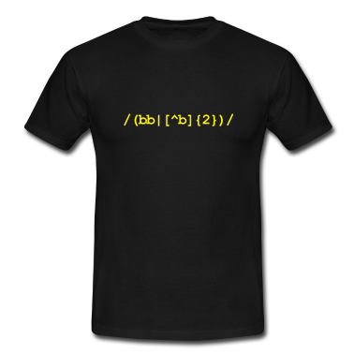
Google regex t-shirts
for fun (funsies?)

