Slide 1
How to check the equivalence of two regular expressions using JFLAP
One of the questions in the previous HW involved converting an NFA to a regular expression by pulling out state number 1 first
and then doing the NFA to regex by pulling out state number 2 first

Slide 2
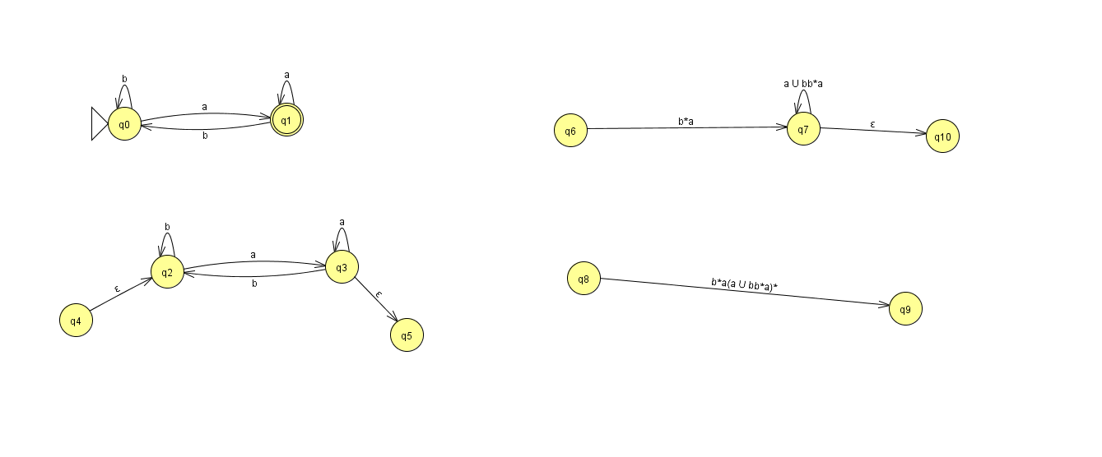
This is the answer after ripping the first state first

Slide 3
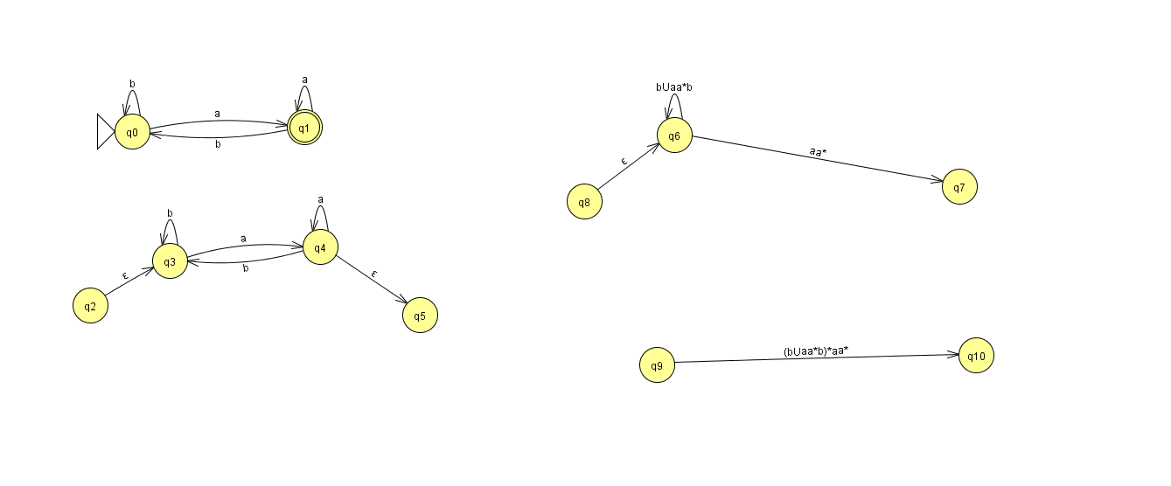
This is the answer after ripping the second state first

Slide 4
In this particular case, we know both those regular expressions came from the same NFA but in general
How do we check if
b*a(a U bb*a)*
Is the same regular expression as
(b U aa*b)*aa*

Slide 5
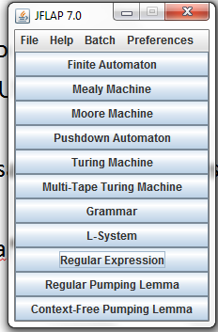

Slide 6
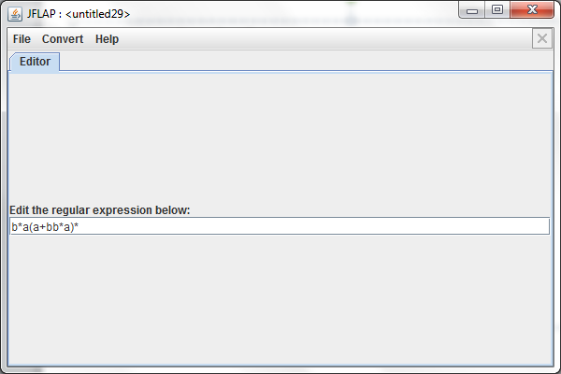
One of the regular expressions. The union replaced by + so we can use JFLAP

Slide 7
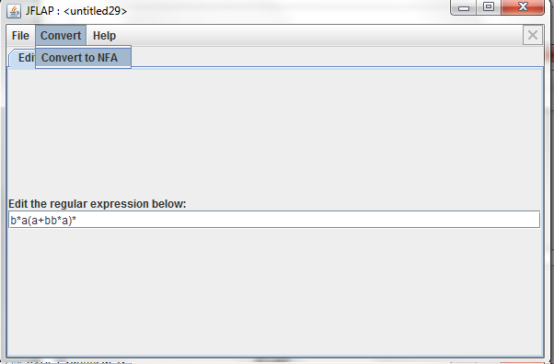
One slightly annoying thing is that JFLAP is super sensitive about any extra whitespace. So be careful when entering the regex

Slide 8
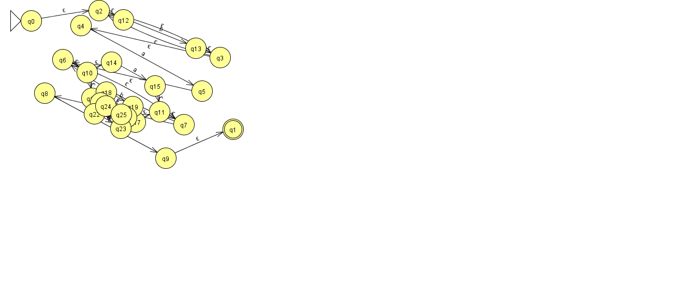
Upon converting to NFA JFLAP makes a ton of states!

Slide 9
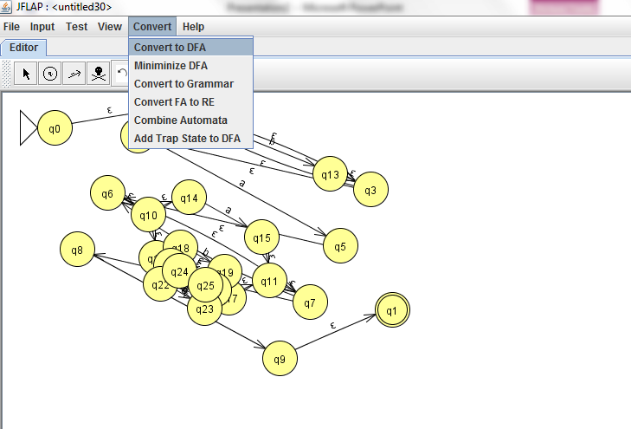

Slide 10
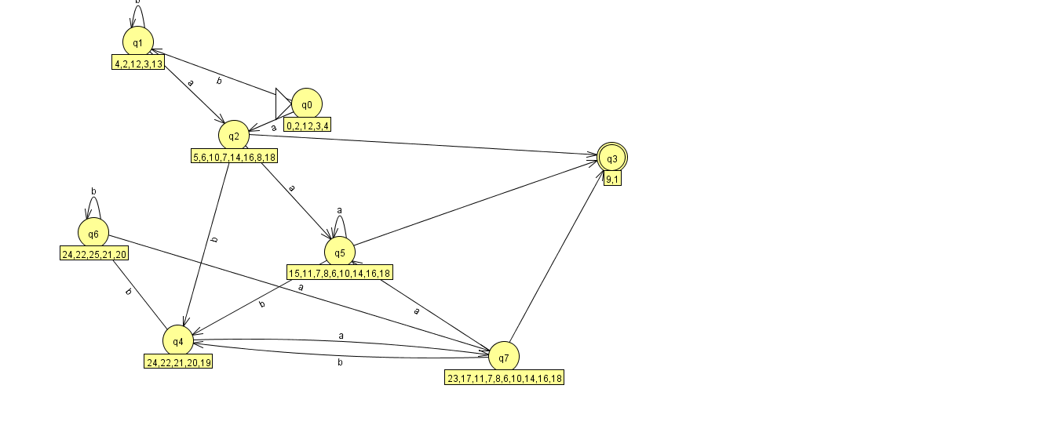

Slide 11
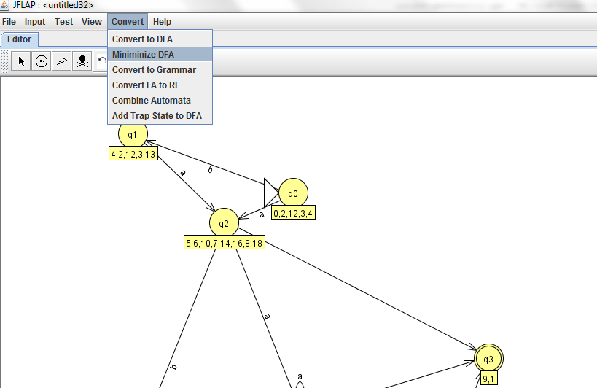
The minimize DFA option in JFLAP

Slide 12
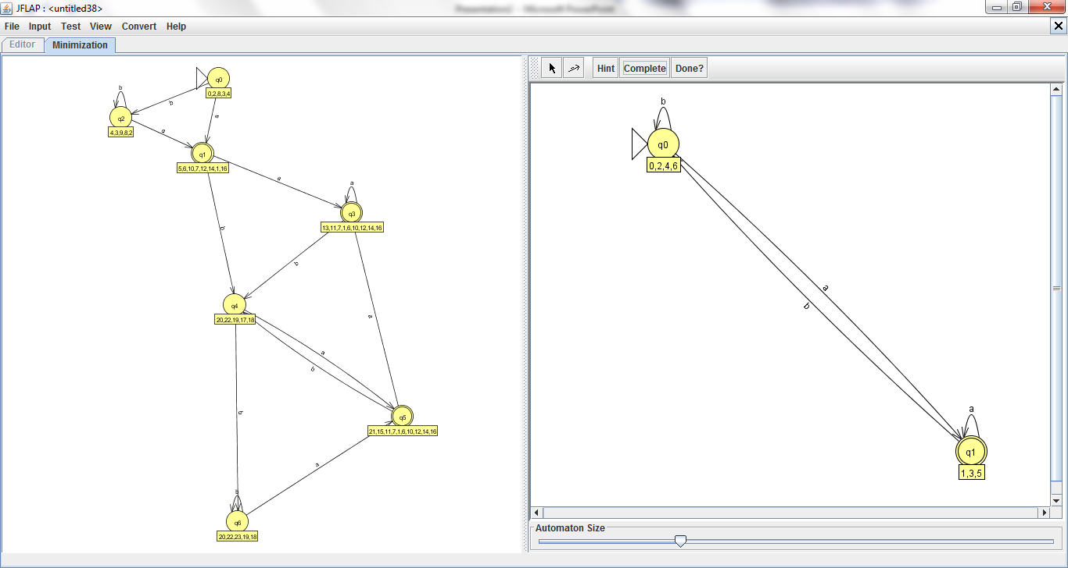

Slide 13
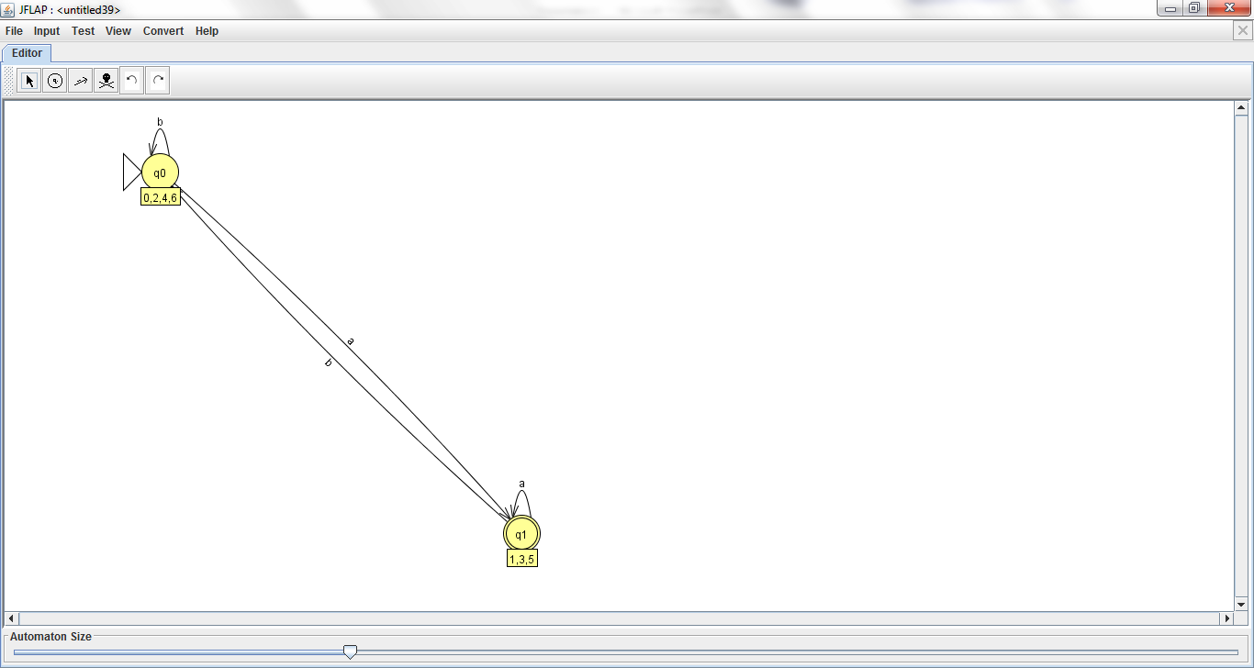
This DFA is the same as the one we started with ☺

Slide 14

This is the other regular expression we got. By ripping out the second state of the NFA first (part 2 of the HW question)

Slide 15
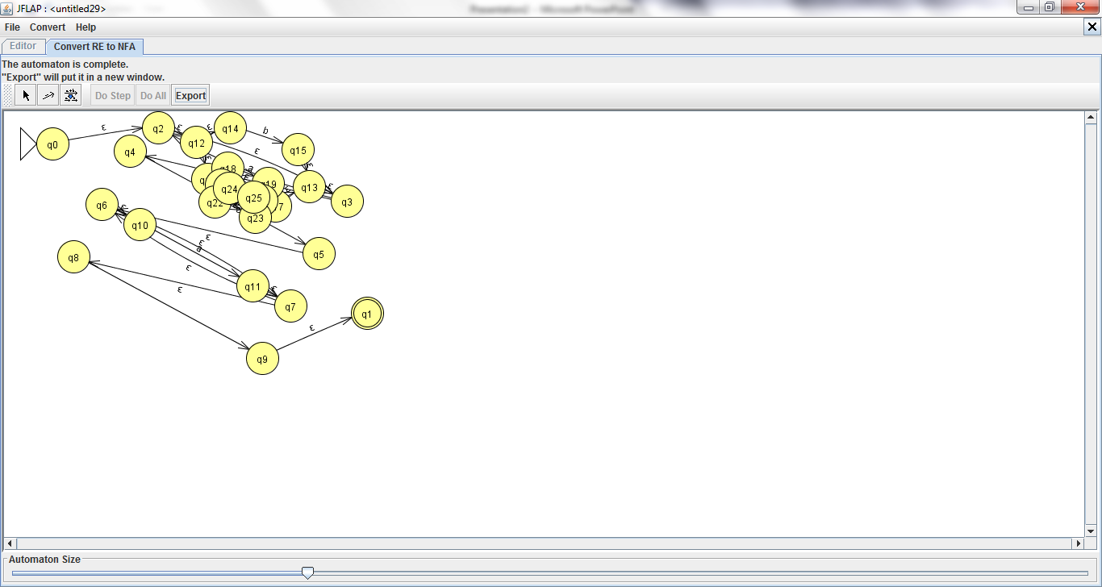
Initial NFA made by JFLAP with lots of states

Slide 16
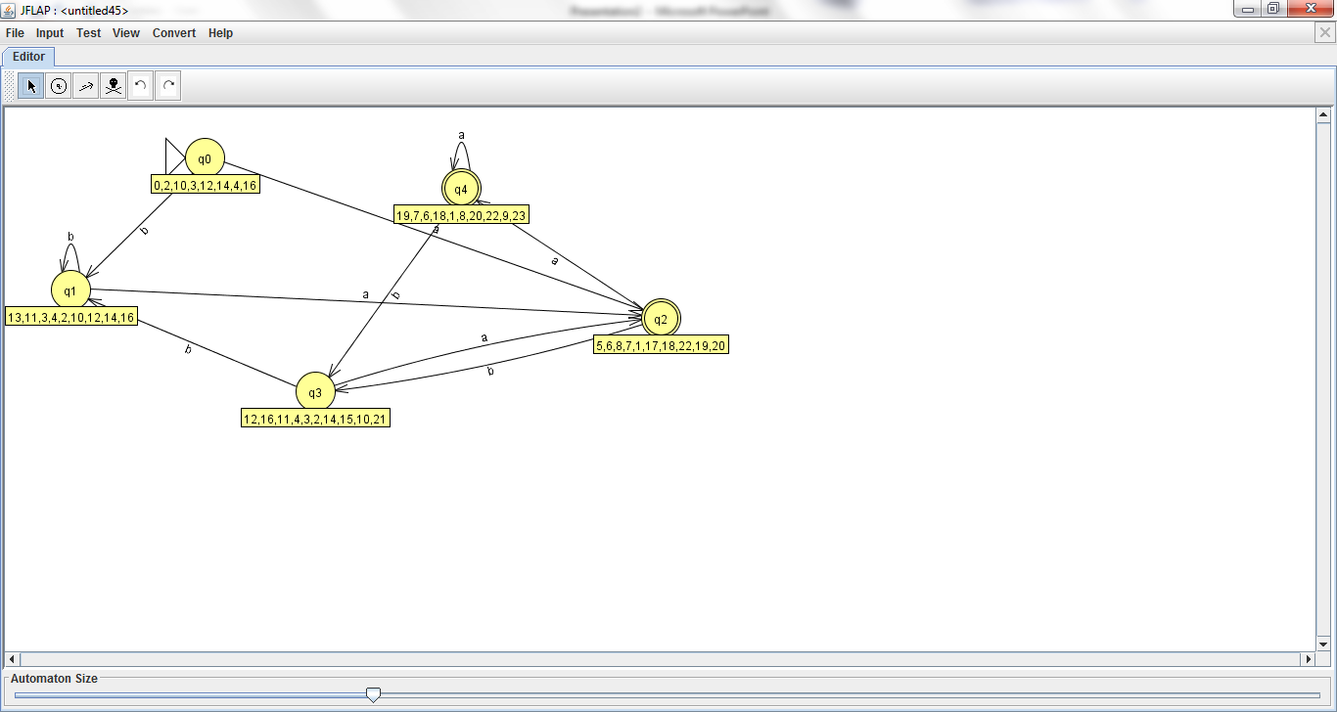
We then minimize this DFA
NFA to DFA conversion

Slide 17
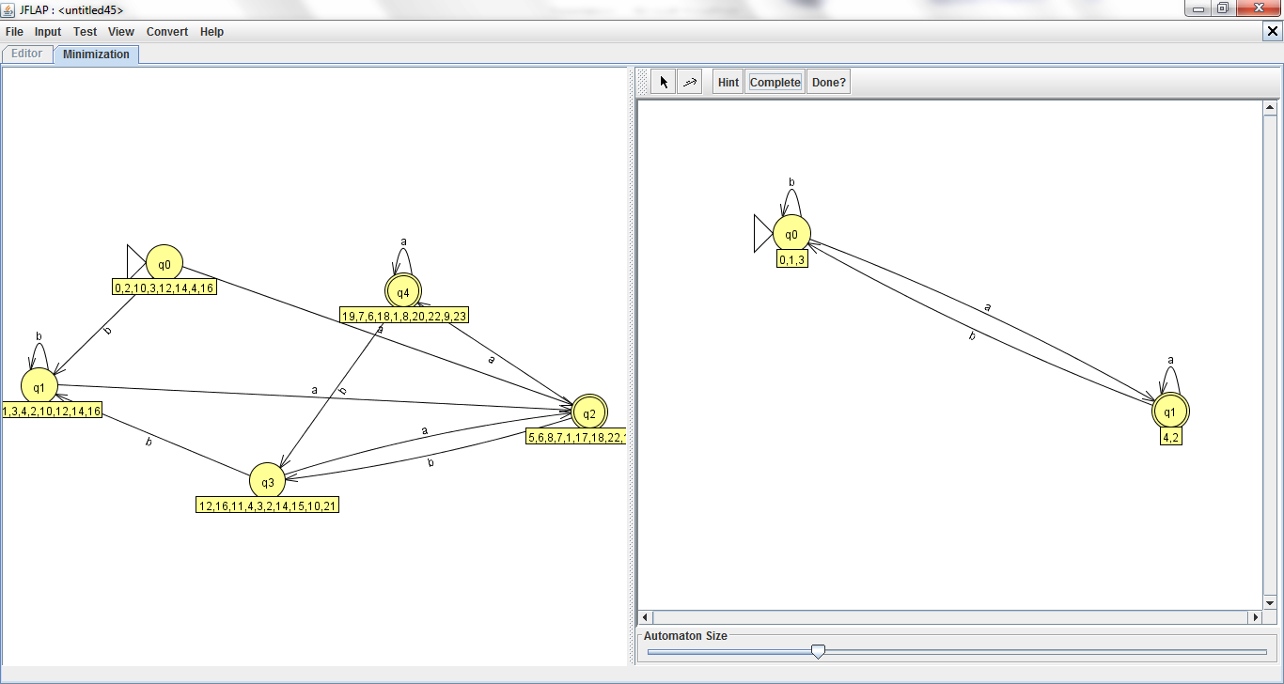
This minimized DFA is the same DFA too.
The 2 regular expressions are equivalent ☺

