Slide 1
Reducibility
Class of problems A can be reduced to the class of problems B
Take any instance of problem A
Show how you can construct an instance of problem B from it such that
  If you solve the instance of problem B you solve the instance of problem B
  If you solve the instance of problem A you solve the instance of problem B

Slide 2
Example of reduction
Sudoku
  A game with constraints on cells
  Two cells in the same row cannot have the same number
  Two cells in the same column cannot have the same number
  Two cells in the same ‘smaller square’ cannot have the same number
Graph colouring
  A game with constraints on what colours can be used
Can they be related?

Slide 3
Polynomial time reducibility
Converting from one problem to another problem needs to be done ‘fast’
For most problems you will see people talk about reducibility only if it is polynomial time.
Is making a CLIQUE graph from 3-CNF SAT polynomial time?
Is making a complement graph polynomial time?
Is making a graph from a Sudoku problem a polynomial time operation?

Slide 4
NP Completeness proofs are weird!
To prove something is NP Complete you need 2 steps
  Prove it is in NP (generally the easy part)
  Show that some OTHER problem that is known to be NP-Complete reduces to it
  Known NP

Slide 5
Hamiltonian cycle problem
Given a graph, does it have a Hamiltonian cycle?
Hamiltonian cycle = visit each vertex once and only once and come back to where you started from
Remember there are no necessary and sufficient conditions for that problem

Slide 6
TSP
Given a list of cities and the distances between each pair of cities, what is the shortest possible route that visits each city exactly once and returns to the origin city
That is an optimization problem
What is the decision version(a problem with a yes/no answer) of the same problem?

Slide 7
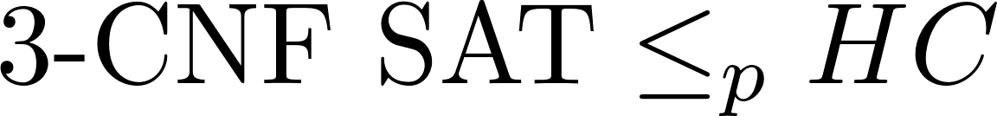
NP completeness
Is Hamiltonian cycle in NP?
  Given a solution how long would verification of the solution take?
Is Traveling Salesman in NP? Yes
It is known that
Can HC be polynomial time reduced to TSP?

Slide 8
TSP
Naïve solution – enumerate all the permutations
Input size is number of vertices (n)
number of edges do not factor in – all cities are connected.
Complexity = n!

Slide 9
DP TSP
Have some numbering of the vertices
We will think of all our tours as beginning and ending at 1
C(S, j) = length of shortest path visiting each node in S exactly once, starting at 1 and ending at j. 1 and j are part of S.
C({1}, 1) = ?

Slide 10
C(S, j) = length of shortest path visiting each node in S exactly once, starting at 1 and ending at j.
C(S,j) can be determined if we focus on the second last city. Let us call that one i.
Where the last term is the distance between i and j.

Slide 11
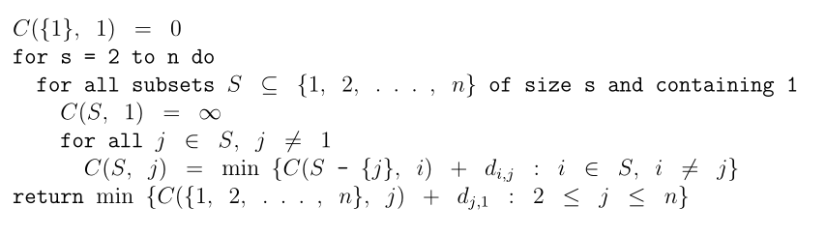
Python implementation - Very cool and uses list comprehensions to the max (which any true geek would!)
What is the running time/complexity?

Slide 12
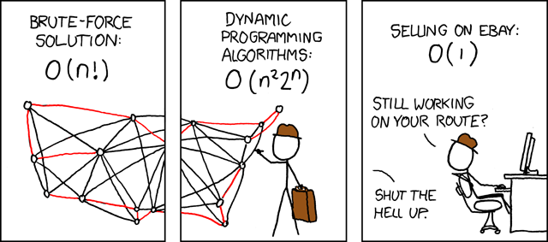

Slide 13
How do we really solve TSP?
Stochastic Gradient descent
Simulated annealing
Genetic algorithms
Ant colony algorithms
Randomized algorithms
Final HW = some version of solving TSP

