Slide 1
DP TSP
Have some numbering of the vertices
We will think of all our tours as beginning and ending at 1
C(S, j) = length of shortest path visiting each node in S exactly once, starting at 1 and ending at j. 1 and j are part of S.
C({1}, 1) = ?

Slide 2
C(S, j) = length of shortest path visiting each node in S exactly once, starting at 1 and ending at j.
C(S,j) can be determined if we focus on the second last city. Let us call that one i.
Where the last term is the distance between i and j.

Slide 3
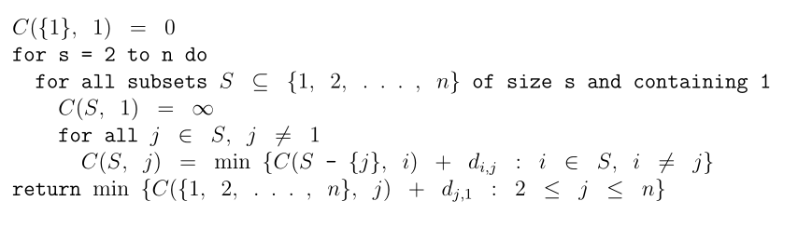
Python implementation - Very cool and uses list comprehensions to the max (which any true geek would!)
What is the running time/complexity?

Slide 4
List of known NP Complete problems
Graph theory
  Cliques
  Vertex cover
  Chromatic number of graph (smallest number of colours needed to colour the graph)
  Hamiltonian cycle
  TSP
  Longest path problem (can be reduced from Hamiltonian cycle. Think about how). Also known as the ‘taxicab ripoff’ problem

Slide 5
Sequencing
Deadlines for tasks
A set T of tasks; for each task t in T:
a positive integer length len(t) - how long they run for
a positive integer release time r(t) – when the task is available for the processor to do
a positive integer deadline d(t) – the task has to be completed by this time
Is there a one-processor schedule for tasks that satisfies the release time constraints and meets all the deadlines?

Slide 6
0/1 Knapsack
You have a bag with limited capacity (total weight that can be put into it)
You have an array of items each with a certain weight and certain value
Once you pick an item you have to put the whole item into your bag (No cutting it into pieces!)
Maximize value

Slide 7
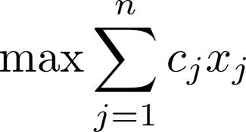
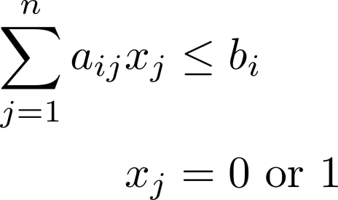
0-1 programming
Maximize returns subject to resource constraints
Assume the returns on the j^{th} investment are c_{j}
Assume you can only spend b_{i} money in total

Slide 8
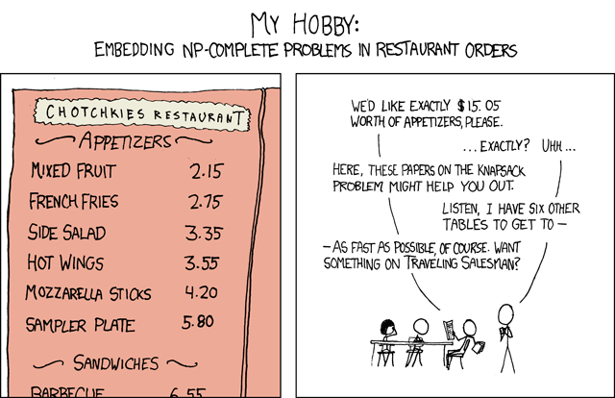
NP Completeness in ‘everyday’ life
Assigning university classes to timeslots to minimize scheduling conflicts
Wedding planning where you want to seat friends together at the same table but not any enemies (along the lines of CLIQUE)

Slide 9
NP complete problems
Painful to solve
Even when we reduce complexity (by DP for instance) we still have non polynomial run times
But these are practical problems!
How to solve?
  Approximation algorithms
  Heuristics
  Randomized algorithms
They are ‘unsolved’ so new and interesting results can be shown about them.
People pay good money for solving these problems

Slide 10
Approximation algorithm for Vertex cover
C←∅
while E = ∅
pick any {u, v} ∈ E
C ← C ∪ {u, v}
delete all edges incident to either u or v
return C

Slide 11
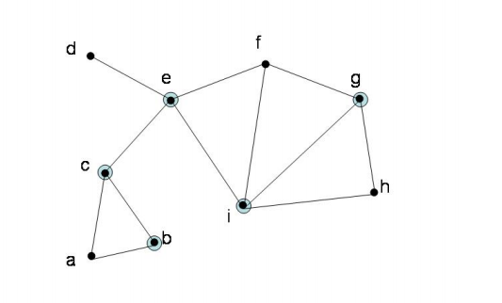
How bad is that approximation?
Look at the edges returned in that algorithm
Will the optimum vertex cover include at least one end point of the edges returned from approx algorithm?

Slide 12
Genetic algorithm for TSP
Your last HW
Has very little to do with this course other than the fact that it is an NP-complete problem and this is one way to solve it.
Hopefully will be fun

Slide 13
High level idea of genetic algorithm
Start with a set of solutions (population)
Create offspring (this is the crossover operation)
Probabilistically create mutations
Hope that the offspring is ‘fitter’
Why should this work?
  Huge debates ☹
  Seems to work in practice

