Slide 1
Exploring Dynamic Interactive Narrative
Jason Merrin
Advisors: Norman Badler and Aline Normoyle
Department of Computer and Information Science- University of Pennsylvania

Slide 2
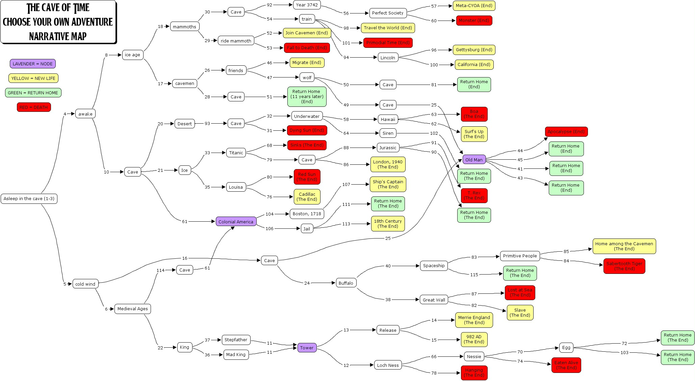
Goals and Motivation
To devise a method of generating narrative dynamically as an alternative to the costly and time consuming “story-tree” method of creating user influenced stories in games.
http://www.samplereality.com/gmu/fall2008/343/wp-content/uploads/2008/09/caveoftime.jpg

Slide 3
Model
Character
Emotions
Interaction
Action
Character
Emotions
Character
Emotions
Interaction
Action
Character
Emotions
Plot
Characters have emotions, emotions drive actions,
actions impact emotions and drive the story forwards.

Slide 4
Design Outline
Characters
Have a range of emotions
Have a gender
Wander in physical space until they find another character to interact with.
Emotions
Vary from character to character.
Value range from 1 to 100.
Strong emotions beget stronger emotional fluctuations. If the character is already very angry, they get angrier faster, or they might get over it faster. Emotional value changes are based on percentage of current emotional value.
Actions
Have an “Action Importance Value” (AIV) from 1 to 5 to determine importance to the story.
Have a set of emotional values that are ideal for said action, and a way in which those emotions are affected by the action in both the enactor and receiver.
Action chosen depends on closest match of emotions to conditions necessary for performing a specific action, with a slight added element of chance.

Slide 5
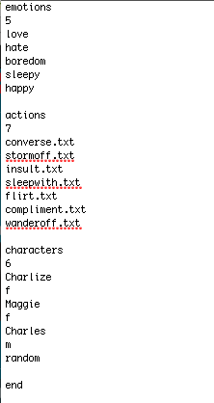
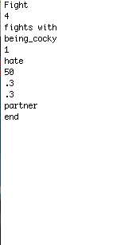
Configuration Files
World File (.txt)
Action File (.txt)

Slide 6
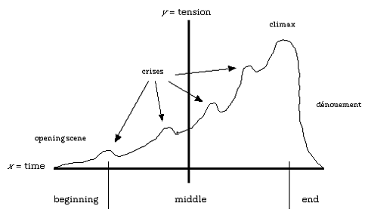
Story Structure
Inciting Incident
Plot Point 1
Plot Point 2
http://www.musik-therapie.at/PederHill/images/Struct1.gif

Slide 7
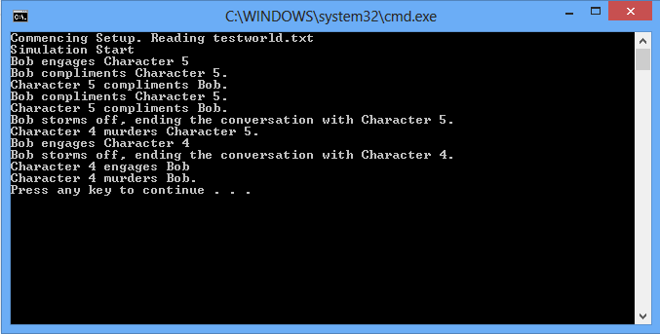
Early Implementation

Slide 8
Gaming Application

Slide 9
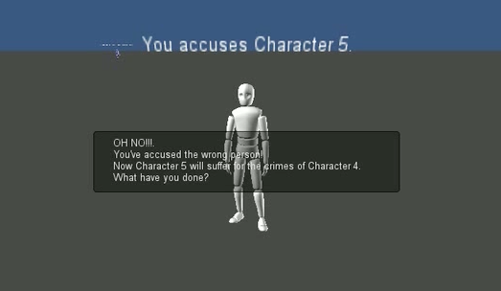
What Happens Next?
Improving the “murder mystery” game with better graphics, more choices of actions, and more potential story twists.
Creating another game in a new genre with radically different start and win states using the same “story engine” to demonstrate that the concept can work across different types of games.
Essentially: prove that this is a perfectly sound and engaging way to create variable storylines for an “always different” gaming experience.

Slide 10
Questions?
Any questions?
Yes.
No!

