Slide 1
Procedural Architecture
With Formal Grammars and Simulated Annealing
By Stewart Hills
Advisors:
Norm Badler, Aline Normoyle

Slide 2
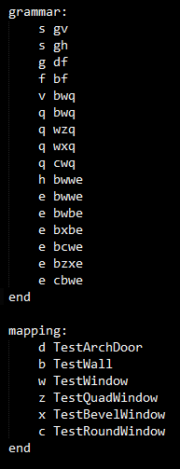
Vocabulary
Formal Grammars
  Map states of Finite State Machine to characters
  Path creates string
  Map terminals to geometry
Simulated Annealing
  Iterative optimization technique
  Size of changes decreases over time
  Allow negative choices to escape local minima

Slide 3
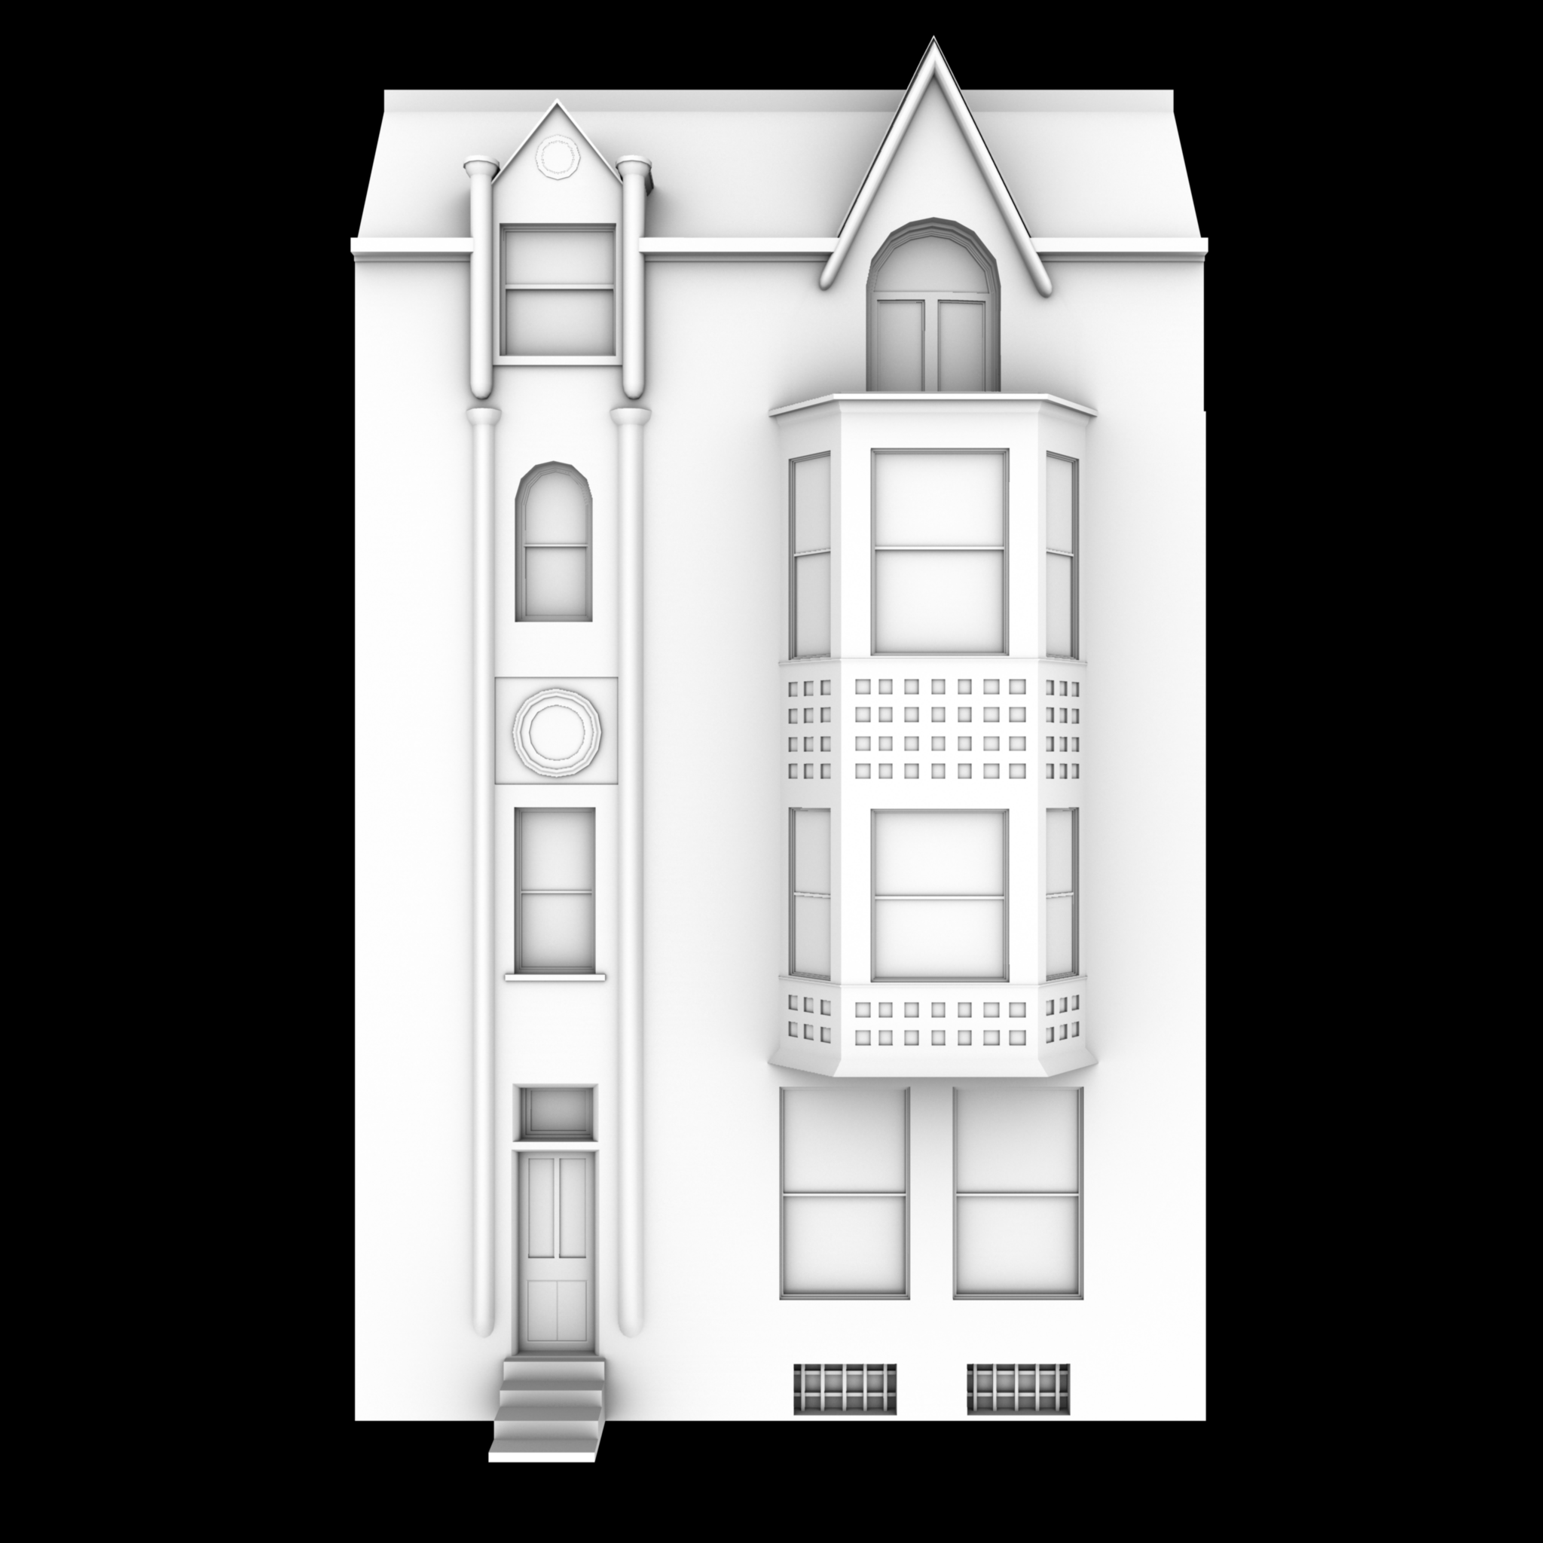
Relevance
Traditional modeling to modern city requirements too slow/expensive
Balance speed and convenience with artistic control

Slide 4
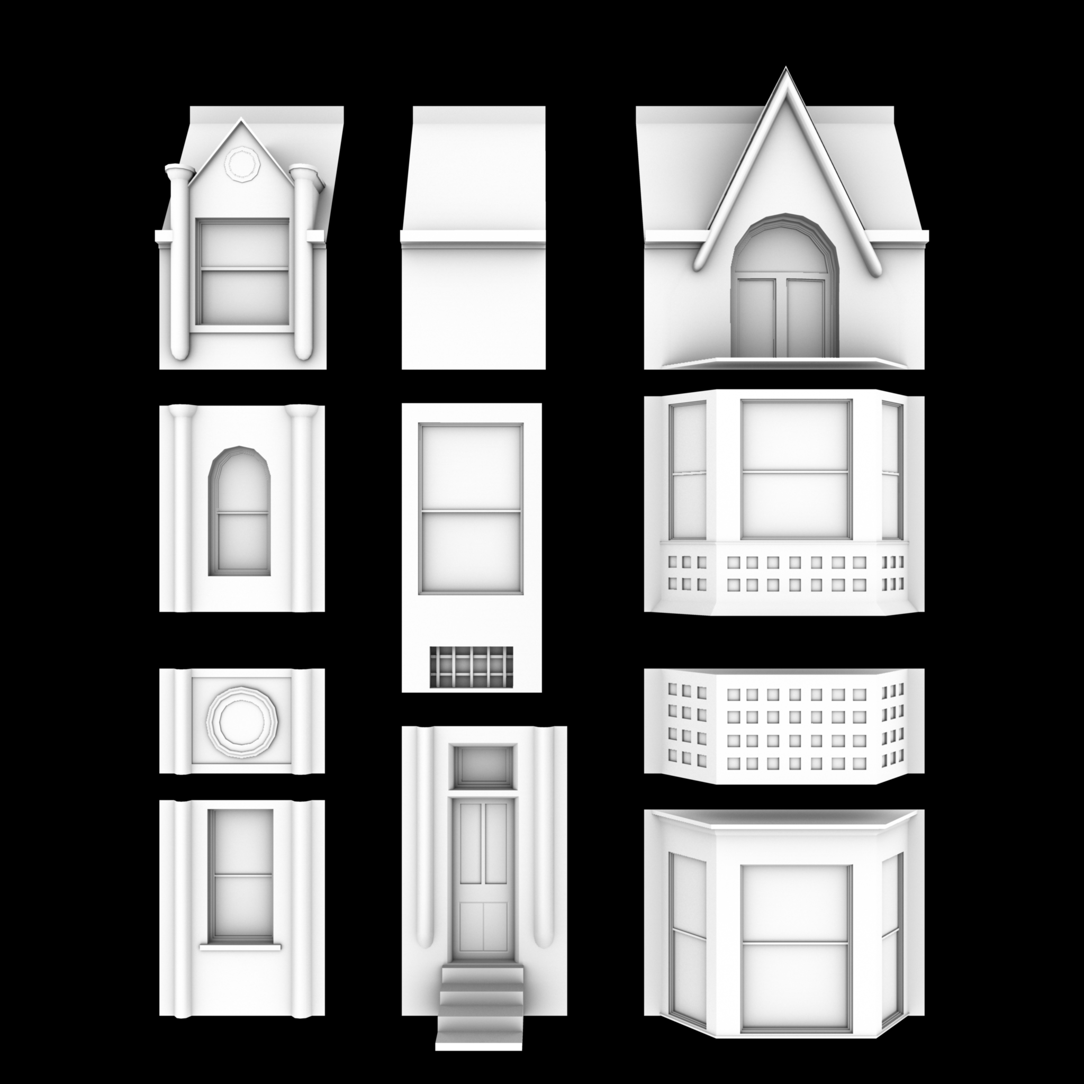
How it Works
User models elements
Arrangement
  Grammar
  Manual specification
Annealing to solve problems

Slide 5
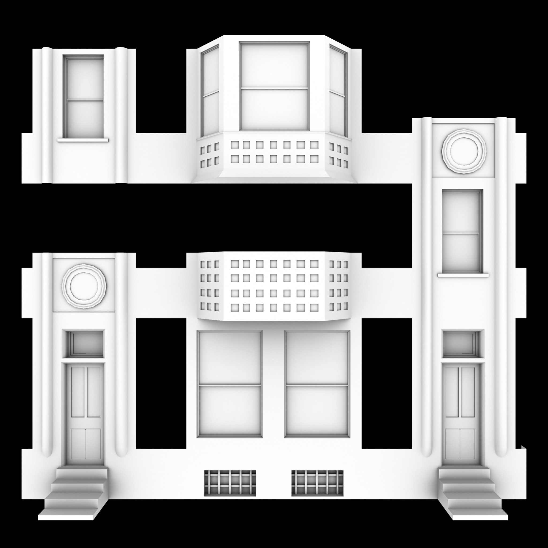

Corrections

Slide 6
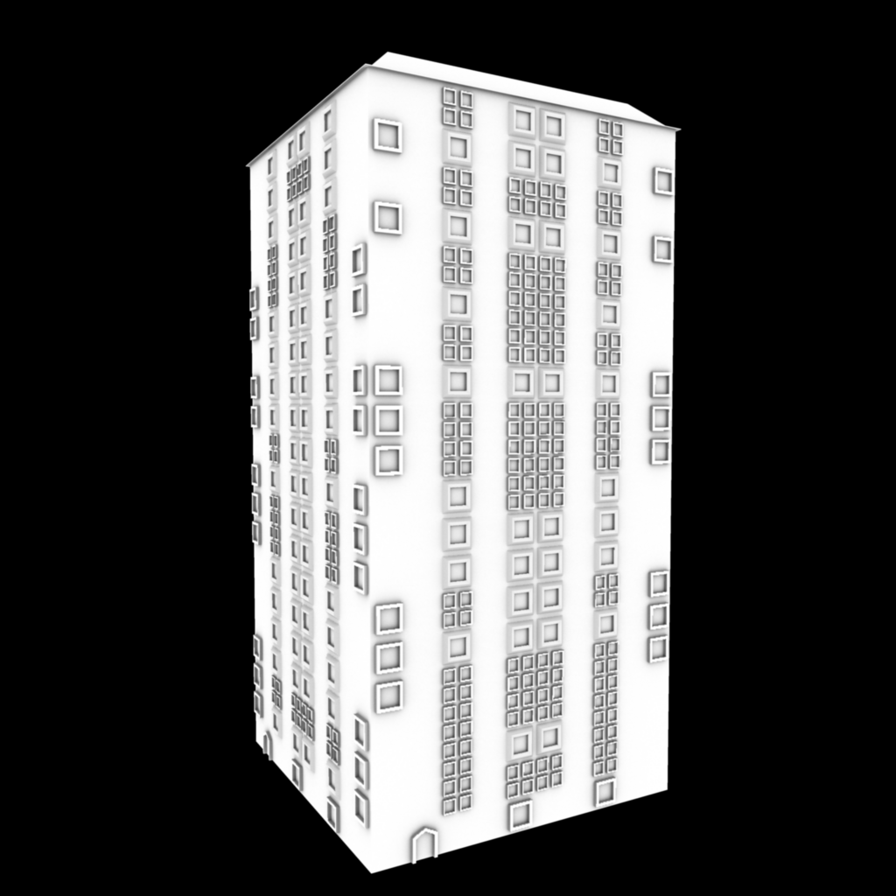
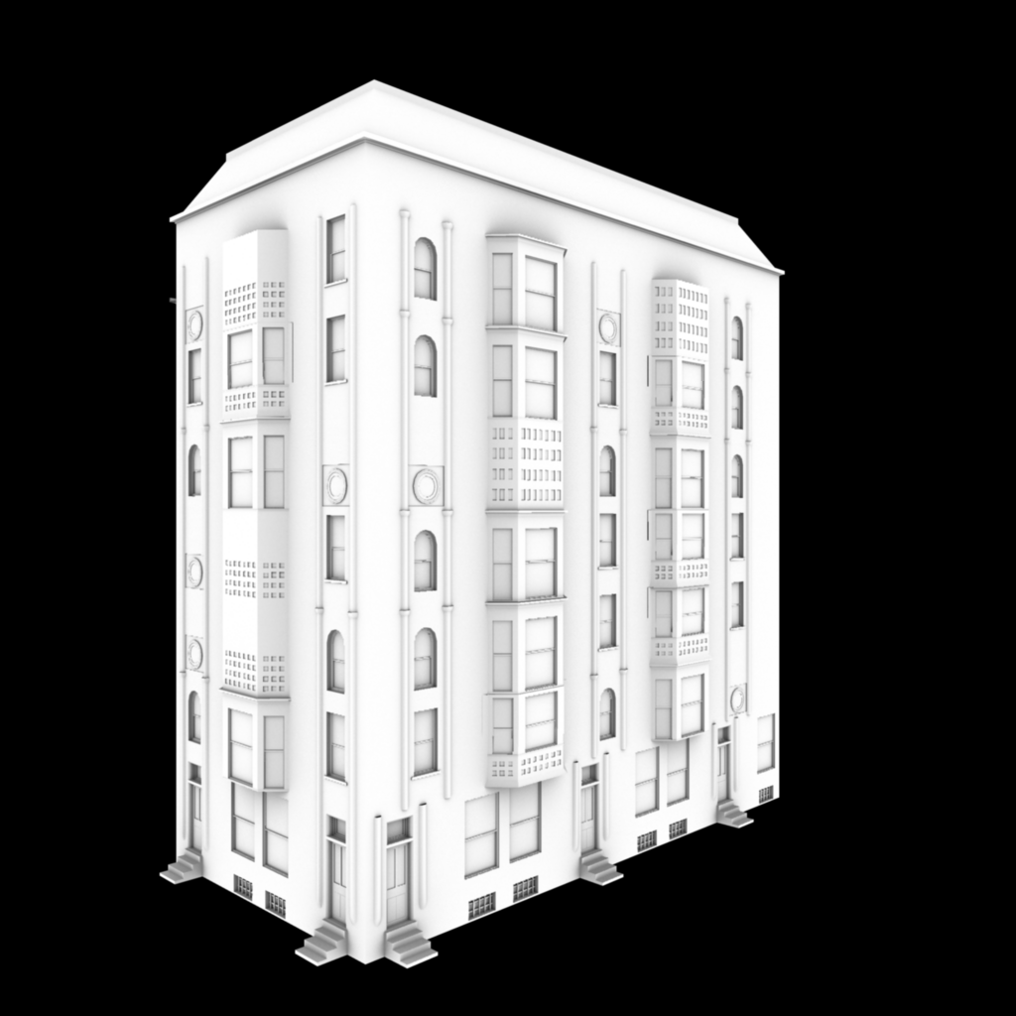
Output Examples

