Slide 1
CIS 519/419
Applied Machine Learning www.seas.upenn.edu/~cis519
Dan Roth
danroth@seas.upenn.edu
http://www.cis.upenn.edu/~danroth/
461C, 3401 Walnut
Slides were created by Dan Roth (for CIS519/419 at Penn or CS446 at UIUC), Eric Eaton for CIS519/419 at Penn, or from other authors who have made their ML slides available.

Slide 2
Exams
Solutions are available.
Midterms will be made available at the recitations, Tuesday and Wednesday.
This will also be a good opportunity to ask the Tas questions about the grading.
1. Overall:
Mean: 62 (18.6 - 13.2 - 18.7 - 10.5)
Std Dev: 13.8 (2.5 - 6.7 - 4.4 - 5.8)
Max: 94, Min: 27.5
2. CIS 519 (91 students):
Mean: 61.48 (18.4 - 12.8 - 18.5 - 10.75)
Std Dev: 14.7 (2.6 - 7.1 - 4.5 - 5.9)
Max: 94 Min: 27.5
3. CIS 419 (47 students):
Mean: 63.6 (19 - 14 - 19 - 10)
Std Dev: 12 (2.2 - 5.9 - 4.1 - 5.8)
Max: 93, Min: 41
Questions?

Slide 3
Projects
Please start working!
Come to my office hours at least once in the next 3 weeks to discuss the project.

Slide 4

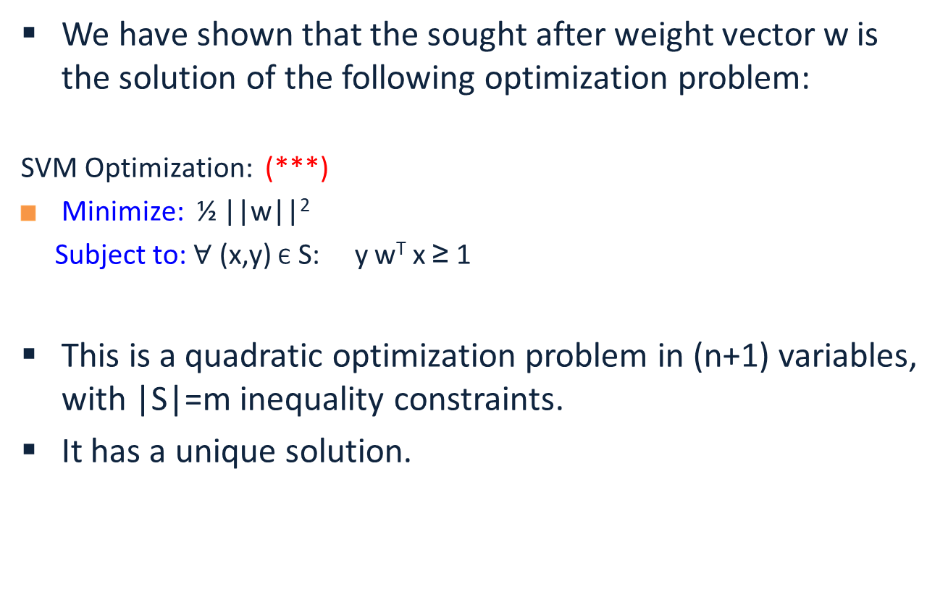
Hard SVM Optimization
We have shown that the sought after weight vector w is the solution of the following optimization problem:
  SVM Optimization: (***)
  Minimize: ½ ||w||²
  Subject to: $∀$ (x,y) Є S: y w^{T} x ≥ 1
This is a quadratic optimization problem in (n+1) variables, with |S|=m inequality constraints.
It has a unique solution.

Slide 5
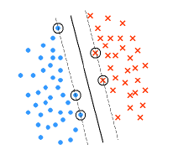
Duality
This, and other properties of Support Vector Machines are shown by moving to the dual problem.
Theorem: Let w* be the minimizer of
the SVM optimization problem (***)
for S = {(x_{i}, y_{i})}.
Let I= {i: y_{i} (w^{*T}x_{i} +b)= 1}.
Then there exists coefficients α_{i} >0
such that:
w* = ∑_{i Є I} α_{i} y_{i} x_{i}

Slide 6
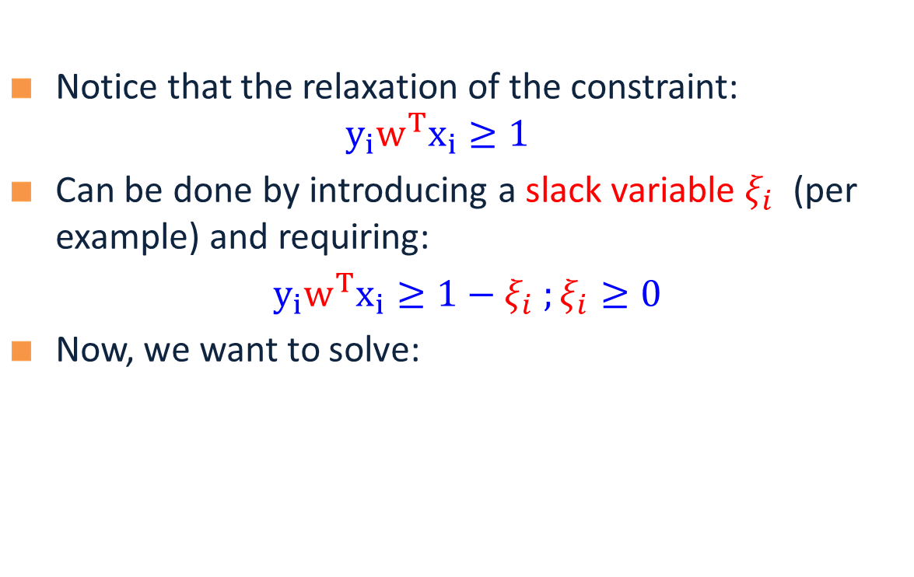
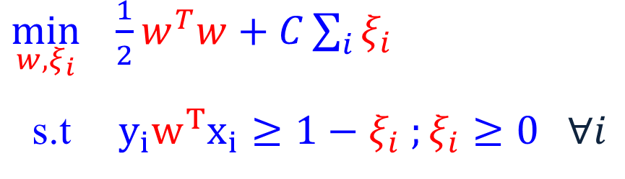
Soft SVM
Notice that the relaxation of the constraint: $y_{i}w^{T}x_{i}≥1$
Can be done by introducing a slack variable $ξ_{i}$ (per example) and requiring:
$y_{i}w^{T}x_{i}≥1−ξ_{i} ;ξ_{i}≥0$
Now, we want to solve:
A large value of C means that misclassifications are bad – we focus on a small training error (at the expense of margin). A small C results in more training error, but hopefully better true error.
  $\min_{w, ξ_{i}} \frac{1}{2}w^{T}w+C\sum_{i}{ξ_{i}}$
  s.t $y_{i}w^{T}x_{i}≥1−ξ_{i} ;ξ_{i}≥0 ∀i$
Notes:
What is the value of slack variable when the data point is classified correctly?

Slide 7
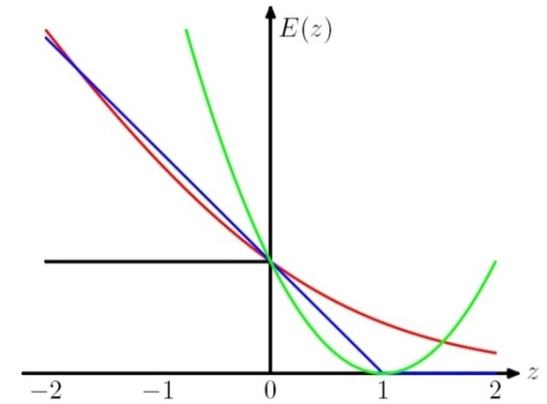

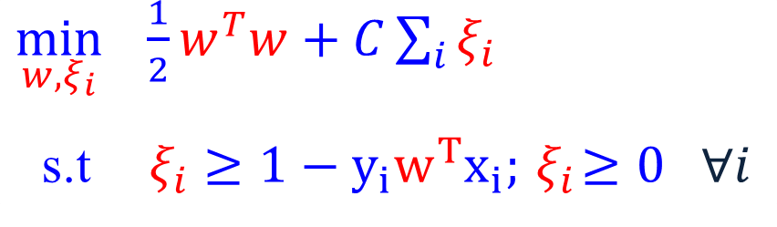

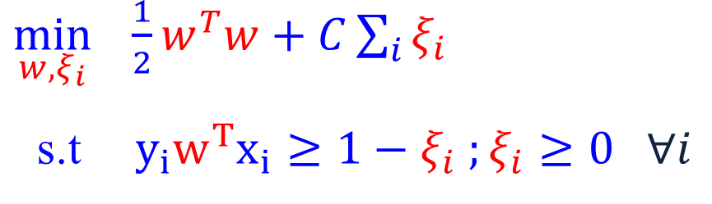
Soft SVM (2)
Now, we want to solve:
Which can be written as:
$$\min_{w} \frac{1}{2}w^{T}w+C\sum_{i}{\max{(0, 1−y_{i}w^{T}x_{i})}}.$$
What is the interpretation of this?
  $\min_{w, ξ_{i}} \frac{1}{2}w^{T}w+C\sum_{i}{ξ_{i}}$
  s.t $y_{i}w^{T}x_{i}≥1−ξ_{i} ;ξ_{i}≥0 ∀i$
  $\min_{w, ξ_{i}} \frac{1}{2}w^{T}w+C\sum_{i}{ξ_{i}}$
  s.t$ξ_{i}≥1−y_{i}w^{T}x_{i};{ ξ}_{i}≥0 ∀i$
In optimum, $ξ_{i}=\max{(0, 1−y_{i}w^{T}x_{i})}$

Slide 8
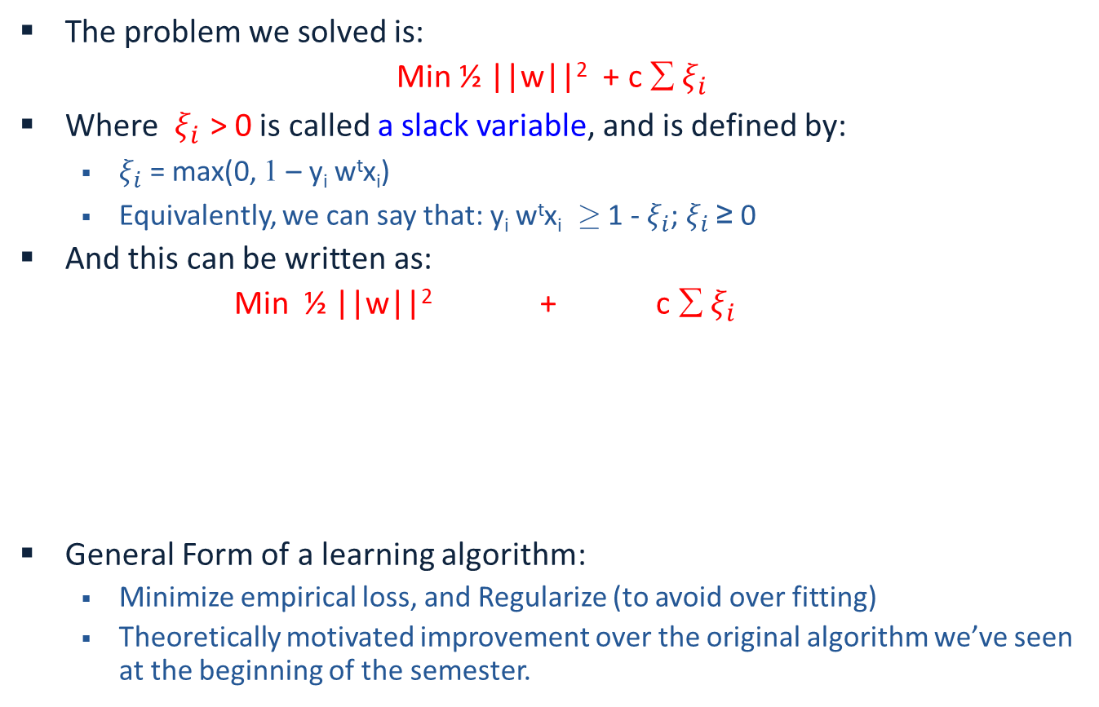
SVM Objective Function
The problem we solved is:
Min ½ ||w||² + c ∑ $ξ_{i}$
Where $ξ_{i}$ > 0 is called a slack variable, and is defined by:
  $ξ_{i}$ = max(0, 1 – y_{i} w^{t}x_{i})
  Equivalently, we can say that: y_{i} w^{t}x_{i} ¸ 1 - $ξ_{i}$; $ξ_{i}$ ≥ 0
And this can be written as:
Min ½ ||w||² + c ∑ $ξ_{i}$
General Form of a learning algorithm:
  Minimize empirical loss, and Regularize (to avoid over fitting)
  Theoretically motivated improvement over the original algorithm we’ve seen at the beginning of the semester.
Regularization term
Empirical loss
Can be replaced by other regularization functions
Can be replaced by other loss functions

Slide 9
Balance between regularization and empirical loss

Slide 10
Balance between regularization and empirical loss
(DEMO)

Slide 11
Optimization: How to Solve
1. Earlier methods used Quadratic Programming. Very slow.
2. The soft SVM problem is an unconstrained optimization problems. It is possible to use the gradient descent algorithm.
Many options within this category:
  Iterative scaling; non-linear conjugate gradient; quasi-Newton methods; truncated Newton methods; trust-region newton method.
  All methods are iterative methods, that generate a sequence w_{k} that converges to the optimal solution of the optimization problem above.
  Currently: Limited memory BFGS is very popular
3. 3rd generation algorithms are based on Stochastic Gradient Decent
  The runtime does not depend on n=#(examples); advantage when n is very large.
  Stopping criteria is a problem: method tends to be too aggressive at the beginning and reaches a moderate accuracy quite fast, but it’s convergence becomes slow if we are interested in more accurate solutions.
4. Dual Coordinated Descent (& Stochastic Version)

Slide 12

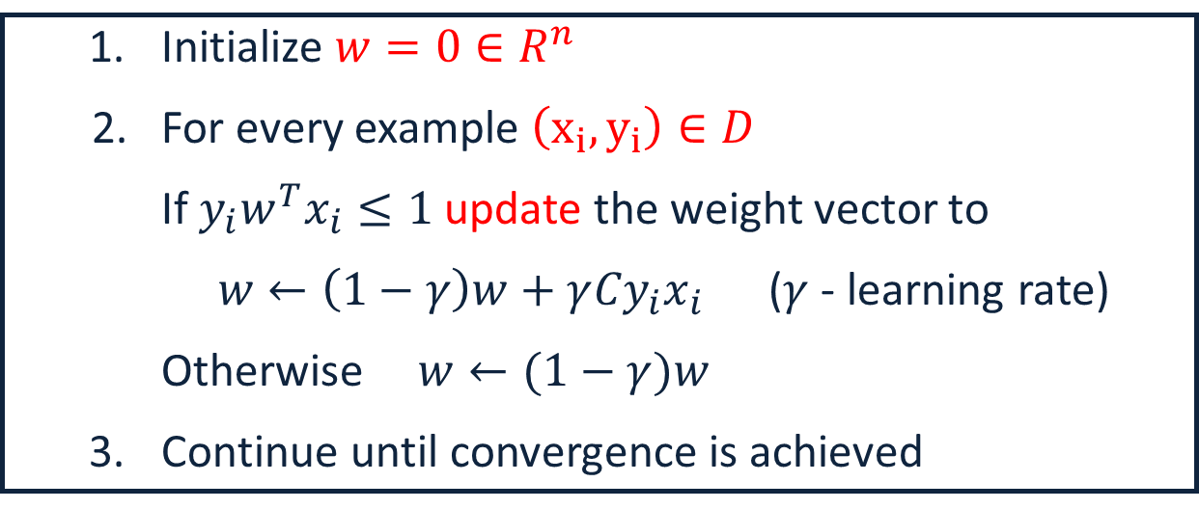
SGD for SVM
Goal: $\min_{w} f\left(w\right)≡ \frac{1}{2}w^{T}w+\frac{C}{m}\sum_{i}{\max\left(0, 1−y_{i}w^{T}x_{i}\right)}.$ m: data size
Compute sub-gradient of $f\left(w\right):$
$∇f\left(w\right)=w−Cy_{i}x_{i}$ if ${1−y_{i}w}^{T}x_{i}≥0$ ; otherwise $∇f\left(w\right)=w$
m is here for mathematical correctness, it doesn’t matter in the view of modeling.
  Initialize $w=0∈R^{n}$
2. For every example $\left(x_{i},y_{i}\right)∈D$
If $y_{i}w^{T}x_{i}≤1$ update the weight vector to
$w←\left(1−γ\right)w+γ{Cy}_{i}x_{i}$ ($γ$ - learning rate)
Otherwise $w←(1−γ)w$
  Continue until convergence is achieved
Convergence can be proved for a slightly complicated version of SGD (e.g, Pegasos)
This algorithm should ring a bell…

Slide 13
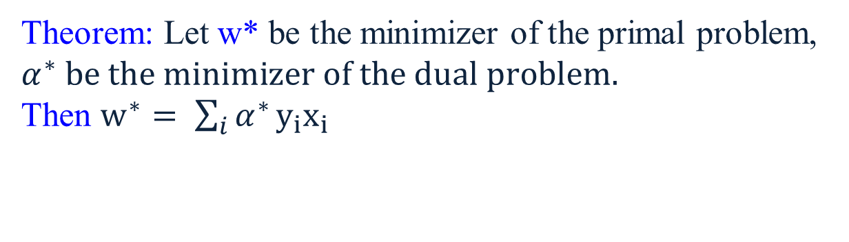
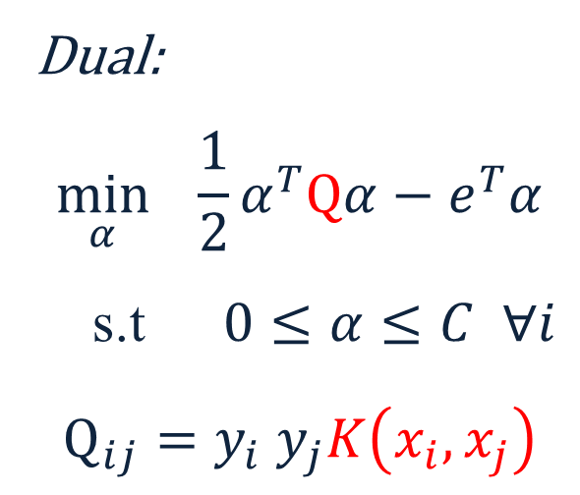
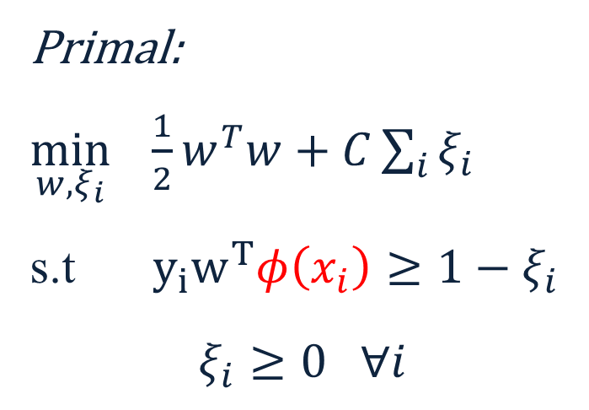

Nonlinear SVM
We can map data to a high dimensional space: $x→φ\left(x\right)$ (DEMO)
Then use Kernel trick: $K\left(x_{i},x_{j}\right)=φ{\left(x_{i}\right)}_{}^{T}φ\left(x_{j}\right)$ (DEMO2)
  Primal:
  $\min_{w, ξ_{i}} \frac{1}{2}w^{T}w+C\sum_{i}{ξ_{i}}$
  s.t $y_{i}w^{T}φ\left(x_{i}\right)≥1−ξ_{i}$
  $$ξ_{i}≥0 ∀i$$
  Dual:
  $$\min_{α} \frac{1}{2}α^{T}Qα−e^{T}α$$
  s.t $0≤α≤C ∀i$
  $$Q_{ij}=y_{i} y_{j}K\left(x_{i}, x_{j}\right)$$
Theorem: Let w* be the minimizer of the primal problem, $α^{∗} be the minimizer of the dual problem.$
Then $w^{∗}= \sum_{i}{α^{∗}}y_{i}x_{i}$

Slide 14
Where are we?
Algorithms
  DTs
  Perceptron + Winnow
  Gradient Descent
  [NN]
Theory
  Mistake Bound
  PAC Learning
We have a formal notion of “learnability”
  We understand Generalization
    How will your algorithm do on the next example?
  How it depends on the hypothesis class (VC dim)
    and other complexity parameters
Algorithmic Implications of the theory?

Slide 15
Boosting
Boosting is (today) a general learning paradigm for putting together a Strong Learner, given a collection (possibly infinite) of Weak Learners.
The original Boosting Algorithm was proposed as an answer to a theoretical question in PAC learning. [The Strength of Weak Learnability; Schapire, 89]
Consequently, Boosting has interesting theoretical implications, e.g., on the relations between PAC learnability and compression.
  If a concept class is efficiently PAC learnable then it is efficiently PAC learnable by an algorithm whose required memory is bounded by a polynomial in n, size c and log(1/ε).
  There is no concept class for which efficient PAC learnability requires that the entire sample be contained in memory at one time – there is always another algorithm that “forgets” most of the sample.

Slide 16
Boosting Notes
However, the key contribution of Boosting has been practical, as a way to compose a good learner from many weak learners.
It is a member of a family of Ensemble Algorithms, but has stronger guarantees than others.
A Boosting demo is available at http://cseweb.ucsd.edu/~yfreund/adaboost/
Example
Theory of Boosting
  Simple & insightful

Slide 17
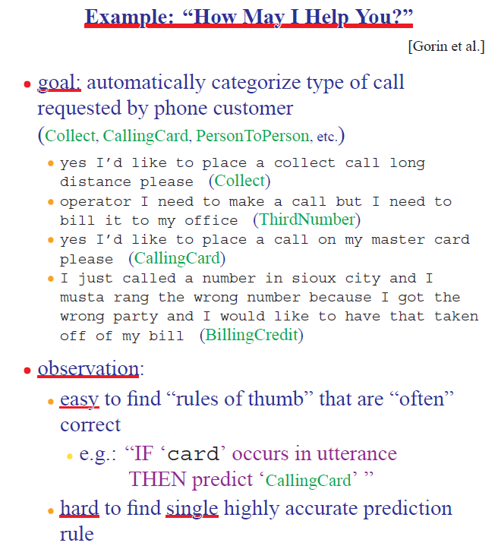
Boosting Motivation

Slide 18
The Boosting Approach
Algorithm
  Select a small subset of examples
  Derive a rough rule of thumb
  Examine 2nd set of examples
  Derive 2nd rule of thumb
  Repeat T times
  Combine the learned rules into a single hypothesis
Questions:
  How to choose subsets of examples to examine on each round?
  How to combine all the rules of thumb into single prediction rule?
Boosting
  General method of converting rough rules of thumb into highly accurate prediction rule

Slide 19
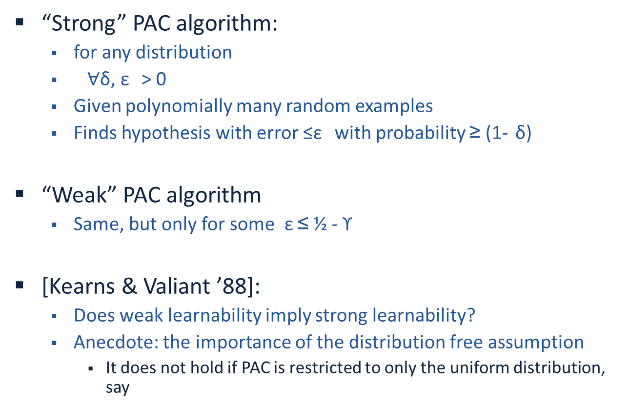
Theoretical Motivation
“Strong” PAC algorithm:
  for any distribution
  $∀$δ², ε ± > 0
  Given polynomially many random examples
  Finds hypothesis with error ≤ε ² with probability ≥ (1- δ±)
“Weak” PAC algorithm
  Same, but only for some ² ε ≤ ½ - ϒ
[Kearns & Valiant ’88]:
  Does weak learnability imply strong learnability?
  Anecdote: the importance of the distribution free assumption
    It does not hold if PAC is restricted to only the uniform distribution, say

Slide 20
History
[Schapire ’89]:
  First provable boosting algorithm
  Call weak learner three times on three modified distributions
  Get slight boost in accuracy
  apply recursively
[Freund ’90]:
  “Optimal” algorithm that “boosts by majority”
[Drucker, Schapire & Simard ’92]:
  First experiments using boosting
  Limited by practical drawbacks
[Freund & Schapire ’95]:
  Introduced “AdaBoost” algorithm
  Strong practical advantages over previous boosting algorithms
AdaBoost was followed by a huge number of papers and practical applications
Some lessons for Ph.D. students

Slide 21
A Formal View of Boosting
Given training set (x₁, y₁), … (x_{m}, y_{m})
y_{i} Є {-1, +1} is the correct label of instance x_{i} Є X
For t = 1, …, T
  Construct a distribution D_{t} on {1,…m}
  Find weak hypothesis (“rule of thumb”)
  h_{t} : X → {-1, +1}
  with small error ε²_{t} on D_{t}:
  ε²_{t} = Pr_{D} [h_{t} (x_{i}) ≠ y_{i}]
Output: final hypothesis H_{final}

Slide 22

Adaboost
Think about unwrapping it all the way to 1/m
  Constructing D_{t} on {1,…m}:
  D₁(i) = 1/m
  Given D_{t} and h_{t} :
  D_{t+1} = D_{t}(i)/z_{t} £ e^{-αt} if y_{i} = h_{t}(x_{i})
  D_{t}(i)/z_{t} £ e^{+αt} if y_{i} ≠ h_{t} (x_{i})
  = D_{t}(i)/z_{t} £ exp(-α_{t} y_{i} h_{t} (x_{i}))
  where z_{t} = normalization constant
  and
  α_{t} = ½ ln{ (1 - ε²_{t})/ε²_{t} }
Final hypothesis: H_{final} (x) = sign (∑_{t} α_{t} h_{t}(x) )
< 1; smaller weight
> 1; larger weight
  Notes about α_{t}:
Positive due to the weak learning assumption
Examples that we predicted correctly are demoted, others promoted
Sensible weighting scheme: better hypothesis (smaller error) → larger weight
  e^{+αt} = sqrt{(1-ε²_{t})/ε²_{t} }>1

Slide 23
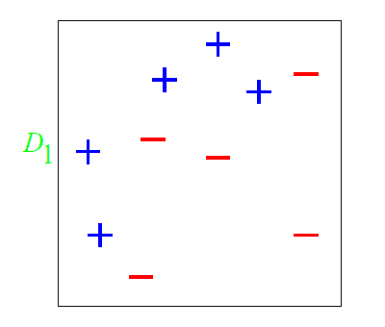
A Toy Example

Slide 24
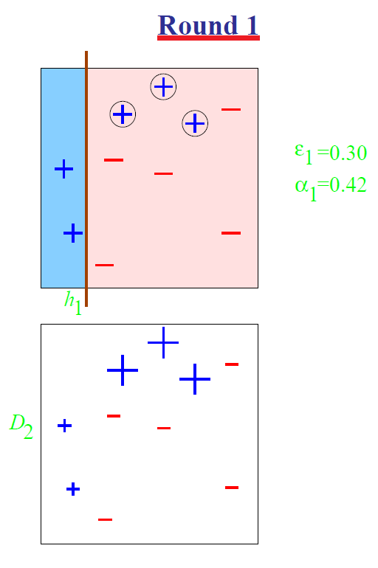
A Toy Example

Slide 25
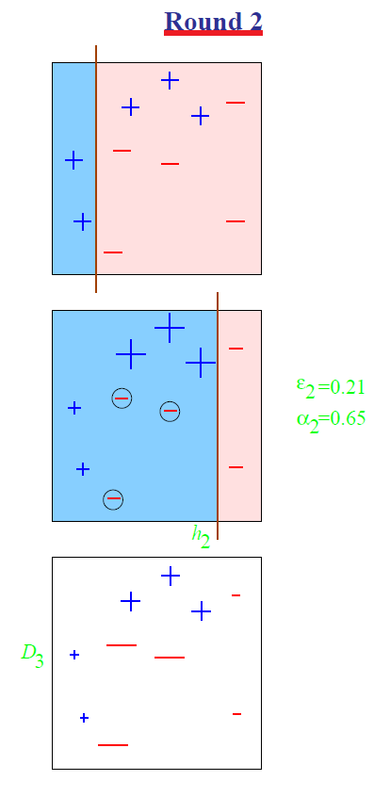
A Toy Example

Slide 26
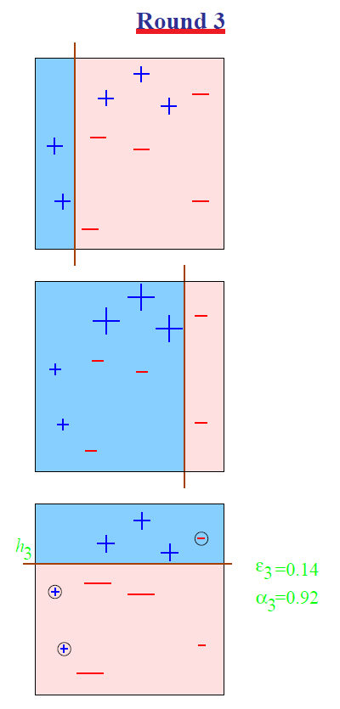
A Toy Example

Slide 27
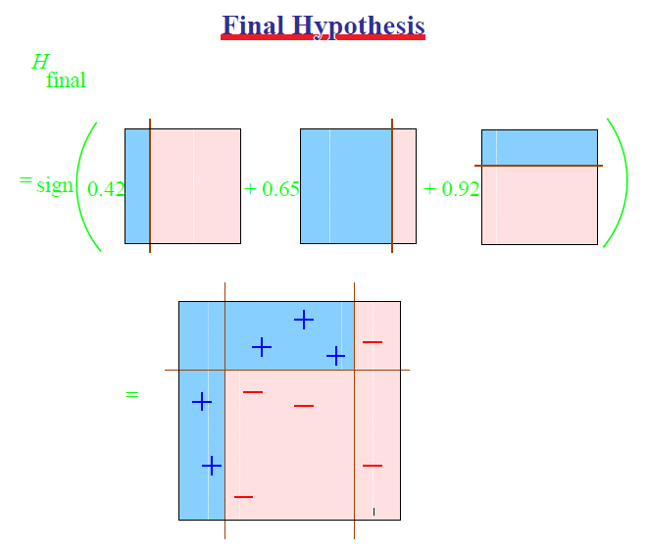
A Toy Example
A cool and important note about the final hypothesis: it is possible that the combined hypothesis makes no mistakes on the training data, but boosting can still learn, by adding more weak hypotheses.

Slide 28
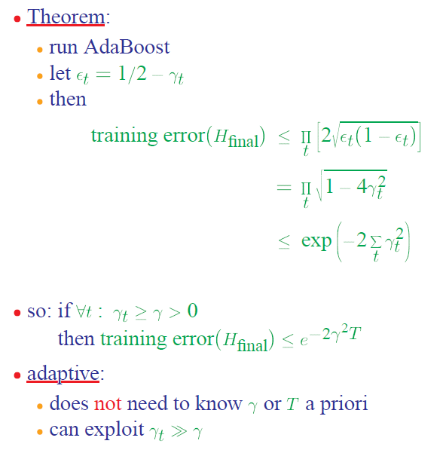
Analyzing Adaboost
1. Why is the theorem stated in terms of minimizing training error? Is that what we want?
2. What does the bound mean?
² ε_{t} (1- ε²_{t}) = (1/2-ϒ_{t})(1/2+ ϒ_{t})) = 1/4 - ϒ_{t}²
1-(2ϒ_{t})² · exp(-(2ϒ_{t})²)
Need to prove only the first inequality, the rest is algebra.

Slide 29
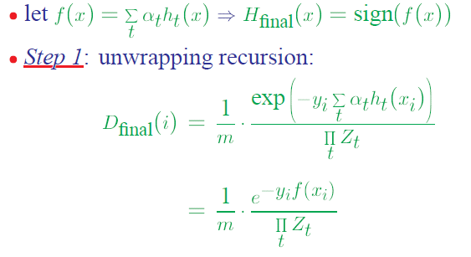
AdaBoost Proof (1)
Need to prove only the first inequality, the rest is algebra.
The final “weight” of the i-th example

Slide 30
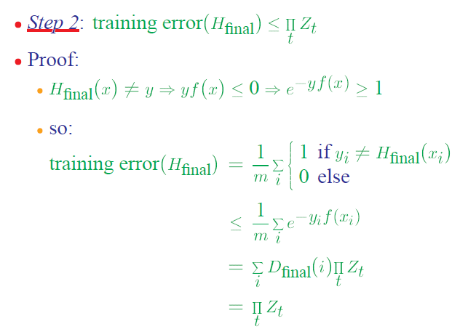
AdaBoost Proof (2)
The definition of training error
Always holds for mistakes (see above)
Using Step 1
D is a distribution over the m examples

Slide 31
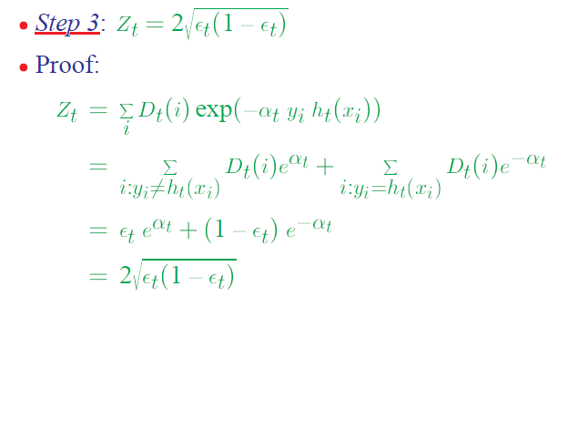
AdaBoost Proof(3)
Why does it work?
The Weak Learning Hypothesis
A strong assumption due to the “for all distributions”.
But – works well in practice
By definition of Z_{t}; it’s a normalization term
Splitting the sum to “mistakes” and no-mistakes”
The definition of ε²_{t}
The definition of α_{t}
  e^{+®t} = sqrt{(1 - ε²_{t})/ ε²_{t} }>1
Steps 2 and 3 together prove the Theorem.
→ The error of the final hypothesis can be as low as you want.

Slide 32
Boosting The Confidence
Unlike Boosting the accuracy (ε), Boosting the confidence (δ) is easy.
Let’s fix the accuracy parameter to ε.
Suppose that we have a learning algorithm L such that for any target concept c Є C and any distribution D, L outputs h s.t. error(h) < ε with confidence at least 1- δ_{0,} where δ₀ = 1/q(n,size(c)), for some polynomial q.
Then, if we are willing to tolerate a slightly higher hypothesis error, ε + γ (γ > 0, arbitrarily small) then we can achieve arbitrary high confidence 1-δ.

Slide 33
Boosting The Confidence(2)
Idea: Given the algorithm L, we construct a new algorithm L’ that simulates algorithm L k times (k will be determined later) on independent samples from the same distribution
Let h₁, …h_{k} be the hypotheses produced. Then, since the simulations are independent, the probability that all of h₁,. h_{k} have error >ε is as most (1-δ₀)^{k}. Otherwise, at least one h_{j} is good.
Solving (1-δ₀)^{k} < δ/2 yields that value of k we need,
k > (1/δ₀) ln(2/δ)
There is still a need to show how L’ works. It would work by using the h_{i} that makes the fewest mistakes on the sample S; we need to compute how large S should be to guarantee that it does not make too many mistakes. [Kearns and Vazirani’s book]

Slide 34
Summary of Ensemble Methods
Boosting
Bagging
Random Forests

Slide 35
Boosting
Initialization:
  Weigh all training samples equally
Iteration Step:
  Train model on (weighted) train set
  Compute error of model on train set
  Increase weights on training cases model gets wrong!!!
Typically requires 100’s to 1000’s of iterations
Return final model:
  Carefully weighted prediction of each model

Slide 36
Boosting: Different Perspectives
Boosting is a maximum-margin method
(Schapire et al. 1998, Rosset et al. 2004)
  Trades lower margin on easy cases for higher margin on harder cases
Boosting is an additive logistic regression model (Friedman, Hastie and Tibshirani 2000)
  Tries to fit the logit of the true conditional probabilities
Boosting is an equalizer
(Breiman 1998) (Friedman, Hastie, Tibshirani 2000)
  Weighted proportion of times example is misclassified by base learners tends to be the same for all training cases
Boosting is a linear classifier, over an incrementally acquired “feature space”.

Slide 37
Bagging
Bagging predictors is a method for generating multiple versions of a predictor and using these to get an aggregated predictor.
The aggregation averages over the versions when predicting a numerical outcome and does a plurality vote when predicting a class.
The multiple versions are formed by making bootstrap replicates of the learning set and using these as new learning sets.
  That is, use samples of the data, with repetition
Tests on real and simulated data sets using classification and regression trees and subset selection in linear regression show that bagging can give substantial gains in accuracy.
The vital element is the instability of the prediction method. If perturbing the learning set can cause significant changes in the predictor constructed then bagging can improve accuracy.

Slide 38
Example: Bagged Decision Trees
Draw 100 bootstrap samples of data
Train trees on each sample → 100 trees
Average prediction of trees on out-of-bag samples
…
Average prediction
(0.23 + 0.19 + 0.34 + 0.22 + 0.26 + … + 0.31) / # Trees = 0.24

Slide 39
Random Forests (Bagged Trees++)
Draw 1000+ bootstrap samples of data
Draw sample of available attributes at each split
Train trees on each sample/attribute set → 1000+ trees
Average prediction of trees on out-of-bag samples
…
Average prediction
(0.23 + 0.19 + 0.34 + 0.22 + 0.26 + … + 0.31) / # Trees = 0.24

Slide 40
So Far: Classification
So far we focused on Binary Classification
For linear models:
  Perceptron, Winnow, SVM, GD, SGD
The prediction is simple:
  Given an example x,
  Prediction = sgn(w^{T}x)
  Where w is the learned model
The output is a single bit

Slide 41
Multi-Categorical Output Tasks
Multi-class Classification (y ∈ {1,...,K})
  character recognition (‘6’)
  document classification (‘homepage’)
Multi-label Classification (y ⊆ {1,...,K})
  document classification (‘(homepage,facultypage)’)
Category Ranking (y ∈ π(K))
  user preference (‘(love > like > hate)’)
  document classification (‘hompage > facultypage > sports’)
Hierarchical Classification (y ⊆ {1,..,K})
  cohere with class hierarchy
  place document into index where ‘soccer’ is-a ‘sport’
Notes:
Most simple, and in some sense most general is the mult-class classification problem
describe each one...
Say: ALL OF THESE TASKS have a fairly limited output space...
IN THAT: NUMBER OF CLASSES IS PRETTY SMALL...
THIS ISN”T ALWAYS THE CASE

Slide 42
Setting
Learning:
  Given a data set D = {(x_{i} , y_{i})}₁^{m}
  Where x_{i} Є R^{n}, y_{i} Є {1,2,…,k}.
Prediction (inference):
  Given an example x, and a learned function (model),
  Output a single class labels y.

Slide 43
Binary to Multiclass
Most schemes for multiclass classification work by reducing the problem to that of binary classification.
There are multiple ways to decompose the multiclass prediction into multiple binary decisions
  One-vs-all
  All-vs-all
  Error correcting codes
We will then talk about a more general scheme:
  Constraint Classification
It can be used to model other non-binary classification schemes and leads to Structured Prediction.

Slide 44
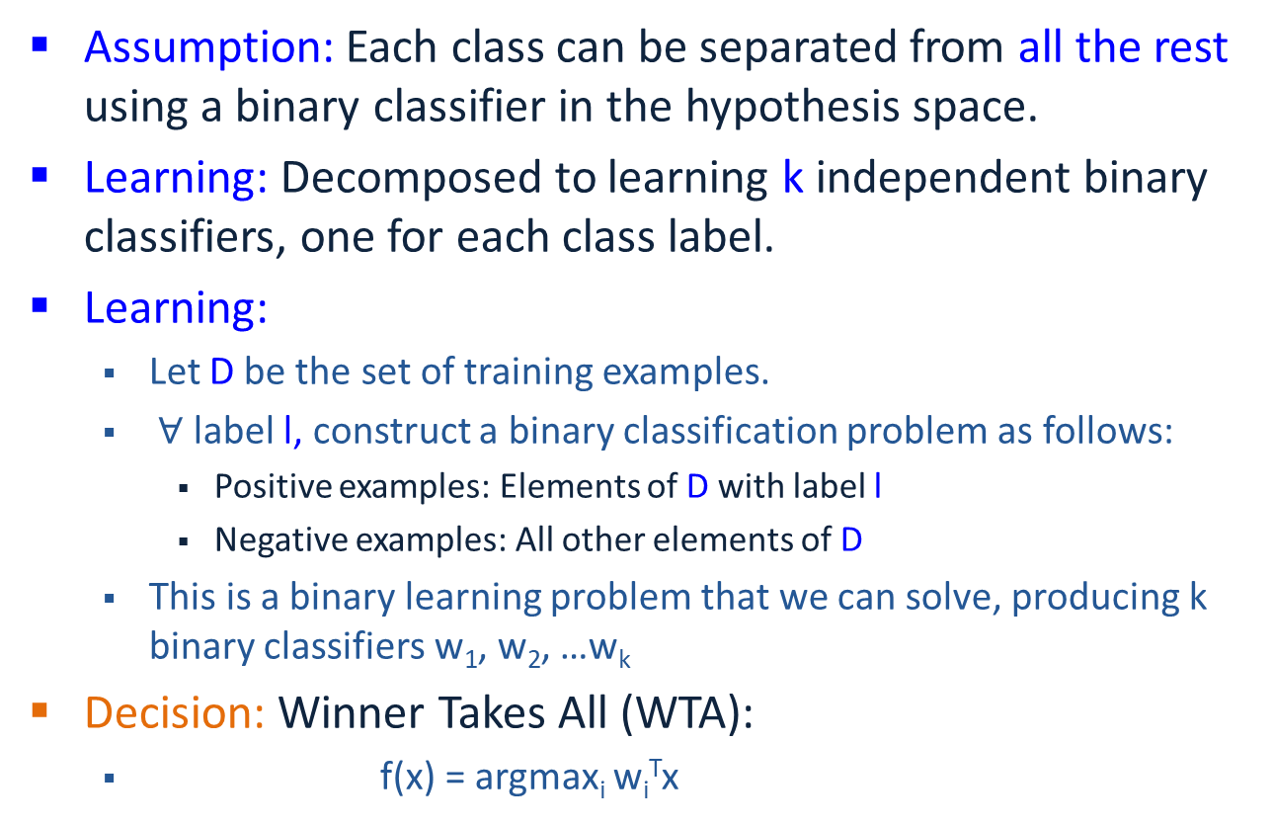
One-Vs-All
Assumption: Each class can be separated from all the rest using a binary classifier in the hypothesis space.
Learning: Decomposed to learning k independent binary classifiers, one for each class label.
Learning:
  Let D be the set of training examples.
  $∀$ label l, construct a binary classification problem as follows:
    Positive examples: Elements of D with label l
    Negative examples: All other elements of D
  This is a binary learning problem that we can solve, producing k binary classifiers w₁, w₂, …w_{k}
Decision: Winner Takes All (WTA):
  f(x) = argmax_{i} w_{i}^{T}x

Slide 45
Solving MultiClass with 1vs All learning
MultiClass classifier
  Function f : R^{n} → {1,2,3,...,k}
Decompose into binary problems
Not always possible to learn
No theoretical justification
  Need to make sure the range of all classifiers is the same
(unless the problem is easy)
Notes:
Most work in ML is for the BINARY problem
Well understood (Theory)
Many algorithms work well (Practice)
Therefore
Tempting and DESIREABLE to use binary algs to solve multiclass
The most common approach : **OvA**
Learn a set of classifiers: one for each class versus the rest
Notice however, that while it may be possilbe to find such a classifier
-NOT ALWAYS THE CASE.
In the last partition here, it is impossible to separate the red points
from the rest using a linear function.
Therefore this classifier will FAIL
**No theoretical justification unless the problem is easy**

Slide 46
Learning via One-Versus-All (OvA) Assumption
Find v_{r},v_{b},v_{g},v_{y} ∈ R^{n} such that
  v_{r}.x > 0 iff y = red ⊗
  v_{b}.x > 0 iff y = blue √
  v_{g}.x > 0 iff y = green √
  v_{y}.x > 0 iff y = yellow √
Classification: f(x) = argmax_{i} v_{i} x
H = R^{nk}
Real Problem
Notes:
OvA (one versus all)
learn k independent classifiers
each separate one class from rest
blue, yellow, green – works fine
red – impossible
It’s possible that f(x) WILL classify correctly
Can be shown that it may not
Look at decision surface.
Colored regions, THERE IS NO DISPUTE FROM CLASSIFIERS
Black – all will be less than zero
the rest depend on the magnitude of weight vectors
... and how they are found
IF RED HAS HIGH MAG → will dominate classification
OVA uses rich enough rep
Learning technique is inadequate
binary classifiers it uses don’t have enough information

Slide 47
All-Vs-All
Assumption: There is a separation between every pair of classes using a binary classifier in the hypothesis space.
Learning: Decomposed to learning [k choose 2] ~ k² independent binary classifiers, one corresponding to each pair of class labels. For the pair (i, j):
  Positive example: all exampels with label i
  Negative examples: all examples with label j
Decision: More involved, since output of binary classifier may not cohere. Each label gets k-1 votes.
Decision Options:
  Majority: classify example x to take label i if i wins on x more often than j (j=1,…k)
  A tournament: start with n/2 pairs; continue with winners .

Slide 48
Learning via All-Verses-All (AvA) Assumption
It is possible to separate all k classes with the O(k²) classifiers
Find v_{rb},v_{rg},v_{ry},v_{bg},v_{by},v_{gy} ∈ R^{d} such that
  v_{rb}.x > 0 if y = red
  < 0 if y = blue
  v_{rg}.x > 0 if y = red
  < 0 if y = green
  ... (for all pairs)
H = R^{kkn}
How to classify?
Individual
Classifiers
Decision
Regions
Notes:
[ GENERAL NOTE: Focus on diagram, say it’s more powerful than WTA]
AvA (All versus all)
expand representation space
learn (k choose 2) classifiers
separate each pair of classes
for example Vred,green separates all red points from greed points
Decision Surface
Can cover any example set the WTA can generate
BUT
1. TOO COMPLEX
2. AMBIGUOUS – Black regions are unknown
tournament or majority vote necessary

Slide 49
Classifying with AvA
Tournament
Majority Vote
1 red, 2 yellow, 2 green
➔ ?
All are post-learning and might cause weird stuff

Slide 50
One-vs-All vs. All vs. All
Assume m examples, k class labels.
  For simplicity, say, m/k in each.
One vs. All:
  classifier f_{i}: m/k (+) and (k-1)m/k (-)
  Decision:
  Evaluate k linear classifiers and do Winner Takes All (WTA):
  f(x) = argmax_{i} f_{i}(x) = argmax_{i} w_{i}^{T}x
All vs. All:
  Classifier f_{ij}: m/k (+) and m/k (-)
  More expressivity, but less examples to learn from.
  Decision:
  Evaluate k² linear classifiers; decision sometimes unstable.
What type of learning methods would prefer All vs. All (efficiency-wise)?
(Think about Dual/Primal)

Slide 51
Error Correcting Codes Decomposition
1-vs-all uses k classifiers for k labels; can you use only log₂ k?
Reduce the multi-class classification to random binary problems.
  Choose a “code word” for each label.
  K=8: all we need is 3 bits, three classifiers
Rows: An encoding of each class (k rows)
Columns: L dichotomies of the data, each corresponds to a new classification problem
Extreme cases:
  1-vs-all: k rows, k columns
  k rows log₂ k columns
Each training example is mapped to one example per column
  (x,3) → {(x,P1), +; (x,P2), -; (x,P3), -; (x,P4), +}
To classify a new example x:
  Evaluate hypothesis on the 4 binary problems
  {(x,P1) , (x,P2), (x,P3), (x,P4),}
  Choose label that is most consistent with the results.
    Use Hamming distance (bit-wise distance)
Nice theoretical results as a function of the performance of the P_{i} s (depending on code & size)
Potential Problems?
Label | P1 | P2 | P3 | P4
1 | - | + | - | +
2 | - | + | + | -
3 | + | - | - | +
4 | + | - | + | +
k | - | + | - | -
Can you separate any dichotomy?
Notes:
However, a PROBLEM W/ DECOMPOSITION TECHNIQUES
Induced Binary problems are optimized INDEPENDENTLY
NO GLOBAL METRIC IS USED.
FOR EXAMPLE, in MC,
we don’t care about 1 vs rest performance
only about the FINAL MC Classification
TRANSISTION:
We can look at a simple example:

Slide 52
Problems with Decompositions
Learning optimizes over local metrics
  Does not guarantee good global performance
  We don’t care about the performance of the local classifiers
Poor decomposition ⇒ poor performance
  Difficult local problems
  Irrelevant local problems
Especially true for Error Correcting Output Codes
  Another (class of) decomposition
  Difficulty: how to make sure that the resulting problems are separable.
Efficiency: e.g., All vs. All vs. One vs. All
Former has advantage when working with the dual space.
Not clear how to generalize multi-class to problems with a very large # of output variables.
Notes:
However, a PROBLEM W/ DECOMPOSITION TECHNIQUES
Induced Binary problems are optimized INDEPENDENTLY
NO GLOBAL METRIC IS USED.
FOR EXAMPLE, in MC,
we don’t care about 1 vs rest performance
only about the FINAL MC Classification
TRANSISTION:
We can look at a simple example:

Slide 53
1 Vs All: Learning Architecture
k label nodes; n input features, nk weights.
Evaluation: Winner Take All
Training: Each set of n weights, corresponding to the i-th label, is trained
  Independently, given its performance on example x, and
  Independently of the performance of label j on x.
Hence: Local learning; only the final decision is global, (Winner Takes All (WTA)).
However, this architecture allows multiple learning algorithms; e.g., see the implementation in the SNoW/LbJava Multi-class Classifier
Targets (each an LTU)
Weighted edges (weight vectors)
Features

Slide 54
Recall: Winnow’s Extensions
Positive
w⁺
Negative
w⁻
Winnow learns monotone Boolean functions
We extended to general Boolean functions via
“Balanced Winnow”
  2 weights per variable;
  Decision: using the “effective weight”,
  the difference between w⁺ and w⁻
  This is equivalent to the Winner take all decision
  Learning: In principle, it is possible to use the 1-vs-all rule and update each set of n weights separately, but we suggested the “balanced” Update rule that takes into account how both sets of n weights predict on example x
Can this be generalized to the case of k labels, k >2?
We need a “global” learning approach

Slide 55
Extending Balanced
In a 1-vs-all training you have a target node that represents positive examples and target node that represents negative examples.
Typically, we train each node separately (mine/not-mine example).
Rather, given an example we could say: this is more a + example than a – example.
We compared the activation of the different target nodes (classifiers) on a given example. (This example is more class + than class -)
Can this be generalized to the case of k labels, k >2?
Notes:
Brief introduction to St. Out. problems
HIGHLIGHT THE DIFFERENCE BETWEEN LOCAL AND GLOBAL LEARNING!!!
Start w/ probably the simplest St. Out. problem: MULTICLASS!!!
where instead of viewing the label as a single integer, we can view it as a bit vector
ALONG WITH THE RESTIRCTION saying “EXACLTY ONE....”
Then, as we saw in the previous section, we can learn a collection of functions in two ways.
OvA attempts to have each function predict a single bit w/o looking at the rest! We call this LOCAL learning.
CC also learns the collection, but in a way the RESPECTS THE GLOB REST. LEARNS GLOBALLY all functions toghehter.
(LOOK AT SLIDE)!
Sequence tasks:
***** EX POS TAGGING,
TWO WAYS TO VIEW LABEL ::: Collection of word/pos pairs
::: Single label (WHOLE SENT TAG).
LEARN IN TWO WAYS ::: Fucnt to predict each POS tag sep.
::: Funct to predict whole tag seq at once.
Struct output:
arbitrary global constraints
**** LOCAL FUNCTIONS DON’T HAVE ACCESS TO THE GLOBAL CONSTRAINTS
--> NO CHANCE!!

Slide 56
Where are we?
Introduction
Combining binary classifiers
  One-vs-all
  All-vs-all
  Error correcting codes
Training a single (global) classifier
  Multiclass SVM
  Constraint classification

Slide 57
Recall: Margin for binary classifiers
The margin of a hyperplane for a dataset is the distance between the hyperplane and the data point nearest to it.
-
-
+
+
+
-
+
+
-
-
-
-
+
+
+
-
-
-
-
-
-
-
-
-
-
Margin with respect to this hyperplane
-

Slide 58
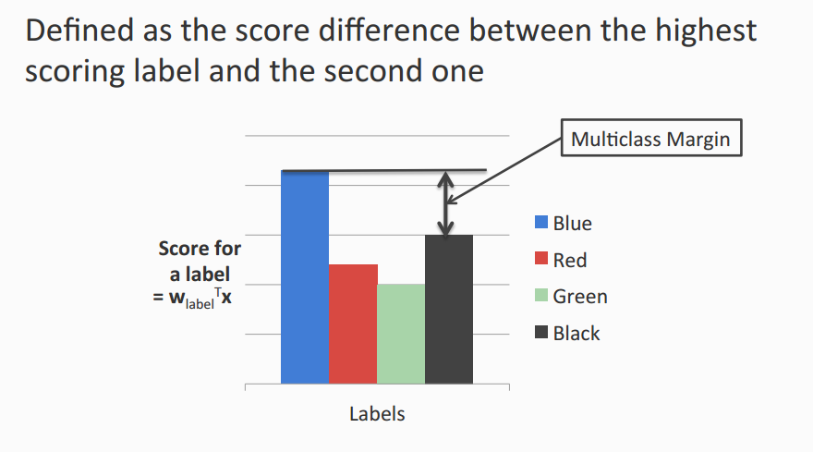
Multiclass Margin

Slide 59
Multiclass SVM (Intuition)
Recall: Binary SVM
  Maximize margin
  Equivalently,
    Minimize norm of weight vector, while keeping the closest points to the hyperplane with a score §1
Multiclass SVM
  Each label has a different weight vector (like one-vs-all)
  Maximize multiclass margin
  Equivalently,
    Minimize total norm of the weight vectors while making sure that the true label scores at least 1 more than the second best one.

Slide 60
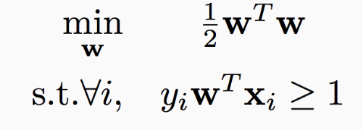
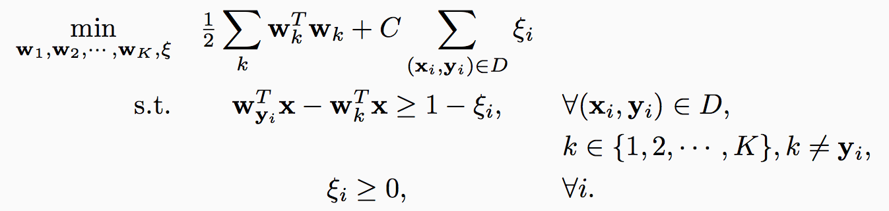
Multiclass SVM in the separable case
Recall hard binary SVM
Size of the weights. Effectively, regularizer
The score for the true label is higher than the score for any other label by 1

Slide 61
Multiclass SVM: General case
Total slack. Effectively, don’t allow too many examples to violate the margin constraint
Size of the weights. Effectively, regularizer
The score for the true label is higher than the score for any other label by 1
Slack variables. Not all examples need to satisfy the margin constraint.
Slack variables can only be positive

Slide 62
Multiclass SVM: General case
Total slack. Effectively, don’t allow too many examples to violate the margin constraint
Size of the weights. Effectively, regularizer
The score for the true label is higher than the score for any other label by 1 - ξ_{i}
Slack variables. Not all examples need to satisfy the margin constraint.
Slack variables can only be positive

Slide 63
Multiclass SVM
Generalizes binary SVM algorithm
  If we have only two classes, this reduces to the binary (up to scale)
Comes with similar generalization guarantees as the binary SVM
Can be trained using different optimization methods
  Stochastic sub-gradient descent can be generalized
    Try as exercise

Slide 64
Multiclass SVM: Summary
Training:
  Optimize the “global” SVM objective
Prediction:
  Winner takes all
    argmax_{i} w_{i}^{T}x
With K labels and inputs in R^{n}, we have nK weights in all
  Same as one-vs-all
Why does it work?
  Why is this the “right” definition of multiclass margin?
A theoretical justification, along with extensions to other algorithms beyond SVM is given by “Constraint Classification”
  Applies also to multi-label problems, ranking problems, etc.
  [Dav Zimak; with D. Roth and S. Har-Peled]

Slide 65
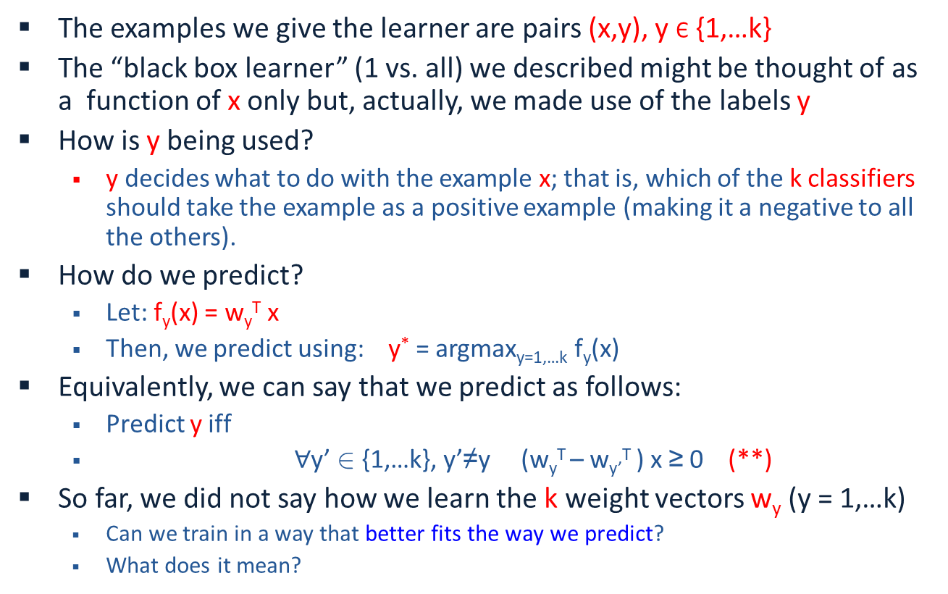
Constraint Classification
The examples we give the learner are pairs (x,y), y Є {1,…k}
The “black box learner” (1 vs. all) we described might be thought of as a function of x only but, actually, we made use of the labels y
How is y being used?
  y decides what to do with the example x; that is, which of the k classifiers should take the example as a positive example (making it a negative to all the others).
How do we predict?
  Let: f_{y}(x) = w_{y}^{T} x
  Then, we predict using: y* = argmax_{y=1,…k} f_{y}(x)
Equivalently, we can say that we predict as follows:
  Predict y iff
  $∀$y’ 2 {1,…k}, y’≠y (w_{y}^{T} – w_{y’}^{T} ) x ≥ 0 (**)
So far, we did not say how we learn the k weight vectors w_{y} (y = 1,…k)
  Can we train in a way that better fits the way we predict?
  What does it mean?
Is it better in any well defined way?
Notes:
Brief introduction to St. Out. problems
HIGHLIGHT THE DIFFERENCE BETWEEN LOCAL AND GLOBAL LEARNING!!!
Start w/ probably the simplest St. Out. problem: MULTICLASS!!!
where instead of viewing the label as a single integer, we can view it as a bit vector
ALONG WITH THE RESTIRCTION saying “EXACLTY ONE....”
Then, as we saw in the previous section, we can learn a collection of functions in two ways.
OvA attempts to have each function predict a single bit w/o looking at the rest! We call this LOCAL learning.
CC also learns the collection, but in a way the RESPECTS THE GLOB REST. LEARNS GLOBALLY all functions toghehter.
(LOOK AT SLIDE)!
Sequence tasks:
***** EX POS TAGGING,
TWO WAYS TO VIEW LABEL ::: Collection of word/pos pairs
::: Single label (WHOLE SENT TAG).
LEARN IN TWO WAYS ::: Fucnt to predict each POS tag sep.
::: Funct to predict whole tag seq at once.
Struct output:
arbitrary global constraints
**** LOCAL FUNCTIONS DON’T HAVE ACCESS TO THE GLOBAL CONSTRAINTS
--> NO CHANCE!!

Slide 66
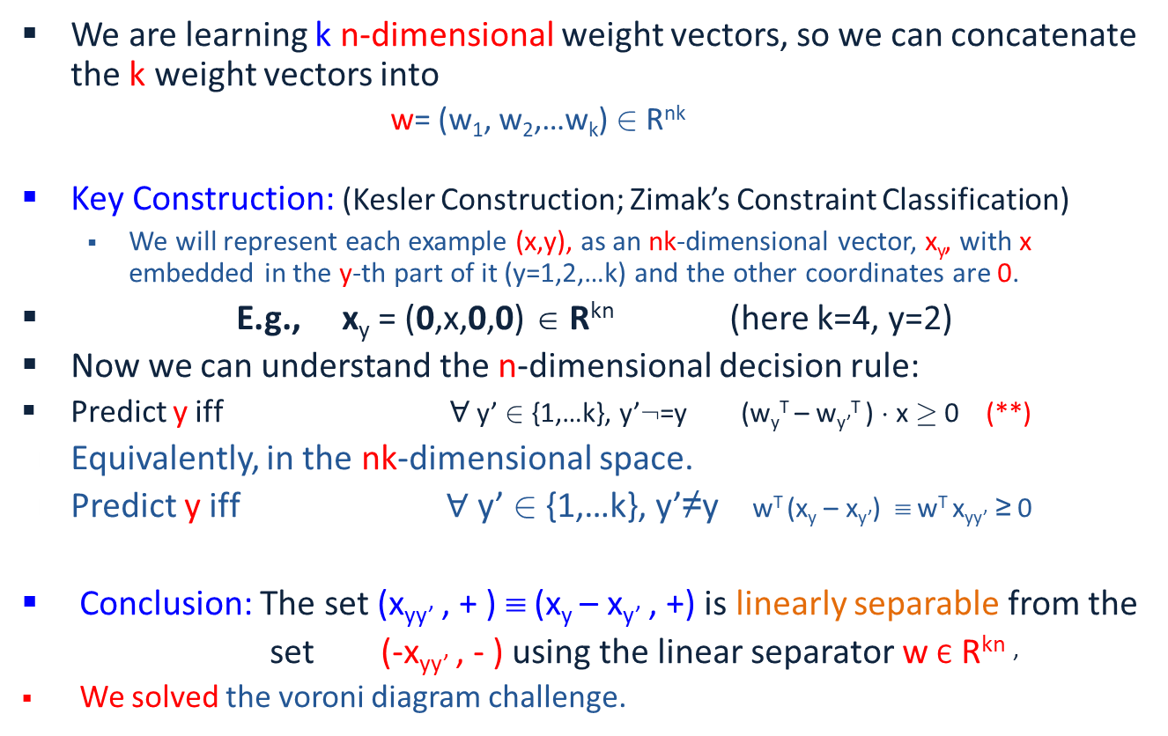
Linear Separability for Multiclass
We showed: if pairs of labels are separable (a reasonable assumption) than in some higher dimensional space, the problem is linearly separable.
We are learning k n-dimensional weight vectors, so we can concatenate the k weight vectors into
  w= (w₁, w₂,…w_{k}) 2 R^{nk}
Key Construction: (Kesler Construction; Zimak’s Constraint Classification)
  We will represent each example (x,y), as an nk-dimensional vector, x_{y}, with x embedded in the y-th part of it (y=1,2,…k) and the other coordinates are 0.
E.g., x_{y} = (0,x,0,0) ∈ R^{kn} (here k=4, y=2)
Now we can understand the n-dimensional decision rule:
Predict y iff $∀$ y’ 2 {1,…k}, y’:=y (w_{y}^{T} – w_{y’}^{T} ) ¢ x ¸ 0 (**)
  Equivalently, in the nk-dimensional space.
  Predict y iff $∀$ y’ 2 {1,…k}, y’≠y w^{T} (x_{y} – x_{y’}) ≡ w^{T} x_{yy’} ≥ 0
Conclusion: The set (x_{yy’} , + ) ≡ (x_{y} – x_{y’} , +) is linearly separable from the
set (-x_{yy’} , - ) using the linear separator w Є R^{kn} ’
  We solved the voroni diagram challenge.
Notice: This is just a representational trick. We did not say how to learn the weight vectors.
Notes:
Brief introduction to St. Out. problems
HIGHLIGHT THE DIFFERENCE BETWEEN LOCAL AND GLOBAL LEARNING!!!
Start w/ probably the simplest St. Out. problem: MULTICLASS!!!
where instead of viewing the label as a single integer, we can view it as a bit vector
ALONG WITH THE RESTIRCTION saying “EXACLTY ONE....”
Then, as we saw in the previous section, we can learn a collection of functions in two ways.
OvA attempts to have each function predict a single bit w/o looking at the rest! We call this LOCAL learning.
CC also learns the collection, but in a way the RESPECTS THE GLOB REST. LEARNS GLOBALLY all functions toghehter.
(LOOK AT SLIDE)!
Sequence tasks:
***** EX POS TAGGING,
TWO WAYS TO VIEW LABEL ::: Collection of word/pos pairs
::: Single label (WHOLE SENT TAG).
LEARN IN TWO WAYS ::: Fucnt to predict each POS tag sep.
::: Funct to predict whole tag seq at once.
Struct output:
arbitrary global constraints
**** LOCAL FUNCTIONS DON’T HAVE ACCESS TO THE GLOBAL CONSTRAINTS
--> NO CHANCE!!

Slide 67
Constraint Classification
Training:
  [We first explain via Kesler’s construction; then show we don’t need it]
  Given a data set {(x,y)}, (m examples) with x Є R^{n}, y Є {1,2,…k}
  create a binary classification task (in R^{kn}):
  (x_{y} - x_{y’}, +), (x_{y’} – x_{y} -), for all y’ ≠ y (2m(k-1) examples)
  Here x_{y} Є R^{kn}
  Use your favorite linear learning algorithm to train a binary classifier.
Prediction:
  Given an nk dimensional weight vector w and a new example x, predict: argmax_{y} w^{T} x_{y}

Slide 68
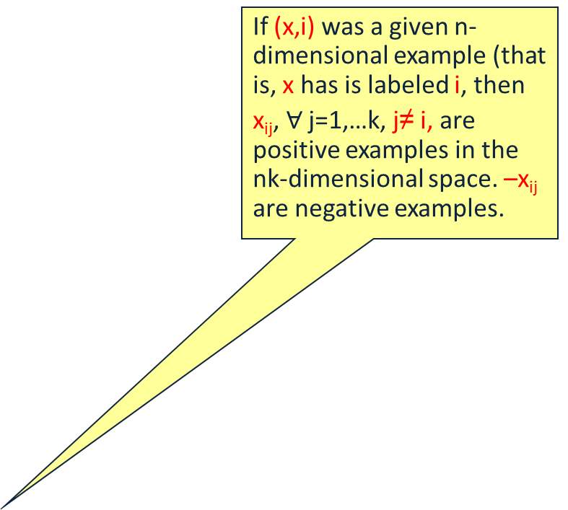
Details: Kesler Construction &
Multi-Class Separability
If (x,i) was a given n-dimensional example (that is, x has is labeled i, then
x_{ij}, $∀$ j=1,…k, j≠ i, are positive examples in the nk-dimensional space. –x_{ij} are negative examples.
Transform Examples
2>4
2>1
2>1
2>3
2>4
2>3
i>j f_{i}(x) - f_{j}(x) > 0
w_{i} ⋅ x - w_{j} ⋅ x > 0
W ⋅ X_{i} - W ⋅ X_{j} > 0
W ⋅ (X_{i} - X_{j}) > 0
W ⋅ X_{ij} > 0
X_{i} = (0,x,0,0) ∈ R^{kd}
X_{j} = (0,0,0,x) ∈ R^{kd}
X_{ij} = X_{i} - X_{j} = (0,x,0,-x)
W = (w₁,w₂,w₃,w₄) ∈ R^{kd}
Notes:
(LOOK AT SLIDE)!
Each example is labeled with a set of constraints.
Then, to maintain these preferences, we must maintain
fi > fj
Linar case, we have
wi.x - wj.x > 0
By rewriting all in one vector
(W = (w1,...))
defining Xi = x in the ith component of Zero vector
we can define NEW EXAMPLES
X IJ
Now, the only thing to learn is W!!!!
[CLICK]
Graphically, this produces a bunch of examples
XIJ -- here we dipict also -XIJ as negative examples so that it is clear we are looking for a BINARY SEPARATION!

Slide 69
Kesler’s Construction (1)
y = argmax_{i=(r,b,g,y)} w_{i}.x
  w_{i} , x ∈ R^{n}
Find w_{r},w_{b},w_{g},w_{y} ∈ R^{n} such that
  w_{r}.x > w_{b}.x
  w_{r}.x > w_{g}.x
  w_{r}.x > w_{y}.x
H = R^{kn}
Notes:
First noticed by Kesler in about 1965
Goal
learn MC classifier
wta (argmax) over linear functions
Each example
(x, RED) written as constraints
RED < BLUE, etc...
Learning goal
find weight vectors such that
v_red .x > v_blue .x
etc...

Slide 70
Kesler’s Construction (2)
Let w = (w_{r},w_{b},w_{g},w_{y} ) ∈ R^{kn}
Let 0^{n}, be the n-dim zero vector
w_{r}.x > w_{b}.x ⬄ w.(x,-x,0^{n},0^{n}) > 0 ⬄ w.(-x,x,0^{n},0^{n}) < 0
w_{r}.x > w_{g}.x ⬄ w.(x,0^{n},-x,0^{n}) > 0 ⬄ w.(-x,0^{n},x,0^{n}) < 0
w_{r}.x > w_{y}.x ⬄ w.(x,0^{n},0^{n},-x) > 0 ⬄ w.(-x,0^{n},0^{n} ,x) < 0
x
-x
-x
x
Notes:
Conditions can be rewritten in kd dim
blowup of 4 here
Let
v – concatenation of 4 d-dim weight vectors
0^d – d-dim zero vec
Rewrite v_red .x > v_blue .x as
BOLD(V) dot a pt in high dim > 0
This is a positive point
Also, a negative point
-FOR LINEAR CASE, REDUNDANT

Slide 71
Kesler’s Construction (3)
Let
  w = (w₁, ..., w_{k}) ∈ R^{n} x ... x R^{n} = R^{kn}
  x_{ij} = (0^{(i-1)n}, x, 0^{(k-i)n}) – (0^{(j-1)n}, –x, 0^{(k-j)n}) ∈ R^{kn}
Given (x, y) ∈ R^{n} x {1,...,k}
  For all j ≠ y (all other labels)
    Add to P⁺(x,y), (x_{yj}, 1)
    Add to P⁻(x,y), (–x_{yj}, -1)
P⁺(x,y) has k-1 positive examples (∈ R^{kn})
P⁻(x,y) has k-1 negative examples (∈ R^{kn})
x
-x
Notes:
The general MC setting for linear functions is exactly the same
BOLD (V) is the weight vector we try to learn
BOLD (xij) is example in kd dim that says that
i is preferred over j for example x
We create Positive examples where the winning class is prefered over all others
Negative examples, the same way.

Slide 72
Learning via Kesler’s Construction
Given (x₁, y₁), ..., (x_{N}, y_{N}) ∈ R^{n} x {1,...,k}
Create
  P⁺ = ∪ P⁺(x_{i},y_{i})
  P– = ∪ P–(x_{i},y_{i})
Find w = (w₁, ..., w_{k}) ∈ R^{kn}, such that
  w.x separates P⁺ from P–
One can use any algorithm in this space: Perceptron, Winnow, SVM, etc.
To understand how to update the weight vector in the n-dimensional space, we note that
w^{T} x_{yy’} ≥ 0 (in the nk-dimensional space)
is equivalent to:
(w_{y}^{T} – w_{y’}^{T} ) x ≥ 0 (in the n-dimensional space)
Notes:
The goal of learning
-SEPARATE positive from negative (P+ from P-)
Notice the output:
- interpret the components of BOLD(v)
as class weight vectors
- a winner take all case
Interpretation of examples in kd
each point specifies that i is preferred over j for example x
linear case, these constraints ensure wta
Any WTA function can be learned
- by perceptron convergence theorem

Slide 73
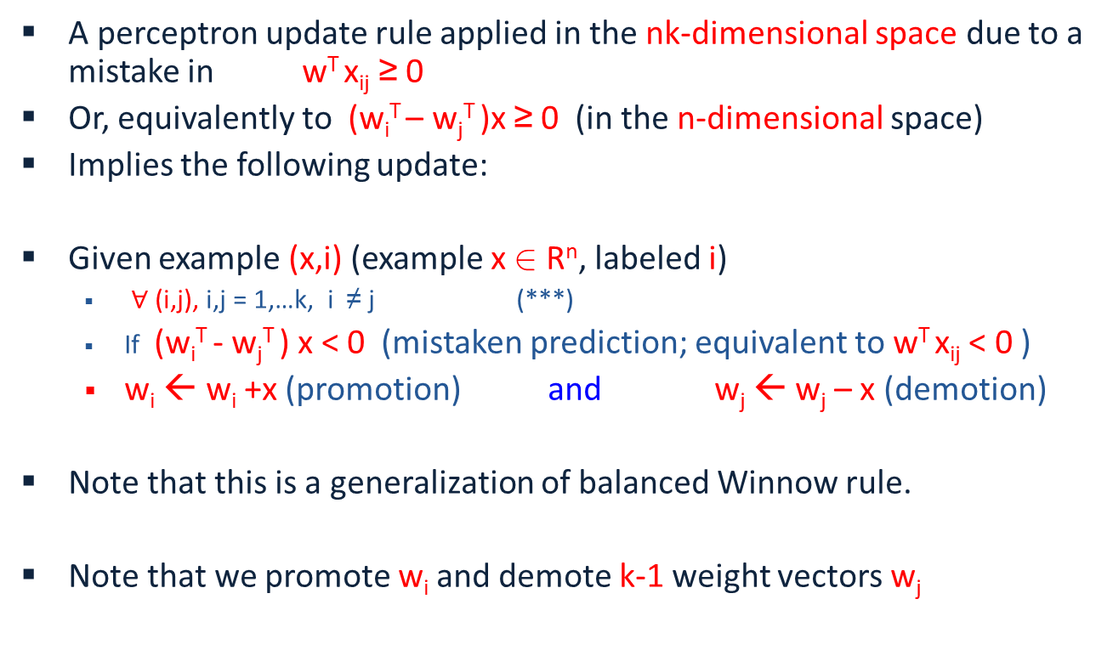
Perceptron in Kesler Construction
A perceptron update rule applied in the nk-dimensional space due to a mistake in w^{T} x_{ij} ≥ 0
Or, equivalently to (w_{i}^{T} – w_{j}^{T} )x ≥ 0 (in the n-dimensional space)
Implies the following update:
Given example (x,i) (example x 2 R^{n}, labeled i)
  $∀$ (i,j), i,j = 1,…k, i ≠ j (***)
  If (w_{i}^{T} - w_{j}^{T} ) x < 0 (mistaken prediction; equivalent to w^{T} x_{ij} < 0 )
  w_{i} ← w_{i} +x (promotion) and w_{j} ← w_{j} – x (demotion)
Note that this is a generalization of balanced Winnow rule.
Note that we promote w_{i} and demote k-1 weight vectors w_{j}
Notes:
Brief introduction to St. Out. problems
HIGHLIGHT THE DIFFERENCE BETWEEN LOCAL AND GLOBAL LEARNING!!!
Start w/ probably the simplest St. Out. problem: MULTICLASS!!!
where instead of viewing the label as a single integer, we can view it as a bit vector
ALONG WITH THE RESTIRCTION saying “EXACLTY ONE....”
Then, as we saw in the previous section, we can learn a collection of functions in two ways.
OvA attempts to have each function predict a single bit w/o looking at the rest! We call this LOCAL learning.
CC also learns the collection, but in a way the RESPECTS THE GLOB REST. LEARNS GLOBALLY all functions toghehter.
(LOOK AT SLIDE)!
Sequence tasks:
***** EX POS TAGGING,
TWO WAYS TO VIEW LABEL ::: Collection of word/pos pairs
::: Single label (WHOLE SENT TAG).
LEARN IN TWO WAYS ::: Fucnt to predict each POS tag sep.
::: Funct to predict whole tag seq at once.
Struct output:
arbitrary global constraints
**** LOCAL FUNCTIONS DON’T HAVE ACCESS TO THE GLOBAL CONSTRAINTS
--> NO CHANCE!!

Slide 74
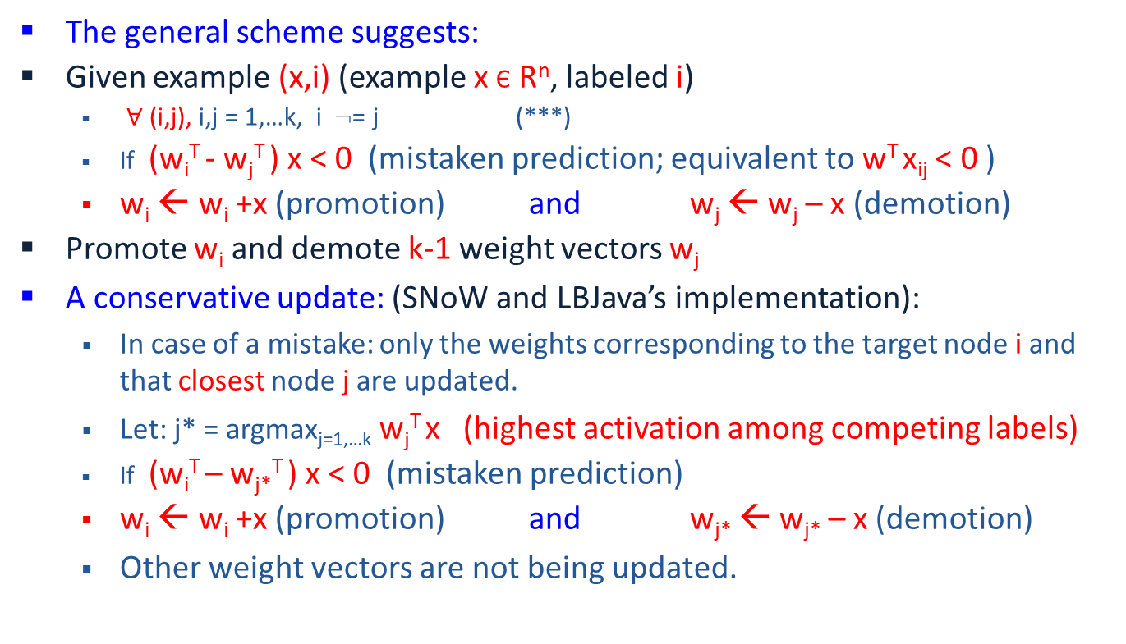
Conservative update
The general scheme suggests:
Given example (x,i) (example x Є R^{n}, labeled i)
  $∀$ (i,j), i,j = 1,…k, i := j (***)
  If (w_{i}^{T} - w_{j}^{T} ) x < 0 (mistaken prediction; equivalent to w^{T} x_{ij} < 0 )
  w_{i} ← w_{i} +x (promotion) and w_{j} ← w_{j} – x (demotion)
Promote w_{i} and demote k-1 weight vectors w_{j}
A conservative update: (SNoW and LBJava’s implementation):
  In case of a mistake: only the weights corresponding to the target node i and that closest node j are updated.
  Let: j* = argmax_{j=1,…k} w_{j}^{T} x (highest activation among competing labels)
  If (w_{i}^{T} – w_{j*}^{T} ) x < 0 (mistaken prediction)
  w_{i} ← w_{i} +x (promotion) and w_{j*} ← w_{j*} – x (demotion)
  Other weight vectors are not being updated.
Notes:
Brief introduction to St. Out. problems
HIGHLIGHT THE DIFFERENCE BETWEEN LOCAL AND GLOBAL LEARNING!!!
Start w/ probably the simplest St. Out. problem: MULTICLASS!!!
where instead of viewing the label as a single integer, we can view it as a bit vector
ALONG WITH THE RESTIRCTION saying “EXACLTY ONE....”
Then, as we saw in the previous section, we can learn a collection of functions in two ways.
OvA attempts to have each function predict a single bit w/o looking at the rest! We call this LOCAL learning.
CC also learns the collection, but in a way the RESPECTS THE GLOB REST. LEARNS GLOBALLY all functions toghehter.
(LOOK AT SLIDE)!
Sequence tasks:
***** EX POS TAGGING,
TWO WAYS TO VIEW LABEL ::: Collection of word/pos pairs
::: Single label (WHOLE SENT TAG).
LEARN IN TWO WAYS ::: Fucnt to predict each POS tag sep.
::: Funct to predict whole tag seq at once.
Struct output:
arbitrary global constraints
**** LOCAL FUNCTIONS DON’T HAVE ACCESS TO THE GLOBAL CONSTRAINTS
--> NO CHANCE!!

Slide 75
Multiclass Classification Summary 1:
Multiclass Classification
From the full dataset, construct three binary classifiers, one for each class
w_{blue}^{T}x > 0 for blue inputs
w_{org}^{T}x > 0 for orange inputs
w_{black}^{T}x > 0 for black inputs
Notation: Score for blue label
Winner Take All will predict the right answer. Only the correct label will have a positive score

Slide 76
Multiclass Classification Summary 2:
One-vs-all may not always work
Red points are not separable with a single binary classifier
The decomposition is not expressive enough!
w_{blue}^{T}x > 0 for blue inputs
w_{org}^{T}x > 0 for orange inputs
w_{black}^{T}x > 0 for black inputs
???

Slide 77
Summary 3:
Local Learning: One-vs-all classification
Easy to learn
  Use any binary classifier learning algorithm
Potential Problems
  Calibration issues
    We are comparing scores produced by K classifiers trained independently. No reason for the scores to be in the same numerical range!
  Train vs. Train
    Does not account for how the final predictor will be used
    Does not optimize any global measure of correctness
  Yet, works fairly well
    In most cases, especially in high dimensional problems (everything is already linearly separable).

Slide 78
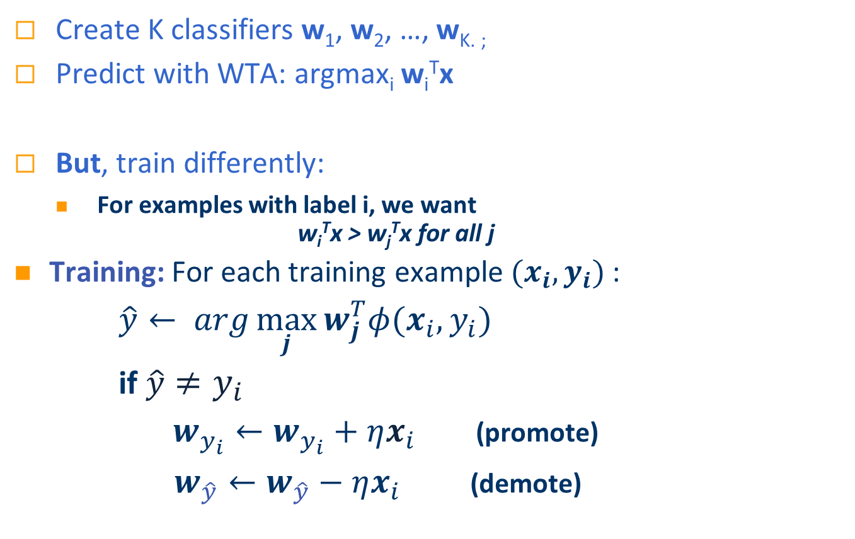
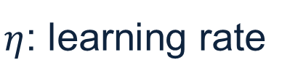
Summary 4:
Global Multiclass Approach [Constraint Classification, Har-Peled et. al ‘02]
  Create K classifiers w₁, w₂, …, w_{K. ;}
  Predict with WTA: argmax_{i} w_{i}^{T}x
  But, train differently:
    For examples with label i, we want
    w_{i}^{T}x > w_{j}^{T}x for all j
Training: For each training example $(x_{i},y_{i})$:
    $\hat{y}← arg\max_{j}{w_{j}^{T}φ(x_{i},y_{i})}$
    if $\hat{y}≠y_{i}$
    $w_{y_{i}}←w_{y_{i}}+ηx_{i}$ (promote)
    $w_{\hat{y}}←w_{\hat{y}}−ηx_{i}$ (demote)
$η$: learning rate

Slide 79
Significance
The hypothesis learned above is more expressive than when the OvA assumption is used.
Any linear learning algorithm can be used, and algorithmic-specific properties are maintained (e.g., attribute efficiency if using winnow.)
E.g., the multiclass support vector machine can be implemented by learning a hyperplane to separate P(S) with maximal margin.
As a byproduct of the linear separability observation, we get a natural notion of a margin in the multi-class case, inherited from the binary separability in the nk-dimensional space.
  Given example x_{ij} Є R^{nk}, margin(x_{ij},w) = min_{ij} w^{T} x_{ij}
  Consequently, given x Є R^{n}, labeled i
  margin(x,w) = min_{j} (w_{i}^{T} - w_{j}^{T} ) x
Notes:
Brief introduction to St. Out. problems
HIGHLIGHT THE DIFFERENCE BETWEEN LOCAL AND GLOBAL LEARNING!!!
Start w/ probably the simplest St. Out. problem: MULTICLASS!!!
where instead of viewing the label as a single integer, we can view it as a bit vector
ALONG WITH THE RESTIRCTION saying “EXACLTY ONE....”
Then, as we saw in the previous section, we can learn a collection of functions in two ways.
OvA attempts to have each function predict a single bit w/o looking at the rest! We call this LOCAL learning.
CC also learns the collection, but in a way the RESPECTS THE GLOB REST. LEARNS GLOBALLY all functions toghehter.
(LOOK AT SLIDE)!
Sequence tasks:
***** EX POS TAGGING,
TWO WAYS TO VIEW LABEL ::: Collection of word/pos pairs
::: Single label (WHOLE SENT TAG).
LEARN IN TWO WAYS ::: Fucnt to predict each POS tag sep.
::: Funct to predict whole tag seq at once.
Struct output:
arbitrary global constraints
**** LOCAL FUNCTIONS DON’T HAVE ACCESS TO THE GLOBAL CONSTRAINTS
--> NO CHANCE!!

Slide 80
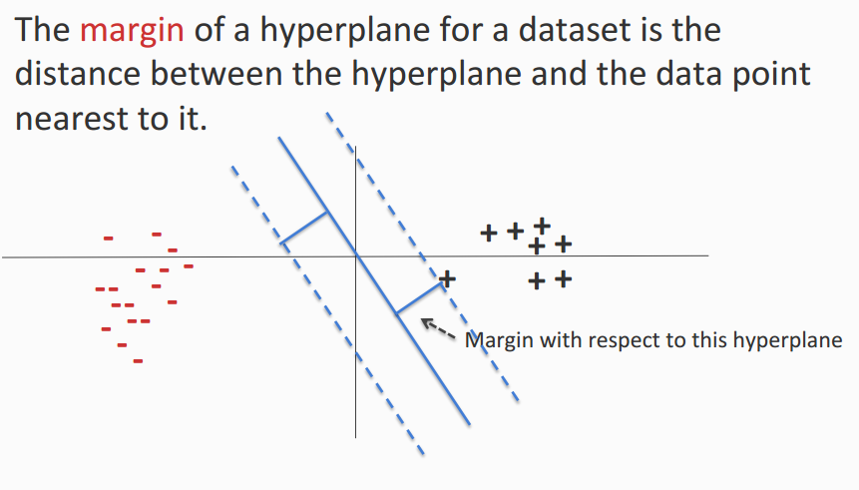
Margin

Slide 81
Multiclass Margin

Slide 82
Constraint Classification
The scheme presented can be generalized to provide a uniform view for multiple types of problems: multi-class, multi-label, category-ranking
Reduces learning to a single binary learning task
Captures theoretical properties of binary algorithm
Experimentally verified
Naturally extends Perceptron, SVM, etc...
It is called “constraint classification” since it does it all by representing labels as a set of constraints or preferences among output labels.
Notes:
SPECIFICALLY, CC is a Framework for small output problems:
MC,ML,CAT, HIER..
Key to unifying these is to
learn a classifier to represent the CONSTRAINTS induced by the Mcat problem
TO reduce MCat to BIN, we
transform each input example to a --> set in higher dim space (pseudo)
each pseudo-example in the pseudo-space is responsible for maintaining a single constraint
Then, a SINGLE BINARY CLASSIFER CAN BE USED to learn these constraints.
Some NICE properties of this:
Can use any binary alg.
Many properties are inherited w/o much (or any) additional work

Slide 83
Multi-category to Constraint Classification
The unified formulation is clear from the following examples:
Multiclass
  (x, A) ⇒ (x, (A>B, A>C, A>D) )
Multilabel
  (x, (A, B)) ⇒ (x, ( (A>C, A>D, B>C, B>D) )
Label Ranking
  (x, (5>4>3>2>1)) ⇒ (x, ( (5>4, 4>3, 3>2, 2>1) )
In all cases, we have examples (x,y) with y ∈ S_{k}
Where S_{k} : partial order over class labels {1,...,k}
  defines “preference” relation ( > ) for class labeling
Consequently, the Constraint Classifier is: h: X → S_{k}
  h(x) is a partial order
  h(x) is consistent with y if (i<j) ∈ y ➔ (i<j) ∈h(x)
Just like in the multiclass we learn one w_{i} Є R^{n} for each label, the same is done for multi-label and ranking. The weight vectors are updated according with the requirements from y Є S_{k}
(Consult the Perceptron in Kesler construction slide)
Notes:
The TRANSFORMATIONS are very natural
GO THROUGH!!!
MC:
ML:
LR:
In general, we define a constraint example as one where the labels
partial order
defined by pairwise preferences.
CC classifier produces this order
Then we map the problem to the (PSEUDO) space
where each of the pairwise constraints can be maintained
and LEARN
TRANSITION: I describe this mapping for the linear case.

Slide 84
Properties of Construction (Zimak et. al 2002, 2003)
Can learn any argmax v_{i}.x function (even when i isn’t linearly separable from the union of the others)
Can use any algorithm to find linear separation
  Perceptron Algorithm
    ultraconservative online algorithm [Crammer, Singer 2001]
  Winnow Algorithm
    multiclass winnow [ Masterharm 2000 ]
Defines a multiclass margin
  by binary margin in R^{kd}
  multiclass SVM [Crammer, Singer 2001]
Notes:
Take a moment to go over some of the implications of the previous construction
1. ANY BINARY classifier can be used -- as long as it respects constraints!!!
2. In the LINEAR CASE, many nice results
1. PERCEPTRON CONVERGENCE implies that ANY argmax function can be learnined
(ulike OvA and other decomp. methods)
2. Related to some recent work in MC setting
perceptron --> Ultraconservative online alg
winnow --> multiclass winnow
3. Not only ALG, but ANALYSIS as well
BEFORE: new bounds were developed.
NOW: extension is easy.
[CLICK]
LOOK at separation in low and high!
Requires just a small amount of tweaking to develop margin bounds and VC bounds.

Slide 85
Margin Generalization Bounds
Linear Hypothesis space:
  h(x) = argsort v_{i}.x
    v_{i}, x ∈R^{d}
    argsort returns permutation of {1,...,k}
CC margin-based bound
  γ = min_{(x,y)∈S} min _{(i < j)∈y} v_{i}.x – v_{j}.x
m - number of examples
R - max_{x} ||x||
δ - confidence
C - average # constraints
Notes:
In the common case, where each class is represented using a linear function (vi.x),
we have both margin based generalization bounds and structure-based bounds.
begin with margin
A very natural definition of margin emerges from the CC framework
The classifier will learn decision function whose boundaries are gamma-“far” away from the example points.
In this case, we can make a statement as to the generality of the classifier.
Specifically, for a given confidence level, we guarantee that the error decreases as the margin and number of examples correctly classified increases and decreases if we are required to predict many constraints (C)
----------------
Then one class i is “prefered” over another class j if vi.x > vj.x
We can provide margin-based bounds and Growth function based bounds
A natural definition of margin falls out of this work
simply the the distance between the classifier and the nearest example
draw a padding around the classifier
Then, we can show a bound where the error increases with
C the number of constraints enforced
And decreases with
m more examples
gamma larger margin

Slide 86
VC-style Generalization Bounds
Linear Hypothesis space:
  h(x) = argsort v_{i}.x
    v_{i}, x ∈R^{d}
    argsort returns permutation of {1,...,k}
CC VC-based bound
Performance: even though this is the right thing to do, and differences can be observed in low dimensional cases, in high dimensional cases, the impact is not always significant.
m - number of examples
d - dimension of input space
delta - confidence
k - number of classes
Notes:
Margin bounds are data dependent, however there are additional bounds that depend on the complexity of the classifier involved
Here, this means the number of linear boundaries in the final classification
increase with
k -number of classes
d- dimension
decrese with
m - more examples, (for law of large number reasons)

Slide 87
Beyond MultiClass Classification
Ranking
  category ranking (over classes)
  ordinal regression (over examples)
Multilabel
  x is both red and blue
Complex relationships
  x is more red than blue, but not green
Millions of classes
  sequence labeling (e.g. POS tagging)
  The same algorithms can be applied to these problems, namely, to Structured Prediction
  This observation is the starting point for CS546.

Slide 88
(more) Multi-Categorical Output Tasks
Sequential Prediction (y ∈ {1,...,K}⁺)
  e.g. POS tagging (‘(NVNNA)’)
  “This is a sentence.” ⇒ D V D N
  e.g. phrase identification
  Many labels: K^{L} for length L sentence
Structured Output Prediction (y ∈ C({1,...,K}⁺))
  e.g. parse tree, multi-level phrase identification
  e.g. sequential prediction
  Constrained by
  domain, problem, data, background knowledge, etc...
Notes:
We view SEQ Pred as a classification problem w/ VERY LARGE # of classes
Label is a list of tokens ( each from {1,..,K})
e.g. POS tagging: 50 POStags, --> Seq of len 10 has 50^10 classes
ALSO, STRCUT. OUT. PRED is mult-cat.
assignm labels to a set of variables.
Doesn’t have to be an ordered list
IMPORTANT ASPECT -- CONSTRAINED OUTPUT!
based on domain or problem specification or output type
NOT CLEAR, but SRL example next slide...

