Slide 1
CIS 519/419
Applied Machine Learning www.seas.upenn.edu/~cis519
Dan Roth
danroth@seas.upenn.edu
http://www.cis.upenn.edu/~danroth/
461C, 3401 Walnut
Slides were created by Dan Roth (for CIS519/419 at Penn or CS446 at UIUC), Eric Eaton for CIS519/419 at Penn, or from other authors who have made their ML slides available.

Slide 2
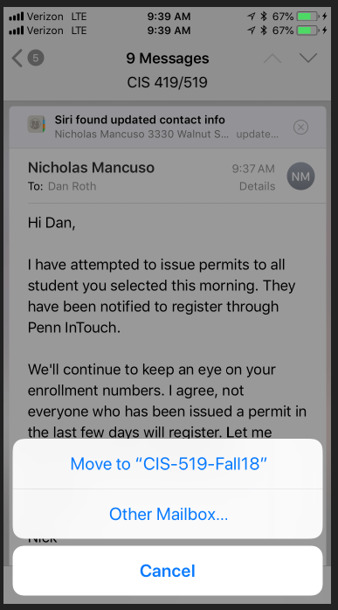
CIS 419/519: Applied Machine Learning
Monday, Wednesday: 12:00pm-1:30pm 101 Levine
Office hours: Mon/Wed 5-6 pm [my office]
10 TAs
Assignments: 5 Problems set (Python Programming)
Weekly (light) on-line quizzes
Weekly Discussion Sessions
Mid Term Exam
[Project] (look at the schedule)
Final
No real textbook:
  Slides/Mitchell/Flach/Other Books/ Lecture notes /Literature
Registration to Class
No office hour today
TAs Office Hours will also start next week
HW0 !!!
Go to the web site
Be on Piazza

Slide 3
CIS519: Today
What is Learning?
Who are you?
What is CIS519 about?
The Badges Game…

Slide 4
An Owed to the Spelling Checker
I have a spelling checker, it came with my PC
It plane lee marks four my revue
Miss steaks aye can knot sea.
Eye ran this poem threw it, your sure reel glad two no.
Its vary polished in it's weigh
My checker tolled me sew.
A checker is a bless sing, it freeze yew lodes of thyme.
It helps me right awl stiles two reed
And aides me when aye rime.
Each frays come posed up on my screen
Eye trussed to bee a joule...

Slide 5
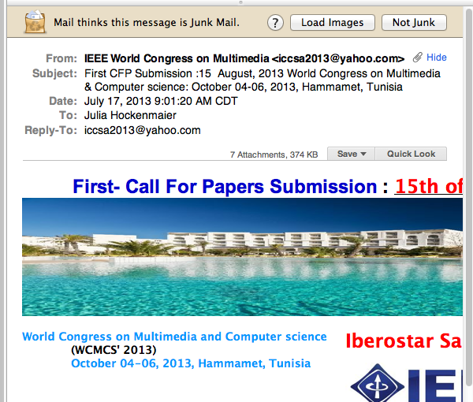
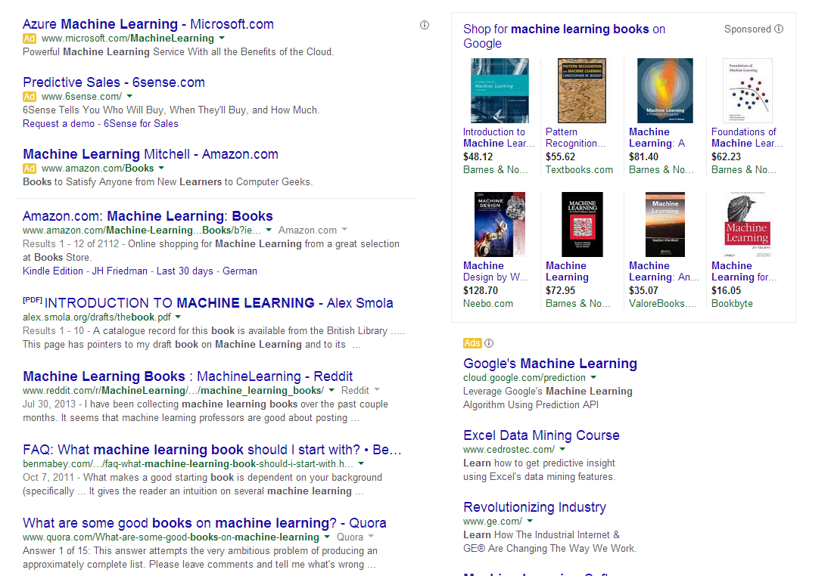
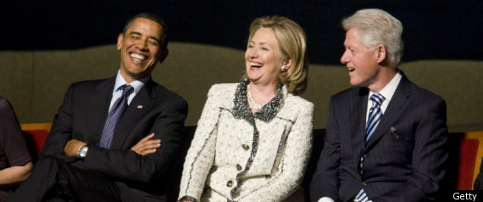
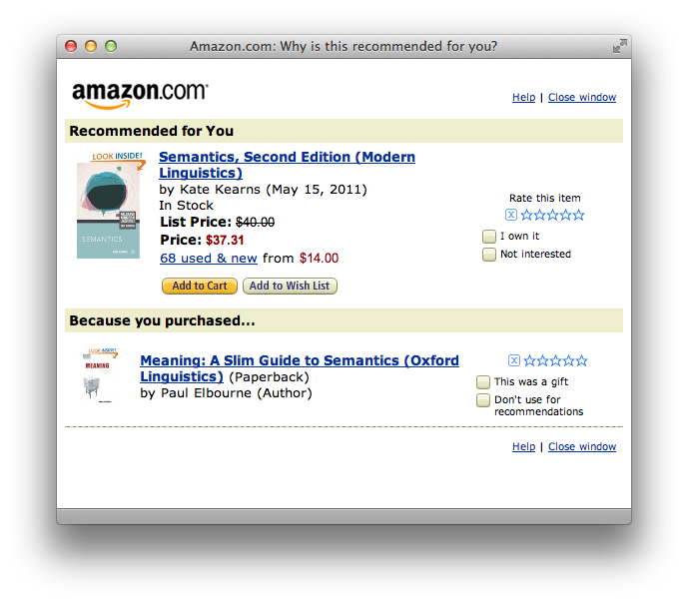
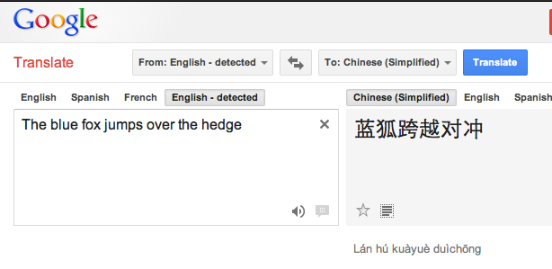
Machine learning is everywhere

Slide 6
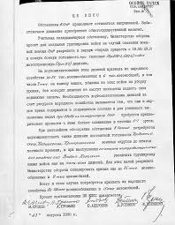
Applications: Spam Detection
This is a binary classification task:
Assign one of two labels (i.e. yes/no)
to the input (here, an email message)
Classification requires a model
(a classifier) to determine which
label to assign to items.
In this class, we study algorithms and techniques to learn such models from data.
Documents Labels
Documents Politics, Sports, Finance
Sentences Positive, Negative
Phrases Person, Location
Images cats, dogs, snakes
Medical records Admit again soon/Not
…..
?

Slide 7
Comprehension
(ENGLAND, June, 1989) - Christopher Robin is alive and well. He lives in England. He is the same person that you read about in the book, Winnie the Pooh. As a boy, Chris lived in a pretty home called Cotchfield Farm. When Chris was three years old, his father wrote a poem about him. The poem was printed in a magazine for others to read. Mr. Robin then wrote a book. He made up a fairy tale land where Chris lived. His friends were animals. There was a bear called Winnie the Pooh. There was also an owl and a young pig, called a piglet. All the animals were stuffed toys that Chris owned. Mr. Robin made them come to life with his words. The places in the story were all near Cotchfield Farm. Winnie the Pooh was written in 1925. Children still love to read about Christopher Robin and his animal friends. Most people don't know he is a real person who is grown now. He has written two books of his own. They tell what it is like to be famous.
1. Christopher Robin was born in England. 2. Winnie the Pooh is a title of a book.
3. Christopher Robin’s dad was a magician. 4. Christopher Robin must be at least 65 now.
This is an Inference Problem; where is the learning?
Notes:
7

Slide 8
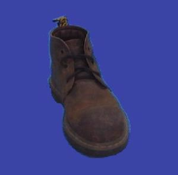
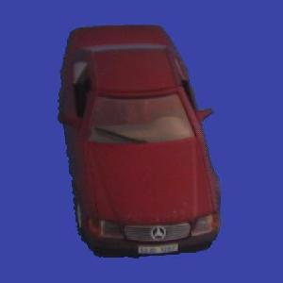
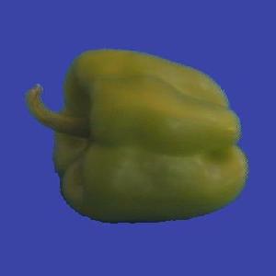
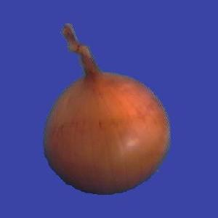
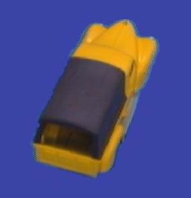
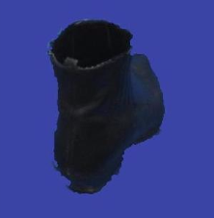
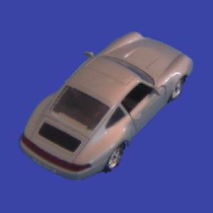
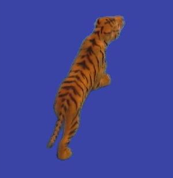
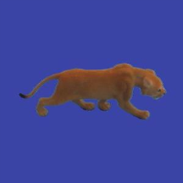
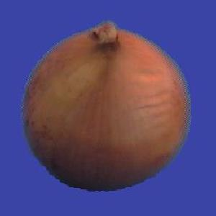
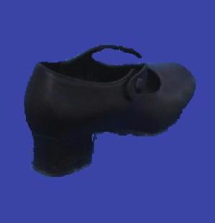
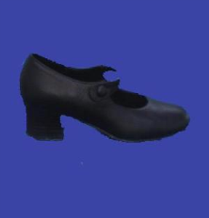
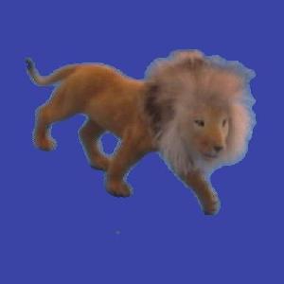
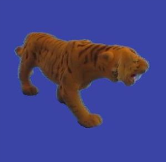
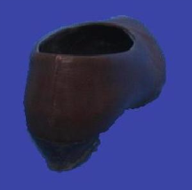
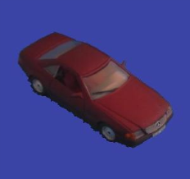
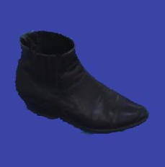
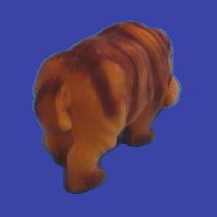
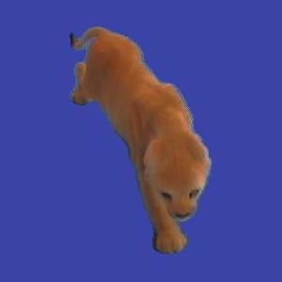
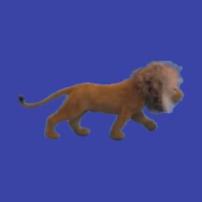
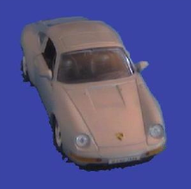
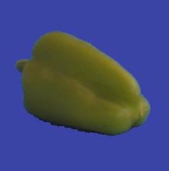

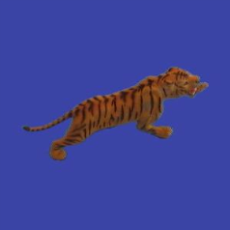
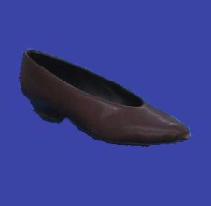
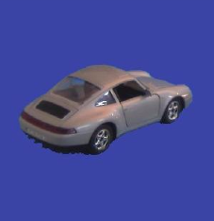
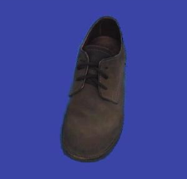
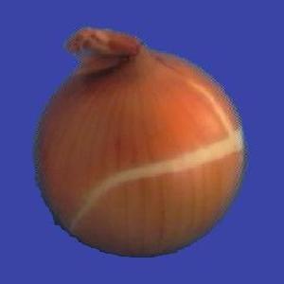
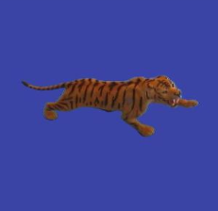
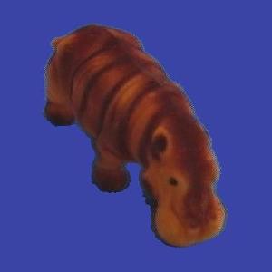
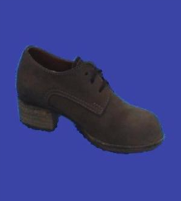
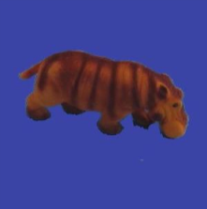
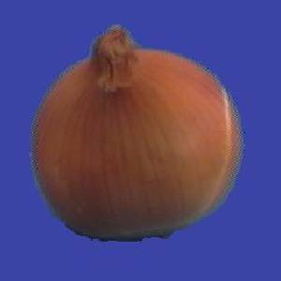
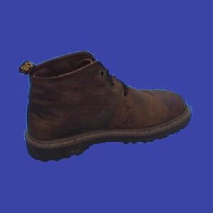
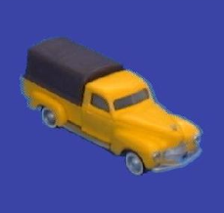
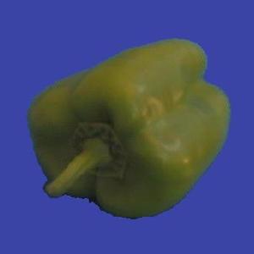
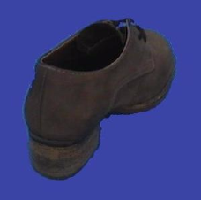
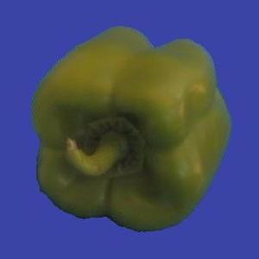
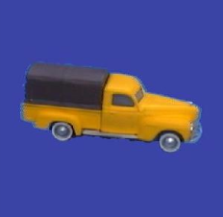
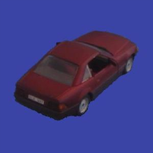
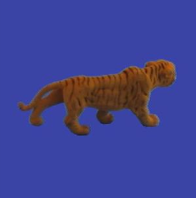
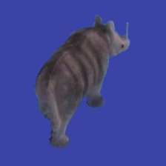
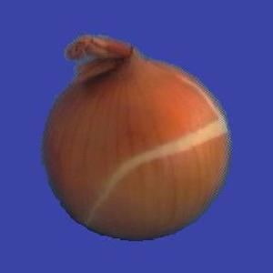
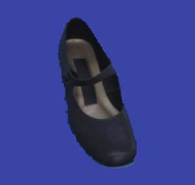











Slide 9
Learning
Learning is at the core of
  Understanding High Level Cognition
  Performing knowledge intensive inferences
  Building adaptive, intelligent systems
  Dealing with messy, real world data
  Analytics
Learning has multiple purposes
  Knowledge Acquisition
  Integration of various knowledge sources to ensure robust behavior
  Adaptation (human, systems)
  Decision Making (Predictions)

Slide 10
Learning = Generalization
H. Simon -
“Learning denotes changes in the system that are adaptive in the sense that they enable the system to do the task or tasks drawn from the same population more efficiently and more effectively the next time.”
The ability to perform a task in a situation which has never been encountered before

Slide 11
Learning = Generalization
The learner has to be able to classify items
it has never seen before.
Mail thinks this message is about my Fall 2018 ML Class

Slide 12
Learning = Generalization
The ability to perform a task in a situation which has never been encountered before
Classification
  Medical diagnosis; credit card applications; hand-written letters; ad selection; sentiment assignment,…
Planning and acting
  Game playing (chess, backgammon, go); driving a car
Skills
  (A robot) balancing a pole; playing tennis
Common sense reasoning
  Natural language interactions
What does the algorithm get as input?
(features)
The Badges game
Generalization depends on the Representation as much as it depends on the Algorithm used.

Slide 13

Same Population?
In New York State, the longest period of daylight occurs during the month of _________.
New Zeeland
Notes:
If you can solve the first problem, you’d expect to be able to solve the other one too; so, what’s the meaning of “same population”?

Slide 14
Why Study Machine Learning?
“A breakthrough in machine learning would be worth ten Microsofts”
-Bill Gates, Chairman, Microsoft
“Machine learning is the next Internet”
-Tony Tether, Former Director, DARPA
Machine learning is the hot new thing”
-John Hennessy, President, Stanford
“Web rankings today are mostly a matter of machine learning”
-Prabhakar Raghavan, Dir. Research, Yahoo
“Machine learning is going to result in a real revolution”
-Greg Papadopoulos, CTO, Sun
“Machine learning is today’s discontinuity”
-Jerry Yang, CEO, Yahoo

Slide 15
Why Study Learning?
Computer systems with new capabilities.
AI
Understand human and biological learning
Understanding teaching better.
Time is right.
  Initial algorithms and theory in place.
  Growing amounts of on-line data
  Computational power available.
  Necessity: many things we want to do cannot be done by “programming”.
  (Think about all the examples given earlier)

Slide 16
Learning is the future
Learning techniques will be a basis for every application that involves a connection to the messy real world
Basic learning algorithms are ready for use in applications today
Prospects for broader future applications make for exciting fundamental research and development opportunities
Many unresolved issues – Theory and Systems
  While learning is hot, there are many things we don’t know how to do
  And that’s why this is NOT a class about deep neural networks
Very active field
What to teach?
  The fundamental paradigms
  Some of the most important algorithmic ideas
  Modeling
And: what we don’t know

Slide 17
Course Overview
Introduction: Basic problems and questions
A detailed example: Linear classifiers; key algorithmic idea
Two Basic Paradigms:
  Discriminative Learning & Generative/Probabilistic Learning
Learning Protocols:
  Supervised; Unsupervised; Semi-supervised
Algorithms
  Gradient Descent
  Decision Trees
  Linear Representations: (Perceptron; SVMs; Kernels)
  Neural Networks/Deep Learning
  Probabilistic Representations (naïve Bayes)
  Unsupervised /Semi supervised: EM
  Clustering; Dimensionality Reduction
Modeling; Evaluation; Real world challenges
Ethics

Slide 18
CIS 419/519: Applied Machine Learning
Monday, Wednesday: 12:00pm-1:30pm 101 Levine
Office hours: Mon/Wed 5-6 pm [my office]
10 TAs
Assignments: 5 Problems set (Python Programming)
Weekly (light) on-line quizzes
Weekly Discussion Sessions
Mid Term Exam
[Project] (look at the schedule)
Final
No real textbook:
  Slides/Mitchell/Flach/Other Books/ Lecture notes /Literature
Registration to Class
No office hour today
TAs Office Hours will also start next week
HW0 !!!
Go to the web site
Be on Piazza

Slide 19
CIS 419/519: Applied Machine Learning
Monday, Wednesday: 12:00pm-1:30pm 101 Levine
Office hours: Mon/Wed 5-6 pm [my office]
10 TAs
Assignments: 5 Problems set (Python Programming)
Weekly (light) on-line quizzes
Weekly Discussion Sessions
Mid Term Exam
[Project] (look at the schedule)
Final
No real textbook:
  Slides/Mitchell/Flach/Other Books/ Lecture notes /Literature
Registration to Class
No office hour today
TAs Office Hours will also start next week
HW0 !!!
Go to the web site
Be on Piazza

Slide 20
CIS(4,5)19: Applied Machine Learning
Tuesday, Thursday: 1:30pm-3:00pm 101 Levine
Office hours: Tue/Thur 4:30-5:30 pm [my office]
9 TAs
Assignments: 5 Problems set (Python Programming)
Weekly (light) on-line quizzes
Weekly Discussion Sessions
Mid Term Exam
[Project]
Final
No real textbook:
  Mitchell/Flach/Other Books/ Lecture notes /Literature
Registration to Class
Go to the web site
Be on Piazza

Slide 21
CIS519: Machine Learning
What do you need to know:
  Some exposure to:
    Theory of Computation
    Probability Theory
    Linear Algebra
  Programming (Python)
Homework 0
  If you could not comfortably deal with 2/3 of this within a few hours, please take the prerequisites first; come back next semester/year.
Participate, Ask Questions
Ask during class, not after class

Slide 22
CIS 519: Policies
Cheating
  No.
  We take it very seriously.
Homework:
  Collaboration is encouraged
  But, you have to write your own solution/code.
Late Policy:
  You have a credit of 4 days; That’s it.
Grading:
  Possible separate for grad/undergrads.
  40% - homework; ; 35%-final; 20%-midterm; 5% Quizzes
  [Projects: 20%]
Questions?
Class’ Web Page
Note also the Schedule Page and our Notes

Slide 23
CIS519 on the web
Check our class website:
  Schedule, slides, videos, policies
    http://www.seas.upenn.edu/~cis519/fall2018/
  Sign up, participate in our Piazza forum:
    Announcements and discussions
    http://piazza.com/upenn/fall2018/cis419519
  Check out our team
    Office hours
    [Optional] Discussion Sessions

Slide 24
What is Learning
The Badges Game……
  This is an example of the key learning protocol: supervised learning
First question: Are you sure you got it?
  Why?
Issues:
  Prediction or Modeling?
  Representation
  Problem setting
  Background Knowledge
  When did learning take place?
  Algorithm
Notes:
Badges game
Don’t give me the answer
Start thinking about how to write a program that will figure out whether my name has + or – next to it.

