Slide 1
CIS 519/419
Applied Machine Learning www.seas.upenn.edu/~cis519
Dan Roth
danroth@seas.upenn.edu
http://www.cis.upenn.edu/~danroth/
461C, 3401 Walnut
Slides were created by Dan Roth (for CIS519/419 at Penn or CS446 at UIUC), Eric Eaton for CIS519/419 at Penn, or from other authors who have made their ML slides available.

Slide 2
Course Overview
Introduction: Basic problems and questions
A detailed example: Linear classifiers; key algorithmic idea
Two Basic Paradigms:
  Discriminative Learning & Generative/Probablistic Learning
Learning Protocols:
  Supervised; Unsupervised; Semi-supervised
Algorithms
  Gradient Descent
  Decision Trees
  Linear Representations: (Perceptron; SVMs; Kernels)
  Neural Networks/Deep Learning
  Probabilistic Representations (naïve Bayes)
  Unsupervised /Semi supervised: EM
  Clustering; Dimensionality Reduction
Modeling; Evaluation; Real world challenges
Ethics

Slide 3
CIS519 Admin
Registration to Class
Check our class website:
  Schedule, slides, videos, policies
    http://www.seas.upenn.edu/~cis519/fall2018/
  Sign up, participate in our Piazza forum:
    Announcements and discussions
    http://piazza.com/upenn/fall2018/cis419519
  Check out our team
    Office hours
  Canvas:
    Notes, homework and videos will be open.
  [Optional] Discussion Sessions:
    Starting this week: Wednesday 4pm, Thursday 5pm: Python Tutorial
    Check the website for the location
HW0 is mandatory!
We start today

Slide 4
What is Learning
The Badges Game……
  This is an example of the key learning protocol: supervised learning
First question: Are you sure you got it?
  Why?
Notes:
Badges game
Don’t give me the answer
Start thinking about how to write a program that will figure out whether my name has + or – next to it.

Slide 5
Training data
+ Naoki Abe
- Myriam Abramson
+ David W. Aha
+ Kamal M. Ali
- Eric Allender
+ Dana Angluin
- Chidanand Apte
+ Minoru Asada
+ Lars Asker
+ Javed Aslam
+ Jose L. Balcazar
- Cristina Baroglio
+ Peter Bartlett
- Eric Baum
+ Welton Becket
- Shai Ben-David
+ George Berg
+ Neil Berkman
+ Malini Bhandaru
+ Bir Bhanu
+ Reinhard Blasig
- Avrim Blum
- Anselm Blumer
+ Justin Boyan
+ Carla E. Brodley
+ Nader Bshouty
- Wray Buntine
- Andrey Burago
+ Tom Bylander
+ Bill Byrne
- Claire Cardie
+ John Case
+ Jason Catlett
- Philip Chan
- Zhixiang Chen
- Chris Darken

Slide 6
The Badges game
+ Naoki Abe
- Eric Baum
Conference attendees to the 1994 Machine Learning conference were given name badges labeled with + or −.
What function was used to assign these labels?

Slide 7
Raw test data
Shivani Agarwal
Gerald F. DeJong
Chris Drummond
Yolanda Gil
Attilio Giordana
Jiarong Hong
J. R. Quinlan
Priscilla Rasmussen
Dan Roth
Yoram Singer
Lyle H. Ungar

Slide 8
Labeled test data
? Shivani Agarwal
+ Gerald F. DeJong
- Chris Drummond
+ Yolanda Gil
- Attilio Giordana
+ Jiarong Hong
- J. R. Quinlan
- Priscilla Rasmussen
+ Dan Roth
+ Yoram Singer
- Lyle H. Ungar

Slide 9

What is Learning
The Badges Game……
  This is an example of the key learning protocol: supervised learning
First question: Are you sure you got it?
  Why?
Issues:
  Which problem was easier?
  Prediction or Modeling?
  Representation
  Problem setting
  Background Knowledge
  When did learning take place?
  Algorithm: can you write a program that takes this data as input and predicts the label for your name?
Notes:
Badges game
Don’t give me the answer
Start thinking about how to write a program that will figure out whether my name has + or – next to it.

Slide 10
Supervised Learning
Input
x∈ X
An item x
drawn from an input space X
System
y = f(x)
Output
y∈ Y
An item y
drawn from an output space Y
We consider systems that apply a function f()
to input items x and return an output y = f(x).

Slide 11
Supervised Learning
Input
x∈ X
An item x
drawn from an input space X
System
y = f(x)
Output
y∈ Y
An item y
drawn from an output space Y
In (supervised) machine learning, we deal with systems whose f(x) is learned from examples.

Slide 12

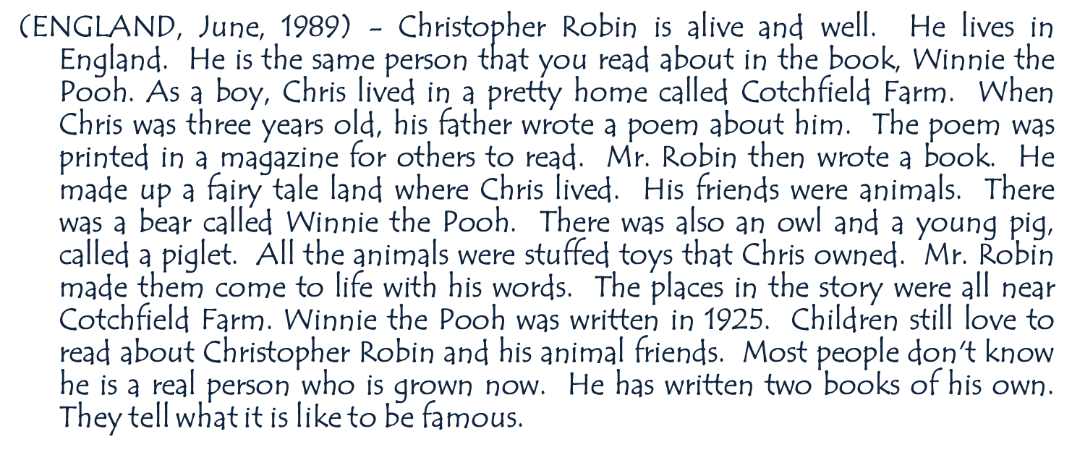
Why use learning?
We typically use machine learning when the function f(x) we want the system to apply is unknown to us, and we cannot “think” about it. The function could actually be simple.

Slide 13
Supervised learning
Input
x∈ X
An item x
drawn from an instance space X
Target function
y = f(x)
Output
y∈ Y
An item y
drawn from a label space Y
Learned Model
y = g(x)

Slide 14
Supervised learning: Training
Can you suggest other learning protocols?
  Labeled Training Data
  D ^{train}
  (x₁, y₁)
  (x₂, y₂)
  …
  (x_{N}, y_{N})
Learned model
g(x)
Learning Algorithm
Give the learner examples in D ^{train}
The learner returns a model g(x)
g(x) is the model we’ll use in our application

Slide 15
Supervised learning: Testing
  Labeled
  Test Data
  D ^{test}
  (x’₁, y’₁)
  (x’₂, y’₂)
  …
  (x’_{M}, y’_{M})
Reserve some labeled data for testing

Slide 16
Supervised learning: Testing
  Labeled
  Test Data
  D ^{test}
  (x’₁, y’₁)
  (x’₂, y’₂)
  …
  (x’_{M}, y’_{M})
  Raw Test Data
  X ^{test}
  x’₁
  x’₂
  ….
  x’_{M}
  Test
  Labels
  Y ^{test}
  y’₁
  y’₂
  ...
  y’_{M}

Slide 17
Supervised learning: Testing
Can you use the test data otherwise?
Apply the model to the raw test data
Evaluate by comparing predicted labels against the test labels
  Raw Test Data
  X ^{test}
  x’₁
  x’₂
  ….
  x’_{M}
  Predicted
  Labels
  g(X ^{test})
  g(x’₁)
  g(x’₂)
  ….
  g(x’_{M})
  Test
  Labels
  Y ^{test}
  y’₁
  y’₂
  ...
  y’_{M}
Learned model
g(x)
Notes:
Could potentially check g(x) (Exact learning);
Can the test data, even without the labels, be used to learn something? Maybe something about the distribution of the tests?

Slide 18
Supervised Learning : Examples
Disease diagnosis
  x: Properties of patient (symptoms, lab tests)
  f : Disease (or maybe: recommended therapy)
Part-of-Speech tagging
  x: An English sentence (e.g., The can will rust)
  f : The part of speech of a word in the sentence
Face recognition
  x: Bitmap picture of person’s face
  f : Name the person (or maybe: a property of)
Automatic Steering
  x: Bitmap picture of road surface in front of car
  f : Degrees to turn the steering wheel
Many problems that do not seem like classification problems can be decomposed to classification problems.
Notes:
Badges game
Don’t give me the answer
Start thinking about how to write a program that will figure out whether my name has + or – next to it.

Slide 19
Course Overview
Introduction: Basic problems and questions
A detailed example: Linear classifiers; key algorithmic idea
Two Basic Paradigms:
  Discriminative Learning & Generative/Probablistic Learning
Learning Protocols:
  Supervised; Unsupervised; Semi-supervised
Algorithms
  Gradient Descent
  Decision Trees
  Linear Representations: (Perceptron; SVMs; Kernels)
  Neural Networks/Deep Learning
  Probabilistic Representations (naïve Bayes)
  Unsupervised /Semi supervised: EM
  Clustering; Dimensionality Reduction
Modeling; Evaluation; Real world challenges
Ethics

Slide 20
Key Issues in Machine Learning
Modeling
  How to formulate application problems as machine learning problems ? How to represent the data?
  Learning Protocols (where is the data & labels coming from?)
Representation
  What functions should we learn (hypothesis spaces) ?
  How to map raw input to an instance space?
  Any rigorous way to find these? Any general approach?
Algorithms
  What are good algorithms?
  How do we define success?
  Generalization vs. over fitting
  The computational problem
Notes:
Badges game
Don’t give me the answer
Start thinking about how to write a program that will figure out whether my name has + or – next to it.

Slide 21
Using supervised learning
What is our instance space?
  Gloss: What kind of features are we using?
What is our label space?
  Gloss: What kind of learning task are we dealing with?
What is our hypothesis space?
  Gloss: What kind of functions (models) are we learning?
What learning algorithm do we use?
  Gloss: How do we learn the model from the labeled data?
What is our loss function/evaluation metric?
  Gloss: How do we measure success? What drives learning?
Notes:
What is the real input the algorithm sees?
What are the labels? Folder names; maybe there is a hierarchy
Set of rules: if the sender is… put it in their folder. Decision tree: if condition A is satisfied, Check condition B; if not, Check condition C.; NN
The representation might dictate the learning algorithm.
Number of correct predictions? Maybe it’s an non-symmetric loss: I never want to file incorrectly, I prefer to abstain. Maybe there is a hierarchy, and I want a loss that is sensitive to the hierarchy.

Slide 22
1. The instance space X
Input
x∈X
An item x
drawn from an instance space X
Learned
Model
y = g(x)
Output
y∈Y
An item y
drawn from a label space Y
Designing an appropriate instance space X
is crucial for how well we can predict y.

Slide 23
1. The instance space X
When we apply machine learning to a task, we first need to define the instance space X.
Instances x ∈ X are defined by features:
  Boolean features:
    Is there a folder named after the sender?
    Does this email contains the word ‘class’?
    Does this email contains the word ‘waiting’?
    Does this email contains the word ‘class’ and the word ‘waiting’?
  Numerical features:
    How often does ‘learning’ occur in this email?
    What long is email?
    How many emails have I seen from this sender over the last day/week/month?
  Bag of tokens
    Just list all the tokens in the input
Does it add anything?

Slide 24
What’s X for the Badges game?
Possible features:
  Gender/age/country of the person?
  Length of their first or last name?
  Does the name contain letter ‘x’?
  How many vowels does their name contain?
  Is the n-th letter a vowel?
  Height;
  Shoe size

Slide 25
X as a vector space
X is an N-dimensional vector space (e.g. <^{N})
  Each dimension = one feature.
Each x is a feature vector (hence the boldface x).
Think of x = [x₁ … x_{N}] as a point in X :
x₂
x₁

Slide 26
From feature templates to vectors
When designing features, we often think in terms of templates, not individual features:
Encoding a name by encoding it characters:
What is the i-th letter?
Abe → [1 0 0 0 0… 0 1 0 0 0 0… 0 0 0 0 1 …]
  26*2 + 1 positions in each group;
  # of groups == upper bounds on length of names

Slide 27
Good features are essential
The choice of features is crucial for how well a task can be learned.
  In many application areas (language, vision, etc.), a lot of work goes into designing suitable features.
  This requires domain expertise.
Think about the badges game – what if you were focusing on visual features?
We can’t teach you what specific features
to use for your task.
  But we will touch on some general principles

Slide 28
2. The label space Y
Input
x∈X
An item x
drawn from an instance space X
Learned Model
y = g(x)
Output
y∈Y
An item y
drawn from a label space Y
The label space Y determines what kind of supervised learning task we are dealing with

Slide 29
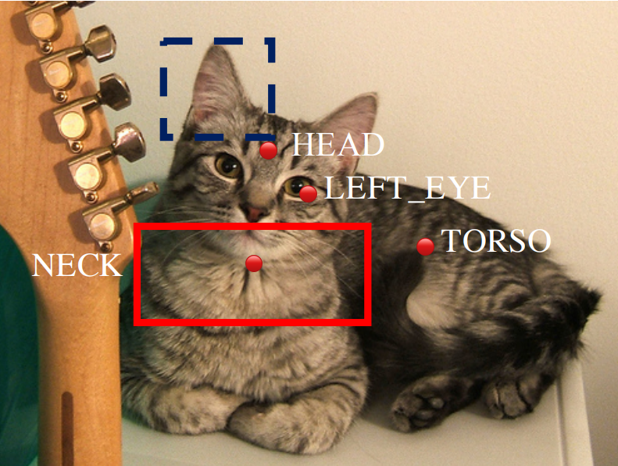
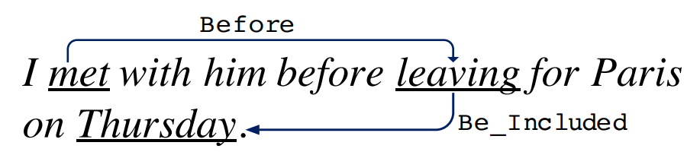
Supervised learning tasks I
Output labels y∈Y are categorical:
  Binary classification: Two possible labels
  Multiclass classification: k possible labels
  Output labels y∈Y are structured objects (sequences of labels, parse trees, etc.)
  Structure learning

Slide 30
Supervised learning tasks II
Output labels y∈Y are numerical:
  Regression (linear/polynomial):
    Labels are continuous-valued
    Learn a linear/polynomial function f(x)
  Ranking:
    Labels are ordinal
    Learn an ordering f(x₁) > f(x₂) over input

Slide 31
3. The model g(x)
Input
x∈X
An item x
drawn from an instance space X
Learned Model
y = g(x)
Output
y∈Y
An item y
drawn from a label space Y
We need to choose what kind of model
we want to learn

Slide 32
A Learning Problem
x1
x2
Unknown
function
x3
y = f (x1, x2, x3, x4)
x4
Example
x1 x2 x3 x4 y
1 0 0 1 0 0
Can you learn this function? What is it?
2 0 1 0 0 0
3 0 0 1 1 1
4 1 0 0 1 1
5 0 1 1 0 0
6 1 1 0 0 0
7 0 1 0 1 0

Slide 33
Hypothesis Space
Complete Ignorance:
There are 2¹⁶ = 65536 possible functions
over four input features.
We can’t figure out which one is
correct until we’ve seen every
possible input-output pair.
After observing seven examples we still
have 2⁹ possibilities for f
Is Learning Possible?
Example
x1 x2 x3 x4 y
1 0 0 0 0 ?
2 0 0 0 1 ?
There are |Y|^{|X|} possible functions f(x) from the instance space X to the label space Y.
Learners typically consider only a subset of the functions from X to Y, called the hypothesis space H . H ⊆|Y|^{|X|}
0 0 1 0 0
0 0 1 1 1
0 1 0 0 0
0 1 0 1 0
0 1 1 0 0
0 1 1 1 ?
1 0 0 0 ?
1 0 0 1 1
1 0 1 0 ?
1 0 1 1 ?
1 1 0 0 0
1 1 0 1 ?
1 1 1 0 ?
16 1 1 1 1 ?
Notes:
Badges game
Don’t give me the answer
Start thinking about how to write a program that will figure out whether my name has + or – next to it.

Slide 34
Hypothesis Space (2)
1 0 0 1 0 0
2 0 1 0 0 0
3 0 0 1 1 1
Simple Rules: There are only 16 simple conjunctive rules
of the form y=x_{i} ˄ x_{j} ˄ x_{k}
No simple rule explains the data. The same is true for simple clauses (disjunctions).
4 1 0 0 1 1
5 0 1 1 0 0
6 1 1 0 0 0
7 0 1 0 1 0
Rule Counterexample
Rule Counterexample
y=c
x1 1100 0
x2 0100 0
x3 0110 0
x4 0101 1
x1 Λ x2 1100 0
x1 Λ x3 0011 1
x1 Λ x4 0011 1
x2 Λ x3 0011 1
x2 Λ x4 0011 1
x3 Λ x4 1001 1
x1 Λ x2 Λ x3 0011 1
x1 Λ x2 Λ x4 0011 1
x1 Λ x3 Λ x4 0011 1
x2 Λ x3 Λ x4 0011 1
x1 Λ x2 Λ x3 Λ x4 0011 1
Notes:
Badges game
Don’t give me the answer
Start thinking about how to write a program that will figure out whether my name has + or – next to it.

Slide 35
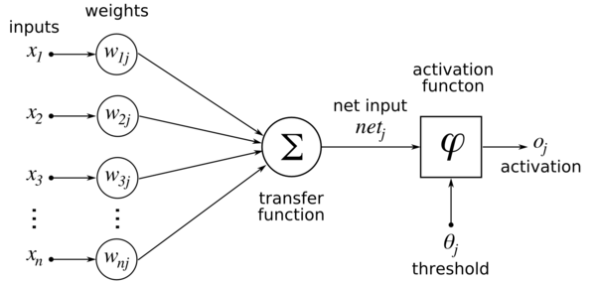
Hypothesis Space (3)
Don’t worry, this function is actually a neural network…
Notation: 2 variables from the set on the left. Value: Index of the counterexample.
1 0 0 1 0 0
2 0 1 0 0 0
3 0 0 1 1 1
m-of-n rules: There are 32 possible rules
of the form ``y = 1 if and only if at least m
of the following n variables are 1”
4 1 0 0 1 1
5 0 1 1 0 0
6 1 1 0 0 0
7 0 1 0 1 0
variables 1-of 2-of 3-of 4-of
variables 1-of 2-of 3-of 4-of
{x1} 3 - - -
{x2} 2 - - -
{x3} 1 - - -
{x4} 7 - - -
{x1,x2} 2 3 - -
{x1, x3} 1 3 - -
{x1, x4} 6 3 - -
{x2,x3} 2 3 - -
{x2, x4} 2 3 - -
{x3, x4} 4 4 - -
{x1,x2, x3} 1 3 3 -
{x1,x2, x4} 2 3 3 -
{x1,x3,x4} 1 ∗ ∗ ∗ 3 -
{x2, x3,x4} 1 5 3 -
{x1, x2, x3,x4} 1 5 3 3
Found a consistent hypothesis!

Slide 36
Views of Learning
Learning is the removal of our remaining uncertainty:
  Suppose we knew that the unknown function was an m-of-n Boolean function, then we could use the training data to infer which function it is.
Learning requires guessing a good hypothesis class:
  We can start with a very small class and enlarge it until it contains an hypothesis that fits the data.
We could be wrong !
  Our prior knowledge might be wrong:
    y=x4 Λ one-of (x1, x3) is also consistent
  Our guess of the hypothesis space could be wrong
If this is the unknown function, then we will make errors when we are given new examples, and are asked to predict the value of the function
Notes:
Badges game
Don’t give me the answer
Start thinking about how to write a program that will figure out whether my name has + or – next to it.

Slide 37
General strategies for Machine Learning
Develop flexible hypothesis spaces:
  Decision trees, neural networks, nested collections.
  Constraining the hypothesis space is done algorithmically
Develop representation languages for restricted classes of functions:
  Serve to limit the expressivity of the target models
  E.g., Functional representation (n-of-m); Grammars; linear functions; stochastic models;
  Get flexibility by augmenting the feature space
In either case:
  Develop algorithms for finding a hypothesis in our hypothesis space, that fits the data
  And hope that they will generalize well
Notes:
Badges game
Don’t give me the answer
Start thinking about how to write a program that will figure out whether my name has + or – next to it.

Slide 38
Terminology
Target function (concept): The true function f :X →{…Labels…}
Concept: Boolean function. Example for which f (x)= 1 are positive examples; those for which f (x)= 0 are negative examples (instances)
Hypothesis: A proposed function h, believed to be similar to f. The output of our learning algorithm.
Hypothesis space: The space of all hypotheses that can, in principle, be the output of the learning algorithm.
Classifier: A discrete valued function produced by the learning algorithm. The possible value of f: {1,2,…K} are the classes or class labels. (In most algorithms the classifier will actually return a real valued function that we’ll have to interpret).
Training examples: A set of examples of the form {(x, f (x))}
Notes:
Badges game
Don’t give me the answer
Start thinking about how to write a program that will figure out whether my name has + or – next to it.

Slide 39
Example: Generalization vs Overfitting
What is a Tree ?
A botanist Her brother
A tree is something with A tree is a green thing
leaves I’ve seen before
Neither will generalize well
Notes:
Badges game
Don’t give me the answer
Start thinking about how to write a program that will figure out whether my name has + or – next to it.

Slide 40
Administration
The class is still full.
  There will be some changes until midnight tonight.
  But there will be chances to petition and get in as people drop.
You all need to complete HW0!
1st quiz was due last night.
HW 1 will be released next week.
Questions?
  Please ask/comment during class.
No Class on Wednesday
Office hours, as usual;
  I will have one today, but not on Wednesday.

Slide 41
Key Issues in Machine Learning
Modeling
  How to formulate application problems as machine learning problems ? How to represent the data?
  Learning Protocols (where is the data & labels coming from?)
Representation
  What functions should we learn (hypothesis spaces) ?
  How to map raw input to an instance space?
  Any rigorous way to find these? Any general approach?
Algorithms
  What are good algorithms?
  How do we define success?
  Generalization Vs. over fitting
  The computational problem
Notes:
Badges game
Don’t give me the answer
Start thinking about how to write a program that will figure out whether my name has + or – next to it.

Slide 42
An Example: Context Sensitive Spelling
I don’t know {whether, weather} to laugh or cry
How can we make this a learning problem?
We will look for a function
f: Sentences→ {whether, weather}
We need to define the domain of this function better.
An option: For each word w in English define a Boolean feature x_{w} :
[x_{w} =1] iff w is in the sentence
This maps a sentence to a point in {0,1}^{50,000}
In this space: some points are whether points
some are weather points
This is the Modeling Step
What is the hypothesis space?
Input/Instance space?
Learning Protocol?
Supervised? Unsupervised?
Notes:
As we said, this is the game we are playing; in NLP, it has always been clear, that the raw information
In a sentence is not sufficient, as is to represent a good predictor. Better functions of the input were
Generated, and learning was done in these terms.

Slide 43

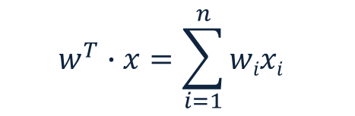
Representation Step: What’s Good?
sgn(z) =0 if z<0;
1 otherwise
$$w^{T}∙x=\sum_{i=1}^{n}{wixi }$$
Learning problem:
  Find a function that
  best separates the data
What function?
What’s best?
(How to find it?)
A possibility: Define the learning problem to be:
  A (linear) function that best separates the data
Memorizing vs. Learning
  Accuracy vs. Simplicity
How well will you do?
  On what?
Impact on Generalization
Linear = linear in the feature space
x= data representation; w = the classifier (w, x, column vectors of dimensionality n)
y = sgn {w^{T}x}
Notes:
As we said, this is the game we are playing; in NLP, it has always been clear, that the raw information
In a sentence is not sufficient, as is to represent a good predictor. Better functions of the input were
Generated, and learning was done in these terms.

Slide 44
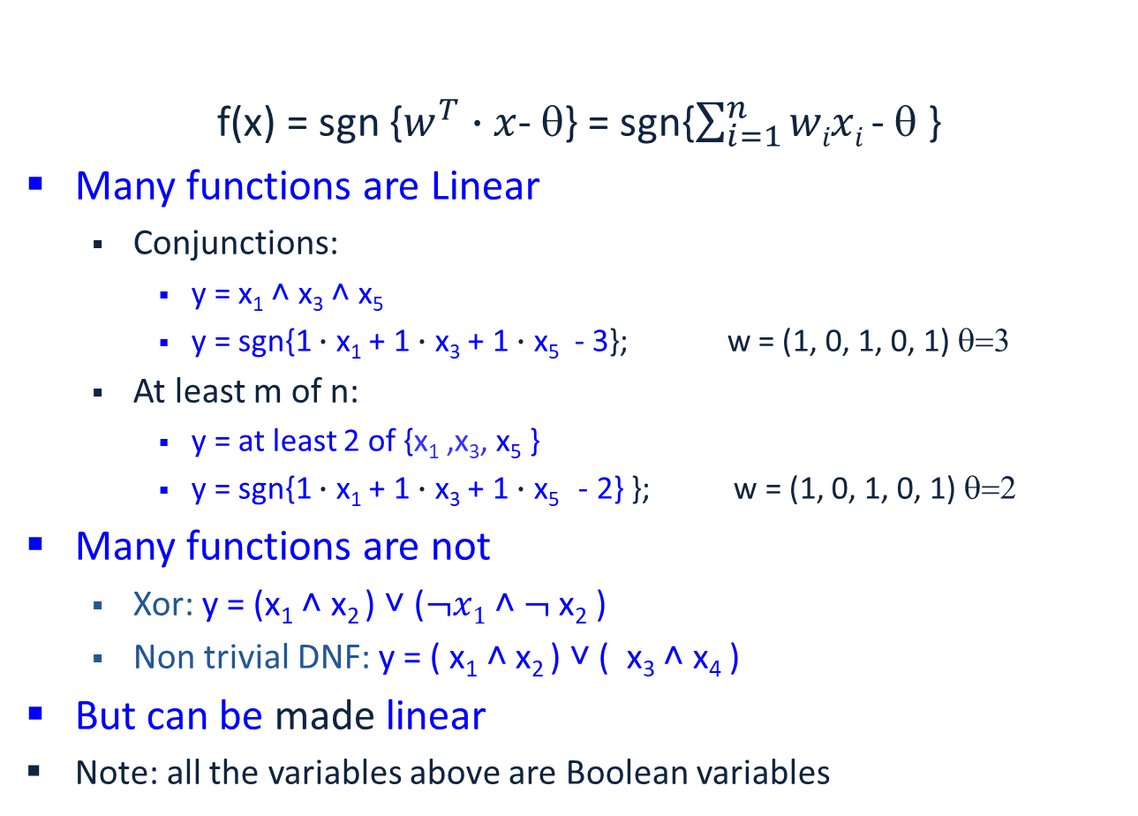
Expressivity
f(x) = sgn {$w^{T}∙x$- θ} = sgn{$\sum_{i=1}^{n}{wixi }$- θ }
Many functions are Linear
  Conjunctions:
    y = x₁ ˄ x₃ ˄ x₅
    y = sgn{1 $∙$ x₁ + 1 $∙$ x₃ + 1 $∙$ x₅ - 3}; w = (1, 0, 1, 0, 1) θ=3
  At least m of n:
    y = at least 2 of {x₁ ,x₃, x₅ }
    y = sgn{1 $∙$ x₁ + 1 $∙$ x₃ + 1 $∙$ x₅ - 2} }; w = (1, 0, 1, 0, 1) θ=2
Many functions are not
  Xor: y = (x₁ ˄ x₂ ) ˅ ($¬x1$˄ $¬$x₂ )
  Non trivial DNF: y = ( x₁ ˄ x₂ ) ˅ ( x₃ ˄ x₄ )
But can be made linear
Note: all the variables above are Boolean variables
Probabilistic Classifiers as well

Slide 45
Functions Can be Made Linear
Data points are not linearly separable in one dimension
Not separable if you insist on using a specific class of functions (e.g., linear)
x

Slide 46
Blown Up Feature Space
Data are separable in <x, x²> space
Key issue: Representation:
  what features to use.
Computationally, can be done implicitly (kernels)
  Not always ideal.
x²
x

Slide 47

Exclusive-OR (XOR)
(x₁ ˄ x₂) ˅ ($¬${x₁} ˄ $¬${x₂})
In general: a parity function.
x_{i} ∈ {0,1}
f(x₁, x₂,…, x_{n}) = 1
iff ∑ x_{i} is even
This function is not
linearly separable.
x₂
x₁
Notes:
As we said, this is the game we are playing; in NLP, it has always been clear, that the raw information
In a sentence is not sufficient, as is to represent a good predictor. Better functions of the input were
Generated, and learning was done in these terms.

Slide 48
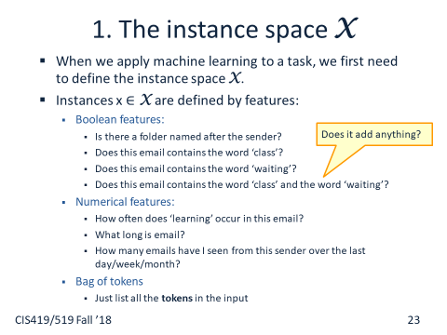
Functions Can be Made Linear
Discrete Case
A real Weather/Whether example
y₃ ˅ y₄ ˅ y₇
New discriminator is functionally simpler
x₁ x₂ x₄ ˅ x₂ x₄ x₅ ˅ x₁ x₃ x₇
Space: X= x₁, x₂,…, x_{n}
Input Transformation
New Space: Y = {y₁,y₂,…} = {x_{i},x_{i} x_{j}, x_{i} x_{j} x_{j,…}}
Whether
Weather
Notes:
As we said, this is the game we are playing; in NLP, it has always been clear, that the raw information
In a sentence is not sufficient, as is to represent a good predictor. Better functions of the input were
Generated, and learning was done in these terms.

Slide 49
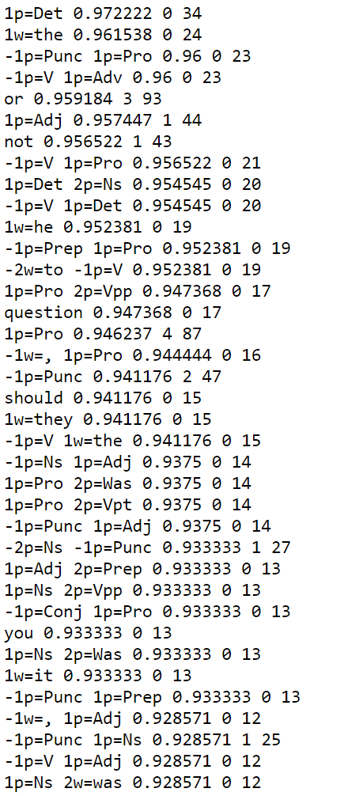
Representation (1)
Feature Types:
(what does the algorithm know about the input):
1,2. relative position (+/-1) has this pos/w
3. Conjunctions of size two
4. word w occurs in (-2,+2) window around target
Note: 4 feature types; many features
The feature resulting from instantiating the type in the given data
Some statistics (not part of the learning process; just for the understanding of the problem)

Slide 50
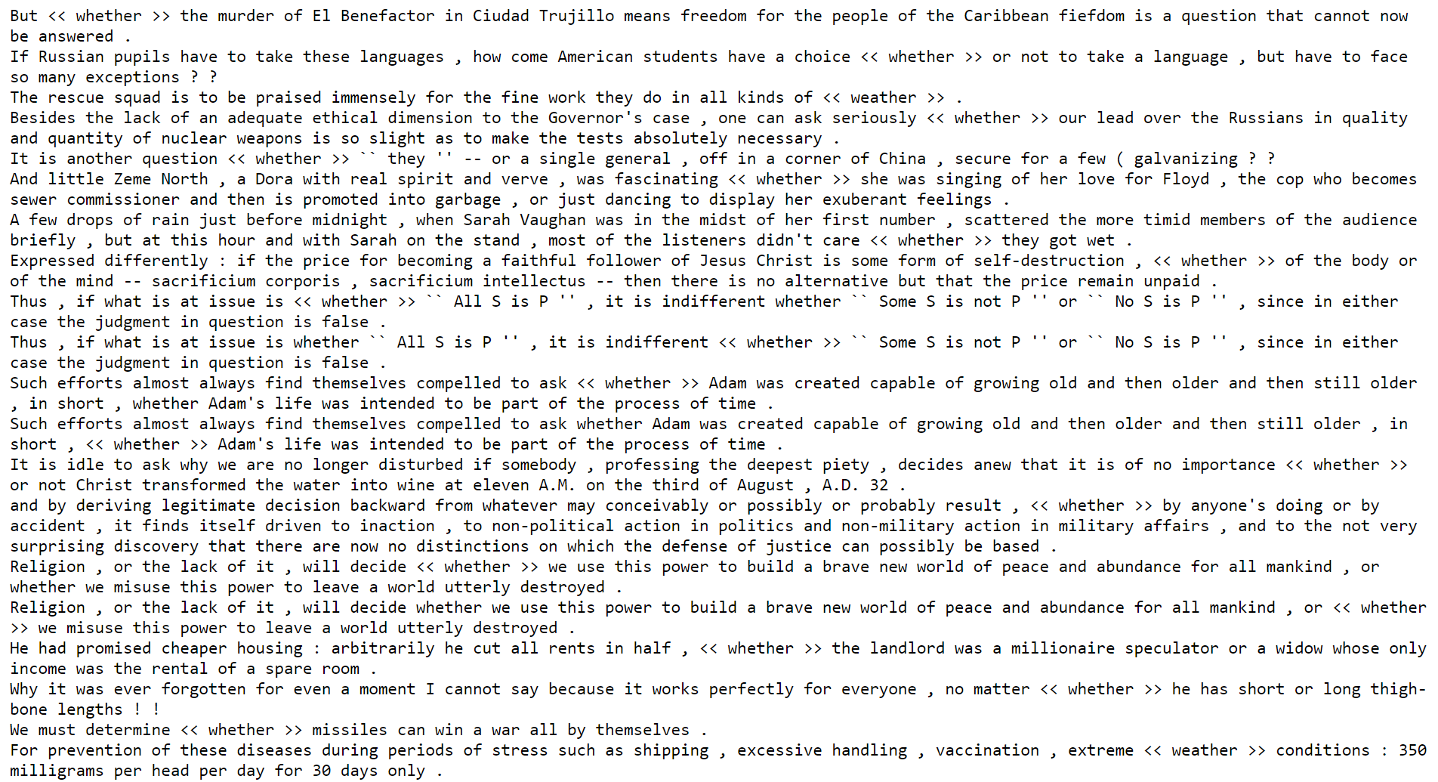
Representation (2)
Extracting features from the data:
(what does the algorithm know about the input):
1,2. relative position (+/-1); pos/w
3. Conjunctions of size two
4. Occurrence of a word in a window around the target
Note: 2 feature types; many features
For each feature type, the data gives rise to multiple features; you don’t know which, before you see the data.

Slide 51
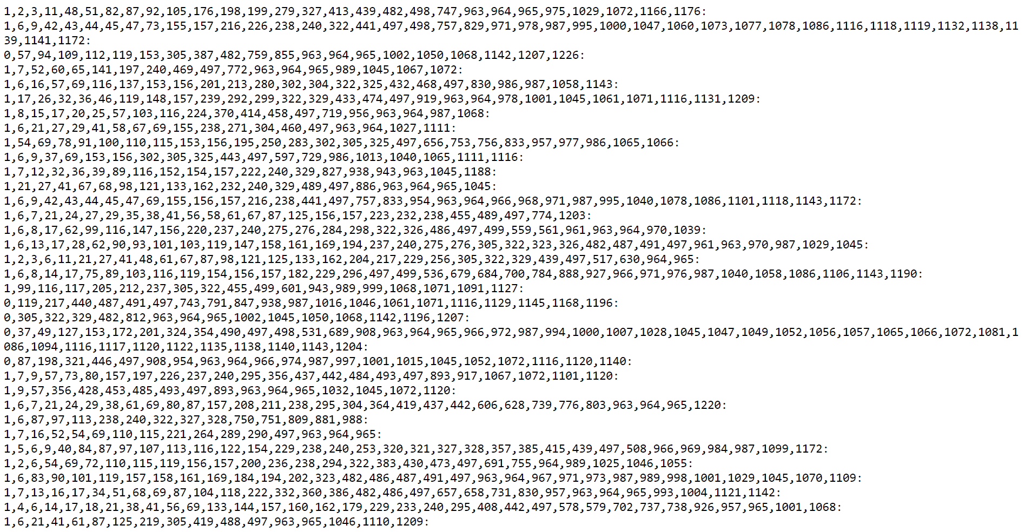
Representation (3)
Each example corresponds to one target occurrence; all the features for this target are collected into a vector, and the label is added.
Here:
- Sparse Representation of the feature vector. Why?
- Variable size: Why?
Here the first index (0/1) is the label)

Slide 52
Administration
“Easy” Registration Period is over.
  But there will be chances to petition and get in as people drop.
  If you want to switch 419/519, talk with Nicholas Mancuso nmancuso@seas.upenn.edu
You all need to complete HW0!
2nd quiz was due last night.
HW 1 will be released on Wednesday this week.
Questions?
  Please ask/comment during class.
Change in my office hours:
  Today: 3-4 pm; Wednesday 1:30-2:30

Slide 53
Third Step: How to Learn?
A possibility: Local search
  Start with a linear threshold function.
  See how well you are doing.
  Correct
  Repeat until you converge.
There are other ways that
do not search directly in
the hypotheses space
  Directly compute the
  hypothesis

Slide 54
A General Framework for Learning
Goal: predict an unobserved output value y 2 Y
based on an observed input vector x 2 X
Estimate a functional relationship y~f(x)
from a set {(x,y)_{i}}_{i=1,n}
Most relevant - Classification: y ∈ {0,1} (or y ∈ {1,2,…k} )
  (But, within the same framework can also talk about Regression, y 2 < )
What do we want f(x) to satisfy?
  We want to minimize the Risk: L(f()) = E _{X,Y}( [f(x)≠y] )
  Where: E _{X,Y} denotes the expectation with respect to the true distribution.
Simple loss function: # of mistakes
[…] is a indicator function

Slide 55
A General Framework for Learning (II)
We want to minimize the Loss: L(f()) = E _{X,Y}( [f(X)≠Y] )
Where: E _{X,Y} denotes the expectation with respect to the true distribution.
We cannot minimize this loss
Instead, we try to minimize the empirical classification error.
For a set of training examples {(x_{i},y_{i})}_{i=1,m}
Try to minimize: L’(f()) = 1/m Σ_{i} [f(x_{i})≠y_{i}] (m=# of examples)
  (Issue I: why/when is this good enough? Not now)
This minimization problem is typically NP hard.
To alleviate this computational problem, minimize a new function – a convex upper bound of the (real) classification error function:
I(f(x),y) =[f(x) ≠y] = {1 when f(x)≠y; 0 otherwise}
Side note: If the distribution over X£Y is known, predict: y = argmax_{y} P(y|x)
This is the best possible (the optimal Bayes' error).

Slide 56
Algorithmic View of Learning: an Optimization Problem
A Loss Function L(f(x),y) measures the penalty incurred by a classifier f on example (x,y).
There are many different loss functions one could define:
  Misclassification Error:
L(f(x),y) = 0 if f(x) = y; 1 otherwise
  Squared Loss:
L(f(x),y) = (f(x) – y)²
  Input dependent loss:
L(f(x),y) = 0 if f(x)= y; c(x)otherwise.
A continuous convex loss function allows a simpler optimization algorithm.
L
f(x) –y

Slide 57
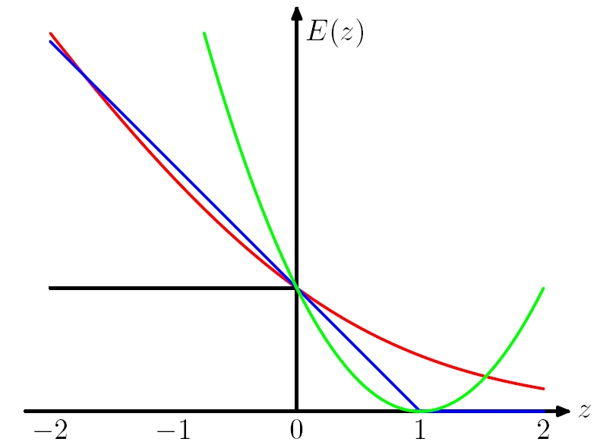
Loss
Here f(x) is the prediction 2 <
y 2 {-1,1} is the correct value
0-1 Loss L(y,f(x))= ½ (1-sgn(yf(x)))
Log Loss 1/ln2 log (1+exp{-yf(x)})
Hinge Loss L(y, f(x)) = max(0, 1 - y f(x))
Square Loss L(y, f(x)) = (y - f(x))²
0-1 Loss x axis = yf(x)
Log Loss = x axis = yf(x)
Hinge Loss: x axis = yf(x)
Square Loss: x axis = (y - f(x)+1)

Slide 58
Example
Putting it all together:
A Learning Algorithm

Slide 59
Third Step: How to Learn?
A possibility: Local search
  Start with a linear threshold function.
  See how well you are doing.
  Correct
  Repeat until you converge.
There are other ways that
do not search directly in
the hypotheses space
  Directly compute the
  hypothesis

Slide 60
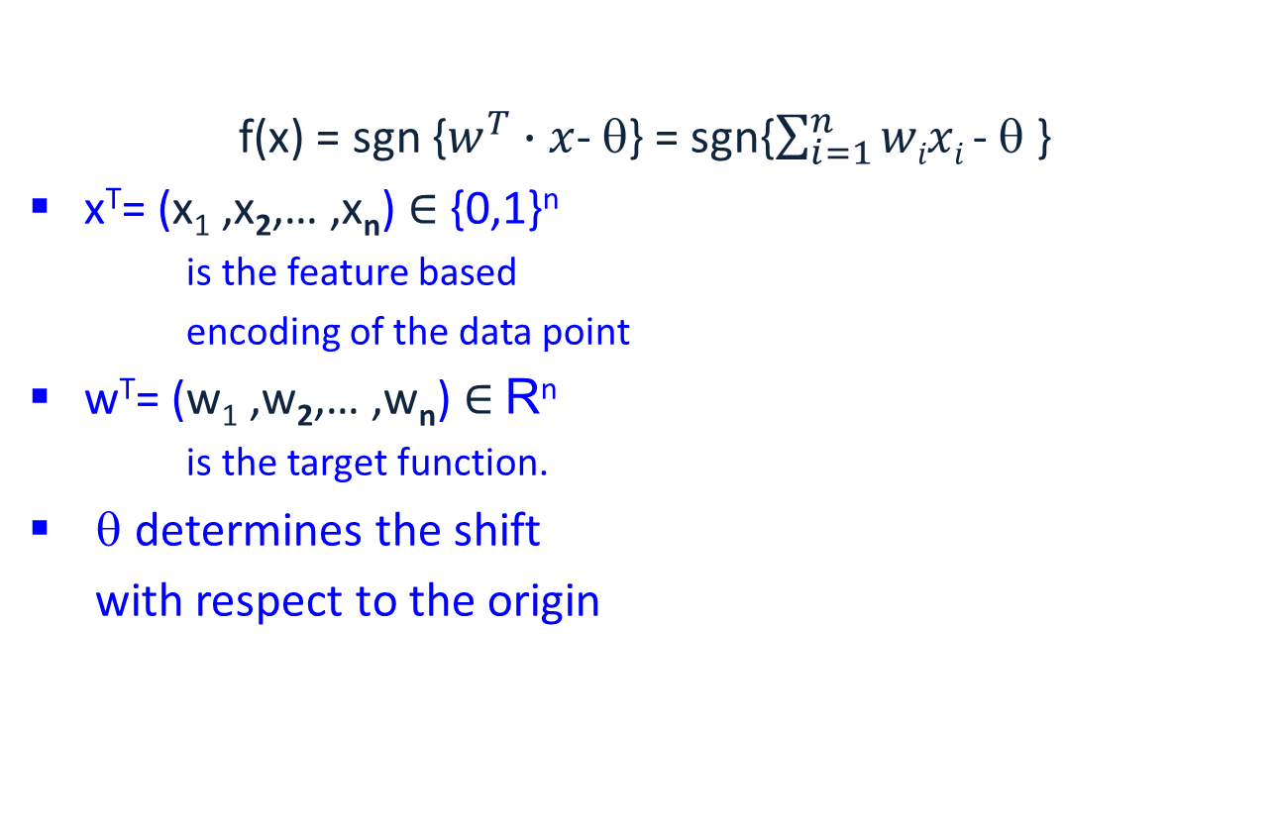
Learning Linear Separators
(LTU=Linear Threshold Unit)
f(x) = sgn {$w^{T}∙x$- θ} = sgn{$\sum_{i=1}^{n}{wixi }$- θ }
x^{T}= (x₁ ,x₂,… ,x_{n}) ∈ {0,1}^{n}
  is the feature based
  encoding of the data point
w^{T}= (w₁ ,w₂,… ,w_{n}) ∈ R^{n}
  is the target function.
θ determines the shift
with respect to the origin
θ
w

Slide 61
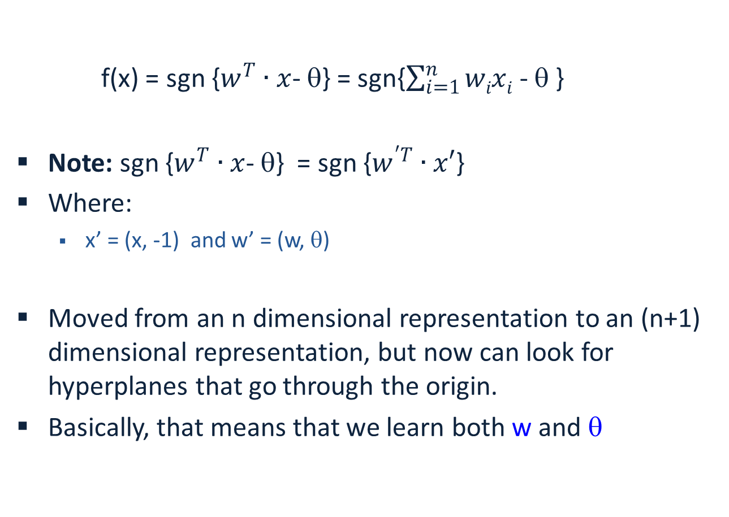
Canonical Representation
f(x) = sgn {$w^{T}∙x$- θ} = sgn{$\sum_{i=1}^{n}{wixi }$- θ }
Note: sgn {$w^{T}∙x$- θ} = sgn {$w^{′T}∙x′$}
Where:
  x’ = (x, -1) and w’ = (w, θ)
Moved from an n dimensional representation to an (n+1) dimensional representation, but now can look for hyperplanes that go through the origin.
Basically, that means that we learn both w and θ

Slide 62
General Learning Principle
The Risk (Err) E: a function of w
The loss Q: a function of x, w and y
Our goal is to find a w that
minimizes the expected risk
E(w) = E _{X,Y} Q(x, y, w)
We cannot do it.
Instead, we approximate E(w)
using a finite training set of
independent samples (x_{i}, y_{i})
E(w) ~=~ 1/m ∑_{1,m} Q(x_{i} ,y_{i}, w)
To find the minimum, we use a
batch gradient descent algorithm
That is, we successively compute
estimates w^{t} of the optimal parameter vector w:
w^{t+1} = w^{t} - r E(w) = w^{t} - 1/m ∑_{1,m} r Q(x_{i} ,y_{i}, w)
θ
w
To find a local minimum of a function using gradient descent, we take steps proportional to the negative of the gradient of the function at the current point.
t here is “time” or “iteration” #

Slide 63
Gradient Descent
We use gradient descent to determine the weight vector that minimizes E(w) (= Err (w)) ;
Fixing the set D of examples, E=Err is a function of w
At each step, the weight vector is modified in the direction that produces the steepest descent along the error surface.
E(w)
To find a local minimum of a function using gradient descent, we take steps proportional to the negative of the gradient of the function at the current point.
w
w⁴ w³ w² w¹

Slide 64
LMS: An Optimization Algorithm
Our Hypothesis Space is the collection of Linear Threshold Units
Loss function:
  Squared loss: LMS (Least Mean Square, L₂)
  Q(x, y, w) = ½ (w^{T} x – y)²
θ
w

Slide 65
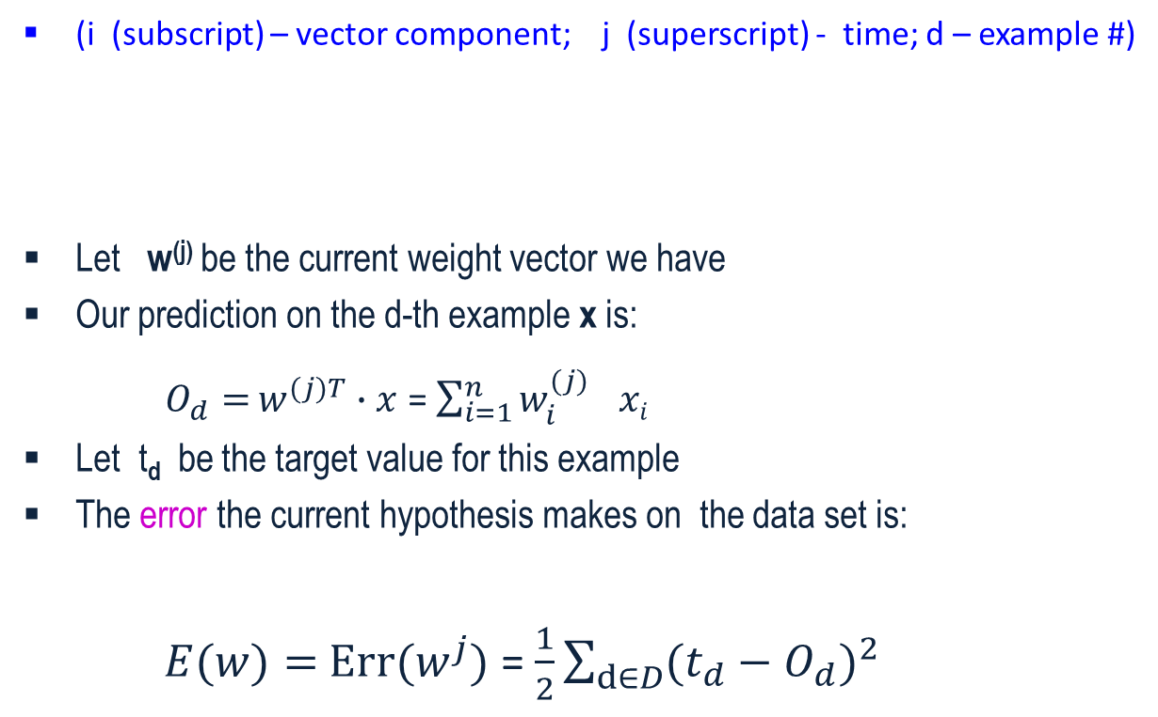
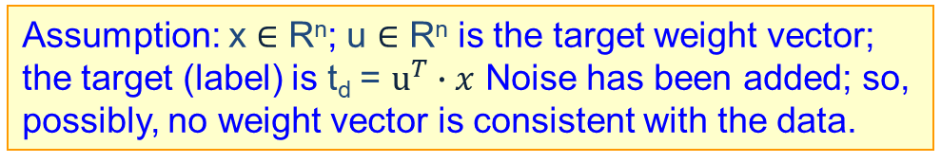
LMS: An Optimization Algorithm
(i (subscript) – vector component; j (superscript) - time; d – example #)
Let w^{(j)} be the current weight vector we have
Our prediction on the d-th example x is:
$O_{d}=$ $w^{(j)T}∙x$ = $\sum_{i=1}^{n}{{w_{i}^{(j)}}^{}xi }$
Let t_{d} be the target value for this example
The error the current hypothesis makes on the data set is:
$E(w)=$ ${Err(w}^{j})$ = $\frac{1}{2}\sum_{d∈D}{(t_{d}−O_{d}})^{2}$
Assumption: x ∈ R^{n}; u ∈ R^{n} is the target weight vector; the target (label) is t_{d} = $u^{T}∙x$ Noise has been added; so, possibly, no weight vector is consistent with the data.
Notes:
Good treatment in Bishop, Chp 3

Slide 66
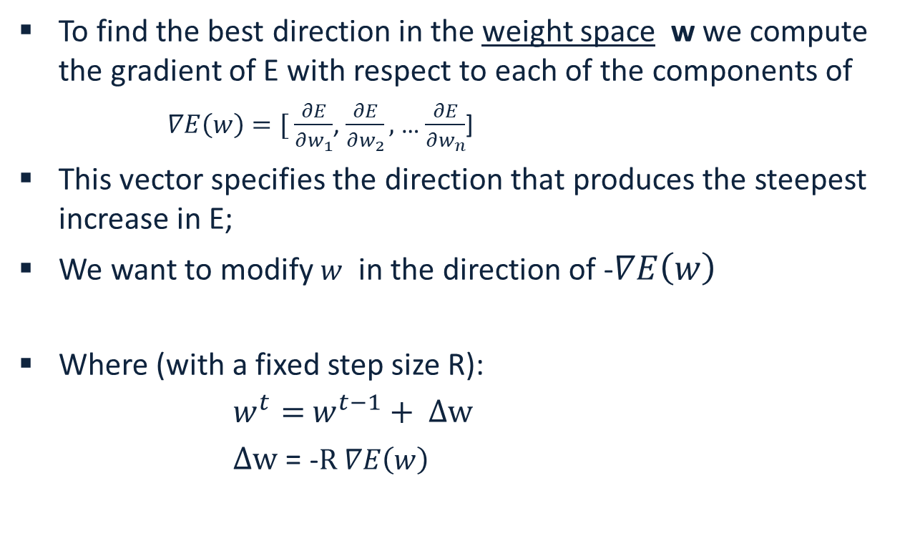
Gradient Descent
To find the best direction in the weight space w we compute the gradient of E with respect to each of the components of
$∇E\left(w\right)=[ \frac{∂E}{∂w_{1}}$, $\frac{∂E}{∂w_{2}},$ … $\frac{∂E}{∂w_{n}}$]
This vector specifies the direction that produces the steepest increase in E;
We want to modify $w$ in the direction of -$∇E\left(w\right)$
Where (with a fixed step size R):
$w^{t}=$ $w^{t−1}+ Δw$
$Δw$ = -$R ∇E\left(w\right)$

Slide 67

Gradient Descent: LMS
We have: $E(w)=$ ${Err(w}^{j})$ = $\frac{1}{2}\sum_{d∈D}{(t_{d}−O_{d}})^{2}$
Therefore:

Slide 68
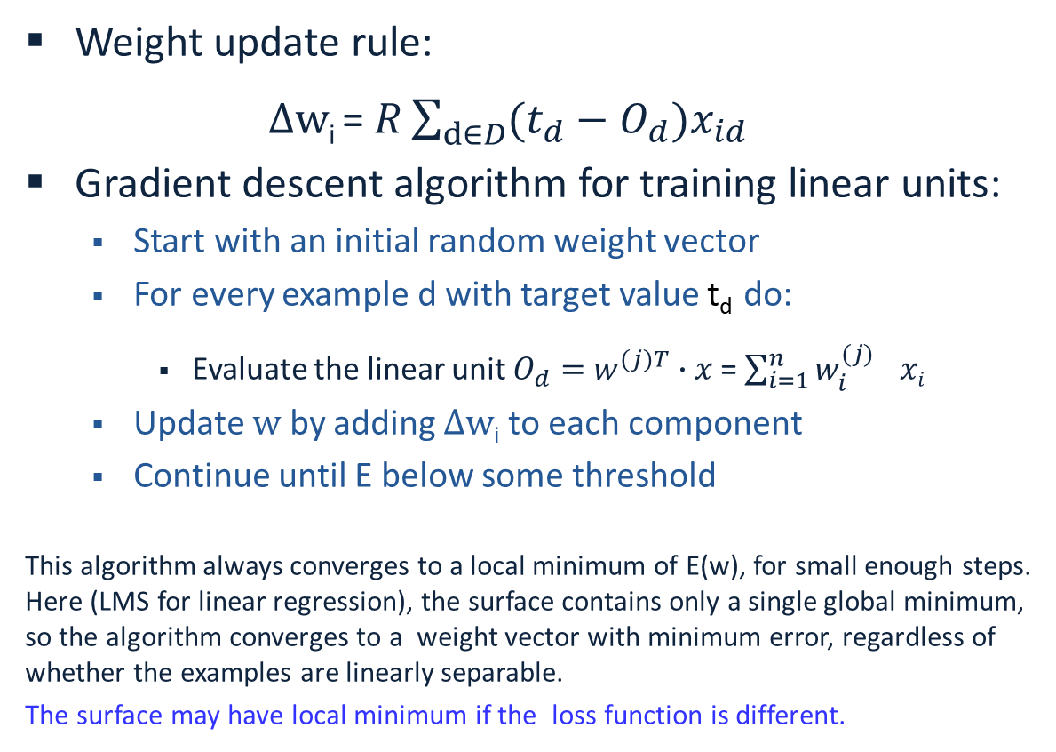
Alg1: Gradient Descent: LMS
Weight update rule:
$Δw$_{i} $\text{= }R\sum_{d∈D}{(t_{d}−O_{d}}{)x_{id}}^{}$
Gradient descent algorithm for training linear units:
  Start with an initial random weight vector
  For every example d with target value t_{d} do:
    Evaluate the linear unit $O_{d}=$ $w^{(j)T}∙x$ = $\sum_{i=1}^{n}{{w_{i}^{(j)}}^{}xi }$
  Update $w$ by adding $Δw$_{i} to each component
  Continue until E below some threshold
This algorithm always converges to a local minimum of E(w), for small enough steps. Here (LMS for linear regression), the surface contains only a single global minimum, so the algorithm converges to a weight vector with minimum error, regardless of whether the examples are linearly separable.
The surface may have local minimum if the loss function is different.

Slide 69
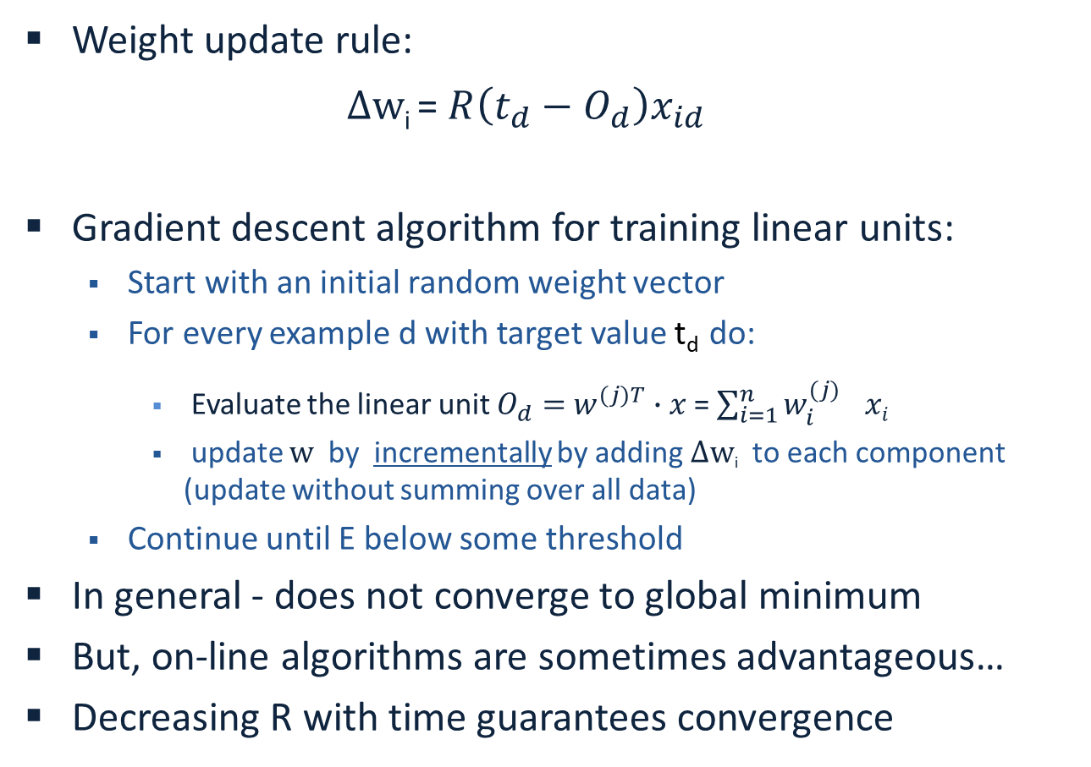
Alg 2: Incremental (Stochastic) Gradient Descent: (LMS)
Dropped the averaging operation.
Instead of averaging the gradient of the loss over the complete training set, choose at random a sample (x,y) (or a subset of examples) and update w^{t}
Weight update rule:
$Δw$_{i} $\text{= }R\left(t_{d}−O_{d}\right){x_{id}}^{}$
Gradient descent algorithm for training linear units:
  Start with an initial random weight vector
  For every example d with target value t_{d} do:
    Evaluate the linear unit $O_{d}=$ $w^{(j)T}∙x$ = $\sum_{i=1}^{n}{{w_{i}^{(j)}}^{}xi }$
    update $w$ by incrementally by adding $Δw$_{i} to each component (update without summing over all data)
  Continue until E below some threshold
In general - does not converge to global minimum
But, on-line algorithms are sometimes advantageous…
Decreasing R with time guarantees convergence

Slide 70
Learning Rates and Convergence
In the general (non-separable) case the learning rate R must decrease to zero to guarantee convergence.
The learning rate is called the step size. There are more sophisticated algorithms that choose the step size automatically and converge faster.
Choosing a better starting point also has impact.
The gradient descent and its stochastic version are very simple algorithms, but almost all the algorithms we will learn in the class can be traced back to gradient decent algorithms for different loss functions and different hypotheses spaces.

Slide 71
Computational Issues
Assume the data is linearly separable.
Sample complexity:
  Suppose we want to ensure that our LTU has an error rate (on new examples) of less than ε with high probability (at least (1-δ))
  How large does m (the number of examples) must be in order to achieve this ? It can be shown that for n dimensional problems
m = O(1/ ε [ln(1/ δ) + (n+1) ln(1/ ε) ].
Computational complexity: What can be said?
  It can be shown that there exists a polynomial time algorithm for finding consistent LTU (by reduction from linear programming).
  [Contrast with the NP hardness for 0-1 loss optimization]
  (On-line algorithms have inverse quadratic dependence on the margin)
Notes:
The problem of minimizing 0-1 loss is NP hard in the non-separable case: (Ben-David, Simon et al. 2001).

Slide 72
Other Methods for LTUs
Fisher Linear Discriminant:
  A direct computation method
Probabilistic methods (naïve Bayes):
  Produces a stochastic classifier that can be viewed as a linear threshold unit.
Winnow/Perceptron
  A multiplicative/additive update algorithm with some sparsity properties in the function space (a large number of irrelevant attributes) or features space (sparse examples)
Logistic Regression, SVM…many other algorithms

