Slide 1
CIS 519/419
Applied Machine Learning www.seas.upenn.edu/~cis519
Dan Roth
danroth@seas.upenn.edu
http://www.cis.upenn.edu/~danroth/
461C, 3401 Walnut
Slides were created by Dan Roth (for CIS519/419 at Penn or CS446 at UIUC), Eric Eaton for CIS519/419 at Penn, or from other authors who have made their ML slides available.

Slide 2
Administration (1)
Surveys:
  Please do it.
  If 80% of the students complete it, we’ll give extra credit!
Projects:
Come to my office hours at least once to discuss the project.
Posters for the projects will be presented on the last meeting of the class, December 10, 12:00-1:30.
Final reports will only be due after the Final exam, on December 18
  Specific instructions are on the web page and will be sent also on Piazza.
HW4: Out now.

Slide 3
Administration (2)
Exam:
  The exam will take place on the originally assigned date, 12/17.
    CHEM 102, 12-2pm
    Structured similarly to the midterm.
    120 minutes; closed books.
  What is covered:
    Cumulative!
    Slightly more focus on the material covered after the previous mid-term.
    However, notice that the ideas in this class are cumulative!!
    Everything that we present in class and in the homework assignments
    Material that is in the slides but is not discussed in class is not part of the material required for the exam.
      Example 1: We talked about Boosting. But not about boosting the confidence.
      Example 2: We talked about multiclass classification: OvA, AvA, but not Error Correcting codes, and not about constraint classification (in the slides).
    We will give practice exams. HW5 will also serve as preparation.

Slide 4
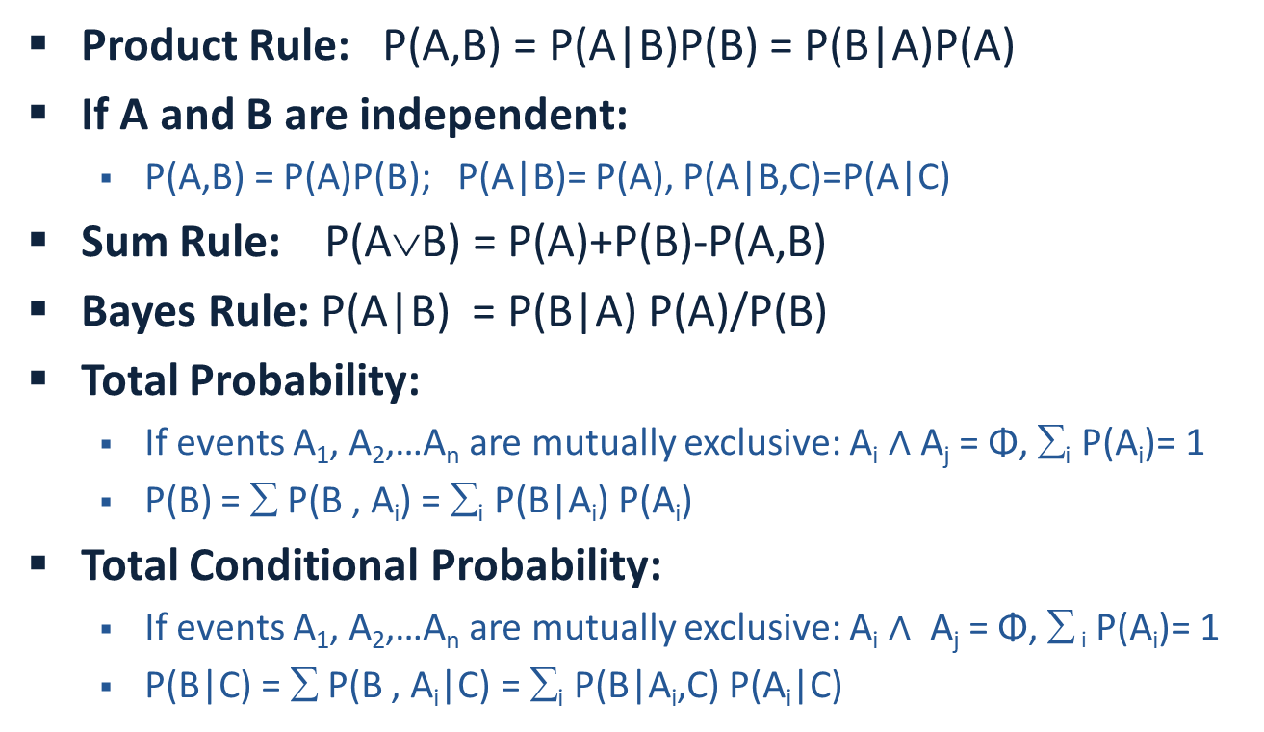
Summary: Basic Probability
Product Rule: P(A,B) = P(A|B)P(B) = P(B|A)P(A)
If A and B are independent:
  P(A,B) = P(A)P(B); P(A|B)= P(A), P(A|B,C)=P(A|C)
Sum Rule: P(A$$B) = P(A)+P(B)-P(A,B)
Bayes Rule: P(A|B) = P(B|A) P(A)/P(B)
Total Probability:
  If events A₁, A₂,…A_{n} are mutually exclusive: A_{i} $∧$Å A_{j} = Φ, ∑_{i} P(A_{i})= 1
  P(B) = ∑ P(B , A_{i}) = ∑_{i} P(B|A_{i}) P(A_{i})
Total Conditional Probability:
  If events A₁, A₂,…A_{n} are mutually exclusive: A_{i} $∧$Å A_{j} = Φ, ∑ _{i} P(A_{i})= 1
  P(B|C) = ∑ P(B , A_{i}|C) = ∑_{i} P(B|A_{i},C) P(A_{i}|C)

Slide 5

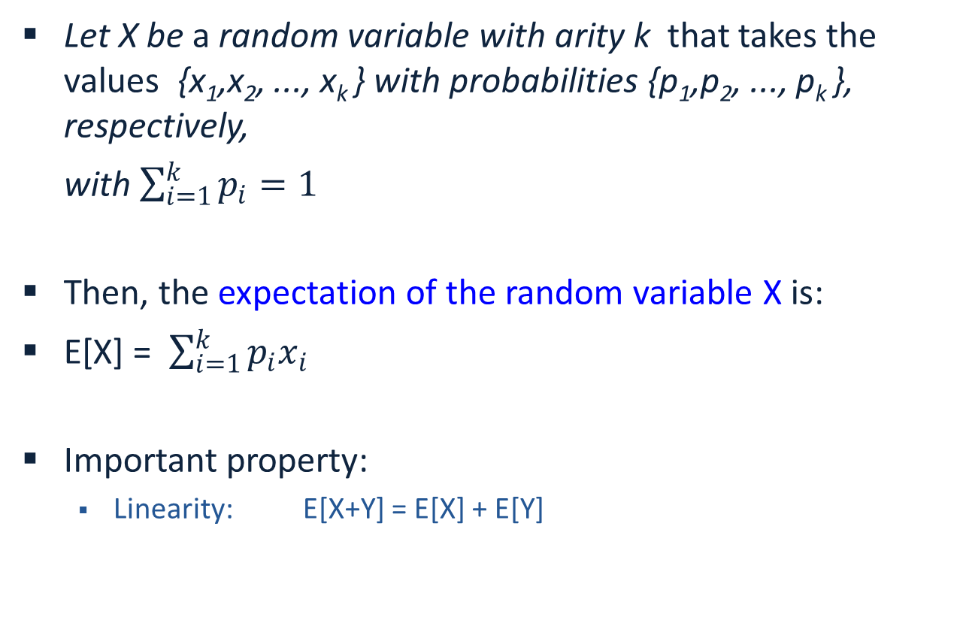
Expectation of a Random Variable
Let X be a random variable with arity k that takes the values {x₁,x₂, ..., x_{k} } with probabilities {p₁,p₂, ..., p_{k} }, respectively,
with $\sum_{i=1}^{k}{p_{i}=1}$
Then, the expectation of the random variable X is:
E[X] = $\sum_{i=1}^{k}{p_{i}x_{i}}$
Important property:
  Linearity: E[X+Y] = E[X] + E[Y]

Slide 6
Semi-Supervised Learning
Consider the problem of Prepositional Phrase Attachment.
  Buy car with money ; buy car with wheel
There are several ways to generate features. Given the limited representation, we can assume that all possible conjunctions of the 4 attributes are used. (15 feature in each example).
Assume we will use naïve Bayes for learning to decide between [n,v]
Examples are: (x₁,x₂,…x_{n},[n,v])

Slide 7
Using naïve Bayes
To use naïve Bayes, we need to use the data to estimate:
P(n) P(v)
P(x₁|n) P(x₁|v)
P(x₂|n) P(x₂|v)
……
P(x_{n}|n) P(x_{n}|v)
Then, given an example (x₁,x₂,…x_{n},?), compare:
P(n|x)~=P(n) P(x₁|n) P(x₂|n)… P(x_{n}|n)
and
P(v|x)~=P(v) P(x₁|v) P(x₂|v)… P(x_{n}|v)

Slide 8
Using naïve Bayes
After seeing 10 examples, we have:
P(n) =0.5; P(v)=0.5
P(x₁|n)=0.75;P(x₂|n) =0.5; P(x₃|n) =0.5; P(x₄|n) =0.5
P(x₁|v)=0.25; P(x₂|v) =0.25;P(x₃|v) =0.75;P(x₄|v) =0.5
Then, given an example x=(1000), we have:
P_{n}(x)~=0.5 0.75 0.5 0.5 0.5 = 3/64
P_{v}(x)~=0.5 0.25 0.75 0.25 0.5=3/256
Now, assume that in addition to the 10 labeled examples, we also have 100 unlabeled examples.
Will that help?

Slide 9
Using naïve Bayes
For example, what can be done with the example (1000) ?
  We have an estimate for its label…
  But, can we use it to improve the classifier (that is, the estimation of the probabilities that we will use in the future)?
Option 1: We can make predictions, and believe them
  Or some of them (based on what?)
Option 2: We can assume the example x=(1000) is a
  An n-labeled example with probability P_{n}(x)/(P_{n}(x) + P_{v}(x))
  A v-labeled example with probability P_{v}(x)/(P_{n}(x) + P_{v}(x))
Estimation of probabilities does not require working with integers!

Slide 10
Using Unlabeled Data
The discussion suggests several algorithms:
Use a threshold. Chose examples labeled with high confidence. Label them [n,v]. Retrain.
Use fractional examples. Label the examples with fractional labels [p of n, (1-p) of v]. Retrain.

Slide 11
Comments on Unlabeled Data
Both algorithms suggested can be used iteratively.
Both algorithms can be used with other classifiers, not only naïve Bayes. The only requirement – a robust confidence measure in the classification.
There are other approaches to Semi-Supervised learning:
  Most are conceptually similar: bootstrapping algorithms
  Some are “graph-based” algorithms: assume “similar” examples have “similar labels”.
What happens if instead of 10 labeled examples we start with 0 labeled examples?
Make a Guess; continue as above; a version of EM

Slide 12
EM
EM is a class of algorithms that is used to estimate a probability distribution in the presence of missing attributes.
Using it requires an assumption on the underlying probability distribution.
The algorithm can be very sensitive to this assumption and to the starting point (that is, the initial guess of parameters.
In general, known to converge to a local maximum of the maximum likelihood function.

Slide 13
Three Coin Example
We observe a series of coin tosses generated in the following way:
A person has three coins.
  Coin 0: probability of Head is α
  Coin 1: probability of Head p
  Coin 2: probability of Head q
Consider the following coin-tossing scenarios:

Slide 14
Estimation Problems
Scenario I: Toss one of the coins four times.
Observing HHTH
Question: Which coin is more likely to produce this sequence ?
Scenario II: Toss coin 0. If Head – toss coin 1; otherwise – toss coin 2
Observing the sequence HHHHT, THTHT, HHHHT, HHTTH, THTTH
produced by Coin 0 , Coin1 and Coin2
Question: Estimate most likely values for p, q (the probability of H in each coin) and the probability to use each of the coins (α)
Scenario III: Toss coin 0. If Head – toss coin 1, o/w – toss coin 2
Observing the sequence HHHT, HTHT, HHHT, HTTH, HTTH
each 4 consecutive tosses are produced by Coin 1 or Coin 2
Question: Estimate most likely values for p, q and α
Coin 0
There is no known analytical solution to this problem (general setting). That is, it is not known how to compute the values of the parameters so as to maximize the likelihood of the data.
1st toss
2nd toss
4th toss

Slide 15
Key Intuition (1)
If we knew which of the data points (HHHT), (HTHT), (HTTH) came from Coin1 and which from Coin2, there was no problem.
Recall that the “simple” estimation is the ML estimation:
Assume that you toss a (p,1-p) coin m times and get k Heads m-k Tails.
log[P(D|p)] = log [ p^{k} (1-p)^{m-k} ]= k log p + (m-k) log (1-p)
To maximize, set the derivative w.r.t. p equal to 0:
d log P(D|p)/dp = k/p – (m-k)/(1-p) = 0
Solving this for p, gives: p=k/m

Slide 16
Key Intuition (2)
If we knew which of the data points (HHHT), (HTHT), (HTTH) came from Coin1 and which from Coin2, there was no problem.
Instead, use an iterative approach for estimating the parameters:
  Guess the probability that a given data point came from Coin 1 or 2; Generate fictional labels, weighted according to this probability.
  Now, compute the most likely value of the parameters. [recall NB example]
  Compute the likelihood of the data given this model.
  Re-estimate the initial parameter setting: set them to maximize the likelihood of the data.
(Labels ←→ Model Parameters)←→ Likelihood of the data
This process can be iterated and can be shown to converge to a local maximum of the likelihood function

Slide 17
EM Algorithm (Coins) -I
We will assume (for a minute) that we know the parameters and use it to estimate which Coin it is (Problem 1)
Then, we will use this “label” estimation of the observed tosses, to estimate the most likely parameters
  and so on...
Notation: n data points; in each one: m tosses each, h_{i} heads in the i-th data point D^{i}
What is the probability that the ith data point, D^{i}, came from Coin1 ?
STEP 1 (Expectation Step): (Here h=h_{i} )

Slide 18
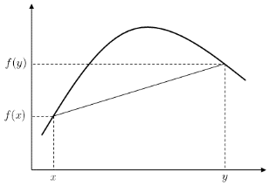
EM Algorithm (Coins) - II
LL= ∑_{i=1,n} log ∑_{y=0,1} P(D^{i}, y | p,q, α) =
= ∑_{i=1,n} log ∑_{y=0,1} P(D^{i}|p,q, α )P(y|D^{i},p,q,α) =
= ∑_{i=1,n} log E_y P(D^{i} |p,q, α) ≥
≥ ∑_{i=1,n} E_y log P(D^{i} |p,q, α)
Where the inequality is due to Jensen’s Inequality.
We maximize a lower bound on the Likelihood.
Now, we would like to compute the likelihood of the data, and find the parameters that maximize it.
We will maximize the log likelihood of the data (n data points)
  LL = ∑_{1,n} logP(D^{i} |p,q,α)
But, one of the variables – the coin’s name - is hidden. We can marginalize:
  LL= ∑_{i=1,n} log ∑_{y=0,1} P(D^{i}, y | p,q, α)
However, the sum is inside the log, making ML solution difficult.
Instead of maximizing the LL we will maximize the expectation of the LL of the data (over the coin’s name, y).
Explanation:
  Since the variable y is not observed, we cannot use the complete-data log likelihood. Instead, we use the expectation of the complete-data log likelihood under the posterior distribution of y to approximate log p(D^{i}| p,q,®) [see above]
  We think of the likelihood logP(D^{i}|p,q,α) as a random variable that depends on the value y of the coin in the i^{th} toss. Therefore, instead of maximizing the LL we will maximize the expectation of this random variable (over the coin’s name). [Justified using Jensen’s Inequality; later & above]
Notes:
We abuse the notation:
Really, we should say whether D^i is only the x part of the data or also the y part; we start by treating D^i = (x^i, y^i), but when we continue we only have D^i = (x^i).

Slide 19
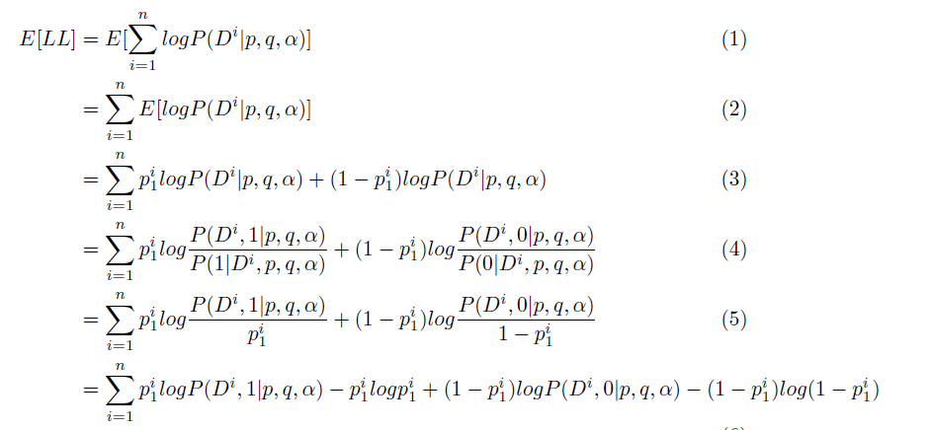
EM Algorithm (Coins) - III
We maximize the expectation of this random variable (over the coin name).
E[LL] = E[∑_{i=1,n} log P(D^{i}| p,q, α)] = ∑_{i=1,n}E[log P(D^{i}| p,q, α)] = (some math; see above)
= ∑_{i=1,n} P₁^{i} log P(D^{i}, 1 | p,q, α)] + (1-P₁^{i}) log P(D^{i}, 0 | p,q, α)]
- P₁^{i} log P₁^{i} - (1-P₁^{i}) log (1- P₁^{i} )
(Does not matter when we maximize)
This is due to the linearity of the expectation and the random variable definition

Slide 20
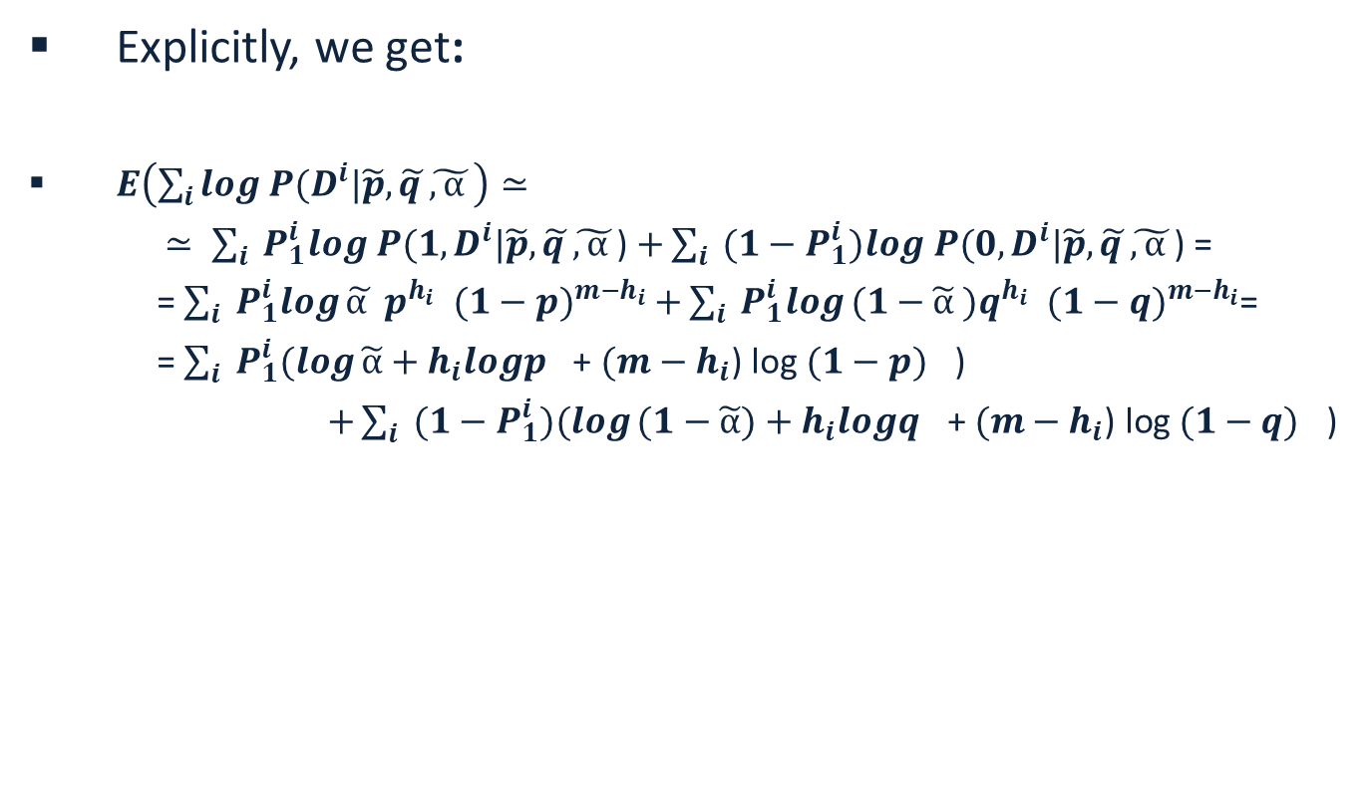
EM Algorithm (Coins) - IV
Explicitly, we get:
$E\left(\sum_{i}{log P(D^{i}|\tilde{p},}\tilde{q }\tilde{,α }\right)≃$
$≃ \sum_{i}{ P_{1}^{i}log P(1,D^{i}|\tilde{p},}\tilde{q }\tilde{,α }$) $+\sum_{i}{ ({1−P}_{1}^{i})log P(0,D^{i}|\tilde{p},}\tilde{q }\tilde{,α }$) =
= $\sum_{i}{ P_{1}^{i}log}\tilde{α }{ p}^{h_{i}}$ ${ (1−p)}^{m−h_{i}}$ $+\sum_{i}{ P_{1}^{i}log}(1−\tilde{α}{ )q}^{h_{i}} { (1−q)}^{m−h_{i}}$=
= $\sum_{i}{ P_{1}^{i}(log}\tilde{α}+{h_{i}logp}^{}$+ $(m−h_{i}$) log${ (1−p)}^{}$)
$+\sum_{i}{ (1−P_{1}^{i})(log}(1−\tilde{α})+{h_{i}logq}^{}\text{+ }(m−h_{i}\text{) }\text{log}{ (1−q)}^{}\text{)}$

Slide 21
EM Algorithm (Coins) - V
Given old parameters we labeled the data. Now we compute the likelihood of the complete data (with the labels; as in the previous slide) and next we will find the new set of parameters that maximizes this likelihood.
Finally, to find the most likely parameters, we maximize the derivatives with respect to :
STEP 2: Maximization Step
(Sanity check: Think of the weighted fictional points)
When computing the derivatives, notice P₁^{i} here is a constant; it was computed using the current parameters in the E step

Slide 22
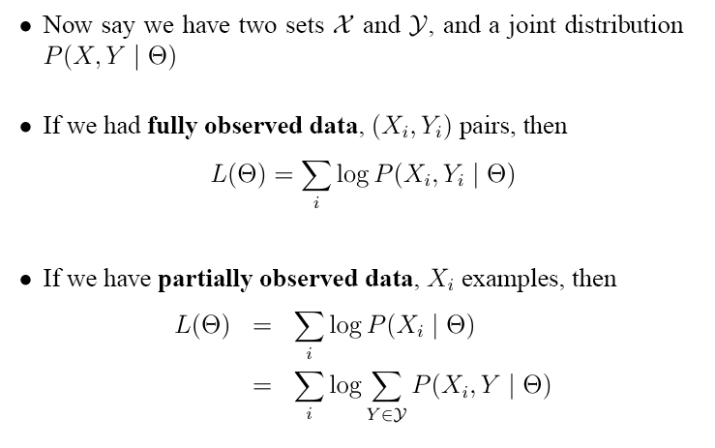
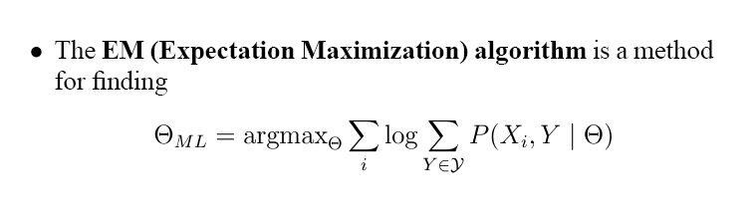
Models with Hidden Variables

Slide 23
EM: General Setting
The EM algorithm is a general purpose algorithm for finding the maximum likelihood estimate in latent variable models.
In the E-Step, we “fill in” the latent variables using the posterior, and in the M-Step, we maximize the expected complete log likelihood with respect to the complete posterior distribution.
  Let D = (x₁, · · · , x_{N} ) be the observed data, and
  Let Z denote hidden random variables.
    (We are not committing to any particular model.)
  Let θ be the model parameters. Then
µ* = argmax_{µ} p(x|µ) = argmax_{µ} ∑_{z} p(x,z |µ) =
= argmax_{µ} ∑_{z} [p(z|µ)p(x|z, µ)]
This expression is called the complete log likelihood.

Slide 24
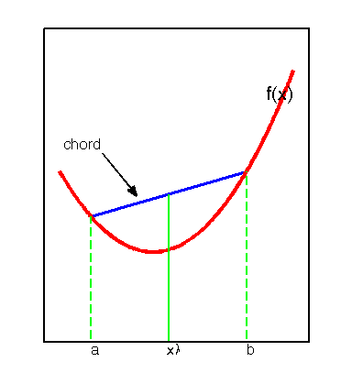
EM: General Setting (2)
Jensen’s Inequality for convex functions:
E(f(x)) ¸ f(E(x))
But log is concave, so
E(log(x)) · log (E(x))
To derive the EM objective function, we re-write the complete log likelihood function by multiplying it by q(z)/q(z), where q(z) is an arbitrary distribution for the random variable z.
log p(x|µ) = log ∑_{z} p(x ,z |µ) = log ∑_{z} p(z|µ) p(x|z,µ) q(z)/q(z) =
= log E_{q} [p(z|µ) p(x|z,µ) /q(z)] ¸
¸ E_{q} log [p(z|µ) p(x|z,µ) /q(z)],
Where the inequality is due to Jensen’s inequality applied to the concave function, log.
We get the objective:
L(µ, q) = E_{q} [log p(z|µ)] + E_{q} [log p(x|z,µ)] - E_{q} [log q(z)]
The last component is an Entropy component; it is also possible to write the objective so that it includes a KL divergence (a distance function between distributions) of q(z) and p(z|x,µ).

Slide 25
EM: General Setting (3)
Other q’s can be chosen [Samdani & Roth2012] to give other EM algorithms. Specifically, you can choose a q that chooses the most likely z in the E-step, and then continues to estimate the parameters (called Truncated EM, or Hard EM).
(Think back to the semi-supervised case)
EM now continues iteratively, as a gradient accent algorithm, where we choose q = p(z|x, µ).
At the t-th step, we have q^{(t)} and µ^{(t)}.
E-Step: update the posterior q, while holding µ^{(t)} fixed:
q^{(t+1)} = argmax_{q} L(q, µ^{(t)}) = p(z|x, µ^{(t)}).
M-Step: update the model parameters to maximize the expected complete log-likelihood function:
µ^{(t+1)} = argmax_{µ} L(q^{(t+1)}, µ)
To wrap it up, with the right q:
L(µ, q) = E_{q} log [p(z|µ) p(x|z,µ) /q(z)]
= ∑_{z} p(z|x, µ) log [p(x, z|µ)/p(z|x, µ)] =
= ∑_{z} p(z|x, µ) log [p(x, z|µ) p(x|µ)/p(z, x|µ)] =
= ∑_{z} p(z|x, µ) log [p(x|µ)] = log [p(x|µ)] ∑_{z} p(z|x, µ) = log [p(x|µ)]
So, by maximizing the objective function, we are also maximizing the log likelihood function.

Slide 26
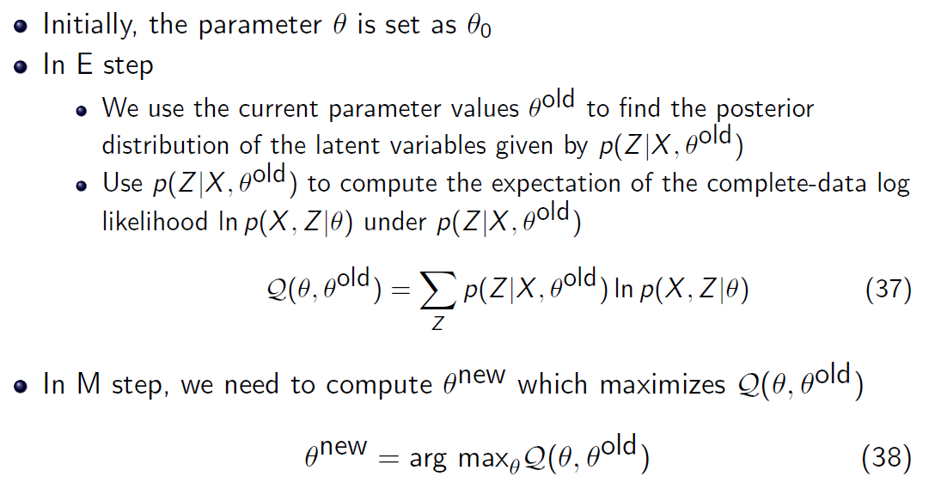
The General EM Procedure
E
M

Slide 27
EM Summary (so far)
EM is a general procedure for learning in the presence of unobserved variables.
We have shown how to use it in order to estimate the most likely density function for a mixture of (Bernoulli) distributions.
EM is an iterative algorithm that can be shown to converge to a local maximum of the likelihood function.
It depends on assuming a family of probability distributions.
In this sense, it is a family of algorithms. The update rules you will derive depend on the model assumed.
It has been shown to be quite useful in practice, when the assumptions made on the probability distribution are correct, but can fail otherwise.

Slide 28
EM Summary (so far)
EM is a general procedure for learning in the presence of unobserved variables.
The (family of ) probability distribution is known; the problem is to estimate its parameters
In the presence of hidden variables, we can often think about it as a problem of a mixture of distributions – the participating distributions are known, we need to estimate:
  Parameters of the distributions
  The mixture policy
Our previous example: Mixture of Bernoulli distributions

Slide 29
Example: K-Means Algorithm
K- means is a clustering algorithm.
We are given data points, known to be sampled independently
from a mixture of k Normal distributions, with
means μ_{i}, i=1,…k and the same standard variation σ
Standard k-means clustering:
Guess k centers.
Repeat:
  Place each point in its center, based on distance.
  Re-estimate centers for each cluster.
  Re-place points

Slide 30
Example: K-Means Algorithm
First, notice that if we knew that all the data points are taken
from a normal distribution with mean μ , finding its most likely value is easy.
We get many data points, D = {x₁,…,x_{m}}
Maximizing the log-likelihood is equivalent to minimizing:
Calculate the derivative with respect to μ, we get that the
minimal point, that is, the most likely mean is

Slide 31
A mixture of Distributions
As in the coin example, the problem is that data is sampled from a mixture of k different normal distributions, and we do not know, for a given data point x_{i}, where is it sampled from.
Assume that we observe data point x_{i} ;what is the probability that it was sampled from the distribution μ_{j} ?

Slide 32
A Mixture of Distributions
As in the coin example, the problem is that data is sampled from a mixture of k different normal distributions, and we do not know, for a given each data point xi, where is it sampled from.
For a data point x_{i}, define k binary hidden variables, z_{i1},z_{i2},…,z_{ik}, s.t z_{ij} =1 iff x_{i} is sampled from the j-th distribution.

Slide 33
Example: K-Means Algorithms
Expectation: (here: h = )
Computing the likelihood given the observed data D = {x₁,…,x_{m}} and the hypothesis h (w/o the constant coefficient)

Slide 34
Example: K-Means Algorithms
Maximization: Maximizing
with respect to we get that:
Which yields:
Given old parameters (h’) we labeled the data. Now we compute the likelihood of the complete data (with the labels) and next we will find the new set of parameters (h) that maximizes this likelihood.

Slide 35
Summary: K-Means Algorithms
Given a set D = {x₁,…,x_{m}} of data points,
guess initial parameters
Compute (for all i,j)
and a new set of means:
repeat to convergence
Difference: now we place “fractional” points into clusters.
Recall: Standard k-means clustering
Guess k centers.
Repeat:
  Place each point in its center, based on distance.
  Re-estimate centers for each cluster.
  Re-place points
Notice that this algorithm will find the best k means in the sense of minimizing the sum of square distance.

Slide 36
Summary: EM
EM is a general procedure for learning in the presence of unobserved variables.
We have shown how to use it in order to estimate the most likely density function for a mixture of probability distributions.
EM is an iterative algorithm that can be shown to converge to a local maximum of the likelihood function. Thus, might requires many restarts.
It depends on assuming a family of probability distributions.
It has been shown to be quite useful in practice, when the assumptions made on the probability distribution are correct, but can fail otherwise.
As examples, we have derived an important clustering algorithm, the k-means algorithm and have shown how to use it in order to estimate the most likely density function for a mixture of probability distributions.

Slide 37
More Thoughts about EM
Training: a sample of data points, (x₀, x₁ ,…, x_{n}) 2 {0,1}^{n+1}
Task: predict the value of x₀, given assignments to all n variables.

Slide 38
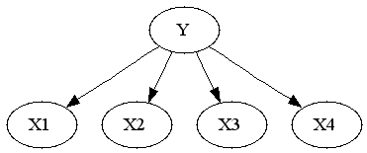
More Thoughts about EM
®_{z}
z
P_{i}^{z}
Assume that a set x^{i} Є {0,1}^{n+1} of data points is generated as follows:
Postulate a hidden variable Z, with k values, 1 ≤ z ≤ k
with probability α_{z}, ∑_{1,k} α_{z} = 1
Having randomly chosen a value z for the hidden variable, we choose the value x_{i} for each observable X_{i} to be 1 with probability p_{i}^{z} and 0 otherwise, [i = 0, 1, 2, ….n]
Training: a sample of data points, (x₀, x₁ ,…, x_{n}) Є {0,1}^{n+1}
Task: predict the value of x₀, given assignments to all n variables.

Slide 39
More Thoughts about EM
®_{z}
z
P_{i}^{z}
Two options:
Parametric: estimate the model using EM. Once a model is known, use it to make predictions.
  Problem: Cannot use EM directly without an additional assumption on the way data is generated.
Non-Parametric: Learn x₀ directly as a function of the other variables.
  Problem: which function to try and learn?
x₀ turns out to be a linear function of the other variables, when k=2 (what does it mean)?
When k is known, the EM approach performs well; if an incorrect value is assumed the estimation fails; the linear methods performs better [Grove & Roth 2001]
Another important distinction to attend to is the fact that, once you estimated all the parameters with EM, you can answer many prediction problems e.g., p(x₀, x₇,…,x₈ |x₁, x₂ ,…, x_{n}) while with Perceptron (say) you need to learn separate models for each prediction problem.

Slide 40
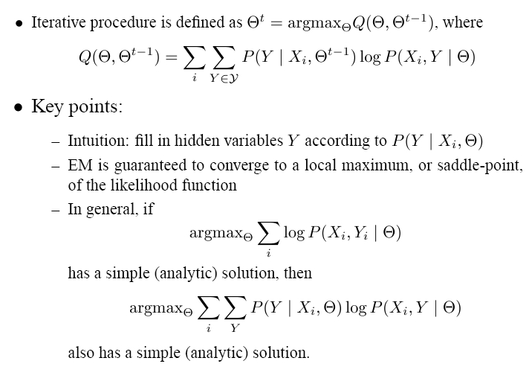
EM

Slide 41
The EM Algorithm
Algorithm:
Guess initial values for the hypothesis h=
Expectation: Calculate Q(h’,h) = E(Log P(Y|h’) | h, X)
using the current hypothesis h and the observed data X.
Maximization: Replace the current hypothesis h by h’, that maximizes the Q function (the likelihood function)
set h = h’, such that Q(h’,h) is maximal
Repeat: Estimate the Expectation again.

