Slide 1
Administration
Exam:
  The exam will take place on the originally assigned date, 4/30.
    Similar to the previous midterm.
    75 minutes; closed books.
  What is covered:
    The focus is on the material covered after the previous mid-term.
    However, notice that the ideas in this class are cumulative!!
    Everything that we present in class and in the homework assignments
    Material that is in the slides but is not discussed in class is not part of the material required for the exam.
      Example 1: We talked about Boosting. But not about boosting the confidence.
      Example 2: We talked about multiclass classification: OvA, AvA, but not Error Correcting codes, and additional material in the slides.
    We will give a few practice exams.
Homework: missing and regrades

Slide 2
Administration
Projects
  We will have a poster session 4-6pm on May 7
    in the active learning room, 3401 Walnut.
  The hope is that this will be a fun event where all of you have an opportunity to see and discuss the projects people have done.
  All are invited!
  Mandatory for CIS519 students
  The final project report will be due on 5/8
  Logistics: you will send us you posters the a day earlier; we will print it and hang it; you will present it.
If you haven’t done so already:
  Come to my office hours at least once this or next week to discuss the project!!

Slide 3
How many are there ?

Slide 4
Clustering
Clustering is a mode of unsupervised learning.
Given a collection of data points, the goal is to find structure in the data: organize that data into sensible groups.
We are after a convenient and valid organization of the data, not after a rule for separating future data into categories.
Cluster analysis is the formal study of algorithms and methods for doing that.
How many are there ?

Slide 5
Clustering
Clustering is a mode on unsupervised learning.
Given a collection of data points, the goal is to find structure in the data: organize that data into sensible groups.
We are after a convenient and valid organization of the data, not after a rule for separating future data into categories.
Cluster analysis is the formal study of algorithms and methods for doing that.

Slide 6
Clustering
A cluster is a set of entities which are alike, and entities in different clusters are not alike.
A cluster is an aggregation of points in the test space such that the distance between any two points in the cluster is less than the distance between any point in the cluster and any point not in it.
Clusters may be described as connected regions of a multi- dimensional space containing a relatively high density of points, separated from other regions by regions containing a low density of points.

Slide 7
Clustering
The last definitions assume that the objects to be clustered are represented as points in some measurements space.
“We recognize a cluster when we see it”.
It is easy to give a functional definition for a cluster, but a lot harder to give an operational definition.
One reason may be that objects can be clustered into groups with a purpose in mind (shape, size, time, resolution,….)

Slide 8
Clustering

Slide 9
Clustering
Theorem: That is no clustering function that maps a set of points into a partition of it, that satisfies all three conditions. [Klienberg, NIPS 2002] (refinements exist)
Clustering is not a Learning Problem. It’s an Optimization Problem. Given a set of points and a pairwise distance, devise an algorithm f that splits the data so that it optimizes some natural conditions.
Scale-Invariance.
  For any distance function d; for any α > 0, we have f(d) = f(α · d).
Richness.
  Range(f) is equal to the set of all partitions of S.
  In other words, suppose we are given the names of the points only (i.e. the indices in S) but not the distances between them. Richness requires that for any desired partition Γ, it should be possible to construct a distance function d on S for which f(d) = Γ
Consistency.
  Let d and d’ be two distance functions. If f(d) = Γ, and d’ is a Γ-transformation of d, then f(d’) = Γ. In other words, suppose that the clustering Γ arises from the distance function d. If we now produce d’ by reducing distances within the clusters and enlarging distances between clusters then the same clustering Γ should arise from d’.

Slide 10
Clustering
Clustering is not a Learning Problem. It’s an Optimization Problem. Given a set of points and a pairwise distance, devise an algorithm f that splits the data so that it optimizes some natural conditions.
So, what do we do?
  Different optimization heuristics that make sense.
Clustering can be done under generative model assumptions, or without any statistical assumptions
A key component in clustering is the measurement space:
  What is a reasonable distance/similarity measure ?
  What are the important dimensions of the data ?
We will discuss:
  Clustering methods → Metric Learning methods
  Dimensionality reduction methods

Slide 11
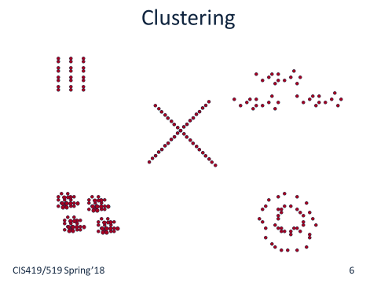
Evaluating Clustering
How can we evaluate how good our clustering is?
  Evaluation by our own criterion
  Comparing to labels
    Sometimes possible
  Evaluation by an expert
  Evaluation by using clustering result for another task (extrinsic evaluation)
  Comparing different clustering results
    Eg. Likelihood, if we have a generative model

Slide 12
The Clustering Problem
We are given a set of data points x₁, x₂, … x_{m} in R^{n} that we would like to cluster.
Each data point is assumed to be an n-dimensional vector, that we will write as a column vector:
x= (x₁, x₂, … x_{n} )^{T}
We do not make any statistical assumptions on the given data, nor on the number of clusters.

Slide 13
Distance Measures
In studying Clustering techniques we will assume that we are given a matrix of distances between all pairs of data points.
We can assume that the input to the problem is:

Slide 14
Distance Measures
In studying Clustering techniques we will assume that we are given a matrix of distances between all pairs of data points.
A distance measure (metric) is a function d:R^{d} x R^{d} → R that satisfies:
For the purpose of clustering, sometimes the distance (similarity) is not required to be a metric
  No Triangle Inequality
  No Symmetry

Slide 15
Distance Measures
Examples:
Euclidean Distance:
Manhattan Distance:
Infinity (Sup) Distance:
Notice that if d(x,y) is the Euclidean metric, d²(x,y) is not a metric
but can be used as a measure (no triangle inequality)

Slide 16
Distance Measures
Examples:
Euclidean Distance:
Manhattan Distance:
Infinity (Sup) Distance:

Slide 17
Distance Measures
Notice that:
Infinity (Sup) Distance < Euclidean Distance <Manhattan Distance:
But different distances do not induce same order on pairs of points

Slide 18
Distance Measures
The clustering may be sensitive to the similarity measure.
Sometimes this can be avoided by using a distance measure
that is invariant to some of the transformations that are natural to
the problem.
Mahalanobis Distance:
where Σ is a symmetric matrix.
Covariance Matrix: Translates all the axes so that they have
Mean=0 and Variance=1 (Shift and Scale invariance)

Slide 19
Distance Measures
The clustering may be sensitive to the similarity measure.
Sometimes this can be avoided by using a distance measure
that is invariant to some of the transformations that are natural to
the problem.
Mahalanobis Distance:
where Σ is a symmetric matrix.
Covariance Matrix: Translates all the axes so that they have
Mean=0 and Variance=1 (Shift and Scale invariance)
It is possible to get rotation invariance by rotating the axes so
that they coincide with the eigenvectors of the covariance matrix.
This is a transformation to the principle components (later).

Slide 20
Distance Measures
Sometimes it is useful to define
distance between a data point x and a set A of points:
and distance between sets of points A, B:
There are many other ways to do it; may depend on the application.

Slide 21
Basic (Greedy) Algorithms
Given: a set x₁, x₂,…x_{m} of data points,
a distance function d(x,y) and
a threshold T
C_{k} will represent clusters, z_{k} their representative
i index into data points, j index into clusters
Problems: Outcome depends on the order of the data points both in assigning points to a cluster and in determining distance of a point from a cluster
process data point i
(where to place it?)

Slide 22
Association-Dissociation
Given a collection of points, one way to define the goal of a
clustering process is to use the following two measures:
A measure of similarity within a group of points
A measure of similarity between different groups
Ideally, we would like to define these so that:
The within similarity can be maximized
The between similarity can be minimized
at the same time.
This turns out to be a hard task.

Slide 23
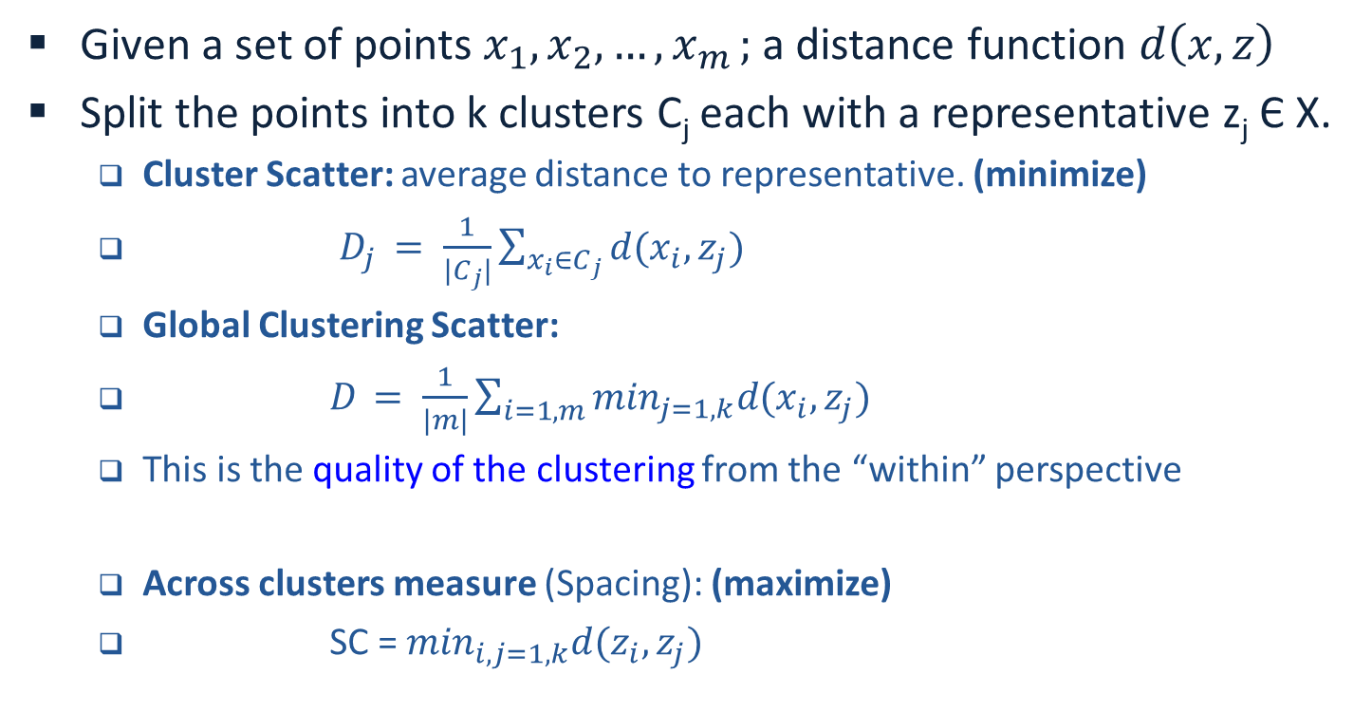
Quality Criteria
Given a set of points $x_{1}, x_{2}, {…,x}_{m};$a distance function $d\left(x, z\right)$
Split the points into k clusters C_{j} each with a representative z_{j} Є X.
  Cluster Scatter: average distance to representative. (minimize)
  $D_{j }= \frac{1}{{|C}_{j}|}\sum_{x_{i}∈C_{j}}{d(x_{i}, z_{j})}$
  Global Clustering Scatter:
  $D_{ }= \frac{1}{|m|}\sum_{i=1,m}{\min_{j=1,k}d(x_{i}, z_{j})}$
  This is the quality of the clustering from the “within” perspective
  Across clusters measure (Spacing): (maximize)
  SC = $\min_{i,j=1,k}d(z_{i}, z_{j})$

Slide 24
Quality
Given: a set X = {x₁, x₂, …x_{m}} of points, a distance function d(x,y)
X is split into k clusters C_{j}, each with a representative z_{j} 2 X
Definitions: (scatter measures)
Within cluster: (average distance to representative)
Global Clustering Scatter:
For each x_{i} choose the closest representative z_{j}.
D_{j} measures the scatter of the jth cluster; we want to minimize it.
D measures the quality of the clustering;

Slide 25
Quality
k: #(clusters); m = #(points)
Average distance to representative:
Global Clustering Scatter:
D_{j} measures the scatter of the jth cluster; we want to minimize it.
D measures the quality of the clustering;
For optimal clustering:
z_{r} is the closest representative for all the points in C_{r}
The distance from x_{i} to its representative z_{r}
The distance from x_{i} to its representative z_{r}

Slide 26
K-Means
Given: a set X = {x₁, x₂, …x_{m}} of points, a distance function d(x,y)
X is split into k clusters C_{j}, each with a representative z_{j} 2 X
Algorithm:
1. Initialize centers randomly round: r=1
2. Cluster x₁, x₂, …x_{m} w.r.t centers using Nearest Neighbor
3. Choose new centers: Choose z_{j} to minimize D_{i} .
Compute the global clustering scatter for this round:
4. Stopping Criterion: Check if
If not, iterate: r = r+1, go back to 2.

Slide 27
K-Means
Given: a set X = {x₁, x₂, …x_{m}} of points, a distance function d(x,y)
X is split into k clusters C_{j}, each with a representative z_{j} 2 X
Will it converge ? It can be shown that the scatter mean goes down.
  Note that this is a Hard EM algorithm (see K-Means in the EM lecture)
We do not know how fast it will converge -- bound # of iterations.
Why should the center be an element in the set ?
Using the Euclidean Distance, minimizing is achieved by
computing the average, which need not be a data element.
What is k ? Can try with different values, and measure the quality of the
clustering.

Slide 28
Improving K-Means
The main problem with k-means is the initial conditions --
determining k and the centers.
Bad initial conditions may generate unimportant cells and may
degrade overall performance.
There are various ways to get around it.
Methods for splitting centers:
Start with k=1; for k=i use the centers of k=i-1, or a simple
function of them.
ISODATA: k-means with provisions for
deleting clusters (if they are too small)
splitting clusters (if their mean scatter is too large)
Adapting k; stopping criterion

Slide 29
Limitations
k-means/ISODATA will work well in cases where all the clusters
behaves similarly statistically.
K-means can be shown to be optimal when the distance function
is derived from the probability distribution that generates the data.
E.g., for a mixture of Normal distribution, the Euclidean metric
yields optimal performance.
This is the EM algorithms studied earlier.
These methods are not so effective when the data has some
internal structure, especially if different clusters have
different structures.

Slide 30
Limitations

Slide 31
Model Based Methods
One advantage of K-means is that it is a principled method –
it has a probabilistic interpretation.
This allows a principle investigation of the algorithm; a better
understanding of what it does, and a way to modify it in a principled way.
Can this be done for other algorithms?

Slide 32
Agglomerative Clustering
Assume a distance measure between points d(x₁,x₂)
Define a distance measure between Clusters D(c₁,c₂)
Algorithm:
  Initialize: Each point in a separate cluster.
  At each stage, merge the two closest clusters according to D.
(I.e., merge the two D-closest clusters).
Different definitions of D, for the same d, give rise to radically different
partitions of the data.

Slide 33
Examples (I)
Assume a distance measure between points d(x₁,x₂)
Define a distance measure between Clusters D(c₁,c₂)
Algorithm:
  Initialize: Each point in a separate cluster.
  At each stage, merge the two closest clusters according to D.
(I.e., merge the two D-closest clusters).
Single Link Clustering:
D_{SL}(C₁,C₂) = min{x_{i} ∈C_{i}} d(x₁,x₂)
Complete Link Clustering:
D_{CL}(C₁,C₂) = max{x_{i} ∈C_{i}} d(x1,x2)

Slide 34
Examples (II)
Assume a distance measure between points d(x₁,x₂)
Define a distance measure between Clusters D(c₁,c₂)
Algorithm:
  Initialize: Each point in a separate cluster.
  At each stage, merge the two closest clusters according to D.
(I.e., merge the two D-closest clusters).
Ward’s Method:
D(ward) = ESS(C1 U C2) – ESS(C1) – ESS(C2)
Where: ESS(C) = Σ(x-m)²
m – mean of data point in cluster C
Group Average Clustering:
D_{GA}(C₁,C₂) = mean{C_{i} ,C_{j}} d(x1,x2)

Slide 35
Model Based Methods
  Claim: Common heuristics for agglomerative clustering algorithms are
  Each equivalent to a hierarchical model-based (probabilistic) method.
This interpretation gives a theoretical explanation for the empirical
behavior of these algorithms, as well as a principled approach to practical
issues: no. of clusters, choice of methods, etc.
Model based clustering views clustering as the problem of computing the
(approximate) maximum for the classification likelihood of the data X.
The classification likelihood of the data X:
L(θ₁,….,θ_{k} ;l₁,…,l_{n} |X) = Πp (x_{i}| θ_{i})
Where: l_{i} is the label (cluster id) of the point x_{i}
θ_{i} are the model parameters.
Notice that this is a model of hard clustering. It is also possible to
model soft clustering, as a mixture model.

Slide 36
Model Based Agglomerative Methods
Model based clustering views clustering as the problem of computing the
(approximate) maximum for the classification likelihood of the data X.
Agglomerative approach:
- Start with a partition P of the data in which each sample is in its own
singleton cluster.
- At each stage, two clusters are chosen from P and merged, forming
a new partition P’.
- The pair which is merged is the one which gives the highest resulting
likelihood. (merges typically reduce the likelihood)
- The process is greedy. The best choice at a certain stage need not
develop into the best strategy.

Slide 37
Model Based Agglomerative Methods
Agglomerative approach:
- Start with a partition P of the data in which each sample is in its own
singleton cluster.
- At each stage, two clusters are chosen from P and merged, forming
a new partition P’.
- The pair which is merged is the one which gives the highest resulting
likelihood. (merges typically reduce the likelihood)
- The process is greedy. The best choice at a certain stage need not
develop into the best strategy.
At each stage of the algorithm we are choosing new labels; we don’t
explicitly choose new parameters. Implicitly, it is assumed we have the
best parameters. The quality of the current labeling:
J(l₁,…,l_{n} |X) = maxΘ L(Θ, l₁,…,l_{n} | X)
Relative cost of a merge:
ΔJ(P.P’) = J(P)/J(P’)
Rather than maximizing J(P’), can maximize the relative cost.

Slide 38
Model Based Methods
The classification likelihood of the data X:
L(θ₁,….,θ_{k} ;l₁,…,l_{n} |X) = Πp (x_{i}| θ_{i})
Where: l_{i} is the label (cluster id) of the point x_{i}
θ_{i} are the model parameters.
Notice that this is a model of hard clustering. It is also possible to
model soft clustering, as a mixture model.

Slide 39
Model Based Interpretation
Ward’s Method:
- If the probability model is multivariate normal with uniform spherical
covariance matrix σI, then
ΔJ ~ D(ward)
In this case we assume the component density is:
Rather than maximizing J(P’), can maximize the relative cost.

Slide 40
Model Based Interpretation
Single-Link clustering:
- The corresponding probability model is a mixture of branching random
walks (BRWs). A BRW is a stochastic process which generates a tree of
data points x as follows:
- The process starts with a single root x₀ in the placed according to some
distribution p₀
- Each node in the frontier of the tree produces zero or more children.
The position of a child is generated according to a multivariate normal
distribution, with variance σI centered around the parent’s location.
Claim: If the probability model is a mixture of BRWs, then:
ΔJ ~ D(SL)

Slide 41
Model Based Methods
One advantage of K-means is that it is a principled method –
it has a probabilistic interpretation.
This allows a principle investigation of the algorithm; a better
understanding of what it does, and a way to modified it in a principled way.
Several Heuristics can be given probabilistic interpretation.

Slide 42
Importance of a Metric for a Clustering Algorithm
d¹(x,x’) = [(f₁ - f₁’) ²+(f₂ - f₂’) ²]^{1/2}
d²(x,x’) = |f₁ – f₁’|+|f₂-f₂’|
(a) Single-Linkage with Euclidean
(b) K-Means with Euclidean
(c) K-Means with a Linear Metric
There is no ‘universal’ distance metric that is good for any clustering algorithms and for any problems.
Notes:
Furthermore, it’s not clear whether there exists a distance metric that is good for any clustering algorithms for any tasks.
This examples shows that different combinations with clustering algorithms and distance m

Slide 43
Input to Clustering
We discussed clustering in the scenario where we are given a set of points, and a distance (similarity) metric.
  In this scenario, we can compute the distances among all pairs of points.
Another realistic scenario is where you are given a set of distances (similarities).
  May not include all pairs of points
It is also possible to assume that you have some constraints ((a,b) must be/cannot be in the same cluster)

Slide 44
Graph Theoretic Methods
Points in an arbitrary feature space are represented as a
weighted graph G=(V,E)
Nodes represent the points in the feature space.
Edges are drawn between every pair of nodes. The weight of the
edge w(i,j) is a function of the similarity between nodes i and j.
Proximity Matrix:
a b c d e
a 0 6 8 2 7
b 6 0 2 5 3
c 8 2 0 10 9
d 2 5 10 0 4
e 7 3 9 4 0
a
b
e
c
d
w(c,d)

Slide 45
Graph Theoretic Methods
Points in an arbitrary feature space are represented as a
weighted graph G=(V,E)
We seek a partition of the set of vertices into disjoint sets
where: some measure of the similarity
among the vertices in each is high , and
across sets is low.
(Notice that we assume a similarity measure, but it need not be metric)
a b c d e
a 0 6 8 2 7
b 6 0 2 5 3
c 8 2 0 10 9
d 2 5 10 0 4
e 7 3 9 4 0
a
b
e
c
d
w(c,d)

Slide 46
Graph Theoretic Methods
What is the precise criterion for a good partition ?
How can such a partition be computed efficiently ?
General Method: Decompose the graph into connected component
by identifying and deleting inconsistent (“bad”) edges.
Algorithm:
Construct the Maximum Spanning Tree (recall: we work with similarity)
Identify inconsistent edges in the MST
Remove the inconsistent edges to form connected components
and call them clusters.

Slide 47
Graph Theoretic Methods
Algorithm:
Construct the Maximum Spanning Tree
Identify inconsistent edges in the MST
Remove the inconsistent edges to form connected components
and call them clusters.
What are inconsistent edges ?
- Use a threshold (delete the light edges)
- Delete an edge if its weight is significantly lower than that of
nearby edges.
Notice: in any case -- methods are local and thus not very different from the distance-based methods used before.

Slide 48
Example: Hierarchical Clustering
Hierarchical clustering is a nested sequence of partitions
Agglomerative:
Places each object in its own cluster and gradually merge the
atomic clusters into larger and larger clusters.
Divisive: Start with all objects in one cluster and subdivide
into smaller clusters.
{(a) ,(b),(c),(d),(e)}
{(a,b),(c),(d),(e)}
{(a,b),(c,d),(e)}
{(a,b,c,d),(e)}
{(a,b,c,d,e)}
a
b
c
d
e

Slide 49
Example: Hierarchical Clustering
Form a Threshold Graph G(k): (i,j) ∈G(k) iff k ≥ d(i,j)
If less clusters then before:
- Name each connected component of G(k) a cluster or
- Name each clique of G(k) a cluster
a b c d e
a 0 3 8 2 7
b 3 0 1 5 4
c 8 1 0 10 9
d 2 5 10 0 4
e 7 4 9 4 0

Slide 50
Example: Hierarchical Clustering
Form a Threshold Graph G(k): (i,j) ∈G(k) iff k ≥ d(i,j)
If less clusters then before:
- Name each connected component of G(k) a cluster or
- Name each clique of G(k) a cluster
b
c
b
c
b
c
b
c
a
d
a
d
a
d
G(1)
G(2)
G(3)
G(4)
a b c d e
a 0 3 8 2 7
b 3 0 1 5 4
c 8 1 0 10 9
d 2 5 10 0 4
e 7 4 9 4 0
b
c
a
d
e

Slide 51
Clustering

Slide 52
Global Algorithms
MST and neighborhood approaches are very efficient but are
based on local properties of the graph.
In many applications (e.g., image segmentation) we need a
partition criterion that depends on global properties.
How to partition the graph G(V,E) into the “natural”
disjoint sets A,B?
Try to define a global degree of similarity
between parts of the graph.

Slide 53
Cut Algorithms
MST and neighborhood approaches are very efficient but are
based on local properties of the graph.
In many applications (e.g., image segmentation) we need a
partition criterion that depends on global properties.
A Graph G(V,E) can be partitioned into two disjoint sets A,B.
The degree of similarity between the two parts:
The optimal bi-partition of G is one that minimizes the cut value.
There exist efficient algorithms for computing the minimal cut.

Slide 54
Cut Algorithms
Cut algorithms can be extended to k-partitions by recursively
finding the minimal cuts that bisects the existing groups.

Slide 55
Cut Algorithms

Slide 56
Cut Algorithms

Slide 57
Cut Algorithms

Slide 58
Cut Algorithms
Minimal cut favors cutting small sets of isolated nodes in the
graph G(V,E)
The cut value increases with the number of edges going across
the partitions. (The drawn partition assumes that distances are
inversely proportional to the similarity).
Improvement: Normalization -
measures the total connection from the nodes in A to the graph V.

Slide 59
Cut Algorithms
The normalized measure would be:
This is a measure of dissociation between clusters in the graph

Slide 60
Cut Algorithms
The normalized measure would be:
This is a measure of dissociation between clusters in the graph
We can also define the normalized association within clusters:
Let be as before (total weights edges with A)

Slide 61
Cut Algorithms
We have two measures:
The disassociation measure
which we want to minimize.
and a measure of association within clusters:
which reflects how tightly, on average, nodes within the groups are
connected to each other and we want to maximize.

Slide 62
Cut Algorithms
The disassociation measure (want to minimize)
Within cluster association measure (want to maximize).

Slide 63
Normalized Cut Algorithms
The two partition criteria that we seek:
minimizing the disassociation measure and
maximizing the within cluster association measure
are related and can be satisfied simultaneously.
How to compute it efficiently:
The problem of Normalized Cut is NP hard.
Approximation algorithms are based on
Spectral Methods - solving an eigenvalue problem

Slide 64
Clustering: Summary
The problem of partitioning a set of point into k groups is ill defined.
Determining the features space and the similarity measure may be
application dependent and are crucial in many cases.
Standard approaches:
k-means; agglomerative methods
Graph Theoretic methods:
MST algorithms
Cut algorithm
Normalized Cut/Spectral Methods
Key questions in current research:
  Scalability; Metric Learning

Slide 65
Importance of a Metric for a Clustering Algorithm
d¹(x,x’) = [(f₁ - f₁’) ²+(f₂ - f₂’) ²]^{1/2}
d²(x,x’) = |(f₁+ f₂)-(f₁’+f₂’)|
(a) Single-Linkage with Euclidean
(b) K-Means with Euclidean
(c) K-Means with a Linear Metric
There is no ‘universal’ distance metric good for any clustering algorithms and for any problems.
Notes:
Furthermore, it’s not clear whether there exists a distance metric that is good for any clustering algorithms for any tasks.
This examples shows that different combinations with clustering algorithms and distance m

Slide 66
Traditional Clustering
A partition function
h(S) = A_{d}(S)
distance
metric d
+
clustering
algorithm A
K-means
X = {x₁,x₂,…}, C = {c₁,c₂,…,c_{k}}
Euclidean Distance:
d(x, x’) = [(x- x’)^{T}(x- x’)]^{1/2}
unlabeled data set S
partition h(S)
Unsupervised, without learning.
Metric learning and supervision: (Mooney etc. 03, 04, Xing etc. 03, Schultz & Joachims 03, Bach & Jordan03) Li & Roth’05

Slide 67
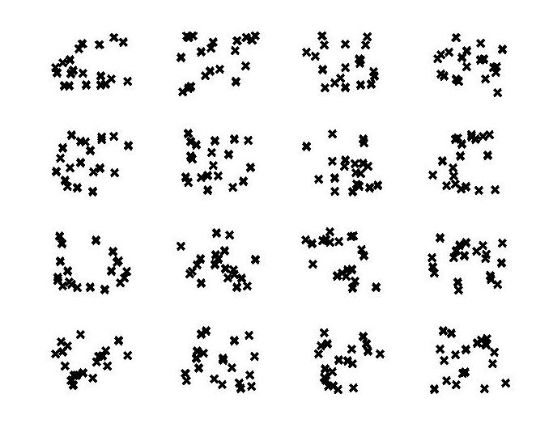
Supervision in Clustering
K=4

Slide 68
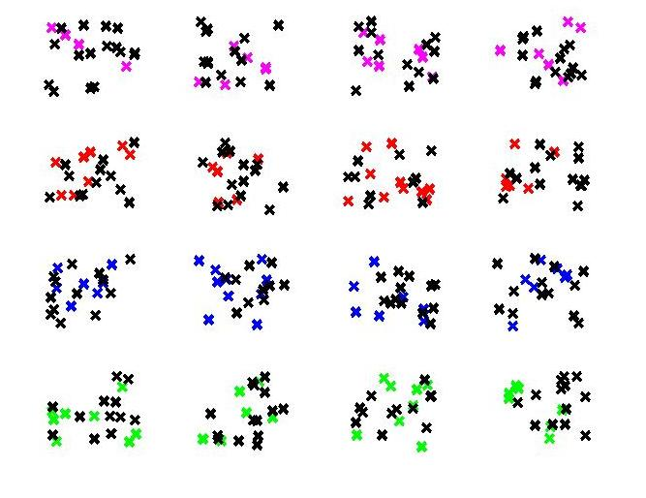
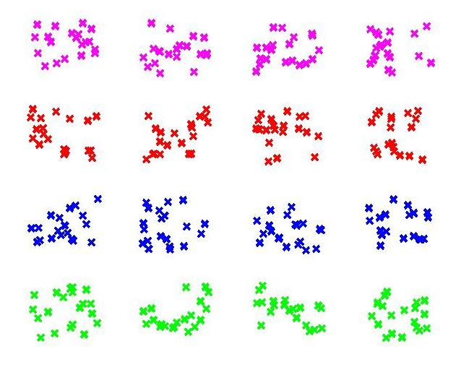
Supervision in Clustering

Slide 69
Supervised Discriminative Clustering (SDC)
Training Stage:
Goal: h*=argmin err_{S}(h,p)
labeled data set S
supervised
learner
A partition function
h(S) = A_{d}(S)
distance
metric d
+
clustering
algorithm A
Application Stage: h(S’ )
unlabeled data set S’
partition h(S’)

Slide 70
Learning partitioning function h by learning metric d
Supervised Metric Learning:
Given a data set S,
a fixed clustering algorithm A
supervision p(S) = {(x_{i},c_{i})}₁^{m} ,
the training process tries to find d*, minimizing the clustering error:
d*= argmin_{d} err_{S}(h,p), where h(S)=A_{d}(S).

Slide 71
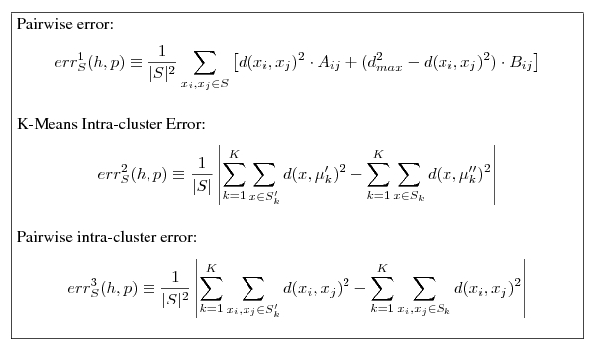
Clustering Error
Supervised Metric Learning: Given a data set S and a fixed clustering algorithm A and supervision p(S) = {(x_{i},c_{i})}₁^{m} , the training process is to find d*, minimizing the clustering error:
d*= argmin_{d} err_{S}(h,p), where h(S)=A_{d}(S).
Mean of P
Mean of h

Slide 72
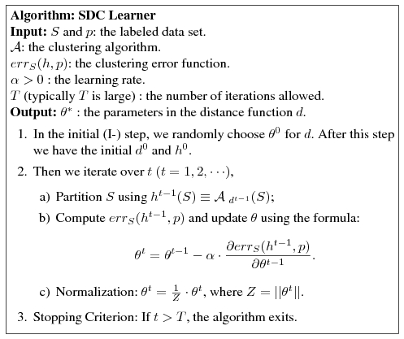

Algorithm
How to parameterize the distance function
Supervised Metric Learning: Given a data set S and a fixed clustering algorithm A and supervision p(S) = {(x_{i},c_{i})}₁^{m} , the training process is to find d*, minimizing the clustering error:
d*= argmin_{d} err_{S}(h,p), where h(S)=A_{d}(S).
Mean of P
Mean of h

