Slide 1

Evaluation
Anietie Andy (Andy)
These slides were assembled by Eric Eaton, with grateful acknowledgement of the many others who made their course materials freely available online. Feel free to reuse or adapt these slides for your own academic purposes, provided that you include proper attribution. Please send comments and corrections to Eric.
Robot Image Credit: Viktoriya Sukhanova © 123RF.com

Slide 2
Announcements
TA office hours
http://www.seas.upenn.edu/~cis519/spring2018/staff.html
Recitation at 3401 Walnut St, Rm 401B
  Tuesdays: 6:30pm – 7:30pm
  Wednesdays: 5:30pm – 6:30pm
Homework submission Instructions

Slide 3
Stages of (Batch) Machine Learning
Given: labeled training data
Assumes each with
Train the model:
model ← classifier.train(X, Y )
Apply the model to new data:
Given: new unlabeled instance
y_{prediction} ← model.predict(x)
X, Y
learner
x
model
y_{prediction}
Notes:
X, Y = \left\{ \left\langle \bm{x}_{i}, y_{i}\right\rangle \right\}_{i=1}^n
\bm{x}_i \sim \mathcal{D}(\mathcal{X})
y_i = f_{\mathit{target}}(\bm{x}_i)
y^{(i)} = f_\mathit{true}\left(x^{(i)}\right)
x \sim \mathcal{D}(\mathcal{X})

Slide 4
Classification Metrics
Notes:
\mbox{accuracy} = \frac{\mbox{\# correct predictions}}{\mbox{\# test instances}}
\mbox{error} = 1 - \mbox{accuracy} = \frac{\mbox{\# incorrect predictions}}{\mbox{\# test instances}}

Slide 5
Recall
No. of relevant records retrieved
Total no. of relevant records in the database
Recall =
Notes:
Recall measures how well our system does at retrieving all the documents in the database that have been determined to be topically relevant.
How much of what we wanted did we get?
If I do a search on T'ang Dynasty painting, does the system retrieve all items in the database related to that topic? What percentage of the topically-relevant items are retrieved?
If there are 100 articles on T'ang Dynasty painting in the database and a search on that topic only brings up 75, then we can say that there was a 75% recall for that search in that database.
[demonstrate with lavender and pink cards]
1 Lavender 25%
2 Lavender 50%
2 lavender + 1 pink still 50%

Slide 6
Precision
No. of relevant records retrieved
Total no. of records retrieved from the database
Precision =
Notes:
A search on calico cats shouldn't retrieve works that are exclusively about pink elephants.
Precision is a measure of how well the system ONLY retrieves relevant items and does not retrieve non-relevant items from the database.
Here we divide the number of relevant documents retrieved by the total number of documents retrieved.
If the system retrieved 100 documents and only 50 of them were relevant the system exhibits a 50% precision rate.
2 lavender cards = 100% 2 lavender + 2 pink cards = 50%
This is an important factor. Studies have shown that a user has what is known as a "futility point." The futility point refers to the maximum number of items the user will tolerate in a retrieved list before he feels overwhelmed and refuses to look at any items in the retrieved set. Example: Alta Vista.
Pulling up a lot of non-relevant material, false drops, not only has the potential of wasting the user's time; it can produce a sufficiently large retrieval set that the user refuses to look at the retrieved items and thus may not have his or her information needs met.

Slide 7
Precision vs. Recall
An inverse relationship
As the level of recall rises the level of precision generally declines and vice versa.
The Cranfield experiments (1957 & 1962)
Cyril Cleverdon, p.i.
Notes:
In 1957 and 1962 Cyril Cleverdon performed two series of experiments known as Cranfield I and II.
He found that, in general, there is a tradeoff between recall and precision. As the one increases the other tends to decrease. If you maximize one you tend to diminish the other.
Other findings: when judging relevance, users with greater depth of subject knowledge tend to agree among themselves on the relevance judgment of materials. The narrower the subject, the better the relevance agreement.

Slide 8
PRECISION: ratio of the number of relevant records retrieved to the total number of irrelevant and relevant records retrieved.
RECALL: ratio of the number of relevant records retrieved to the total number of relevant records in the database.

Slide 9
Confusion Matrix
Given a dataset of P positive instances and N negative instances:
Imagine using classifier to identify positive cases (i.e., for information retrieval)
Predicted Class
Yes
No
Yes
TP
FN
Actual Class
No
FP
TN
Probability that a randomly selected result is relevant
Probability that a randomly selected relevant document is retrieved
Notes:
\mbox{accuracy} = \frac{TP + TN}{P + N}
\definecolor{darkgreen}{rgb}{0.0, 0.5, 0.1}
\color{darkgreen}\mbox{precision} = \frac{TP}{TP + FP}
\mbox{recall} = \frac{TP}{TP + FN}

Slide 10
Example
N = 165 | Predicted: Yes | Predicted: No | Total
Actual: Yes | TP = 100 | FN=5 | 105
Actual: No | FP = 10 | TN = 50 | 60
Total | 110 | 55
Accuracy = (TP+TN)/N = (100+50)/165 = 0.91
Precision = TP/TP + FP = 100/110 = 0.91
Recall = TP / TP + FN = 100/105 = 0.95

Slide 11
Training Data and Test Data
Training data: data used to build the model
Test data: new data, not used in the training process
Training performance is often a poor indicator of generalization performance
  Generalization is what we really care about in ML
  Easy to overfit the training data
  Performance on test data is a good indicator of generalization performance
  i.e., test accuracy is more important than training accuracy

Slide 12
Training and Test Data
Training Data
Idea:
Train each
model on the
“training data”...
...and then test
each model’s
accuracy on
the test data
Full Data Set
Test Data

Slide 13
Simple Decision Boundary
Slide by Padhraic Smyth, UCIrvine

Slide 14
More Complex Decision Boundary
TWO-CLASS DATA IN A TWO-DIMENSIONAL FEATURE SPACE
6
Decision
Region 1
Decision
Region 2
5
4
3
Feature 2
2
1
0
Decision
Boundary
-1
Feature 1
2
3
4
5
6
7
8
9
10
Slide by Padhraic Smyth, UCIrvine

Slide 15
Overfitting
“Fitting the data more than is warranted”

Slide 16
Example: The Overfitting Phenomenon
Y
X
Slide by Padhraic Smyth, UCIrvine

Slide 17
A Complex Model
Y = high-order polynomial in X
Y
X
Slide by Padhraic Smyth, UCIrvine

Slide 18
The True (simpler) Model
Y = a X + b + noise
Y
X
Slide by Padhraic Smyth, UCIrvine

Slide 19
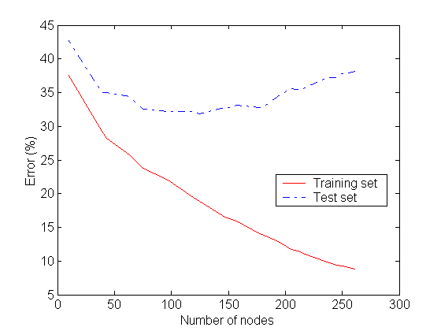
Underfitting and Overfitting
Underfitting
Overfitting
Complexity of a Decision
Tree := number of nodes
It uses
Complexity of the Used Model
Underfitting: when model is too simple, both training and test errors are large
Overfitting: when model is too complex and test errors are large although training errors are small.
Christopher Erick: Learning Models to Predict and Classify

Slide 20
Notes on Overfitting
Overfitting results in models that are more complex than necessary: after learning knowledge they “tend to learn noise”
More complex models tend to have more complicated decision boundaries and tend to be more sensitive to noise, missing examples,…
Training error no longer provides a good estimate of how well the tree will perform on previously unseen records

Slide 21
How Overfitting Affects Prediction
Predictive
Error
Error on Training Data
Model Complexity
Slide by Padhraic Smyth, UCIrvine

Slide 22
How Overfitting Affects Prediction
Predictive
Error
Error on Test Data
Error on Training Data
Model Complexity
Slide by Padhraic Smyth, UCIrvine

Slide 23
How Overfitting Affects Prediction
Predictive
Error
Underfitting
Overfitting
Error on Test Data
Error on Training Data
Model Complexity
Ideal Range
for Model Complexity
Slide by Padhraic Smyth, UCIrvine

Slide 24
Comparing Classifiers
Say we have two classifiers, C1 and C2, and want to choose the best one to use for future predictions
Can we use training accuracy to choose between them?
No!
  e.g., C1 = pruned decision tree, C2 = 1-NN
    training_accuracy(1-NN) = 100%, but may not be best
Instead, choose based on test accuracy...
Based on Slide by Padhraic Smyth, UCIrvine

Slide 25
k-Fold Cross-Validation
Why just choose one particular “split” of the data?
  In principle, we should do this multiple times since performance may be different for each split
k-Fold Cross-Validation (e.g., k=5)
  randomly partition full data set of n instances into
  k disjoint subsets (each roughly of size n/k)
  Choose each fold in turn as the test set; train model on the other folds and evaluate
  Compute statistics over k test performances, or choose best of the k models
  Can also do “leave-one-out CV” where k = n

Slide 26
N-fold cross validation
Instead of a single test-training split:
Split data into N equal-sized parts
Train and test N different classifiers
Report average accuracy and standard deviation of the accuracy
train
test

Slide 27
Example 3-Fold CV
Full Data Set
1st Partition
2nd Partition
k^{th} Partition
Test Data
Training
Data
Training
Data
...
Test Data
Training
Data
Training
Data
Test Data
Test
Performance
Test
Performance
Test
Performance
Summary statistics
over k test
performances

Slide 28
Optimizing Model Parameters
Can also use CV to choose value of model parameter P
Search over space of parameter values
  Evaluate model with P = p on validation set
Choose value p’ with highest validation performance
Learn model on full training set with P = p’
Training Data
1st Partition
2nd Partition
k^{th} Partition
Validation
Set
Training
Data
Training
Data
...
Validation
Set
Training
Data
Training
Data
Validation
Set
Found that optimal P = p₁
Found that optimal P = p₂
Found that optimal P = p_{k}
Test Data
Choose value of p of the model with the best validation performance

Slide 29
More on Cross-Validation
Cross-validation generates an approximate estimate of how well the classifier will do on “unseen” data
  As k → n, the model becomes more accurate (more training data)
  ...but, CV becomes more computationally expensive
  Choosing k < n is a compromise
Averaging over different partitions is more robust than just a single train/validate partition of the data
It is an even better idea to do CV repeatedly!

Slide 30
Multiple Trials of k-Fold CV
1.) Loop for t trials:
a.) Randomize Data Set
Full Data Set
Shuffle
Full Data Set
1st Partition
2nd Partition
k^{th} Partition
Test Data
Training
Data
b.) Perform k-fold CV
...
Training
Data
Test Data
Training
Data
Training
Data
Test Data
Test
Performance
Test
Performance
Test
Performance
2.) Compute statistics over t x k test performances

Slide 31
Comparing Multiple Classifiers
1.) Loop for t trials:
Full Data Set
Test each candidate learner on same training/testing splits
a.) Randomize Data Set
Shuffle
Full Data Set
1st Partition
2nd Partition
k^{th} Partition
Test Data
Training
Data
b.) Perform k-fold CV
...
Training
Data
Test Data
Training
Data
Training
Data
Test Data
Test Perf. C1
Test Perf. C2
Test
C1
Test
C2
Test
C1
Test
C2
2.) Compute statistics over t x k test performances
Allows us to do paired summary statistics (e.g., paired t-test)

Slide 32
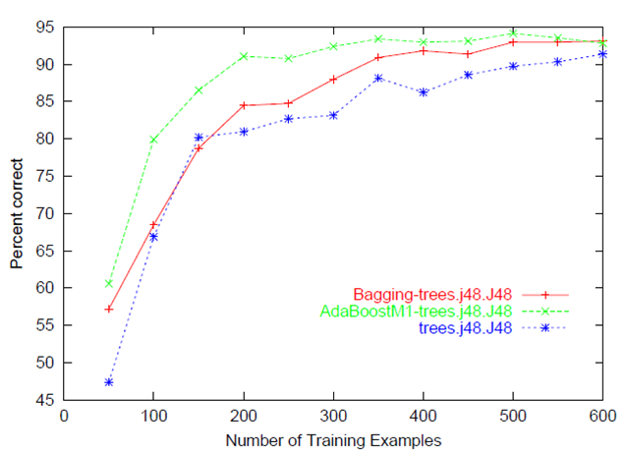
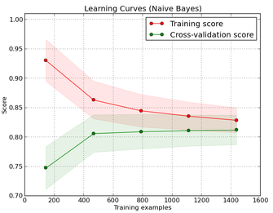
Learning Curve
Shows performance versus the # training examples
  Compute over a single training/testing split
  Then, average across multiple trials of CV

Slide 33
Building Learning Curves
1.) Loop for t trials:
Full Data Set
Compute learning curve over each training/testing split
a.) Randomize Data Set
Shuffle
Full Data Set
1st Partition
2nd Partition
k^{th} Partition
Test Data
Training
Data
b.) Perform k-fold CV
...
Training
Data
Test Data
Training
Data
Training
Data
Test Data
Curve C1
CurveC2
Curve C1
Curve C2
Curve C1
Curve C2
2.) Compute statistics over t x k learning curves

Slide 34
N-fold cross validation
Instead of a single test-training split:
Split data into N equal-sized parts
Train and test N different classifiers
Report average accuracy and standard deviation of the accuracy
train
test

Slide 35
Evaluation: significance tests
You have two different classifiers, A and B
You train and test them on the same data set using N-fold cross-validation
For the n-th fold:
accuracy(A, n), accuracy(B, n)
p_{n} = accuracy(A, n) - accuracy(B, n)
Is the difference between A and B’s accuracies significant?

Slide 36
Hypothesis testing
You want to show that hypothesis H is true, based on your data
  (e.g. H = “classifier A and B are different”)
Define a null hypothesis H₀
  (H₀ is the contrary of what you want to show)
H₀ defines a distribution P(m |H₀) over some statistic
  e.g. a distribution over the difference in accuracy between A and B
Can you refute (reject) H₀?

Slide 37
Rejecting H₀
H₀ defines a distribution P(M |H₀) over some statistic M
  (e.g. M= the difference in accuracy between A and B)
Select a significance value S
  (e.g. 0.05, 0.01, etc.)
  You can only reject H0 if P(m |H₀) ≤ S
Compute the test statistic m from your data
  e.g. the average difference in accuracy over your N folds
Compute P(m |H₀)
Refute H₀ with p ≤ S if P(m |H₀) ≤ S

Slide 38
Excercise
It is believed that a candy machine makes chocolate bars that are on average 5g. A worker claims that the machine after maintenance no longer makes 5g bars. Write H0 and hypothesis.
H0:
Hypothesis:
http://www.MathTutorDVD.com

Slide 39
Paired t-test
A paired t-test is used to compare two population means where you have two samples in which observations in one sample can be paired with observations in the other sample.
E.g.
Before-and-after observations on the same subjects (e.g.
students)

Slide 40
Paired t Tests
Paired tests produce tighter bounds since any difference is due to
difference in the hypotheses rather than differences in the test set.
Significance Testing of the Paired Tests:
Compute the statistics:
where is the measured difference between A and B on the
ith data set and is their average.
The statistics is distributed according to a t-distribution(k)
When k paired test are performed
With k=30, to get N=95%, we need |t| < 2.04

Slide 41
Procedure for carrying out Paired t-test
Calculate the difference between the two observations on each pair.
Calculate the mean difference
Calculate the standard deviation of the differences
Calculate the error of the mean difference
Calculate the t-statistic

Slide 42
Paired t-test example
Question: The downtimes (measured in hours) for computer systems in six branches of a major bank were recorded for year 1 and year 2. Compute the test statistics for the paired t-test.
Solution:
Branch | Year 1 | Year 2 | Difference (Year 1 – Year 2) | Square of Difference
A | 40 | 30 | 10 | 100
B | 54 | 41 | 13 | 169
C | 32 | 24 | 8 | 64
D | 36 | 38 | -2 | 4
E | 55 | 56 | -1 | 1
F | 46 | 37 | 9 | 81
 |  |  | Sum = 37 | Sum = 419
Dragonfly Statistics

Slide 43

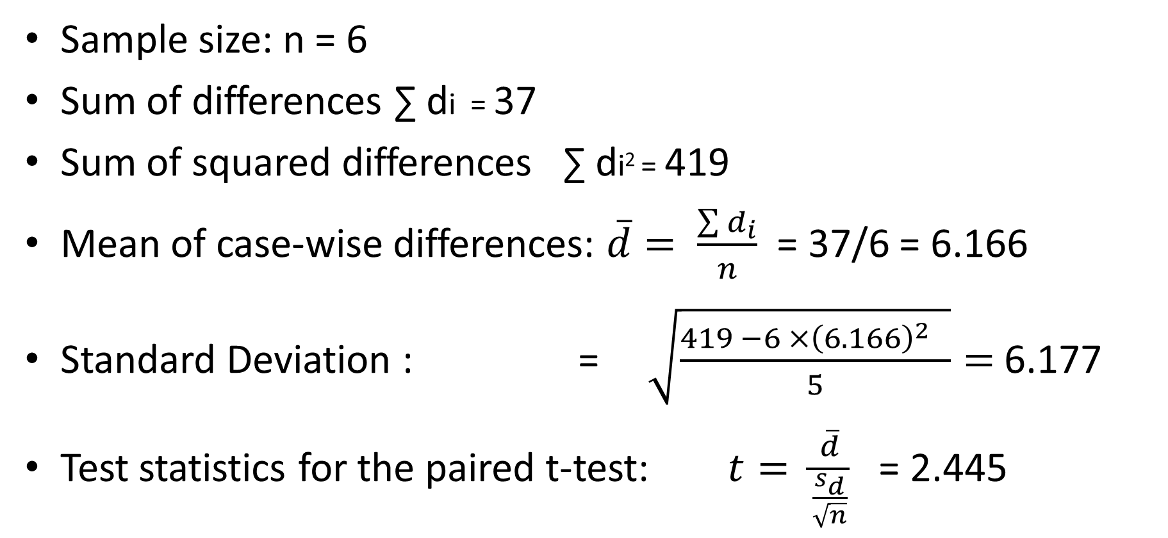
Paired t-test
Sample size: n = 6
Sum of differences ∑ di = 37
Sum of squared differences ∑ di² = 419
Mean of case-wise differences: $\overline{d}= \frac{\sum{d_{i}}}{n}$ = 37/6 = 6.166
Standard Deviation : = $\sqrt{\frac{419 −6 ×{\left(6.166\right)}^{2} }{5}}=$6.177
Test statistics for the paired t-test: $t= \frac{\overline{d}}{\frac{s_{d}}{\sqrt{n}}}$ = 2.445
Sd$=\frac{\sum{d_{i}}−n{\overline{d}}^{2}}{n−1}$

Slide 44
Paired t-test
Null hypothesis (H₀; to be refuted):
  There is no difference between A and B, i.e. the expected accuracies of A and B are the same
That is, the expected difference (over all possible data sets) between their accuracies is 0:
  H₀: E[p_{D}] = 0
We don’t know the true E[p_{D}]
N-fold cross-validation gives us N samples of p_{D}

Slide 45
Paired t-test
Null hypothesis H₀: E[diff_{D}] = μ = 0
m: our estimate of μ based on N samples of diff_{D}
m = 1/N ∑_{n} diff_{n}
The estimated variance S²:
    S² = 1/(N-1) ∑_{1,N} (diff_{n} – m)²
Accept Null hypothesis at significance level a if the
following statistic lies in (-t_{a/2, N-1}, +t_{a/2, N-1})

Slide 46
McNemar’s Test
The test is often used for the situation where one tests for the presence (1) or absence (0) of something and variable A is the state at the first observation (i.e., pretest) and variable B is the state at the second observation (i.e., posttest).

Slide 47
McNemar’s Test
An alternative to Cross Validation, when the test can be run only once
Divide the sample S into a training set R and a test set T.
Train algorithms A and B on R, yielding classifiers A,B
Record how each example in T is classified and compute the number of
Examples misclassified by both A and B N00 | Examples misclassified by A but not B N01
Examples misclassified by B but not A N10 | Examples misclassified by neither A nor B N11
where N is the total number of examples in the test set T

Slide 48
McNemar’s Test
The hypothesis: the two learning algorithms have the same error rate
on a randomly drawn sample. That is, we expect that
The statistics we use to measure deviation from the expected counts:

Slide 49
END

Slide 50
Uses of the McNemar Test
The McNemar test is a nonparametric chi-square procedure that compares proportions obtained from a 2 x 2 contingency table where the row variable (A) is the DV and the column variable (B) is the IV.
The test is used to determine if there is a statistically significant difference between the probability of a (0,1) pair and the probability of a (1,0) pair.
Dichotomous variables are employed where data are coded as "1" for those participants that display the property defined by the variable in question and "0" for those who do not display that property. The test addresses two possible outcomes (presence/absence of a characteristic) on each measurement.

Slide 51
Uses of the McNemar Test
The test is often used for the situation where one tests for the presence (1) or absence (0) of something and variable A is the state at the first observation (i.e., pretest) and variable B is the state at the second observation (i.e., posttest).
Below is a diagram of the data structure:
 |  | B |  | Totals
 |  | 0 | 1
A | 0 | d | c | c + d
 | 1 | b | a | a + b
Totals |  | b + d | a + c | N

Slide 52
This statistics is distributed (approximately) as with 1 degree
of freedom. (with a continuity correction since the statistics is discrete)
Example: Since we reject the hypothesis with
95% confidence if the above ratio is greater the 3.841

