Slide 1
CIS 519/419
Applied Machine Learning www.seas.upenn.edu/~cis519
Dan Roth
danroth@seas.upenn.edu
http://www.cis.upenn.edu/~danroth/
461C, 3401 Walnut
Lecture given by Daniel Khashabi
Slides were created by Dan Roth (for CIS519/419 at Penn or CS446 at UIUC), Eric Eaton for CIS519/419 at Penn, or from other authors who have made their ML slides available.

Slide 2
Functions Can be Made Linear
Data are not linearly separable in one dimension
Not separable if you insist on using a specific class of functions
x

Slide 3
Blown Up Feature Space
Data are separable in <x, x²> space
x²
x

Slide 4
Multi-Layer Neural Network
Multi-layer network were designed to overcome the computational (expressivity) limitation of a single threshold element.
The idea is to stack several
layers of threshold elements,
each layer using the output of
the previous layer as input.
Multi-layer networks can represent arbitrary functions, but building effective learning methods for such network was [thought to be] difficult.
activation
Output
Hidden
Input

Slide 5
Basic Units
Linear Unit: Multiple layers of linear functions o_{j} = w ¢ x produce linear functions. We want to represent nonlinear functions.
Need to do it in a way that
facilitates learning
Threshold units: o_{j} = sgn(w ¢ x)
are not differentiable, hence
unsuitable for gradient descent.
The key idea was to notice that the discontinuity of the threshold element can be represents by a smooth non-linear approximation: o_{j} = [1+ exp{-w ¢ x}]⁻¹
(Rumelhart, Hinton, Williiam, 1986), (Linnainmaa, 1970) , see: http://people.idsia.ch/~juergen/who-invented-backpropagation.html )
activation
Output
w²_{ij}
Hidden
w¹_{ij}
Input

Slide 6
Model Neuron (Logistic)
Us a non-linear, differentiable output function such as the sigmoid or logistic function
Net input to a unit is defined as:
Output of a unit is defined as:
1
2
T
7
3
4
5
6

Slide 7
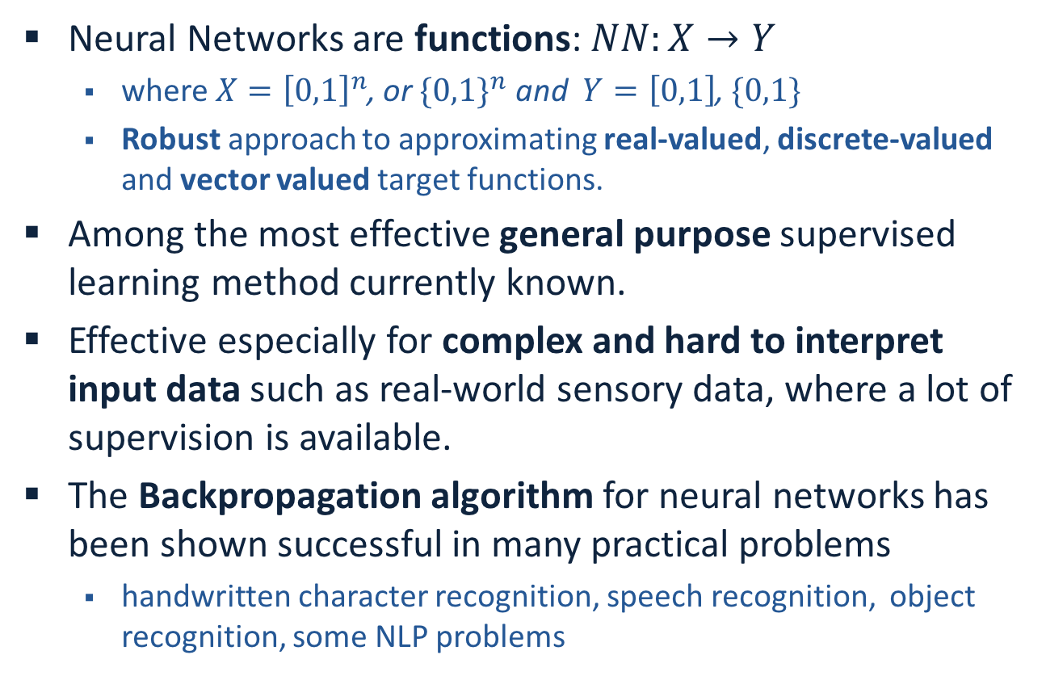
Neural Networks
Neural Networks are functions: $NN:X→Y$
  where $X={\left[0,1\right]}^{n}$, or ${\{0,1\}}^{n}$ and $Y=\left[0,1\right]$, $\{0,1\}$
  Robust approach to approximating real-valued, discrete-valued and vector valued target functions.
Among the most effective general purpose supervised learning method currently known.
Effective especially for complex and hard to interpret input data such as real-world sensory data, where a lot of supervision is available.
The Backpropagation algorithm for neural networks has been shown successful in many practical problems
  handwritten character recognition, speech recognition, object recognition, some NLP problems

Slide 8
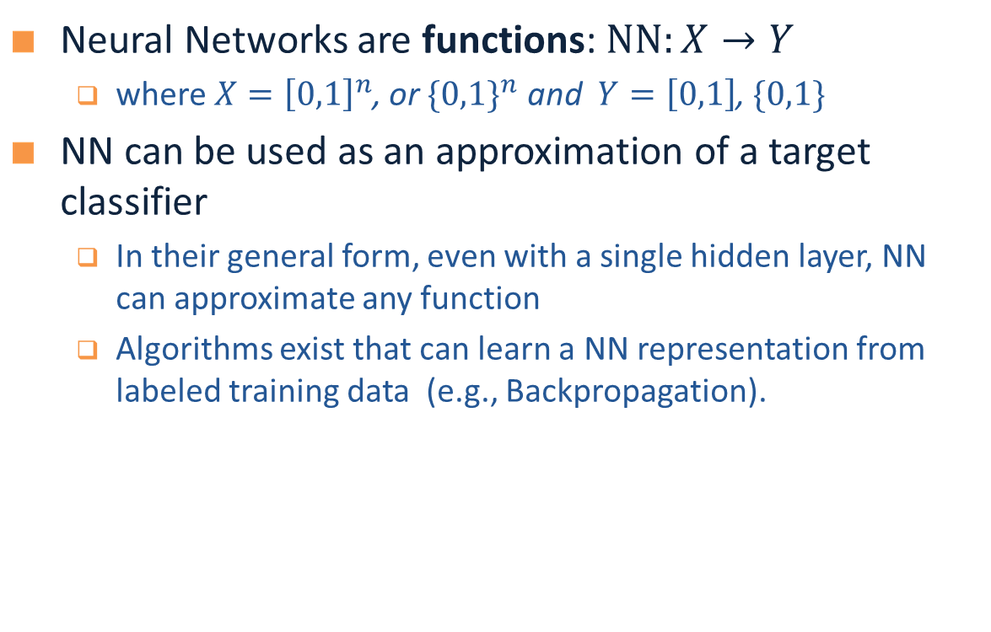
Neural Networks
Neural Networks are functions: $NN:X→Y$
  where $X={\left[0,1\right]}^{n}$, or ${\{0,1\}}^{n}$ and $Y=\left[0,1\right]$, $\{0,1\}$
NN can be used as an approximation of a target classifier
  In their general form, even with a single hidden layer, NN can approximate any function
  Algorithms exist that can learn a NN representation from labeled training data (e.g., Backpropagation).

Slide 9
Multi-Layer Neural Networks
Multi-layer network were designed to overcome the computational (expressivity) limitation of a single threshold element.
The idea is to stack several
layers of threshold elements,
each layer using the output of
the previous layer as input.
activation
Output
Hidden
Input

Slide 10
Motivation for Neural Networks
Inspired by biological systems
  But don’t take this (as well as any other words in the new on “emergence” of intelligent behavior) seriously;
We are currently on rising part of a wave of interest in NN architectures, after a long downtime from the mid-90-ies.
  Better computer architecture (GPUs, parallelism)
  A lot more data than before; in many domains, supervision is available.
Current surge of interest has seen very minimal algorithmic changes

Slide 11
Motivation for Neural Networks
Minimal to no algorithmic changes
One potentially interesting perspective:
  Before we looked at NN only as function approximators.
  Now, we look at the intermediate representations generated while learning as meaningful
  Ideas are being developed on the value of these intermediate representations for transfer learning etc.
We will present in the next two lectures a few of the basic architectures and learning algorithms, and provide some examples for applications

Slide 12
Neural Speed Constraints
Neuron “switching time” is O(milliseconds), compared to nanosecond for transistors.
  However, biological systems can perform significant cognitive tasks (vision, language understanding) in fractions of a second.
Even for limited abilities, current AI systems require orders of magnitude more steps.
Human brain has approximately 10^10 neurons, each connected to 10^4; must explore massive parallelism (but there’s more…)

Slide 13
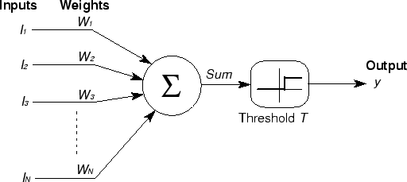

Basic Unit in Multi-Layer Neural Network
Linear Unit: $o_{j}=\vec{w}.\vec{x}$ multiple layers of linear functions produce linear functions. We want to represent nonlinear functions.
Threshold units: $o_{j}=sgn(\vec{w}.\vec{x}−T)$ are not differentiable, hence unsuitable for gradient descent
activation
Output
Hidden
Input

Slide 14
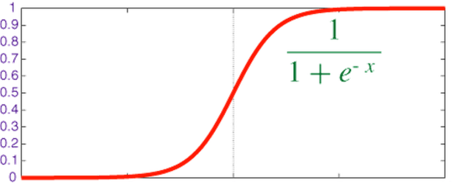

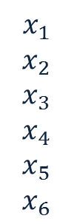



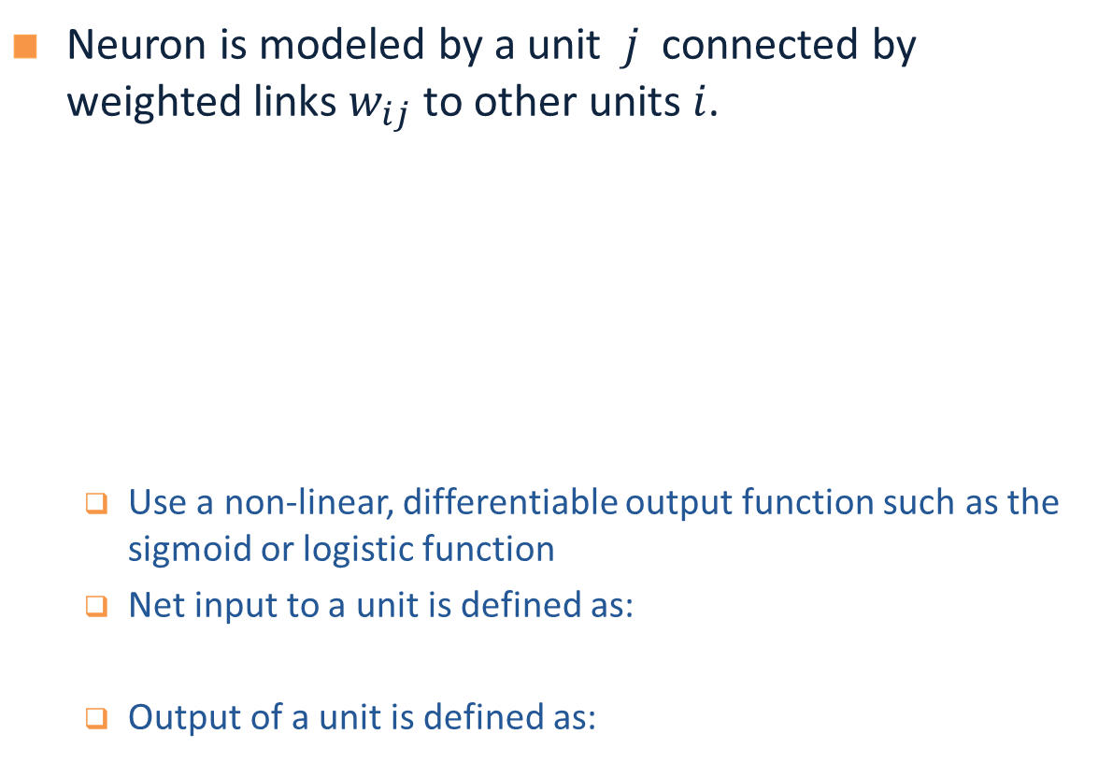

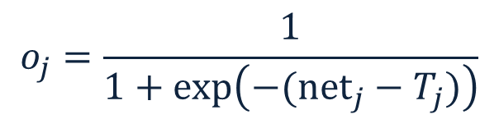
Model Neuron (Logistic)
Neuron is modeled by a unit $j$ connected by weighted links $w_{ij}$ to other units $i$.
  Use a non-linear, differentiable output function such as the sigmoid or logistic function
  Net input to a unit is defined as:
  Output of a unit is defined as:
$$x_{1}$$
$$x_{2}$$
$$x_{3}$$
$$x_{4}$$
$$x_{5}$$
$$x_{6}$$
$$w_{1j}$$
$$x_{j}$$
$$o_{j}$$
$$w_{6j}$$
$${net}_{j}=∑w_{ij}.x_{i}$$
$$o_{j}=\frac{1}{1+exp\left(−({net}_{j}−T_{j})\right)}$$

Slide 15
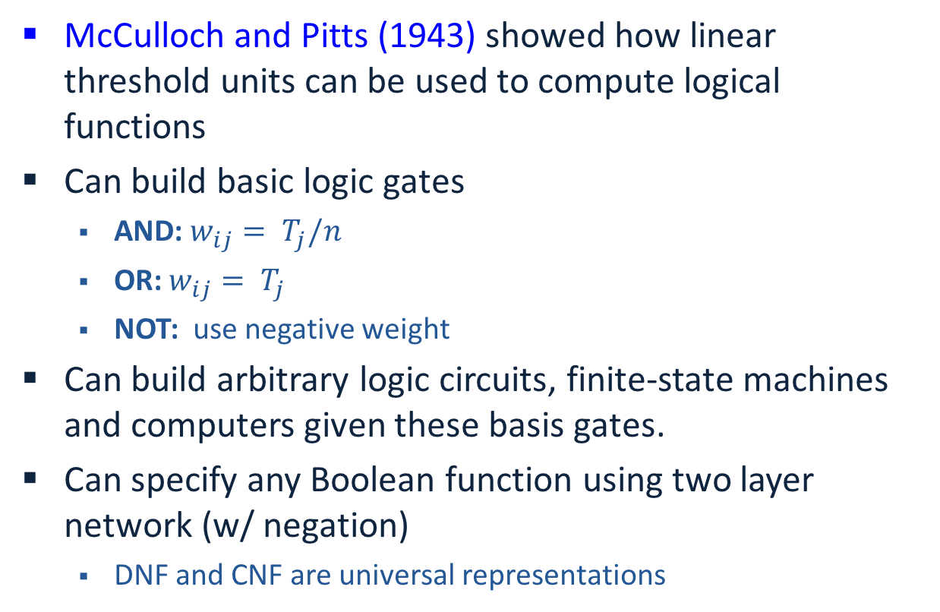

History: Neural Computation
McCulloch and Pitts (1943) showed how linear threshold units can be used to compute logical functions
Can build basic logic gates
  AND:$w_{ij}= T_{j}/n$
  OR: $w_{ij}= T_{j}$
  NOT: use negative weight
Can build arbitrary logic circuits, finite-state machines and computers given these basis gates.
Can specify any Boolean function using two layer network (w/ negation)
  DNF and CNF are universal representations
$${net}_{j}=∑w_{ij}.x_{i}$$
$$o_{j}=\frac{1}{1+exp\left(−({net}_{j}−T_{j})\right)}$$

Slide 16
Representational Power
Any Boolean function can be represented by a two layer network (simulate a two layer AND-OR network)
Any bounded continuous function can be approximated with arbitrary small error by a two layer network.
Sigmoid functions provide a set of basis function from which arbitrary function can be composed.
Any function can be approximated to arbitrary accuracy by a three layer network.

Slide 17
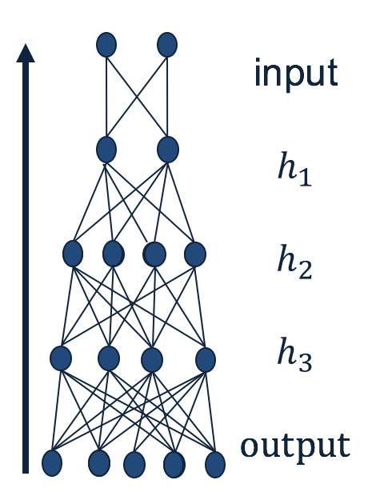
Quiz Time!
Given a neural network, how can we make predictions?
  Given input, calculate the output of each layer (starting from the first layer), until you get to the output.
What is required to fully specify a neural network?
  The weights.
Why NN predictions can be quick?
  Because many of the computations could be parallelized.
What makes a neural networks non-linear approximator?
  The non-linear units.

Slide 18
Training a Neural Net

Slide 19
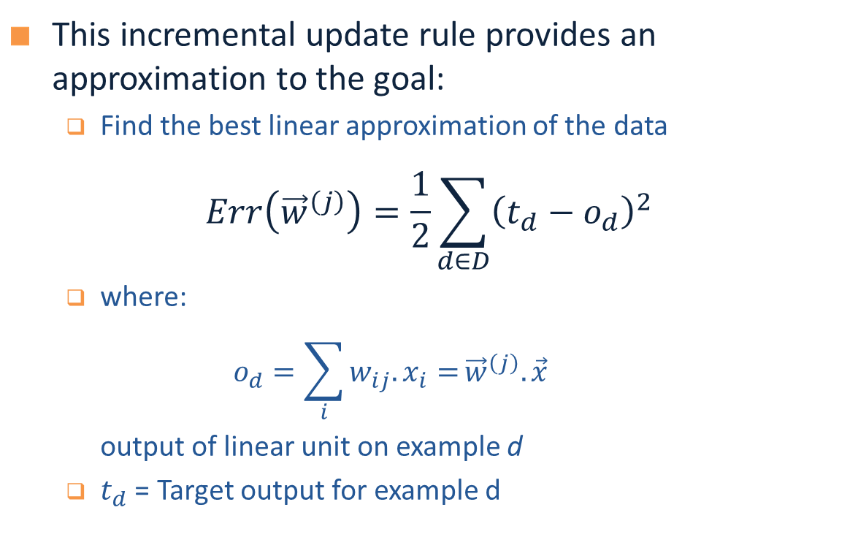
Widrow-Hoff Rule
This incremental update rule provides an approximation to the goal:
  Find the best linear approximation of the data
$$Err\left({\vec{w}}^{\left(j\right)}\right)=\frac{1}{2}\sum_{d∈D}{{\left(t_{d}−o_{d}\right)}^{2}}$$
  where:
  $$o_{d}=\sum_{i}{w_{ij}.x_{i}=}{\vec{w}}^{\left(j\right)}.{\vec{x}}^{}$$
  output of linear unit on example d
  $t_{d}$ = Target output for example d

Slide 20
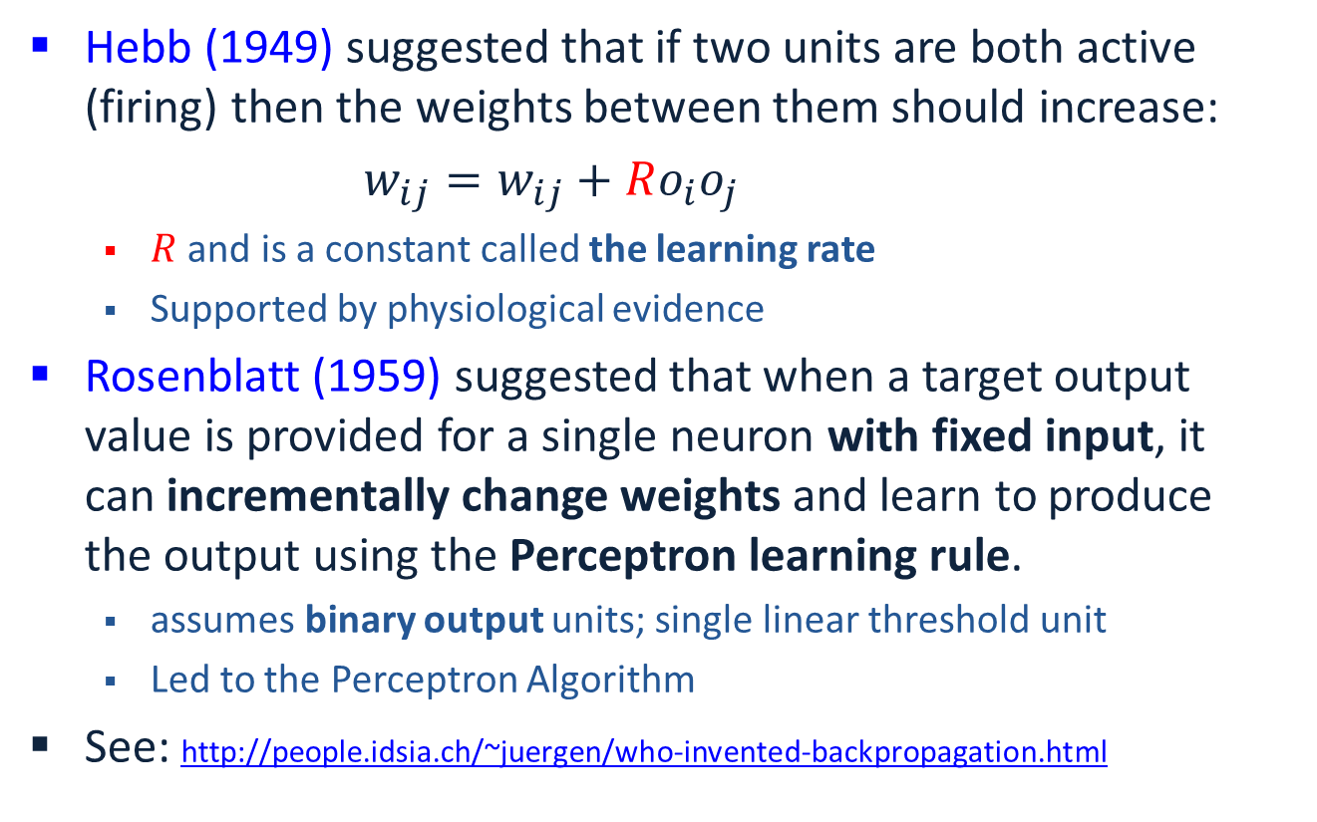
History: Learning Rules
Hebb (1949) suggested that if two units are both active (firing) then the weights between them should increase:
$w_{ij}=w_{ij}+Ro_{i}o_{j}$
  $R$ and is a constant called the learning rate
  Supported by physiological evidence
Rosenblatt (1959) suggested that when a target output value is provided for a single neuron with fixed input, it can incrementally change weights and learn to produce the output using the Perceptron learning rule.
  assumes binary output units; single linear threshold unit
  Led to the Perceptron Algorithm
See: http://people.idsia.ch/~juergen/who-invented-backpropagation.html

Slide 21
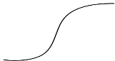







Perceptron Learning Rule
Given:
  the target output for the output unit is $t_{j}$
  the input the neuron sees is $x_{i}$
  the output it produces is $o_{j}$
Update weights according to $w_{ij}←w_{ij}+R\left(t_{j}−o_{j}\right)x_{i}$
  If output is correct, don’t change the weights
  If output is wrong, change weights for all inputs which are 1
    If output is low (0, needs to be 1) increment weights
    If output is high (1, needs to be 0) decrement weights
$$x_{1}$$
$$x_{2}$$
$$x_{3}$$
$$x_{4}$$
$$x_{5}$$
$$x_{6}$$
$$w_{17}$$
$$x_{7}$$
$$o_{j}$$
$$T_{j}$$
$$w_{67}$$

Slide 22




Gradient Descent
We use gradient descent determine the weight vector that minimizes $Err\left({\vec{w}}^{\left(j\right)}\right)$;
Fixing the set $D$ of examples, $E$ is a function of ${\vec{w}}^{\left(j\right)}$
At each step, the weight vector is modified in the direction that produces the steepest descent along the error surface.
$Err(w)$
$$w$$
$w_{3}$ $w_{2}$ $w_{1}$ $w_{0}$

Slide 23
Summary: Single Layer Network
Variety of update rules
  Multiplicative
  Additive
Batch and incremental algorithms
Various convergence and efficiency conditions
There are other ways to learn linear functions
  Linear Programming (general purpose)
  Probabilistic Classifiers ( some assumption)
Key algorithms are driven by gradient descent

Slide 24
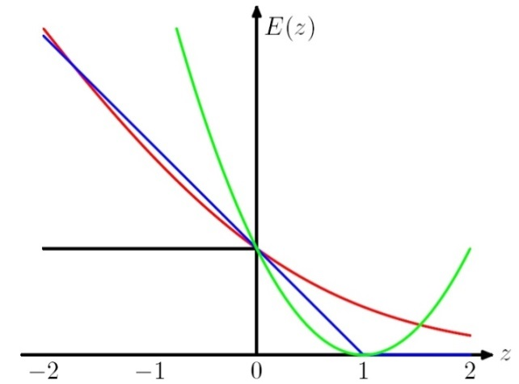

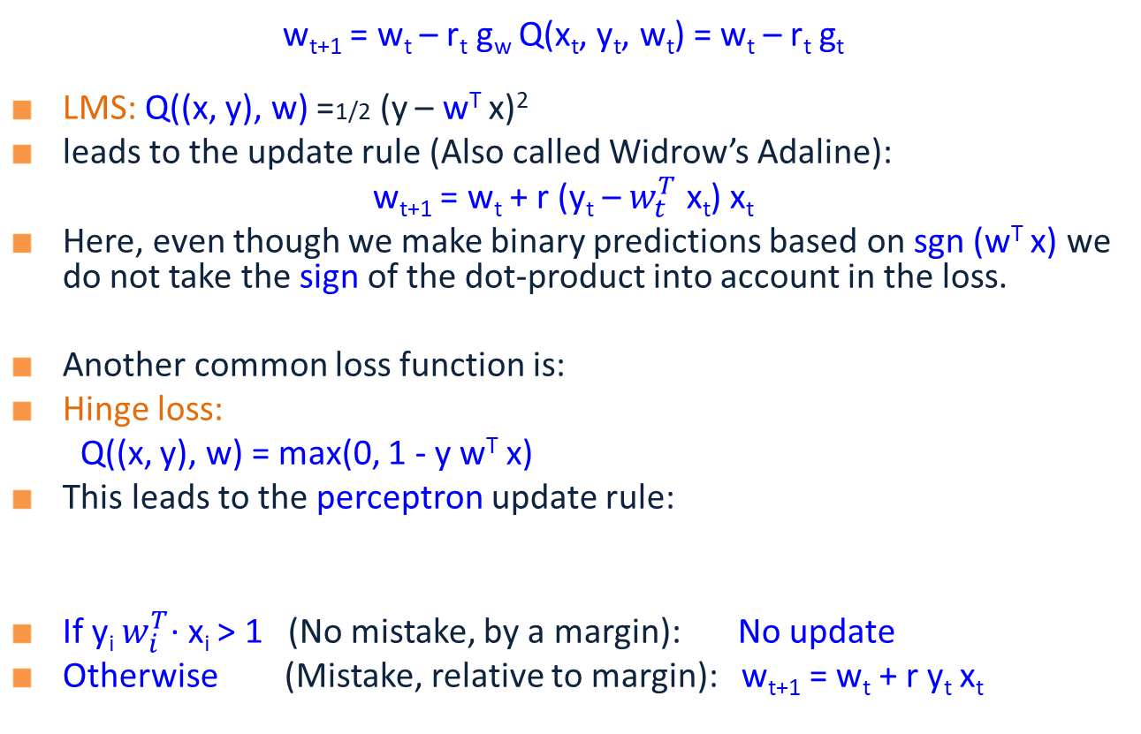
General Stochastic Gradient Algorithms
Learning rate
gradient
The loss Q: a function of x, w and y
w_{t+1} = w_{t} – r_{t} g_{w} Q(x_{t}, y_{t}, w_{t}) = w_{t} – r_{t} g_{t}
  LMS: Q((x, y), w) =1/2 (y – w^{T} x)²
  leads to the update rule (Also called Widrow’s Adaline):
  w_{t+1} = w_{t} + r (y_{t} – $w_{t}^{T}$ x_{t}) x_{t}
  Here, even though we make binary predictions based on sgn (w^{T} x) we do not take the sign of the dot-product into account in the loss.
  Another common loss function is:
  Hinge loss:
  Q((x, y), w) = max(0, 1 - y w^{T} x)
  This leads to the perceptron update rule:
  If y_{i} $w_{i}^{T}$∙ x_{i} > 1 (No mistake, by a margin): No update
  Otherwise (Mistake, relative to margin): w_{t+1} = w_{t} + r y_{t} x_{t}
w^{T} x
Here g = -yx
Good to think about the case of Boolean examples

Slide 25
Summary: Single Layer Network
Variety of update rules
  Multiplicative
  Additive
Batch and incremental algorithms
Various convergence and efficiency conditions
There are other ways to learn linear functions
  Linear Programming (general purpose)
  Probabilistic Classifiers ( some assumption)
Key algorithms are driven by gradient descent
However, the representational restriction is limiting in many applications

Slide 26
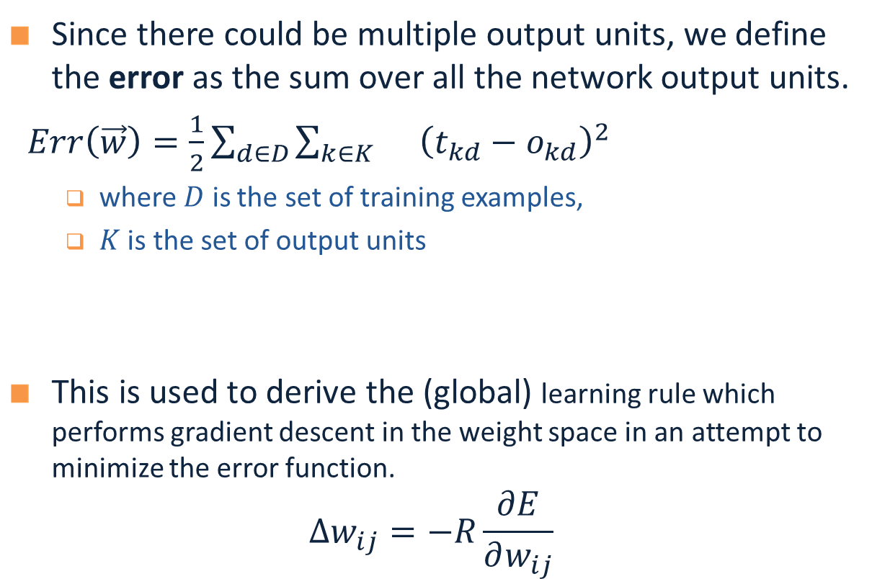

Backpropagation Learning Rule
Since there could be multiple output units, we define the error as the sum over all the network output units.
$Err\left(\vec{w}\right)=\frac{1}{2}\sum_{d∈D}{\sum_{k∈K}{}{\left(t_{kd}−o_{kd}\right)}^{2}}$
  where $D$ is the set of training examples,
  $K$ is the set of output units
This is used to derive the (global) learning rule which performs gradient descent in the weight space in an attempt to minimize the error function.
$$Δw_{ij}=−R\frac{∂E}{∂w_{ij}}$$
$o_{1}$…$o_{k}$
$$(1, 0, 1, 0, 0)$$
Function 1

Slide 27
Learning with a Multi-Layer Perceptron
It’s easy to learn the top layer – it’s just a linear unit.
Given feedback (truth) at the top layer, and the activation at the layer below it, you can use the Perceptron update rule (more generally, gradient descent) to updated these weights.
The problem is what to do with
the other set of weights – we do
not get feedback in the
intermediate layer(s).
activation
Output
w²_{ij}
Hidden
w¹_{ij}
Input

Slide 28
Learning with a Multi-Layer Perceptron
The problem is what to do with
the other set of weights – we do
not get feedback in the
intermediate layer(s).
Solution: If all the activation
functions are differentiable, then
the output of the network is also
a differentiable function of the input and weights in the network.
Define an error function (e.g., sum of squares) that is a differentiable function of the output, i.e. this error function is also a differentiable function of the weights.
We can then evaluate the derivatives of the error with respect to the weights, and use these derivatives to find weight values that minimize this error function, using gradient descent (or other optimization methods).
This results in an algorithm called back-propagation.
activation
Output
w²_{ij}
Hidden
w¹_{ij}
Input

Slide 29
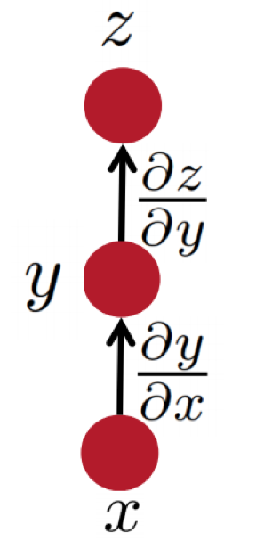
Some facts from real analysis
  First let’s get the notation right:
  The arrow shows functional dependnence of z on y
  i.e. given y, we can calculate z.
  e.g., for example: z(y) = 2y^2
  The derivative of z, with respect to y.

Slide 30
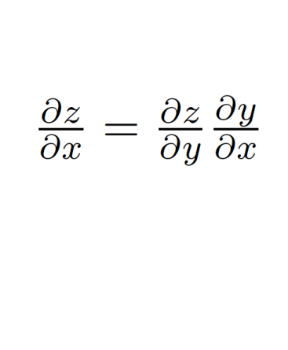

Some facts from real analysis
Simple chain rule
  If $z$ is a function of $y$, and $y$ is a function of $x$
    Then $z$ is a function of $x$, as well.
  Question: how to find $\frac{∂z}{∂x}$
We will use these facts to derive the details of the Backpropagation algorithm.
z will be the error (loss) function.
- We need to know how to differentiate z
Intermediate nodes use a logistics function (or another differentiable step function).
- We need to know how to differentiate it.

Slide 31
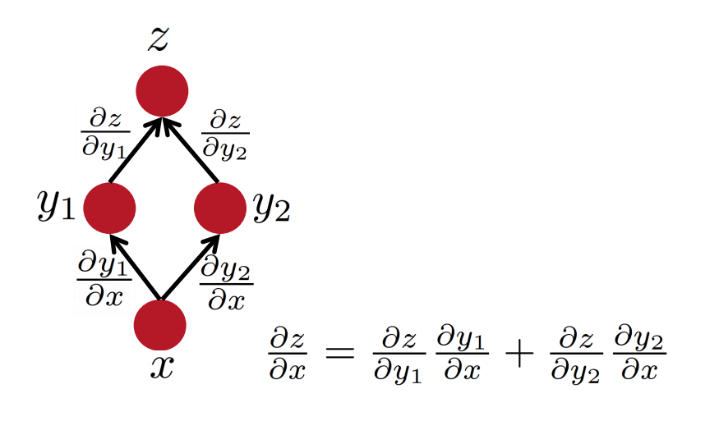
Some facts from real analysis
Multiple path chain rule
Slide Credit: Richard Socher

Slide 32
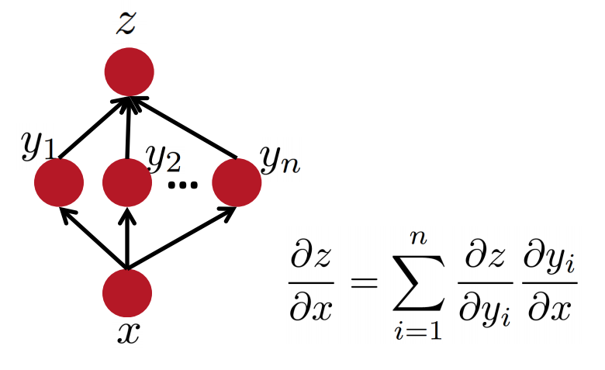
Some facts from real analysis
Multiple path chain rule: general
Slide Credit: Richard Socher

Slide 33
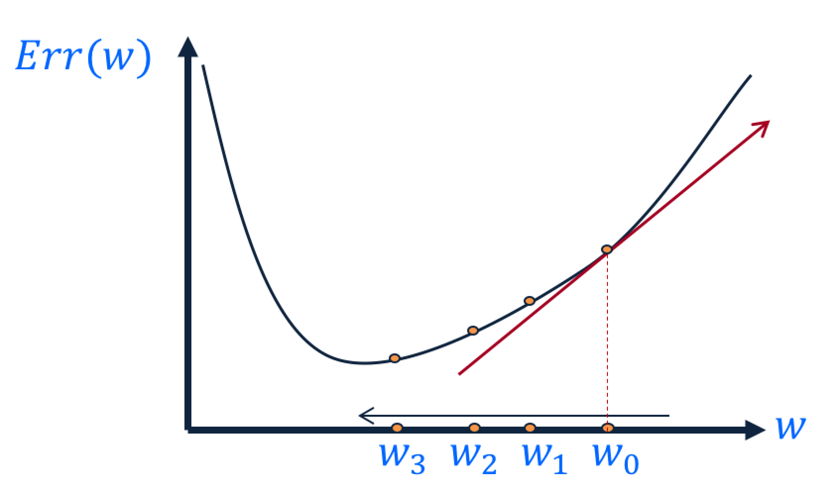
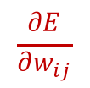
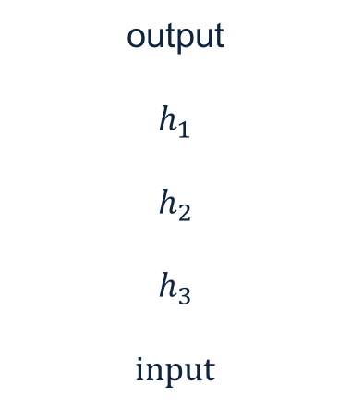
Key Intuitions Required for BP
Gradient Descent
  Change the weights in the direction of gradient to minimize the error function.
Chain Rule
  Use the chain rule to calculate the weights of the intermediate weights
Dynamic Programming (Memoization)
  Memoize the weight updates to make the updates faster.
  The “back” part of “backpropagation”
output
$$h_{1}$$
$$h_{2}$$
$$h_{3}$$
input
$$\frac{∂E}{∂w_{ij}}$$

Slide 34
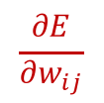
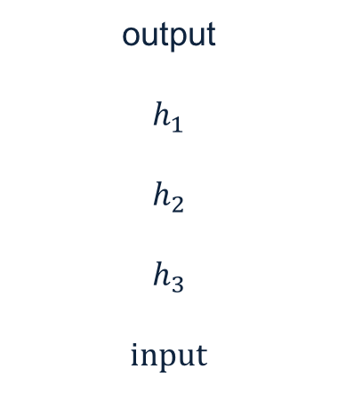
Backpropagation: the big picture
Loop over instances:
  The forward step
    Given the input, make predictions layer-by-layer, starting from the first layer)
  The backward step
    Calculate the error in the output
    Update the weights layer-by-layer, starting from the final layer
output
$$h_{1}$$
$$h_{2}$$
$$h_{3}$$
input
$$\frac{∂E}{∂w_{ij}}$$

Slide 35
Quiz time!
What is the purpose of forward step?
  To make predictions, given an input.
What is the purpose of backward step?
  To update the weights, given an output error.
Why do we use the chain rule?
  To calculate gradient in the intermediate layers.
Why backpropagation could be efficient?
  Because it can be parallelized.

Slide 36
Deriving the update rules

Slide 37



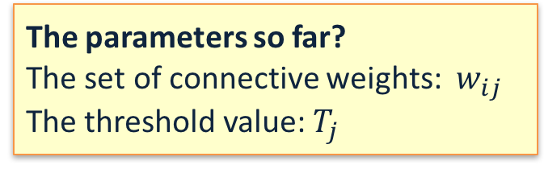

Reminder: Model Neuron (Logistic)
Neuron is modeled by a unit $j$ connected by weighted links $w_{ij}$ to other units $i$.
  Use a non-linear, differentiable output function such as the sigmoid or logistic function
  Net input to a unit is defined as:
  Output of a unit is defined as:
The parameters so far?
The set of connective weights: $w_{ij}$ The threshold value: $T_{j}$
$$x_{1}$$
$$x_{2}$$
$$x_{3}$$
$$x_{4}$$
$$x_{5}$$
$$x_{6}$$
$$w_{17}$$
$$x_{7}$$
$$o_{j}$$
$$w_{67}$$
$${net}_{j}=∑w_{ij}.x_{i}$$
$$o_{j}=\frac{1}{1+exp\left(−({net}_{j}−T_{j})\right)}$$

Slide 38



Derivatives
Function 1 (error):
  $E= \frac{1}{2}\sum_{k∈K}{{\left(t_{k}−o_{k}\right)}^{2}}$
  $\frac{∂E}{∂o_{i}}=−\left(ti −o_{i}\right)$
Function 2 (linear gate):
  ${net}_{j}=∑w_{ij}.x_{i}$
  $\frac{∂{net}_{j}}{∂w_{ij}}=xi$
Function 3 (differentiable step function):
  $o_{i}=\frac{1}{1+\exp{\{−({net}_{j}−T)\}}}$
  $\frac{∂o_{i}}{∂{net}_{j}}=\frac{\exp{\{−({net}_{j}−T)\}}}{(1+\exp{\{−({net}_{j}−T)\})2}}$=$o_{i}(1−o_{i})$
$o_{1}$…$o_{k}$
$j$
$i$
$$w_{ij}$$

Slide 39
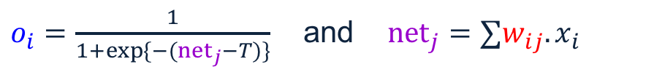
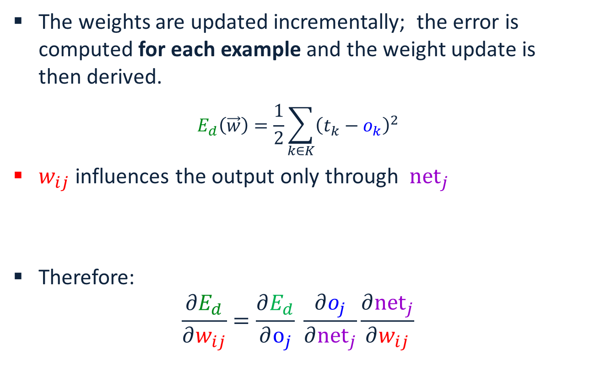
Derivation of Learning Rule
The weights are updated incrementally; the error is computed for each example and the weight update is then derived.
$$E_{d}\left(\vec{w}\right)=\frac{1}{2}\sum_{k∈K}{{\left(t_{k}−o_{k}\right)}^{2}}$$
$w_{ij}$ influences the output only through ${net}_{j}$
Therefore:
$$\frac{∂E_{d}}{∂w_{ij}}=\frac{∂E_{d}}{∂o_{j}} \frac{∂o_{j}}{∂{net}_{j}}\frac{∂{net}_{j}}{∂w_{ij}}$$
$o_{1}$…$o_{k}$
$j$
$i$
$o_{i}=\frac{1}{1+\exp{\{−({net}_{j}−T)\}}}$ and ${net}_{j}=∑w_{ij}.x_{i}$
$$w_{ij}$$

Slide 40
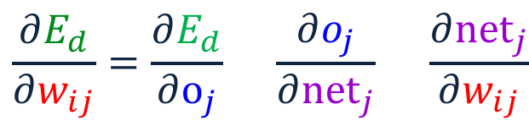
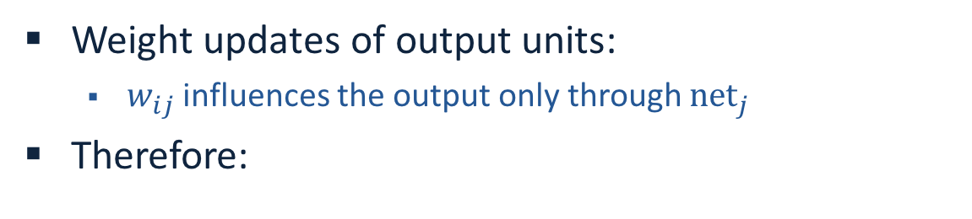


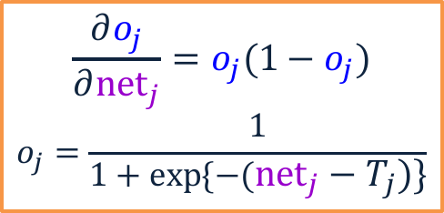
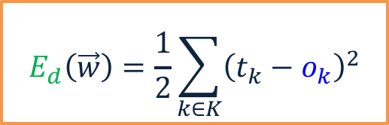

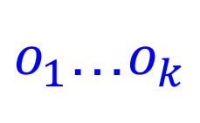

Derivation of Learning Rule (2)
Weight updates of output units:
  $w_{ij}$ influences the output only through ${net}_{j}$
Therefore:
$o_{1}$…$o_{k}$
$j$
$i$
$$w_{ij}$$
$$\frac{∂E_{d}}{∂w_{ij}}=\frac{∂E_{d}}{∂o_{j}} \frac{∂o_{j}}{∂{net}_{j}} \frac{∂{net}_{j}}{∂w_{ij}}$$
$$=−\left(t_{j}−o_{j}\right) o_{j}\left(1−o_{j}\right) x_{i}$$
$$E_{d}\left(\vec{w}\right)=\frac{1}{2}\sum_{k∈K}{{\left(t_{k}−o_{k}\right)}^{2}}$$
$$\frac{∂o_{j}}{∂{net}_{j}}=o_{j}(1−o_{j})$$
$$o_{j}=\frac{1}{1+\exp{\{−({net}_{j}−T_{j})\}}}$$
$${net}_{j}=∑w_{ij}.x_{i}$$

Slide 41
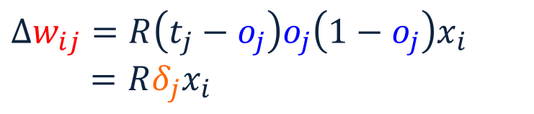





Derivation of Learning Rule (3)
Weights of output units:
  $w_{ij}$ is changed by:
Where we defined:
$δ_{j}=\frac{∂E_{d}}{∂{net}_{j}}=\left(t_{j}−o_{j}\right)o_{j}\left(1−o_{j}\right)$
$$o_{j}$$
$j$
$i$
$$w_{ij}$$
$$Δw_{ij}=R\left(t_{j}−o_{j}\right)o_{j}\left(1−o_{j}\right)x_{i}$$
$=Rδ_{j}x_{i}$
$$x_{i}$$

Slide 42
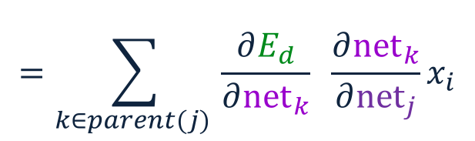
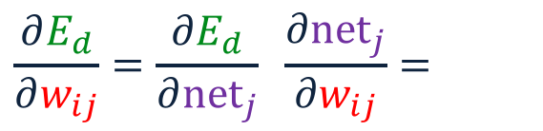
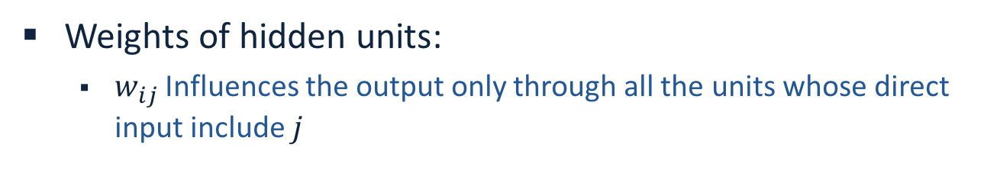
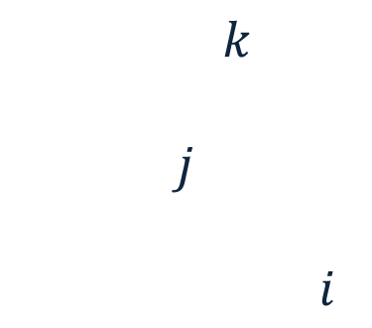



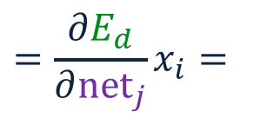
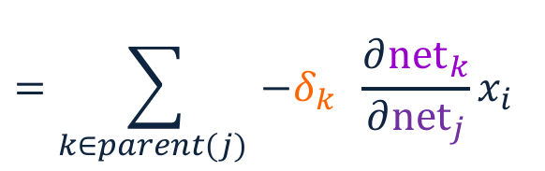
Derivation of Learning Rule (4)
Weights of hidden units:
  $w_{ij}$ Influences the output only through all the units whose direct input include $j$
$$\frac{∂E_{d}}{∂w_{ij}}=\frac{∂E_{d}}{∂{net}_{j}} \frac{∂{net}_{j}}{∂w_{ij}}=$$
$$o_{k}$$
$${net}_{j}=∑w_{ij}.x_{i}$$
$k$
$j$
$i$
$$=\frac{∂E_{d}}{∂{net}_{j}}x_{i}=$$
$$w_{ij}$$
$$=\sum_{k∈parent(j) }{\frac{∂E_{d}}{∂{net}_{k}} \frac{∂{net}_{k}}{∂{net}_{j}}x_{i}}$$
$$=\sum_{k∈parent(j) }{−δ_{k} \frac{∂{net}_{k}}{∂{net}_{j}}x_{i}}$$

Slide 43
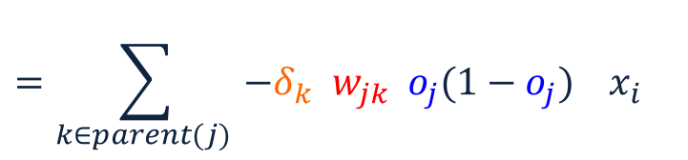






Derivation of Learning Rule (5)
Weights of hidden units:
  $w_{ij}$influences the output only through all the units whose direct input include $j$
$$o_{k}$$
$k$
$j$
$i$
$$w_{ij}$$
$$\frac{∂E_{d}}{∂w_{ij}}=\sum_{k∈parent(j) }{−δ_{k}\frac{∂{net}_{k}}{∂{net}_{j}}x_{i}}=$$
$$=\sum_{k∈parent(j) }{−δ_{k} \frac{∂{net}_{k}}{∂o_{j}}\frac{∂o_{j}}{∂{net}_{j}}x_{i}}$$
$$=\sum_{k∈parent(j) }{−δ_{k} w_{jk}{ o}_{j}(1−o_{j}) x_{i}}$$

Slide 44





Derivation of Learning Rule (6)
Weights of hidden units:
  $w_{ij}$ is changed by:
Where
$δ_{j}=o_{j}\left(1−o_{j}\right).\left(\sum_{k∈parent\left(j\right)}{−δ_{k} w_{jk} }\right)$
First determine the error for the output units.
Then, backpropagate this error layer by layer through the network, changing weights appropriately in each layer.
$$Δw_{ij}= R o_{j}\left(1−o_{j}\right).\left(\sum_{k∈parent\left(j\right)}{−δ_{k} w_{jk}}\right)x_{i}$$
$=Rδ_{j}x_{ij}$
$$o_{k}$$
$k$
$j$
$i$
$$w_{ij}$$

Slide 45

The Backpropagation Algorithm
Create a fully connected three layer network. Initialize weights.
Until all examples produce the correct output within $ε$ (or other criteria)
For each example in the training set do:
  Compute the network output for this example
  Compute the error between the output and target value
  $$δ_{k}=\left(t_{k}−o_{k}\right)o_{k}\left(1−o_{k}\right)$$
  For each output unit k, compute error term
  $${δ_{j}= o}_{j}\left(1−o_{j}\right).\sum_{k∈downstream\left(j\right)}{−δ_{k} w_{jk} }$$
  For each hidden unit, compute error term:
  $$Δw_{ij}=Rδ_{j}x_{i}$$
  Update network weights with $Δw_{ij}$
End epoch

Slide 46

More Hidden Layers
The same algorithm holds for more hidden layers.
output
$$h_{1}$$
$$h_{2}$$
$$h_{3}$$
input

Slide 47
Demo time!
Link: https://playground.tensorflow.org/

Slide 48
Comments on Training
No guarantee of convergence; may oscillate or reach a local minima.
In practice, many large networks can be trained on large amounts of data for realistic problems.
Many epochs (tens of thousands) may be needed for adequate training. Large data sets may require many hours of CPU
Termination criteria: Number of epochs; Threshold on training set error; No decrease in error; Increased error on a validation set.
To avoid local minima: several trials with different random initial weights with majority or voting techniques

Slide 49
Over-training Prevention
Running too many epochs may over-train the network and result in over-fitting. (improved result on training, decrease in performance on test set)
Keep an hold-out validation set and test accuracy after every epoch
Maintain weights for best performing network on the validation set and return it when performance decreases significantly beyond that.
To avoid losing training data to validation:
  Use 10-fold cross-validation to determine the average number of epochs that optimizes validation performance
  Train on the full data set using this many epochs to produce the final results

Slide 50
Over-fitting prevention
Too few hidden units prevent the system from adequately fitting the data and learning the concept.
Using too many hidden units leads to over-fitting.
Similar cross-validation method can be used to determine an appropriate number of hidden units. (general)
Another approach to prevent over-fitting is weight-decay: all weights are multiplied by some fraction in (0,1) after every epoch.
  Encourages smaller weights and less complex hypothesis
  Equivalently: change Error function to include a term for the sum of the squares of the weights in the network. (general)

Slide 51

Dropout training
Proposed by (Hinton et al, 2012)
Each time decide whether to delete one hidden unit with some probability p

Slide 52

Dropout training
  Dropout of 50% of the hidden units and 20% of the input units (Hinton et al, 2012)

Slide 53

Dropout training
Model averaging effect
  Among 2^{H} models, with shared parameters
    H: number of units in the network
  Only a few get trained
  Much stronger than the known regularizer
What about the input space?
  Do the same thing!

Slide 54
Input-Output Coding
Appropriate coding of inputs and outputs can make learning problem easier and improve generalization.
Encode each binary feature as a separate input unit;
For multi-valued features include one binary unit per value rather than trying to encode input information in fewer units.
  Very common today to use distributed representation of the input – real valued, dense representation.
For disjoint categorization problem, best to have one output unit for each category rather than encoding N categories into log N bits.
One way to do it, if you start with a collection of sparsely representation examples, is to use dimensionality reduction methods:
Your m examples are represented as a m x 10⁶ matrix
Multiple it by a random matrix of size 10⁶ x 300, say.
Random matrix: Normal(0,1)
New representation: m x 300 dense rows

Slide 55
Hidden Layer Representation
Weight tuning procedure sets weights that define whatever hidden units representation is most effective at minimizing the error.
Sometimes Backpropagation will define new hidden layer features that are not explicit in the input representation, but which capture properties of the input instances that are most relevant to learning the target function.
Trained hidden units can be seen as newly constructed features that re-represent the examples so that they are linearly separable

Slide 56

Gradient Checks are useful!
Allow you to know that there are no bugs in your neural network implementation!
  Implement your gradient
  Implement a finite difference computation by looping through the parameters of your network, adding and subtracting a small epsilon (∼10^-4) and estimate derivatives
  $f^{′}\left(θ\right)≈\frac{f\left(θ^{+}\right)−f(θ^{−})}{2ε}$ $θ^{±}=θ^{}±ε$
  Compare the two and make sure they are almost the same

Slide 57
Auto-associative Network
An auto-associative network trained with 8 inputs, 3 hidden units and 8 output nodes, where the output must reproduce the input.
When trained with vectors with only one bit on
INPUT HIDDEN
1 0 0 0 0 0 0 0 .89 .40 0.8
0 1 0 0 0 0 0 0 .97 .99 .71
….
0 0 0 0 0 0 0 1 .01 .11 .88
Learned the standard 3-bit encoding for the 8 bit vectors.
Illustrates also data compression aspects of learning
1 0 0 0 1 0 0 0
1 0 0 0 1 0 0 0

Slide 58






Sparse Auto-encoder
Encoding:
Decoding:
  Goal: perfect reconstruction of
  input vector $x$, by the output ${\hat{x}}_{}$
    Where $θ=\{W, W′\}$
  Minimize an error function $l(\hat{x}, x)$
    For example:
  And regularize it
After optimization drop the
reconstruction layer and add a new layer
$$y=f(Wx+b)$$
$$\hat{x}=g(W′y+b′)$$
$$l\left(\hat{x}, x\right)={\left\|\hat{x}−x\right\|}^{2}$$
$$\min_{θ}{\sum_{x}{l \left(\hat{x}, x\right)}+\sum_{i}{|w_{i}|}}$$

Slide 59



Stacking Auto-encoder
Add a new layer, and a reconstruction layer for it.
And try to tune its parameters such that
And continue this for each layer

Slide 60
Beyond supervised learning
So far what we had was purely supervised.
  Initialize parameters randomly
  Train in supervised mode typically, using backprop
  Used in most practical systems (e.g. speech and image recognition)
Unsupervised, layer-wise pre-training + supervised classifier on top
  Train each layer unsupervised, one after the other
  Train a supervised classifier on top, keeping the other layers fixed
  Good when very few labeled samples are available
Unsupervised, layer-wise pre-training + supervised fine-tuning
  Train each layer unsupervised, one after the other
  Add a classifier layer, and retrain the whole thing supervised
  Good when label set is poor (e.g. pedestrian detection)
We won’t talk about unsupervised pre-training here. But it’s good to have this in mind, since it is an active topic of research.

Slide 61
NN-2

Slide 62
Recap: Multi-Layer Perceptrons
Multi-layer network
  A global approximator
  Different rules for training it
The Back-propagation
  Forward step
  Back propagation of errors
Congrats! Now you know the one of the important algorithms in neural networks!
Today:
  Convolutional Neural Networks
  Recurrent Neural Networks
activation
Output
Hidden
Input

Slide 63

Receptive Fields
The receptive field of an individual sensory neuron is the particular region of the sensory space (e.g., the body surface, or the retina) in which a stimulus will trigger the firing of that neuron.
  In the auditory system, receptive fields can correspond to volumes in auditory space
Designing “proper” receptive fields for the input Neurons is a significant challenge.
Consider a task with image inputs
  Receptive fields should give expressive features from the raw input to the system
  How would you design the receptive fields for this problem?

Slide 64

A fully connected layer:
  Example:
    100x100 images
    1000 units in the input
  Problems:
    10^7 edges!
    Spatial correlations lost!
    Variables sized inputs.
Input layer
Slide Credit: Marc'Aurelio Ranzato

Slide 65

Consider a task with image inputs:
A locally connected layer:
  Example:
    100x100 images
    1000 units in the input
    Filter size: 10x10
  Local correlations preserved!
  Problems:
    10^5 edges
    This parameterization is good
    when input image is
    registered (e.g., face recognition).
    Variable sized inputs, again.
Input layer
Slide Credit: Marc'Aurelio Ranzato

Slide 66

Convolutional Layer
A solution:
  Filters to capture different patterns in the input space.
    Share parameters across different locations (assuming input is stationary)
    Convolutions with learned filters
  Filters will be learned during training.
  The issue of variable-sized inputs will be
  resolved with a pooling layer.
So what is a convolution?
Input layer
Slide Credit: Marc'Aurelio Ranzato

Slide 67












Convolution Operator
Convolution operator: $∗$
  takes two functions and gives another function
One dimension:
$$\left(x∗h\right)\left(t\right)=\int{x\left(τ\right)h\left(t−τ\right)dτ}$$
$\left(x∗h\right)[n]=\sum_{m}{x\left[m\right]h[n−m]}$
“Convolution” is very similar to “cross-correlation”, except that in convolution one of the functions is flipped.

Slide 68


Convolution Operator (2)
Convolution in two dimension:
  The same idea: flip one matrix and slide it on the other matrix
  Example: Sharpen kernel:
Try other kernels: http://setosa.io/ev/image-kernels/

Slide 69









Convolution Operator (3)
Convolution in two dimension:
  The same idea: flip one matrix and slide it on the other matrix

Slide 70

Complexity of Convolution
Complexity of convolution operator is $nlog\left(n\right)$, for $n$ inputs.
  Uses Fast-Fourier-Transform (FFT)
For two-dimension, each convolution takes $MNlog\left(MN\right)$ time, where the size of input is $MN$.
Slide Credit: Marc'Aurelio Ranzato

Slide 71
Convolutional Layer
The convolution of the input (vector/matrix) with weights (vector/matrix) results in a response vector/matrix.
We can have multiple filters in each convolutional layer, each producing an output.
If it is an intermediate layer, it can have multiple inputs!
Convolutional Layer
Filter
Filter
Filter
One can add nonlinearity at the output of convolutional layer
Filter

Slide 72


Pooling Layer
How to handle variable sized inputs?
  A layer which reduces inputs of different size, to a fixed size.
  Pooling
Slide Credit: Marc'Aurelio Ranzato

Slide 73

Pooling Layer
How to handle variable sized inputs?
  A layer which reduces inputs of different size, to a fixed size.
  Pooling
  Different variations
    Max pooling
    $h_{i}\left[n\right]=\max_{i∈N(n)} \tilde{h} [i]$
    Average pooling
    $h_{i}\left[n\right]=\frac{1}{n}\underset{i∈N(n)}{∑} \tilde{h} [i]$
    L2-pooling
    $h_{i}\left[n\right]=\frac{1}{n}\sqrt{\underset{i∈N(n)}{∑} {\tilde{h}}^{2} [i]}$
    etc

Slide 74

Convolutional Nets
One stage structure:
Whole system:
Conv.
Pooling
Stage 1
Stage 2
Stage 3
Fully Connected Layer
Input Image
Class Label

Slide 75






Training a ConvNet
The same procedure from Back-propagation applies here.
  Remember in backprop we started from the error terms in the last stage, and passed them back to the previous layers, one by one.
Back-prop for the pooling layer:
  Consider, for example, the case of “max” pooling.
  This layer only routes the gradient to the input that has the highest value in the forward pass.
  Hence, during the forward pass of a pooling layer it is common to keep track of the index of the max activation (sometimes also called the switches) so that gradient routing is efficient during backpropagation.
  Therefore we have: $δ=\frac{∂E_{d}}{∂y_{i}}$
$$x_{i}$$
$$y_{i}$$
$$δ_{last−layer}=\frac{∂E_{d}}{∂y_{last−layer}}$$
Convol.
Pooling
$$δ_{first−layer}=\frac{∂E_{d}}{∂y_{first−layer}}$$
$$E_{d}$$
Input Image
Stage 1
Stage 2
Stage 3
Fully Connected Layer
Class Label

Slide 76












Training a ConvNet
Back-prop for the convolutional layer:
We derive the update rules for a 1D convolution, but the idea is the same for bigger dimensions.
$$\tilde{y}=w∗x ⟺ {\tilde{y}}_{i}=\sum_{a=0}^{m−1}{w_{a}}x_{i−a}=\sum_{a=0}^{m−1}{w_{i−a}}x_{a} ∀i$$
The convolution
$$y=f\left(\tilde{y}\right) ⟺ {y_{i}=f(\tilde{y}}_{i}) ∀i$$
A differentiable nonlinearity
$$\frac{∂E_{d}}{∂w_{a}}=$$
$$\sum_{i=0}^{m−1}{\frac{∂E_{d}}{∂{\tilde{y}}_{i}}\frac{∂{\tilde{y}}_{i}}{∂w_{a}}}$$
$$=\sum_{i=0}^{m−1}{\frac{∂E_{d}}{∂{\tilde{y}}_{i}}x_{i−a}}$$
$$\frac{∂E_{d}}{∂{\tilde{y}}_{i}}=$$
$$\frac{∂E_{d}}{∂y_{i}}\frac{∂y_{i}}{∂{\tilde{y}}_{i}}$$
$$=\frac{∂E_{d}}{∂y_{i}}f′(\tilde{y})$$
Now we have everything in this layer to update the filter
Now we can repeat this for each stage of ConvNet.
$$δ= \frac{∂E_{d}}{∂x_{a}}=$$
$$\sum_{i=0}^{m−1}{\frac{∂E_{d}}{∂{\tilde{y}}_{i}}\frac{∂{\tilde{y}}_{i}}{∂x_{a}}}$$
$$=\sum_{i=0}^{m−1}{\frac{∂E_{d}}{∂{\tilde{y}}_{i}}w_{i−a}}$$
We need to pass the gradient to the previous layer
$$x_{i}$$
$$y_{i}$$
$$δ_{last−layer}=\frac{∂E_{d}}{∂y_{last−layer}}$$
Convol.
Pooling
$$δ_{first−layer}=\frac{∂E_{d}}{∂y_{first−layer}}$$
$$E_{d}$$
Input Image
Stage 1
Stage 2
Stage 3
Fully Connected Layer
Class Label

Slide 77


Convolutional Nets
Stage 1
Stage 2
Stage 3
Fully Connected Layer
Input Image
Class Label
Feature visualization of convolutional net trained on ImageNet from [Zeiler & Fergus 2013]

Slide 78
Demo (Teachable Machines)
https://teachablemachine.withgoogle.com/

Slide 79

ConvNet roots
Fukushima, 1980s designed network with same basic structure but did not train by backpropagation.
The first successful applications of Convolutional Networks by Yann LeCun in 1990's (LeNet)
  Was used to read zip codes, digits, etc.
Many variants nowadays, but the core idea is the same
  Example: a system developed in Google (GoogLeNet)
    Compute different filters
    Compose one big vector from all of them
    Layer this iteratively
See more: http://arxiv.org/pdf/1409.4842v1.pdf

Slide 80

Depth matters
Slide from [Kaiming He 2015]

Slide 81

Vanishing/exploding gradients
Vanishing gradients are quite prevalent and a serious issue.
A real example
  Training a feed-forward network
  y-axis: sum of the gradient norms
  Earlier layers have exponentially
  smaller sum of gradient norms
  This will make training earlier
  layers much slower.
Gradient can become very small or very large quickly, and the locality assumption of gradient descent breaks down (Vanishing gradient) [Bengio et al 1994]

Slide 82

Vanishing/exploding gradients
In architectures with many layers (e.g. >10) the gradients can easily explode or vanish.
Many methods proposed for reduce the effect of vanishing gradients; although it is still a problem
  Introduce shorter path between long connections
  Abandon stochastic gradient descent in favor of a much more sophisticated Hessian-Free (HF) optimization
  Clip gradients with bigger sizes:
Defnne $g=\frac{∂E}{∂W}$
If $\left\|g\right\|≥threshold$ then
$g←\frac{threshold}{\left\|g\right\|}g$

Slide 83

Practical Tips
Before large scale experiments, test on a small subset of the data and check the error should go to zero.
  Overfitting on small training
Visualize features (feature maps need to be uncorrelated) and have high variance
Bad training: many hidden units ignore the input and/or exhibit strong correlations.
Figure Credit: Marc'Aurelio Ranzato

Slide 84
Debugging
Training diverges:
  Learning rate may be too large → decrease learning rate
  BackProp is buggy → numerical gradient checking
Loss is minimized but accuracy is low
  Check loss function: Is it appropriate for the task you want to solve? Does it have degenerate solutions?
NN is underperforming / under-fitting
  Compute number of parameters → if too small, make network larger
NN is too slow
  Compute number of parameters → Use distributed framework, use GPU, make network smaller
Many of these points apply to many machine learning models, no just neural networks.

Slide 85

CNN for vector inputs
Let’s study another variant of CNN for language
  Example: sentence classification (say spam or not spam)
First step: represent each word with a vector in $ℝ^{d}$
  This is not a spam
  Concatenate the vectors
Now we can assume that the input to the system is a vector $ℝ^{dl}$
  Where the input sentence has length $l$ ($l=5$ in our example )
  Each word vector’s length $d$ ($d=7$ in our example )
O O O O O O O
O O O O O O O
O O O O O O O
O O O O O O O
O O O O O O O
O O O O O O O O O O O O O O O O O O O O O O O O O O O O O O O O O O O

Slide 86






Convolutional Layer on vectors
Think about a single convolutional layer
  A bunch of vector filters
    Each defined in $ℝ^{dh}$
      Where $h$ is the number of the words the filter covers
      Size of the word vector $d$
  Find its (modified) convolution with the input vector
  Result of the convolution with the filter
  Convolution with a filter that spans 2 words, is operating on all of the bi-grams (vectors of two consecutive word, concatenated): “this is”, “is not”, “not a”, “a spam”.
  Regardless of whether it is grammatical (not appealing linguistically)
O O O O O O O O O O O O O O
O O O O O O O O O O O O O O
O O O O O O O O O O O O O O
O O O O O O O O O O O O O O
O O O O O O O O O O O O O O
O O O O O O O O O O O O O O O O O O O O O O O O O O O O O O O O O O O
O O O O O O O O O O O O O O O O O O O O O O O O O O O O O O O O O O O
O O O O O O O O O O O O O O O O O O O O O O O O O O O O O O O O O O O
O O O O O O O O O O O O O O O O O O O O O O O O O O O O O O O O O O O
O O O O O O O O O O O O O O O O O O O O O O O O O O O O O O O O O O O
$$c_{1}=f(w.x_{1:h})$$
$$c_{2}=f(w.x_{h+1:2h})$$
$$c_{3}=f(w.x_{2h+1:3h})$$
$$c_{4}=f(w.x_{3h+1:4h})$$
$$c=[c_{1}, …., c_{n−h+1}]$$
O O O O

Slide 87
Convolutional Layer on vectors
  This is not a spam
Get word vectors for each words
O O O O O O O
O O O O O O O
O O O O O O O
O O O O O O O
O O O O O O O
Concatenate vectors
O O O O O O O O O O O O O O O O O O O O O O O O O O O O O O O O O O O
*
Perform convolution with each filter
O O O O O O O
O O O O O O O O O O O O O O
Filter bank
O O O O O O O O O O O O O O
O O O O O O O O O O O O O O O O O O O O O
O O O O O O O O O O O O O O O O O O O O O
How are we going to handle the variable sized response vectors?
Pooling!
O O O O O
O O O O
Set of response vectors
#of filters
O O O O
O O O
O O O
#words - #length of filter + 1

Slide 88
Convolutional Layer on vectors
  This is not a spam
Get word vectors for each words
Now we can pass the fixed-sized vector to a logistic unit (softmax), or give it to multi-layer network (last session)
O O O O O O O
O O O O O O O
O O O O O O O
O O O O O O O
O O O O O O O
Concatenate vectors
O O O O O O O O O O O O O O O O O O O O O O O O O O O O O O O O O O O
*
Perform convolution with each filter
O O O O O O O
O O O O O O O O O O O O O O
Filter bank
O O O O O O O O O O O O O O
O O O O O O O O O O O O O O O O O O O O O
O O O O O O O O O O O O O O O O O O O O O
Some choices for pooling:
k-max, mean, etc
Pooling on filter responses
O O O O O
O O O
O O O O
O O O
#of filters
O O O O
O O O
O O O
O O O
O O O
O O O
#words - #length of filter + 1

Slide 89
Recurrent Neural Networks
Prediction on chain-like input:
  Example: POS tagging words of a sentence
  Issues :
    Structure in the output: There is connections between labels
    Interdependence between elements of the inputs: The final decision is based on an intricate interdependence of the words on each other.
    Variable size inputs: e.g. sentences differ in size
How would you go about solving this task?
This
is
a
sample
sentence
DT
VBZ
DT
NN
NN

Slide 90
Recurrent Neural Networks
Infinite uses of finite structure
Input
X0
X1
X2
X3
H0
H1
H2
H3
Hidden state representation
Y0
Y1
Y2
Y3
Output

Slide 91

Recurrent Neural Networks
A chain RNN:
  Has a chain-like structure
  Each input is replaced with its vector representation $x_{t}$
  Hidden (memory) unit $h_{t}$ contain information about previous inputs and previous hidden units $h_{t−1},h_{t−2},$ etc
    Computed from the past memory and current word. It summarizes the sentence up to that time.
$x_{t−1}$ $x_{t}$ $x_{t+1}$
O O O O O
O O O O O
O O O O O
Input layer
O O O O O
O O O O O
O O O O O
Memory layer
$h_{t−1}$ $h_{t}$ $h_{t+1}$

Slide 92

Recurrent Neural Networks
A popular way of formalizing it:
  $$h_{t}=f(W_{h}h_{t−1}+W_{i}x_{t})$$
  Where $f$ is a nonlinear, differentiable (why?) function.
Outputs?
  Many options; depending on problem and computational resource
$x_{t−1}$ $x_{t}$ $x_{t+1}$
O O O O O
O O O O O
O O O O O
Input layer
O O O O O
O O O O O
O O O O O
Memory layer
$h_{t−1}$ $h_{t}$ $h_{t+1}$

Slide 93


Recurrent Neural Networks
Prediction for $x_{t}$, with $h_{t}$:
Some inherent issues with RNNs:
  Recurrent neural nets cannot capture phrases without prefix context
  They often capture too much of last words in final vector
    A slightly more sophisticated solution: Long Short-Term Memory (LSTM) units
$$y_{t}=softmax\left(W_{o}h_{t} \right)$$
$x_{t−1}$ $x_{t}$ $x_{t+1}$
O O O O O
O O O O O
O O O O O
Input layer
O O O O O
O O O O O
O O O O O
Memory layer
$h_{t−1}$ $h_{t}$ $h_{t+1}$
$y_{t−1}$ $y_{t}$ $y_{t+1}$
Output layer

Slide 94


Recurrent Neural Networks
Multi-layer feed-forward NN: DAG
  Just computes a fixed sequence of
  non-linear learned transformations to convert an input patter into an output pattern
Recurrent Neural Network: Digraph
  Has cycles.
  Cycle can act as a memory;
  The hidden state of a recurrent net can carry along information about a “potentially” unbounded number of previous inputs.
  They can model sequential data in a much more natural way.

Slide 95
Equivalence between RNN and Feed-forward NN
Assume that there is a time delay of 1 in using each connection.
The recurrent net is just a layered net that keeps reusing the same weights.
time=3
1
2
3
w1 w4
W1 W2 W3 W4
time=2
1
2
3
1
2
3
W1 W2 W3 W4
time=1
1
2
3
w2 w3
W1 W2 W3 W4
time=0
1
2
3
Slide Credit: Geoff Hinton

Slide 96


Bi-directional RNN
One of the issues with RNN:
  Hidden variables capture only one side context
A bi-directional structure
RNN
Bi-directional RNN

Slide 97

Stack of bi-directional networks
Use the same idea and make your model further complicated:

Slide 98





Training RNNs
How to train such model?
  Generalize the same ideas from back-propagation
Total output error: $E\left(\vec{y}, \vec{t}\right)=\sum_{t=1}^{T}{E_{t}\left(y_{t}{, t}_{t}\right)}$
Parameters?
$W_{o}$, $W_{i}$, $W_{h}$ +
vectors for input
$$\frac{∂E}{∂W}=\sum_{t=1}^{T}{\frac{∂E_{t}}{∂W}}$$
Reminder:
$$y_{t}=softmax\left(W_{o}h_{t} \right)$$
  $$h_{t}=f(W_{h}h_{t−1}+W_{i}x_{t})$$
$$\frac{∂E_{t}}{∂W}=\sum_{t=1}^{T}{\frac{∂E_{t}}{∂y_{t}}\frac{∂y_{t}}{∂h_{t}}\frac{∂h_{t}}{∂h_{t−k}}\frac{∂h_{t−k}}{∂W}}$$
This sometimes is called “Backpropagation Through Time”, since the gradients are propagated back through time.
$x_{t−1}$ $x_{t}$ $x_{t+1}$
O O O O O
O O O O O
O O O O O
O O O O O
O O O O O
O O O O O
$h_{t−1}$ $h_{t}$ $h_{t+1}$
$y_{t−1}$ $y_{t}$ $y_{t+1}$

Slide 99







Recurrent Neural Network
$$\frac{∂E}{∂W}=\sum_{t=1}^{T}{\frac{∂E_{t}}{∂y_{t}}\frac{∂y_{t}}{∂h_{t}}\frac{∂h_{t}}{∂h_{t−k}}\frac{∂h_{t−k}}{∂W}}$$
Reminder:
$$y_{t}=softmax\left(W_{o}h_{t} \right)$$
  $$h_{t}=f(W_{h}h_{t−1}+W_{i}x_{t})$$
$$\frac{∂h_{t}}{∂h_{t−1}}=W_{h}diag\left[f^{′}(W_{h}h_{t−1}+W_{i}x_{t})\right]$$
$$diag\left[a_{1}, …, a_{n}\right]=\left[\begin{matrix}a_{1} & 0 & 0 \\ 0 & ⋱ & 0 \\ 0 & 0 & a_{n}\end{matrix}\right]$$
$$\frac{∂h_{t}}{∂h_{t−k}}=\prod_{j=t−k+1}^{t}{\frac{∂h_{j}}{∂h_{j−1}}}=\prod_{j=t−k+1}^{t}{W_{h}diag\left[f^{′}(W_{h}h_{t−1}+W_{i}x_{t})\right]}$$
$x_{t−1}$ $x_{t}$ $x_{t+1}$
O O O O O
O O O O O
O O O O O
O O O O O
O O O O O
O O O O O
$h_{t−1}$ $h_{t}$ $h_{t+1}$
$y_{t−1}$ $y_{t}$ $y_{t+1}$

Slide 100



Unsupervised RNNs
What to put here?
  He was locked up after he ______ .
Note that:
  This is unsupervised; you can use tons of data to train this.
  While training the model, we train the word representations too.
Input (context)
output
$x_{t−2}$ $x_{t−1}$ $x_{t}$ $y$
O O O O O
O O O O O
O O O O O
O O O O O
O O O O O
O O O O O
O O O O O
$$h_{t−1}$$
$$h_{t}$$
$$h_{t+1}$$
Memory layer

Slide 101

Unsupervised RNNs
This would result in word representations
  that convey information about their co-occurrence
  Or some form of weak “semantic” similarity
  A big part of progress (past 5-10 years) is partly due to discovering better ways create unsupervised context-sensitive representations

