Slide 1
CIS 519 Recitation
10/3/18

Slide 2
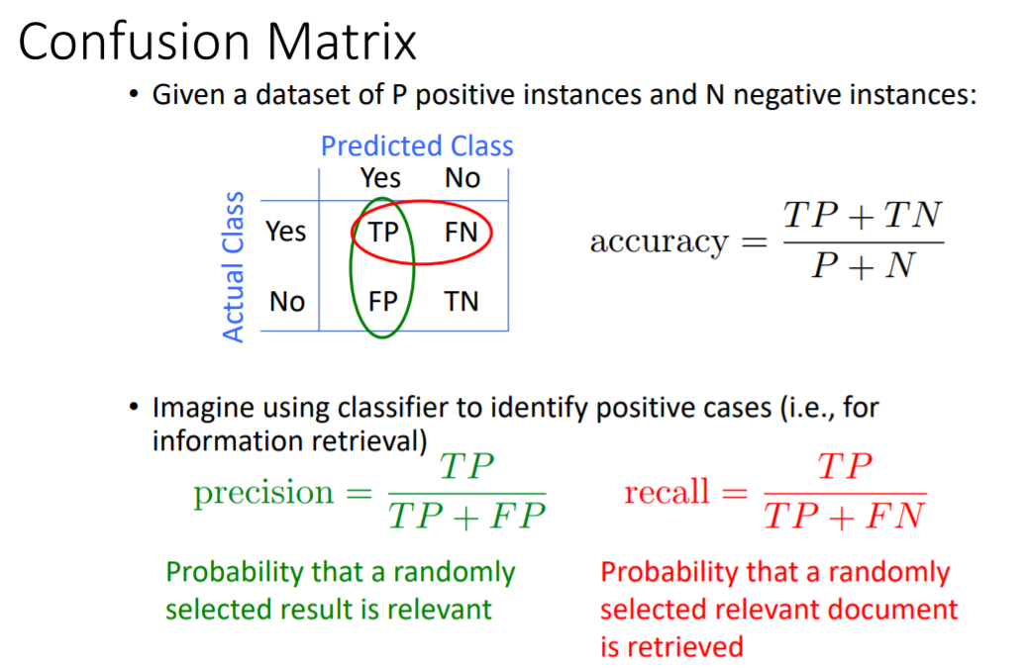


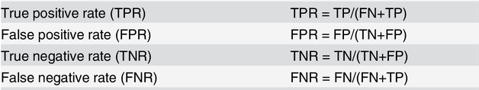
Performance Measures
(sensitivity)

Slide 3
Scikit Learn
Read the documentation!
  http://scikit-learn.org/stable/
http://scikit-learn.org/stable/modules/generated/sklearn.linear_model.SGDClassifier.html
http://scikit-learn.org/0.16/modules/generated/sklearn.cross_validation.train_test_split.html

Slide 4
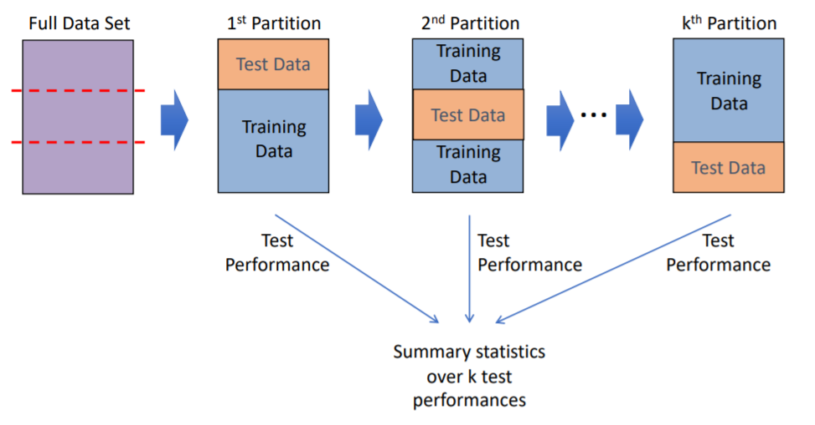
Cross Validation
Coding Exercise: Given the list [0,1,2,3,4] can you write function print_split that will do the following:
> print_split([0,1,2,3,4])
0 [1,2,3,4]
1 [0,2,3,4]
2 [0,1,3,4]
3 [0,1,2,4]
4 [0,1,2,3]

