Slide 1
Introduction to CIS 419/519 Applied Machine Learning
Dan Roth
danroth@seas.upenn.edu|http://www.cis.upenn.edu/~danroth/|461C, 3401 Walnut
Slides were created by Dan Roth (for CIS519/419 at Penn or CS446 at UIUC), Eric Eaton for CIS519/419 at Penn, or from other authors who have made their ML slides available.

Slide 2
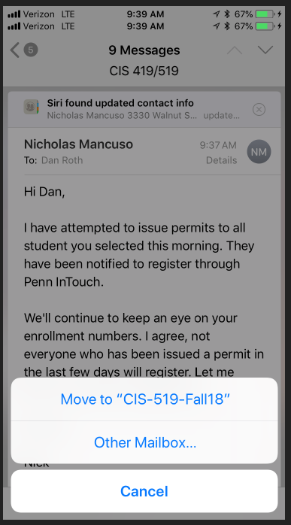
CIS 419/519: Applied Machine Learning
Monday, Wednesday: 10:30pm-12:00pm 101 Levine
Office hours: Mon/Tue 5-6 pm [my office]
10 TAs
Assignments: 5 Problems set (Python Programming)
Weekly (light) on-line quizzes
Weekly Discussion Sessions
Mid Term Exam
[Project] (look at the schedule)
Final
No real textbook:
Slides/Mitchell/Flach/Other Books/ Lecture notes /Literature
Starting next week
TAs Office Hours will also start next week
HW0 !!!
Go to the web site
Be on Piazza
Registration for Class

Slide 3
CIS 419/519: Today
What is Learning?
Who are you?
What is CIS 419/519 about?
The Badges Game…

Slide 4
An Owed to the Spelling Checker
I have a spelling checker, it came with my PC
It plane lee marks four my revue
Miss steaks aye can knot sea.
Eye ran this poem threw it, your sure reel glad two no.
Its vary polished in it's weigh
My checker tolled me sew.
A checker is a bless sing, it freeze yew lodes of thyme.
It helps me right awl stiles two reed
And aides me when aye rime.
Each frays come posed up on my screen
Eye trussed to bee a joule...

Slide 5
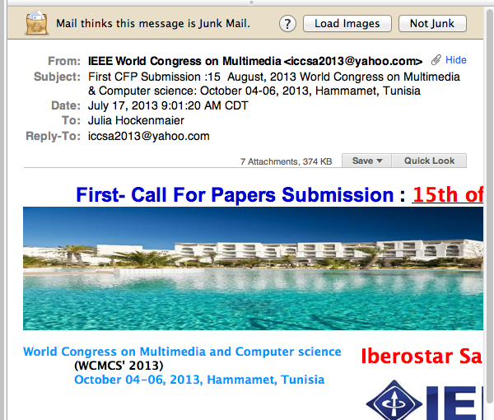
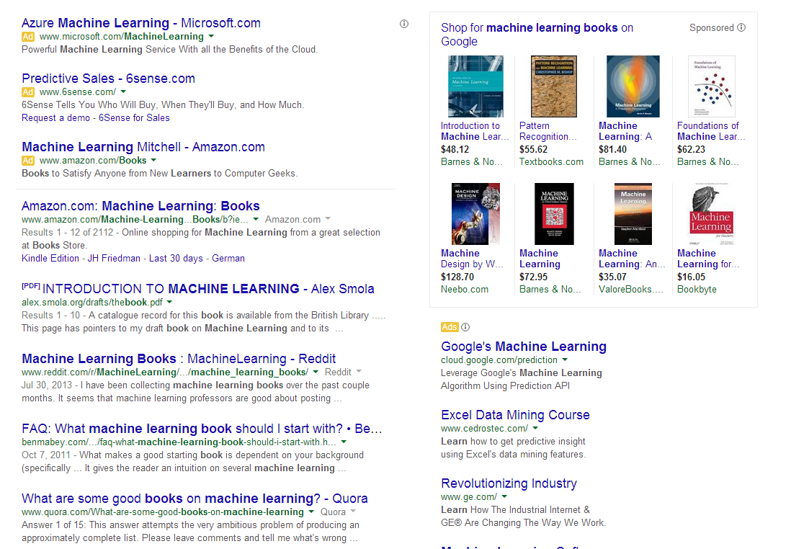
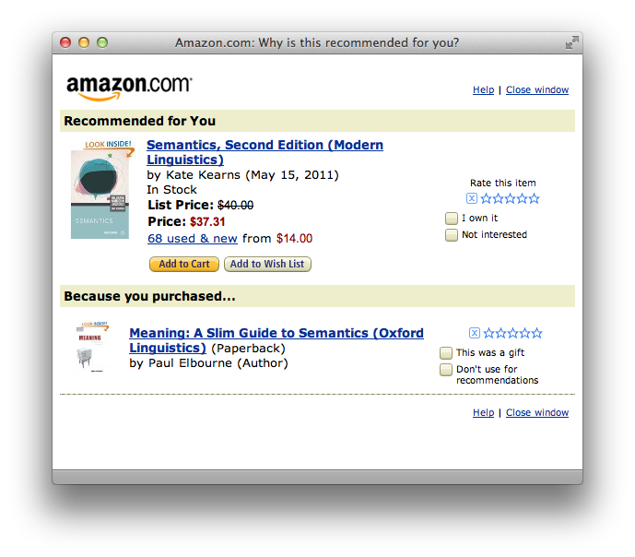
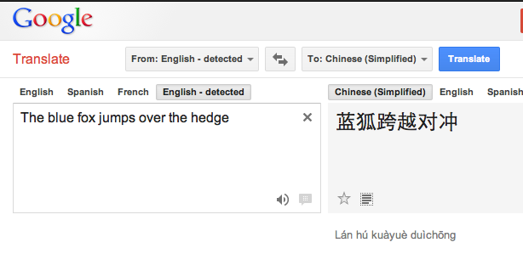
Machine Learning is Everywhere
Notes:
What else do you know about them?
Affluent
Gender
Ethnicity
There are other people around

Slide 6
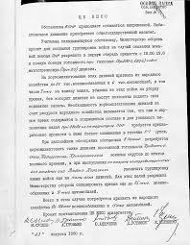
Applications: Spam Detection
This is a binary classification task: Assign one of two labels (i.e. yes/no) to the input (here, an email message)
Classification requires a model (a classifier) to determine which label to assign to items.
In this class, we study algorithms and techniques to learn such models from data.
Documents Labels
Documents Politics, Sports, Finance
Sentences Positive, Negative
Phrases Person, Location
Images Cats, Dogs, Snakes
Medical records Admit again soon/Not
?

Slide 7
Machine Learning: Any Limitations?
Notes:
What else do you know about them?
Affluent
Gender
Ethnicity
There are other people around

Slide 8
Comprehension
(ENGLAND, June, 1989) - Christopher Robin is alive and well. He lives in England. He is the same person that you read about in the book, Winnie the Pooh. As a boy, Chris lived in a pretty home called Cotchfield Farm. When Chris was three years old, his father wrote a poem about him. The poem was printed in a magazine for others to read. Mr. Robin then wrote a book. He made up a fairy tale land where Chris lived. His friends were animals. There was a bear called Winnie the Pooh. There was also an owl and a young pig, called a piglet. All the animals were stuffed toys that Chris owned. Mr. Robin made them come to life with his words. The places in the story were all near Cotchfield Farm. Winnie the Pooh was written in 1925. Children still love to read about Christopher Robin and his animal friends. Most people don't know he is a real person who is grown now. He has written two books of his own. They tell what it is like to be famous.
1. Christopher Robin was born in England. 2. Winnie the Pooh is a title of a book.
3. Christopher Robin’s dad was a magician. 4. Christopher Robin must be at least 65 now.
This is an Inference Problem; where is the learning?
Notes:
8

Slide 9
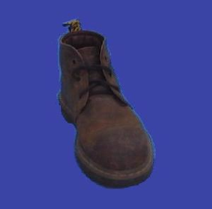
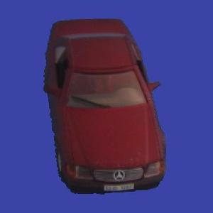
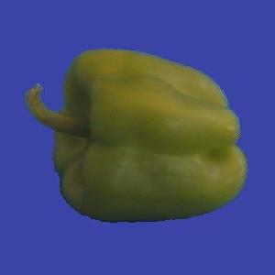
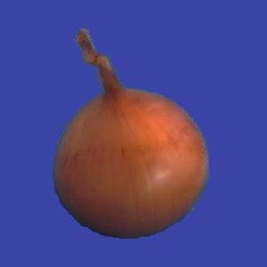
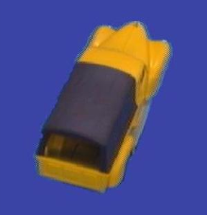
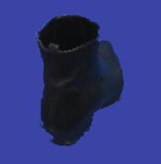
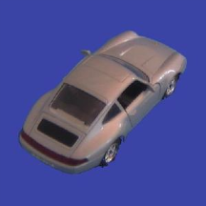
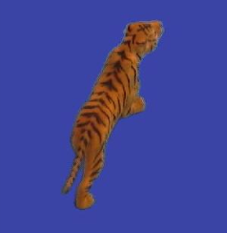
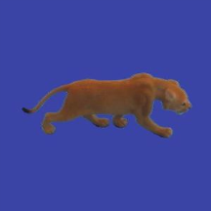
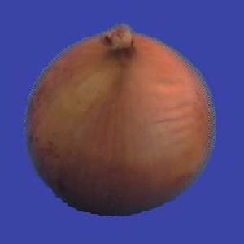
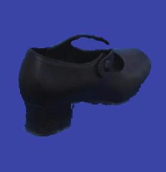
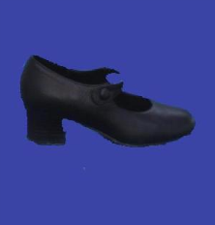
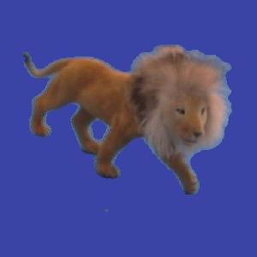
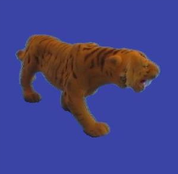
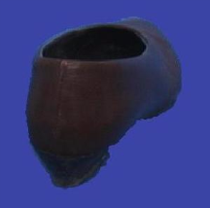
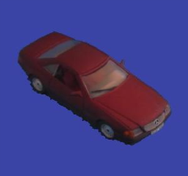
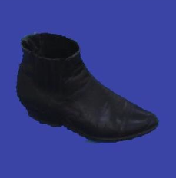
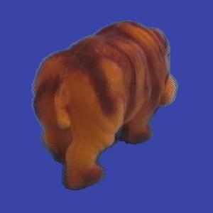
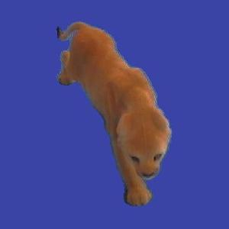
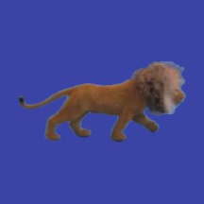
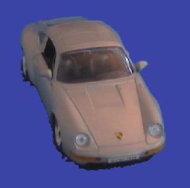
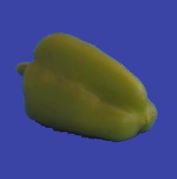
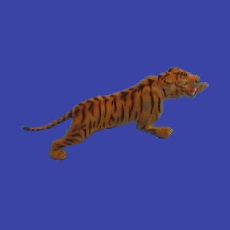
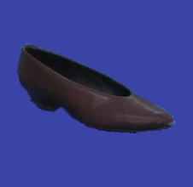
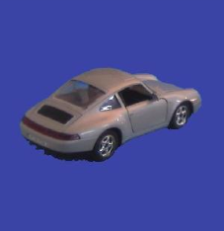
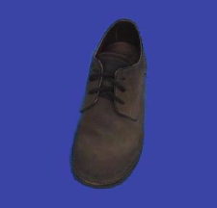
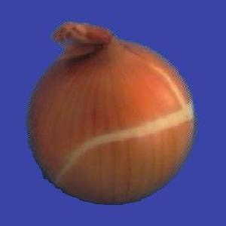
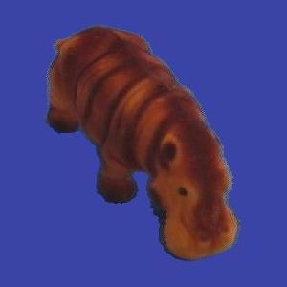
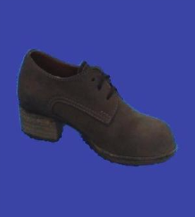
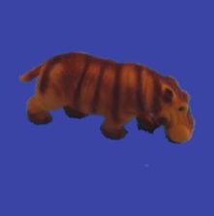
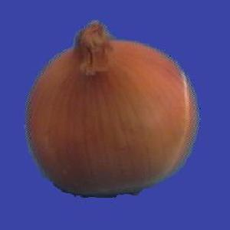
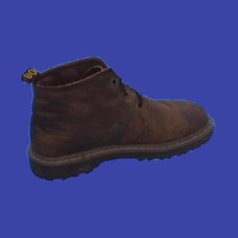
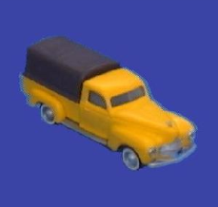
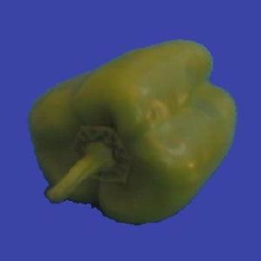
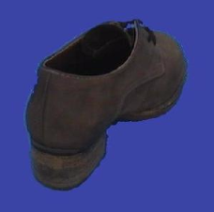
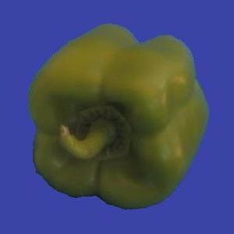
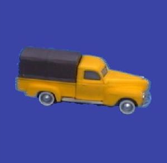
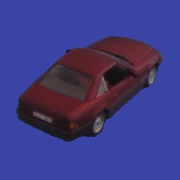
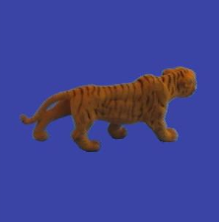
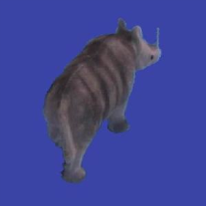
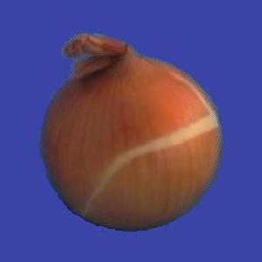
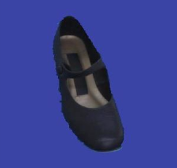
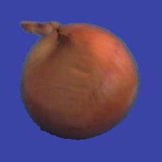
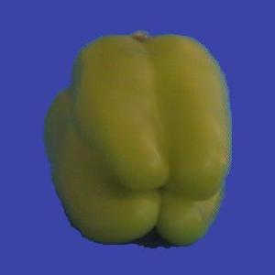

Slide 10
Learning
Learning is at the core of
Understanding High Level Cognition
Performing knowledge intensive inferences
Building adaptive, intelligent systems
Dealing with messy, real world data
Analytics
Learning has multiple purposes
Knowledge Acquisition
Integration of various knowledge sources to ensure robust behavior
Adaptation (human, systems)
Decision Making (Predictions)

Slide 11
Learning = Generalization
H. Simon -
“Learning denotes changes in the system that are adaptive in the sense that they enable the system to do the task or tasks drawn from the same population more efficiently and more effectively the next time.”
The ability to perform a task in a situation which has never been encountered before

Slide 12
Learning = Generalization
The learner has to be able to classify items it has never seen before.
Mail thinks this message is about my Fall 2018 ML Class

Slide 13
Learning = Generalization
The ability to perform a task in a situation which has never been encountered before
Classification
Medical diagnosis; credit card applications; hand-written letters; ad selection; sentiment assignment,…
Planning and acting
Game playing (chess, backgammon, go); driving a car
Skills
(A robot) balancing a pole; playing tennis
Common sense reasoning
Natural language interactions
The Badges game
What does the algorithm gets as input?
(features)
Generalization depends on the Representation as much as it depends on the Algorithm used.

Slide 14
Same Population?
In New York State, the longest period of daylight occurs during the month of _________.
New Zealand
Notes:
If you can solve the first problem, you’d expect to be able to solve the other one too; so, what’s the meaning of “same population”?

Slide 15
Why Study Machine Learning?
“A breakthrough in machine learning would be worth ten Microsofts”
-Bill Gates, Chairman, Microsoft
“Machine learning is the next Internet” -Tony Tether, Former Director, DARPA
Machine learning is the hot new thing” -John Hennessy, President, Stanford
“Web rankings today are mostly a matter of machine learning”
-Prabhakar Raghavan, Dir. Research, Yahoo
“Machine learning is going to result in a real revolution”
-Greg Papadopoulos, CTO, Sun
“Machine learning is today’s discontinuity” -Jerry Yang, CEO, Yahoo

Slide 16
Why Study Learning?
Computer systems with new capabilities.
AI
Understand human and biological learning
Understanding teaching better.
Time is right.
Initial algorithms and theory in place.
Growing amounts of on-line data
Computational power available.
Necessity: many things we want to do cannot be done by “programming”.
(Think about all the examples given earlier)

Slide 17
Learning is the Future
Learning techniques will be a basis for every application that involves a connection to the messy real world
Basic learning algorithms are ready for use in applications today
Prospects for broader future applications make for exciting fundamental research and development opportunities
Many unresolved issues – Theory and Systems
While learning is hot, there are many things we don’t know how to do
And that’s why this is NOT a class about deep neural networks
Very active field
What to teach?
The fundamental paradigms
Some of the most important algorithmic ideas
Modeling
And: what we don’t know

Slide 18
US Open Highlights
Over 700 matches over two weeks periods.
A lot of manpower required to generate video highlights….
Key: automate using incidental signals
Crowd noises, like gasps and cheers.
Players’ gestures and reactions (e.g. celebratory air punches and fist pumps)
Non-trivial: need to deal with biases, etc.
https://venturebeat.com/2019/07/05/how-wimbledon-and-watson-are-using-ai-to-curate-video-highlights/

Slide 19
Course Overview
Introduction: Basic problems and questions
A detailed example: Linear classifiers; key algorithmic idea
Two Basic Paradigms:
Discriminative Learning & Generative/Probabilistic Learning
Learning Protocols:
Supervised; Unsupervised; Semi-supervised
Algorithms
Gradient Descent
Decision Trees
Linear Representations: (Perceptron; SVMs; Kernels)
Neural Networks/Deep Learning
Probabilistic Representations (naïve Bayes)
Unsupervised /Semi supervised: EM
Clustering; Dimensionality Reduction
Modeling; Evaluation; Real world challenges
Ethics

Slide 20
CIS 419/519: Applied Machine Learning
Monday, Wednesday: 10:30pm-12:00pm 101 Levine
Office hours: Mon/Tue 5-6 pm [my office]
10 TAs
Assignments: 5 Problems set (Python Programming)
Weekly (light) on-line quizzes
Weekly Discussion Sessions
Mid Term Exam
[Project] (look at the schedule)
Final
No real textbook:
Slides/Mitchell/Flach/Other Books/ Lecture notes /Literature
Starting next week
TAs Office Hours will also start next week
HW0 !!!
Go to the web site
Be on Piazza
Registration for Class

Slide 21
CIS 519: What have you learned so far?
What do you need to know:
Some exposure to:
Theory of Computation
Probability Theory
Linear Algebra
Programming (Python)
Homework 0
If you could not comfortably deal with 2/3 of this within a few hours, please take the prerequisites first; come back next semester/year.
Participate, Ask Questions
Ask during class, not after class
Applied Machine Learning
Applied: mostly in HW
Machine learning: mostly in class, quizzes, exams

Slide 22
CIS 519: Policies
Cheating
No.
We take it very seriously.
Homework:
Collaboration is encouraged
But, you have to write your own solution/code.
Late Policy:
You have a credit of 4 days; That’s it.
Grading:
Possible separate for grad/undergrads.
40% - homework; ; 35%-final; 20%-midterm; 5% Quizzes
[Projects: 20%]
Questions?
Class’ Web Page
Note also the Schedule Page and our Notes

Slide 23
CIS 519 on the web
Check our class website:
Schedule, slides, videos, policies
http://www.seas.upenn.edu/~cis519/fall2019/
Sign up, participate in our Piazza forum:
Announcements and discussions
http://piazza.com/upenn/fall2019/cis419519
Check out our team
Office hours
[Optional] Discussion Sessions

Slide 24
What is Learning?
The Badges Game…
This is an example of the key learning protocol: supervised learning
First question: Are you sure you got it?
Why?
Issues:
Prediction or Modeling?
Representation
Problem setting
Background Knowledge
When did learning take place?
Algorithm
Notes:
Badges game
Don’t give me the answer
Start thinking about how to write a program that will figure out whether my name has + or – next to it.

