Slide 1
Evaluation
Dan Roth
danroth@seas.upenn.edu|http://www.cis.upenn.edu/~danroth/|461C, 3401 Walnut
Slides were created by Dan Roth (for CIS519/419 at Penn or CS446 at UIUC), Eric Eaton for CIS519/419 at Penn, or from other authors who have made their ML slides available.

Slide 2
Administration
HW1 is out. Due on October 7.
  Please start working on it.
  Go to office hours and recitations.
Recall our late policy
  4 days
Piazza
  Be active on Piazza
  We will reward highly active students

Slide 3
Metrics
Methodologies
Statistical Significance

Slide 4
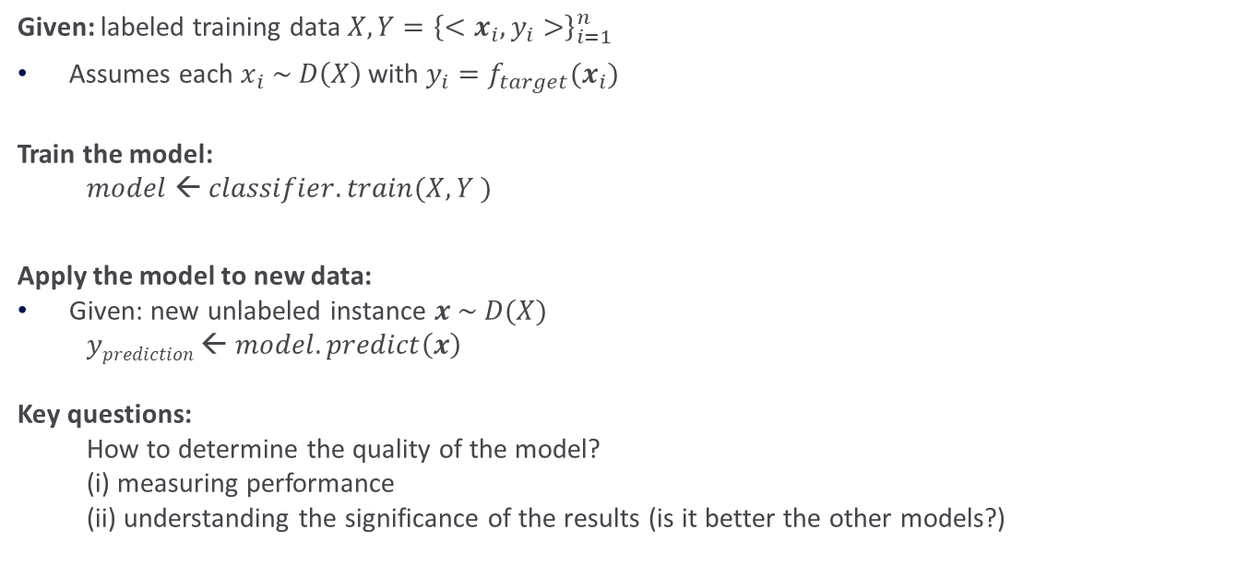



Flow of Batch Machine Learning
Given: labeled training data $X,Y={\left\{<x_{i},y_{i}>\right\}}_{i=1}^{n}$
Assumes each $x_{i} \sim D\left(X\right)$with $y_{i}=f_{target}(x_{i})$
Train the model:
$model ← classifier.train(X, Y )$
Apply the model to new data:
Given: new unlabeled instance $x \sim D(X)$
$yprediction ← model.predict\left(x\right)$
Key questions:
How to determine the quality of the model?
(i) measuring performance
(ii) understanding the significance of the results (is it better the other models?)
$$X, Y$$
learner
$$x$$
model
$yprediction$
Notes:
X, Y = \left\{ \left\langle \bm{x}_{i}, y_{i}\right\rangle \right\}_{i=1}^n
\bm{x}_i \sim \mathcal{D}(\mathcal{X})
y_i = f_{\mathit{target}}(\bm{x}_i)
y^{(i)} = f_\mathit{true}\left(x^{(i)}\right)
x \sim \mathcal{D}(\mathcal{X})

Slide 5
Metrics
We train on our training data Train = {x_{i}, y_{i}}_{1,m}
We test on Test data.
We often set aside part of the training data as a development set, especially when the algorithms require tuning.
  In the HW we asked you to present results also on the Training; why?
When we deal with binary classification we often measure performance simply using Accuracy:
Any possible problems with it?
Notes:
\mbox{accuracy} = \frac{\mbox{\# correct predictions}}{\mbox{\# test instances}}
\mbox{error} = 1 - \mbox{accuracy} = \frac{\mbox{\# incorrect predictions}}{\mbox{\# test instances}}

Slide 6
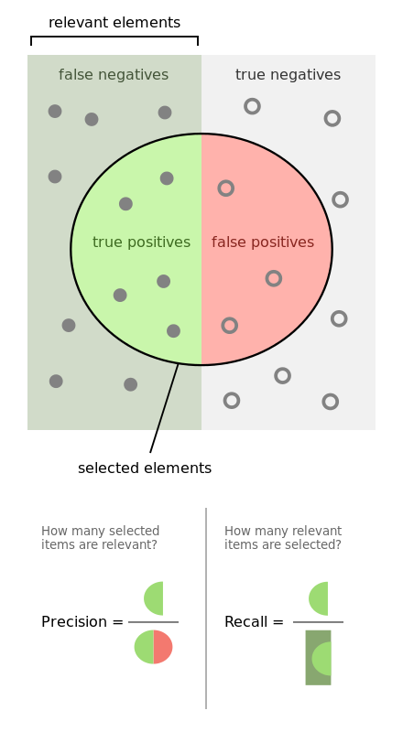
Alternative Metrics
Positive
negative
If the Binary classification problem is biased
  In many problems most examples are negative
Or, in multiclass classification
  The distribution over labels is often non-uniform
Simple accuracy is not a useful metric.
  Often we resort to task specific metrics
However one important example that is being used often involves Recall and Precision
Recall: # (positive identified = true positives)
# (all positive)
Precision: # (positive identified = true positives)
# (predicted positive)
Predicted positive

Slide 7
Example
Positive
negative
100 examples, 5% are positive.
Just say NO: your accuracy is 95%
  Recall = precision = 0
Predict 4+, 96-; 2 of the +s are indeed positive
  Recall:2/5; Precision: 2/4
Recall: # (positive identified = true positives)
# (all positive)
Precision: # (positive identified = true positives)
# (predicted positive)

Slide 8
Confusion Matrix
Given a dataset of P positive instances and N negative instances:
Imagine using classifier to identify positive cases (i.e., for information retrieval)
Predicted Class
Yes
No
The notion of a confusion matrix can be usefully extended to the multiclass case
(i,j) cell indicate how many of the i-labeled examples were predicted to be j
Yes
TP
FN
Actual Class
No
FP
TN
Probability that a randomly selected positive prediction is indeed positive
Probability that a randomly selected positive is identified
Notes:
\mbox{accuracy} = \frac{TP + TN}{P + N}
\definecolor{darkgreen}{rgb}{0.0, 0.5, 0.1}
\color{darkgreen}\mbox{precision} = \frac{TP}{TP + FP}
\mbox{recall} = \frac{TP}{TP + FN}

Slide 9
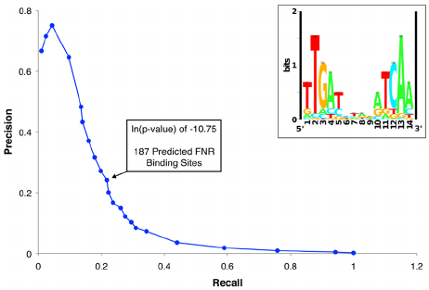

Relevant Metrics
It makes sense to consider Recall and Precision together or combine them into a single metric.
Recall-Precision Curve:
F-Measure:
  A measure that combines precision and recall is the harmonic mean of precision and recall.
  F1 is the most commonly used metric.

Slide 10
Comparing Classifiers
Say we have two classifiers, C1 and C2, and want to choose the best one to use for future predictions
Can we use training accuracy to choose between them?
No!
What about accuracy on test data?
Yes, but…
  We basically want to look at more than a single number; gather some statistical evidence.

Slide 11
N-fold cross validation
Instead of a single test-training split:
Split data into N equal-sized parts
Train and test N different classifiers
Report average accuracy and standard deviation of the accuracy
train
test

Slide 12
Example 3-Fold CV
Full Data Set
1st Partition
2nd Partition
k^{th} Partition
Test Data
Training
Data
Training
Data
...
Test Data
Training
Data
Training
Data
Test Data
Test
Performance
Test
Performance
Test
Performance
Summary statistics
over k test
performances

Slide 13
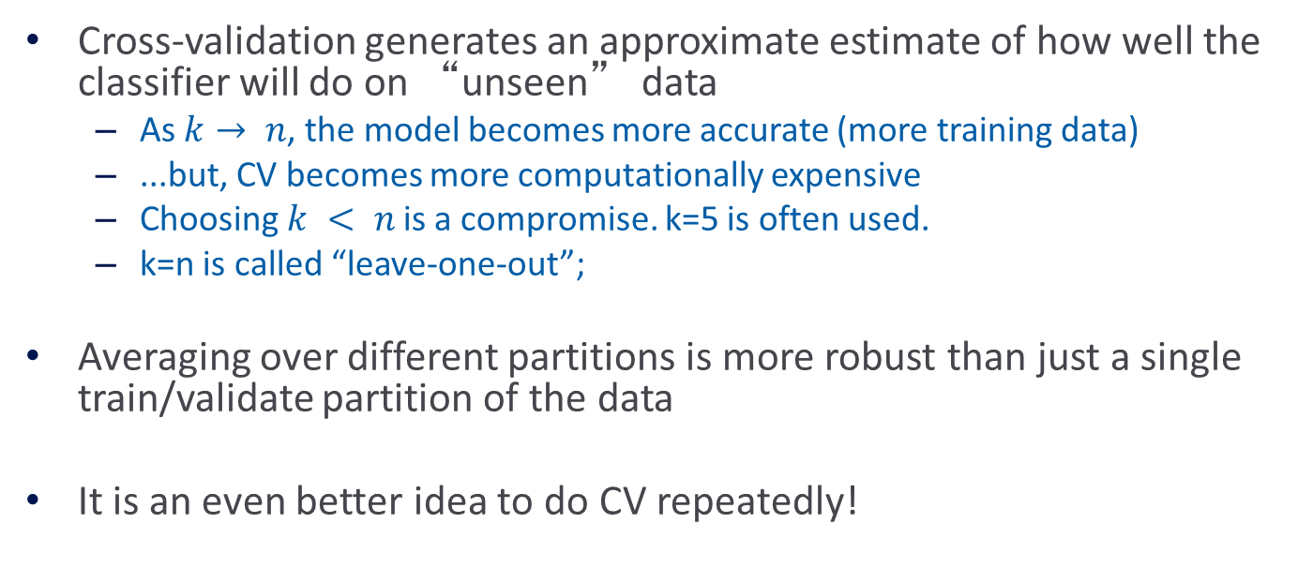
More on Cross-Validation
Cross-validation generates an approximate estimate of how well the classifier will do on “unseen” data
  As $k→ n$, the model becomes more accurate (more training data)
  ...but, CV becomes more computationally expensive
  Choosing $k < n$is a compromise. k=5 is often used.
  k=n is called “leave-one-out”;
Averaging over different partitions is more robust than just a single train/validate partition of the data
It is an even better idea to do CV repeatedly!

Slide 14
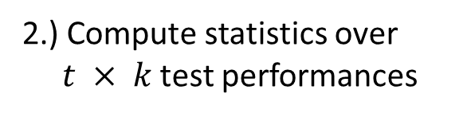

Multiple Trials of k-Fold CV
1.) Loop for $t$ trials:
a.) Randomize Data Set
Full Data Set
Shuffle
Full Data Set
1st Partition
2nd Partition
k^{th} Partition
Test Data
Training
Data
b.) Perform k-fold CV
...
Training
Data
Test Data
Training
Data
Training
Data
Test Data
Test
Performance
Test
Performance
Test
Performance
2.) Compute statistics over $t × k$test performances

Slide 15
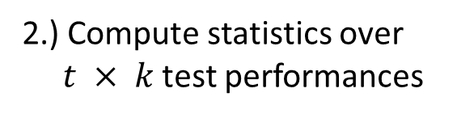
Comparing Multiple Classifiers
1.) Loop for $t$ trials:
Full Data Set
Test each candidate learner on same training/testing splits
a.) Randomize Data Set
Shuffle
Full Data Set
1st Partition
2nd Partition
k^{th} Partition
Test Data
Training
Data
b.) Perform k-fold CV
...
Training
Data
Test Data
Training
Data
Training
Data
Test Data
Test Perf. C1
Test Perf. C2
Test
C1
Test
C2
Test
C1
Test
C2
2.) Compute statistics over $t × k$test performances
Allows us to do paired summary statistics (e.g., paired t-test)

Slide 16
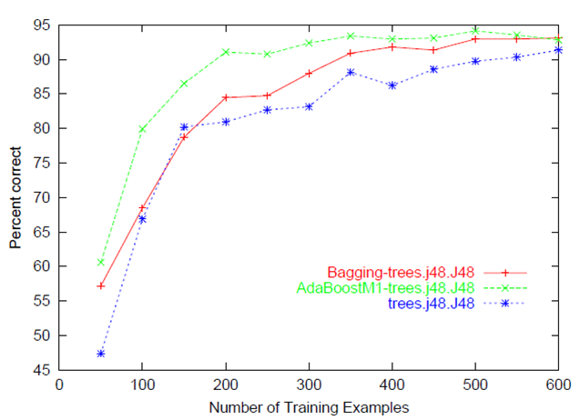
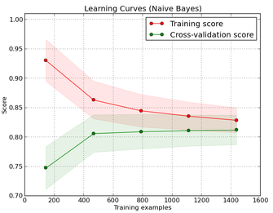
Learning Curve
Shows performance versus the # training examples
  Compute over a single training/testing split
  Then, average across multiple trials of CV

Slide 17
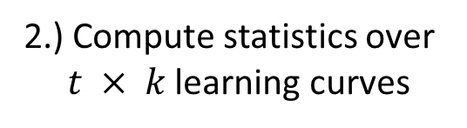
Building Learning Curves
1.) Loop for $t$ trials:
Full Data Set
Compute learning curve over each training/testing split
a.) Randomize Data Set
Shuffle
Full Data Set
1st Partition
2nd Partition
k^{th} Partition
Test Data
Training
Data
b.) Perform k-fold CV
...
Training
Data
Test Data
Training
Data
Training
Data
Test Data
Curve C1
CurveC2
Curve C1
Curve C2
Curve C1
Curve C2
2.) Compute statistics over $t × k$learning curves

Slide 18
Evaluation: significance tests
You have two different classifiers, A and B
You train and test them on the same data set using N-fold cross-validation
For the n-th fold:
accuracy(A, n), accuracy(B, n)
p_{n} = accuracy(A, n) - accuracy(B, n)
Is the difference between A and B’s accuracies significant?

Slide 19
Hypothesis testing
[Next we are introducing a methodology for answering the question: can we distinguish two models? Which one is better?]
You want to show that hypothesis H is true, based on your data
  (e.g. H = “classifier A and B are different”)
Define a null hypothesis H₀
  (H₀ is the contrary of what you want to show)
H₀ defines a distribution P(m |H₀) over some statistic
  e.g. a distribution over the difference in accuracy between A and B
Can you refute (reject) H₀?

Slide 20
Rejecting H₀
H₀ defines a distribution P(M |H₀) over some statistic M
  (e.g. M= the difference in accuracy between A and B)
Select a significance value S
  (e.g. 0.05, 0.01, etc.)
  You can only reject H₀ if P(m |H₀) ≤ S
Compute the test statistic m from your data
  e.g. the average difference in accuracy over your N folds
Compute P(m |H₀)
Refute H₀ with p ≤ S if P(m |H₀) ≤ S

Slide 21
Paired t-test
A paired t-test is used to compare two population means where you have two samples in which observations in one sample can be paired with observations in the other sample.

Slide 22
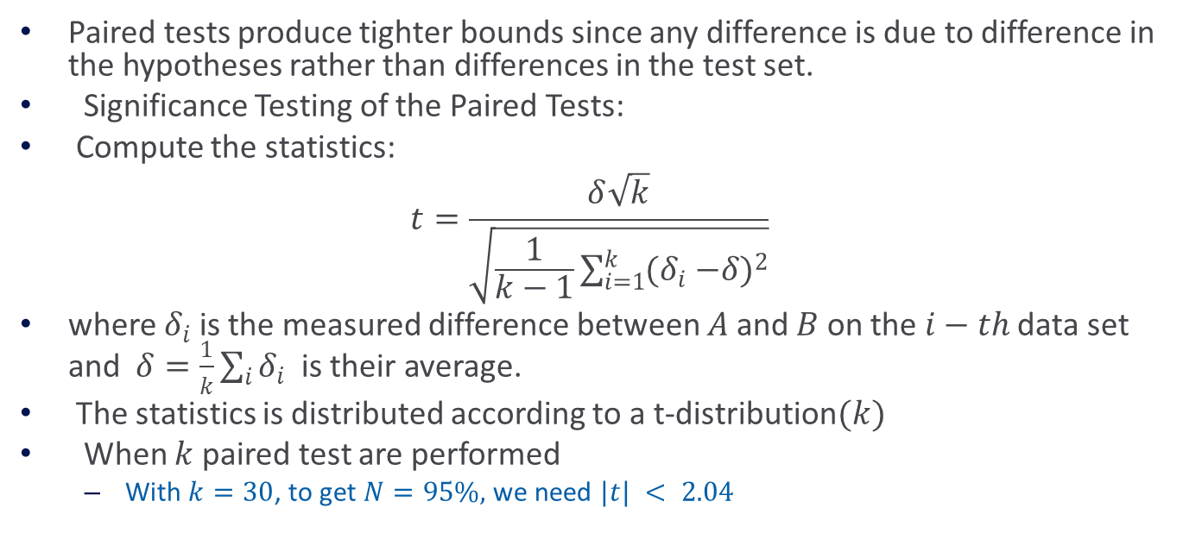
Paired t Tests
Paired tests produce tighter bounds since any difference is due to difference in the hypotheses rather than differences in the test set.
Significance Testing of the Paired Tests:
Compute the statistics:
$$t=\frac{δ\sqrt{k}}{\sqrt{\frac{1}{k−1}\sum_{i=1}^{k}{{(δ}_{i} −{δ)}^{2}}}}$$
where $δ_{i}$ is the measured difference between $A$ and $B$ on the$i−th$data set and $δ=\frac{1}{k}\sum_{i}{δ_{i}}$ is their average.
The statistics is distributed according to a t-distribution$(k)$
When $k$ paired test are performed
  With $k=30$, to get $N=95\%,$we need $|t| < 2.04$

Slide 23
Paired t-test
Null hypothesis (H₀; to be refuted):
  There is no difference between A and B, i.e. the expected accuracies of A and B are the same
That is, the expected difference (over all possible data sets) between their accuracies is 0:
  H₀: E[p_{D}] = 0
We don’t know the true E[p_{D}]
N-fold cross-validation gives us N samples of p_{D}

Slide 24
Paired t-test
Null hypothesis H₀: E[diff_{D}] = μ = 0
m: our estimate of μ based on N samples of diff_{D}
m = 1/N ∑_{n} diff_{n}
The estimated variance S²:
    S² = 1/(N-1) ∑_{1,N} (diff_{n} – m)²
Accept Null hypothesis at significance level a if the
following statistic lies in (-t_{a/2, N-1}, +t_{a/2, N-1})

Slide 25
Procedure for carrying out Paired t-test
Calculate the difference between the two observations on each pair.
Calculate the mean difference
Calculate the standard deviation of the differences
Calculate the error of the mean difference
Calculate the t-statistic

Slide 26

Paired t-test example
Question: The downtimes (measured in hours) for computer systems in six branches of a major bank were recorded for year $1$ and year$2$. Compute the test statistics for the paired t-test.
Solution:
Branch | Year 1 | Year 2 | Difference (Year 1 – Year 2) | Square of Difference
A | 40 | 30 | 10 | 100
B | 54 | 41 | 13 | 169
C | 32 | 24 | 8 | 64
D | 36 | 38 | -2 | 4
E | 55 | 56 | -1 | 1
F | 46 | 37 | 9 | 81
 |  |  | Sum = 37 | Sum = 419
Dragonfly Statistics

Slide 27
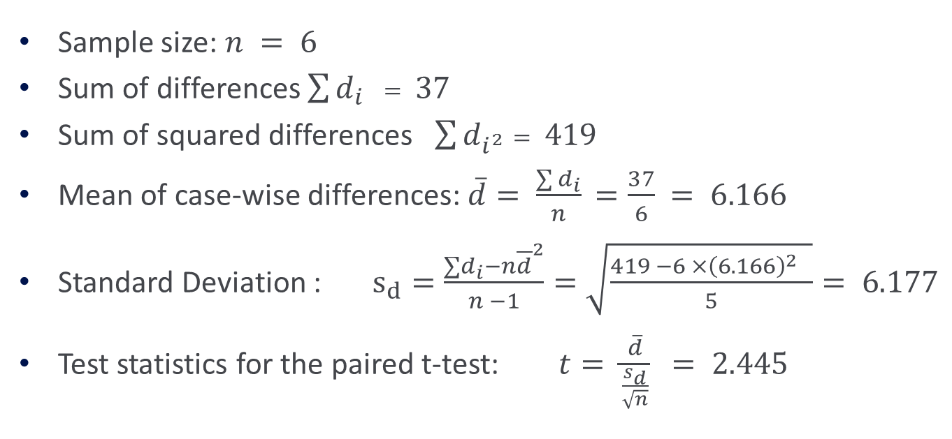
Paired t-test
Sample size: $n = 6$
Sum of differences $\sum{d_{i}} = 37$
Sum of squared differences $\sum{d_{i^{2}}}= 419$
Mean of case-wise differences: $\overline{d}= \frac{\sum{d_{i}}}{n}$ $=\frac{37}{6} = 6.166$
Standard Deviation : $s_{d}=\frac{∑d_{i}−n{\overline{d}}^{2}}{n −1}=\sqrt{\frac{419 −6 ×{\left(6.166\right)}^{2} }{5}}= 6.177$
Test statistics for the paired t-test: $t= \frac{\overline{d}}{\frac{s_{d}}{\sqrt{n}}}$ $= 2.445$

Slide 28
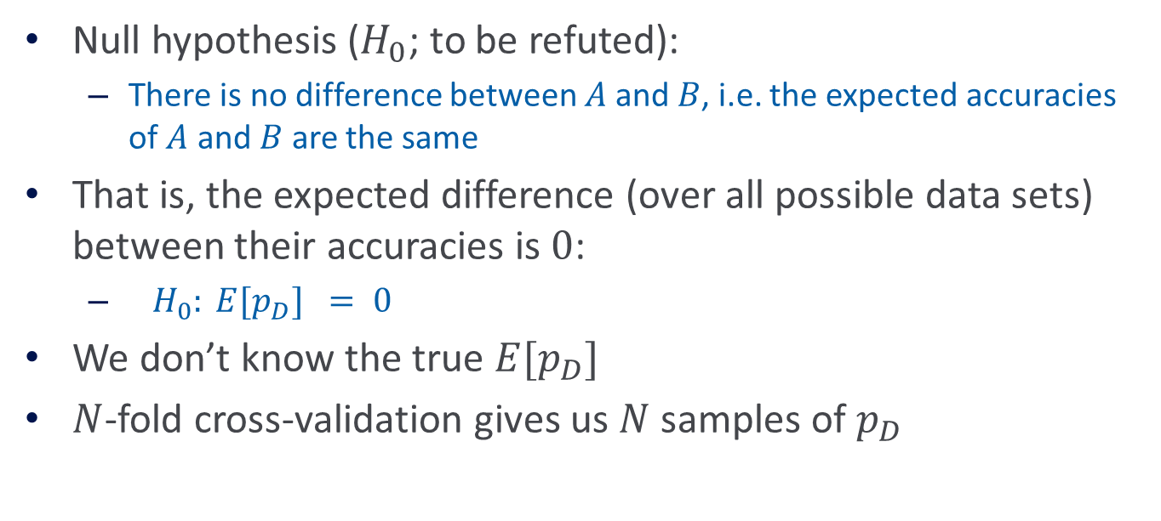
Paired t-test
Null hypothesis ($H_{0}$; to be refuted):
  There is no difference between $A$and $B$, i.e. the expected accuracies of $A$ and $B$ are the same
That is, the expected difference (over all possible data sets) between their accuracies is $0$:
  $H_{0}: E[p_{D}] = 0$
We don’t know the true $E[p_{D}]$
$N$-fold cross-validation gives us $N$ samples of $p_{D}$

Slide 29

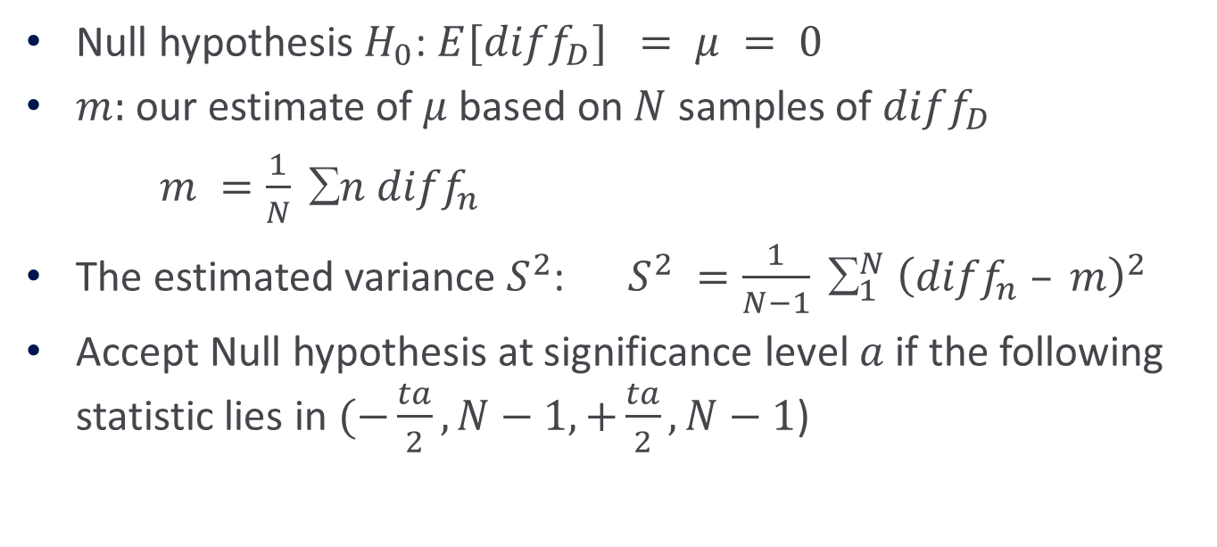
Paired t-test
Null hypothesis $H_{0}$: $E[diff_{D}] = μ = 0$
$m:$ our estimate of $μ$ based on $N$ samples of $diff_{D}$
$m =\frac{1}{N} ∑n diff_{n}$
The estimated variance $S^{2}$: $S^{2} =\frac{1}{N−1} ∑_{1}^{N} {\left(diff_{n} – m\right)}^{2}$
Accept Null hypothesis at significance level $a$ if the following statistic lies in $(−\frac{ta}{2}, N−1, +\frac{ta}{2}, N−1$)
$$\frac{\sqrt{N}m}{S}\sim t_{N−1}$$

Slide 30
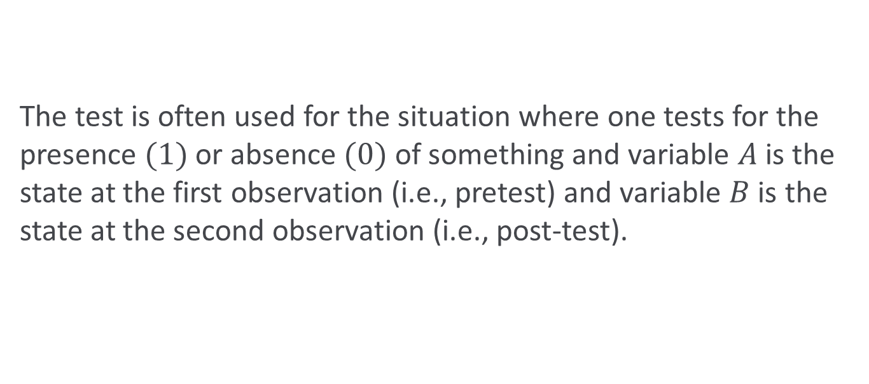
McNemar’s Test
The test is often used for the situation where one tests for the presence $(1)$or absence $(0)$ of something and variable $A$is the state at the first observation (i.e., pretest) and variable $B$is the state at the second observation (i.e., post-test).

Slide 31
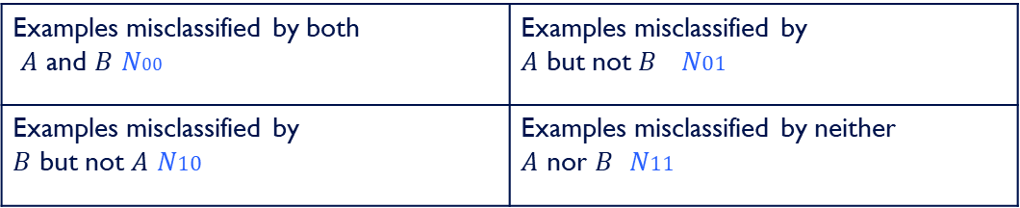
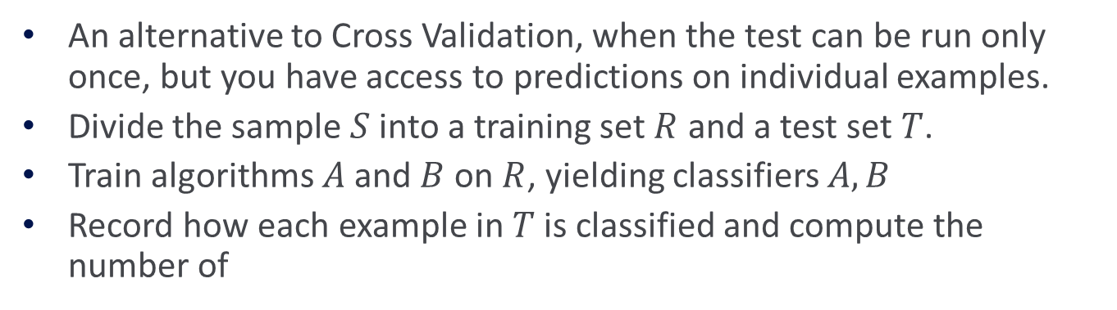

McNemar’s Test
An alternative to Cross Validation, when the test can be run only once, but you have access to predictions on individual examples.
Divide the sample $S$ into a training set $R$ and a test set $T$.
Train algorithms $A$ and $B$ on $R$, yielding classifiers $A,B$
Record how each example in $T$ is classified and compute the number of
Examples misclassified by both $A$ and $B$ $N00$ | Examples misclassified by $A$ but not $B$ $N01$
Examples misclassified by $B$ but not $A$ $N10$ | Examples misclassified by neither $A$ nor $B$ $N11$
where $N$ is the total number of examples in the test set $T$
$$N_{00}+N_{10}+N_{01}+N_{11}=N$$

Slide 32
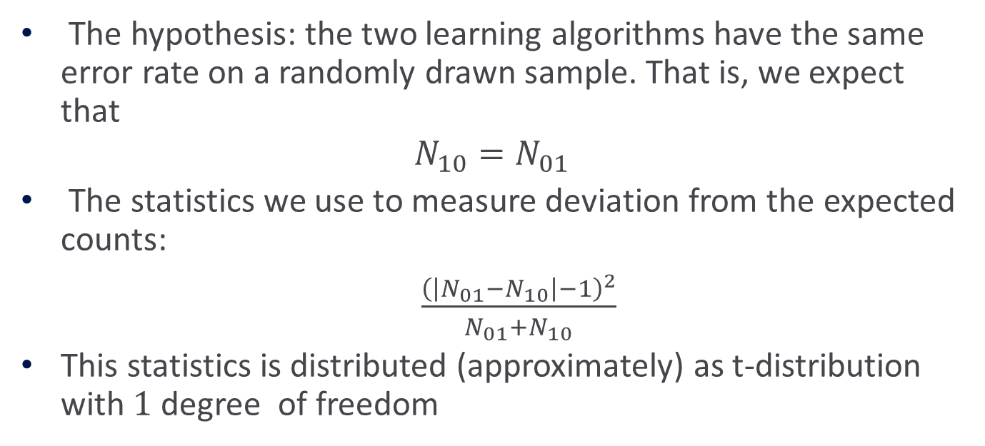
McNemar’s Test
The hypothesis: the two learning algorithms have the same error rate on a randomly drawn sample. That is, we expect that
$$N_{10}=N_{01}$$
The statistics we use to measure deviation from the expected counts:
$\frac{{\left(\left|N_{01}−N_{10}\right|−1\right)}^{2}}{N_{01}+N_{10}}$
This statistics is distributed (approximately) as t-distribution with $1$ degree of freedom

Slide 33
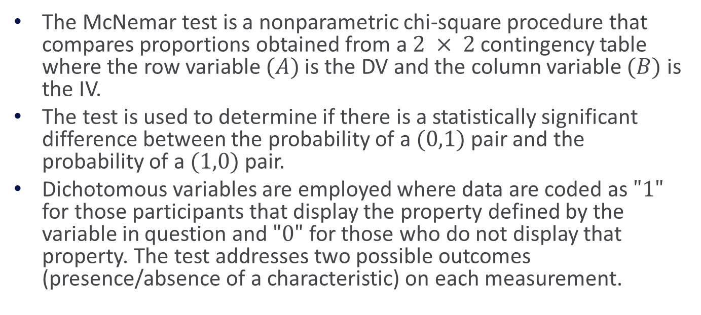
Uses of the McNemar Test
The McNemar test is a nonparametric chi-square procedure that compares proportions obtained from a $2 × 2$contingency table where the row variable $(A)$ is the DV and the column variable $(B)$is the IV.
The test is used to determine if there is a statistically significant difference between the probability of a $(0,1)$pair and the probability of a $(1,0)$pair.
Dichotomous variables are employed where data are coded as $"1"$ for those participants that display the property defined by the variable in question and $"0"$ for those who do not display that property. The test addresses two possible outcomes (presence/absence of a characteristic) on each measurement.

Slide 34
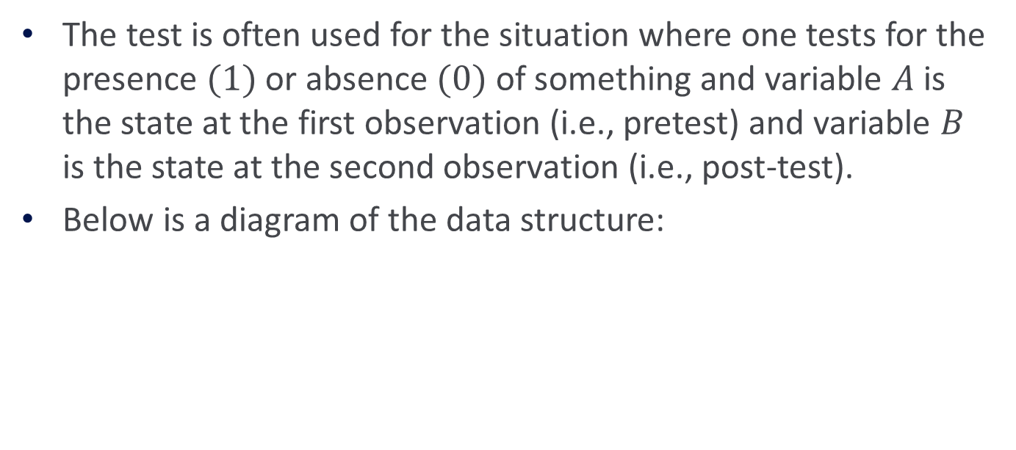
Uses of the McNemar Test
The test is often used for the situation where one tests for the presence $(1)$or absence $(0)$ of something and variable $A$ is the state at the first observation (i.e., pretest) and variable $B$ is the state at the second observation (i.e., post-test).
Below is a diagram of the data structure:
 |  | B |  | Totals
 |  | 0 | 1
A | 0 | d | c | c + d
 | 1 | b | a | a + b
Totals |  | b + d | a + c | N

Slide 35
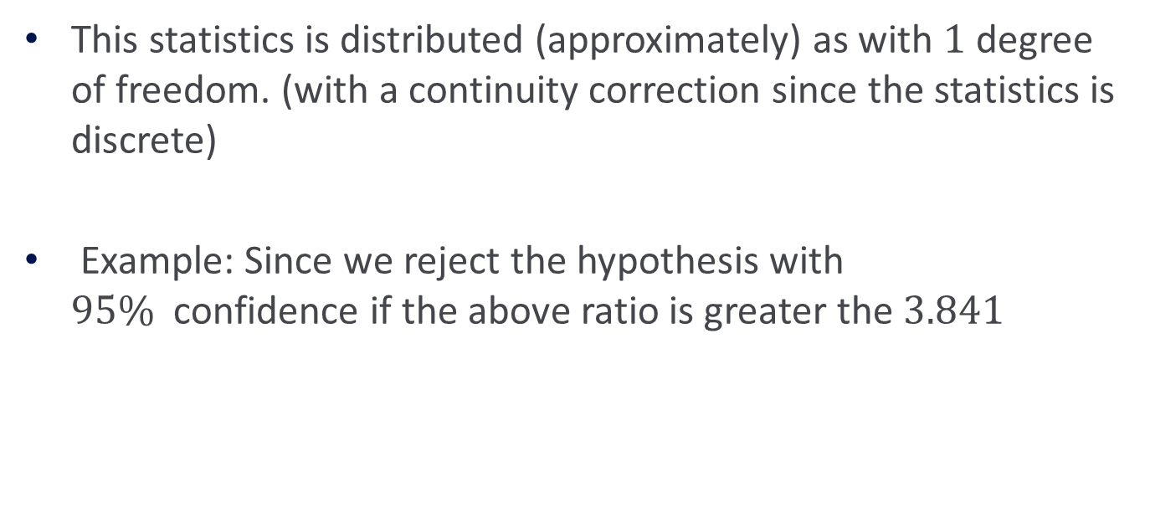
This statistics is distributed (approximately) as with $1$ degree of freedom. (with a continuity correction since the statistics is discrete)
Example: Since we reject the hypothesis with $95\%$confidence if the above ratio is greater the $3.841$

