Slide 1
On-line Learning, Perceptron, Kernels
Dan Roth
danroth@seas.upenn.edu | http://www.cis.upenn.edu/~danroth/ | 461C, 3401 Walnut
Slides were created by Dan Roth (for CIS519/419 at Penn or CS446 at UIUC), Eric Eaton for CIS519/419 at Penn, or from other authors who have made their ML slides available.

Slide 2
A Guide
Learning Algorithms
  (Stochastic) Gradient Descent (with LMS)
  Decision Trees
Importance of hypothesis space (representation)
How are we doing?
  Quantification in terms of cumulative # of mistakes
  Our algorithms were driven by a different metric than the one we care about.
*

Slide 3
A Guide
Versions of Perceptron
  How to deal better with large features spaces & sparsity?
  Variations of Perceptron
    Dealing with overfitting
  Closing the loop: Back to Gradient Descent
  Dual Representations & Kernels
Multilayer Perceptron
Beyond Binary Classification?
  Multi-class classification and Structured Prediction
More general way to quantify learning performance (PAC)
  New Algorithms (SVM, Boosting)
Today:
Take a more general perspective and think more about learning, learning protocols, quantifying performance, etc.
This will motivate some of the ideas we will see next.

Slide 4
Quantifying Performance
We want to be able to say something rigorous about the performance of our learning algorithm.
We will concentrate on discussing the number of examples one needs to see before we can say that our learned hypothesis is good.

Slide 5
Learning Conjunctions

Slide 6
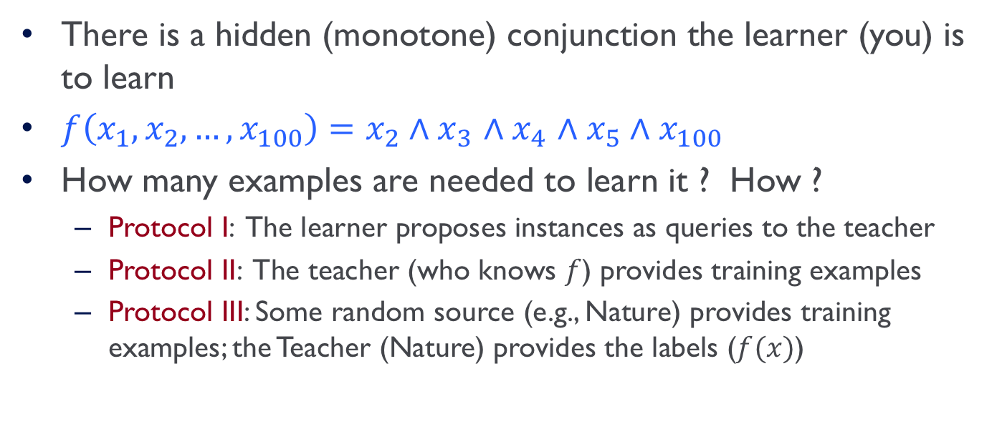
Learning Conjunctions
There is a hidden (monotone) conjunction the learner (you) is to learn
$f\left(x_{1}, x_{2},…, x_{100}\right)=x_{2}∧x_{3}$ $∧x_{4}$ $∧x_{5}∧x_{100}$
How many examples are needed to learn it ? How ?
  Protocol I: The learner proposes instances as queries to the teacher
  Protocol II: The teacher (who knows $f$) provides training examples
  Protocol III: Some random source (e.g., Nature) provides training examples; the Teacher (Nature) provides the labels ($f(x)$)

Slide 7
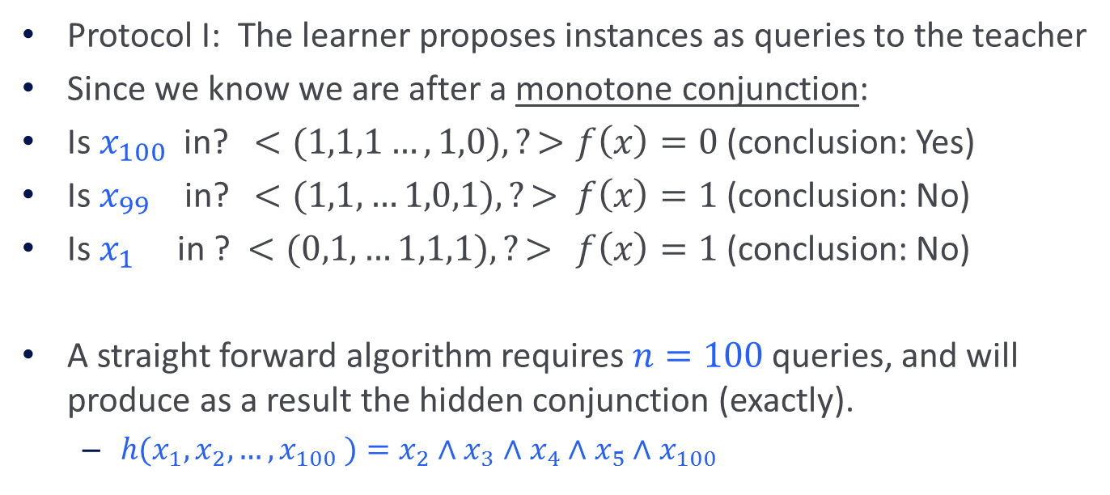
Learning Conjunctions (I)
Protocol I: The learner proposes instances as queries to the teacher
Since we know we are after a monotone conjunction:
Is $x_{100}$ in? $<(1,1,1…,1,0), ?>$ $f\left(x\right)=0$(conclusion: Yes)
Is $x_{99}$ in? $<(1,1,…1,0,1), ?>$ $f\left(x\right)=1$ (conclusion: No)
Is $x_{1}$ in ? $<(0,1,…1,1,1), ?>$ $f\left(x\right)=1$(conclusion: No)
A straight forward algorithm requires $n=100$ queries, and will produce as a result the hidden conjunction (exactly).
  $h(x_{1}, x_{2},…, x_{100} )=x_{2}∧x_{3}$ $∧x_{4}$ $∧x_{5}∧x_{100}$
What happens here if the conjunction
is not known to be monotone?
If we know of a positive example,
the same algorithm works.

Slide 8

Learning Conjunctions(II)
Protocol II: The teacher (who knows $f$) provides training examples

Slide 9

Learning Conjunctions (II)
Protocol II: The teacher (who knows $f$) provides training examples
$<(0,1,1,1,1,0,…,0,1), 1>$

Slide 10

Learning Conjunctions (II)
Protocol II: The teacher (who knows $f$) provides training examples
$<(0,1,1,1,1,0,…,0,1), 1>$(We learned a superset of the good variables)

Slide 11
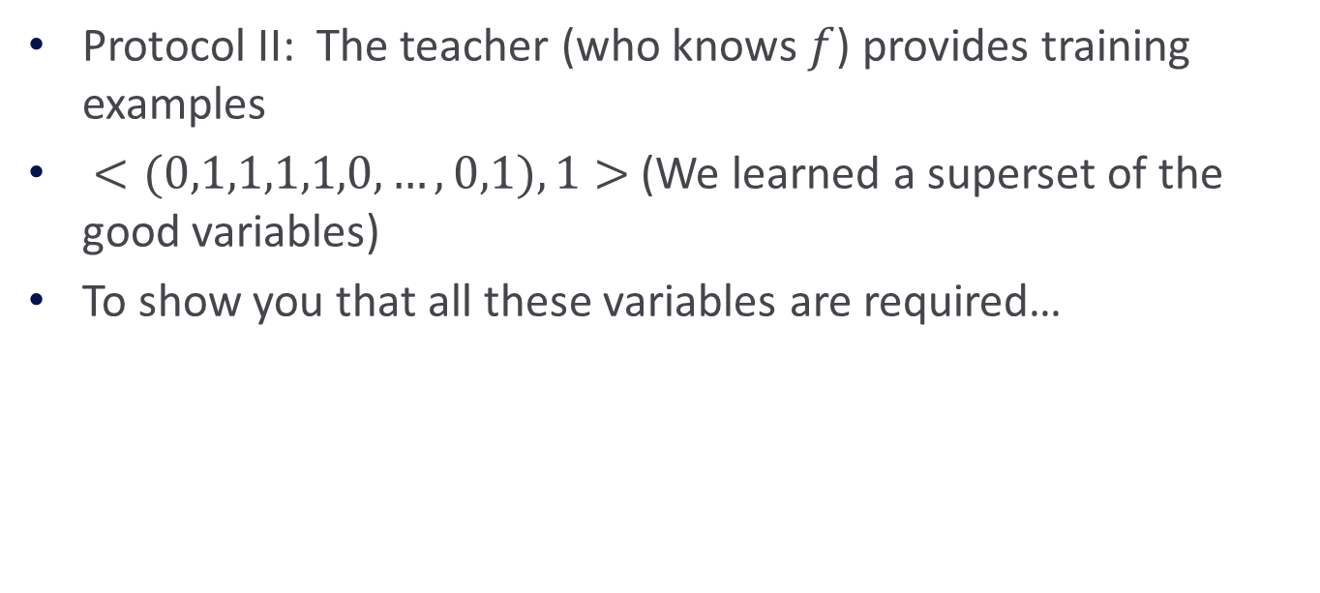
Learning Conjunctions (II)
Protocol II: The teacher (who knows $f$) provides training examples
$<(0,1,1,1,1,0,…,0,1), 1>$(We learned a superset of the good variables)
To show you that all these variables are required…

Slide 12
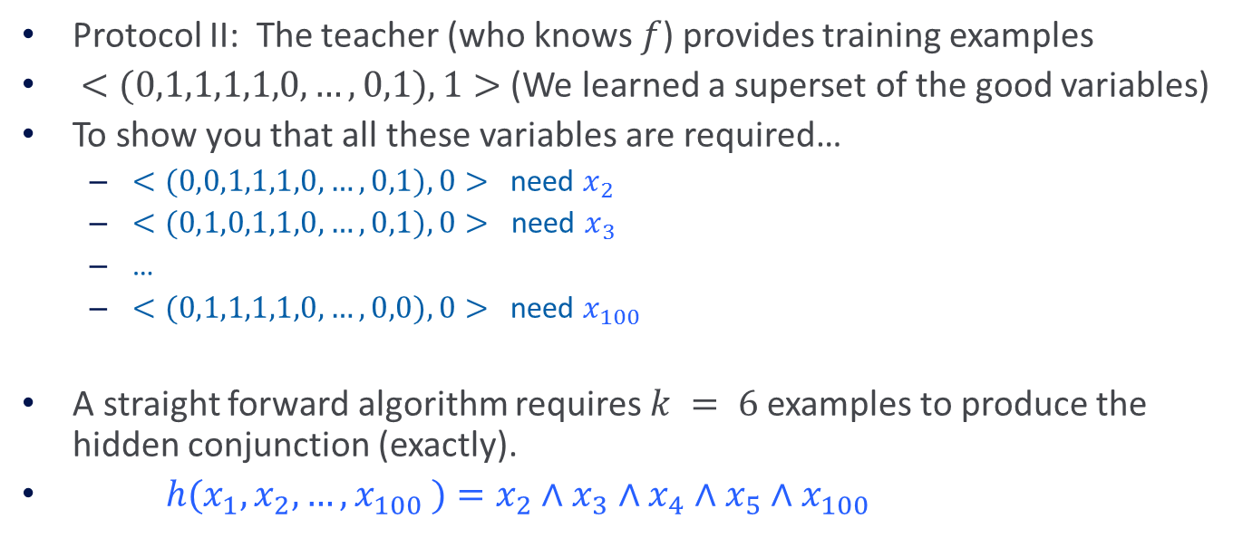
Learning Conjunctions (II)
Protocol II: The teacher (who knows $f$) provides training examples
$<(0,1,1,1,1,0,…,0,1), 1>$(We learned a superset of the good variables)
To show you that all these variables are required…
  $<(0,0,1,1,1,0,…,0,1), 0>$need $x_{2}$
  $<(0,1,0,1,1,0,…,0,1), 0>$ need $x_{3}$
  …
  $<(0,1,1,1,1,0,…,0,0), 0>$need $x_{100}$
A straight forward algorithm requires $k = 6$examples to produce the hidden conjunction (exactly).
$h(x_{1}, x_{2},…, x_{100} )=x_{2}∧x_{3}$ $∧x_{4}$ $∧x_{5}∧x_{100}$
Modeling Teaching Is tricky

Slide 13
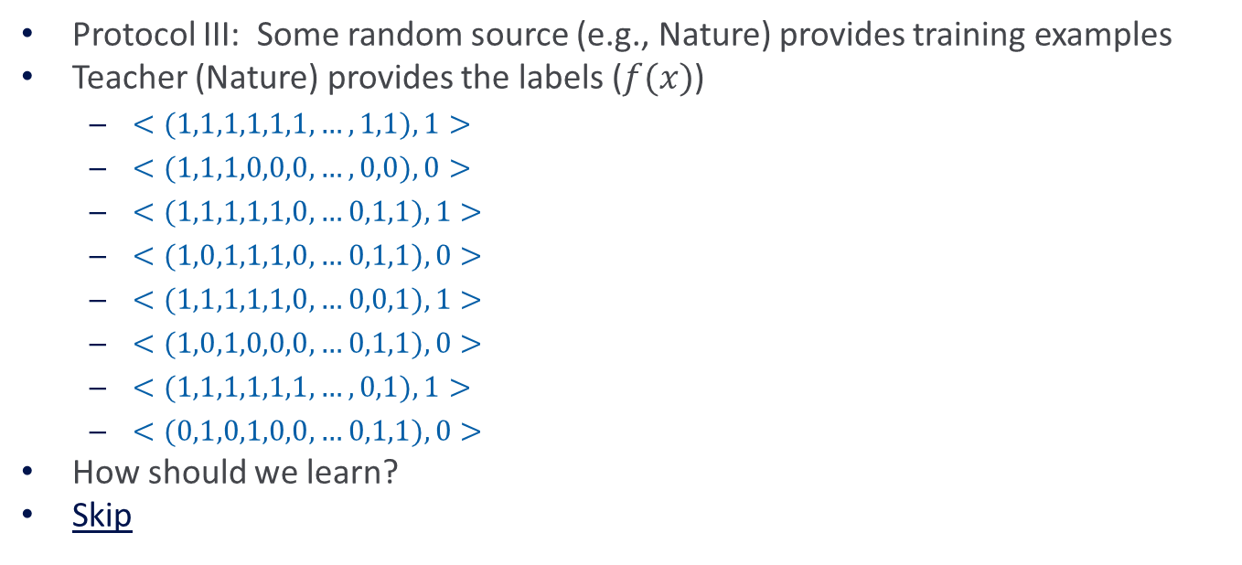

Learning Conjunctions (III)
$f=x_{2}∧x_{3}$ $∧x_{4}$ $∧x_{5}∧x_{100}$
Protocol III: Some random source (e.g., Nature) provides training examples
Teacher (Nature) provides the labels ($f(x)$)
  $<(1,1,1,1,1,1,…,1,1), 1>$
  $<(1,1,1,0,0,0,…,0,0), 0>$
  $<(1,1,1,1,1,0,…0,1,1), 1>$
  $<(1,0,1,1,1,0,…0,1,1), 0>$
  $<(1,1,1,1,1,0,…0,0,1), 1>$
  $<(1,0,1,0,0,0,…0,1,1), 0>$
  $<(1,1,1,1,1,1,…,0,1), 1>$
  $<(0,1,0,1,0,0,…0,1,1), 0>$
How should we learn?
Skip

Slide 14
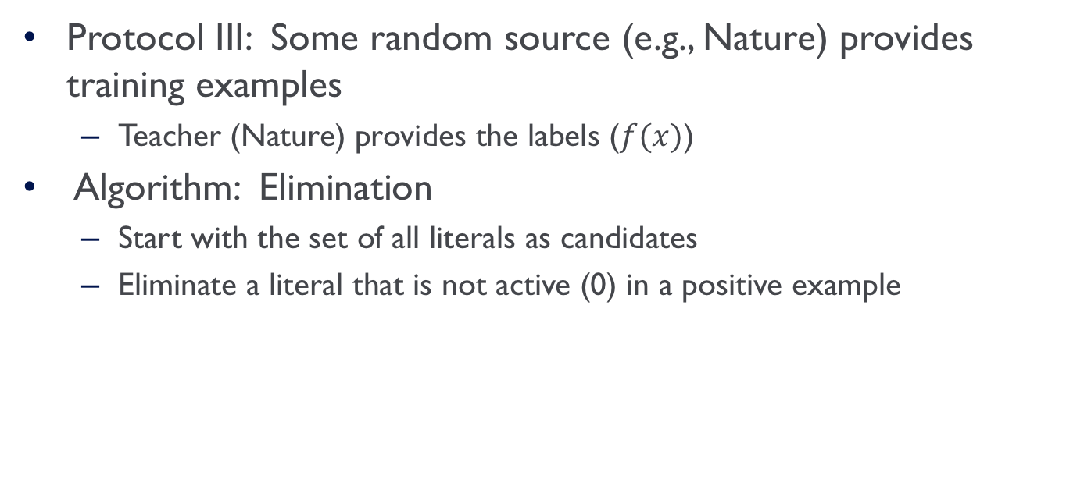
Learning Conjunctions (III)
$f=x_{2}∧x_{3}$ $∧x_{4}$ $∧x_{5}∧x_{100}$
Protocol III: Some random source (e.g., Nature) provides training examples
  Teacher (Nature) provides the labels ($f(x)$)
Algorithm: Elimination
  Start with the set of all literals as candidates
  Eliminate a literal that is not active (0) in a positive example

Slide 15
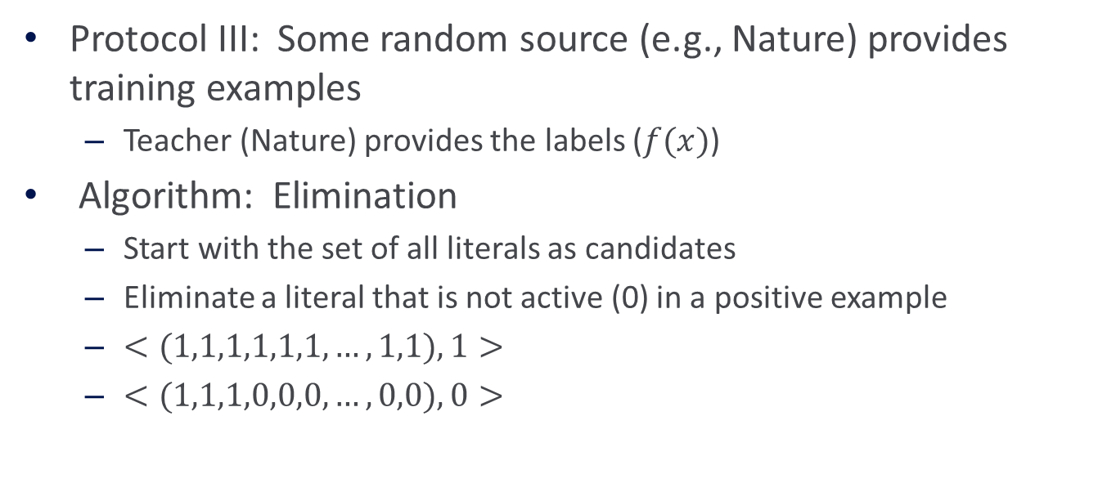
Learning Conjunctions (III)
$f=x_{2}∧x_{3}$ $∧x_{4}$ $∧x_{5}∧x_{100}$
Protocol III: Some random source (e.g., Nature) provides training examples
  Teacher (Nature) provides the labels ($f(x)$)
Algorithm: Elimination
  Start with the set of all literals as candidates
  Eliminate a literal that is not active (0) in a positive example
  $<(1,1,1,1,1,1,…,1,1), 1>$
  $<(1,1,1,0,0,0,…,0,0), 0>$

Slide 16
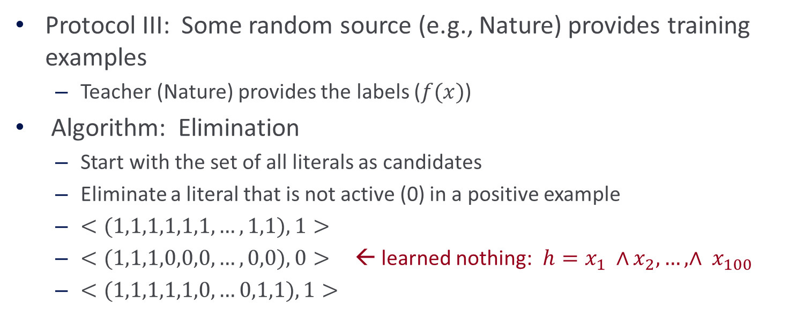
Learning Conjunctions (III)
$f=x_{2}∧x_{3}$ $∧x_{4}$ $∧x_{5}∧x_{100}$
Protocol III: Some random source (e.g., Nature) provides training examples
  Teacher (Nature) provides the labels ($f(x)$)
Algorithm: Elimination
  Start with the set of all literals as candidates
  Eliminate a literal that is not active (0) in a positive example
  $<(1,1,1,1,1,1,…,1,1), 1>$
  $<(1,1,1,0,0,0,…,0,0), 0>$← learned nothing: $h=x_{1} ∧$ $x_{2}, …, ∧ x_{100}$
  $<(1,1,1,1,1,0,…0,1,1), 1>$

Slide 17
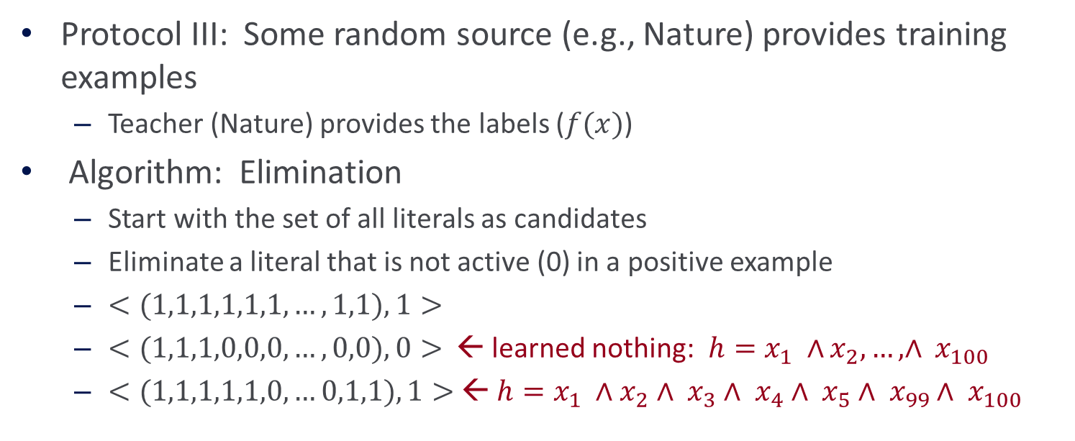
Learning Conjunctions (III)
$f=x_{2}∧x_{3}$ $∧x_{4}$ $∧x_{5}∧x_{100}$
Protocol III: Some random source (e.g., Nature) provides training examples
  Teacher (Nature) provides the labels ($f(x)$)
Algorithm: Elimination
  Start with the set of all literals as candidates
  Eliminate a literal that is not active (0) in a positive example
  $<(1,1,1,1,1,1,…,1,1), 1>$
  $<(1,1,1,0,0,0,…,0,0), 0>$← learned nothing: $h=x_{1} ∧$ $x_{2}, …, ∧ x_{100}$
  $<(1,1,1,1,1,0,…0,1,1), 1>$← $h=x_{1} ∧$ $x_{2}∧ x_{3}∧ x_{4}∧ x_{5}∧ x_{99}∧ x_{100}$

Slide 18
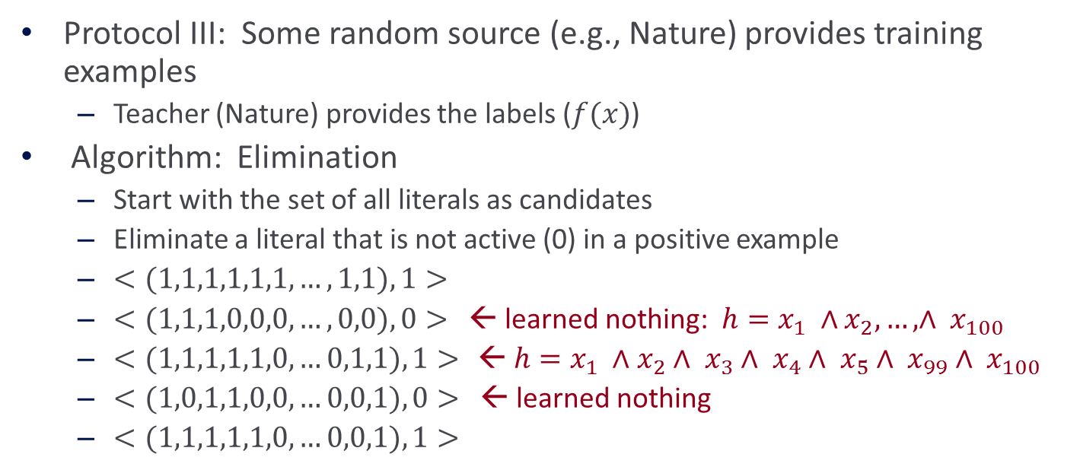
Learning Conjunctions (III)
$f=x_{2}∧x_{3}$ $∧x_{4}$ $∧x_{5}∧x_{100}$
Protocol III: Some random source (e.g., Nature) provides training examples
  Teacher (Nature) provides the labels ($f(x)$)
Algorithm: Elimination
  Start with the set of all literals as candidates
  Eliminate a literal that is not active (0) in a positive example
  $<(1,1,1,1,1,1,…,1,1), 1>$
  $<(1,1,1,0,0,0,…,0,0), 0>$← learned nothing: $h=x_{1} ∧$ $x_{2}, …, ∧ x_{100}$
  $<(1,1,1,1,1,0,…0,1,1), 1>$ ← $h=x_{1} ∧$ $x_{2}∧ x_{3}∧ x_{4}∧ x_{5}∧ x_{99}∧ x_{100}$
  $<(1,0,1,1,0,0,…0,0,1), 0>$← learned nothing
  $<(1,1,1,1,1,0,…0,0,1), 1>$

Slide 19
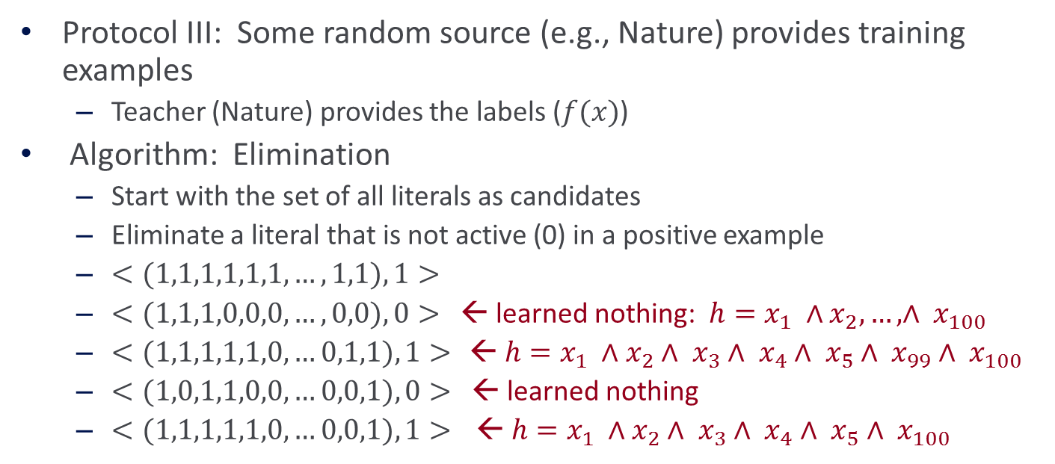
Learning Conjunctions (III)
$f=x_{2}∧x_{3}$ $∧x_{4}$ $∧x_{5}∧x_{100}$
Protocol III: Some random source (e.g., Nature) provides training examples
  Teacher (Nature) provides the labels ($f(x)$)
Algorithm: Elimination
  Start with the set of all literals as candidates
  Eliminate a literal that is not active (0) in a positive example
  $<(1,1,1,1,1,1,…,1,1), 1>$
  $<(1,1,1,0,0,0,…,0,0), 0>$← learned nothing: $h=x_{1} ∧$ $x_{2}, …, ∧ x_{100}$
  $<(1,1,1,1,1,0,…0,1,1), 1>$ ← $h=x_{1} ∧$ $x_{2}∧ x_{3}∧ x_{4}∧ x_{5}∧ x_{99}∧ x_{100}$
  $<(1,0,1,1,0,0,…0,0,1), 0>$← learned nothing
  $<(1,1,1,1,1,0,…0,0,1), 1>$ ← $h=x_{1} ∧$ $x_{2}∧ x_{3}∧ x_{4}∧ x_{5}∧ x_{100}$

Slide 20
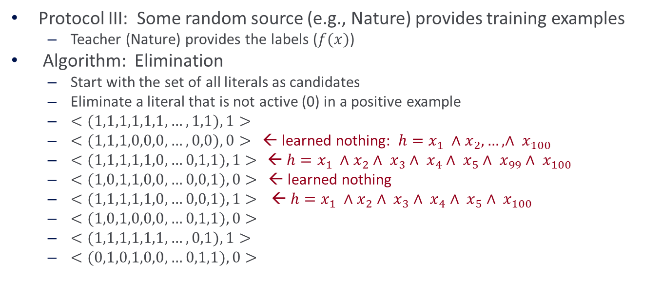
Learning Conjunctions (III)
$f=x_{2}∧x_{3}$ $∧x_{4}$ $∧x_{5}∧x_{100}$
Protocol III: Some random source (e.g., Nature) provides training examples
  Teacher (Nature) provides the labels ($f(x)$)
Algorithm: Elimination
  Start with the set of all literals as candidates
  Eliminate a literal that is not active (0) in a positive example
  $<(1,1,1,1,1,1,…,1,1), 1>$
  $<(1,1,1,0,0,0,…,0,0), 0>$← learned nothing: $h=x_{1} ∧$ $x_{2}, …, ∧ x_{100}$
  $<(1,1,1,1,1,0,…0,1,1), 1>$ ← $h=x_{1} ∧$ $x_{2}∧ x_{3}∧ x_{4}∧ x_{5}∧ x_{99}∧ x_{100}$
  $<(1,0,1,1,0,0,…0,0,1), 0>$← learned nothing
  $<(1,1,1,1,1,0,…0,0,1), 1>$ ← $h=x_{1} ∧$ $x_{2}∧ x_{3}∧ x_{4}∧ x_{5}∧ x_{100}$
  $<(1,0,1,0,0,0,…0,1,1), 0>$
  $<(1,1,1,1,1,1,…,0,1), 1>$
  $<(0,1,0,1,0,0,…0,1,1), 0>$

Slide 21

Learning Conjunctions (III)
$f=x_{2}∧x_{3}$ $∧x_{4}$ $∧x_{5}∧x_{100}$
Protocol III: Some random source (e.g., Nature) provides training examples
  Teacher (Nature) provides the labels ($f(x)$)
Algorithm: Elimination
  Start with the set of all literals as candidates
  Eliminate a literal that is not active (0) in a positive example
  $<(1,1,1,1,1,1,…,1,1), 1>$
  $<(1,1,1,0,0,0,…,0,0), 0>$← learned nothing: $h=x_{1} ∧$ $x_{2}, …, ∧ x_{100}$
  $<(1,1,1,1,1,0,…0,1,1), 1>$ ← $h=x_{1} ∧$ $x_{2}∧ x_{3}∧ x_{4}∧ x_{5}∧ x_{99}∧ x_{100}$
  $<(1,0,1,1,0,0,…0,0,1), 0>$← learned nothing
  $<(1,1,1,1,1,0,…0,0,1), 1>$ ← $h=x_{1} ∧$ $x_{2}∧ x_{3}∧ x_{4}∧ x_{5}∧ x_{100}$
  $<(1,0,1,0,0,0,…0,1,1), 0>$
  $<(1,1,1,1,1,1,…,0,1), 1>$
  $<(0,1,0,1,0,0,…0,1,1), 0>$
Is it good
Performance ?
# of examples ?
Final hypothesis:
$h=x_{1} ∧$ $x_{2}∧ x_{3}∧ x_{4}∧ x_{5}∧ x_{100}$

Slide 22
Administration
Registration ☺
Hw1 is due next week
  You should have started working on it already…
  Recall that this is an Applied Machine Learning class.
  We are not asking you to simply give us back what you’ve seen in class.
  The HW will try to simulate challenges you might face when you want to apply ML.
  Allow you to experience various ML scenarios and make observations that are best experienced when you play with it yourself.
Hw2 will be out next week
Questions

Slide 23
Projects
https://www.seas.upenn.edu/~cis519/fall2019/project.html
CIS 519 students need to do a team project
  Teams will be of size 3-4
Projects proposals are due on Friday 10/25/19
  Details will be available on the website
  We will give comments and/or requests to modify / augment/ do a different project.
  There may also be a mechanism for peer comments.
Please start thinking and working on the project now.
  Your proposal is limited to 1 page, but needs to include references and, ideally, some preliminary results/ideas. It should look like a paper – use latex, bibtex.
Any project with a significant Machine Learning component is good.
  Experimental work, theoretical work, a combination of both or a critical survey of results in some specialized topic.
  The work has to include some reading of the literature .
  Originality is not mandatory but is encouraged.
Try to make it interesting!

Slide 24
Project Examples
Just going to Kaggle to take a dataset and running algorithms on it is not enough.
KDD Cup 2013:
  "Author-Paper Identification": given an author and a small set of papers, we are asked to identify which papers are really written by the author.
    https://www.kaggle.com/c/kdd-cup-2013-author-paper-identification-challenge
  “Author Profiling”: given a set of document, profile the author: identification, gender, native language, ….
File my e-mail to folders better than Apple does
Caption Control: Is it gibberish? Spam? High quality text?
Adapt an NLP program to a new domain
NER that adapts to new entity types
Work on making learned hypothesis more comprehensible
  Explain the prediction
Develop a (multi-modal) People Identifier
Identify contradictions in news stories
  Other relations between claims; opinion vs. facts
Large scale clustering of documents + name the cluster
  E.g., cluster news documents and give a title to the document
Spam calls for my phone
Find interesting data on data.gov
You need to have a “thesis”.
Example: classify internal organisms; Thesis: can generalize across gender, other populations.

Slide 25
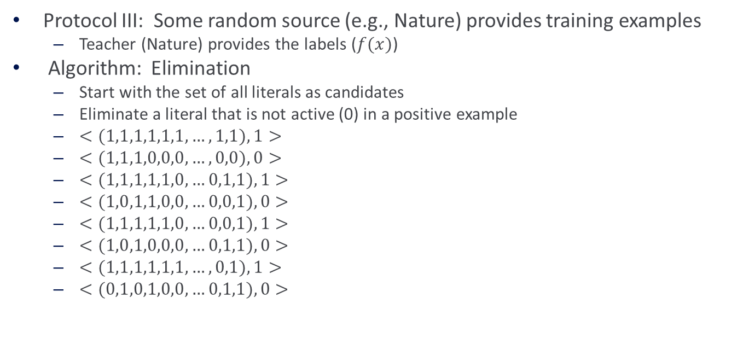
Learning Conjunctions (III)
$f=x_{2}∧x_{3}$ $∧x_{4}$ $∧x_{5}∧x_{100}$
Protocol III: Some random source (e.g., Nature) provides training examples
  Teacher (Nature) provides the labels ($f(x)$)
Algorithm: Elimination
  Start with the set of all literals as candidates
  Eliminate a literal that is not active (0) in a positive example
  $<(1,1,1,1,1,1,…,1,1), 1>$
  $<(1,1,1,0,0,0,…,0,0), 0>$
  $<(1,1,1,1,1,0,…0,1,1), 1>$
  $<(1,0,1,1,0,0,…0,0,1), 0>$
  $<(1,1,1,1,1,0,…0,0,1), 1>$
  $<(1,0,1,0,0,0,…0,1,1), 0>$
  $<(1,1,1,1,1,1,…,0,1), 1>$
  $<(0,1,0,1,0,0,…0,1,1), 0>$
Is it good
Performance ?
# of examples ?
With the given data, we only learned an “approximation” to the true concept
We don’t know how many examples we need to see to learn exactly. (do we care?)
But we know that we can make a limited # of mistakes.
Final hypothesis:
$h=x_{1} ∧$ $x_{2}∧ x_{3}∧ x_{4}∧ x_{5}∧ x_{100}$

Slide 26
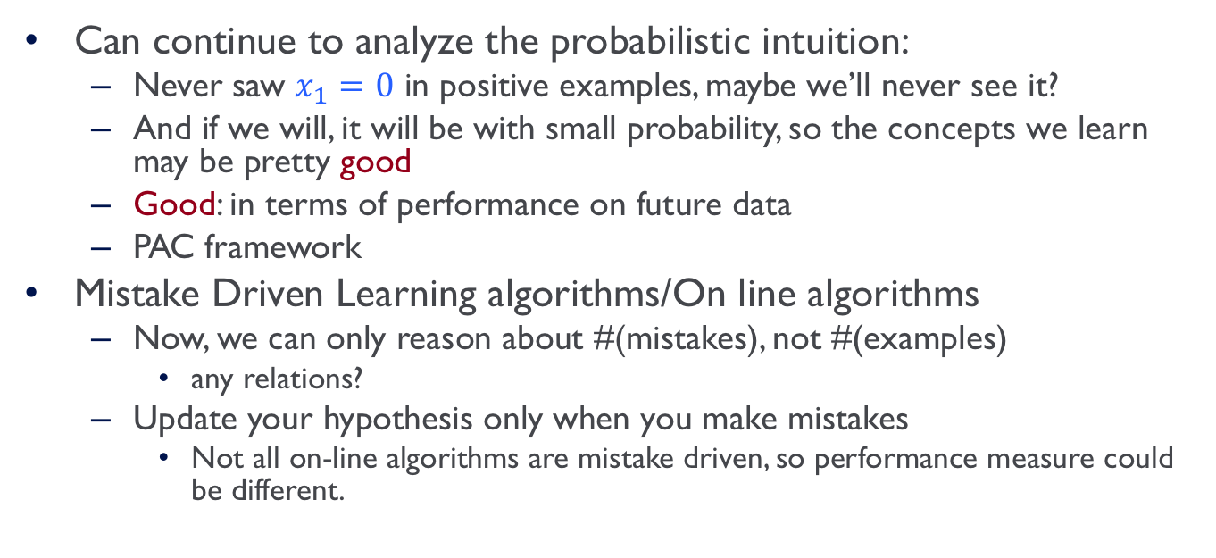
Two Directions
Can continue to analyze the probabilistic intuition:
  Never saw $x_{1}=0$ in positive examples, maybe we’ll never see it?
  And if we will, it will be with small probability, so the concepts we learn may be pretty good
  Good: in terms of performance on future data
  PAC framework
Mistake Driven Learning algorithms/On line algorithms
  Now, we can only reason about #(mistakes), not #(examples)
    any relations?
  Update your hypothesis only when you make mistakes
    Not all on-line algorithms are mistake driven, so performance measure could be different.

Slide 27
On-Line Learning
New learning algorithms
(all learn a linear function over the feature space)
  Perceptron (+ many variations)
  General Gradient Descent view
Issues:
  Importance of Representation
  Complexity of Learning
  Idea of Kernel Based Methods
  More about features

Slide 28
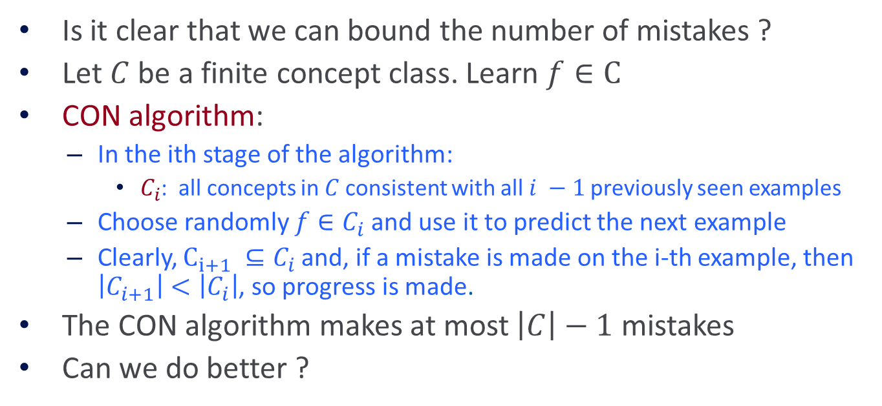
Generic Mistake Bound Algorithms
Is it clear that we can bound the number of mistakes ?
Let $C$ be a finite concept class. Learn $f∈C$
CON algorithm:
  In the ith stage of the algorithm:
    $C_{i}$: all concepts in $C$consistent with all $i −1$previously seen examples
  Choose randomly $f∈C_{i}$and use it to predict the next example
  Clearly, $C_{i+1} ⊆C_{i}$and, if a mistake is made on the i-th example, then $\left|C_{i+1}\right|<\left|C_{i}\right|$, so progress is made.
The CON algorithm makes at most $\left|C\right|−1$ mistakes
Can we do better ?
The goal of the following discussion is to think about hypothesis spaces, and some “optimal” algorithms, as a way to understand what might be possible.
For this reason, here we think about the class of possible target functions and the class of hypothesis as the same.

Slide 29
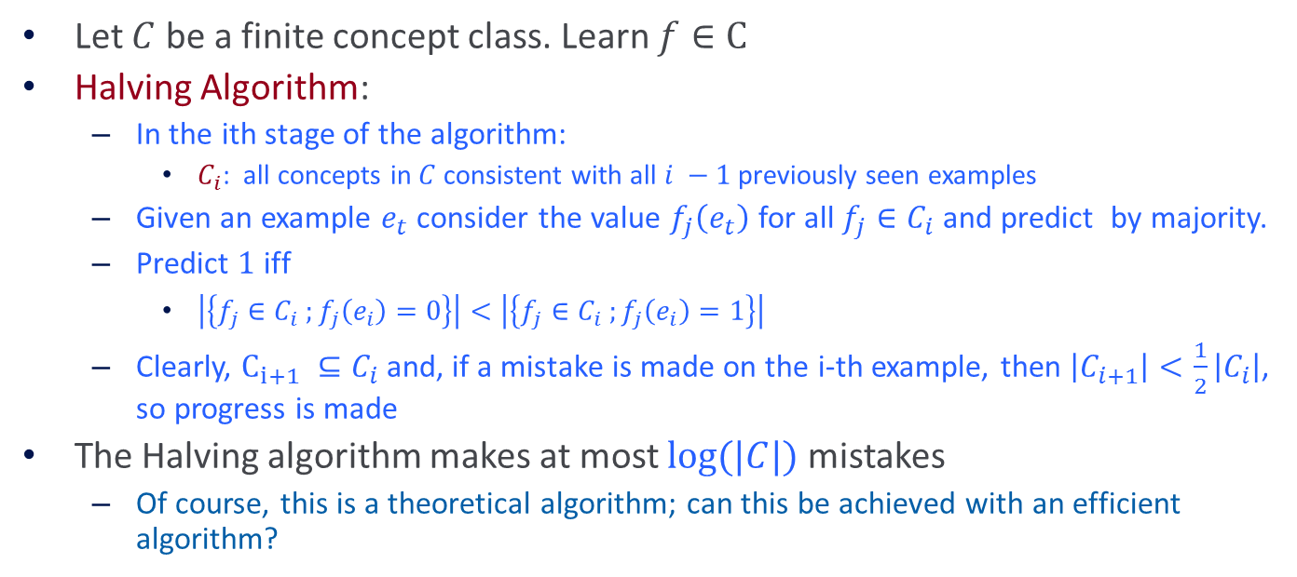
The Halving Algorithm
Let $C$ be a finite concept class. Learn $f∈C$
Halving Algorithm:
  In the ith stage of the algorithm:
    $C_{i}$: all concepts in $C$consistent with all $i −1$previously seen examples
  Given an example $e_{t}$ consider the value $f_{j}\left(e_{t}\right)$ for all $f_{j}∈C_{i}$ and predict by majority.
  Predict $1$ iff
    $\left|\left\{f_{j}∈C_{i} ;f_{j}\left(e_{i}\right)=0\right\}\right|<\left|\left\{f_{j}∈C_{i} ;f_{j}\left(e_{i}\right)=1\right\}\right|$
  Clearly, $C_{i+1} ⊆C_{i}$and, if a mistake is made on the i-th example, then $\left|C_{i+1}\right|<\frac{1}{2}\left|C_{i}\right|$, so progress is made
The Halving algorithm makes at most $log⁡(|C|)$ mistakes
  Of course, this is a theoretical algorithm; can this be achieved with an efficient algorithm?

Slide 30
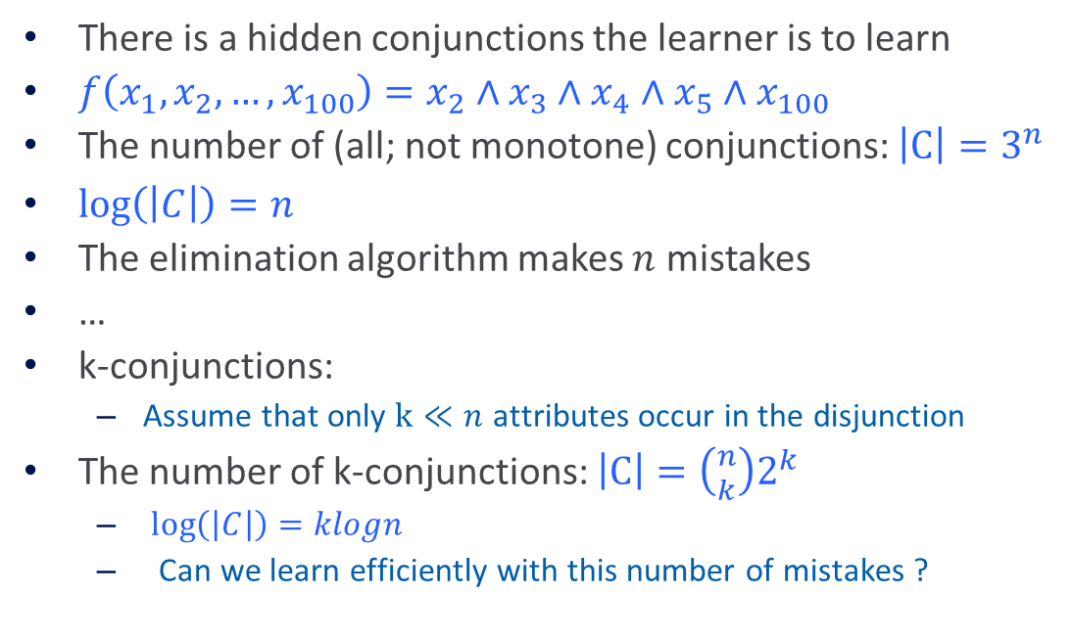
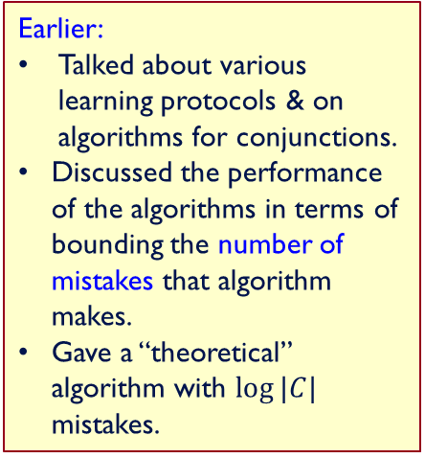
Learning Conjunctions
Can this bound be achieved?
Can mistakes be bounded in the non-finite case?
There is a hidden conjunctions the learner is to learn
$f\left(x_{1}, x_{2},…, x_{100}\right)=x_{2}∧x_{3}$ $∧x_{4}$ $∧x_{5}∧x_{100}$
The number of (all; not monotone) conjunctions: ${\left|C\right|=3}^{n}$
$\log\left(\left|C\right|\right)=n$
The elimination algorithm makes $n$ mistakes
…
k-conjunctions:
  Assume that only $k≪n$ attributes occur in the disjunction
The number of k-conjunctions: $\left|C\right|=\left({n \atop k}\right)2^{k}$
  $\log\left(\left|C\right|\right)=klogn$
  Can we learn efficiently with this number of mistakes ?
Earlier:
Talked about various learning protocols & on algorithms for conjunctions.
Discussed the performance of the algorithms in terms of bounding the number of mistakes that algorithm makes.
Gave a “theoretical” algorithm with $log⁡|C|$ mistakes.

Slide 31
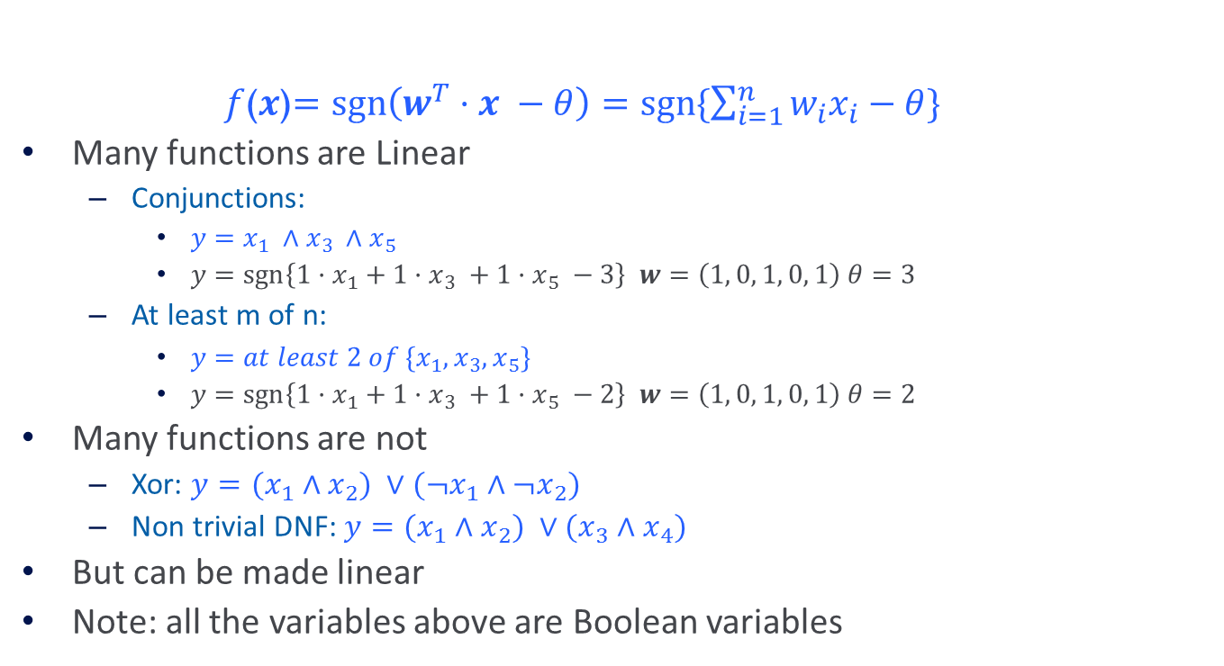
Linear Threshold Functions
$f$($x$)$=\operatorname{sgn}\left(w^{T}·x −θ\right)=sgn\{\sum_{i=1}^{n}{w_{i}x_{i}−θ}\}$
Many functions are Linear
  Conjunctions:
    $y=x_{1} ∧$ $x_{3} ∧$ $x_{5}$
    $y=\operatorname{sgn}\left\{1·x_{1}+1·x_{3} +1·x_{5} −3\right\}$ $w=\left(1, 0, 1, 0, 1\right)$ $θ=3$
  At least m of n:
    $y={at least 2 of \{x}_{1},x_{3}, x_{5}\}$
    $y=\operatorname{sgn}\left\{1·x_{1}+1·x_{3} +1·x_{5} −2\right\}$ $w=\left(1, 0, 1, 0, 1\right)$ $θ=2$
Many functions are not
  Xor: $y={(x}_{1} ∧$ $x_{2}) ∨(¬x_{1}∧$ $¬x_{2})$
  Non trivial DNF: $y={(x}_{1} ∧$ $x_{2}) ∨(x_{3}∧$ $x_{4})$
But can be made linear
Note: all the variables above are Boolean variables

Slide 32
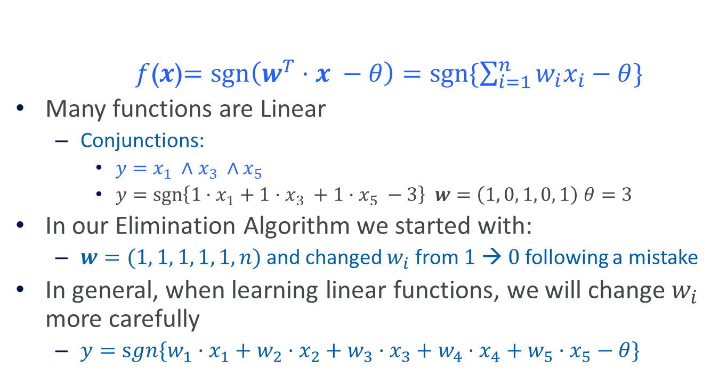
Linear Threshold Functions
$f$($x$)$=\operatorname{sgn}\left(w^{T}·x −θ\right)=sgn\{\sum_{i=1}^{n}{w_{i}x_{i}−θ}\}$
Many functions are Linear
  Conjunctions:
    $y=x_{1} ∧$ $x_{3} ∧$ $x_{5}$
    $y=\operatorname{sgn}\left\{1·x_{1}+1·x_{3} +1·x_{5} −3\right\}$ $w=\left(1, 0, 1, 0, 1\right)$ $θ=3$
In our Elimination Algorithm we started with:
  $w=(1, 1, 1, 1, 1, n)$and changed $w_{i}$ from $1 → 0$following a mistake
In general, when learning linear functions, we will change $w_{i}$ more carefully
  $y=sgn\{w_{1}·x_{1}+w_{2}·x_{2}+w_{3}·x_{3}+w_{4}·x_{4}+w_{5}·x_{5}−θ\}$

Slide 33
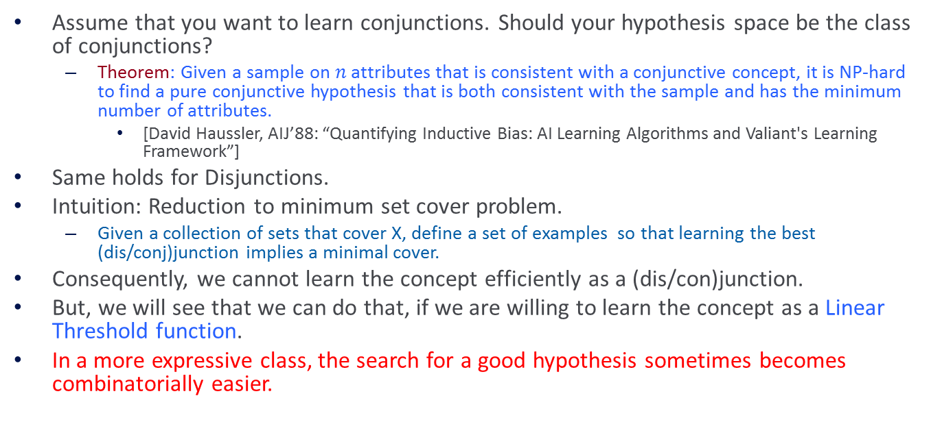
Representation
Assume that you want to learn conjunctions. Should your hypothesis space be the class of conjunctions?
  Theorem: Given a sample on $n$ attributes that is consistent with a conjunctive concept, it is NP-hard to find a pure conjunctive hypothesis that is both consistent with the sample and has the minimum number of attributes.
    [David Haussler, AIJ’88: “Quantifying Inductive Bias: AI Learning Algorithms and Valiant's Learning Framework”]
Same holds for Disjunctions.
Intuition: Reduction to minimum set cover problem.
  Given a collection of sets that cover X, define a set of examples so that learning the best (dis/conj)junction implies a minimal cover.
Consequently, we cannot learn the concept efficiently as a (dis/con)junction.
But, we will see that we can do that, if we are willing to learn the concept as a Linear Threshold function.
In a more expressive class, the search for a good hypothesis sometimes becomes combinatorially easier.

Slide 34



$$wT x = $$
-
-
-
-
-
-
-
-
-
-
-
-
-
-
$$wT x = 0$$
-
$$w$$

Slide 35

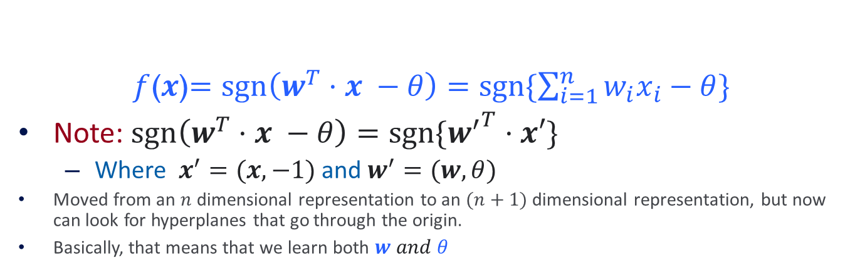

Canonical Representation
$f$($x$)$=\operatorname{sgn}\left(w^{T}·x −θ\right)=sgn\{\sum_{i=1}^{n}{w_{i}x_{i}−θ}\}$
Note: $\operatorname{sgn}\left(w^{T}·x −θ\right)=sgn⁡\{{w^{′}}^{T}·x′\}$
  Where $x^{′}=(x, −1)$ and $w^{′}=(w, θ)$
Moved from an $n$ dimensional representation to an $(n+1)$ dimensional representation, but now can look for hyperplanes that go through the origin.
Basically, that means that we learn both $w and θ$
$w^{′T}∙x$’ = 0
$w^{T}∙x$ = θ

Slide 36

Perceptron
Earlier:
Talked about various learning protocols & on algorithms for conjunctions.
Measured performance of algorithms in terms of bounding the number of mistakes that algorithm makes.
Showed that in the case of a finite concept class we will stop making mistakes at some point (a “theoretical” algorithm had $log⁡|C|$ mistakes.

Slide 37
Perceptron learning rule
On-line, mistake driven algorithm.
Rosenblatt (1959) suggested that when a target output value is provided for a single neuron with fixed input, it can incrementally change weights and learn to produce the output using the Perceptron learning rule
(Perceptron == Linear Threshold Unit)
1
2
7
T
3
4
5
6

Slide 38

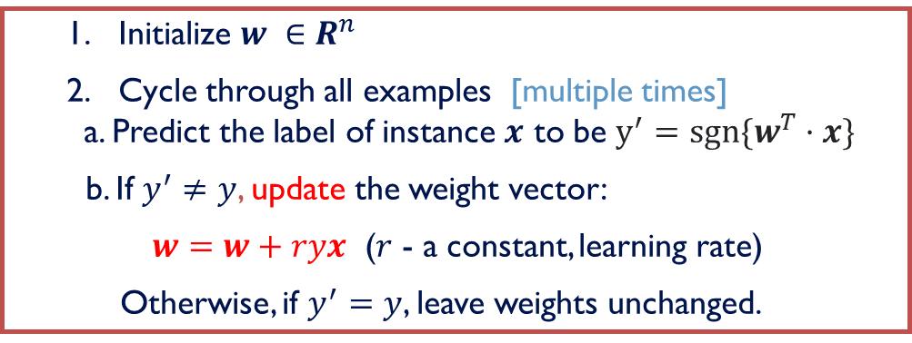
Perceptron learning rule
We learn $f:X →Y=\left\{−1, +1\right\}$ represented as $f=sgn⁡\{w^{T}·x\}$
Where $X={\{0, 1\}}^{n}$ or $X=R^{n}$ and $w∈R^{n}$
Given Labeled examples: $\{\left\{x_{1}, y_{1}\right\},\left\{x_{2}, y_{2}\right\},…\left\{x_{m}, y_{m}\right\}$}
  Initialize $w ∈R^{n}$
  Cycle through all examples [multiple times]
a. Predict the label of instance $x$ to be $y^{′}=sgn⁡\{w^{T}·x\}$
  b. If $y^{′}≠y$, update the weight vector:
  $w=w+ryx$ ($r$ - a constant, learning rate)
Otherwise, if $y^{′}=y$, leave weights unchanged.

Slide 39


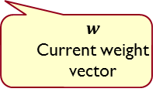
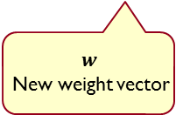
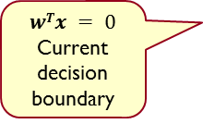
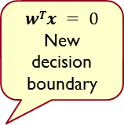
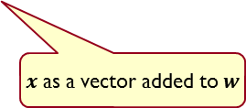
Perceptron in action
$x$ $(with y = +1)$
next item to be classified
$x$ as a vector
$$wTx = 0$$
New
decision boundary
$$wTx = 0$$
Current decision boundary
$$w$$
Current weight vector
$$w$$
New weight vector
$x$ as a vector added to $w$
Positive
(Figures from Bishop 2006)
Negative

Slide 40
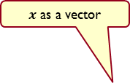


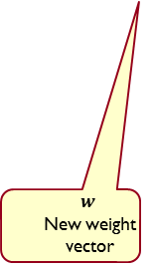
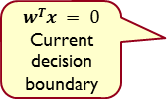
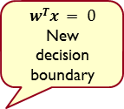

Perceptron in action
$$x (with y = +1)$$
next item to be classified
$$wTx = 0$$
New
decision boundary
$x$ as a vector
$$wTx = 0$$
Current decision boundary
$$w$$
Current weight vector
$x$ as a vector added to $w$
$$w$$
New weight vector
Positive
(Figures from Bishop 2006)
Negative

Slide 41
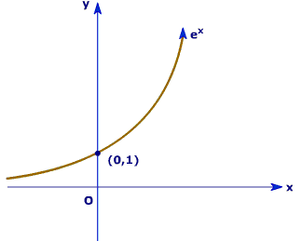
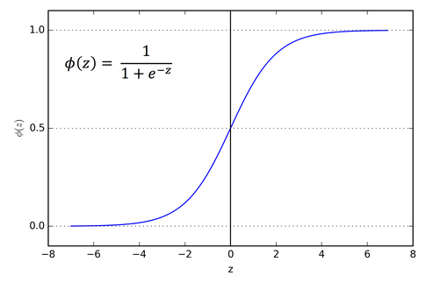

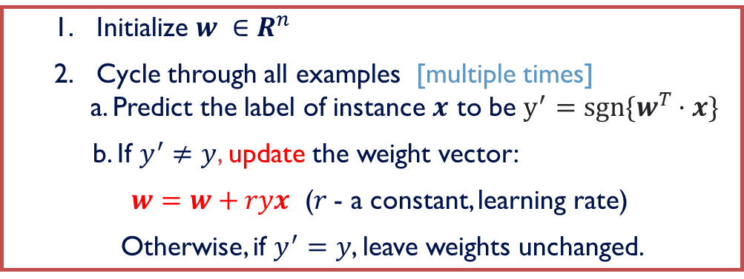
Perceptron learning rule
If $x$ is Boolean, only weights of active features are updated
Why is this important?
$w^{T}·x>0 is equivalent to: P\left(y=+1 | x\right)= \frac{1}{1+e^{−w^{T}x}}$ > $\frac{1}{2}$
  Initialize $w ∈R^{n}$
  Cycle through all examples [multiple times]
a. Predict the label of instance $x$ to be $y^{′}=sgn⁡\{w^{T}·x\}$
  b. If $y^{′}≠y$, update the weight vector:
  $w=w+ryx$ ($r$- a constant, learning rate)
Otherwise, if $y^{′}=y$, leave weights unchanged.

Slide 42
Perceptron Learnability
Obviously can’t learn what it can’t represent (???)
  Only linearly separable functions
Minsky and Papert (1969) wrote an influential book demonstrating Perceptron’s representational limitations
  Parity functions can’t be learned (XOR)
  In vision, if patterns are represented with local features, can’t represent symmetry, connectivity
Research on Neural Networks stopped for years
Rosenblatt himself (1959) asked,
  “What pattern recognition problems can be transformed so as to become linearly separable?”
Perceptron

Slide 43


$${(x}_{1}∧x_{2})∨(x_{3}∧x_{4})$$
$$y_{1}∧y_{2}$$

Slide 44
Perceptron Convergence
  Perceptron Convergence Theorem:
    If there exist a set of weights that are consistent with the data (i.e., the data is linearly separable), the perceptron learning algorithm will converge
    How long would it take to converge ?
  Perceptron Cycling Theorem:
    If the training data is not linearly separable the perceptron learning algorithm will eventually repeat the same set of weights and therefore enter an infinite loop.
    How to provide robustness, more expressivity ?

Slide 45
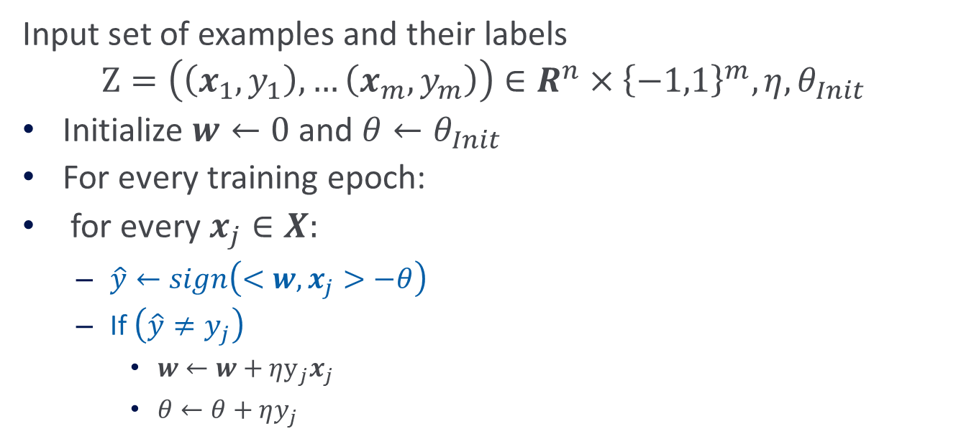
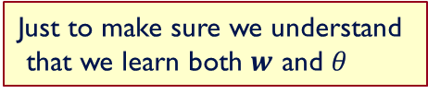
Perceptron
Input set of examples and their labels
$$Ζ=\left(\left(x_{1}, y_{1}\right),…\left(x_{m},y_{m}\right)\right)∈R^{n}×{\left\{−1,1\right\}}^{m}, η, θ_{Init}$$
Initialize $w←0$ and $θ←θ_{Init}$
For every training epoch:
for every $x_{j}∈X:$
  $\hat{y}←sign\left(<w, x_{j}>−θ\right)$
  If $\left(\hat{y}≠y_{j}\right)$
    $w←w+ηy_{j}x_{j}$
    $θ←θ+ηy_{j}$
Just to make sure we understand
that we learn both $w$ and $θ$

Slide 46
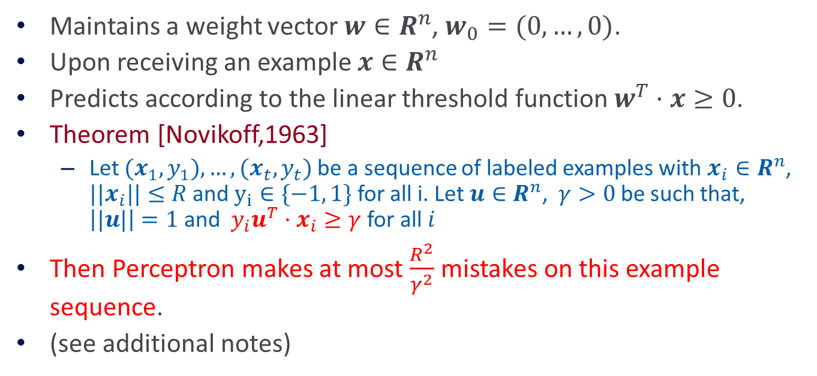
Perceptron: Mistake Bound Theorem
Maintains a weight vector $w∈R^{n}$, $w_{0}=(0,…,0)$.
Upon receiving an example $x∈R^{n}$
Predicts according to the linear threshold function $w^{T}·x≥0$.
Theorem [Novikoff,1963]
  Let ${(x}_{1}, y_{1}),…,{(x}_{t}, y_{t})$ be a sequence of labeled examples with $x_{i}∈R^{n}$, ${||x}_{i}||≤R$and $y_{i}∈\{−1, 1\}$for all i. Let $u∈R^{n}$, $γ>0$ be such that, $\left||u|\right|=1$ and $y_{i}u^{T}·x_{i}≥γ$ for all $i$
Then Perceptron makes at most $\frac{R^{2}}{γ^{2}}$ mistakes on this example sequence.
(see additional notes)
Complexity Parameter

Slide 47
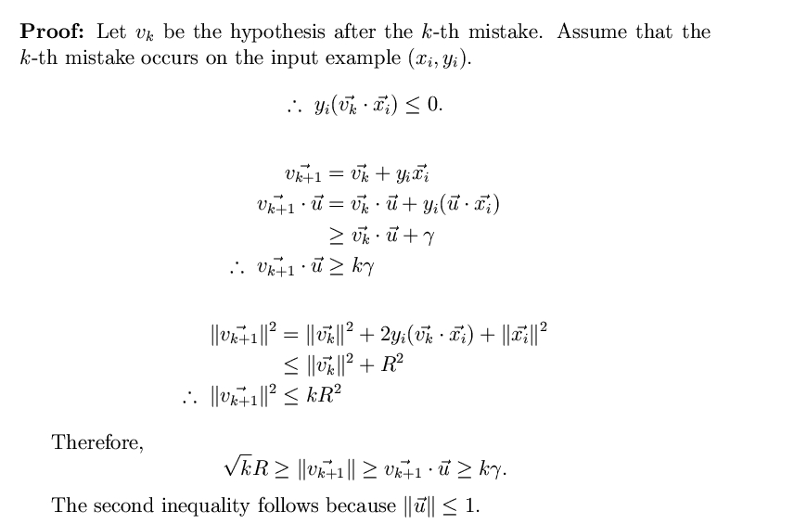


Perceptron-Mistake Bound
Note that the bound does not
depend on the dimensionality
nor on the number of examples.
Note that we place weight vectors
and examples in the same space.
3. Interpretation of the theorem
Assumptions
$${\overline{v}}_{1} = 0$$
$$|\left|\overline{u}\right|| = 1$$
$$yi {\overline{u}}^{T} •{\overline{x}}_{i} ≥ $$
$$k < R2 /  2$$
Notes:
Second inequality: u\cdot v = ||u|| ||v|| cos(u,v) <=||u|| ||v|| <= ||v||
Interpretation: if the data satisfies this separability condition, then the number of mistake is bounded. It does not matter how many more examples you see – not more mistakes after you have done the r/\gamma)^2 mistakes.

Slide 48
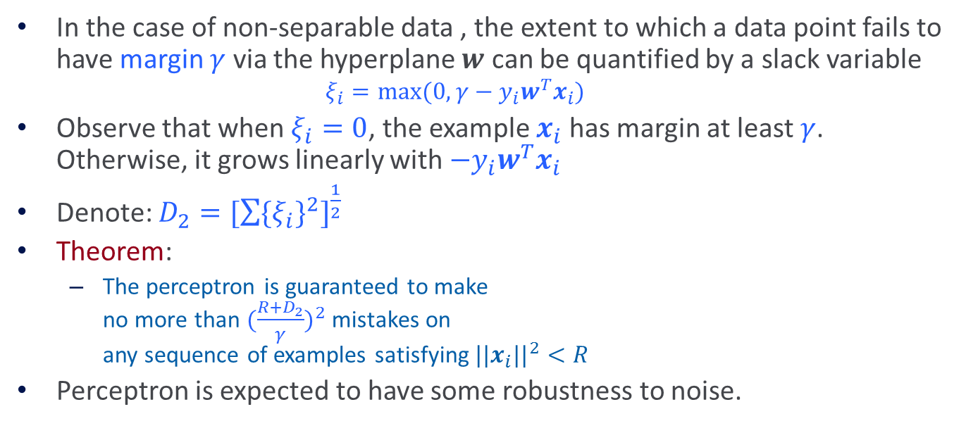
Robustness to Noise
In the case of non-separable data , the extent to which a data point fails to have margin $γ$ via the hyperplane $w$ can be quantified by a slack variable
  $$ξ_{i}=max⁡(0, γ−y_{i}w^{T}x_{i})$$
Observe that when $ξ_{i}=0$, the example $x_{i}$ has margin at least $γ$. Otherwise, it grows linearly with ${−y}_{i}w^{T}x_{i}$
Denote: $D_{2}={[\sum{{{\{ξ}_{i}\}}^{2}}]}^{\frac{1}{2}}$
Theorem:
  The perceptron is guaranteed to make
  no more than ${(\frac{R+D_{2}}{γ})}^{2}$ mistakes on
  any sequence of examples satisfying ${||x_{i}||}^{2}<R$
Perceptron is expected to have some robustness to noise.
-
-
-
-
-
-
-
-
-
-
-
-
-
-
-
Notes:
Need to understand \xi :
The interpretation of the theorem (as well as the Perceptron in the separable case): there is a sequence of examples satisfying these conditions; on this sequence of examples (irrespective of its size and irrespective of its dimensionality) this is the bound on the number of mistakes.

Slide 49
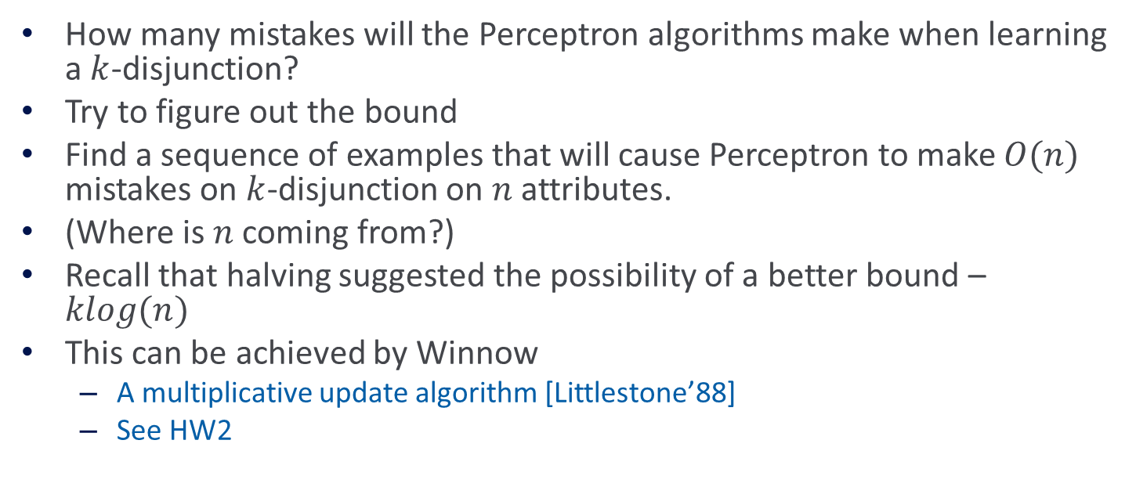
Perceptron for Boolean Functions
How many mistakes will the Perceptron algorithms make when learning a $k$-disjunction?
Try to figure out the bound
Find a sequence of examples that will cause Perceptron to make $O(n)$ mistakes on $k$-disjunction on $n$ attributes.
(Where is $n$ coming from?)
Recall that halving suggested the possibility of a better bound – $klog(n)$
This can be achieved by Winnow
  A multiplicative update algorithm [Littlestone’88]
  See HW2

Slide 50
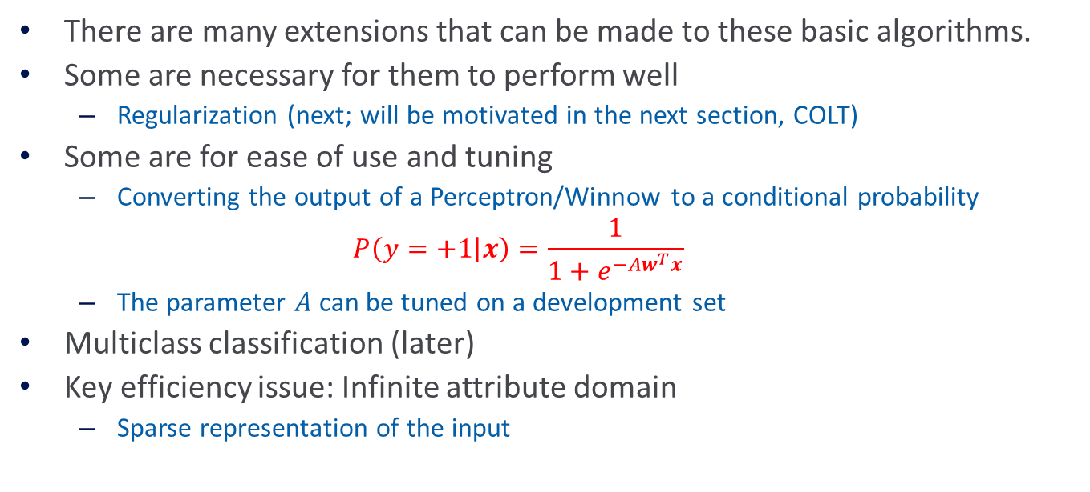
Practical Issues and Extensions
There are many extensions that can be made to these basic algorithms.
Some are necessary for them to perform well
  Regularization (next; will be motivated in the next section, COLT)
Some are for ease of use and tuning
  Converting the output of a Perceptron/Winnow to a conditional probability
  $$P\left(y=+1 | x\right)=\frac{1}{1+e^{−Aw^{T}x}}$$
  The parameter $A$ can be tuned on a development set
Multiclass classification (later)
Key efficiency issue: Infinite attribute domain
  Sparse representation of the input

Slide 51

Conditional Probabilities
How to tune $A$ so that you get a conditional probability?
Plotting: For example $z$ and $f(z) = \frac{1}{1+e^{−Aw^{T}z}}$
$y = Prob(label=1 | f(z)=s)$
(Histogram: for $0.8$, # (of examples with $f(z)<0.8$))
Claim: If we make $Prob(label=1 | f(z)≤s) = s$
  Then $f(z)$is a probability dist.
That is, yes, if the graph is linear.
Theorem: Let $X$ be a RV with distribution $F$.
  $F(X)$ is uniformly distributed in $(0,1).$
  If $U$is $uniform(0,1), F^{−1}(U)$is distributed $F,$ where $F^{−1}(x)$ is the value of $y$s.t. $F(y) =x$.
  Alternatively: $f(z)$ is a probability if:
  $$Prob_{U} \{z| Prob[(f(z)=1 · y]\} = y$$
Plotted for SNoW (Winnow). Similarly, perceptron; more tuning is required for SVMs.

Slide 52
Regularization Via Averaged Perceptron
An Averaged Perceptron Algorithm is motivated by the following considerations:
  In real life, we want [more] guarantees from our learning algorithm
  In the mistake bound model:
    We don’t know when we will make the mistakes.
    In a sequential/on-line scenario, which hypothesis will you choose…??
    Being consistent with more examples is better (why?)
  Ideally, we want to quantify the expected performance as a function of the number of examples seen and not number of mistakes. (“a global guarantee”; the PAC model does that)
  Every Mistake-Bound Algorithm can be converted efficiently to a PAC algorithm – to yield global guarantees on performance.
To convert a given Mistake Bound algorithm (into a global guarantee algorithm):
  Wait for a long stretch w/o mistakes (there must be one)
  Use the hypothesis at the end of this stretch.
  Its PAC behavior is relative to the length of the stretch.
Averaged Perceptron returns a weighted average of earlier hypotheses; the weights are a function of the length of no-mistakes stretch.
Notes:
Assume that you are hoping to see a stretch of 1000 examples, with no mistakes; if you see that, you know that the algorithm is good enough. (to be justified when we talk about PAC).
And assume that your mistake bound algorithm has a bound of 500.
The worst scenario is that you go 999 examples, almost happy, but then you see a mistake; so you start again; see 999 examples, and another mistake; and so on. But this can happen at most 500 times. After that, you will get as long a stretch as you want.

Slide 53

Regularization Via Averaged Perceptron
Variables:
  $m$: number of examples
  $k$: number of mistakes
  $c_{i}$: consistency count for hypothesis $v_{i}$
  $T$: number of epochs
Input: a labeled training {$\left\{x_{1}, y_{1}\right\},\left\{x_{2}, y_{2}\right\},…\left\{x_{m}, y_{m}\right\}$}
Output: a list of weighted perceptrons {$\left\{v_{1}, c_{1}\right\},…,\left\{v_{k}, c_{k}\right\}$}
Initialize: $k=0, v_{1}=0, c_{1}=0$
Repeat $T$times:
  For $i=1,…,m;$
  Compute prediction $y^{′}=sgn⁡(v_{k}^{T}·x_{i})$
  If $y^{′}=y,$ then $c_{k}=c_{k}+1$
  else: $v_{k+1}=v_{k}+y_{i}x;c_{k+1}=1;k=k+1$
Prediction:
  Given: a list of weighted perceptrons {$\left\{v_{1}, c_{1}\right\},…,\left\{v_{k}, c_{k}\right\}$}; a new example x
  Predict the label $(x)$as follows: $y\left(x\right)=sgn⁡[\sum_{1}^{k}{c_{i}(v_{i}^{T}x)}]$
This can be done on top of any online mistake driven algorithm.
In HW 2 you will run it over three different algorithms.
The implementation requires thinking.
Averaged version of Perceptron/Winnow is as good as any other linear learning algorithm, if not better.

Slide 54



Perceptron with Margin
Thick Separator (aka as Perceptron with Margin)
(Applies both for Perceptron and Winnow)
Promote weights if:
  $w^{T}·x − θ<γ$
Demote weights if:
  $w^{T}·x − θ>γ$
$$w^{T}·x= θ$$
-
-
-
-
-
-
-
-
-
-
-
-
-
-
$$w^{T}·x=0$$
-
Note: γ is a functional margin. Its effect could disappear as $w$ grows.
Nevertheless, this has been shown to be a very effective algorithmic addition.(Grove & Roth 98,01; Karov et. al 97)

Slide 55

Other Extensions
Assume you made a mistake on example $x$.
You then see example $x$ again; will you make a mistake on it?
Threshold relative updating (Aggressive Perceptron)
$w ←w+rx$
$r=\frac{θ−w^{T} x}{{\left|\left|x\right|\right|}^{2}}$
Equivalent to updating on the same example multiple times
Notes:
Derive the update rule by requiring that w’x > \theta; that is (w+rx) x > \theta

Slide 56
LBJava
Several of these extensions (and a couple more) are implemented in the LBJava learning architecture that supports several linear update rules (Winnow, Perceptron, naïve Bayes)
Supports
  Regularization(averaged Winnow/Perceptron; Thick Separator)
  Conversion to probabilities
  Automatic parameter tuning
  True multi-class classification
  Feature Extraction and Pruning
  Variable size examples
  Good support for large scale domains in terms of number of examples and number of features.
  Very efficient
  Many other options
[Download from: http://cogcomp.org/page/software/]

Slide 57
Administration
No class on Wednesday (Yom Kippur)
I will not have an office hour on Tuesday
My office hour today is 6-7 (instead of 5-6)
Hw1: due today
HW2: will be out tonight
  Started working on it early
  Recall: this is an Applied Machine Learning class.
  The HW will try to simulate challenges you might face when you want to apply ML.
  HW2 will emphasize, in addition to understanding a few algorithms,
    How algorithms differ
    Scaling to realistic problem sizes: the importance of thinking about your implementation
    Adaptation
  Allow you to experience various ML scenarios and make observations that are best experienced when you play with it yourself.
Questions

Slide 58
Perceptron learning rule
If $x$ is Boolean, only weights of active features are updated
Why is this important?
$w^{T}·x>0 is equivalent to: P\left(y=+1 | x\right)= \frac{1}{1+e^{−w^{T}x}}$ > $\frac{1}{2}$
  Initialize $w ∈R^{n}$
  Cycle through all examples [multiple times]
a. Predict the label of instance $x$ to be $y^{′}=sgn⁡\{w^{T}·x\}$
  b. If $y^{′}≠y$, update the weight vector:
  $w=w+ryx$ ($r$- a constant, learning rate)
Otherwise, if $y^{′}=y$, leave weights unchanged.

Slide 59
Regularization Via Averaged Perceptron
Variables:
  $m$: number of examples
  $k$: number of mistakes
  $c_{i}$: consistency count for hypothesis $v_{i}$
  $T$: number of epochs
Input: a labeled training {$\left\{x_{1}, y_{1}\right\},\left\{x_{2}, y_{2}\right\},…\left\{x_{m}, y_{m}\right\}$}
Output: a list of weighted perceptrons {$\left\{v_{1}, c_{1}\right\},…,\left\{v_{k}, c_{k}\right\}$}
Initialize: $k=0, v_{1}=0, c_{1}=0$
Repeat $T$times:
  For $i=1,…,m;$
  Compute prediction $y^{′}=sgn⁡(v_{k}^{T}·x_{i})$
  If $y^{′}=y,$ then $c_{k}=c_{k}+1$
  else: $v_{k+1}=v_{k}+y_{i}x;c_{k+1}=1;k=k+1$
Prediction:
  Given: a list of weighted perceptrons {$\left\{v_{1}, c_{1}\right\},…,\left\{v_{k}, c_{k}\right\}$}; a new example x
  Predict the label $(x)$as follows: $y\left(x\right)=sgn⁡[\sum_{1}^{k}{c_{i}(v_{i}^{T}x)}]$
This can be done on top of any online mistake driven algorithm.
In HW 2 you will run it over three different algorithms.
The implementation requires thinking.
Averaged version of Perceptron/Winnow is as good as any other linear learning algorithm, if not better.

Slide 60


General Stochastic Gradient Algorithms
Given examples ${\left\{z=\left(x,y\right)\right\}}_{1,m}$ from a distribution over $X×Y$, we are trying to learn a linear function, parameterized by a weight vector $w$, so that we minimize the expected risk function
$J\left(w\right)=E_{z}Q(z,w)\text{\sim =\sim }\frac{1}{m}\sum_{1}^{m}{Q(z_{i}, w_{i})}$
In Stochastic Gradient Descent Algorithms we approximate this minimization by incrementally updating the weight vector w as follows:
$$w_{t+1}=w_{t}−r_{t}g_{w}Q\left(z_{t}, w_{t}\right)=w_{t}−r_{t}g_{t}$$
  Where $g_{t}=g_{w}Q\left(z_{t}, w_{t}\right)$ is the gradient with respect to $w$ at time $t$.
The difference between algorithms now amounts to choosing a different loss function $Q(z, w)$
The loss Q: a function of $x, w$and$y$

Slide 61





General Stochastic Gradient Algorithms
Learning rate
gradient
The loss Q: a function of $x, w$and$y$
$$w_{t+1} = w_{t} – r_{t} g_{w} Q(x_{t}, y_{t}, w_{t}) = w_{t} – r_{t} g_{t}$$
  LMS: $Q\left(\left(x, y\right), w\right)=\frac{1}{2}{\left(y – w^{T} x\right)}^{2}$
  Computing the gradient leads to the update rule (Also called Widrow’s Adaline):
  $$w_{t+1} = w_{t} + r \left(y_{t} –w_{t}^{T}x_{t}\right)x_{t}$$
  Here, even though we make binary predictions based on$sgn⁡(w^{T} x)$ we do not take the sign of the dot-product into account in the loss.
  Another common loss function is:
  Hinge loss:
  $Q((x, y), w) = max⁡(0, 1 − y w^{T} x)$
  Computing the gradient leads to the perceptron update rule:
  g = 0 if If $y_{i} ∙w_{i}^{T} x_{i} > 1$; otherwise, g = - y $x$
  If $y_{i} ∙w_{i}^{T} x_{i} > 1$(No mistake, by a margin): No update
  Otherwise, (Mistake, relative to margin): $w_{t+1} = w_{t} + r y_{t} x_{t}$
$$ywT x$$
Here $g = −yx$
Good to think about the case of Boolean examples

Slide 62

New Stochastic Gradient Algorithms
$$w_{t+1} = w_{t} – r_{t} g_{w} Q(z_{t}, w_{t}) = w_{t} – r_{t} g_{t}$$
(notice that this is a vector, each coordinate (feature) has its own $w_{t,j}$ and $g_{t,j}$)
  So far, we used fixed learning rates $r = r_{t}$, but this can change.
  AdaGrad alters the update to adapt based on historical information
    Frequently occurring features in the gradients get small learning rates and infrequent features get higher ones.
    The idea is to “learn slowly” from frequent features but “pay attention” to rare but informative features.
  Define a “per feature” learning rate for the feature$j$, as:
  $$r_{t,j} = r/{\left(G_{t,j}\right)}^{1/2}$$
  where $G_{t,j} = _{k=1}^{t} g_{k,j}^{2}$the sum of squares of gradients at feature $j$ until time $t$.
  Overall, the update rule for Adagrad is:
  $$w_{t+1,j} = w_{t,j} − g_{t,j} r/{\left(G_{t,j}\right)}^{1/2}$$
  This algorithm is supposed to update weights faster than Perceptron or LMS when needed.
Easy to think about the case of Perceptron, and on Boolean examples.

Slide 63
Preventing Overfitting
h₁
h₂
Notes:
As we said, this is the game we are playing; in NLP, it has always been clear, that the raw information
In a sentence is not sufficient, as is to represent a good predictor. Better functions of the input were
Generated, and learning was done in these terms.

Slide 64

Regularization
The more general formalism adds a regularization term to the risk function, and minimize:
$J\left(w\right)=\frac{1}{m}∑_{1}^{m} Q(z_{i}, w_{i}) + λ R_{i} (w_{i})$
Where$R$is used to enforce “simplicity” of the learned functions.
LMS case: $Q((x, y), w) ={\left(y – w^{T} x\right)}^{2}$
  $R(w) = {\left|\left|w\right|\right|}_{2}^{2}$gives the optimization problem called Ridge Regression.
  $R(w) = {\left|\left|w\right|\right|}_{1}$gives a problem called the LASSO problem
Hinge Loss case: $Q((x, y), w) = max⁡(0, 1 − y w^{T}x)$
  $R(w) = {\left|\left|w\right|\right|}_{2}^{2}$gives the problem called Support Vector Machines
Logistics Loss case:$Q((x, y), w)= log⁡(1+exp⁡\{−y w^{T} x\})$
  $R(w) = {\left|\left|w\right|\right|}_{2}^{2}$gives the problem called Logistics Regression
These are convex optimization problems and, in principle, the same gradient descent mechanism can be used in all cases.
We will see later why it makes sense to use the “size” of w as a way to control “simplicity”.

Slide 65
Algorithmic Approaches
Focus: Two families of algorithms (one of the on-line representative)
  Additive update algorithms: Perceptron
    SVM is a close relative of Perceptron
  Multiplicative update algorithms: Winnow
    Close relatives: Boosting, Max entropy/Logistic Regression

Slide 66

Summary of Algorithms
Examples$: x∈ {\left\{0,1\right\}}^{n}$; or $x∈ R^{n}$(indexed by $k$) ; Hypothesis: $w∈ R^{n}$
Prediction: $y ∈\{−1,+1\}:$Predict$: y = 1$iff$w⋅ x >θ$
Update: Mistake Driven
Additive weight update algorithm: $w ← w +r y_{k} x_{k}$
  (Perceptron, Rosenblatt, 1958. Variations exist)
  In the case of Boolean features:
Multiplicative weight update algorithm $w_{i} ← w_{i} α⁡y_{k}x_{i}$ (component-wise update)
(Winnow, Littlestone, 1988. Variations exist)
  Boolean features: (as an example, $α$=2)
$$If Class=1 but w⋅x≤θ, w_{i}←w_{i}+1 \left(if x_{i}=1\right)\left(promotion\right)$$
$$If Class=0 but w⋅x≥θ, w_{i}←w_{i}−1 \left(if x_{i}=1\right)\left(demotion\right)$$
$$If Class=1 but w⋅x≤θ, w_{i}←{2w}_{i} \left(if x_{i}=1\right)\left(promotion\right)$$
$$If Class=0 but w⋅x≥θ, w_{i}←w_{i}/2 \left(if x_{i}=1\right)\left(demotion\right)$$

Slide 67
Which algorithm is better? How to Compare?
Generalization
  Since we deal with linear learning algorithms, we know (???) that they will all converge eventually to a perfect representation.
    All can represent the data
So, how do we compare:
  How many examples are needed to get to a given level of accuracy?
  Efficiency: How long does it take to learn a hypothesis and evaluate it (per-example)?
  Robustness (to noise);
  Adaptation to a new domain, ….
With (1) being the most fundamental question:
  Compare as a function of what?
    One key issue is the characteristics of the data

Slide 68

Sentence Representation
$S=$ I don’t know whether to laugh or cry
Define a set of features:
  features are relations that hold in the sentence
Map a sentence to its feature-based representation
  The feature-based representation will give some of the information in the sentence
Use this feature-based representation as an example to your algorithm

Slide 69

Sentence Representation
$S=$ I don’t know whether to laugh or cry
Define a set of features:
  features are properties that hold in the sentence
Conceptually, there are two steps in coming up with a feature-based representation
  What are the information sources available?
    Sensors: words, order of words, properties (?) of words
  What features to construct based on these?
Why is this distinction needed?

Slide 70



Blow Up Feature Space
Whether
Weather
$$x_{1}x_{2}\overline{x_{3}}∨\overline{x_{1}}x_{4}\overline{x_{3}}∨x_{3}\overline{x_{2}}x_{5}$$
New discriminator in functionally simpler
$$y_{1}∨y_{4}∨y_{5}$$

Slide 71
Domain Characteristics
The number of potential features is very large
The instance space is sparse
Decisions depend on a small set of features: the function space is sparse
Want to learn from a number of examples that is small relative to the dimensionality

Slide 72

Generalization
Dominated by the sparseness of the function space
  Most features are irrelevant
# of examples required by multiplicative algorithms depends mostly on # of relevant features
  (Generalization bounds depend on the target $||u||$)
# of examples required by additive algorithms depends heavily on sparseness of features space:
  Advantage to additive. Generalization depend on input $||x||$
    (Kivinen/Warmuth 95).
Nevertheless, today most people use additive algorithms.

Slide 73


Which Algorithm to Choose?
Generalization (in terms of # of mistakes made)
  Multiplicative algorithms:
    Bounds depend on $||u||,$the separating hyperplane; $i$: example #)
    $M_{w} =2\ln{n}{\left|\left|u\right|\right|}_{1}^{2}\max_{i}{{\left|\left|x^{\left(i\right)}\right|\right|}_{∞}^{2}} /\min_{i}{{\left(u x^{\left(i\right)}\right)}^{2}}$
    Do not care much about data; advantage with sparse target $u$
  Additive algorithms:
    Bounds depend on $||x||$(Kivinen / Warmuth, ‘95)
    $M_{p} = {\left|\left|u\right|\right|}_{2}^{2}\max_{i}{{\left|\left|x^{\left(i\right)}\right|\right|}_{2}^{2}}/\min_{i}{{\left(u x^{\left(i\right)}\right)}^{2}}$
    Advantage with few active features per example
The $l1$ norm: ${\left|\left|x\right|\right|}_{1} =\sum_{i}{|x_{i}|}$The $l2$ norm: ${\left|\left|x\right|\right|}_{2}{(\sum_{1}^{n}{{\left|x_{i}\right|}^{2})}}^{1/2}$
The$lp$norm: $||x||p = {(\sum_{1}^{n}{{\left|x_{i}\right|}^{p})}}^{1/p}$The$l_{∞}$norm: ${\left|\left|x\right|\right|}_{∞} = maxi|x_{i}|$

Slide 74


Examples
$$M_{w} =2\ln{n}{\left|\left|u\right|\right|}_{1}^{2}\max_{i}{{\left|\left|x^{\left(i\right)}\right|\right|}_{∞}^{2}} /\min_{i}{{\left(u x^{\left(i\right)}\right)}^{2}}$$
$$M_{p} = {\left|\left|u\right|\right|}_{2}^{2}\max_{i}{{\left|\left|x^{\left(i\right)}\right|\right|}_{2}^{2}}/\min_{i}{{\left(u x^{\left(i\right)}\right)}^{2}}$$
Extreme Scenario 1: Assume the $u$ has exactly $k$ active features, and the other $n−k$ are 0. That is, only $k$ input features are relevant to the prediction. Then:
    ${\left|\left|u\right|\right|}_{2}, =\sqrt{k} ; {\left|\left|u\right|\right|}_{1}, = k ;{{\max\left|\left|x\right|\right|}_{2^{′}}}^{}=\sqrt{n} ;{\max\left|\left|x\right|\right|}_{∞}, = 1$
    We get that: $M_{p} = kn$; $M_{w} = 2k^{2} ln⁡n$
    Therefore, if $k<<n$, Winnow behaves much better.
Extreme Scenario 2: Now assume that $u=(1, 1,….1)$and the instances are very sparse, the rows of an $n×n$ unit matrix. Then:
    ${\left|\left|u\right|\right|}_{2}, =\sqrt{n} ; {\left|\left|u\right|\right|}_{1}, = n ;{\max\left|\left|x\right|\right|}_{2}, = 1 ;{\max\left|\left|x\right|\right|}_{∞}, = 1$
    We get that: $M_{p} = n; M_{w} = 2n^{2} ln⁡n$
    Therefore, Perceptron has a better bound.

Slide 75




`
HW2
Mistakes bounds for $10$ of $100$ of $n$
Function: At least $10$ out of
fixed $100$ variables are active
Dimensionality is$n$
Perceptron,SVMs
# of mistakes to convergence
Winnow
$n$: Total # of Variables (Dimensionality)
Notes:
The function is pretty reasonable for cases we are interested in; 10 out of these 100 variables
Should be active. Clearly, linear threshold function. And observe that the multiplicative update algorithm
Scales very nicely; essentially, the total number of variables (n) does not affect that time (number of
Examples) required to learn. This is far from what happens with an additive update algorithm.
This phenomenon will allow us to generate many many potentially plausible features, and learn
On top of them.

Slide 76


Summary
-
Introduced multiple versions of on-line algorithms
Most turned out to be Stochastic Gradient Algorithms
  For different loss functions
Some turned out to be mistake driven
We suggested generic improvements via:
  Regularization via adding a term that forces a “simple hypothesis”
  $J(w) = 1, m Q(z_{i}, w_{i}) + λ R_{i} (w_{i})$
  Regularization via the Averaged Trick
    “Stability” of a hypothesis is related to its ability to generalize
  An improved, adaptive, learning rate (Adagrad)
Dependence on function space and the instance space properties.
Now:
  A way to deal with non-linear target functions (Kernels)
  Beginning of Learning Theory.
-
-
-
-
-
-
-
-
$$wT x =θ$$
-
-
-
-
-
-
A term that minimizes error on the training data
A term that forces simple hypothesis

Slide 77


Efficiency
Dominated by the size of the feature space
Most features are functions (e.g. conjunctions) of raw attributes
Additive algorithms allow the use of Kernels
  No need to explicitly generate complex features
Could be more efficient since work is done in the original feature space, but expressivity is a function of the kernel expressivity.
$X\left(x_{1},x_{2},x_{3},…x_{k}\right)←X\left(χ_{1}\left(x\right), χ_{2}\left(x\right), χ_{3}\left(x\right),…, χ_{n}\left(x\right)\right) n≫k$
$$f\left(x\right)=\sum_{i}{c_{i}K(x, x_{i})}$$

Slide 78
Administration
Hw2 is due next week; 10/21.
  You should have started working on it already…
The midterm is on October 28. In class.
  4-5 questions
  Covering all the material discussed in class, HWs and quizzes.
Project proposals are due on October 25th.
  Poster session will probably be on the last day of classes.
Recall that our Final exam is on the last day of the Finals. Plan accordingly.
Questions

Slide 79
Projects
https://www.seas.upenn.edu/~cis519/fall2019/project.html
CIS 519 students need to do a team project
  Teams will be of size 3-4
Projects proposals are due on Friday 10/25/19
  Details will be available on the website
  We will give comments and/or requests to modify / augment/ do a different project.
  There may also be a mechanism for peer comments.
Please start thinking and working on the project now.
  Your proposal is limited to 1 page, but needs to include references and, ideally, some preliminary results/ideas. It should look like a paper – use latex, bibtex.
Any project with a significant Machine Learning component is good.
  Experimental work, theoretical work, a combination of both or a critical survey of results in some specialized topic.
  The work has to include some reading of the literature .
  Originality is not mandatory but is encouraged.
Try to make it interesting!

Slide 80

Functions Can be Made Linear
Data are not linearly separable in one dimension
Not separable if you insist on using a specific class of functions
$$x$$

Slide 81



Blown Up Feature Space
Data are separable in $<x, x^{2}>$space
$$x2$$
$$x$$

Slide 82



Making data linearly separable
$$x_{2}$$
$$x_{1}$$
$f\left(x\right)= 1$iff$x12 + x22 ≤ 1$

Slide 83




Making data linearly separable
In order to deal with this, we introduce two new concepts:
  Dual Representation
  Kernel (& the kernel trick)
$$x_{2}∗x_{2}$$
$$x_{1}∗x_{1}$$
Transform data: $x = \left(x1, x2 \right)→ x’ = (x12, x22 )$
$f(x’) = 1$iff$x’_{1} + x’_{2} ≤ 1$

Slide 84

Transforming a Feature Space
Results in a very high dimensional feature space
Features are functions (e.g. conjunctions) of raw attributes
However, additive algorithms allow the use of Kernels
  No need to explicitly generate complex features
Could be more efficient since work is done in the original feature space, but expressivity is a function of the kernel expressivity.
$X\left(x_{1},x_{2},x_{3},…x_{k}\right)→X\left(χ_{1}\left(x\right), χ_{2}\left(x\right), χ_{3}\left(x\right),…, χ_{n}\left(x\right)\right) n≫k$
$$f\left(x\right)=\sum_{i}{c_{i}K(x, x_{i})}$$

Slide 85



Dual Representation
Examples $x  \{0,1\}N$; Learned hypothesis $w  RN$
$f(x) = sgn⁡\{w^{T}∙x$} = $sgn⁡\{\sum_{i=1}^{n}{wixi }$}
Perceptron Update:
  If $y’y$, update: $w = w + ry x$
Note: We care about the dot product: $f(x) = wT x =$
$$= (_{1}^{m}r αi yi xi)T x$$
$$= _{1}^{m} r αi yi (xiT x)$$
Let $w$ be an initial weight vector for perceptron. Let $(x^{1},+), (x^{2},+), (x^{3},−), (x^{4},−)$be examples and assume mistakes are made on $x^{1}, x^{2}$and$x^{4}$.
What is the resulting weight vector?
        $$w = w + x^{1} + x^{2} − x^{4}$$
(here $r=1)$
In general, the weight vector $w$can be written as a linear combination of examples:
$w = _{1}^{m} r α_{i} y_{i} x^{i}$
Where $α_{i}$is the number of mistakes made on $x^{i}$.

Slide 86

Kernel Based Methods
$f(x) = sgn⁡${$w^{T}∙x$} = sgn{$\sum_{i=1}^{n}{wixi }$}
Representing the model in the dual space will allow us to use Kernels.
A method to run Perceptron on a very large feature set, without incurring the cost of keeping a very large weight vector.
Computing the dot product can be done in the original feature space.
Notice: this pertains only to efficiency: The classifier is identical to the one you get by blowing up the feature space.
Generalization is still relative to the real dimensionality (or, related properties).
Kernels were popularized by SVMs, but many other algorithms can make use of them (== run in the dual).
  Linear Kernels: no kernels; stay in the original space. A lot of applications actually use linear kernels.

Slide 87



Kernel Base Methods
$$Examples x  \{0,1\}N ; Learned hypothesis w  RN$$
$f(x) = sgn⁡${$w^{T}∙x$} = $sgn⁡\{\sum_{i=1}^{n}{wixi }(x)$}
Let’s transform the space to an expressive one.
Let $I$ be the set $t_{1},t_{2},t_{3} …$of monomials (conjunctions) over the feature space $x_{1}, x_{2}… x_{n}$.
Then we can write a linear function over this new feature space.
$f(x) = sgn⁡\{w^{T}∙x$} = $sgn⁡\{\sum_{I}{witi }(x)\}$
Example: $x_{1}x_{2}x_{4}(11010) =1 x_{3}x_{4}(11010) =0 x_{1}x_{2} (11010) =1$

Slide 88


Kernel Based Methods
$$Examples x  \{0,1\}N ; Learned hypothesis w  RN$$
$f(x) = sgn⁡${$w^{T}∙x$} = $sgn⁡\{\sum_{i=1}^{n}{witi }(x)$}
Perceptron Update:
  $If y’y, update: w = w + ry x$
Great Increase in expressivity
Can run Perceptron (and Winnow) but the convergence bound may suffer exponential growth.
Exponential number of monomials are true in each example.
Also, will have to keep many weights.

Slide 89
Embedding
Whether
Weather
$$x_{1}x_{2}\overline{x_{3}}∨\overline{x_{1}}x_{4}\overline{x_{3}}∨x_{3}\overline{x_{2}}x_{5}$$
New discriminator in functionally simpler
$$y_{1}∨y_{4}∨y_{5}$$

Slide 90



The Kernel Trick(1)
$$Examples x  \{0,1\}N ; Learned hypothesis w  RN$$
$f(x) = sgn⁡${$w^{T}∙x$} = $sgn⁡\{\sum_{i=1}^{n}{witi }(x)$}
Perceptron Update:
  $If y’y, update: w = w + ry x$
Consider the value of $w$ used in the prediction.
Each previous mistake, on example $z$, makes an additive contribution of $+/−1$ to some of the coordinates of $w$.
  Note: examples are Boolean, so only coordinates of $w$ that correspond to ON terms in the example $z (t_{i}(z) = 1)$are being updated.
The value of $w$ is determined by the number and type of mistakes.

Slide 91




The Kernel Trick(2)
$$Examples x  \{0,1\}N ; Learned hypothesis w  RN$$
$f(x) = sgn⁡${$w^{T}∙x$} = $sgn⁡\{\sum_{i=1}^{n}{witi }(x)$}
Perceptron Update:
  $If y’y, update: w = w + ry x$
$P –$ set of examples on which we Promoted
$D –$ set of examples on which we Demoted
$M = P∪ D$
$f(x) = sgn⁡\sum_{I}{witi }(x)$= $\sum_{I}{\left[\sum_{z∈P, t_{i}\left(z\right)=1}{1− }\sum_{z∈D, t_{i}\left(z\right)=1}{1}\right]t_{i} } (x)$=
$= \sum_{I}{[\sum_{z∈M}{S(z)ti\left(z\right)ti(x)}]}$

Slide 92

The Kernel Trick(3)
$f(x) = sgn⁡${$w^{T}∙x$} = $sgn⁡\{\sum_{I}{w_{i}t_{i} }(x)\}$
$P –$ set of examples on which we Promoted
$D –$ set of examples on which we Demoted
$M = P∪ D$
$f(x) = sgn⁡\sum_{I}{w_{i}t_{i} }(x)$ = $\sum_{I}{\left[\sum_{z∈P, t_{i}\left(z\right)=1}{1− }\sum_{z∈D, t_{i}\left(z\right)=1}{1}\right]t_{i} }(x)$
$=sgn\{\sum_{I}{[\sum_{z∈M}{S\left(z\right)t_{i}\left(z\right)t_{i}\left(x\right)}]\}}$
Where $S\left(z\right)=1 if z∈P$and $S\left(z\right)= −1 if z∈D.$
Reordering:
$f(x) = sgn⁡\{\sum_{z∈M}{S(z)\sum_{I}{t_{i}(z)t_{i}(x)\}}}$

Slide 93





The Kernel Trick(4)
$$f(x) =sgn\sum_{i∈I}{w_{i}t_{i}(x)}$$
$S(y)=1$if $y∈P$ and $S(y) = −1$if $y∈D$.
A mistake on $z$contributes the value $+/−1$ to all monomials satisfied by $z$. The total contribution of $z$to the sum is equal to the number of monomials that satisfy both $x$ and $z$.
Define a dot product in the t-space:
We get the standard notation:
$$f(x) =sgn\sum_{z∈M}{{S\left(z\right)}_{}\sum_{i∈I}{t_{i}\left(z\right)}t_{i}(x)}$$
$$K\left(x,z\right)=\sum_{i∈I}{t_{i}\left(z\right)t_{i}(x) }$$
$$f(x) =sgn(\sum_{z∈M}{S\left(z\right)K\left(x,z\right)})$$

Slide 94



Kernel Based Methods
$$f(x) =sgn(\sum_{z∈M}{S\left(z\right)K\left(x,z\right)})$$
What does this representation give us?
We can view this Kernel as the distance between $x,z$ in the t-space.
So far, all we did is algebra; as written above I is huge.
But, $K(x,z)$can be measured in the original space, without explicitly writing the t-representation of $x, z$
$$K\left(x,z\right)=\sum_{i∈I}{t_{i}\left(z\right)t_{i}(x) }$$

Slide 95






Kernel Trick
$$x1x3 (001) = x1x3 (011) = 1$$
$$x1 (001) = x1 (011) = 1 ; x3 (001) = x3 (011) = 1$$
$$Φ (001) = Φ (011) = 1$$
If any other variables appears in the monomial, it’s evaluation on $x, z$will be different.
$$f(x) =sgn(\sum_{z∈M}{S\left(z\right)K\left(x,z\right)})$$
$$K\left(x,z\right)=\sum_{i∈I}{t_{i}\left(z\right)t_{i}(x) }$$
Consider the space of all $3^{n}$ monomials (allowing both positive and negative literals). Then,
Claim:
  Where $same(x,z)$ is the number of features that have the same value for both $x$ and $z$.
We get:
Example: Take $n=3; x=(001), z=(011),$monomials of size $0,1,2,3$
Proof: let $k=same(x,z);$construct a “surviving” monomials by: (1) choosing to include one of these $k$literals with the right polarity in the monomial, or (2) choosing to not include it at all. Monomials with literals outside this set disappear.
$$K\left(x,z\right)=\sum_{i∈I}{t_{i}\left(z\right)t_{i}\left(x\right)=2^{same(x,z)} }$$
$$f(x) =sgn(\sum_{z∈M}{S\left(z\right){(2}^{same(x,z)})})$$

Slide 96



Example
$$f\left(x\right)=sgn(\sum_{z∈M}{S\left(z\right)K(x,z))}$$
$$K\left(x,z\right)=\sum_{i∈I}{t_{i}\left(z\right)t_{i}(x)}$$
Take $X=\{x_{1}, x_{2}, x_{3}, x_{4}\}$
$I =$The space of all $3^{n}$ monomials; $| I |= 81$
Consider $x=(1100), z=(1101)$
Write down $I(x), I(z),$the representation of $x, z$in the $I$ space.
Compute $I(x) ∙I(z).$
Show that:
  $K(x,z) =I(x) ∙ I(z) =\sum_{I}{t_{i}\left(z\right)t_{i}(x)} = 2^{same\left(x,z \right)}= 8$
Try to develop another kernel, e.g., where $I$ is the space of all conjunctions of size $3$ (exactly).

Slide 97



Implementation: Dual Perceptron
$$f\left(x\right)=sgn(\sum_{z∈M}{S\left(z\right)K(x,z))}$$
$$K\left(x,z\right)=\sum_{i∈I}{t_{i}\left(z\right)t_{i}(x)}$$
Simply run Perceptron in an on-line mode, but keep track of the set $M$.
Keeping the set $M$ allows us to keep track of $S(z).$
Rather than remembering the weight vector $w,$remember the set $M$ ($P$ and $D$) – all those examples on which we made mistakes.
Dual Representation

Slide 98


Example: Polynomial Kernel
We called this a “dual representation:
$$f\left(x\right)=sgn(\sum_{z∈M}{S\left(z\right)K(x,z))}$$
Prediction with respect to a separating hyper planes w (produced by Perceptron, SVM) can be computed instead, as a function of dot products of feature based representation of (some of) the examples.
We want to define a dot product in a high dimensional space.
Given two examples $x = (x_{1}, x_{2}, …x_{n})$ and $y = (y_{1},y_{2}, …y_{n})$we want to map them to a high dimensional space [example- quadratic]:
$Φ(x_{1}, x_{2}, …x_{n})= (1, x_{1},…,x_{n}, x_{1}^{2},…,x_{n}^{2}, x_{1}x_{2},…,x_{n−1}x_{n})$
$Φ(y_{1},y_{2}, …y_{n})= (1, y_{1},…,y_{n} ,y_{1}^{2},…,y_{n}^{2}, y_{1}y_{2},…,y_{n−1}y_{n})$
and compute the dot product $A =Φ{\left(x\right)}^{T}Φ(y)$ [takes time ]
Instead, in the original space, compute
  $B = k(x , y)= [1+{\left(x_{1}, x_{2}, …x_{n}\right)}^{T}{\left(y_{1},y_{2}, …y_{n}\right)]}^{2}$
Theorem: $A = B$(Coefficients do not really matter)
Sq(2)

Slide 99




Kernels – General Conditions
Kernel Trick: You want to work with degree $2$ polynomial features, $Φ(x)$. Then, your dot product will be in a space of dimensionality $n(n+1)/2$. The kernel trick allows you to save and compute dot products in an$n$dimensional space.
Can we use any $K(.,.)?$
  A function $K(x,z)$ is a valid kernel if it corresponds to a dot (an inner) product in some (perhaps infinite dimensional) feature space.
Take the quadratic function: $k(x,z) = {\left(x^{T}z\right)}^{2}$
  Is it a kernel?
Example: Direct construction (2 dimensional, for simplicity):
$K(x,z) = {\left(x_{1} z_{1} + x_{2} z_{2}\right)}^{2} = x_{1}^{2} z_{1}^{2} +2x_{1} z_{1} x_{2} z_{2} + x_{2}^{2} z_{2}^{2}$
$= \left(x_{1}^{2}, \sqrt{2}x_{1}x_{2}, x_{2}^{2}\right){\left(z_{1}^{2},\sqrt{2}z_{1}z_{2}, z_{2}^{2}\right)}^{T}$
$= Φ{\left(x\right)}^{T} Φ (z)$→ A dot product in an expanded space.
Comment:
In general, it is not necessary to explicitly show the feature function $Φ$.
General condition: construct the kernel matrix $\{k(x_{i} ,z_{j})\}$(indices are over the examples); check that it’s positive semi definite.
$$f\left(x\right)=sgn(\sum_{z∈M}{S\left(z\right)K(x,z))}$$
$$K\left(x,z\right)=\sum_{i∈I}{t_{i}\left(z\right)t_{i}(x)}$$
We proved that $K$ is a valid kernel by explicitly showing that it corresponds to a dot product.

Slide 100

The Kernel Matrix
The Gram matrix of a set of $n$ vectors $S = \{x_{1}…x_{n}\}$is the $n×n$matrix $G$ with $G_{ij} = x_{i}x_{j}$
  The kernel matrix is the Gram matrix of $\{φ(x_{1}), …,φ(x_{n})\}$
  (size depends on the # of examples, not dimensionality)
Direct option:
  If you have the $φ(x_{i})$, you have the Gram matrix (and it’s easy to see that it will be positive semi-definite)
Indirect:
  If you have the Kernel, write down the Kernel matrix $K_{ij},$ and show that it is a legitimate kernel, without an explicit construction of $φ(x_{i})$

Slide 101


Kernels – General Conditions
Called the Gram Matrix.
A is positive semidefinite if$zAzT >0$for all nonzero $z∈ Rn$
In fact, no need to have an explicit representation of Á, only that $K$ satisfies:

Slide 102

The kernel trick
Define a feature function $φ(x)$ which maps items $x$ into a higher-dimensional space.
We can then write a linear function in this space in its dual form:
  $f(x) = \sum_{d}{α_{d}φ\left(x_{d}\right)∙φ\left(x\right)} = \sum_{d}{α_{d} K(x_{d}∙x)}$
Dual representation: We don’t need to learn $w$ in this higher-dimensional space. It is sufficient to evaluate $K(x_{i}, x_{j})$
The kernel function$K(x_{i}, x_{j})=φ(x_{i})φ(x_{j})$ computes the inner product between the $φ(x_{i})$ and$φ(x_{j})$
Kernel Trick: it is possible to compute $K(x_{i}, x_{j})=φ(x_{i})φ(x_{j})$ in the original space.

Slide 103




Properties of the kernel matrix K
$K$ is symmetric:
  $K_{ij} = k(x_{i}, x_{j}) =φ(x_{i})φ(x_{j}) = k(x_{j}, x_{i}) = K_{ji}$
$K$ is positive semi-definite (∀ vectors $v: v^{T}Kv ≥0$):
Proof:
$$v^{T}Kv=\sum_{i=1}^{D}{\sum_{j=1}^{D}{v_{i}v_{j}K_{ij}=\sum_{i=1}^{D}{\sum_{j=1}^{D}{v_{i}v_{j}<φ\left(x_{i}\right),φ\left(x_{j}\right)> }}}}$$
$$=\sum_{i=1}^{D}{\sum_{j=1}^{D}{v_{i}v_{j}\sum_{k=1}^{N}{φ_{k}\left(x_{i}\right)⋅φ_{k}\left(x_{j}\right)=\sum_{k=1}^{N}{\sum_{i=1}^{D}{\sum_{j=1}^{D}{v_{i}φ_{k}\left(x_{i}\right)⋅v_{j}φ_{k}(x_{j})}}} }}}$$
$$=\sum_{k=1}^{N}{{\left(\sum_{i=1}^{D}{v_{i}φ_{k}\left(x_{i}\right)}\right)}^{2}≥0}$$

Slide 104

Polynomial kernels
Linear kernel: $k(x, z) = xz$
Polynomial kernel of degree $d$: $k(x, z) = {\left(xz\right)}^{d}$
(only d-th-order interactions)
Polynomial kernel up to degree $d$: $k(x, z) = {\left(xz + c\right)}^{d} (c>0)$
(all interactions of order $d$ or lower)

Slide 105

Constructing New Kernels
You can construct new kernels $k’(x, x’)$from existing ones:
  Multiplying $k(x, x’)$by a constant $c$:
  $k’(x,x’) = ck(x,x’)$
  Multiplying $k(x,x’)$by a function $f$ applied to $x$ and $x’$:
  $k’(x,x’) = f(x)k(x,x’)f(x’)$
  Applying a polynomial (with non-negative coefficients) to $k(x,x’):$
  $k’(x,x’) = P( k(x,x’) )$ with $P(z) = \sum_{i}{a_{i}z_{i}} and a_{i}≥0$
  Exponentiating $k(x,x’):$
  $k’(x,x’) = exp⁡(k(x,x’))$

Slide 106

Constructing New Kernels (2)
You can construct $k’(x, x’)$from $k_{1}(x, x’), k_{2}(x, x’)$by:
  Adding $k_{1}(x, x’)$and $k_{2}(x, x’):$
  $k’(x, x’) =k_{1}(x, x’)+k_{2}(x, x’)$
  Multiplying $k_{1}(x, x’)$and $k_{2}(x, x’):$
  $k’(x, x’) =k_{1}(x, x’)k_{2}(x, x’)$
Also:
  If $φ(x) ∈ R^{m}$and $k_{m}(z, z’)$a valid kernel in $R^{m}$,
  $k(x, x’) = k_{m}(φ(x),φ(x’))$is also a valid kernel
  If $A$ is a symmetric positive semi-definite matrix,
  $k(x, x’) = xAx’$is also a valid kernel
In all cases, it is easy to prove these directly by construction.

Slide 107


Gaussian Kernel (Radial Basis Function kernel)
$k\left(x, z\right)=exp⁡(−{\left(x − z\right)}^{2}/c）$
  ${\left(x − z\right)}^{2}$: squared Euclidean distance between $x$ and $z$
  $c = 2σ^{2}$: a free parameter
  very small $c$: K ≈ identity matrix (every item is different)
  very large $c$: K ≈ unit matrix (all items are the same)
  $k(x, z) ≈ 1$when $x, z$close
  $k(x, z) ≈ 0$when $x, z$dissimilar

Slide 108

Gaussian Kernel
$k(x, z) = exp⁡(−{\left(x − z\right)}^{2}/c）$
  Is this a kernel?
$k(x, z) = exp⁡(−{\left(x − z\right)}^{2}/2σ^{2}）$
  $= exp⁡(−(xx + zz − 2xz)/2σ^{2}）$
  $= exp⁡(−xx/2σ^{2}）exp⁡(xz/σ^{2}) exp⁡(−zz/2σ^{2}）$
  $= f(x) exp⁡(xz/σ^{2}) f(z)$
$exp⁡(xz/σ^{2})$is a valid kernel:
  $xz$is the linear kernel;
  we can multiply kernels by constants $(1/σ^{2})$
  we can exponentiate kernels
Unlike the discrete kernels discussed earlier, here you cannot easily explicitly blow up the feature space to get an identical representation.

Slide 109

Kernels Over (Finite) Sets
$X, Z:$subsets of a finite set $D$ with $|D|$elements
$k(X, Z) = |X∩Z|$ (the number of elements in $X$ and $Z$)
is a valid kernel:
    $k(X, Z) =φ(X)φ(Z)$ where $φ(X)$ maps $X$to a bit vector of length $|D|$
    (i-th bit: does $X$contains the i-th element of $D$?).
$k(X, Z) = 2|X∩Z|$(the number of subsets shared by $X$ and $Z$) is a valid kernel:
    $φ(X)$maps $X$ to a bit vector of length $2^{\left|D\right|}$
    (i-th bit: does $X$ contains the i-th subset of$D$?)

Slide 110

Summary – Kernel Based Methods
$$f\left(x\right)=sgn(\sum_{z∈M}{S\left(z\right)K(x,z))}$$
A method to run Perceptron on a very large feature set, without incurring the cost of keeping a very large weight vector.
Computing the weight vector can be done in the original feature space.
Notice: this pertains only to efficiency: the classifier is identical to the one you get by blowing up the feature space.
Generalization is still relative to the real dimensionality (or, related properties).
Kernels were popularized by SVMs but apply to a range of models, Perceptron, Gaussian Models, PCAs, etc.

Slide 111
Efficiency-Generalization Tradeoff
There is a tradeoff between the computational efficiency with which these kernels can be computed and the generalization ability of the classifier.
For example, using such kernels the Perceptron algorithm can make an exponential number of mistakes even when learning simple functions. [Khardon,Roth,Servedio,NIPS’01; Ben David et al.]
In addition, computing with kernels depends strongly on the number of examples. It turns out that sometimes working in the blown up space is more efficient than using kernels. [Cumby,Roth,ICML’03]

Slide 112

Explicit & Implicit Kernels: Complexity
Is it always worthwhile to define kernels and work in the dual space?
Computationally:
  Let $m$ be # of examples, $t_{1}, t_{2}$be the dimensionalities of the (Dual, Primal) feature spaces, respectively.
    (That is, $t_{1}, t_{2}$ is the cost of a dotproduct in the respective space)
  Then, computational cost is:
    Dual space – $t_{1} m2$vs, Primal Space – $t_{2} m$ (think about it)
  Typically, $t_{1} << t_{2}$, so it boils down to the number of examples one needs to consider relative to the growth in dimensionality.
Rule of thumb: a lot of examples → use Primal space
Most applications today: People use explicit kernels. That is, they blow up the feature space explicitly.

Slide 113
Kernels: Generalization
Do we want to use the most expressive kernels we can?
  (e.g., when you want to add quadratic terms, do you really want to add all of them?)
No; this is equivalent to working in a larger feature space, and will lead to overfitting.
It’s possible to give simple arguments that show that simply adding irrelevant features does not help.

Slide 114

Kernels: Generalization(2)
Given: A linearly separable set of points $S=\left\{x_{1},…x_{n}\right\}∈R^{n}$with separator $w  R^{n}$
Embed $S$ into a higher dimensional space $n’>n$, by adding zero-mean random noise $e$ to the additional dimensions.
Then $w^{′T} x’= {\left(w,0\right)}^{T} ∙ \left(x,e\right)= w^{T} x$
So $w’  R^{n^{′}}$still separates $S$.
We will now look at$ϒ /||x||$which we have shown to be inversely proportional to generalization (and mistake bound).
$ϒ (S, w’)/||x’|| =\min_{S}{} w^{’T} x’ / ||w’|| ||x’|| =$
$\min_{S}{} w^{T} x /||w|| ||x’|| < ϒ (S, w’)/||x||$
Since $||x’|| = ||(x,e)|| > ||x||$
The new ratio is smaller, which implies generalization suffers.
Intuition: adding a lot of noisy/irrelevant features cannot help

Slide 115
Conclusion- Kernels
The use of Kernels to learn in the dual space is an important idea
  Different kernels may expand/restrict the hypothesis space in useful ways.
  Need to know the benefits and hazards
To justify these methods we must embed in a space much larger than the training set size.
  Can affect generalization
Expressive structures in the input data could give rise to specific kernels, designed to exploit these structures.
  E.g., people have developed kernels over parse trees: corresponds to features that are sub-trees.
  It is always possible to trade these with explicitly generated features, but it might help one’s thinking about appropriate features.

Slide 116
Functions Can be Made Linear
Data are not linearly separable in one dimension
Not separable if you insist on using a specific class of functions
$$x$$

Slide 117
Blown Up Feature Space
Data are separable in $<x, x^{2}>$space
$$x2$$
$$x$$

Slide 118
Multi-Layer Neural Network
Multi-layer network were designed to overcome the computational (expressivity) limitation of a single threshold element.
The idea is to stack several layers of threshold elements, each layer using the output of the previous layer as input.
Multi-layer networks can represent arbitrary functions, but building effective learning methods for such network was [thought to be] difficult.
activation
Output
Hidden
Input

Slide 119



Basic Units
Linear Unit: Multiple layers of linear functions $oj = w⋅ x$produce linear functions. We want to represent nonlinear functions.
Need to do it in a way that
facilitates learning
Threshold units: $oj = sgn(w⋅ x)$
are not differentiable, hence
unsuitable for gradient descent.
The key idea was to notice that the discontinuity of the threshold element can be represents by a smooth non-linear approximation:
$$oj = {\left[1+\exp\left\{−w⋅ x\right\}\right]}^{−1}$$
(Rumelhart, Hinton, Williiam, 1986), (Linnainmaa, 1970) , see: http://people.idsia.ch/~juergen/who-invented-backpropagation.html )
activation
Output
$$w2ij$$
Hidden
$$w1ij$$
Input

Slide 120





Model Neuron (Logistic)
Use a non-linear, differentiable output function such as the sigmoid or logistic function
Net input to a unit is defined as: $net_{j}=\sum{w_{ij}⋅x_{i}}$
Output of a unit is defined as: $o_{j}=\frac{1}{1+e^{−(net_{j} −T_{j})}}$
$$x_{1}$$
1
2
T
7
$$o_{j}$$
3
4
$$x_{7}$$
5
$$T_{j}$$
6

Slide 121


Learning with a Multi-Layer Perceptron
It’s easy to learn the top layer – it’s just a linear unit.
Given feedback (truth) at the top layer, and the activation at the layer below it, you can use the Perceptron update rule (more generally, gradient descent) to updated these weights.
The problem is what to do with the other set of weights – we do not get feedback in the intermediate layer(s).
activation
Output
$$w2ij$$
Hidden
$$w1ij$$
Input

Slide 122


Learning with a Multi-Layer Perceptron
The problem is what to do with the other set of weights – we do not get feedback in the intermediate layer(s).
Solution: If all the activation functions are differentiable, then the output of the network is also a differentiable function of the input and weights in the network.
Define an error function (multiple options) that is a differentiable function of the output, that this error function is also a differentiable function of the weights.
We can then evaluate the derivatives of the error with respect to the weights, and use these derivatives to find weight values that minimize this error function. This can be done, for example, using gradient descent .
This results in an algorithm called back-propagation.
activation
Output
$$w2ij$$
Hidden
$$w1ij$$
Input

