Slide 1
Neural Networks and Deep Learning
Dan Roth, Lecture by Nitish Gupta
danroth@seas.upenn.edu|http://www.cis.upenn.edu/~danroth/|461C, 3401 Walnut
Slides were created by Dan Roth (for CIS519/419 at Penn or CS446 at UIUC), Eric Eaton for CIS519/419 at Penn, or from other authors who have made their ML slides available.

Slide 2
Functions Can be Made Linear
Data is not linearly separable in one dimension
Not separable if you insist on using a specific class of functions
$$x$$

Slide 3
Blown Up Feature Space
Data are separable in $<x, x^{2}>$space
$$x2$$
$$x$$

Slide 4
Neural Networks
Multi-layer networks were designed to overcome the computational (expressivity) limitation of a single threshold element.
Linear Threshold Unit
Output
Hidden
Input
$$y=sign(∑w_{i}x_{i} − T)$$

Slide 5
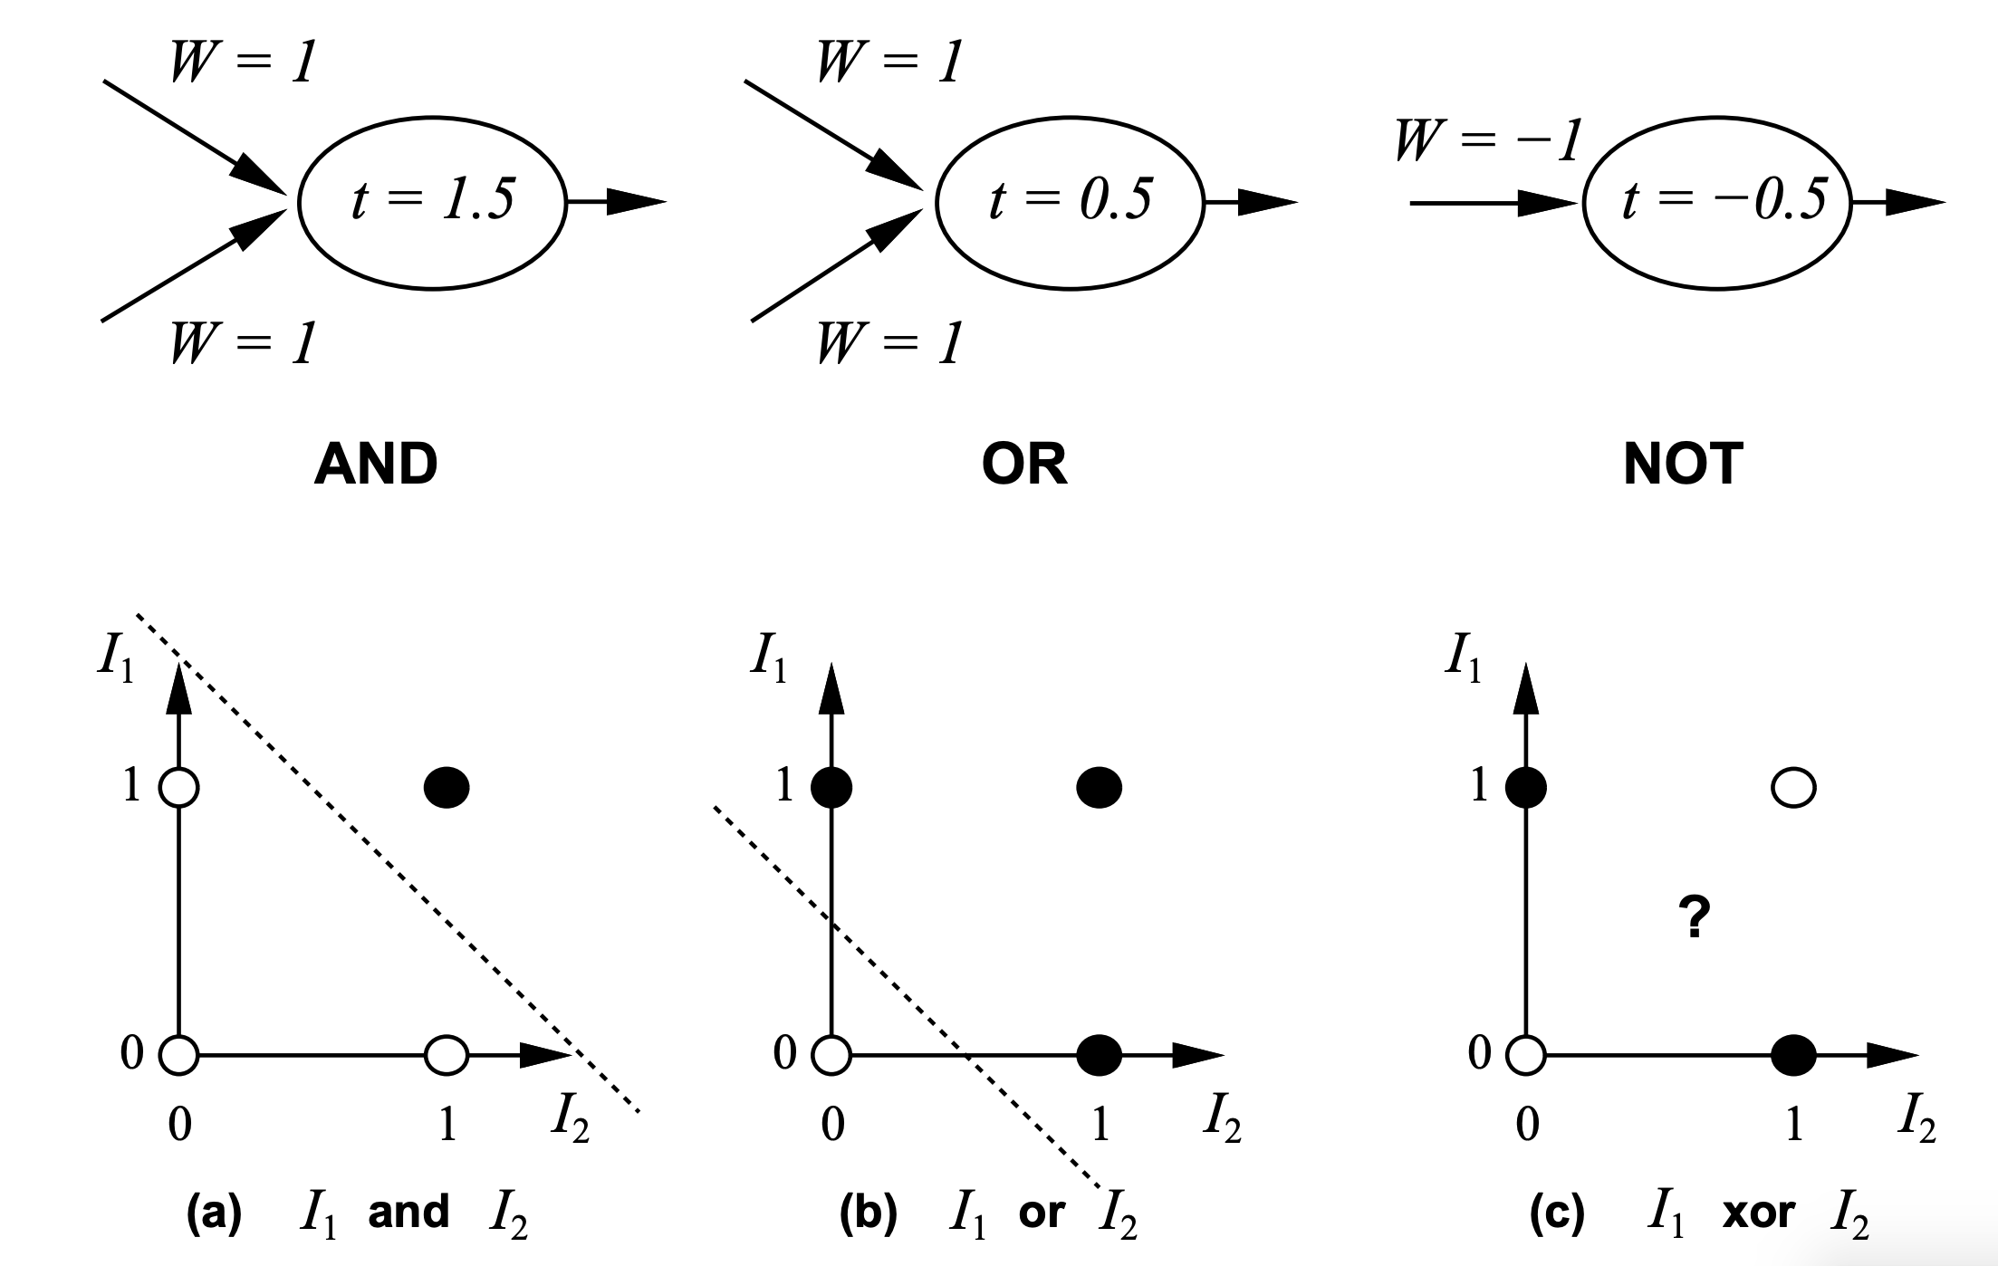
History: Neural Computation
McCulloch and Pitts (1943) showed how linear threshold units can be used to compute logical functions
$$y=sign(∑w_{i}I_{i} − T)$$

Slide 6
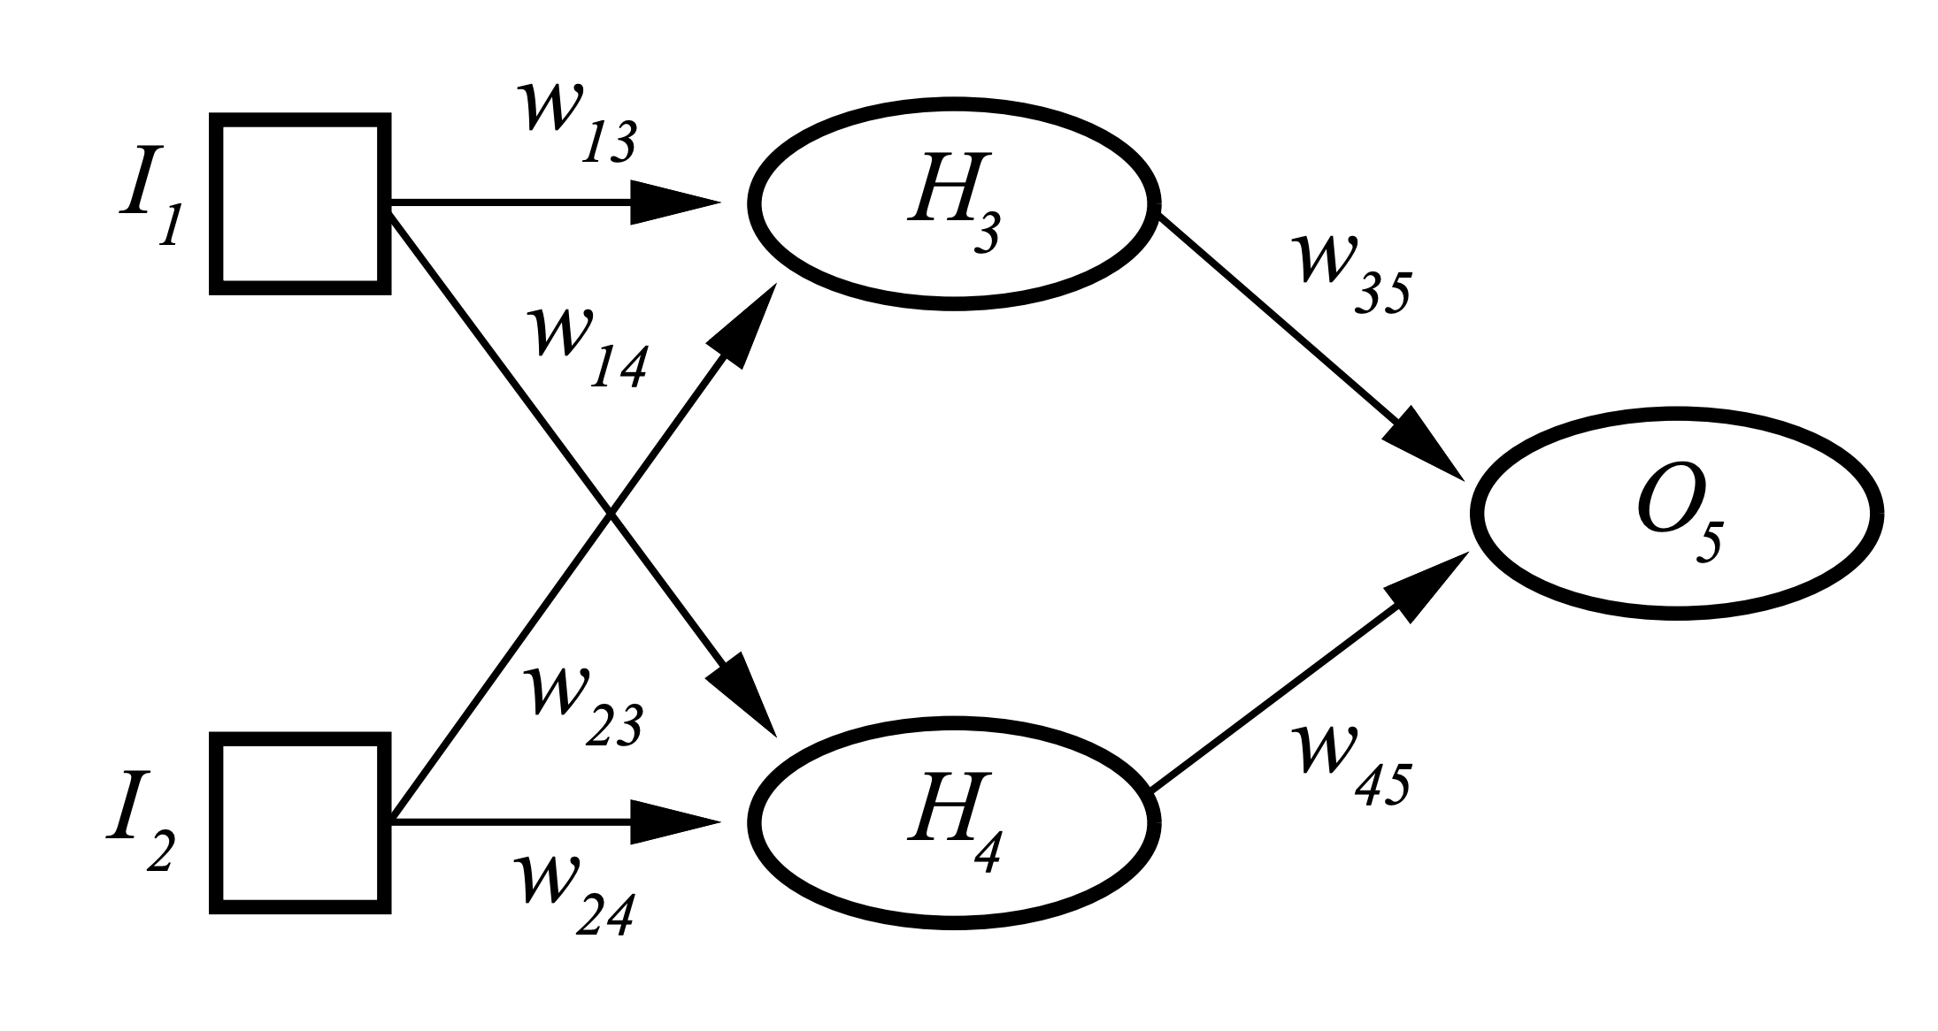
History: Neural Computation
But XOR?
Two Layered Two Unit Network

Slide 7
Neural Networks
Multi-layer networks were designed to overcome the computational (expressivity) limitation of a single threshold element.
Linear Threshold Unit
Output
Hidden
Input

Slide 8
Neural Networks
Multi-layer networks were designed to overcome the computational (expressivity) limitation of a single threshold element.
The idea is to stack several layers of threshold elements, each layer using the output of the previous layer as input.
Multi-layer networks can represent arbitrary functions, but building effective learning methods for such network was [thought to be] difficult.
Output
Hidden
Input

Slide 9
Neural Networks
Neural Networks are functions: $NN:X→Y$
where $X={\left[0,1\right]}^{n}$, or $ℝ^{n}$ and $Y=[0,1], \{0,1\}$
Robust approach to approximating real-valued, discrete-valued and vector valued target functions.
$H_{3}=sign(\left(w_{13}I_{1}+w_{23}I_{2}\right)−T_{1}$)
$H_{4}=sign(\left(w_{14}I_{1}+w_{24}I_{2}\right)−T_{2}$)
$O_{5}=sign(\left(w_{35}H_{3}+w_{45}H_{4}\right)−T_{3}$)
Trainable Parameters:
$w_{13},w_{14}, w_{23}, w_{24}, w_{35}, w_{45}, T_{1},T_{2}$, $T_{3}$

Slide 10
Neural Networks
Neural Networks are functions: $NN:X→Y$
where $X={\left[0,1\right]}^{n}$, or $ℝ^{n}$ and $Y=[0,1], \{0,1\}$
Robust approach to approximating real-valued, discrete-valued and vector valued target functions.
Among the most effective general purpose supervised learning method currently known.
Effective especially for complex and hard to interpret input data such as real-world sensory data, where a lot of supervision is available.
Learning:
The Backpropagation algorithm for neural networks has been shown successful in many practical problems

Slide 11
Motivation for Neural Networks
Inspired by biological neural network systems
But are not identical to them
We are currently on rising part of a wave of interest in NN architectures, after a long downtime from the mid-90-ies.
Better computer architecture (parallelism on GPUs & TPUs)
A lot more data than before; in many domains, supervision is available.

Slide 12
Motivation for Neural Networks
One potentially interesting perspective:
Before we looked at NN only as function approximators.
Geoffrey Hinton introduced RBMs in the mid 2000s – method to learn high-level representations of input
Ideas are being developed on the value of these intermediate representations for transfer learning etc.
We will present in the next two lectures a few of the basic architectures and learning algorithms, and provide some examples for applications

Slide 13
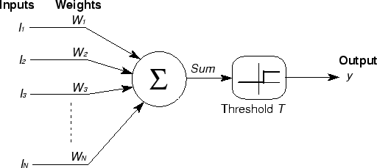
Basic Unit in Multi-Layer Neural Network
Threshold units: $o_{j}=sgn⁡(w⋅x−T)$introduce non-linearity
But not differentiable,
hence unsuitable for learning via Gradient Descent
activation
Output
Hidden
Input

Slide 14
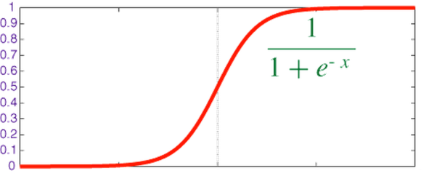
Logistic Neuron / Sigmoid Activation
Neuron is modeled by a unit $j$ connected by weighted links $w_{ij}$ to other units $i$.
Use a non-linear, differentiable output function such as the sigmoid or logistic function
Net input to a unit is defined as:
Output of a unit is defined as:
$$x_{1}$$
$$x_{2}$$
$$x_{3}$$
$$x_{4}$$
$$x_{5}$$
$$x_{6}$$
$$w_{1j}$$
$$x_{j}$$
$$o_{j}$$
$$w_{6j}$$
$${net}_{j}=∑w_{ij}⋅x_{i}$$
$$o_{j}=σ\left(net_{j}\right)=\frac{1}{1+exp\left(− {(net}_{j}−T_{j})\right)}$$

Slide 15
Representational Power
Any Boolean function can be represented by a two layer network (simulate a two layer AND-OR network)
Any bounded continuous function can be approximated with arbitrary small error by a two layer network.
Sigmoid functions provide a set of basis functions from which arbitrary function can be composed.
Any function can be approximated to arbitrary accuracy by a three layer network.

Slide 16
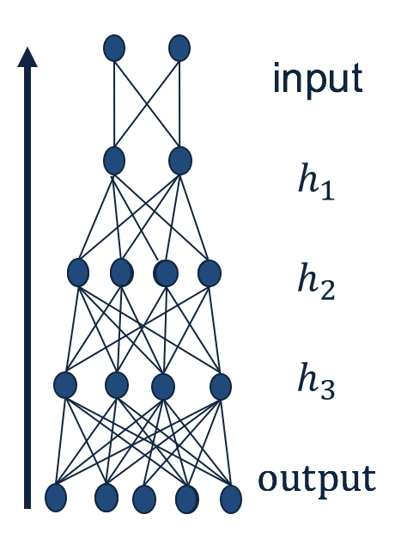
Quiz Time!
Given a neural network, how can we make predictions?
Given input, calculate the output of each layer (starting from the first layer), until you get to the output.
What is required to fully specify a neural network?
The weights.
Why NN predictions can be quick?
Because many of the computations could be parallelized.
What makes a neural networks non-linear approximator?
The non-linear units.

Slide 17
Training a Neural Net

Slide 18
History: Learning Rules
Hebb (1949) suggested that if two units are both active (firing) then the weights between them should increase:
$w_{ij}=w_{ij}+Ro_{i}o_{j}$
$R$ and is a constant called the learning rate
Supported by physiological evidence
Rosenblatt (1959) suggested that when a target output value is provided for a single neuron with fixed input, it can incrementally change weights and learn to produce the output using the Perceptron learning rule.
assumes binary output units; single linear threshold unit
Led to the Perceptron Algorithm
See: http://people.idsia.ch/~juergen/who-invented-backpropagation.html

Slide 19
Two layer Two Unit Neural Network
$H_{3}=σ(\left(w_{13}I_{1}+w_{23}I_{2}\right)−T_{1}$)
$H_{4}=σ(\left(w_{14}I_{1}+w_{24}I_{2}\right)−T_{2}$)
$O_{5}=σ(\left(w_{35}H_{3}+w_{45}H_{4}\right)−T_{3}$)
Trainable Parameters:
$w_{13},w_{14}, w_{23}, w_{24}, w_{35}, w_{45}, T_{1},T_{2}$, $T_{3}$

Slide 20
Gradient Descent
We use gradient descent to determine the weight vector that minimizes some scalar valued loss function $Err\left(w^{\left(j\right)}\right)$;
Fixing the set $D$ of examples, $Err$ is a function of $w^{\left(j\right)}$
At each step, the weight vector is modified in the direction that produces the steepest descent along the error surface.
$Err(w)$
$$w$$
$w_{3}$ $w_{2}$ $w_{1}$ $w_{0}$

Slide 21
Backpropagation Learning Rule
Since there could be multiple output units, we define the error as the sum over all the network output units.
$Err\left(w\right)=\frac{1}{2}\sum_{d∈D}{\sum_{k∈K}{}{\left(t_{kd}−o_{kd}\right)}^{2}}$
where $D$ is the set of training examples,
$K$ is the set of output units
This is used to derive the (global) learning rule which performs gradient descent in the weight space in an attempt to minimize the error function.
$$Δw_{ij}=−R\frac{∂E}{∂w_{ij}}$$
$o_{1}$…$o_{k}$
$$(1, 0, 1, 0, 0)$$

Slide 22
Learning with a Multi-Layer Perceptron
It’s easy to learn the top layer – it’s just a linear unit.
Given feedback (truth) at the top layer, and the activation at the layer below it, you can use the Perceptron update rule (more generally, gradient descent) to updated these weights.
The problem is what to do with the other set of weights – we do
not get feedback in the intermediate layer(s).
activation
Output
w²_{ij}
Hidden
w¹_{ij}
Input

Slide 23
Learning with a Multi-Layer Perceptron
The problem is what to do with the other set of weights – we do not get feedback in the intermediate layer(s).
Solution: If all the activation functions are differentiable, then the output of the network is also a differentiable function of the input and weights in the network.
Define an error function (e.g., sum of squares) that is a differentiable function of the output, i.e. this error function is also a differentiable function of the weights.
We can then evaluate the derivatives of the error with respect to the weights, and use these derivatives to find weight values that minimize this error function, using gradient descent (or other optimization methods).
This results in an algorithm called back-propagation.
activation
Output
w²_{ij}
Hidden
w¹_{ij}
Input

Slide 24
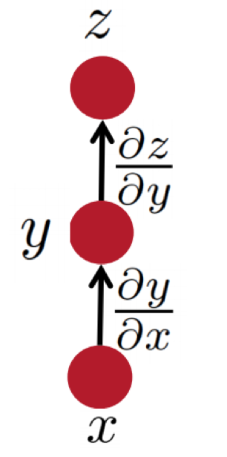
Some facts from real analysis
First let’s get the notation right:
The arrow shows functional dependence of $z$on $y$
i.e. given $y$, we can calculate$z$.
e.g., for example:$z(y) = 2y^{2}$
The derivative of $z$, with respect to $y$.

Slide 25
Some facts from real analysis
Simple chain rule
If $z$ is a function of $y$, and $y$ is a function of $x$
Then $z$ is a function of $x$, as well.
Question: how to find $\frac{∂z}{∂x}$
We will use these facts to derive the details of the Backpropagation algorithm.
$z$ will be the error (loss) function.
- We need to know how to differentiate$z$
$\frac{∂z}{∂x}=\frac{∂z}{∂y}$ $\frac{∂y}{∂x}$
Intermediate nodes use a logistics function (or another differentiable step function).
- We need to know how to differentiate it.

Slide 26
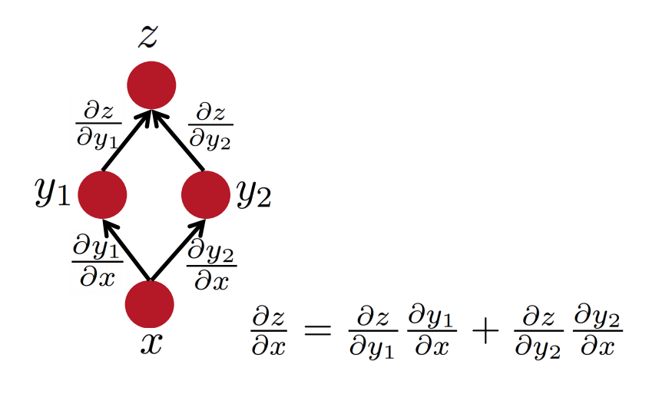
Some facts from real analysis
Multiple path chain rule
$\frac{∂z}{∂x }=\frac{∂z}{∂y_{1} }$ $\frac{∂y_{1}}{∂x }+\frac{∂z}{∂y_{2} }$ $\frac{∂y_{2}}{∂x }$
Slide Credit: Richard Socher

Slide 27
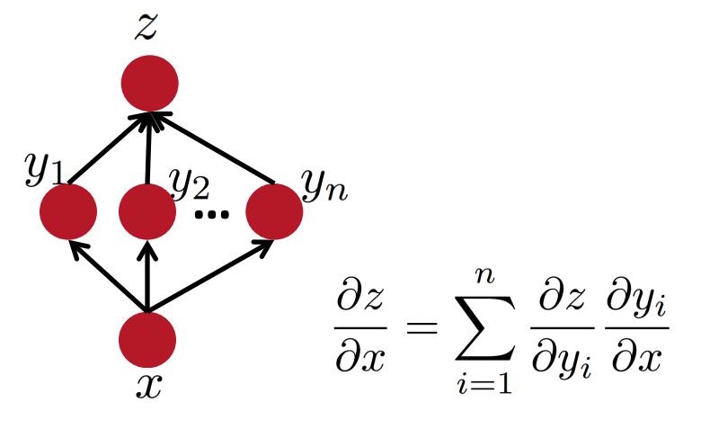
Some facts from real analysis
Multiple path chain rule: general
$$\frac{∂z}{∂x }=\sum_{i=1}^{n}{\frac{∂z}{∂y_{i} } \frac{∂y_{i}}{∂x }}$$
Slide Credit: Richard Socher

Slide 28
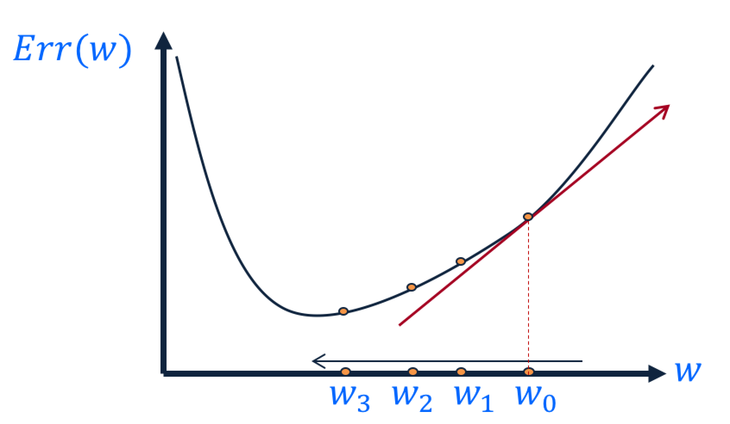
Key Intuitions Required for BP
Gradient Descent
Change the weights in the direction of gradient to minimize the error function.
Chain Rule
Use the chain rule to calculate the weights of the intermediate weights
Dynamic Programming (Memoization)
Memoize the weight updates to make the updates faster.
output
$$h_{1}$$
$$h_{2}$$
$$h_{3}$$
input
$$\frac{∂E}{∂w_{ij}}$$

Slide 29
Backpropagation: the big picture
Loop over instances:
The forward step
Given the input, make predictions layer-by-layer, starting from the first layer)
The backward step
Calculate the error in the output
Update the weights layer-by-layer, starting from the final layer
output
$$h_{1}$$
$$h_{2}$$
$$h_{3}$$
input
$$\frac{∂E}{∂w_{ij}}$$

Slide 30
Quiz time!
What is the purpose of forward step?
To make predictions, given an input.
What is the purpose of backward step?
To update the weights, given an output error.
Why do we use the chain rule?
To calculate gradient in the intermediate layers.
Why backpropagation could be efficient?
Because it can be parallelized.

Slide 31
Deriving the update rules

Slide 32
Reminder: Model Neuron (Logistic)
Neuron is modeled by a unit $j$ connected by weighted links $w_{ij}$ to other units $i$.
Use a non-linear, differentiable output function such as the sigmoid or logistic function
Net input to a unit is defined as:
Output of a unit is defined as:
The parameters so far?
The set of connective weights: $w_{ij}$ ; The threshold value: $T_{j}$
$$x_{1}$$
$$x_{2}$$
$$x_{3}$$
$$x_{4}$$
$$x_{5}$$
$$x_{6}$$
$$w_{17}$$
$$x_{7}$$
$$o_{j}$$
$$w_{67}$$
$${net}_{j}=∑w_{ij}.x_{i}$$
$$o_{j}=\frac{1}{1+exp\left(−({net}_{j}−T_{j})\right)}$$

Slide 33
Derivation of Learning Rule
The weights are updated incrementally; the error is computed for each example and the weight update is then derived.
$$E_{d}\left(w\right)=\frac{1}{2}\sum_{k∈K}{{\left(t_{k}−o_{k}\right)}^{2}}$$
$w_{ij}$ influences the output only through ${net}_{j}$
Therefore:
$$\frac{∂E_{d}}{∂w_{ij}}=\frac{∂E_{d}}{∂o_{j}} \frac{∂o_{j}}{∂{net}_{j}}\frac{∂{net}_{j}}{∂w_{ij}}$$
$o_{1}$…$o_{k}$
$j$
$o_{i}=\frac{1}{1+\exp{\{−({net}_{j}−T)\}}}$ and ${net}_{j}=∑w_{ij}.x_{i}$
$$w_{ij}$$

Slide 34
Derivatives
Function 1 (error):
$E= \frac{1}{2}\sum_{k∈K}{{\left(t_{k}−o_{k}\right)}^{2}}$
$\frac{∂E}{∂o_{i}}=−\left(ti −o_{i}\right)$
Function 2 (linear gate):
${net}_{j}=∑w_{ij}⋅x_{i}$
$\frac{∂{net}_{j}}{∂w_{ij}}=xi$
Function 3 (differentiable activation function):
$o_{i}=\frac{1}{1+\exp{\{−({net}_{j}−T)\}}}$
$\frac{∂o_{i}}{∂{net}_{j}}=\frac{\exp{\{−({net}_{j}−T)\}}}{(1+\exp{\{−({net}_{j}−T)\})2}}$ = $o_{i}(1−o_{i})$
$o_{1}$…$o_{k}$
$j$
$i$
$$w_{ij}$$

Slide 35
Derivation of Learning Rule (2)
Weight updates of output units:
$w_{ij}$ influences the output only through ${net}_{j}$
Therefore:
$o_{1}$…$o_{k}$
$j$
$i$
$$w_{ij}$$
$$\frac{∂E_{d}}{∂w_{ij}}=\frac{∂E_{d}}{∂o_{j}} \frac{∂o_{j}}{∂{net}_{j}} \frac{∂{net}_{j}}{∂w_{ij}}$$
$$=−\left(t_{j}−o_{j}\right) o_{j}\left(1−o_{j}\right) x_{i}$$
$$E_{d}\left(w\right)=\frac{1}{2}\sum_{k∈K}{{\left(t_{k}−o_{k}\right)}^{2}}$$
$$\frac{∂o_{j}}{∂{net}_{j}}=o_{j}(1−o_{j})$$
$$o_{j}=\frac{1}{1+\exp{\{−({net}_{j}−T_{j})\}}}$$
$${net}_{j}=∑w_{ij}.x_{i}$$

Slide 36
Derivation of Learning Rule (3)
Weights of output units:
$w_{ij}$ is changed by:
Where we defined:
$δ_{j}=\frac{∂E_{d}}{∂{net}_{j}}=\left(t_{j}−o_{j}\right)o_{j}\left(1−o_{j}\right)$
$$o_{j}$$
$j$
$i$
$$w_{ij}$$
$$Δw_{ij}=R\left(t_{j}−o_{j}\right)o_{j}\left(1−o_{j}\right)x_{i}$$
$=Rδ_{j}x_{i}$
$$x_{i}$$

Slide 37
Derivation of Learning Rule (4)
Weights of hidden units:
$w_{ij}$ Influences the output only through all the units whose direct input include $j$
$$E_{d}$$
$$\frac{∂E_{d}}{∂w_{ij}}$$
$$o_{1}$$
$$o_{k}$$
$k$
$j$
$i$
$$w_{ij}$$

Slide 38
Derivation of Learning Rule (4)
Weights of hidden units:
$w_{ij}$ Influences the output only through all the units whose direct input include $j$
$$E_{d}$$
$$\frac{∂E_{d}}{∂w_{ij}}=\frac{∂E_{d}}{∂{net}_{j}} \frac{∂{net}_{j}}{∂w_{ij}}=$$
$$o_{1}$$
$$o_{k}$$
$${net}_{j}=∑w_{ij}.x_{i}$$
$k$
$j$
$i$
$$=\frac{∂E_{d}}{∂{net}_{j}}x_{i}=$$
$$w_{ij}$$
$$=\sum_{k∈parent(j) }{\frac{∂E_{d}}{∂{net}_{k}} \frac{∂{net}_{k}}{∂{net}_{j}}x_{i}}$$
$$=\sum_{k∈parent(j) }{−δ_{k} \frac{∂{net}_{k}}{∂{net}_{j}}x_{i}}$$

Slide 39
Derivation of Learning Rule (5)
Weights of hidden units:
$w_{ij}$influences the output only through all the units whose direct input include $j$
$$o_{k}$$
$k$
$j$
$i$
$$w_{ij}$$
$$\frac{∂E_{d}}{∂w_{ij}}=\sum_{k∈parent(j) }{−δ_{k}\frac{∂{net}_{k}}{∂{net}_{j}}x_{i}}=$$
$$=\sum_{k∈parent(j) }{−δ_{k} \frac{∂{net}_{k}}{∂o_{j}}\frac{∂o_{j}}{∂{net}_{j}}x_{i}}$$
$$=\sum_{k∈parent(j) }{−δ_{k} w_{jk}{ o}_{j}(1−o_{j}) x_{i}}$$

Slide 40
Derivation of Learning Rule (6)
Weights of hidden units:
$w_{ij}$ is changed by:
Where
$δ_{j}=o_{j}\left(1−o_{j}\right).\left(\sum_{k∈parent\left(j\right)}{−δ_{k} w_{jk} }\right)$
First determine the error for the output units.
Then, backpropagate this error layer by layer through the network, changing weights appropriately in each layer.
$$Δw_{ij}= R o_{j}\left(1−o_{j}\right).\left(\sum_{k∈parent\left(j\right)}{−δ_{k} w_{jk}}\right)x_{i}$$
$=Rδ_{j}x_{ij}$
$$o_{k}$$
$k$
$j$
$i$
$$w_{ij}$$

Slide 41
The Backpropagation Algorithm
Create a fully connected three layer network. Initialize weights.
Until all examples produce the correct output within $ε$ (or other criteria)
For each example in the training set do:
Compute the network output for this example
Compute the error between the output and target value
$$δ_{k}=\left(t_{k}−o_{k}\right)o_{k}\left(1−o_{k}\right)$$
For each output unit k, compute error term
$${δ_{j}= o}_{j}\left(1−o_{j}\right).\sum_{k∈downstream\left(j\right)}{−δ_{k} w_{jk} }$$
For each hidden unit, compute error term: $Δw_{ij}=Rδ_{j}x_{i}$
Update network weights with $Δw_{ij}$
End epoch

Slide 42
More Hidden Layers
The same algorithm holds for more hidden layers.
output
$$h_{1}$$
$$h_{2}$$
$$h_{3}$$
input

Slide 43
Demo time!
Link: https://playground.tensorflow.org/

Slide 44
Comments on Training
No guarantee of convergence; neural networks form non-convex functions with multiple local minima
In practice, many large networks can be trained on large amounts of data for realistic problems.
Many epochs (tens of thousands) may be needed for adequate training. Large data sets may require many hours of CPU
Termination criteria: Number of epochs; Threshold on training set error; No decrease in error; Increased error on a validation set.
To avoid local minima: several trials with different random initial weights with majority or voting techniques

Slide 45
Over-training Prevention
Running too many epochs and/or a NN with many hidden layers may lead to an overfit network
Keep an held-out validation set and test accuracy after every epoch
Early stopping: maintain weights for best performing network on the validation set and return it when performance decreases significantly beyond that.
To avoid losing training data to validation:
Use 10-fold cross-validation to determine the average number of epochs that optimizes validation performance
Train on the full data set using this many epochs to produce the final results

Slide 46
Over-fitting prevention
Too few hidden units prevent the system from adequately fitting the data and learning the concept.
Using too many hidden units leads to over-fitting.
Similar cross-validation method can be used to determine an appropriate number of hidden units. (general)
Another approach to prevent over-fitting is weight-decay: all weights are multiplied by some fraction in (0,1) after every epoch.
Encourages smaller weights and less complex hypothesis
Equivalently: change Error function to include a term for the sum of the squares of the weights in the network. (general)

Slide 47
Neural Networks and Deep Learning
Dan Roth, Lecture by Nitish Gupta
danroth@seas.upenn.edu|http://www.cis.upenn.edu/~danroth/|461C, 3401 Walnut
Slides were created by Dan Roth (for CIS519/419 at Penn or CS446 at UIUC), Eric Eaton for CIS519/419 at Penn, or from other authors who have made their ML slides available.

Slide 48
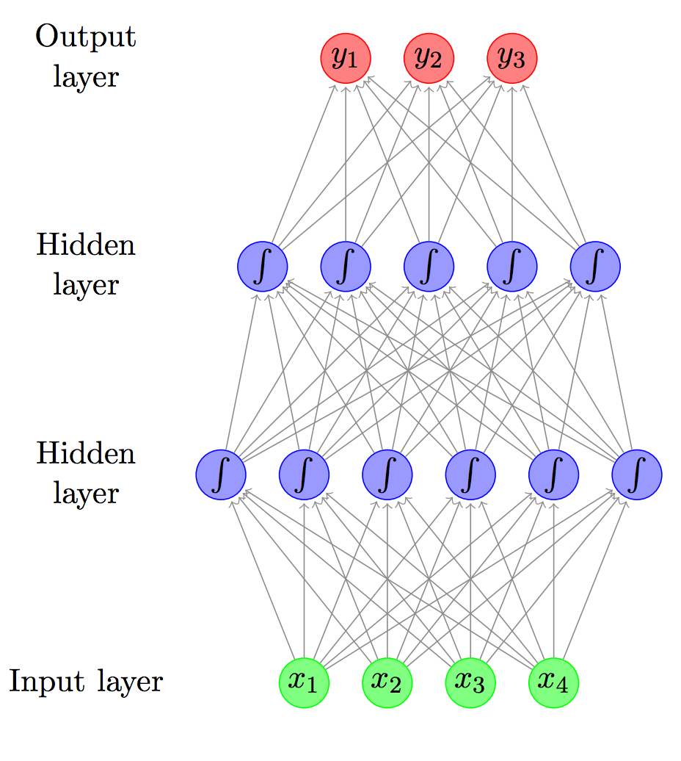
Feed-forward (FF) Network / Multi-layer Perceptron (MLP)
$y∈R^{n}$
$h_{2}∈R^{d_{2}}$
$h_{1}∈R^{d_{1}}$
$x∈R^{m}$

Slide 49
Feed-forward (FF) Network / Multi-layer Perceptron (MLP)
$y∈R^{n}$
$h_{2}∈R^{d_{2}}$
$h_{1}∈R^{d_{1}}$
$h_{1}={σ(W}_{1}x) ; W_{1}∈R^{d_{1}ⅹm}$
$$w_{11}$$ | $$w_{21}$$ | $$w_{31}$$ | $$w_{41}$$
$x∈R^{m}$

Slide 50
Feed-forward (FF) Network / Multi-layer Perceptron (MLP)
$y∈R^{n}$
$h_{2}∈R^{d_{2}}$
$h_{1}∈R^{d_{1}}$
$h_{1}={σ(W}_{1}x) ; W_{1}∈R^{d_{1}ⅹm}$
$$w_{11}$$
$$w_{12}$$
$$w_{13}$$
$$w_{14}$$
$$w_{15}$$
$$w_{16}$$
$x∈R^{m}$

Slide 51
Feed-forward (FF) Network / Multi-layer Perceptron (MLP)
$y∈R^{n}$
$y={σ(W}_{3}h_{2}) ; W_{3}∈R^{nⅹd_{2}}$
$h_{2}∈R^{d_{2}}$
$h_{2}={σ(W}_{2}h_{1}) ; W_{2}∈R^{d_{2}ⅹd_{1}}$
$h_{1}∈R^{d_{1}}$
$h_{1}={σ(W}_{1}x) ; W_{1}∈R^{d_{1}ⅹm}$
$x∈R^{m}$

Slide 52
The Backpropagation Algorithm
Create a fully connected network. Initialize weights.
Until all examples produce the correct output within $ε$ (or other criteria)
For each example $(x_{i},t_{i})$ in the training set do:
Compute the network output $y_{i}$for this example
Compute the error between the output and target value $E=\sum{{\left({t_{i}^{k}}_{ }−o_{i}^{k} \right)}^{2}}$
Compute the gradient for all weight values, $Δw_{ij}$
Update network weights with $w_{ij}=w_{ij}−R∗Δw_{ij}$
End epoch
Auto-differentiation packages such as Tensorflow, Torch, etc. help!
Quick example in code

Slide 53
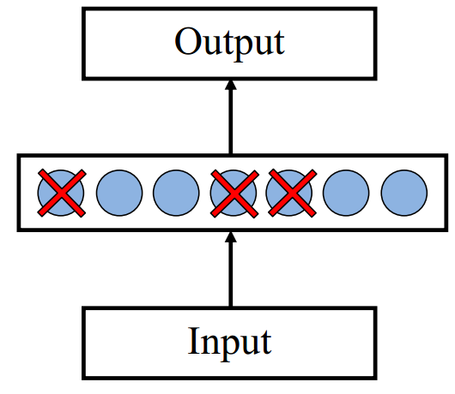
Dropout training
Proposed by (Hinton et al, 2012)
Each time decide whether to delete one hidden unit with some probability $p$

Slide 54
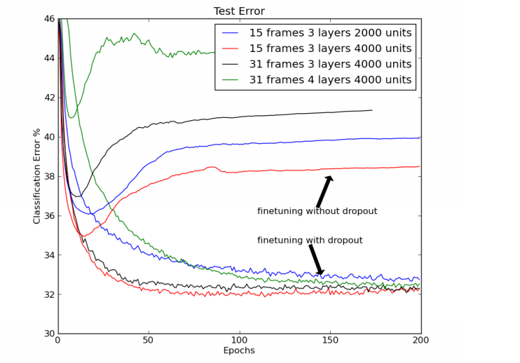
Dropout training
Dropout of $50\%$ of the hidden units and $20\%$ of the input units (Hinton et al, 2012)

Slide 55
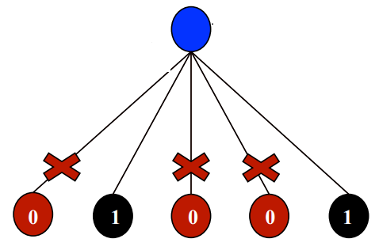
Dropout training
Model averaging effect
Among $2^{H}$ models, with shared parameters
$H$: number of units in the network
Only a few get trained
Much stronger than the known regularizer
What about the input space?
Do the same thing!

Slide 56
Recap: Multi-Layer Perceptrons
Multi-layer network
A global approximator
Different rules for training it
The Back-propagation
Forward step
Back propagation of errors
Congrats! Now you know the one of the important algorithms in neural networks!
Today:
Convolutional Neural Networks
Recurrent Neural Networks
activation
Output
Hidden
Input

Slide 57
Hidden Layer Representation
Weight tuning procedure sets weights that define whatever hidden units representation is most effective at minimizing the error.
Sometimes Backpropagation will define new hidden layer features that are not explicit in the input representation, but which capture properties of the input instances that are most relevant to learning the target function.
Trained hidden units can be seen as newly constructed features that re-represent the examples so that they are linearly separable

Slide 58
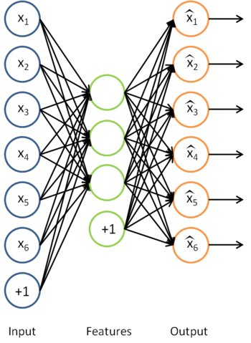
Sparse Auto-encoder
Encoding:
Decoding:
Goal: perfect reconstruction of
input vector $x$, by the output ${\hat{x}}_{}$
Where $θ=\{W, W′\}$
Minimize an error function $l(\hat{x}, x)$
For example:
And regularize it
After optimization drop the
reconstruction layer and add a new layer
$$y=f(Wx+b)$$
$$\hat{x}=g(W′y+b′)$$
$$l\left(\hat{x}, x\right)={\left\|\hat{x}−x\right\|}^{2}$$
$$\min_{θ}{\sum_{x}{l \left(\hat{x}, x\right)}+\sum_{i}{|w_{i}|}}$$

Slide 59
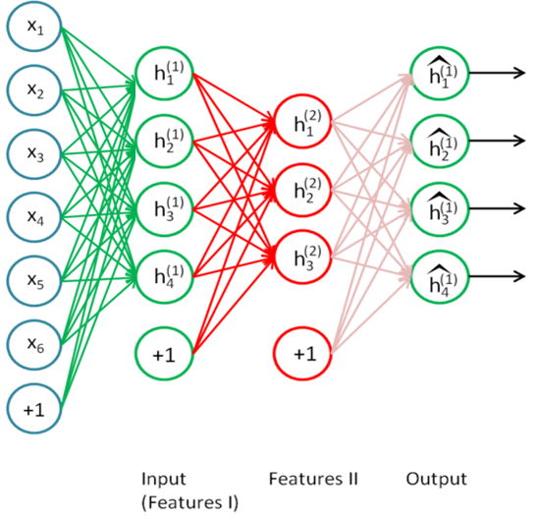
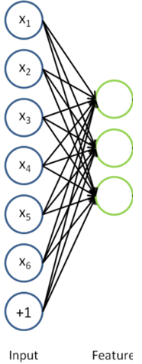
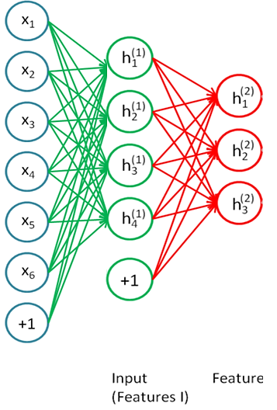
Stacking Auto-encoder
Add a new layer, and a reconstruction layer for it.
And try to tune its parameters such that
And continue this for each layer

Slide 60
Beyond supervised learning
So far what we had was purely supervised.
Initialize parameters randomly
Train in supervised mode typically, using backprop
Used in most practical systems (e.g. speech and image recognition)
Unsupervised, layer-wise pre-training + supervised classifier on top
Train each layer unsupervised, one after the other
Train a supervised classifier on top, keeping the other layers fixed
Good when very few labeled samples are available
Unsupervised, layer-wise pre-training + supervised fine-tuning
Train each layer unsupervised, one after the other
Add a classifier layer, and retrain the whole thing supervised
Good when label set is poor (e.g. pedestrian detection)
We won’t talk about unsupervised pre-training here. But it’s good to have this in mind, since it is an active topic of research.

Slide 61
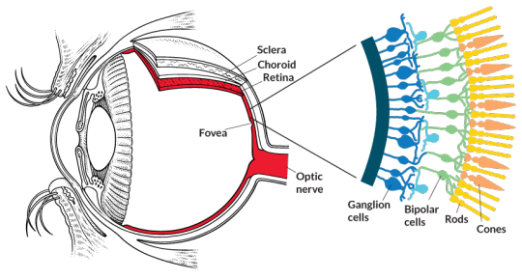
Receptive Fields
The receptive field of an individual sensory neuron is the particular region of the sensory space (e.g., the body surface, or the retina) in which a stimulus will trigger the firing of that neuron.
In the auditory system, receptive fields can correspond to wave amplitudes in auditory space
Designing “proper” receptive fields for the input Neurons is a significant challenge.

Slide 62
Image Classification
Consider a task with image inputs
Receptive fields should give expressive features from the raw input to the system
How would you design the receptive fields for this problem?
Human face or not?

Slide 63
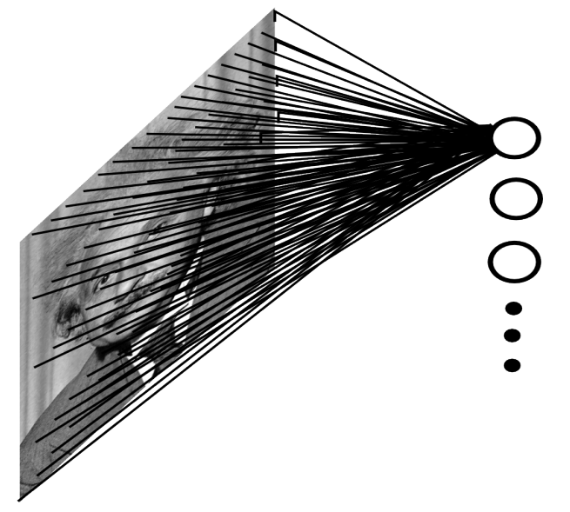
A fully connected layer:
Example:
$100 ×100$ sized image
$1000$ units in the hidden layer
Problems:
${10}^{7}$edges!
Spatial correlations lost!
Variables sized inputs.
Input layer
Slide Credit: Marc'Aurelio Ranzato

Slide 64
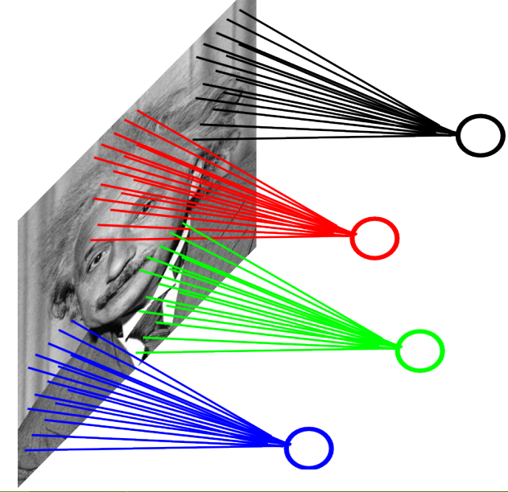
Consider a task with image inputs:
A locally connected layer:
Example:
$100 ×100$ images
$1000$ units in the input
Filter size: $10 ×10$
Local correlations preserved!
Problems:
${10}^{5}$ edges
Correlation across sub-parts not captured
Variable sized inputs, again.
Input layer
Slide Credit: Marc'Aurelio Ranzato

Slide 65
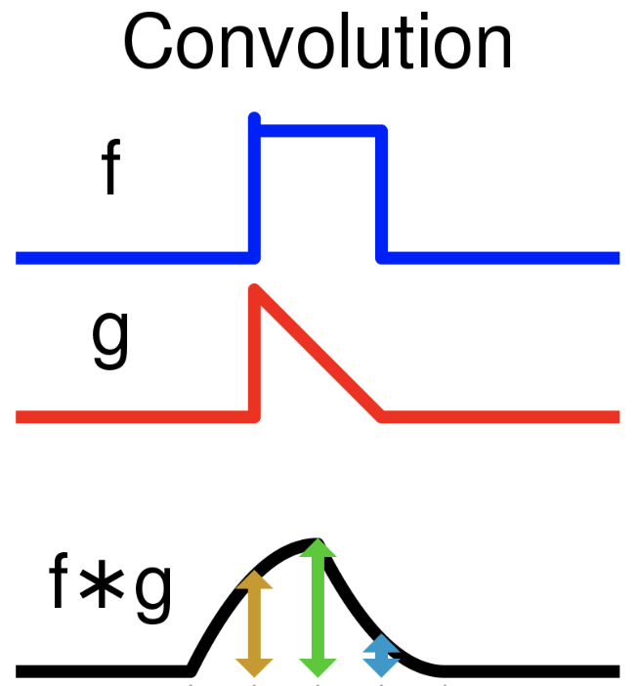
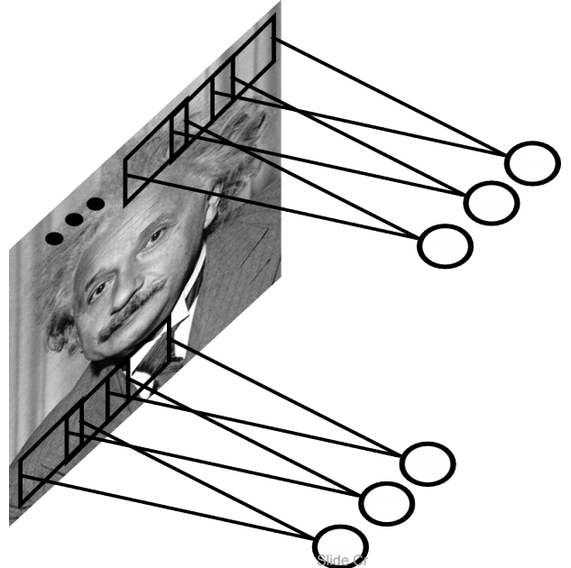
Convolutional Layer
A solution:
Filters to capture different patterns in the input space.
Share parameters across different locations (assuming input is stationary)
Convolutions with learned filters
Filters will be learned during training.
The issue of variable-sized inputs will be resolved with a pooling layer.
Convolution: A mathematical operation on two functions that produces a third function expressing how the shape of one is modified by the other.
So what is a convolution?
Input layer
Slide Credit: Marc'Aurelio Ranzato

Slide 66
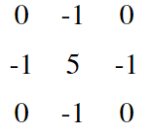
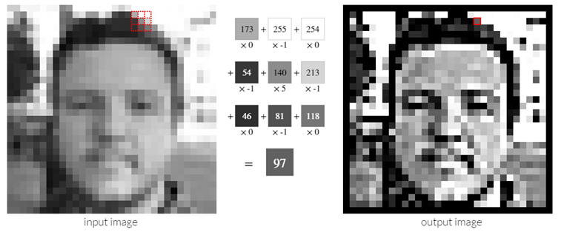
Convolution Operator (2)
Convolution in two dimension:
Example: Sharpen kernel:
Try other kernels: http://setosa.io/ev/image-kernels/

Slide 67
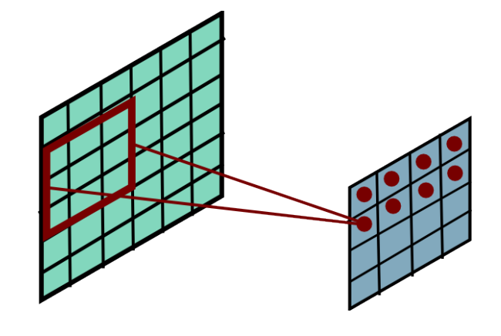
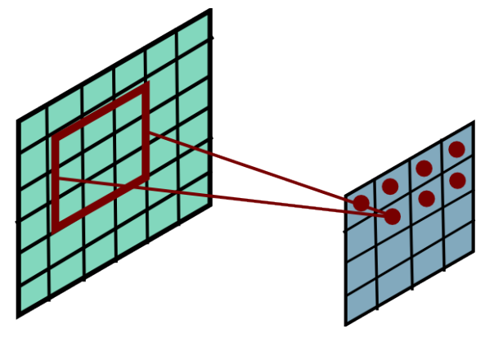
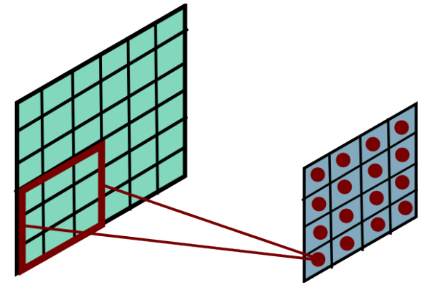
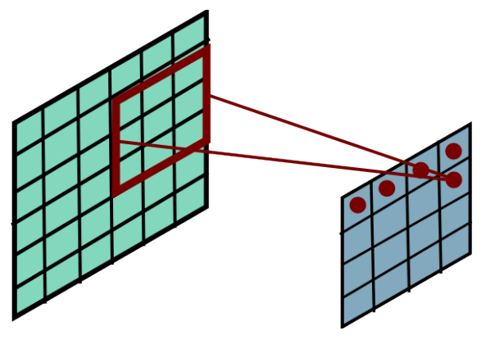
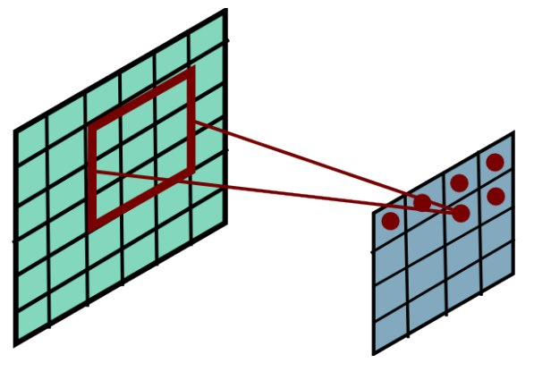
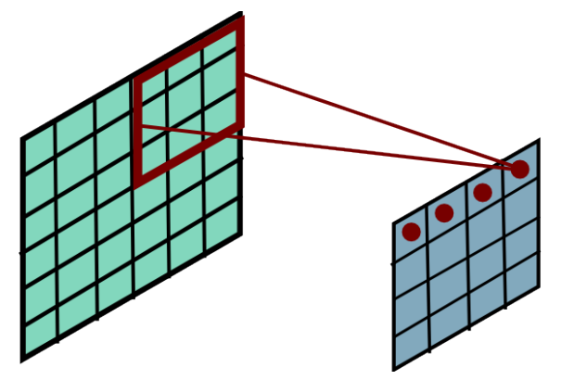
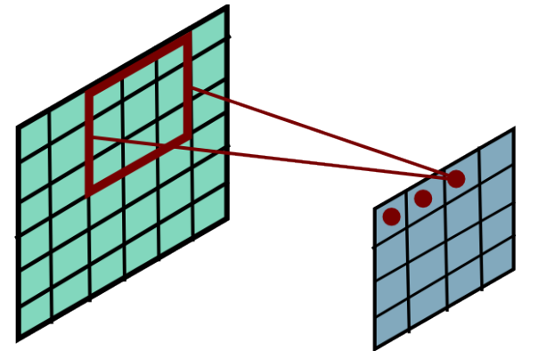
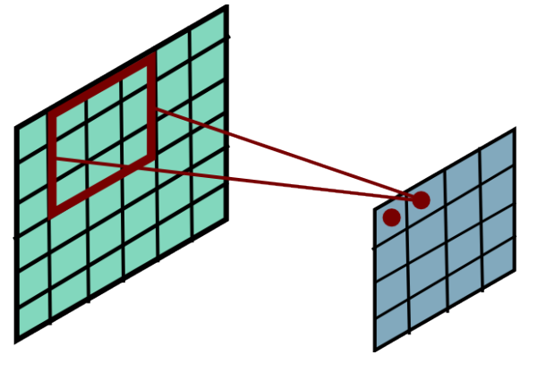
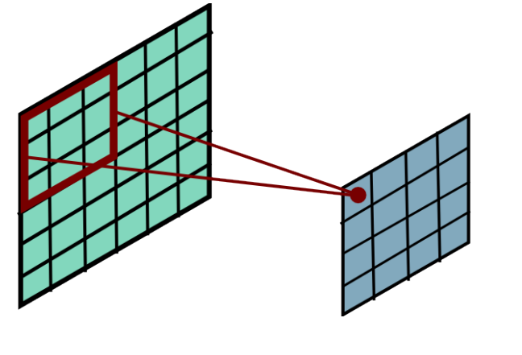
Convolution Operator (3)
Convolution in two dimension:
Convolve a filter matrix across the image matrix

Slide 68
Convolutional Layer
The convolution of the input (vector/matrix) with weights (vector/matrix) results in a response vector/matrix.
We can have multiple filters in each convolutional layer, each producing an output.
If it is an intermediate layer, it can have multiple inputs!
Convolutional Layer
Filter
Filter
Filter
One can add nonlinearity at the output of convolutional layer
Filter

Slide 69
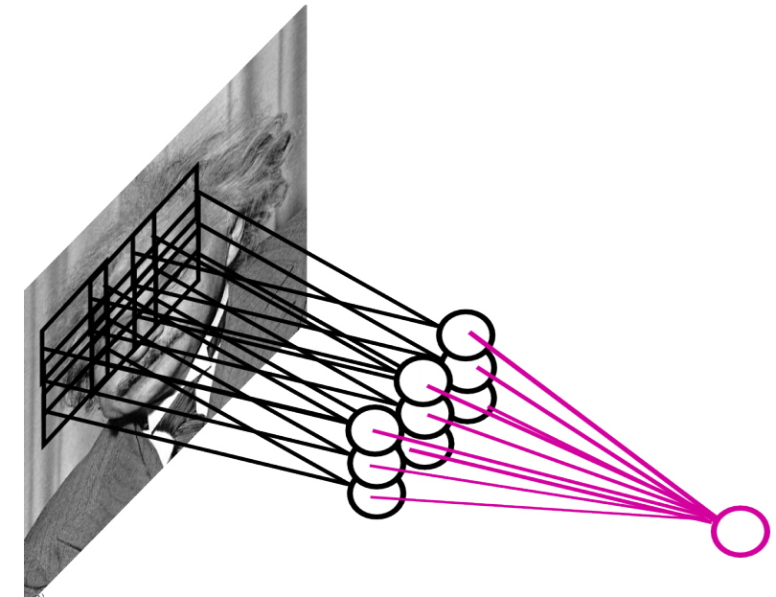
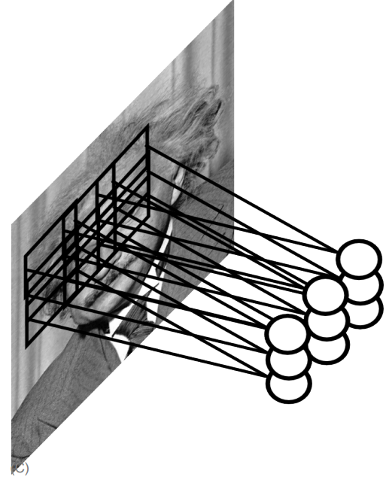
Pooling Layer
How to handle variable sized inputs?
A layer which reduces inputs of different size, to a fixed size.
Pooling
Slide Credit: Marc'Aurelio Ranzato

Slide 70
Pooling Layer
How to handle variable sized inputs?
A layer which reduces inputs of different size, to a fixed size.
Pooling
Different variations
Max pooling
$h_{i}\left[n\right]=\max_{i∈N(n)} \tilde{h} [i]$
Average pooling
$h_{i}\left[n\right]=\frac{1}{n}\underset{i∈N(n)}{∑} \tilde{h} [i]$
L2-pooling
$h_{i}\left[n\right]=\frac{1}{n}\sqrt{\underset{i∈N(n)}{∑} {\tilde{h}}^{2} [i]}$
etc

Slide 71
Convolutional Nets
One stage structure:
Whole system:
Conv.
Pooling
Stage 1
Stage 2
Stage 3
Fully Connected Layer
Input Image
Class Label

Slide 72
Training a ConvNet
The same procedure from Back-propagation applies here.
Remember in backprop we started from the error terms in the last stage, and passed them back to the previous layers, one by one.
Back-prop for the pooling layer:
Consider, for example, the case of “max” pooling.
This layer only routes the gradient to the input that has the highest value in the forward pass.
Hence, during the forward pass of a pooling layer it is common to keep track of the index of the max activation (sometimes also called the switches) so that gradient routing is efficient during backpropagation.
Therefore we have: $δ=\frac{∂E_{d}}{∂y_{i}}$
$$x_{i}$$
$$y_{i}$$
$$δ_{last−layer}=\frac{∂E_{d}}{∂y_{last−layer}}$$
Convol.
Pooling
$$δ_{first−layer}=\frac{∂E_{d}}{∂y_{first−layer}}$$
$$E_{d}$$
Input Image
Stage 1
Stage 2
Stage 3
Fully Connected Layer
Class Label

Slide 73
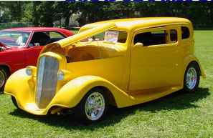
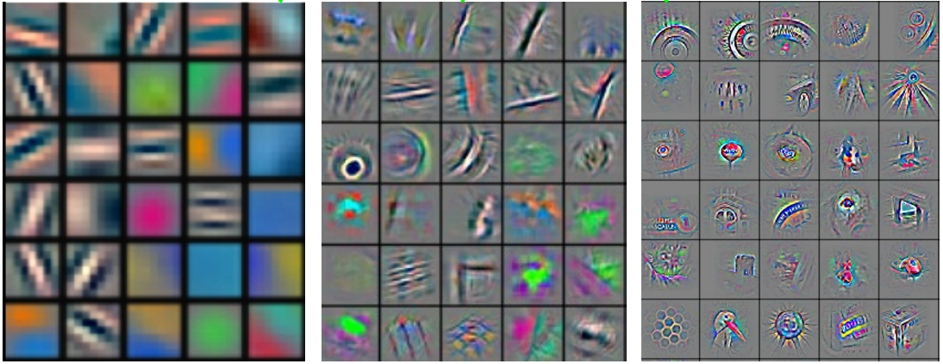
Convolutional Nets
Stage 1
Stage 2
Stage 3
Fully Connected Layer
Input Image
Class Label
Feature visualization of convolutional net trained on ImageNet from [Zeiler & Fergus 2013]

Slide 74
Demo (Teachable Machines)
https://teachablemachine.withgoogle.com/

Slide 75
ConvNet roots
Fukushima, 1980s designed network with same basic structure but did not train by backpropagation.
The first successful applications of Convolutional Networks by Yann LeCun in 1990's (LeNet)
Was used to read zip codes, digits, etc.
Many variants nowadays, but the core idea is the same
Example: a system developed in Google (GoogLeNet)
Compute different filters
Compose one big vector from all of them
Layer this iteratively
See more: http://arxiv.org/pdf/1409.4842v1.pdf

Slide 76
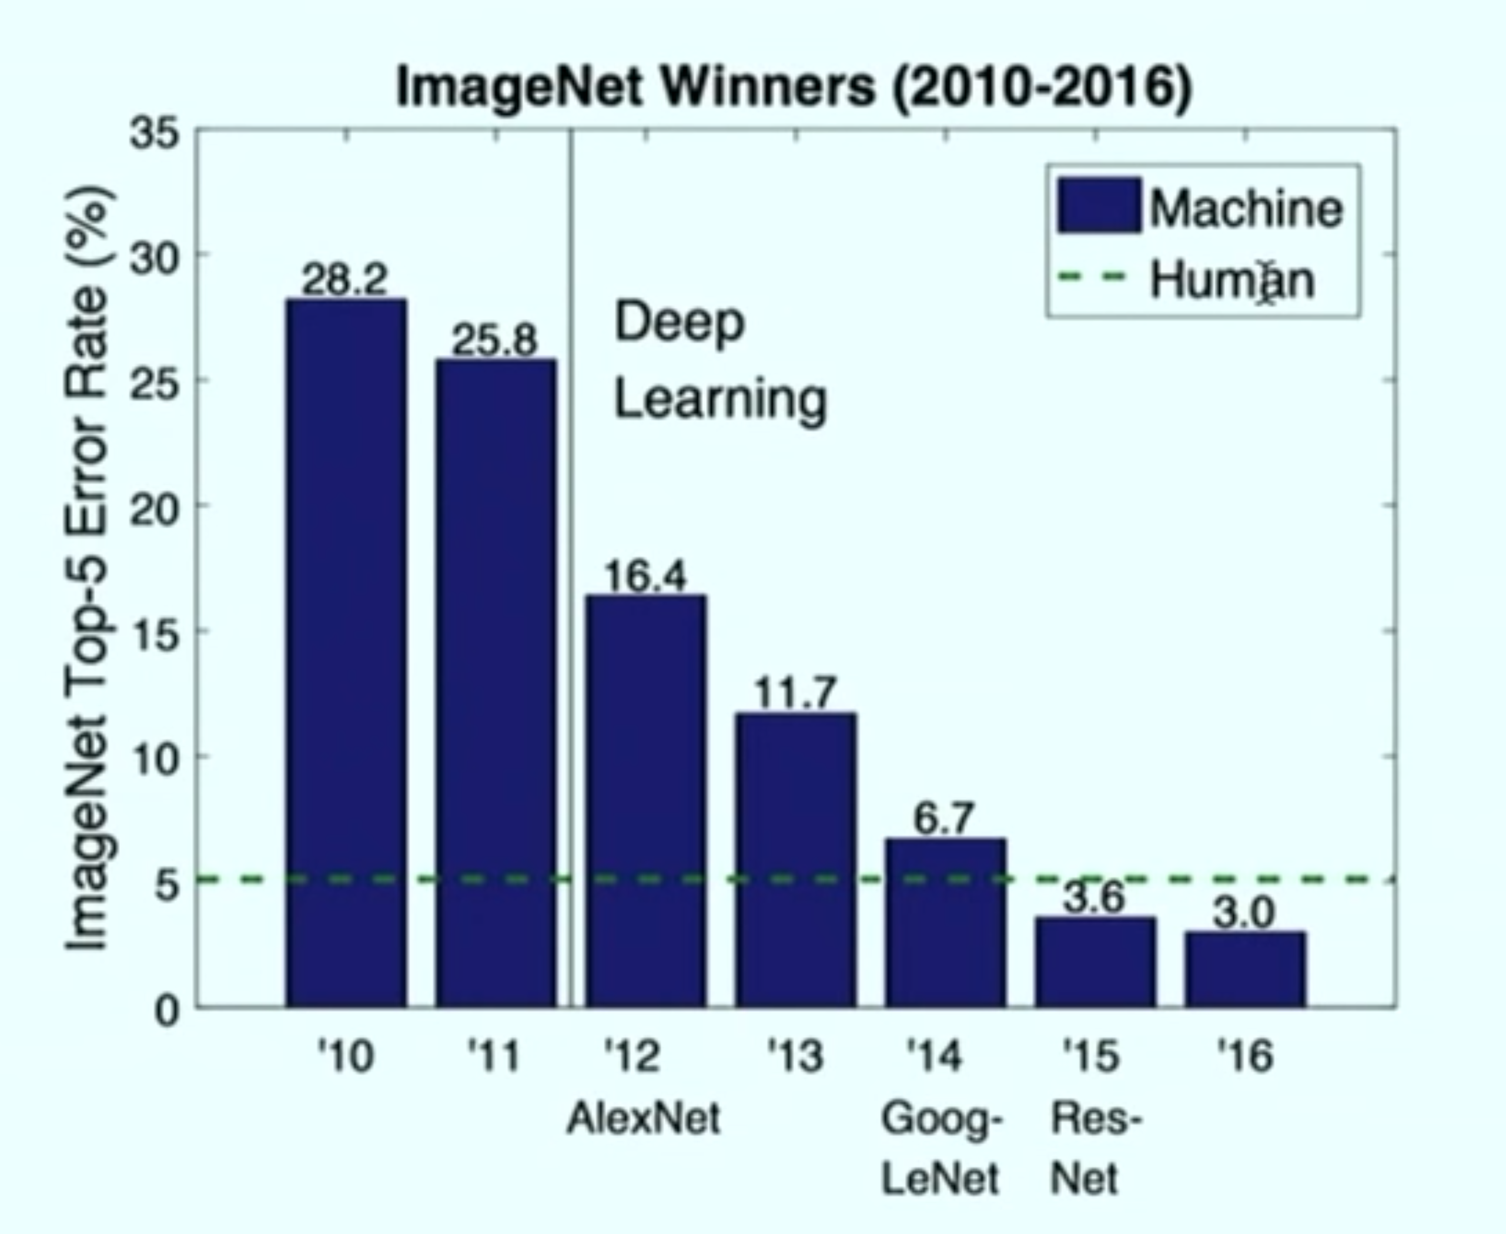
Depth matters
Slide from Michael Collins

Slide 77
Natural Language Processing
Word-level prediction on natural language:
Example: Part of Speech tagging words in a sentence
Challenges:
Structure in the input: Dependence between different parts of the inputs
Structure in the output: Correlations between labels
Variable size inputs: e.g. sentences differ in size
This
is
a
sample
sentence
Det
Verb
Det
Noun
Noun

Slide 78
Natural Language Processing
I
saw
him
today
Pron
Verb
Pron
Noun
I
will
buy
a
saw
Pron
Aux
Verb
Det
Noun
How would you go about solving this task?

Slide 79
Recurrent Neural Networks
Infinite uses of finite structure
Input
X0
X1
X2
X3
H0
H1
H2
W
W
W
W
H0
H1
H2
Hidden state representation
Y1
Y2
Y3
Y0
Output

Slide 80
Recurrent Neural Networks
A chain RNN:
Each input is replaced with its vector representation $x_{t}$
Hidden (memory) unit $h_{t}$ contain information about previous inputs and previous hidden units $h_{t−1},h_{t−2},$ etc
Computed from the past memory and current word. It summarizes the sentence up to that time.
$x_{t−1}$ ${ x}_{t}$ $x_{t+1}$
O O O O O
O O O O O
O O O O O
Input layer
O O O O O
O O O O O
O O O O O
Memory layer
$h_{t−1}$ $h_{t}$ $h_{t+1}$

Slide 81
Recurrent Neural Networks
A popular way of formalizing it:
$$h_{t}=f(W_{h}h_{t−1}+W_{i}x_{t})$$
Where $f$ is a nonlinear, differentiable (why?) function.
Outputs?
Many options; depending on problem and computational resource
$x_{t−1}$ ${ x}_{t}$ $x_{t+1}$
O O O O O
O O O O O
O O O O O
Input layer
O O O O O
O O O O O
O O O O O
Memory layer
$h_{t−1}$ $h_{t}$ $h_{t+1}$

Slide 82
Recurrent Neural Networks
Prediction for $x_{t}$, with $h_{t}$:
Some inherent issues with RNNs:
Recurrent neural nets cannot capture phrases without prefix context
They focus too much on last words in final vector
A slightly more sophisticated solution: Long Short-Term Memory (LSTM) units
$$y_{t}=softmax\left(W_{o}h_{t} \right)$$
$x_{t−1}$ ${ x}_{t}$ $x_{t+1}$
O O O O O
O O O O O
O O O O O
Input layer
O O O O O
O O O O O
O O O O O
Memory layer
$h_{t−1}$ $h_{t}$ $h_{t+1}$
$y_{t−1}$ ${ y}_{t}$ $y_{t+1}$
Output layer

Slide 83
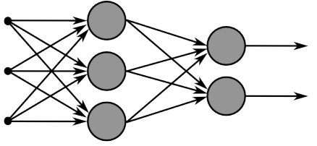
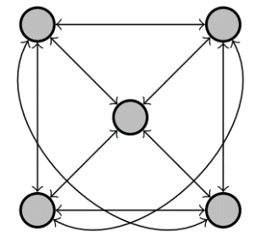
Recurrent Neural Networks
Multi-layer feed-forward NN: DAG
Just computes a fixed sequence of
non-linear learned transformations to convert an input patter into an output pattern
Recurrent Neural Network: Digraph
Has cycles.
Cycle can act as a memory;
The hidden state of a recurrent net can carry along information about a “potentially” unbounded number of previous inputs.
They can model sequential data in a much more natural way.

Slide 84
Equivalence between RNN and Feed-forward NN
Assume that there is a time delay of 1 in using each connection.
The recurrent net is just a layered net that keeps reusing the same weights.
w1 w4
time=3
1
2
3
W1 W2 W3 W4
time=2
1
2
3
1
2
3
W1 W2 W3 W4
w2 w3
time=1
1
2
3
W1 W2 W3 W4
time=0
1
2
3
Slide Credit: Geoff Hinton

Slide 85
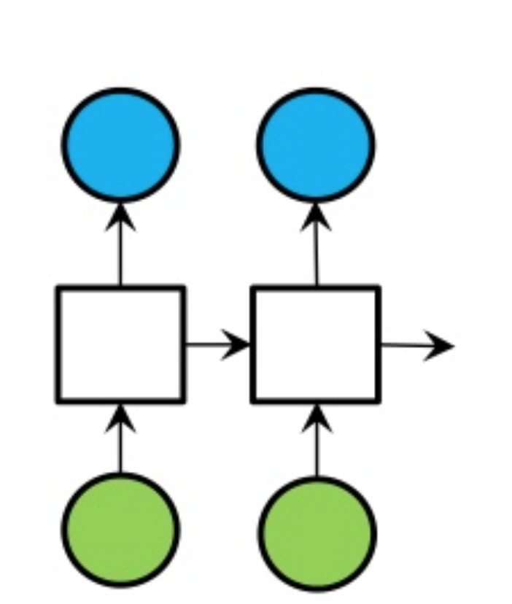
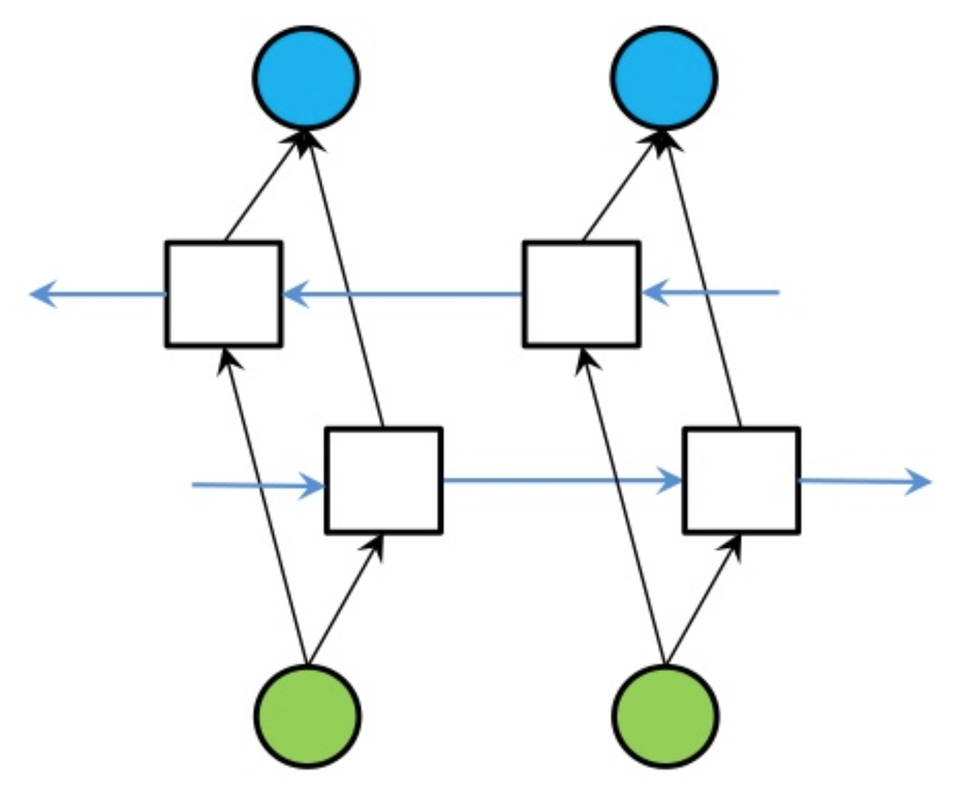
Bi-directional RNN
One of the issues with RNN:
Hidden variables capture only one side context
A bi-directional structure
RNN
Bi-directional RNN

Slide 86
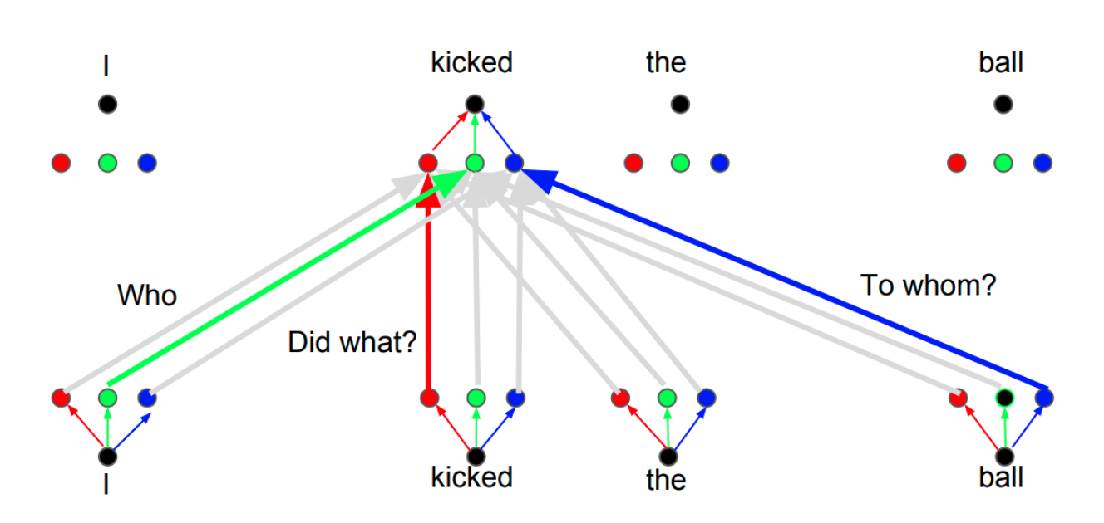
Self-Attention and Transformers

Slide 87
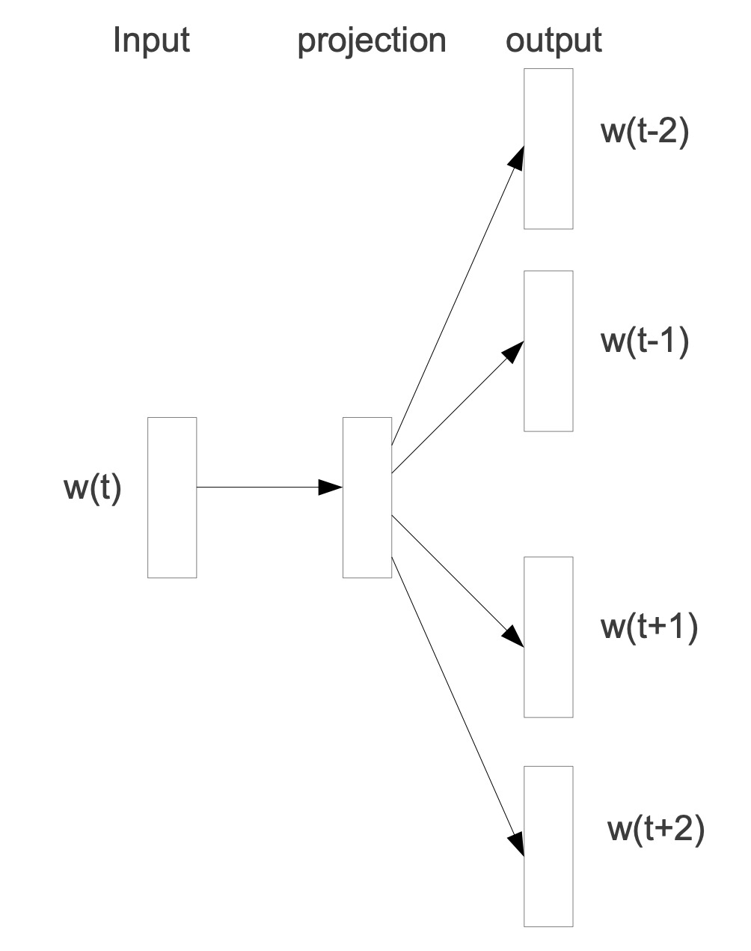
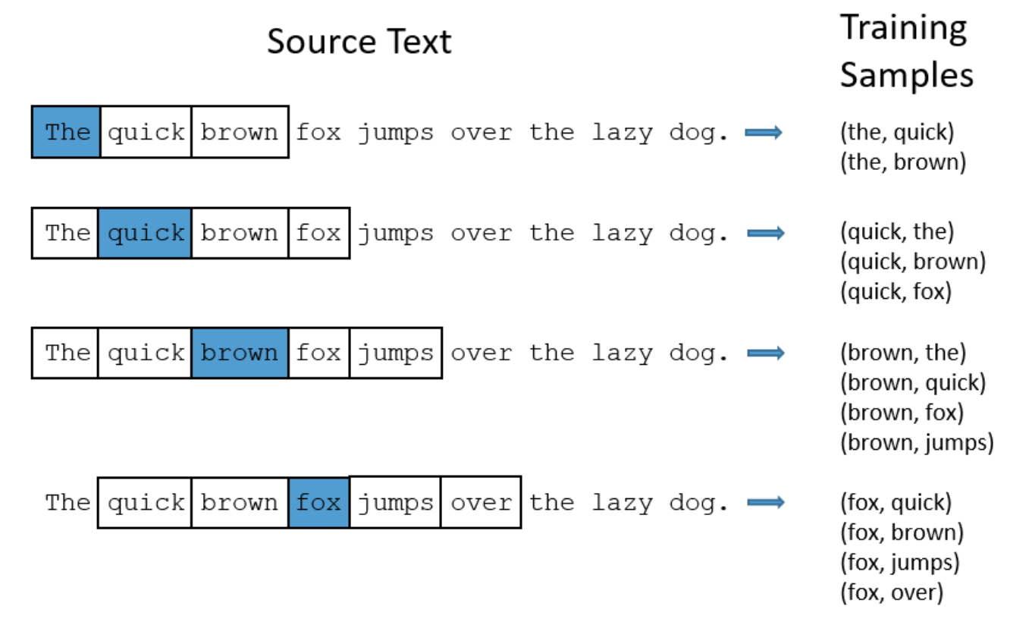
Unsupervised Word Embeddings

Slide 88
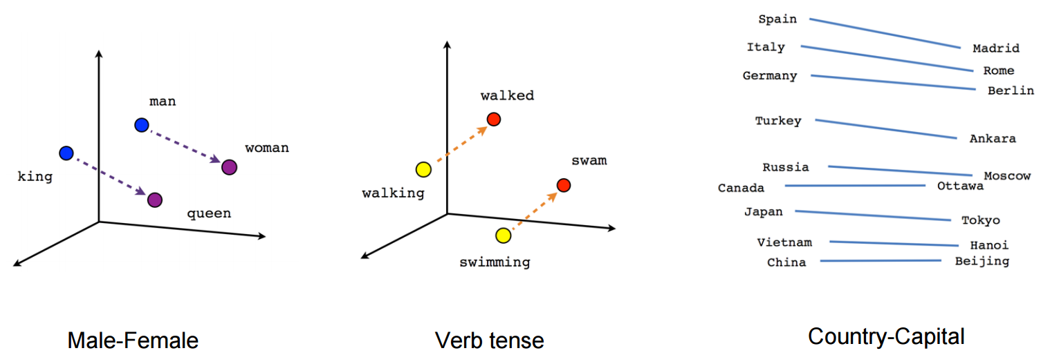
Word2Vec
This would result in word representations
that convey information about their co-occurrence
Or some form of weak “semantic” similarity
A big part of progress (past 5-10 years) is partly due to discovering better ways create unsupervised context-sensitive representations

Slide 89
Unsupervised RNNs
What to put here?
He was locked up after he ______ .
Input (context)
output
$x_{t−2}$ $x_{t−1}$ $x_{t}$ $y$
O O O O
O O O O
O O O O
O O O O
O O O O
O O O O
O O O O
$$h_{t−1}$$
$$h_{t}$$
$$h_{t+1}$$
Note that:
This is unsupervised; you can use tons of data to train this.
While training the model, we train the word representations too.
Memory layer

Slide 90
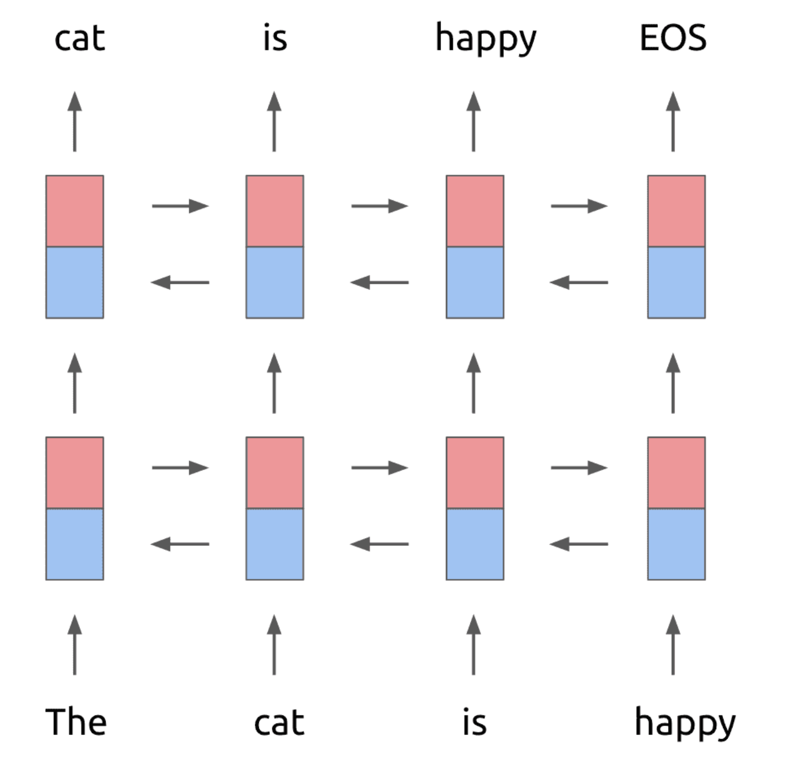
Unsupervised Pretraining

Slide 91
Any Questions?
nitishg@seas.upenn.edu

