Slide 1
Generative Models; Naive Bayes
Dan Roth
danroth@seas.upenn.edu|http://www.cis.upenn.edu/~danroth/|461C, 3401 Walnut
Slides were created by Dan Roth (for CIS519/419 at Penn or CS446 at UIUC), Eric Eaton for CIS519/419 at Penn, or from other authors who have made their ML slides available.

Slide 2
Administration
Projects:
  Come to my office hours at least once to discuss the project.
  Posters for the projects will be presented on the last meeting of the class, Monday, December 9; we’ll start earlier: 9am – noon.
  We will also ask you to prepare a 3-minute video
Final reports will only be due after the Final exam, on December 19
  Specific instructions are on the web page and will be sent also on Piazza.

Slide 3
Administration (2)
Exam:
  The exam will take place on the originally assigned date, 12/19.
    Location: TBD
    Structured similarly to the midterm.
    120 minutes; closed books.
  What is covered:
    Cumulative!
    Slightly more focus on the material covered after the previous mid-term.
    However, notice that the ideas in this class are cumulative!!
    Everything that we present in class and in the homework assignments
    Material that is in the slides but is not discussed in class is not part of the material required for the exam.
      Example 1: We talked about Boosting. But not about boosting the confidence.
      Example 2: We talked about multiclass classification: OvA, AvA, but not Error Correcting codes, and not about constraint classification (in the slides).
    We will give practice exams. HW5 will also serve as preparation.
Applied Machine Learning
The exams are mostly about understanding Machine Learning.
HW is about applying machine learning.
Go to Bayesian Learning

Slide 4
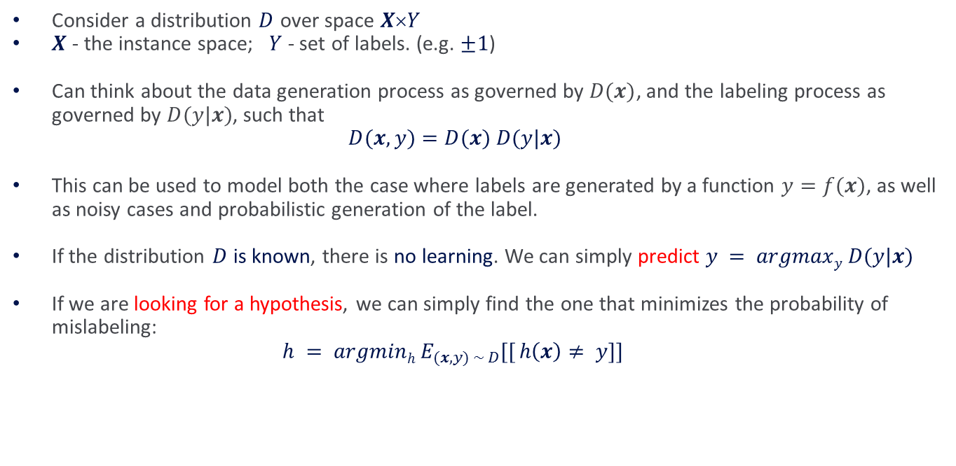
Recap: Error Driven Learning
Consider a distribution $D$ over space $XY$
$X$ - the instance space; $Y$ - set of labels. (e.g. $±1$)
Can think about the data generation process as governed by $D(x)$, and the labeling process as governed by $D(y|x)$, such that
$$D(x,y)=D(x) D(y|x)$$
This can be used to model both the case where labels are generated by a function $y=f(x)$, as well as noisy cases and probabilistic generation of the label.
If the distribution $D$ is known, there is no learning. We can simply predict $y = argmaxy D(y|x)$
If we are looking for a hypothesis, we can simply find the one that minimizes the probability of mislabeling:
$$h = argminh E_{(x,y) \sim D}[[ h\left(x\right)≠ y]]$$

Slide 5
Recap: Error Driven Learning (2)
Inductive learning comes into play when the distribution is not known.
Then, there are two basic approaches to take.
  Discriminative (Direct) Learning
and
  Bayesian Learning (Generative)
Running example:
  Text Correction:
    “I saw the girl it the park” → I saw the girl in the park

Slide 6
1: Direct Learning
Model the problem of text correction as a problem of learning from examples.
Goal: learn directly how to make predictions.
PARADIGM
Look at many (positive/negative) examples.
Discover some regularities in the data.
Use these to construct a prediction policy.
A policy (a function, a predictor) needs to be specific.
[it/in] rule: if “the” occurs after the target ⇒in
Assumptions comes in the form of a hypothesis class.
Bottom line: approximating $h : X → Y$ is estimating $P(Y|X)$.

Slide 7
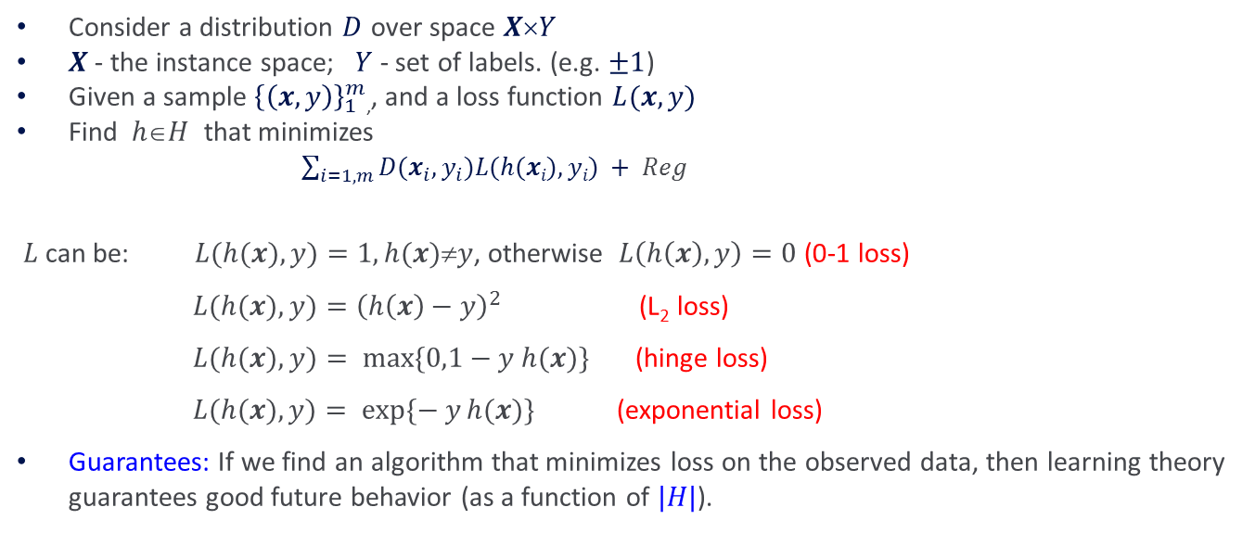
Direct Learning (2)
Consider a distribution $D$ over space $XY$
$X$- the instance space; $Y$ - set of labels. (e.g. $±1$)
Given a sample ${\left\{\left(x,y\right)\right\}}_{1}^{m}$,, and a loss function $L(x,y)$
Find $hH$ that minimizes
$\sum_{i=1,m}{D(x_{i}, y_{i})L(h(xi),yi) + Reg}$
$L$ can be: $L(h(x),y)=1, h(x)y$, otherwise $L\left(h\left(x\right),y\right)=0$(0-1 loss)
$L(h(x),y)={\left(h\left(x\right)−y\right)}^{2}$ (L₂ loss)
$L(h(x),y)= max⁡\{0,1−y h(x)\}$ (hinge loss)
$L(h(x),y)= exp⁡\{− y h(x)\}$(exponential loss)
Guarantees: If we find an algorithm that minimizes loss on the observed data, then learning theory guarantees good future behavior (as a function of $|H|$).

Slide 8
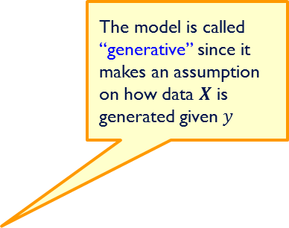

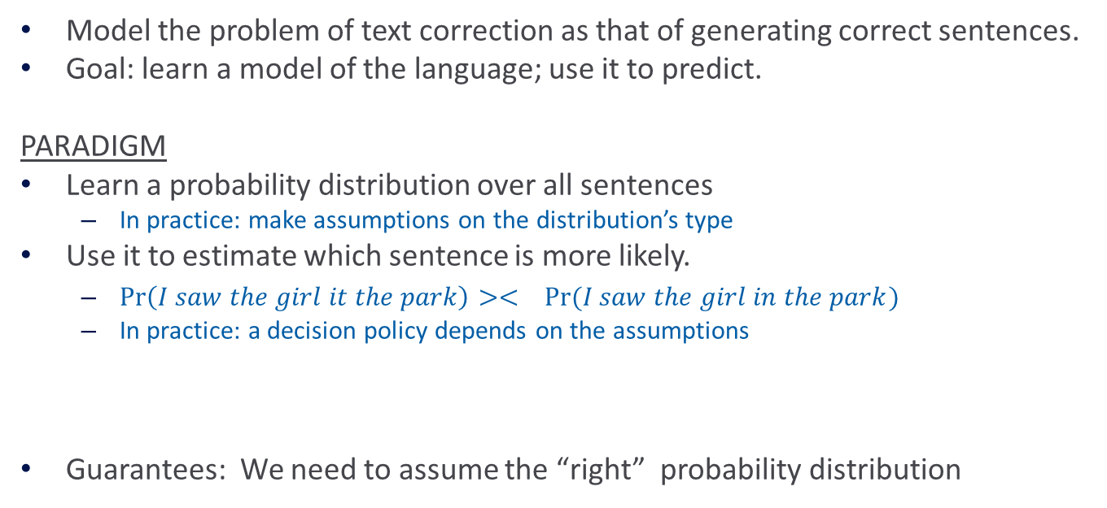
2: Generative Model
Model the problem of text correction as that of generating correct sentences.
Goal: learn a model of the language; use it to predict.
PARADIGM
Learn a probability distribution over all sentences
  In practice: make assumptions on the distribution’s type
Use it to estimate which sentence is more likely.
  $\operatorname{Pr}\left(I saw the girl it the park\right)>< Pr⁡(I saw the girl in the park)$
  In practice: a decision policy depends on the assumptions
Guarantees: We need to assume the “right” probability distribution
The model is called “generative” since it makes an assumption on how data $X$ is generated given $y$
Bottom line: the generating paradigm approximates
$$P(X,Y) = P(X|Y) P(Y)$$

Slide 9
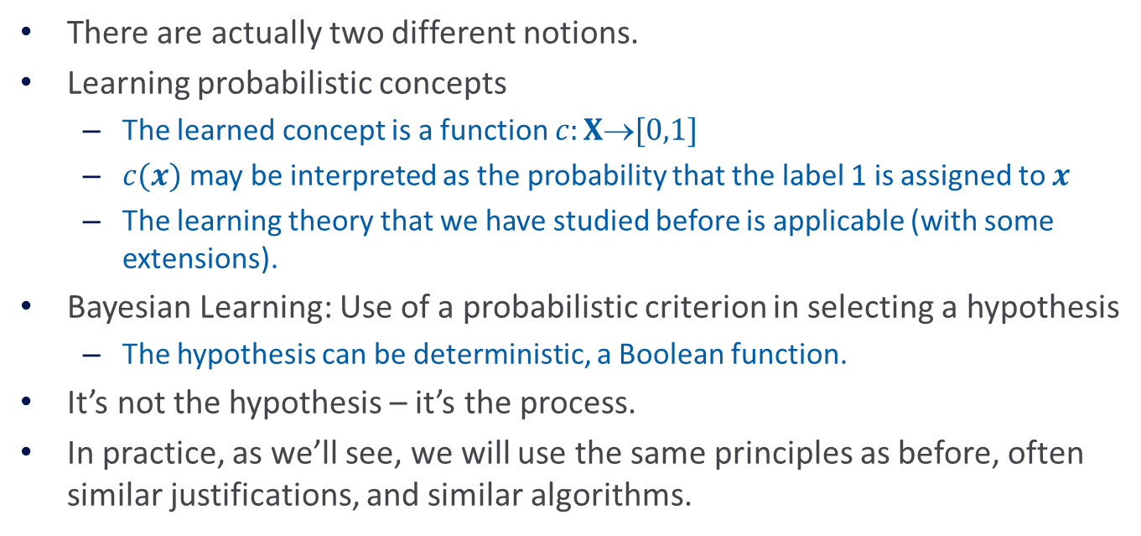
Probabilistic Learning
There are actually two different notions.
Learning probabilistic concepts
  The learned concept is a function $c:X[0,1]$
  $c(x)$may be interpreted as the probability that the label 1 is assigned to $x$
  The learning theory that we have studied before is applicable (with some extensions).
Bayesian Learning: Use of a probabilistic criterion in selecting a hypothesis
  The hypothesis can be deterministic, a Boolean function.
It’s not the hypothesis – it’s the process.
In practice, as we’ll see, we will use the same principles as before, often similar justifications, and similar algorithms.
Remind yourself of basic probability

Slide 10
Probabilities
30 years of AI research danced around the fact that the world was inherently uncertain
Bayesian Inference:
  Use probability theory and information about independence
  Reason diagnostically (from evidence (effects) to conclusions (causes))...
  ...or causally (from causes to effects)
Probabilistic reasoning only gives probabilistic results
  i.e., it summarizes uncertainty from various sources
We will only use it as a tool in Machine Learning.

Slide 11
Concepts
Probability, Probability Space and Events
Joint Events
Conditional Probabilities
Independence
  Next week’s recitation will provide a refresher on probability
  Use the material we provided on-line
Next I will give a very quick refresher

Slide 12

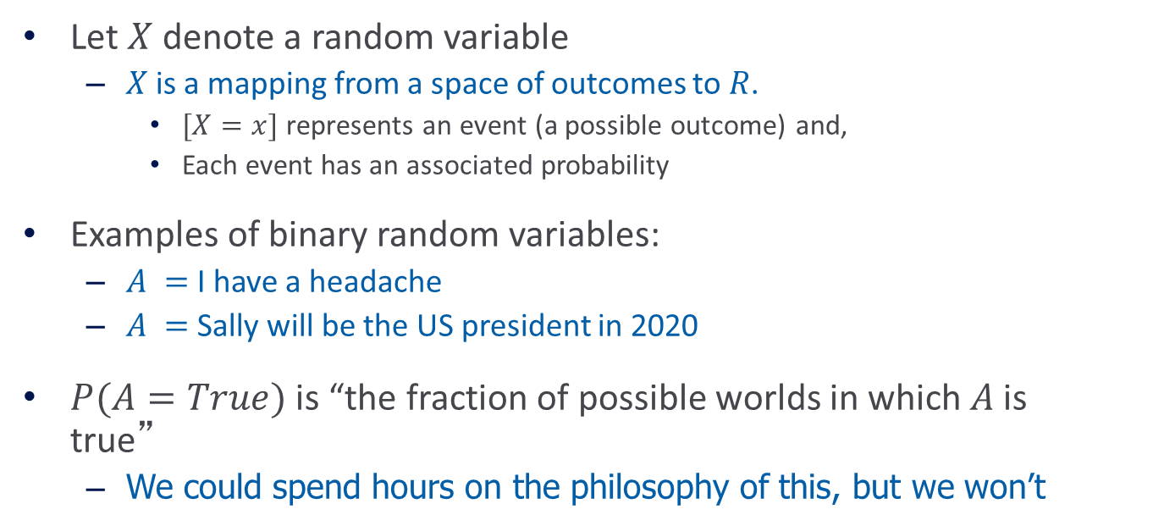
(1) Discrete Random Variables
Let $X$ denote a random variable
  $X$ is a mapping from a space of outcomes to $R$.
    $[X=x]$ represents an event (a possible outcome) and,
    Each event has an associated probability
Examples of binary random variables:
  $A =$ I have a headache
  $A =$ Sally will be the US president in 2020
$P(A=True)$is “the fraction of possible worlds in which $A$ is true”
  We could spend hours on the philosophy of this, but we won’t
Adapted from slide by Andrew Moore

Slide 13




Visualizing A
Universe $U$ is the event space of all possible worlds
  Its area is 1
  $P(U) = 1$
$P(A)$ = area of red oval
Therefore:
$$P\left(A\right)+P\left(¬A\right)=1$$
$$P\left(¬A\right)=1 −P\left(A\right)$$
$$U$$
worlds in which $A$ is true
worlds in which $A$ is false
Notes:
P(A) + P(\lnot A) = 1\\
P(\lnot A) = 1 - P(A)

Slide 14

Axioms of Probability
Kolmogorov showed that three simple axioms lead to the rules of probability theory
  de Finetti, Cox, and Carnap have also provided compelling arguments for these axioms
All probabilities are between 0 and 1:
  $0 ≤ P(A) ≤ 1$
Valid propositions (tautologies) have probability 1, and unsatisfiable propositions have probability 0:
  $$P(true) = 1 ; P(false) = 0$$
The probability of a disjunction is given by:
  $P(A∨B) = P(A) + P(B) – P(A  B$)
Notes:
P(A\lor B) = P(A) + P(B) - P(A\land B)

Slide 15




Interpreting the Axioms
$0 ≤ P(A) ≤ 1$
$P(true) = 1$
$P(false) = 0$
$P(A∨B) = P(A) + P(B) – P(A  B)$
From these you can prove other properties:
$P\left(¬A\right)=1 −P\left(A\right)$
$P\left(A \right)= P\left(A ∧ B\right)+P(A ∧ ¬B\text{)}$
$$A$$
$$AB$$
$$B$$

Slide 16

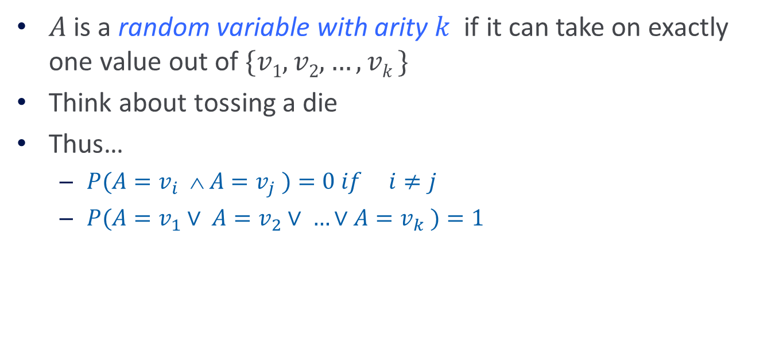
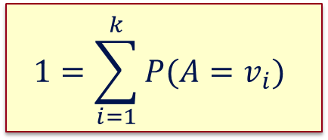
Multi-valued Random Variables
$A$ is a random variable with arity $k$ if it can take on exactly one value out of $\{v1,v2, …, vk \}$
Think about tossing a die
Thus…
  $P(A=v_{i}  A=v_{j} )=0 if i≠j$
  $P(A=v_{1}∨ A=v_{2}∨ …∨A=v_{k} )=1$
$$1=\sum_{i=1}^{k}{P(A=v_{i})}$$
Based on slide by Andrew Moore
Notes:
P(A = v_i \land A = v_j) = 0 \mbox{~~~~if $i \neq j$}
P(A = v_1 \lor A = v_2 \lor \ldots \lor A = v_k) = 1
1 = \sum_{i=1}^k P(A = v_i)

Slide 17
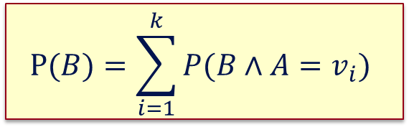

Multi-valued Random Variables
We can also show that:
$$P\left(B \right)= P( B∧\left[A=v_{1}∨A=v_{2}∨…∨A=v_{k}\right])$$
This is called marginalization over A
$$P(B)=\sum_{i=1}^{k}{P(B∧A=v_{i})}$$
Notes:
P(B) &= P(B \land [A = v_1 \lor A = v_2 \lor \ldots \lor A = v_k])\\
P(B) &= \sum_{i=1}^k P(B \land A = v_i)

Slide 18
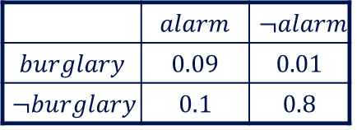
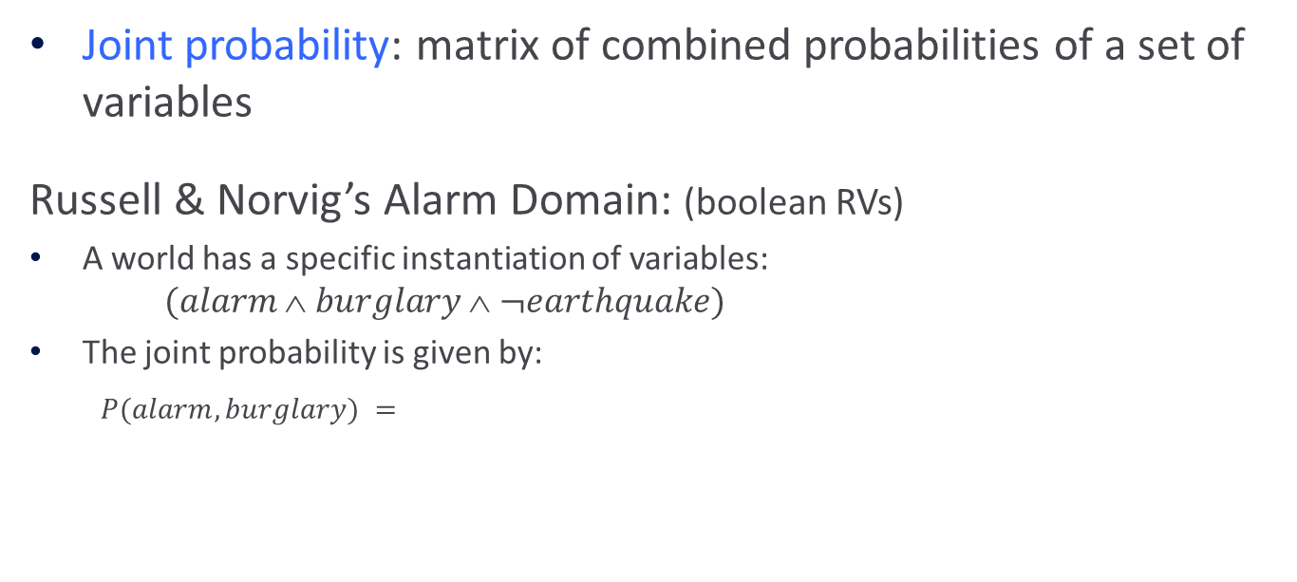

(2) Joint Probabilities
Joint probability: matrix of combined probabilities of a set of variables
Russell & Norvig’s Alarm Domain: (boolean RVs)
A world has a specific instantiation of variables:
$(alarm  burglary  ¬earthquake)$
The joint probability is given by:
$P(alarm, burglary) =$
 | $$alarm$$ | $$¬alarm$$
$$burglary$$ | $$0.09$$ | $$0.01$$
$$¬burglary$$ | $$0.1$$ | $$0.8$$
Probability of burglary:
$$P(burglary) = 0.1$$
by marginalization over $alarm$

Slide 19

The Joint Distribution
Recipe for making a joint distribution of $d$ variables:
e.g., Boolean variables A, B, C
Slide © Andrew Moore

Slide 20
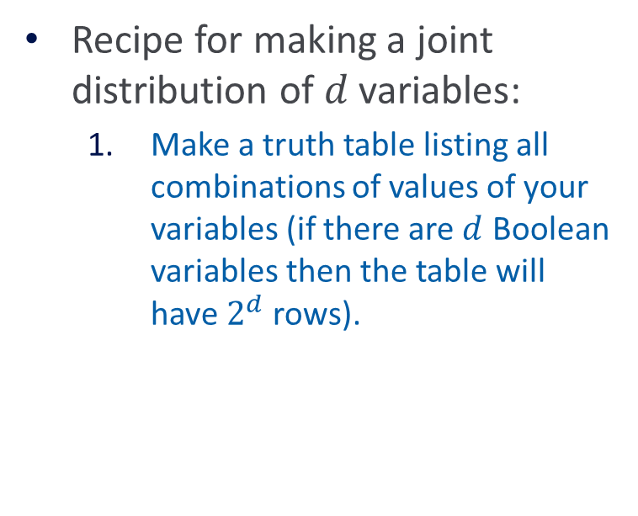
The Joint Distribution
Recipe for making a joint distribution of $d$ variables:
  Make a truth table listing all combinations of values of your variables (if there are $d$ Boolean variables then the table will have $2^{d}$ rows).
e.g., Boolean variables A, B, C
A | B | C
0 | 0 | 0
0 | 0 | 1
0 | 1 | 0
0 | 1 | 1
1 | 0 | 0
1 | 0 | 1
1 | 1 | 0
1 | 1 | 1
Slide © Andrew Moore

Slide 21
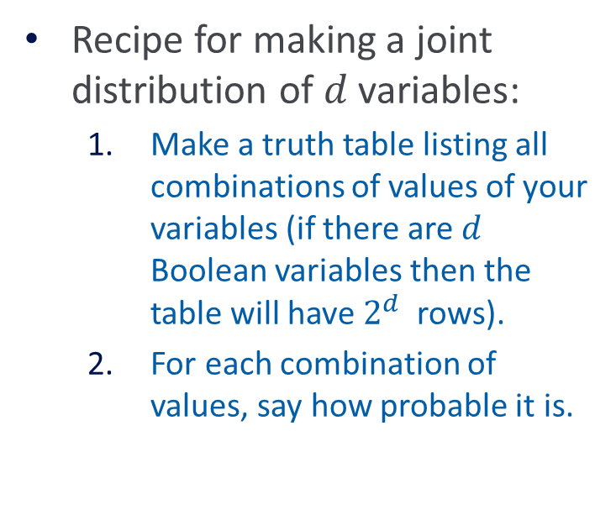
The Joint Distribution
Recipe for making a joint distribution of $d$ variables:
  Make a truth table listing all combinations of values of your variables (if there are $d$ Boolean variables then the table will have $2^{d}$rows).
  For each combination of values, say how probable it is.
e.g., Boolean variables A, B, C
A | B | C | Prob
0 | 0 | 0 | 0.30
0 | 0 | 1 | 0.05
0 | 1 | 0 | 0.10
0 | 1 | 1 | 0.05
1 | 0 | 0 | 0.05
1 | 0 | 1 | 0.10
1 | 1 | 0 | 0.25
1 | 1 | 1 | 0.10
Slide © Andrew Moore

Slide 22
The Joint Distribution
Recipe for making a joint distribution of d variables:
  Make a truth table listing all combinations of values of your variables (if there are d Boolean variables then the table will have 2^{d} rows).
  For each combination of values, say how probable it is.
  If you subscribe to the axioms of probability, those numbers must sum to 1.
e.g., Boolean variables A, B, C
A | B | C | Prob
0 | 0 | 0 | 0.30
0 | 0 | 1 | 0.05
0 | 1 | 0 | 0.10
0 | 1 | 1 | 0.05
1 | 0 | 0 | 0.05
1 | 0 | 1 | 0.10
1 | 1 | 0 | 0.25
1 | 1 | 1 | 0.10
0.05
C
A
0.10
0.05
0.25
0.10
0.05
0.10
B
0.30
Slide © Andrew Moore

Slide 23
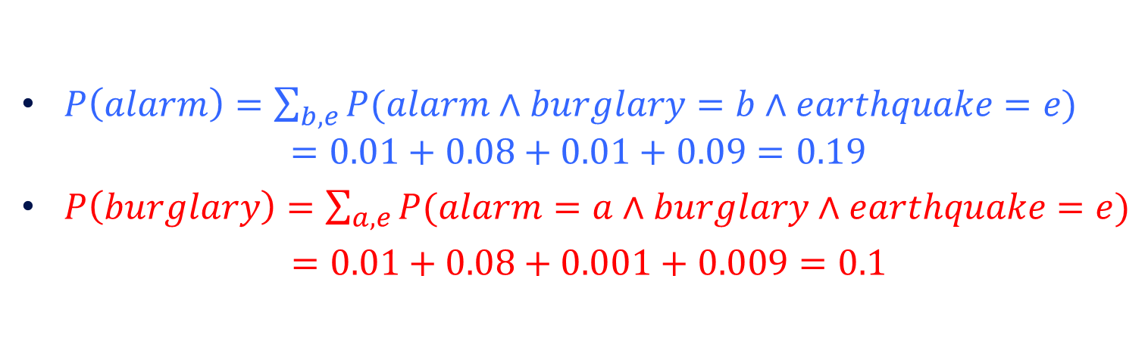
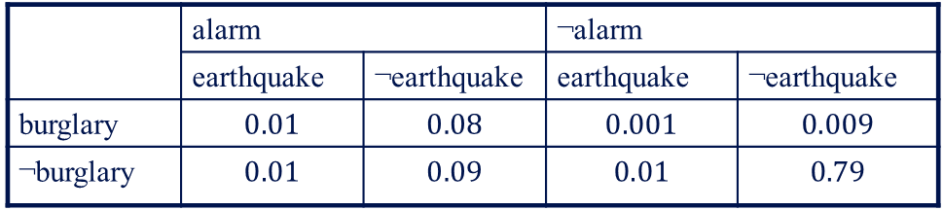
Inferring Probabilities from the Joint
 | alarm |  | ¬alarm
 | earthquake | ¬earthquake | earthquake | ¬earthquake
burglary | $$0.01$$ | $$0.08$$ | $$0.001$$ | $$0.009$$
¬burglary | $$0.01$$ | $$0.09$$ | $$0.01$$ | $$0.79$$
$P\left(alarm\right)=\sum_{b, e}{P(alarm∧burglary}=b∧earthquake=e)$
$$=0.01+0.08+0.01+0.09=0.19$$
$P\left(burglary\right)=\sum_{a,e}{P(alarm=a∧burglary}∧earthquake=e)$
$=0.01+0.08+0.001+0.009=0.1$
Notes:
\color{blue} P(\mathit{alarm}) &\color{blue}= \sum_{b,e} P(\mathit{alarm} \land \mathrm{Burglary} = b \land \mathrm{Earthquake} = e)\\
&\color{blue}= 0.01 + 0.08 + 0.01 + 0.09 = 0.19
\color{red} P(\mathit{burglary}) &\color{red}=\sum_{a,e} P(\mathrm{Alarm} = a \land \mathit{burglary} \land \mathrm{Earthquake} = e)\\
&\color{red}= 0.01 + 0.08 + 0.001 + 0.009 = 0.1

Slide 24

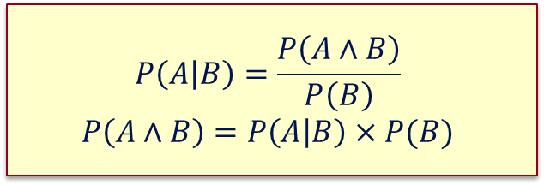
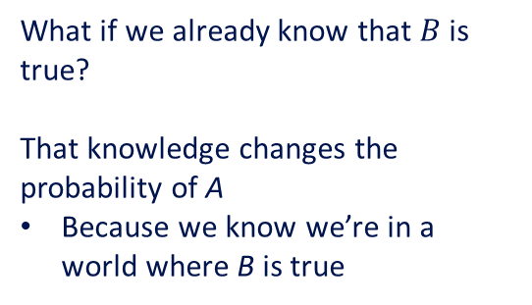
(3) Conditional Probability
$P(A | B)$= Fraction of worlds in which $B$ is true that also have A true
U
What if we already know that $B$ is true?
That knowledge changes the probability of A
Because we know we’re in a world where B is true
A
B
$$P\left(A | B\right)=\frac{P\left(A∧B\right)}{P\left(B\right)}$$
$$P\left(A∧B\right)=P\left(A | B\right)×P(B)$$
Notes:
P(A \mid B) &= \frac{P(A \land B)}{P(B)}\\
P(A \land B) &= P(A \mid B) \times P(B)

Slide 25




Example: Conditional Probabilities
$$P\left(A | B\right)=\frac{P\left(A∧B\right)}{P\left(B\right)}$$
$$P\left(A∧B\right)=P\left(A | B\right)×P(B)$$
 | alarm | ¬alarm
burglary | 0.09 | 0.01
¬burglary | 0.1 | 0.8
$P(alarm, burglary)$ =
$$P(burglary | alarm)$$
$$P(alarm | burglary)$$
$P(burglary∧ alarm)$
$$= P(burglary∧ alarm) / P(alarm)$$
$$= 0.09 / 0.19 = 0.47$$
$$= P(burglary∧ alarm) / P(burglary)$$
$$= 0.09/0.1 = 0.9$$
$$= P(burglary | alarm) P(alarm)$$
$$= 0.47 ∗ 0.19 = 0.09$$

Slide 26

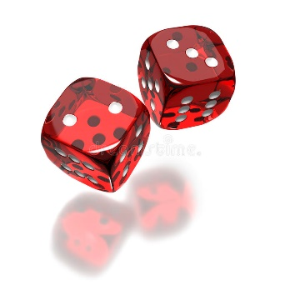
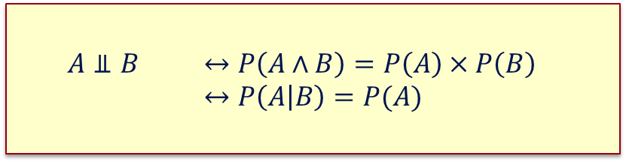
(4) Independence
When two event do not affect each others’ probabilities, we call them independent
Formal definition:
$$A⫫B ↔P\left(A∧B\right)=P\left(A\right)×P\left(B\right) ↔P\left(A | B\right)=P(A)$$
Notes:
A{\perp\!\!\!\!\perp}B \ \ &\leftrightarrow \ \ P(A \land B) = P(A) \times P(B) \\
&\leftrightarrow \ \ P(A \mid B) = P(A)

Slide 27
Exercise: Independence
P(smart ∧ study ∧ prep) | smart |  | ¬ smart
 | study | ¬ study | study | ¬ study
prepared | 0.432 | 0.16 | 0.084 | 0.008
¬prepared | 0.048 | 0.16 | 0.036 | 0.072
Is smart independent of study?
Is prepared independent of study?

Slide 28
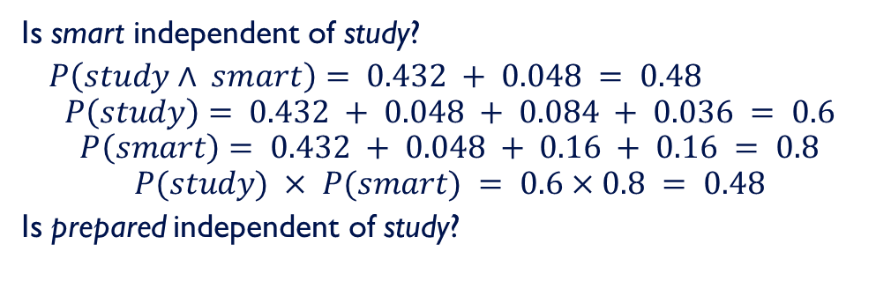
Exercise: Independence
P(smart ∧ study ∧ prep) | smart |  | ¬smart
 | study | ¬ study | study | ¬ study
prepared | 0.432 | 0.16 | 0.084 | 0.008
¬prepared | 0.048 | 0.16 | 0.036 | 0.072
Is smart independent of study?
$P\left(study∧ smart\right)= 0.432 + 0.048 = 0.48$
$$P\left(study\right)= 0.432 + 0.048 + 0.084 + 0.036 = 0.6$$
$$P\left(smart\right)= 0.432 + 0.048 + 0.16 + 0.16 = 0.8$$
$$P(study) × P(smart) = 0.6×0.8 = 0.48$$
Is prepared independent of study?
So yes!

Slide 29
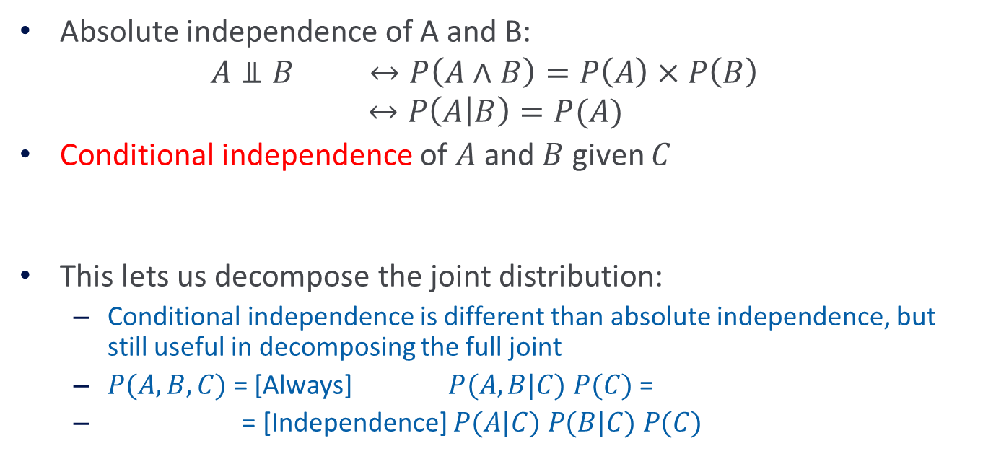
Conditional Independence
Absolute independence of A and B:
$$A⫫B ↔P\left(A∧B\right)=P\left(A\right)×P\left(B\right)$$
$$↔P\left(A | B\right)=P(A)$$
Conditional independence of $A$and $B$ given $C$
This lets us decompose the joint distribution:
  Conditional independence is different than absolute independence, but still useful in decomposing the full joint
  $P(A,B,C)$ = [Always] $P(A,B|C) P(C)$ =
  = [Independence] $P(A|C) P(B|C) P(C)$
$A⫫B| C↔P\left(A∧B | C\right)=P\left(A | C\right) ×P(B|C)$
Notes:
A{\perp\!\!\!\!\perp}B \mid C \ \ &\leftrightarrow \ \ P(A \land B \mid C) = P(A \mid C) \times P(B \mid C)
P(A \land B \land C) = P(A \mid C) \times P(B \mid C) \times P(C)

Slide 30
Exercise: Independence
P(smart ∧ study ∧ prep) | smart |  | ¬ smart
 | study | ¬ study | study | ¬ study
prepared | 0.432 | 0.16 | 0.084 | 0.008
¬ prepared | 0.048 | 0.16 | 0.036 | 0.072
Is smart independent of study?
Is prepared independent of study?

Slide 31
Take Home Exercise: Conditional independence
P(smart ∧ study ∧ prep) | smart |  | ¬ smart
 | study | ¬ study | study | ¬ study
prepared | 0.432 | 0.16 | 0.084 | 0.008
¬ prepared | 0.048 | 0.16 | 0.036 | 0.072
Is smart conditionally independent of prepared, given study?
Is study conditionally independent of prepared, given smart?

Slide 32
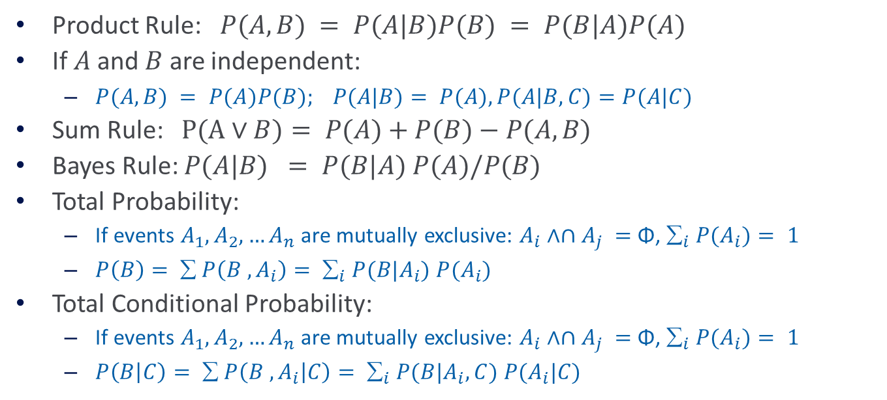
Summary: Basic Probability
Product Rule: $P(A,B) = P(A|B)P(B) = P(B|A)P(A)$
If $A$and $B$ are independent:
  $P(A,B) = P(A)P(B); P(A|B)= P(A), P(A|B,C)=P(A|C)$
Sum Rule: $P(A∨B)= P(A)+P(B)−P(A,B)$
Bayes Rule: $P(A|B) = P(B|A) P(A)/P(B)$
Total Probability:
  If events $A_{1}, A_{2},…A_{n}$are mutually exclusive: $A_{i}∧∩A_{j} =$Φ, $_{i} P(A_{i})= 1$
  $P\left(B\right)= ∑ P\left(B , A_{i}\right)= ∑_{i} P(B|A_{i}) P(A_{i})$
Total Conditional Probability:
  If events $A_{1}, A_{2},…A_{n}$are mutually exclusive: $A_{i}∧∩A_{j} =$Φ, $_{i} P(A_{i})= 1$
  $P\left(B | C\right)=  P\left(B , A_{i} | C\right)= _{i} P(B|A_{i},C) P(A_{i}|C)$

Slide 33
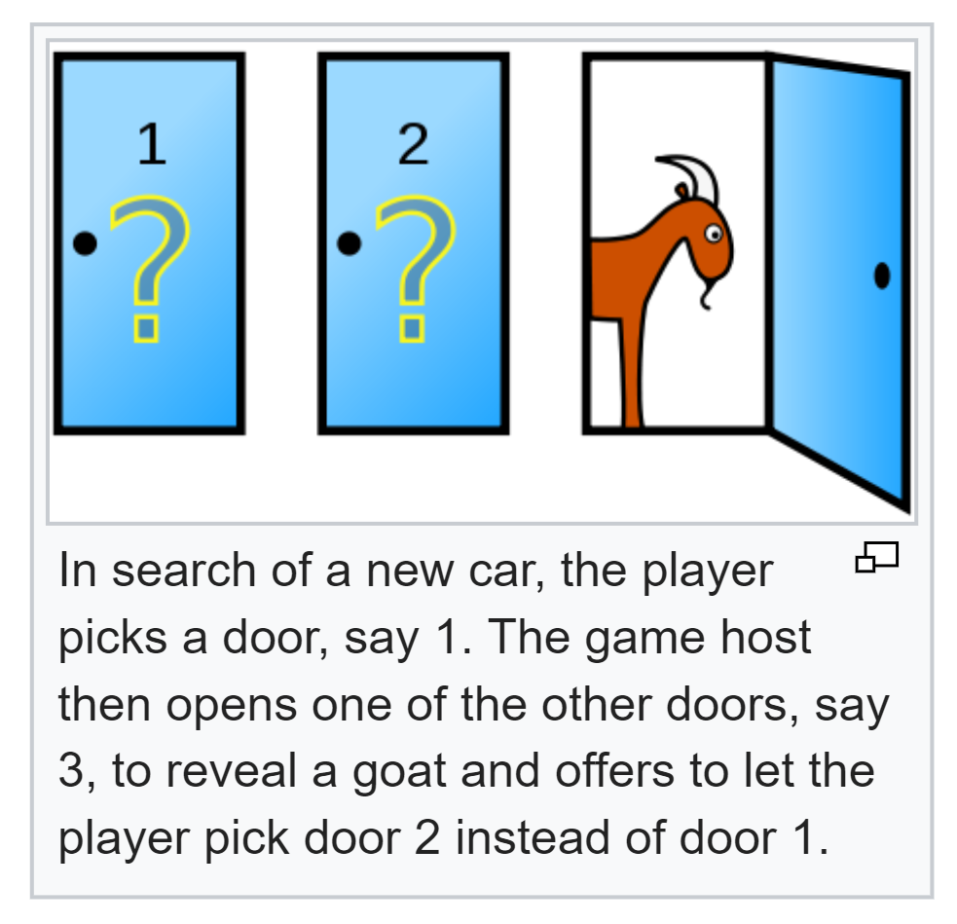
Summary: The Monty Hall problem
Suppose you're on a game show, and you're given the choice of three doors.
  Behind one door is a car; behind the others, goats.
  You pick a door, say No. 1, and the host, who knows what's behind the doors, opens another door, say No. 3, which has a goat.
  He then says to you, "Do you want to switch to door No. 2?"
Is it to your advantage to switch your choice?
Try to develop an argument using the concepts we discussed.

Slide 34
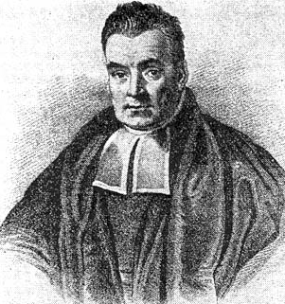


Bayes’ Rule
Exactly the process we just used
The most important formula in probabilistic machine learning
$$P\left(A | B\right)=\frac{P(B|A)×P\left(A\right)}{P\left(B\right)}$$
(Super Easy) Derivation:
$$P\left( A∧B\right)=P\left(A | B\right)×P\left(B\right)$$
$$P\left(B∧A\right) =P\left(B | A\right)×P\left(A\right)$$
Just set equal...
and solve...
$$P\left(A | B\right)×P\left(B\right)=P\left(B | A\right)×P(A)$$
Bayes, Thomas (1763) An essay towards solving a problem in the doctrine of chances. Philosophical Transactions of the Royal Society of London, 53:370-418
Notes:
P(A \mid B) &= \frac{P(B \mid A) \times P(A)}{P(B)}
P(A \land B) &= P(A \mid B) \times P(B)\\
P(B \land A) &= P(B \mid A) \times P(A)

Slide 35
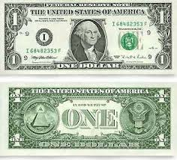
Using Bayes Rule to Gamble
The “Win” envelope has a dollar and four beads in it
The “Lose” envelope has three beads and no money
Trivial question: Someone draws an envelope at random and offers to sell it to you.
How much should you pay?
Slide © Andrew Moore

Slide 36
Using Bayes Rule to Gamble
The “Win” envelope has a dollar and four beads in it
The “Lose” envelope has three beads and no money
A question: Before deciding, you are allowed to see one bead drawn randomly from the chosen envelope.
- Will that help?
- Suppose it’s black: How much should you pay?
Slide © Andrew Moore

Slide 37
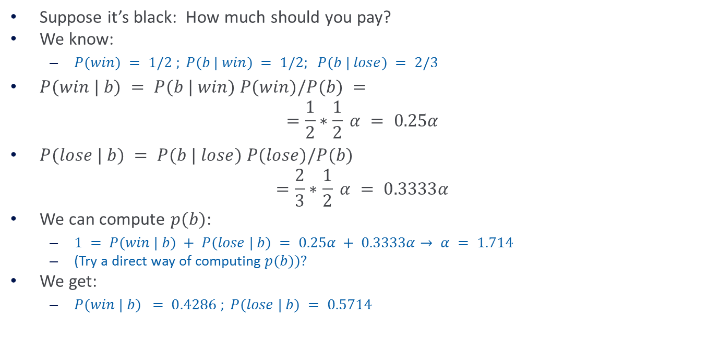
Calculation…
Suppose it’s black: How much should you pay?
We know:
  $P(win) = 1/2 ; P(b | win) = 1/2; P(b | lose) = 2/3$
$P(win | b) = P(b | win) P(win)/P(b) =$
$$=\frac{1}{2}∗\frac{1}{2} α = 0.25α$$
$P(lose | b) = P(b | lose) P(lose)/P(b)$
$$=\frac{2}{3}∗\frac{1}{2} α = 0.3333α$$
We can compute $p(b)$:
  $1 = P(win | b) + P(lose | b) = 0.25α + 0.3333α→ α = 1.714$
  (Try a direct way of computing $p(b))?$
We get:
  $P(win | b) = 0.4286 ; P(lose | b) = 0.5714$
Based on example by Andrew Moore

Slide 38
Bayes’ Rule for Machine Learning
Allows us to reason from evidence to hypotheses
Another way of thinking about Bayes’ rule:
Notes:
P(\mathrm{hypothesis} \mid \mathrm{evidence}) &= \frac{P(\mathrm{evidence} \mid \mathrm{hypothesis}) \times P(\mathrm{hypothesis})}{P(\mathrm{evidence})}

Slide 39
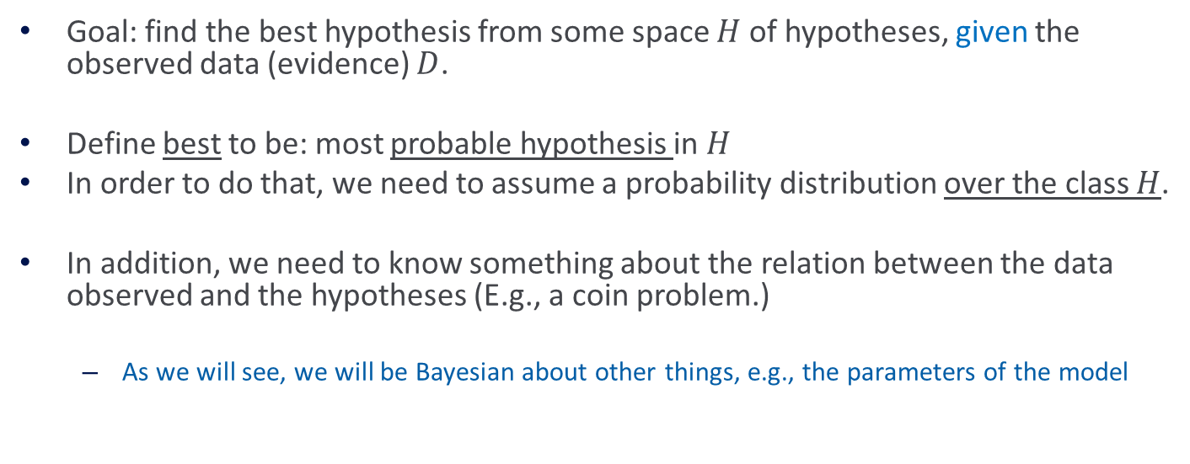
Basics of Bayesian Learning
Goal: find the best hypothesis from some space $H$ of hypotheses, given the observed data (evidence) $D$.
Define best to be: most probable hypothesis in $H$
In order to do that, we need to assume a probability distribution over the class $H$.
In addition, we need to know something about the relation between the data observed and the hypotheses (E.g., a coin problem.)
  As we will see, we will be Bayesian about other things, e.g., the parameters of the model

Slide 40
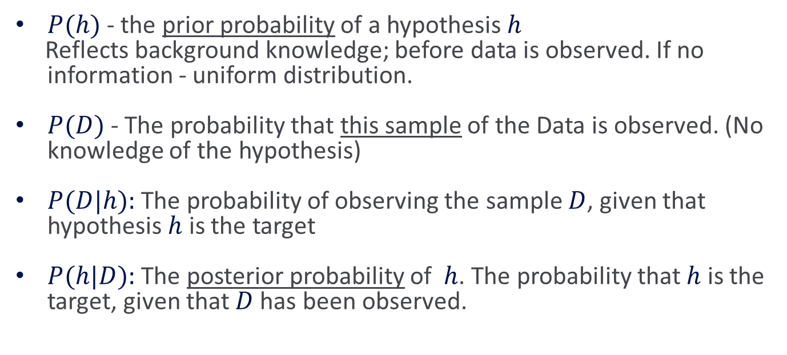
Basics of Bayesian Learning
$P(h)$- the prior probability of a hypothesis $h$
Reflects background knowledge; before data is observed. If no information - uniform distribution.
$P(D)$- The probability that this sample of the Data is observed. (No knowledge of the hypothesis)
$P(D|h):$The probability of observing the sample $D$, given that hypothesis $h$ is the target
$P(h|D):$The posterior probability of $h$. The probability that $h$ is the target, given that $D$ has been observed.

Slide 41

Bayes Theorem
$$P\left(h | D\right)=\frac{P(D|h)P\left(h\right)}{P(D)}$$
$P(h|D)$increases with $P(h)$and with $P(D|h)$
$P(h|D)$decreases with $P(D)$

Slide 42
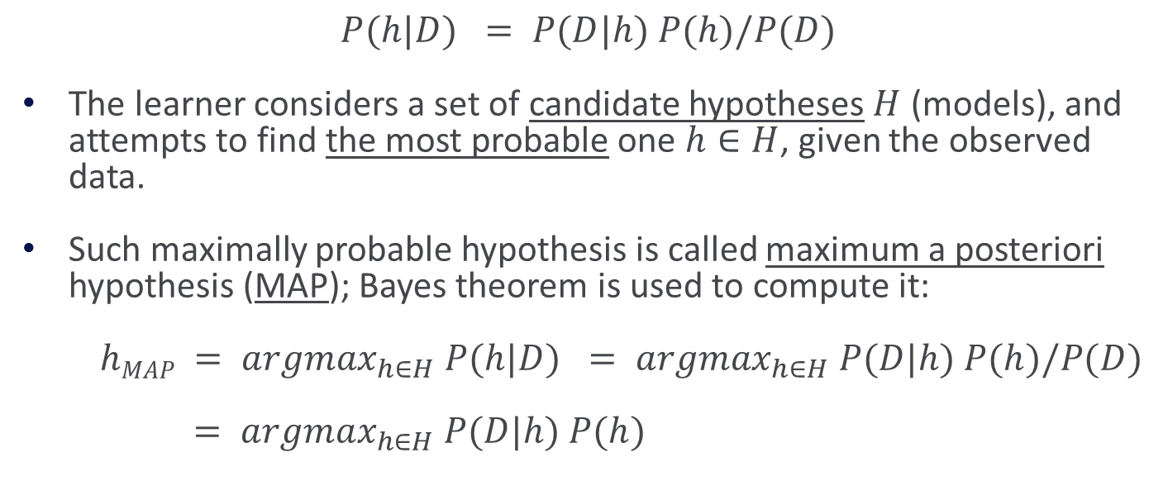
Learning Scenario
$$P(h|D) = P(D|h) P(h)/P(D)$$
The learner considers a set of candidate hypotheses $H$ (models), and attempts to find the most probable one $h∈H$, given the observed data.
Such maximally probable hypothesis is called maximum a posteriori hypothesis (MAP); Bayes theorem is used to compute it:
$hMAP = argmax_{h∈H} P(h|D) = argmax_{h∈H} P(D|h) P(h)/P(D)$
$= argmax_{h∈H} P(D|h) P(h)$

Slide 43
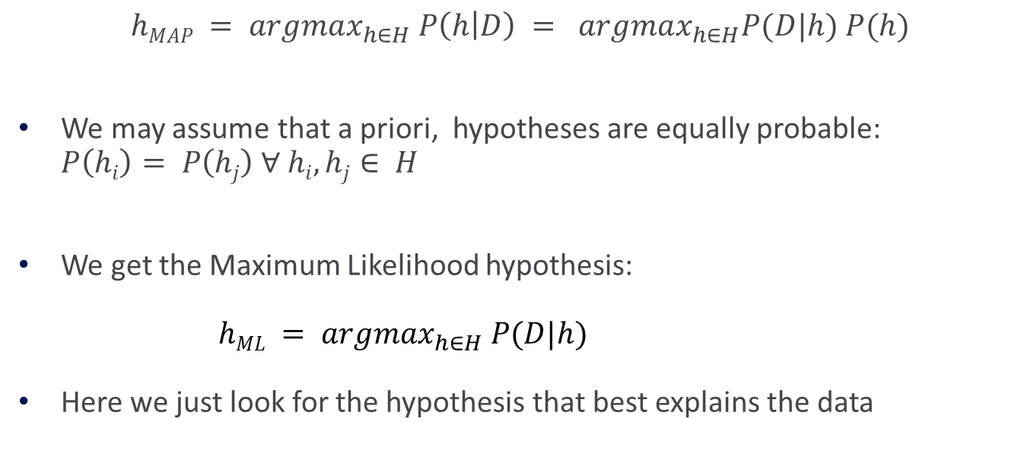
Learning Scenario (2)
$$hMAP = argmax_{h∈H} P\left(h | D\right) = argmax_{h∈H}P(D|h) P(h)$$
We may assume that a priori, hypotheses are equally probable: $P\left(hi\right)= P\left(hj\right) ∀$ $hi, hj∈ H$
We get the Maximum Likelihood hypothesis:
$hML = argmax_{h∈H} P(D|h)$
Here we just look for the hypothesis that best explains the data

Slide 44
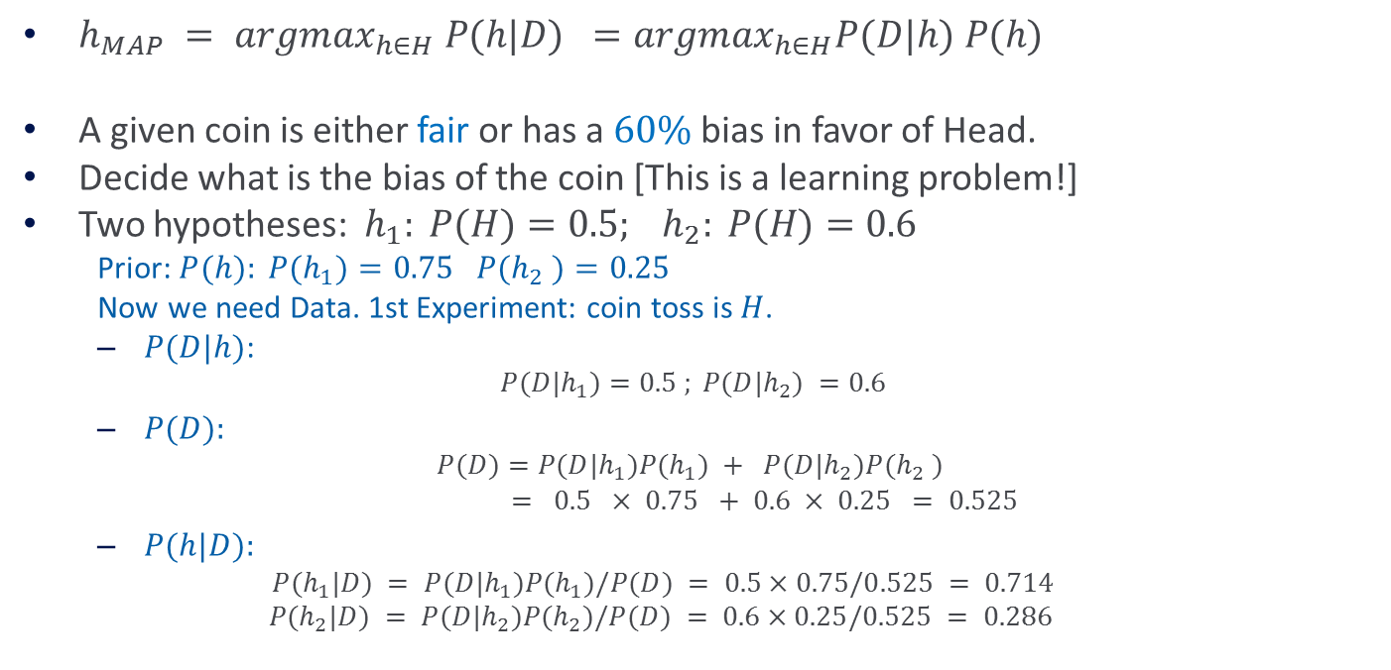
Examples
$h_{MAP} = argmax_{h∈H} P(h|D) =argmax_{h∈H}P(D|h) P(h)$
A given coin is either fair or has a $60\%$bias in favor of Head.
Decide what is the bias of the coin [This is a learning problem!]
Two hypotheses: $h_{1}: P(H)=0.5; h_{2}: P(H)=0.6$
  Prior: $P(h): P(h_{1})=0.75 P(h_{2} )=0.25$
  Now we need Data. 1st Experiment: coin toss is $H$.
  $P(D|h)$:
    $$P(D|h_{1})=0.5 ; P(D|h_{2}) =0.6$$
  $P(D):$
    $$P(D)=P(D|h_{1})P(h_{1}) + P(D|h_{2})P(h_{2} )$$
    $= 0.5 × 0.75 + 0.6 × 0.25 = 0.525$
  $P(h|D):$
    $P(h_{1}|D) = P(D|h_{1})P(h_{1})/P(D) = 0.5×0.75/0.525 = 0.714$
    $$P(h_{2}|D) = P(D|h_{2})P(h_{2})/P(D) = 0.6×0.25/0.525 = 0.286$$

Slide 45
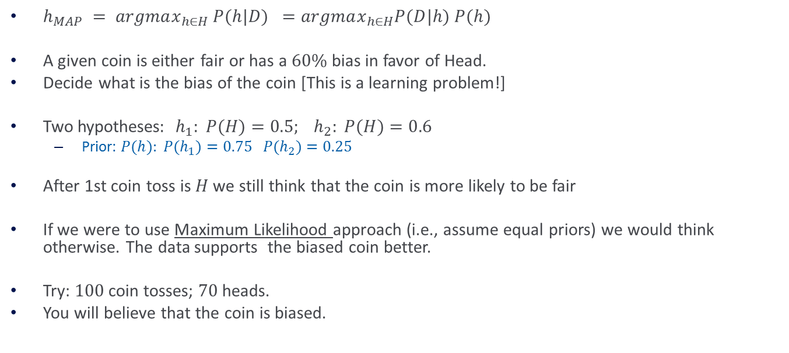
Examples(2)
$h_{MAP} = argmax_{h∈H} P(h|D) =argmax_{h∈H}P(D|h) P(h)$
A given coin is either fair or has a $60\%$ bias in favor of Head.
Decide what is the bias of the coin [This is a learning problem!]
Two hypotheses$: h_{1}: P(H)=0.5; h_{2}: P(H)=0.6$
  Prior: $P(h): P(h_{1})=0.75 P(h_{2})=0.25$
After 1st coin toss is $H$we still think that the coin is more likely to be fair
If we were to use Maximum Likelihood approach (i.e., assume equal priors) we would think otherwise. The data supports the biased coin better.
Try: $100$coin tosses; $70$ heads.
You will believe that the coin is biased.

Slide 46
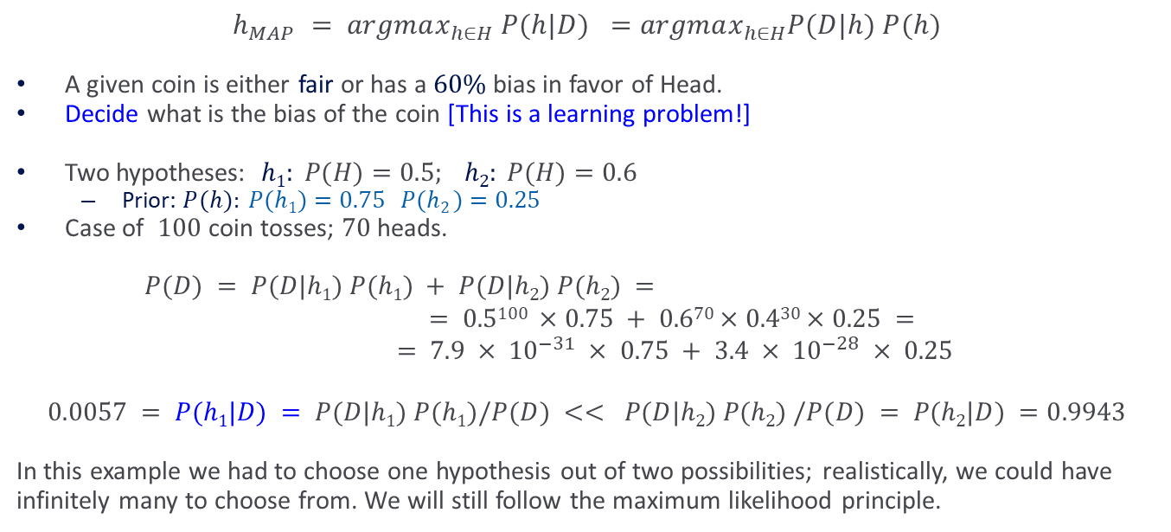
Examples(2)
$$h_{MAP} = argmax_{h∈H} P(h|D) =argmax_{h∈H}P(D|h) P(h)$$
A given coin is either fair or has a $60\%$bias in favor of Head.
Decide what is the bias of the coin [This is a learning problem!]
Two hypotheses: $h1: P(H)=0.5; h2: P(H)=0.6$
  Prior: $P(h): P(h1)=0.75 P(h2 )=0.25$
Case of $100$ coin tosses; $70$ heads.
$P(D) = P(D|h1) P(h1) + P(D|h2) P(h2) =$
$$= 0.5100 ×0.75 + 0.670×0.430×0.25 =$$
$$= 7.9 × {10}^{−31} × 0.75 + 3.4 × {10}^{−28} × 0.25$$
$$0.0057 = P(h1|D) = P(D|h1) P(h1)/P(D) << P(D|h2) P(h2) /P(D) = P(h2|D) =0.9943$$
In this example we had to choose one hypothesis out of two possibilities; realistically, we could have infinitely many to choose from. We will still follow the maximum likelihood principle.

Slide 47
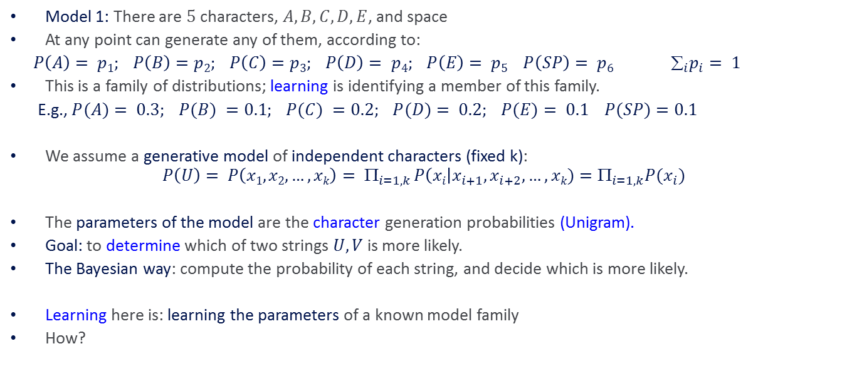
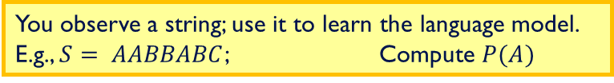

Example: A Model of Language
Model 1: There are $5$ characters, $A, B, C, D, E$, and space
At any point can generate any of them, according to:
$P\left(A\right)= p1; P\left(B\right)=p2; P\left(C\right)=p3; P\left(D\right)= p4; P\left(E\right)= p5 P\left(SP\right)= p6 ∑_{i}p_{i}= 1$
This is a family of distributions; learning is identifying a member of this family.
E.g., $P(A)= 0.3; P(B) =0.1; P(C) =0.2; P(D)= 0.2; P(E)= 0.1 P(SP)=0.1$
We assume a generative model of independent characters (fixed k):
$$P\left(U\right)= P\left(x1, x2,…, xk\right)= Π_{i=1,k} P\left(xi\right|x_{i+1}, x_{i+2},…, xk)=Π_{i=1,k}P(x_{i})$$
The parameters of the model are the character generation probabilities (Unigram).
Goal: to determine which of two strings $U, V$is more likely.
The Bayesian way: compute the probability of each string, and decide which is more likely.
Learning here is: learning the parameters of a known model family
How?
Consider Strings: $AABBC$ & $ABBBA$
You observe a string; use it to learn the language model. E.g., $S= AABBABC$; Compute $P(A)$

Slide 48
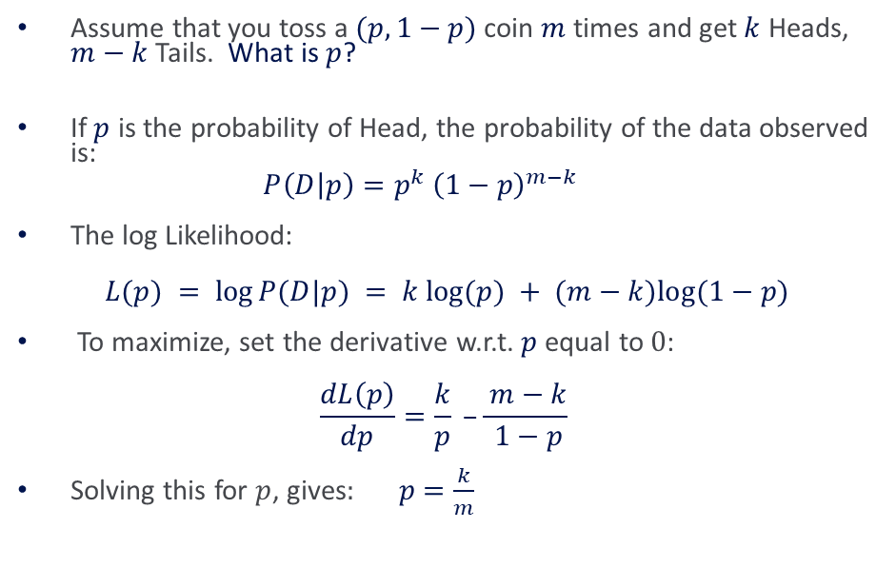
Maximum Likelihood Estimate
Assume that you toss a $(p,1−p)$coin $m$ times and get $k$ Heads, $m−k$ Tails. What is $p$?
If $p$ is the probability of Head, the probability of the data observed is:
$$P\left(D | p\right)=p^{k}{ \left(1−p\right)}^{m−k}$$
The log Likelihood:
$$L(p) = log⁡P(D|p) = k log⁡(p) + (m−k)log⁡(1−p)$$
To maximize, set the derivative w.r.t. $p$ equal to $0$:
$$\frac{dL\left(p\right)}{dp}=\frac{k}{p} –\frac{ m−k}{ 1−p}$$
Solving this for $p$, gives$: p=\frac{k}{m}$
1. The model we assumed is binomial. You could assume a different model! Next we will consider other models and see how to learn their parameters.
2. In practice, smoothing is advisable – deriving the right smoothing can be done by assuming a prior.

Slide 49
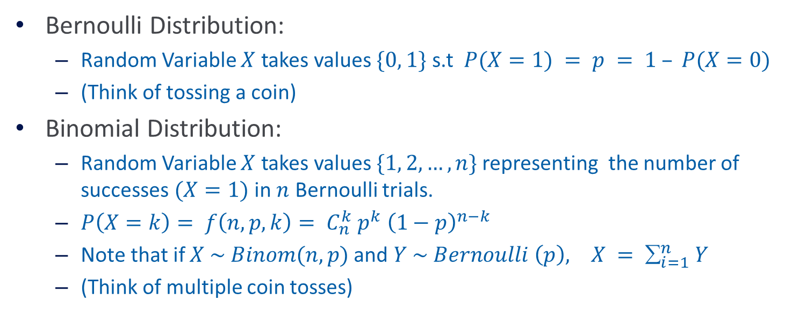
Probability Distributions
Bernoulli Distribution:
  Random Variable $X$ takes values $\{0, 1\}$ s.t $P(X=1) = p = 1 – P(X=0)$
  (Think of tossing a coin)
Binomial Distribution:
  Random Variable $X$ takes values $\{1, 2,…, n\}$representing the number of successes $(X=1)$ in $n$ Bernoulli trials.
  $P\left(X=k\right)= f\left(n, p, k\right)= C_{n}^{k} p^{k} {\left(1−p\right)}^{n−k}$
  Note that if $X \sim Binom(n, p)$and $Y \sim Bernoulli \left(p\right), X = ∑_{i=1}^{n} Y$
  (Think of multiple coin tosses)

Slide 50
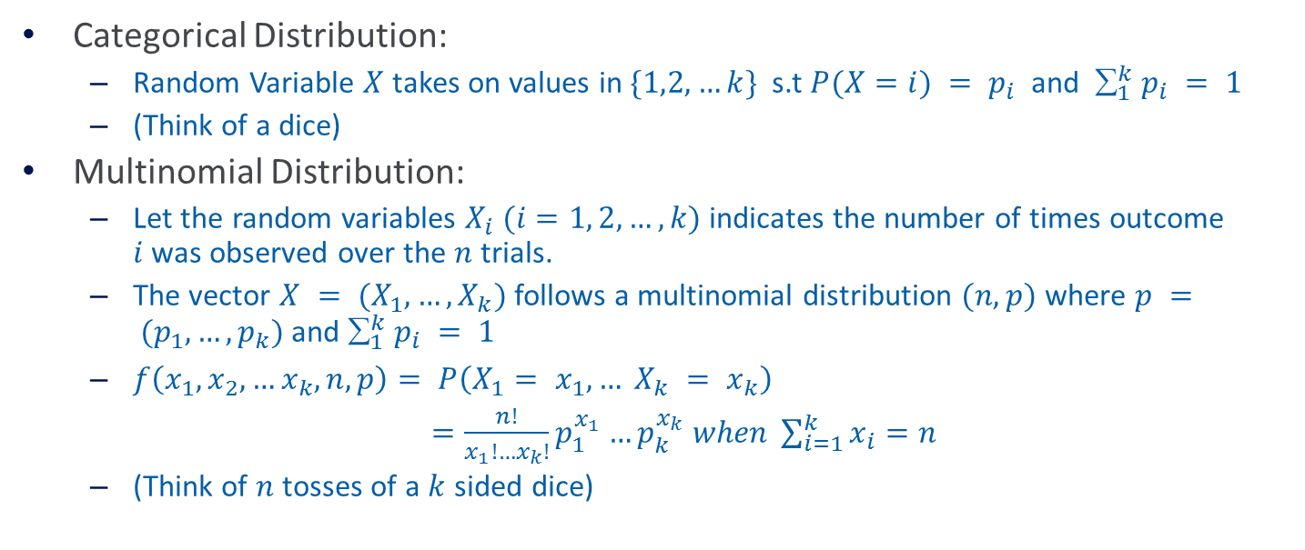
Probability Distributions(2)
Categorical Distribution:
  Random Variable $X$ takes on values in $\{1,2,…k\}$s.t $P(X=i) = p_{i}$ and $_{1}^{k} p_{i} = 1$
  (Think of a dice)
Multinomial Distribution:
  Let the random variables $X_{i} (i=1, 2,…, k)$indicates the number of times outcome $i$was observed over the $n$ trials.
  The vector $X = (X_{1}, …, X_{k})$follows a multinomial distribution $(n,p)$ where $p = (p_{1}, …, p_{k})$and $_{1}^{k} p_{i} = 1$
  $f\left(x_{1}, x_{2},…x_{k}, n, p\right)= P\left(X_{1}= x_{1}, … X_{k} = x_{k}\right)$
  $=\frac{n!}{x_{1}!…x_{k}!}p_{1}^{x_{1}}…p_{k}^{x_{k}} when \sum_{i=1}^{k}{x_{i}=n}$
  (Think of $n$tosses of a $k$ sided dice)

Slide 51
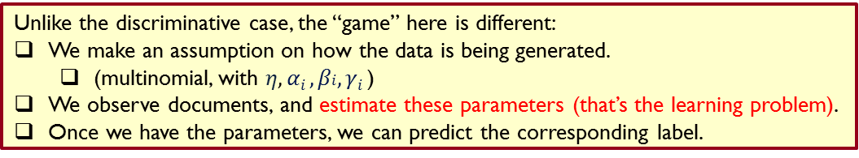

A Multinomial Bag of Words
Our eventual goal will be: Given a document, predict whether it’s “good” or “bad”
How do we model it?
What is the learning problem?
We are given a collection of documents written in a three word language $\{a, b, c\}$. All the documents have exactly $n$ words (each word can be either $a, b or c)$.
We are given a labeled document collection $\{D1, D2 … , Dm\}.$The label $yi$ of document $Di$is 1 or 0, indicating whether $Di$is “good” or “bad”.
Our generative model uses the multinominal distribution. It first decides whether to generate a good or a bad document (with $P(yi=1) = η).$Then, it places words in the document; let $ai (bi, ci$, resp.) be the number of times word $a (b, c,$resp.) appears in document $Di.$ That is, we have $ai + b_{i} + c_{i} = |D_{i}| = n.$
In this generative model, we have:
$P(Di|y = 1) =n!/(ai! b_{i}! c_{i}!) α$₁^{ai} $β$₁^{bi} $γ$₁^{ci}
where $α$₁ ($β$1, $γ$₁ resp.) is the probability that $a (b , c)$appears in a “good” document.
Similarly, $P(Di|y = 0) =n!/(ai! b_{i}! c_{i}!) α$₀^{ai} $β0$^{bi} $γ$₀^{ci}
Note that: $α0 +β0+γ0= α1 +β1+γ1 =1$
Unlike the discriminative case, the “game” here is different:
We make an assumption on how the data is being generated.
  (multinomial, with $η, αi , βi, γi$)
We observe documents, and estimate these parameters (that’s the learning problem).
Once we have the parameters, we can predict the corresponding label.

Slide 52

A Multinomial Bag of Words (2)
We are given a collection of documents written in a three word language $\{a, b, c\}$. All the documents have exactly $n$words (each word can be either $a, b or c$).
We are given a labeled document collection $\{D1, D2 … , Dm\}$. The label $yi$of document $Di$ is $1$ or $0$, indicating whether $Di$is “good” or “bad”.
The classification problem: given a document $D$, determine if it is good or bad; that is, determine $P(y|D)$.
This can be determined via Bayes rule: $P(y|D) = P(D|y) P(y)/P(D)$
But, we need to know the parameters of the model to compute that.

Slide 53


A Multinomial Bag of Words (3)
How do we estimate the parameters?
We derive the most likely value of the parameters defined above, by maximizing the log likelihood of the observed data.
$PD =\prod_{i}{P(yi , Di )} = \prod_{i}{P(D_{i} |y_{i} ) P(y_{i})} =$
  We denote by $P(y_{i}=1) = η$ the probability that an example is “good” ($yi=1$; otherwise $yi=0$). Then:
$$\prod_{i}{P(y, D_{i} )} =\prod_{i}{[\left(η\frac{n!}{ai! b_{i}! c_{i}!}α\text{1}\text{a}\text{i} β\text{1}\text{b}\text{i} γ1ci \right)yi⋅{\left(\left(1 − η\right)\frac{n!}{ai! b_{i}! c_{i}!}α \text{0}\text{a}\text{i} β0 \text{b}\text{i} γ\text{0}\text{c}\text{i} \right)}^{1−y_{i}} ] }$$
We want to maximize it with respect to each of the parameters. We first compute $log⁡(PD)$and then differentiate:
$log⁡(PD) =∑i yi [ log⁡(η) + C + a_{i} log⁡(α_{1}) + b_{i} log⁡(β_{1}) + c_{i} log⁡(γ_{1})] +$
$$(1− yi) [log⁡(1−η) + C’ + a_{i} log⁡(α_{0}) + b_{i} log⁡(β_{0}) + c_{i} log⁡(γ_{0}) ]$$
$\frac{dlogPD}{η}=\sum_{i}{[\frac{y_{i}}{η} −\frac{{1−y}_{i}}{1 −η}}]= 0→ ∑i (y_{i}−η)= 0 → η= ∑i \frac{yi}{m}$
The same can be done for the other 6 parameters. However, notice that they are not independent: $α$₀+ $β$₀+ $γ$₀= $α$₁+ $β$₁+ $γ$₁ =1 and also $ai + b_{i} + c_{i} = |D_{i}| = n$.
Labeled data, assuming that the examples are independent
Notice that this is an important trick to write down the joint probability without knowing what the outcome of the experiment is. The ith expression evaluates to $p(D_{i} , yi)$
(Could be written as a sum with multiplicative $yi$ but less convenient)
Makes sense?

Slide 54





Other Examples (HMMs)
We can do the same exercise we did before.
Data: ${\left\{\left(x1 ,x2,…xm ,s1 ,s2,…sm\right)\right\}}_{1}^{n}$
Find the most likely parameters of the model:
  $$P(x_{i} |si), P(s_{i+1} |si), p(s1)$$
Given an unlabeled example (observation)
$x = (x1, x2,…xm)$
use Bayes rule to predict the label $l=(s1, s2,…sm):$
$l^{∗} = argmaxl P(l|x) = argmaxl P(x|l) P(l)/P(x)$
The only issue is computational: there are $2m$ possible values of $l$(labels)
This is an HMM model (but nothing was hidden; the $si$ were given in training. It’s also possible to solve when the $s1 ,s2,…sm$are hidden, via EM.
Consider data over $5$ characters, $x=a, b, c, d, e,$ and $2$ states $s=B, I$
  Think about chunking a sentence to phrases; $B$ is the Beginning of each phrase, I is Inside a phrase.
  (Or: think about being in one of two rooms, observing $x$ in it, moving to the other)
We generate characters according to:
Initial state prob: $p(B)= 1; p(I)=0$
State transition prob:
  $p(BB)=0.8 p(BI)=0.2$
  $p(IB)=0.5 p(II)=0.5$
Output prob:
  $p(a|B) = 0.25,p(b|B)=0.10, p(c|B)=0.10,….$
  $p(a|I) = 0.25,p(b,I)=0,…$
Can follow the generation process to get the observed sequence.
0.8
0.8
0.5
0.5
$$P(B)=1$$
$$P(I) = 0$$
0.2
0.2
B
I
$$P(x|B)$$
$$P(x|I)$$
0.5
0.5
B
0.2
I
0.5
I
0.5
0.5
1
I
B
0.25
0.25
0.25
0.25
0.4
a
c
d
a
d

Slide 55

Bayes Optimal Classifier
How should we use the general formalism?
What should $H$ be?
$H$ can be a collection of functions. Given the training data, choose an optimal function. Then, given new data, evaluate the selected function on it.
$H$ can be a collection of possible predictions. Given the data, try to directly choose the optimal prediction.
Could be different!

Slide 56

Bayes Optimal Classifier
The first formalism suggests to learn a good hypothesis and use it.
(Language modeling, grammar learning, etc. are here)
$$h_{MAP}=argmax_{h∈H}P\left(h | D\right)=argmax_{h∈H}P\left(D | h\right)P(h)$$
The second one suggests to directly choose a decision.[it/in]:
This is the issue of “thresholding” vs. entertaining all options until the last minute. (Computational Issues)

Slide 57

Bayes Optimal Classifier: Example
Assume a space of 3 hypotheses:
  $P\left(h_{1} | D\right)= 0.4; P\left(h_{2} | D\right)= 0.3; P\left(h_{3} | D\right)= 0.3 →h_{MAP} = h_{1}$
Given a new instance $x$, assume that
  $h_{1}(x) = 1 h_{2}(x) = 0 h_{3}(x) = 0$
In this case,
  $P(f(x) =1 ) = 0.4 ; P(f(x) = 0) = 0.6 but h_{MAP} (x) =1$
We want to determine the most probable classification by combining the prediction of all hypotheses, weighted by their posterior probabilities
Think about it as deferring your commitment – don’t commit to the most likely hypothesis until you have to make a decision (this has computational consequences)

Slide 58

Bayes Optimal Classifier: Example(2)
Let $V$ be a set of possible classifications
$$P\left(v_{j} | D\right)=\sum_{h_{i}∈H}{P\left(v_{j} | h_{i}, D\right)P\left(h_{i} | D\right)=\sum_{h_{i}∈H}{P\left(v_{j} | h_{i}\right)P(h_{i}|D) } }$$
Bayes Optimal Classification:
$$v=argmax_{v_{j}∈V}P\left(v_{j} | D\right)=argmax_{v_{j}∈V}\sum_{h_{i}∈H}{P\left(v_{j} | h_{i}\right)P(h_{i}|D)}$$
In the example:
$$P\left(1 | D\right)=\sum_{h_{i}∈H}{P\left(1 | h_{i}\right)P\left(h_{i} | D\right)=1∗0.4+0∗0.3}+0∗0.3=0.4$$
$$P\left(0 | D\right)=\sum_{h_{i}∈H}{P\left(0 | h_{i}\right)P\left(h_{i} | D\right)=0∗0.4+1∗0.3}+1∗0.3=0.6$$
and the optimal prediction is indeed $0$.
The key example of using a “Bayes optimal Classifier” is that of the Naïve Bayes algorithm.

Slide 59

Bayesian Classifier
$f:XV,$ finite set of values
Instances $xX$ can be described as a collection of features
$x = \left(x1, x2, … xn\right) x_{i}∈ \{0,1\}$
Given an example, assign it the most probable value in $V$
Bayes Rule:
$v_{MAP}=argmax_{v_{j}∈V}P\left(v_{j} | x\right)=argmax_{v_{j}∈V}P(v_{j}|x1, x2, … xn$)
$$v_{MAP}=argmax_{v_{j}∈V}\frac{P(x_{1},x_{2},…,x_{n}|v_{j})P\left(v_{j}\right)}{P(x_{1},x_{2},…,x_{n})}=argmax_{v_{j}∈V}P(x_{1},x_{2},…,x_{n}|v_{j})P\left(v_{j}\right)$$
Notational convention: $P(y)$ means$P(Y=y)$

Slide 60

Bayesian Classifier
$VMAP = argmax_{v} P(x1, x2, …, x_{n} | v )P(v)$
Given training data we can estimate the two terms.
Estimating $P(v)$is easy. E.g., under the binomial distribution assumption, count the number of times $v$ appears in the training data.
However, it is not feasible to estimate $P(x1, x2, …, xn | v )$
In this case we have to estimate, for each target value, the probability of each instance (most of which will not occur).
In order to use a Bayesian classifiers in practice, we need to make assumptions that will allow us to estimate these quantities.

Slide 61

Naive Bayes
$$VMAP = argmax_{v} P(x1, x2, …, x_{n} | v )P(v)$$
$$P\left(x_{1},x_{2},…,x_{n} | v_{j}\right)=P\left(x_{1} | x_{2},…,x_{n},v_{j}\right)P(x_{2},…,x_{n}|v_{j})$$
$=P\left(x_{1} | x_{2},…,x_{n},v_{j}\right)$ $P\left(x_{2} | x_{3},…,x_{n},v_{j}\right)P(x_{3},…,x_{n}|v_{j})$
$$=…$$
$$=P\left(x_{1} | x_{2},…,x_{n},v_{j}\right) P\left(x_{2} | x_{3},…,x_{n},v_{j}\right)P\left(x_{3} | x_{4},…,x_{n},v_{j}\right)…P\left(x_{n} | v_{j}\right)$$
$$=\prod_{i=1}^{n}{P(x_{i}|v_{j})}$$
Assumption: feature values are independent given the target value

Slide 62

Naive Bayes (2)
$VMAP = argmaxv P(x1, x2, …, xn | v )P(v)$
Assumption: feature values are independent given the target value
$P\left(x_{1}=b_{1},x_{2}=b_{2}, …, x_{n}=b_{n} | v=v_{j}\right)\prod_{i=1}^{n}{(x_{i}= b_{i}| v = v_{j} )}$
Generative model:
First choose a value $vj V$ according to $P(v)$
For each $vj$ : choose $x1 x2, …, xn$ according to $P(xk |vj )$

Slide 63

Naive Bayes (3)
$VMAP = argmaxv P(x1, x2, …, xn | v )P(v)$
Assumption: feature values are independent given the target value
$P\left(x_{1}=b_{1},x_{2}=b_{2}, …, x_{n}=b_{n} | v=v_{j}\right)\prod_{i=1}^{n}{(x_{i}= b_{i}| v = v_{j} )}$
Learning method: Estimate $n|V| + |V|$parameters and use them to make a prediction. (How to estimate?)
Notice that this is learning without search. Given a collection of training examples, you just compute the best hypothesis (given the assumptions).
This is learning without trying to achieve consistency or even approximate consistency.
Why does it work?

Slide 64


Conditional Independence
Notice that the features values are conditionally independent given the target value, and are not required to be independent.
Example: The Boolean features are $x$ and $y$.
We define the label to be $l = f\left(x,y\right)=x∧ y$ over the product distribution:
$p(x=0)=p(x=1)=\frac{1}{2}$and $p(y=0)=p(y=1)=\frac{1}{2}$
The distribution is defined so that $x$ and $y$ are independent: $p(x,y) = p(x)p(y)$
That is:
But, given that $l =0$:
$p(x=1| l =0) = p(y=1\left| l =0\right)=\frac{1}{3}$
while: $p(x=1,y=1 | l =0) = 0$
so $x$ and $y$are not conditionally independent.
 | $$X=0$$ | $$X=1$$
$$Y=0$$ | $$¼ (l = 0)$$ | $$¼ (l = 0)$$
$$Y=1$$ | $$¼ (l = 0)$$ | $$¼ (l = 1)$$

Slide 65


Conditional Independence
The other direction also does not hold.
$x$and $y$ can be conditionally independent but not independent.
Example: We define a distribution s.t.:
$$l =0: p(x=1| l =0) =1, p(y=1| l =0) = 0$$
$l =1: p(x=1| l =1) =0, p(y=1| l =1) = 1$
and assume, that: $p(l =0) = p(l =1)=\frac{1}{2}$
Given the value of l, $x$ and $y$ are independent (check)
What about unconditional independence ?
$p(x=1) = p(x=1| l =0)p(l =0)+p(x=1| l =1)p(l =1) = 0.5+0=0.5$
$p(y=1) = p(y=1| l =0)p(l =0)+p(y=1| l =1)p(l =1) = 0+0.5=0.5$
But,
$p(x=1, y=1)=p(x=1,y=1| l =0)p(l =0)+p(x=1,y=1| l =1)p(l =1) = 0$
so $x$ and $y$ are not independent.
 | $$X=0$$ | $$X=1$$
$$Y=0$$ | $$0 (l= 0)$$ | $$½ (l= 0)$$
$$Y=1$$ | $$½ (l= 1)$$ | $$0 (l= 1)$$

Slide 66

Naïve Bayes Example
$$v_{NB}=argmax_{v_{j}∈V }P\left(v_{j}\right)\prod_{i}{P(x_{i}|v_{j})}$$
Day Outlook Temperature Humidity Wind PlayTennis
1 Sunny Hot High Weak No
2 Sunny Hot High Strong No
3 Overcast Hot High Weak Yes
4 Rain Mild High Weak Yes
5 Rain Cool Normal Weak Yes
6 Rain Cool Normal Strong No
7 Overcast Cool Normal Strong Yes
8 Sunny Mild High Weak No
9 Sunny Cool Normal Weak Yes
10 Rain Mild Normal Weak Yes
11 Sunny Mild Normal Strong Yes
12 Overcast Mild High Strong Yes
13 Overcast Hot Normal Weak Yes
14 Rain Mild High Strong No

Slide 67

Estimating Probabilities
$v_{NB}=argmax_{v∈\left\{yes,no\right\}}P\left(v\right)\prod_{i}{P(x_{i}=observation|v)}$
How do we estimate $P\left(observation | v\right)?$

Slide 68


Example
$$v_{NB}=argmax_{v_{j}∈V }P\left(v_{j}\right)\prod_{i}{P(x_{i}|v_{j})}$$
Compute $P(PlayTennis= yes); P(PlayTennis= no)$
Compute $P(outlook= s/oc/r | PlayTennis= yes/no)$(6 numbers)
Compute $P(Temp= h/mild/cool | PlayTennis= yes/no)$(6 numbers)
Compute $P(humidity= hi/nor | PlayTennis= yes/no)$(4 numbers)
Compute $P(wind= w/st | PlayTennis= yes/no)$(4 numbers)

Slide 69


Example
$$v_{NB}=argmax_{v_{j}∈V}P\left(v_{j}\right)\prod_{i}{P}\left(x_{i} | v_{j}\right)$$
Compute $P(PlayTennis= yes); P(PlayTennis= no)$
Compute $P(outlook= s/oc/r | PlayTennis= yes/no)$ (6 numbers)
Compute $P(Temp= h/mild/cool | PlayTennis= yes/no)$(6 numbers)
Compute $P(humidity= hi/nor| PlayTennis= yes/no)$(4 numbers)
Compute $P(wind= w/st | PlayTennis= yes/no)$(4 numbers)
Given a new instance:
  (Outlook=sunny; Temperature=cool; Humidity=high; Wind=strong)
Predict: $PlayTennis=$ ?

Slide 70


Example
$$v_{NB}=argmax_{v_{j}∈V}P\left(v_{j}\right)\prod_{i}{P}\left(x_{i} | v_{j}\right)$$
Given: (Outlook=sunny; Temperature=cool; Humidity=high; Wind=strong)
$P\left(PlayTennis= yes\right)$ $P\left(PlayTennis= no\right)$
$$=9/14=0.64) =5/14=0.36$$
$P(outlook = sunny | yes)= 2/9 P(outlook = sunny | no)= 3/5$
$P(temp = cool | yes) = 3/9 P(temp = cool | no) = 1/5$
$P(humidity = hi |yes) = 3/9 P(humidity = hi | no) = 4/5$
$P(wind = strong | yes) = 3/9 P(wind = strong | no)= 3/5$
$P(yes, …..) \sim 0.0053 P(no, …..) \sim 0.0206$

Slide 71

Example
$$v_{NB}=argmax_{v_{j}∈V}P\left(v_{j}\right)\prod_{i}{P}\left(x_{i} | v_{j}\right)$$
Given: (Outlook=sunny; Temperature=cool; Humidity=high; Wind=strong)
$P\left(PlayTennis= yes\right)$ $P\left(PlayTennis= no\right)$
$$=9/14=0.64) =5/14=0.36$$
$P(outlook = sunny | yes)= 2/9 P(outlook = sunny | no)= 3/5$
$P(temp = cool | yes) = 3/9 P(temp = cool | no) = 1/5$
$P(humidity = hi |yes) = 3/9 P(humidity = hi | no) = 4/5$
$P(wind = strong | yes) = 3/9 P(wind = strong | no)= 3/5$
$P\left(yes, …..\right)\sim 0.0053 P\left(no, …..\right)\sim 0.0206$
$P(no|instance) = 0.0206/(0.0053+0.0206)=0.795$
What if we were asked about Outlook=OC ?

Slide 72

Estimating Probabilities
$$v_{NB}= argmax_{v} \prod_{i}{P\left(x_{i} | v\right)P(v)}$$
How do we estimate $P(x_{i} | v)$ ?
As we suggested before, we made a Binomial assumption; then:
$P(x_{i}=1\left|v\right)= \frac{\#(x_{i}=1 in training in an example labeld v)}{\#(v labeled examples)}$= $\frac{n_{i}}{n}$
Sparsity of data is a problem
  if $n$ is small, the estimate is not accurate
  if $n_{i}$ is $0$, it will dominate the estimate: we will never predict $v$if a word that never appeared in training (with $v$) appears in the test data

Slide 73



Robust Estimation of Probabilities
$$v_{NB}=argmax_{v∈\left\{like,dislike\right\}}P\left(v\right)\prod_{i}{P(x_{i}=word_{i}|v)}$$
This process is called smoothing.
There are many ways to do it, some better justified than others;
An empirical issue.
Here:
$n_{k}$ is # of occurrences of the $k$-th feature given the label $v$
$n$ is # of occurrences of the label $v$
$p$ is a prior estimate of $v$ (e.g., uniform)
$m$ is equivalent sample size (# of labels)
  Is this a reasonable definition?
$$P\left(x_{k} | v\right)=\frac{n_{k}+mp}{n+m}$$

Slide 74



Robust Estimation of Probabilities
Smoothing:
Common values:
  Laplace Rule for the Boolean case, $p=\frac{1}{2} , m=2$
$$P\left(x_{k} | v\right)=\frac{n_{k}+mp}{n+m}$$
$$P\left(x_{k} | v\right)=\frac{n_{k}+1}{n+2}$$

Slide 75

Robust Estimation
Assume a Binomial r.v.:
  $p(k|n,µ) = C_{n}^{k}μ^{k}{\left(1−μ\right)}^{n−k}$
We saw that the maximum likelihood estimate is $µML = k/n$
In order to compute the MAP estimate, we need to assume a prior.
It’s easier to assume a prior of the form:
  $p\left(µ\right)= µ^{a−1} {\left(1− µ\right)}^{b−1}$ ($a$ and $b$ are called the hyper parameters)
  The prior in this case is the beta distribution, and it is called a conjugate prior, since it has the same form as the posterior. Indeed, it’s easy to compute the posterior:
  $p\left(µ | D\right)\sim = p\left(D | µ\right)p\left(µ\right)= µ^{a+k−1} {\left(1− µ\right)}^{b+n−k−1}$
Therefore, as we have shown before (differentiate the log posterior)
$µmap = k+a−1/(n+a+b−2)$
The posterior mean:
$E(µ|D) =\int_{0}^{1}{µp(µ|D)dµ} = a+k/(a+b+n)$
Under the uniform prior, the posterior mean of observing $(k,n) is: k+1/n+2$

Slide 76



Another comment on estimation
$$v_{NB}=argmax_{v_{j}∈V}P\left(v_{j}\right)\prod_{i}{P}\left(x_{i} | v_{j}\right)$$
In practice, we will typically work in the log space:
$v_{NB} =argmax\log{P\left(v_{j}\right)}\prod_{i}{P(x_{i}│v_{j} )= }$
$$= argmax [ log⁡P(v_{j}) + \sum_{i}{log⁡P(x_{i}|v_{j} )]}$$

Slide 77



Naïve Bayes: Two Classes
Why do things work?
$$v_{NB}=argmax_{v_{j}∈V}P\left(v_{j}\right)\prod_{i}{P(x_{i}|v_{j})}$$
Notice that the naïve Bayes method gives a method for predicting
rather than an explicit classifier.
In the case of two classes, $v\{0,1\}$we predict that $v=1$ iff:
$$\frac{P\left(v_{j}=1\right)⋅\prod_{i=1}^{n}{P\left(x_{i} | v_{j}=1\right)}}{ P\left(v_{j}=0\right)⋅\prod_{i=1}^{n}{P\left(x_{i} | v_{j}=0\right) }}>1$$

Slide 78




Naïve Bayes: Two Classes
$$v_{NB}=argmax_{v_{j}∈V}P\left(v_{j}\right)\prod_{i}{P(x_{i}|v_{j})}$$
Notice that the naïve Bayes method gives a method for predicting rather than an explicit classifier.
In the case of two classes, $v\{0,1\}$we predict that $v=1$iff:
$$\frac{P\left(v_{j}=1\right)⋅\prod_{i=1}^{n}{P\left(x_{i} | v_{j}=1\right)}}{ P\left(v_{j}=0\right)⋅\prod_{i=1}^{n}{P\left(x_{i} | v_{j}=0\right) }}>1$$
Denote $p_{i}=P\left(x_{i}=1 | v=1\right), q_{i}=P\left(x_{i}=1 | v=0\right)$
$$\frac{P\left(v_{j}=1\right)⋅\prod_{i=1}^{n}{p_{i}^{x_{i}}{\left(1−p_{i}\right)}^{1−x_{i}}}}{ P\left(v_{j}=0\right)⋅\prod_{i=1}^{n}{q_{i}^{x_{i}}{\left(1−q_{i}\right)}^{1−x_{i}}}}>1$$

Slide 79


Naïve Bayes: Two Classes
In the case of two classes, $v\{0,1\}$we predict that $v=1$iff:
$$\frac{P\left(v_{j}=1\right)⋅\prod_{i=1}^{n}{p_{i}^{x_{i}}{\left(1−p_{i}\right)}^{1−x_{i}}}}{\begin{aligned} P\left(v_{j}=0\right)⋅\prod_{i=1}^{n}{q_{i}^{x_{i}}{\left(1−q_{i}\right)}^{1−x_{i}}} \\ \end{aligned}}=\frac{P\left(v_{j}=1\right)⋅\prod_{i=1}^{n}{(1 −p_{i}){\left(p_{i}/1−p_{i }\right)}^{x_{i}}}}{ P\left(v_{j}=0\right)⋅\prod_{i=1}^{n}{(1 −q_{i}){\left(q_{i}/1−q_{i}\right)}^{x_{i}}}}>1$$

Slide 80



Naïve Bayes: Two Classes
In the case of two classes, $v\{0,1\}$we predict that $v=1$iff:
$$\frac{P\left(v_{j}=1\right)⋅\prod_{i=1}^{n}{p_{i}^{x_{i}}{\left(1−p_{i}\right)}^{1−x_{i}}}}{\begin{aligned} P\left(v_{j}=0\right)⋅\prod_{i=1}^{n}{q_{i}^{x_{i}}{\left(1−q_{i}\right)}^{1−x_{i}}} \\ \end{aligned}}=\frac{P\left(v_{j}=1\right)⋅\prod_{i=1}^{n}{(1 −p_{i}){\left(p_{i}/1−p_{i }\right)}^{x_{i}}}}{ P\left(v_{j}=0\right)⋅\prod_{i=1}^{n}{(1 −q_{i}){\left(q_{i}/1−q_{i}\right)}^{x_{i}}}}>1$$
Take logarithm; we predict $v=1$iff
$$log\frac{P\left(v_{j}=1\right)}{P(v_{j}=0)}+\sum_{i}{\log{\frac{1−p_{i}}{1 −q_{i}}}}+\sum_{i}{(\log{\frac{p_{i}}{1−p_{i}}−\log{\frac{q_{i}}{1 −q_{i}})x_{i}>0}}}$$

Slide 81




Naïve Bayes: Two Classes
In the case of two classes, v∈{0,1} we predict that v=1 iff:
We get that naive Bayes is a linear separator with
If $p_{i}=q_{i}$ then $w_{i}=0$ and the feature is irrelevant
$$\frac{P\left(v_{j}=1\right)⋅\prod_{i=1}^{n}{p_{i}^{x_{i}}{\left(1−p_{i}\right)}^{1−x_{i}}}}{\begin{aligned} P\left(v_{j}=0\right)⋅\prod_{i=1}^{n}{q_{i}^{x_{i}}{\left(1−q_{i}\right)}^{1−x_{i}}} \\ \end{aligned}}=\frac{P\left(v_{j}=1\right)⋅\prod_{i=1}^{n}{(1 −p_{i}){\left(p_{i}/1−p_{i }\right)}^{x_{i}}}}{ P\left(v_{j}=0\right)⋅\prod_{i=1}^{n}{(1 −q_{i}){\left(q_{i}/1−q_{i}\right)}^{x_{i}}}}>1$$
Take logarithm; we predict $v=1$iff
$$log\frac{P\left(v_{j}=1\right)}{P(v_{j}=0)}+\sum_{i}{\log{\frac{1−p_{i}}{1 −q_{i}}}}+\sum_{i}{(\log{\frac{p_{i}}{1−p_{i}}−\log{\frac{q_{i}}{1 −q_{i}})x_{i}>0}}}$$
$$w_{i}=\log{\frac{p_{i}}{1−p_{i}}}−\log{\frac{q_{i}}{1−q_{i}}=\log{\frac{{p_{i} 1−q}_{i}}{q_{i} 1−p_{i}}}}$$

Slide 82


Naïve Bayes: Two Classes
In the case of two classes we have that:
$$\log{\frac{P(v_{j}=1|x)}{P(v_{j}=0|x)}}=\sum_{i}{w_{i}x_{i} −b}$$
but since
$$P\left(v_{j}=1 | x\right)=1 −P(v_{j}=0|x)$$
We get:
$$P\left(v_{j}=1 | x\right)=\frac{1}{1+exp⁡(−\sum_{i}{w_{i}x_{i}+b)}}$$
Which is simply the logistic function.
The linearity of NB provides a better explanation for why it works.
We have:
$A = 1−B; Log(B/A) = −C$. Then:
$$Exp(−C) = B/A =$$
$$= (1−A)/A = 1/A – 1$$
$$= 1 + Exp(−C) = 1/A$$
$$A = 1/(1+Exp(−C))$$

Slide 83

Why Does it Work?
Learning Theory
  Probabilistic predictions are done via Linear Models
  The low expressivity explains Generalization + Robustness
Expressivity (1: Methodology)
  Is there a reason to believe that these hypotheses minimize the empirical error?
    In General, No. (Unless some probabilistic assumptions happen to hold).
  But: if the hypothesis does not fit the training data,
    Experimenters will augment set of features (in fact, add dependencies)
  But now, this actually follows the Learning Theory Protocol:
    Try to learn a hypothesis that is consistent with the data
    Generalization will be a function of the low expressivity
Expressivity (2: Theory)
  (a) Product distributions are “dense” in the space of all distributions.
    Consequently, the resulting predictor’s error is actually close to optimal classifier.
  (b) NB classifiers cannot express all linear functions; but they converge faster to what they can express.
$$Err_{s}\left(h\right)=\frac{\left| \left\{x∈S \right|h\left(x\right)≠1\right\}|}{|S|}$$
Notes:
What did I say so far?

Slide 84
What’s Next?
(1) If probabilistic hypotheses are actually like other linear functions, can we interpret the outcome of other linear learning algorithms probabilistically?
  Yes
(2) If probabilistic hypotheses are actually like other linear functions, can you train them similarly (that is, discriminatively)?
  Yes.
  Classification: Logistics regression/Max Entropy
  HMM: can be learned as a linear model, e.g., with a version of Perceptron (Structured Models class)

Slide 85

Recall: Naïve Bayes, Two Classes
In the case of two classes we have:
$$log\frac{P(v_{j}=1|x)}{P(v_{j}=0|x)}=\sum_{i}{w_{i}x_{i} −b}$$
but since
$$P\left(v_{j}=1 | x\right)=1 −P(v_{j}=0|x)$$
We get (plug in (2) in (1); some algebra):
$$P\left(v_{j}=1 | x\right)=\frac{1}{1+exp⁡(−\sum_{i}{w_{i}x_{i}+b})}$$
Which is simply the logistic (sigmoid) function used in the
neural network representation.

Slide 86

Conditional Probabilities
(1) If probabilistic hypotheses are actually like other linear functions, can we interpret the outcome of other linear learning algorithms probabilistically?
  Yes
General recipe
  Train a classifier f using your favorite algorithm (Perceptron, SVM, Winnow, etc). Then:
  Use Sigmoid1/1+exp{-(Aw^{T}x + B)} to get an estimate for P(y | x)
  $A, B$can be tuned using a held out that was not used for training.
  Done in LBJava, for example

Slide 87

Logistic Regression (1)
(2) If probabilistic hypotheses are actually like other linear functions, can you actually train them similarly (that is, discriminatively)?
The logistic regression model assumes the following model:
$$P(y= +1 | x,w)= [1+{\exp\left(−y\left(wTx + b\right)\right]}^{−1}$$
This is the same model we derived for naïve Bayes, only that now we will not assume any independence assumption.
We will directly find the best $w.$
Therefore training will be more difficult. However, the weight vector derived will be more expressive.
  It can be shown that the naïve Bayes algorithm cannot represent all linear threshold functions.
  On the other hand, NB converges to its performance faster.
How?

Slide 88

Logistic Regression (2)
Given the model:
$$P(y= +1 | x,w)= [1+{\exp\left(−y\left(wTx + b\right)\right]}^{−1}$$
The goal is to find the $(w, b)$that maximizes the log likelihood of the data: $\{x1,x2… xm\}.$
We are looking for $(w, b)$ that minimizes the negative log-likelihood
$$\min_{w,b}{_{1}^{m} log⁡P(y= +1 | x,w)=}\min_{w,b}{_{1}^{m} log⁡[1+exp⁡(−y_{i}(w^{T}x_{i} + b)] }$$
This optimization problem is called Logistics Regression.
Logistic Regression is sometimes called the Maximum Entropy model in the NLP community (since the resulting distribution is the one that has the largest entropy among all those that activate the same features).

Slide 89

Logistic Regression (3)
Using the standard mapping to linear separators through the origin, we would like to minimize:
$$\min_{w,b}{_{1}^{m} log⁡P(y= +1 | x,w)=}\min_{w,b}{_{1}^{m} log⁡[1+exp⁡(−y_{i}(w^{T}x_{i} + b)] }$$
To get good generalization, it is common to add a regularization term, and the regularized logistics regression then becomes:
$$minw f\left(w\right)= ½ wTw + C \sum_{1}^{m}{log⁡[1+exp⁡(−y_{i}(w^{T}x_{i})],}$$
  Where $C$ is a user selected parameter that balances the two terms.
Regularization term
Empirical loss

Slide 90


Comments on Discriminative Learning
$minw f\left(w\right)= ½ wTw + C \sum_{1}^{m}{log⁡[1+exp⁡(−y_{i}(w^{T}x_{i})],}$
  Where $C$ is a user selected parameter that balances the two terms.
Since the second term is the loss function
Therefore, regularized logistic regression can be related to other learning methods, e.g., SVMs.
L₁ SVM solves the following optimization problem:
$minw f1(w) = ½ wTw + C \sum_{1}^{m}{max⁡(0,1−y_{i}(wTxi)}$
L₂ SVM solves the following optimization problem:
$minw f2(w) = ½ wTw + C \sum_{1}^{m}{{\left(\max\left(0,1−y_{i}w^{T}x_{i}\right)\right)}^{2}}$
Regularization term
Empirical loss

Slide 91
A few more NB examples

Slide 92

Example: Learning to Classify Text
Instance space $X$: Text documents
Instances are labeled according to $f(x)=like/dislike$
Goal: Learn this function such that, given a new document
you can use it to decide if you like it or not
How to represent the document ?
How to estimate the probabilities ?
How to classify?
$$v_{NB}=argmax_{v∈V}P\left(v\right)\prod_{i}{P(x_{i}|v)}$$

Slide 93

Document Representation
Instance space $X:$Text documents
Instances are labeled according to $y = f(x) = like/dislike$
How to represent the document ?
A document will be represented as a list of its words
The representation question can be viewed as the generation question
We have a dictionary of $n$ words (therefore $2n$ parameters)
We have documents of size $N$: can account for word position & count
Having a parameter for each word & position may be too much:
  # of parameters: $2×N×n (2×100 × 50,000 \sim {10}^{7})$
Simplifying Assumption:
  The probability of observing a word in a document is independent of its location
  This still allows us to think about two ways of generating the document

Slide 94


Classification via Bayes Rule (B)
Parameters:
Priors: $P(y=0/1)$
$∀$ $wi∈ Dictionary$
$p(wi =0/1 |y=0/1)$
We want to compute
$argmaxy P(y|D) = argmaxy P(D|y) P(y)/P(D) =$
$= argmaxy P(D|y)P(y)$
Our assumptions will go into estimating $P(D|y)$:
Multivariate Bernoulli
  To generate a document, first decide if it’s good $(y=1)$or bad $(y=0).$
  Given that, consider your dictionary of words and choose $w$into your document with probability $p(w |y)$, irrespective of anything else.
  If the size of the dictionary is $|V|=n$, we can then write
$P(d|y) =\prod_{1}^{n}{P(w_{i}=1|y)bi P(w_{i} =0|{y)}^{1−b_{i}}}$
Where:
$p(w=1/0|y):$ the probability that $w$ appears/does-not in a $y−$labeled document.
$b_{i}∈\{0,1\}$ indicates whether word $wi$ occurs in document $d$
$2n+2$ parameters:
Estimating $P(wi =1|y)$and $P(y)$ is done in the ML way as before (counting).

Slide 95


A Multinomial Model
Parameters:
Priors: $P(y=0/1)$
$∀$ $wi ∈ Dictionary$
$p(wi =0/1 |y=0/1)$
$N$ dictionary items are
chosen into$D$
We want to compute
$argmaxy P(y|D) = argmaxy P(D|y) P(y)/P(D) =$
$= argmaxy P(D|y)P(y)$
Our assumptions will go into estimating $P(D|y):$
2. Multinomial
  To generate a document, first decide if it’s good $(y=1)$or bad $(y=0$).
  Given that, place $N$ words into $d$, such that $wi$ is placed with probability $P(wi|y)$, and $iN P(wi|y) =1.$
  The Probability of a document is:
  $P(d|y) = N!/n1!…nk! P(w1|y)n1…p(wk|y)nk$
Where $ni$ is the # of times $wi$ appears in the document.
Same # of parameters: $2n+2$, where $n =$ |Dictionary|, but the estimation is done a bit differently. (HW).

Slide 96


Model Representation
The generative model in these two cases is different
µ
¯
µ
¯
label
label
Documents d
Appear
Documents d
Appear (d)
Words w
Position p
Bernoulli: A binary variable corresponds to a document d and a dictionary word $w$, and it takes the value 1 if $w$ appears in d. Document topic/label is governed by a prior µ, its topic (label), and the variable in the intersection of the plates is governed by µ and the Bernoulli parameter ¯ for the dictionary word w
Multinomial: Words do not correspond to dictionary words but to positions (occurrences) in the document d. The internal variable is then $W(D,P)$. These variables are generated from the same multinomial distribution ¯, and depend on the topic/label.

Slide 97

General NB Scenario
We assume a mixture probability model, parameterized by $µ$.
Different components $\{c_{1},c_{2},… c_{k}\}$of the model are parameterize by disjoint subsets of $µ$.
The generative story: A document $d$ is created by
selecting a component according to the priors, $P(c_{j} |µ)$, then
having the mixture component generate a document according to its own parameters, with distribution $P(d|c_{j}, µ)$
So we have:
$P\left(d | µ\right)= _{1}^{k} P(c_{j}|µ) P(d|c_{j},µ)$
In the case of document classification, we assume a one to one correspondence between components and labels.

Slide 98

Naïve Bayes: Continuous Features
$X_{i}$ can be continuous
We can still use
$$P\left(X_{1},…., X_{n}|Y\right)=\prod_{i}{P(X_{i}|Y)}$$
And
$$P\left(Y=y\right|X_{1},…, X_{n})=\frac{P\left(Y=y\right) \prod_{i}{P(X_{i}|Y=y)}}{\sum_{j}{P(Y=y_{j})}\prod_{i}{P(X_{i}|Y=y_{j})}}$$

Slide 99

Naïve Bayes: Continuous Features
$X_{i}$ can be continuous
We can still use
$$P\left(X_{1},…., X_{n}|Y\right)=\prod_{i}{P(X_{i}|Y)}$$
And
$$P\left(Y=y\right|X_{1},…, X_{n})=\frac{P\left(Y=y\right) \prod_{i}{P(X_{i}|Y=y)}}{\sum_{j}{P(Y=y_{j})}\prod_{i}{P(X_{i}|Y=y_{j})}}$$
Naïve Bayes classifier:
$$Y=\arg{\max_{y}{P\left(Y=y\right)\prod_{i}{P(X_{i}|Y=y)}}}$$

Slide 100

Naïve Bayes: Continuous Features
$X_{i}$ can be continuous
We can still use
$$P\left(X_{1},…., X_{n}|Y\right)=\prod_{i}{P(X_{i}|Y)}$$
And
$$P\left(Y=y\right|X_{1},…, X_{n})=\frac{P\left(Y=y\right) \prod_{i}{P(X_{i}|Y=y)}}{\sum_{j}{P(Y=y_{j})}\prod_{i}{P(X_{i}|Y=y_{j})}}$$
Naïve Bayes classifier:
$$Y=\arg{\max_{y}{P\left(Y=y\right)\prod_{i}{P(X_{i}|Y=y)}}}$$
Assumption: $P(X_{i}|Y)$has a Gaussian distribution

Slide 101

The Gaussian Probability Distribution
Gaussian probability distribution also called normal distribution.
It is a continuous distribution with pdf:
$$ = mean of distribution
$σ^{2}$ = variance of distribution
$x$ is a continuous variable ($−∞≤x≤∞)$
Probability of $x$ being in the range $[a, b]$cannot be evaluated analytically (has to be looked up in a table)
$p\left(x\right)=\frac{1}{σ\sqrt{2π}}e^{−\frac{{\left(x −μ\right)}^{2}}{2 σ^{2}}}$
x

Slide 102


Naïve Bayes: Continuous Features
$P(X_{i}|Y)$is Gaussian
Training: estimate mean and standard deviation
  $μ_{i}=E\left[X_{i} | Y=y\right]$
  $σ_{i}^{2}=E\left[{\left(X_{i}−μ_{i}\right)}^{2} | Y=y\right]$
Note that the following slides abuse notation significantly. Since $P(x) =0$for continues distributions, we think of
$P (X=x| Y=y)$, not as a classic probability distribution, but just as a function $f(x) = N(x, μ$, $σ^{2})$.
$f(x)$behaves as a probability distribution in the sense that $8 x, f(x) ¸ 0$and the values add up to 1. Also, note that $f(x)$satisfies Bayes Rule, that is, it is true that:
$fY(y|X = x) = fX (x|Y = y) fY (y)/fX(x)$

Slide 103

Naïve Bayes: Continuous Features
$P(X_{i}|Y)$is Gaussian
Training: estimate mean and standard deviation
  $μ_{i}=E\left[X_{i} | Y=y\right]$
  $σ_{i}^{2}=E\left[{\left(X_{i}−μ_{i}\right)}^{2} | Y=y\right]$
$$X_{1}$$ | $$X_{2}$$ | $$X_{3}$$ | $$Y$$
$$2$$ | $$3$$ | $$1$$ | $$1$$
$$−1.2$$ | $$2$$ | $$0.4$$ | $$1$$
$$1.2$$ | $$0.3$$ | $$0$$ | $$0$$
$$2.2$$ | $$1.1$$ | $$0$$ | $$1$$

Slide 104


Naïve Bayes: Continuous Features
$P(X_{i}|Y)$is Gaussian
Training: estimate mean and standard deviation
  $μ_{i}=E\left[X_{i} | Y=y\right]$
  $σ_{i}^{2}=E\left[{\left(X_{i}−μ_{i}\right)}^{2} | Y=y\right]$
  $μ_{1}=E\left[X_{1} | Y=1\right]=\frac{2+\left(−1.2\right)+2.2}{3}=1$
  $σ_{1}^{2}=E\left[\left(X_{1}−μ_{1}\right) | Y=1\right]=\frac{{{\left(2−1\right)}^{2}+{\left(−1.2 −1\right)}^{2}+\left(2.2 −1\right)}^{2}}{3}=2.43$
$$X_{1}$$ | $$X_{2}$$ | $$X_{3}$$ | $$Y$$
$$2$$ | $$3$$ | $$1$$ | $$1$$
$$−1.2$$ | $$2$$ | $$0.4$$ | $$1$$
$$1.2$$ | $$0.3$$ | $$0$$ | $$0$$
$$2.2$$ | $$1.1$$ | $$0$$ | $$1$$

Slide 105

Recall: Naïve Bayes, Two Classes
In the case of two classes we have that:
$$\log{\frac{P(v=1|x)}{P(v=0|x)}=\sum_{i}{w_{i}x_{i} −b}}$$
but since
$$P\left(v=1 | x\right)=1 −P(v=0|x)$$
We get:
$$P\left(v=1 | x\right)=\frac{1}{1+exp⁡( −\sum_{i}{w_{i}x_{i}+b)}}$$
Which is simply the logistic function (also used in the neural network representation)
The same formula can be written for continuous features

Slide 106


Logistic Function: Continuous Features
$$P\left(v=1 | x\right)=\frac{1}{1+exp⁡(\log{\frac{P(v=0|x)}{P(v=1|x)})}}$$
$$=\frac{1}{1+exp⁡(\log{\frac{P\left(v=0\right)P(x|v=0)}{P\left(v=1\right)P(x|v=1)})}}$$
$$=\frac{1}{1+exp⁡(\log{\frac{P\left(v=0\right)}{P(v=1)}+\sum_{i}{\log{\frac{P(x_{i}|v=0)}{P(x_{i}|v=1)})}}}}$$
$$\sum_{i}{\log{\frac{P(x_{i}|v=0)}{P(x_{i}|v=1)}}=}\sum_{i}{log}\frac{\frac{1}{\sqrt{2πσ_{i}^{2}}}\exp\left(−\frac{{\left(x_{i}−μ_{i0}\right)}^{2}}{2σ_{i}^{2}}\right)}{\frac{1}{\sqrt{2πσ_{i}^{2}}}\exp\left(−\frac{{\left(x_{i}−μ_{i1}\right)}^{2}}{2σ_{i}^{2}}\right)}$$
$$=\sum_{i}{\log{\exp{(\frac{{\left(x_{i} −μ_{i1}\right)}^{2} −{\left(x_{i} −μ_{i0}\right)}^{2}}{2 σ_{i}^{2}}) }}}$$
$$=\sum_{i}{( \frac{μ_{i0 }−μ_{i1 }}{σ_{i}^{2}}}x_{i}+\frac{μ_{i1}^{2}−μ_{i0 }^{2}}{{2σ}_{i}^{2}})$$
Logistic function for Gaussian features
Note that we are using ratio of probabilities, since $x$ is a continuous variable.

