Slide 1
Introduction to CIS 419/519
Applied Machine Learning
Dan Roth
danroth@seas.upenn.edu|http://www.cis.upenn.edu/~danroth/|461C, 3401 Walnut
Slides were created by Dan Roth (for CIS519/419 at Penn or CS446 at UIUC),
Some slides were taken with approval from other authors who have made their ML slides available.

Slide 2
CIS 419/519 Remote Version
Weird Times, but the show must go on.
I will try to run the class as usual, with a few exceptions
  Exams
  It could be boring to just sit there and listen to me talking
  We’ll try to get you to participate.
    Chat
    Poll Everywhere
      (we will ask you to login using your upenn account since participation is mandatory)
    Raise your hand

Slide 3
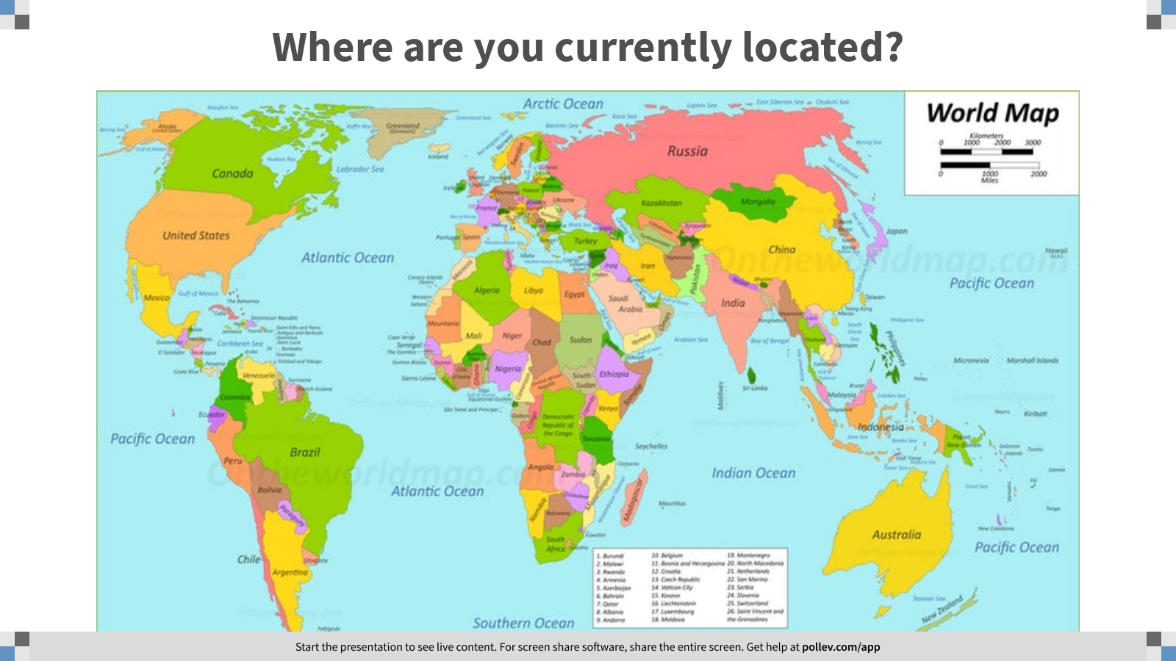
Notes:
Poll Title: Where are you currently located?
https://www.polleverywhere.com/clickable_images/QbDzcK30Z9pZO1dU5qhoJ

Slide 4
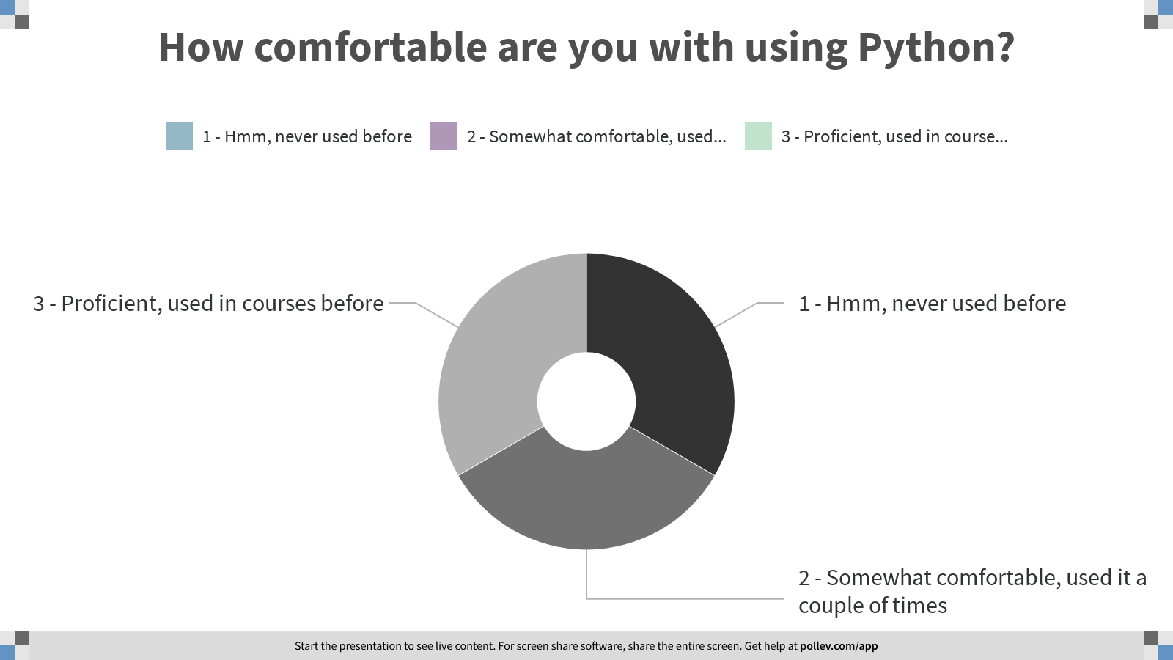
Notes:
Poll Title: How comfortable are you with using Python?
https://www.polleverywhere.com/multiple_choice_polls/l7rXFeE3c7FkHecMHbmZC

Slide 5
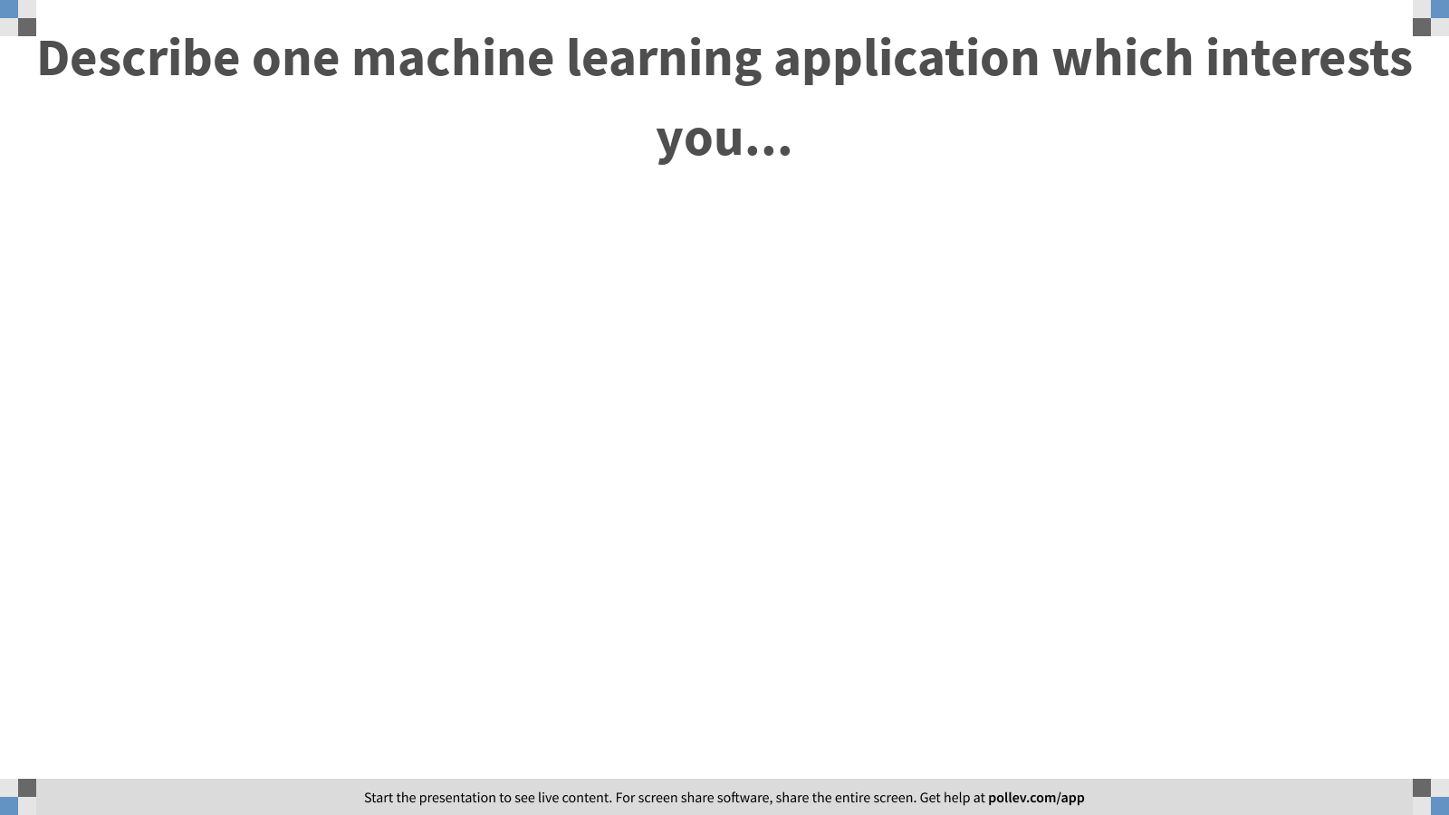
Notes:
Poll Title: Describe one machine learning application which interests you...
https://www.polleverywhere.com/free_text_polls/RAgbjbyT0APanibwlU78v

Slide 6
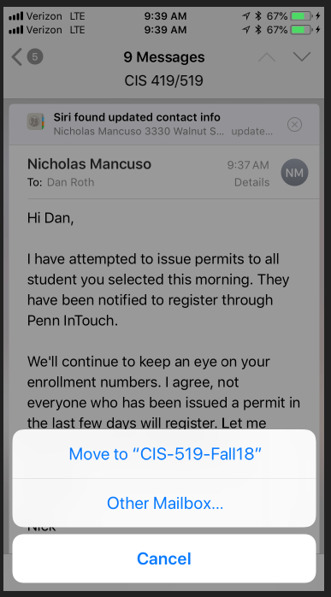
CIS 419/519: Applied Machine Learning
Monday, Wednesday: 10:30pm-12:00pm On Zoom
(My) Office hours: Mon 5-6 pm; Tue 12-1pm
13 TAs
Assignments: 5 Problems set (Python Programming)
  Weekly (light) on-line quizzes
Weekly Discussion Sessions
Mid Term Exam (take home)
[Project] (We’ll talk about it later)
Final (take home)
No real textbook:
  Slides/Mitchell/Goldberg/Other Books/Lecture notes /Literature
Starting next week
TAs Office Hours will also start next week
HW0 !!!
Go to the web site
Be on Piazza
Registration for Class

Slide 7
CIS 419/519: Today
What is Learning?
Who are you?
What is CIS 419/519 about?
The Badges Game…

Slide 8
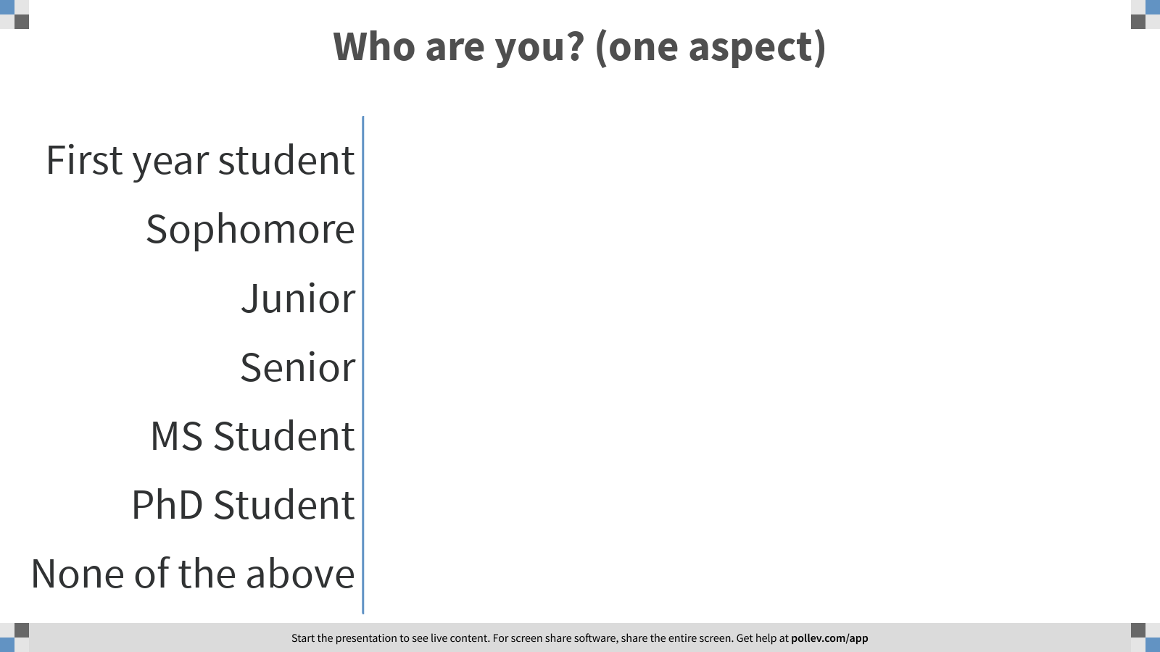
Notes:
Poll Title: Who are you? (one aspect)
https://www.polleverywhere.com/multiple_choice_polls/7uuauLkP0HvyKNPcvYlI8

Slide 9
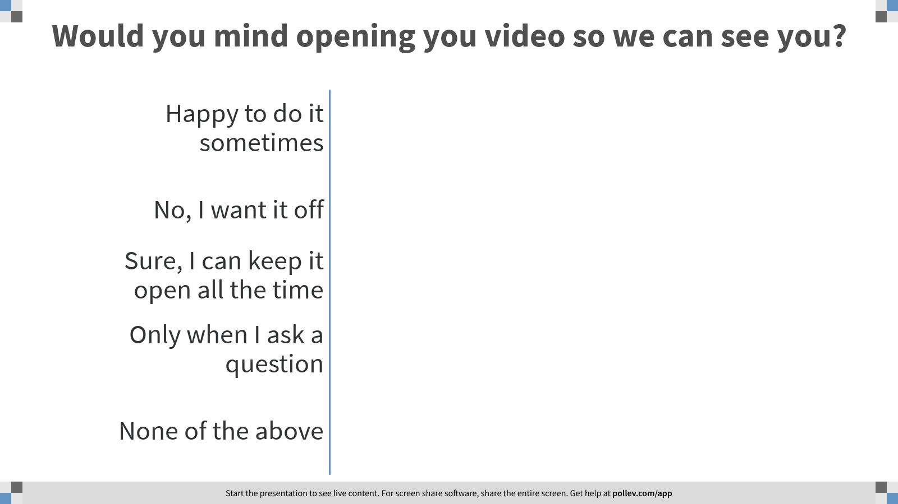
Notes:
Poll Title: Would you mind opening you video so we can see you?
https://www.polleverywhere.com/multiple_choice_polls/V02FjycXA7bhwGkJuLOXk

Slide 10
An Owed to the Spelling Checker
    I have a spelling checker, it came with my PC
    It plane lee marks four my revue
    Miss steaks aye can knot sea.
    Eye ran this poem threw it, your sure reel glad two no.
    Its vary polished in it's weigh
    My checker tolled me sew.
    A checker is a bless sing, it freeze yew lodes of thyme.
    It helps me right awl stiles two reed
    And aides me when aye rime.
    Each frays come posed up on my screen
    Eye trussed to bee a joule...

Slide 11
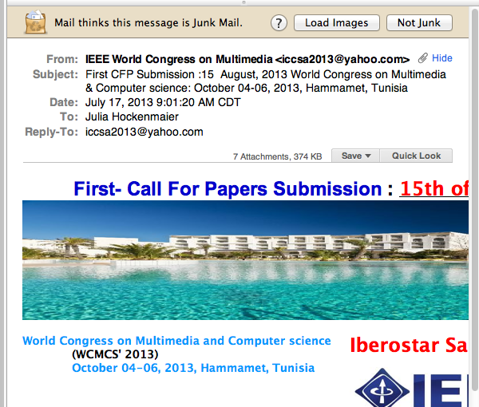
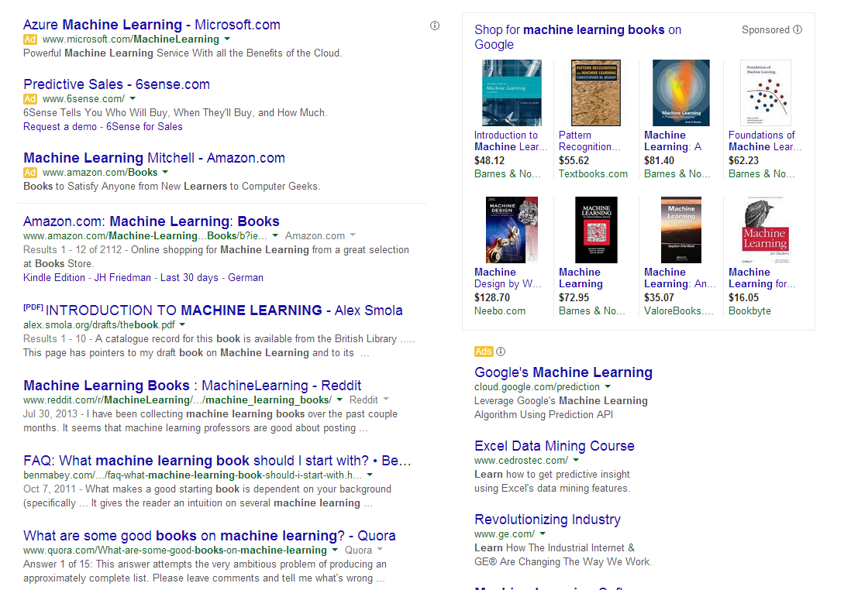
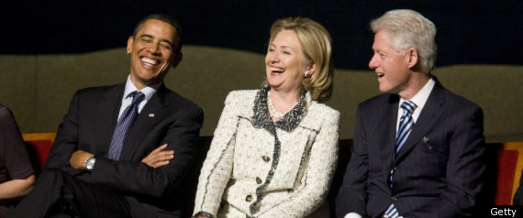
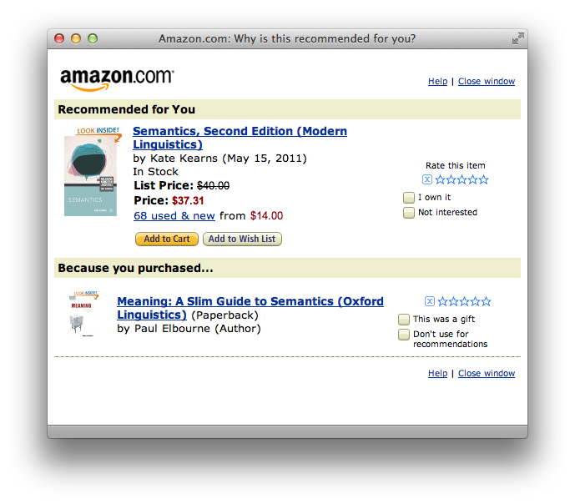
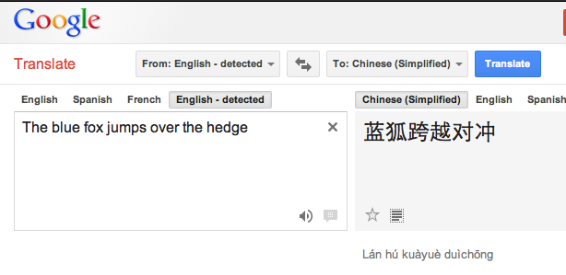
Machine Learning is Everywhere
Notes:
What else do you know about them?
Affluent
Gender
Ethnicity
There are other people around

Slide 12
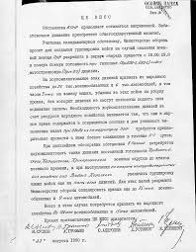
Applications: Spam Detection
  This is a binary classification task:
  Assign one of two labels (i.e. yes/no) to the input (here, an email message)
  Classification requires a model (a classifier) to determine which label to assign to items.
  In this class, we study algorithms and techniques to learn such models from data.
Documents Labels
Documents Politics, Sports, Finance
Sentences Positive, Negative
Phrases Person, Location
Images Cats, Dogs, Snakes
Medical records Admit again soon/Not
?

Slide 13
Some More Involved Examples
Driving:
  https://www.youtube.com/watch?v=_1MHGUC_BzQ
  E.g., go to 11:48
Objects:
  https://www.youtube.com/watch?v=_1MHGUC_BzQ
  Go to 1:41
Tesla Accidents:
  https://www.youtube.com/watch?v=FVgkWii5JdM
  Go to 1:45

Slide 14
Machine Learning: Any Limitations?
Notes:
What else do you know about them?
Affluent
Gender
Ethnicity
There are other people around

Slide 15
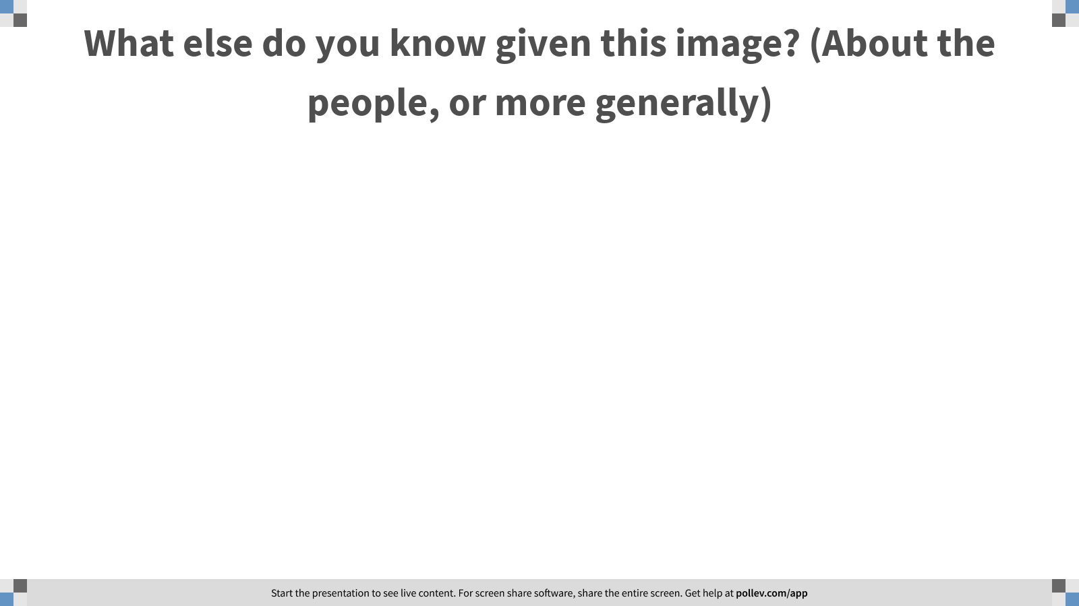
Notes:
Poll Title: What else do you know about them?
https://www.polleverywhere.com/free_text_polls/P8ggiTzV2CD3HrN3jXMUb

Slide 16
Some More Involved Examples
Wikifier:
  https://www.youtube.com/watch?v=IkryLTdogjw
Some text generation:
  https://transformer.huggingface.co/doc/arxiv-nlp

Slide 17
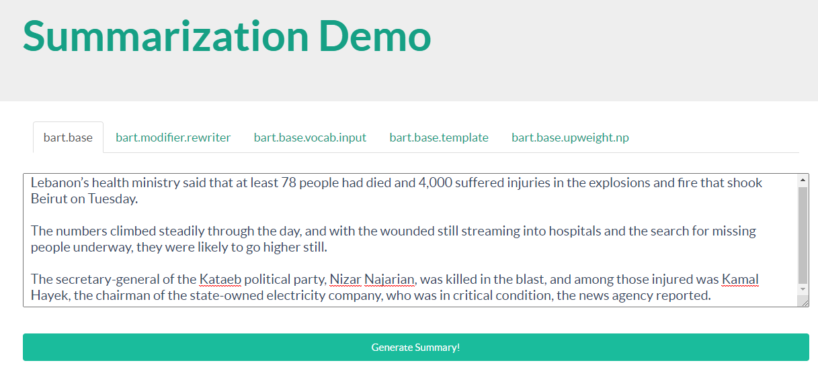
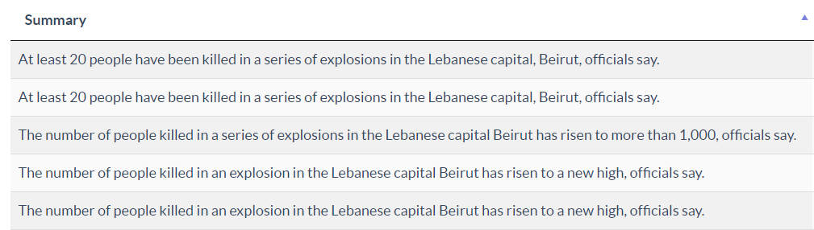
Automated Summarization (And hallucination)
A NYT article on the Beirut explosion
And its summary

Slide 18
Comprehension
(ENGLAND, June, 1989) - Christopher Robin is alive and well. He lives in England. He is the same person that you read about in the book, Winnie the Pooh. As a boy, Chris lived in a pretty home called Cotchfield Farm. When Chris was three years old, his father wrote a poem about him. The poem was printed in a magazine for others to read. Mr. Robin then wrote a book. He made up a fairy tale land where Chris lived. His friends were animals. There was a bear called Winnie the Pooh. There was also an owl and a young pig, called a piglet. All the animals were stuffed toys that Chris owned. Mr. Robin made them come to life with his words. The places in the story were all near Cotchfield Farm. Winnie the Pooh was written in 1925. Children still love to read about Christopher Robin and his animal friends. Most people don't know he is a real person who is grown now. He has written two books of his own. They tell what it is like to be famous.
1. Christopher Robin was born in England. 2. Winnie the Pooh is a title of a book.
3. Christopher Robin’s dad was a magician. 4. Christopher Robin must be at least 65 now.
This is an Inference Problem; where is the learning?
Notes:
18

Slide 19
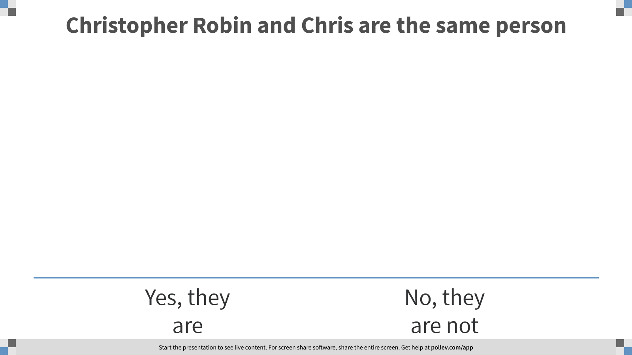
Notes:
Poll Title: Christopher Robin and Chris are the same person
https://www.polleverywhere.com/multiple_choice_polls/IBC7VgblHd7YoeSd7rmAY

Slide 20
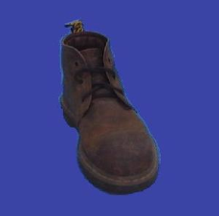
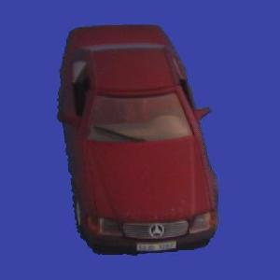
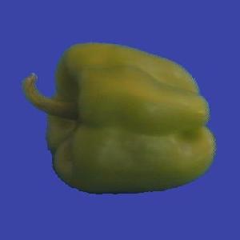
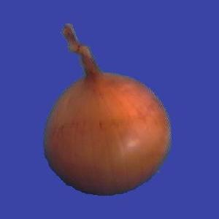
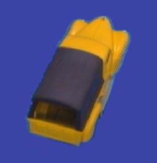
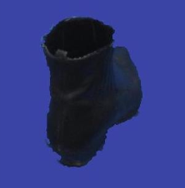
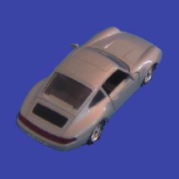
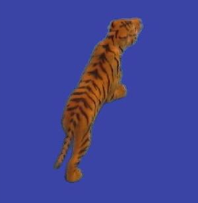
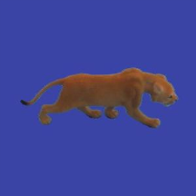
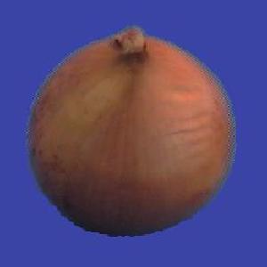
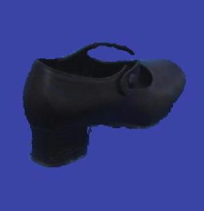
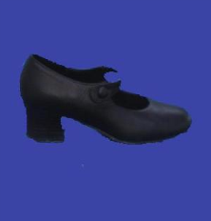
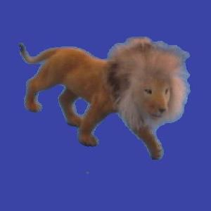
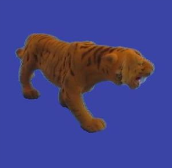
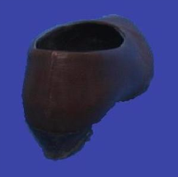
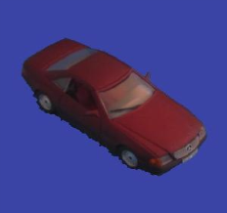
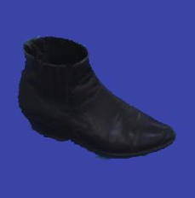
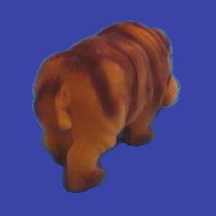

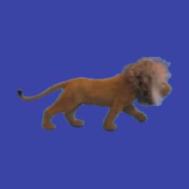
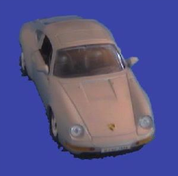
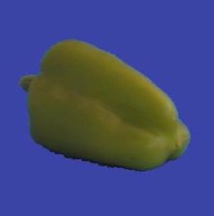

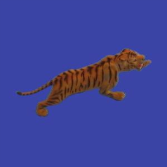
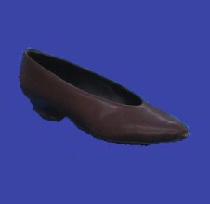
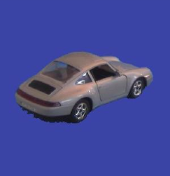
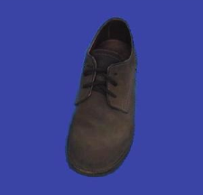
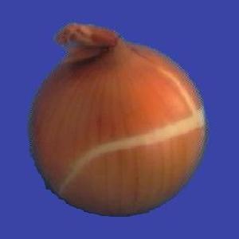

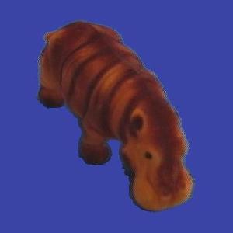
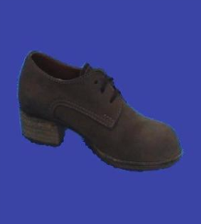
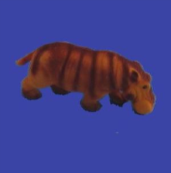
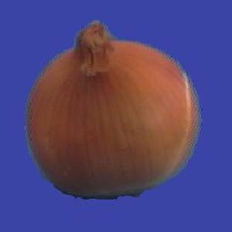
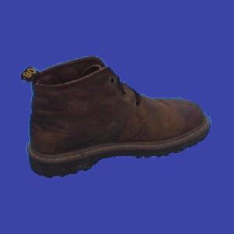
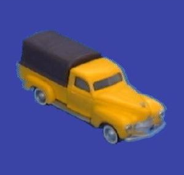
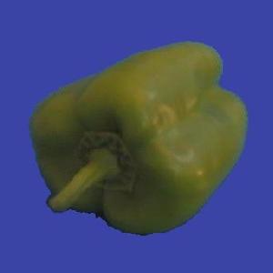
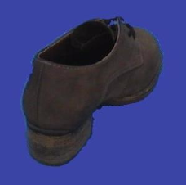


















Slide 21

Notes:
Poll Title: What do you see in this image?
https://www.polleverywhere.com/free_text_polls/42LWu0njynpUcsHCs1DUg

Slide 22
Learning
  Learning is at the core of
    Understanding High Level Cognition
    Performing knowledge intensive inferences
    Building adaptive, intelligent systems
    Dealing with messy, real world data
    Analytics
  Learning has multiple purposes
    Knowledge Acquisition
    Integration of various knowledge sources to ensure robust behavior
    Adaptation (human, systems)
    Decision Making (Predictions)

Slide 23
Learning = Generalization
H. Simon -
“Learning denotes changes in the system that are adaptive in the sense that they enable the system to do the task or tasks drawn from the same population more efficiently and more effectively the next time.”
Remember this!
(and remember the Tesla example)
The ability to perform a task in a situation which has never been encountered before

Slide 24
Learning = Generalization
The learner has to be able to classify items
it has never seen before.
Mail thinks this message is about my Fall 2018 ML Class

Slide 25

Notes:
Poll Title: How can we expect a program to make predictions on items it has never seen before? What should this program rely on?
https://www.polleverywhere.com/free_text_polls/RUbytjjOp2IT2fUOrkJ9j

Slide 26
Learning = Generalization
The ability to perform a task in a situation which has never been encountered before
Classification
  Medical diagnosis; credit card applications; hand-written letters; ad selection; sentiment assignment,…
Planning and acting
  Game playing (chess, backgammon, go); driving a car
Skills
  (A robot) balancing a pole; playing tennis; driving
Common sense reasoning
  Natural language interactions
The Badges game
What does the algorithm gets as input?
(features)
Generalization depends on the Representation as much as it depends on the Algorithm used.

Slide 27

Same Population?
In New York State, the longest period of daylight occurs during the month of _________.
New Zealand
Notes:
If you can solve the first problem, you’d expect to be able to solve the other one too; so, what’s the meaning of “same population”?

Slide 28
Why Study Machine Learning?
“A breakthrough in machine learning would be worth ten Microsofts”
-Bill Gates, Chairman, Microsoft
“Machine learning is the next Internet”
-Tony Tether, Former Director, DARPA
Machine learning is the hot new thing”
-John Hennessy, President, Stanford
“Machine learning is going to result in a real revolution”
-Greg Papadopoulos, CTO, Sun
“Machine learning is today’s discontinuity”
-Jerry Yang, CEO, Yahoo

Slide 29
Why Study Learning?
  Computer systems with new capabilities.
  AI
  Understand human and biological learning
  Understanding teaching better.
  Time is right.
    Initial algorithms and theory in place.
    Growing amounts of on-line data
    Computational power available.
    Necessity: many things we want to do cannot be done by “programming”.
    (Think about all the examples given earlier)

Slide 30
Learning is the Future
Learning techniques will be a basis for every application that involves a connection to the messy real world
Basic learning algorithms are ready for use in applications today
Prospects for broader future applications make for exciting fundamental research and development opportunities
Many unresolved issues – Theory and Systems
  While learning is hot, there are many things we don’t know how to do
  And that’s why this is NOT a class about deep neural networks
Very active field
What to teach?
  The fundamental paradigms
  Some of the most important algorithmic ideas
  Modeling
And: what we don’t know

Slide 31




US Open Highlights
Over 700 matches over two weeks periods.
A lot of manpower required to generate video highlights….
Key: automate using incidental signals
  Crowd noise, like gasps and cheers.
  Players’ gestures and reactions (e.g. celebratory air punches and fist pumps)
  Non-trivial: need to deal with biases, etc.
https://venturebeat.com/2019/07/05/how-wimbledon-and-watson-are-using-ai-to-curate-video-highlights/

Slide 32
Course Overview
      Introduction: Basic problems and questions
      A detailed example: Linear classifiers; key algorithmic idea
      Two Basic Paradigms:
        Discriminative Learning & Generative/Probabilistic Learning
      Learning Protocols:
        Supervised; Unsupervised; Semi-supervised
      Algorithms
        Gradient Descent
        Decision Trees
        Linear Representations: (Perceptron; SVMs; Kernels)
        Neural Networks/Deep Learning
        Probabilistic Representations (naïve Bayes)
        Unsupervised /Semi supervised: EM
        Clustering; Dimensionality Reduction
      Modeling; Evaluation; Real world challenges
      Ethics

Slide 33
CIS 419/519: Applied Machine Learning
Monday, Wednesday: 10:30pm-12:00pm On Zoom
Office hours: Mon 5-6 pm; Tue 12-1pm
13 TAs
Assignments: 5 Problems set (Python Programming)
  Weekly (light) on-line quizzes
Weekly Discussion Sessions
Mid Term Exam (take home)
[Project] (look at the schedule)
Final (take home)
No real textbook:
  Slides/Mitchell/Goldberg/Other Books/Lecture notes /Literature
Starting next week
TAs Office Hours will also start next week
HW0 !!!
Go to the web site
Be on Piazza
Registration for Class

Slide 34
CIS 519: What have you learned so far?
What do you need to know:
  Some exposure to:
    Theory of Computation
    Probability Theory
    Linear Algebra
  Programming (Python)
Homework 0
  If you could not comfortably deal with 2/3 of this within a few hours, please take the prerequisites first; come back next semester/year.
Participate, Ask Questions
Ask during class, not after class
Applied Machine Learning
Applied: mostly in HW
Machine learning: mostly in class, quizzes, exams

Slide 35
CIS 519: Policies
  Cheating
    No.
    We take it very seriously.
  Homework:
    Collaboration is encouraged
    But, you have to write your own solution/code.
  Late Policy:
    You have a credit of 4 days; That’s it.
  Grading:
    40% - homework; ; 35%-final; 20%-midterm; 5% Quizzes;
    Participation in Polls is mandatory (80% of the meetings)
    [Projects: 20%]
  Questions?
Class’ Web Page
Note also the Schedule Page and our Notes

Slide 36
CIS 519 on the web
Check our class website:
  Schedule, slides, videos, policies
    https://www.seas.upenn.edu/~cis519/fall2020/index.html
    Sign up, participate in our Piazza forum:
    Announcements and discussions
    https://piazza.com/class/kec0q01gqceim
  Check out our team
    Office hours
    [Optional] Discussion Sessions

Slide 37

Notes:
Poll Title: How will you rate today's lecture?
https://www.polleverywhere.com/multiple_choice_polls/7IigS9Ca1MBufgVcLVIZg

Slide 38

Notes:
Poll Title: Did I ask too many questions?
https://www.polleverywhere.com/multiple_choice_polls/QwjqXOPy8Eq0J2QYuQ5RL

Slide 39
What is Learning?
  The Badges Game…
    This is an example of the key learning protocol: supervised learning
  First question: Are you sure you got it?
    Why?
  Issues:
    Prediction or Modeling?
    Representation
    Problem setting
    Background Knowledge
    When did learning take place?
    Algorithm
Notes:
Badges game
Don’t give me the answer
Start thinking about how to write a program that will figure out whether my name has + or – next to it.

