Slide 1
Introduction to Machine Learning
Dan Roth
danroth@seas.upenn.edu|http://www.cis.upenn.edu/~danroth/|461C, 3401 Walnut
Slides were created by Dan Roth (for CIS519/419 at Penn or CS446 at UIUC),
Some slides were taken with approval from other authors who have made their ML slides available.

Slide 2
Course Overview
The class is recorded
Will be available on the web site
Introduction: Basic problems and questions
A detailed example: Linear classifiers; key algorithmic idea
Two Basic Paradigms:
Discriminative Learning & Generative/Probabilistic Learning
Learning Protocols:
Supervised; Unsupervised; Semi-supervised
Algorithms
Gradient Descent
Decision Trees
Linear Representations: (Perceptron; SVMs; Kernels)
Neural Networks/Deep Learning
Probabilistic Representations (naïve Bayes)
Unsupervised /Semi supervised: EM
Clustering; Dimensionality Reduction
Modeling; Evaluation; Real world challenges
Ethics

Slide 3
CIS 419/519: Applied Machine Learning
Monday, Wednesday: 10:30pm-12:00pm On Zoom
(My) Office hours: Mon 5-6 pm; Tue 12-1pm
13 TAs
Assignments: 5 Problems set (Python Programming)
Weekly (light) on-line quizzes
Weekly Discussion Sessions
Mid Term Exam (take home)
[Project] (We’ll talk about it later)
Final (take home)
No real textbook:
Slides/Mitchell/Goldberg/Other Books/Lecture notes /Literature
Started this week
TAs Office Hours also started
HW0 !!!
Go to the web site
Be on Piazza
Registration for Class

Slide 4
CIS 519: What have you learned so far?
What do you need to know:
Some exposure to:
Theory of Computation
Probability Theory
Linear Algebra
Programming (Python)
Homework 0
If you could not comfortably deal with 2/3 of this within a few hours, please take the prerequisites first; come back next semester/year.
Participate, Ask Questions
Applied Machine Learning
Applied: mostly in HW
Machine learning: mostly in class, quizzes, exams

Slide 5
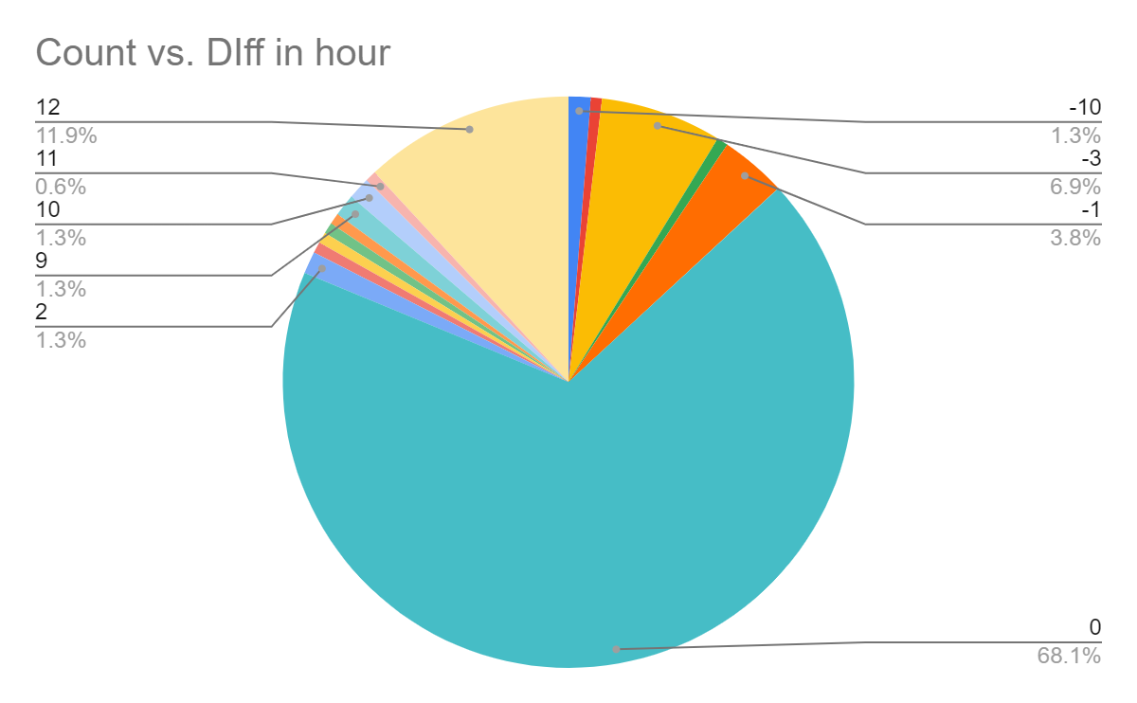
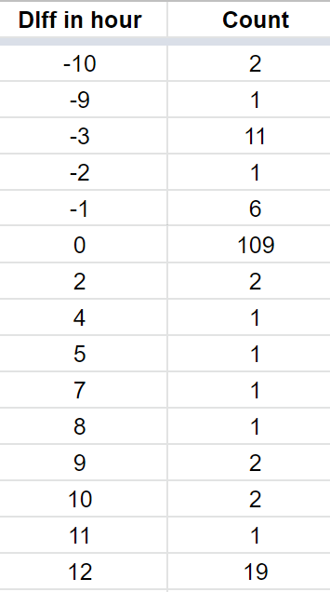
Key Comments From Survey
Math Background
We’ll add recitations to help with that.
Still, HW0 is your yard stick
Computation
We’ll provide guidelines
Time Zones
The vast majority of you are in “ok” times zones [ET-3,ET+12]. Please email if you are not.
Additional time on exams
Penn has standard ways to deal with it; ask me if you don’t know how to access it. [May not be needed, though]

Slide 6
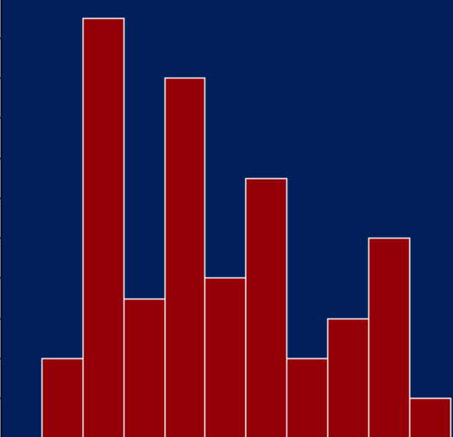
CIS 519: Policies
Cheating
No.
We take it very seriously.
Homework:
Collaboration is encouraged
But, you have to write your own solution/code.
Late Policy:
You have a credit of 4 days; That’s it.
Grading:
Possible separate for grad/undergrads.
40% - homework; 35%-final; 20%-midterm; 5% Quizzes
[Projects: 20%]
Questions?
Class’ Web Page
Note also the Schedule Page and our Notes
A: 35-40% ; B: 40% C: 20%
Past Grade Distribution

Slide 7
CIS 519 on the web
Check our class website:
Schedule, slides, videos, policies
https://www.seas.upenn.edu/~cis519/fall2020/
Sign up, participate in our Piazza forum:
Announcements and discussions
https://piazza.com/class/kec0q01gqceim
Check out our team
Office hours
[Optional] Discussion Sessions

Slide 8
Notes:
Poll Title: Any additional administrative questions? https://www.polleverywhere.com/free_text_polls/12TZgX0hVIms4TLf11sQZ

Slide 10
Today
Introduce some key concepts in Machine Learning
At a high level
Representation
Supervised Learning Protocol
New Concepts:
Instance Space
Label Space
Model
A Hypothesis Space

Slide 11
What is Learning?
The Badges Game…
This is an example of the key learning protocol: supervised learning
First question: Are you sure you got it?
Why?
Issues:
Prediction or Modeling?
Representation
Problem setting
Background Knowledge
When did learning take place?
Algorithm
Notes:
Badges game
Don’t give me the answer
Start thinking about how to write a program that will figure out whether my name has + or – next to it.

Slide 12
Notes:
Poll Title: Do you that answer (the function used to generate this data)? https://www.polleverywhere.com/multiple_choice_polls/2RiHNQnT5wxTkiwmPykmb?flow=Default&onscreen=persist

Slide 13
Notes:
Poll Title: If you know the answer, say concisely why are you sure you have the right answer? (don't give the answer, just say why you are sure) https://www.polleverywhere.com/free_text_polls/yvPXwS4WIAkSj6om3VaKY

Slide 14
What is Learning?
The Badges Game…
This is an example of the key learning protocol: supervised learning
First question: Are you sure you got it?
Why?
Issues:
Prediction or Modeling?
Representation
Problem setting
Background Knowledge
When did learning take place?
Algorithm
Notes:
Badges game
Don’t give me the answer
Start thinking about how to write a program that will figure out whether my name has + or – next to it.

Slide 15
Training data
+ Naoki Abe
- Myriam Abramson
+ David W. Aha
+ Kamal M. Ali
- Eric Allender
+ Dana Angluin
- Chidanand Apte
+ Minoru Asada
+ Lars Asker
+ Javed Aslam
+ Jose L. Balcazar
- Cristina Baroglio
+ Peter Bartlett
- Eric Baum
+ Welton Becket
- Shai Ben-David
+ George Berg
+ Neil Berkman
+ Malini Bhandaru
+ Bir Bhanu
+ Reinhard Blasig
- Avrim Blum
- Anselm Blumer
+ Justin Boyan
+ Carla E. Brodley
+ Nader Bshouty
- Wray Buntine
- Andrey Burago
+ Tom Bylander
+ Bill Byrne
- Claire Cardie
+ John Case
+ Jason Catlett
- Philip Chan
- Zhixiang Chen
- Chris Darken

Slide 16
The Badges game
+ Naoki Abe
- Eric Baum
Conference attendees to the 1994 Machine Learning conference were given name badges labeled with + or −.
What function was used to assign these labels?

Slide 17
Raw test data
Shivani Agarwal
Gerald F. DeJong
Chris Drummond
Yolanda Gil
Attilio Giordana
Jiarong Hong
J. R. Quinlan
Priscilla Rasmussen
Dan Roth
Yoram Singer
Lyle H. Ungar

Slide 18
Labeled test data
? Shivani Agarwal
+ Gerald F. DeJong
- Chris Drummond
+ Yolanda Gil
- Attilio Giordana
+ Jiarong Hong
- J. R. Quinlan
- Priscilla Rasmussen
+ Dan Roth
+ Yoram Singer
- Lyle H. Ungar

Slide 19
Notes:
Poll Title: Which problem is easier? Yours, or the one presented to the conference attendees? https://www.polleverywhere.com/multiple_choice_polls/KPr74EU5SpeDVh5rEa9t4

Slide 20
Notes:
Poll Title: Which problem was easier, yours or the conference attendees (type: Ours, Theirs); why (brief reason) https://www.polleverywhere.com/free_text_polls/UtfnXzozcKR95g0qEHZmk

Slide 21
Notes:
Poll Title: If you were to write a computer program to solve this problem, what would you do? https://www.polleverywhere.com/free_text_polls/0AngFavVFDMr10MIJDE9M

Slide 22
Notes:
Poll Title: If I ask you to write a program that solves this problem, how would you represent the input? https://www.polleverywhere.com/free_text_polls/Vk1MqdInDCgXLn7fUWz3a

Slide 23
Notes:
Poll Title: What is the function the generated the badges data? https://www.polleverywhere.com/free_text_polls/sjbNdRCQyuLaAIomrkrGJ

Slide 24
Experiments with MLP
MLP: Multi=Layer Perceptron (feed forward Neural Network)
Architecture:
2 layers; 32 nodes in each layer.
Learning:
Loss function: Cross Entropy; optimizer: Adam
Learning rate: 5e-4
500 epochs; batch size 16
Tuning: only for epochs and learning rate.
Data:
234 train / 60 test

Slide 25
Token based MLP model
input
Dan Roth
vocab | one-hot
Jane | 1,0,0,0,...
... | ...
Dan | 0,0,0,1,...
...
Roth | 0,1,0,0,...
Vocab-vector lookup
tokens
Dan
Roth
features
0,0,0,1...
0,1,0,0...
Fully connected layer
Model | Test Accuracy | Training Accuracy
Token based MLP | 58% | 100%
T5-3B | 52% | 100%
NN layers
Nonlinear layer
Fully connected layer
Nonlinear layer
Predicted probabilities

Slide 26
Character based MLP model
input
Dan Roth
vocab | one-hot
a | 1,0,0,0,...
... | ...
d | 0,0,0,1,...
...
z | 0,0,0,0,...
Vocab-vector lookup
tokens
d
a
...
features
0,0,0,1...
1,0,0,0...
Fully connected layer
Model | Test Accuracy | Training Accuracy
Token based MLP | 58% | 100%
T5-3B | 52% | 100%
Char. based MLP | 92% | 100%
Char. based MLP with only 2nd char as input | 100% | 100%
NN layers
Nonlinear layer
Fully connected layer
Nonlinear layer
Predicted probabilities

Slide 27
What is Learning
The Badges Game…
This is an example of the key learning protocol: supervised learning
First question: Are you sure you got it?
Why?
Issues:
Which problem was easier?
Yours or the conference attendees?
Representation
Problem setting
Background Knowledge
When did learning take place?
Algorithm: can you write a program that takes this data as input and predicts the label for your name?
Notes:
Badges game
Don’t give me the answer
Start thinking about how to write a program that will figure out whether my name has + or – next to it.

Slide 28
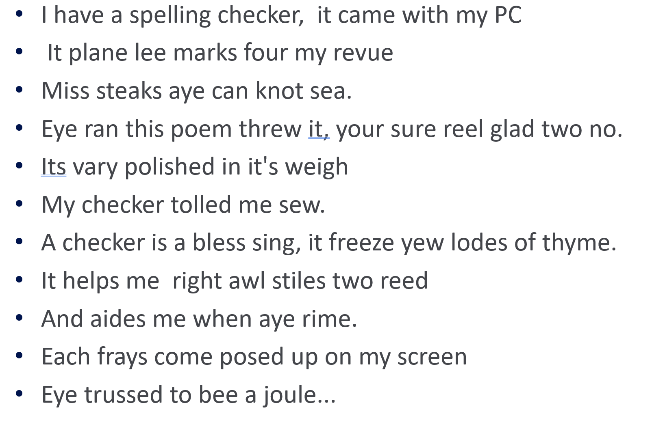
Other Examples

Slide 29
Machine Learning
Sort these numbers in decreasing order
2, 4, 18, 1, 77, 0, 85
Rules
Traditional Programming
Answers
Data
Makes sense.
Use Machine Learning
Does not make sense.
Do not use Machine Learning
(what are the risks if you do?)
Answers
Machine Learning
Rules
Data

Slide 30
Notes:
Poll Title: Questions? Comments? https://www.polleverywhere.com/free_text_polls/xUNumMJihogUFQHamsw8P

Slide 31
Supervised Learning
Input
$$x∈ X$$
An item$x$ drawn from an input space $X$
System
$$y = f(x)$$
Output
$$y∈ Y$$
An item$y$ drawn from an output space $Y$
Dan Roth
+/-
We consider systems that apply a function $f( )$ to input items x and return an output $y=f(x)$.

Slide 32
Supervised Learning
Input
$$x∈ X$$
An item$x$ drawn from an input space $X$
System
$$y = f(x)$$
Output
$$y∈ Y$$
An item$y$ drawn from an output space $Y$
In (supervised) machine learning, we deal with systems whose $f(x)$ is learned from examples.

Slide 33
Why use learning?
We typically use machine learning when the function $f(x)$ we want the system to apply is unknown to us, and we cannot “think” about it. The function could actually be simple.

Slide 34
Supervised Learning
Input
$$x∈ X$$
An item $x$ drawn from an instance space $X$
Target function
$$y = f(x)$$
Output
$$y∈ Y$$
An item $y$ drawn from a
label space $Y$
Learned Model $$y = g(x)$$
The space of all functions our algorithm “considers” is called the Hypothesis space.

Slide 35
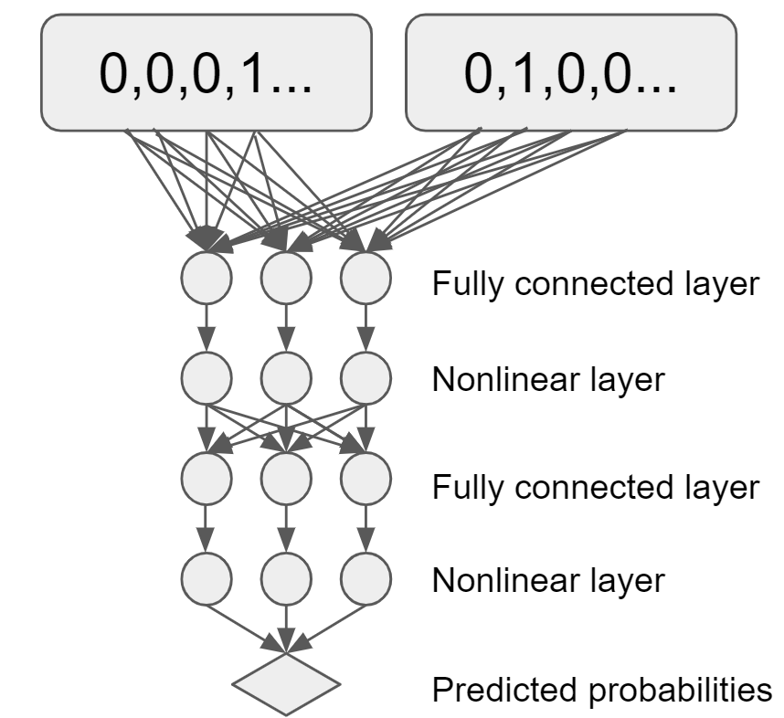
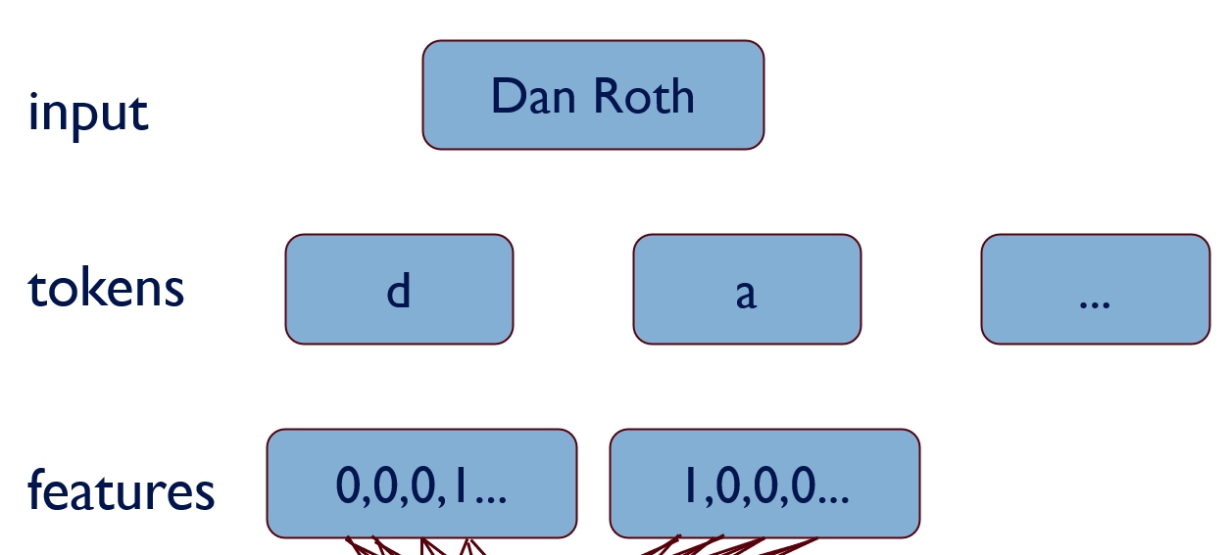
Supervised learning: Training
Give the learner examples in $D train$
The learner returns a model $g(x)$
Labeled Training Data $$D train$$ $(x1, y1)$
$$(x2, y2)$$
…
$$(xN, y_{N})$$
( Dan Roth,
+)
An input example
Learned model
$$g(x)$$
Learning Algorithm
If
(the…character of the …token is..) AND
(the …. is…. )
then Negative. Otherwise,
Positive.
An element in the instance Space
$g(x)$is the model we’ll use in our application

Slide 36
Supervised learning: Testing
Reserve some labeled data for testing
Labeled
Test Data $$D test$$ $(x’1, y’_{1})$
$(x’2, y’_{2})$
…
$$(x’M, y’M)$$

Slide 37
Supervised learning: Testing
Labeled
Test Data $$D test \\ (x’1, y’_{1})$$
$$(x’2, y’_{2})$$
$$…$$
$$(x’M, y’M)$$
Raw Test Data $$X test$$ $x’1$ $$x’2$$
$$…$$
$$x’M$$
Test Labels $$Y test \\ y’_{1}$$
$y’_{2}$
...
$$y’M$$

Slide 38
Supervised learning: Testing
Apply the model to the raw test data
Evaluate by comparing predicted labels against the test labels
Raw Test Data $$X test$$ $x’1$ $$x’2$$
$$…$$
$$x’M$$
Predicted Labels $$g(X test)$$ $g(x’1)$ $$g(x’2)$$
$$…$$
$$g(x’M)$$
Test Labels $$Y test \\ y’_{1}$$
$$y’_{2}$$
$$…$$
$$y’M$$
Learned model
$$g(x)$$
Notes:
Could potentially check g(x) (Exact learning);
Can the test data, even without the labels, be used to learn something? Maybe something about the distribution of the tests?

Slide 39
Key Issues in Machine Learning
Modeling
How to formulate application problems as machine learning problems ? How to represent the data?
Learning Protocols (where is the data & labels coming from?)
Representation
What functions should we learn (hypothesis spaces) ?
How to map raw input to an instance space?
Any rigorous way to find these? Any general approach?
Algorithms
What are good algorithms?
How do we define success?
Generalization vs. over fitting
The computational problem
Notes:
Badges game
Don’t give me the answer
Start thinking about how to write a program that will figure out whether my name has + or – next to it.

Slide 40
Using supervised learning
What is our instance space?
Gloss: What kind of features are we using?
What is our label space?
Gloss: What kind of learning task are we dealing with?
What is our hypothesis space?
Gloss: What kind of functions (models) are we learning?
What learning algorithm do we use?
Gloss: How do we learn the model from the labeled data?
What is our loss function/evaluation metric?
Gloss: How do we measure success? What drives learning?
Notes:
What is the real input the algorithm sees?
What are the labels? Folder names; maybe there is a hierarchy
Set of rules: if the sender is… put it in their folder. Decision tree: if condition A is satisfied, Check condition B; if not, Check condition C.; NN
The representation might dictate the learning algorithm.
Number of correct predictions? Maybe it’s an non-symmetric loss: I never want to file incorrectly, I prefer to abstain. Maybe there is a hierarchy, and I want a loss that is sensitive to the hierarchy.

Slide 41
Notes:
Poll Title: Questions so far? https://www.polleverywhere.com/free_text_polls/Sv8B3YbtKhEHO7xJmMwnO

Slide 42
1. The instance space $X$
Input
$$x∈X$$
An item $x$ drawn from an instance space X
Learned
Model
$$y = g(x)$$
Output
$$y∈Y$$
An item $y$ drawn from a label space $Y$
Designing an appropriate instance space$X$ is crucial for how well we can predict $y$.

Slide 43
Instance Spaces
What instance spaces would you consider?

Slide 44
Notes:
Poll Title: Suggest an instance space for email classification problem. Choose either (1) Boolean Features, (2) Numerical Features, (3) Others. Say which type you choose and give two examples. https://www.polleverywhere.com/free_text_polls/3j28aWzGamxZ383Ve3MsJ

Slide 45
Notes:
Poll Title: Did I ask too many questions? https://www.polleverywhere.com/multiple_choice_polls/QwjqXOPy8Eq0J2QYuQ5RL?flow=Default&onscreen=persist

Slide 46
Notes:
Poll Title: How will you rate today's lecture? https://www.polleverywhere.com/multiple_choice_polls/7IigS9Ca1MBufgVcLVIZg?display_state=chart&activity_state=opened&state=opened&flow=Engagement&onscreen=persist

Slide 47
Administration (9/14/20)
Are we recording? YES!
Will be available on the web site
HW0: please complete it. It’s mandatory (graded Pass/Fail)
1st quiz is out this week (Thursday night; due on Sunday night)
HW 1 will be released next week.
Questions?
Please ask/comment during class.
Feedback/Suggestions?

Slide 48
Last Time: Supervised Learning
Input
$$x∈ X$$
An item $x$ drawn from an instance space $X$
Target function
$$y = f(x)$$
Output
$$y∈ Y$$
An item $y$ drawn from a
label space $Y$
Learned Model $$y = g(x)$$
The space of all functions our algorithm “considers” is called the Hypothesis space.

Slide 49
Key Issues in Machine Learning
Modeling
How to formulate application problems as machine learning problems ? How to represent the data?
Learning Protocols (where is the data & labels coming from?)
Representation
What functions should we learn (hypothesis spaces) ?
How to map raw input to an instance space?
Any rigorous way to find these? Any general approach?
Algorithms
What are good algorithms?
How do we define success?
Generalization vs. over fitting
The computational problem
Notes:
Badges game
Don’t give me the answer
Start thinking about how to write a program that will figure out whether my name has + or – next to it.

Slide 50
Today
We’ll go in more details into the concepts introduced last time
Instance Space & Hypothesis Space
(since we’ll keep, for the most part, the labels to be Boolean {Yes/No})
We’ll begin to formalize
Modeling and Representation
We’ll see our first Learning Algorithm

Slide 51
1. The instance space $X$
When we apply machine learning to a task, we first need to define the instance space $X$.
Instances $x ∈ X$are defined by features:
Boolean features:
Is there a folder named after the sender?
Does this email contain the word ‘class’?
Does this email contain the word ‘waiting’?
Does this email contain the word ‘class’ and the word ‘waiting’?
Numerical features:
How often does ‘learning’ occur in this email?
How long is the email?
How many emails have I seen from this sender over the last day/week/month?
Bag of tokens
Just list all the tokens in the input
Does it add anything if you already have the previous two features?

Slide 52
What’s $X$ for the Badges game?
Possible features:
Gender/age/country of the person?
Length of their first or last name?
Does the name contain letter ‘x’?
How many vowels does their name contain?
Is the n-th letter a vowel?
Height;
Shoe size

Slide 53
$X$as a vector space
$X$ is an N-dimensional vector space (e.g. {0,1}^{N}, $ℝ_{}^{N}$)
Each dimension = one feature.
Each $x$is a feature vector (hence the boldface $x$).
Think of $x$ = [$x_{1}$ … $x_{N}$] as a point in$X$:
$$x2$$
$$x1$$

Slide 54
Good features are essential
The choice of features is crucial for how well a task can be learned.
In many application areas (language, vision, etc.), a lot of work goes into designing suitable features.
This requires domain expertise.
Think about the badges game
what if you were focusing on visual features?
Recall the two neural network examples: Token-based and Character-based
We can’t teach you what specific features to use for your task.
But we will touch on some general principles

Slide 55
2. The label space $Y$
Input
$$x∈X$$
An item $x$ drawn from an instance space $X$
Learned Model
$$y = g(x)$$
Output
$$y∈Y$$
An item $y$ drawn from a label space $Y$
The label space $Y$ determines what kind of supervised learning task we are dealing with

Slide 56
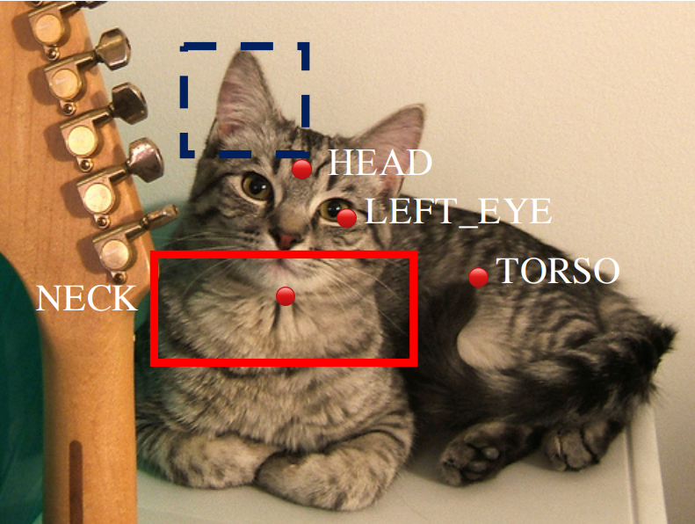
Supervised learning tasks I
Output labels $y∈ Y$ are categorical:
Binary classification: Two possible labels
Multiclass classification: $k$ possible labels
Output labels $y∈ Y$ are structured objects (sequences of labels, parse trees, graphs, etc.)
Structure learning: multiple labels that are related (thus constrained)
Three events. When classifying the temporal relations between them we need to account for the relations between them.

Slide 57
Supervised learning tasks II
Output labels $y∈ Y$ are numerical:
Regression (linear/polynomial):
Labels are continuous-valued
Learn a linear/polynomial function $f(x)$
Ranking:
Labels are ordinal
Learn an ordering ${f(x}_{1})>f\left(x_{2}\right)$ over input

Slide 58
3. The model $g(x)$
Input
$$x∈X$$
An item $x$ drawn from an instance space $X$
Learned Model
$$y = g(x)$$
Output
$$y∈Y$$
An item $y$ drawn from a
label space $Y$
We need to choose what kind of model we want to learn

Slide 59
Notes:
Poll Title: Questions so far? https://www.polleverywhere.com/free_text_polls/Sv8B3YbtKhEHO7xJmMwnO

Slide 60
A Learning Problem
$$x_{1}$$
$$x_{2}$$
Unknown
function
$$y = f (x_{1}, x_{2}, x_{3}, x_{4})$$
$$x_{3}$$
$$x_{4}$$
Example
$x_{1} x_{2} x_{3} x_{4}$ $y$
1 0 0 1 0 0
Can you learn this function? What is it?
2 0 1 0 0 0
3 0 0 1 1 1
4 1 0 0 1 1
5 0 1 1 0 0
6 1 1 0 0 0
7 0 1 0 1 0

Slide 61
Notes:
Poll Title: Suggest a target function given this data (write it in words or mathematical symbols) https://www.polleverywhere.com/free_text_polls/zRP4fZevhsThEkorzMXfZ

Slide 62
Hypothesis Space
Example
$x_{1} x_{2} x_{3} x_{4} y$
Complete Ignorance:
There are $216 = 65536$possible functions
over four input features.
We can’t figure out which one is
correct until we’ve seen every
possible input-output pair.
After observing seven examples we still
have $29$ possibilities for $f$
Is Learning Possible?
1 0 0 0 0 ?
2 0 0 0 1 ?
0 0 1 0 0
There are ${\left|Y\right|}^{\left|X\right|}$ possible functions $f(x)$from the instance space $X$ to the label space $Y$.
Learners typically consider only a subset of the functions from $X$ to $Y$, called the hypothesis space $H$. $H ⊆{\left|Y\right|}^{\left|X\right|}$
0 0 1 1 1
0 1 0 0 0
0 1 0 1 0
0 1 1 0 0
0 1 1 1 ?
1 0 0 0 ?
1 0 0 1 1
1 0 1 0 ?
1 0 1 1 ?
1 1 0 0 0
1 1 0 1 ?
1 1 1 0 ?
16 1 1 1 1 ?
Notes:
Badges game
Don’t give me the answer
Start thinking about how to write a program that will figure out whether my name has + or – next to it.

Slide 63
Hypothesis Space (2)
Simple Rules: There are only 16 simple conjunctive rules
of the form $y=x_{i}∧x_{j}∧x_{k}$
No simple rule explains the data. The same is true for simple clauses (disjunctions).
1 | 0 | 0 | 1 | 0 | 0
2 | 0 | 1 | 0 | 0 | 0
3 | 0 | 0 | 1 | 1 | 1
4 | 1 | 0 | 0 | 1 | 1
5 | 0 | 1 | 1 | 0 | 0
6 | 1 | 1 | 0 | 0 | 0
7 | 0 | 1 | 0 | 1 | 0
Rule Counterexample
Rule Counterexample
$$y=c$$
$$x_{1} 1100 0$$
$$x_{2} 0100 0$$
$$x_{3} 0110 0$$
$$x_{4} 0101 1$$
$$x_{1} ☹ x_{2} 1100 0$$
$$x_{1} ☹ x_{3} 0011 1$$
$$x_{1} ☹ x_{4} 0011 1$$
$$x_{2} ☹ x_{3} 0011 1$$
$$x_{2} ☹ x_{4} 0011 1$$
$$x_{3} ☹ x_{4} 1001 1$$
$$x_{1} ☹ x_{2} ☹ x_{3} 0011 1$$
$$x_{1} ☹ x_{2} ☹ x_{4} 0011 1$$
$$x_{1} ☹ x_{3} ☹ x_{4} 0011 1$$
$$x_{2} ☹ x_{3} ☹ x_{4} 0011 1$$
$$x_{1} ☹ x_{2} ☹ x_{3} ☹ x_{4} 0011 1$$
Notes:
Badges game
Don’t give me the answer
Start thinking about how to write a program that will figure out whether my name has + or – next to it.

Slide 64
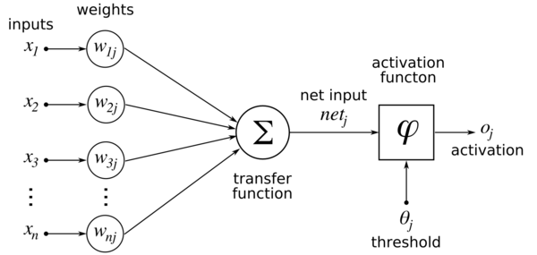
Hypothesis Space (3)
Don’t worry, this function is actually a neural network…
m-of-n rules: There are 32 possible rules
of the form “$y = 1$if and only if at least $m$ of the following $n$ variables are 1”
Notation: 2 variables from the set on the left.
Value: Index of the counterexample.
1 | 0 | 0 | 1 | 0 | 0
2 | 0 | 1 | 0 | 0 | 0
3 | 0 | 0 | 1 | 1 | 1
4 | 1 | 0 | 0 | 1 | 1
5 | 0 | 1 | 1 | 0 | 0
6 | 1 | 1 | 0 | 0 | 0
7 | 0 | 1 | 0 | 1 | 0
variables 1-of 2-of 3-of 4-of
variables 1-of 2-of 3-of 4-of
$x_{1}$ 3 - - -
$x_{2}$2 - - -
$x_{3}$1 - - -
$x_{4}$7 - - -
$x_{1},x_{2}$ 2 3 - -
$x_{1}, x_{3}$ 1 3 - -
$x_{1}, x_{4}$ 6 3 - -
$x_{2},x_{3}$2 3 - -
$x_{2}, x_{4}$2 3 - -
$x_{3}, x_{4}$4 4 - -
$x_{1},x_{2}, x_{3}$ 1 3 3 -
$x_{1},x_{2}, x_{4}$ 2 3 3 -
$x_{1},x_{3},x_{4}$ 1 ∗ ∗ ∗ 3 -
$x_{2}, x_{3},x_{4}$ 1 5 3 -
$x_{1}, x_{2}, x_{3},x_{4}$ 1 5 3 3
Found a consistent hypothesis!

Slide 65
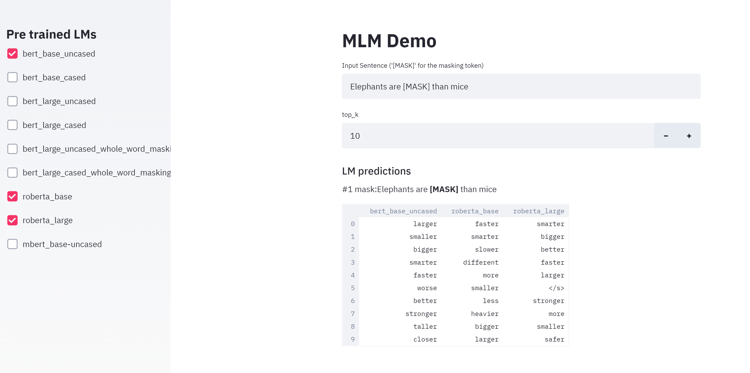
Is this Typical (1)?
Language Models: https://nlp.biu.ac.il/~lazary/lms/
Same Training Data
(used differently)
Different Predictions

Slide 66
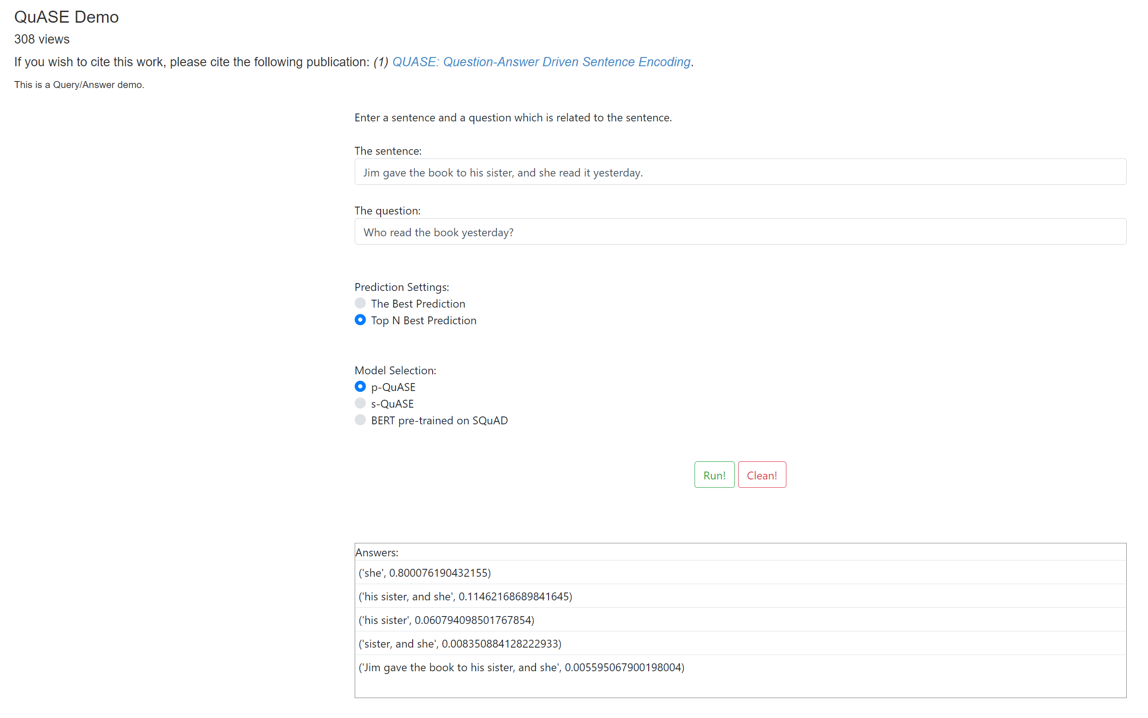
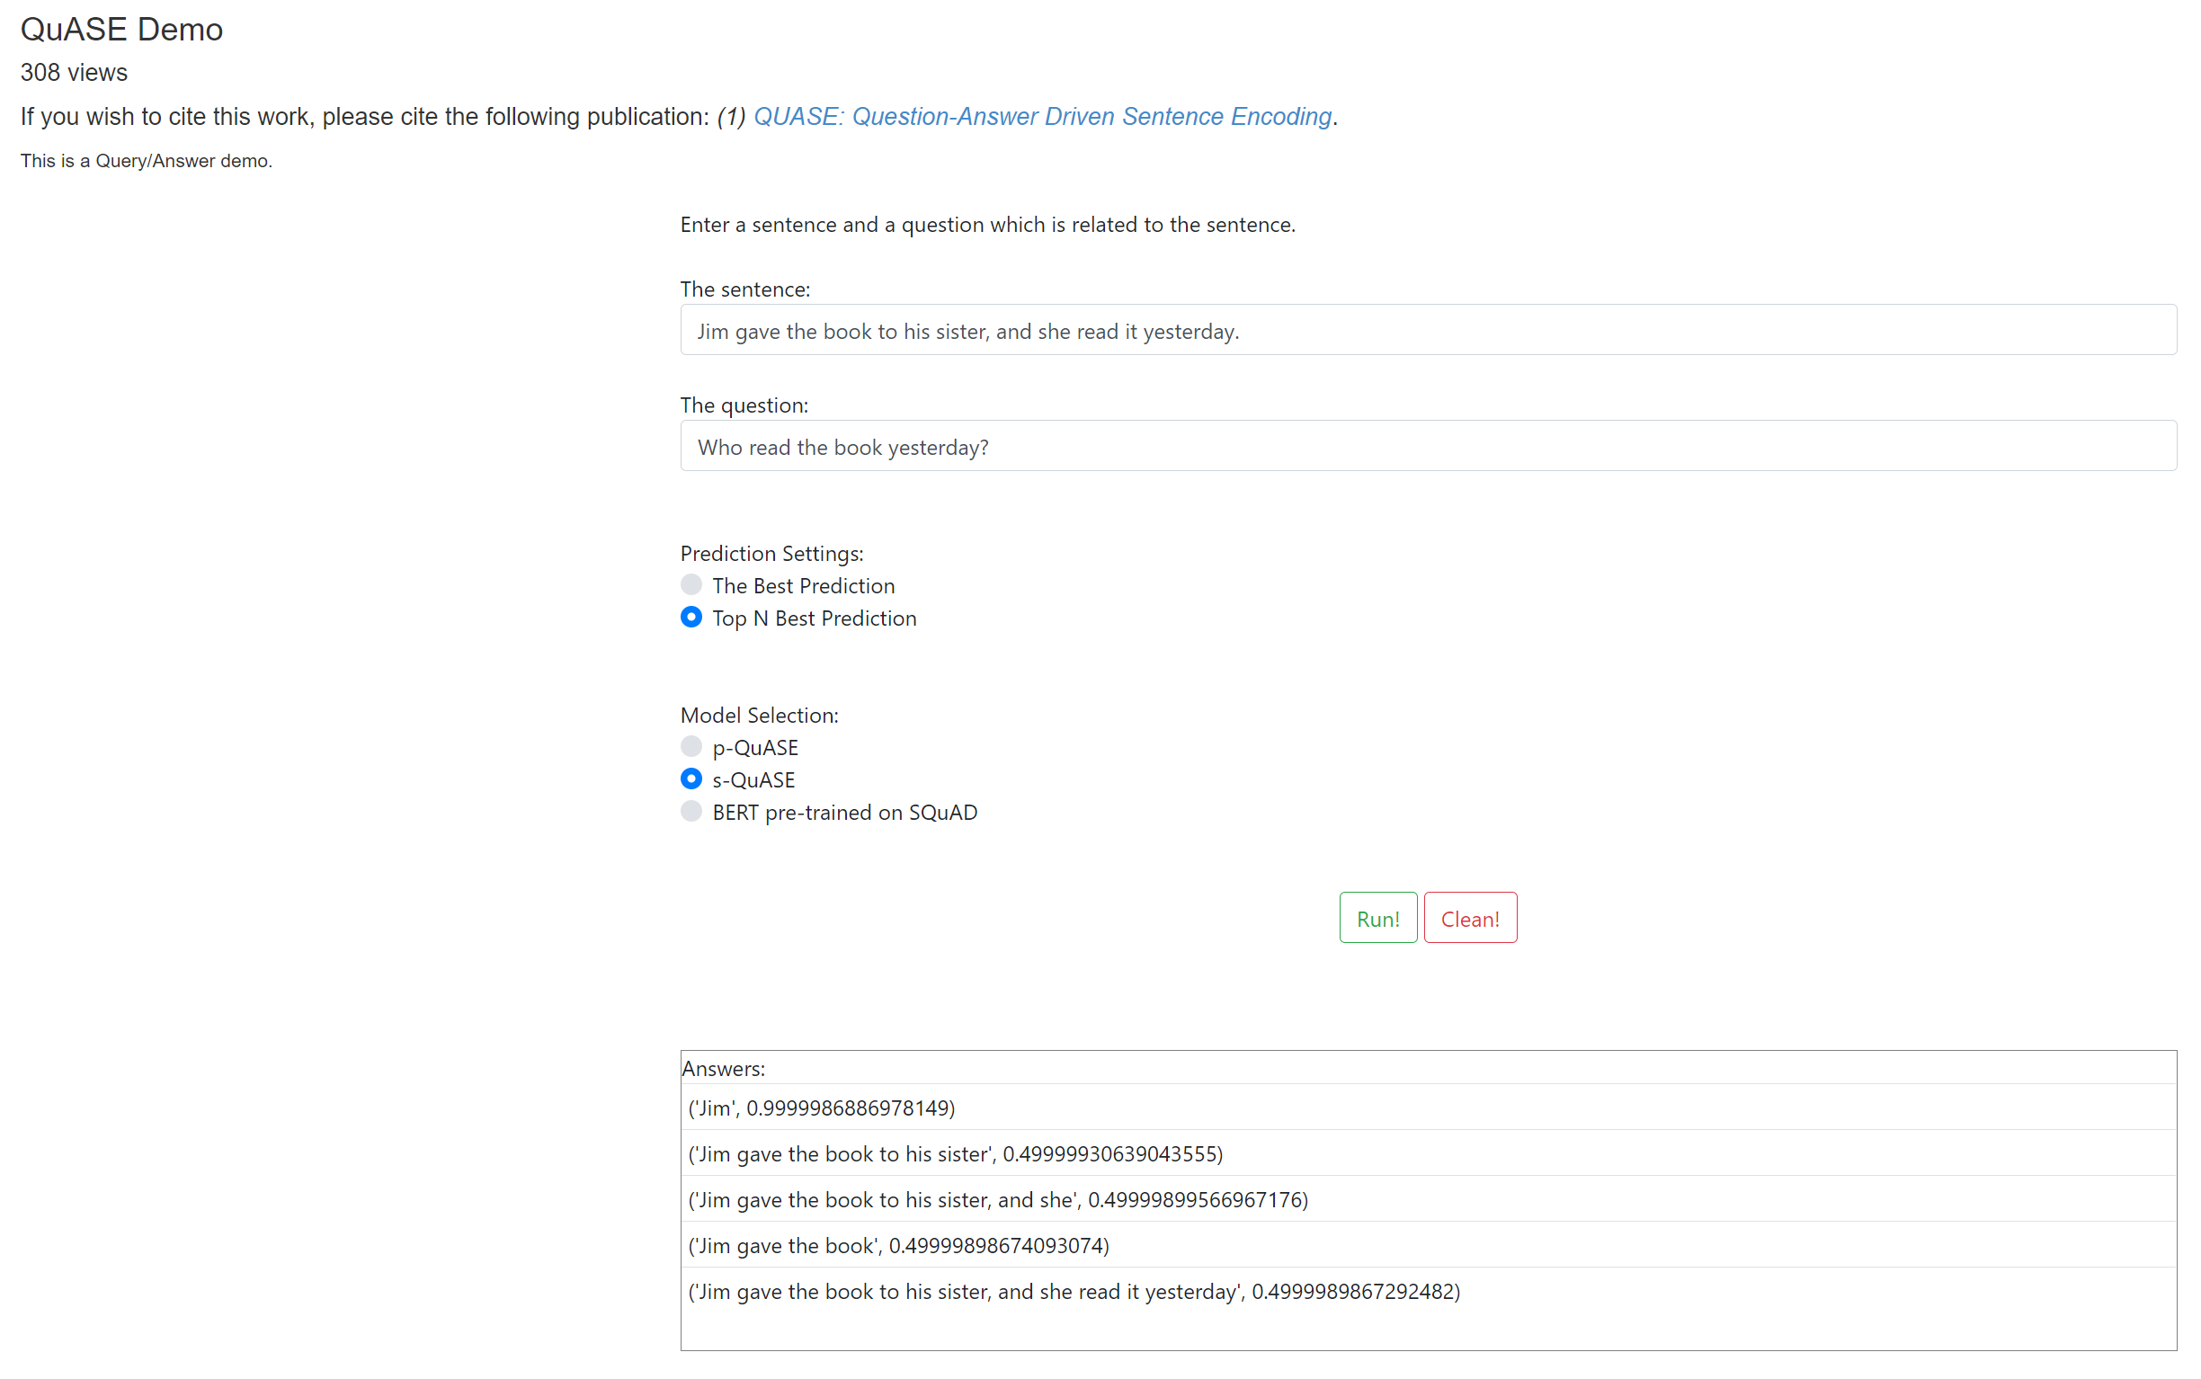
Is this Typical (2)?
Question Answering Models: https://cogcomp.seas.upenn.edu/page/demo_view/QuASE
Same Training Data
(used differently)
Different Predictions

Slide 67
Views of Learning
Learning is the removal of our remaining uncertainty:
Suppose we knew that the unknown function was an m-of-n Boolean function, then we could use the training data to infer which function it is.
Learning requires guessing a good hypothesis class:
We can start with a very small class and enlarge it until it contains a hypothesis that fits the data.
The hypothesis set selection could also happen due to algorithmic bias
We could be wrong !
Our prior knowledge might be wrong:
$y=x_{4}∧one of \left\{x_{1}, x_{3}\right\}$is also consistent
Our guess of the hypothesis space could be wrong
If this is the unknown function, then we will make errors when we are given new examples, and are asked to predict the value of the function

Slide 68
General strategies for Machine Learning
Develop flexible hypothesis spaces:
Decision trees, neural networks, nested collections.
Constraining the hypothesis space is done algorithmically
Develop representation languages for restricted classes of functions:
Serve to limit the expressivity of the target models
E.g., Functional representation (n-of-m); Grammars; linear functions; stochastic models;
Get flexibility by augmenting the feature space
In either case:
Develop algorithms for finding a hypothesis in our hypothesis space, that fits the data
And hope that they will generalize well
Notes:
Badges game
Don’t give me the answer
Start thinking about how to write a program that will figure out whether my name has + or – next to it.

Slide 69
Terminology
Target function (concept): The true function f :X →{…Labels…}
Concept: Boolean function. Example for which f (x)= 1 are positive examples; those for which
$f\left(x\right)=0$ are negative examples (instances)
Hypothesis: A proposed function h, believed to be similar to f. The output of our learning algorithm.
Hypothesis space: The space of all hypotheses that can, in principle, be the output of the learning algorithm.
Classifier: A discrete valued function produced by the learning algorithm. The possible value of f: {1,2,…K} are the classes or class labels. (In most algorithms the classifier will actually return a real valued function that we’ll have to interpret).
Training examples: A set of examples of the form $\{\left(x, f\left(x\right)\right)\}$
Notes:
Badges game
Don’t give me the answer
Start thinking about how to write a program that will figure out whether my name has + or – next to it.

Slide 70
Example: Generalization vs Overfitting
What is a Tree ?
A botanist Her brother
A tree is something with A tree is a green thing
leaves I’ve seen before
Neither will generalize well
Notes:
Badges game
Don’t give me the answer
Start thinking about how to write a program that will figure out whether my name has + or – next to it.

Slide 71
Key Issues in Machine Learning
Modeling
How to formulate application problems as machine learning problems ? How to represent the data?
Learning Protocols (where is the data & labels coming from?)
Representation
What functions should we learn (hypothesis spaces) ?
How to map raw input to an instance space?
Any rigorous way to find these? Any general approach?
Algorithms
What are good algorithms?
How do we define success?
Generalization Vs. over fitting
The computational problem
Notes:
Badges game
Don’t give me the answer
Start thinking about how to write a program that will figure out whether my name has + or – next to it.

Slide 72
An Example: Context Sensitive Spelling
I don’t know {whether, weather} to laugh or cry
How can we make this a learning problem?
We will look for a function
f: Sentences→ {whether, weather}
We need to define the domain of this function better.
An option: For each word $w$ in English define a Boolean feature $x_{w}$ :
$[x_{w}=1]$ iff $w$ is in the sentence
This maps a sentence to a point in ${\left\{0,1\right\}}^{50,000}$
In this space: some points are whether points, some are weather points
This is the Modeling Step
What is the hypothesis space?
Input/Instance space?
Learning Protocol?
Supervised? Unsupervised?
Notes:
As we said, this is the game we are playing; in NLP, it has always been clear, that the raw information
In a sentence is not sufficient, as is to represent a good predictor. Better functions of the input were
Generated, and learning was done in these terms.

Slide 73
Representation Step: What’s Good?
Learning problem:
Find a function that
best separates the data
What function?
What’s best?
(How to find it?)
Notes:
As we said, this is the game we are playing; in NLP, it has always been clear, that the raw information
In a sentence is not sufficient, as is to represent a good predictor. Better functions of the input were
Generated, and learning was done in these terms.

Slide 74
Notes:
Poll Title: Which of the functions do you think is best here? https://www.polleverywhere.com/multiple_choice_polls/W9LlVncX5souTapAIibeP?flow=Default&onscreen=persist

Slide 75
Representation Step: What’s Good?
Learning problem:
Find a function that
best separates the data
What function?
What’s best?
(How to find it?)
A possibility: Define the learning problem to be:
A (linear) function that best separates the data
$$w^{T}∙x=\sum_{i=1}^{n}{wixi }$$
Linear = linear in the feature space
$x$= data representation;
$w$ = the classifier: a weight for each feature
($w, x$, column vectors of dimensionality $n$)
The prediction: $y=sgn⁡\{w^{T}x\}$
$$\operatorname{sgn}\left(z\right)=0 if z<0;$$
$$1 otherwise$$
Memorizing vs. Learning
Accuracy vs. Simplicity
The set of functions your algorithm can learn (hypotheses space) determines how the learned model will do.
Will do on what?
Impact on Generalization
Notes:
As we said, this is the game we are playing; in NLP, it has always been clear, that the raw information
In a sentence is not sufficient, as is to represent a good predictor. Better functions of the input were
Generated, and learning was done in these terms.

Slide 76
A Small Detour
Let’s talk a bit about expressivity of functions

Slide 77
Functions Can be Made Linear
Data points are not linearly separable in one dimension
Not separable if you insist on using a specific class of functions (e.g., linear)
$$x$$

Slide 78
Blown Up Feature Space
But, we can change the way we represent the data
Data are separable in $<x, x2>$space
Key issue: Representation:
what features to use.
Computationally, can be done implicitly (kernels)
$$x2$$
$$x$$

Slide 79
Similar Idea in a Discrete Space: Exclusive-OR (XOR)
The function ${(x}_{1} ∧$ $x_{2})$is linear (why?)
But:
${(x}_{1} ∧$ $x_{2})∨(¬ x_{1}∧$ $¬ x_{2}$)
Is not linear
Note: this is a special case of a parity function.
$x_{i} ε \{0,1\}$
$f(x_{1}$, $x_{2}$,…, $x_{n})=1$
iff ∑ $x_{i}$ is even
This function is not linearly separable.
x₂
x₁
Notes:
As we said, this is the game we are playing; in NLP, it has always been clear, that the raw information
In a sentence is not sufficient, as is to represent a good predictor. Better functions of the input were
Generated, and learning was done in these terms.

Slide 80
Linear Functions
$f\left(x\right)=\operatorname{sgn}\left(w^{T}⋅x −θ\right\}=sgn⁡\{\sum_{i=1}^{n}{w_{i}x_{i} −θ\}}$
Many functions are Linear
Conjunctions (over $x^{T}= {(x}_{1}, x_{2},…x_{5}) )$:
$y=x_{1}∧x_{3}∧x_{5}$
Dogs = have four legs AND Bark AND have a tails AND….
A bit simplistic, but you get the point…
Being a linear function means that
There is a set of weights (vector $w$) and a threshold $θ$
So that $y=x_{1}∧x_{3}∧x_{5}$ is 1 if and only if $\operatorname{sgn}\left(w^{T}⋅x −θ\right\}$= 1
All variables here are Boolean variables

Slide 81
Notes:
Poll Title: What do I mean when I say that the function x1 ^ x3 ^ x5 (read: X1 AND X3 AND x5) is a linear function? Give a set of weights (w1,...w5) and a threshold T, that show that. https://www.polleverywhere.com/free_text_polls/e41KKGioyZi6mGFhpLfFQ

Slide 82
Linear Functions
$f\left(x\right)=\operatorname{sgn}\left(w^{T}⋅x −θ\right\}=sgn⁡\{\sum_{i=1}^{n}{w_{i}x_{i} −θ\}}$
Many functions are Linear
Conjunctions:
$y=x_{1}∧x_{3}∧x_{5}$
$y=\operatorname{sgn}\left\{1⋅x_{1}+1⋅x_{3}+1⋅x_{5} −3\right\};w=\left(1,0,1,0,1\right) θ=3$
Disjunctions
Do it yourself
At least m of n:
$y=at least 2 of \{x_{1},x_{3},x_{5}\}$
$y=\operatorname{sgn}\left\{1⋅x_{1}+1⋅x_{3}+1⋅x_{5} −2\right\};w=\left(1,0,1,0,1\right) θ=2$
Many functions are not
Xor: $y=\left(x_{1}∧x_{2}\right)∨(¬{ x}_{1}∧¬ x_{2}$)
Non trivial DNF: $y=(x_{1}∧$ $x_{2})∨$ ($x_{3}∧$ $x_{4}$ )
But can be made linear (it is linear if we invent new variables)
$z_{1}=$ $x_{1}∧x_{2}$ and $z_{2}=(¬{ x}_{1}∧¬ x_{2}$)
Since now: $y=\left(z_{1}∨z_{2}\right)$
All variables here are Boolean variables

Slide 83
Representation
The next few hidden slides provide a detailed explanation of feature generation in the discrete case.
View
We may discuss later

Slide 84
Functions Can be Made Linear Discrete Case
$$y3 ˅ y4 ˅ y7$$
New discriminator is functionally simpler
$$x1 x2 x4 ˅ x2 x4 x5 ˅ x1 x3 x7$$
Space: $X= x1, x2,…, xn$
Input Transformation
New Space: $Y = \{y1,y2,…\} = \{x_{i}, x_{i}, xj, x_{i} xj xj,…\}$
A real Weather/Whether example
Whether
Weather
Notes:
As we said, this is the game we are playing; in NLP, it has always been clear, that the raw information
In a sentence is not sufficient, as is to represent a good predictor. Better functions of the input were
Generated, and learning was done in these terms.

Slide 85
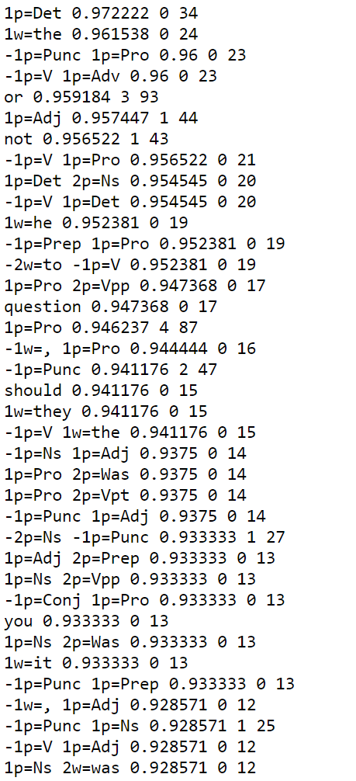
Representation (1)
Feature Types:
(what does the algorithm know about the input):
1,2. relative position (+/-1) has this pos/w
3. Conjunctions of size two
4. word w occurs in (-2,+2) window around target
Note: 4 feature types; many features
The feature resulting from instantiating the type in the given data
Some statistics (not part of the learning process; just for the understanding of the problem)

Slide 86
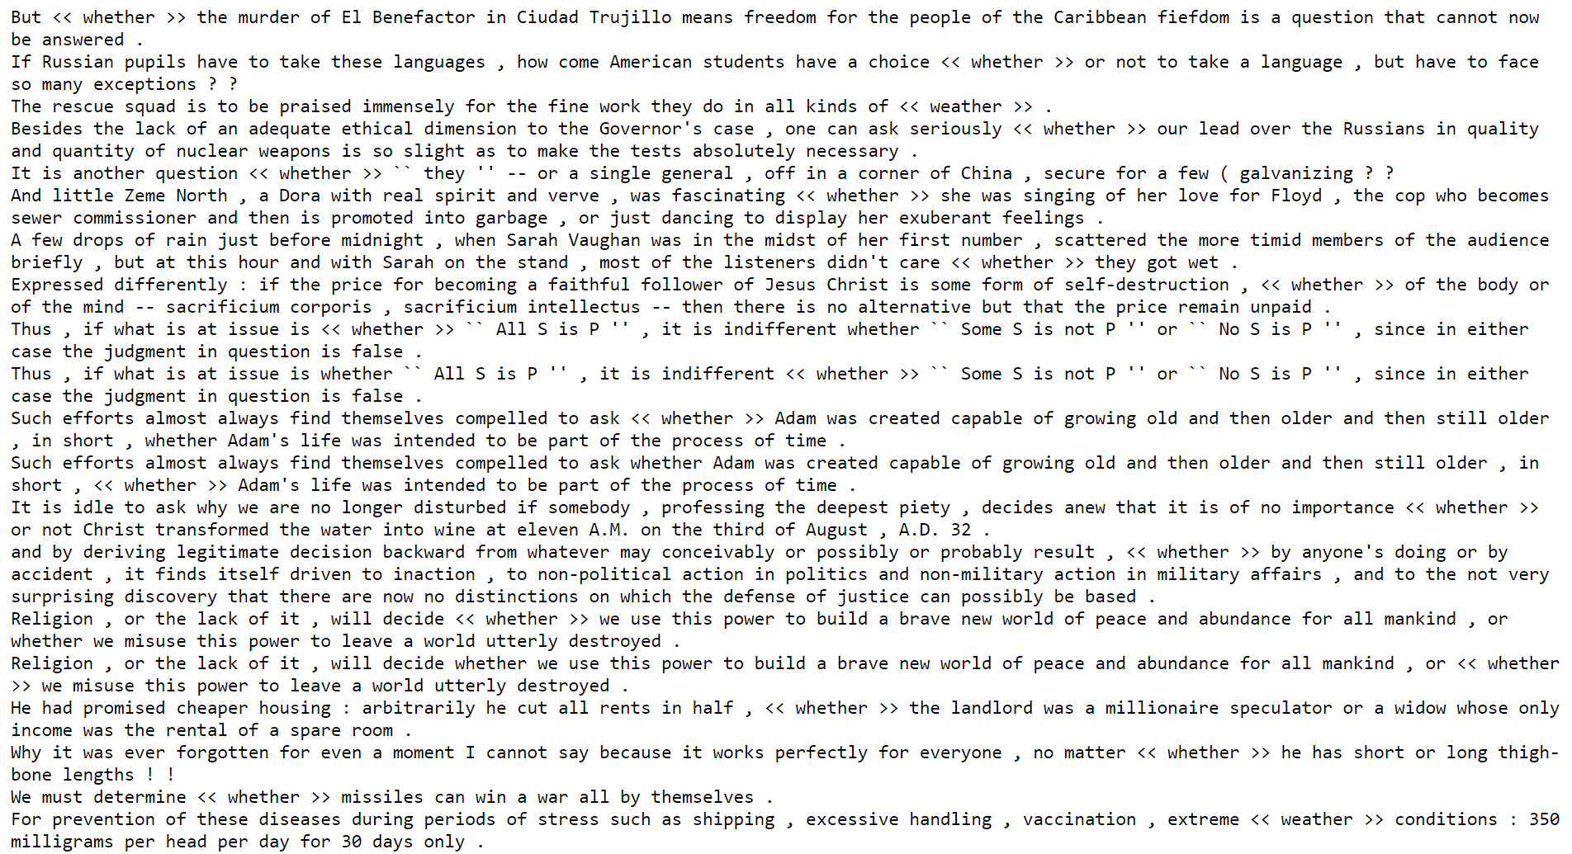
Representation (2)
Extracting features from the data:
(what does the algorithm know about the input):
1,2. relative position (+/- 1); pos/w
3. Conjunctions of size two
4. Occurrence of a word in a window around the target
Note: 2 feature types; many features
For each feature type, the data gives rise to multiple features; you don’t know which, before you see the data.

Slide 87
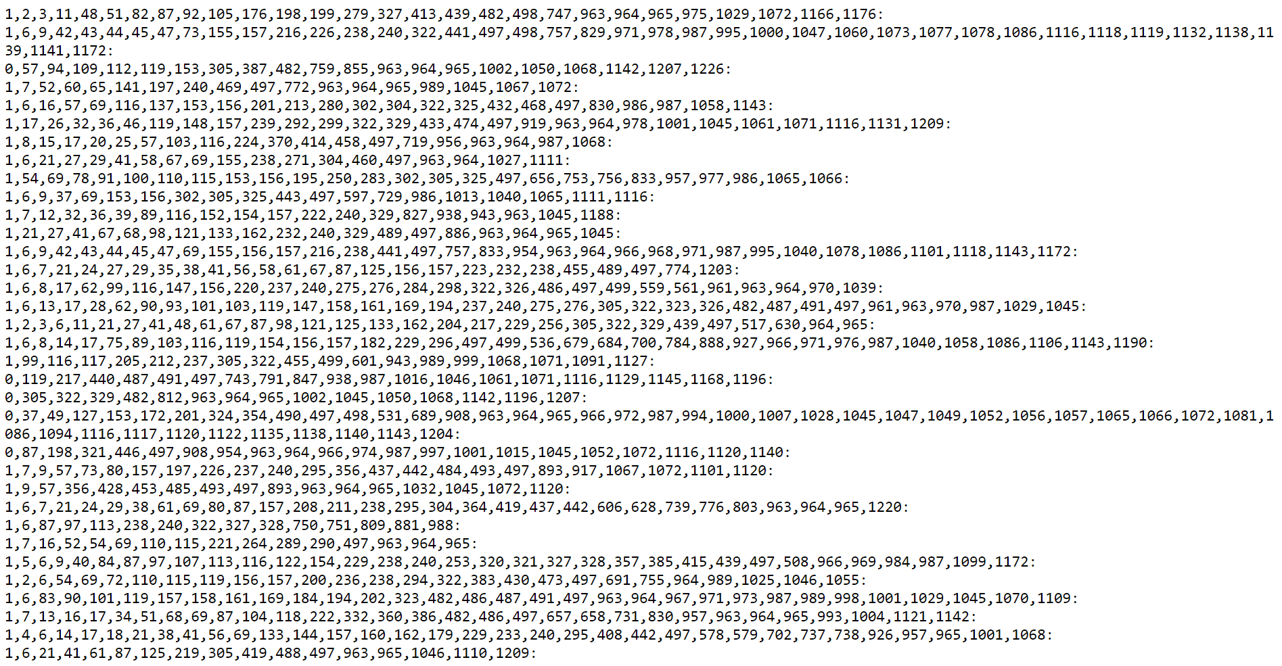
Representation (3)
Here the first index (0/1) is the label)
Each example corresponds to one target occurrence; all the features for this target are collected into a vector, and the label is added.
Here:
- Sparse Representation of the feature vector. Why?
- Variable size: Why?

Slide 88
Key Issues in Machine Learning
Modeling
How to formulate application problems as machine learning problems ? How to represent the data?
Learning Protocols (where is the data & labels coming from?)
Representation
What functions should we learn (hypothesis spaces) ?
How to map raw input to an instance space?
Any rigorous way to find these? Any general approach?
Algorithms
What are good algorithms?
How do we define success?
Generalization Vs. over fitting
The computational problem
Notes:
Badges game
Don’t give me the answer
Start thinking about how to write a program that will figure out whether my name has + or – next to it.

Slide 89
Third Step: How to Learn?
A possibility: Local search
Start with a linear threshold function.
See how well you are doing.
Correct
Repeat until you converge.
There are other ways that
do not search directly in the
hypotheses space
Directly compute the hypothesis

Slide 90
Notes:
Poll Title: How can we learn the blue linear separator given the red (positive) and purple (negative) examples? Note that the blue separator is represented as a vector of weights https://www.polleverywhere.com/free_text_polls/XPtQD6ocpTDfTxcxFepZ2

Slide 91
Notes:
Poll Title: Questions so far? https://www.polleverywhere.com/free_text_polls/Sv8B3YbtKhEHO7xJmMwnO

Slide 92
Notes:
Poll Title: Comments/feedback on Today's Lecture? https://www.polleverywhere.com/free_text_polls/M9VGJtFlyi11Fhwhbs0zb

Slide 93
Administration (9/16/20)
Are we recording? YES!
Available on the web site
1st quiz is out this week (Thursday night; due on Sunday night)
HW 1 will be released next week.
Questions?
Please ask/comment during class.
Feedback/Suggestions?

Slide 94
Last Time
The importance of a hypothesis space
The need to make some assumptions of the function we are trying to learn
Expressivity of functions and feature spaces
And Linear functions

Slide 95
Labels come with the training data. It’s part of the problem definition. (Think about the +/- associated with each name in the Badges problem)
Features are your decision as the person who models the problem as a learning problem. HW1 will help with that.
We did not. And in HW1 you will use other algorithms to learn a function for this data.
Let’s assume that class of functions we learning (our Hypothesis class) is a class of linear functions in an N dimensional space. After we are presented with data ${\left\{{\left(x,y\right)}_{i}\right\}}_{i=1,n}$ we will learn a function $w^{}$ (because a linear function is defined by a weight vector). But there are many ways to learn it (and each algorithm might learn a slightly different $w^{T}$
Notes:
Poll Title: Questions so far? https://www.polleverywhere.com/free_text_polls/Sv8B3YbtKhEHO7xJmMwnO

Slide 96
Some Questions You Asked
Any Text Book?
Not Really
Some options:
Machine Learning by Tom Mitchell
A Course in Machine Learning by Hal Daumé III
Pattern Recognition and Machine Learning by Bishop

Slide 97
Third Step: How to Learn?

Slide 98
Notes:
Poll Title: How can we learn the blue linear separator given the red (positive) and purple (negative) examples? Note that the blue separator is represented as a vector of weights https://www.polleverywhere.com/free_text_polls/XPtQD6ocpTDfTxcxFepZ2

Slide 99
Third Step: How to Learn?
A possibility: Local search
Start with a linear threshold function.
See how well you are doing.
Correct
Repeat until you converge.
There are other ways that
do not search directly in the
hypotheses space
Directly compute the hypothesis

Slide 100
A General Framework for Learning
Goal: predict an unobserved output value $y∈ Y$based on an observed input vector $x ∈ X$
Estimate a functional relationship $y \sim f(x)$ from a set ${\left\{{\left(x,y\right)}_{i}\right\}}_{i=1,n}$
This is the blue separator we are after
We will deal now with Classification: $y∈\{0,1\}$
(But, within the same framework can be used for $y∈\{1,2, …,k\}$ or Regression, y ϵ $R$)
What do we want $f(x)$to satisfy?
We want to minimize the Risk: $L \left( l\left(f\left(x\right),y\right)\right)=E_{X,Y}( [f\left(x\right)≠y])$
Where: $E_{X,Y}$denotes the expectation with respect to the true distribution over XxY.
In general, a loss function is a mapping $l$: YxY → R that measures how much the prediction of the current model is far from the desired prediction (the gold label)
Simple loss function: # of mistakes
[…] denotes an indicator function

Slide 101
A General Framework for Learning (II)
We want to minimize the Risk: $L \left(f\left( \right)\right)=E_{X,Y}( [f\left(X\right)≠Y])$
Where: $E_{X,Y}$denotes the expectation with respect to the true distribution.
We cannot minimize this loss (we don’t know the distribution)
Instead, we try to minimize the empirical classification error.
For a set of training examples ${\left\{\left(x_{i}, y_{i}\right)\right\}}_{i=1,m}$
Try to minimize$: L’(f()) = 1/m i [f(x_{i})yi]$($m$=# of examples)
(Issue I: why/when is this good enough? Not now)
This minimization problem is typically NP hard.
To alleviate this computational problem, minimize a new function – a convex upper bound of the (real) classification error function:
$$I(f(x),y) =[f\left(x\right)≠y] = \{1 when f\left(x\right)≠y; 0 otherwise\}$$
Side note: If the distribution over X ×Y is known, predict$: y = argmaxy P(y|x)$
The best possible (optimal Bayes' error).

Slide 102
Algorithmic View of Learning: an Optimization Problem
A Loss Function $L(f\left(x\right), y)$ measure how far is the prediction f(x) from the desired y;
the penalty incurred by a classifier $f$on example $(x,y)$.
There are many different loss functions one could define:
Misclassification Error: (0-1 loss)
$L\left(f\left(x\right), y\right)=0$ if $f\left(x\right)=y$; 1 otherwise
Squared Loss:
$L\left(f\left(x\right), y\right)={\left(f\left(x\right)−y\right)}^{2}$
Input dependent loss:
$L\left(f\left(x\right), y\right)=0$ if $f\left(x\right)=y$; $c\left(x\right)$otherwise.
A continuous convex loss function allows a simpler optimization algorithm.
L
f(x) –y

Slide 103
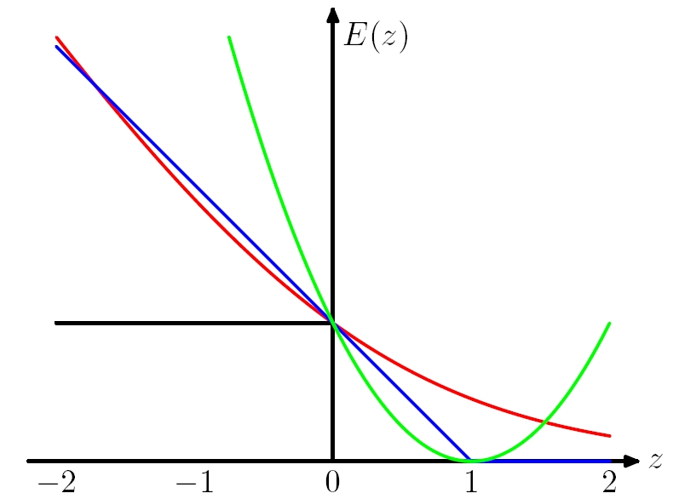
Loss
$$\operatorname{sgn}\left(z\right)=−1if z<0$$
+$1 otherwise$
Here $f(x)$is the prediction $∈R$
$y∈ \{−1,1\}$is the correct value
0-1 Loss $L(y,f(x))= ½ (1−sgn⁡(yf(x)))$
Log Loss $1/ln2 log⁡(1+exp⁡\{−yf(x)\})$
Hinge Loss $L(y, f(x)) = max⁡(0, 1 − y f(x))$
Square Loss $L(y, f(x)) = {\left(y − f\left(x\right)\right)}^{2}$
0-1 Loss : z axis = $yf(x)$
Log Loss: z axis = $yf(x)$
Hinge Loss: z axis = $yf(x)$
Square Loss: z axis = $(y − f(x)+1)$

Slide 104
Example
Putting it all together:
A Learning Algorithm

Slide 105
Third Step: How to Learn?
A possibility: Local search
Start with a linear threshold function.
See how well you are doing.
Correct
Repeat until you converge.
There are other ways that
do not search directly in the hypotheses space
Directly compute the hypothesis

Slide 106
Learning Linear Separators (LTU=Linear Threshold Unit; a single layer neural network)
$f(x) = sgn⁡${$w^{T}∙x$- θ} $= sgn⁡${$\sum_{i=1}^{n}{wixi }$- θ }
$xT= (x1 ,x2,… ,xn) ∈ \{0,1\}n$
is the feature based
encoding of the data point
$wT= (w1 ,w2,… ,wn) ∈ R^{n}$
is the target function.
θ determines the shift
with respect to the origin
θ
w

Slide 107
Canonical Representation
$f(x) = sgn⁡${$w^{T}∙x$- θ} $= sgn⁡\{\sum_{i=1}^{n}{wixi }$- θ }
Note: $sgn⁡$ {$w^{T}∙x$ - θ} = $sgn⁡$ {$w^{′T}∙x′$}
Where:
$x’ = (x, −1)$and $w’ = (w, θ)$
Moved from an $n$ dimensional representation to an $(n+1)$dimensional representation, but now can look for hyperplanes that go through the origin.
Basically, that means that we learn both $w$ and $$

Slide 108
General Learning Principle
The loss Q: a function of x, w and y
Our goal is to find a $w$ that
minimizes the expected risk
$E\left(w\right)= E_{X,Y} Q(x, y, w)$
We cannot do it.
Instead, we approximate $E(w)$
using a finite training set of
independent samples $(x_{i}, yi)$
$E(w) \sim =\sim 1/m ∑1,m Q(x_{i} ,yi, w)$
To find the minimum, we use a
batch gradient descent algorithm
That is, we successively compute
estimates $wt$ of the optimal parameter vector $w$:
$w^{t+1} = w^{t} −∇ E\left(w\right)= w^{t} −\frac{1}{m}∑1,m ∇ Q(x_{i} ,yi, w)$
The Risk (Err) E: a function of w
θ
To find a local minimum of a function using gradient descent, we take steps proportional to the negative of the gradient of the function at the current point.
w
t here is “time” or “iteration” #

Slide 109
Gradient Descent
We use gradient descent to determine the weight vector that minimizes
$E(w) (= Err (w))$;
Fixing the set $D$ of examples, E=Err is a function of $w$
At each step, the weight vector is modified in the direction that produces the steepest descent along the error surface.
E(w)
To find a local minimum of a function using gradient descent, we take steps proportional to the negative of the gradient of the function at the current point.
w
w⁴ w³ w² w¹

Slide 110
LMS: An Optimization Algorithm
Our Hypothesis Space is the collection of Linear Threshold Units
Loss function:
Squared loss: LMS (Least Mean Square, L₂)
$Q(x, y, w) = ½ {\left(wT x – y\right)}^{2}$
θ
w

Slide 111
LMS: An Optimization Algorithm
(i (subscript) – vector component; j (superscript) - time; d – example #)
Let $w^{j}$ be the current weight vector we have
Our prediction on the d-th example $x$ is:
$O_{d}=$ $w^{(j)T}∙x$ = $\sum_{i=1}^{n}{{w_{i}^{(j)}}^{}xi }$
Let $td$ be the target value for this example
The error the current hypothesis makes on the data set is:
$E(w)=$ ${Err(w}^{j})$ = $\frac{1}{2}\sum_{d∈D}{(t_{d}−O_{d}})^{2}$
Assumption: x ∈ R^{n}; u ∈ R^{n} is the target weight vector; the target (label) is t_{d} = $u^{T}∙x$ Noise has been added; so, possibly, no weight vector is consistent with the data.
Notes:
Good treatment in Bishop, Chp 3

Slide 112
Gradient Descent
To find the best direction in the weight space $w$ we compute the gradient of E with respect to each of the components of
$∇E\left(w\right)=[ \frac{∂E}{∂w_{1}}$, $\frac{∂E}{∂w_{2}},$ … $\frac{∂E}{∂w_{n}}$]
This vector specifies the direction that produces the steepest increase in E;
We want to modify $w$ in the direction of -$∇E\left(w\right)$
Where (with a fixed step size [learning rate] R):
$w^{t}=$ $w^{t−1}+ Δw$
$Δw$ = -$R ∇E\left(w\right)$
E(w)
w
w⁴ w³ w² w¹

Slide 113
Gradient Descent: LMS
We have: $E(w)=$ ${Err(w}^{j})$ = $\frac{1}{2}\sum_{d∈D}{(t_{d}−O_{d}})^{2}$
$$\frac{∂E}{∂w_{i}}=\frac{∂}{∂w_{i}} \frac{1}{2}\sum_{d∈D}{{\left(t_{d}−o_{d}\right)}^{2}= }$$
Therefore:
=$\frac{1}{2}\sum_{d∈D}{\frac{∂}{∂w_{i}}{\left(t_{d}−o_{d}\right)}^{2}= }$
=$\frac{1}{2}\sum_{d∈D}{\begin{aligned}{2\left(t_{d}−o_{d}\right)}^{} \\ \end{aligned}\frac{∂}{∂w_{i}}}\begin{aligned}{\left(t_{d}−w_{d}∙x_{d}\right)=}^{} \\ \end{aligned}$
=$\sum_{d∈D}{\begin{aligned}{\left(t_{d}−o_{d}\right)\left(−x_{id}\right)}^{} \\ \end{aligned}}$
Recall:

Slide 114
Alg1: Gradient Descent: LMS
Weight update rule:
$Δw$_{i} $\text{= }R\sum_{d∈D}{(t_{d}−O_{d}}{)x_{id}}^{}$
Gradient descent algorithm for training linear units:
Start with an initial random weight vector
For every example d with target value t_{d} do:
Evaluate the linear unit $O_{d}=$ $w^{(j)T}∙x$ = $\sum_{i=1}^{n}{{w_{i}^{(j)}}^{}xi }$
Update $w$ by adding $Δw$_{i} to each component
Continue until E below some threshold
This algorithm always converges to a local minimum of $E(w)$, for small enough steps. Here (LMS for linear regression), the surface contains only a single global minimum, so the algorithm converges to a weight vector with minimum error, regardless of whether the examples are linearly separable.
The surface may have local minimum if the loss function is different.

Slide 115
What Have We Done So Far?
We wanted to separate Red point from Purple points
With the goal of minimizing the number of mistakes
It’s hard to do, so we decided to use a surrogate loss function (LMS) and use it to guide our search for a good linear separator
The algorithm is guaranteed to minimize the LMS loss
But, is it guaranteed to minimize the number of mistakes (0-1 loss) ?

Slide 116
Notes:
Poll Title: Given a training set, we run Alg1. What will happen to the (a) LMS loss and (b) to the number of mistakes as a function of the number of iterations? https://www.polleverywhere.com/multiple_choice_polls/r8u5qYmZXneSpbbbqOJTF?flow=Default&onscreen=persist

Slide 117
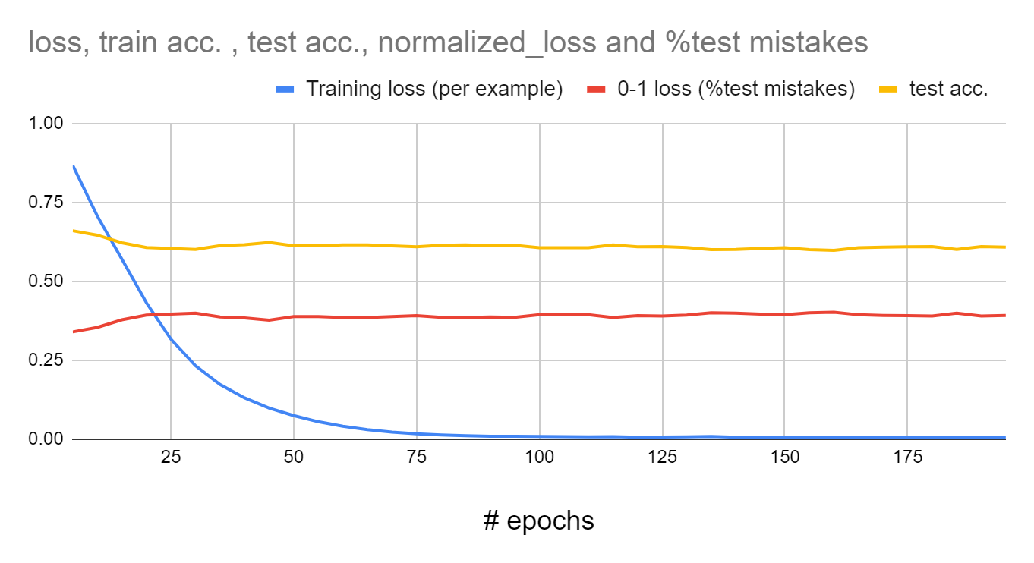
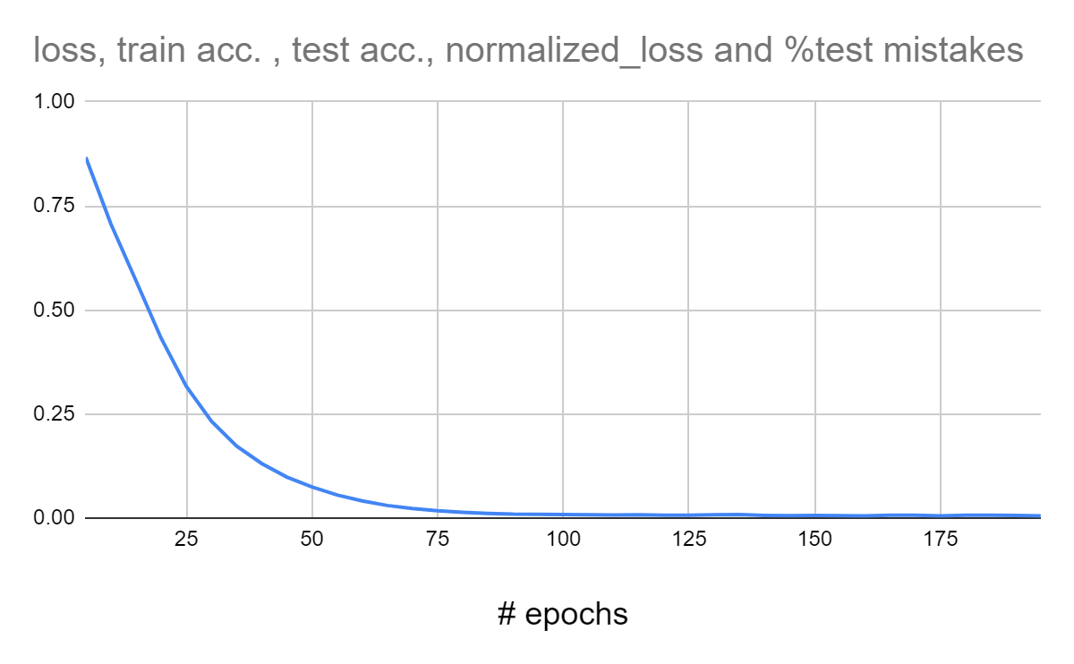
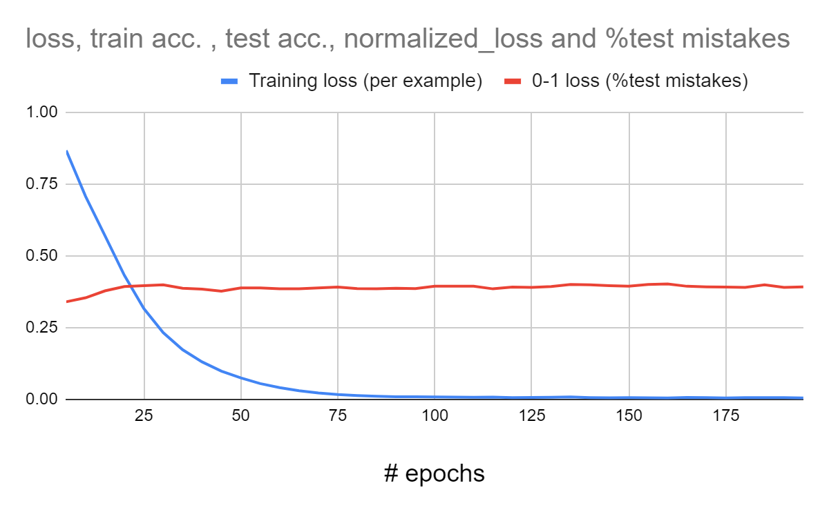
LMS Loss and 0-1 Loss
The data used here is a re-labeling of the Badges data
(re-labaling is done since the original function was too easy)
LMS Loss (per example)
We knew that the loss will go down and converge.
The fact that it converges to 0 is just since we used an expressive model (not a single layer neural network, a three layer one)
The 0-1 loss did not go to 0, so we are still making mistakes on this dataset.

Slide 118
Alg1: Gradient Descent: LMS
Weight update rule:
$Δw$_{i} $\text{= }R\sum_{d∈D}{(t_{d}−O_{d}}{)x_{id}}^{}$
Gradient descent algorithm for training linear units:
Start with an initial random weight vector
For every example d with target value t_{d} do:
Evaluate the linear unit $O_{d}=$ $w^{(j)T}∙x$ = $\sum_{i=1}^{n}{{w_{i}^{(j)}}^{}xi }$
Update $w$ by adding $Δw$_{i} to each component
Continue until E below some threshold
This algorithm always converges to a local minimum of $E(w)$, for small enough steps. Here (LMS for linear regression), the surface contains only a single global minimum, so the algorithm converges to a weight vector with minimum error, regardless of whether the examples are linearly separable.
The surface may have local minimum if the loss function is different.

Slide 119
Alg 2: Incremental (Stochastic) Gradient Descent: (LMS)
Weight update rule:
$Δw$_{i} $\text{= }R\left(t_{d}−O_{d}\right){x_{id}}^{}$
Gradient descent algorithm for training linear units:
Start with an initial random weight vector
For every example d with target value t_{d} do:
Evaluate the linear unit $O_{d}=$ $w^{(j)T}∙x$ = $\sum_{i=1}^{n}{{w_{i}^{(j)}}^{}xi }$
update $w$ by incrementally by adding $Δw$_{i} to each component (update without summing over all data)
Continue until E below some threshold
In general - does not converge to global minimum
But, on-line algorithms are sometimes advantageous…
Typically, not used as a complete on-line algorithm, but rather run in small batches.
Decreasing R with time guarantees convergence
Dropped the averaging operation.
Instead of averaging the gradient of the loss over the complete training set, choose at random a sample (x,y) (or a subset of examples) and update w^{t}

Slide 120
Learning Rates and Convergence
In the general (non-separable) case the learning rate $R$ must decrease to zero to guarantee convergence.
The learning rate is called the step size. There are more sophisticated algorithms that choose the step size automatically and converge faster.
We will see versions of this algorithm as we go
Choosing a better starting point also has impact.
The gradient descent and its stochastic version are very simple algorithms
But, almost all the algorithms we will learn in the class
In particular, all the neural networks learning algorithms
Are gradient descent algorithms (with some bells and whistles) for different loss functions and different hypotheses spaces.

Slide 121
Computational Issues
Assume the data is linearly separable.
Sample complexity:
Suppose we want to ensure that our LTU has an error rate (on new examples) of less than $ϵ$ with high probability (at least ($1 −δ$))
How large does m (the number of examples) must be in order to achieve this? It can be shown that for $n$ dimensional problems:
$m=O(\frac{1}{ε} [\ln\left(\frac{1}{δ}\right)+\left(n+1\right)\ln\left(\frac{1}{ε}\right)]$)
Computational : What can be said?
It can be shown that there exists a polynomial time algorithm for finding consistent LTU (by reduction from linear programming).
[Contrast with the NP hardness for 0-1 loss optimization]
(On-line algorithms have inverse quadratic dependence on the margin)
Notes:
The problem of minimizing 0-1 loss is NP hard in the non-separable case: (Ben-David, Simon et al. 2001).

Slide 122
Other Methods for LTUs
Fisher Linear Discriminant:
A direct computation method
Probabilistic methods (naïve Bayes):
Produces a stochastic classifier that can be viewed as a linear threshold unit.
Winnow/Perceptron
A multiplicative/additive update algorithm with some sparsity properties in the function space (a large number of irrelevant attributes) or features space (sparse examples)
Logistic Regression, SVM…many other algorithms

Slide 123
Notes:
Poll Title: Comments/feedback on Today's Lecture? https://www.polleverywhere.com/free_text_polls/M9VGJtFlyi11Fhwhbs0zb

Slide 124
Notes:
Poll Title: How will you rate today's lecture? https://www.polleverywhere.com/multiple_choice_polls/7IigS9Ca1MBufgVcLVIZg?flow=Default&onscreen=persist

