Slide 1
Un/Semi-Supervised Learning:
EM and K-Means
Dan Roth
danroth@seas.upenn.edu|http://www.cis.upenn.edu/~danroth/|461C, 3401 Walnut
Slides were created by Dan Roth (for CIS519/419 at Penn or CS446 at UIUC), or by other authors who have made their ML slides available.

Slide 2
Administration (12/02/20)
Are we recording? YES!
Available on the web site
Remember that all the lectures are available on the website before the class
  Go over it and be prepared
  A new set of written notes will accompany most lectures, with some more details, examples and, (when relevant) some code.
HW4 is out – NNs and Bayesian Learning
  Due 12/3 → 12/7 (Next Monday)
HW5 will be out tomorrow, 12/3. Due 12/10 (last day of the semester).
  It is mostly a summary of the material we covered this semester (with a focus on the second half) and will help you prepare for the exam.
  No programming.
  We will give an extension until a few days before the exam.
Next week is the last week of classes – there will be three meetings (Monday, Wednesday, Thursday)
Projects
  You should have received an email from one of the TAs that will help guide your project
  Progress reports are due today. Check the course’s web site
The Final is on 12/18; it is scheduled for 9am; we will try to given you a larger window of time.
Project Paper and Video Submission: 12/21

Slide 3
Projects
CIS 519 students need to do a team project: Read the project descriptions and follow the updates on the Project webpage
  Teams will be of size 2-4
  We will help grouping if needed
There will be 3 options for projects.
  Natural Language Processing (Text)
  Computer Vision (Images)
  Speech (Audio)
In all cases, we will give you datasets and initial ideas
  The problem will be multiclass classification problems
  You will get annotated data only for some of the labels, but will also have to predict other labels
  0-zero shot learning; few-shot learning; transfer learning
A detailed note will come out today.
Timeline:
  11/11 Choose a project and team up
  11/23 Initial proposal describing what your team plans to do
  12/2 Progress report: 1 page. What you have done; plans; problems.
  12/21 Final paper + short video
Try to make it interesting!

Slide 4
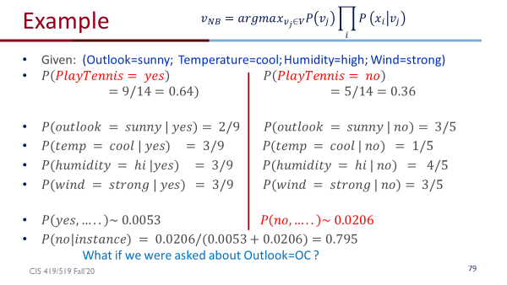
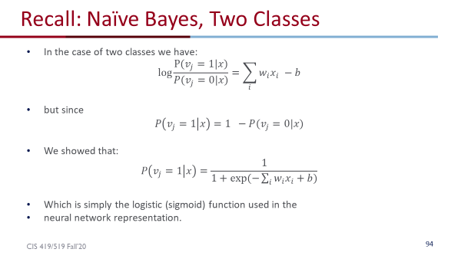
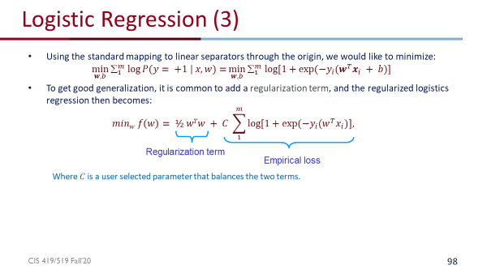
From NB to Logistic Regression
Naïve Bayes and Logistic Regression:
  https://colab.research.google.com/drive/1xWrXz0vs3PpTlBqWbJ9JYxAGui49sOra?usp=sharing#scrollTo=gG9pycPfUOrr

Slide 5
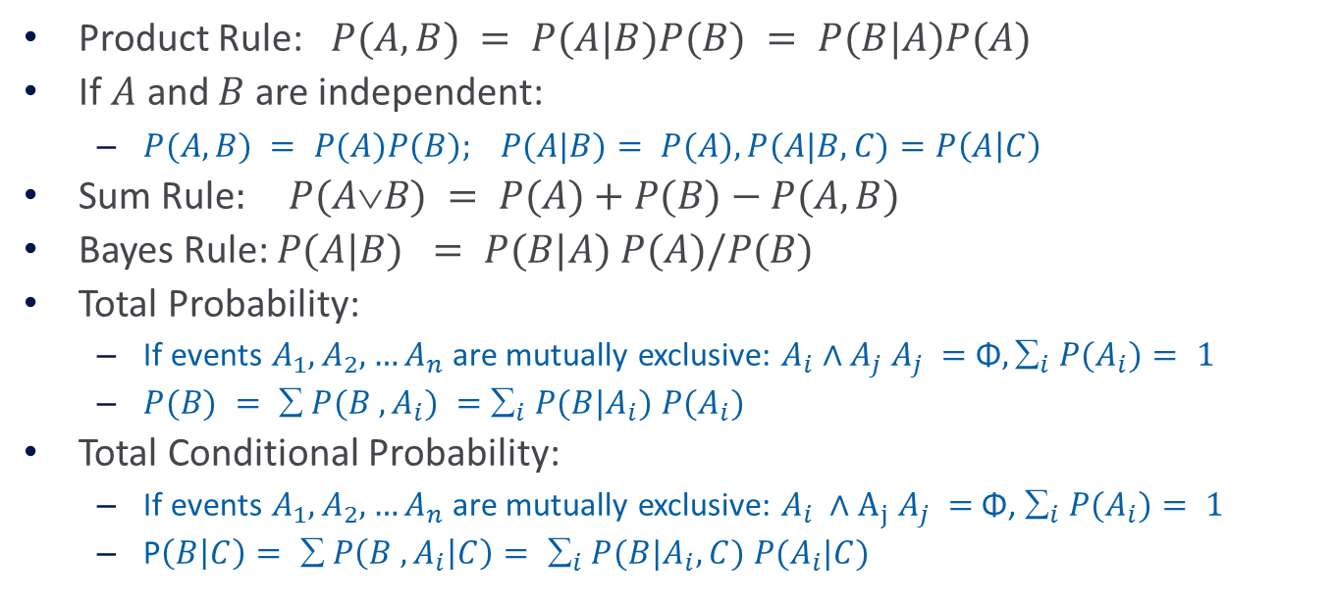
Summary: Basic Probability
Product Rule: $P(A,B) = P(A|B)P(B) = P(B|A)P(A)$
If $A$ and $B$ are independent:
  $P(A,B) = P(A)P(B); P(A|B)= P(A), P(A|B,C)=P\left(A | C\right)$
Sum Rule$: P(AB) = P(A)+P(B)−P(A,B)$
Bayes Rule: $P(A|B) = P(B|A) P(A)/P(B)$
Total Probability:
  If events $A_{1}, A_{2},…A_{n}$are mutually exclusive: $A_{i}∧A_{j} A_{j} =$ Φ$, _{i} P(A_{i})= 1$
  $P(B) =  P(B , A_{i}) =$ $_{i} P(B|A_{i}) P(A_{i})$
Total Conditional Probability:
  If events $A_{1}, A_{2},…A_{n}$are mutually exclusive: $A_{i} ∧A_{j} A_{j} =$Φ, $_{i} P(A_{i})= 1$
  P$\left(B | C\right)=  P\left(B , A_{i} | C\right)= _{i} P(B|A_{i},C) P(A_{i}|C)$

Slide 6

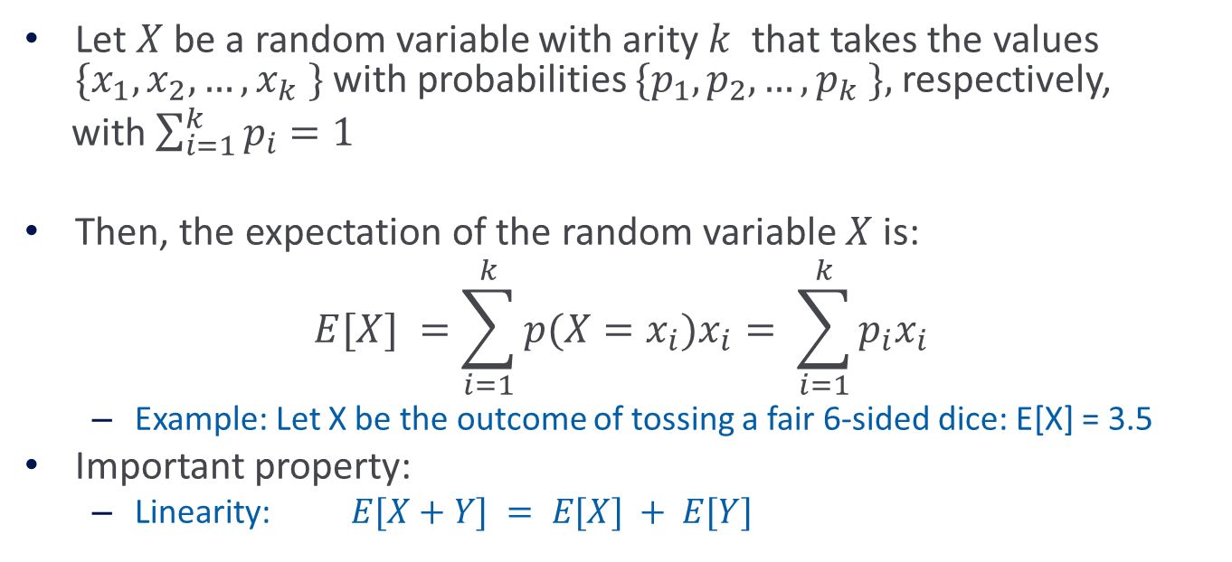
Expectation of a Random Variable
Let $X$ be a random variable with arity $k$ that takes the values $\{x_{1},x_{2}, …, x_{k} \}$with probabilities $\{p_{1},p_{2}, …, p_{k} \},$respectively,
with $\sum_{i=1}^{k}{p_{i}=1}$
Then, the expectation of the random variable $X$is:
$$E[X] =\sum_{i=1}^{k}{p(X=x_{i}})x_{i}= \sum_{i=1}^{k}{p_{i}x_{i}}$$
  Example: Let X be the outcome of tossing a fair 6-sided dice: E[X] = 3.5
Important property:
  Linearity: $E[X+Y] = E[X] + E[Y]$

Slide 7
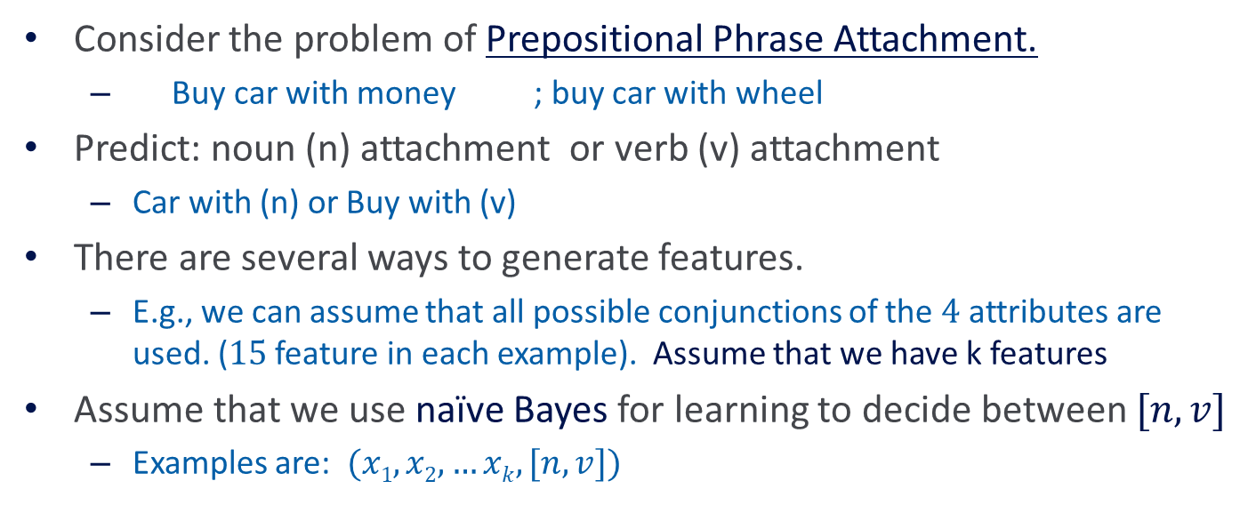
Semi-Supervised Learning
Consider the problem of Prepositional Phrase Attachment.
  Buy car with money ; buy car with wheel
Predict: noun (n) attachment or verb (v) attachment
  Car with (n) or Buy with (v)
There are several ways to generate features.
  E.g., we can assume that all possible conjunctions of the $4$ attributes are used. ($15$ feature in each example). Assume that we have k features
Assume that we use naïve Bayes for learning to decide between $[n,v]$
  Examples are: $(x1,x2,…xk,[n,v])$

Slide 8
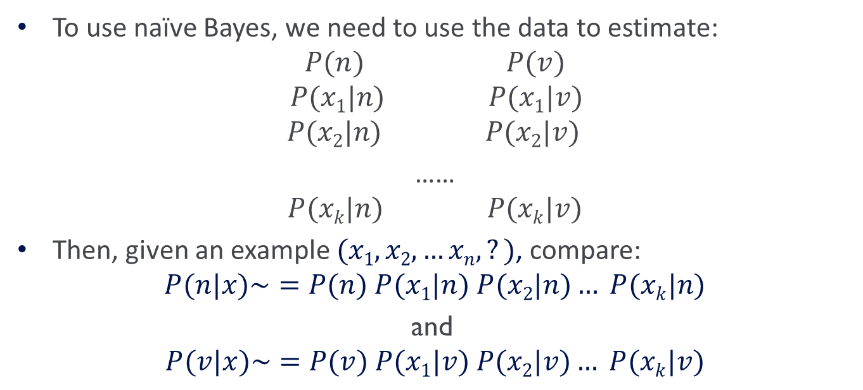
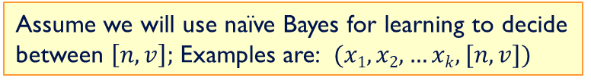
Using Naïve Bayes
Assume we will use naïve Bayes for learning to decide between $\left[n,v\right];$Examples are: $(x1,x2,…xk,[n,v])$
To use naïve Bayes, we need to use the data to estimate:
$$P(n) P(v)$$
$$P(x1|n) P(x1|v)$$
$$P(x2|n) P(x2|v)$$
……
$$P(xk|n) P(xk|v)$$
Then, given an example $(x1,x2,…xn,?)$, compare:
$$P(n|x)\sim =P(n) P(x1|n) P(x2|n)… P(xk|n)$$
and
$$P(v|x)\sim =P(v) P(x1|v) P(x2|v)… P(xk|v)$$

Slide 9
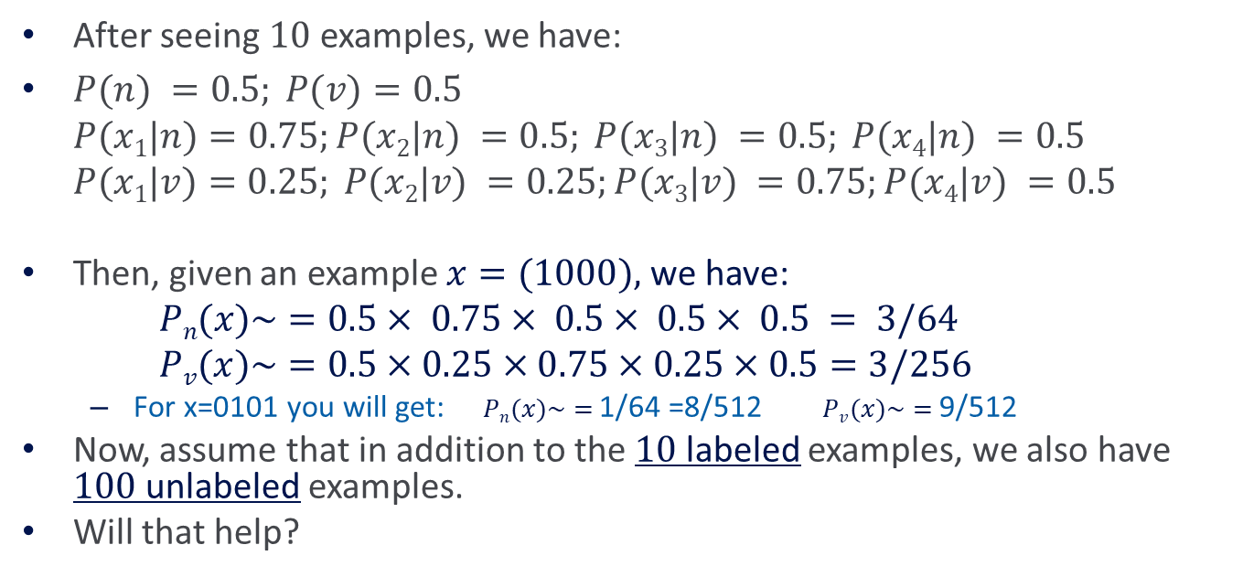
Using Naïve Bayes
After seeing $10$ examples, we have:
$P(n) =0.5; P(v)=0.5$
$P(x1|n)=0.75;P(x2|n) =0.5; P(x3|n) =0.5; P(x4|n) =0.5$
$P(x1|v)=0.25; P(x2|v) =0.25;P(x3|v) =0.75;P(x4|v) =0.5$
Then, given an example $x=(1000),$we have:
$Pn(x)\sim =0.5× 0.75× 0.5× 0.5× 0.5 = 3/64$
$Pv(x)\sim =0.5×0.25×0.75×0.25×0.5=3/256$
  For x=0101 you will get: $Pn(x)\sim =$ 1/64 =8/512 $Pv(x)\sim =$ 9/512
Now, assume that in addition to the $10$ labeled examples, we also have $100$ unlabeled examples.
Will that help?

Slide 10
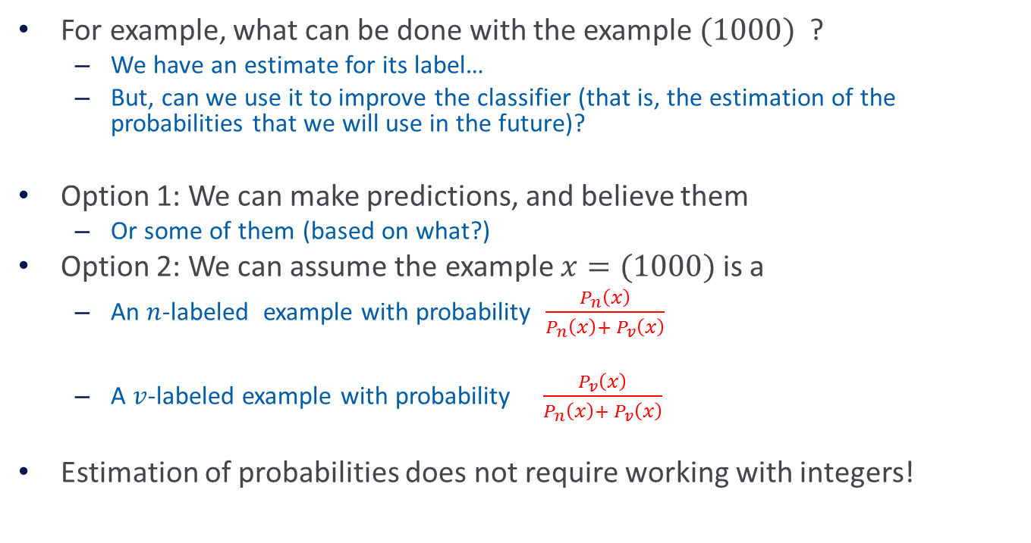
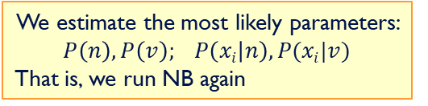
Using Naïve Bayes
For example, what can be done with the example $(1000)$?
  We have an estimate for its label…
  But, can we use it to improve the classifier (that is, the estimation of the probabilities that we will use in the future)?
Option 1: We can make predictions, and believe them
  Or some of them (based on what?)
Option 2: We can assume the example $x=(1000)$is a
  An $n$-labeled example with probability $\frac{P_{n}\left(x\right)}{P_{n}\left(x\right)+ P_{v}\left(x\right)}$
  A $v$-labeled example with probability $\frac{P_{v}\left(x\right)}{P_{n}\left(x\right)+ P_{v}\left(x\right)}$
Estimation of probabilities does not require working with integers!
What do we do once we have these labels?
We estimate the most likely parameters: $P\left(n\right), P\left(v\right); P\left(xi | n\right), P(xi|v)$
That is, we run NB again

Slide 11
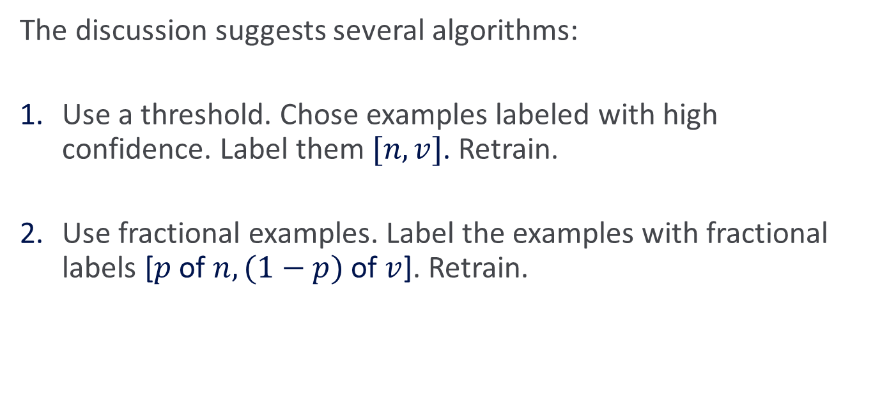
Using Unlabeled Data
The discussion suggests several algorithms:
Use a threshold. Chose examples labeled with high confidence. Label them $[n,v]$. Retrain.
Use fractional examples. Label the examples with fractional labels [$p$ of $n, (1−p)$of $v$]. Retrain.

Slide 12
Comments on Unlabeled Data
Both algorithms suggested can be used iteratively.
Both algorithms can be used with other classifiers, not only naïve Bayes. The only requirement – a robust confidence measure in the classification.
There are other approaches to Semi-Supervised learning:
  Most are conceptually similar: bootstrapping algorithms, self-training
  Some are “graph-based” algorithms: assume “similar” examples have “similar labels”.
What happens if instead of 10 labeled examples we start with
0 labeled examples?
  Make a Guess; continue as above; a version of EM

Slide 13
EM
EM is a class of algorithms that is used to estimate a probability distribution in the presence of missing attributes.
  Using it requires an assumption on the underlying probability distribution.
The algorithm can be very sensitive to this assumption and to the starting point (that is, the initial guess of parameters).
  In general, known to converge to a local maximum of the maximum likelihood function.

Slide 14
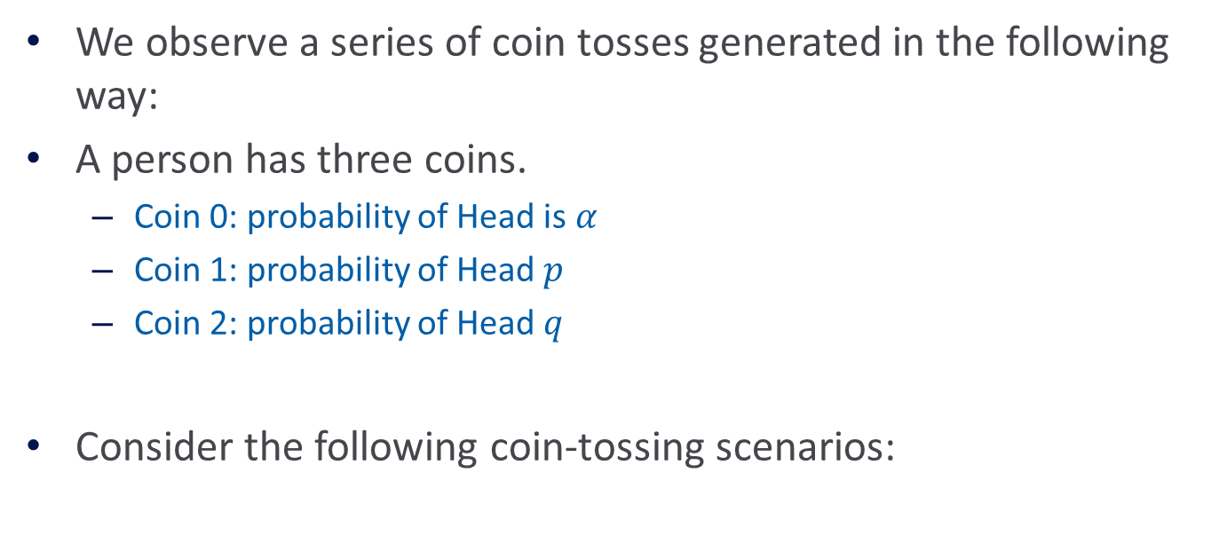
Three Coin Example
We observe a series of coin tosses generated in the following way:
A person has three coins.
  Coin 0: probability of Head is $α$
  Coin 1: probability of Head $p$
  Coin 2: probability of Head $q$
Consider the following coin-tossing scenarios:

Slide 15
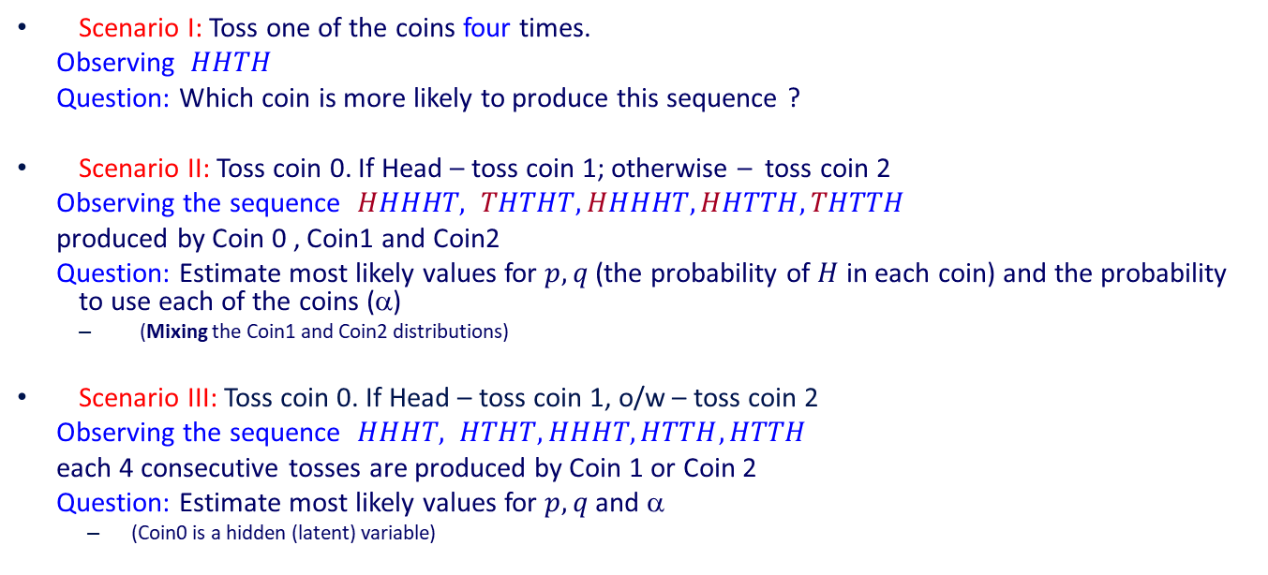
Estimation Problems
Scenario I: Toss one of the coins four times.
Observing $HHTH$
Question: Which coin is more likely to produce this sequence ?
Scenario II: Toss coin 0. If Head – toss coin 1; otherwise – toss coin 2
Observing the sequence $HHHHT, THTHT, HHHHT, HHTTH, THTTH$
produced by Coin 0 , Coin1 and Coin2
Question: Estimate most likely values for $p, q$(the probability of $H$ in each coin) and the probability to use each of the coins (α)
  (Mixing the Coin1 and Coin2 distributions)
Scenario III: Toss coin 0. If Head – toss coin 1, o/w – toss coin 2
Observing the sequence $HHHT, HTHT, HHHT, HTTH, HTTH$
each 4 consecutive tosses are produced by Coin 1 or Coin 2
Question: Estimate most likely values for $p, q$and α
  (Coin0 is a hidden (latent) variable)
Coin 0
1st toss
2nd toss
4th toss
There is no known analytical solution to this problem (general setting). That is, it is not known how to compute the values of the parameters so as to maximize the likelihood of the data.

Slide 16
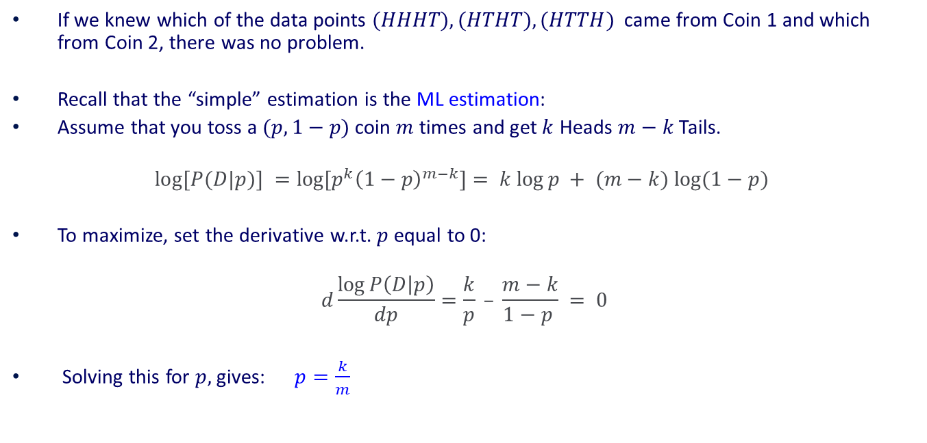
Key Intuition (1)
If we knew which of the data points $(HHHT), (HTHT), (HTTH)$came from Coin 1 and which from Coin 2, there was no problem.
Recall that the “simple” estimation is the ML estimation:
Assume that you toss a $(p,1−p)$coin $m$ times and get $k$ Heads $m−k$ Tails.
$$log⁡[P(D|p)] =log⁡[p^{k}{\left(1−p\right)}^{m−k}]= k log⁡p + (m−k) log⁡(1−p)$$
To maximize, set the derivative w.r.t. $p$equal to 0:
$$d\frac{\log{P\left(D | p\right)}}{dp}=\frac{k}{p} – \frac{m−k}{1−p } = 0$$
Solving this for $p,$ gives: $p=\frac{k}{m}$

Slide 17
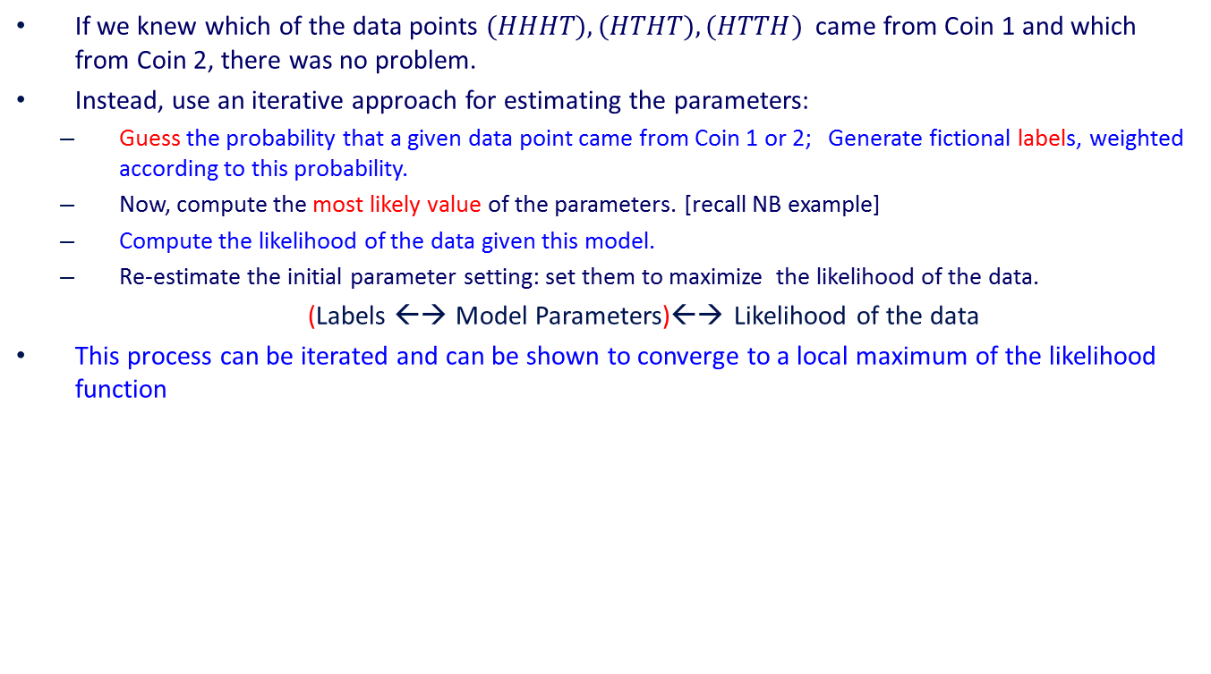
Key Intuition (2)
If we knew which of the data points $(HHHT), (HTHT), (HTTH)$came from Coin 1 and which from Coin 2, there was no problem.
Instead, use an iterative approach for estimating the parameters:
  Guess the probability that a given data point came from Coin 1 or 2; Generate fictional labels, weighted according to this probability.
  Now, compute the most likely value of the parameters. [recall NB example]
  Compute the likelihood of the data given this model.
  Re-estimate the initial parameter setting: set them to maximize the likelihood of the data.
(Labels ←→ Model Parameters)←→ Likelihood of the data
This process can be iterated and can be shown to converge to a local maximum of the likelihood function

Slide 18


EM Algorithm (Coins) -I
We will assume (for a minute) that we know the parameters $\tilde{p},\tilde{q},\tilde{α}$ and use it to estimate which Coin it is (Problem 1)
Then, we will use this “label” estimation of the observed tosses, to estimate the most likely parameters
  and so on...
Notation: $n$data points; in each one: m tosses each, $hi$ heads in the i-th data point $Di$
What is the probability that the i-th data point, $Di$, came from Coin 1 ?
STEP 1 (Expectation Step): (Here $h=h_{i}$)
$$P_{1}^{i}=P(Coin1|D^{i})=\frac{P(D^{i}|Coin1) P(Coin1)}{P(D^{i})}=$$
$$=\frac{ \tilde{α} {\tilde{p}}^{h}(1−\tilde{p})^{m−h}}{\tilde{α} {\tilde{p}}^{h}(1−\tilde{p})^{m−h}+(1−\tilde{α}){\tilde{q}}^{h}(1−\tilde{q})^{m−h}}$$

Slide 19
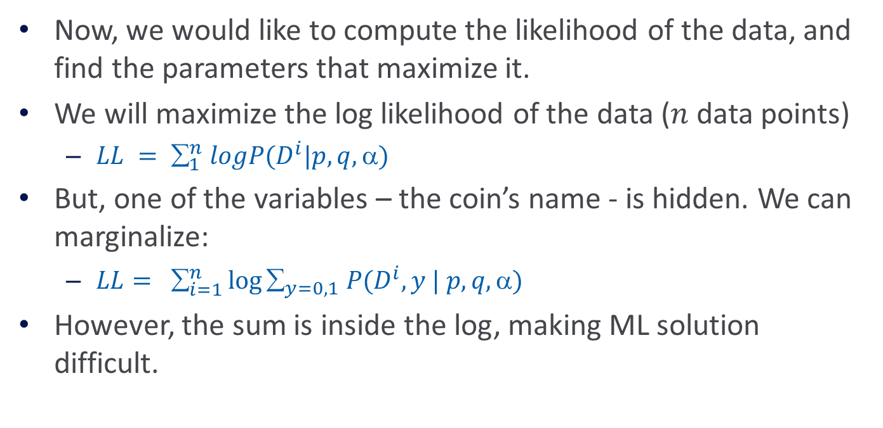
EM Algorithm (Coins) - II
Now, we would like to compute the likelihood of the data, and find the parameters that maximize it.
We will maximize the log likelihood of the data ($n$ data points)
  $LL = _{1}^{n} logP(D^{i}|p,q,)$
But, one of the variables – the coin’s name - is hidden. We can marginalize:
  $LL= _{i=1}^{n}\log{_{y=0,1} P(D^{i},y | p,q, )}$
However, the sum is inside the log, making ML solution difficult.
Notes:
We abuse the notation:
Really, we should say whether D^i is only the x part of the data or also the y part; we start by treating D^i = (x^i, y^i), but when we continue we only have D^i = (x^i).

Slide 20
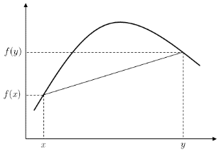
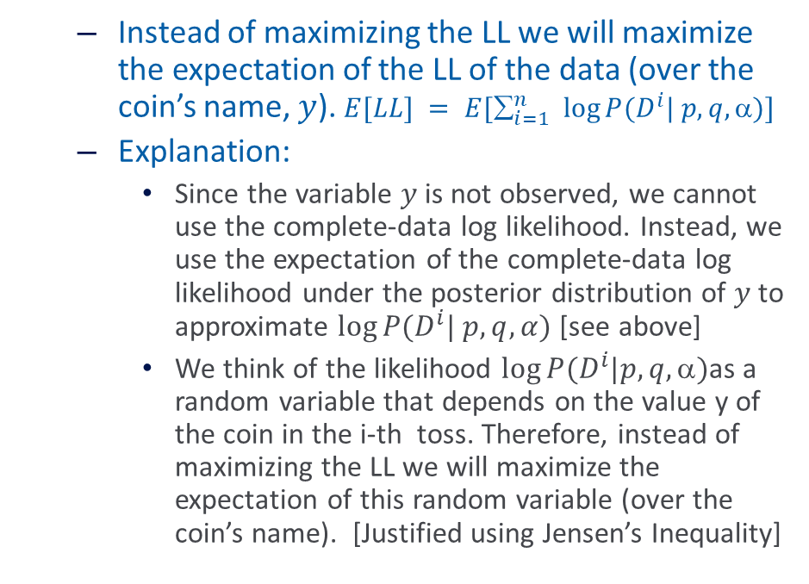
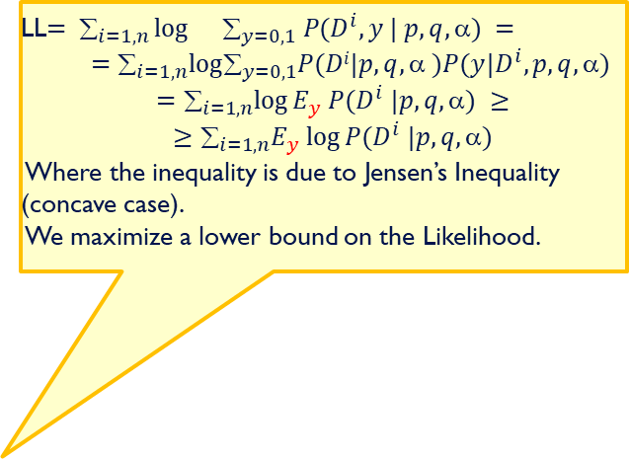
EM Algorithm (Coins) - II
LL$= _{i=1,n}\log{}_{y=0,1} P(D^{i}, y | p,q, ) =$
$$=_{i=1,n}log_{y=0,1}P(Di|p,q,  )P(y|D^{i},p,q,) =$$
$$=_{i=1,n}log⁡E_{y} P(D^{i} |p,q, ) ≥$$
$$≥_{i=1,n}E_{y} log⁡P(D^{i} |p,q, )$$
Where the inequality is due to Jensen’s Inequality (concave case).
We maximize a lower bound on the Likelihood.
  Instead of maximizing the LL we will maximize the expectation of the LL of the data (over the coin’s name, $y$). $E[LL] = E[_{i=1}^{n} log⁡P(D^{i}| p,q, )]$
  Explanation:
    Since the variable $y$ is not observed, we cannot use the complete-data log likelihood. Instead, we use the expectation of the complete-data log likelihood under the posterior distribution of $y$ to approximate $log⁡P(D^{i}| p,q,α)$ [see above]
    We think of the likelihood $\log{P(D^{i}|p,q,α)}$as a random variable that depends on the value y of the coin in the i-th toss. Therefore, instead of maximizing the LL we will maximize the expectation of this random variable (over the coin’s name). [Justified using Jensen’s Inequality]

Slide 21
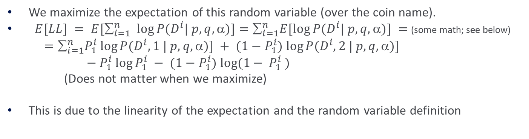
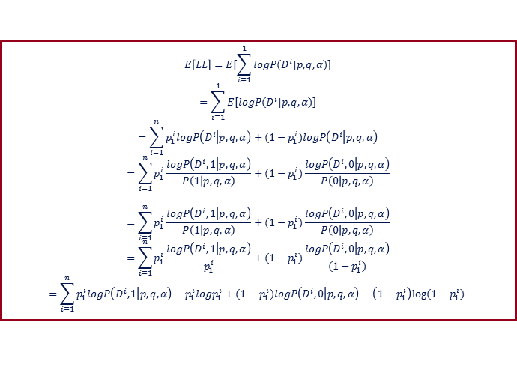
EM Algorithm (Coins) - III
We maximize the expectation of this random variable (over the coin name).
$E[LL] = E[_{i=1}^{n} log⁡P(D^{i}| p,q, )]=_{i=1}^{n}E[log⁡P(D^{i}| p,q, )] =$(some math; see below)
$=_{i=1}^{n}P_{1}^{i} log⁡P(D^{i}, 1 | p,q, )] + (1−P_{1}^{i}) log⁡P(D^{i}, 2 | p,q, )]$
$− P_{1}^{i} log⁡P_{1}^{i} − (1−P_{1}^{i}) log⁡(1− P_{1}^{i} )$
(Does not matter when we maximize)
This is due to the linearity of the expectation and the random variable definition
$$E\left[LL\right]=E[\sum_{i=1}^{1}{logP(D^{i}|p,q,α)]}$$
$$=\sum_{i=1}^{1}{E[logP(D^{i}|p,q,α)]}$$
$$=\sum_{i=1}^{n}{p_{1}^{i}logP\left(D^{i} | p,q,α\right)+(1−p_{1}^{i})logP\left(D^{i} | p,q,α\right)}$$
$$=\sum_{i=1}^{n}{p_{1}^{i}\frac{logP\left(D^{i},1 | p,q,α\right)}{P\left(1 | p,q,α\right)}+(1−p_{1}^{i})\frac{logP\left(D^{i},0 | p,q,α\right)}{P\left(0 | p,q,α\right)}}$$
$$=\sum_{i=1}^{n}{p_{1}^{i}\frac{logP\left(D^{i},1 | p,q,α\right)}{P\left(1 | p,q,α\right)}+(1−p_{1}^{i})\frac{logP\left(D^{i},0 | p,q,α\right)}{P\left(0 | p,q,α\right)}}$$
$$=\sum_{i=1}^{n}{p_{1}^{i}\frac{logP\left(D^{i},1 | p,q,α\right)}{p_{1}^{i}}+(1−p_{1}^{i})\frac{logP\left(D^{i},0 | p,q,α\right)}{(1−p_{1}^{i})}}$$
$$=\sum_{i=1}^{n}{p_{1}^{i}logP\left(D^{i},1 | p,q,α\right)−p_{1}^{i}logp_{1}^{i}+(1−p_{1}^{i})logP\left(D^{i},0 | p,q,α\right)}−\left(1−p_{1}^{i}\right)log⁡(1−p_{1}^{i})$$

Slide 22
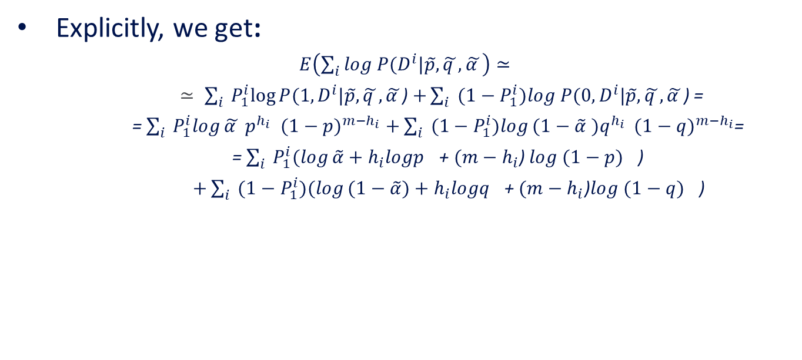
EM Algorithm (Coins) - IV
Explicitly, we get:
$E\left(\sum_{i}{log P(D^{i}|\tilde{p},}\tilde{q },\tilde{α }\right)≃$
$≃ \sum_{i}{ P_{1}^{i}log⁡P(1,D^{i}|\tilde{p},}\tilde{q },\tilde{α }$) $+\sum_{i}{ ({1−P}_{1}^{i})log P(0,D^{i}|\tilde{p},}\tilde{q },\tilde{α }$) =
= $\sum_{i}{ P_{1}^{i}log}\tilde{α }{ p}^{h_{i}}$ ${ (1−p)}^{m−h_{i}}$ $+\sum_{i}{ {(1−P}_{1}^{i})log}(1−\tilde{α}{ )q}^{h_{i}} { (1−q)}^{m−h_{i}}$=
= $\sum_{i}{ P_{1}^{i}(log}\tilde{α}+{h_{i}logp}^{}$+ $(m−h_{i}$) $log{ (1−p)}^{}$)
$+\sum_{i}{ (1−P_{1}^{i})(log}(1−\tilde{α})+{h_{i}logq}^{}\text{+ }(m−h_{i}\text{)}log{ (1−q)}^{}\text{)}$

Slide 23
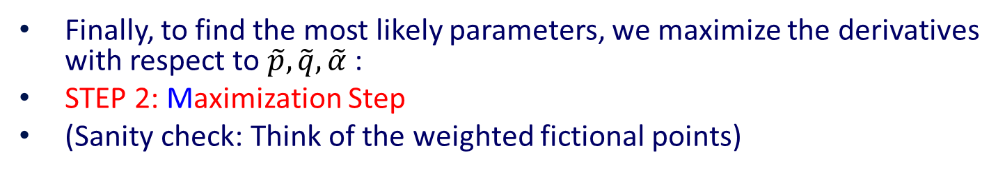
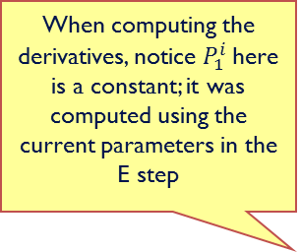
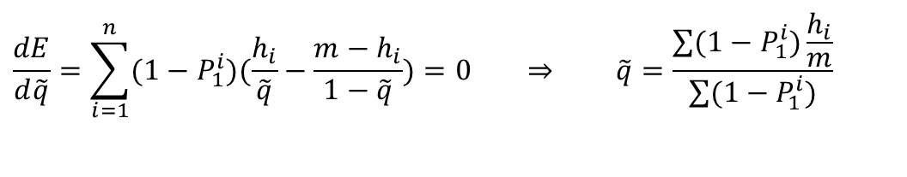
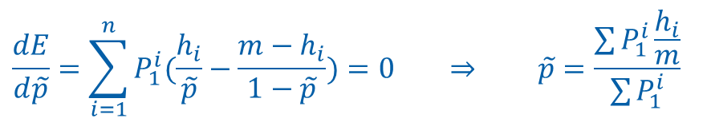
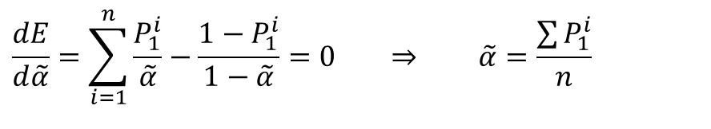
EM Algorithm (Coins) - V
Finally, to find the most likely parameters, we maximize the derivatives with respect to $\tilde{p},\tilde{q},\tilde{α}$ :
STEP 2: Maximization Step
(Sanity check: Think of the weighted fictional points)
Given old parameters we labeled the data. Now we compute the likelihood of the complete data (with the labels; as in the previous slide) and next we will find the new set of parameters that maximizes this likelihood.
When computing the derivatives, notice $P_{1}^{i}$here is a constant; it was computed using the current parameters in the E step
$$\frac{dE}{d\tilde{α}}=\sum_{i=1}^{n}{\frac{P_{1}^{i}}{\tilde{α}}−\frac{1−P_{1}^{i}}{1−\tilde{α}}}=0 ⇒ \tilde{α}=\frac{\sum{P_{1}^{i}}}{n}$$
$$\frac{dE}{d\tilde{p}}=\sum_{i=1}^{n}{P_{1}^{i}(\frac{h_{i}}{\tilde{p}}−\frac{m−h_{i}}{1−\tilde{p}})}=0 ⇒ \tilde{p}=\frac{\sum{P_{1}^{i}\frac{h_{i}}{m}}}{\sum{P_{1}^{i}}}$$
$$\frac{dE}{d\tilde{q}}=\sum_{i=1}^{n}{(1−P_{1}^{i})(\frac{h_{i}}{\tilde{q}}−\frac{m−h_{i}}{1−\tilde{q}})}=0 ⇒ \tilde{q}=\frac{\sum{(1−P_{1}^{i})\frac{h_{i}}{m}}}{\sum{(1−P_{1}^{i})}}$$

Slide 24

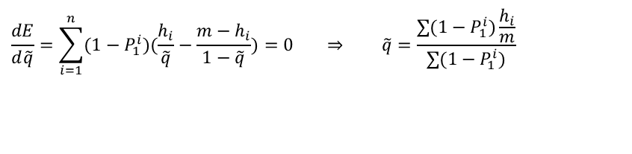
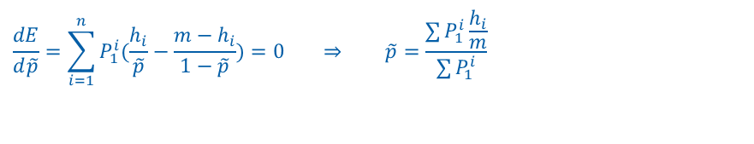
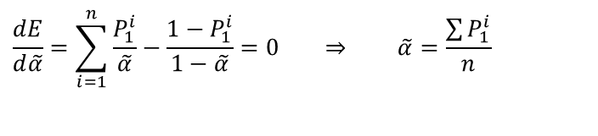
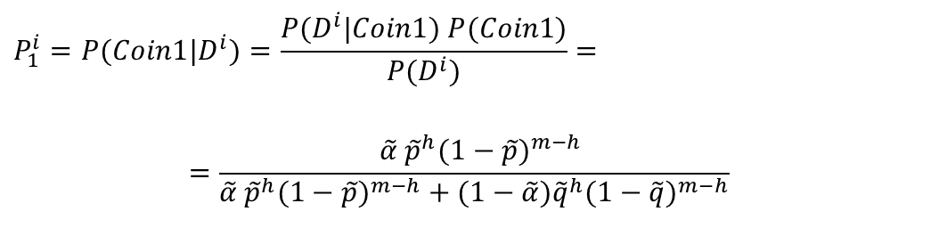
Summary: EM Algorithm (Coins)
We will assume (for a minute) that we know the parameters $\tilde{p},\tilde{q},\tilde{α}$ and use it to estimate which Coin it STEP 1 (Expectation Step): (Here $h=h_{i}$)
Iterate
Why does it work?
It can be shown that the likelihood of the observed data when computed with the set of parameters at time t+1, is larger than the likelihood of the observed data when computed with the set of parameters at time t. That is, the likelihood of the data grows in each round, reaching a local maxima.
$$P_{1}^{i}=P(Coin1|D^{i})=\frac{P(D^{i}|Coin1) P(Coin1)}{P(D^{i})}=$$
$$=\frac{ \tilde{α} {\tilde{p}}^{h}(1−\tilde{p})^{m−h}}{\tilde{α} {\tilde{p}}^{h}(1−\tilde{p})^{m−h}+(1−\tilde{α}){\tilde{q}}^{h}(1−\tilde{q})^{m−h}}$$
STEP 2: Maximization Step
$$\frac{dE}{d\tilde{α}}=\sum_{i=1}^{n}{\frac{P_{1}^{i}}{\tilde{α}}−\frac{1−P_{1}^{i}}{1−\tilde{α}}}=0 ⇒ \tilde{α}=\frac{\sum{P_{1}^{i}}}{n}$$
$$\frac{dE}{d\tilde{p}}=\sum_{i=1}^{n}{P_{1}^{i}(\frac{h_{i}}{\tilde{p}}−\frac{m−h_{i}}{1−\tilde{p}})}=0 ⇒ \tilde{p}=\frac{\sum{P_{1}^{i}\frac{h_{i}}{m}}}{\sum{P_{1}^{i}}}$$
$$\frac{dE}{d\tilde{q}}=\sum_{i=1}^{n}{(1−P_{1}^{i})(\frac{h_{i}}{\tilde{q}}−\frac{m−h_{i}}{1−\tilde{q}})}=0 ⇒ \tilde{q}=\frac{\sum{(1−P_{1}^{i})\frac{h_{i}}{m}}}{\sum{(1−P_{1}^{i})}}$$

Slide 25
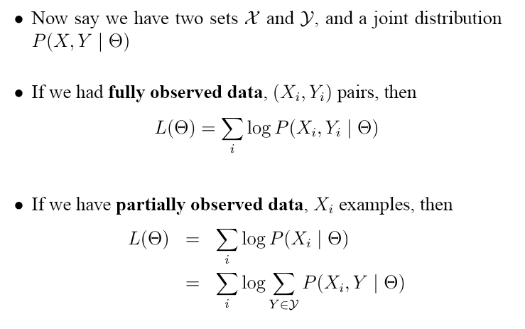
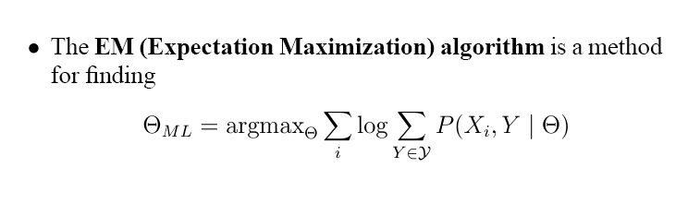
Models with Hidden Variables

Slide 26
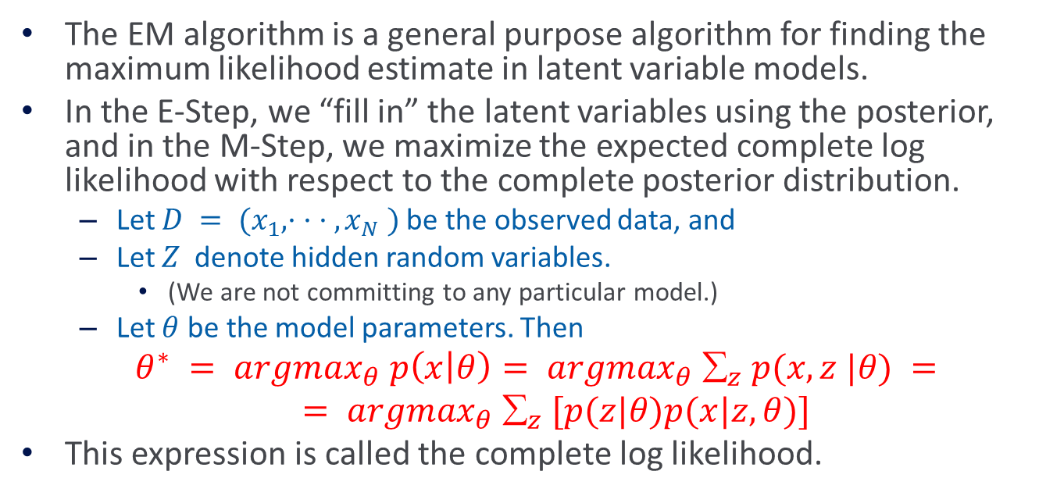
EM: General Setting
The EM algorithm is a general purpose algorithm for finding the maximum likelihood estimate in latent variable models.
In the E-Step, we “fill in” the latent variables using the posterior, and in the M-Step, we maximize the expected complete log likelihood with respect to the complete posterior distribution.
  Let $D = (x_{1}, · · · , x_{N} )$be the observed data, and
  Let $Z$ denote hidden random variables.
    (We are not committing to any particular model.)
  Let $θ$ be the model parameters. Then
$θ^{∗} = argmax_{θ} p\left(x | θ\right)= argmax_{θ} _{z} p(x,z |θ) =$
$= argmax_{θ} _{z} [p(z|θ)p(x|z,θ)]$
This expression is called the complete log likelihood.

Slide 27
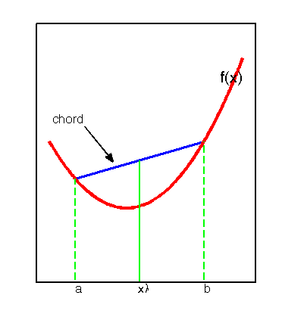
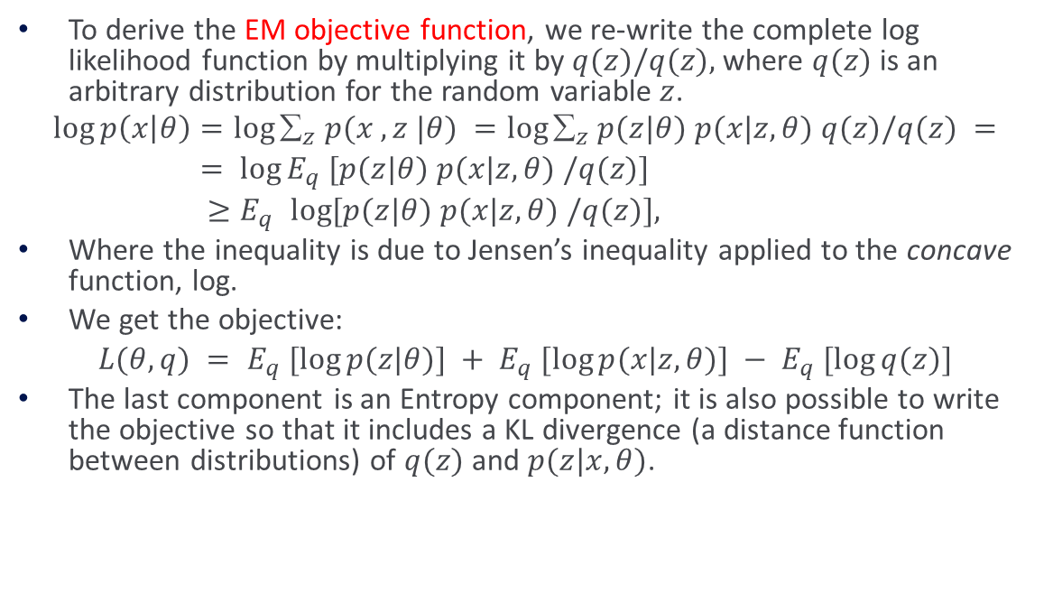
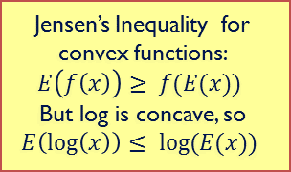
EM: General Setting (2)
To derive the EM objective function, we re-write the complete log likelihood function by multiplying it by $q(z)/q(z),$where $q(z)$ is an arbitrary distribution for the random variable $z$.
$$\log{p\left(x | θ\right)}=\log{_{z} p(x ,z |θ)} =\log{_{z} p(z|θ) p(x|z,θ) q(z)/q(z)} =$$
$= log⁡E_{q} [p(z|θ) p(x|z,θ) /q(z)]$
${≥E}_{q} log⁡[p(z|θ) p(x|z,θ) /q(z)],$
Where the inequality is due to Jensen’s inequality applied to the concave function, log.
We get the objective:
$L(θ, q) = E_{q} [log⁡p(z|θ)] + E_{q} [log⁡p(x|z,θ)] − E_{q} [log⁡q(z)]$
The last component is an Entropy component; it is also possible to write the objective so that it includes a KL divergence (a distance function between distributions) of $q(z)$ and $p(z|x,θ)$.
Jensen’s Inequality for convex functions:
$$E\left(f\left(x\right)\right)≥ f(E(x))$$
But log is concave, so
$$E\left(\log\left(x\right)\right)≤ log⁡(E(x))$$

Slide 28
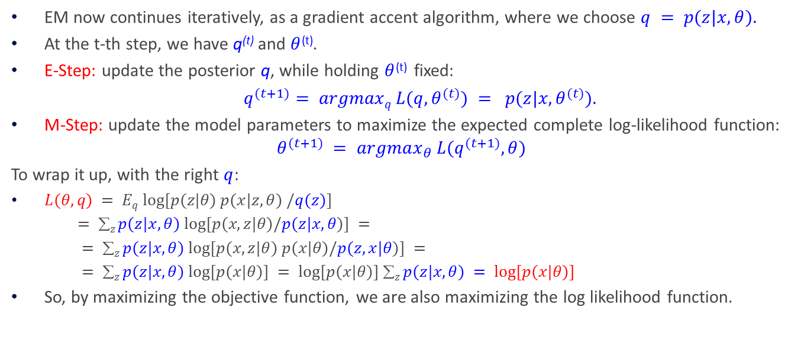
EM: General Setting (3)
EM now continues iteratively, as a gradient accent algorithm, where we choose $q = p(z|x, θ).$
At the t-th step, we have q^{(t)} and $θ$^{(t)}.
E-Step: update the posterior q, while holding $θ$^{(t)} fixed:
$q^{(t+1)}= argmaxq L(q, θ^{(t)}) = p(z|x, θ^{(t)}).$
M-Step: update the model parameters to maximize the expected complete log-likelihood function:
$$θ^{(t+1)} = argmax_{θ} L(q^{(t+1)}, θ)$$
To wrap it up, with the right $q$:
$L(θ, q) = Eq log⁡[p(z|θ) p(x|z,θ) /q(z)]$
$= z p(z|x, θ) log⁡[p(x, z|θ)/p(z|x, θ)] =$
$= z p(z|x, θ) log⁡[p(x, z|θ) p(x|θ)/p(z, x|θ)] =$
$= z p(z|x, θ) log⁡[p(x|θ)] = log⁡[p(x|θ)] z p(z|x, θ) = log⁡[p(x|θ)]$
So, by maximizing the objective function, we are also maximizing the log likelihood function.
Other q’s can be chosen [Samdani & Roth2012] to give other EM algorithms. Specifically, you can choose a q that chooses the most likely z in the E-step, and then continues to estimate the parameters (called Truncated EM, or Hard EM).
(Think back to the semi-supervised case)

Slide 29
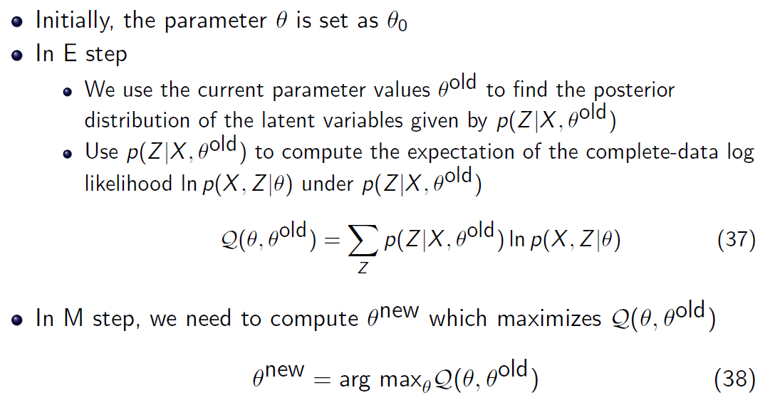
The General EM Procedure
E
M

Slide 30
EM Summary (so far)
EM is a general procedure for learning in the presence of unobserved variables.
We have shown how to use it in order to estimate the most likely density function for a mixture of (Bernoulli) distributions.
EM is an iterative algorithm that can be shown to converge to a local maximum of the likelihood function.
  It depends on assuming a family of probability distributions.
  In this sense, it is a family of algorithms. The update rules you will derive depend on the model assumed.
It has been shown to be quite useful in practice, when the assumptions made on the probability distribution are correct, but can fail otherwise.

Slide 31
EM Summary (so far)
EM is a general procedure for learning in the presence of unobserved variables.
The (family of ) probability distribution is known; the problem is to estimate its parameters
In the presence of hidden variables, we can often think about it as a problem of a mixture of distributions – the participating distributions are known, we need to estimate:
  Parameters of the distributions
  The mixture policy
Our previous example: Mixture of Bernoulli distributions

Slide 32



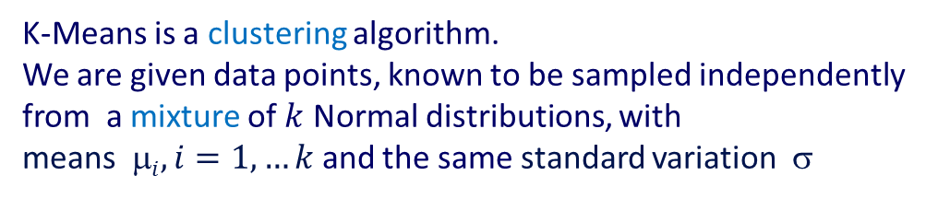
Example: K-Means Algorithm
K-Means is a clustering algorithm.
We are given data points, known to be sampled independently
from a mixture of $k$ Normal distributions, with
means $i, i=1,…k$and the same standard variation $$
$$p(x)$$
$$p(x)$$
Standard K-Means clustering:
Guess k centers.
Repeat:
  Place each point in its center, based on distance.
  Re-estimate centers for each cluster.
  Re-place points
$$x$$

Slide 33
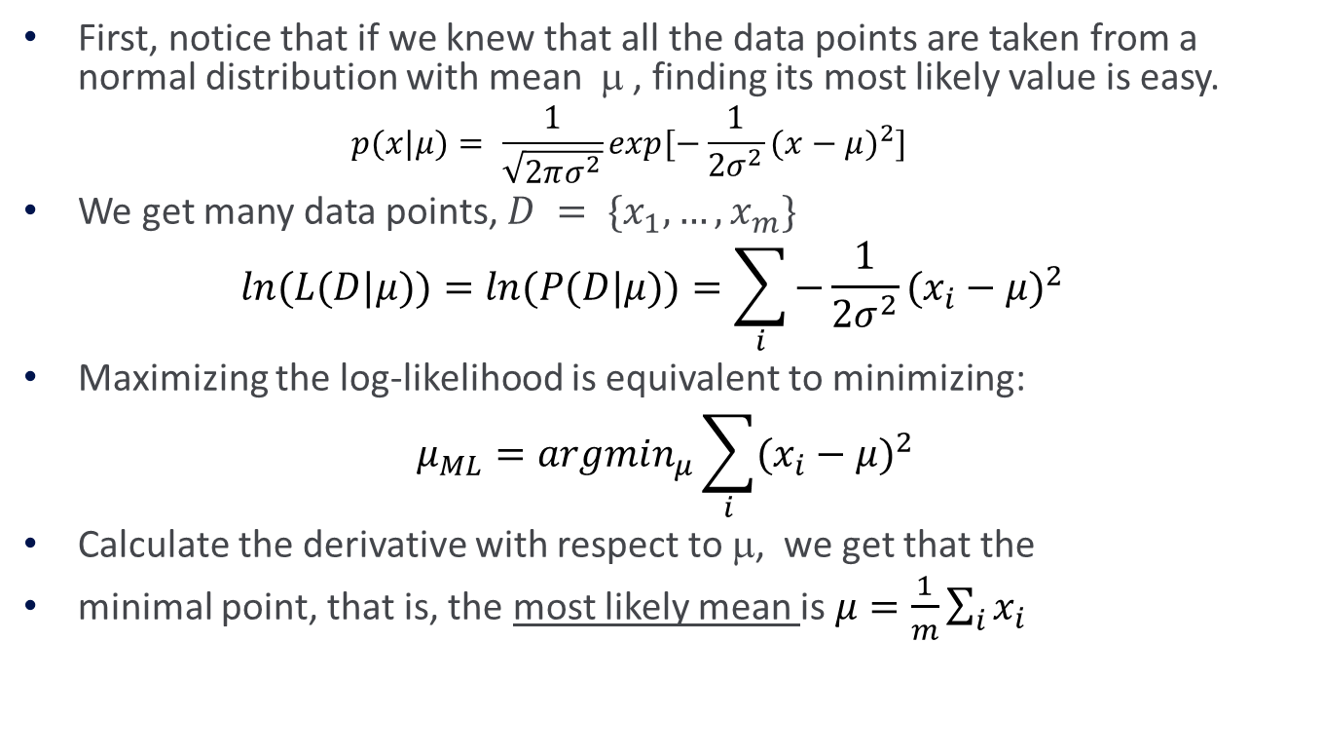
Example: K-Means Algorithm
First, notice that if we knew that all the data points are taken from a normal distribution with mean μ , finding its most likely value is easy.
  $$p(x|μ)= \frac{1}{\sqrt{2πσ^{2}}}exp[−\frac{1}{2σ^{2}}(x−μ)^{2}]$$
We get many data points, $D = \{x_{1},…,x_{m}\}$
$$ln(L(D|μ))=ln(P(D|μ))=\sum_{i}{−\frac{1}{2σ^{2}}(x_{i}−μ)^{2}}$$
Maximizing the log-likelihood is equivalent to minimizing:
$$μ_{ML}=argmin_{μ}\sum_{i}{(x_{i}−μ)^{2}}$$
Calculate the derivative with respect to μ, we get that the
minimal point, that is, the most likely mean is $μ=\frac{1}{m}\sum_{i}{x_{i}}$

Slide 34
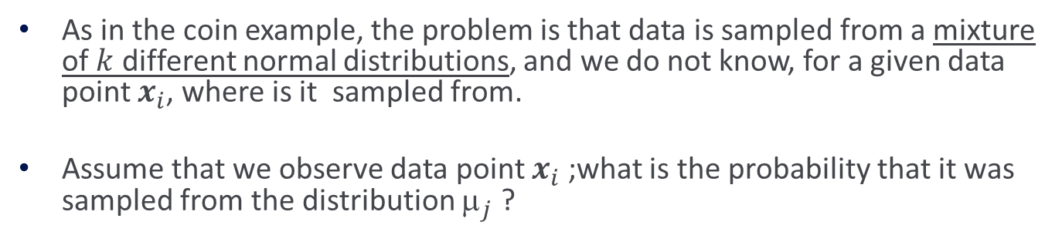
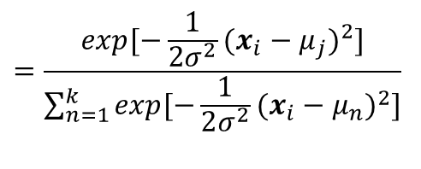
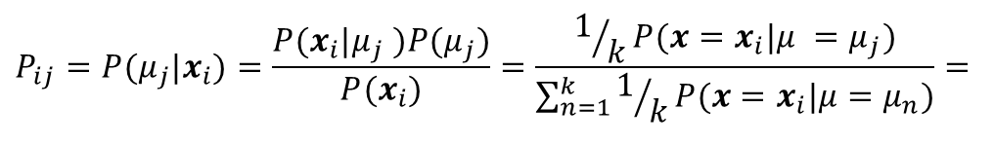
A mixture of Distributions
As in the coin example, the problem is that data is sampled from a mixture of $k$ different normal distributions, and we do not know, for a given data point $x_{i}$, where is it sampled from.
Assume that we observe data point $x_{i}$ ;what is the probability that it was sampled from the distribution $_{j}$ ?
$$P_{ij}=P(μ_{j}|x_{i})=\frac{P(x_{i}|μ_{j} )P(μ_{j})}{P(x_{i})}=\frac{1/kP(x=x_{i}|μ =μ_{j})}{\sum_{n=1}^{k}{1/kP(x=x_{i}|μ=μ_{n})}}=$$
$$=\frac{exp[−\frac{1}{2σ^{2}}(x_{i}−μ_{j})^{2}]}{\sum_{n=1}^{k}{exp[−\frac{1}{2σ^{2}}(x_{i}−μ_{n})^{2}]}}$$

Slide 35
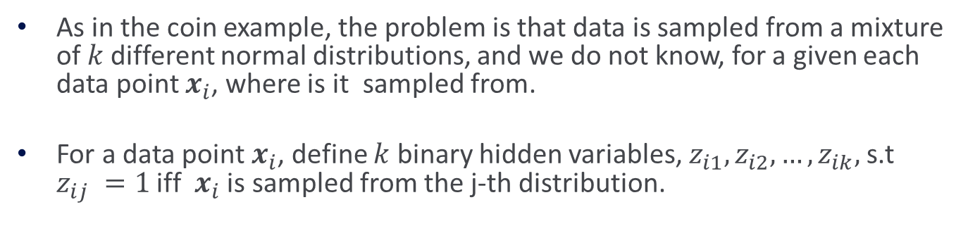

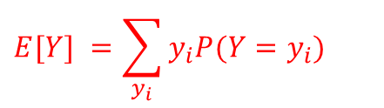

A Mixture of Distributions
As in the coin example, the problem is that data is sampled from a mixture of $k$different normal distributions, and we do not know, for a given each data point $x_{i}$, where is it sampled from.
For a data point $x_{i}$, define $k$ binary hidden variables, $z_{i1},z_{i2},…,z_{ik},$s.t $z_{ij} =1$ iff $x_{i}$ is sampled from the j-th distribution.
$$E\left[z_{ij}\right]=1•P\left(x_{i} was sampled from μ_{j}\right)+0•P(x_{i} was not sampled from μ_{j})= P_{ij}$$
$$E[Y] =\sum_{y_{i}}{y_{i}P(Y=y_{i})}$$
$$E[X+Y] =E[X]+E[Y]$$

Slide 36





Example: K-Means Algorithms
Expectation: (here: $h = σ,μ_{1},μ_{2},...,μ_{k}$ )
Computing the likelihood given the observed data $D = \{x_{1},…,x_{m}\}$and the hypothesis $h$ (w/o the constant coefficient)
$$p(d_{i}|h)= p(x_{i},z_{i1},...,z_{ik}|h)=\frac{1}{\sqrt{2πσ^{2}}}exp[−\frac{1}{2σ^{2}}\sum_{j}{z_{ij}}(x_{i}−μ_{j})^{2}]$$
$$ln(P(D|h))=\sum_{i=1}^{m}{−\frac{1}{2σ^{2}}}\sum_{j}{z_{ij}(x_{i}−μ_{j})^{2}}$$
$$E[ln(P(D|h))]=E[\sum_{i=1}^{m}{−\frac{1}{2σ^{2}}}\sum_{j}{z_{ij}\left(x_{i}−μ_{j})^{2}\right]}=$$
$$=\sum_{i=1}^{m}{−\frac{1}{2σ^{2}}}\sum_{j}{E[z_{ij}](x_{i}−μ_{j})^{2}}$$

Slide 37





Example: K-Means Algorithms
Maximization: Maximizing
with respect to $u_{j}$ we get that:
Which yields:
$$Q(h|h′)=\sum_{i=1}^{m}{−\frac{1}{2σ^{2}}}\sum_{j}{E[z_{ij}](x_{i}−μ_{j})^{2}}$$
Given old parameters ($h’)$we labeled the data. Now we compute the likelihood of the complete data (with the labels) and next we will find the new set of parameters ($h$) that maximizes this likelihood.
$$\frac{dQ}{dμ_{j}}=C\sum_{i=1}^{m}{E[z_{ij}](x_{i}−μ_{j})}=0$$
$$μ_{j}=\frac{\sum_{i=1}^{m}{E[z_{ij}]x_{i}}}{\sum_{i=1}^{m}{E[z_{ij}]}}$$

Slide 38





Summary: K-Means Algorithms
Given a set $D = \{x_{1},…,x_{m}\}$of data points, guess initial parameters $σ,μ_{1},μ_{2},...,μ_{k}$
Compute (for all $i,j$)
and a new set of means:
repeat to convergence
$$p_{ij}=E[z_{ij}]=\frac{exp[−\frac{1}{2σ^{2}}(x_{i}−μ_{j})^{2}]}{\sum_{n=1}^{k}{exp[−\frac{1}{2σ^{2}}(x_{i}−μ_{n})^{2}]}}$$
Difference: now we place “fractional” points into clusters.
$p_{ij}$ is the fractional label
$$μ_{j}=\frac{\sum_{i=1}^{m}{E[z_{ij}]x_{i}}}{\sum_{i=1}^{m}{E[z_{ij}]}}$$
Recall: Standard K-Means clustering
Guess k centers.
Repeat:
  Place each point in its center, based on distance.
  Re-estimate centers for each cluster.
  Re-place points
Notice that this algorithm will find the best $k$means in the sense of minimizing the sum of square distance.
The hard EM algorithm
(threshold the distribution and keep the top option)

Slide 39



EM
We think about the probabilistic model generating the data
  But, some of the data is not observed, making a direct estimation of the parameters more difficult
  EM is used to estimate the model parameters in these cases
  We have made some code available.

Slide 40
Summary: EM
EM is a general procedure for learning in the presence of unobserved variables.
We have shown how to use it in order to estimate the most likely density function for a mixture of probability distributions.
EM is an iterative algorithm that can be shown to converge to a local maximum of the likelihood function. Thus, might requires many restarts.
It depends on assuming a family of probability distributions.
It has been shown to be quite useful in practice, when the assumptions made on the probability distribution are correct, but can fail otherwise.
As examples, we have derived an important clustering algorithm, the k-means algorithm and have shown how to use it in order to estimate the most likely density function for a mixture of probability distributions.

Slide 41

More Thoughts about EM
Training: a sample of data points, $\left(x0, x1 ,…, xn\right)∈{\left\{0,1\right\}}^{n+1}$
Task: predict the value of $x0$, given assignments to all $n$ variables.

Slide 42

Notes:
Poll Title: How would you model this as a learning problem? What learning approach would you use?
https://www.polleverywhere.com/free_text_polls/X9D6lNRk0HXjqksWsp8GC

Slide 43





More Thoughts about EM
$$α_{z}$$
$$z$$
$$Piz$$
Assume that a set $xi∈ {\left\{0,1\right\}}^{n+1}$of data points is generated as follows:
  Postulate a hidden variable $Z$, with $k$ values, $1 ≤ z ≤ k$with probability $αz, _{1}^{k} αz = 1$
Having randomly chosen a value $z$ for the hidden variable, we choose the value $xi$ for each observable $Xi$ to be 1 with probability $p_{i}^{z}$ and 0 otherwise, $[i = 0, 1, 2, ….n]$
Training: a sample of data points, $\left(x0, x1 ,…, xn\right)∈ {\left\{0,1\right\}}^{n+1}$
Task: predict the value of $x0$, given assignments to all $n$ variables.

Slide 44





More Thoughts about EM
$$α_{z}$$
$$z$$
$$Piz$$
Another important distinction to attend to is the fact that, once you estimated all the parameters with EM, you can answer many prediction problems e.g., $p(x0, x7,…,x8 |x1, x2 ,…, xn)$ while with Perceptron (say) you need to learn separate models for each prediction problem.
Two options:
Parametric: estimate the model using EM.
Once a model is known, use it to make predictions.
  Problem: Cannot use EM directly without an additional assumption on the way data is generated.
Non-Parametric: Learn $x0$ directly as a function of the other variables.
  Problem: which function to try and learn?
$x0$ turns out to be a linear function of the other variables, when $k=2$(what does it mean)?
When $k$ is known, the EM approach performs well; if an incorrect value is assumed the estimation fails; the linear methods performs better
[Grove & Roth 2001]

Slide 45

EM

Slide 46

The EM Algorithm
Algorithm:
  Guess initial values for the hypothesis $h=σ,μ_{1},μ_{2},...,μ_{k}$
Expectation:
  Calculate $Q(h’,h) = E(Log P(Y|h’) | h, X)$ using the current hypothesis $h$ and the observed data $X$.
Maximization:
  Replace the current hypothesis $h$ by $h’$, that maximizes the $Q$ function (the likelihood function)
  set $h = h’,$such that $Q(h’,h)$is maximal
Repeat: Estimate the Expectation again.

