Slide 1
Bayesian Networks
Dan Roth
danroth@seas.upenn.edu|http://www.cis.upenn.edu/~danroth/|461C, 3401 Walnut
Slides were created by Dan Roth (for CIS519/419 at Penn or CS446 at UIUC), or by other authors who have made their ML slides available.

Slide 2
Administration (12/07/20)
Are we recording? YES!
Available on the web site
Remember that all the lectures are available on the website before the class
  Go over it and be prepared
  A new set of written notes will accompany most lectures, with some more details, examples and, (when relevant) some code.
HW4 is due today.
HW5 is out; due 12/10 (last day of the semester).
  It is mostly a summary of the material we covered this semester (with a focus on the second half) and will help you prepare for the exam.
  No programming.
  We will give an extension until a few days before the exam.
We meet three time (Monday, Wednesday, Thursday) this week.
The Final is on 12/18.
  Similar style to the mid-term. Comprehensive, with emphasis on the material after the mid-term.
  90 minutes. You can start it any time between 9am and 7:30 pm ET. Your 90 minutes will be measure from the time you start.
  Between 10:30-noon ET, most of the TAs will be on-board to respond to clarification questions. If possible, do it at that time.
  There will be at least one TA available throughout the day to respond to clarification questions.
  Communication will only be done via private Piazza posts.

Slide 3
Projects
CIS 519 students need to do a team project: Read the project descriptions and follow the updates on the Project webpage
  Teams will be of size 2-4
  We will help grouping if needed
There will be 3 options for projects.
  Natural Language Processing (Text)
  Computer Vision (Images)
  Speech (Audio)
In all cases, we will give you datasets and initial ideas
  The problem will be multiclass classification problems
  You will get annotated data only for some of the labels, but will also have to predict other labels
  0-zero shot learning; few-shot learning; transfer learning
A detailed note will come out today.
Timeline:
  11/11 Choose a project and team up
  11/23 Initial proposal describing what your team plans to do
  12/2 Progress report: 1 page. What you have done; plans; problems.
  12/21 Final paper + short video
Try to make it interesting!

Slide 4
So far…
Bayesian Learning
  What does it mean to be Bayesian?
Naïve Bayes
  Independence assumptions
EM Algorithm
  Learning with hidden variables
Today:
  Representing arbitrary probability distributions
  Inference
    Exact inference; Approximate inference
  Learning Representations of Probability Distributions

Slide 5
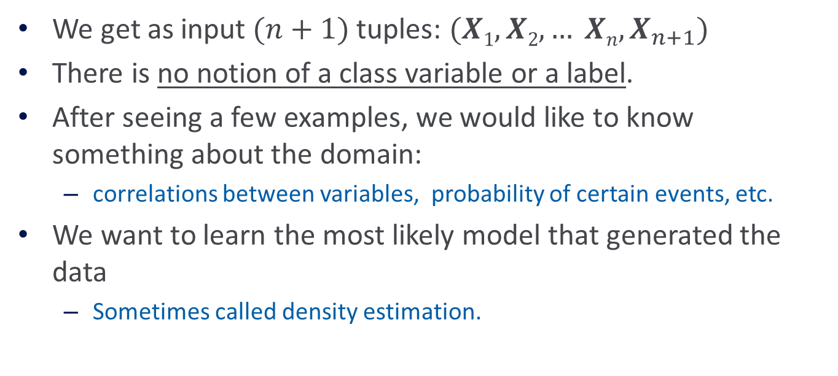
Unsupervised Learning
We get as input$(n+1)$tuples: $(X1, X2, … Xn, X_{n+1})$
There is no notion of a class variable or a label.
After seeing a few examples, we would like to know something about the domain:
  correlations between variables, probability of certain events, etc.
We want to learn the most likely model that generated the data
  Sometimes called density estimation.

Slide 6

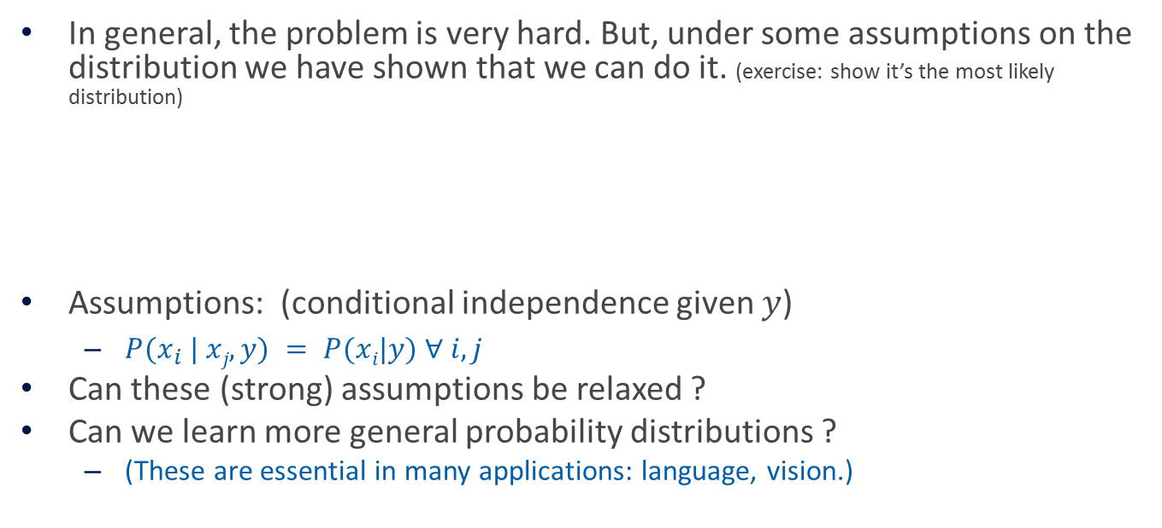








Simple Distributions
In general, the problem is very hard. But, under some assumptions on the distribution we have shown that we can do it. (exercise: show it’s the most likely distribution)
Assumptions: (conditional independence given $y$)
  $P(x_{i} | xj,y) = P(xi|y) ∀ i,j$
Can these (strong) assumptions be relaxed ?
Can we learn more general probability distributions ?
  (These are essential in many applications: language, vision.)
$$P(y)$$
$$y$$
$$P(x_{2}|y)$$
$$P(x_{n}|y)$$
$$P(x_{1}|y)$$
$$x_{1}$$
$$x_{2}$$
$$x_{3}$$
$$x_{n}$$

Slide 7

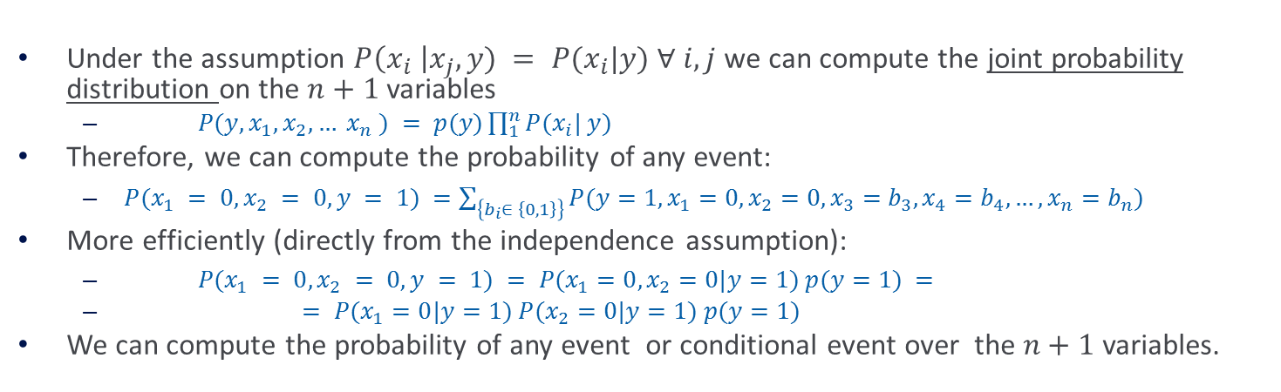






Simple Distributions
$$P(y)$$
$$y$$
$$P(x_{2}|y)$$
$$P(x_{n}|y)$$
$$P(x_{1}|y)$$
$$x_{1}$$
$$x_{2}$$
$$x_{3}$$
$$x_{n}$$
Under the assumption $P\left(x_{i} \right|x_{j},y) = P(x_{i}|y) ∀$ $i,j$ we can compute the joint probability distribution on the $n+1$ variables
  $P(y, x_{1}, x_{2}, … x_{n} ) = p(y)\prod_{1}^{n}{P(x_{i}| y) }$
Therefore, we can compute the probability of any event:
  $P(x_{1} = 0, x_{2} = 0, y = 1) =\sum_{\left\{b_{i}∈ \left\{0,1\right\}\right\}}{P(y=1, x_{1}=0, x_{2}=0, x_{3}=b_{3}, x_{4}=b_{4},…,x_{n}=b_{n})}$
More efficiently (directly from the independence assumption):
  $P(x_{1} = 0, x_{2} = 0, y = 1) = P(x_{1}=0, x_{2}=0|y=1) p(y=1) =$
  $= P(x_{1}=0|y=1) P(x_{2}=0|y=1) p(y=1)$
We can compute the probability of any event or conditional event over the $n+1$ variables.

Slide 8
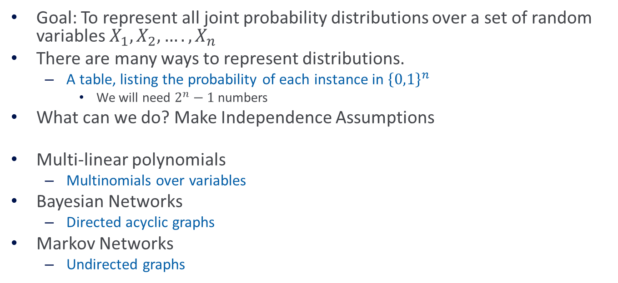
Representing Probability Distribution
Goal: To represent all joint probability distributions over a set of random variables $X_{1}, X_{2},…., X_{n}$
There are many ways to represent distributions.
  A table, listing the probability of each instance in ${\left\{0,1\right\}}^{n}$
    We will need $2^{n}−1$numbers
What can we do? Make Independence Assumptions
Multi-linear polynomials
  Multinomials over variables
Bayesian Networks
  Directed acyclic graphs
Markov Networks
  Undirected graphs

Slide 9
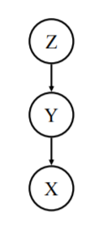









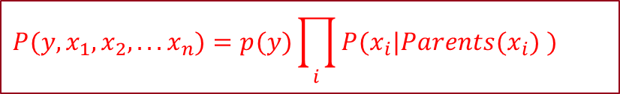


Graphical Models of Probability Distributions
Bayesian Networks represent the joint probability distribution over a set of variables.
Independence Assumption: $∀$ $x, x$is independent of its non-descendants given its parents
With these conventions, the joint probability distribution is given by:
This is a theorem. To prove it, order the nodes from leaves up, and use the product rule.
The terms are called CPTs (Conditional Probability tables) and they completely define the probability distribution.
$$Y$$
$z$ is a parent of $x$
$x$ is a descendant of$y$
$$Z1$$
$$Z2$$
$$Z$$
$$Z3$$
Show that: P(X|Y,Z) = P(X|Y).
BTW, since independence is symmetric, you can also show that P(Z|Y,X) = P(Z|Y)
$$X10$$
$$X$$
$$X2$$
$$P(y,x_{1},x_{2},...x_{n})=p(y)\prod_{i}{P(x_{i}|Parents(x_{i}) )}$$

Slide 10
Bayesian Network
Semantics of the DAG
  Nodes are random variables
  Edges represent causal influences
  Each node is associated with a conditional probability distribution
Two equivalent viewpoints
  A data structure that represents the joint distribution compactly
  A representation for a set of conditional independence assumptions about a distribution

Slide 11
Bayesian Network: Example
The burglar alarm in your house rings when there is a burglary or an earthquake. An earthquake will be reported on the radio. If an alarm rings and your neighbors hear it, they will call you.
What are the random variables?

Slide 12
Bayesian Network: Example
If there’s an earthquake, you’ll probably hear about it on the radio.
Earthquake
Burglary
An alarm can ring because of a burglary or an earthquake.
Radio
Alarm
How many parameters do we have?
How many would we have if we had to store the entire joint?
Mary Calls
John Calls
If your neighbors hear an alarm, they will call you.

Slide 13
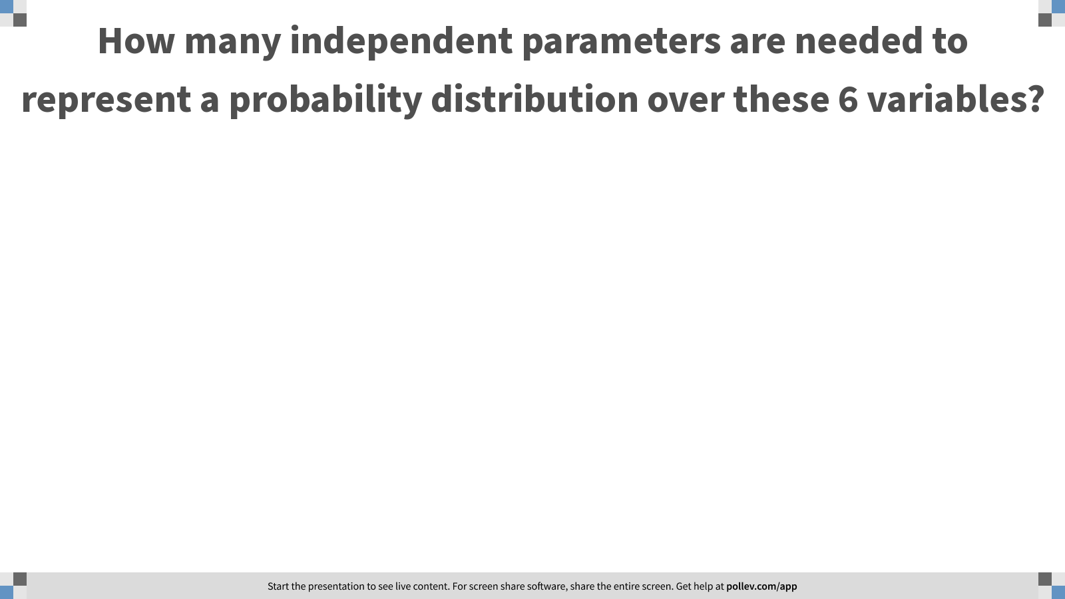
Notes:
Poll Title: How many independent parameters are needed to represent a probability distribution over these 6 variables?
https://www.polleverywhere.com/free_text_polls/ti5LaXDdEPOe2LdOG1ZlQ

Slide 14
Bayesian Network: Example
If there’s an earthquake, you’ll probably hear about it on the radio.
Earthquake
Burglary
An alarm can ring because of a burglary or an earthquake.
Radio
Alarm
How many parameters do we have?
How many would we have if we had to store the entire joint?
Mary Calls
John Calls
If your neighbors hear an alarm, they will call you.

Slide 15
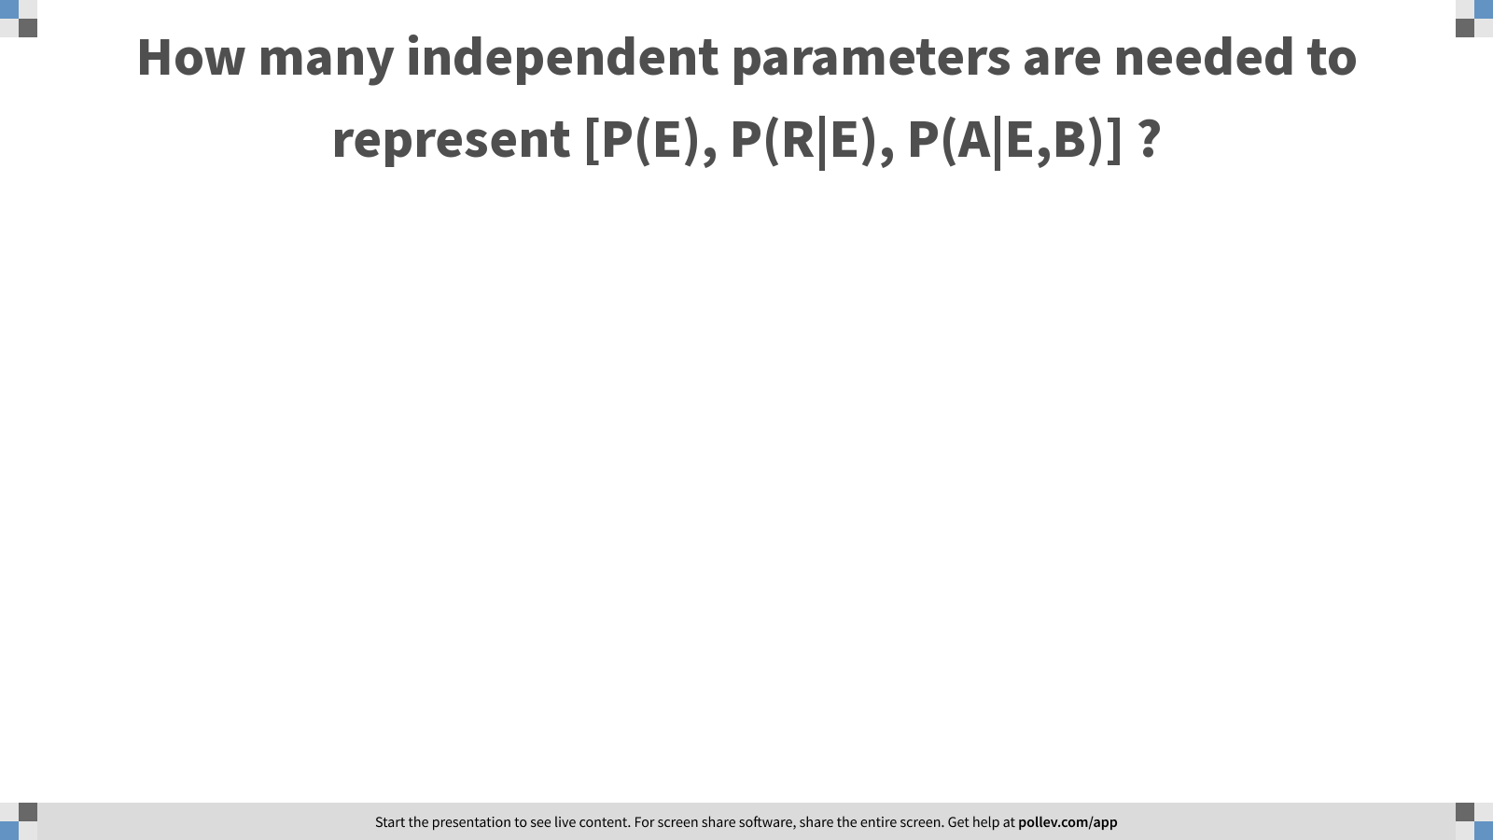
Notes:
Poll Title: How many independent parameters are needed to represent [P(E), P(R|E), P(A|E,B)] ?
https://www.polleverywhere.com/free_text_polls/VNWwYMBtknDSiWNcY01PA

Slide 16

Bayesian Network: Example
P(E)
Earthquake
P(B)
Burglary
P(R | E)
P(A | E, B)
Radio
Alarm
With these probabilities,
(and assumptions, encoded in the graph) we can compute the probability of any event over these variables.
P(M | A)
P( J | A)
Mary Calls
John Calls
$$P(E, B, A, R, M, J) = P(E) P(B, A, R, M, J |E) =$$
$$= P(E) P(B) P(A, R, M, J |E, B) =$$
$$= P(E) P(B) P(R | E, B ) P(M, J, A | E, B)$$
$$= P(E) P(B) P(R | E) P(M, J| A, E, B) P(A| E, B)$$
$$= P(E) P(B) P(R | E) P(M |A) P(J | A) P(A |E, B)$$
Notes:
Note that Naïve Bayes is a very simple bayes net.

Slide 17

Bayesian Network: Markov Blanket
Given a Bayesian Network, the Markov Blanket of a node $X$is the following set of nodes:
  The parents of $X$, the children of $X$ and the other parents of the children of $X$
Markov blanket of Earthquake node
Earthquake
Burglary
A variable is conditionally independent of all other variables given its Markov Blanket
Radio
Alarm
Mary Calls
John Calls

Slide 18
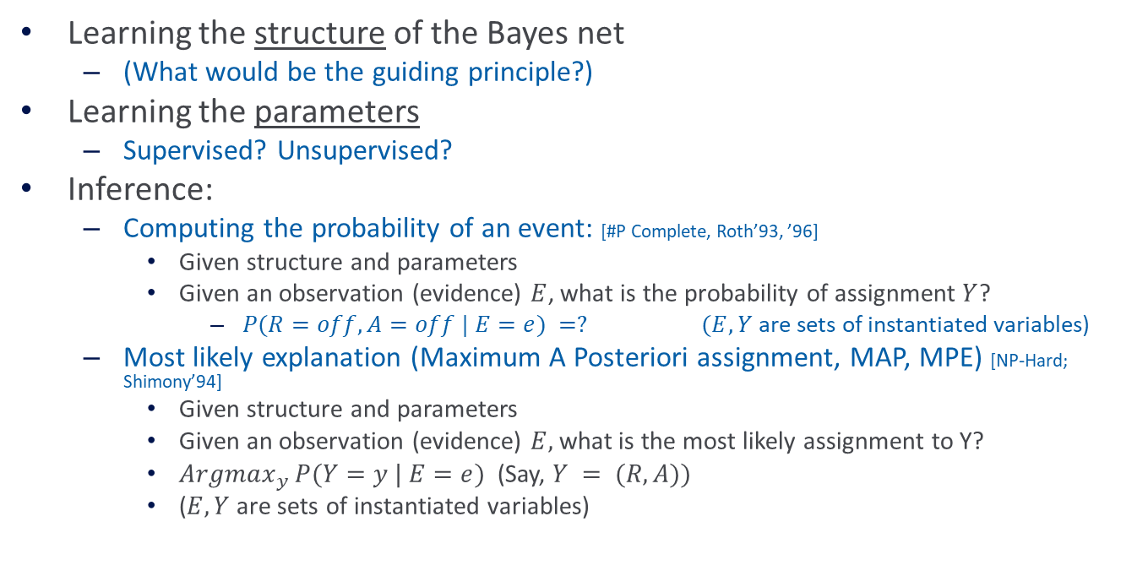
Computational Problems
Learning the structure of the Bayes net
  (What would be the guiding principle?)
Learning the parameters
  Supervised? Unsupervised?
Inference:
  Computing the probability of an event: [#P Complete, Roth’93, ’96]
    Given structure and parameters
    Given an observation (evidence) $E$, what is the probability of assignment $Y$?
      $P(R=off, A=off | E=e) =? (E, Y$are sets of instantiated variables)
  Most likely explanation (Maximum A Posteriori assignment, MAP, MPE) [NP-Hard; Shimony’94]
    Given structure and parameters
    Given an observation (evidence) $E,$ what is the most likely assignment to Y?
    $Argmax_{y} P(Y=y | E=e)$(Say, $Y = (R, A))$
    ($E, Y$are sets of instantiated variables)

Slide 19
Inference
Inference in Bayesian Networks is generally intractable in the worst case
Two broad approaches for inference
  Exact inference
    Eg. Variable Elimination
  Approximate inference
    Eg. Gibbs sampling

Slide 20
Administration (12/09/20)
Are we recording? YES!
Available on the web site
Remember that all the lectures are available on the website before the class
  Go over it and be prepared
  A new set of written notes will accompany most lectures, with some more details, examples and, (when relevant) some code.
HW5 is out; due 12/10 (last day of the semester).
  It is mostly a summary of the material we covered this semester (with a focus on the second half) and will help you prepare for the exam. No programming.
  An extension until Tuesday 12/15 – no additional slack day. This is a hard deadline.
We meet three time (Monday, Wednesday, Thursday) this week.
The Final is on 12/18.
  Similar style to the mid-term. Comprehensive, with emphasis on the material after the mid-term.
  90 minutes. You can start it any time between 9am and 7:30 pm ET. Your 90 minutes will be measure from the time you start.
  Between 10:30-noon ET, most of the TAs will be on-board to respond to clarification questions. If possible, do it at that time.
  There will be at least one TA available throughout the day to respond to clarification questions.
  Communication will only be done via private Piazza posts.

Slide 21
Projects
CIS 519 students need to do a team project: Read the project descriptions and follow the updates on the Project webpage
  Teams will be of size 2-4
  We will help grouping if needed
There will be 3 options for projects.
  Natural Language Processing (Text)
  Computer Vision (Images)
  Speech (Audio)
In all cases, we will give you datasets and initial ideas
  The problem will be multiclass classification problems
  You will get annotated data only for some of the labels, but will also have to predict other labels
  0-zero shot learning; few-shot learning; transfer learning
A detailed note will come out today.
Timeline:
  11/11 Choose a project and team up
  11/23 Initial proposal describing what your team plans to do
  12/2 Progress report: 1 page. What you have done; plans; problems.
  12/21 Final paper + short video
Try to make it interesting!

Slide 22
Bayesian Network: Example
How many parameters do we have?
How many would we have if we had to store the entire joint on 6 variables, without any independence assumptions?
P(E)
Earthquake
P(B)
Burglary
P(R | E)
P(A | E, B)
Radio
Alarm
With these probabilities,
(and assumptions, encoded in the graph) we can compute the probability of any event over these variables.
P(M | A)
P( J | A)
Mary Calls
John Calls
$$P(E, B, A, R, M, J) = P(E) P(B, A, R, M, J |E) =$$
$$= P(E) P(B) P(A, R, M, J |E, B) =$$
$$= P(E) P(B) P(R | E, B ) P(M, J, A | E, B)$$
$$= P(E) P(B) P(R | E) P(M, J| A, E, B) P(A| E, B)$$
$$= P(E) P(B) P(R | E) P(M |A) P(J | A) P(A |E, B)$$
Notes:
Note that Naïve Bayes is a very simple bayes net.

Slide 23


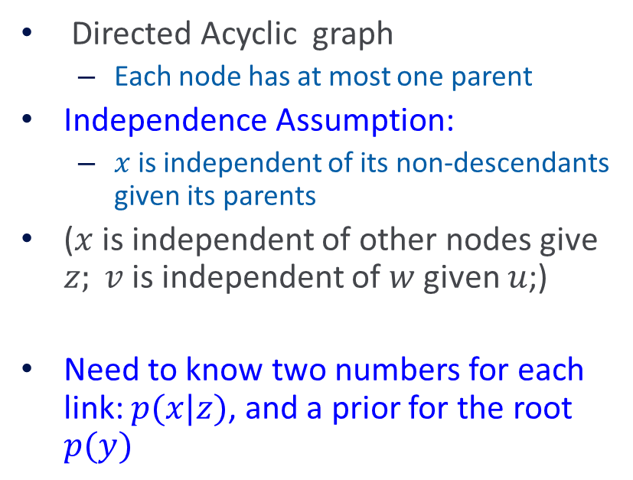







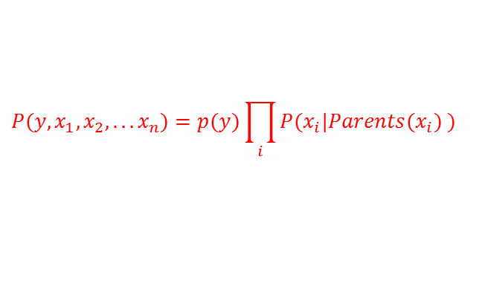


Tree Dependent Distributions
Directed Acyclic graph
  Each node has at most one parent
Independence Assumption:
  $x$ is independent of its non-descendants given its parents
($x$ is independent of other nodes give $z; v$is independent of $w$ given $u$;)
Need to know two numbers for each link: $p(x|z)$, and a prior for the root $p(y)$
$$Y$$
$$P(y)$$
$$P(s|y)$$
$$W$$
$$U$$
$$Z$$
$$S$$
$$P(y,x_{1},x_{2},...x_{n})=p(y)\prod_{i}{P(x_{i}|Parents(x_{i}) )}$$
$$V$$
$$X$$
$$P(x|z)$$
$$T$$

Slide 24


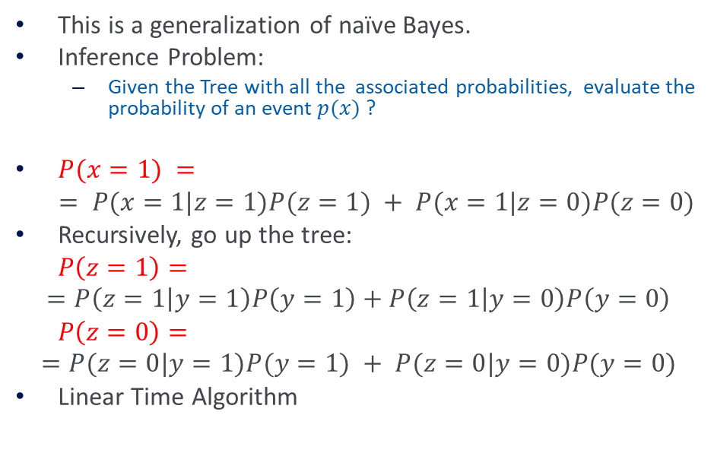





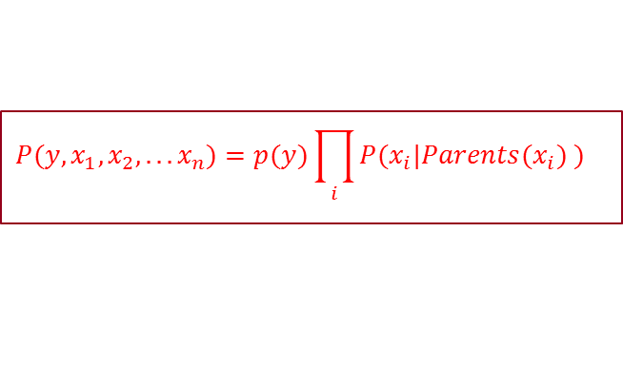




Tree Dependent Distributions
$$Y$$
This is a generalization of naïve Bayes.
Inference Problem:
  Given the Tree with all the associated probabilities, evaluate the probability of an event $p(x)$ ?
$P(x=1) =$
$$= P(x=1|z=1)P(z=1) + P(x=1|z=0)P(z=0)$$
Recursively, go up the tree:
$P\left(z=1\right)=$
$$=P\left(z=1 | y=1\right)P\left(y=1\right)+P\left(z=1 | y=0\right)P\left(y=0\right)$$
$P\left(z=0\right)=$
$$=P(z=0|y=1)P(y=1) + P(z=0|y=0)P(y=0)$$
Linear Time Algorithm
$$P(y)$$
$$P(s|y)$$
$$W$$
$$U$$
$$Z$$
$$S$$
$$P(x|z)$$
$$V$$
$$X$$
$$T$$
Now we have everything in terms of the CPTs (conditional probability tables)
$$P(y,x_{1},x_{2},...x_{n})=p(y)\prod_{i}{P(x_{i}|Parents(x_{i}) )}$$

Slide 25

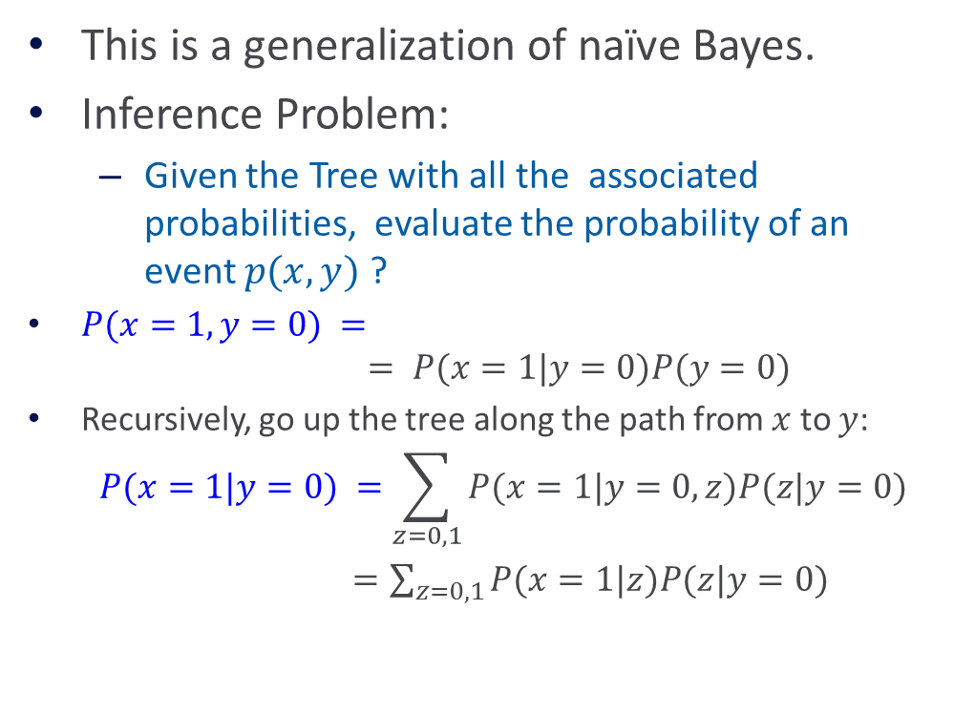
Tree Dependent Distributions
$$Y$$
This is a generalization of naïve Bayes.
Inference Problem:
  Given the Tree with all the associated probabilities, evaluate the probability of an event $p(x,y)$ ?
$P(x=1,y=0) =$
$$= P(x=1|y=0)P(y=0)$$
Recursively, go up the tree along the path from $x$ to $y$:
$$P(x=1|y=0) =\sum_{z=0,1}{P(x=1|y=0, z)P(z|y=0)}$$
$=\sum_{z=0,1}{P(x=1|z)P(z|y=0)}$
$$P(y)$$
$$P(s|y)$$
$$W$$
$$U$$
$$Z$$
$$S$$
$$P(x|z)$$
$$V$$
$$X$$
$$T$$
Now we have everything in terms of the CPTs (conditional probability tables)

Slide 26
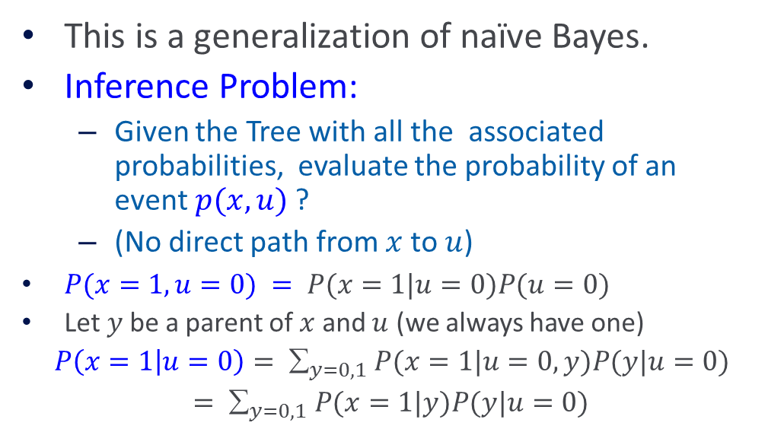
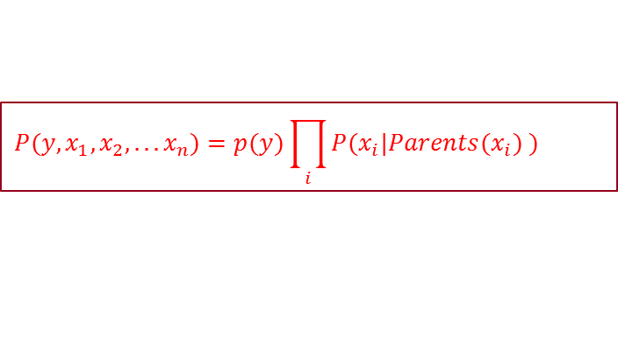

Tree Dependent Distributions
$$Y$$
This is a generalization of naïve Bayes.
Inference Problem:
  Given the Tree with all the associated probabilities, evaluate the probability of an event$p(x,u)$?
  (No direct path from $x$ to $u$)
$P(x=1,u=0) = P(x=1|u=0)P(u=0)$
Let $y$be a parent of $x$ and $u$ (we always have one)
$P\left(x=1 | u=0\right)= _{y=0,1} P(x=1|u=0, y)P(y|u=0)$
$= _{y=0,1} P(x=1|y)P(y|u=0)$
$$P(y)$$
$$P(s|y)$$
$$W$$
$$U$$
$$Z$$
$$V$$
$$X$$
$$P(x|z)$$
$$T$$
Now we have reduced it to cases we have seen
$$P(y,x_{1},x_{2},...x_{n})=p(y)\prod_{i}{P(x_{i}|Parents(x_{i}) )}$$

Slide 27

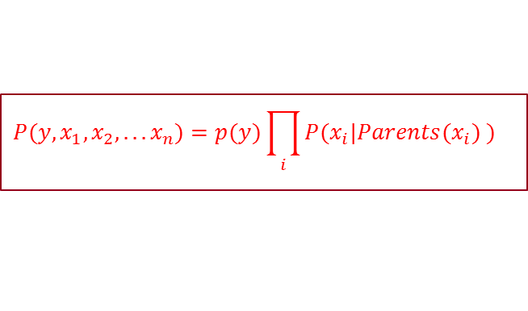
Tree Dependent Distributions
$$Y$$
  Inference Problem:
    Given the Tree with all the associated CPTs, we “showed” that we can evaluate the probability of all events efficiently.
    There are more efficient algorithms
    The idea was to show that the inference is this case is a simple application of Bayes rule and probability theory.
$$P(y)$$
$$P(s|y)$$
$$W$$
$$U$$
$$Z$$
$$P(x|z)$$
$$V$$
$$X$$
$$T$$
$$P(y,x_{1},x_{2},...x_{n})=p(y)\prod_{i}{P(x_{i}|Parents(x_{i}) )}$$
Things are not so simple in the general case, due to cycles; there are multiple ways to “get” from node A to B, and this has to be accounted for in Inference.
Skip Inference

Slide 28












Graphical Models of Probability Distributions
For general Bayesian Networks
  The learning problem is hard
  The inference problem (given the network, evaluate the probability of a given event) is hard (#P Complete)
$$Y$$
$$P(y)$$
$$Z1$$
$$Z2$$
$$Z$$
$$Z3$$
$$P(z3 | y)$$
$$X10$$
$$X$$
$$X2$$
$$P(x | z1, z2 ,z, z3)$$
$$P(y,x_{1},x_{2},...x_{n})=p(y)\prod_{i}{P(x_{i}|Parents(x_{i}) )}$$

Slide 29

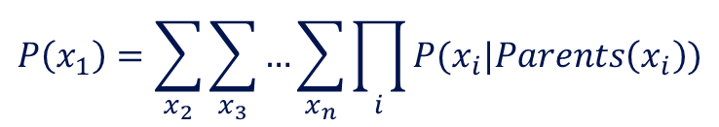
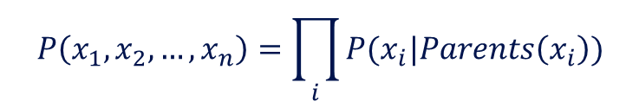

Variable Elimination
$$P\left(x_{1},x_{2},…,x_{n}\right)=\prod_{i}{P(x_{i}|Parents\left(x_{i}\right))}$$
Suppose the query is $P(X1)$
Key Intuition: Move irrelevant terms outside summation and cache intermediate results
$$P\left(x_{1}\right)=\sum_{x_{2},…,x_{n}}{P(x_{1},x_{2},…,x_{n})}$$
$$P\left(x_{1}\right)=\sum_{x_{2}}{\sum_{x_{3}}{…\sum_{x_{n}}{\prod_{i}{P(x_{i}|Parents\left(x_{i}\right))}}}}$$

Slide 30
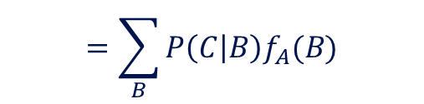



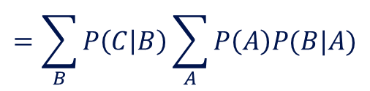

Variable Elimination: Example 1
A
A
B
C
We want to compute $P(C)$
What have we saved with this procedure?
  How many multiplications and additions did we perform?
$$P\left(C\right)=\sum_{A}{\sum_{B}{P\left(A,B,C\right)=\sum_{A}{\sum_{B}{P\left(A\right)P\left(B | A\right)P(C|B)}}}}$$
$$=\sum_{B}{P\left(C | B\right)\sum_{A}{P\left(A\right)P(B|A)}}$$
Let’s call this $fA(B)$
$$=\sum_{B}{P\left(C | B\right)f_{A}(B)}$$
$A$has been (instantiated and) eliminated

Slide 31
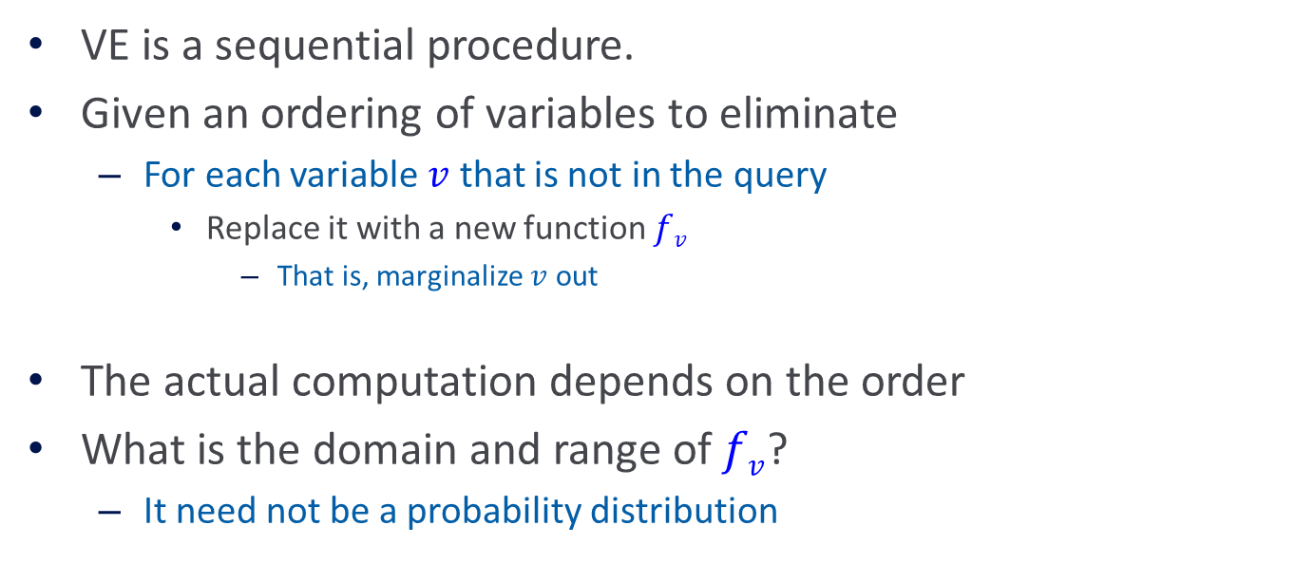
Variable Elimination
VE is a sequential procedure.
Given an ordering of variables to eliminate
  For each variable $v$ that is not in the query
    Replace it with a new function $fv$
      That is, marginalize $v$ out
The actual computation depends on the order
What is the domain and range of $fv$?
  It need not be a probability distribution

Slide 32






Variable Elimination: Example 2
$$P(E)$$
Earthquake
$$P(B)$$
Burglary
$$P(A | E, B)$$
Radio
Alarm
$$P(R | E)$$
P(M | A)
$$P(J | A)$$
What is $P(M, J | B)?$
Mary Calls
John Calls

Slide 33

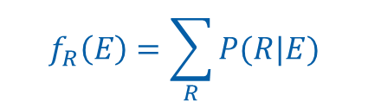

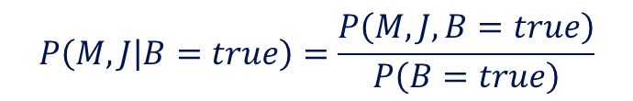
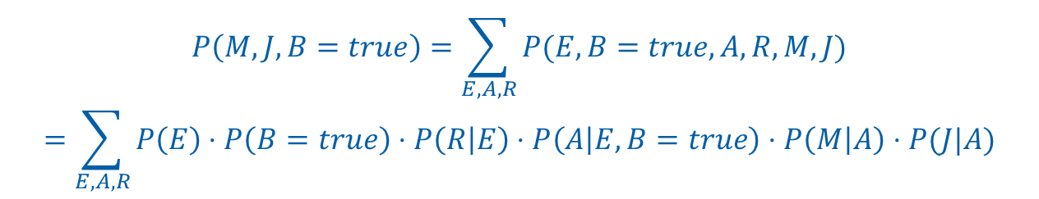
Variable Elimination: Example 2
$$P\left(E,B,A,R,M,J\right)=P\left(E\right)⋅P\left(B\right)⋅P\left(R | E\right)⋅P\left(A | E,B\right)⋅P\left(M | A\right)⋅P(J|A)$$
$$P\left(M,J | B=true\right)=\frac{P\left(M,J,B=true\right)}{P\left(B=true\right)}$$
It is sufficient to compute the numerator and normalize
Assumptions (graph; joint representation)
$$P\left(M,J,B=true\right)=\sum_{E,A,R}{P(E,B=true, A,R,M,J)}$$
$$=\sum_{E,A,R}{P\left(E\right)⋅P\left(B=true\right)⋅P\left(R | E\right)⋅P\left(A | E,B=true\right)⋅P\left(M | A\right)⋅P(J|A)}$$
Elimination order $R, A, E$
To eliminate $R$
$$f_{R}\left(E\right)=\sum_{R}{P(R|E)}$$

Slide 34
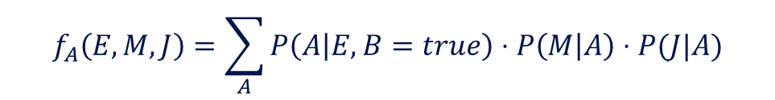

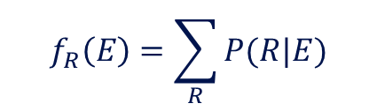
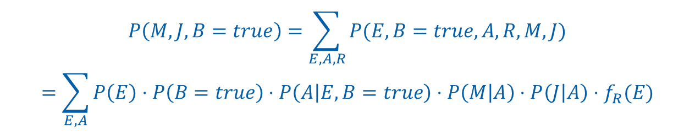
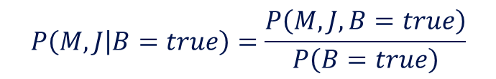

Variable Elimination: Example 2
$$P\left(E,B,A,R,M,J\right)=P\left(E\right)⋅P\left(B\right)⋅P\left(R | E\right)⋅P\left(A | E,B\right)⋅P\left(M | A\right)⋅P(J|A)$$
$$P\left(M,J | B=true\right)=\frac{P\left(M,J,B=true\right)}{P\left(B=true\right)}$$
It is sufficient to compute the numerator and normalize
$$P\left(M,J,B=true\right)=\sum_{E,A,R}{P(E,B=true, A,R,M,J)}$$
$$=\sum_{E,A}{P\left(E\right)⋅P\left(B=true\right)⋅P\left(A | E,B=true\right)⋅P\left(M | A\right)⋅P\left(J | A\right)⋅f_{R}(E)}$$
Elimination order $A, E$
To eliminate $A$
$$f_{R}\left(E\right)=\sum_{R}{P(R|E)}$$
$$f_{A}\left(E,M,J\right)=\sum_{A}{P\left(A | E,B=true\right)⋅P\left(M | A\right)⋅P(J|A)}$$

Slide 35

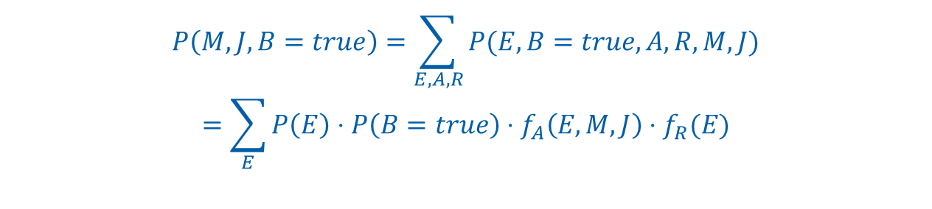
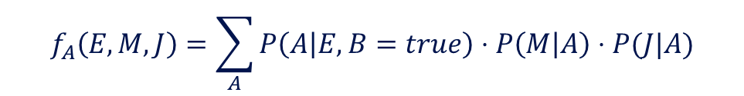
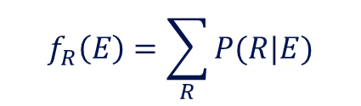
Variable Elimination: Example 2
$$P\left(E,B,A,R,M,J\right)=P\left(E\right)⋅P\left(B\right)⋅P\left(R | E\right)⋅P\left(A | E,B\right)⋅P\left(M | A\right)⋅P(J|A)$$
$$P\left(M,J | B=true\right)=\frac{P\left(M,J,B=true\right)}{P\left(B=true\right)}$$
It is sufficient to compute the numerator and normalize
$$P\left(M,J,B=true\right)=\sum_{E,A,R}{P(E,B=true, A,R,M,J)}$$
$$=\sum_{E}{P\left(E\right)⋅P\left(B=true\right)⋅f_{A}\left(E,M,J\right)⋅f_{R}(E)}$$
Finally eliminate $E$
Factors
$$f_{R}\left(E\right)=\sum_{R}{P(R|E)}$$
$$f_{A}\left(E,M,J\right)=\sum_{A}{P\left(A | E,B=true\right)⋅P\left(M | A\right)⋅P(J|A)}$$

Slide 36
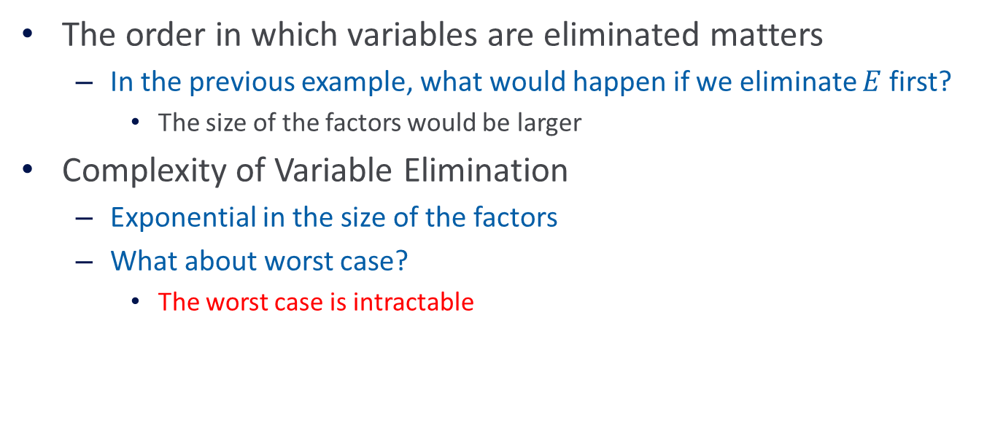
Variable Elimination
The order in which variables are eliminated matters
  In the previous example, what would happen if we eliminate $E$first?
    The size of the factors would be larger
Complexity of Variable Elimination
  Exponential in the size of the factors
  What about worst case?
    The worst case is intractable

Slide 37
Inference
Exact Inference in Bayesian Networks is #P-hard
  We can count the number of satisfying assignments for 3-SAT with a Bayesian Network
Approximate inference
  Eg. Gibbs sampling
  Skip

Slide 38
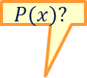


Approximate Inference
Basic idea
  If we had access to a set of examples from the joint distribution, we could just count.
  For inference, we generate instances from the joint and count
  How do we generate instances?
$$P(x)?$$
$$E\left[f\left(x\right)\right]≈\frac{1}{N}\sum_{i=1}^{N}{f(x^{(i)})}$$
$$X$$

Slide 39
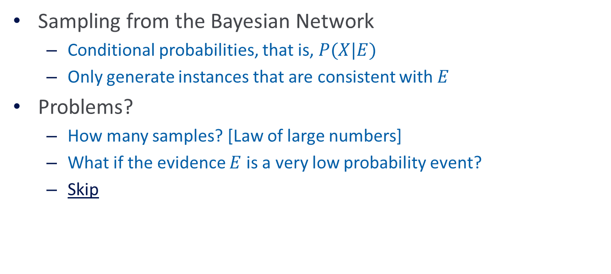
Generating instances
Sampling from the Bayesian Network
  Conditional probabilities, that is, $P(X|E)$
  Only generate instances that are consistent with $E$
Problems?
  How many samples? [Law of large numbers]
  What if the evidence $E$ is a very low probability event?
  Skip

Slide 40
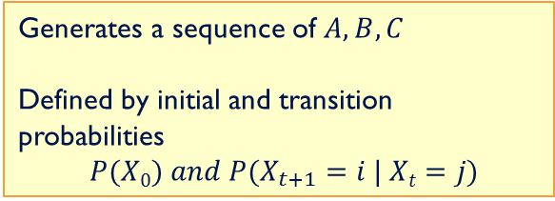
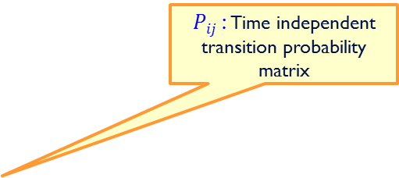


Detour: Markov Chain Review
0.1
Generates a sequence of $A,B,C$
Defined by initial and transition probabilities
$P(X0) and P(X_{t+1}=i | Xt=j)$
C
0.3
0.6
0.4
0.5
0.1
0.6
A
B
0.1
$Pij$: Time independent transition probability matrix
0.3
Stationary Distributions: A vector$q$is called a stationary distribution if
$$q_{j}=\sum_{i}{q_{i}P_{ij}}$$
$qi$ : The probability of being in state$i$
If we sample from the Markov Chain repeatedly, the distribution over the states converges to the stationary distribution

Slide 41
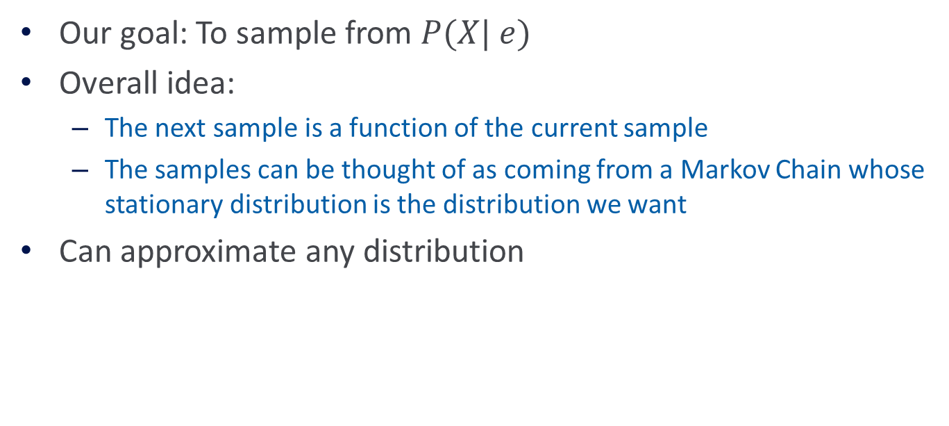
Markov Chain Monte Carlo
Our goal: To sample from $P(X| e)$
Overall idea:
  The next sample is a function of the current sample
  The samples can be thought of as coming from a Markov Chain whose stationary distribution is the distribution we want
Can approximate any distribution

Slide 42
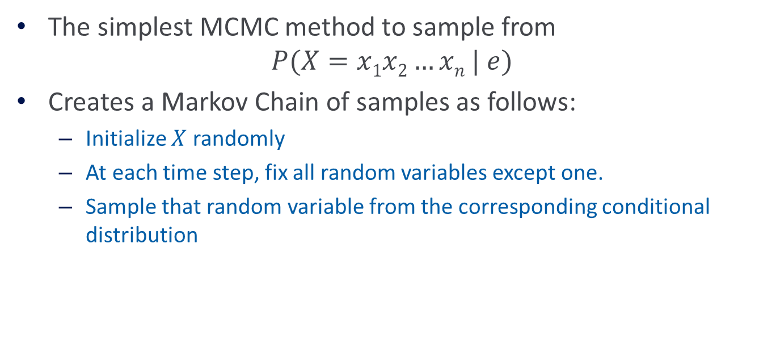
Gibbs Sampling
The simplest MCMC method to sample from
$$P(X=x1x2…xn | e)$$
Creates a Markov Chain of samples as follows:
  Initialize $X$ randomly
  At each time step, fix all random variables except one.
  Sample that random variable from the corresponding conditional distribution

Slide 43
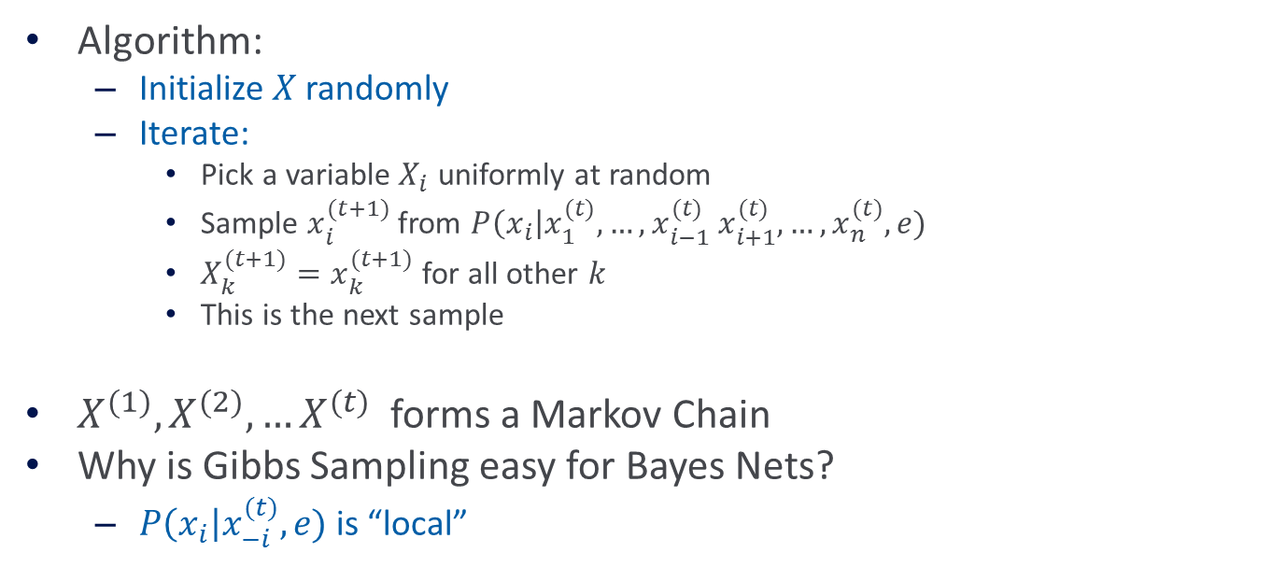
Gibbs Sampling
Algorithm:
  Initialize $X$ randomly
  Iterate:
    Pick a variable $X_{i}$ uniformly at random
    Sample $x_{i}^{(t+1)}$ from $P\left(x_{i}\right|x_{1}^{(t)},…,x_{i−1}^{(t)} x_{i+1}^{(t)},…, x_{n}^{(t)},e)$
    $X_{k}^{(t+1)}=x_{k}^{(t+1)}$ for all other $k$
    This is the next sample
$X^{(1)},X^{(2)},…X^{(t)}$ forms a Markov Chain
Why is Gibbs Sampling easy for Bayes Nets?
  $P\left(x_{i}\right|x_{−i}^{(t)},e)$ is “local”

Slide 44
Gibbs Sampling: Big picture
Given some conditional distribution we wish to compute, collect samples from the Markov Chain
Typically, the chain is allowed to run for some time before collecting samples (burn in period)
    So that the chain settles into the stationary distribution
Using the samples, we approximate the posterior by counting

Slide 45
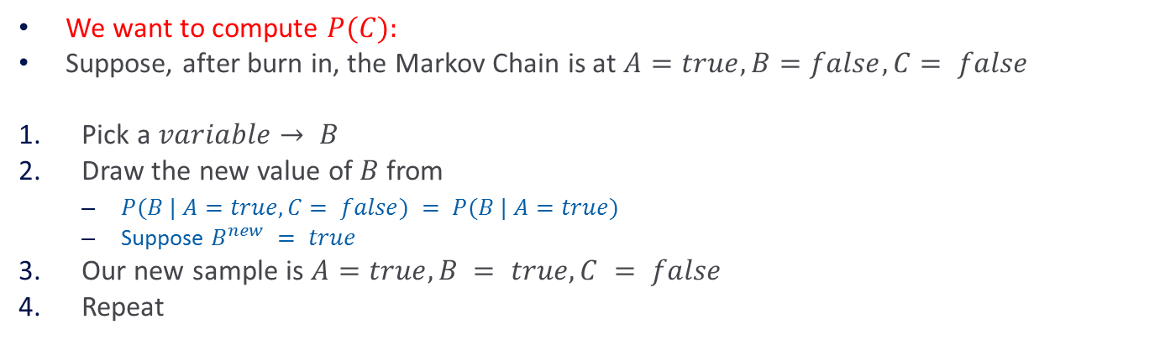
Gibbs Sampling Example 1
A
B
C
We want to compute $P(C):$
Suppose, after burn in, the Markov Chain is at $A=true, B=false, C= false$
Pick a $variable→ B$
Draw the new value of $B$ from
  $P(B | A=true, C= false) = P(B | A=true)$
  Suppose $B^{new} = true$
Our new sample is $A=true, B = true, C = false$
Repeat

Slide 46

Gibbs Sampling Example 2
Exercise: $P(M,J|B)$?
$$P(E)$$
Earthquake
$$P(B)$$
Burglary
$$P(A | E, B)$$
Radio
Alarm
$$P(R | E)$$
P(M | A)
$$P(J | A)$$
Mary Calls
John Calls

Slide 47
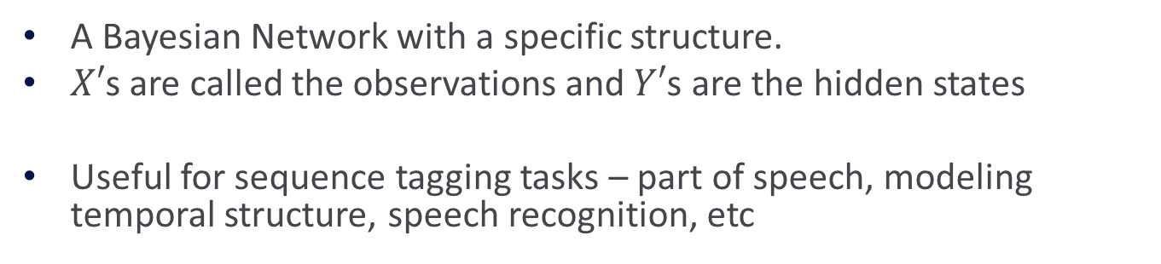
Example: Hidden Markov Model
Y₁
Y₂
Y₃
Y₄
Y₅
Y₆
X₁
X₂
X₃
X₄
X₅
X₆
Transition probabilities
Emission probabilities
A Bayesian Network with a specific structure.
$X′$s are called the observations and $Y′$s are the hidden states
Useful for sequence tagging tasks – part of speech, modeling temporal structure, speech recognition, etc

Slide 48
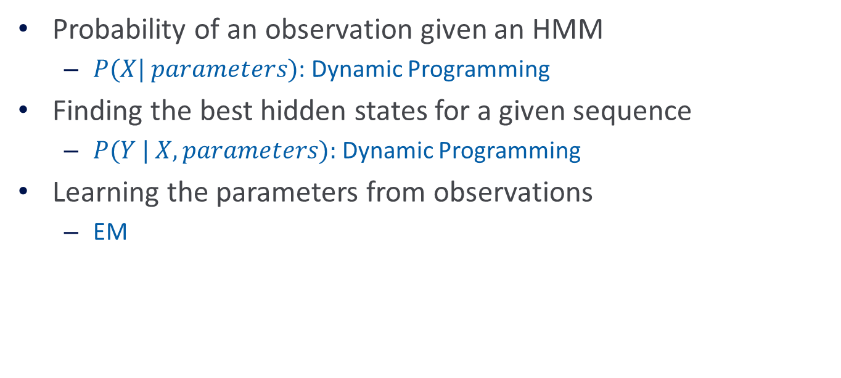
HMM: Computational Problems
Probability of an observation given an HMM
  $P(X| parameters)$: Dynamic Programming
Finding the best hidden states for a given sequence
  $P(Y | X, parameters):$Dynamic Programming
Learning the parameters from observations
  EM

Slide 49


Gibbs Sampling for HMM
Goal:Computing $P(y|x)$
Initialize the $Y′$s randomly
Iterate:
  Pick a random $Yi$
  Draw $Y_{i}^{t}$from $P\left(Yi\right|Y_{i−1}Y_{i+1},X_{i})$
Compute the probability using counts after the burn in period
Only these variables are needed because they form the Markov blanket of $Yi$.
Gibbs sampling allows us to introduce priors on the emission and transition probabilities.

Slide 50
Bayesian Networks
Bayesian Networks
  Compact representation probability distributions
  Universal: Can represent all distributions
    In the worst case, every random variable will be connected to all others
Inference
  Inference is hard in the worst case
    Exact inference is #P-hard, approximate inference is NP-hard [Roth93,96]
    Inference for Trees is efficient
    General exact Inference: Variable Elimination
Learning?

Slide 51




Tree Dependent Distributions
Learning Problem:
  Given data ($n$ tuples) assumed to be sampled from a tree-dependent distribution
    What does that mean?
    Think about it as a Generative model
  Find the tree representation of the distribution.
    What does that mean?
Among all trees, find the most likely one, given the data:
$P(T|D) = P(D|T) P(T)/P(D)$
$$P(y,x_{1},x_{2},...x_{n})=p(y)\prod_{i}{P(x_{i}|Parents(x_{i}) )}$$
$$Y$$
$$P(y)$$
$$P(s|y)$$
$$W$$
$$U$$
$$Z$$
$$S$$
$$V$$
$$X$$
$$P(x|z)$$
$$T$$

Slide 52


Tree Dependent Distributions
Learning Problem:
  Given data ($n$ tuples) assumed to be sampled from a tree-dependent distribution
  Find the tree representation of the distribution.
Assuming uniform prior on trees, the Maximum Likelihood approach is to maximize $P(D|T)$,
Now we can see why we had to solve the inference problem first; it is required for learning.
$$Y$$
$$P(y)$$
$$P(s|y)$$
$$W$$
$$U$$
$$Z$$
$$S$$
$$T_{ML} = argmax_{T} P\left(D | T\right)=argmax_{T} \prod_{\{x\}}{P_{T} (x_{1}, x_{2}, … x_{n}) }$$
$$V$$
$$X$$
$$P(x|z)$$
$$T$$

Slide 53



Tree Dependent Distributions
Learning Problem:
  Given data ($n$ tuples) assumed to be sampled from a tree-dependent distribution
  Find the tree representation of the distribution.
Assuming uniform prior on trees, the Maximum Likelihood approach is to maximize $P(D|T)$,
Try this for naïve Bayes
$$Y$$
$$P(y)$$
$$P(s|y)$$
$TML = argmaxT P(D|T) =argmaxT\prod_{\left\{x\right\}}{P_{T}(x_{1},x_{2},…,x_{n})}=$
$=argmax_{T}\prod_{\left\{x\right\}}{P_{T}(x_{i}|Parents\left(x_{i}\right))}$
$$W$$
$$U$$
$$Z$$
$$S$$
$$V$$
$$X$$
$$P(x|z)$$
$$T$$
Next we will look at some examples over 4 Boolean variables
Note that when we talk about trees, they could have multiple shapes.

Slide 54

Notes:
Poll Title: How many independent parameters are needed to represent a distribution over 4 Boolean variable?
https://www.polleverywhere.com/multiple_choice_polls/N5GwpSMHEZjDiZw8VSQ8t?flow=Default&onscreen=persist

Slide 55

Notes:
Poll Title: How many independent parameters are needed to represent a tree dependent distribution over 4 Boolean variables?
https://www.polleverywhere.com/multiple_choice_polls/aE0u9xxLZegjUj77QYpAI?flow=Default&onscreen=persist

Slide 56
















Example: Learning Distributions
Are these representations of the same distribution?
Given a sample, which of these generated it?
Probability Distribution 1:
0000 0.1 0001 0.1 0010 0.1 0011 0.1
0100 0.1 0101 0.1 0110 0.1 0111 0.1
1000 0 1001 0 1010 0 1011 0
1100 0.05 1101 0.05 1110 0.05 1111 0.05
Probability Distribution 2:
Probability Distribution 3:
$$X4$$
$$P(x4)$$
$$P(x3|x4)$$
$$P(x1|x4)$$
$$P(x2|x4)$$
$$X1$$
$$X2$$
$$X3$$
$$P(x4)$$
$$X4$$
$$P(x1|x4)$$
$$P(x2|x4)$$
$$X2$$
$$X1$$
$$P(x3|x2)$$
$$X3$$

Slide 57

Example: Learning Distributions
We are given 3 data points: $1011; 1001; 0100$
Which one is the target distribution?
Probability Distribution 1:
0000 0.1 0001 0.1 0010 0.1 0011 0.1
0100 0.1 0101 0.1 0110 0.1 0111 0.1
1000 0 1001 0 1010 0 1011 0
1100 0.05 1101 0.05 1110 0.05 1111 0.05
Probability Distribution 2:
Probability Distribution 3:
$$X4$$
$$P(x4)$$
$$P(x3|x4)$$
$$P(x1|x4)$$
$$P(x2|x4)$$
$$X1$$
$$X2$$
$$X3$$
$$P(x4)$$
$$X4$$
$$P(x1|x4)$$
$$P(x2|x4)$$
$$X2$$
$$X1$$
$$P(x3|x2)$$
$$X3$$

Slide 58

Example: Learning Distributions
We are given 3 data points: $1011; 1001; 0100$
Which one is the target distribution?
Probability Distribution 1:
0000 0.1 0001 0.1 0010 0.1 0011 0.1
0100 0.1 0101 0.1 0110 0.1 0111 0.1
1000 0 1001 0 1010 0 1011 0
1100 0.05 1101 0.05 1110 0.05 1111 0.05
What is the likelihood that this table generated the data?

Slide 59

Notes:
Poll Title: What is the likelihood that the given dataset was sampled from Distribution 1?
https://www.polleverywhere.com/free_text_polls/7Ve2vbVd6Xy2X5R779bLn

Slide 60

Example: Learning Distributions
We are given 3 data points: $1011; 1001; 0100$
Which one is the target distribution?
Probability Distribution 1:
0000 0.1 0001 0.1 0010 0.1 0011 0.1
0100 0.1 0101 0.1 0110 0.1 0111 0.1
1000 0 1001 0 1010 0 1011 0
1100 0.05 1101 0.05 1110 0.05 1111 0.05
What is the likelihood that this table generated the data?
$P(T|D) = P(D|T) P(T)/P(D)$
$Likelihood(T) \sim = P(D|T) \sim = P(1011|T) P(1001|T)P(0100|T)$
  $P(1011|T)= 0$
  $P(1001|T)= 0.1$
  $P(0100|T)= 0.1$
$P(Data|Table)=0$

Slide 61









Example: Learning Distributions
Probability Distribution 2:
What is the likelihood that the data was
sampled from Distribution 2?
Need to define it:
  $P(x_{4}=1)=1/2$
  $p(x_{1}=1|x_{4}=0)=1/2 p(x_{1}=1|x_{4}=1)=1/2$
  $p(x_{2}=1|x_{4}=0)=1/3 p(x_{2}=1|x_{4}=1)=1/3$
  $p(x_{3}=1|x_{4}=0)=1/6 p(x_{3}=1|x_{4}=1)=5/6$
$Likelihood(T) \sim = P(D|T) \sim = P(1011|T) P(1001|T)P(0100|T)$
  $P\left(1011 | T\right)= p\left(x_{4}=1\right)p\left(x_{1}=1 | x_{4}=1\right)p\left(x_{2}=0 | x_{4}=1\right)p\left(x_{3}=1 | x_{4}=1\right)=\frac{1}{2}×\frac{1}{2}×\frac{2}{3}×\frac{5}{6}=\frac{10}{72}$
  $P\left(1001 | T\right)= =\frac{1}{2}×\frac{1}{2}×\frac{2}{3}×\frac{5}{6}=\frac{10}{72}$
  $P(0100|T)= =\frac{1}{2}×\frac{1}{2}×\frac{2}{3}×\frac{5}{6}=\frac{10}{72}$
  $P(Data|Tree)=125/4∗3^{6}$
$$X4$$
$$P(x4)$$
$$P(x1|x4)$$
$$P(x2|x4)$$
$$P(x3|x4)$$
$$X1$$
$$X2$$
$$X3$$

Slide 62









Example: Learning Distributions
Probability Distribution 3:
What is the likelihood that the data was
sampled from Distribution 2?
Need to define it:
  $P(x_{4}=1)=2/3$
  $p(x_{1}=1|x_{4}=0)=1/3 p(x_{1}=1|x_{4}=1)=1$
  $p(x_{2}=1|x_{4}=0)=1 p(x_{2}=1|x_{4}=1)=1/2$
  $p(x_{3}=1|x_{2}=0)=2/3 p(x_{3}=1|x_{2}=1)=1/6$
$Likelihood(T) \sim = P(D|T) \sim = P(1011|T) P(1001|T)P(0100|T)$
  $P\left(1011 | T\right)= p\left(x_{4}=1\right)p\left(x_{1}=1 | x_{4}=1\right)p\left(x_{2}=0 | x_{4}=1\right)p\left(x_{3}=1 | x_{2}=0\right)=\frac{2}{3} ×1×\frac{1}{2}×\frac{2}{3}=\frac{2}{9}$
  $P\left(1001 | T\right)= =\frac{1}{2}×\frac{1}{2}×\frac{2}{3}×\frac{1}{6}=\frac{1}{36}$
  $P(0100|T)= =\frac{1}{2}×\frac{1}{2}×\frac{1}{3}×\frac{5}{6}=\frac{5}{72}$
  $P\left(Data | Tree\right)=10/3^{6}2^{6}$
$$P(x4)$$
$$X4$$
$$P(x1|x4)$$
$$P(x2|x4)$$
$$X2$$
$$X1$$
$$X3$$
$$P(x3|x2)$$
Distribution 2 is the most likely distribution to have produced the data.

Slide 63

Example: Summary
We are now in the same situation we were when we decided which of two coins, fair $(0.5,0.5)$or biased $(0.7,0.3$) generated the data.
But, this isn’t the most interesting case.
In general, we will not have a small number of possible distributions to choose from, but rather a parameterized family of distributions. (analogous to a coin with $p∈ [0,1] )$
We need a systematic way to search this family of distributions.

Slide 64

Example: Summary
First, let’s make sure we understand what we are after.
We have 3 data points that have been generated according to our target distribution: $1011; 1001; 0100$
What is the target distribution ?
  We cannot find THE target distribution.
What is our goal?
  As before – we are interested in generalization –
  Given Data (e.g., the above 3 data points), we would like to know $P(1111) or P(11∗∗), P(∗∗∗0) etc$.
We could compute it directly from the data, but….
  Assumptions about the distribution are crucial here

Slide 65












Learning Tree Dependent Distributions
Learning Problem:
  1. Given data ($n$ tuples) assumed to be sampled from a tree-dependent distribution
  find the most probable tree representation of the distribution.
  2. Given data ($n$tuples)
  find the tree representation that best approximates the distribution (without assuming that the data is sampled from a tree-dependent distribution.)
$$Y$$
$$P(y)$$
$$P(s|y)$$
$$W$$
$$U$$
$$Z$$
$$S$$
$$V$$
$$X$$
$$P(x|z)$$
$$T$$
Space of all Distributions
Space of all Tree Distributions
Target Distribution
Find the Tree closest to the target
Target Distribution

Slide 66


Learning Tree Dependent Distributions
Learning Problem:
  1. Given data ($n$ tuples) assumed to be sampled from a tree-dependent distribution
  find the most probable tree representation of the distribution.
  2. Given data ($n$ tuples)
  find the tree representation that best approximates the distribution (without assuming that the data is sampled from a tree-dependent distribution.)
$$Y$$
$$P(y)$$
$$P(s|y)$$
$$W$$
$$U$$
$$Z$$
$$S$$
$$V$$
$$X$$
$$P(x|z)$$
$$T$$
The simple minded algorithm for learning a tree dependent distribution requires:
$(1)$ for each tree, compute its likelihood
$$L(T) = P(D|T) =$$
$$=argmaxT \prod_{\left\{x\right\}}{P_{T}(x_{1},x_{2},…,x_{n})}=$$
$=argmaxT$ $\prod_{\left\{x\right\}}{P_{T}(x_{i}|Parents\left(x_{i}\right))}$
$(2)$ Find the maximal one

Slide 67


1. Distance Measure
To measure how well a probability distribution $P$ is approximated by probability distribution $T$ we use here the Kullback-Leibler cross entropy measure (KL-divergence):
Non negative.
$D(P,T)=0$iff $P$ and $T$ are identical
Non symmetric. Measures how much $P$ differs from $T$.
$$D(P,T)=\sum_{x}{P(x)log\frac{P(x)}{T(x)}}$$

Slide 68


2. Ranking Dependencies
Intuitively, the important edges to keep in the tree are edges ($x$--$y$) for $x, y$which depend on each other.
Given that the distance between the distribution is measured using the KL divergence, the corresponding measure of dependence is the mutual information between $x$ and $y$, (measuring the information $x$ gives about $y$)
which we can estimate with respect to the empirical distribution (that is, the given data).
$$I(x,y)=\sum_{x,y}{P(x,y)log\frac{P(x,y)}{P(x)P(y)}}$$

Slide 69

Learning Tree Dependent Distributions
The algorithm is given $m$ independent measurements from $P$.
For each variable $x$, estimate $P(x)$(Binary variables – $n$ numbers)
For each pair of variables $x, y$, estimate $P(x,y)$ ($O(n2)$numbers)
For each pair of variables compute the mutual information
Build a complete undirected graph with all the variables as vertices.
Let $I(x,y)$be the weights of the edge $(x,y)$
Build a maximum weighted spanning tree

Slide 70

Spanning Tree
Goal: Find a subset of the edges that forms a tree that includes every vertex, where the total weight of all the edges in the tree is maximized
  Sort the weights
  Start greedily with the largest one.
  Add the next largest as long as it does not create a loop.
  In case of a loop, discard this weight and move on to the next weight.
This algorithm will create a tree;
It is a spanning tree: it touches all the vertices.
It is not hard to see that this is the maximum weighted spanning tree
The complexity is $O(n^{2} log⁡(n))$
Notes:
This is Prim’s algorithm, written for max rather than min

Slide 71

Learning Tree Dependent Distributions
The algorithm is given $m$ independent measurements from $P$.
For each variable $x$, estimate $P(x)$ (Binary variables – $n$numbers)
For each pair of variables $x, y$, estimate $P(x,y)$ ($O(n2)$numbers)
For each pair of variables compute the mutual information
Build a complete undirected graph with all the variables as vertices.
Let $I(x,y)$ be the weights of the edge $(x,y)$
Build a maximum weighted spanning tree
Transform the resulting undirected tree to a directed tree.
  Choose a root variable and set the direction of all the edges away from it.
Place the corresponding conditional probabilities on the edges.
(2)
(3)
(1)

Slide 72


Correctness (1)
Place the corresponding conditional probabilities on the edges.
Given a tree $t$, defining probability distribution $T$ by forcing the conditional probabilities along the edges to coincide with those computed from a sample taken from $P$, gives the best tree dependent approximation to $P$
Let $T$ be the tree-dependent distribution according to the fixed tree $t$.
$T(x) =∏ T(xi|Parent(x_{i})) =∏ P(xi|❐ (xi))$
Recall:
$$D(P,T)=\sum_{x}{P(x)log\frac{P(x)}{T(x)}}$$

Slide 73


Correctness (1)
Place the corresponding conditional probabilities on the edges.
Given a tree $t$, defining $T$ by forcing the conditional probabilities along the edges to coincide with those computed from a sample taken from $P$, gives the best t-dependent approximation to $P$
When is this maximized?
  That is, how to define $T(x_{i}|(x_{i}))$?
$$D(P,T)=\sum_{x}{P(x)log\frac{P(x)}{T(x)}=} \\ =\sum_{x}{P(x)log P(x) −}\sum_{x}{P(x)log T(x)=} \\ =−H(x)−\sum_{x}{P(x)\sum_{i=1}^{n}{log T(x_{i}|π(x_{i}))}=}$$
Slight abuse of notation at the root

Slide 74



Correctness (1)
$$D(P,T)=\sum_{x}{P(x)log\frac{P(x)}{T(x)}=}\sum_{x}{P(x)log P(x) −}\sum_{x}{P(x)log T(x)=} \\ =−H(x)−\sum_{x}{P(x)\sum_{i=1}^{n}{logT(x_{i}|π(x_{i}))}=} \\ =−H(x)−E_{P}[\sum_{i=1}^{n}{log T(x_{i}|π(x_{i}))}]= \\ =−H(x)−\sum_{i=1}^{n}{E_{P}[log T(x_{i}|π(x_{i}))}]= \\ =−H(x)−\sum_{i=1}^{n}{\sum_{(x_{i,},π(x_{i}))}{P(x_{i},π(x_{i})) }log T(x_{i}|π(x_{i}))}= \\ =−H(x)−\sum_{i=1}^{n}{\sum_{π(x_{i})}{P(π(x_{i}))}\sum_{x_{i}}{P(x_{i}|π(x_{i})}log T(x_{i}|π(x_{i}))}$$
$i P(x_{i}|π(x_{i}) log⁡T(x_{i}|π(x_{i}))$takes its maximal value when we set:
$$T(x_{i}|π(x_{i})) = P(x_{i}|π(x_{i}))$$
$$\text{To} \text{see} \text{this} \text{look} \text{at} \text{the} \text{difference}\text{: }$$
$i P(x_{i}|π\left(x_{i})\right)\log{P\left(x_{i} | π\left(x_{i}\right)\right)}$ -
$$i P(x_{i}|π\left(x_{i})\right)\log{T\left(x_{i} | π\left(x_{i}\right)\right)= }=D(P(x_{i}|π\left(x_{i})\right),T(x_{i}|π\left(x_{i})\right))$$
$$\text{T}\text{his} \text{is} \text{non}\text{−}\text{negative}\text{, }\text{and} \text{equal} \text{to}\text{ 0 }\text{only} \text{when} \text{T}\text{=}\text{P}\text{. }$$
Definition of expectation:
Notes:
The maximal value argument you get by looking at the difference between the expression and the one when you plug in the P(..); you get an entropy expression, but since Entropy is non-negative, the largest value is when they are equal.
The maximal value argument you get by looking at the difference between the expression and the one when you plug in the P(..); you get an entropy expression, but since Entropy is non-negative, the largest value is when they are equal.
maximal value when

Slide 75



Correctness (2)
Let $I(x,y)$be the weights of the edge $(x,y)$. Maximizing the sum of the information gains minimizes the distributional distance.
We showed that:
However:
This gives:
$$D\left(P,T\right)= −H\left(x\right)− ∑_{1}^{n} I(x_{i},π\left(x_{i}\right))− ∑_{1}^{n}∑x P(x_{i}) log⁡P(x_{i})$$
1st and 3rd term do not depend on the tree structure. Since the distance is non negative, minimizing it is equivalent to maximizing the sum of the edges weights $I(x,y)$ .
$$D(P,T)=−H(x)−\sum_{i=1}^{n}{\sum_{(x_{i,},π(x_{i}))}{P(x_{i},π(x_{i})) }log P(x_{i}|π(x_{i}))}$$
$$log P(x_{i}|π(x_{i})) =log \frac{P(x_{i},π(x_{i})) }{P(x_{i})P(π(x_{i})) }+log P(x_{i})$$
$$P(x_{i},π(x_{i}))log P(x_{i}|π(x_{i})) =P(x_{i},π(x_{i}))log \frac{P(x_{i},π(x_{i})) }{P(x_{i})P(π(x_{i})) }+P(x_{i},π(x_{i}))log P(x_{i})$$
Notes:
Red line is just substitution
Orange line requires algebra

Slide 76

Correctness (2)
Let $I(x,y)$be the weights of the edge $(x,y)$. Maximizing the sum of the information gains minimizes the distributional distance.
We showed that the $T$ is the best tree approximation of $P$ if it is chosen to maximize the sum of the edges weights.
$D\left(P,T\right)= −H\left(x\right)− ∑_{1}^{n} I\left(xi,π\left(xi\right)\right)− ∑_{1}^{n}∑x P(x_{i}) log⁡P(x_{i})$
The minimization problem is solved without the need to exhaustively consider all possible trees.
This was achieved since we transformed the problem of finding the best tree to that of finding the heaviest one, with mutual information on the edges.

Slide 77

Correctness (3)
Transform the resulting undirected tree to a directed tree. (Choose a root variable and direct of all the edges away from it.)
  What does it mean that you get the same distribution regardless of the chosen root? (Exercise)
This algorithm learns the best tree-dependent approximation of a distribution $D$.
$L(T) = P(D|T) = \prod_{i}{PT (xi|Parent(xi)) }$
Given data, this algorithm finds the tree that maximizes the likelihood of the data.
The algorithm is called the Chow-Liu Algorithm. Suggested in 1968 in the context of data compression, and adapted by Pearl to Bayesian Networks. Invented a couple more times, and generalized since then.

Slide 78


Example: Learning tree Dependent Distributions
We have 3 data points that have been generated according to the target distribution: $1011; 1001; 0100$
We need to estimate some parameters:
$P\left(A=1\right)=\frac{2}{3}, P(B=1)=\frac{1}{3}, P(C=1)=\frac{1}{3}), P(D=1)=\frac{2}{3}$
For the values 00, 01, 10, 11 respectively, we have that:
  $P(A,B)=0; 1/3; 2/3; 0 P(A,B)/P(A)P(B)=0; 3; 3/2; 0 I(A,B) \sim 9/2$
  $P(A,C)=1/3; 0; 1/3; 1/3 P(A,C)/P(A)P(C)=3/2; 0; 3/4; 3/2 I(A,C) \sim 15/4$
  $P(A,D)=1/3; 0; 0; 2/3 P(A,D)/P(A)P(D)=3; 0; 0; 3/2 I(A,D) \sim 9/2$
  $P(B,C)=1/3; 1/3; 1/3;0 P(B,C)/P(B)P(C)=3/4; 3/2; 3/2; 0 I(B,C) \sim 15/4$
  $P(B,D)=0; 2/3; 1/3;0 P(B,D)/P(B)P(D)=0; 3; 3/2; 0 I(B,D) \sim 9/2$
  $P(C,D)=1/3; 1/3; 0; 1/3 P(C,D)/P(C)P(D)=3/2; 3/4; 0; 3/2 I(C,D) \sim 15/4$
Generate the tree; place probabilities.
$$I(x,y)=\sum_{x,y}{P(x,y)log\frac{P(x,y)}{P(x)P(y)}}$$
D
B
A
C

Slide 79


Learning tree Dependent Distributions
Chow-Liu algorithm finds the tree that maximizes the likelihood.
In particular, if $D$ is a tree dependent distribution, this algorithm learns $D$. (what does it mean ?)
Less is known on how many examples are needed in order for it to converge. (what does that mean?)
Notice that we are taking statistics to estimate the probabilities of some event in order to generate the tree. Then, we intend to use it to evaluate the probability of other events.
One may ask the question: why do we need this structure ? Why can’t answer the query directly from the data ?
(Almost like making prediction directly from the data in the badges problem)

Slide 80
Administration (12/10/20)
Are we recording? YES!
Available on the web site
Remember that all the lectures are available on the website before the class
  Go over it and be prepared
  A new set of written notes will accompany most lectures, with some more details, examples and, (when relevant) some code.
HW5 is out; due 12/10 (last day of the semester).
  It is mostly a summary of the material we covered this semester (with a focus on the second half) and will help you prepare for the exam. No programming.
  An extension until Tuesday 12/15 – no additional slack day. This is a hard deadline.
The Final is on 12/18.
  Similar style to the mid-term. Comprehensive, with emphasis on the material after the mid-term.
  90 minutes. You can start it any time between 9am and 7:30 pm ET. Your 90 minutes will be measure from the time you start.
  Between 10:30-noon ET, most of the TAs will be on-board to respond to clarification questions. If possible, do it at that time.
  Please open your video – if there are any technical issues, let me know.
  There will be at least one TA available throughout the day to respond to clarification questions.
  Communication will only be done via private Piazza posts.
Extra Time?

Slide 81
Projects
CIS 519 students need to do a team project: Read the project descriptions and follow the updates on the Project webpage
  Teams will be of size 2-4
  We will help grouping if needed
There will be 3 options for projects.
  Natural Language Processing (Text)
  Computer Vision (Images)
  Speech (Audio)
In all cases, we will give you datasets and initial ideas
  The problem will be multiclass classification problems
  You will get annotated data only for some of the labels, but will also have to predict other labels
  0-zero shot learning; few-shot learning; transfer learning
A detailed note will come out today.
Timeline:
  11/11 Choose a project and team up
  11/23 Initial proposal describing what your team plans to do
  12/2 Progress report: 1 page. What you have done; plans; problems.
  12/21 Final paper + short video
Try to make it interesting!

Slide 82
Review
Applied Machine Learning
Applied: mostly in HW
Machine learning: mostly in class, quizzes, exams

Slide 83


Learning Theory
PAC Learning
  Occam’s Razor
  Consistent Learners
  Generalizing to “almost consistent”
What does learnability depend on?
From finite hypothesis space to infinite
  VC Dimension

Slide 84


SVMs
Max Margin
  Relations to VC dimension
  Relations to ||W||
Support Vectors Machines
  Hard SVM Optimization
  Soft SVM Optimization
  Regularization
  Dual and Primal
  Kernels
Back to SGD
  Relations to Perceptron
Multiclass SVM
  Notion of margin

Slide 85


Boosting, Ensembles, Multiclass
Weak vs. Strong Learnability
Notion of Error
  Distribution dependent
  Changing the distribution of the data
  Adaboost: proof and why does it work
Boosting, Bagging, & Random Forests
Multiclass
  1 vs. all
  All vs. all
  Global multiclass (SVM)

Slide 86


NNs and Deep Learning
Neural Networks
  Expressivity
  Non-linearity and differentiability
  Backpropagation
    Delta Rule
Convolutional Networks
Recurrent Neural Networks
  Embeddings

Slide 87



Generative Models, Naïve Bayes
Bayes Rule
Generative Models
Bayesian Learning Scenario
  Examples
Bayesian Classifiers
  Naïve Bayes
  Why does it work?
Logistic Regression

Slide 88



Un/Semi-Supervised Learning: EM and K-Means
Semi-Supervised
  Bootstrapping from a few labeled examples
  Fractional Labels
Expectation-Maximization
  Coin problem
  K-Means

Slide 89



Bayesian Networks
Representing Distributions
  Independence assumptions
  # of parameters
Tree Dependent Distributions
  Inference
  Most likely distribution

