Slide 1
Decision Trees
Dan Roth
danroth@seas.upenn.edu | http://www.cis.upenn.edu/~danroth/ | 461C, 3401 Walnut
Slides were created by Dan Roth (for CIS519/419 at Penn or CS446 at UIUC),
Some slides were taken with approval from other authors who have made their ML slides available.

Slide 2
Administration (9/21/20)
Are we recording? YES!
Available on the web site
  Quiz1
    Statistics
    We already got some positive feedback – the more feedback, the better.
  Remember that all the lectures are available on the website before the class
    Go over it and be prepared
  HW 1 will be released today
    I will discuss it on Wednesday, once you had a chance to read and think about it
    You will see some new material there; for example, regarding procedures for evaluating classifiers and statistical significance. This is intentional. The material should be self explanatory.
    Start working on it now. Don’t wait until the last day (or two) since it could take a lot of your time
  Go to the recitations and office hours
  Questions?
    Please ask/comment during class.
    Give us feedback

Slide 3
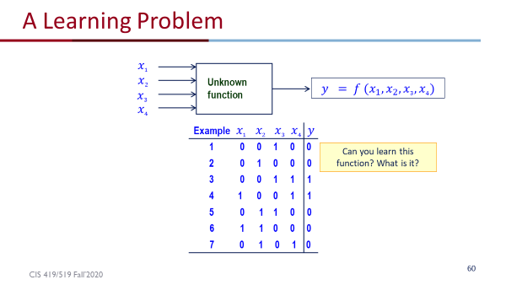
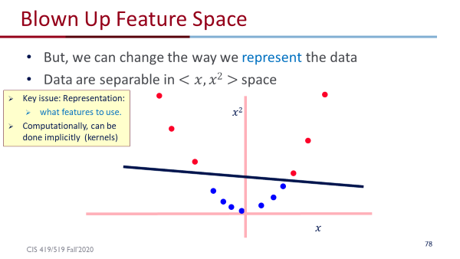
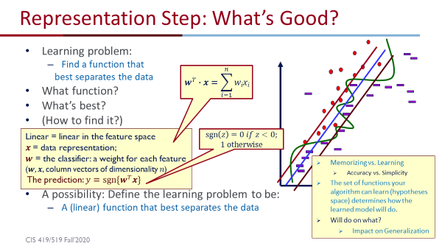
Introduction – Summary
The importance of a hypothesis space
  The need to make some assumptions of the function we are trying to learn
Expressivity of functions and feature spaces
And Linear functions

Slide 4
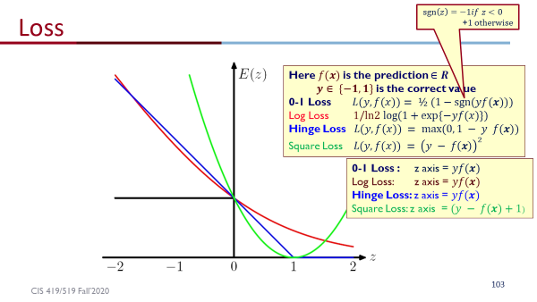
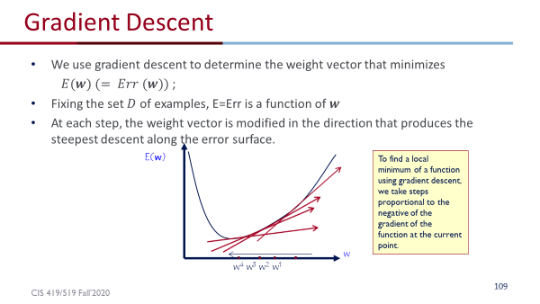


Introduction – Summary (2)
Loss functions
  They drive the search for a good hypothesis
How to search?
  Via gradient Descent
GD: averaging the gradient of the loss over the complete training set.
Algorithms: GD and SGD
  A sequence of weight vectors (hypotheses) from an initial guess to the final learned function.
SGD: update the weight vector based on a single example (or a small batch)

Slide 5
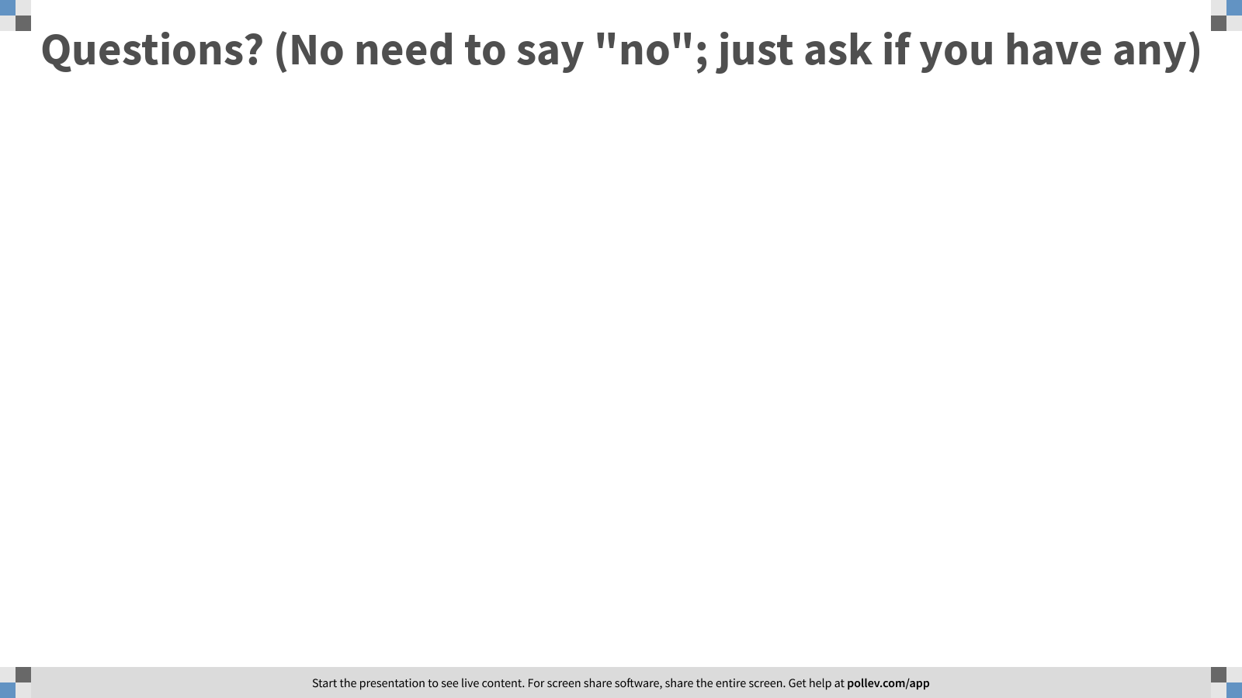
Notes:
Poll Title: Questions? (No need to say "no"; just ask if you have any)
https://www.polleverywhere.com/free_text_polls/PCdIhObYAJokRe1zkv76L

Slide 6
Introduction - Summary
We introduced the technical part of the class by giving two (very important) examples for learning approaches to linear discrimination.
There are many other solutions.
Question 1: Our solution learns a linear function; in principle, the target function may not be linear, and this will have implications on the performance of our learned hypothesis.
  Can we learn a function that is more flexible in terms of what it does with the feature space?
Question 2: Do we understand what we learn (the interpretability of the model)?
Question 3: Can we say something about the quality of what we learn (sample complexity, time complexity; quality)

Slide 7
Decision Trees
Earlier, we decoupled the generation of the feature space from the learning.
Argued that we can map the given examples into another space, in which the target functions are linearly separable.
Do we always want to do it?
How do we determine what are good mappings?
The study of decision trees may shed some light on this.
Learning is done directly from the given data representation.
The algorithm ``transforms” the data itself.
Some would argue: Boosted Decision Trees
  Interpretation of the final model might also play a role
Think about the Badges problem (vowel)
What’s the best learning algorithm?
x²
x

Slide 8
This Lecture
Decision trees for (binary) classification
  Non-linear classifiers
Learning decision trees (ID3 algorithm)
  Greedy heuristic (based on information gain)
  Originally developed for discrete features
  Some extensions to the basic algorithm
Overfitting
  Some experimental issues

Slide 9
Introduction of Decision trees

Slide 10
Representing Data
Think about a large table, N attributes, and assume you want to know something about the people represented as entries in this table.
E.g. reads a lot of books or not;
Simplest way: Histogram on the first attribute – reads
Then, histogram on 1st and 2nd: (reads (0/1) & gender (0/1): 00, 01, 10, 11)
But, what if the # of attributes is larger: N=16
How large are the 1-d histograms (contingency tables) ? 16 numbers
How large are the 2-d histograms? 16-choose-2 (all pairs) = 120 numbers
How many 3-d tables? 560 numbers
With 100 attributes, the 3-d tables need 161,700 numbers
We need to figure out a way to represent data in a better way;
  In part, this depends on identifying the important attributes, since we want to look at these first.
  Information theory has something to say about it – we will use it to better represent the data.

Slide 11
Decision Trees
A hierarchical data structure that represents data by implementing a divide and conquer strategy
  Can be used as a non-parametric classification and regression method (real numbers associated with each example, rather than a categorical label)
Process:
  Given a collection of examples, learn a decision tree that represents it.
  Use this representation to classify new examples
Given this collection of shapes, what shapes are type A, B, and C?
C
B
A

Slide 12
The Representation
Decision Trees are classifiers for instances represented as feature vectors
  color={red, blue, green} ; shape={circle, triangle, rectangle} ; label= {A, B, C}
  An example: <(color = green; shape = rectangle), label = B>
Nodes are tests for feature values
There is one branch for each value of the feature
Leaves specify the category (labels)
Can categorize instances into multiple disjoint categories
Learning a
Decision Tree?
Check the color
feature.
If it is blue than check the shape feature
if it is …then…
Color
Evaluation of a
Decision Tree
C
B
A
Shape
B
Shape
B
A
C
B
A

Slide 13
Expressivity of Decision Trees
As Boolean functions they can represent any Boolean function.
Can be rewritten as rules in Disjunctive Normal Form (DNF)
  Green ∧ Square → positive
  Blue ∧ Circle → positive
  Blue ∧ Square → positive
The disjunction of these rules is equivalent to the Decision Tree
What did we show? What is the hypothesis space here?
  2 dimensions: color and shape
  3 values each: color(red, blue, green), shape(triangle, square, circle)
  |X| = 9: (red, triangle), (red, circle), (blue, square) …
  |Y| = 2: + and -
  |H| = 2⁹
And, all these functions can be represented as decision trees.
Color
Shape
B
Shape
-
+
+
+
-

Slide 14
Decision Trees
    Output is a discrete category. Real valued outputs are possible (regression trees)
    There are efficient algorithms for processing large amounts of data (but not too many features)
    There are methods for handling noisy data (classification noise and attribute noise) and for handling missing attribute values
Color
Shape
B
Shape
-
+
+
+
-

Slide 15
Decision Boundaries
    Usually, instances are represented as attribute-value pairs (color=blue, shape = square, +)
    Numerical values can be used either by discretizing or by using thresholds for splitting nodes
    In this case, the tree divides the features space into axis-parallel rectangles, each labeled with one of the labels
X < 3
Y
no
yes
+
+
+
7
Y > 7
Y < 5
+
+
-
no
yes
no
yes
5
-
+
-
-
+
+
X < 1
no
yes
1 3 X
+
-

Slide 16
Learning decision trees (ID3 algorithm

Slide 17
Decision Trees
Can represent any Boolean Function
Can be viewed as a way to compactly represent a lot of data.
Natural representation: (20 questions)
The evaluation of the Decision Tree Classifier is easy
Clearly, given data, there are
many ways to represent it as
a decision tree.
Learning a good representation
from data is the challenge.
Outlook
Sunny
Overcast
Rain
Humidity
Wind
Yes
High
Normal
Strong
Weak
No
Yes
No
Yes

Slide 18
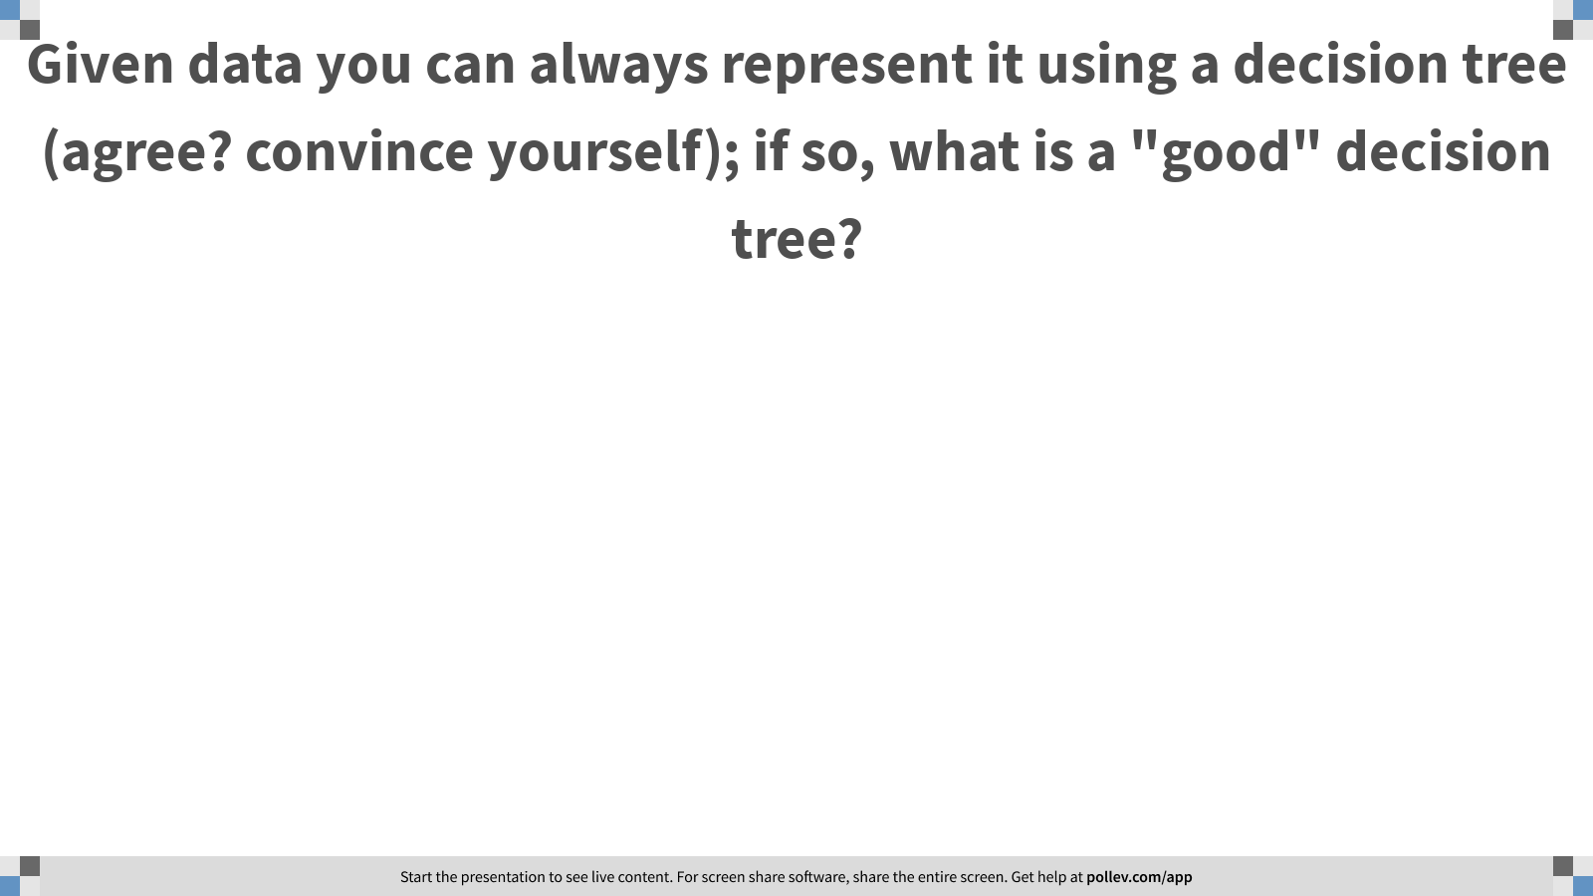
Notes:
Poll Title: Given data you can always represent it using a decision tree (agree? convince yourself); if so, what is a "good" decision tree?
https://www.polleverywhere.com/free_text_polls/MNxd9GnDYR3tFZsFjKGFP

Slide 19
Will I play tennis today?
Features
  Outlook: {Sun, Overcast, Rain}
  Temperature: {Hot, Mild, Cool}
  Humidity: {High, Normal, Low}
  Wind: {Strong, Weak}
Labels
  Binary classification task: Y = {+, -}

Slide 20
Will I play tennis today?
 | O | T | H | W | Play?
1 | S | H | H | W | -
2 | S | H | H | S | -
3 | O | H | H | W | +
4 | R | M | H | W | +
5 | R | C | N | W | +
6 | R | C | N | S | -
7 | O | C | N | S | +
8 | S | M | H | W | -
9 | S | C | N | W | +
10 | R | M | N | W | +
11 | S | M | N | S | +
12 | O | M | H | S | +
13 | O | H | N | W | +
14 | R | M | H | S | -
Outlook: S(unny),
O(vercast),
R(ainy)
Temperature: H(ot),
M(edium),
C(ool)
Humidity: H(igh),
N(ormal),
L(ow)
Wind: S(trong),
W(eak)

Slide 21
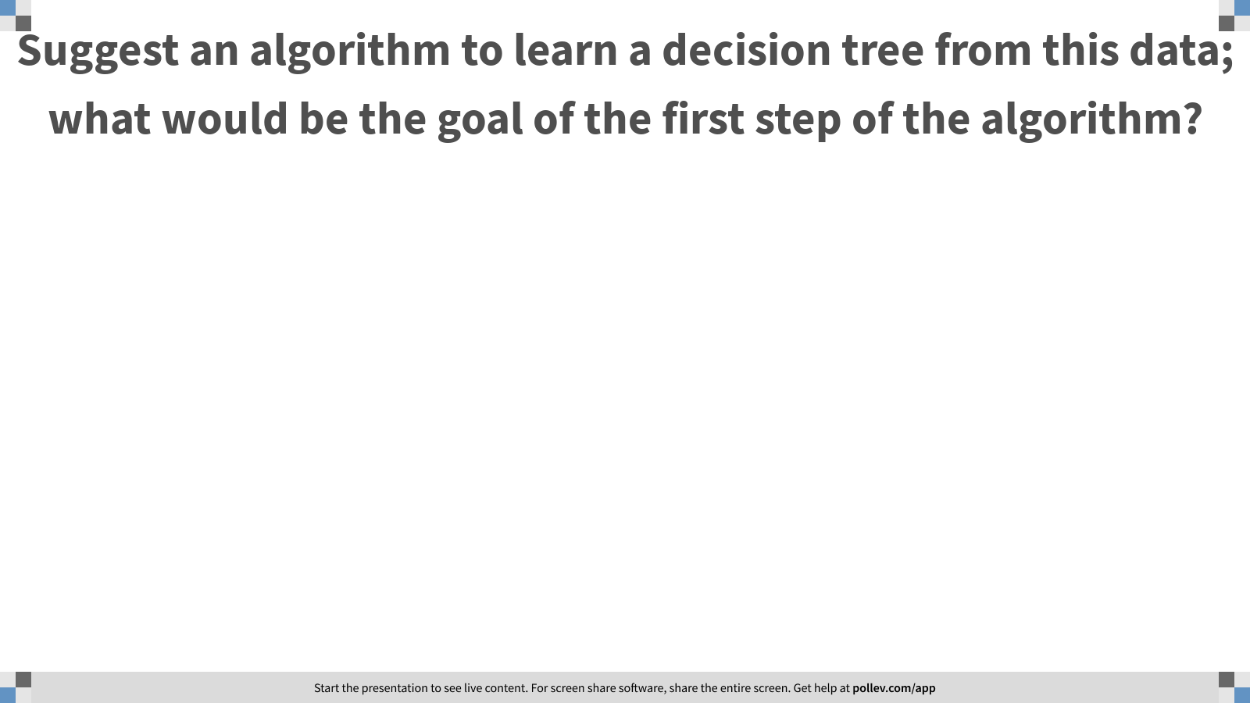
Notes:
Poll Title: Suggest an algorithm to learn a decision tree from this data; what would be the goal of the first step of the algorithm?
https://www.polleverywhere.com/free_text_polls/aIEn9KKXwmrTyF4cHeXOt

Slide 22
Basic Decision Trees Learning Algorithm
 | O | T | H | W | Play?
1 | S | H | H | W | -
2 | S | H | H | S | -
3 | O | H | H | W | +
4 | R | M | H | W | +
5 | R | C | N | W | +
6 | R | C | N | S | -
7 | O | C | N | S | +
8 | S | M | H | W | -
9 | S | C | N | W | +
10 | R | M | N | W | +
11 | S | M | N | S | +
12 | O | M | H | S | +
13 | O | H | N | W | +
14 | R | M | H | S | -
Data is processed in Batch (i.e. all the data available)
Recursively build a decision tree top down.
Algorithm?
Outlook
Sunny
Overcast
Rain
Humidity
Yes
Wind
High
Normal
Strong
Weak
No
Yes
No
Yes

Slide 23
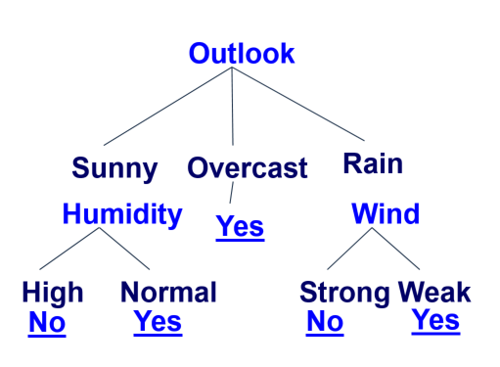
Basic Decision Tree Algorithm
Let S be the set of Examples
  Label is the target attribute (the prediction)
  Attributes is the set of measured attributes
ID3(S, Attributes, Label)
If all examples are labeled the same return a single node tree with Label
Otherwise Begin
A = attribute in Attributes that best classifies S (Create a Root node for tree)
for each possible value v of A
Add a new tree branch corresponding to A=v
Let Sv be the subset of examples in S with A=v
if Sv is empty: add leaf node with the common value of Label in S
Else: below this branch add the subtree
ID3(Sv, Attributes - {a}, Label)
End
Return Root
why?
For evaluation time

Slide 24
Picking the Root Attribute
The goal is to have the resulting decision tree as small as possible (Occam’s Razor)
  But, finding the minimal decision tree consistent with the data is NP-hard
The recursive algorithm is a greedy heuristic search for a simple tree, but cannot guarantee optimality.
The main decision in the algorithm is the selection of the next attribute to condition on.

Slide 25
Picking the Root Attribute
Consider data with two Boolean attributes (A,B).
< (A=0,B=0), - >: 50 examples
< (A=0,B=1), - >: 50 examples
< (A=1,B=0), - >: 0 examples
< (A=1,B=1), + >: 100 examples
What should be the first attribute we select?
Notes:
One

Slide 26
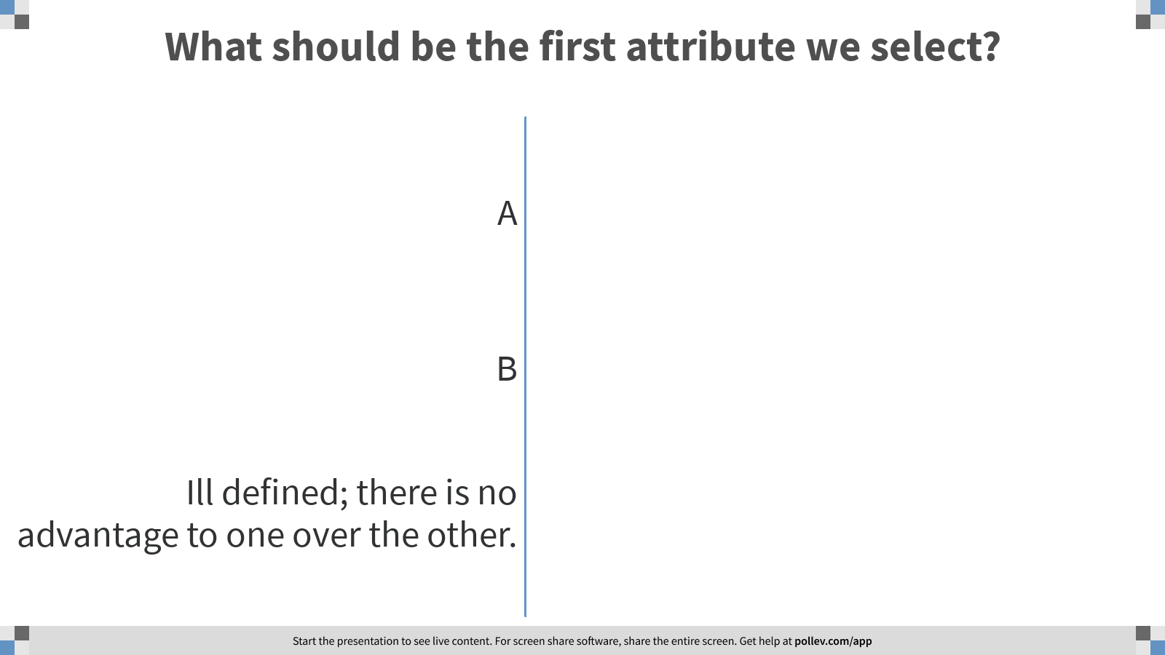
Notes:
Poll Title: What should be the first attribute we select?
https://www.polleverywhere.com/multiple_choice_polls/o4pcaU3XGtbD6WgVa8GTe?flow=Default&onscreen=persist

Slide 27
Picking the Root Attribute
Consider data with two Boolean attributes (A,B).
< (A=0,B=0), - >: 50 examples
< (A=0,B=1), - >: 50 examples
< (A=1,B=0), - >: 0 examples
< (A=1,B=1), + >: 100 examples
What should be the first attribute we select?
  Splitting on A: we get purely labeled nodes.
  Splitting on B: we don’t get purely labeled nodes.
  What if we have: <(A=1,B=0), - >: 3 examples?
(one way to think about it: # of queries required to label a random data point)
A
1
0
+
-
splitting on A
B
1
0
A
-
1
0
+
-
splitting on B
Notes:
One

Slide 28
Picking the Root Attribute
Consider data with two Boolean attributes (A,B).
< (A=0,B=0), - >: 50 examples
< (A=0,B=1), - >: 50 examples
< (A=1,B=0), - >: 0 examples 3 examples
< (A=1,B=1), + >: 100 examples
What should be the first attribute we select?

Slide 29
Notes:
Poll Title: What should be the first attribute we select?
https://www.polleverywhere.com/multiple_choice_polls/o4pcaU3XGtbD6WgVa8GTe?flow=Default&onscreen=persist

Slide 30
Picking the Root Attribute
Consider data with two Boolean attributes (A,B).
< (A=0,B=0), - >: 50 examples
< (A=0,B=1), - >: 50 examples
< (A=1,B=0), - >: 0 examples 3 examples
< (A=1,B=1), + >: 100 examples
What should be the first attribute we select?
Trees looks structurally similar; which attribute should we choose?
Advantage A. But…
Need a way to quantify things
One way to think about it: # of queries required to
label a random data point.
If we choose A we have less uncertainty about
the labels.
A
B
1
0
1
0
B
-
A
-
1
0
100
1
0
53
+
-
+
-
100
3
100
50
splitting on A
splitting on B

Slide 31
Picking the Root Attribute
The goal is to have the resulting decision tree as small as possible (Occam’s Razor)
  The main decision in the algorithm is the selection of the next attribute to condition on.
We want attributes that split the examples to sets that are relatively pure in one label; this way we are closer to a leaf node.
  The most popular heuristics is based on information gain, originated with the ID3 system of Quinlan.

Slide 32
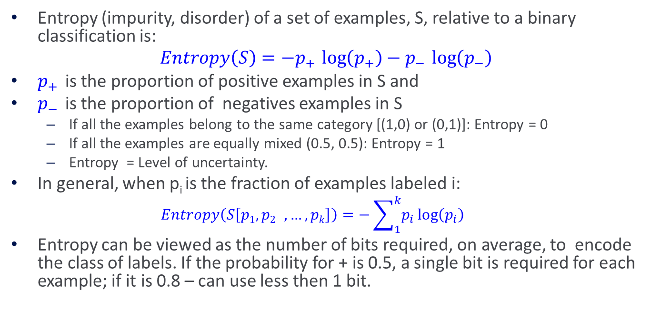
Entropy
Entropy (impurity, disorder) of a set of examples, S, relative to a binary classification is:
$$Entropy\left(S\right)=−p_{+ }\log\left(p_{+}\right)−p_{− }\log\left(p_{−}\right)$$
$p_{+ }$is the proportion of positive examples in S and
$p_{− }$is the proportion of negatives examples in S
  If all the examples belong to the same category [(1,0) or (0,1)]: Entropy = 0
  If all the examples are equally mixed (0.5, 0.5): Entropy = 1
  Entropy = Level of uncertainty.
In general, when p_{i} is the fraction of examples labeled i:
  $$Entropy\left(S\left[p1,p2 ,…,pk\right]\right)=−\sum_{1}^{k}{p_{i}}\log\left(p_{i}\right)$$
Entropy can be viewed as the number of bits required, on average, to encode the class of labels. If the probability for + is 0.5, a single bit is required for each example; if it is 0.8 – can use less then 1 bit.

Slide 33
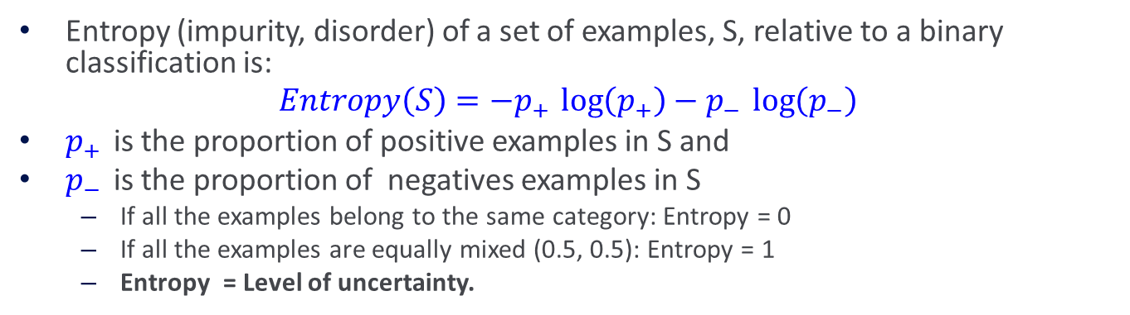
Entropy
Entropy (impurity, disorder) of a set of examples, S, relative to a binary classification is:
$$Entropy\left(S\right)=−p_{+ }\log\left(p_{+}\right)−p_{− }\log\left(p_{−}\right)$$
$p_{+ }$is the proportion of positive examples in S and
$p_{− }$is the proportion of negatives examples in S
  If all the examples belong to the same category: Entropy = 0
  If all the examples are equally mixed (0.5, 0.5): Entropy = 1
  Entropy = Level of uncertainty.
Test yourself: assign high, medium, low to each of these distributions
1
1
1
--
+
--
+
--
+

Slide 34


Entropy
(Convince yourself that the max value would be $\log\left(k\right)$ )
(Also note that the base of the log only introduces a constant factor; therefore, we’ll think about base 2)
Test yourself again: assign high, medium, low to each of these distributions.
For the middle distribution, try to guess the value of the entropy.
1
1
1

Slide 35
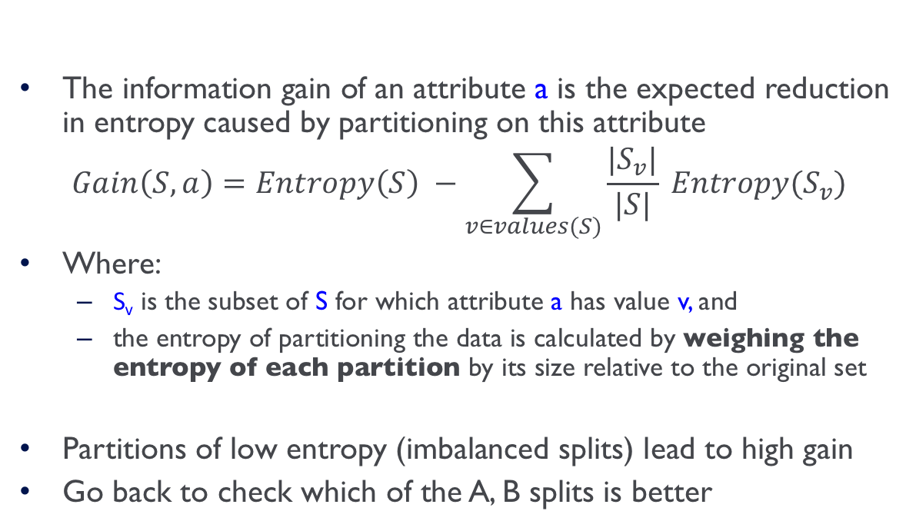
Information Gain
High Entropy – High level of Uncertainty
Low Entropy – No Uncertainty.
The information gain of an attribute a is the expected reduction in entropy caused by partitioning on this attribute
$$Gain\left(S,a\right)=Entropy\left(S\right) −\sum_{v∈values(S)}{\frac{|S_{v}|}{|S|} Entropy(S_{v})}$$
Where:
  S_{v} is the subset of S for which attribute a has value v, and
  the entropy of partitioning the data is calculated by weighing the entropy of each partition by its size relative to the original set
Partitions of low entropy (imbalanced splits) lead to high gain
Go back to check which of the A, B splits is better
Outlook
Sunny
Overcast
Rain
Notes:
The A, B case:
If we choose A: the reduction is: 100/203 Ent(100,0) + 103/203 Ent(100,3) ~~ 0
If we choose B: the reduction is: 53/203 Ent(53,0) + 150/203 Ent(100,50) >> 0

Slide 36
Administration (9/21/20)
Are we recording? YES!
Available on the web site
  Remember that all the lectures are available on the website before the class
    Go over it and be prepared
  HW 1 was released on Monday
    Covers: SGD, DT, Feature Extraction, Ensemble Models, & Experimental Machine Learning
    Start working on it now. Don’t wait until the last day (or two) since it could take a lot of your time
  Go to the recitations and office hours
  No Class on Monday 9/28 for Yom Kippur
  Questions?
    Please ask/comment during class.
    Give us feedback

Slide 37
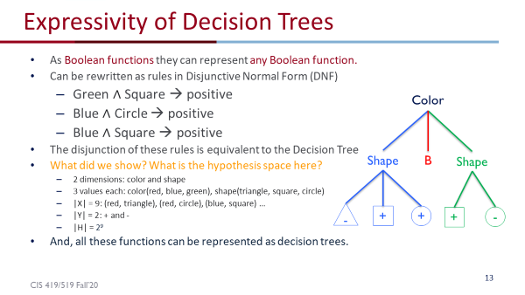
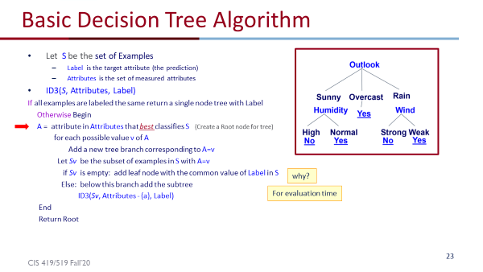
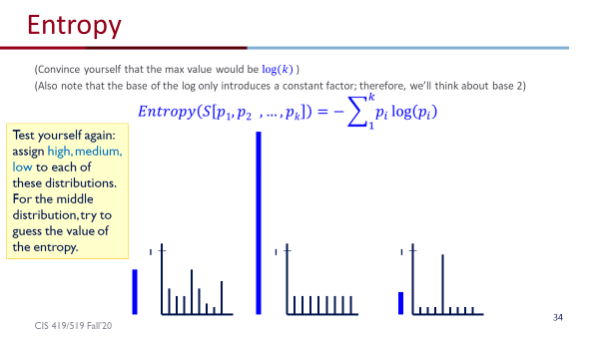
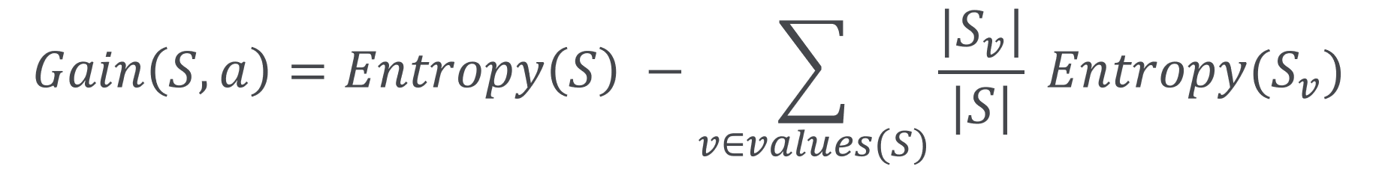
What Have We Done?
Decision Trees
  Expressivity
A Recursive Decision Tree Algorithm
Entropy and Information Gain

Slide 38
Will I play tennis today?
 | O | T | H | W | Play?
1 | S | H | H | W | -
2 | S | H | H | S | -
3 | O | H | H | W | +
4 | R | M | H | W | +
5 | R | C | N | W | +
6 | R | C | N | S | -
7 | O | C | N | S | +
8 | S | M | H | W | -
9 | S | C | N | W | +
10 | R | M | N | W | +
11 | S | M | N | S | +
12 | O | M | H | S | +
13 | O | H | N | W | +
14 | R | M | H | S | -
Outlook: S(unny),
O(vercast),
R(ainy)
Temperature: H(ot), M(edium),
C(ool)
Humidity: H(igh),
N(ormal),
L(ow)
Wind: S(trong),
W(eak)

Slide 39

Will I play tennis today?
 | O | T | H | W | Play?
1 | S | H | H | W | -
2 | S | H | H | S | -
3 | O | H | H | W | +
4 | R | M | H | W | +
5 | R | C | N | W | +
6 | R | C | N | S | -
7 | O | C | N | S | +
8 | S | M | H | W | -
9 | S | C | N | W | +
10 | R | M | N | W | +
11 | S | M | N | S | +
12 | O | M | H | S | +
13 | O | H | N | W | +
14 | R | M | H | S | -
calculate current entropy
$p_{+ }= \frac{9}{14}$ ${ p}_{− }= \frac{5}{14}$
$Entropy\left(Play\right)=−p_{+ }\log{2\left(p_{+}\right)}−p_{− }\log{2\left(p_{−}\right)}$
$=−\frac{9}{14}log2\frac{9}{14}−\frac{5}{14}log2\frac{5}{14}$
≈ 0.94

Slide 40
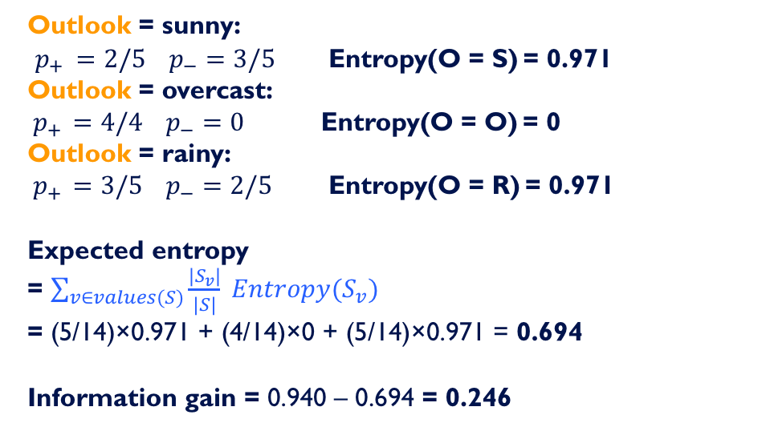
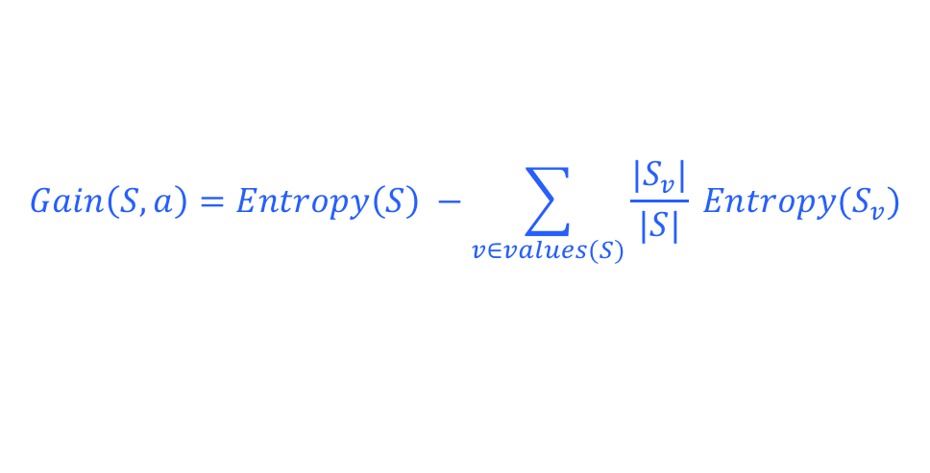
Information Gain: Outlook
$$Gain\left(S,a\right)=Entropy\left(S\right) −\sum_{v∈values(S)}{\frac{|S_{v}|}{|S|} Entropy(S_{v})}$$
 | O | T | H | W | Play?
1 | S | H | H | W | -
2 | S | H | H | S | -
3 | O | H | H | W | +
4 | R | M | H | W | +
5 | R | C | N | W | +
6 | R | C | N | S | -
7 | O | C | N | S | +
8 | S | M | H | W | -
9 | S | C | N | W | +
10 | R | M | N | W | +
11 | S | M | N | S | +
12 | O | M | H | S | +
13 | O | H | N | W | +
14 | R | M | H | S | -
Outlook = sunny:
$p_{+ }=2/5$ $p_{−}=3/5$ Entropy(O = S) = 0.971
Outlook = overcast:
${ p}_{+ } =4/4$ $p_{−}=0$ Entropy(O = O) = 0
Outlook = rainy:
${ p}_{+ } =3/5$ $p_{−}=2/5$ Entropy(O = R) = 0.971
Expected entropy
= $\sum_{v∈values(S)}{\frac{|S_{v}|}{|S|} Entropy(S_{v})}$
= (5/14)×0.971 + (4/14)×0 + (5/14)×0.971 = 0.694
Information gain = 0.940 – 0.694 = 0.246

Slide 41
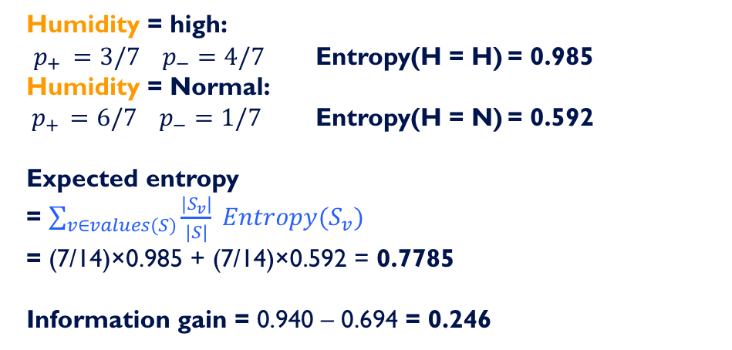
Information Gain: Humidity
$$Gain\left(S,a\right)=Entropy\left(S\right) −\sum_{v∈values(S)}{\frac{|S_{v}|}{|S|} Entropy(S_{v})}$$
 | O | T | H | W | Play?
1 | S | H | H | W | -
2 | S | H | H | S | -
3 | O | H | H | W | +
4 | R | M | H | W | +
5 | R | C | N | W | +
6 | R | C | N | S | -
7 | O | C | N | S | +
8 | S | M | H | W | -
9 | S | C | N | W | +
10 | R | M | N | W | +
11 | S | M | N | S | +
12 | O | M | H | S | +
13 | O | H | N | W | +
14 | R | M | H | S | -
Humidity = high:
$p_{+ }=3/7$ $p_{−}=4/7$ Entropy(H = H) = 0.985
Humidity = Normal:
${ p}_{+ } =6/7$ $p_{−}=1/7$ Entropy(H = N) = 0.592
Expected entropy
= $\sum_{v∈values(S)}{\frac{|S_{v}|}{|S|} Entropy(S_{v})}$
= (7/14)×0.985 + (7/14)×0.592 = 0.7785
Information gain = 0.940 – 0.694 = 0.246

Slide 42
Which feature to split on?
 | O | T | H | W | Play?
1 | S | H | H | W | -
2 | S | H | H | S | -
3 | O | H | H | W | +
4 | R | M | H | W | +
5 | R | C | N | W | +
6 | R | C | N | S | -
7 | O | C | N | S | +
8 | S | M | H | W | -
9 | S | C | N | W | +
10 | R | M | N | W | +
11 | S | M | N | S | +
12 | O | M | H | S | +
13 | O | H | N | W | +
14 | R | M | H | S | -
Information gain:
Outlook: 0.246
Humidity: 0.151
Wind: 0.048
Temperature: 0.029
→ Split on Outlook

Slide 43
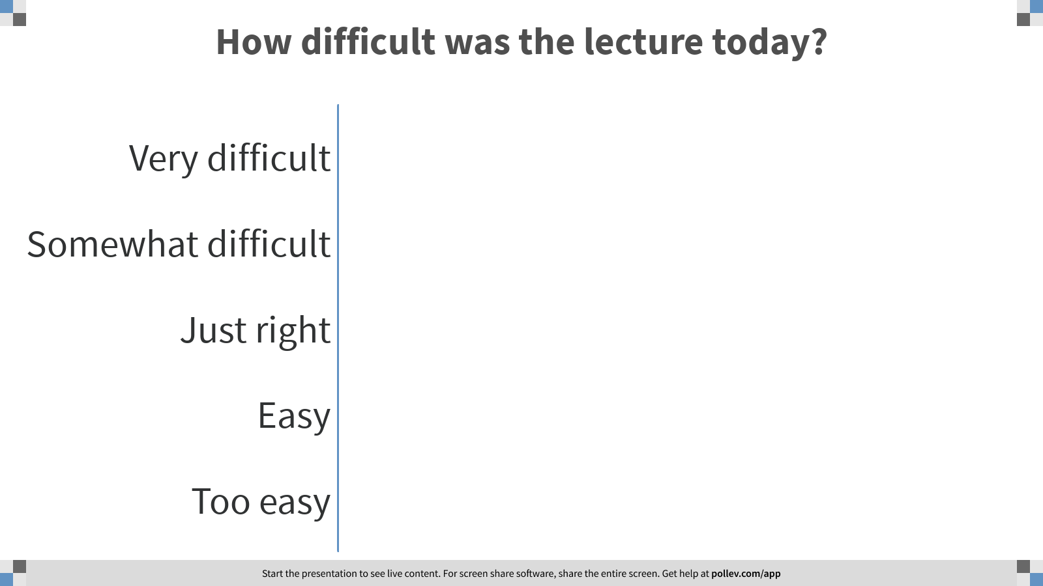
Notes:
Poll Title: How difficult was the lecture today?
https://www.polleverywhere.com/multiple_choice_polls/NZ7gbOibqs6U3BIbkFlse?flow=Default&onscreen=persist

Slide 44
An Illustrative Example (III)
Gain(S,Humidity)=0.151
Gain(S,Wind) = 0.048
Gain(S,Temperature) = 0.029
Gain(S,Outlook) = 0.246
Outlook

Slide 45
An Illustrative Example (III)
 | O | T | H | W | Play?
1 | S | H | H | W | -
2 | S | H | H | S | -
3 | O | H | H | W | +
4 | R | M | H | W | +
5 | R | C | N | W | +
6 | R | C | N | S | -
7 | O | C | N | S | +
8 | S | M | H | W | -
9 | S | C | N | W | +
10 | R | M | N | W | +
11 | S | M | N | S | +
12 | O | M | H | S | +
13 | O | H | N | W | +
14 | R | M | H | S | -
Outlook
Sunny
Overcast
Rain
1,2,8,9,11
3,7,12,13
4,5,6,10,14
2+,3-
4+,0-
3+,2-
?
Yes
?

Slide 46
An Illustrative Example (III)
Outlook
 | O | T | H | W | Play?
1 | S | H | H | W | -
2 | S | H | H | S | -
3 | O | H | H | W | +
4 | R | M | H | W | +
5 | R | C | N | W | +
6 | R | C | N | S | -
7 | O | C | N | S | +
8 | S | M | H | W | -
9 | S | C | N | W | +
10 | R | M | N | W | +
11 | S | M | N | S | +
12 | O | M | H | S | +
13 | O | H | N | W | +
14 | R | M | H | S | -
Sunny
Overcast
Rain
1,2,8,9,11
3,7,12,13
4,5,6,10,14
2+,3-
4+,0-
3+,2-
?
Yes
?
Continue until:
Every attribute is included in path, or,
All examples in the leaf have same label

Slide 47
An Illustrative Example (IV)
Outlook
 | O | T | H | W | Play?
1 | S | H | H | W | -
2 | S | H | H | S | -
4 | R | M | H | W | +
5 | R | C | N | W | +
6 | R | C | N | S | -
7 | O | C | N | S | +
8 | S | M | H | W | -
9 | S | C | N | W | +
10 | R | M | N | W | +
11 | S | M | N | S | +
12 | O | M | H | S | +
13 | O | H | N | W | +
14 | R | M | H | S | -
Sunny
Overcast
Rain
1,2,8,9,11
3,7,12,13
4,5,6,10,14
2+,3-
4+,0-
3+,2-
?
Yes
?
.97-(3/5) 0-(2/5) 0 = .97
.97- 0-(2/5) 1 = .57
.97-(2/5) 1 - (3/5) .92= .02
Split on Humidity

Slide 48
An Illustrative Example (V)
Outlook
Sunny
Overcast
Rain
1,2,8,9,11
3,7,12,13
4,5,6,10,14
2+,3-
4+,0-
3+,2-
?
Yes
?

Slide 49
An Illustrative Example (V)
Outlook
Sunny
Overcast
Rain
1,2,8,9,11
3,7,12,13
4,5,6,10,14
2+,3-
4+,0-
3+,2-
Humidity
Yes
?
High
Normal
No
Yes

Slide 50
induceDecisionTree(S)
1. Does S uniquely define a class?
if all s ∈ S have the same label y: return S;
2. Find the feature with the most information gain:
i = argmax _{i} Gain(S, X_{i})
3. Add children to S:
for k in Values(X_{i}):
S_{k} = {s ∈ S | x_{i} = k}
addChild(S, S_{k})
induceDecisionTree(S_{k})
return S;

Slide 51
An Illustrative Example (VI)
Outlook
Sunny
Overcast
Rain
1,2,8,9,11
3,7,12,13
4,5,6,10,14
2+,3-
4+,0-
3+,2-
Humidity
Yes
Wind
High
Normal
Strong
Weak
No
Yes
No
Yes

Slide 52
Hypothesis Space in Decision Tree Induction
Conduct a search of the space of decision trees which can represent all possible discrete functions. (pros and cons)
Goal: to find the best decision tree
  Best could be “smallest depth”
  Best could be “minimizing the expected number of tests”
Finding a minimal decision tree consistent with a set of data is NP-hard.
Performs a greedy heuristic search: hill climbing without backtracking
Makes statistically based decisions using all data

Slide 53
History of Decision Tree Research
Hunt and colleagues in Psychology used full search decision tree methods to model human concept learning in the 60s
  Quinlan developed ID3, with the information gain heuristics in the late 70s to learn expert systems from examples
  Breiman, Freidman and colleagues in statistics developed CART (classification and regression trees simultaneously)
A variety of improvements in the 80s: coping with noise, continuous attributes, missing data, non-axis parallel etc.
  Quinlan’s updated algorithm, C4.5 (1993) is commonly used (New: C5)
Boosting (or Bagging) over DTs is a very good general-purpose algorithm

Slide 54
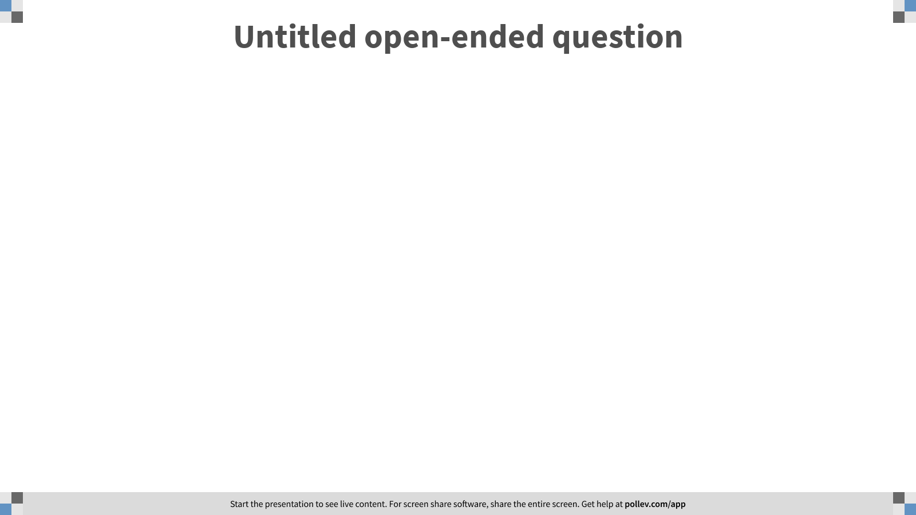
Notes:
Poll Title: Questions?
https://www.polleverywhere.com/free_text_polls/c4SckTtQP9AGJ1pPVj6jw

Slide 55






















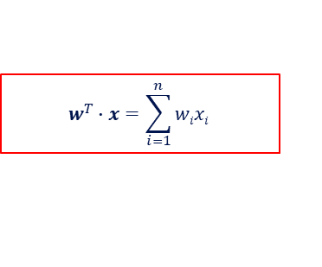




$$w^{T}∙x=\sum_{i=1}^{n}{wixi }$$
SGD: You will learn the weights $wi$
DT/DT-stumps: learn a small DTs
$$w1$$
$$w600$$
$$x1$$
$$x600$$
$x7$
$x81$
$$white$$
$$blue$$
$$mac$$
$$pc$$
$$red$$
$$red$$
$$x101$$
$$x3$$
$$x101$$
$$x3$$
Yes
No
$$low$$
$$hi$$
$$low$$
$$hi$$
$$small$$
$$large$$
$$small$$
$$large$$
Yes
No
Yes
No
Yes
Yes
No
No

Slide 56
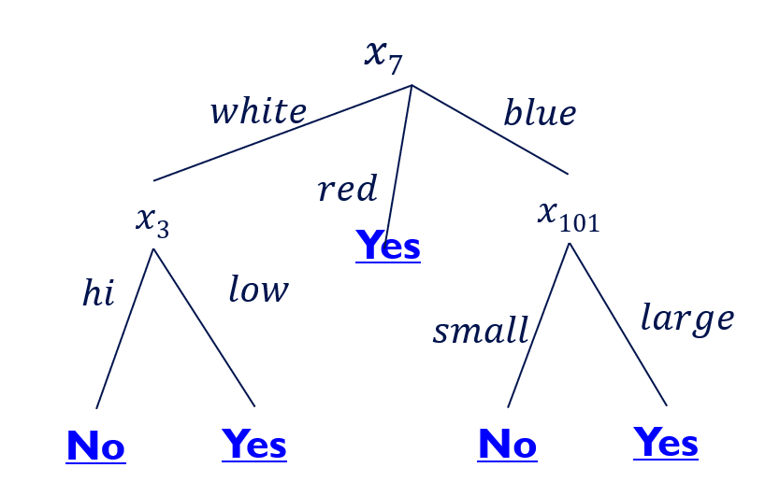
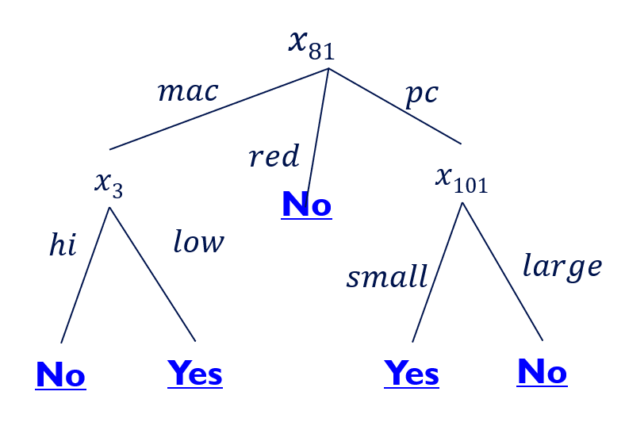


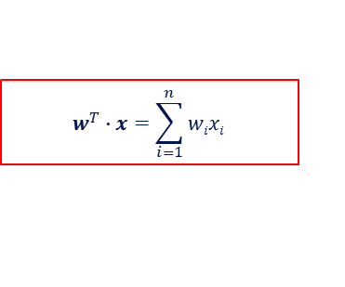

HW1 – Learning Algorithms
$$w^{T}∙x=\sum_{i=1}^{n}{wixi }$$
SGD: You will learn the weights $wi$
DT/DT-stumps: learn a small DTs
SGD+Stumps
  But, the DT algorithm is deterministic, and will give me the same DT every time
  Run it on different data – in this case, use random 50% of the features; 100 times
    Not the only option; you could use random 50% of the data
$$w1$$
$$w600$$
$$w100$$
$$x1$$
$$x600$$
₁$00$
Final Process:
  For each example: x_{1,600} → (DT₁(x),…, DT₁₀₀(x))
  Run SGD on 100 dimensional examples

Slide 57
Overfitting

Slide 58
Example
Outlook
Outlook = Sunny,
Temp = Hot
Humidity = Normal
Wind = Strong
label: NO
this example doesn’t exist in the tree
Sunny
Overcast
Rain
1,2,8,9,11
3,7,12,13
4,5,6,10,14
2+,3-
4+,0-
3+,2-
Humidity
Yes
Wind
High
Normal
Strong
Weak
No
Yes
No
Yes

Slide 59
Overfitting - Example
This can always be done – may fit noise or other coincidental regularities
Outlook
Outlook = Sunny,
Temp = Hot
Humidity = Normal
Wind = Strong
label: NO
this example doesn’t exist in the tree
Sunny
Overcast
Rain
1,2,8,9,11
3,7,12,13
4,5,6,10,14
2+,3-
4+,0-
3+,2-
Humidity
Yes
Wind
High
Normal
Strong
Weak
No
Wind
No
Yes
Strong
Weak
No
Yes

Slide 60
Our training data

Slide 61
The instance space

Slide 62
Overfitting the Data
Learning a tree that classifies the training data perfectly may not lead to the tree with the best generalization performance.
  There may be noise in the training data the tree is fitting
  The algorithm might be making decisions based on very little data
A hypothesis h is said to overfit the training data if there is another hypothesis h’, such that h has a smaller error than h’ on the training data but h has larger error on the test data than h’.
accuracy
On training
On testing
Complexity of tree

Slide 63
Reasons for overfitting
Too much variance in the training data
  Training data is not a representative sample
  of the instance space
  We split on features that are actually irrelevant
Too much noise in the training data
  Noise = some feature values or class labels are incorrect
  We learn to predict the noise
In both cases, it is a result of our will to minimize the empirical error when we learn, and the ability to do it (with DTs)

Slide 64
Pruning a decision tree
Prune = remove leaves and assign majority label of the parent to all items
Prune the children of node s if:
  all children are leaves, and
  the accuracy on the validation set does not decrease if we assign the most frequent class label to all items at s.

Slide 65
Avoiding Overfitting
How can this be avoided with linear classifiers?
Two basic approaches
  Pre-pruning: Stop growing the tree at some point during construction when it is determined that there is not enough data to make reliable choices.
  Post-pruning: Grow the full tree and then remove nodes that seem not to have sufficient evidence.
Methods for evaluating subtrees to prune
  Cross-validation: Reserve hold-out set to evaluate utility
  Statistical testing: Test if the observed regularity can be dismissed as likely to occur by chance
  Other
The goal is to guarantee/improve generalization
This is related to the notion of regularization that we will see in other contexts – keep the hypothesis simple.
Hand waving, for now.
Next: a brief detour into explaining generalization and overfitting

Slide 66
Preventing Overfitting
h₁
h₂
Notes:
As we said, this is the game we are playing; in NLP, it has always been clear, that the raw information
In a sentence is not sufficient, as is to represent a good predictor. Better functions of the input were
Generated, and learning was done in these terms.

Slide 67
Notes:
Poll Title: Which Hypothesis is expected to be better, h1 or h2? Why?
https://www.polleverywhere.com/free_text_polls/L0vcK8k6Mw2UsBFAt2IKx

Slide 68
Preventing Overfitting
h₁
h₂
Notes:
As we said, this is the game we are playing; in NLP, it has always been clear, that the raw information
In a sentence is not sufficient, as is to represent a good predictor. Better functions of the input were
Generated, and learning was done in these terms.

Slide 69
Trees and Rules
Decision Trees can be represented as Rules
  (outlook = sunny) and (humidity = normal) then YES
  (outlook = rain) and (wind = strong) then NO
Sometimes Pruning can be done at the rules level
  Rules are generalized by
  erasing a condition (different!)
Outlook
Sunny
Overcast
Rain
1,2,8,9,11
3,7,12,13
4,5,6,10,14
2+,3-
4+,0-
3+,2-
Humidity
Yes
Wind
High
Normal
Strong
Weak
No
Yes
No
Yes

Slide 70
DT Extensions: continuous attributes and missing values

Slide 71
Continuous Attributes
Real-valued attributes can, in advance, be discretized into ranges, such as big, medium, small
Alternatively, one can develop splitting nodes based on thresholds of the form A<c that partition the data into examples that satisfy A<c and A>=c.
  The information gain for these splits is calculated in the same way and compared to the information gain of discrete splits.
How to find the split with the highest gain?
For each continuous feature A:
  Sort examples according to the value of A
  For each ordered pair (x,y) with different labels
    Check the mid-point as a possible threshold, i.e.
    S_{a < x} S_{a >= y}

Slide 72
Continuous Attributes
Example:
  Length (L): 10 15 21 28 32 40 50
  labels: - + + - + + -
  Check thresholds: L < 12.5; L < 24.5; L < 45
  Subset of Examples= {…}, Split= k+,j-
How to find the split with the highest gain ?
  For each continuous feature A:
    Sort examples according to the value of A
    For each ordered pair (x,y) with different labels
      Check the mid-point as a possible threshold. I.e,
      S_{a < x}, S_{a >= y}

Slide 73
Missing Values
Diagnosis = < fever, blood_pressure,…, blood_test=?,…>
Many times values are not available for all attributes during training or testing (e.g., medical diagnosis)
Training: evaluate Gain(S,a) where in some of the examples a value for a is not given

Slide 74
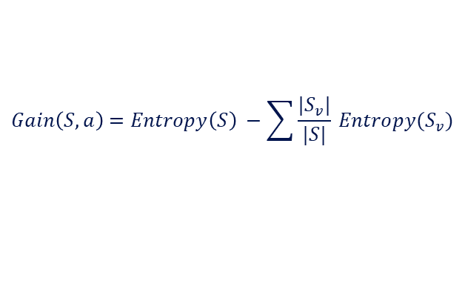
Missing Values
$$Gain\left(S,a\right)=Entropy\left(S\right) −\sum{\frac{|S_{v}|}{|S|} Entropy(S_{v})}$$
Other suggestions?
Outlook
.97- 0-(2/5) 1 = .57
Fill in: assign the most likely value of X_{i} to s:
argmax _{k} P( X_{i} = k ): Normal
  97-(3/5) Ent[+0,-3] -(2/5) Ent[+2,-0] = .97
Assign fractional counts P(X_{i} =k)
for each value of X_{i} to s
  .97-(2.5/5) Ent[+0,-2.5] - (2.5/5) Ent[+2,-.5] < .97
Sunny
Overcast
Rain
1,2,8,9,11
3,7,12,13
4,5,6,10,14
2+,3-
4+,0-
3+,2-
?
Yes
?
Day Outlook Temperature Humidity Wind PlayTennis
1 Sunny Hot High Weak No
2 Sunny Hot High Strong No
8 Sunny Mild ??? Weak No
9 Sunny Cool Normal Weak Yes
11 Sunny Mild Normal Strong Yes
Notes:
Other suggestions: hints about EM

Slide 75
Missing Values
Diagnosis = < fever, blood_pressure,…, blood_test=?,…>
Many times values are not available for all attributes during training or testing (e.g., medical diagnosis)
Training: evaluate Gain(S,a) where in some of the examples a value for a is not given
Testing: classify an example without knowing the value of a

Slide 76
Missing Values
Outlook = Sunny, Temp = Hot, Humidity = ???, Wind = Strong, label = ??
Normal/High
Outlook = ???, Temp = Hot, Humidity = Normal, Wind = Strong, label = ??
Outlook
1/3 Yes + 1/3 Yes +1/3 No = Yes
Sunny
Overcast
Rain
1,2,8,9,11
3,7,12,13
4,5,6,10,14
2+,3-
4+,0-
3+,2-
Humidity
Yes
Wind
High
Normal
Strong
Weak
No
Yes
No
Yes

Slide 77
Other Issues
Attributes with different costs
  Change information gain so that low cost attribute are preferred
    Dealing with features with different # of values
Alternative measures for selecting attributes
  When different attributes have different number of values information gain tends to prefer those with many values
Oblique Decision Trees
  Decisions are not axis-parallel
Incremental Decision Trees induction
  Update an existing decision tree to account for new examples incrementally (Maintain consistency?)

Slide 78
Summary: Decision Trees
Presented the hypothesis class of Decision Trees
  Very expressive, flexible, class of functions
Presented a learning algorithm for Decision Tress
  Recursive algorithm.
  Key step is based on the notion of Entropy
Discussed the notion of overfitting and ways to address it within DTs
  In your problem set – look at the performance on the training vs. test
Briefly discussed some extensions
  Real valued attributes
  Missing attributes
Evaluation in machine learning
  Cross validation
  Statistical significance

Slide 79
Decision Trees as Features
Rather than using decision trees to represent the target function it is becoming common to use small decision trees as features
When learning over a large number of features, learning decision trees is difficult and the resulting tree may be very large
→ (over fitting)
Instead, learn small decision trees, with limited depth.
Treat them as “experts”; they are correct, but only on a small region in the domain. (what DTs to learn? same every time?)
Then, learn another function, typically a linear function, over these as features.
Boosting (but also other linear learners) are used on top of the small decision trees. (Either Boolean, or real valued features)
In HW1 you learn a linear classifier over DTs.
  Not learning the DTs sequentially; all are learned at once.
    How can you learn multiple DTs?
  Combining them using an SGD algorithm.

Slide 80
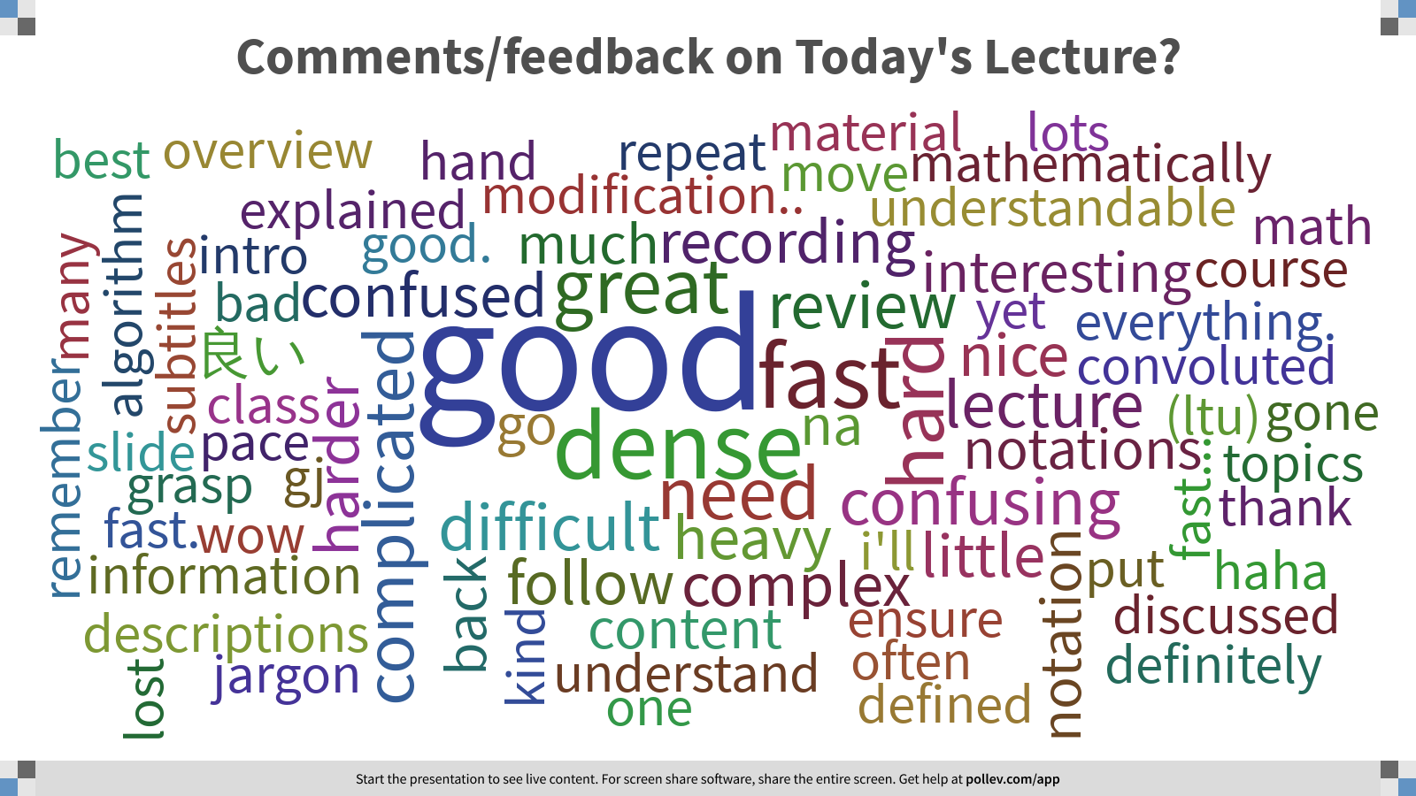
Notes:
Poll Title: Comments/feedback on Today's Lecture?
https://www.polleverywhere.com/free_text_polls/M9VGJtFlyi11Fhwhbs0zb

Slide 81
Expectation
X is a discrete random variable with distribution P(X):
Expectation of X (E[X]), aka. the mean of X (μ_{X})
E[X} = ∑_{x} P(X=x)X := μ_{X}
Expectation of a function of X (E[f(X)])
E[f(X)} = ∑_{x} P(X=x)f(x)
If X is continuous, replace sums with integrals

Slide 82
Variance and standard deviation
Squared difference between X and its mean:
(X – E[X])² = (X – μ_{X})²
Variance of X:
The expected value of the square difference between X and its mean
Standard deviation of X:
(= the square root of the variance)

Slide 83
More on variance
The variance of X is equal to the expected value of X² minus the square of its mean
Var(X) = E[X²] − (E[X])²
= E[X²] − μ_{X}²
Proof:
Var(X) = E[(X − μ_{X})²]
= E[X² − 2μ_{X}X + μ_{X}²]
= E[X²] − 2μ_{X}E[X] + μ_{X}²
= E[X²] − μ_{X}²

Slide 84
The i.i.d. assumption
Training and test items are independently and identically distributed (i.i.d.):
  There is a distribution P(X, Y) from which the data D = {(x, y)} is generated.
    Sometimes it’s useful to rewrite P(X, Y) as P(X)P(Y|X)
    Usually P(X, Y) is unknown to us (we just know it exists)
  Training and test data are samples drawn from the same P(X, Y): they are identically distributed
  Each (x, y) is drawn independently from P(X, Y)

Slide 85
Overfitting
On training data
Accuracy
Why this shape of curves?
On test data
Size of tree
A decision tree overfits the training data when its accuracy on the training data goes up but its accuracy on unseen data goes down

Slide 86
Overfitting
Empirical
Error
??
Model complexity
Empirical error (= on a given data set):
The percentage of items in this data set are misclassified by the classifier f.

Slide 87
Overfitting
Empirical
Error
Model complexity
Model complexity (informally):
How many parameters do we have to learn?
    Decision trees: complexity = #nodes

Slide 88
Overfitting
Expected
Error
Model complexity
Expected error:
What percentage of items drawn from P(x,y) do we expect to be misclassified by f?
(That’s what we really care about – generalization)

Slide 89
Variance of a learner (informally)
Variance
Model complexity
How susceptible is the learner to minor changes in the training data?
  (i.e. to different samples from P(X, Y))
Variance increases with model complexity
  Think about extreme cases: a hypothesis space with one function vs. all functions.
  Or, adding the “wind” feature in the DT earlier.
  The larger the hypothesis space is, the more flexible the selection of the chosen hypothesis is as a function of the data.
  More accurately: for each data set D, you will learn a different hypothesis h(D), that will have a different true error e(h); we are looking here at the variance of this random variable.
Notes:
Really: for each data set d, you will learn a different hypothesis h(d), that will have a different true error e(h); we are looking here at the variance of this random variable.

Slide 90
Bias of a learner (informally)
Bias
Model complexity
How likely is the learner to identify the target hypothesis?
Bias is low when the model is expressive (low empirical error)
Bias is high when the model is (too) simple
  The larger the hypothesis space is, the easiest it is to be close to the true hypothesis.
  More accurately: for each data set D, you learn a different hypothesis h(D), that has a different true error e(h); we are looking here at the difference of the mean of this random variable from the true error.
Notes:
Really: for each data set d, you will learn a different hypothesis h(d), that will have a different true error e(h); we are looking here at the difference of the mean of this random variable from the true error.

Slide 91
Impact of bias and variance
Expected
Error
Variance
Bias
Model complexity
Expected error ≈ bias + variance

Slide 92
Model complexity
Expected
Error
Variance
Bias
Model complexity
Simple models:
High bias and low variance
Complex models:
High variance and low bias

Slide 93

Underfitting and Overfitting
Underfitting
Overfitting
Expected
Error
Variance
Bias
Model complexity
Simple models:
High bias and low variance
Complex models:
High variance and low bias
This can be made more accurate for some loss functions.
We will discuss a more precise and general theory that trades expressivity of models with empirical error

Slide 94
Experimental Machine Learning
Machine Learning is an Experimental Field and we will spend some time (in Problem sets) learning how to run experiments and evaluate results
  First hint: be organized; write scripts
Basics:
  Split your data into three sets:
    Training data (often 70-90%)
    Test data (often 10-20%)
    Development data (10-20%)
You need to report performance on test data, but you are not allowed to look at it.
  You are allowed to look at the development data (and use it to tune parameters)

Slide 95
Metrics
Methodologies
Statistical Significance

Slide 96
Metrics
We train on our training data Train = {x_{i}, y_{i}}_{1,m}
We test on Test data.
We often set aside part of the training data as a development set, especially when the algorithms require tuning.
  In the HW we asked you to present results also on the Training; why?
When we deal with binary classification we often measure performance simply using Accuracy:
Any possible problems with it?
Notes:
\mbox{accuracy} = \frac{\mbox{\# correct predictions}}{\mbox{\# test instances}}
\mbox{error} = 1 - \mbox{accuracy} = \frac{\mbox{\# incorrect predictions}}{\mbox{\# test instances}}

Slide 97
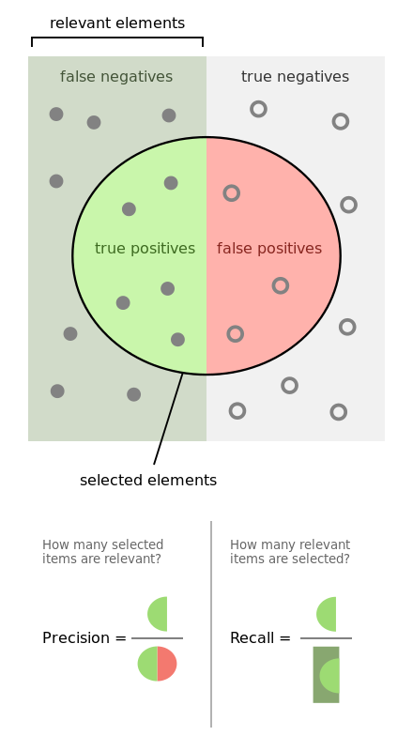
Alternative Metrics
Positive
negative
If the Binary classification problem is biased
  In many problems most examples are negative
Or, in multiclass classification
  The distribution over labels is often non-uniform
Simple accuracy is not a useful metric.
  Often we resort to task specific metrics
However one important example that is being used often involves Recall and Precision
Recall: # (positive identified = true positives)
# (all positive)
Precision: # (positive identified = true positives)
# (predicted positive)
Predicted positive

Slide 98
Example
Positive
negative
100 examples, 5% are positive.
Just say NO: your accuracy is 95%
  Recall = precision = 0
Predict 4+, 96-; 2 of the +s are indeed positive
  Recall:2/5; Precision: 2/4
Recall: # (positive identified = true positives)
# (all positive)
Precision: # (positive identified = true positives)
# (predicted positive)

Slide 99
Confusion Matrix
Given a dataset of P positive instances and N negative instances:
Imagine using classifier to identify positive cases (i.e., for information retrieval)
Predicted Class
Yes
No
The notion of a confusion matrix can be usefully extended to the multiclass case
(i,j) cell indicate how many of the i-labeled examples were predicted to be j
Yes
TP
FN
Actual Class
No
FP
TN
Probability that a randomly selected positive prediction is indeed positive
Probability that a randomly selected positive is identified
Notes:
\mbox{accuracy} = \frac{TP + TN}{P + N}
\definecolor{darkgreen}{rgb}{0.0, 0.5, 0.1}
\color{darkgreen}\mbox{precision} = \frac{TP}{TP + FP}
\mbox{recall} = \frac{TP}{TP + FN}

Slide 100
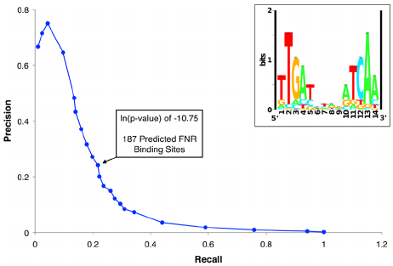

Relevant Metrics
It makes sense to consider Recall and Precision together or combine them into a single metric.
Recall-Precision Curve:
F-Measure:
  A measure that combines precision and recall is the harmonic mean of precision and recall.
  F1 is the most commonly used metric.

Slide 101
Comparing Classifiers
Say we have two classifiers, C1 and C2, and want to choose the best one to use for future predictions
Can we use training accuracy to choose between them?
No!
What about accuracy on test data?

Slide 102
N-fold cross validation
Instead of a single test-training split:
Split data into N equal-sized parts
Train and test N different classifiers
Report average accuracy and standard deviation of the accuracy
train
test

Slide 103
Evaluation: significance tests
You have two different classifiers, A and B
You train and test them on the same data set using N-fold cross-validation
For the n-th fold:
accuracy(A, n), accuracy(B, n)
p_{n} = accuracy(A, n) - accuracy(B, n)
Is the difference between A and B’s accuracies significant?

Slide 104
Hypothesis testing
You want to show that hypothesis H is true, based on your data
  (e.g. H = “classifier A and B are different”)
Define a null hypothesis H₀
  (H₀ is the contrary of what you want to show)
H₀ defines a distribution P(m |H₀) over some statistic
  e.g. a distribution over the difference in accuracy between A and B
Can you refute (reject) H₀?

Slide 105
Rejecting H₀
H₀ defines a distribution P(M |H₀) over some statistic M
  (e.g. M= the difference in accuracy between A and B)
Select a significance value S
  (e.g. 0.05, 0.01, etc.)
  You can only reject H₀ if P(m |H₀) ≤ S
Compute the test statistic m from your data
  e.g. the average difference in accuracy over your N folds
Compute P(m |H₀)
Refute H₀ with p ≤ S if P(m |H₀) ≤ S

Slide 106
Paired t-test
Null hypothesis (H₀; to be refuted):
  There is no difference between A and B, i.e. the expected accuracies of A and B are the same
That is, the expected difference (over all possible data sets) between their accuracies is 0:
  H₀: E[p_{D}] = 0
We don’t know the true E[p_{D}]
N-fold cross-validation gives us N samples of p_{D}

Slide 107
Paired t-test
Null hypothesis H₀: E[diff_{D}] = μ = 0
m: our estimate of μ based on N samples of diff_{D}
m = 1/N ∑_{n} diff_{n}
The estimated variance S²:
    S² = 1/(N-1) ∑_{1,N} (diff_{n} – m)²
Accept Null hypothesis at significance level a if the
following statistic lies in (-t_{a/2, N-1}, +t_{a/2, N-1})

Slide 108
Decision Trees - Summary
Hypothesis Space:
  Variable size (contains all functions)
  Deterministic; Discrete and Continuous attributes
Search Algorithm
  ID3 - batch
  Extensions: missing values
Issues:
  What is the goal?
  When to stop? How to guarantee good generalization?
Did not address:
  How are we doing? (Correctness-wise, Complexity-wise)

