Slide 1
Evaluation
Rotem Dror
rtmdrr@seas.upenn.edu|http://rtmdrr.github.io
Slides were created by Dan Roth (for CIS519/419 at Penn or CS446 at UIUC), Rotem Dror, or other authors who have made their ML slides available.

Slide 2
Administration (9/30/20)
Are we recording? YES!
Available on the web site
  Remember that all the lectures are available on the website before the class
    Go over it and be prepared
  HW 1 is out
    Covers: SGD, DT, Feature Extraction, Ensemble Models, & Experimental Machine Learning
    Start working on it now. Don’t wait until the last day (or two) since it could take a lot of your time
  Go to the recitations and office hours
  Questions?
    Please ask/comment during class.
    Give us feedback

Slide 3

Notes:
Poll Title: Have you started to work on HW1?
https://www.polleverywhere.com/multiple_choice_polls/0KPkiurAhDTSqNs8zilNG?flow=Default&onscreen=persist

Slide 4
Metrics
Methodologies
Statistical Significance

Slide 5
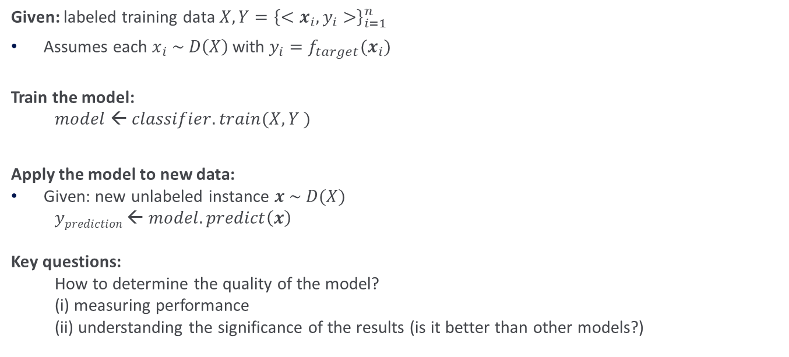



Flow of Batch Machine Learning
Given: labeled training data $X,Y={\left\{<x_{i},y_{i}>\right\}}_{i=1}^{n}$
Assumes each $x_{i} \sim D\left(X\right)$with $y_{i}=f_{target}(x_{i})$
Train the model:
$model ← classifier.train(X, Y )$
Apply the model to new data:
Given: new unlabeled instance $x \sim D(X)$
$yprediction ← model.predict\left(x\right)$
Key questions:
How to determine the quality of the model?
(i) measuring performance
(ii) understanding the significance of the results (is it better than other models?)
$$X, Y$$
learner
$$x$$
model
$yprediction$
Notes:
X, Y = \left\{ \left\langle \bm{x}_{i}, y_{i}\right\rangle \right\}_{i=1}^n
\bm{x}_i \sim \mathcal{D}(\mathcal{X})
y_i = f_{\mathit{target}}(\bm{x}_i)
y^{(i)} = f_\mathit{true}\left(x^{(i)}\right)
x \sim \mathcal{D}(\mathcal{X})

Slide 6
Metrics
Methodologies
Statistical Significance

Slide 7
Metrics
We train on our training data Train = {x_{i}, y_{i}}_{1,m}
We test on Test data.
We often set aside part of the training data as a development set, especially when the algorithms require tuning.
  In the HW we asked you to present results also on the Training; why?
When we deal with binary classification we often measure performance simply using Accuracy:
Any possible problems with it?
Notes:
\mbox{accuracy} = \frac{\mbox{\# correct predictions}}{\mbox{\# test instances}}
\mbox{error} = 1 - \mbox{accuracy} = \frac{\mbox{\# incorrect predictions}}{\mbox{\# test instances}}

Slide 8
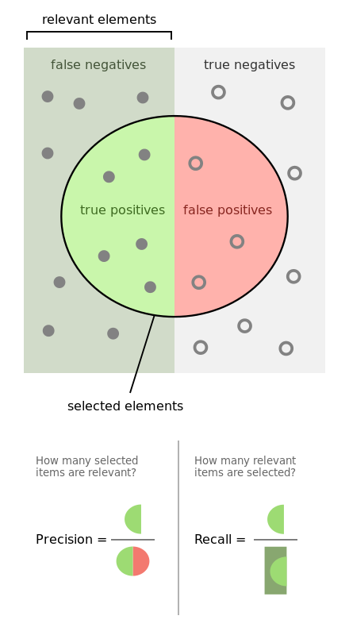
Alternative Metrics
Positive
negative
If the Binary classification problem is biased
  In many problems most examples are negative
Or, in multiclass classification
  The distribution over labels is often non-uniform
Simple accuracy is not a useful metric.
  Often we resort to task specific metrics
However one important example that is being used often involves Recall and Precision
Recall: # (positive identified = true positives)
# (all positive)
Precision: # (positive identified = true positives)
# (predicted positive)
Predicted positive

Slide 9
Example
Positive
negative
100 examples, 5% are positive.
Just say NO: your accuracy is 95%
  Recall = precision = 0
Predict 4+, 96-; 2 of the +s are indeed positive
  Recall:2/5; Precision: 2/4
Recall: # (positive identified = true positives)
# (all positive)
Precision: # (positive identified = true positives)
# (predicted positive)

Slide 10
Confusion Matrix
Given a dataset of P positive instances and N negative instances:
Imagine using classifier to identify positive cases (i.e., for information retrieval)
Predicted Class
Yes
No
The notion of a confusion matrix can be usefully extended to the multiclass case
(i,j) cell indicate how many of the i-labeled examples were predicted to be j
Yes
TP
FN
Actual Class
No
FP
TN
Probability that a randomly selected positive prediction is indeed positive
Probability that a randomly selected positive is identified
Notes:
\mbox{accuracy} = \frac{TP + TN}{P + N}
\definecolor{darkgreen}{rgb}{0.0, 0.5, 0.1}
\color{darkgreen}\mbox{precision} = \frac{TP}{TP + FP}
\mbox{recall} = \frac{TP}{TP + FN}

Slide 11
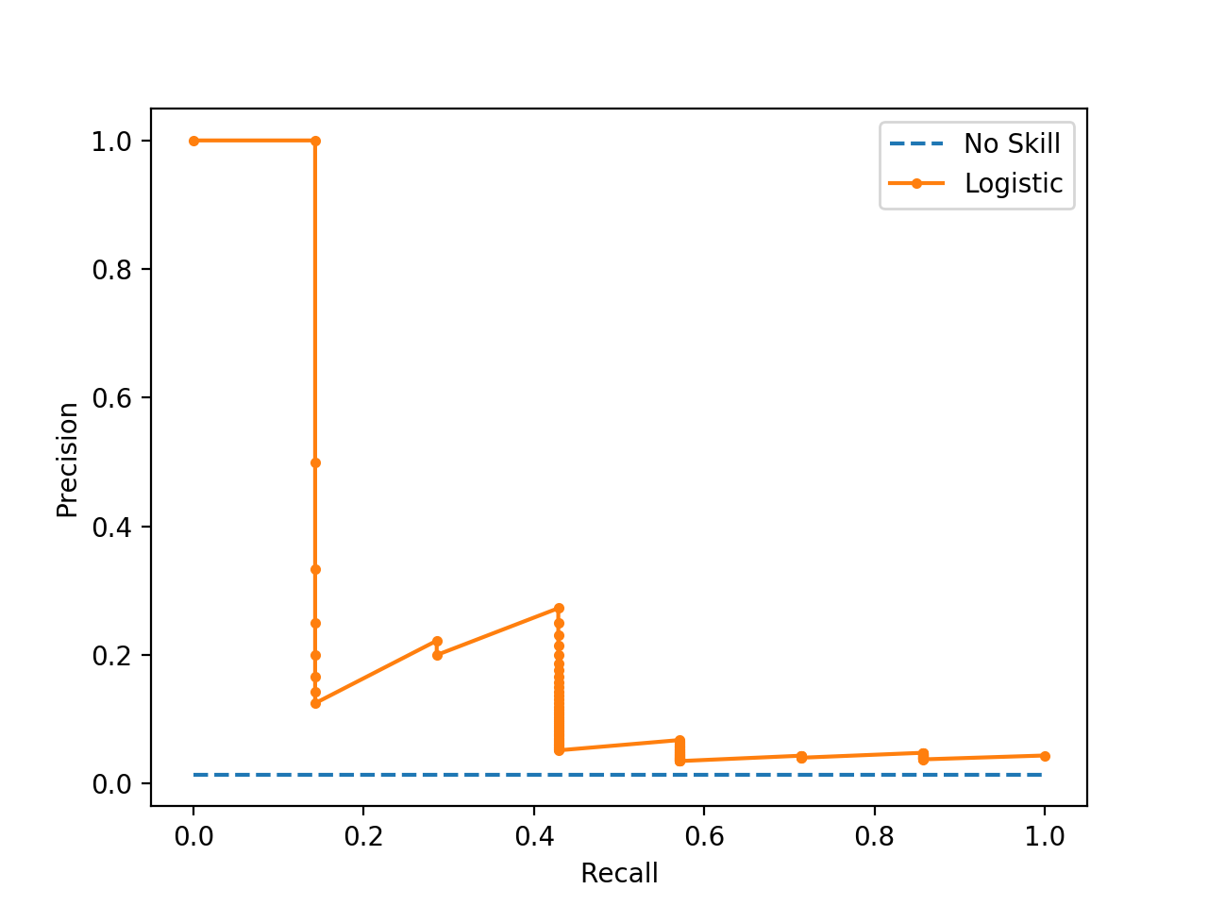
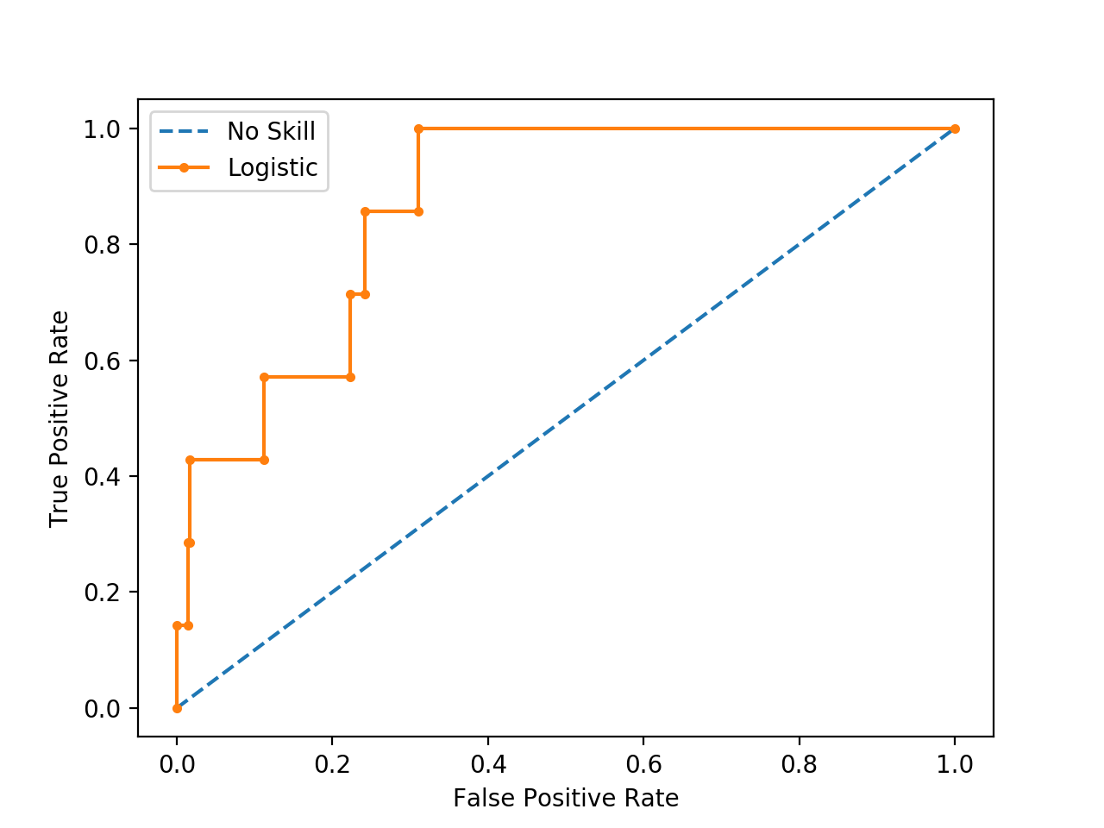
Relevant Metrics
Recall-Precision Curve: Plot of Recall (x) vs Precision (y).
ROC Curve: Plot of False Positive Rate (x) vs. True Positive Rate (y).
It makes sense to consider Recall and Precision together or combine them into a single metric.
AUC – Area Under the Curve

Slide 12
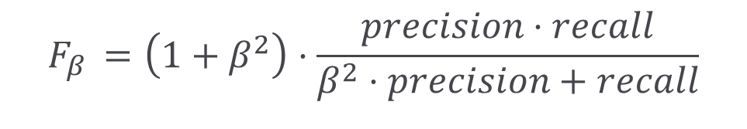
Relevant Metrics
F-Measure:
  A measure that combines precision and recall is the harmonic mean of precision and recall.
  F1 is the most commonly used metric.
$$F_{β }=\left(1+β^{2}\right)⋅\frac{precision⋅recall}{β^{2}⋅precision+recall}$$

Slide 13
Metrics
Methodologies
Statistical Significance

Slide 14
Comparing Classifiers
Say we have two classifiers, C1 and C2, and want to choose the best one to use for future predictions
Can we use training accuracy to choose between them?
No!
What about accuracy on test data?
Yes, but…
  We basically want to look at more than a single number; gather some statistical evidence.

Slide 15

$k$-fold cross validation
Instead of a single test-training split:
Split data into k equal-sized parts
Train and test k different classifiers
Report average accuracy and standard deviation of the accuracy
train
test

Slide 16
Example 3-Fold CV
Full Data Set
1st Partition
2nd Partition
k^{th} Partition
Test Data
Training
Data
Training
Data
...
Test Data
Training
Data
Training
Data
Test Data
Test
Performance
Test
Performance
Test
Performance
Summary statistics
over k test
performances

Slide 17
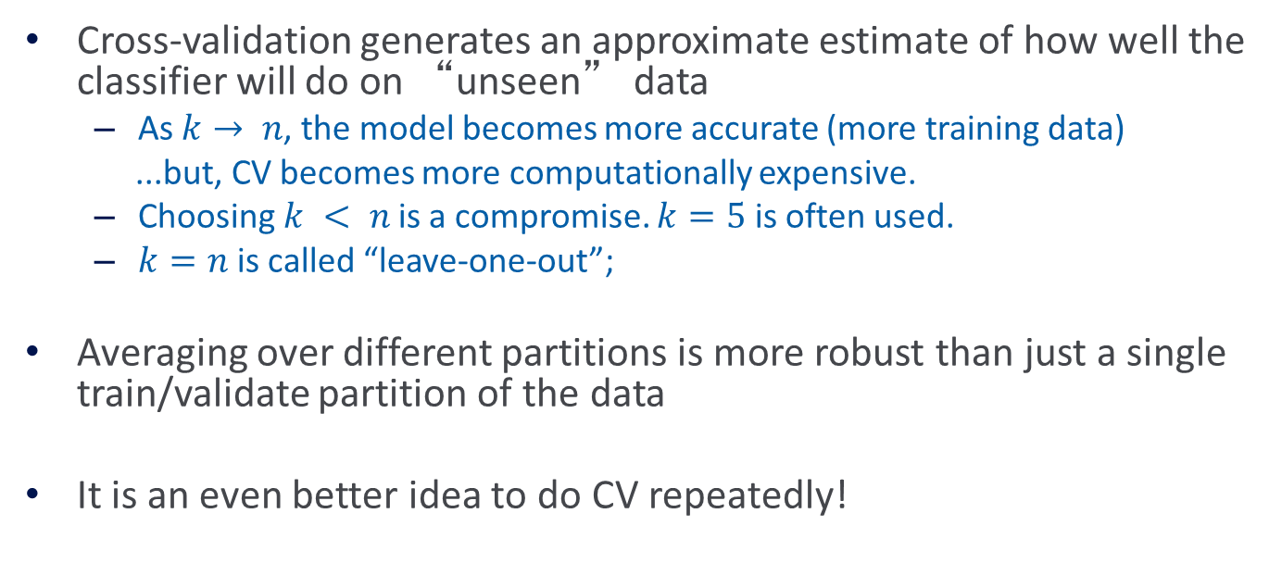
More on Cross-Validation
Cross-validation generates an approximate estimate of how well the classifier will do on “unseen” data
  As $k→ n$, the model becomes more accurate (more training data)
  ...but, CV becomes more computationally expensive.
  Choosing $k < n$is a compromise. $k=5$ is often used.
  $k=n$is called “leave-one-out”;
Averaging over different partitions is more robust than just a single train/validate partition of the data
It is an even better idea to do CV repeatedly!

Slide 18


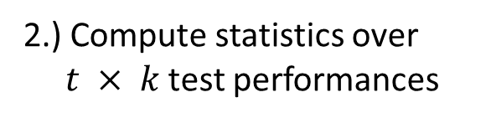
Multiple Trials of $k$-Fold CV
1.) Loop for $t$ trials:
a.) Randomize Data Set
Full Data Set
Shuffle
Full Data Set
1st Partition
2nd Partition
k^{th} Partition
Test Data
Training
Data
b.) Perform k-fold CV
...
Training
Data
Test Data
Training
Data
Training
Data
Test Data
Test
Performance
Test
Performance
Test
Performance
2.) Compute statistics over $t × k$test performances

Slide 19
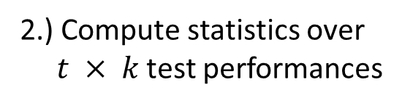
Comparing Multiple Classifiers
1.) Loop for $t$ trials:
Full Data Set
Test each candidate learner on same training/testing splits
a.) Randomize Data Set
Shuffle
Full Data Set
1st Partition
2nd Partition
k^{th} Partition
Test Data
Training
Data
b.) Perform k-fold CV
...
Training
Data
Test Data
Training
Data
Training
Data
Test Data
Test Perf. C1
Test Perf. C2
Test
C1
Test
C2
Test
C1
Test
C2
2.) Compute statistics over $t × k$test performances
Allows us to do paired summary statistics (e.g., paired t-test)

Slide 20
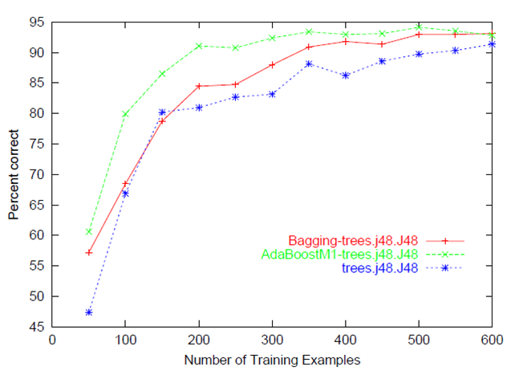
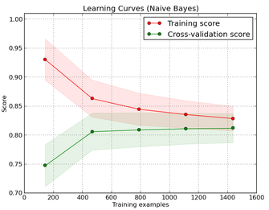
Learning Curve
Shows performance versus the # training examples
  Compute over a single training/testing split
  Then, average across multiple trials of CV

Slide 21
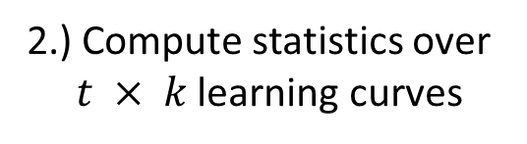
Building Learning Curves
1.) Loop for $t$ trials:
Full Data Set
Compute learning curve over each training/testing split
a.) Randomize Data Set
Shuffle
Full Data Set
1st Partition
2nd Partition
k^{th} Partition
Test Data
Training
Data
b.) Perform k-fold CV
...
Training
Data
Test Data
Training
Data
Training
Data
Test Data
Curve C1
CurveC2
Curve C1
Curve C2
Curve C1
Curve C2
2.) Compute statistics over $t × k$learning curves

Slide 22
Metrics
Methodologies
Statistical Significance

Slide 23
Evaluation: Significance Tests
You have two different classifiers, A and B
You train and test them on the same data set using N-fold cross-validation
For the n-th fold:
accuracy(A, n), accuracy(B, n)
p_{n} = accuracy(A, n) - accuracy(B, n)
Is the difference between A and B’s accuracies significant?

Slide 24
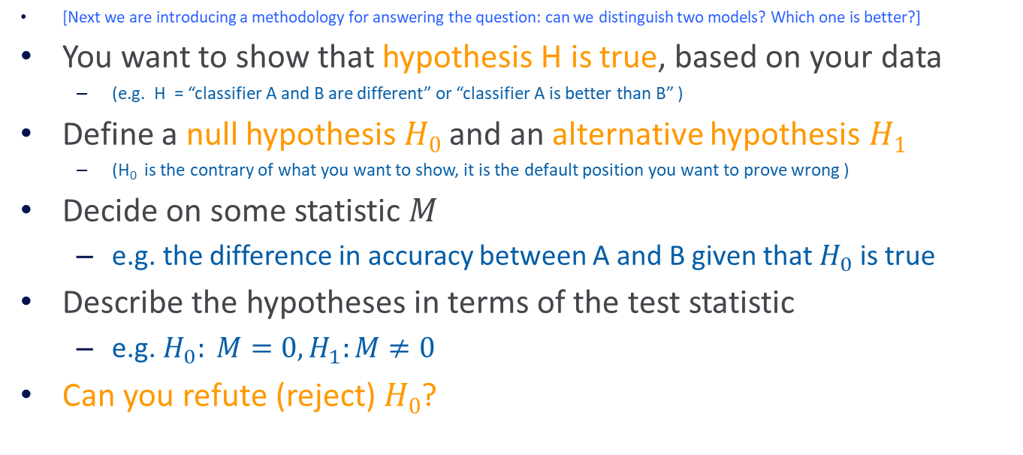
Hypothesis testing
[Next we are introducing a methodology for answering the question: can we distinguish two models? Which one is better?]
You want to show that hypothesis H is true, based on your data
  (e.g. H = “classifier A and B are different” or “classifier A is better than B” )
Define a null hypothesis $H0$ and an alternative hypothesis $H1$
  (H₀ is the contrary of what you want to show, it is the default position you want to prove wrong )
Decide on some statistic $M$
  e.g. the difference in accuracy between A and B given that $H_{0}$ is true
Describe the hypotheses in terms of the test statistic
  e.g. $H_{0}: M=0, H_{1}:M≠0$
Can you refute (reject) $H0$?

Slide 25
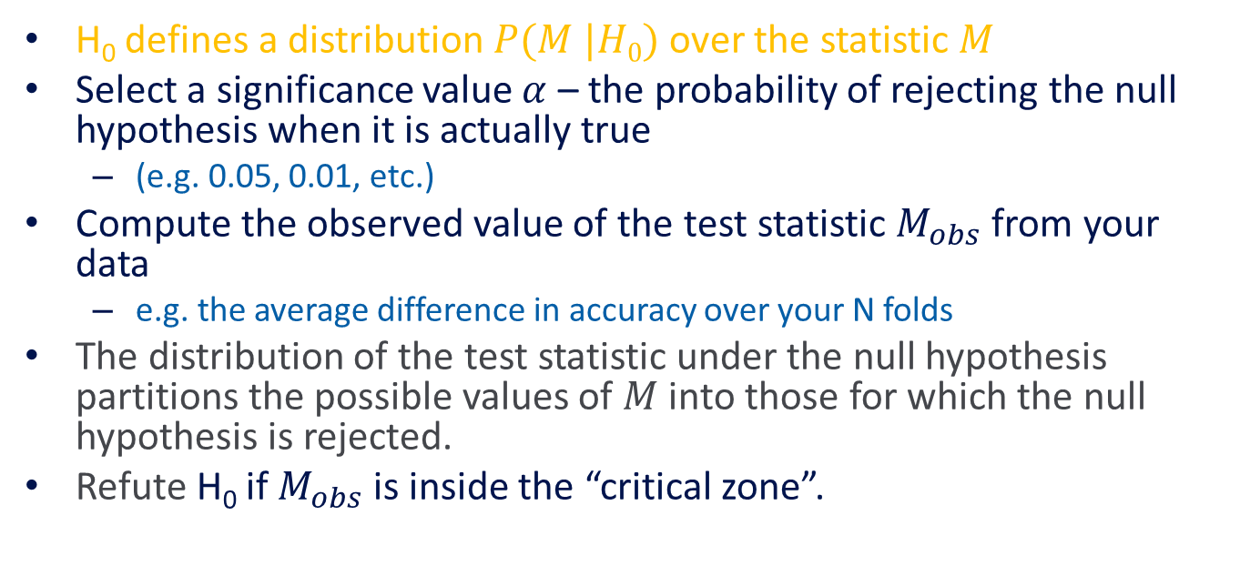

Rejecting $H0$
H₀ defines a distribution $P(M |H0)$over the statistic $M$
Select a significance value $α$ – the probability of rejecting the null hypothesis when it is actually true
  (e.g. 0.05, 0.01, etc.)
Compute the observed value of the test statistic $M_{obs}$ from your data
  e.g. the average difference in accuracy over your N folds
The distribution of the test statistic under the null hypothesis partitions the possible values of $M$ into those for which the null hypothesis is rejected.
Refute H₀ if $M_{obs}$is inside the “critical zone”.

Slide 26
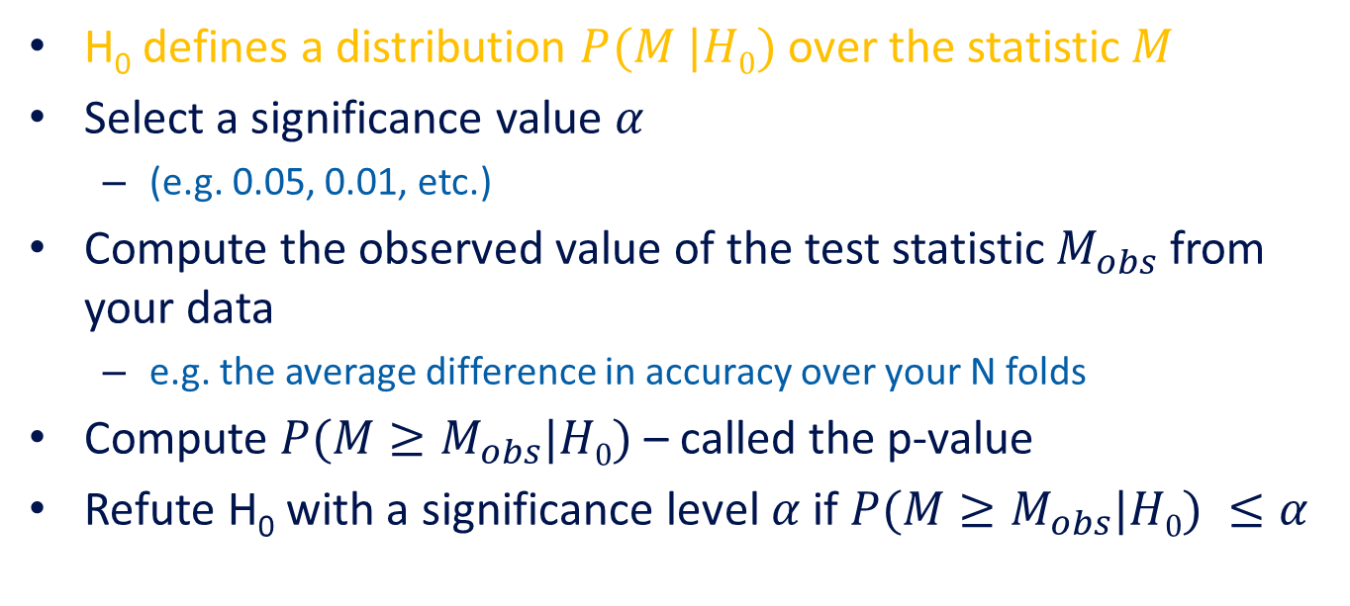

Rejecting $H0$ – Another Alternative
H₀ defines a distribution $P(M |H0)$over the statistic $M$
Select a significance value $α$
  (e.g. 0.05, 0.01, etc.)
Compute the observed value of the test statistic $M_{obs}$ from your data
  e.g. the average difference in accuracy over your N folds
Compute $P({M≥M}_{obs}|H0)$ – called the p-value
Refute H₀ with a significance level $α$if $P({M≥M}_{obs}|H0) ≤α$

Slide 27
Statistical Concepts - Example
Say we wish to know if getting up from the chair and exercise after today’s class will help us to lose weight.
The null hypothesis: exercise does not effect weight loss
The alternative hypothesis: exercise does have an effect!
We take a poll and ask people of they have lost weight after exercise
The test statistic could be – the number of people who did lose weight, or the amount of weight that they have lost.

Slide 28
Statistical Concepts - Example
The test statistic depends on how exactly we formulate the hypotheses (w.r.t. the total weight of all people or something else).
The p-value could be something like: how probable is it to see a wight loss of 10 pounds or more when remaining seated on the chair?
If this probability is very low, then we will reject the null hypothesis and conclude that after class we should exercise.

Slide 29
Metrics
Methodologies
Statistical Significance
Paired t-test
McNemar
Bootstrap

Slide 30
Metrics
Methodologies
Statistical Significance
Paired t-test
McNemar
Bootstrap

Slide 31
Paired t-test
A paired t-test is used to compare two population means where you have two samples in which observations in one sample can be paired with observations in the other sample.

Slide 32
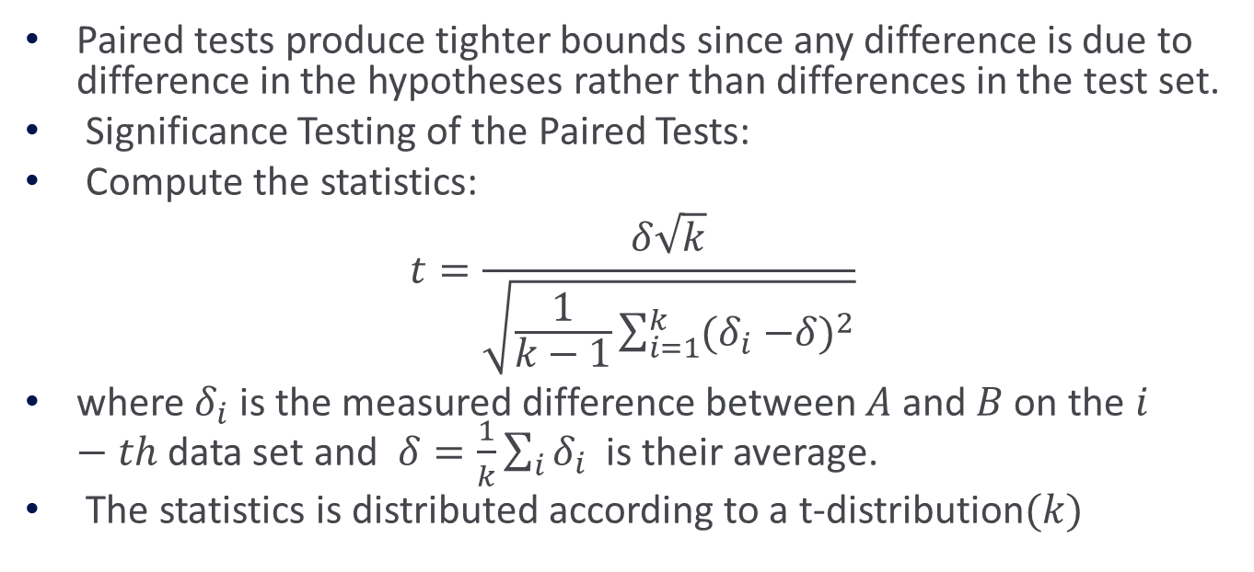
Paired t-test
Paired tests produce tighter bounds since any difference is due to difference in the hypotheses rather than differences in the test set.
Significance Testing of the Paired Tests:
Compute the statistics:
$$t=\frac{δ\sqrt{k}}{\sqrt{\frac{1}{k−1}\sum_{i=1}^{k}{{(δ}_{i} −{δ)}^{2}}}}$$
where $δ_{i}$ is the measured difference between $A$ and $B$ on the$i−th$data set and $δ=\frac{1}{k}\sum_{i}{δ_{i}}$ is their average.
The statistics is distributed according to a t-distribution$(k)$

Slide 33
Paired t-test
Null hypothesis (H₀; to be refuted):
  There is no difference between A and B, i.e. the expected accuracies of A and B are the same
That is, the expected difference (over all possible data sets) between their accuracies is 0:
  H₀: E[p_{D}] = 0
We don’t know the true E[p_{D}]
N-fold cross-validation gives us N samples of p_{D}

Slide 34
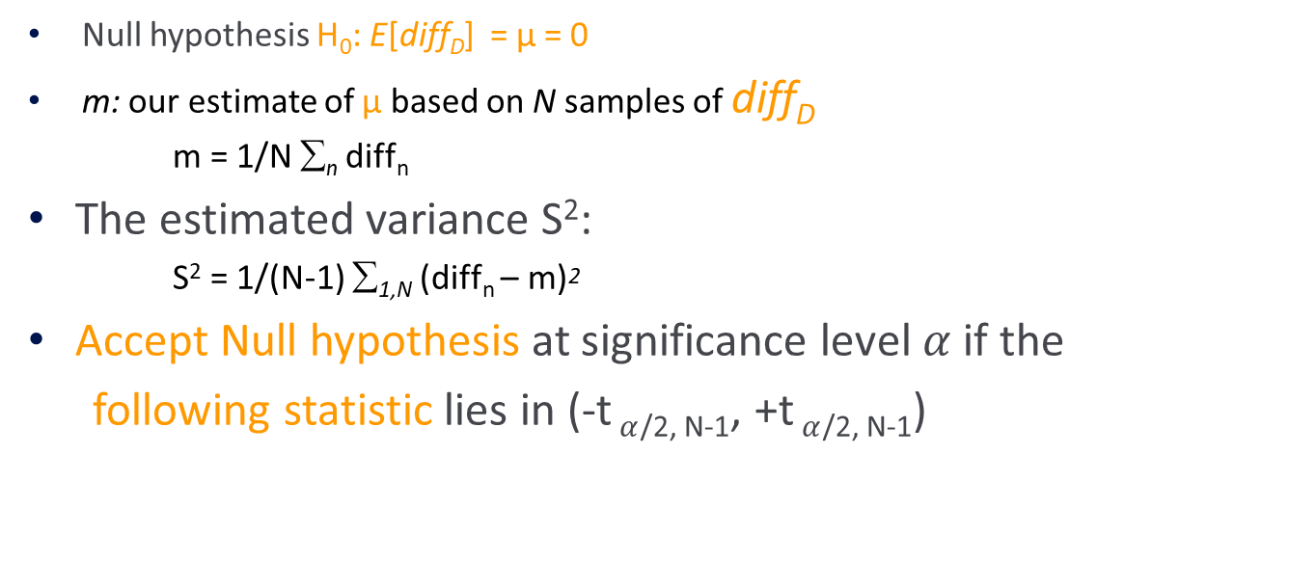
Paired t-test
Null hypothesis H₀: E[diff_{D}] = μ = 0
m: our estimate of μ based on N samples of diff_{D}
m = 1/N ∑_{n} diff_{n}
The estimated variance S²:
    S² = 1/(N-1) ∑_{1,N} (diff_{n} – m)²
Accept Null hypothesis at significance level $α$ if the
following statistic lies in (-t$α$_{/2, N-1}, +t$α$_{/2, N-1})

Slide 35
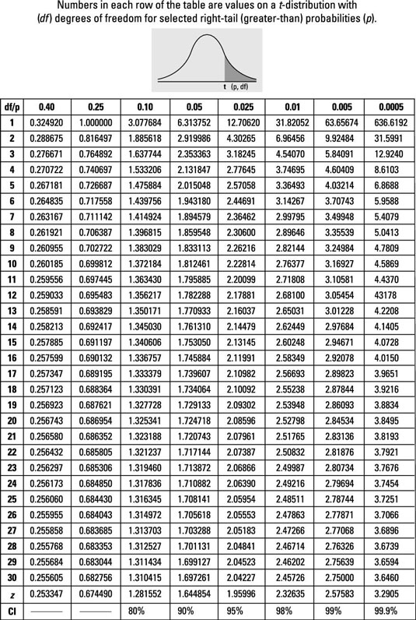
T – Distribution Table

Slide 36
Procedure for carrying out Paired t-test
Calculate the difference between the two observations on each pair.
Calculate the mean difference
Calculate the standard deviation of the differences
Calculate the error of the mean difference
Calculate the t-statistic

Slide 37

Paired t-test example
Question: The downtimes (measured in hours) for computer systems in six branches of a major bank were recorded for year $1$ and year$2$. Compute the test statistics for the paired t-test.
Solution:
Branch | Year 1 | Year 2 | Difference (Year 1 – Year 2) | Square of Difference
A | 40 | 30 | 10 | 100
B | 54 | 41 | 13 | 169
C | 32 | 24 | 8 | 64
D | 36 | 38 | -2 | 4
E | 55 | 56 | -1 | 1
F | 46 | 37 | 9 | 81
 |  |  | Sum = 37 | Sum = 419
Dragonfly Statistics

Slide 38
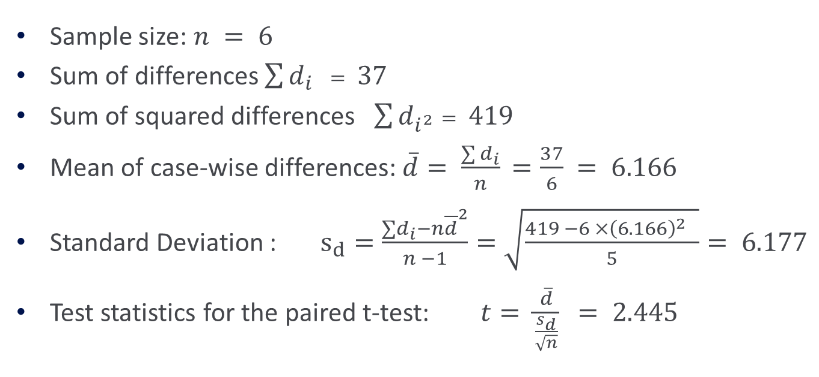
Paired t-test
Sample size: $n = 6$
Sum of differences $\sum{d_{i}} = 37$
Sum of squared differences $\sum{d_{i^{2}}}= 419$
Mean of case-wise differences: $\overline{d}= \frac{\sum{d_{i}}}{n}$ $=\frac{37}{6} = 6.166$
Standard Deviation : $s_{d}=\frac{∑d_{i}−n{\overline{d}}^{2}}{n −1}=\sqrt{\frac{419 −6 ×{\left(6.166\right)}^{2} }{5}}= 6.177$
Test statistics for the paired t-test: $t= \frac{\overline{d}}{\frac{s_{d}}{\sqrt{n}}}$ $= 2.445$

Slide 39
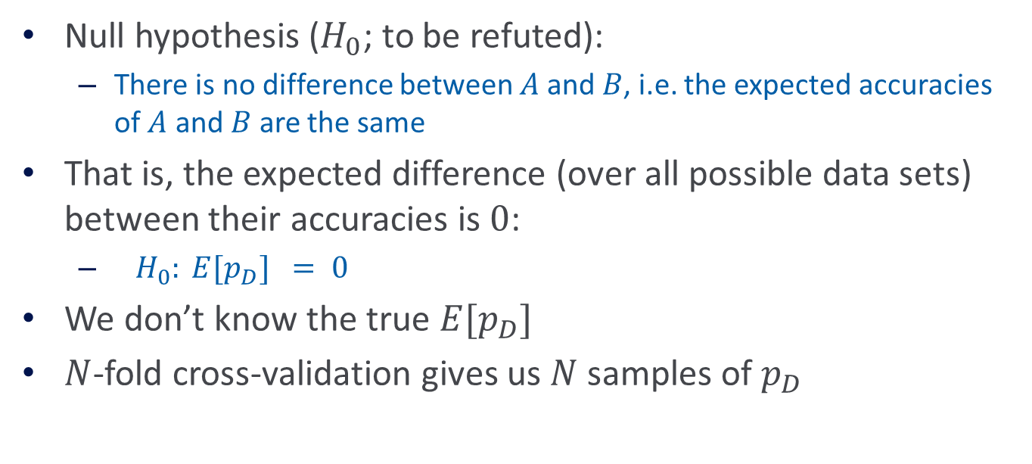
Paired t-test
Null hypothesis ($H_{0}$; to be refuted):
  There is no difference between $A$and $B$, i.e. the expected accuracies of $A$ and $B$ are the same
That is, the expected difference (over all possible data sets) between their accuracies is $0$:
  $H_{0}: E[p_{D}] = 0$
We don’t know the true $E[p_{D}]$
$N$-fold cross-validation gives us $N$ samples of $p_{D}$

Slide 40

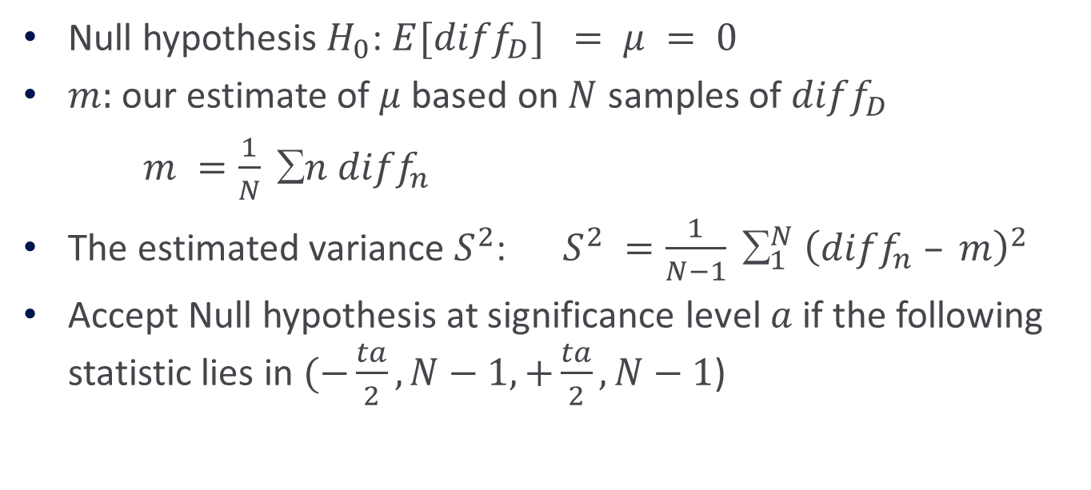
Paired t-test
Null hypothesis $H_{0}$: $E[diff_{D}] = μ = 0$
$m:$ our estimate of $μ$ based on $N$ samples of $diff_{D}$
$m =\frac{1}{N} ∑n diff_{n}$
The estimated variance $S^{2}$: $S^{2} =\frac{1}{N−1} ∑_{1}^{N} {\left(diff_{n} – m\right)}^{2}$
Accept Null hypothesis at significance level $a$ if the following statistic lies in $(−\frac{ta}{2}, N−1, +\frac{ta}{2}, N−1$)
$$\frac{\sqrt{N}m}{S}\sim t_{N−1}$$

Slide 41
Metrics
Methodologies
Statistical Significance
Paired t-test
McNemar
Bootstrap

Slide 42
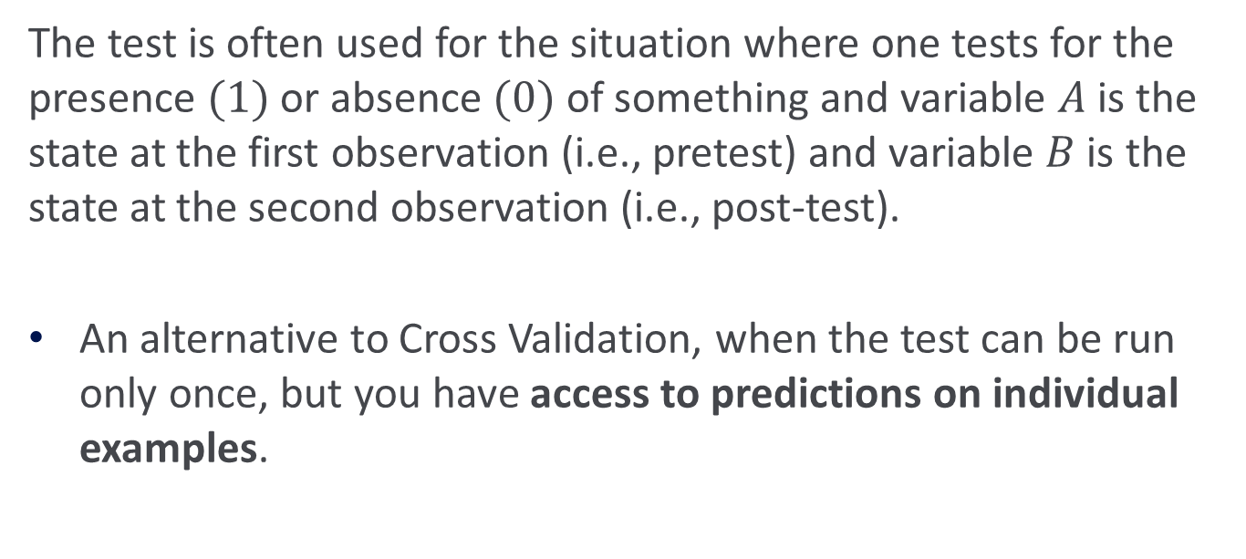
McNemar’s Test
The test is often used for the situation where one tests for the presence $(1)$or absence $(0)$ of something and variable $A$is the state at the first observation (i.e., pretest) and variable $B$is the state at the second observation (i.e., post-test).
An alternative to Cross Validation, when the test can be run only once, but you have access to predictions on individual examples.

Slide 43
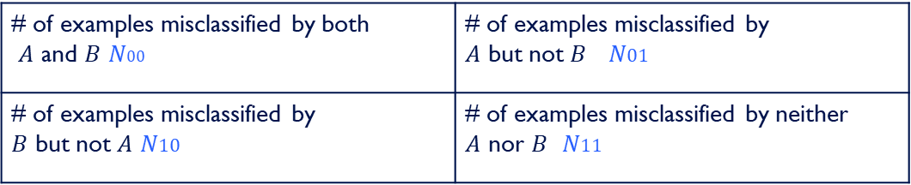
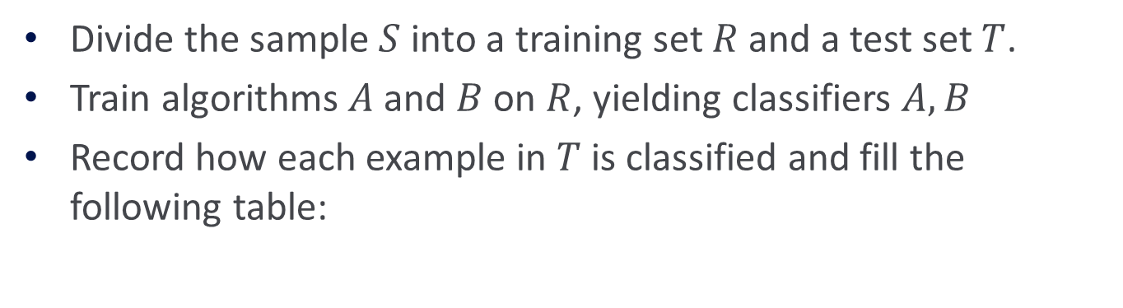

McNemar’s Test
Divide the sample $S$ into a training set $R$ and a test set $T$.
Train algorithms $A$ and $B$ on $R$, yielding classifiers $A,B$
Record how each example in $T$ is classified and fill the following table:
# of examples misclassified by both $A$ and $B$ $N00$ | # of examples misclassified by $A$ but not $B$ $N01$
# of examples misclassified by $B$ but not $A$ $N10$ | # of examples misclassified by neither $A$ nor $B$ $N11$
where $N$ is the total number of examples in the test set $T$
$$N_{00}+N_{10}+N_{01}+N_{11}=N$$

Slide 44
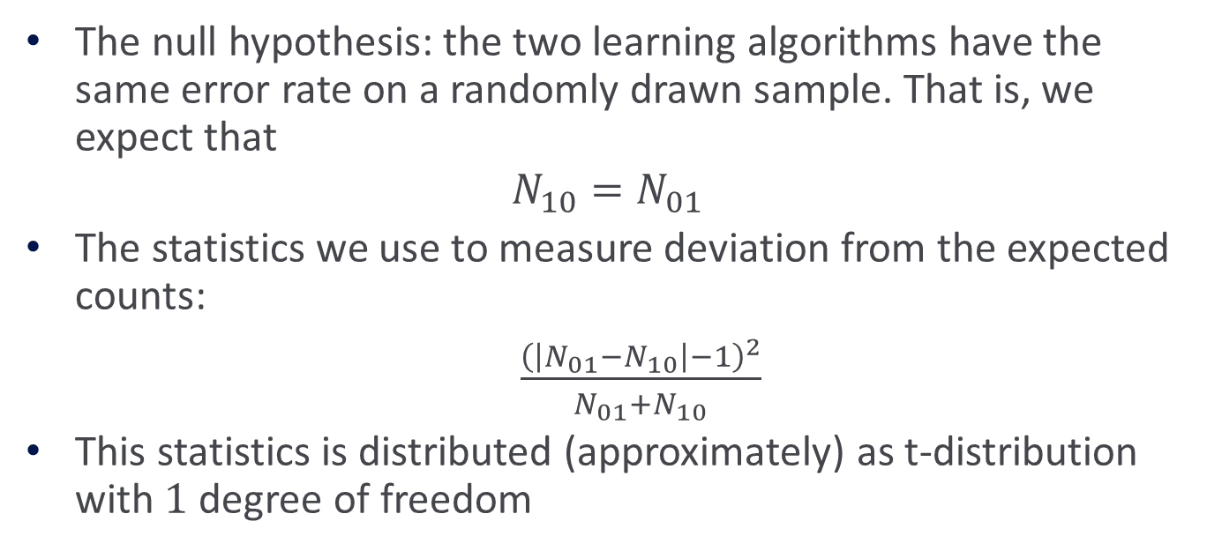
McNemar’s Test
The null hypothesis: the two learning algorithms have the same error rate on a randomly drawn sample. That is, we expect that
$$N_{10}=N_{01}$$
The statistics we use to measure deviation from the expected counts:
$\frac{{\left(\left|N_{01}−N_{10}\right|−1\right)}^{2}}{N_{01}+N_{10}}$
This statistics is distributed (approximately) as t-distribution with $1$ degree of freedom

Slide 45
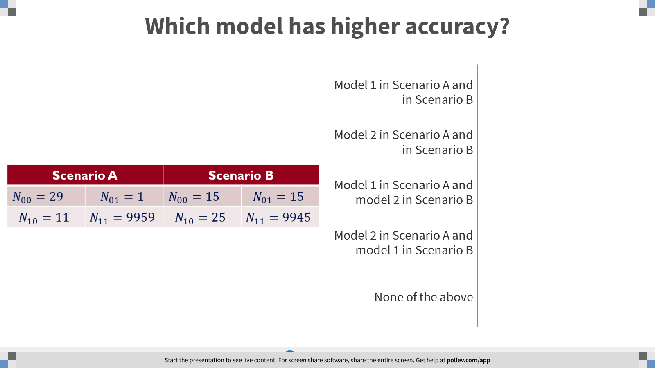
Notes:
Poll Title: Which model has higher accuracy?
https://www.polleverywhere.com/multiple_choice_polls/UDB68ekRW7bgxWG5KctCb?flow=Default&onscreen=persist

Slide 46
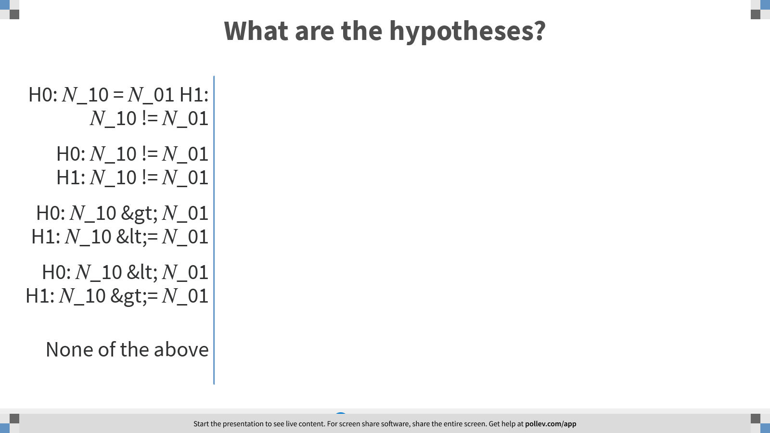
Notes:
Poll Title: What are the hypotheses?
https://www.polleverywhere.com/multiple_choice_polls/EdSQyYIkMkLqQclrKoJrL?flow=Default&onscreen=persist

Slide 47
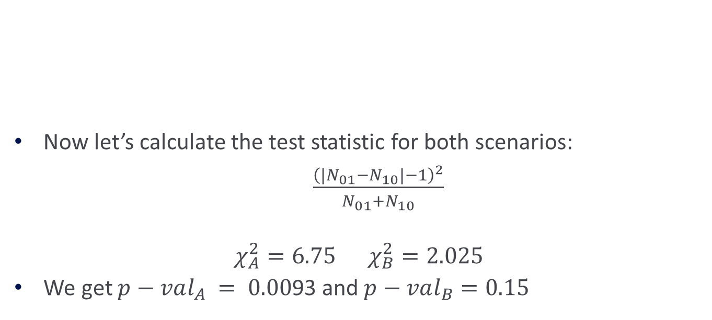
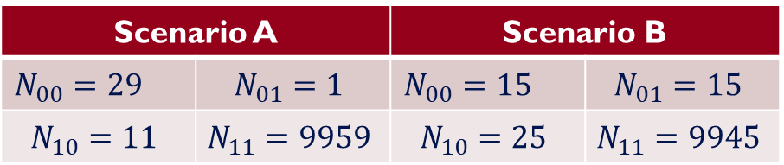
McNemar’s Test - Example
Now let’s calculate the test statistic for both scenarios:
$\frac{{\left(\left|N_{01}−N_{10}\right|−1\right)}^{2}}{N_{01}+N_{10}}$
$$χ_{A}^{2}=6.75 χ_{B}^{2}=2.025$$
We get $p−val_{A} = 0.00$93 and $p−val_{B}=0.15$
Scenario B |  | Scenario A
$$N_{01}=15$$ | $$N_{00}=15$$ | $$N_{01}=1$$ | $$N_{00}=29$$
$$N_{11}=9945$$ | $$N_{10}=25$$ | $$N_{11}=9959$$ | $$N_{10}=11$$

Slide 48
Metrics
Methodologies
Statistical Significance
Paired t-test
McNemar
Bootstrap

Slide 49
Bootstrap Hypothesis Testing
Sometimes, we are not interested in comparing the mean performance of the two classifiers.
When comparing different statistics, we cannot use the t-test because we do not know the distribution of the test statistic under the null hypothesis.
In this case we can use statistical tests that are called non-parametric tests. One of them is Bootstrap.

Slide 50
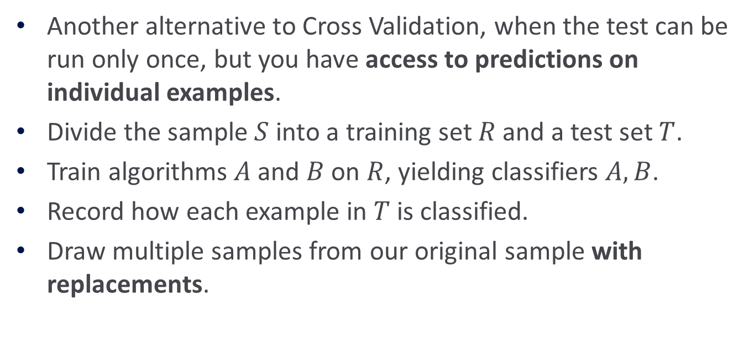
Bootstrap Hypothesis Testing
Another alternative to Cross Validation, when the test can be run only once, but you have access to predictions on individual examples.
Divide the sample $S$ into a training set $R$ and a test set $T$.
Train algorithms $A$ and $B$ on $R$, yielding classifiers $A,B$.
Record how each example in $T$ is classified.
Draw multiple samples from our original sample with replacements.

Slide 51
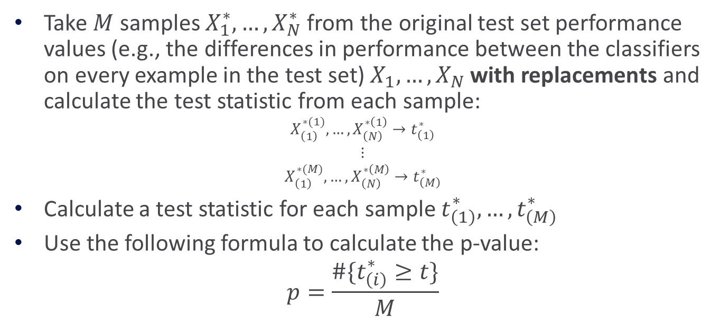
Bootstrap Hypothesis Testing
Take $M$ samples $X_{1}^{∗},…,X_{N}^{∗}$ from the original test set performance values (e.g., the differences in performance between the classifiers on every example in the test set) $X_{1},…,X_{N}$ with replacements and calculate the test statistic from each sample:
$$X_{\left(1\right)}^{∗(1)},…,X_{\left(N\right)}^{∗\left(1\right)}→t_{\left(1\right)}^{∗}$$
$$⋮$$
$$X_{\left(1\right)}^{∗(M)},…,X_{\left(N\right)}^{∗\left(M\right)}→t_{\left(M\right)}^{∗}$$
Calculate a test statistic for each sample $t_{\left(1\right)}^{∗},…,t_{\left(M\right)}^{∗}$
Use the following formula to calculate the p-value:
$$p=\frac{\#\{t_{\left(i\right)}^{∗}≥t\}}{M}$$

