Slide 1
Why Machine Learning Works: Explaining Generalization
Dan Roth
danroth@seas.upenn.edu|http://www.cis.upenn.edu/~danroth/|461C, 3401 Walnut
Slides were created by Dan Roth (for CIS519/419 at Penn or CS446 at UIUC), or by other authors who have made their ML slides available.

Slide 2
Administration (10/26/20)
Are we recording? YES!
Available on the web site
Remember that all the lectures are available on the website before the class
  Go over it and be prepared
  A new set of written notes will accompany most lectures, with some more details, examples and, (when relevant) some code.
HW 2: Due date extended to 10/22; late submissions are due today.
Quizzes: Quiz 6 Statistics
Mid-term is on 10/28; at the class time.

Slide 3
Midterm on 10/28/20
Mid-term will be a Quiz style.
  It will be done on Canvas.
  We will open at 10:30am Eastern time, and close it at 11:30am
    Except for people that have been approved for extended time
      And have heard from me (some time today)
    You need to be on zoom. If at all possible, open your video.
  No one came forward with a time zone problem.
Short questions
  Multiple choice; a few will require filling in answers
  There will be quite a few questions
  Open books (but you may not have time to consult it too much)
  We try to make it about understanding rather than memorization
Questions? Please ask/comment during class; give us feedback

Slide 4
Projects
CIS 519 students need to do a team project
  Teams will be of size 2-4
  We will help grouping if needed
There will only be ~3 types of projects.
  We will provide initial ideas and ask that you write a short proposal/plan for what you want to do.
If you have an idea for a project that you would like to be one of these projects –
  please send me a short write-up (< 1 page) with a description, motivation, relevant data available, and any other relevant information.
  No later than Friday this week: 10/30/20
Details will be available on the website
  Start teaming up
The project will require developing a machine learning system and running experiments with it
  You will be given some data
  Beyond running several algorithms on the data, the key part will require asking a question or proposing a hypothesis and investigating it.
    Say that the data comes from multiple domains – it is enough to train on one of the domains?
  The work has to include some reading of the literature .
  Originality is not mandatory but is encouraged.
Try to make it interesting!

Slide 5
Where are we?
Algorithmically:
  Perceptron + Variations
  (Stochastic) Gradient Descent
Models:
  Online Learning; Mistake Driven Learning
What do we know about Generalization? (to previously unseen examples?)
  How will your algorithm do on the next example?
Next we develop a theory of Generalization.
  We will come back to the same (or very similar) algorithms and show how the new theory sheds light on appropriate modifications of them, and provides guarantees.

Slide 6
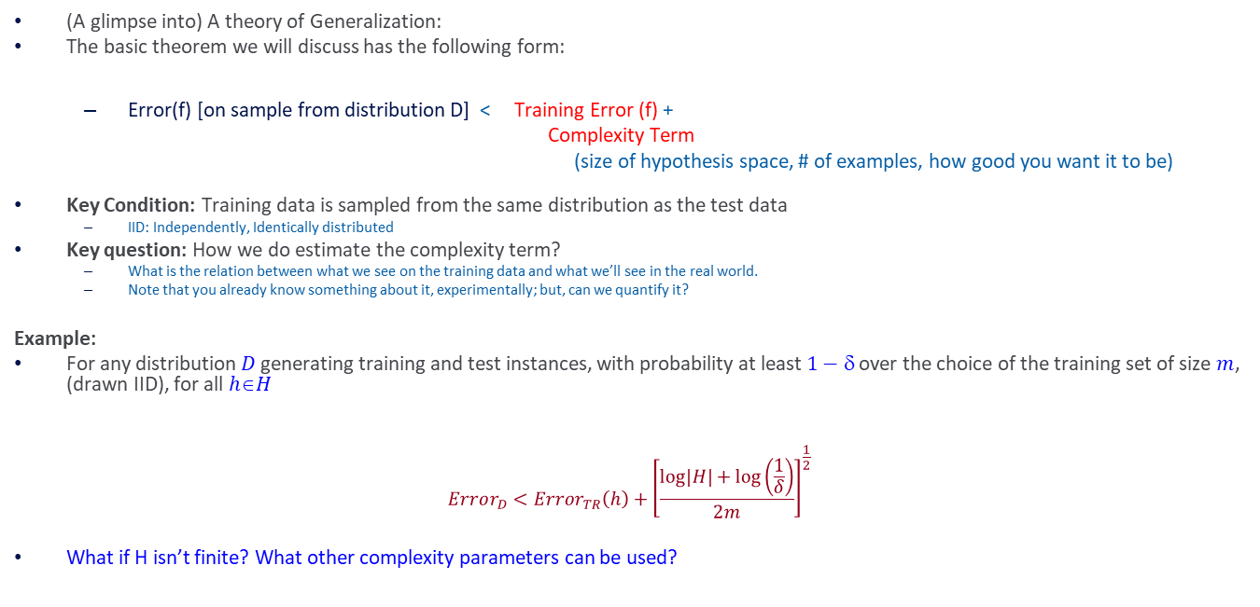
Why Learning Works?
(A glimpse into) A theory of Generalization:
The basic theorem we will discuss has the following form:
  Error(f) [on sample from distribution D] < Training Error (f) +
  Complexity Term
  (size of hypothesis space, # of examples, how good you want it to be)
Key Condition: Training data is sampled from the same distribution as the test data
  IID: Independently, Identically distributed
Key question: How we do estimate the complexity term?
  What is the relation between what we see on the training data and what we’ll see in the real world.
  Note that you already know something about it, experimentally; but, can we quantify it?
Example:
For any distribution$D$generating training and test instances, with probability at least $1−$ over the choice of the training set of size $m$, (drawn IID), for all $hH$
$$Error_{D}<Error_{TR}\left(h\right)+{\left[\frac{\log\left|H\right|+\log\left(\frac{1}{δ}\right)}{2m}\right]}^{\frac{1}{2}}$$
What if H isn’t finite? What other complexity parameters can be used?
Error on the training data
Generalization: a function of the Hypothesis class size

Slide 7
Computational Learning Theory
What general laws constrain inductive learning ?
  What learning problems can be solved ?
  When can we trust the output of a learning algorithm ?
We seek theory to relate
  Probability of successful Learning
  Number of training examples
  Complexity of hypothesis space
  Accuracy to which target concept is approximated
  Manner in which training examples are presented

Slide 8
Quantifying Performance
Recall what we did earlier:
We want to be able to say something rigorous about the performance of our learning algorithm.
We will concentrate on discussing the number of examples one needs to see before we can say that our learned hypothesis is good.

Slide 9
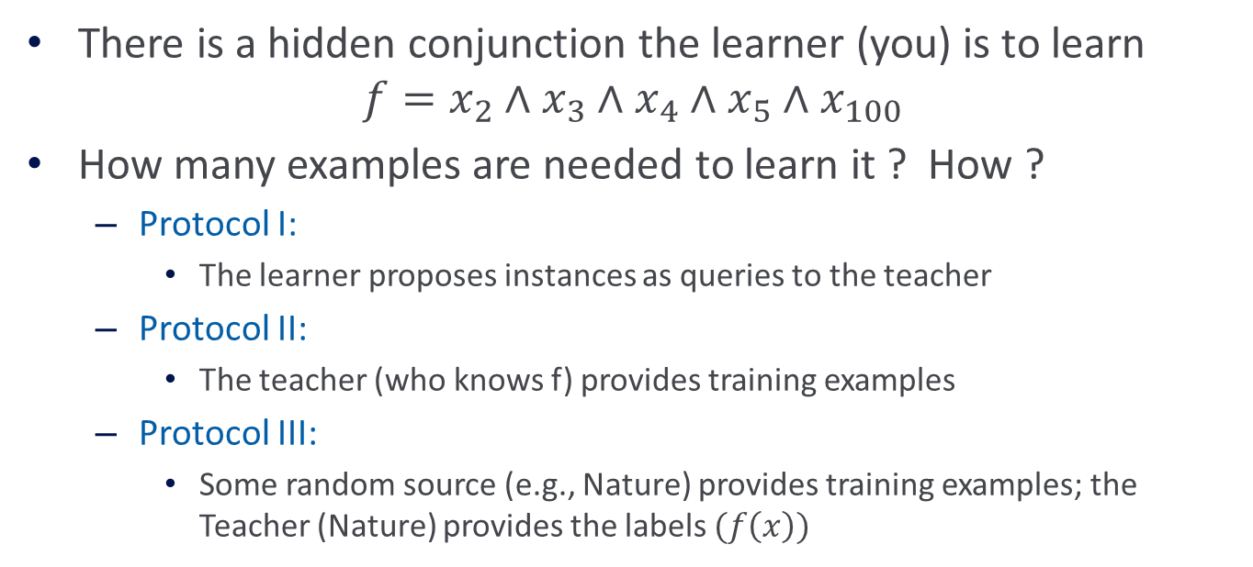
Quantifying Performance via Learning Conjunctions
Recall what we did earlier:
There is a hidden conjunction the learner (you) is to learn
$$f=x_{2}∧x_{3}∧x_{4}∧x_{5}∧x_{100}$$
How many examples are needed to learn it ? How ?
  Protocol I:
    The learner proposes instances as queries to the teacher
  Protocol II:
    The teacher (who knows f) provides training examples
  Protocol III:
    Some random source (e.g., Nature) provides training examples; the Teacher (Nature) provides the labels $(f\left(x\right))$

Slide 10
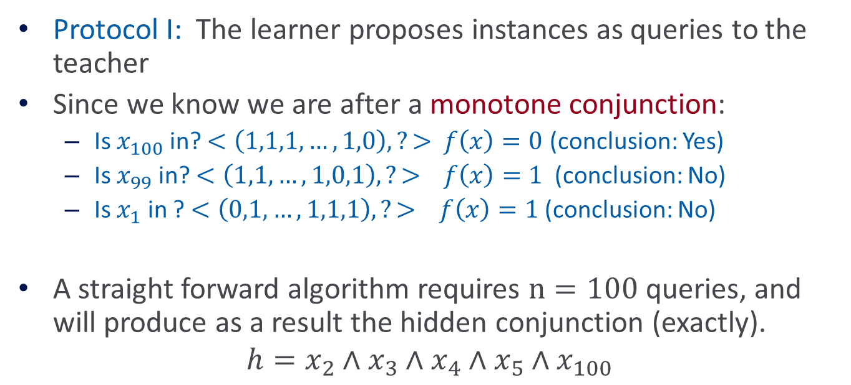
Learning Conjunctions
Protocol I: The learner proposes instances as queries to the teacher
Since we know we are after a monotone conjunction:
  Is $x_{100}$in? $<\left(1,1,1,…,1,0\right),?>$ $f\left(x\right)=0$ (conclusion: Yes)
  Is $x_{99}$ in? $<\left(1,1,…,1,0,1\right),?>$ $f\left(x\right)=1$ (conclusion: No)
  Is $x_{1}$ in ? $<\left(0,1,…,1,1,1\right),?>$ $f\left(x\right)=1$ (conclusion: No)
A straight forward algorithm requires $n=100$ queries, and will produce as a result the hidden conjunction (exactly).
$$h=x_{2}∧x_{3}∧x_{4}∧x_{5}∧x_{100}$$
What happens here if the conjunction
is not known to be monotone?
If we know of a positive example,
the same algorithm works.

Slide 11
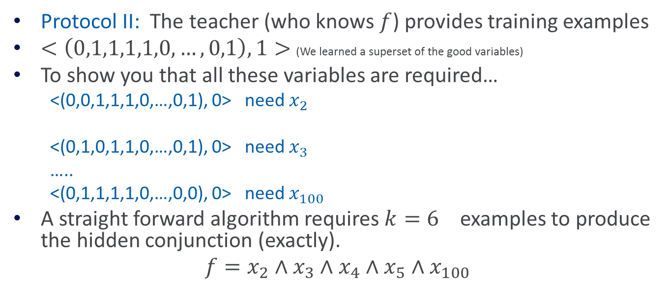
Learning Conjunctions
Protocol II: The teacher (who knows $f$) provides training examples
$<\left(0,1,1,1,1,0,…,0,1\right),1>$ (We learned a superset of the good variables)
To show you that all these variables are required…
  <(0,0,1,1,1,0,…,0,1), 0> need $x_{2}$
  <(0,1,0,1,1,0,…,0,1), 0> need $x_{3}$
  …..
  <(0,1,1,1,1,0,…,0,0), 0> need $x_{100}$
A straight forward algorithm requires ${k=6}_{}$examples to produce the hidden conjunction (exactly).
$$f=x_{2}∧x_{3}∧x_{4}∧x_{5}∧x_{100}$$
Modeling Teaching is tricky

Slide 12

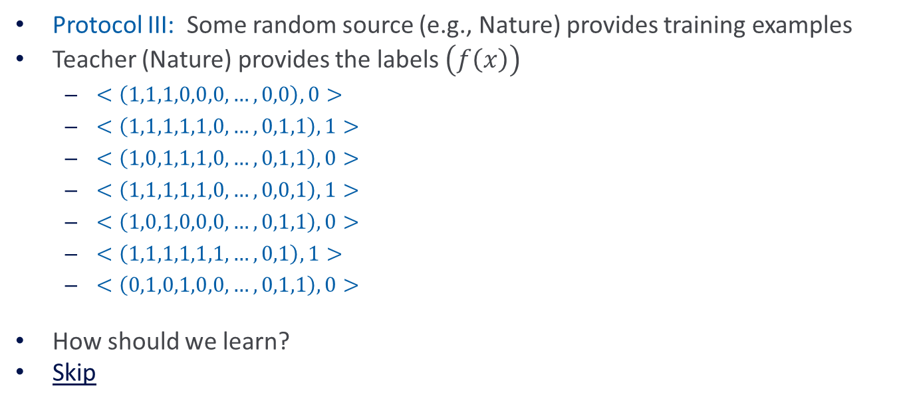
Learning Conjunctions (III)
$$f=x_{2}∧x_{3}∧x_{4}∧x_{5}∧x_{100}$$
Protocol III: Some random source (e.g., Nature) provides training examples
Teacher (Nature) provides the labels $\left(f\left(x\right)\right)$
  $<\left(1,1,1,0,0,0,…,0,0\right),0>$
  $<\left(1,1,1,1,1,0,…,0,1,1\right),1>$
  $<\left(1,0,1,1,1,0,…,0,1,1\right),0>$
  $<\left(1,1,1,1,1,0,…,0,0,1\right),1>$
  $<\left(1,0,1,0,0,0,…,0,1,1\right),0>$
  $<\left(1,1,1,1,1,1,…,0,1\right),1>$
  $<\left(0,1,0,1,0,0,…,0,1,1\right),0>$
How should we learn?
Skip

Slide 13
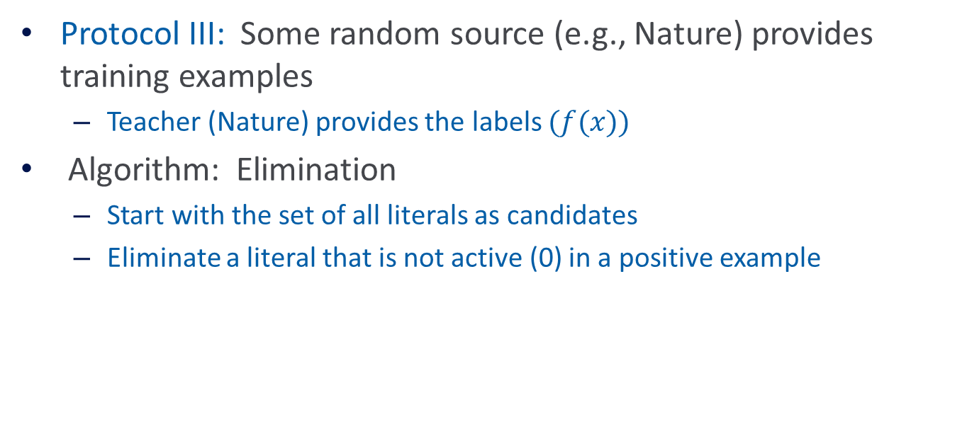

Learning Conjunctions (III)
$$f=x_{2}∧x_{3}∧x_{4}∧x_{5}∧x_{100}$$
Protocol III: Some random source (e.g., Nature) provides training examples
  Teacher (Nature) provides the labels $(f(x))$
Algorithm: Elimination
  Start with the set of all literals as candidates
  Eliminate a literal that is not active (0) in a positive example

Slide 14
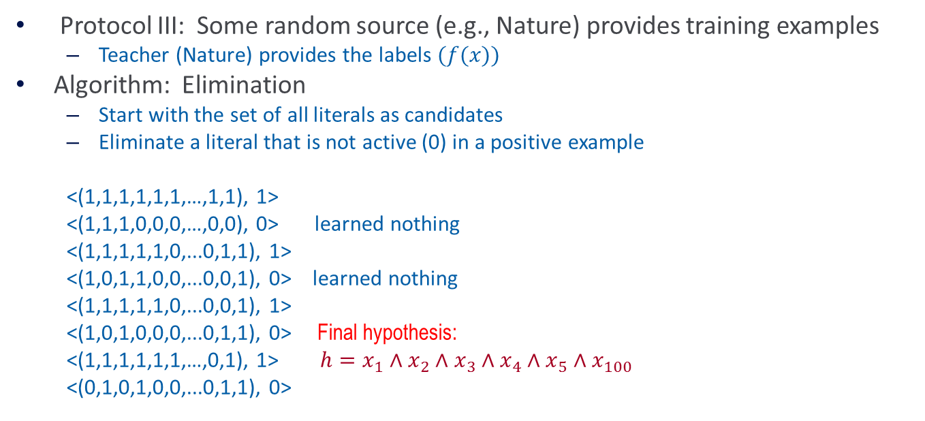

Learning Conjunctions(III)
$$f=x_{2}∧x_{3}∧x_{4}∧x_{5}∧x_{100}$$
Protocol III: Some random source (e.g., Nature) provides training examples
  Teacher (Nature) provides the labels $(f(x))$
Algorithm: Elimination
  Start with the set of all literals as candidates
  Eliminate a literal that is not active (0) in a positive example
  <(1,1,1,1,1,1,…,1,1), 1>
  <(1,1,1,0,0,0,…,0,0), 0> learned nothing
  <(1,1,1,1,1,0,...0,1,1), 1>
  <(1,0,1,1,0,0,...0,0,1), 0> learned nothing
  <(1,1,1,1,1,0,...0,0,1), 1>
  <(1,0,1,0,0,0,...0,1,1), 0> Final hypothesis:
  <(1,1,1,1,1,1,…,0,1), 1> $h=x_{1}∧x_{2}∧x_{3}∧x_{4}∧x_{5}∧x_{100}$
  <(0,1,0,1,0,0,...0,1,1), 0>
Is it good?
Performance ?
# of examples ?

Slide 15
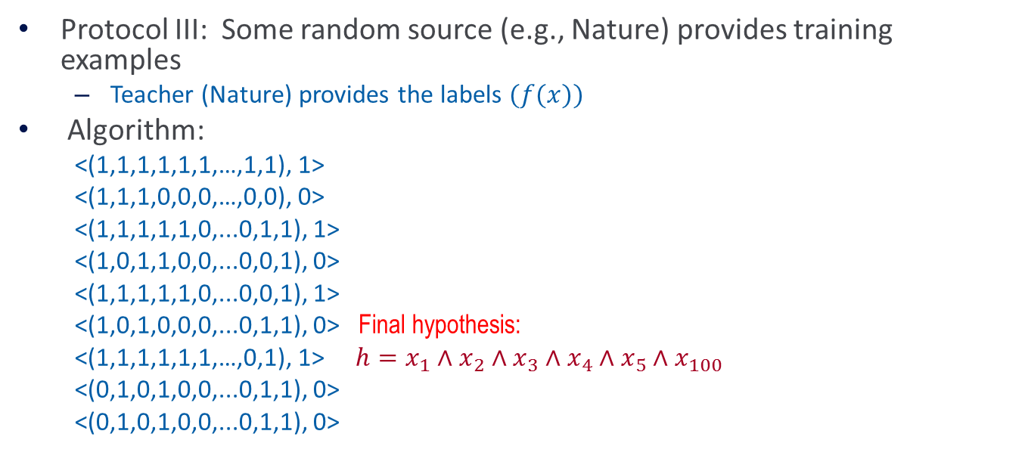

Learning Conjunctions (III)
$$f=x_{2}∧x_{3}∧x_{4}∧x_{5}∧x_{100}$$
Protocol III: Some random source (e.g., Nature) provides training examples
  Teacher (Nature) provides the labels $(f(x))$
Algorithm:
  <(1,1,1,1,1,1,…,1,1), 1>
  <(1,1,1,0,0,0,…,0,0), 0>
  <(1,1,1,1,1,0,...0,1,1), 1>
  <(1,0,1,1,0,0,...0,0,1), 0>
  <(1,1,1,1,1,0,...0,0,1), 1>
  <(1,0,1,0,0,0,...0,1,1), 0> Final hypothesis:
  <(1,1,1,1,1,1,…,0,1), 1> $h=x_{1}∧x_{2}∧x_{3}∧x_{4}∧x_{5}∧x_{100}$
  <(0,1,0,1,0,0,...0,1,1), 0>
  <(0,1,0,1,0,0,...0,1,1), 0>
Is it good
Performance ?
# of examples ?
With the given data, we only learned an “approximation” to the true concept
We don’t know how many examples we need to see to learn exactly. (do we care?)
But we know that we can make a limited # of mistakes.

Slide 16
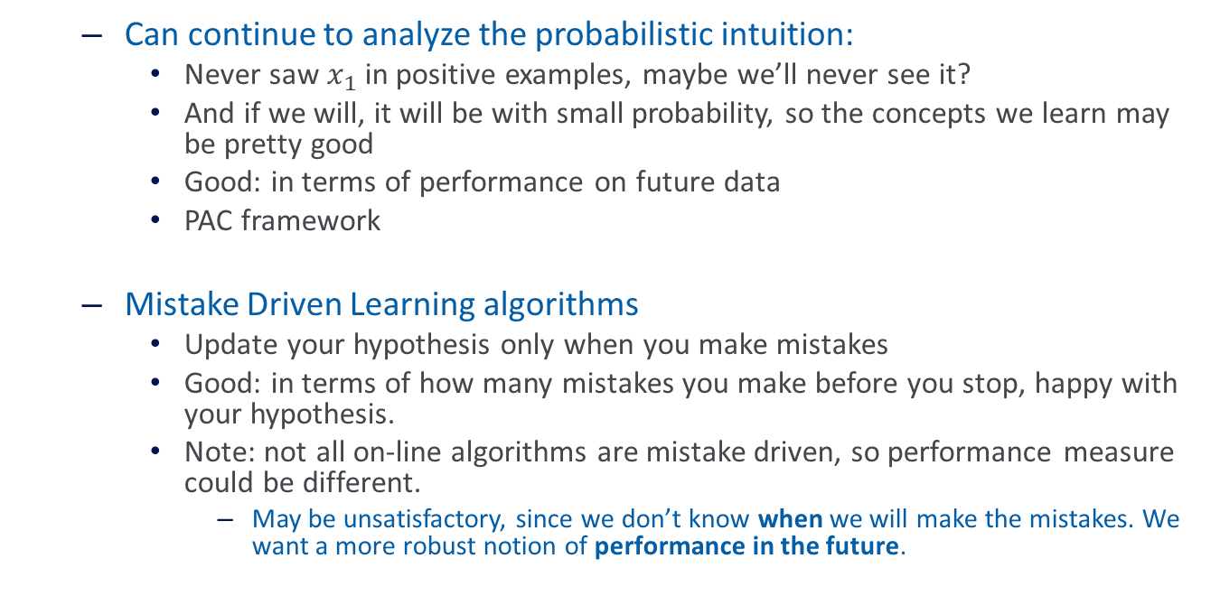
Two Directions
  Can continue to analyze the probabilistic intuition:
    Never saw $x_{1}$in positive examples, maybe we’ll never see it?
    And if we will, it will be with small probability, so the concepts we learn may be pretty good
    Good: in terms of performance on future data
    PAC framework
  Mistake Driven Learning algorithms
    Update your hypothesis only when you make mistakes
    Good: in terms of how many mistakes you make before you stop, happy with your hypothesis.
    Note: not all on-line algorithms are mistake driven, so performance measure could be different.
      May be unsatisfactory, since we don’t know when we will make the mistakes. We want a more robust notion of performance in the future.

Slide 17
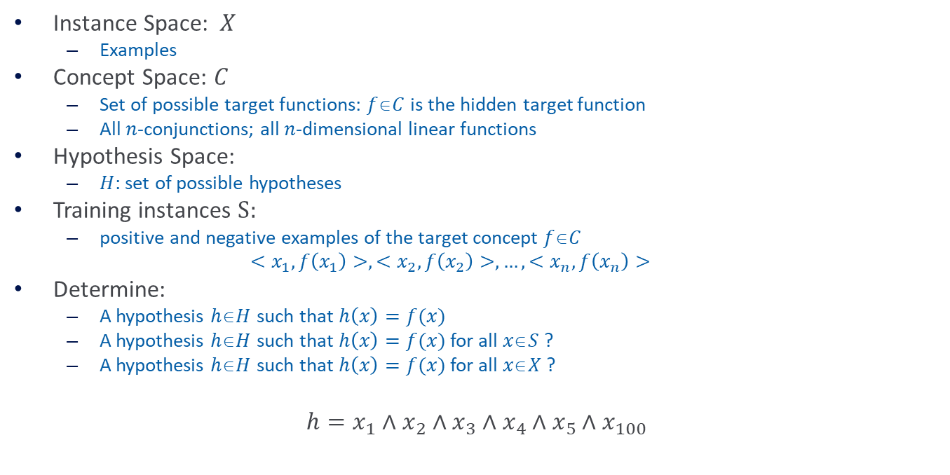
Prototypical Concept Learning
Instance Space: $X$
  Examples
Concept Space: $C$
  Set of possible target functions: $fC$is the hidden target function
  All $n$-conjunctions; all $n$-dimensional linear functions
Hypothesis Space:
  $H$: set of possible hypotheses
Training instances ${S:}_{}$
  positive and negative examples of the target concept $fC$
  $$<x_{1},f\left(x_{1}\right)>,<x_{2}, f\left(x_{2}\right)>,…,<x_{n}, f\left(x_{n}\right)>$$
Determine:
  A hypothesis $hH$such that $h\left(x\right)=f(x)$
  A hypothesis $hH$such that $h\left(x\right)=f(x)$ for all $xS$?
  A hypothesis $hH$such that $h\left(x\right)=f(x)$ for all $xX$?
$$h=x_{1}∧x_{2}∧x_{3}∧x_{4}∧x_{5}∧x_{100}$$

Slide 18
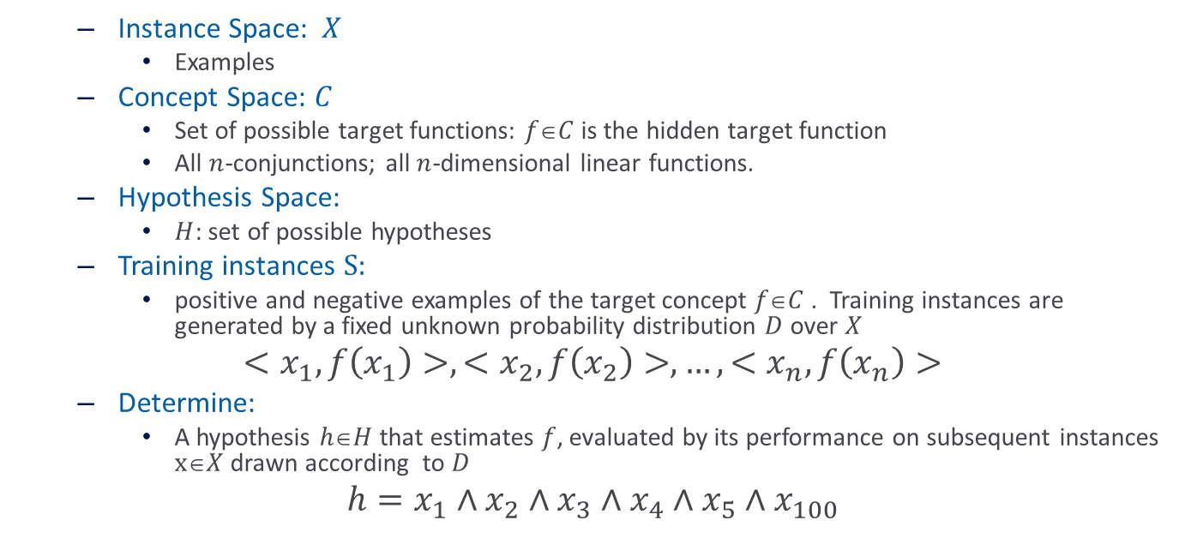
Prototypical Concept Learning
  Instance Space: $X$
    Examples
  Concept Space: $C$
    Set of possible target functions: $fC$is the hidden target function
    All $n$-conjunctions; all $n$-dimensional linear functions.
  Hypothesis Space:
    $H$: set of possible hypotheses
  Training instances ${S: }_{}$
    positive and negative examples of the target concept $fC$. Training instances are generated by a fixed unknown probability distribution $D$ over $X$
$$<x_{1},f\left(x_{1}\right)>,<x_{2}, f\left(x_{2}\right)>,…,<x_{n}, f\left(x_{n}\right)>$$
  Determine:
    A hypothesis $hH$that estimates $f$, evaluated by its performance on subsequent instances $xX$drawn according to $D$
$$h=x_{1}∧x_{2}∧x_{3}∧x_{4}∧x_{5}∧x_{100}$$

Slide 19
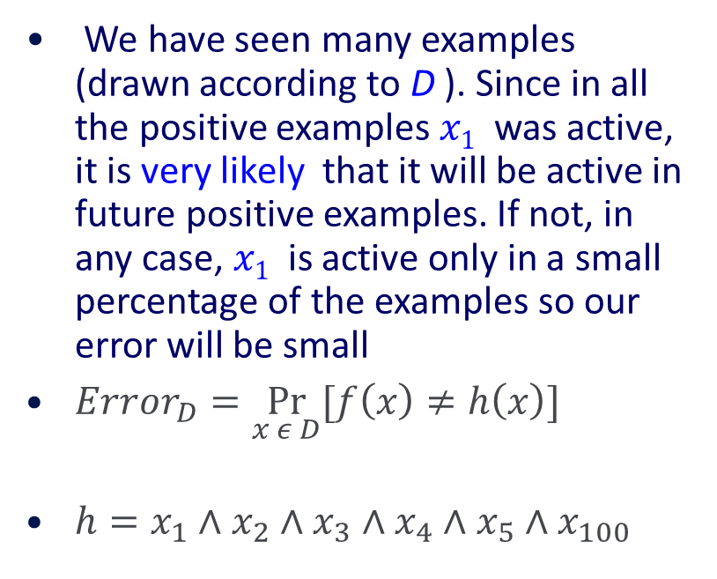
PAC Learning – Intuition
We have seen many examples (drawn according to D ). Since in all the positive examples $x1$ was active, it is very likely that it will be active in future positive examples. If not, in any case, $x1$ is active only in a small percentage of the examples so our error will be small
$Error_{D}=\underset{x ε D}{Pr}[f\left(x\right)≠h\left(x\right)]{}$
$h=x_{1}∧x_{2}∧x_{3}∧x_{4}∧x_{5}∧x_{100}$
-
f
+
h
+
-
-
f and h disagree

Slide 20
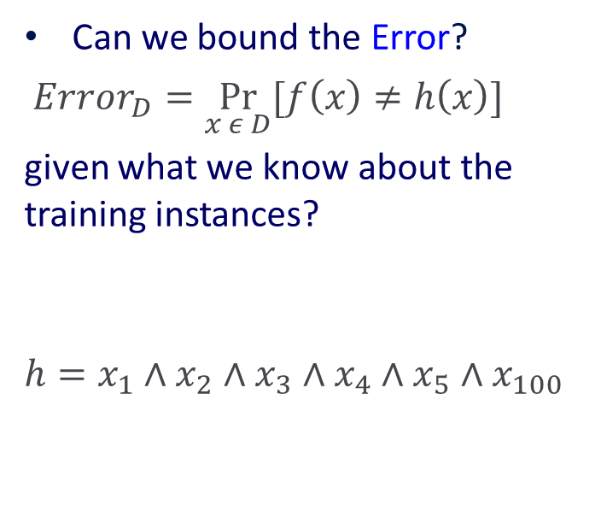
The notion of error
Can we bound the Error?
$Error_{D}=\underset{x ε D}{Pr}[f\left(x\right)≠h\left(x\right)]{}$
given what we know about the training instances?
$$h=x_{1}∧x_{2}∧x_{3}∧x_{4}∧x_{5}∧x_{100}$$
-
f
+
h
+
-
-
f and h disagree
Is this the right picture? Why? Why not?

Slide 21
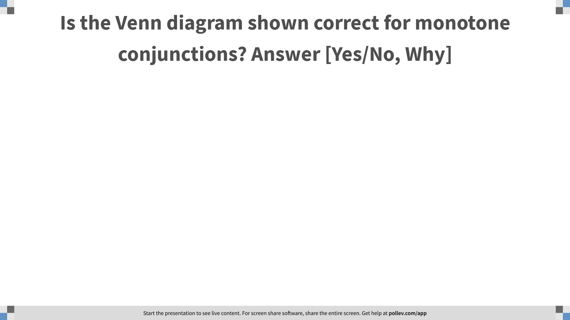
Notes:
Poll Title: Is the Venn diagram shown correct for monotone conjunctions? Answer [Yes/No, Why]
https://www.polleverywhere.com/free_text_polls/pxfJNw7V066uZsNjhc8De

Slide 22
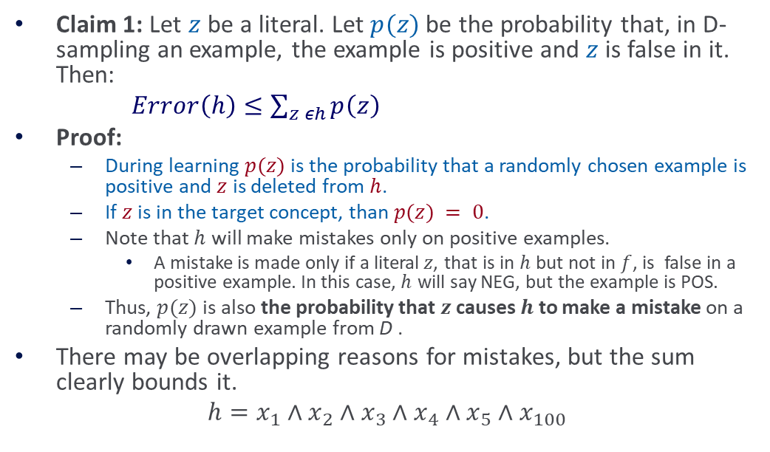
Learning Conjunctions– Analysis (1)
Claim 1: Let $z$ be a literal. Let $p(z)$be the probability that, in D-sampling an example, the example is positive and $z$ is false in it. Then:
$Error\left(h\right)≤\sum_{z εh}{p\left(z\right)}$
Proof:
  During learning $p(z)$ is the probability that a randomly chosen example is positive and $z$ is deleted from $h$.
  If $z$ is in the target concept, than $p(z) = 0$.
  Note that $h$ will make mistakes only on positive examples.
    A mistake is made only if a literal$z$, that is in $h$ but not in $f$, is false in a positive example. In this case, $h$ will say NEG, but the example is POS.
  Thus, $p(z)$is also the probability that $z$ causes $h$ to make a mistake on a randomly drawn example from D .
There may be overlapping reasons for mistakes, but the sum clearly bounds it.
$$h=x_{1}∧x_{2}∧x_{3}∧x_{4}∧x_{5}∧x_{100}$$
-
f
+
h
+
-
-

Slide 23
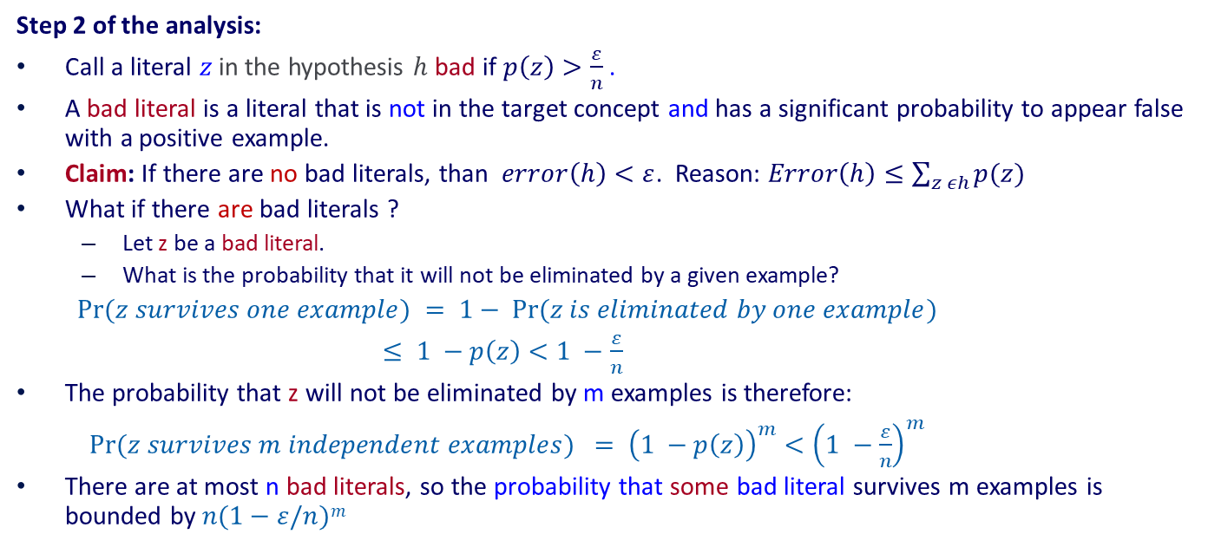
Learning Conjunctions– Analysis (2)
Step 2 of the analysis:
Call a literal $z$in the hypothesis $h$ bad if $p\left(z\right)>\frac{ε}{n}$ .
A bad literal is a literal that is not in the target concept and has a significant probability to appear false with a positive example.
Claim: If there are no bad literals, than $error\left(h\right)<ε$. Reason: $Error\left(h\right)≤\sum_{z εh}{p(z)}$
What if there are bad literals ?
  Let z be a bad literal.
  What is the probability that it will not be eliminated by a given example?
$Pr⁡(z survives one example) = 1− Pr⁡(z is eliminated by one example)$
$≤ 1 −p\left(z\right)<1 −\frac{ε}{n}$
The probability that z will not be eliminated by m examples is therefore:
$Pr⁡(z survives m independent examples) = {\left(1 −p\left(z\right)\right)}^{m}<{\left(1 −\frac{ε}{n}\right)}^{m}$
There are at most n bad literals, so the probability that some bad literal survives m examples is bounded by $n(1−ε/n)m$

Slide 24
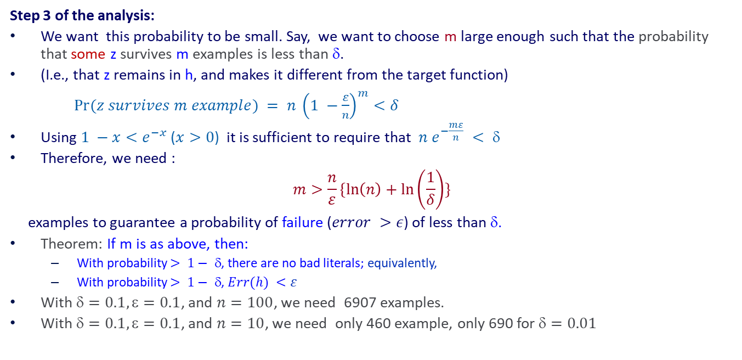
Learning Conjunctions– Analysis (3)
Step 3 of the analysis:
We want this probability to be small. Say, we want to choose m large enough such that the probability that some z survives m examples is less than δ.
(I.e., that z remains in h, and makes it different from the target function)
$Pr⁡(z survives m example) = n {\left(1 −\frac{ε}{n}\right)}^{m}<δ$
Using$1 −x<e^{−x}$ ($x>0$) it is sufficient to require that $n e^{−\frac{mε}{n}} < $
Therefore, we need :
$$m>\frac{n}{ε}\{\ln\left(n\right)+\ln\left(\frac{1}{δ}\right)\}$$
examples to guarantee a probability of failure ($error >ε$) of less than δ.
Theorem: If m is as above, then:
  With probability $> 1− $, there are no bad literals; equivalently,
  With probability $> 1− $, $Err(h) <ε$
With $=0.1, =0.1$, and $n=100$, we need 6907 examples.
With $=0.1, =0.1$, and $n=10$, we need only 460 example, only 690 for $=0.01$

Slide 25
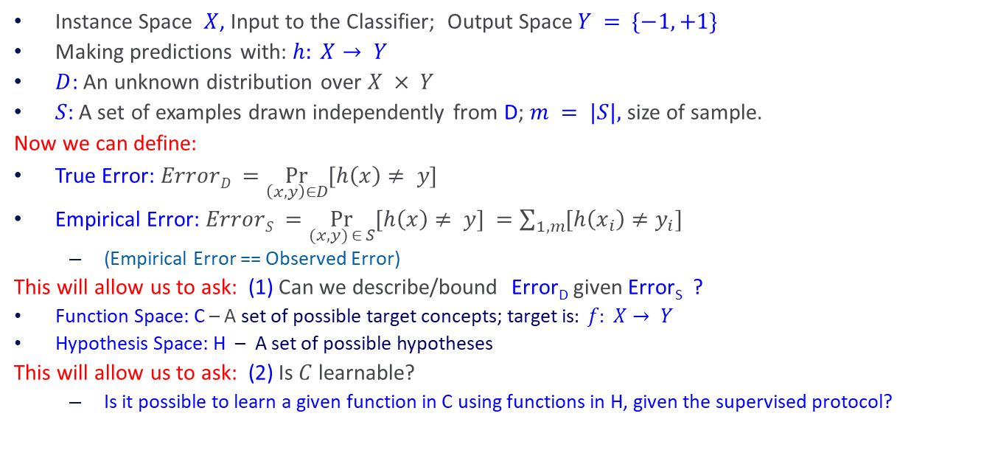
More Generally: Formulating Prediction Theory
Instance Space $X$, Input to the Classifier; Output Space$Y = \{−1, +1\}$
Making predictions with: $h: X→ Y$
$D$: An unknown distribution over $X × Y$
$S$: A set of examples drawn independently from D; $m = |S|,$size of sample.
Now we can define:
True Error: $ErrorD =\underset{\left(x,y\right)∈D}{Pr}{[h\left(x\right)≠ y]}$
Empirical Error: $ErrorS =\underset{(x,y) ∈ S}{Pr}{[h\left(x\right)≠ y]} =\sum_{1,m}{[h\left(x_{i}\right)≠y_{i}]}$
  (Empirical Error == Observed Error)
This will allow us to ask: (1) Can we describe/bound Error_{D} given Error_{S} ?
Function Space: C – A set of possible target concepts; target is$: f: X→ Y$
Hypothesis Space: H – A set of possible hypotheses
This will allow us to ask: (2) Is $C$learnable?
  Is it possible to learn a given function in C using functions in H, given the supervised protocol?

Slide 26
Requirements of Learning
Cannot expect a learner to learn a concept exactly, since
  There will generally be multiple concepts consistent with the available data (which represent a small fraction of the available instance space).
  Unseen examples could potentially have any label
  We “agree” to misclassify uncommon examples that do not show up in the training set.
Cannot always expect to learn a close approximation to the target concept since
  Sometimes (only in rare learning situations, we hope) the training set will not be representative (will contain uncommon examples).
Therefore, the only realistic expectation of a good learner is that with high probability it will learn a close approximation to the target concept.

Slide 27

Those of you who cannot vote (and those who can):
A documentary: All In

Slide 28
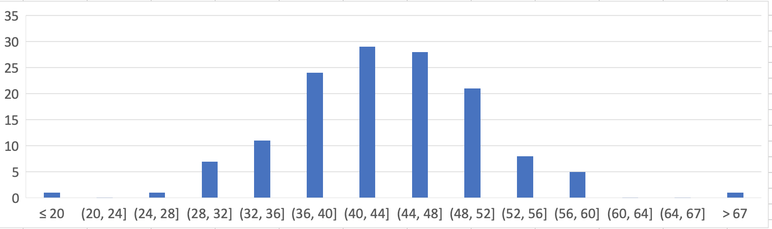
Administration (11/2/20)
Are we recording? YES!
Available on the web site
Remember that all the lectures are available on the website before the class
  Go over it and be prepared
  A new set of written notes will accompany most lectures, with some more details, examples and, (when relevant) some code.
HW 3: Due on 11/16/
  You cannot solve all the problems yet.
  Less time consuming; no programming
Mid-term:
  Average: 43.4/81= 53.5%
  Median: 43.5/81
  Standard Deviation: 7.7
Expectation:
Top 35-40% of the students = A
Next 40% = B
Next 20% = C
Very few (hopefully none) who stop doing the work < C.

Slide 29
Projects
CIS 519 students need to do a team project
  Teams will be of size 2-4
  We will help grouping if needed
There will be 3 projects.
  Natural Language Processing (Text)
  Computer Vision (Images)
  Speech (Audio)
In all cases, we will give you datasets and initial ideas
  The problem will be multiclass classification problems
  You will get annotated data only for some of the labels, but will also have to predict other labels
  0-zero shot learning; few-shot learning; transfer learning
A detailed note will come out today.
Timeline:
  11/9: Choose a project and team up
  11/23 Initial proposal describing what your team plans to do
  12/2 Progress report
  12/15-20 (TBD) Final paper + short video
Try to make it interesting!

Slide 30
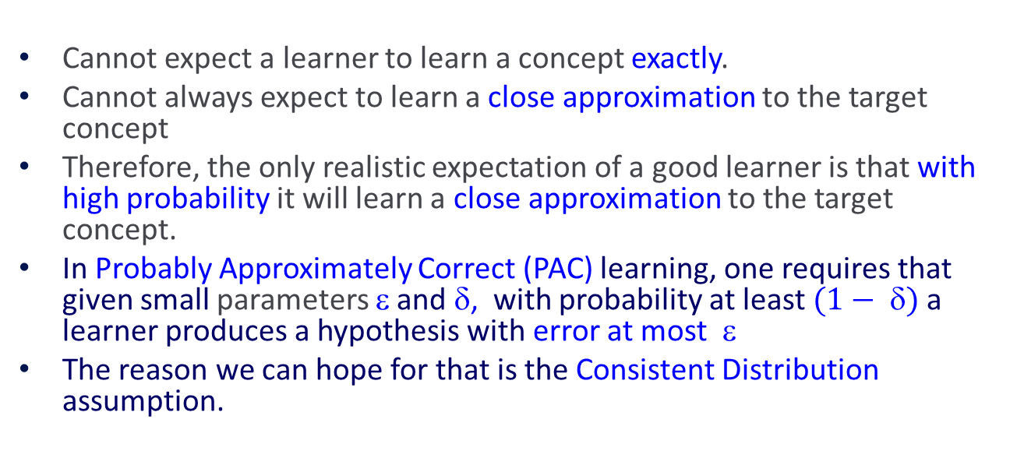
Probably Approximately Correct
We want a theory, so that we understand
what observed performance says about future performance, and
what contributes to this (gap in performance) .
-
f
h
+
+
-
Cannot expect a learner to learn a concept exactly.
Cannot always expect to learn a close approximation to the target concept
Therefore, the only realistic expectation of a good learner is that with high probability it will learn a close approximation to the target concept.
In Probably Approximately Correct (PAC) learning, one requires that given small parameters ε and $$, with probability at least $(1− )$a learner produces a hypothesis with error at most $$
The reason we can hope for that is the Consistent Distribution assumption.
-

Slide 31
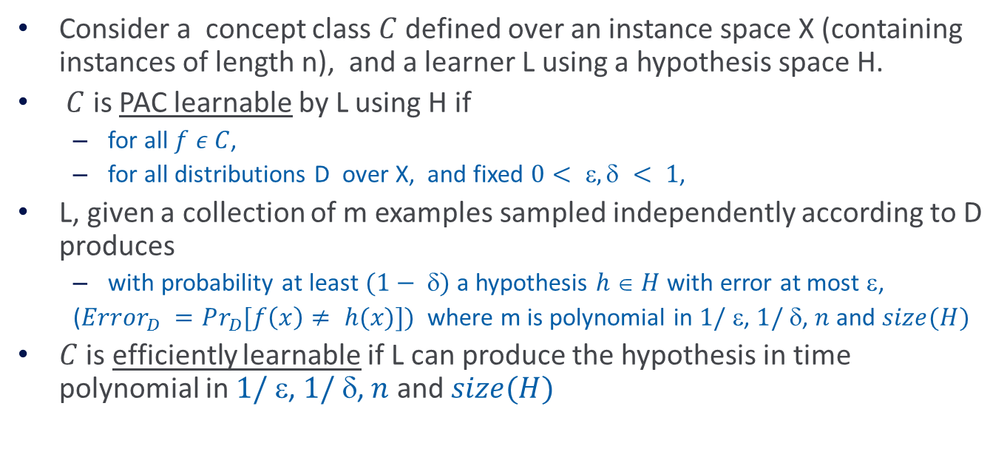
PAC Learnability
Consider a concept class $C$ defined over an instance space X (containing instances of length n), and a learner L using a hypothesis space H.
$C$ is PAC learnable by L using H if
  for all $f ε C$,
  for all distributions D over X, and fixed $0< ,  < 1$,
L, given a collection of m examples sampled independently according to D produces
  with probability at least $(1− )$a hypothesis $h  H$with error at most $$,
  ($Error_{D} =Pr_{D}{[f\left(x\right)≠ h(x)]) }$where m is polynomial in $1/ $, $1/ $, $n$ and $size(H)$
$C$ is efficiently learnable if L can produce the hypothesis in time polynomial in $1/ $, $1/ $, $n$ and $size(H)$

Slide 32
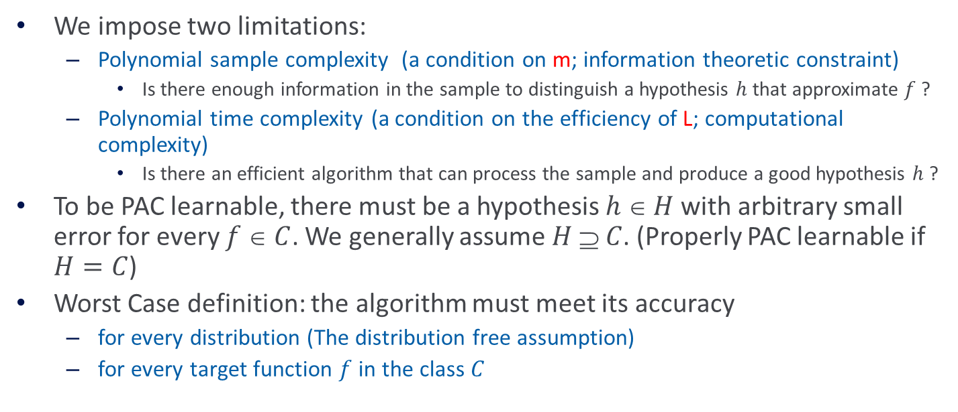
PAC Learnability
We want a theory, so that we understand
what observed performance says about future performance, and
what contributes to this (gap in performance) .
We impose two limitations:
  Polynomial sample complexity (a condition on m; information theoretic constraint)
    Is there enough information in the sample to distinguish a hypothesis $h$ that approximate $f$ ?
  Polynomial time complexity (a condition on the efficiency of L; computational complexity)
    Is there an efficient algorithm that can process the sample and produce a good hypothesis $h$ ?
To be PAC learnable, there must be a hypothesis $h  H$with arbitrary small error for every $f  C$. We generally assume $H  C$. (Properly PAC learnable if $H=C$)
Worst Case definition: the algorithm must meet its accuracy
  for every distribution (The distribution free assumption)
  for every target function $f$ in the class $C$

Slide 33
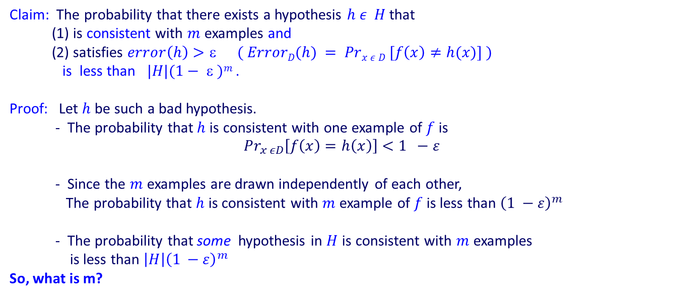
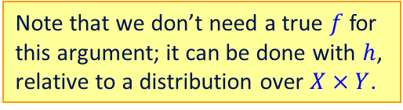
Occam’s Razor (1)
Key Theorem (simple case):
Generalizing the example we showed for conjunctions
Claim: The probability that there exists a hypothesis $h ε H$that
(1) is consistent with $m$ examples and
(2) satisfies $error\left(h\right)>ε ( ErrorD(h) = Prx ε D [f\left(x\right)≠h(x)] )$
is less than $|H|(1−  )m$.
Proof: Let $h$ be such a bad hypothesis.
- The probability that $h$is consistent with one example of $f$ is
$$Pr_{x εD}\left[f\left(x\right)=h\left(x\right)\right]<1 −ε$$
- Since the $m$ examples are drawn independently of each other,
The probability that $h$ is consistent with $m$ example of $f$ is less than ${\left(1 −ε\right)}^{m}$
- The probability that some hypothesis in $H$ is consistent with $m$ examples
is less than $\left|H\right|{\left(1 −ε\right)}^{m}$
So, what is m?
Note that this is an ideal situation – the learner is perfect on the training data. We call it the “consistent learner scheme”.
First, we will ask “how good are we going to be in the future if we are perfect in training”; then we’ll generalize to a more realistic scenario.
Note that we don’t need a true $f$ for this argument; it can be done with $h$, relative to a distribution over $X×Y$.

Slide 34
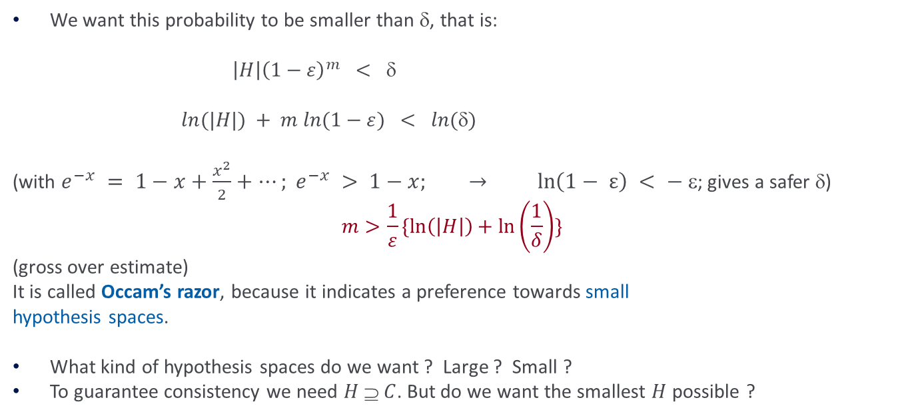
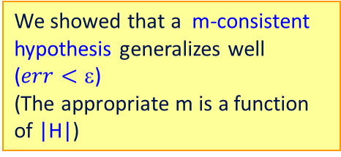
Occam’s Razor (1)
What do we know now about the Consistent Learner scheme?
We want this probability to be smaller than δ, that is:
$\left|H\right|{\left(1−ε\right)}^{m} < $
$ln(|H|) + m ln(1−ε) < ln()$
(with $e^{−x} = 1−x+\frac{x^{2}}{2}+…; e^{−x} > 1−x; → ln\left(1− ε\right) < − $; gives a safer δ)
$$m>\frac{1}{ε}\{\ln\left(\left|H\right|\right)+\ln\left(\frac{1}{δ}\right)\}$$
(gross over estimate)
It is called Occam’s razor, because it indicates a preference towards small
hypothesis spaces.
What kind of hypothesis spaces do we want ? Large ? Small ?
To guarantee consistency we need $H  C$. But do we want the smallest $H$ possible ?
We showed that a m-consistent hypothesis generalizes well ($err<$)
(The appropriate m is a function of |H|)

Slide 35
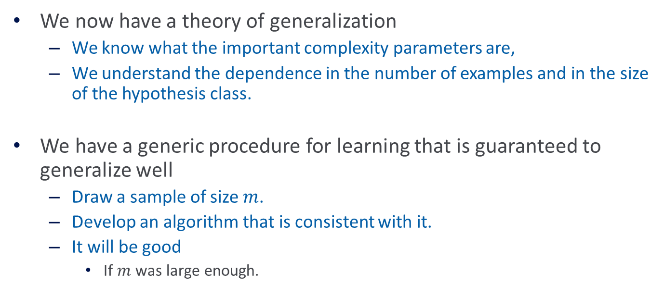
Why Should We Care?
We now have a theory of generalization
  We know what the important complexity parameters are,
  We understand the dependence in the number of examples and in the size of the hypothesis class.
We have a generic procedure for learning that is guaranteed to generalize well
  Draw a sample of size $m$.
  Develop an algorithm that is consistent with it.
  It will be good
    If $m$ was large enough.

Slide 36

Consistent Learners
Immediately from the definition, we get the following general scheme for PAC learning:
Given a sample D of $m$ examples
  Find some $h  H$that is consistent with all $m$examples
    We showed that if $m$ is large enough, a consistent hypothesis must be close enough to $f$
  Check that $m$ is not too large (polynomial in the relevant parameters):
    we showed that the “closeness” guarantee requires that
    $m >\frac{1}{ε} (\ln\left|H\right|+\ln\left(\frac{1}{δ}\right))$
  Show that the consistent hypothesis $h  H$can be computed efficiently
In the case of conjunctions
  We used the Elimination algorithm to find a hypothesis h that is consistent with the training set (easy to compute)
  We showed directly that if we have sufficiently many examples (polynomial in the parameters), than h is close to the target function.
We did not need to show it directly. As shown above we could have just relied on the fact the H is not too large.

Slide 37
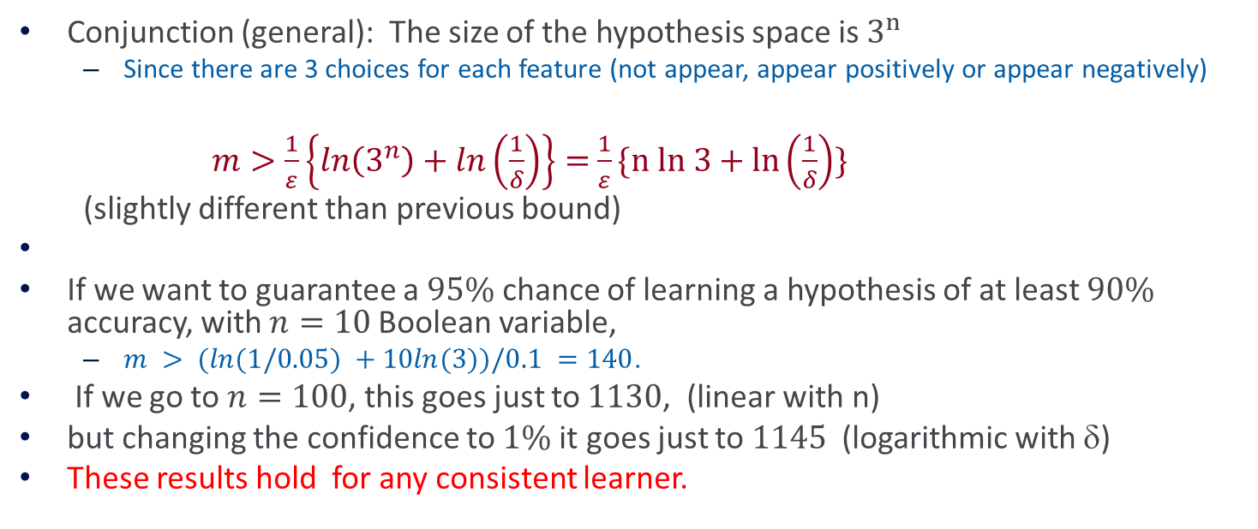
Examples
Conjunction (general): The size of the hypothesis space is $3^{n}$
  Since there are 3 choices for each feature (not appear, appear positively or appear negatively)
$m>\frac{1}{ε}\left\{ln\left(3^{n}\right)+ln\left(\frac{1}{δ}\right)\right\}=$ $\frac{1}{ε}\{n ln 3+ln\left(\frac{1}{δ}\right)\}$
(slightly different than previous bound)
If we want to guarantee a $95\%$chance of learning a hypothesis of at least $90\%$ accuracy, with $n=10$Boolean variable,
  $m > (ln(1/0.05) +10ln(3))/0.1 =140$.
If we go to $n=100$, this goes just to $1130$, (linear with n)
but changing the confidence to $1\%$ it goes just to $1145$ (logarithmic with $$)
These results hold for any consistent learner.

Slide 38
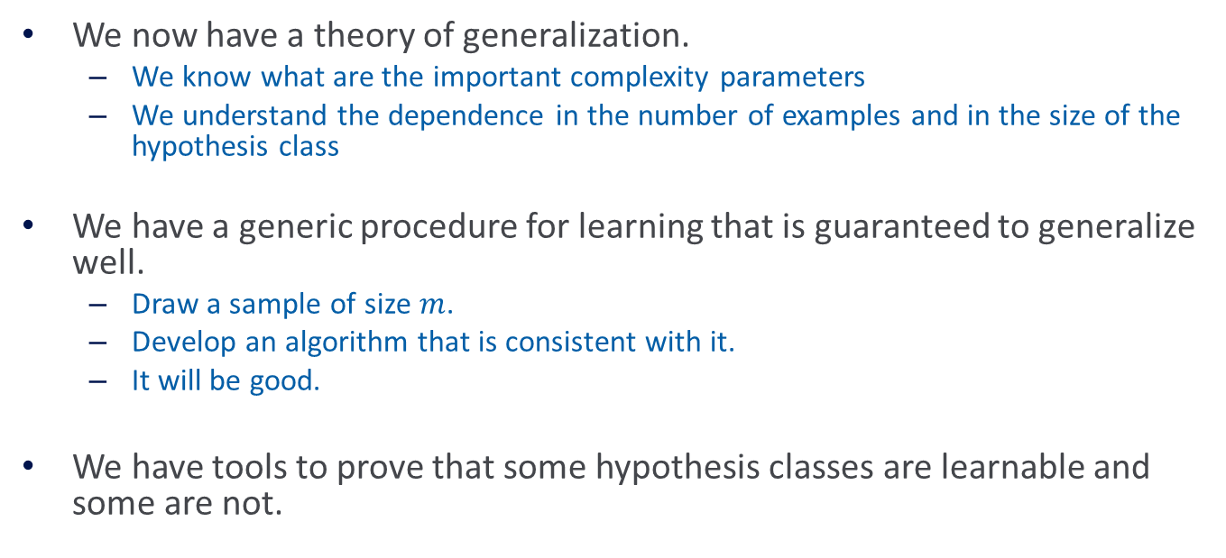
Why Should We Care?
We now have a theory of generalization.
  We know what are the important complexity parameters
  We understand the dependence in the number of examples and in the size of the hypothesis class
We have a generic procedure for learning that is guaranteed to generalize well.
  Draw a sample of size $m$.
  Develop an algorithm that is consistent with it.
  It will be good.
We have tools to prove that some hypothesis classes are learnable and some are not.

Slide 39
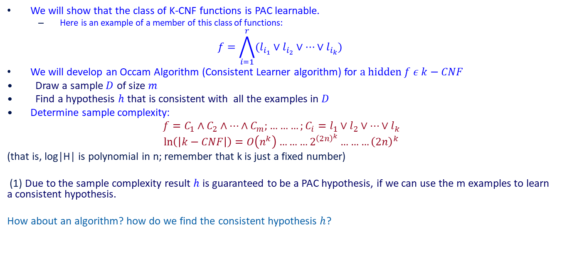
Example: K-CNF
We will show that the class of K-CNF functions is PAC learnable.
  Here is an example of a member of this class of functions:
$$f=\bigwedge_{i=1}^{r}{(l_{i_{1}}}∨l_{i_{2}}∨…∨l_{i_{k}})$$
We will develop an Occam Algorithm (Consistent Learner algorithm) for $a hidden f ε k−CNF$
Draw a sample $D$ of size $m$
Find a hypothesis $h$ that is consistent with all the examples in $D$
Determine sample complexity:
$$f=C_{1}∧C_{2}∧…∧C_{m};………;C_{i}=l_{1}∨l_{2}∨…∨l_{k}$$
$$\ln\left(\left|k−CNF\right|\right)=O\left(n^{k}\right)………2^{{\left(2n\right)}^{k}}………{\left(2n\right)}^{k}$$
(that is, log|H| is polynomial in n; remember that k is just a fixed number)
(1) Due to the sample complexity result $h$ is guaranteed to be a PAC hypothesis, if we can use the m examples to learn a consistent hypothesis.
How about an algorithm? how do we find the consistent hypothesis $h$?

Slide 40
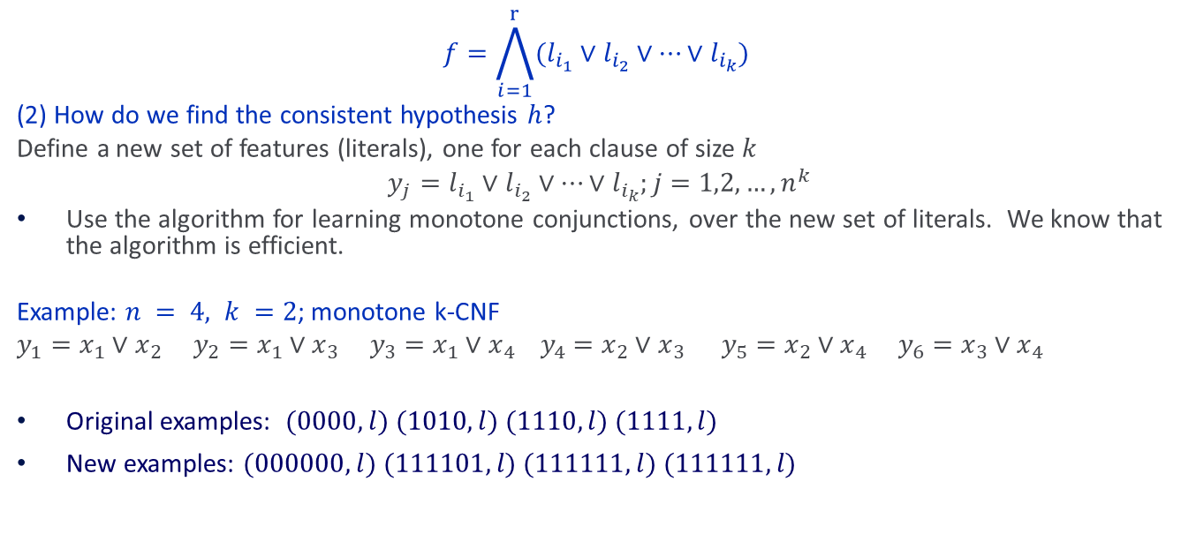
Example: K-CNF (cont.)
$$f=\bigwedge_{i=1}^{r}{(l_{i_{1}}}∨l_{i_{2}}∨…∨l_{i_{k}})$$
(2) How do we find the consistent hypothesis $h$?
Define a new set of features (literals), one for each clause of size $k$
$$y_{j}=l_{i_{1}}∨l_{i_{2}}∨…∨l_{i_{k}};j=1,2,…, n^{k}$$
Use the algorithm for learning monotone conjunctions, over the new set of literals. We know that the algorithm is efficient.
Example: $n = 4, k =2$; monotone k-CNF
$y_{1}=x_{1}∨x_{2}$ $y_{2}=x_{1}∨x_{3} y_{3}=x_{1}∨x_{4} y_{4}=x_{2}∨x_{3} y_{5}=x_{2}∨x_{4} y_{6}=x_{3}∨x_{4}$
Original examples: $(0000,l) (1010,l) (1110,l) (1111,l)$
New examples: $(000000,l) (111101,l) (111111,l) (111111,l)$
Distribution?

Slide 41
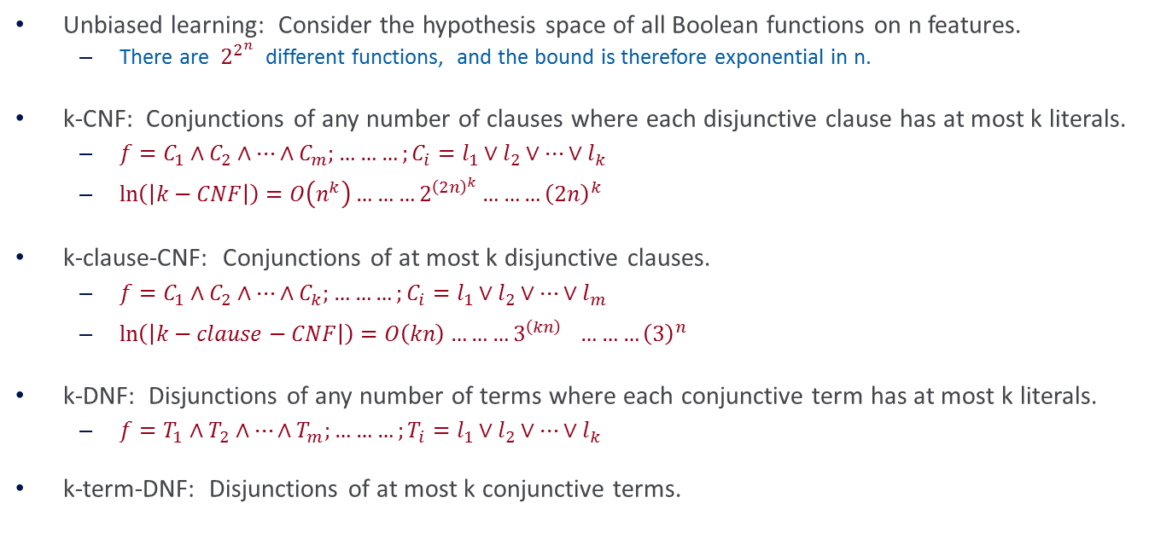
More Examples
Unbiased learning: Consider the hypothesis space of all Boolean functions on n features.
  There are $2^{2^{n}}$ different functions, and the bound is therefore exponential in n.
k-CNF: Conjunctions of any number of clauses where each disjunctive clause has at most k literals.
  $f=C_{1}∧C_{2}∧…∧C_{m};………;C_{i}=l_{1}∨l_{2}∨…∨l_{k}$
  $\ln\left(\left|k−CNF\right|\right)=O\left(n^{k}\right)………2^{{\left(2n\right)}^{k}}………{\left(2n\right)}^{k}$
k-clause-CNF: Conjunctions of at most k disjunctive clauses.
  $f=C_{1}∧C_{2}∧…∧C_{k};………;C_{i}=l_{1}∨l_{2}∨…∨l_{m}$
  $\ln\left(\left|k−clause−CNF\right|\right)=O\left(kn\right)………3^{{\left(kn\right)}^{}}………{\left(3\right)}^{n}$
k-DNF: Disjunctions of any number of terms where each conjunctive term has at most k literals.
  $f=T_{1}∧T_{2}∧…∧T_{m};………;T_{i}=l_{1}∨l_{2}∨…∨l_{k}$
k-term-DNF: Disjunctions of at most k conjunctive terms.

Slide 42
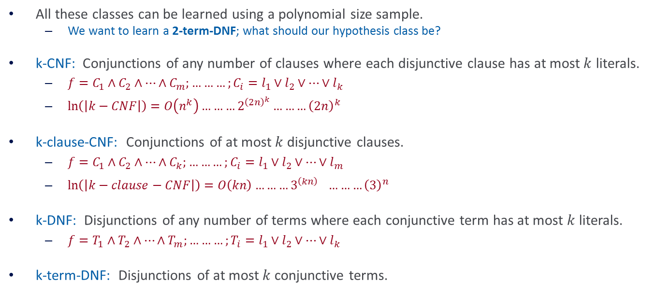
Sample Complexity
All these classes can be learned using a polynomial size sample.
  We want to learn a 2-term-DNF; what should our hypothesis class be?
k-CNF: Conjunctions of any number of clauses where each disjunctive clause has at most $k$ literals.
  $f=C_{1}∧C_{2}∧…∧C_{m};………;C_{i}=l_{1}∨l_{2}∨…∨l_{k}$
  $\ln\left(\left|k−CNF\right|\right)=O\left(n^{k}\right)………2^{{\left(2n\right)}^{k}}………{\left(2n\right)}^{k}$
k-clause-CNF: Conjunctions of at most $k$ disjunctive clauses.
  $f=C_{1}∧C_{2}∧…∧C_{k};………;C_{i}=l_{1}∨l_{2}∨…∨l_{m}$
  $\ln\left(\left|k−clause−CNF\right|\right)=O\left(kn\right)………3^{{\left(kn\right)}^{}}………{\left(3\right)}^{n}$
k-DNF: Disjunctions of any number of terms where each conjunctive term has at most $k$ literals.
  $f=T_{1}∧T_{2}∧…∧T_{m};………;T_{i}=l_{1}∨l_{2}∨…∨l_{k}$
k-term-DNF: Disjunctions of at most $k$ conjunctive terms.

Slide 43
Computational Complexity
What does it mean?
Even though from the sample complexity perspective things are good, they are not good from a computational complexity in this case.
Determining whether there is a 2-term DNF consistent with a set of training data is NP-Hard. Therefore the class of k-term-DNF is not efficiently (properly) PAC learnable due to computational complexity
But, we have seen an algorithm for learning k-CNF.
And, k-CNF is a superset of k-term-DNF
  (That is, every k-term-DNF can be written as a k-CNF)

Slide 44
Computational Complexity
Determining whether there is a 2-term DNF consistent with a set of training data is NP-Hard
Therefore the class of k-term-DNF is not efficiently (properly) PAC learnable due to computational complexity
We have seen an algorithm for learning k-CNF.
And, k-CNF is a superset of k-term-DNF
  (That is, every k-term-DNF can be written as a k-CNF)
Therefore, C=k-term-DNF can be learned as using H=k-CNF as the hypothesis Space
Importance of representation:
  Concepts that cannot be learned using one representation can be learned using another (more expressive) representation.
H
C
This result is analogous to an earlier observation that it’s better to learn linear separators than conjunctions.

Slide 45
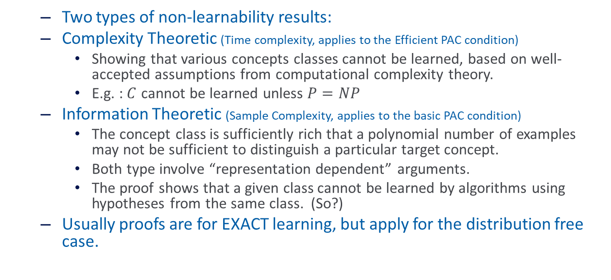
Negative Results – Examples
  Two types of non-learnability results:
  Complexity Theoretic (Time complexity, applies to the Efficient PAC condition)
    Showing that various concepts classes cannot be learned, based on well-accepted assumptions from computational complexity theory.
    E.g. : $C$ cannot be learned unless $P=NP$
  Information Theoretic (Sample Complexity, applies to the basic PAC condition)
    The concept class is sufficiently rich that a polynomial number of examples may not be sufficient to distinguish a particular target concept.
    Both type involve “representation dependent” arguments.
    The proof shows that a given class cannot be learned by algorithms using hypotheses from the same class. (So?)
  Usually proofs are for EXACT learning, but apply for the distribution free case.

Slide 46
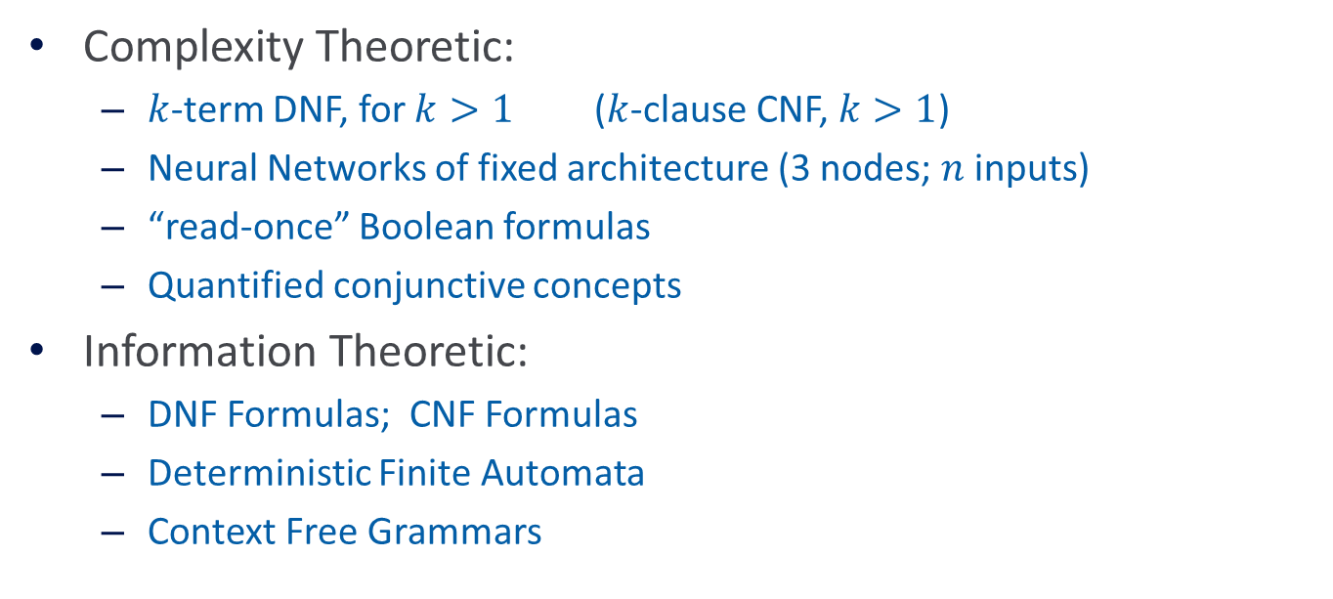
Negative Results for Learning
Complexity Theoretic:
  $k$-term DNF, for $k>1$($k$-clause CNF, $k>1$)
  Neural Networks of fixed architecture (3 nodes; $n$ inputs)
  “read-once” Boolean formulas
  Quantified conjunctive concepts
Information Theoretic:
  DNF Formulas; CNF Formulas
  Deterministic Finite Automata
  Context Free Grammars
We need to extend the theory in two ways:
What if we cannot be completely consistent with the training data?
What if the hypothesis class we work with is not finite?

Slide 47
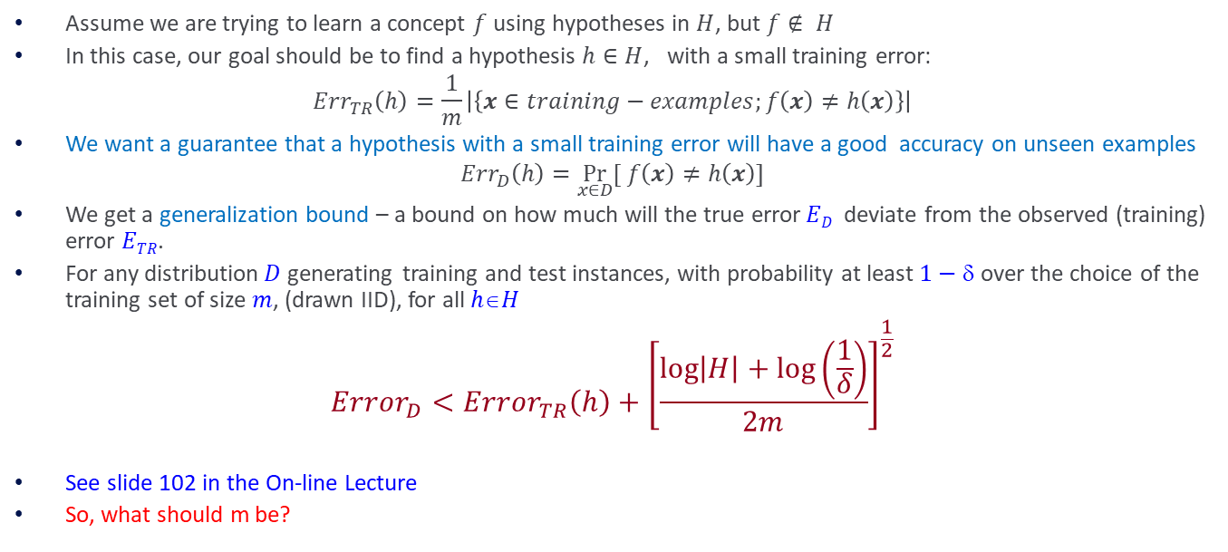
Agnostic Learning
Assume we are trying to learn a concept $f$ using hypotheses in $H$, but $f∉ H$
In this case, our goal should be to find a hypothesis $h∈H$, with a small training error:
$$Err_{TR}\left(h\right)=\frac{1}{m}\left|\left\{x∈training−examples;f\left(x\right)≠h\left(x\right)\right\}\right|$$
We want a guarantee that a hypothesis with a small training error will have a good accuracy on unseen examples
$$Err_{D}\left(h\right)=\underset{x∈D}{Pr}{[ f\left(x\right)≠h\left(x\right)]}$$
We get a generalization bound – a bound on how much will the true error$ED$deviate from the observed (training) error $ETR$.
For any distribution$D$generating training and test instances, with probability at least $1−$ over the choice of the training set of size $m$, (drawn IID), for all $hH$
$$Error_{D}<Error_{TR}\left(h\right)+{\left[\frac{\log\left|H\right|+\log\left(\frac{1}{δ}\right)}{2m}\right]}^{\frac{1}{2}}$$
See slide 102 in the On-line Lecture
So, what should m be?
Error on the training data
Generalization: a function of the Hypothesis class size

Slide 48
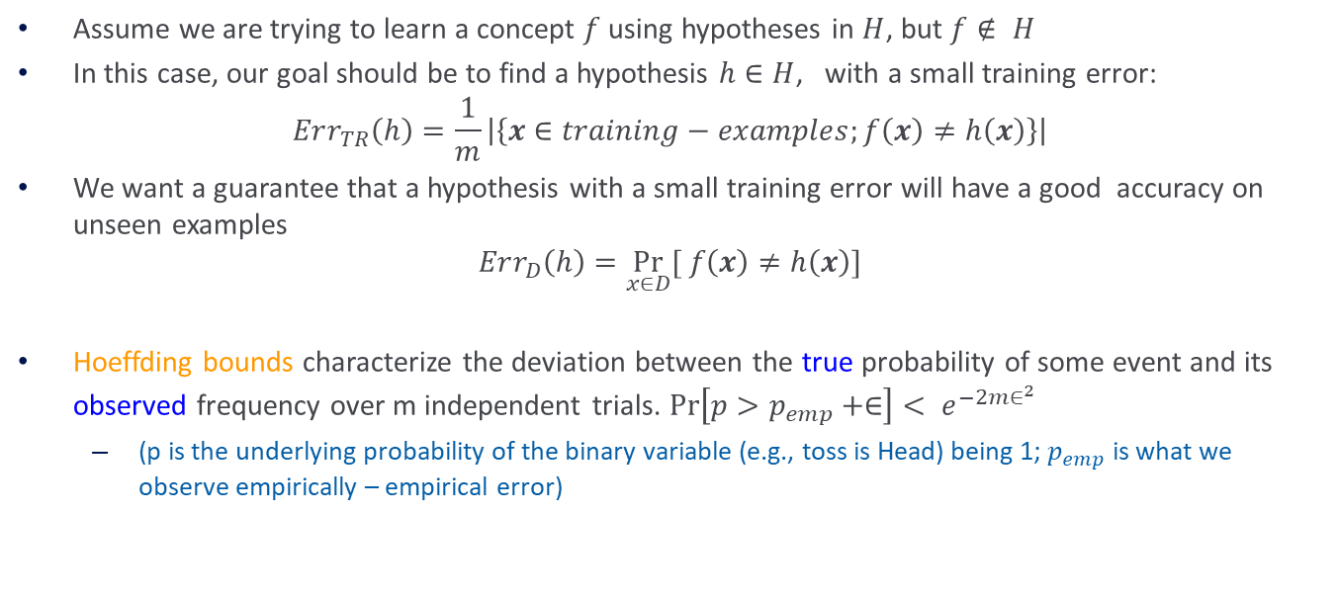
Agnostic Learning [Details]
Assume we are trying to learn a concept $f$ using hypotheses in $H$, but $f∉ H$
In this case, our goal should be to find a hypothesis $h∈H$, with a small training error:
$$Err_{TR}\left(h\right)=\frac{1}{m}\left|\left\{x∈training−examples;f\left(x\right)≠h\left(x\right)\right\}\right|$$
We want a guarantee that a hypothesis with a small training error will have a good accuracy on unseen examples
$$Err_{D}\left(h\right)=\underset{x∈D}{Pr}{[ f\left(x\right)≠h\left(x\right)]}$$
Hoeffding bounds characterize the deviation between the true probability of some event and its observed frequency over m independent trials. $\operatorname{Pr}\left[p>p_{emp}+∈\right]< e^{−2m∈^{2}}$
  (p is the underlying probability of the binary variable (e.g., toss is Head) being 1; $p_{emp}$ is what we observe empirically – empirical error)

Slide 49
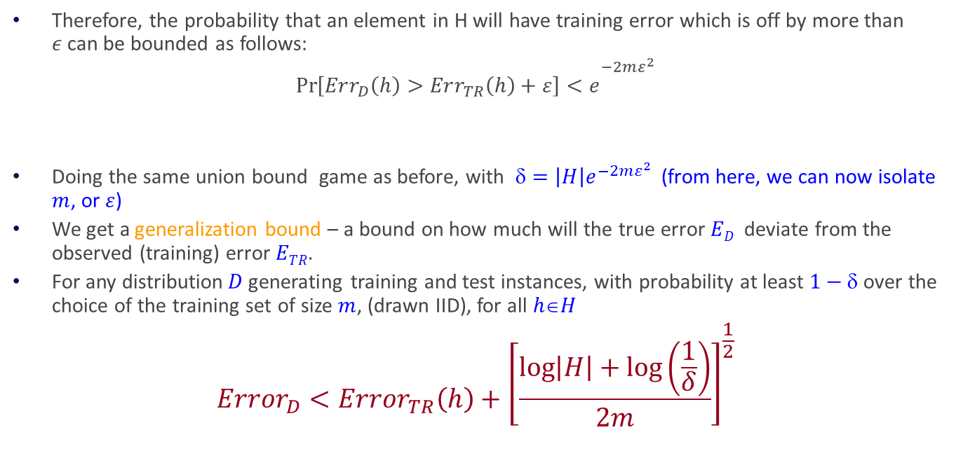
Agnostic Learning [Details]
Therefore, the probability that an element in H will have training error which is off by more than $ε$can be bounded as follows:
$$\operatorname{Pr}\left[Err_{D}\left(h\right)>Err_{TR}\left(h\right)+ε\right]<e^{\begin{aligned}−2mε^{2} \\ \end{aligned}}$$
Doing the same union bound game as before, with $=\left|H\right|e^{−2mε^{2}}$(from here, we can now isolate $m$, or $ε$)
We get a generalization bound – a bound on how much will the true error$ED$deviate from the observed (training) error $ETR$.
For any distribution$D$generating training and test instances, with probability at least $1−$ over the choice of the training set of size $m$, (drawn IID), for all $hH$
$$Error_{D}<Error_{TR}\left(h\right)+{\left[\frac{\log\left|H\right|+\log\left(\frac{1}{δ}\right)}{2m}\right]}^{\frac{1}{2}}$$
Error on the training data
Generalization: a function of the Hypothesis class size

Slide 50
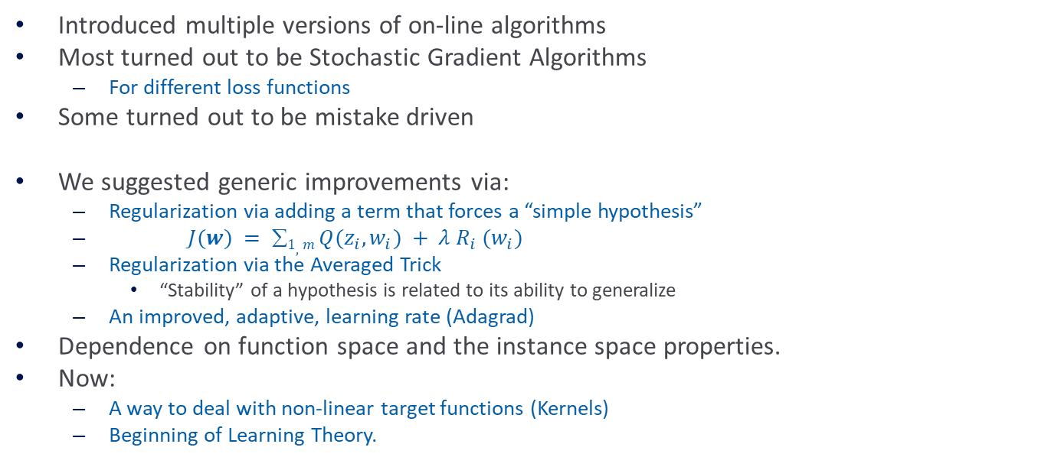

Summary (slide 102; On-line Lecture)
-
Introduced multiple versions of on-line algorithms
Most turned out to be Stochastic Gradient Algorithms
  For different loss functions
Some turned out to be mistake driven
We suggested generic improvements via:
  Regularization via adding a term that forces a “simple hypothesis”
  $J(w) = 1, m Q(z_{i}, w_{i}) + λ R_{i} (w_{i})$
  Regularization via the Averaged Trick
    “Stability” of a hypothesis is related to its ability to generalize
  An improved, adaptive, learning rate (Adagrad)
Dependence on function space and the instance space properties.
Now:
  A way to deal with non-linear target functions (Kernels)
  Beginning of Learning Theory.
-
-
-
-
-
-
-
-
$$wT x =θ$$
-
-
-
-
-
-
A term that minimizes error on the training data
A term that forces simple hypothesis

Slide 51
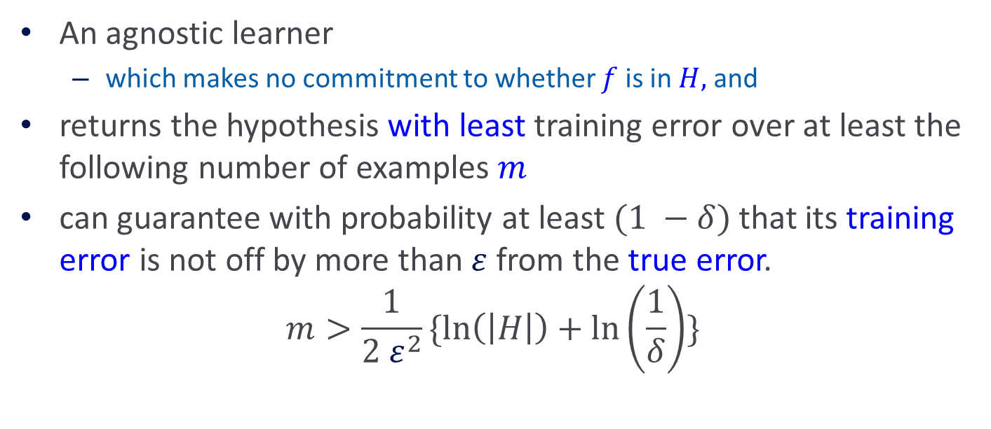
Agnostic Learning
An agnostic learner
  which makes no commitment to whether $f$ is in $H,$ and
returns the hypothesis with least training error over at least the following number of examples $m$
can guarantee with probability at least $(1 −δ)$ that its training error is not off by more than$ε$ from the true error.
$$m>\frac{1}{2 ε^{2}}\{\ln\left(\left|H\right|\right)+\ln\left(\frac{1}{δ}\right)\}$$
Learnability depends on the log of the size of the hypothesis space

Slide 52
Learning Rectangles
Assume the target concept is an axis parallel rectangle
Y
X

Slide 53
Learning Rectangles
Assume the target concept is an axis parallel rectangle
Y
+
+
-
X

Slide 54
Learning Rectangles
Assume the target concept is an axis parallel rectangle
Y
+
+
-
X

Slide 55
Learning Rectangles
Assume the target concept is an axis parallel rectangle
Y
+
+
-
+
+
X

Slide 56
Learning Rectangles
Assume the target concept is an axis parallel rectangle
Y
+
+
-
+
+
X

Slide 57
Learning Rectangles
Assume the target concept is an axis parallel rectangle
Y
+
+
+
-
+
+
+
+
+
+
+
X

Slide 58
Learning Rectangles
Assume the target concept is an axis parallel rectangle
Y
+
+
+
+
-
+
+
+
+
+
+
+
X

Slide 59
Learning Rectangles
Assume the target concept is an axis parallel rectangle
Will we be able to learn the Rectangle?
Y
+
+
+
+
-
+
+
+
+
+
+
+
X

Slide 60
Learning Rectangles
Assume the target concept is an axis parallel rectangle
Will we be able to learn the target rectangle ?
Can we come close ?
Y
+
+
+
+
-
+
+
+
+
+
+
+
X

Slide 61
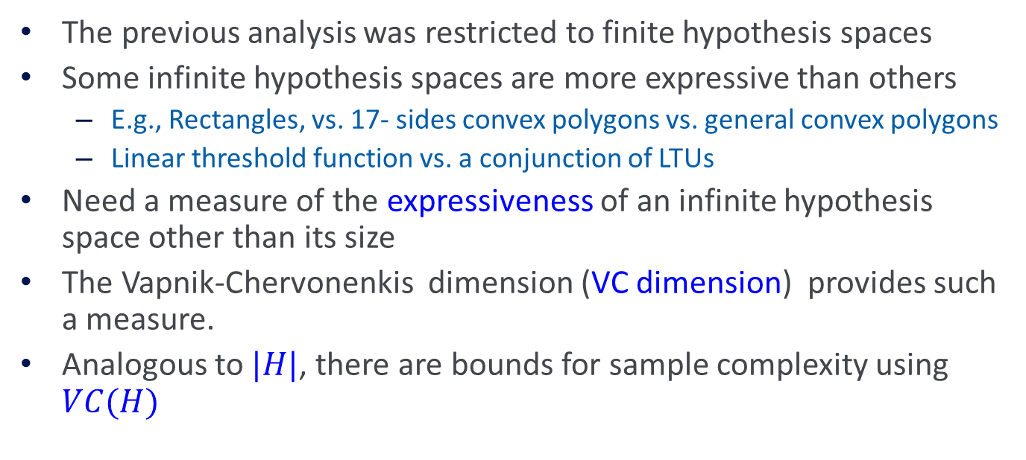
Infinite Hypothesis Space
The previous analysis was restricted to finite hypothesis spaces
Some infinite hypothesis spaces are more expressive than others
  E.g., Rectangles, vs. 17- sides convex polygons vs. general convex polygons
  Linear threshold function vs. a conjunction of LTUs
Need a measure of the expressiveness of an infinite hypothesis space other than its size
The Vapnik-Chervonenkis dimension (VC dimension) provides such a measure.
Analogous to $|H|$, there are bounds for sample complexity using $VC(H)$

Slide 62
Shattering

Slide 63
Shattering
Linear functions are expressive enough to shatter 2 points
(4 options; not all shown)

Slide 64
Shattering
We say that a set S of examples is shattered by a set of functions H if for every partition of the examples in S into positive and negative examples there is a function in H that gives exactly these labels to the examples
Linear functions are not expressive enough to shatter 13 points

Slide 65
Shattering
We say that a set S of examples is shattered by a set of functions H if for every partition of the examples in S into positive and negative examples there is a function in H that gives exactly these labels to the examples
(Intuition: A rich set of functions shatters large sets of points)

Slide 66
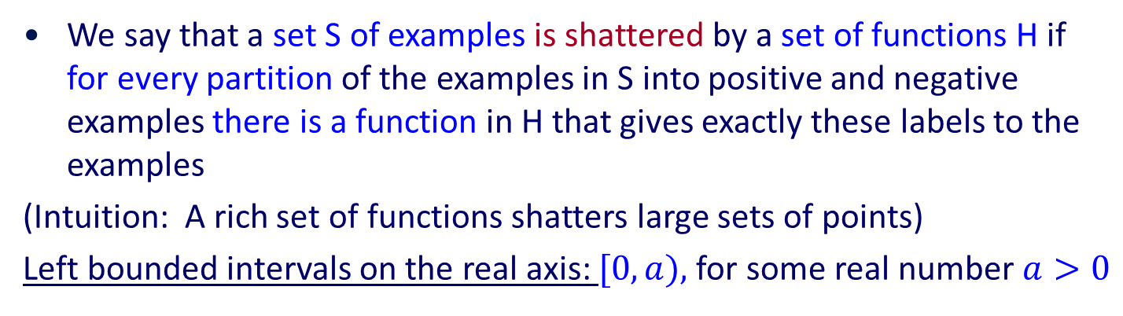

Shattering
We say that a set S of examples is shattered by a set of functions H if for every partition of the examples in S into positive and negative examples there is a function in H that gives exactly these labels to the examples
(Intuition: A rich set of functions shatters large sets of points)
Left bounded intervals on the real axis: $[0,a),$for some real number $a>0$
+
+
+
+
+
-
-
0
$$a$$

Slide 67
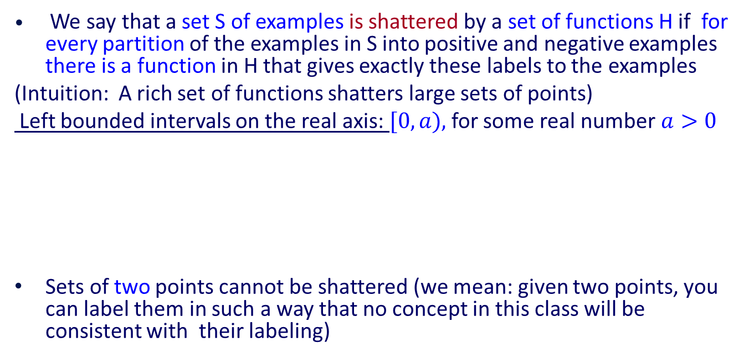
Shattering
We say that a set S of examples is shattered by a set of functions H if for every partition of the examples in S into positive and negative examples there is a function in H that gives exactly these labels to the examples
(Intuition: A rich set of functions shatters large sets of points)
Left bounded intervals on the real axis: $[0,a),$for some real number$a>0$
Sets of two points cannot be shattered (we mean: given two points, you can label them in such a way that no concept in this class will be consistent with their labeling)
+
+
+
+
+
-
-
+
+
+
+
+
-
0
a
0
-
a
+

Slide 68
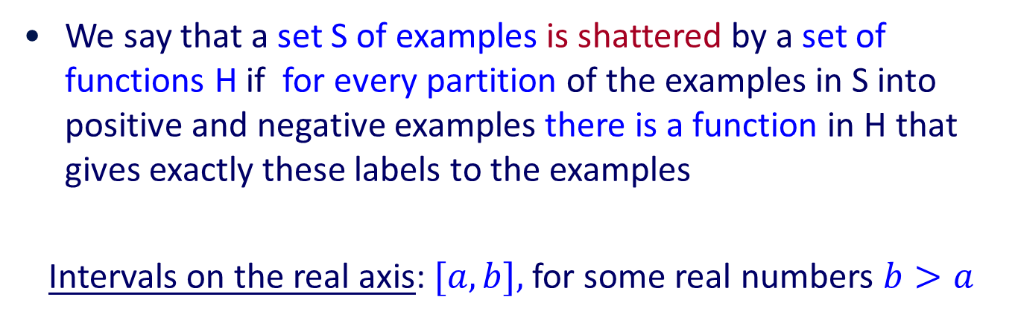
Shattering
We say that a set S of examples is shattered by a set of functions H if for every partition of the examples in S into positive and negative examples there is a function in H that gives exactly these labels to the examples
Intervals on the real axis: $[a,b],$for some real numbers $b>a$
This is the set of functions (concept class) considered here
-
-
+
+
+
+
+
-
-
a
b

Slide 69
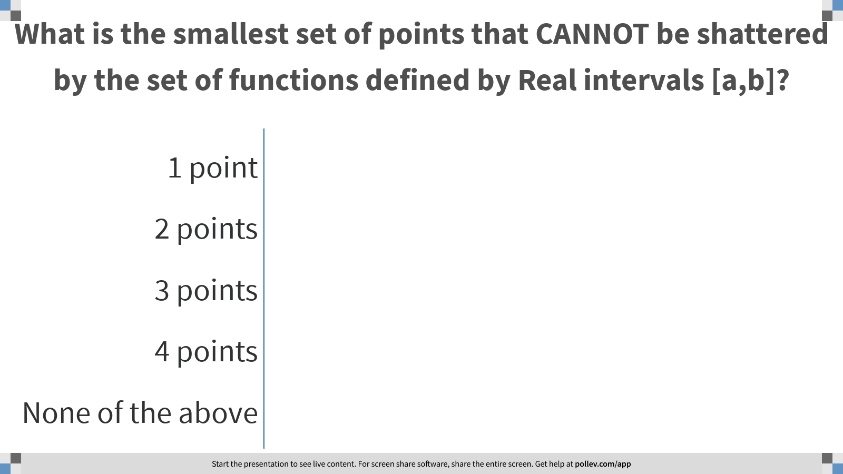
Notes:
Poll Title: What is the smallest set of points that CANNOT be shattered by the set of functions defined by Real intervals [a,b]?
https://www.polleverywhere.com/multiple_choice_polls/I3NpsvJvffsHI6DooZDjk?flow=Default&onscreen=persist

Slide 70
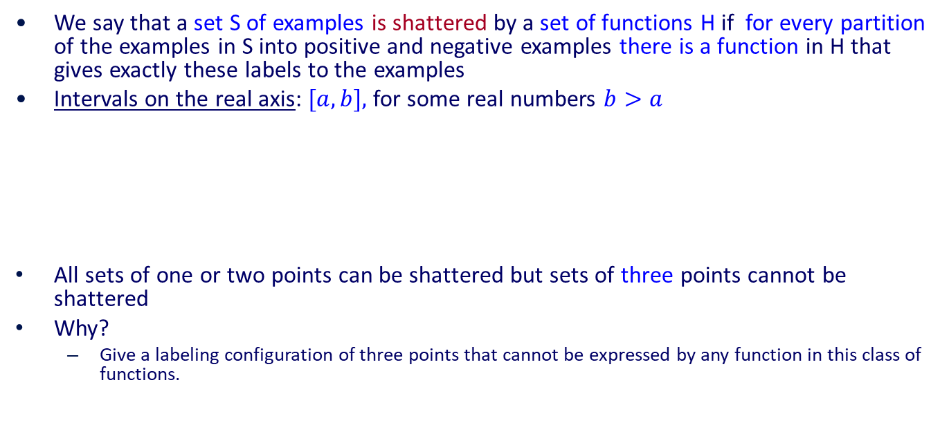
Shattering
We say that a set S of examples is shattered by a set of functions H if for every partition of the examples in S into positive and negative examples there is a function in H that gives exactly these labels to the examples
Intervals on the real axis: $[a,b],$for some real numbers $b>a$
All sets of one or two points can be shattered but sets of three points cannot be shattered
Why?
  Give a labeling configuration of three points that cannot be expressed by any function in this class of functions.
-
-
+
+
+
+
+
-
-
-
-
+
+
+
+
+
-
a
b
+
a
-
b
+

Slide 71
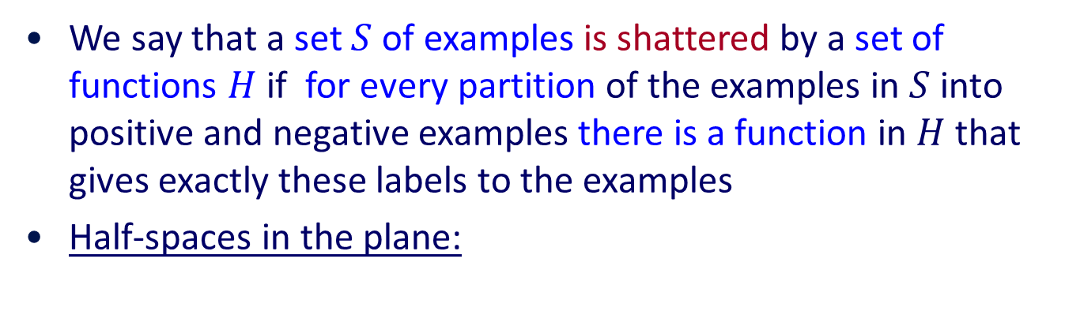
Shattering
We say that a set $S$ of examples is shattered by a set of functions $H$ if for every partition of the examples in $S$ into positive and negative examples there is a function in $H$ that gives exactly these labels to the examples
Half-spaces in the plane:
+
+
+
-
-
-
+
-

Slide 72
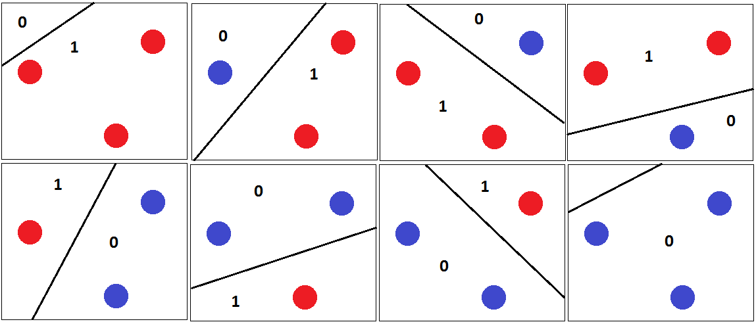
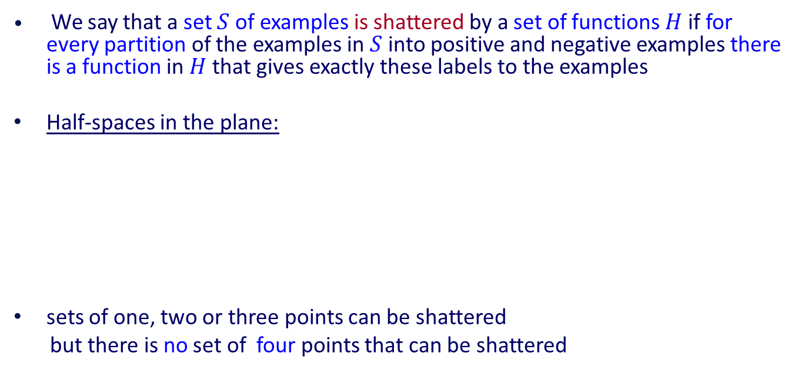
Shattering
We say that a set $S$ of examples is shattered by a set of functions $H$ if for every partition of the examples in $S$ into positive and negative examples there is a function in$H$ that gives exactly these labels to the examples
Half-spaces in the plane:
sets of one, two or three points can be shattered
but there is no set of four points that can be shattered
1. If the 4 points form a convex polygon… (if not?)
2. If one point is inside the convex hull defined by the other three…
(if not?)
+
+
+
+
-
-
-
-
+
-
All sets of three points?
-
+
Some sets of three points?
Notes:
Case of 4 points: If three of the points are on the same line, label the middle one differently that the others.
O/w: no three on the same line.
- Form the convex hull. If all points are on it, label them +,-,+,- walking around the convex hull
- if one is inside the convex hull, label it + and the rest –

Slide 73

VC Dimension: Motivation
An unbiased hypothesis space $H$ shatters the entire instance space $X$, i.e, it is able to induce every possible partition on the set of all possible instances.
The larger the subset of $X$ that can be shattered, the more expressive a hypothesis space is, i.e., the less biased.

Slide 74

VC Dimension
We say that a set $S$ of examples is shattered by a set of functions $H$ if for every partition of the examples in $S$ into positive and negative examples there is a function in $H$ that gives exactly these labels to the examples
The VC dimension of hypothesis space $H$ over instance space $X$ is the size of the largest finite subset of $X$ that is shattered by $H$.
Two steps to proving that $VC\left(H\right)=d$ :
If there exists a subset of size d that can be shattered, then $VC\left(H\right)≥d$
If no subset of size $d+1$can be shattered, then $VC\left(H\right)<d+1$
VC(Half intervals) = 1 (no subset of size 2 can be shattered)
VC(Intervals) = 2 (no subset of size 3 can be shattered)
VC(Half-spaces in the plane) = 3 (no subset of size 4 can be shattered)
Even if only one subset of this size does it!
Some are shattered, but some are not

Slide 75

Sample Complexity & VC Dimension
Using $VC\left(H\right)$as a measure of expressiveness, we can get an Occam algorithm for infinite hypothesis spaces.
Given a sample D of $m$ examples, find some $h ε H$ that is consistent with all $m$ examples
If $m>\frac{1}{ε}\{8VC\left(H\right)\log{\frac{13}{ε}}+4 log\left(\frac{2}{δ}\right)\}$
Then with probability at least $(1 −δ)$, $h$ has error less than$ε$. (that is, if $m$ is polynomial we have a PAC learning algorithm; to be efficient, we need to produce the hypothesis $h$ efficiently.
Note that the notion of VC applies also to finite hypothesis spaces:
  Assume that H shatters $k$ examples.
  Notice that to shatter $k$ examples it must be that: $\left|H\right|>2^{k} (why?)$
    So,
$$\log\left(\left|H\right|\right)≥VC(H)$$
What if H is finite?

Slide 76

Notes:
Poll Title: Assume that H shatters k points; how many different functions must be in H? Respond with: [#, reason]
https://www.polleverywhere.com/free_text_polls/0cdPS5vusP1b2vrTkBhCi

Slide 77
Learning Rectangles
Consider axis parallel rectangles in the real plane
Can we PAC learn it ?

Slide 78
Learning Rectangles
Consider axis parallel rectangles in the real plane
Can we PAC learn it ?
  (1) What is the VC dimension ?

Slide 79

Learning Rectangles
Consider axis parallel rectangles in the real plane
Can we PAC learn it ?
  (1) What is the VC dimension ?
Some four instance can be shattered
(need to consider here 16 different rectangles) Shows that $VC\left(H\right)≥4$

Slide 80

Learning Rectangles
Consider axis parallel rectangles in the real plane
Can we PAC learn it ?
  (1) What is the VC dimension ?
Some four instance can be shattered and some cannot
(need to consider here 16 different rectangles)
Shows that $VC\left(H\right)≥4$

Slide 81
Learning Rectangles
Consider axis parallel rectangles in the real plan
Can we PAC learn it ?
  (1) What is the VC dimension ?
But, no five instances can be shattered

Slide 82

Learning Rectangles
Consider axis parallel rectangles in the real plan
Can we PAC learn it ?
  (1) What is the VC dimension ?
But, no five instances can be shattered
There can be at most 4 distinct
extreme points (smallest or largest
along some dimension) and these
cannot be included (labeled +)
without including the 5th point.
Therefore $VC\left(H\right)=4$ . As far as sample complexity, this guarantees PAC learnability.

Slide 83
Learning Rectangles
Consider axis parallel rectangles in the real plan
Can we PAC learn it ?
  (1) What is the VC dimension ?
  (2) Can we give an efficient algorithm ?

Slide 84
Learning Rectangles
Consider axis parallel rectangles in the real plan
Can we PAC learn it ?
  (1) What is the VC dimension ?
  (2) Can we give an efficient algorithm ?
Find the smallest rectangle that
contains the positive examples
(necessarily, it will not contain any
negative example, and the hypothesis
is consistent.
  Axis parallel rectangles are efficiently PAC learnable.

Slide 85

Sample Complexity Lower Bound
There is also a general lower bound on the minimum number of examples necessary for PAC leaning in the general case.
Consider any concept class $C$ such that $VC\left(C\right)>2$ , any learner $L$ and small enough$ε$, $δ$. Then, there exists a distribution $D$ and a target function in $C$ such that if $L$ observes less than
$$m=\max{[\frac{1}{ε}\log\left(\frac{1}{δ}\right), (VC\left(C\right)−1)}/32ε]$$
examples, then with probability at least $δ$, $L$ outputs a hypothesis having $error \left(h\right)>ε$.
Ignoring constant factors, the lower bound is the same as the upper bound, except for the extra $\log{\frac{1}{ε} }$factor in the upper bound.

Slide 86

COLT Conclusions
The PAC framework provides a reasonable model for theoretically analyzing the effectiveness of learning algorithms.
The sample complexity for any consistent learner using the hypothesis space, $H$, can be determined from a measure of $H$’s expressiveness $(|H|, VC(H))$
If the sample complexity is tractable, then the computational complexity of finding a consistent hypothesis governs the complexity of the problem.
Sample complexity bounds given here are far from being tight, but separate learnable classes from non-learnable classes (and show what’s important). They also guide us to try and use smaller hypothesis spaces.
Computational complexity results exhibit cases where information theoretic learning is feasible, but finding good hypothesis is intractable.
The theoretical framework allows for a concrete analysis of the complexity of learning as a function of various assumptions (e.g., relevant variables)

Slide 87
COLT Conclusions (2)
Many additional models have been studied as extensions of the basic one:
  Learning with noisy data
  Learning under specific distributions
  Learning probabilistic representations
  Learning neural networks
  Learning finite automata
  Active Learning; Learning with Queries
  Models of Teaching
An important extension: PAC-Bayesians theory.
  In addition to the Distribution Free assumption of PAC, makes also an assumption of a prior distribution over the hypothesis the learner can choose from.

Slide 88
COLT Conclusions (3)
Theoretical results shed light on important issues such as the importance of the bias (representation), sample and computational complexity, importance of interaction, etc.
Bounds guide model selection even when not practical.
A lot of recent work is on data dependent bounds.
The impact COLT has had on practical learning system in the last few years has been very significant:
  SVMs;
  Winnow (Sparsity),
  Boosting
  Regularization

Slide 89
COLT approach to explaining Learning
No Distributional Assumption
Training Distribution is the same as the Test Distribution
IID Assumption is the basis for theoretical support
  Relaxations have been studied
Generalization bounds depend on this view and affect model selection.
As presented, the VC dimension is a combinatorial parameter that is associated with a class of functions.
Next we see that this notion can be refined to depend on a given data set, and this way directly affect the hypothesis chosen for this data set.

