Slide 1
Support Vector Machines (SVM)
Dan Roth
danroth@seas.upenn.edu|http://www.cis.upenn.edu/~danroth/|461C, 3401 Walnut
Slides were created by Dan Roth (for CIS519/419 at Penn or CS446 at UIUC), and other authors who have made their ML slides available.

Slide 2
Administration (11/4/20)
Are we recording? YES!
Available on the web site
Remember that all the lectures are available on the website before the class
  Go over it and be prepared
  A new set of written notes will accompany most lectures, with some more details, examples and, (when relevant) some code.
HW 3: Due on 11/16/20
  You cannot solve all the problems yet.
  Less time consuming; no programming
Projects

Slide 3
Projects
CIS 519 students need to do a team project
  Teams will be of size 2-4
  We will help grouping if needed
There will be 3 projects.
  Natural Language Processing (Text)
  Computer Vision (Images)
  Speech (Audio)
In all cases, we will give you datasets and initial ideas
  The problem will be multiclass classification problems
  You will get annotated data only for some of the labels, but will also have to predict other labels
  0-zero shot learning; few-shot learning; transfer learning
A detailed note will come out today.
Timeline:
  11/11 Choose a project and team up
  11/23 Initial proposal describing what your team plans to do
  12/2 Progress report
  12/15-20 (TBD) Final paper + short video
Try to make it interesting!

Slide 4
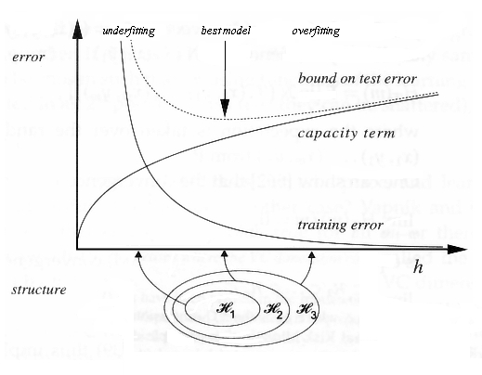
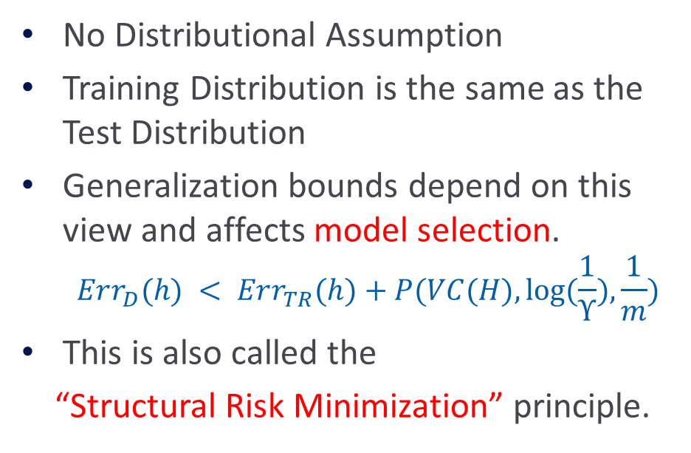
COLT approach to explaining Learning
No Distributional Assumption
Training Distribution is the same as the Test Distribution
Generalization bounds depend on this view and affects model selection.
  $$Err_{D}(h) < Err_{TR}(h)+P(VC(H), log⁡(\frac{1}{ϒ}),\frac{1}{m})$$
This is also called the
“Structural Risk Minimization” principle.

Slide 5
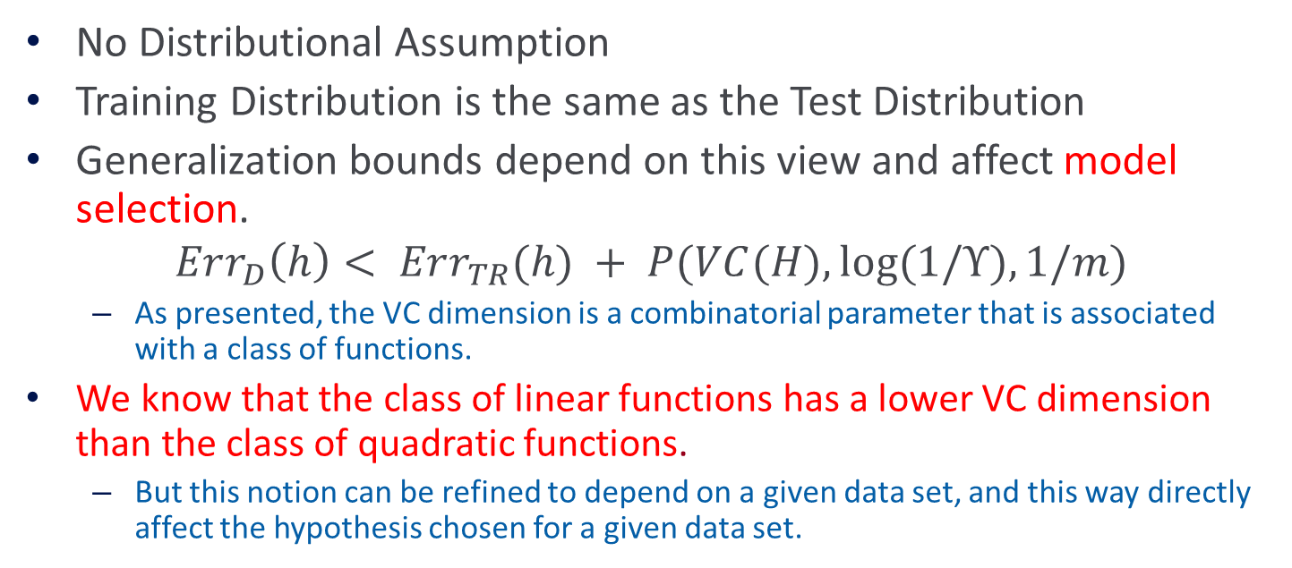
COLT approach to explaining Learning
No Distributional Assumption
Training Distribution is the same as the Test Distribution
Generalization bounds depend on this view and affect model selection.
$$Err_{D}\left(h\right)< Err_{TR}(h) + P(VC(H), log⁡(1/ϒ),1/m)$$
  As presented, the VC dimension is a combinatorial parameter that is associated with a class of functions.
We know that the class of linear functions has a lower VC dimension than the class of quadratic functions.
  But this notion can be refined to depend on a given data set, and this way directly affect the hypothesis chosen for a given data set.

Slide 6

Linear Classification
Let $X = R2, Y=\{+1, −1\}$
Which of these classifiers would be likely to generalize better?
h₁
h₂

Slide 7
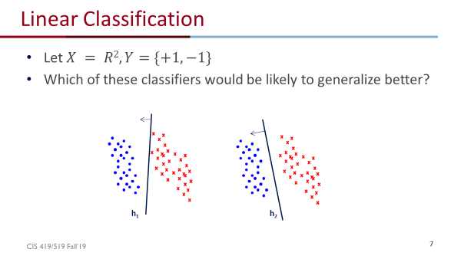
Data Dependent VC dimension
So far, we discussed VC dimension in the context of a fixed class of functions.
We can also parameterize the class of functions in interesting ways.
Consider the class of linear functions, parameterized by their margin. Note that this is a data dependent notion.

Slide 8
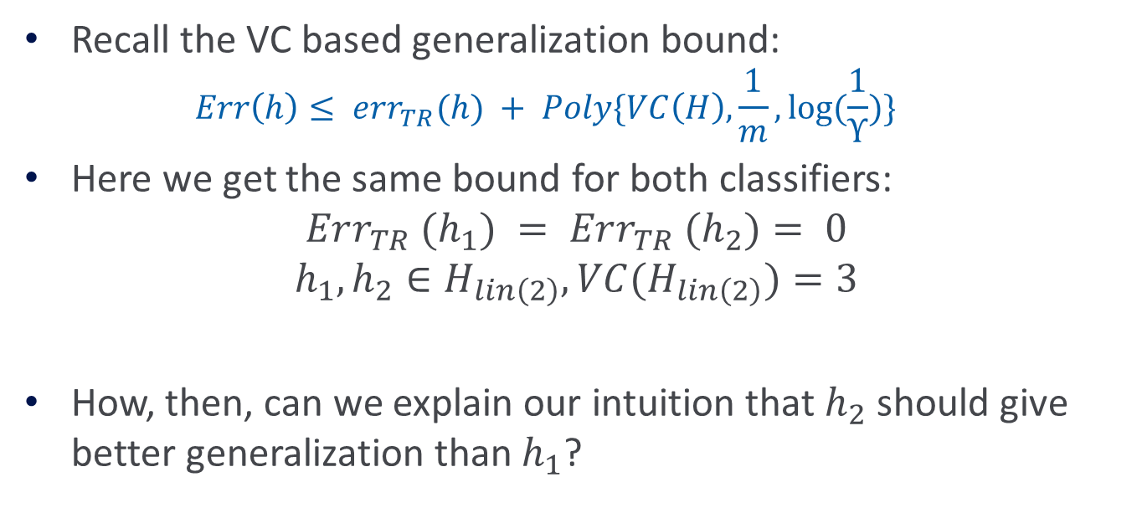
VC and Linear Classification
Recall the VC based generalization bound:
  $$Err\left(h\right)≤ err_{TR}(h) + Poly\{VC\left(H\right),\frac{1}{m}, log⁡(\frac{1}{ϒ})\}$$
Here we get the same bound for both classifiers:
$$Err_{TR} (h_{1}) = Err_{TR} (h_{2})= 0$$
$$h_{1}, h_{2}∈H_{lin\left(2\right)}, VC(H_{lin\left(2\right)})=3$$
How, then, can we explain our intuition that $h_{2}$should give better generalization than $h_{1}$?

Slide 9
Linear Classification
Although both classifiers separate the data, the distance with which the separation is achieved is different:
h₁
h₂

Slide 10
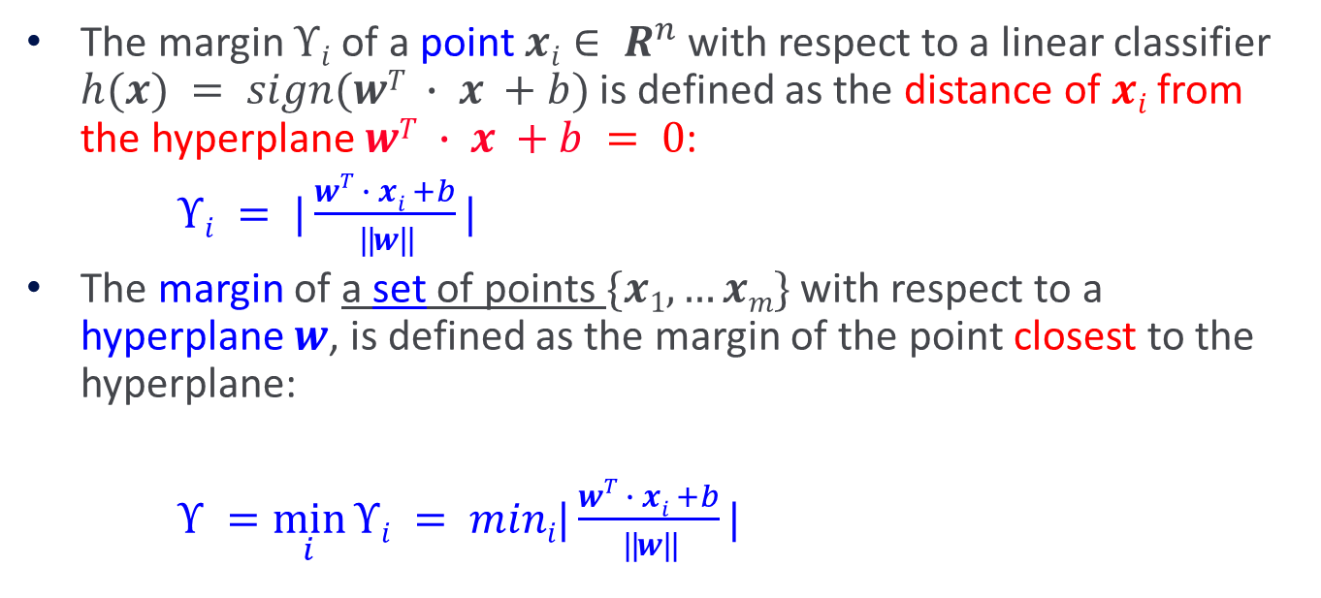
Concept of Margin
The margin $ϒi$of a point $xi∈ R^{n}$with respect to a linear classifier $h(x) = sign(wT ∙ x +b)$is defined as the distance of $xi$ from the hyperplane $wT ∙ x +b = 0$:
$ϒi = |\frac{wT ∙ xi +b}{||w||}|$
The margin of a set of points $\{x1,…xm\}$with respect to a hyperplane $w$, is defined as the margin of the point closest to the hyperplane:
$ϒ =\min_{i}{ϒi} = mini|\frac{wT ∙ xi +b}{||w||}|$

Slide 11
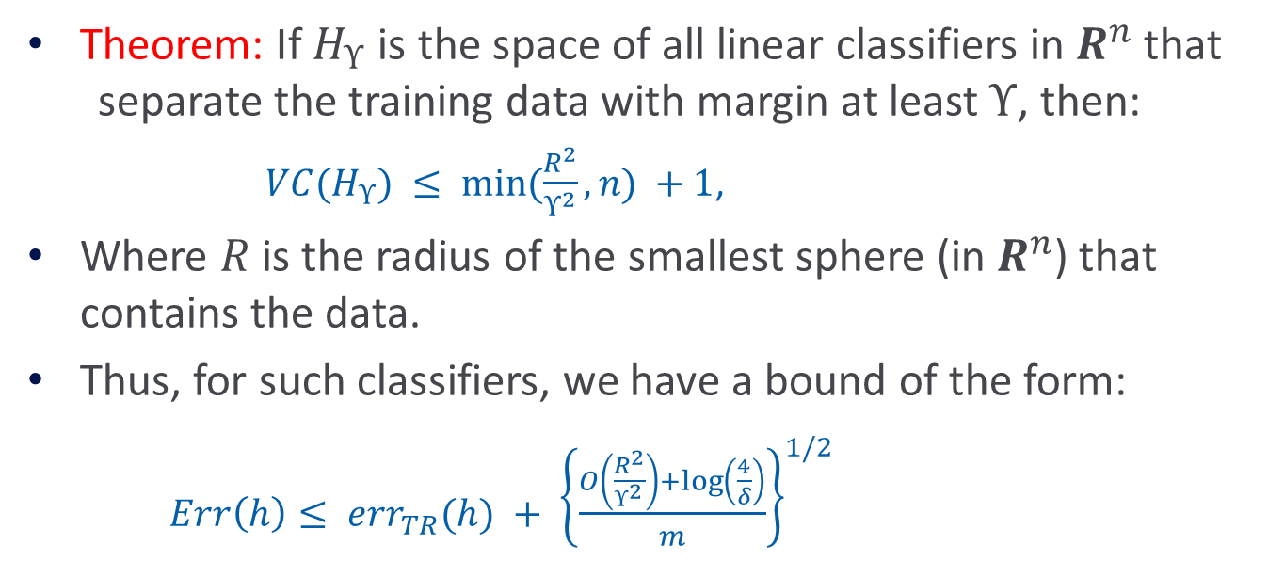
VC and Linear Classification
Theorem: If $H_{ϒ}$ is the space of all linear classifiers in $R^{n}$ that separate the training data with margin at least$ϒ$, then:
  $VC(H_{ϒ}) ≤ min⁡(\frac{R^{2}}{ϒ^{2}}, n) +1$,
Where $R$ is the radius of the smallest sphere (in $R^{n}$) that contains the data.
Thus, for such classifiers, we have a bound of the form:
  $Err\left(h\right)≤ err_{TR}(h) + {\left\{\frac{O\left(\frac{R^{2}}{ϒ^{2}}\right)+\log\left(\frac{4}{δ}\right)}{m}\right\}}^{1/2}$
In particular, you see here that for “general” linear separators of dimensionality n, the VC is n+1

Slide 12
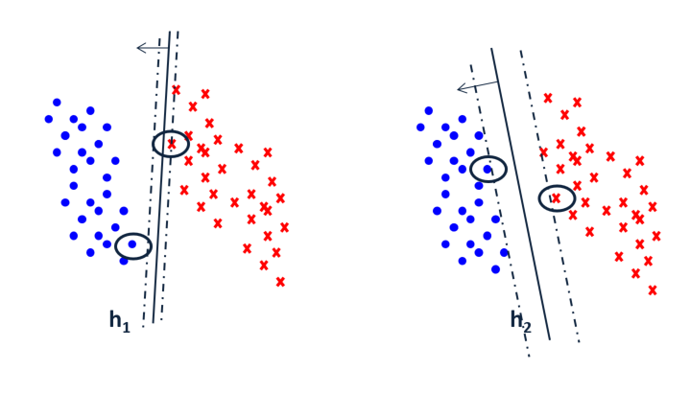
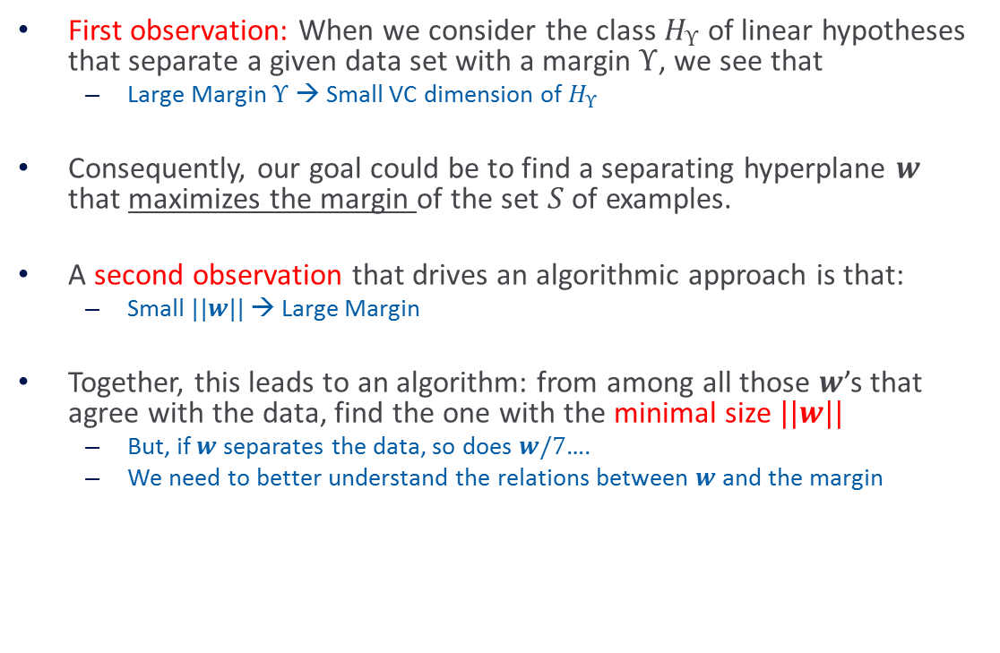
Towards Max Margin Classifiers
First observation: When we consider the class $H_{ϒ}$of linear hypotheses that separate a given data set with a margin $ϒ$, we see that
  Large Margin $ϒ$ → Small VC dimension of $H_{ϒ}$
Consequently, our goal could be to find a separating hyperplane $w$ that maximizes the margin of the set $S$ of examples.
A second observation that drives an algorithmic approach is that:
  Small $||w|| →$Large Margin
Together, this leads to an algorithm: from among all those $w$’s that agree with the data, find the one with the minimal size $||w||$
  But, if $w$ separates the data, so does $w/7$….
  We need to better understand the relations between $w$ and the margin
But, how can we do it algorithmically?

Slide 13
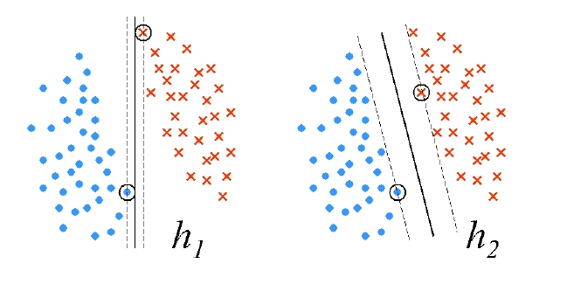

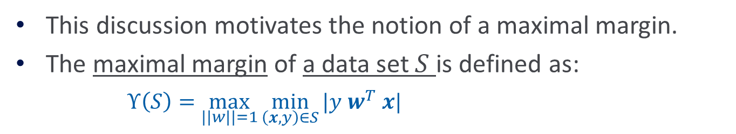

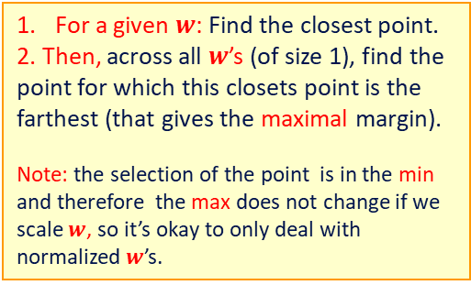
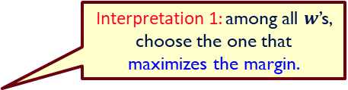
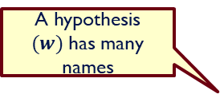
Maximal Margin
The distance between a point$x$and the hyperplane defined by $w$is: $|w^{T} x |/\left|\left|w\right|\right|$
This discussion motivates the notion of a maximal margin.
The maximal margin of a data set $S$ is defined as:
  $ϒ\left(S\right)=\max_{||w||=1}{\min_{\left(x,y\right)∈S}{|y w^{T} x|}}$
A hypothesis $(w)$has many names
For a given $w$: Find the closest point.
2. Then, across all $w$’s (of size 1), find the point for which this closets point is the farthest (that gives the maximal margin).
Note: the selection of the point is in the min and therefore the max does not change if we scale $w$, so it’s okay to only deal with normalized $w$’s.
Interpretation 1: among all $w$’s, choose the one that maximizes the margin.
How does it help us to derive these $h$’s?
$argmax_{\left|\left|w\right|\right|=1}\min_{(x,y) ∈ S}⁡|y wT x$|

Slide 14
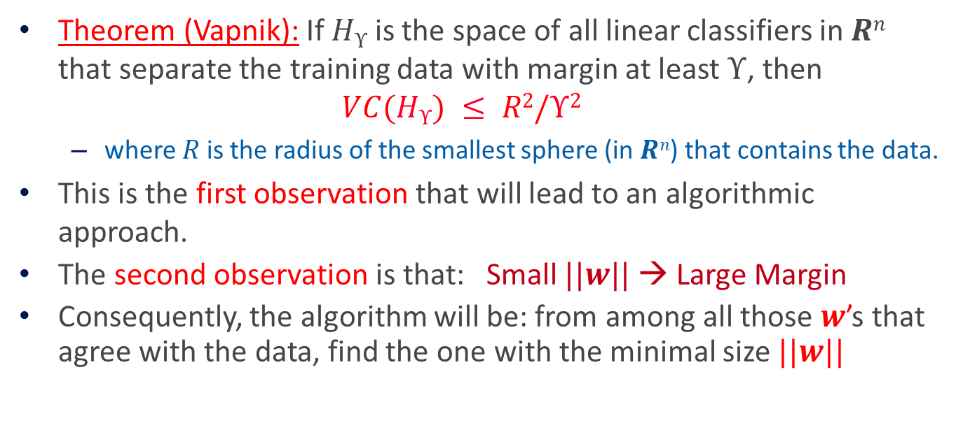
Recap: Margin and VC dimension
Theorem (Vapnik): If $Hϒ$is the space of all linear classifiers in $Rn$ that separate the training data with margin at least $ϒ$, then
$$VC(Hϒ) ≤ R2/ϒ2$$
  where $R$ is the radius of the smallest sphere (in $Rn$) that contains the data.
This is the first observation that will lead to an algorithmic approach.
The second observation is that: Small $||w|| →$ Large Margin
Consequently, the algorithm will be: from among all those $w$’s that agree with the data, find the one with the minimal size $||w||$
Believe
We’ll show this

Slide 15

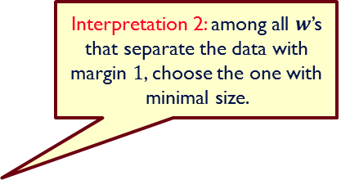
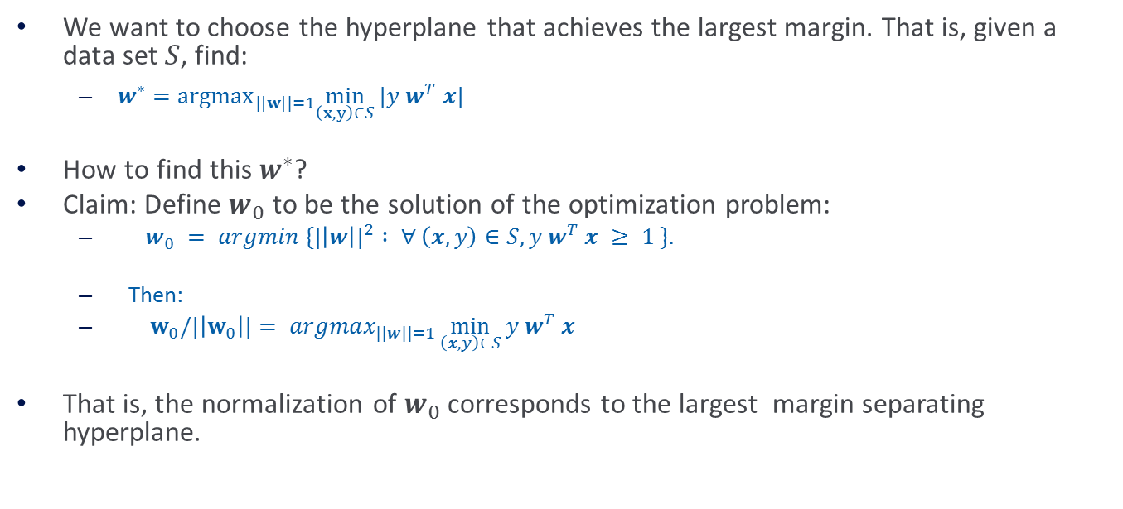
From Margin to $||w||$
We want to choose the hyperplane that achieves the largest margin. That is, given a data set $S$, find:
  $w^{∗}={argmax}_{|\left|w\right||=1}\min_{\left(x,y\right)∈S}⁡|y w^{T} x|$
How to find this $w^{∗}$?
Claim: Define $w_{0}$ to be the solution of the optimization problem:
  $w_{0} = argmin \{{|\left|w\right||}^{2} : ∀$ $\left(x,y\right)∈S, y w^{T} x ≥ 1 \}.$
  Then:
  $w_{0}/|\left|w_{0}\right||= argmax_{||w||=1}\min_{\left(x,y\right)∈S}{y w^{T} x}$
That is, the normalization of $w_{0}$ corresponds to the largest margin separating hyperplane.
Interpretation 2: among all $w$’s that separate the data with margin $1$, choose the one with minimal size.
The next slide will show that the two interpretations are equivalent

Slide 16







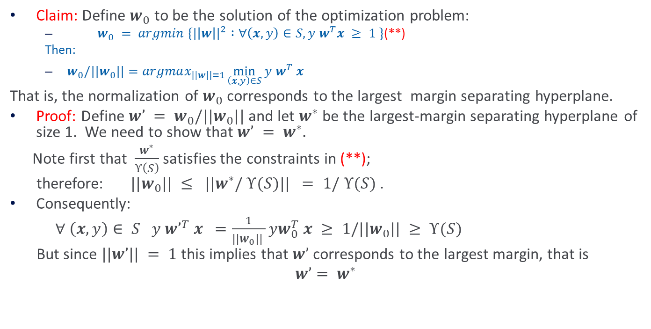

From Margin to $||w||$(2)
$$w^{∗}={argmax}_{|\left|w\right||=1}\min_{\left(x,y\right)∈S}⁡|y w^{T} x|$$
$$And, recall that ϒ\left(S\right) is the$$
$$maximal margin for the set S$$
Claim: Define $w_{0}$ to be the solution of the optimization problem:
  $w_{0} = argmin \{{|\left|w\right||}^{2} :∀\left(x,y\right)∈S, y w^{T}x ≥ 1 \}$(**)
  Then:
  $w_{0}/||w_{0}||=argmax_{|\left|w\right||=1}\min_{\left(x,y\right)∈S}{y w^{T} x}$
That is, the normalization of $w_{0}$ corresponds to the largest margin separating hyperplane.
Proof: Define $w’ = w_{0}/||w_{0}||$ and let $w^{∗}$ be the largest-margin separating hyperplane of size 1. We need to show that $w’ = w^{∗}.$
Note first that $\frac{w^{∗}}{ϒ\left(S\right)}$ satisfies the constraints in (**);
therefore: $||w_{0}|| ≤ ||w^{∗}/ ϒ(S)|| = 1/ ϒ(S)$ .
Consequently:
$∀$ $\left(x,y\right)∈ S y w’^{T} x =\frac{1}{{||w}_{0}|| }yw_{0}^{T} x ≥ 1/||w_{0}|| ≥ ϒ(S)$
But since $||w’|| = 1$this implies that $w’$ corresponds to the largest margin, that is
$$w’= w^{∗}$$
Def. of $w^{∗}$
Def. of $w0$
Def. of $w’$
Def. of $w0$
Prev. ineq.
Def. of $w∗$

Slide 17






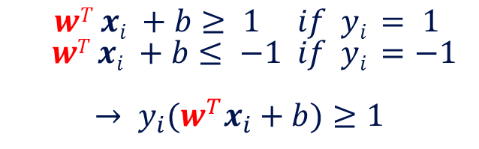
Margin of a Separating Hyperplane
Distance between
$wT x+b = +1 and −1$is $2/|\left|w\right||$
What we did:
Consider all possible $w$ with different angles
Scale $w$ such that the constraints are tight (closets points are on the +/-1 line)
Pick the one with largest margin/minimal size
A separating hyperplane: $wT x+b = 0$
Assumption: data is linearly separable
Let $(x0 ,y0)$be a point on $wTx+b = 1$
Then its distance to the separating plane $wT x+b = 0$is: $|wT x0 +b|/||w||= 1/||w||$
  $$wT xi +b≥ 1 if yi = 1$$
  $$wT xi +b≤ −1 if yi =−1$$
  $$→ y_{i}(w^{T}x_{i}+b)≥1$$
$$wT x+b = 0$$
$$wT x+b =−1$$

Slide 18
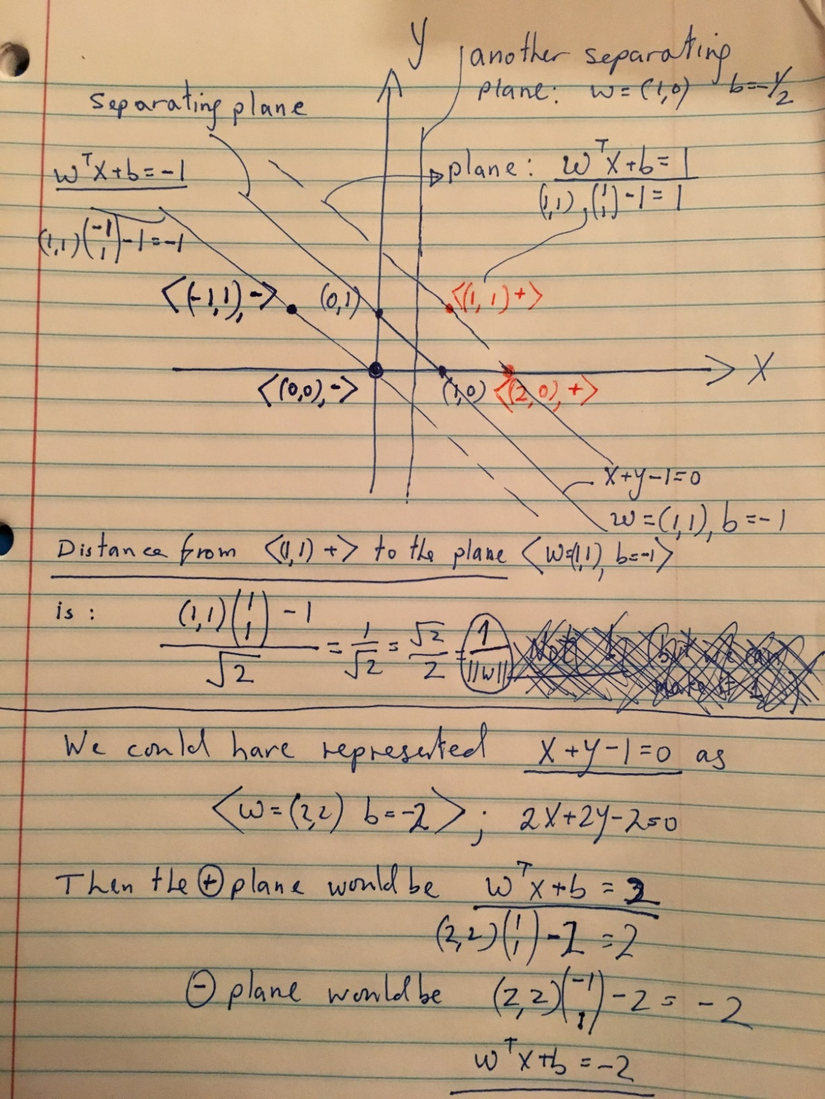
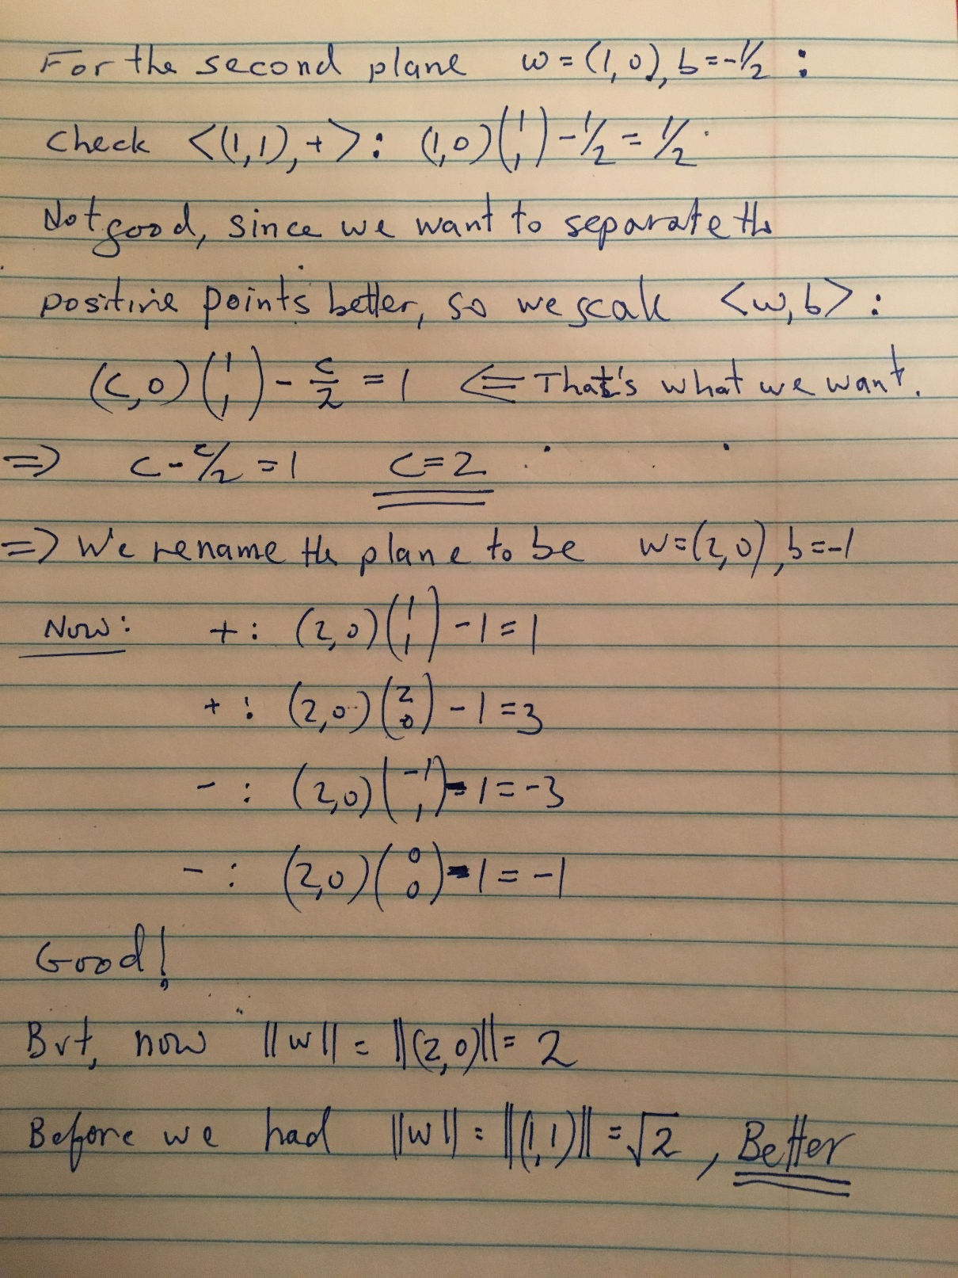

Slide 19
Administration (11/9/20)
Are we recording? YES!
Available on the web site
Remember that all the lectures are available on the website before the class
  Go over it and be prepared
  A new set of written notes will accompany most lectures, with some more details, examples and, (when relevant) some code.
HW 3: Due on 11/16/20
  You cannot solve all the problems yet.
  Less time consuming; no programming
Cheating
  Several problems in HW1 and HW2

Slide 20
Projects
CIS 519 students need to do a team project: Read the project descriptions
  Teams will be of size 2-4
  We will help grouping if needed
There will be 3 projects.
  Natural Language Processing (Text)
  Computer Vision (Images)
  Speech (Audio)
In all cases, we will give you datasets and initial ideas
  The problem will be multiclass classification problems
  You will get annotated data only for some of the labels, but will also have to predict other labels
  0-zero shot learning; few-shot learning; transfer learning
A detailed note will come out today.
Timeline:
  11/11 Choose a project and team up
  11/23 Initial proposal describing what your team plans to do
  12/2 Progress report
  12/15-20 (TBD) Final paper + short video
Try to make it interesting!

Slide 21
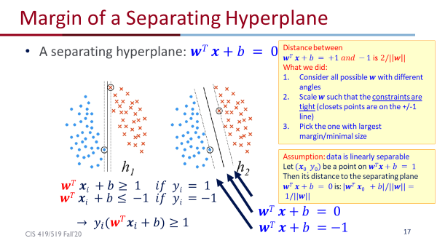
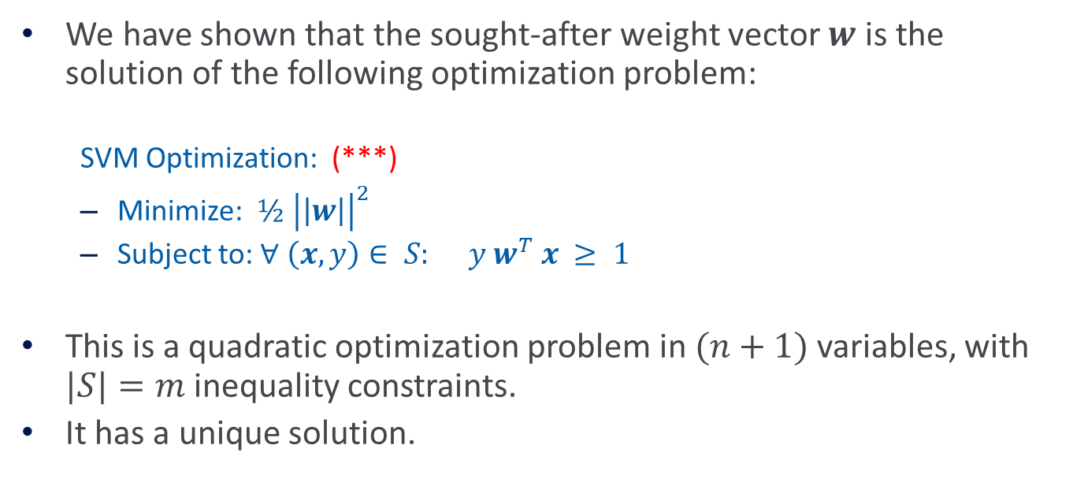
Hard SVM Optimization
We have shown that the sought-after weight vector $w$ is the solution of the following optimization problem:
  SVM Optimization: (***)
  Minimize: $½ {\left|\left|w\right|\right|}^{2}$
  Subject to: $∀$ $\left(x,y\right)∈ S: y w^{T} x ≥ 1$
This is a quadratic optimization problem in $(n+1)$ variables, with $|S|=m$inequality constraints.
It has a unique solution.

Slide 22
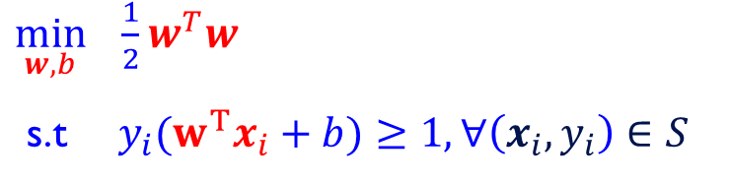

Maximal Margin
The margin of a linear separator
$wT x+b = 0$ is $\frac{1}{||w||}$
$\max{\frac{1}{||w||}}= min⁡||w||$
$$= min⁡½ wTw$$
  $\min_{w,b} \frac{1}{2}w^{T}w$
  s.t $y_{i}{(w}^{T}x_{i}+b)≥1, ∀\left(x_{i},y_{i}\right)∈S$

Slide 23
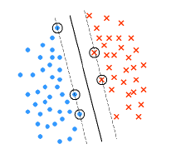
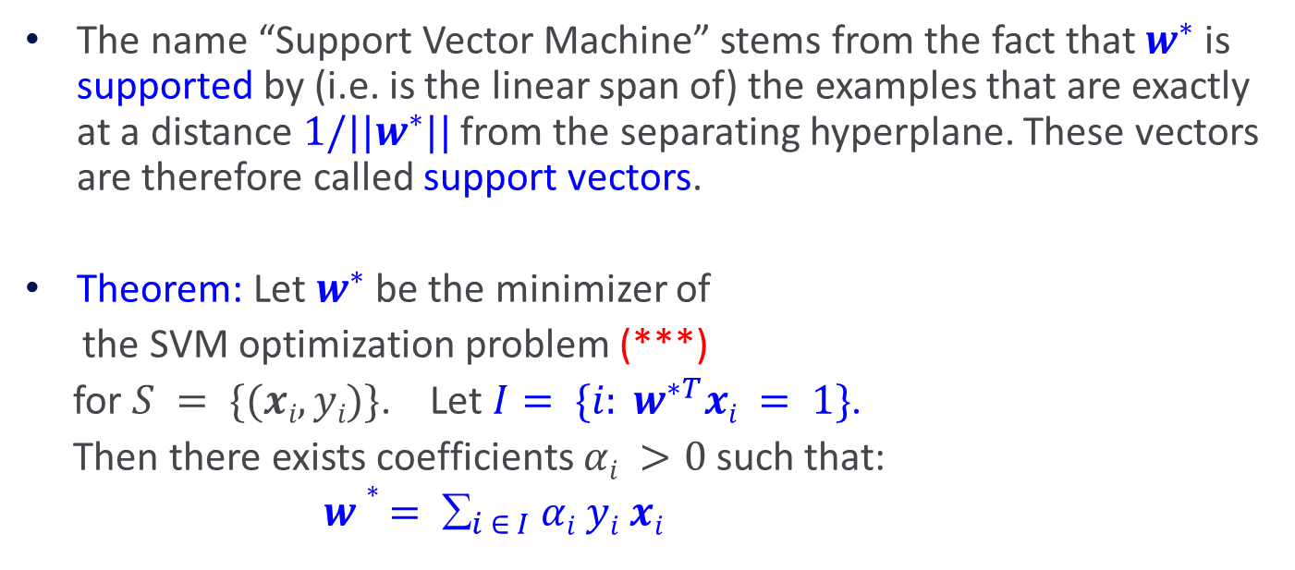
Support Vector Machines
The name “Support Vector Machine” stems from the fact that $w^{∗}$is supported by (i.e. is the linear span of) the examples that are exactly at a distance $1/||w^{∗}||$from the separating hyperplane. These vectors are therefore called support vectors.
Theorem: Let $w^{∗}$be the minimizer of
the SVM optimization problem (***)
for $S = \{(xi, yi)\}$. Let $I= \{i: w^{∗T}xi = 1\}$.
Then there exists coefficients $αi >0$such that:
$w∗ = _{i ∈ I} αi yi xi$
This representation should ring a bell…

Slide 24
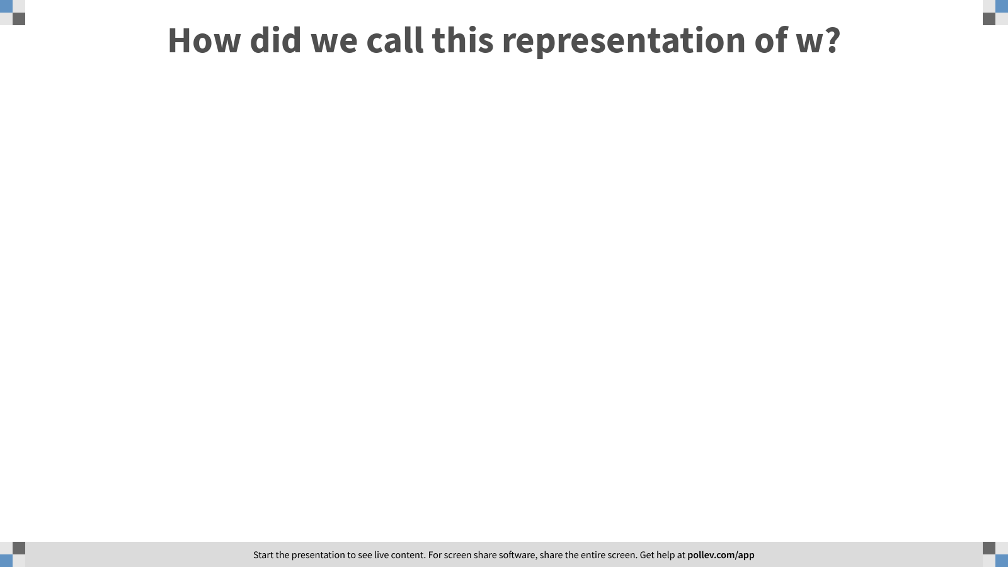
Notes:
Poll Title: How did we call this representation of w?
https://www.polleverywhere.com/free_text_polls/7e9ET5R4raA5hWeWqPHHu

Slide 25
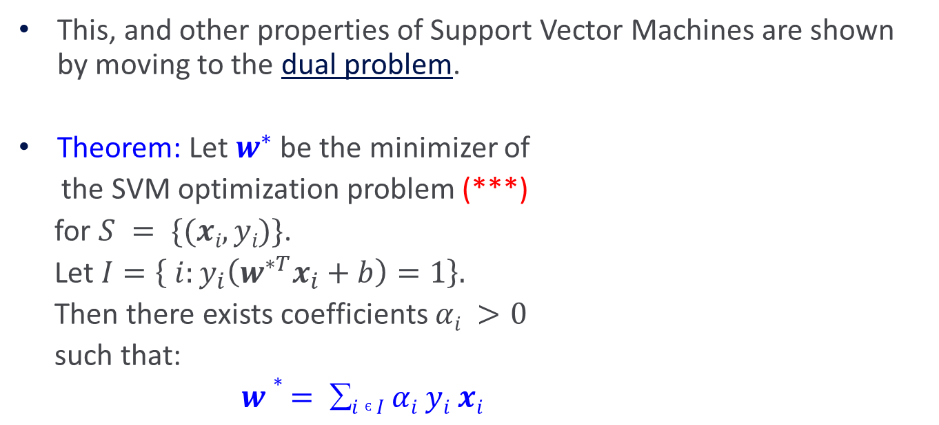
Duality
This, and other properties of Support Vector Machines are shown by moving to the dual problem.
Theorem: Let $w^{∗}$ be the minimizer of
the SVM optimization problem (***)
for $S = \{(xi, yi)\}$.
Let $I=\left\{ i:y_{i}\left(w^{∗T}x_{i}+b\right)=1\right\}.$
Then there exists coefficients $αi >0$
such that:
$w∗ = i Є I αi yi xi$

Slide 26
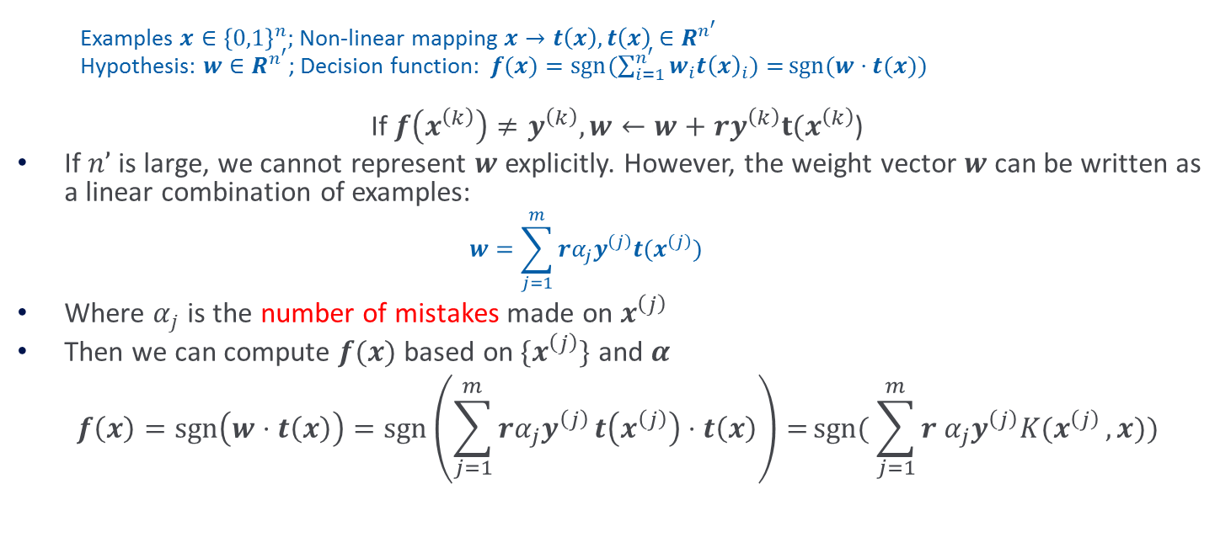
(recap) Kernel Perceptron
  Examples $x∈{\left\{0,1\right\}}^{n};$ Non-linear mapping $x→t\left(x\right), t\left(x\right)∈R^{n^{′}}$
  Hypothesis: $w∈R^{n^{′}}$; Decision function:$f(x)=\operatorname{sgn}{(\sum_{i=1}^{n^{′}}{w_{i}t{\left(x\right)}_{i})=}}sgn⁡(w⋅t(x))$
If $f\left(x^{\left(k\right)}\right)≠y^{\left(k\right)}, w←w+ry^{\left(k\right)}t(x^{\left(k\right)}$)
If $n’$is large, we cannot represent $w$ explicitly. However, the weight vector $w$ can be written as a linear combination of examples:
  $$w=\sum_{j=1}^{m}{rα_{j}y^{\left(j\right)}t(x^{\left(j\right)})}$$
Where $α_{j}$ is the number of mistakes made on $x^{\left(j\right)}$
Then we can compute $f(x)$ based on${ \{x}^{\left(j\right)}\}$ and $α$
$$f\left(x\right)=\operatorname{sgn}\left(w⋅t\left(x\right)\right)=\operatorname{sgn}\left(\sum_{j=1}^{m}{rα_{j}y^{\left(j\right)}}t\left(x^{\left(j\right)}\right)⋅t\left(x\right)\right)=sgn( \sum_{j=1}^{m}{r α_{j}y^{\left(j\right)}K(x^{\left(j\right)}},x))$$

Slide 27
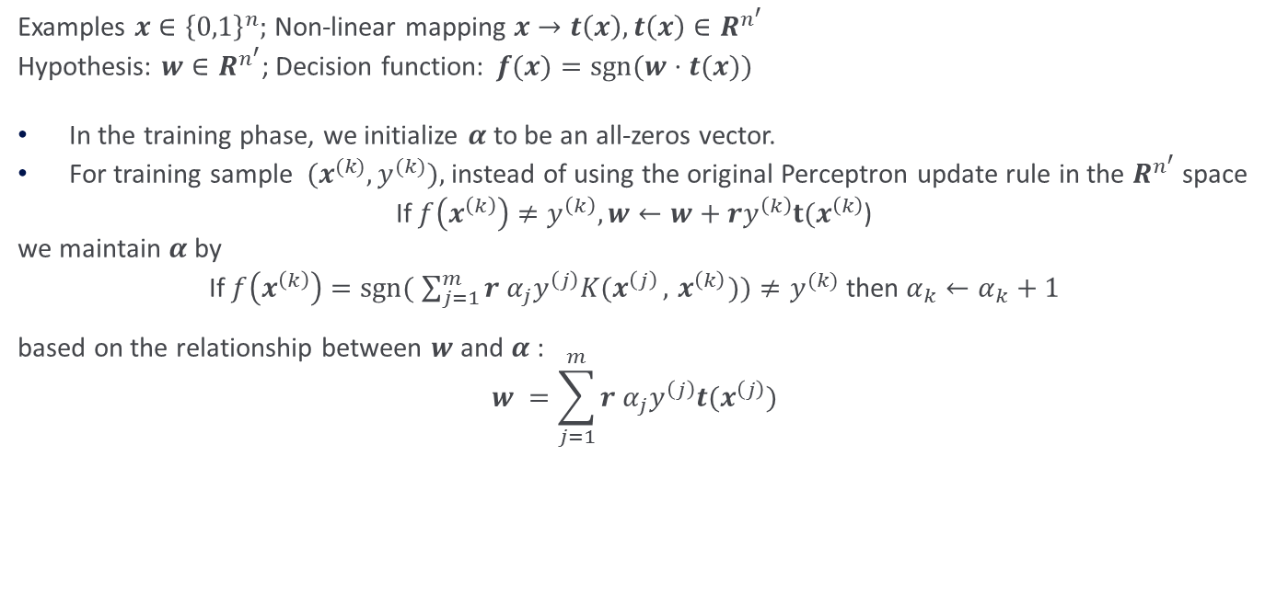
(recap) Kernel Perceptron
Examples $x∈{\left\{0,1\right\}}^{n};$ Non-linear mapping $x→t\left(x\right), t\left(x\right)∈R^{n^{′}}$
Hypothesis: $w∈R^{n^{′}}$; Decision function:$f(x)=sgn⁡(w⋅t(x))$
In the training phase, we initialize $α$ to be an all-zeros vector.
For training sample ${ (x}^{(k)}, y^{(k)}),$ instead of using the original Perceptron update rule in the $R^{n^{′}}$ space
If $f\left(x^{\left(k\right)}\right)≠y^{\left(k\right)}, w←w+ry^{\left(k\right)}t(x^{\left(k\right)}$)
we maintain $α$by
If $f\left(x^{\left(k\right)}\right)=sgn( \sum_{j=1}^{m}{r α_{j}y^{\left(j\right)}K(x^{\left(j\right)}},{ x}^{\left(k\right)}))≠y^{(k)}$ then $α_{k}←α_{k}+1$
based on the relationship between $w$ and $α$:
$$w =\sum_{j=1}^{m}{r α_{j}y^{\left(j\right)}t(x^{\left(j\right)})}$$

Slide 28
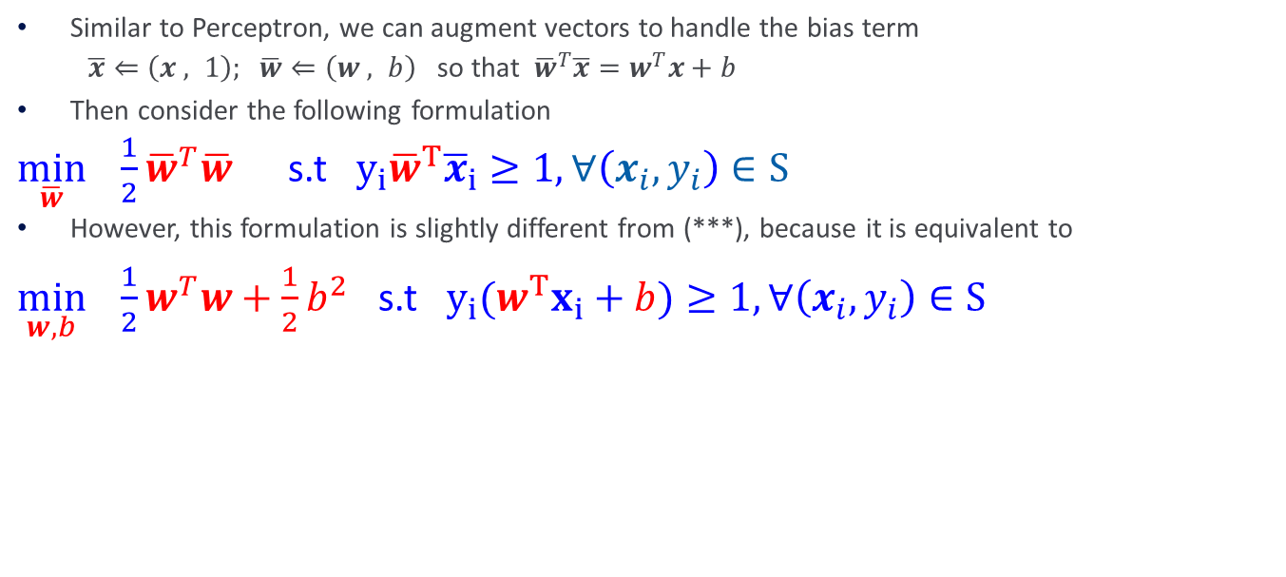
Footnote about the threshold
Similar to Perceptron, we can augment vectors to handle the bias term
$\overline{x}⇐\left(x , 1\right); \overline{w}⇐\left(w , b\right)$ so that ${\overline{w}}^{T}\overline{x}=w^{T}x+b$
Then consider the following formulation
  $\min_{\overline{w}} \frac{1}{2}{\overline{w}}^{T}\overline{w}$ s.t$y_{i}{\overline{w}}^{T}{\overline{x}}_{i}≥1, ∀\left(x_{i},y_{i}\right)∈S$
However, this formulation is slightly different from (***), because it is equivalent to
  $\min_{w,b} \frac{1}{2}w^{T}w+\frac{1}{2}b^{2}$ s.t$y_{i}(w^{T}x_{i}+b)≥1, ∀\left(x_{i},y_{i}\right)∈S$
The bias term is included in the regularization.
This usually doesn’t matter
For simplicity, we ignore the bias term

Slide 29
Key Issues
Computational Issues
  Training of an SVM used to be is very time consuming – solving quadratic program.
  Modern methods are based on Stochastic Gradient Descent and Coordinate Descent and are much faster.
Is it really optimal?
  Is the objective function we are optimizing the “right” one?

Slide 30
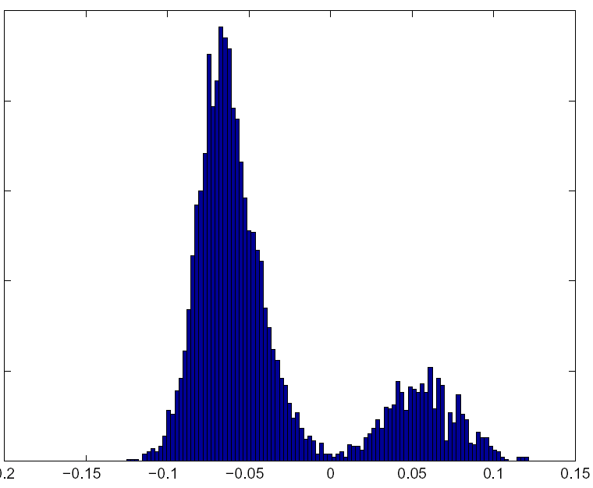
Real Data
17,000 dimensional context sensitive spelling
Histogram of distance of points from the hyperplane
In practice, even in the separable case, we may not want to depend on the points closest to the hyperplane but rather on the distribution of the distance. If only a few are close, maybe we can dismiss them.

Slide 31
Soft SVM
The hard SVM formulation assumes linearly separable data.
A natural relaxation:
  maximize the margin while minimizing the # of examples that violate the margin (separability) constraints.
However, this leads to non-convex problem that is hard to solve.
Instead, we relax in a different way, that results in optimizing a surrogate loss function that is convex.

Slide 32
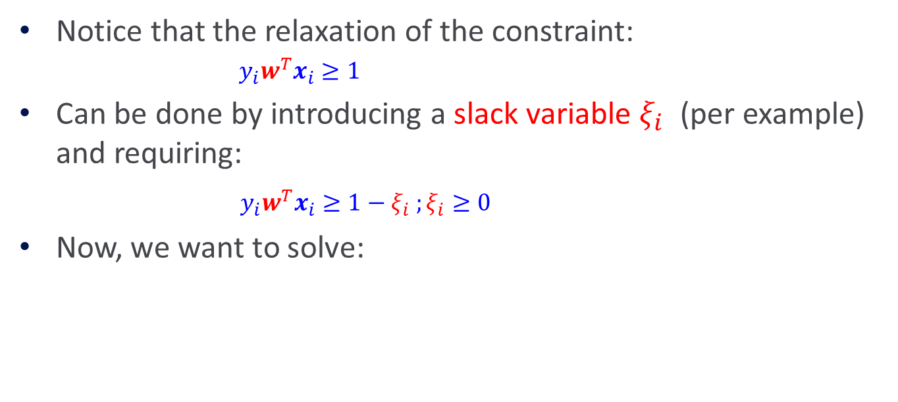
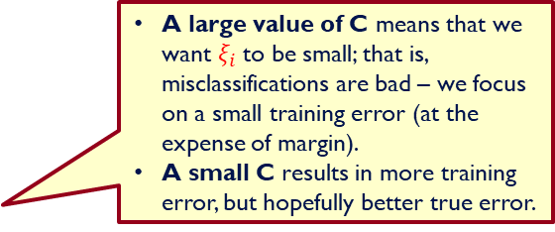
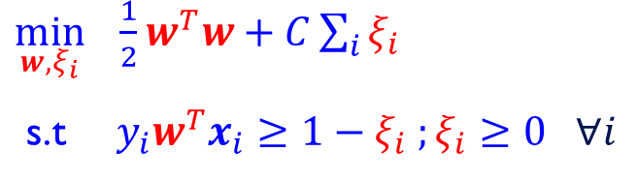
Soft SVM
Notice that the relaxation of the constraint:
$y_{i}w^{T}x_{i}≥1$
Can be done by introducing a slack variable $ξ_{i}$ (per example) and requiring:
$y_{i}w^{T}x_{i}≥1−ξ_{i} ;ξ_{i}≥0$
Now, we want to solve:
A large value of C means that we want $ξ_{i}$to be small; that is, misclassifications are bad – we focus on a small training error (at the expense of margin).
A small C results in more training error, but hopefully better true error.
  $\min_{w, ξ_{i}} \frac{1}{2}w^{T}w+C\sum_{i}{ξ_{i}}$
  s.t $y_{i}w^{T}x_{i}≥1−ξ_{i} ;ξ_{i}≥0 ∀i$
Notes:
What is the value of slack variable when the data point is classified correctly?

Slide 33
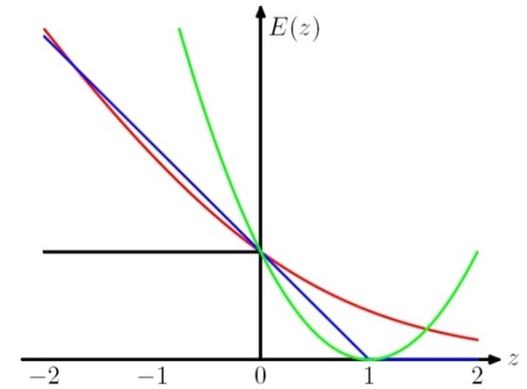
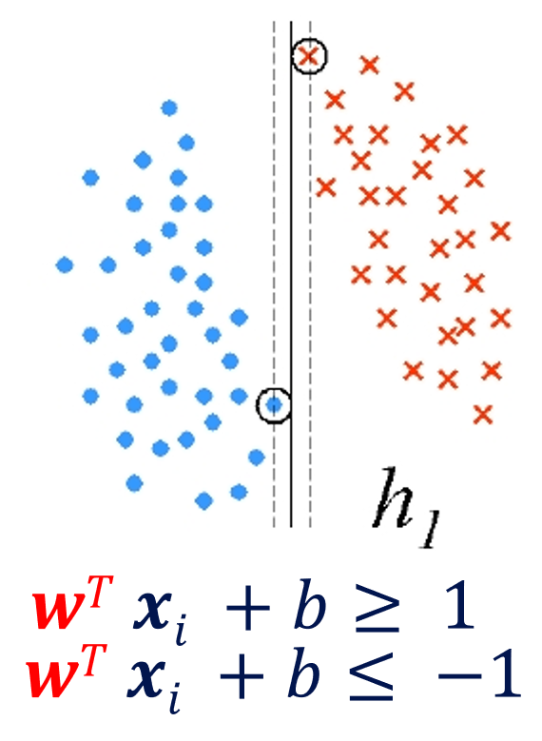

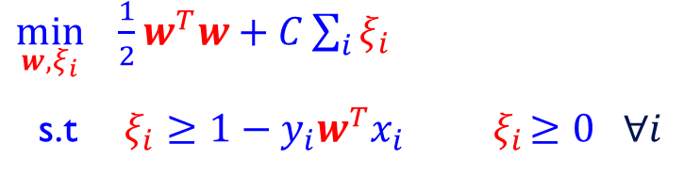

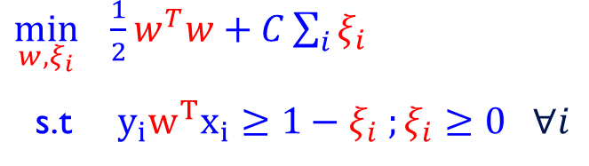
Soft SVM (2)
Now, we want to solve:
Which can be written as:
$$\min_{w} \frac{1}{2}w^{T}w+C\sum_{i}{\max{(0, 1−y_{i}w^{T}x_{i})}}.$$
What is the interpretation of this?
  $\min_{w, ξ_{i}} \frac{1}{2}w^{T}w+C\sum_{i}{ξ_{i}}$
  s.t $y_{i}w^{T}x_{i}≥1−ξ_{i} ;ξ_{i}≥0 ∀i$
  $\min_{w, ξ_{i}} \frac{1}{2}w^{T}w+C\sum_{i}{ξ_{i}}$
  s.t$ξ_{i}≥1−y_{i}w^{T}x_{i}{ ξ}_{i}≥0 ∀i$
In optimum, $ξ_{i}=max⁡(0, 1−y_{i} w^{T} x_{i})$

Slide 34
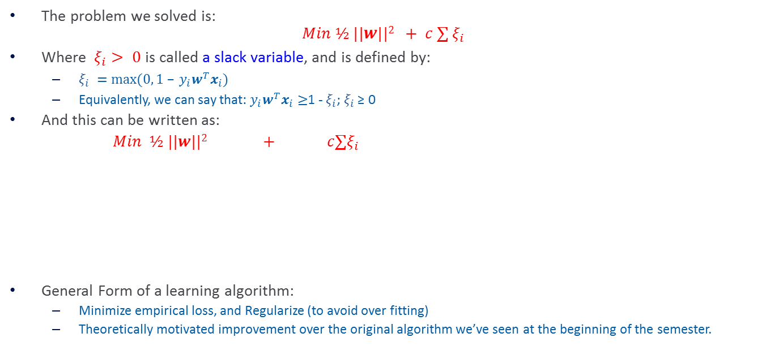
SVM Objective Function
The problem we solved is:
$$Min ½ ||w||2 + c ∑ ξ_{i}$$
Where $ξ_{i}> 0$is called a slack variable, and is defined by:
  $ξ_{i} =max⁡(0, 1 – y_{i}w^{T}x_{i})$
  Equivalently, we can say that: $y_{i}w^{T}x_{i}≥$1 - $ξ_{i}$; $ξ_{i}$ ≥ 0
And this can be written as:
$Min ½ ||w||2 + c∑ξ_{i}$
General Form of a learning algorithm:
  Minimize empirical loss, and Regularize (to avoid over fitting)
  Theoretically motivated improvement over the original algorithm we’ve seen at the beginning of the semester.
Regularization term
Empirical loss
Can be replaced by other regularization functions
Can be replaced by other loss functions

Slide 35
Balance between regularization and empirical loss

Slide 36
Balance between regularization and empirical loss
(DEMO)

Slide 37
Underfitting and Overfitting
Underfitting
Overfitting
Expected
Error
Variance
Bias
Model complexity
High Empirical Error
Low Empirical Error
Simple models:
High bias and low variance
Complex models:
High variance and low bias
Smaller C
Larger C

Slide 38
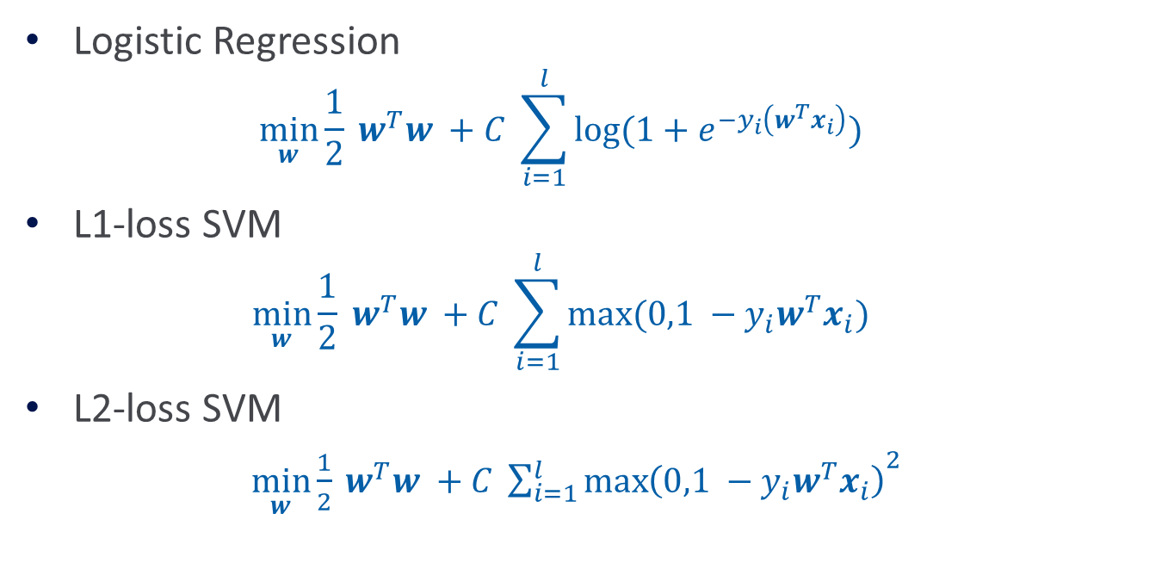
What Do We Optimize?
Logistic Regression
  $$\min_{w}{\frac{1}{2} w^{T}w} +C \sum_{i=1}^{l}{log⁡(1+e^{{−y}_{i}\left(w^{T}x_{i}\right)})}$$
L1-loss SVM
  $$\min_{w}{\frac{1}{2} w^{T}w} +C \sum_{i=1}^{l}{max⁡(0,1 −y_{i}w^{T}x_{i})}$$
L2-loss SVM
  $\min_{w}{\frac{1}{2} w^{T}w} +C {\sum_{i=1}^{l}{\max\left(0,1 −y_{i}w^{T}x_{i}\right)}}^{2}$

Slide 39
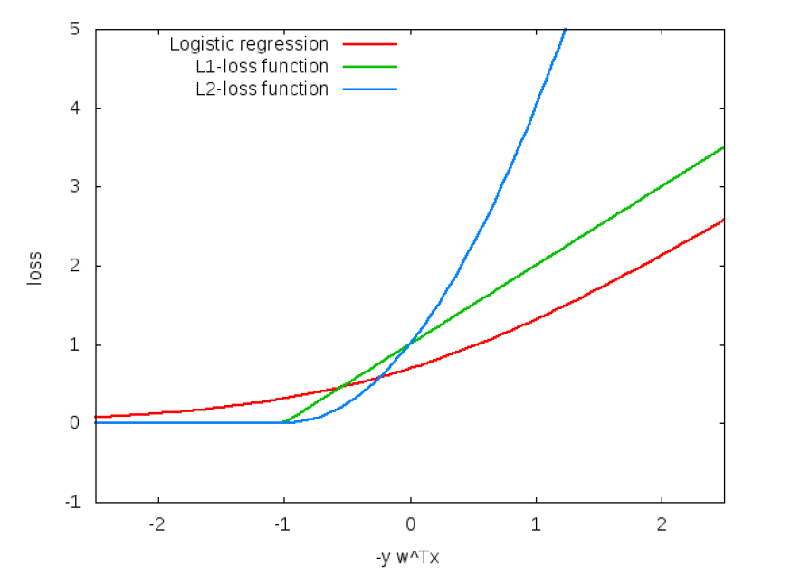
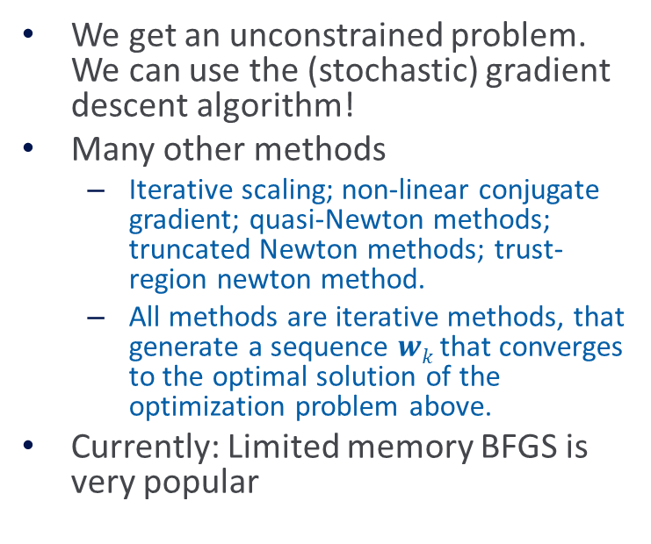
What Do We Optimize(2)?
We get an unconstrained problem. We can use the (stochastic) gradient descent algorithm!
Many other methods
  Iterative scaling; non-linear conjugate gradient; quasi-Newton methods; truncated Newton methods; trust-region newton method.
  All methods are iterative methods, that generate a sequence $wk$ that converges to the optimal solution of the optimization problem above.
Currently: Limited memory BFGS is very popular

Slide 40
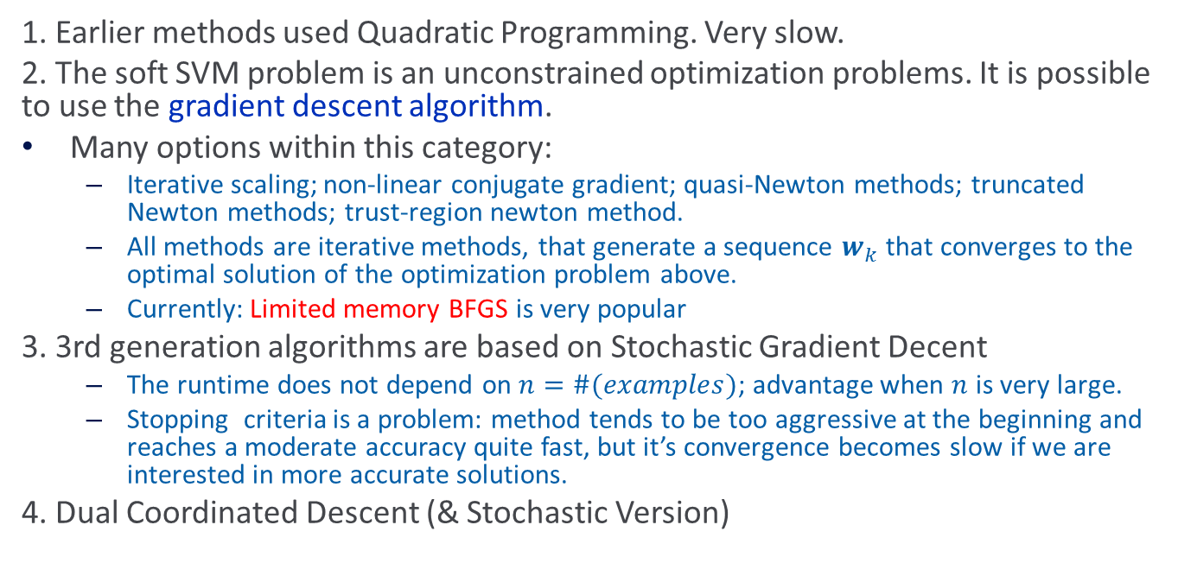
Optimization: How to Solve
1. Earlier methods used Quadratic Programming. Very slow.
2. The soft SVM problem is an unconstrained optimization problems. It is possible to use the gradient descent algorithm.
Many options within this category:
  Iterative scaling; non-linear conjugate gradient; quasi-Newton methods; truncated Newton methods; trust-region newton method.
  All methods are iterative methods, that generate a sequence $w_{k}$ that converges to the optimal solution of the optimization problem above.
  Currently: Limited memory BFGS is very popular
3. 3rd generation algorithms are based on Stochastic Gradient Decent
  The runtime does not depend on $n=\#(examples)$; advantage when $n$ is very large.
  Stopping criteria is a problem: method tends to be too aggressive at the beginning and reaches a moderate accuracy quite fast, but it’s convergence becomes slow if we are interested in more accurate solutions.
4. Dual Coordinated Descent (& Stochastic Version)

Slide 41



SGD for SVM
Goal: $\min_{w} f\left(w\right)≡ \frac{1}{2}w^{T}w+\frac{C}{m}\sum_{i}{\max\left(0, 1−y_{i}w^{T}x_{i}\right)}$ $m$: data size
Compute sub-gradient of $f(w):$
$∇f\left(w\right)=w−Cy_{i}x_{i}$ if ${1−y_{i}w}^{T}x_{i}≥0$ ; otherwise $∇f\left(w\right)=w$
$m$ is here for mathematical correctness, it doesn’t matter in the view of modeling.
  Initialize $w=0∈R^{n}$
2. For every example $(x_{i},y_{i} )∈D$
If $y_{i}w^{T}x_{i}≤1$ update the weight vector to
$w←w−γ(w−Cy_{i}x_{i})=\left(1−γ\right)w+γ{Cy}_{i}x_{i}$ ($γ$ - learning rate)
Otherwise $w←(1−γ)w$
  Continue until convergence is achieved
Convergence can be proved for a slightly complicated version of SGD (e.g, Pegasos)
This algorithm should ring a bell…

Slide 42




Nonlinear SVM
We can map data to a high dimensional space: $x→φ(x)$ (DEMO)
Then use Kernel trick: $K\left(x_{i},x_{j}\right)=φ{\left(x_{i}\right)}_{}^{T}φ\left(x_{j}\right)$ (DEMO2)
Primal
$$\min_{w}{\frac{1}{2}w^{T}w}+C \sum_{i}{ξ_{i} }$$
s.t $y_{i}w^{T}φ\left(x_{i}\right)≥1 −ξ_{i}$
$$ξ_{i}≥0 ∀i$$
Dual
$$\min_{α }{\frac{1}{2}α^{T}Qα}−e^{T}α$$
s.t $0≤α≤C ∀i$
$$Q_{ij}=y_{i}y_{j}K{(x}_{i},x_{j})$$
Theorem: Let $w^{∗}$be the minimizer of the primal problem, $α^{∗} be the minimizer of the dual problem.$
Then $w^{∗}=\sum_{i}{α^{∗}y_{i}x_{i}}$

Slide 43
Nonlinear SVM
Tradeoff between training time and accuracy
Complex model vs. simple model
From: http://www.csie.ntu.edu.tw/~cjlin/papers/lowpoly_journal.pdf

Slide 44



PEGASOS
$$|A_{t}| = 1$$
Stochastic gradient
Input: training set $S=\left\{{(x}_{1},y_{1}\right),…, (x_{m},y_{m})\},$
Regularization parameter $λ$
Number of iterations $T$
Initialize: Choose $w_{1}$ s.t. ${||w}_{1}||≤\frac{1}{\sqrt{λ}}$
For $t=1,2,…,T$
Choose $A_{t}⊆S$
$$A_{t}^{+}=\{\left(x,y\right)∈A_{t} :y(w_{t},x) <1\}$$
$$∇_{t}=λw_{t} −η_{t}/{|A}_{t}| \sum_{\left(x,y\right)∈A_{t}}{+ yx}$$
$$η_{t}=\frac{1}{tλ}$$
$$w_{t}^{′}=w_{t} −η_{t}∇_{t}$$
$$w_{t+1}=\min\left\{1,\frac{\frac{1}{\sqrt{λ}}}{\left|\left|w_{t}^{′}\right|\right|}\right\}w_{t}^{′}$$
Output: $w_{T+1}$
$$At = S$$
Subgradient method
LibSVM has a version that is called LibLinear that implements similar ideas in the dual space.
At this point these work only for linear kernels
Not a real problem.
Subgradient
Projection

Slide 45

Support Vector Machines – Short Summary
SVM = Linear Classifier + Regularization + [Kernel Trick].
Typically we are looking for the best $w$:
  $$wopt = argminw \sum_{1}^{m}{L(f(x,w,b),y)}$$
  Where $L$ is a loss function that penalizes $f$ when it makes a mistake.
Typically, L is the 0-1 loss (hinge-loss):
  $$L(y’, y)= ½ |y – sgn⁡y’| (y, y’∈\{−1,1\})$$
Just optimizing with respect to the training data may lead to overfitting. We want to achieve good performance on the training while maintaining some notion of “simple” hypothesis. We therefore change our goal to:
  $$wopt = argminw \sum_{1}^{m}{L(f(x,w,b),y) +λ R(w) }$$
  Where $L$ is a loss function, and $R$ is a regularization function, which penalizes $w$ that results in a model that is too complex (high VC dimension). $$ determines the tradeoff between the empirical error and the regularization.

Slide 46

Support Vector Machines – Short Version
SVM = Linear Classifier + Regularization + [Kernel Trick].
This leads to an algorithm: from among all those $w$’s that agree with the data, find the one with the minimal size $||w||$
Minimize $½ ||w||2$
Subject to: $y\left(w⋅x + b\right)≥1$, for all $x∈ S$
This is an optimization problem that can be solved using techniques from optimization theory. By introducing Lagrange multipliers α we can rewrite the dual formulation of this optimization problems as:
$$w =\sum_{i}{α_{i}y^{i}x^{i}}$$
Where the α’s are such that the following functional is maximized:
$L\left(α\right) = −\frac{1}{2} \sum_{i}{\sum_{j}{α1 αj x^{i} xj yi yj}} + ∑i αi$
The optimum setting of the $$’s turns out to be:
$i yi \left(w⋅x^{i}+b −1 \right)= 0 ∀ i$

Slide 47

Support Vector Machines – Short Version
SVM = Linear Classifier + Regularization + [Kernel Trick].
Minimize $½ ||w||2$
Subject to: $y\left(w⋅ x + b\right)¸ 1, for all x∈ S$
The dual formulation of this optimization problems gives:
$$w =\sum_{i}{αi y^{i}x^{i} }$$
Optimum setting of α’s : $i y_{i} \left(w⋅ xi +b −1 \right)= 0 ∀ i$
That is, $i≠0$only when $w⋅xi +b −1=0$
Those are the points sitting on the margin, call support vectors
We get:
$$f\left(x,w,b\right)= w⋅ x +b =\sum_{i}{αi yi xi⋅ x +b }$$
The value of the function depends on the support vectors, and only on their dot product with the point of interest $x$.
Dependence on the dot product leads to the ability to introduce kernels (just like in perceptron)
What if the data is not linearly separable?
What is the difference from regularized perceptron/Winnow?

Slide 48
SVM Notes
Chp. 5 of “Support Vector Machine” [Cristianini and Shawe-Taylor] provides an introduction to the theory of Optimization required in order to understand SVMs.

Slide 49

Optimization
We are interested in finding the minimum or a maximum of a function, typically subject to some constraints.
The general problem is:
Minimize $f\left(w\right),w∈ R^{n}$
Subject to $g_{i}\left(w\right)≤ 0, i=1,…k$
$h_{i}(w) = 0, i=1,…m$
An Inequality constraint $g_{i}\left(w\right)≤ 0$is called active if the solution $w^{∗}$ satisfies $g_{i}(w^{∗}) = 0$
An inequality constraint can be transformed into an equality constraint by introducing a slack variable: optimization
$$g_{i}\left(w\right)≤ 0 g_{i}\left(w\right)+ ξ_{i} = 0, ξ≥ 0$$

Slide 50
Optimization Problems
An optimization problem in which the objective function and the constraints are linear is called a linear program.
If the objective function is quadratic and the constraints linear it is called a quadratic program.
If the objective function, the constraints and the domain of the functions are convex, that problem is a convex optimization problem.

Slide 51

Convexity
A real valued function $f(w)$ is called convex for $w∈ R^{n}$if, $∀ w,u∈ R^{n}$, and for any $a∈ (0,1):$
$$f\left(aw + \left(1−a\right)u\right)≤ af(w) + (1−a) f(u)$$
Claim: If a function is convex, any local minimum $w^{∗}$ of the unconstrained optimization problem with objective function $f$ is also a global minimum.
Proof: Take any $u≠w^{∗}.$By the definition of the local minimum there exists a sufficiently close to 1 that
$$f\left(w^{∗}\right)≤ f\left(aw^{∗}+ \left(1−a\right)u\right)≤ af(w^{∗}) + (1−a) f(u)$$
Where the first inequality is a result of the assumption of local minimum and the second is from the convexity assumption. But that implies (algebra) that $f\left(w^{∗}\right)≤ f(u)$
This is important. It renders optimization problems tractable when the functions involved are convex.
f(w)
f(u)
w
u

Slide 52

Solving Optimization Problems (1)
Theorem 1:
A necessary condition for $w^{∗}$ to be a minimum of $f∈ C$, is
$\frac{df\left(w^{∗}\right)}{d\left(w\right)} =0$.
This condition, together with convexity, is also a sufficient solution.

Slide 53

Constrained Optimization Problems
Solved by converting constrained problems to unconstrained problems.
When the problems are constrained, there is a need to define the Lagrangian function, which incorporates information about both the objective function and the constraints, and which can be used to detect solutions.
The Lagrangian is defined as the objective function plus a linear combination of the constraints, where the coefficients of the combination are call the Lagrange multipliers.
Given an optimization problem with objective function $f(w),$and equality constraints $h_{i}(w)=0, i=1,…,m$, we define the Lagrangian function as:
  $$L\left(w,β\right)= f\left(w\right)+ ∑_{i=1}^{m} β_{i} h_{i}(w)$$
where the coefficients $_{i}$are called the Lagrange multipliers.

Slide 54

Constrained Optimization Problems (2)
If $w^{∗}$is a local minimum for an optimization problem with only equality constraints, it is possible that $\frac{df\left(w^{∗}\right)}{d\left(w\right)}≠ 0$(so, w/o constraints it would not be a candidate for extreme point) but that the direction in which we could move to reduce $f$ would violate one or more of the constraints.
In order to respect the equality constraints $h_{i}$ we must move in directions that are perpendicular to$\frac{dh_{i}\left(w^{∗}\right)}{dw}$, that is they do not change the constraints.
Therefore, in order to respect all the constraints we must move perpendicular to the subspace $V$ spanned by: $\frac{dh_{i}\left(w^{∗}\right)}{dw}, (i =1,m)$
So, we make the constrained problem be an unconstrained one in which we require that there exists $b_{i}$ such that
  $$\frac{df\left(w^{∗}\right)}{dw} + ∑_{i=1}^{m} β_{i}\frac{dh_{i}\left(w^{∗}\right)}{dw} = 0$$

Slide 55

Constrained Optimization Problems (3)
Theorem 2 (Lagrange):
A necessary condition for $w^{∗}$to be a minimum for an optimization problem with objective $f(w)$ and equality constraints $h_{i} (1,…,m)$ is:
$$\frac{df\left(w^{∗}\right)}{dw}+ ∑_{i=1}^{m} β_{i}\frac{dh_{i}\left(w^{∗}\right)}{dw} = 0$$
For some values $^{∗}$. These conditions are also sufficient provided that $L(w,^{∗})$is also a convex function of $w$.
Another way to write it is $\frac{L\left(w^{∗},β\right)}{dw} =0$
The first condition results in a new system of equations. The second, returns the equality constraints. By solving jointly the two systems, one obtains the solution.

Slide 56

Lagrange Theorem: Example
Consider the standard problem of finding the largest volume box with a given surface area. Let the sides of the box be $u,v,w$.
Optimization problem
Minimize: $− uvw$
Subject to: $wu+uv+vw=c$
The Lagrangian: $L = −uvw + (uv+wu+vw−c)$
Necessary conditions:
  $$\frac{dL}{dw}= −uv+β\left(u+v\right);\frac{dL}{du}= −wv+β\left(w+v\right);\frac{dL}{dv}= −uw+β(u+w)$$
Solving the equations gives $β v(w−u) =β w (u−v) = 0$,
implying that the only non trivial solution is $w=v=u={\left(\frac{c}{3}\right)}^{\frac{1}{2}}$

Slide 57

Example (Maximum Entropy Distribution)
Suppose we wish to find the discrete probability distribution
$p= (p_{1},p_{2},…p_{n})$with maximal entropy $H\left(p\right)= −∑_{i=1}^{n} p_{i} log⁡\{p_{i}\}.$
The optimization problem: minimize $−H(p)$, subject to $_{i=1}^{n} p_{i}=1$
  $$L(p,β) =_{i=1}^{n} p_{i} log⁡\{p_{i}\}+β(_{i=1}^{n} p_{i} −1 )$$
Differentiating, we get: $log⁡\{e p_{i}) +β = 0 (i=1,…n)$
Which implies that all the $p_{i}$’ s are the same $p=(1/n…1/n)$.
It is not hard to show that the function $H(p)$ is convex, so the uniform distribution is the global solution.

Slide 58

General Optimization Problems
We now move to the general case, where the optimization problem contains both equality and inequality constraints. Define the generalize Lagrangian:
$$L\left(w,α, β\right)= f\left(w\right)+ ∑_{i=1}^{k} α_{i} g_{i}\left(w\right)+ ∑_{i=1}^{m} β_{i} h_{i}(w)$$
Theorem 3 (Kuhn-Tucker):Given an optimization problem on $R^{n}$:
Minimize $f\left(w\right), w∈ R^{n}$
Subject to $g_{i}\left(w\right)≤ 0, i=1,…k$
$h_{i}(w) = 0, i=1,…m$
Necessary and sufficient conditions for $w^{∗}$to be an optimum are the existence of $^{∗}$, $^{∗}$ such that:
$$\frac{dL\left(w^{∗}, α^{∗}, β^{∗} \right)}{dw} =\frac{dL\left(w^{∗}, α^{∗}, β^{∗} \right)}{dβ} = 0$$
And
  $$_{i}^{∗} g_{i}(w^{∗}) = 0 i=1,…,k$$
  $g_{i}\left(w^{∗}\right)≤ 0 i=1,…,k$
  $_{i}^{∗}≥ 0 i=1,…,k$

Slide 59

General Optimization Problems (2)
The last conditions are called KKT: Karush-Kuhn-Tucker conditions.
  $_{i}^{∗} g_{i}(w^{∗}) = 0 i=1,…,k$
  $g_{i}\left(w^{∗}\right)≤ 0 i=1,…,k$
  $_{i}^{∗}≥ 0 i=1,…,k$
It implies that solutions can be in one of two positions with respect to the inequality constraints.
Either the solution is in the interior of the feasible region, so that the constraint is inactive $(g_{i}\left(w^{∗}\right)≤ 0)$, or on the boundary defined by that constraints, which is active. In the first case, the $_{i}′$s need to be zero. In the second case, the constraint is active $(g_{i}(w^{∗}) = 0),$and $_{i}$can be non-zero. This condition will give rise to the notion of support vectors.

