Slide 1
Neural Networks and Deep Learning Part I
Dan Roth,
danroth@seas.upenn.edu|http://www.cis.upenn.edu/~danroth/|461C, 3401 Walnut
Slides were created by Dan Roth (for CIS519/419 at Penn or CS446 at UIUC), or by other authors who have made their ML slides available.

Slide 2
Administration (11/16/20)
Are we recording? YES!
Available on the web site
Remember that all the lectures are available on the website before the class
Go over it and be prepared
A new set of written notes will accompany most lectures, with some more details, examples and, (when relevant) some code.
HW 3: Due Today
HW4: Out today – NNs, and Bayesian Learning; Due 12/2
Recitations will be devoted to introducing you to PyTorch
Cheating
Several problems in HW1 and HW2
Projects
Most of you have chosen a project and a team.

Slide 3
Projects
CIS 519 students need to do a team project: Read the project descriptions
Teams will be of size 2-4
We will help grouping if needed
There will be 3 projects.
Natural Language Processing (Text)
Computer Vision (Images)
Speech (Audio)
In all cases, we will give you datasets and initial ideas
The problem will be multiclass classification problems
You will get annotated data only for some of the labels, but will also have to predict other labels
0-zero shot learning; few-shot learning; transfer learning
A detailed note will come out today.
Timeline:
11/11 Choose a project and team up
11/23 Initial proposal describing what your team plans to do
12/2 Progress report
12/15-20 (TBD) Final paper + short video
Try to make it interesting!

Slide 4
Functions Can be Made Linear
Data is not linearly separable in one dimension
Not separable if you insist on using a specific class of functions
$$x$$

Slide 5
Blown Up Feature Space
Data are separable in $<x, x^{2}>$space
$$x2$$
$$x$$

Slide 6
Neural Networks
Multi-layer networks were designed to overcome the computational (expressivity) limitation of a single threshold element.
Linear Threshold Unit
Output
Hidden
Input
$$y=sign(∑w_{i}x_{i} − T)$$

Slide 7
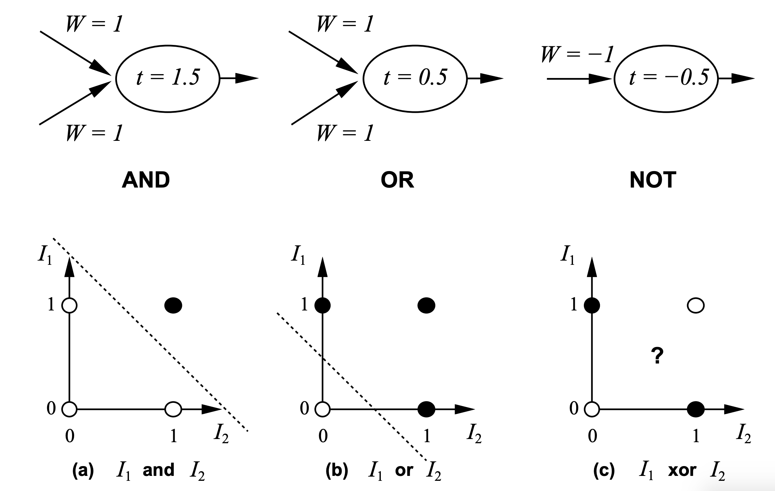
History: Neural Computation
McCulloch and Pitts (1943) showed how linear threshold units can be used to compute logical functions
$$y=sign(∑w_{i}I_{i} − T)$$

Slide 8
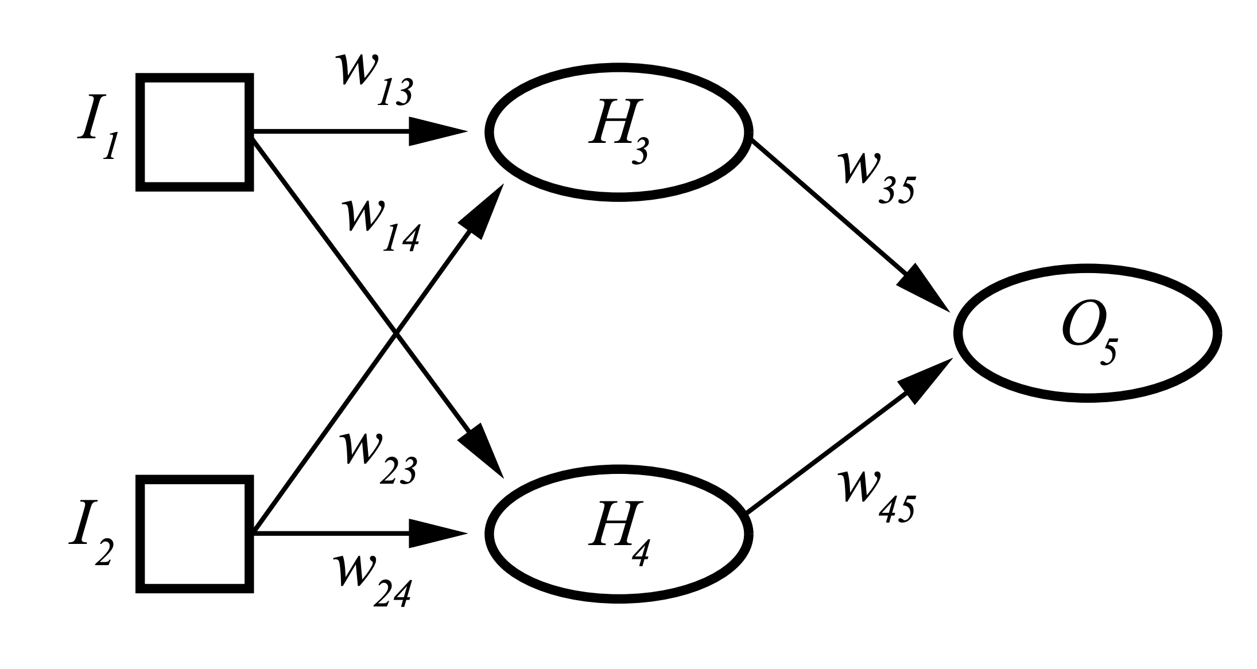
History: Neural Computation
But XOR?
Two Layered Two Unit Network

Slide 9
Neural Networks
Multi-layer networks were designed to overcome the computational (expressivity) limitation of a single threshold element.
Linear Threshold Unit
Output
Hidden
Input

Slide 10
Neural Networks
Multi-layer networks were designed to overcome the computational (expressivity) limitation of a single threshold element.
The idea is to stack several layers of threshold elements, each layer using the output of the previous layer as input.
Multi-layer networks can represent arbitrary functions, but building effective learning methods for such network was [thought to be] difficult.
Output
Hidden
Input

Slide 11
Neural Networks
Neural Networks are functions: $NN:X→Y$
where $X={\left[0,1\right]}^{n}$, or $ℝ^{n}$ and $Y=[0,1], \{0,1\}$
Robust approach to approximating real-valued, discrete-valued and vector valued target functions.
$$T_{3}$$
$H_{3}=sign(\left(w_{13}I_{1}+w_{23}I_{2}\right)−T_{3}$)
$H_{4}=sign(\left(w_{14}I_{1}+w_{24}I_{2}\right)−T_{4}$)
$O_{5}=sign(\left(w_{35}H_{3}+w_{45}H_{4}\right)−T_{5}$)
Trainable Parameters:
$w_{13},w_{14}, w_{23}, w_{24}, w_{35}, w_{45}, T_{3},T_{4}$, $T_{5}$
$$T_{5}$$
$$T_{4}$$

Slide 12
Neural Networks
Neural Networks are functions: $NN:X→Y$
where $X={\left[0,1\right]}^{n}$, or $ℝ^{n}$ and $Y=[0,1], \{0,1\}$
Robust approach to approximating real-valued, discrete-valued and vector valued target functions.
Among the most effective general purpose supervised learning method currently known.
Effective especially for complex and hard to interpret input data such as real-world sensory data, where a lot of supervision is available.
Learning:
The Backpropagation algorithm for neural networks has been shown successful in many practical problems

Slide 13
Motivation for Neural Networks
Inspired by biological neural network systems
But are not identical to them
We are currently on rising part of a wave of interest in NN architectures, after a long downtime from the mid-90-ies.
Better computer architecture (parallelism on GPUs & TPUs)
A lot more data than before; in many domains, supervision is available.

Slide 14
Motivation for Neural Networks
One potentially interesting perspective:
We used to think about NNs only as function approximators.
Geoffrey Hinton introduced “Restricted Boltzman Machines” (RBMs) in the mid 2000s – method to learn high-level representations of input
Many other ideas focusing in the Intermediate Representations of NNs
Ideas are being developed on the value of these intermediate representations for transfer learning, for the meaning they represent etc.
We will present in the next two lectures a few of the basic architectures and learning algorithms, and provide some examples for applications

Slide 15
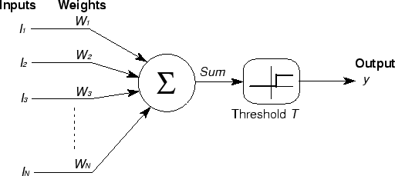
Basic Unit in Multi-Layer Neural Network
Threshold units: $o_{j}=sgn⁡(w⋅x−T)$introduce non-linearity
But not differentiable,
Hence unsuitable for learning via Gradient Descent
activation
Output
Hidden
Input

Slide 16
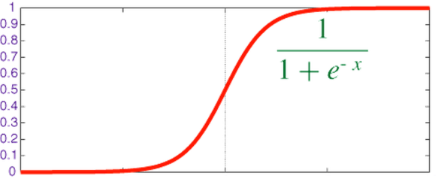
Logistic Neuron / Sigmoid Activation
Neuron is modeled by a unit $j$ connected by weighted links $w_{ij}$ to other units $i$.
Use a non-linear, differentiable output function such as the sigmoid or logistic function
Net input to a unit is defined as:
Output of a unit is defined as:
$$x_{1}$$
$$x_{2}$$
$$x_{3}$$
$$x_{4}$$
$$x_{5}$$
$$x_{6}$$
$$w_{1j}$$
$$x_{j}$$
$$o_{j}$$
$$w_{6j}$$
$${net}_{j}=∑w_{ij}⋅x_{i}$$
$$o_{j}=σ\left(net_{j}\right)=\frac{1}{1+exp\left(− {(net}_{j}−T_{j})\right)}$$

Slide 17
Representational Power
Any Boolean function can be represented by a two layer network (simulate a two layer AND-OR network)
Any bounded continuous function can be approximated with arbitrary small error by a two layer network.
Sigmoid functions provide a set of basis functions from which arbitrary function can be composed.
Any function can be approximated to arbitrary accuracy by a three layer network.

Slide 18
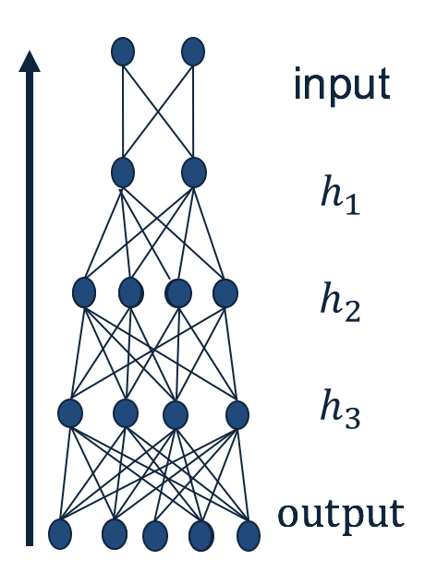
Quiz Time!
Given a neural network, how can we make predictions?
Given input, calculate the output of each layer (starting from the first layer), until you get to the output.
What is required to fully specify a neural network?
The weights.
Why NN predictions can be quick?
Because many of the computations could be parallelized.
What makes a neural networks expressive?
The non-linear units.

Slide 19
Training a Neural Net

Slide 20
History: Learning Rules
Hebb (1949) suggested that if two units are both active (firing) then the weights between them should increase:
$w_{ij}=w_{ij}+Ro_{i}o_{j}$
$R$ and is a constant called the learning rate
Supported by physiological evidence
Rosenblatt (1959) suggested that when a target output value is provided for a single neuron with fixed input, it can incrementally change weights and learn to produce the output using the Perceptron learning rule.
assumes binary output units; single linear threshold unit
Led to the Perceptron Algorithm
See: http://people.idsia.ch/~juergen/who-invented-backpropagation.html

Slide 21
Two layer Two Unit Neural Network
$H_{3}=σ(\left(w_{13}I_{1}+w_{23}I_{2}\right)−T_{3}$)
$H_{4}=σ(\left(w_{14}I_{1}+w_{24}I_{2}\right)−T_{4}$)
$O_{5}=σ(\left(w_{35}H_{3}+w_{45}H_{4}\right)−T_{5}$)
Trainable Parameters:
$w_{13},w_{14}, w_{23}, w_{24}, w_{35}, w_{45}, T_{3},T_{4}$, $T_{5}$
$$T_{3}$$
$$T_{5}$$
$$T_{4}$$

Slide 22
Gradient Descent
We use gradient descent to determine the weight vector that minimizes some scalar valued loss function $Err\left(w^{\left(j\right)}\right)$;
Fixing the set $D$ of examples, $Err$ is a function of $w^{\left(j\right)}$
At each step, the weight vector is modified in the direction that produces the steepest descent along the error surface.
$Err(w)$
$$w$$
$w_{3}$ $w_{2}$ $w_{1}$ $w_{0}$

Slide 23
Backpropagation Learning Rule
Since there could be multiple output units, we define the error as the sum over all the network output units.
$Err\left(w\right)=\frac{1}{2}\sum_{d∈D}{\sum_{k∈K}{}{\left(t_{kd}−o_{kd}\right)}^{2}}$
where $D$ is the set of training examples,
$K$ is the set of output units
This is used to derive the (global) learning rule which performs gradient descent in the weight space in an attempt to minimize the error function.
$$Δw_{ij}=−R\frac{∂E}{∂w_{ij}}$$
$o_{1}$…$o_{k}$
$$(1, 0, 1, 0, 0)$$

Slide 24
Learning with a Multi-Layer Perceptron
It’s easy to learn the top layer – it’s just a linear unit.
Given feedback (truth) at the top layer, and the activation at the layer below it, you can use the Perceptron update rule (more generally, gradient descent) to updated these weights.
The problem is what to do with the other set of weights – we do
not get feedback in the intermediate layer(s).
activation
Output
w²_{ij}
Hidden
w¹_{ij}
Input

Slide 25
Learning with a Multi-Layer Perceptron
The problem is what to do with the other set of weights – we do not get feedback in the intermediate layer(s).
Solution: If all the activation functions are differentiable, then the output of the network is also a differentiable function of the input and weights in the network.
Define an error function (e.g., sum of squares) that is a differentiable function of the output, i.e. this error function is also a differentiable function of the weights.
We can then evaluate the derivatives of the error with respect to the weights, and use these derivatives to find weight values that minimize this error function, using gradient descent (or other optimization methods).
This results in an algorithm called back-propagation.
activation
Output
w²_{ij}
Hidden
w¹_{ij}
Input

Slide 26
Notes:
Poll Title: What is the chain rule for differentiating a composite function? d/dx(f(g(x)) = https://www.polleverywhere.com/free_text_polls/3aKqz7h6Hldbc7soOgm7i

Slide 27
Chain Rule
$\frac{df}{dx}$= $\frac{df}{dg}$ $\frac{dg}{dx}$

Slide 28
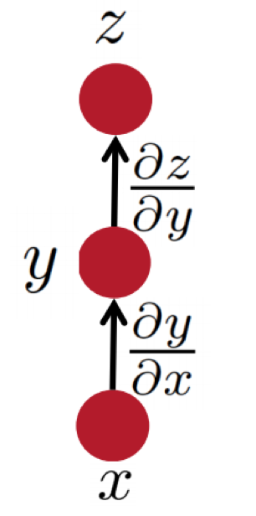
Some facts from real analysis
First let’s get the notation right:
The arrow shows functional dependence of $z$on $y$
i.e. given $y$, we can calculate$z$.
e.g., for example:$z(y) = 2y^{2}$
The derivative of $z$, with respect to $y$.

Slide 29
Some facts from real analysis
Simple chain rule
If $z$ is a function of $y$, and $y$ is a function of $x$
Then $z$ is a function of $x$, as well.
Question: how to find $\frac{∂z}{∂x}$
We will use these facts to derive the details of the Backpropagation algorithm.
$z$ will be the error (loss) function.
- We need to know how to differentiate$z$
$\frac{∂z}{∂x}=\frac{∂z}{∂y}$ $\frac{∂y}{∂x}$
Intermediate nodes use a logistics function (or another differentiable step function).
- We need to know how to differentiate it.

Slide 30
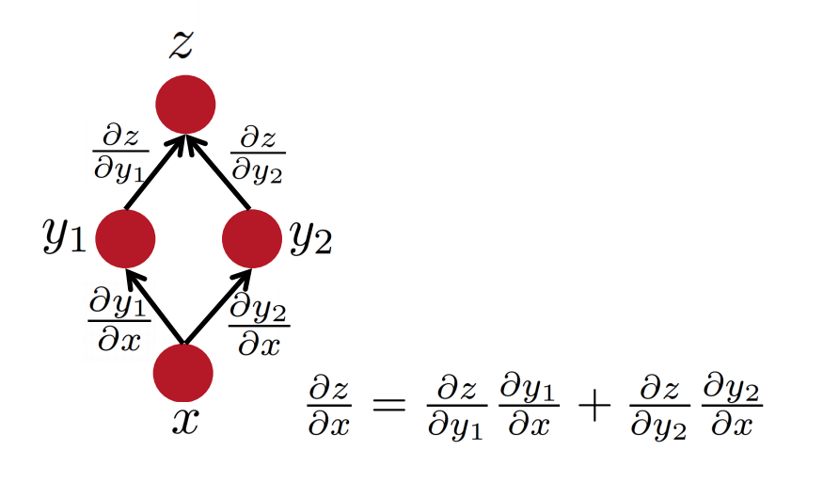
Some facts from real analysis
Multiple path chain rule
$\frac{∂z}{∂x }=\frac{∂z}{∂y_{1} }$ $\frac{∂y_{1}}{∂x }+\frac{∂z}{∂y_{2} }$ $\frac{∂y_{2}}{∂x }$
Slide Credit: Richard Socher

Slide 31
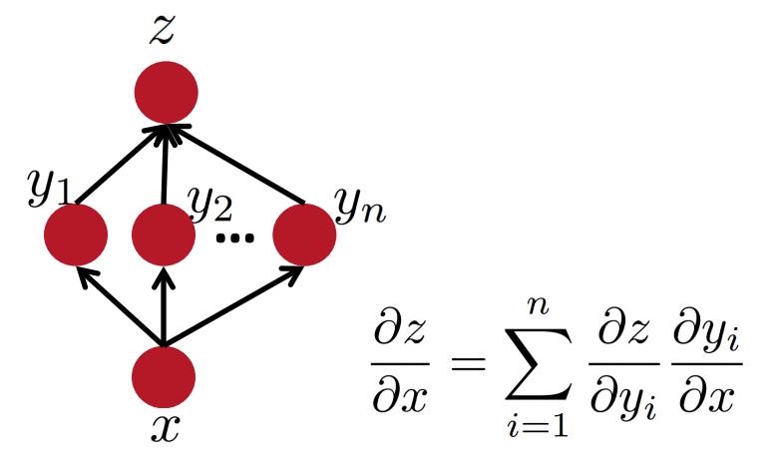
Some facts from real analysis
Multiple path chain rule: general
$$\frac{∂z}{∂x }=\sum_{i=1}^{n}{\frac{∂z}{∂y_{i} } \frac{∂y_{i}}{∂x }}$$
Slide Credit: Richard Socher

Slide 32
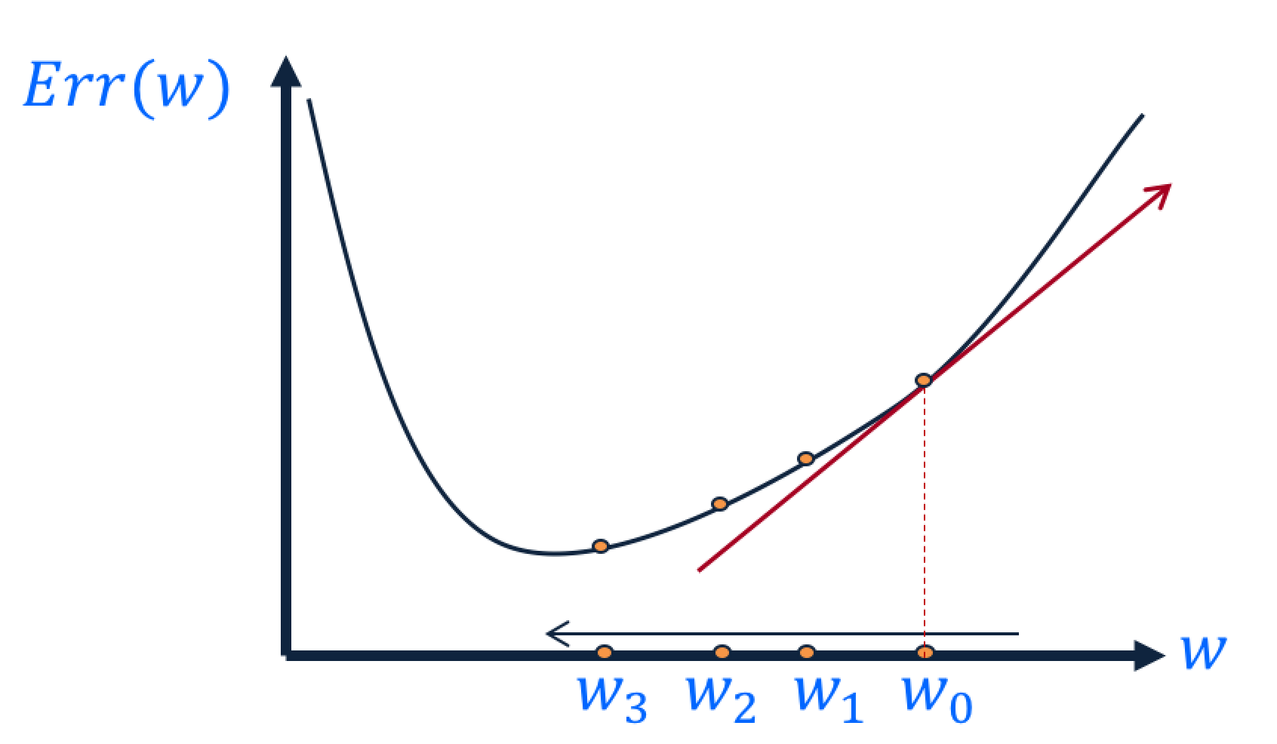
Key Intuitions Required for BP
Gradient Descent
Change the weights in the direction of gradient to minimize the error function.
Chain Rule
Use the chain rule to calculate the weights of the intermediate weights
Dynamic Programming (Memoization)
Memoize the weight updates to make the updates faster.
output
$$h_{1}$$
$$h_{2}$$
$$h_{3}$$
input
$$\frac{∂E}{∂w_{ij}}$$

Slide 33
Backpropagation: the big picture
Loop over instances:
The forward step
Given the input, make predictions layer-by-layer, starting from the first layer)
The backward step
Calculate the error in the output
Update the weights layer-by-layer, starting from the final layer
output
$$h_{1}$$
$$h_{2}$$
$$h_{3}$$
input
$$\frac{∂E}{∂w_{ij}}$$

Slide 34
Quiz time!
What is the purpose of forward step?
To make predictions, given an input.
What is the purpose of backward step?
To update the weights, given an output error.
Why do we use the chain rule?
To calculate gradient in the intermediate layers.
Why backpropagation could be efficient?
Because it can be parallelized.
output
$$h_{1}$$
$$h_{2}$$
$$h_{3}$$
input

Slide 35
Deriving the update rules

Slide 36
Reminder: Model Neuron (Logistic)
Neuron is modeled by a unit $j$ connected by weighted links $w_{ij}$ to other units $i$.
Use a non-linear, differentiable output function such as the sigmoid or logistic function
Net input to a unit is defined as:
Output of a unit is defined as:
$$x_{1}$$
$$x_{2}$$
$$x_{3}$$
$$x_{4}$$
$$x_{5}$$
$$x_{6}$$
$$w_{17}$$
$$x_{7}$$
$$o_{j}$$
$$w_{67}$$
$${net}_{j}=∑w_{ij}.x_{i}$$
$$o_{j}=\frac{1}{1+exp\left(−({net}_{j}−T_{j})\right)}$$
Note:
Other gates, beyond Sigmoid, can be used (TanH, ReLu)
Other Loss functions, beyond LMS, can be used.

Slide 37
Derivation of Learning Rule
The weights are updated incrementally; the error is computed for each example and the weight update is then derived.
$$E_{d}\left(w\right)=\frac{1}{2}\sum_{k∈K}{{\left(t_{k}−o_{k}\right)}^{2}}$$
$w_{ij}$ influences the output $o_{j}$only through ${net}_{j}$
Therefore:
$$\frac{∂E_{d}}{∂w_{ij}}=\frac{∂E_{d}}{∂o_{j}} \frac{∂o_{j}}{∂{net}_{j}}\frac{∂{net}_{j}}{∂w_{ij}}$$
$o_{1}$…${,o_{j},..o}_{k}$
$xi$
$o_{j}=\frac{1}{1+\exp{\{−({net}_{j}−T)\}}}$ and ${net}_{j}=∑w_{ij}.x_{i}$
$$w_{ij}$$

Slide 38
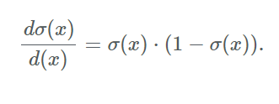
Derivatives
$o_{1}$…${,o_{j},..o}_{k}$
$xi$
Function 1 (error):
$E= \frac{1}{2}\sum_{k∈K}{{\left(t_{k}−o_{k}\right)}^{2}}$
$\frac{∂E}{∂o_{i}}=−\left(ti −o_{i}\right)$
Function 2 (linear gate):
${net}_{j}=∑w_{ij}⋅x_{i}$
$\frac{∂{net}_{j}}{∂w_{ij}}=xi$
Function 3 (differentiable activation function):
$o_{i}=\frac{1}{1+\exp{\{−({net}_{j}−T)\}}}$
$\frac{∂o_{i}}{∂{net}_{j}}=\frac{\exp{\{−({net}_{j}−T)\}}}{(1+\exp{\{−({net}_{j}−T)\})2}}$ = $o_{i}(1−o_{i})$
$$w_{ij}$$

Slide 39
Derivation of Learning Rule (2)
Weight updates of output units:
$w_{ij}$ influences the output only through ${net}_{j}$
Therefore:
$o_{1}$…$o_{k}$
$j$
$i$
$$w_{ij}$$
$$\frac{∂E_{d}}{∂w_{ij}}=\frac{∂E_{d}}{∂o_{j}} \frac{∂o_{j}}{∂{net}_{j}} \frac{∂{net}_{j}}{∂w_{ij}}$$
$$=−\left(t_{j}−o_{j}\right) o_{j}\left(1−o_{j}\right) x_{i}$$
$$E_{d}\left(w\right)=\frac{1}{2}\sum_{k∈K}{{\left(t_{k}−o_{k}\right)}^{2}}$$
$$\frac{∂o_{j}}{∂{net}_{j}}=o_{j}(1−o_{j})$$
$$o_{j}=\frac{1}{1+\exp{\{−({net}_{j}−T_{j})\}}}$$
$${net}_{j}=∑w_{ij}.x_{i}$$

Slide 40
Derivation of Learning Rule (3)
Weights of output units:
$w_{ij}$ is changed by:
Where we defined:
$δ_{j}=\frac{∂E_{d}}{∂{net}_{j}}=\left(t_{j}−o_{j}\right)o_{j}\left(1−o_{j}\right)$
$$o_{j}$$
$j$
$i$
$$w_{ij}$$
$$Δw_{ij}=R\left(t_{j}−o_{j}\right)o_{j}\left(1−o_{j}\right)x_{i}$$
$=Rδ_{j}x_{i}$
$$x_{i}$$

Slide 41
Derivation of Learning Rule (4)
Weights of hidden units:
$w_{ij}$ Influences the output only through all the units whose direct input include $j$
$$E_{d}$$
$$\frac{∂E_{d}}{∂w_{ij}}$$
$$o_{1}$$
$$o_{k}$$
$k$
$j$
$i$
$$w_{ij}$$

Slide 42
Derivation of Learning Rule (4)
Weights of hidden units:
$w_{ij}$ Influences the output only through all the units whose direct input include $j$
$$E_{d}$$
$$\frac{∂E_{d}}{∂w_{ij}}=\frac{∂E_{d}}{∂{net}_{j}} \frac{∂{net}_{j}}{∂w_{ij}}=$$
$$o_{1}$$
$$o_{k}$$
$${net}_{j}=∑w_{ij}.x_{i}$$
$k$
$j$
$i$
$$=\frac{∂E_{d}}{∂{net}_{j}}x_{i}=$$
$$w_{ij}$$
$$=\sum_{k∈parent(j) }{\frac{∂E_{d}}{∂{net}_{k}} \frac{∂{net}_{k}}{∂{net}_{j}}x_{i}}$$
$$=\sum_{k∈parent(j) }{−δ_{k} \frac{∂{net}_{k}}{∂{net}_{j}}x_{i}}$$

Slide 43
Derivation of Learning Rule (5)
Weights of hidden units:
$w_{ij}$influences the output only through all the units whose direct input include $j$
$$o_{k}$$
$k$
$j$
$i$
$$w_{ij}$$
$$\frac{∂E_{d}}{∂w_{ij}}=\sum_{k∈parent(j) }{−δ_{k}\frac{∂{net}_{k}}{∂{net}_{j}}x_{i}}=$$
$$=\sum_{k∈parent(j) }{−δ_{k} \frac{∂{net}_{k}}{∂o_{j}}\frac{∂o_{j}}{∂{net}_{j}}x_{i}}$$
$$=\sum_{k∈parent(j) }{−δ_{k} w_{jk}{ o}_{j}(1−o_{j}) x_{i}}$$

Slide 44
Derivation of Learning Rule (6)
Weights of hidden units:
$w_{ij}$ is changed by:
Where
$δ_{j}=o_{j}\left(1−o_{j}\right).\left(\sum_{k∈parent\left(j\right)}{−δ_{k} w_{jk} }\right)$
First determine the error for the output units.
Then, backpropagate this error layer by layer through the network, changing weights appropriately in each layer.
$$Δw_{ij}= R o_{j}\left(1−o_{j}\right).\left(\sum_{k∈parent\left(j\right)}{−δ_{k} w_{jk}}\right)x_{i}$$
$=Rδ_{j}x_{i}$
$$o_{k}$$
$k$
$j$
$i$
$$w_{ij}$$

Slide 45
The Backpropagation Algorithm
Create a fully connected three layer network. Initialize weights.
Until all examples produce the correct output within $ε$ (or other criteria)
For each example in the training set do:
Compute the network output for this example
Compute the error between the output and target value
$$δ_{k}=\left(t_{k}−o_{k}\right)o_{k}\left(1−o_{k}\right)$$
For each output unit k, compute error term
$${δ_{j}= o}_{j}\left(1−o_{j}\right).\sum_{k∈downstream\left(j\right)}{−δ_{k} w_{jk} }$$
For each hidden unit, compute error term: $Δw_{ij}=Rδ_{j}x_{i}$
Update network weights with $Δw_{ij}$
End epoch

Slide 46
More Hidden Layers
The same algorithm holds for more hidden layers.
output
$$h_{1}$$
$$h_{2}$$
$$h_{3}$$
input

Slide 47
Demo time!
Link: https://playground.tensorflow.org/

Slide 48
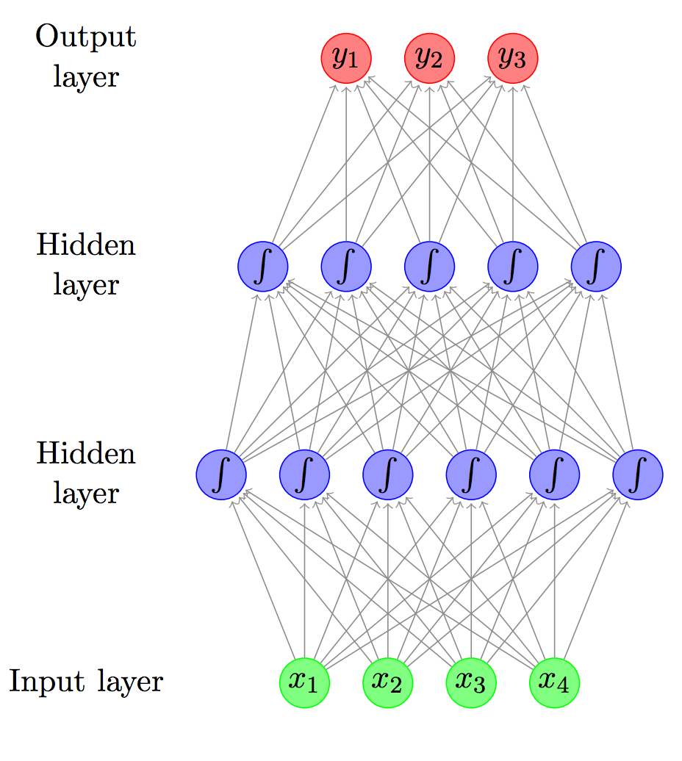
Feed-forward (FF) Network / Multi-layer Perceptron (MLP)
$y∈R^{n}$
$h_{2}∈R^{d_{2}}$
$h_{1}∈R^{d_{1}}$
$x∈R^{m}$

Slide 49
Feed-forward (FF) Network / Multi-layer Perceptron (MLP)
$y∈R^{n}$
$h_{2}∈R^{d_{2}}$
$h_{1}∈R^{d_{1}}$
$h_{1}={σ(W}_{1}x) ; W_{1}∈R^{d_{1}ⅹm}$
$$w_{11}$$ | $$w_{21}$$ | $$w_{31}$$ | $$w_{41}$$
$x∈R^{m}$

Slide 50
Feed-forward (FF) Network / Multi-layer Perceptron (MLP)
$y∈R^{n}$
$h_{2}∈R^{d_{2}}$
$h_{1}∈R^{d_{1}}$
$h_{1}={σ(W}_{1}x) ; W_{1}∈R^{d_{1}ⅹm}$
$$w_{11}$$
$$w_{12}$$
$$w_{13}$$
$$w_{14}$$
$$w_{15}$$
$$w_{16}$$
$x∈R^{m}$

Slide 51
Feed-forward (FF) Network / Multi-layer Perceptron (MLP)
$y∈R^{n}$
$y={σ(W}_{3}h_{2}) ; W_{3}∈R^{nⅹd_{2}}$
$h_{2}∈R^{d_{2}}$
$h_{2}={σ(W}_{2}h_{1}) ; W_{2}∈R^{d_{2}ⅹd_{1}}$
$h_{1}∈R^{d_{1}}$
$h_{1}={σ(W}_{1}x) ; W_{1}∈R^{d_{1}ⅹm}$
$x∈R^{m}$

Slide 52
The Backpropagation Algorithm
Create a fully connected network. Initialize weights.
Until all examples produce the correct output within $ε$ (or other criteria)
For each example $(x_{i},t_{i})$ in the training set do:
Compute the network output $y_{i}$for this example
Compute the error between the output and target value $E=\sum{{\left({t_{i}^{k}}_{ }−o_{i}^{k} \right)}^{2}}$
Compute the gradient for all weight values, $Δw_{ij}$
Update network weights with $w_{ij}=w_{ij}−R∗Δw_{ij}$
End epoch
Auto-differentiation packages such as Tensorflow, Torch, etc. help!
Quick example in code

Slide 53
Comments on Training
No guarantee of convergence; neural networks form non-convex functions with multiple local minima
In practice, many large networks can be trained on large amounts of data for realistic problems.
Many epochs (tens of thousands) may be needed for adequate training. Large data sets may require many hours of CPU
Termination criteria: Number of epochs; Threshold on training set error; No decrease in error; Increased error on a validation set.
To avoid local minima: several trials with different random initial weights with majority or voting techniques

Slide 54
Over-training Prevention
Running too many epochs and/or a NN with many hidden layers may lead to an overfit network
Keep an held-out validation set and test accuracy after every epoch
Early stopping: maintain weights for best performing network on the validation set and return it when performance decreases significantly beyond that.
To avoid losing training data to validation:
Use 10-fold cross-validation to determine the average number of epochs that optimizes validation performance
Train on the full data set using this many epochs to produce the final results

Slide 55
Over-fitting prevention
Too few hidden units prevent the system from adequately fitting the data and learning the concept.
Using too many hidden units leads to over-fitting.
Similar cross-validation method can be used to determine an appropriate number of hidden units. (general)
Another approach to prevent over-fitting is weight-decay: all weights are multiplied by some fraction in (0,1) after every epoch.
Encourages smaller weights and less complex hypothesis
Equivalently: change Error function to include a term for the sum of the squares of the weights in the network. (general)

Slide 56
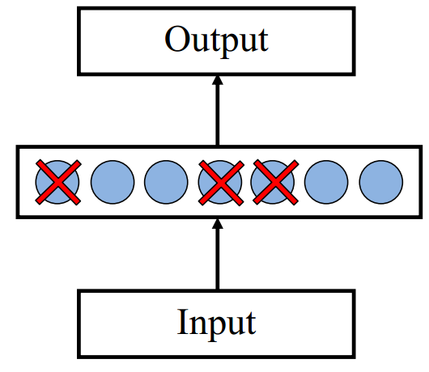
Dropout training
Proposed by (Hinton et al, 2012)
Each time decide whether to delete one hidden unit with some probability $p$

Slide 57
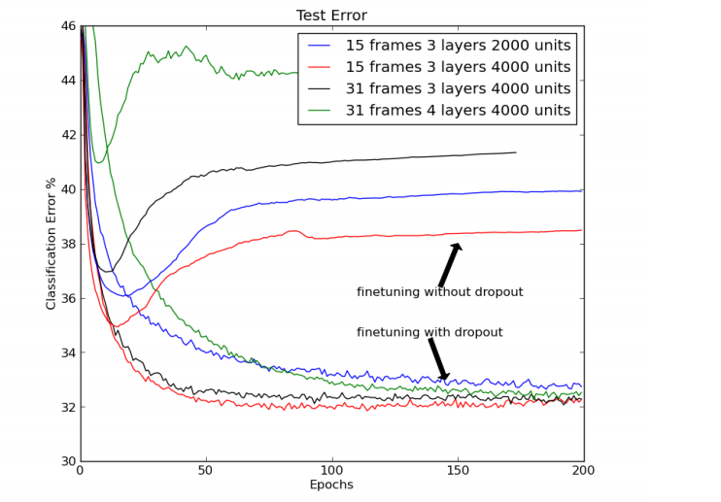
Dropout training
Dropout of $50\%$ of the hidden units and $20\%$ of the input units (Hinton et al, 2012)

Slide 58
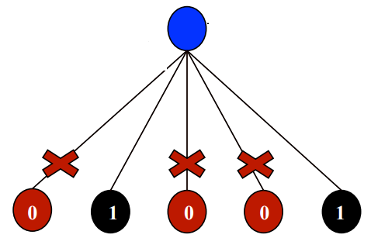
Dropout training
Model averaging effect
Among $2^{H}$ models, with shared parameters
$H$: number of units in the network
Only a few get trained
Much stronger than the known regularizer
What about the input space?
Do the same thing!

Slide 59
Recap: Multi-Layer Perceptrons
Multi-layer network
A global approximator
Different rules for training it
The Back-propagation
Forward step
Back propagation of errors
Congrats! Now you know the most important algorithm in neural networks!
Next Time:
Convolutional Neural Networks
Recurrent Neural Networks
activation
Output
Hidden
Input

