Slide 1
Neural Networks and Deep Learning
Part II
Dan Roth & Ben Zhou
danroth@seas.upenn.edu|http://www.cis.upenn.edu/~danroth/|461C, 3401 Walnut
Slides were created by Dan Roth (for CIS519/419 at Penn or CS446 at UIUC), Daniel Khashabi, Nitish Gupta and Ben Zhou
(or by other authors who have made their ML slides available.)

Slide 2
Administration (11/18/20)
Are we recording? YES!
Available on the web site
Remember that all the lectures are available on the website before the class
  Go over it and be prepared
  A new set of written notes will accompany most lectures, with some more details, examples and, (when relevant) some code.
HW4 is out – NNs and Bayesian Learning
  Due 12/3
  Recitations will be devoted to introducing you to PyTorch
Projects
  Most of you have chosen a project and a team.

Slide 3
Projects
CIS 519 students need to do a team project: Read the project descriptions and follow the updates on the Project webpage
  Teams will be of size 2-4
  We will help grouping if needed
There will be 3 options for projects.
  Natural Language Processing (Text)
  Computer Vision (Images)
  Speech (Audio)
In all cases, we will give you datasets and initial ideas
  The problem will be multiclass classification problems
  You will get annotated data only for some of the labels, but will also have to predict other labels
  0-zero shot learning; few-shot learning; transfer learning
A detailed note will come out today.
Timeline:
  11/11 Choose a project and team up
  11/23 Initial proposal describing what your team plans to do
  12/2 Progress report
  12/15-20 (TBD) Final paper + short video
Try to make it interesting!

Slide 4
Recap: Multi-Layer Perceptrons
Multi-layer network
  A global approximator
  Different rules for training it
The Back-propagation
  Forward step
  Back propagation of errors
Congrats! Now you know the most important algorithm in neural networks!
Today:
  Convolutional Neural Networks
  Recurrent Neural Networks
  Attention and Transformers
activation
Output
Hidden
Input

Slide 5
Hidden Layer Representation
Weight tuning procedure sets weights that define whatever hidden units representation is most effective at minimizing the error.
Sometimes Backpropagation will define new hidden layer features that are not explicit in the input representation, but which capture properties of the input instances that are most relevant to learning the target function.
Trained hidden units can be seen as newly constructed features that re-represent the examples so that they are linearly separable

Slide 6
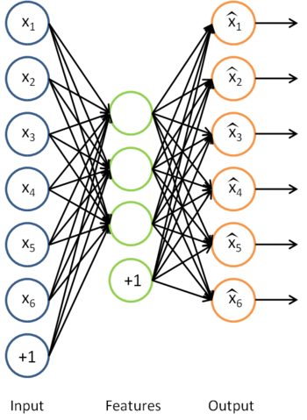


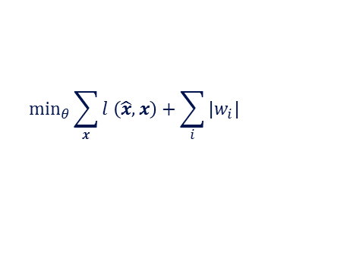


Sparse Auto-encoder
Encoding:
Decoding:
  Goal: perfect reconstruction of
  input vector $x$, by the output ${\hat{x}}_{}$
    Where $θ=\{W, W′\}$
  Minimize an error function $l(\hat{x}, x)$
    For example:
  And regularize it
After optimization drop the
reconstruction layer and add a new layer
$$y=f(Wx+b)$$
$$\hat{x}=g(W′y+b′)$$
$$l\left(\hat{x}, x\right)={\left\|\hat{x}−x\right\|}^{2}$$
$$\min_{θ}{\sum_{x}{l \left(\hat{x}, x\right)}+\sum_{i}{|w_{i}|}}$$

Slide 7
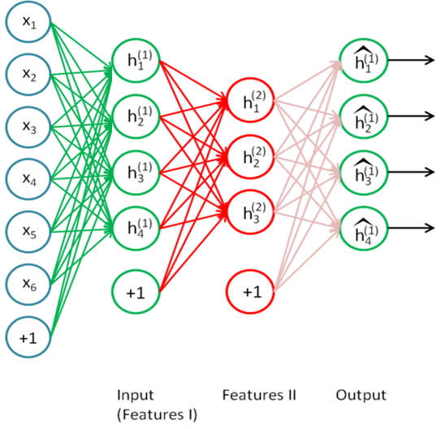
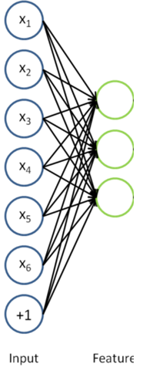
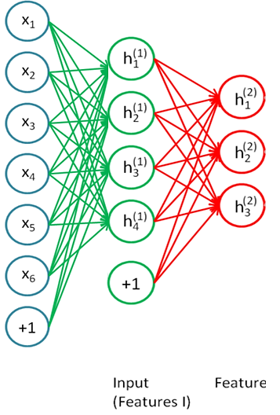
Stacking Auto-encoder
Add a new layer, and a reconstruction layer for it.
And try to tune its parameters such that
And continue this for each layer

Slide 8
Beyond supervised learning
  So far what we had was purely supervised.
    Initialize parameters randomly
    Train in supervised mode typically, using backprop
    Used in most practical systems (e.g. speech and image recognition)
  Unsupervised, layer-wise pre-training + supervised classifier on top
    Train each layer unsupervised, one after the other
    Train a supervised classifier on top, keeping the other layers fixed
    Good when very few labeled samples are available
  Unsupervised, layer-wise pre-training + supervised fine-tuning
    Train each layer unsupervised, one after the other
    Add a classifier layer, and retrain the whole thing supervised
    Good when label set is poor (e.g. pedestrian detection)
We won’t talk about unsupervised pre-training here. But it’s good to have this in mind, since it is an active topic of research.

Slide 9
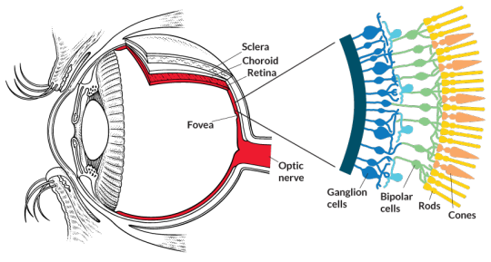
Receptive Fields
The receptive field of an individual sensory neuron is the particular region of the sensory space (e.g., the body surface, or the retina) in which a stimulus will trigger the firing of that neuron.
  In the auditory system, receptive fields can correspond to wave amplitudes in auditory space
Designing “proper” receptive fields for the input Neurons is a significant challenge.

Slide 10
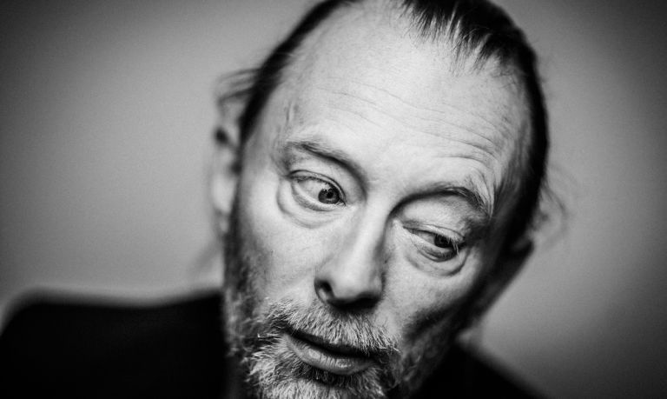
Image Classification
Consider a task with image inputs
  Receptive fields should give expressive features from the raw input to the system
  How would you design the receptive fields for this problem?
Human face or not?

Slide 11
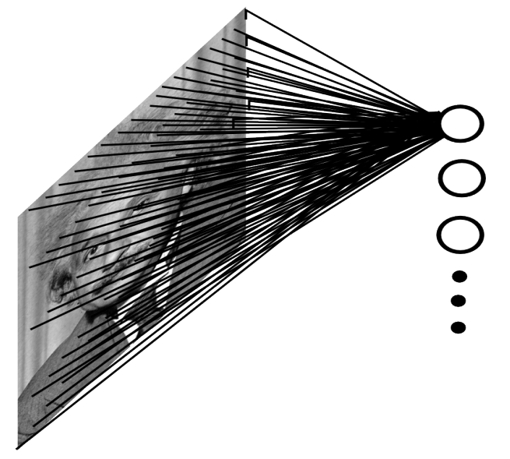
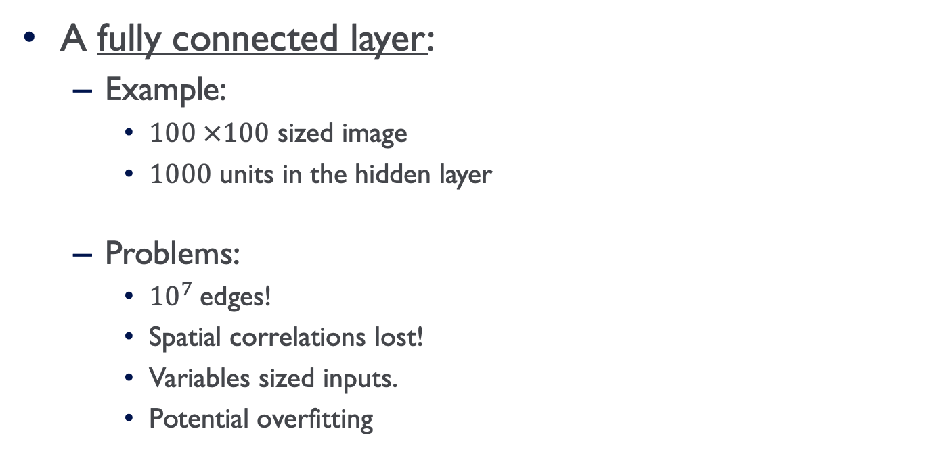
A fully connected layer:
  Example:
    $100 ×100$ sized image
    $1000$ units in the hidden layer
  Problems:
    ${10}^{7}$edges!
    Spatial correlations lost!
    Variables sized inputs.
    Potential overfitting
Input layer
Slide Credit: Marc'Aurelio Ranzato

Slide 12
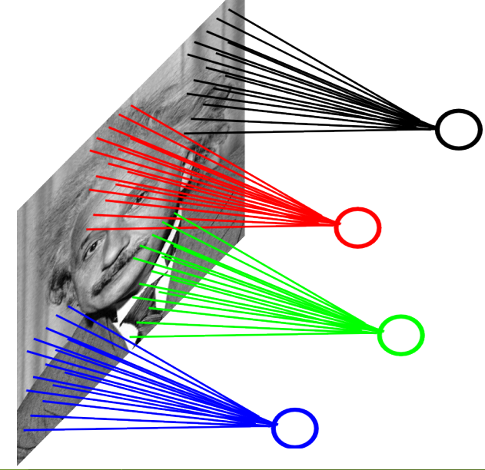
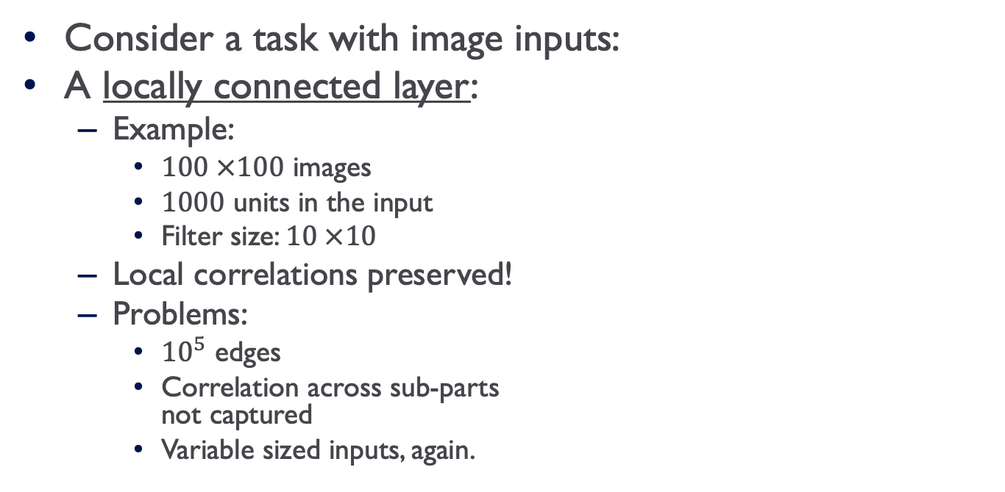
Consider a task with image inputs:
A locally connected layer:
  Example:
    $100 ×100$ images
    $1000$ units in the input
    Filter size: $10 ×10$
  Local correlations preserved!
  Problems:
    ${10}^{5}$ edges
    Correlation across sub-parts
    not captured
    Variable sized inputs, again.
Input layer
Slide Credit: Marc'Aurelio Ranzato

Slide 13
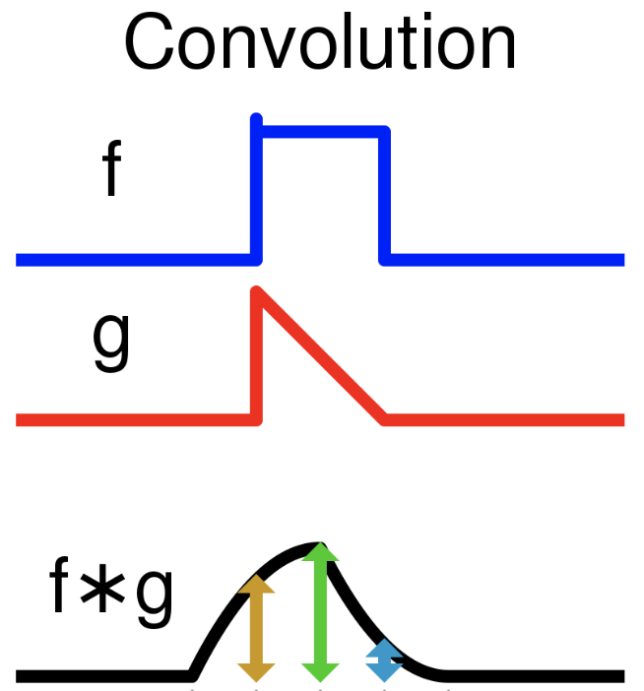
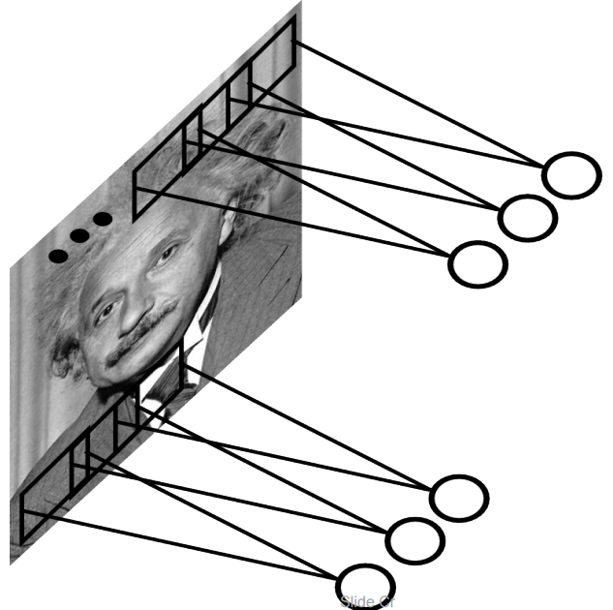
Convolutional Layer
A solution:
  Filters to capture different patterns in the input space.
    Share parameters across different locations (assuming input is stationary)
    Convolutions with learned filters
  Filters will be learned during training.
  The issue of variable-sized inputs will be
  resolved with a pooling layer.
Convolution:
A mathematical operation on two functions that produces a third function expressing how the shape of one is modified by the other.
So what is a convolution?
Input layer
Slide Credit: Marc'Aurelio Ranzato

Slide 14
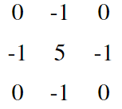
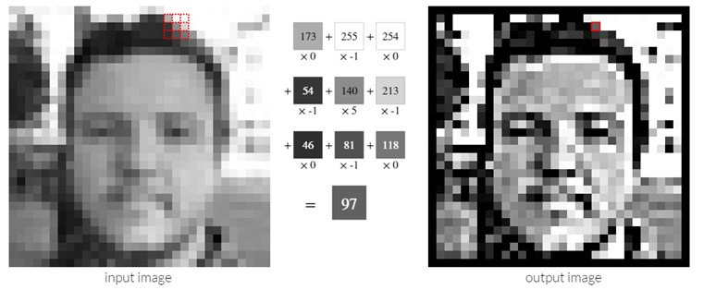
Convolution Operator (2)
Convolution in two dimension:
  Example: Sharpen kernel:
Try other kernels: http://setosa.io/ev/image-kernels/

Slide 15
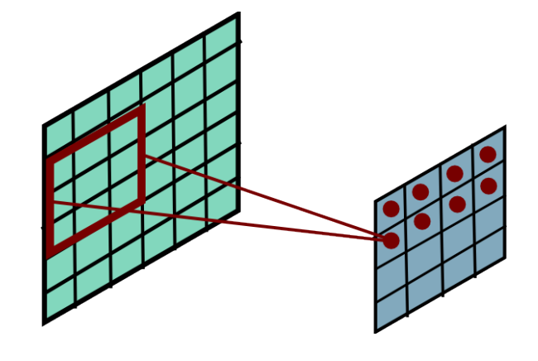
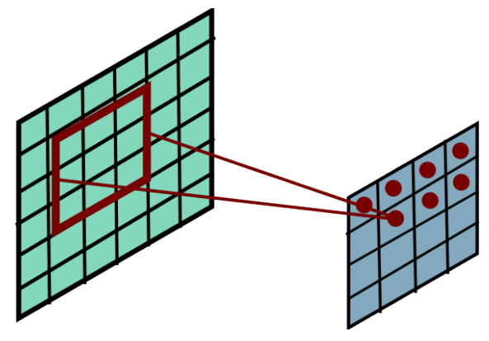
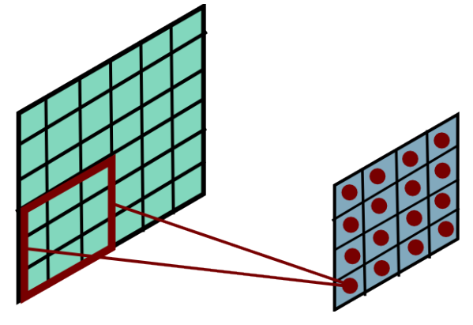
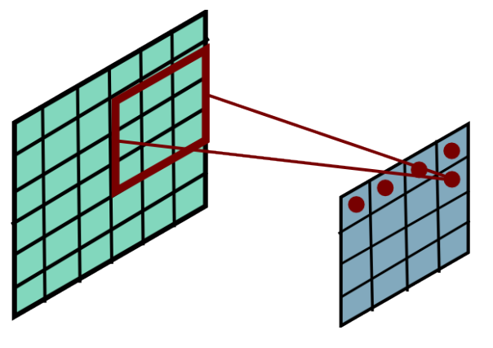
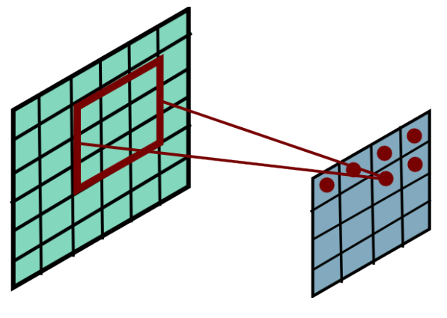
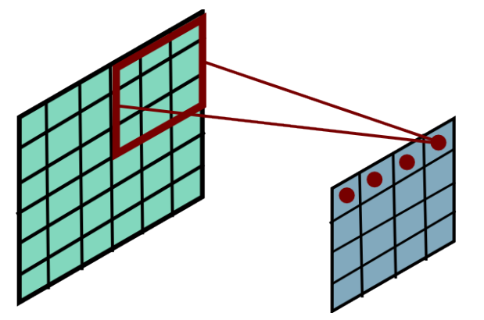
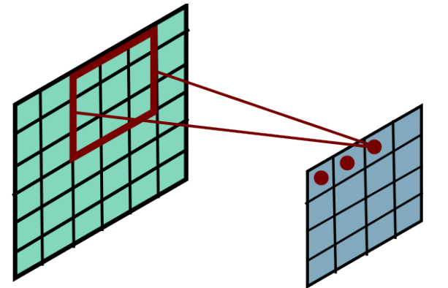
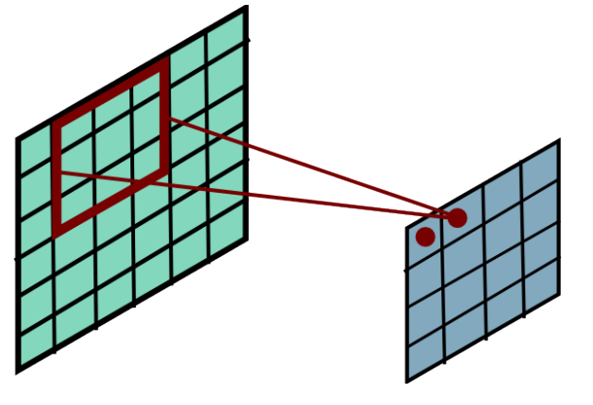
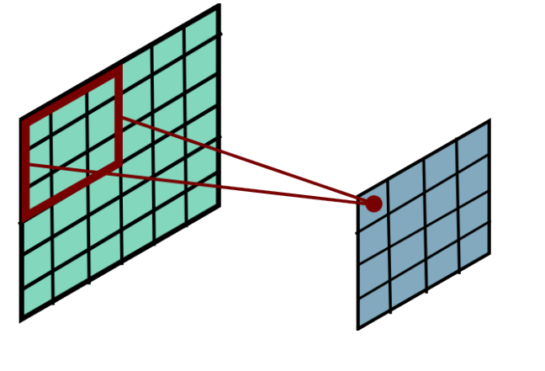
Convolution Operator (3)
Convolution in two dimension:
  Convolve a filter matrix across the image matrix

Slide 16
Convolutional Layer
The convolution of the input (vector/matrix) with weights (vector/matrix) results in a response vector/matrix.
We can have multiple filters in each convolutional layer, each producing an output.
If it is an intermediate layer, it can have multiple inputs!
Convolutional Layer
Filter
Filter
Filter
One can add nonlinearity at the output of convolutional layer
Filter

Slide 17
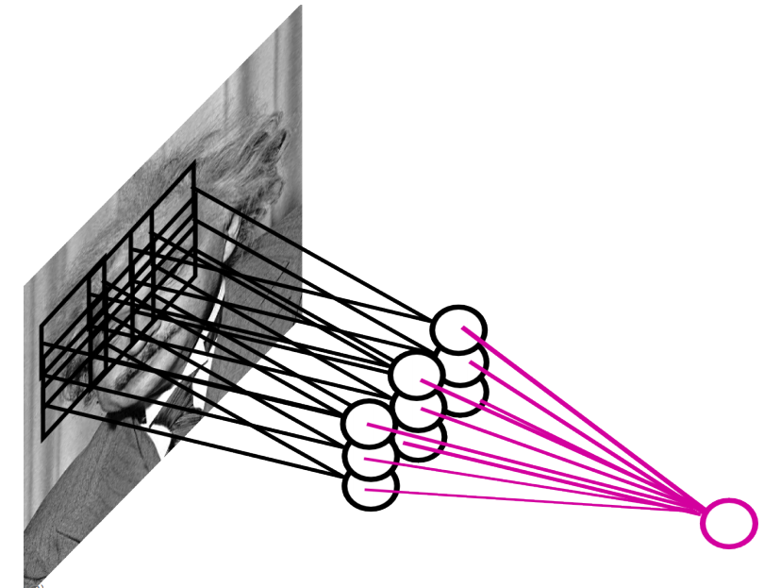
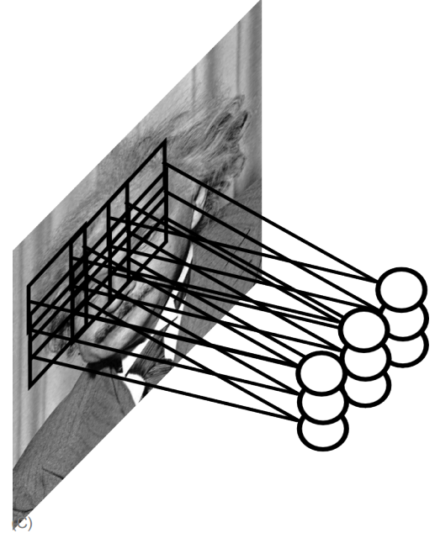
Pooling Layer
How to handle variable sized inputs?
  A layer which reduces inputs of different size, to a fixed size.
  Pooling
Slide Credit: Marc'Aurelio Ranzato

Slide 18
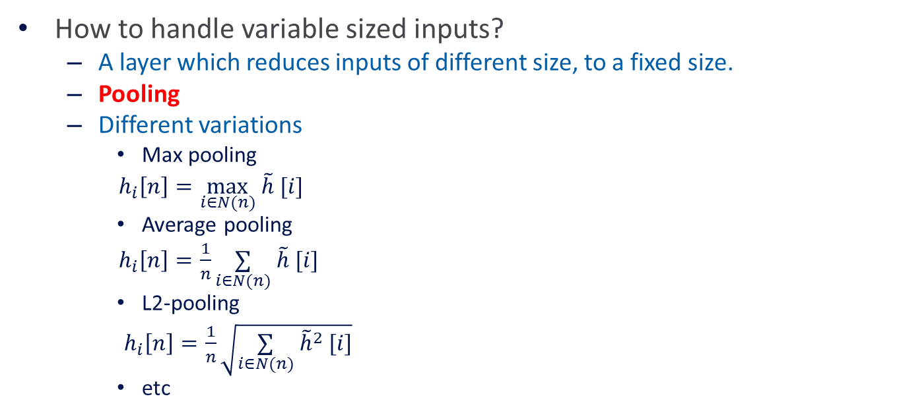
Pooling Layer
How to handle variable sized inputs?
  A layer which reduces inputs of different size, to a fixed size.
  Pooling
  Different variations
    Max pooling
    $h_{i}\left[n\right]=\max_{i∈N(n)} \tilde{h} [i]$
    Average pooling
    $h_{i}\left[n\right]=\frac{1}{n}\underset{i∈N(n)}{∑} \tilde{h} [i]$
    L2-pooling
    $h_{i}\left[n\right]=\frac{1}{n}\sqrt{\underset{i∈N(n)}{∑} {\tilde{h}}^{2} [i]}$
    etc

Slide 19
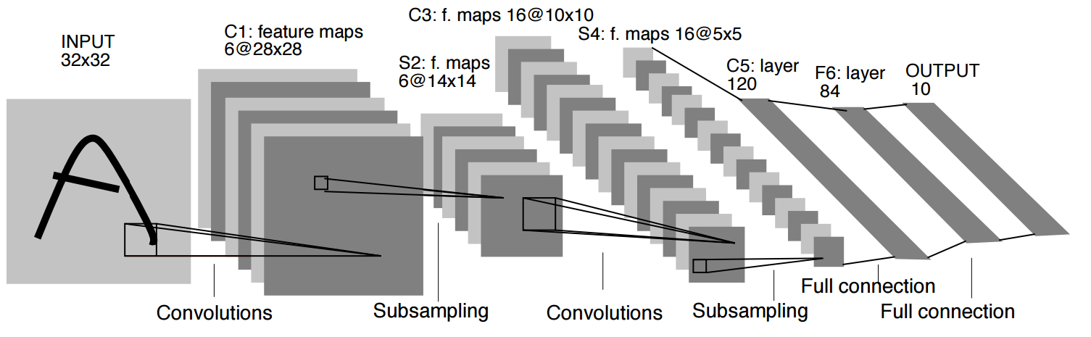
Convolutional Nets
One stage structure:
Whole system:
Conv.
Pooling
Stage 1
Stage 2
Stage 3
Fully Connected Layer
Input Image
Class Label

Slide 20





Training a ConvNet
The same procedure from Back-propagation applies here.
  Remember in backprop we started from the error terms in the last stage, and passed them back to the previous layers, one by one.
Back-prop for the pooling layer:
  Consider, for example, the case of “max” pooling.
  This layer only routes the gradient to the input that has the highest value in the forward pass.
  Hence, during the forward pass of a pooling layer it is common to keep track of the index of the max activation (sometimes also called the switches) so that gradient routing is efficient during backpropagation.
$$x_{i}$$
$$y_{i}$$
$$δ_{last−layer}=\frac{∂E_{d}}{∂y_{last−layer}}$$
Convol.
Pooling
$$δ_{first−layer}=\frac{∂E_{d}}{∂y_{first−layer}}$$
$$E_{d}$$
Input Image
Stage 1
Stage 2
Stage 3
Fully Connected Layer
Class Label

Slide 21
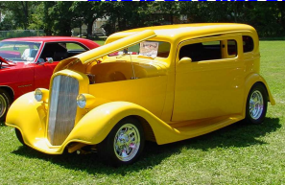
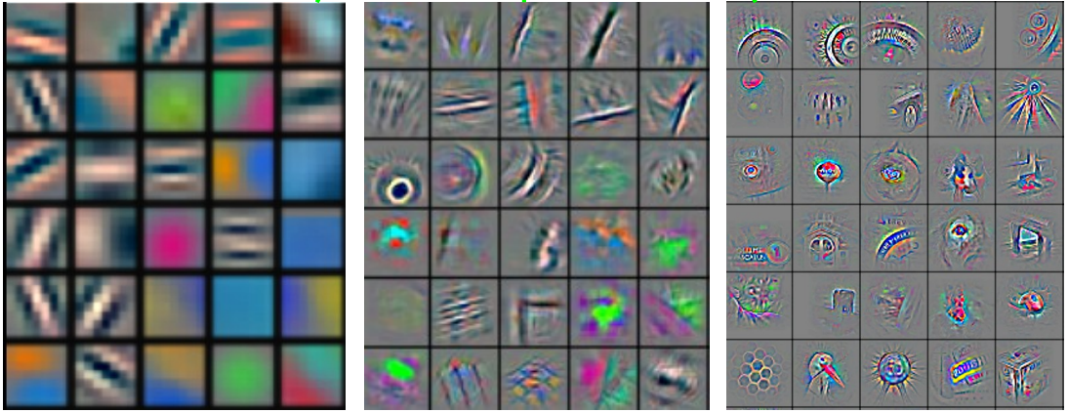
Convolutional Nets
Stage 1
Stage 2
Stage 3
Fully Connected Layer
Input Image
Class Label
Feature visualization of convolutional net trained on ImageNet from [Zeiler & Fergus 2013]

Slide 22
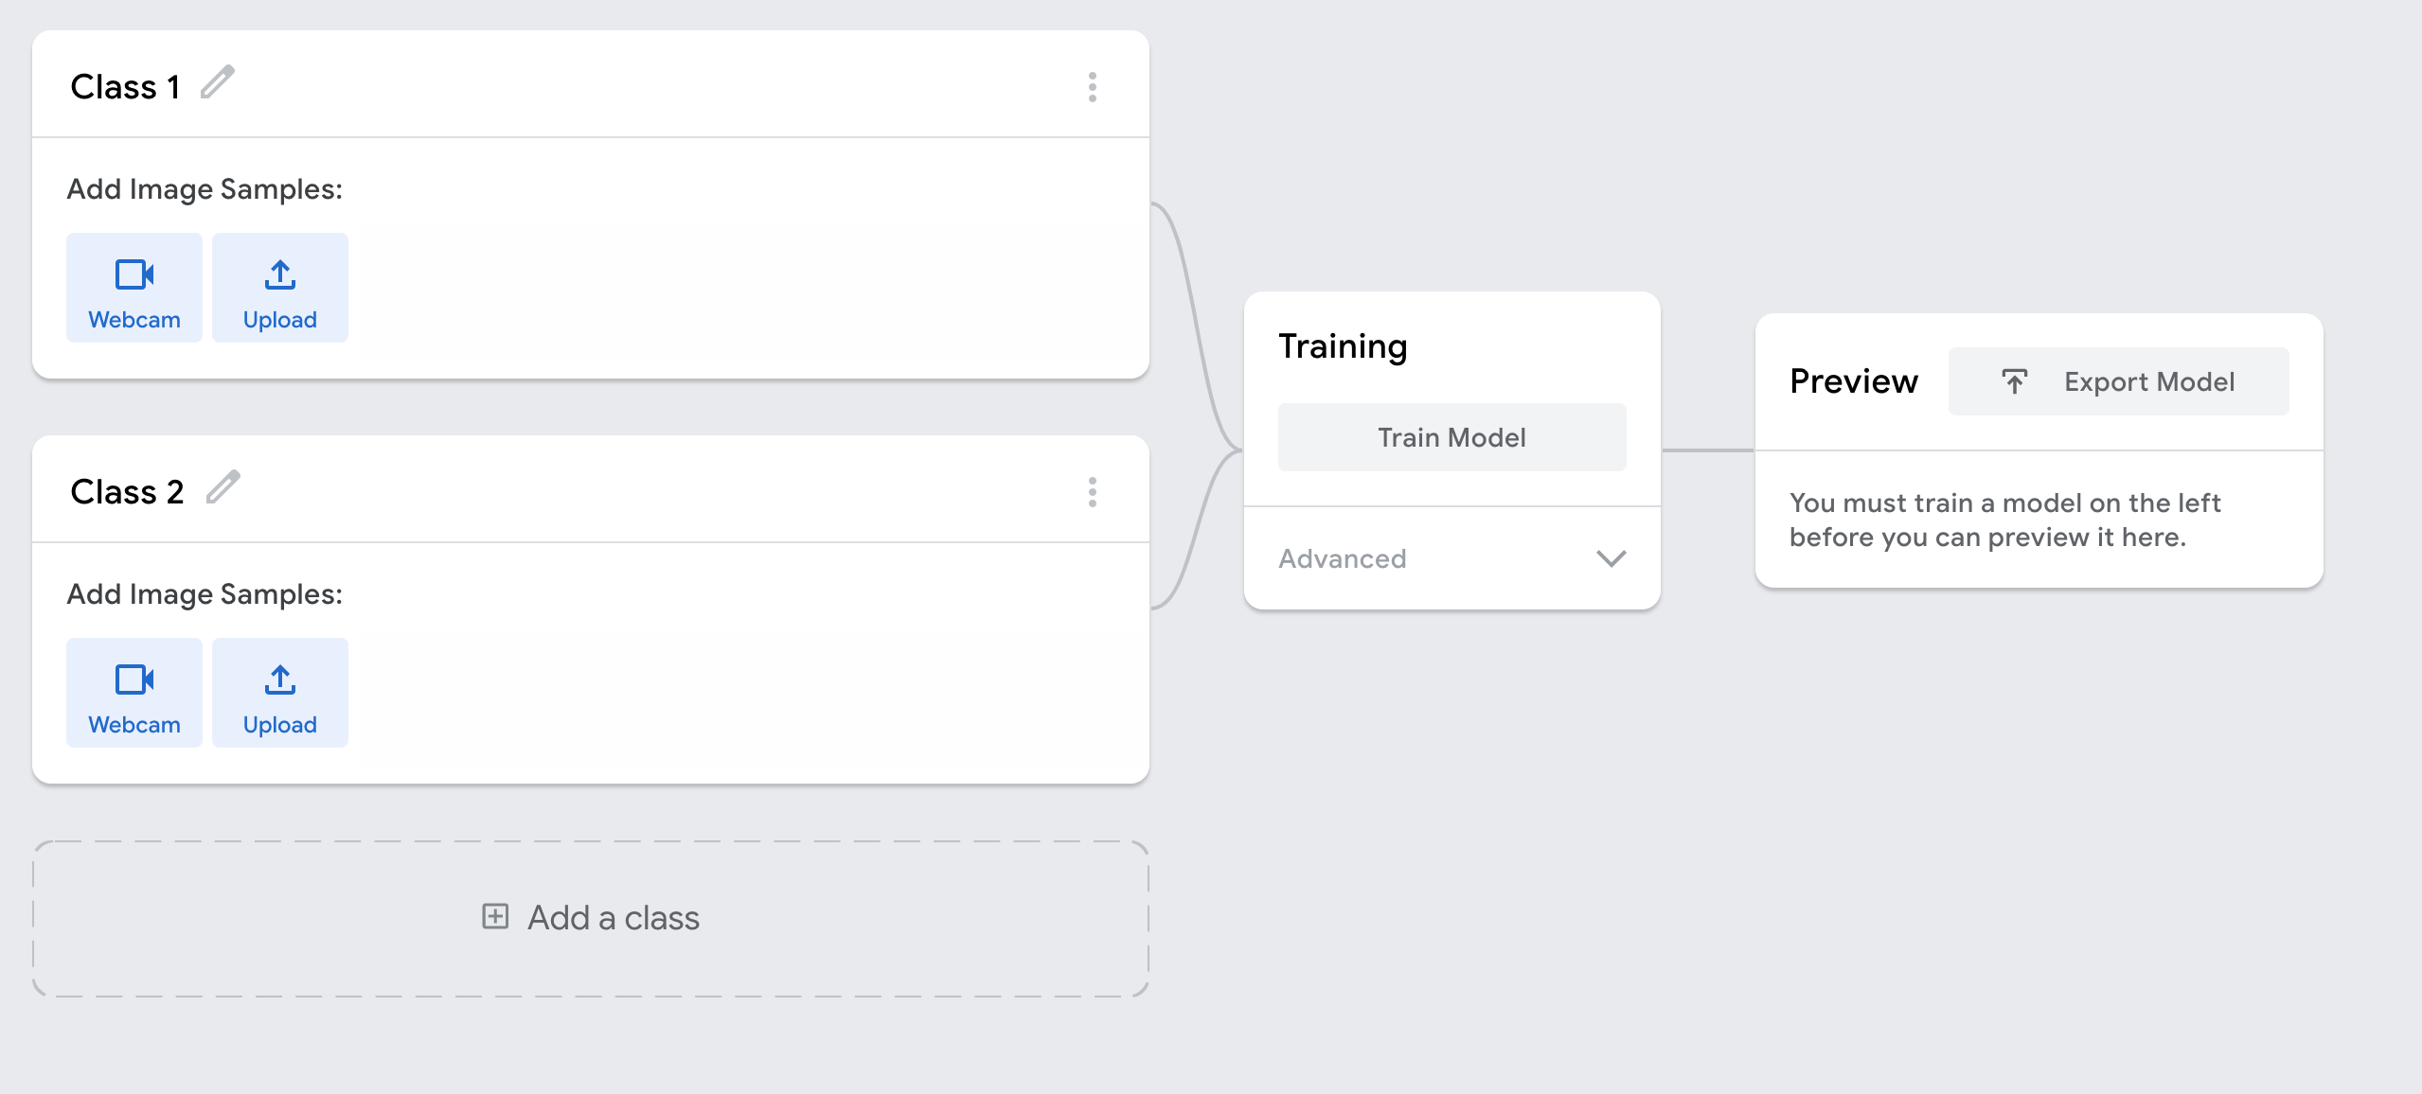
Demo (Teachable Machines)
https://teachablemachine.withgoogle.com/

Slide 23
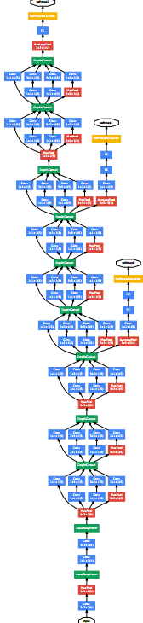
ConvNet roots
Fukushima, 1980s designed network with same basic structure but did not train by backpropagation.
The first successful applications of Convolutional Networks by Yann LeCun in 1990's (LeNet)
  Was used to read zip codes, digits, etc.
Many variants nowadays, but the core idea is the same
  Example: a system developed in Google (GoogLeNet)
    Compute different filters
    Compose one big vector from all of them
    Layer this iteratively
See more: http://arxiv.org/pdf/1409.4842v1.pdf

Slide 24
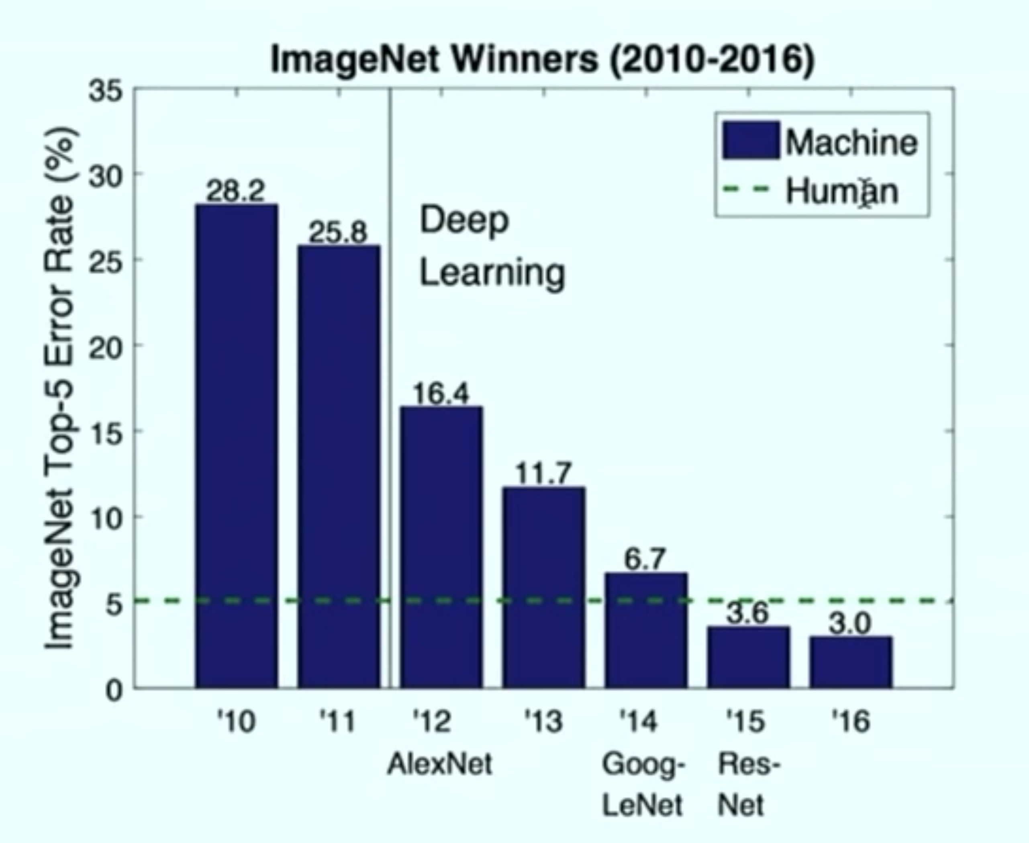
Depth matters
Slide from Michael Collins

Slide 25
Natural Language Processing
Word-level prediction on natural language:
  Example: Part of Speech tagging words in a sentence
  Challenges:
    Structure in the input: Dependence between different parts of the inputs
    Structure in the output: Correlations between labels
    Variable size inputs: e.g. sentences differ in size
This
is
a
sample
sentence
Det
Verb
Det
Noun
Noun

Slide 26
Natural Language Processing
I
saw
him
today
Pron
Verb
Pron
Noun
I
will
buy
a
saw
Pron
Aux
Verb
Det
Noun
  How would you go about solving this task?

Slide 27
Recurrent Neural Networks
Infinite uses of finite structure
Input
X0
X1
X2
X3
H0
H1
H2
W
W
W
W
H0
H1
H2
Hidden state representation
Y1
Y2
Y3
Y0
Output

Slide 28
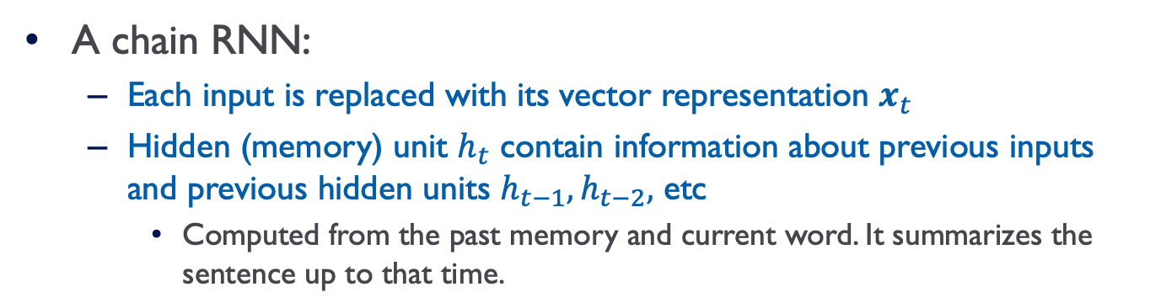
Recurrent Neural Networks
A chain RNN:
  Each input is replaced with its vector representation $x_{t}$
  Hidden (memory) unit $h_{t}$ contain information about previous inputs and previous hidden units $h_{t−1},h_{t−2},$ etc
    Computed from the past memory and current word. It summarizes the sentence up to that time.
$x_{t−1}$ ${ x}_{t}$ $x_{t+1}$
O O O O O
O O O O O
O O O O O
Input layer
O O O O O
O O O O O
O O O O O
Memory layer
$h_{t−1}$ $h_{t}$ $h_{t+1}$

Slide 29
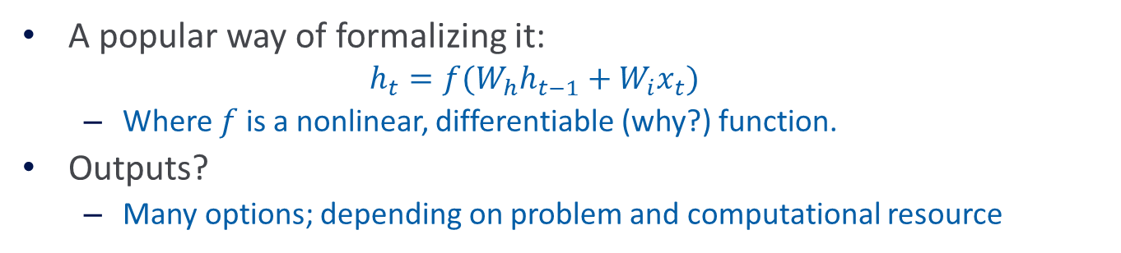
Recurrent Neural Networks
A popular way of formalizing it:
  $$h_{t}=f(W_{h}h_{t−1}+W_{i}x_{t})$$
  Where $f$ is a nonlinear, differentiable (why?) function.
Outputs?
  Many options; depending on problem and computational resource
$x_{t−1}$ ${ x}_{t}$ $x_{t+1}$
O O O O O
O O O O O
O O O O O
Input layer
O O O O O
O O O O O
O O O O O
Memory layer
$h_{t−1}$ $h_{t}$ $h_{t+1}$

Slide 30


Recurrent Neural Networks
Prediction for $x_{t}$, with $h_{t}$:
Some inherent issues with RNNs:
  Recurrent neural nets cannot capture phrases without prefix context
  They focus too much on last words in final vector
    A slightly more sophisticated solution: Long Short-Term Memory (LSTM) units
$$y_{t}=softmax\left(W_{o}h_{t} \right)$$
$x_{t−1}$ ${ x}_{t}$ $x_{t+1}$
O O O O O
O O O O O
O O O O O
Input layer
O O O O O
O O O O O
O O O O O
Memory layer
$h_{t−1}$ $h_{t}$ $h_{t+1}$
$y_{t−1}$ ${ y}_{t}$ $y_{t+1}$
Output layer

Slide 31
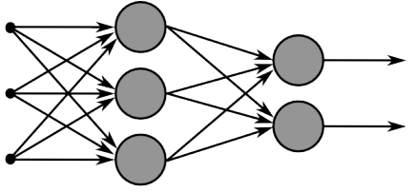
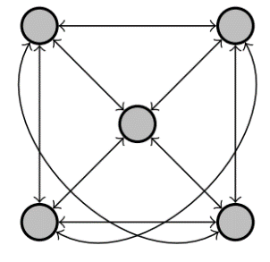
Recurrent Neural Networks
Multi-layer feed-forward NN: DAG
  Just computes a fixed sequence of
  non-linear learned transformations to convert an input patter into an output pattern
Recurrent Neural Network: Digraph
  Has cycles.
  Cycle can act as a memory;
  The hidden state of a recurrent net can carry along information about a “potentially” unbounded number of previous inputs.
  They can model sequential data in a much more natural way.

Slide 32
Equivalence between RNN and Feed-forward NN
Assume that there is a time delay of 1 in using each connection.
The recurrent net is just a layered net that keeps reusing the same weights.
w1 w4
time=3
1
2
3
W1 W2 W3 W4
time=2
1
2
3
1
2
3
W1 W2 W3 W4
w2 w3
time=1
1
2
3
W1 W2 W3 W4
time=0
1
2
3
Slide Credit: Geoff Hinton

Slide 33
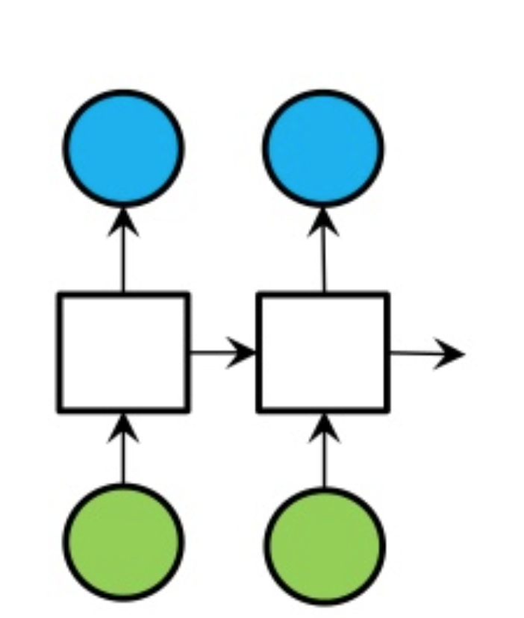
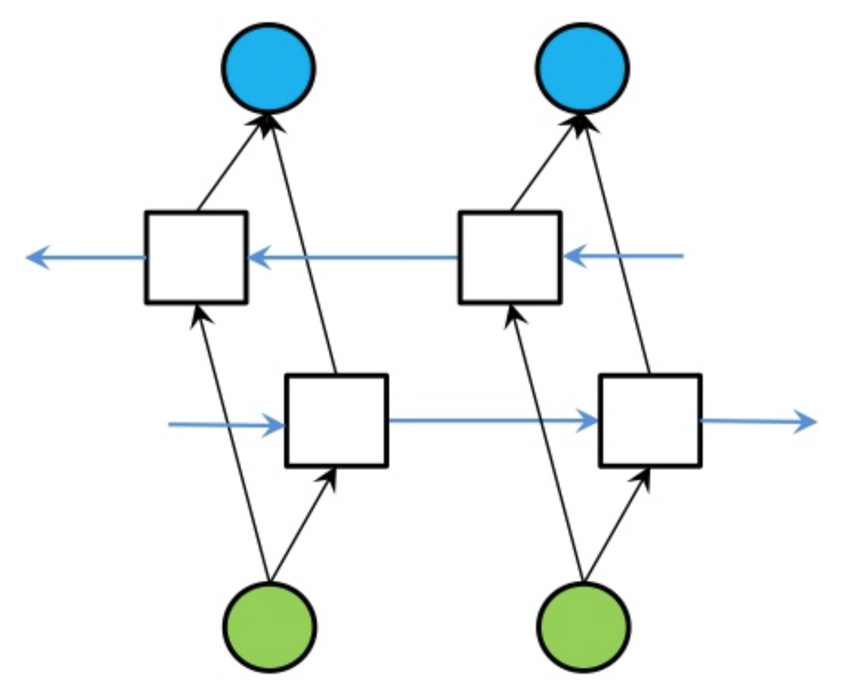
Bi-directional RNN
One of the issues with RNN:
  Hidden variables capture only one side context
A bi-directional structure
RNN
Bi-directional RNN

Slide 34
Sequence to sequence models
I
will
buy
a
saw
Works!
Pron
Aux
Verb
Det
Noun
I
will
buy
a
saw
What about other endings?
to
cut
wood
.
EOS
I
will
buy
a
saw
What if prediction depends on the future?
我
会
买
一把
锯

Slide 35
Sequence to sequence models
I
will
buy
a
saw
encoder
REP
REP
REP
REP
REP
wood
cut
to
.
wood
cut
decoder
How do we train?

Slide 36
Sequence to sequence models
I
will
buy
a
saw
encoder
REP
REP
REP
REP
REP
What could go wrong with a simple RNN?
wood
cut
to
<SOS>
.
wood
eat
to
decoder
Long range dependencies!
Long Short Term Memory networks (LSTM)
Doesn’t have to be an RNN!

Slide 37
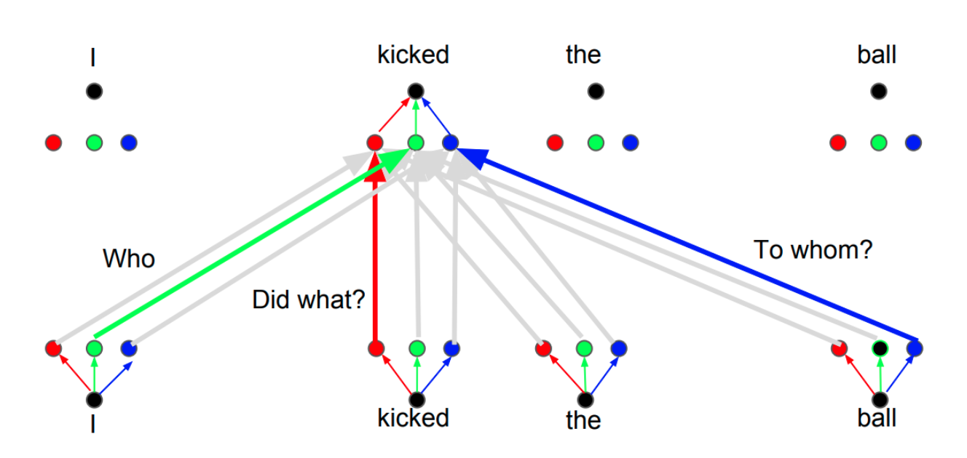
Self-Attention and Transformers
I
will
buy
a
saw
Transformers:
Many attention layers stacked
I
will
buy
a
saw
I
will
buy
a
saw

Slide 38
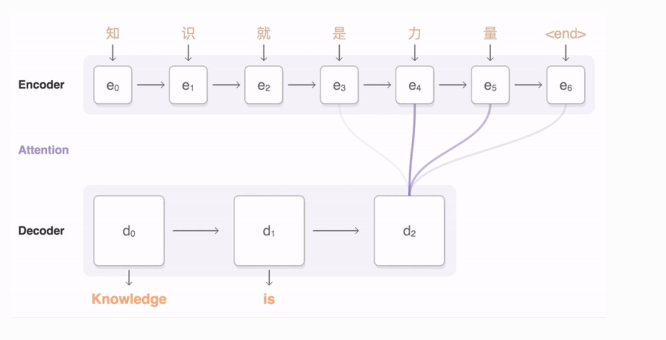
Seq2seq with attention
Figure Credit: Google Open Source

Slide 39
Unsupervised (Pre-) training
Motivation: representation learning and transfer learning
I
will
buy
a
saw
will
buy
a
saw
.
A vector that represents something buyable.
In part-of-speech: a noun!

Slide 40
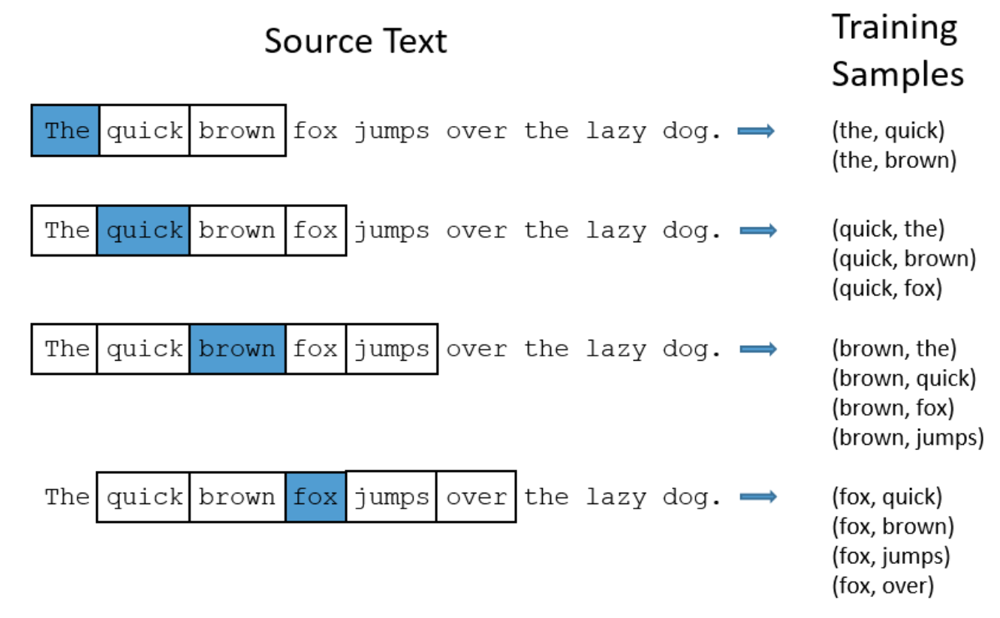
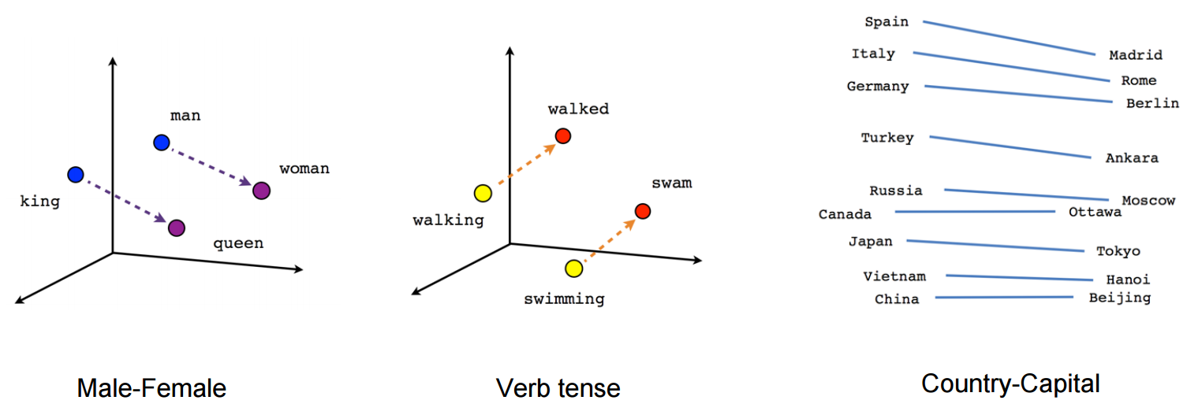
Unsupervised (Pre-) training
Early works
  Word embeddings from N-grams (Mikolov 2013)

Slide 41
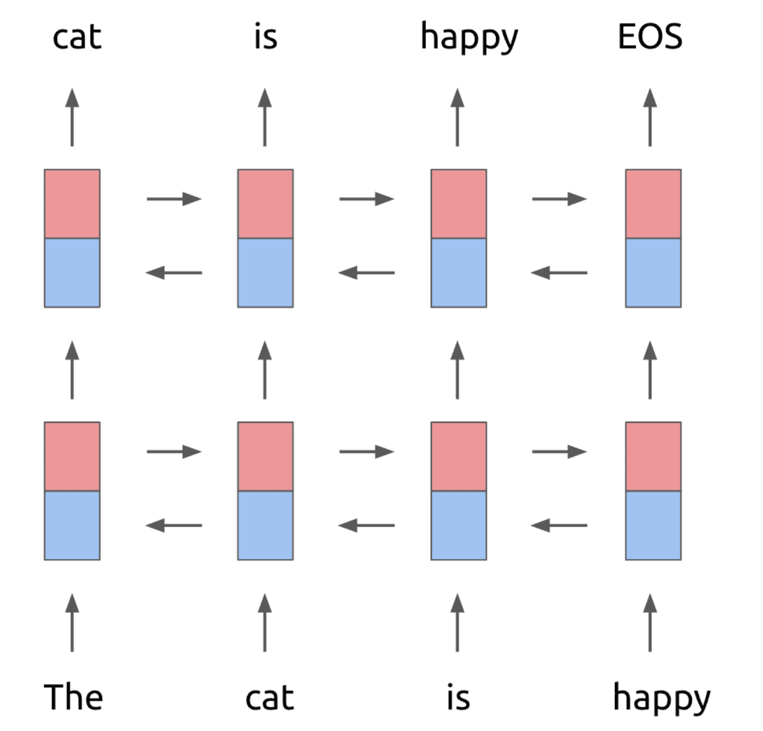
Unsupervised (Pre-) training
Early works
  Word embeddings from N-grams (Mikolov 2013)
Contextualized embeddings
  ELMo (Peters et al. 2018), a bi-directional RNN
In training: only predict next words in the forward run or previous words in the backward run.

Slide 42
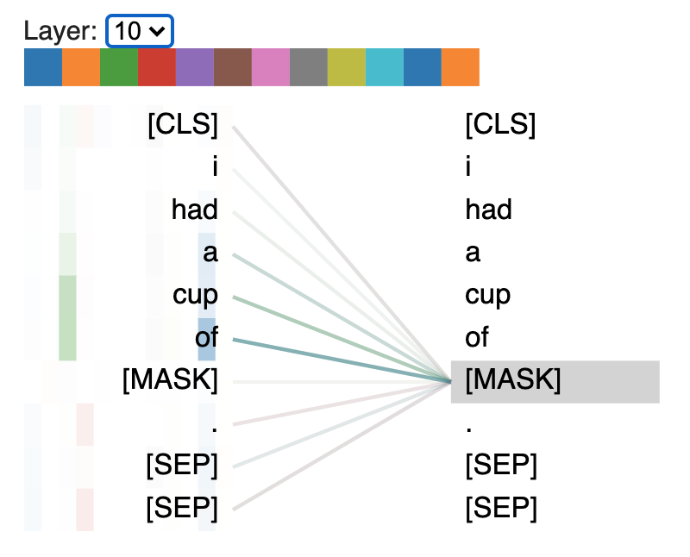
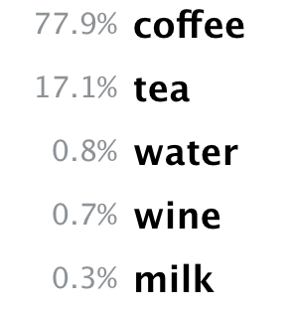
Unsupervised (Pre-) training
Early works
  Word embeddings from N-grams (Mikolov 2013)
Contextualized embeddings
  ELMo (Peters et al. 2018), a bi-directional RNN
  Bert (Devlin et al. 2018), a transformer (many layers of attentions)
some drink that goes in a cup
Reflects a problem! Ideas?

Slide 43
Unsupervised (Pre-) training
Early works
  Word embeddings from N-grams (Mikolov 2013)
Contextualized embeddings
  ELMo (Peters et al. 2018), a bi-directional RNN
  Bert (Devlin et al. 2018), a transformer (many layers of attentions)
All of them (any many others)
  Unsupervised; used as much data as there is
  Contributed to a big part of NLP progress in the past decade

Slide 44
Unsupervised (Pre-) training in vision
The computer vision community also uses a similar spirit to learn general representations of images before a specific task
ImageNet
  14 million images of objects, 21,841 potential fine-grained labels
  Initializes “good” convolution filters or other layers in a model
Transfers to many other tasks
  Even chest radiology!

Slide 45
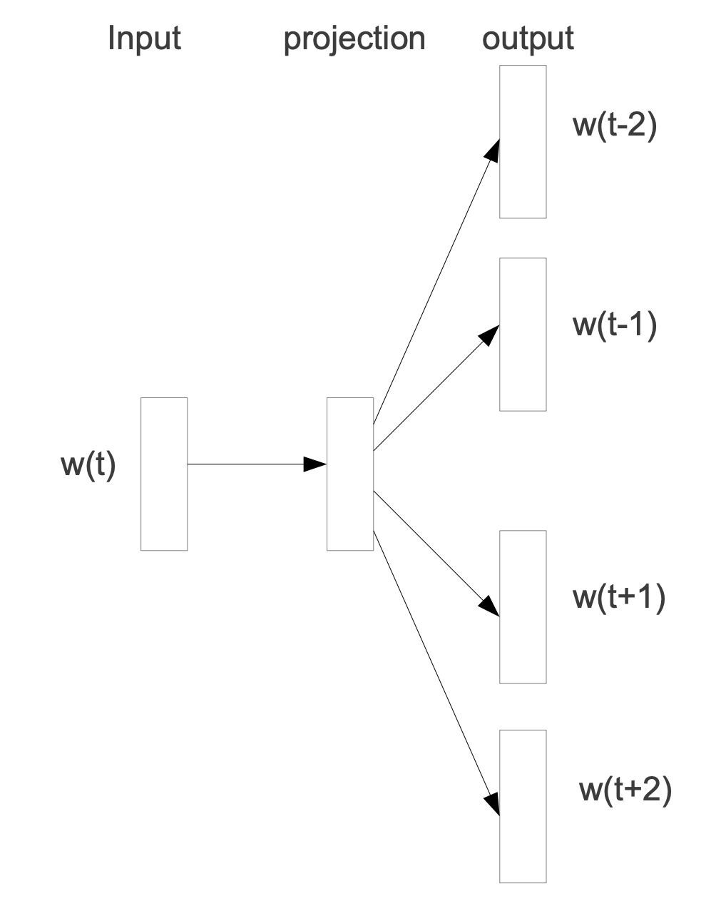
Unsupervised Word Embeddings

Slide 46
Word2Vec
This would result in word representations
  that convey information about their co-occurrence
  Or some form of weak “semantic” similarity
  A big part of progress (past 5-10 years) is partly due to discovering better ways create unsupervised context-sensitive representations

Slide 47



Unsupervised RNNs
What to put here?
  He was locked up after he ______ .
Input (context)
output
$x_{t−2}$ $x_{t−1}$ $x_{t}$ $y$
O O O O
O O O O
O O O O
O O O O
O O O O
O O O O
O O O O
$$h_{t−1}$$
$$h_{t}$$
$$h_{t+1}$$
Note that:
  This is unsupervised; you can use tons of data to train this.
  While training the model, we train the word representations too.
Memory layer

Slide 48
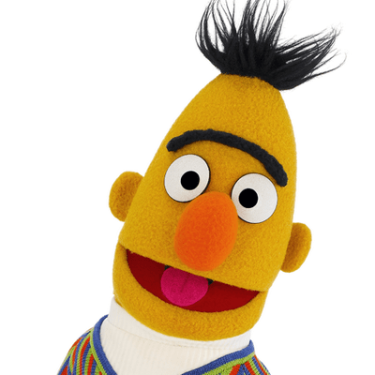


Unsupervised Pretraining

