Slide 1


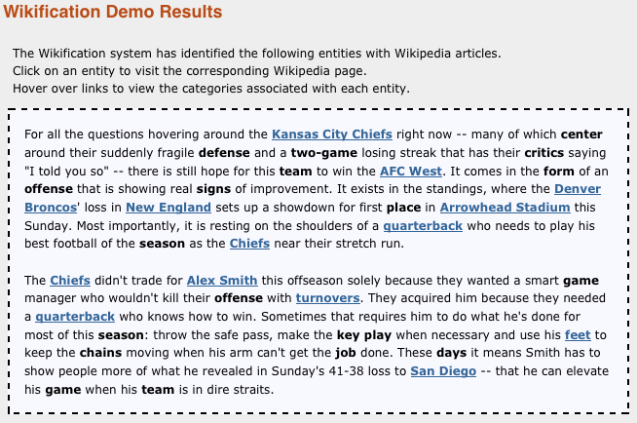
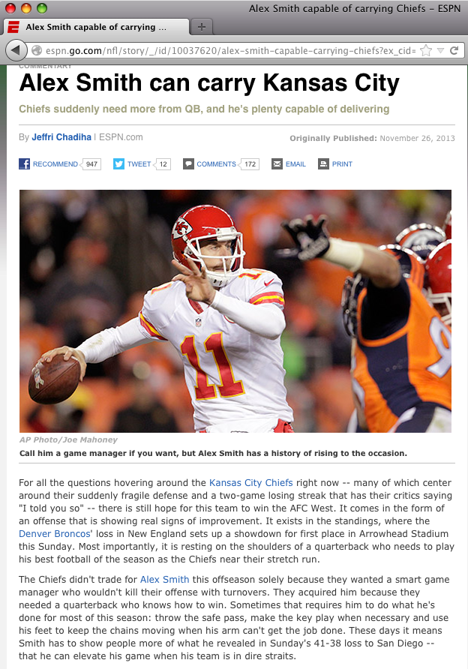

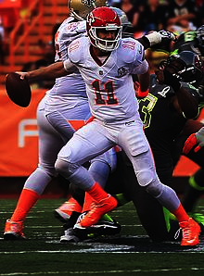

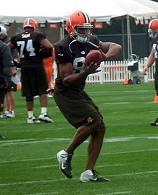
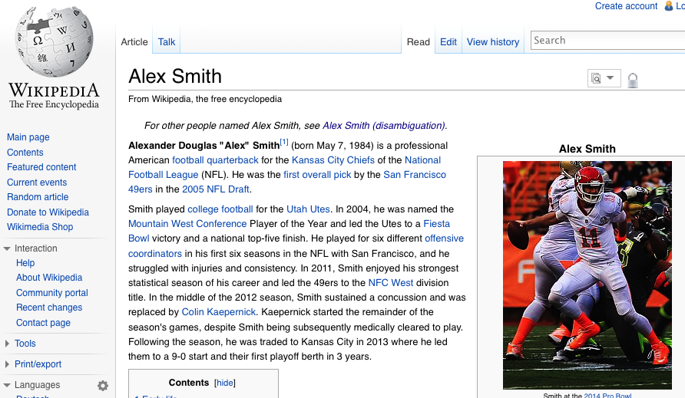
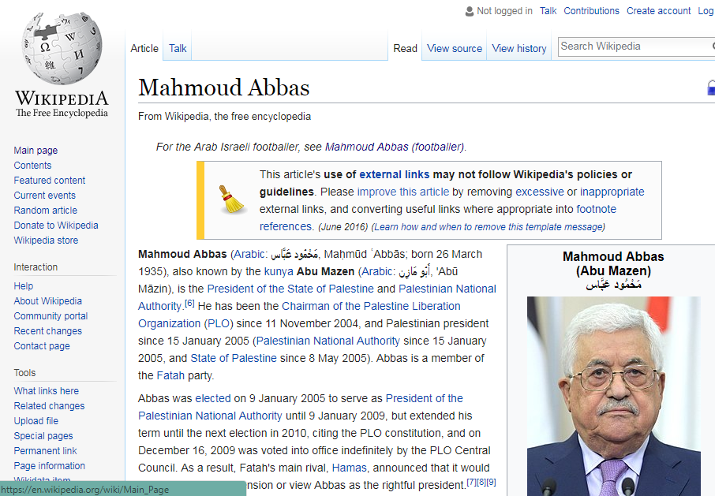
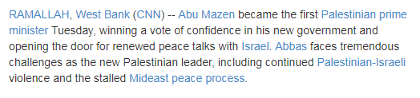
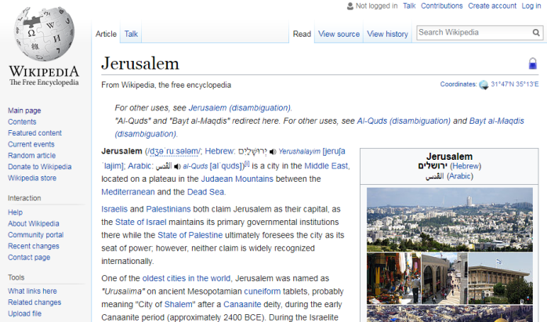
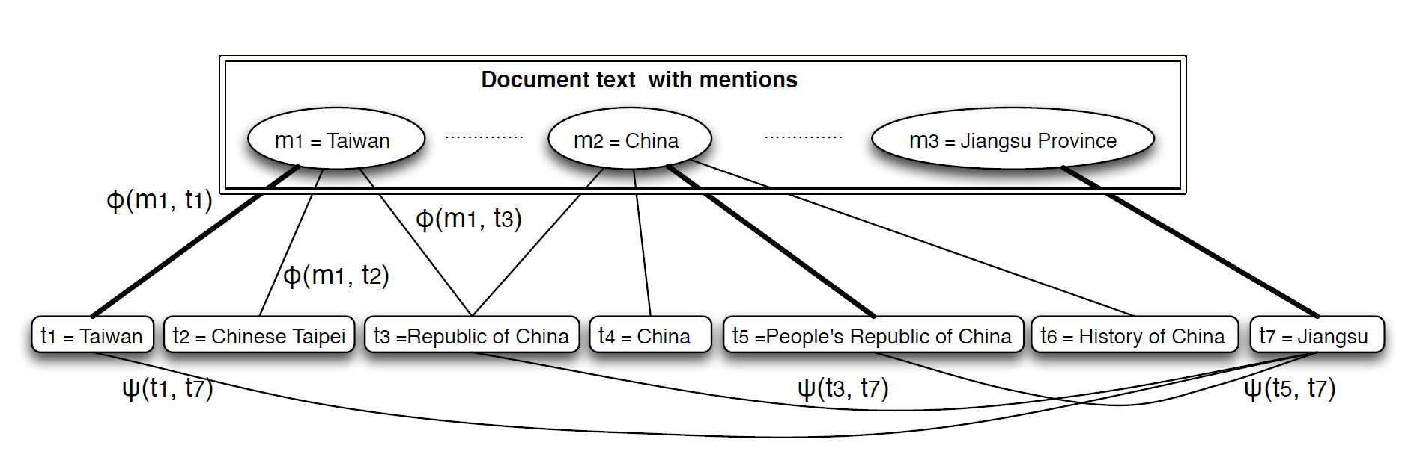
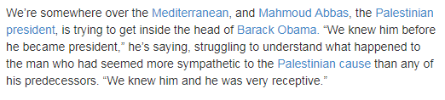
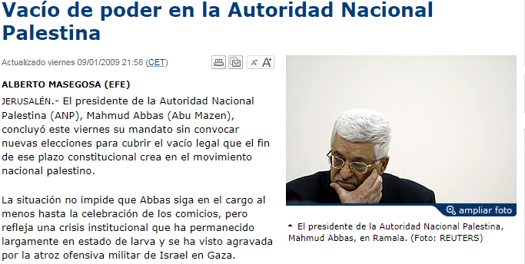
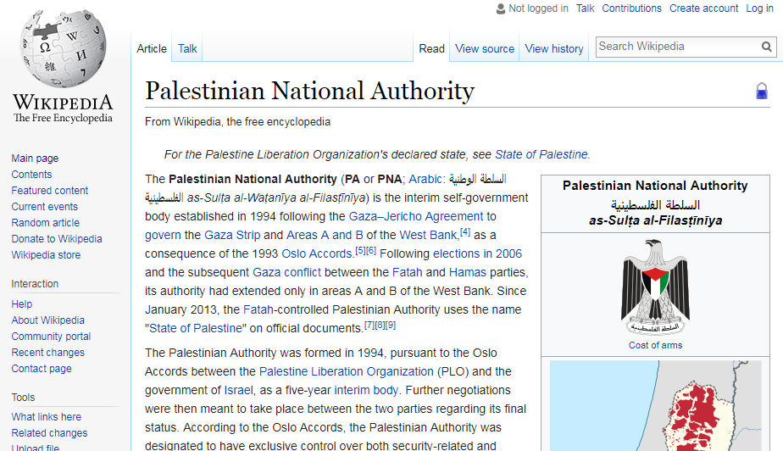
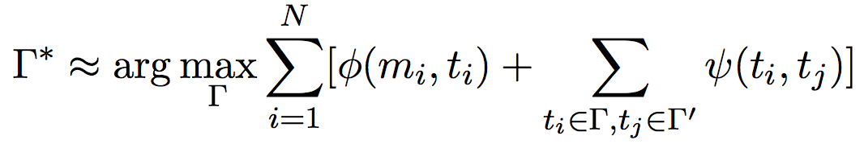
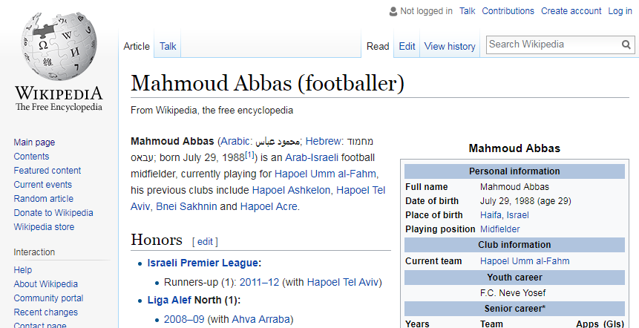

Try the demo at http://cogcomp.org/page/demo_view/xl_wikifier
takes input text (web pages, Word docs, plain text)
identifies and disambiguates important entities and concepts
returns text enhanced with links to Encyclopedic resources (Wikipedia) describing contextually unambiguous concepts.
Keywords: Entity Resolution & Linking; Contextual Disambiguation; Grounding to Reference Records
Developed by: Chen-Tse Tsai, Chase Duncan, Liang-Wei Chen, Shyam Upadhyay, Nitish Gupta, Mark Sammons
Ambiguity & Variability
There are many ways to say the same thing. Wikifier uses context to recognize what is meant and ground it in the most specific Wikipedia page. (It would also recognize “Kansas City” here, just as it links “San Diego” to the Chargers’ page).
Which “Alex Smith” are we talking about?
The Challenge
Much of the world’s information is expressed as natural language text – in documents such as emails, reports, articles, blogs, social media, …
An entity or concept mentioned in text is often ambiguous, and could refer to multiple different entities. Also, different surface representations can refer to the same entity or concept.
Wikifier addresses these problems by (i) contextually disambiguating entities and concepts and (ii) grounding entities and concepts in encyclopedic resources that provide additional knowledge on them.
This opens up a range of opportunities for better understanding of the text and accessing it at the level of concepts, not keywords.
The Wikifier Solution
  Γ* is a solution to the problem, a set of mention-title pairs (m,t).
Φ(m,t) scores how well mention m maps to title t based on local context
Ψ(t_{i},t_{j}) scores how likely two titles t_{i}, t_{j} are to appear in a document
A global assignment of all mentions to titles is evaluated based on local context, relational structure of the text and global coherence.
Wikifier links to the Chiefs’ QB, not the Bengals’ TE.
Who is Abu Mazen? Who is Mahmoud Abbas? Wikifier can help (in many languages)…
Variability
X
Cross-Lingual Wikification

