Slide 1
CIS-620
Spring 2021
Learning in Few-Labels Setting
Dan Roth
Computer and Information Science
University of Pennsylvania

Slide 2
This class
Understand early and current work on Learning in Few-Labels Settings
  (Learn to) read critically, present, and discuss papers
Think about, and Understand realistic learning situations
  Move away from the “easy cases” to the challenging ones
  Conceptual and technical
Try some new ideas
How:
  Presenting/discussing papers
    Probably: 1-2 presentations each;
    Each paper will have 2 discussants: pro/con
  Writing 4 critical reviews
  “Small” individual project (reproducing);
  Large project (pairs)
  Tentative details are on the web site.
Machine Learning
  519/419
  520
  Other?
NLP
  Yoav Goldberg’s book
  Jurafsky and Martin
  Jacob Eisenstein
Attendance is mandatory
Participation is mandatory
Time: Monday 3pm, break, 4:30 pm.
Zoom Meeting https://upenn.zoom.us/j/95494190734?pwd=MzhMek83U0hCSVgrblZkenZjL1hIUT09
TA: Soham Dan
  Office hours: 6-7pm Monday

Slide 3
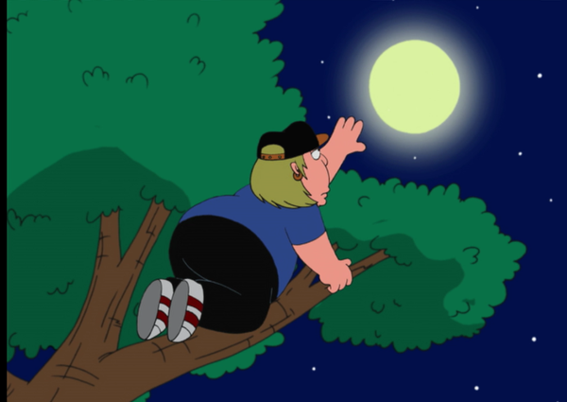
What’s Important in order to make progress in NLU
How to make progress towards natural language understanding
  Learning and Reasoning; knowledge
Dispel with [some] of the current trends
  Mostly – invent training datasets and hope…
  If we want to reach the moon…
What are the real challenges today?
  “Sparse” reasoning tasks
  Generalization
  Supporting latent decisions
  Low resource languages
  ….
  These are likely to present different technical challenges
Today: Examples & Discussion
Notes:
This is my model for natural language comprehension – and I’d like to talk about some of the key issues we need to think about if we want to make progress in NLU
In doing it, I’ll dispel with some of the currently hot trends – they can help up clime trees, but we want to reach the moon.
I will use it to pay tribute to John McCarthy – many of you, I hope, know that he thought a lot about representations and Reasoning, I will discuss some of his thoughts about natural language stories
And I’ll use it to give you a brief tour of some of the relevant, hopefully important, ideas came from my work in these directions, and were we should go.

Slide 4
Some Examples

Slide 5
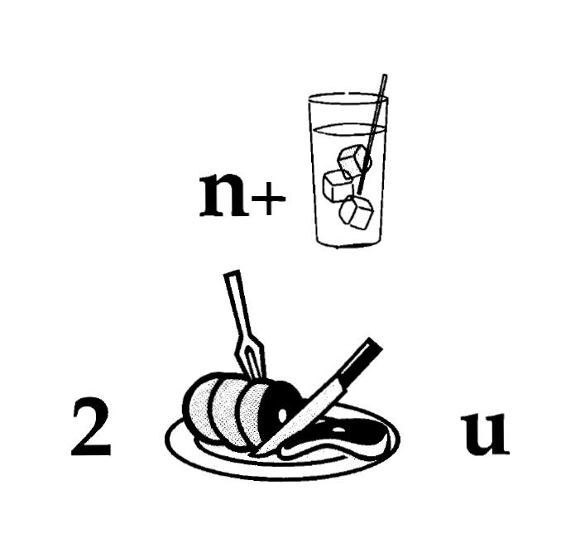
Nice to Meet You
Today, think about it from the perspective of:
  How do we train systems that can solve it?
Identify units
Consider multiple
representations & interpretations
  Pictures, text, layout, spelling, phonetics
Put it all together:
  Determine “best” global interpretation
Satisfy expectations
  Slide; puzzle
Computational Problem:
Assigning values to multiple variables, accounting for interdependencies among them

Slide 6
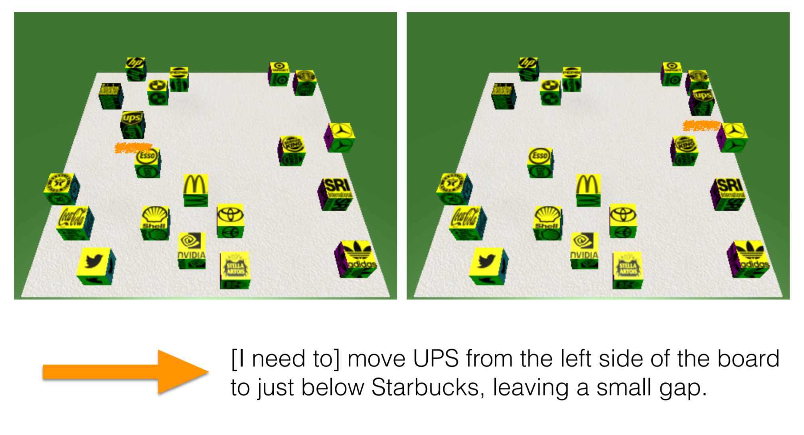
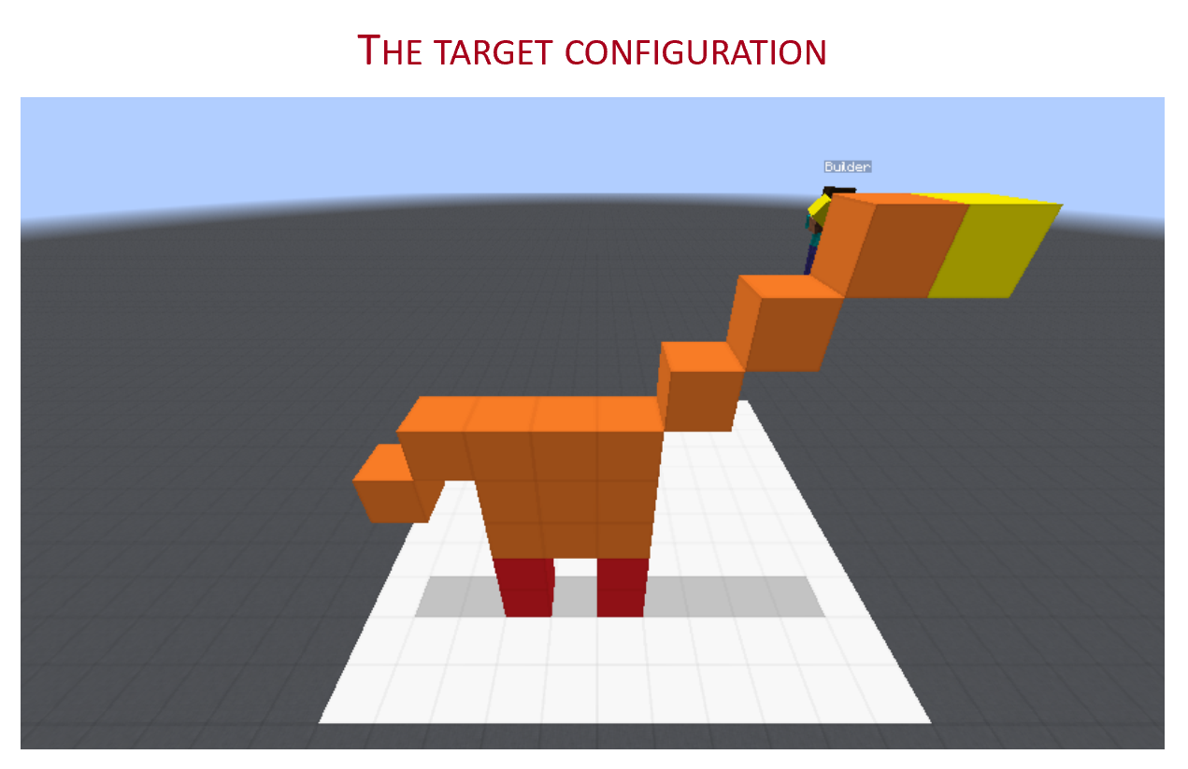
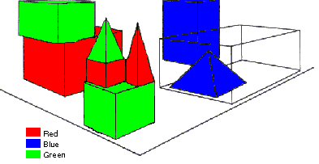
Communication (CwC Project, 2017-2020)
Consider the following explanation:
  [Example from Yonatan Bisk]
  Imagine that this is a chess board
  Place the UPS in H2, and McDonald in G6.
Can you follow these instructions?
  What’s needed for us to be able to write programs that can do it?
Without being trained on thousands of chess-understanding examples

Slide 7



Easy for humans, hard for machines
Humans “understand” text at levels that are far from AI capabilities today
Moving forward often requires “reasoning” about the world
Who was in the store when the events began?
What did the porter say to the robbers?
Why did Mr. Hug yell from the bottom of the elevator shaft?
A 61-year old furniture salesman was pushed down the shaft of a freight elevator yesterday in his downtown Brooklyn store by two robbers while a third attempted to crush him with the elevator car because they were dissatisfied with the $1,200 they had forced him to give them.
The buffer springs at the bottom of the shaft prevented the car from crushing the salesman, John J. Hug, after he was pushed from the first floor to the basement. The car stopped about 12 inches above him as he flattened himself at the bottom of the pit.
  Probably Mr. Hug alone, although the robbers might have been waiting for him, but if so, this would have been stated.
  Nothing, because the robbers left before he came.
  So as to attract the attention of someone who would rescue him.
[McCarthy, 1976]
Notes:
Language is a complex phenomenon.
The reason that it's easy for us, humans, is because we are born and raised with language. We get to experience language and get used to its complexity.
It is because of these reasons that it’s almost impossible to see where these complexities are hiding, without a closer look into its instances.
To make it easier to see these issues, I will go an ordinary snippets taken from the New York Times.
# This story in the past has been used to explain challenges of NLU, for example McCarthy 76 tech report.
(you don't have to read the whole text now; I will be showing you bits and pieces of this story in the next few slides.)
Let me briefly tell you what this story is about:
This is the story of an unfortunate salesman that gets thrown into an elevator hole, by a few people trying to take away his money.
A really troubling story; and if you’re sitting here safe and sound listening to me, probably none of you have experienced anything nearly similar to what happens in this story;
While you have not experienced this incident, you are able to read this text and make sense of it, .... and that is the magic of “language understanding”.
In the next few slides, I explain a few key challenges in understanding for machines, using the snippets taken from this simple story.

Slide 8
How to Train to Support Reasoning?
Rodgers finished 23-of-36 for 296 yards and two touchdowns. His numbers could've been even better had his receivers not dropped a couple of his passes. One dropped ball was a potential score to Allen Lazard. Despite the drop, Lazard made up for it by leading the Packers in receiving. With Davante Adams tied up with Jalen Ramsey, Lazard was able to snatch four balls for 96 yards and a touchdown. Adams still had a great game despite Ramsey's coverage, hauling in nine of his 10 targets for 66 yards and a touchdown. The score frustrated Ramsey because another defensive back was supposed to pick up Adams, who was in motion.
Mayor Rahm Emanuel now has raised more than $10 million toward his bid for a third term – more than five times the total raised by his 10 challengers combined, campaign finance records show.
Notes:
Table is a collection of things in world.

Slide 9
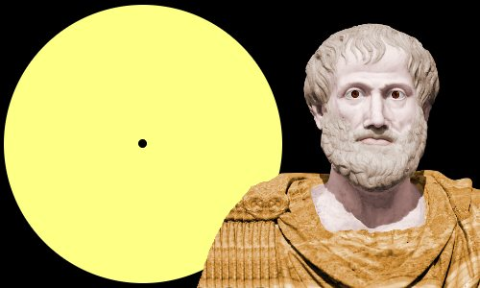

Aristotle’s Logic https://www.famousscientists.org/aristotle/
Aristotle founded the study of formal logic, systematizing logical arguments – he is famous for the syllogism, a method by which known information can be used to prove a point.
Here is a famous example, from Aristotle himself, of a simple syllogism:
  All men are mortal.
  Socrates is a man.
  Therefore, Socrates is mortal.
So, did Aristotle have a laptop?
[Geva et al. TACL’21]
[Example due to Les Valiant]
Notes:
Google will say yes!

Slide 10
De-compositions for Reasoning about Text [Gupta et al. 18’, 19’ 20’]
In the first quarter, the Bears Cutler fired a 7-yard TD pass to tight end Greg Olsen. … In the third quarter, the … back Adrian Peterson's 1-yard touchdown run. The Bears increased their lead over the Vikings with Cutler's 2-yard TD pass to tight end Desmond Clark. The Vikings … with Favre firing a 6-yard TD pass to tight end Visanthe Shiancoe. The Vikings … with Adrian Peterson's second 1-yard TD run. The Bears then responded with Cutler firing a 20-yard TD pass to wide receiver Earl Bennett. The Bears then won on Jay Cutler's game-winning 39-yard TD pass to wide receiver Devin Aromashodu.
Who scored the longest touchdown pass of the game?
Text Comprehension challenges:
  Understand the text
    Identify and contextualize events, entities, quantities (and their scope), relations, etc.
  Understand questions about the text
    Often, requires decomposing the question in a way that depends on the text
  Reason about the text
    Combine and manipulate the identified information to accomplish information needs (e.g., answering questions)
How can we supervise to support this level of understanding?
  Too many (ill-defined) latent decisions
    Annotating text for all is not scalable
  End-task supervision is the only realistic approach [Clarke et. al.’10] but it is too loose – how can we learn all the latent decisions from end-to-end supervision?
She reports worsened seizure frequency, seizures now occurring up to 10/week, in clusters about 2-3 day/week. Previously reported seizures occurring about 2-3 times per month, often around the time of menses,…
What is her seizure frequency?
Mayor Rahm Emanuel has raised more than $10 million toward his bid for a third term – more than five times the total raised by his 10 challengers combined, campaign finance records show.
How much did his challengers raise?
The COVID-19 pandemic in the United States is part of the worldwide pandemic of coronavirus disease 2019 (COVID-19). As of October 2020, there were more than 9,000,000 cases and 230,000 COVID-19-related deaths in the U.S., representing 20% of the world's known COVID-19 deaths, and the most deaths of any country.
Notes:
We are interested in developing a question answering system that given as input a question and a relevant paragraph of context, produces the correct answer
For example, given the question “Who scored the longest touchdown pass of the game?” and a summary of an American Football game, the model should be able to produce the correct answer

Slide 11
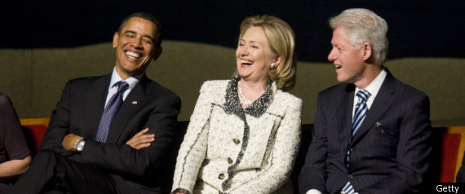
Challenges
When you read a piece of text, your understanding of the text goes far beyond any of the “tasks defined so far by the NLP community”
O’Hare must be in Chicago
O’Hare must be in Chicago
Feb 5 2017 Dozens of passengers heading to Chicago had to undergo additional screenings… It took Hesam Aamyab two tries to make it back to the United States from Iran. He is an Iranian citizen with a US visa who is doing post-doctoral research at UIC. …"Right now, I am in the USA and I'm very happy," Aamyab said. But now, he can't go back to Iran or anywhere else without risk. Other travelers shared the same worry. Asem Aleisawi was at O'Hare on Sunday to meet his wife who was coming in from Jordan.

Slide 12

CliffsNotes
Multiple natural language documents
  Small units of text or large units of texts
  Reading news about an event/situation over time and/or from multiple sources
  Reading a book
  The novel features the character David Copperfield, his journey of change and growth from infancy to maturity, as many people enter and leave his life and he passes through the stages of his development. (Fiction, and you know it)
  London and England in the 19-th century; socio-economic state, child exploitation; schools, prisons, emigration to Australia (True historical facts)
What are the computational tasks that we should think about?

Slide 13
Low Resource Languages
Written languages
(3.5K)
All languages
(7K)
Can we translate the annotation to other languages?
Requires parallel data for training
Languages with
NER Annotation
(30?)
(Diagram roughly to scale. Numbers from ethnologue.com)

Slide 14
Low Resource Languages
Written languages
(3.5K)
All languages
(7K)
Languages with
parallel text
(100?)
Wikipedia
languages
(300)
Can we use the multilingual links in Wikipedia?
Languages with
NER Annotation
(30?)
(Diagram roughly to scale. Numbers from ethnologue.com)

Slide 15
Low Resource Languages
Written languages
(3.5K)
All languages
(7K)
Languages with
Query Logs
(?)
Languages with
Lexicons
(2K?)
Languages with
parallel text
(100?)
Wikipedia
languages
(300)
What else can we do?
Languages with
NER Annotation
(30?)
(Diagram roughly to scale. Numbers from ethnologue.com)

Slide 16
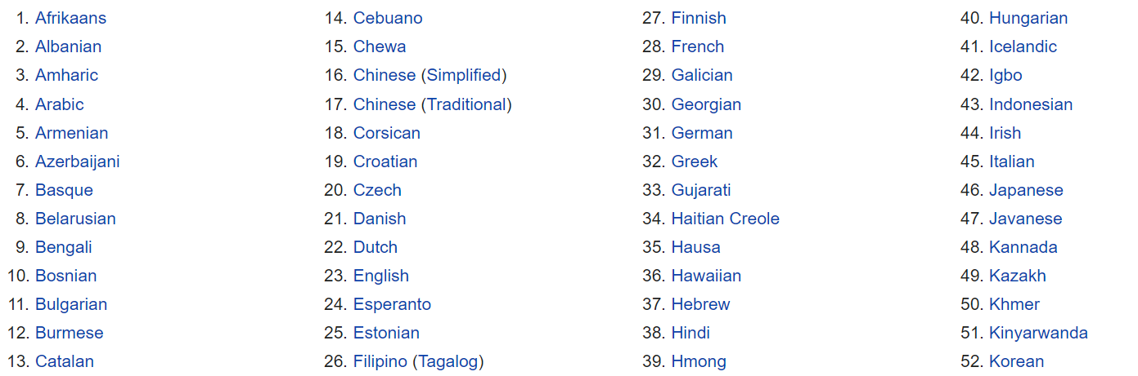
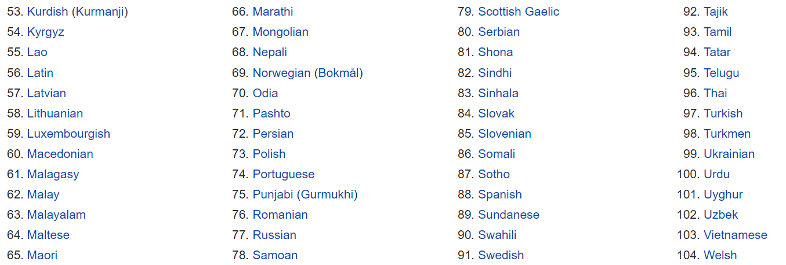
Indian Languages
Languages Translated by Google
Among the top 80 languages in the world, spoken by more than 10m people, 18 are Indian languages
http://www2.harpercollege.edu/mhealy/g101ilec/intro/clt/cltclt/top100.html
There are 109 languages in Google Translate
10 of them are Indian Languages
(all, with >25m speakers)

Slide 17
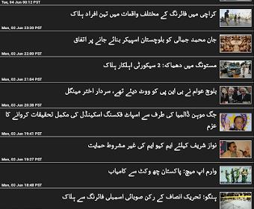
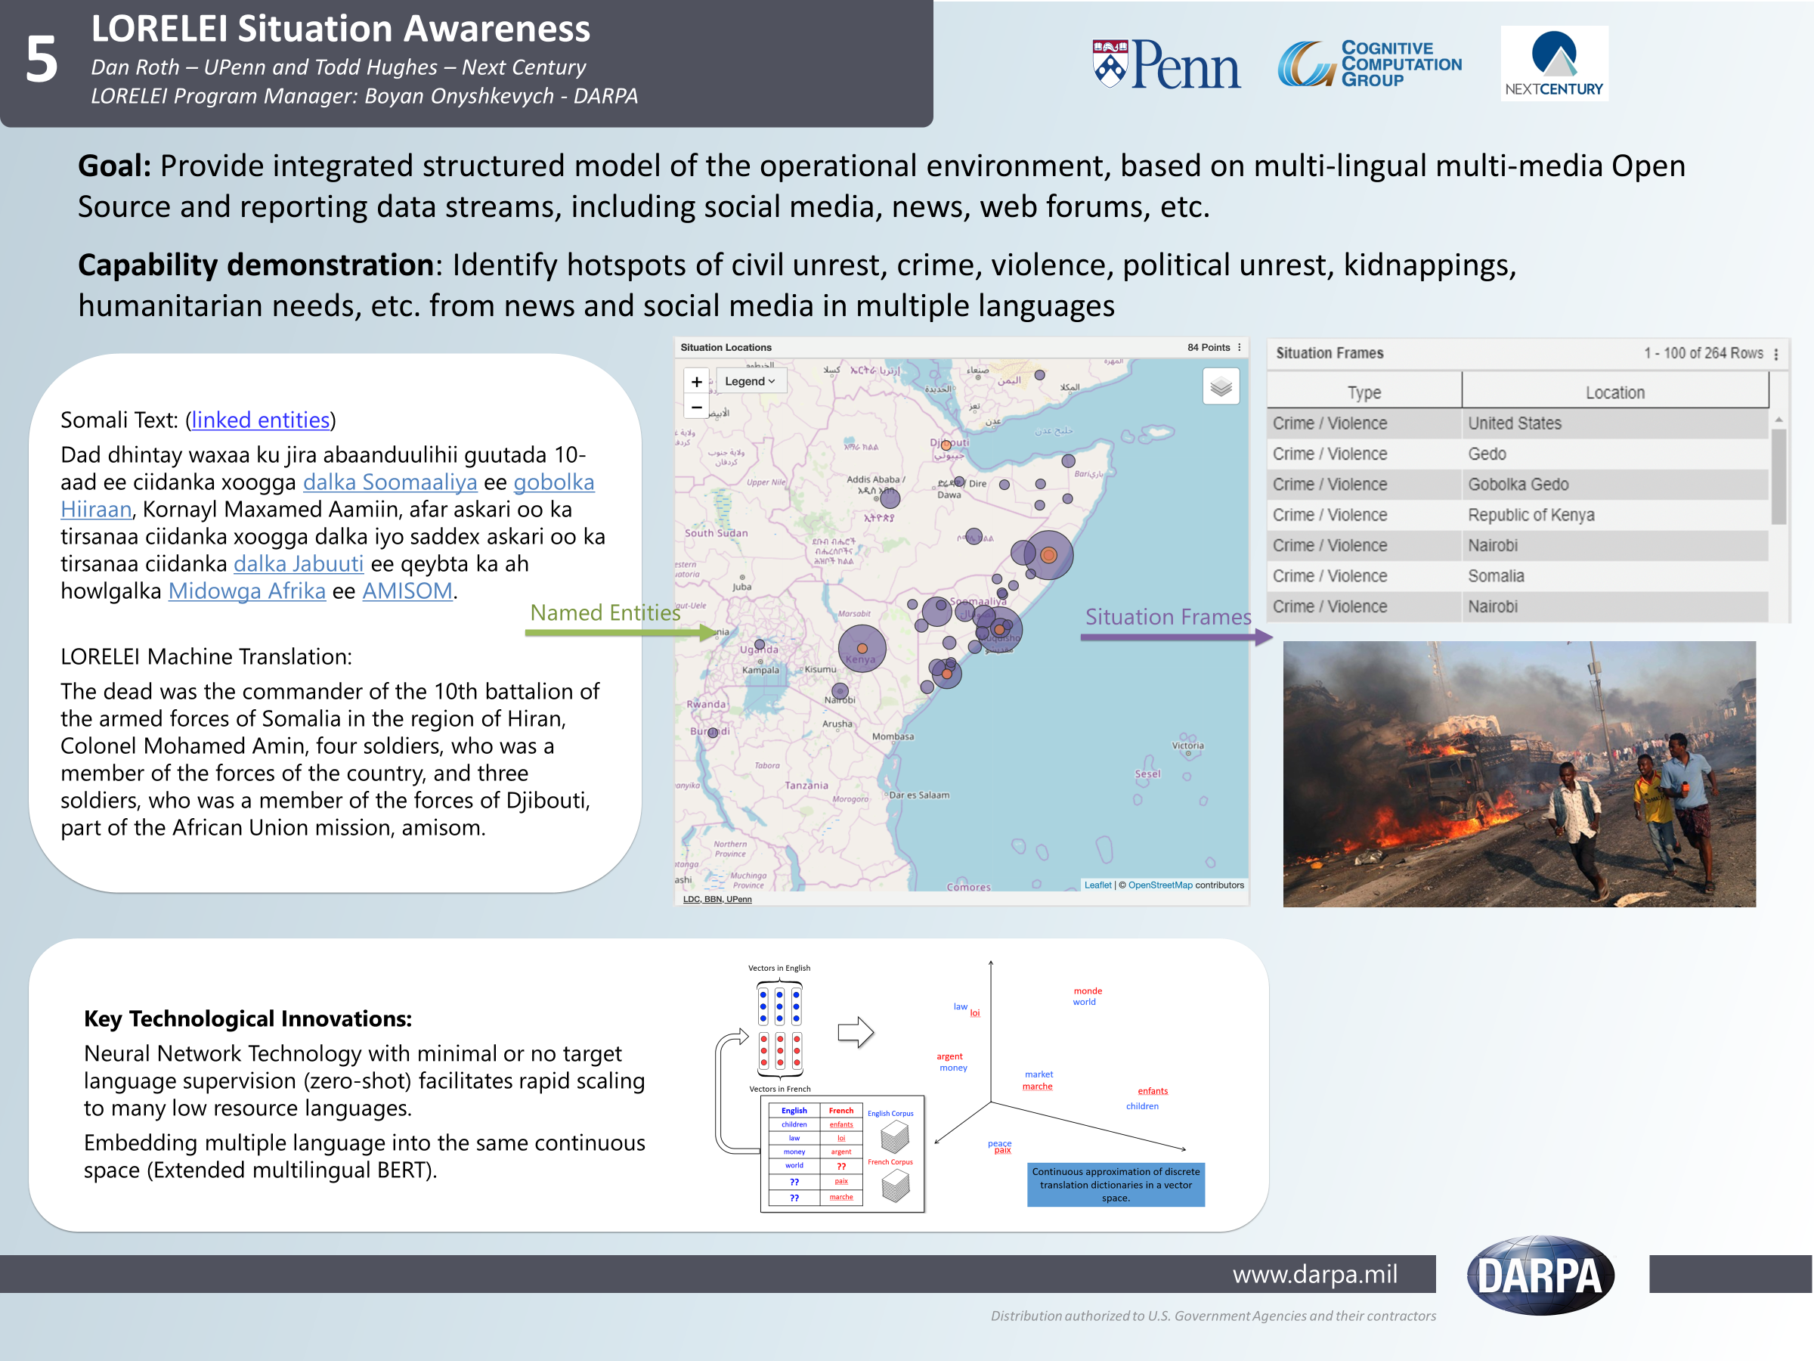
Target Language Source English
Can we at least “understand” documents in low resource languages?
Of course, you can imagine many other challenges in low resource languages
Somali streaming data
Situation Awareness
(described in English)
What is it about?
  Identify topics & events
“Understand” a situation described in Target Language
  Identify Entities & Concepts (NER)
  Ground in English Resources (XEL)

Slide 18
New Domains; New Tasks
Electronic Health Records
Many questions:
  Blame classifier: give reported Failures: who is at fault?
  Discourse with patients: did the physician informed them about A?
  …
She reports worsened seizure frequency, seizures now occurring up to 10/week, in clusters about 2-3 day/week. Previously reported seizures occurring about 2-3 times per month, often around the time of menses,…

Slide 19
Challenges (1)
Analyze Suspicious Transaction Reports (STRs) that banks submit to government agencies.
  Extract relationships and transaction details.
ALERTED ACTIVITY
  On 01/01/2011 the 01/01/2011 wire was stopped by ABC DE’s filter:
  JJ sent a $4,950.00 wire from account 123567 at GH Bank DE, through ABC DE, to account 123456 at Peoples’ Bank of Malibu head office, Malibu, to be remitted to People’s Bank of Malibu, XYZ Branch, for the benefit of BB for “Prayer Religious Items.”
Determine: who did what to whom, where and when?
  What are the transactions; from whom, to whom?
  People involved, roles and affiliations
  Organizations and their roles
  Timelines of events

Slide 20
Challenges (2)
Inter-banking rate issues
  A client investigates if bankers were fixing the inter-banking rate.
  "Mate, can you raise the main one by 0.2 till Wednesday? I owe you a drink.“
Messages here are typically very short; the language is colloquial and ungrammatical. Messages include many quantities (rates), how much to adjust, etc.
A “simple” classification problem – but what is the label?
  And, where is the training data?
  (Australian company)

Slide 21
The Space
There is a wide range of challenges to the current supervision paradigms
  But, what we know is to train supervised models
Can we think about a collection of reductions
  Mapping realistic scenarios (with realistic scenarios) to a supervised setting?
  Example: context sensitive spelling correction
  How do we train for it?
    Invent a notion of confusion set;
    Use available text; drop a confusion set member – positive example; other members – negatives
    The 1990-ies version of the (discriminative) masked language model
  This is a reduction to the supervised paradigm; accomplished by dreaming up an indirect supervision signal.
  .
Exposure to the sun had the affect of toughening his skin.

Slide 22
What Should We Address?
Zero-shot (few shot) Learning
  Label-Aware methods
  Transfer learning methods
  Representation driven methods
Incidental Supervision Signal
  Where can we get signals from?
  How to use them?
  Is it art?

Slide 23
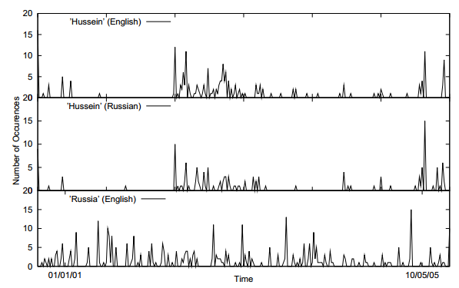
Incidental Supervision Signals
Supervision could be incidental, in the sense that it makes use of signals that might be co-related to the target task.
Searching for supervision signals could be challenging.
Temporal histograms
Assume a comparable, weakly temporally aligned news feeds.
Hussein (English)
Transliteration: How to write “Hussein” in Russian?
Hussein (Russian)
Weak synchronicity provides a cue about the relatedness of (some) NEs across the languages, and can be exploited to associate them
[Klementiev & Roth, 06,08]
Germany (English)
Notes:
If I want to solve this transliteration task, I need examples; but I don’t need anyone to label many for me.
But I did not learn it this way – I learned from a few examples, that were not annotated, but for various reasons, I was pretty sure were pretty good….
I could make the observation, that if one looks at comparable news articles from about the same time, the key entities they cover are the same, and they occur with about the same temporal frequency.
Start with labeling
Then transliteration
Then psychology
Then semantic parsing
(Emphasize that this requires reasoning)
End with the example of reasoning in learning (Chicago)

Slide 24
Incidental Supervision Signals
Need an inference mechanism that supports combining signals/models
By itself, this temporal signal may not be sufficient to support learning robust models.
Along with weak phonetic signals, context, topics, etc. it can be used to get robust models.
Temporal histograms
Assume a comparable, weakly temporally aligned news feeds.
Hussein (English)
Hussein (Russian)
Weak synchronicity provides a cue about the relatedness of (some) NEs across the languages, and can be exploited to associate them
[Klementiev & Roth, 06,08]
Russia (English)

Slide 25
What Should We Address?
Zero-shot (few shot) Learning
  Label-Aware methods
  Transfer learning methods
  Representation driven methods
Incidental Supervision Signals
  Where can we get signals from?
  How to use them?
  Is it art?
Low Resource Languages
  New Signals & projection
  Representations
End-task Supervision
  When and How?
  How to use indirect supervision signals?
Knowledge as supervision
  Constraints driven paradigms
  Partial supervision
Transfer Learning & Adaptation
  Domain shift
  Label space shift
Theory

Slide 26
This class
Presentations
  Key part of the class
  Send me your presentation by Wednesday before you present.
Discussion/Discussants
Projects
Questions?
Understand early and current work on Learning in Few-Labels Settings
  (Learn to) read critically, present, and discuss papers
Think about, and Understand realistic learning situations
  Move away from the “easy cases” to the challenging ones
  Conceptual and technical
Try some new ideas
How:
  Presenting/discussing papers
    Probably: 1-2 presentations each;
    Each paper will have 2 discussants: pro/con
  Writing 4 critical reviews
  “Small” individual project (reproducing);
  Large project (pairs)
  Tentative details are on the web site.
Machine Learning
  519/419
  520
  Other?
NLP
  Yoav Goldberg’s book
  Jurafsky and Martin
  Jacob Eisenstein
Attendance is mandatory
Participation is mandatory
Time: Monday 3pm, break, 4:30 pm.
Zoom Meeting https://upenn.zoom.us/j/95494190734?pwd=MzhMek83U0hCSVgrblZkenZjL1hIUT09
TA: Soham Dan
  Office hours: 6-7pm Monday

