Slide 1
CIS-620
Spring 2021
Learning in Few-Labels Settings
Dan Roth
Computer and Information Science
University of Pennsylvania

Slide 2
This class
Presentations
  Key part of the class
  Send me your presentation by Wednesday before you present.
Discussion/Discussants
Projects
Questions?
Understand early and current work on Learning in Few-Labels Settings
  (Learn to) read critically, present, and discuss papers
Think about, and Understand realistic learning situations
  Move away from the “easy cases” to the challenging ones
  Conceptual and technical
Try some new ideas
How:
  Presenting/discussing papers
    Probably: 1-2 presentations each;
    Each paper will have 2 discussants: pro/con
  Writing 4 critical reviews
  “Small” individual project (reproducing);
  Large project (pairs)
  Tentative details are on the web site.
Machine Learning
  519/419
  520
  Other?
NLP
  Yoav Goldberg’s book
  Jurafsky and Martin
  Jacob Eisenstein
Attendance is mandatory
Participation is mandatory
Time: Monday 3pm, break, 4:30 pm.
Zoom Meeting https://upenn.zoom.us/j/95494190734?pwd=MzhMek83U0hCSVgrblZkenZjL1hIUT09
TA: Soham Dan
  Office hours: 6-7pm Monday
All the material will be available on the class’ web site, open to all. Let me know if you don’t want your presentation to be avaialble.

Slide 3
What Should We Address?
Zero-shot (few shot) Learning
  Label-Aware methods
  Transfer learning methods
  Representation driven methods
Incidental Supervision Signals
  Where can we get signals from?
  How to use them?
  Is it art?
Low Resource Languages
  New Signals & projection
  Representations
End-task Supervision
  When and How?
  How to use indirect supervision signals?
Knowledge as supervision
  Constraints driven paradigms
  Partial supervision
Transfer Learning & Adaptation
  Domain shift
  Label space shift
Theory

Slide 4
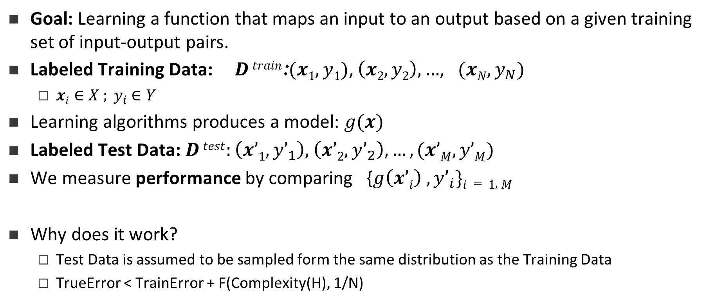
Supervised Machine Learning
Goal: Learning a function that maps an input to an output based on a given training set of input-output pairs.
Labeled Training Data: $D train$:$(x1, y1)$, $\left(x2, y2\right), …$, $(xN, y_{N})$
  ${xi∈X ; y}_{i}$ $∈Y$
Learning algorithms produces a model: $g(x)$
Labeled Test Data: $D test:\left(x’1, y’_{1}\right),$ $\left(x’2, y’_{2}\right), …,(x’M, y’M)$
We measure performance by comparing {$g\left(x’i\right) , y’_{i}\}i=1,M$
Why does it work?
  Test Data is assumed to be sampled form the same distribution as the Training Data
  TrueError < TrainError + F(Complexity(H), 1/N)
Does the label carry any meaning?
What if the set Y changes after training?
What if that doesn’t hold?
What if N is small?

Slide 5
Zero-Shot

Slide 6
Zero-Shot Learning
If Labels have meaning, we can imagine being “label-aware”.
  Developing models that “understand” the label and classify an instance x to an appropriate label given this “understanding”.
  In this case, the notion of a test-set may not be important anymore:
    Given a single example, we should be able to classify it.
  There are multiple ways to be “label-aware”
    Prototypes; definitions, other forms of knowledge
But the power of “label-aware” is not the only power that can drive zero-shot
  Maybe you have seen training data for some labels (but not all) and you are aware of “relations” between labels.
    Common in Computer Vision
Transfer Learning:
  Maybe learning model for task T₁, can be used to make predictions on task T₂.

Slide 7
Text Classification
A lot of the work in NLP can still be viewed as text classification
  Categorization into topics
  Identify intention of text
  Identify abusing text
  Be admitted again soon/no
  Classify fact/opinion
  ……
While you understand the labels, models are not given information about the labels
We simply view these tasks as multi-class classification
The only thing that has changed since the 70-ies is slightly better learning algorithms, and slightly better word representations
The research community uses data embeddings broadly!
And, heavy reliance on task specific supervision
But there is almost no use of task/label understanding.
Promote Label-Aware Models as a form of Incidental Supervision

Slide 8
Say something about over fitting – the issue that training for a specific ontology on a given data set could also do that.

Slide 9
Text Categorization
Is it possible to map a document to an entry in a taxonomy of semantic categories, without training with labeled data?
Second seed Rafael Nadal continues his quest for an unprecedented 12th title at this event against Grigor Dimitrov of Bulgaria. The Spaniard leads their FedEx ATP Head2Head 11-1 and has won their past four matches, in addition to all four of their previous battles on clay. Their most recent meeting took place in the 2018 Monte-Carlo semi-finals, which saw Nadal drop just five games in his victory.
It’s about Sport
It’s about Tennis
Traditional text categorization requires training a classifier over a set of labeled documents (1,2,….k)
Someone needs to label the data (costly)
All your model knows is to classify into these given labels
Total costs for on-the-job health care benefits are expected to rise an average of 5% in 2018, surpassing $14,000 a year per employee, according to a National Business Group on Health survey of large employers. Specialty drugs continue to be the top driver of increasing costs. Companies will pick up nearly 70% of the tab, but employees must still bear about 30%, or roughly $4,400, on average.
It’s about Money
It’s about Health Care
You can classify these documents without task specific annotation, since you have an “understanding” of the labels

Slide 10
Categorization without Labeled Data [AAAI’08, AAAI’14, IJCAI’16]
This is not an unsupervised learning scenario. Unsupervised learning assumes a coherent collection of data points, where similar data points are assigned similar labels. It does not work on a single document. 0-shot learning.
Given:
  A single document (or: a collection of documents)
  A taxonomy of categories into which we want to classify the documents
Dataless/Zero-Shot procedure:
  Let f(l_{i}) be the semantic representation of the labels (label descriptions)
  Let f(d) be the semantic representation of a document
  Select the most appropriate category:
  l_{i}* = argmin_{i} dist (f(l_{i}) - f(d))
  Bootstrap
    Label the most confident documents; use this to train a model.
Key Question:
  How to generate good Semantic Representations?
Originally:
  Task Independent Representations: best results with Wikipedia-based (ESA) [Gabrilovich & Markovitch AAAI’06]
  Sparse representation: a TF/IDF weighted list of URL a concept appears in
Hard to beat

Slide 11
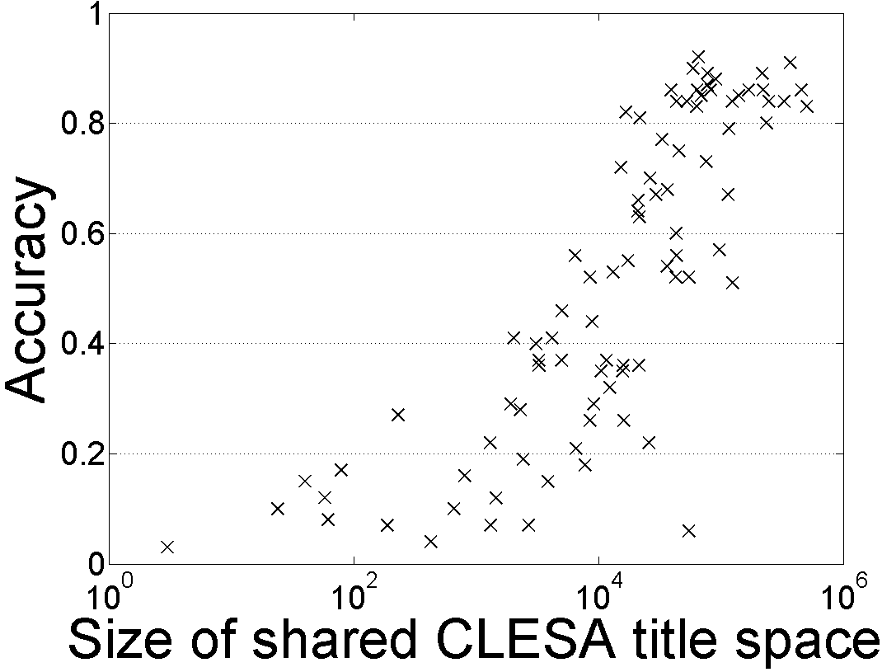
Single Document Classification (88 Languages)
[Song et. al. IJCAI’16; AIJ’19]
Can be done to all 293 languages represented in Wikipedia
Performance depends on the Wikipedia size (Cross-language links)
Dataless classification for English
Accuracy
Hausa
Hindi
Size of shared English-Language L title space

Slide 12
Understanding a Taxonomy
A former Democrat, Bloomberg, switched his party registration in 2001.
label aware models
Key question: how do we “understand” the taxonomy?
“Type” as a conceptual container binding entities together.
  Defined extensionally as a set of members of the type
  (Not examples annotated in context; Wikipedia pages, say)
politician
Richard Nixon
Bill Clinton
Elizabeth Warren
Boris Johnson
company
Computational Approach: Determine the type of an input mention by finding entities in the type-defining-set that share a similar context
Of course, each entity will be in multiple such buckets
Lehman Brothers
Reuters
CNN
Google
Notes:
Types are conceptual containers that bind entities together to form a coherent group.
I know what a politician is since I know many politicians

Slide 13
ZOE: Type-Compatible Grounding
“Type” as conceptual container binding entities together.
A former Democrat, Bloomberg, switched his party registration in 2001.
politician
Richard Nixon
Bill Clinton
ELMo [Peters et al. 18]
Context-consistent
Elizabeth Warren
Boris Johnson
Different contexts where “Elizabeth Warren” is mentioned
Warren is a member of the Democratic Party, after switching party affiliation from the Republican Party in 1996.
company
Lehman Brothers
Reuters
CNN
Google
WikiLinks [Singh et al. 12]
Notes:
Types are conceptual containers that bind entities together to form a coherent group.
I know what a politician is since I know many politicians

Slide 14
ZOE: Type-Compatible Grounding
“Type” as conceptual container binding entities together.
Since its founding, Bloomberg has made several acquisitions.
politician
Richard Nixon
Bill Clinton
Context-consistent
Elizabeth Warren
Boris Johnson
Different contexts where “Berkshire Hathaway” is mentioned
Berkshire Hathaway Berkshire Hathaway Inc has acquired a 25 billion rupees ($356 million) stake in the parent of digital payments company Paytm.
company
Lehman Brothers
Reuters
Berkshire Hathaway
Enron
Context consistency allows us to determine good candidates for type compatibility.
Notes:
Types are conceptual containers that bind entities together to form a coherent group.
I know what a politician is since I know many politicians

Slide 15
Zero-Shot Open Typing: Big Picture
A former Democrat, Bloomberg switched his party registration in 2001.
A mention &
its context
High-level Algorithm:
Map the mention to context-consistent Wikipedia concepts (noting that each belong to multiple types)
  Simple Entity Linking
Rank candidate titles by context-consistency and infer the types according to the type taxonomy.
Mapping type-compatible Wikipedia entities
Richard Nixon
Bill de Blasio
Elizabeth Warren
person
mayor
person
politician
politician
politician
president
person
scholar
Inference: aggregate and rank the consistency scores.
person
politician
official

Slide 16
Zero-Shot Via Transfer
Assume that I already know how to solve some tasks
  I have models that can support QA: (Context, Question) → Answer
  I have models that can support Textual Entailment (Premise, Hypothesis) → [Entails, Contr, IDK]
Can we use it to solve other tasks without tasks specific annotation?

Slide 17
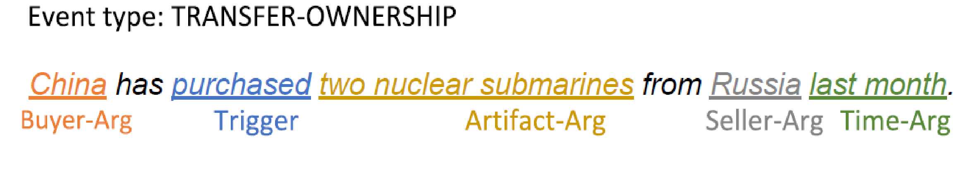
Zero-Shot Event Extraction
Input: “China purchased two nuclear submarines from Russia last month.”
Output:
Annotation at this level is costly and requires expertise
And, it needs to be done whenever we update the event anthology.
On the other hand, it makes sense to assume that one can get a definition of each event type of interest.
Can this be used to classify events and their arguments?

Slide 18
Events’ Definitions
Event type:
TRANSFER-OWNERSHIP
Argument slots:
Buyer-Arg: The buying agent
Seller-Arg: The selling agent
Beneficiary-Arg: The agent that benefits from the transaction
Artifact-Arg: The item or organization that was bought or sold
Price-Arg: The sale price of the ARTIFACT-ARG
Time-Arg: When the sale takes place
Place-Arg: Where the sale takes place
Given Event Schema for each event type in the anthology
Given a text snippet
(1) Identify the event type
  Zero-shot text classification
(2) Choose the appropriate schema, and, with this guidance, generate questions that can determine the event’s arguments.
Importantly, there is a need to support also I-don’t-know, since some of the questions will have know answer

Slide 19
Event Extraction as Question Answering
Input: China purchased two nuclear submarines from Russia last month.
Trigger: purchased
Event Type:
  Q0: Did someone transfer ownership? (multiple questions are being asked)
  A0: Yes ⇒TRANSFER-OWNERSHIP (TC)
Arguments: (now we know the event type)
  Q1: What was purchased? (multiple questions for each arg type)
  A1: Two nuclear submarines. ⇒Artifact-Arg
  Q2: Who purchased two nuclear submarines?
  A2: China. ⇒Buyer-Arg
  Q3: Who did China purchase two nuclear submarines from?
  A3: Russia. ⇒Seller-Arg
  …..
  Q7: Where was the transaction?
  A7: I-don’t-know. ⇒Place-Arg
Work in progress
We are relying on the ability to answer extractive questions and the fact that there are multiple large datasets for this task.
e.g., [He et al. 2019]
The ability to support I-don’t-know is harder.
19
Notes:
19

Slide 20
Low Resource Languages

Slide 21
Low Resource Languages
We have annotations for many NLP tasks in English
We have almost very little annotation for most NLP tasks in other languages
  We have no annotation in low resource languages (some spoken by dozens of millions)
What options do we have?
  Translation
    Not feasible in most cases. Requires a lot of annotation
  Clever use of existing resources (dictionaries, similar “rich” languages)
  Projection of annotation
  Multilingual representations of language

Slide 22

Cross-lingual Representations [Upadhyay et al. (ACL’16)]
Vectors in English
Research Question
What levels of supervision are needed to support multi-lingual transfer for various tasks?
monde
law
world
loi
argent
money
market
Vectors in French
marche
enfants
children
English | French
children | enfants
law | loi
money | argent
world | ??
?? | paix
?? | marche
English Corpus
peace
paix
French Corpus
Continuous approximation of discrete translation dictionaries in a vector space.

Slide 23

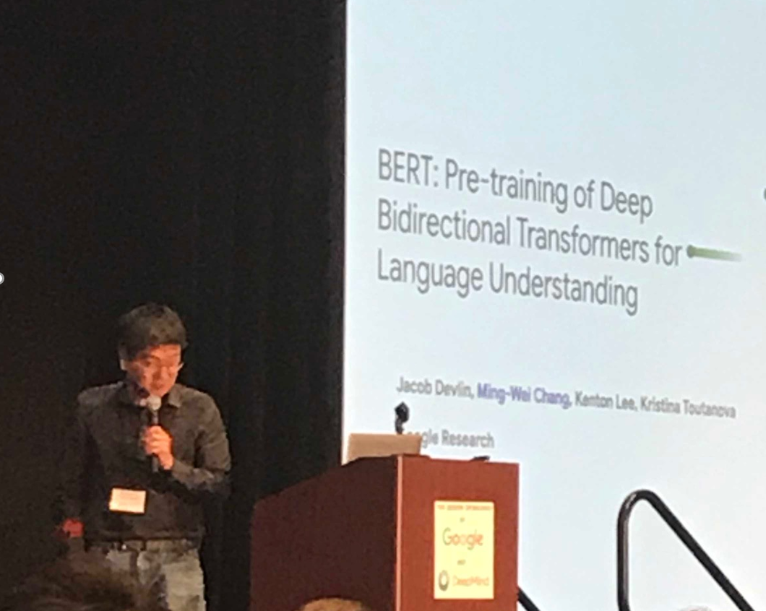
What Happened?
It has been established that multilingual embeddings are essential
  NER, EDL, SF all rely on these representations.
However, it’s also clear that in order to develop tools that span many languages we may need many models, and some (minimal) level of supervision.
BERT: powerful contextual language model
  mBERT: a multilingual version – multilingual embeddings
  A single multilingual embedding for many languages.
  No direct supervision – only needs sufficient data in each language.
Needs to be extended to make use in low-resource languages
Many questions remain
  Why and when does it work?
Ming-Wei Chang
NAACL’19 Best Paper Award
Contextual embeddings are behind many of the advances in NLP in the last couple of years. But, on their own, they are not sufficient to address low-resource languages

Slide 24
Massively Multilingual Analysis of NER
Language | 3 letter code
Akan (Twi) | aka
Amharic | amh
Arabic | ara
Bengali | ben
Farsi | fas
Hindi | hin
Hungarian | hun
Indonesian | ind
Chinese | cmn
Russian | rus
Somali | som
Spanish | spa
Swahili | swa
Tagalog | tgl
Tamil | tam
Thai | tha
Turkish | tur
Uzbek | uzb
Vietnamese | vie
Wolof | wol
Yoruba | yor
Zulu | zul
Low-resource NER:
  different methods, parameters, languages
Evaluation in 22 languages (LORELEI)
  10 different scripts
  10 language families (Niger-Congo most popular)
Notes:
State of the art is gerrymandered.
Patchwork understanding.

Slide 25
Overall: Still Ways to Go
Average of best cross-lingual (47 F1) is still less than monolingual (74 F1)
Amazing: this can be done almost “for free”
Cross-lingual transfer by itself isn’t sufficient
The gap can be narrowed with additional methods

Slide 26
What Else can be Done? Case of NER
Multilingual NER with no Target Language Training Data [Tsai et al. ‘16]
  Using Wikipedia-based language-independent features for NER
Transfer of annotation via cheap translation [Mayhew et al. ‘17]
Use of Weak signals:
  Character-Based Language Models for Entities [Yu et al.’ 18]
    Identifying Entities across languages with minimal supervision
  Partial annotation [Mayhew et al.’19]
    Forms of annotation that are typical to those provided by non-native speakers
    High precision, low recall

Slide 27
Multilingual NER with no Target Language Training Data
Cross-lingual EDL generates good language-independent features for NER by grounding n-grams
Words in any language are grounded to the English Wikipedia
  Features extracted based on the titles can be used across languages
Instead of the traditional pipeline: NER → Wikification/EDL
  Simple-minded EDL of n-grams is sufficient to provide features for the NER model
Person
Location
… nachvollziehenden Verstehen Albrecht Lehmann läßt Flüchtlinge und Vertriebene in Westdeutschland
Understanding
Albert,_Duke_of_Prussia
Jens_Lehmann
Refugee
Western_Germany
media_common
quotation_subject
person
noble_person
person
athlete
field_of_study
literature_subject
location
country

Slide 28
SoTA NER in Multiple Languages [Tsai et. al. CoNLL’16]
 | English | Dutch | German | Spanish | Turkish | Tagalog | Yoruba | Bengali | Tamil | Avg
Wikipedia Size | 5.1M | 1.9M | 1.9M | 1.3M | 269K | 64K | 31K | 42K | 85K
Monolingual Experiments (train and test on the same language)
Direct Transfer Experiments (train on English)
Non-latin script
Täckström’12 |  | 58.4 | 40.4 | 59.3 | - | - | - | - | - | -
Zhang’16 |  | - | - | - | 43.6 | 51.3 | 36.0 | 34.8 | 26.0 | -

Slide 29
Transfer via Cheap Translation [Mayhew, Tsai, Roth EMNLP’17]
Start with English Gold NER data
Translate word-by-word into Turkish
Result is “Turkish-flavored English”
Train with a standard, state-of-the-art NER
Translation is bad:
  Ignorance of morphology
  Wrong word order
  Missing vocabulary

Slide 30
NER with Partial Annotation
Romanized Bengali
Low recall, high precision annotation
Can be solicited even from non-native speakers
Challenge:
ebisi’ra giliyyaana phinnddale aaja pyaalestaaina adhiinastha gaajaa theke aaja raate ekhabara jaaniyyechhena .
ABC’s Gillian Findale has reported from Gaza under Palestine today.
An algorithmic approach that allows training high quality NER from partial annotation given by non-native speaker.
Notes:
If you or I annotated this sentence, chances are we would have high-precision / low-recall annotations.
Success of non-speaker annotations is one of the biggest lessons of LORELEI EDL.

Slide 31
Learning from Responses

Slide 32

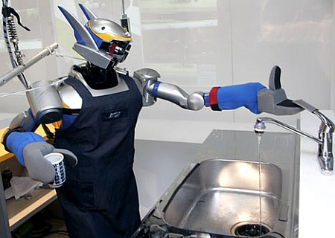

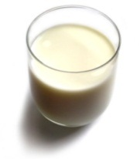
Understanding Language Requires (some) Feedback
Can I get a coffee with lots of sugar and no milk
Can we rely on this interaction to provide supervision (and eventually, recover meaning) ?
Great!
The Goal
Arggg
Meaning Representation:
MAKE(COFFEE,SUGAR=YES,MILK=NO)
How to recover meaning from text?
Standard “example based” ML: annotate text with meaning representation
  The teacher needs deep understanding of the agent ; not scalable.
Response Driven Learning (current name: learning from denotation): Exploit indirect signals in the interaction between the learner and the teacher/environment
[A lot of work in this direction, following Clarke et al. 2010: Driving Semantic Parsing from the World's Response – a lot more to do]
Notes:
NLU: about recovering meaning from text – a lot of work aims directly at that or at some subtasks that might look like this:….

Slide 33
Response Based Learning
We want to learn a model that transforms a natural language sentence to some meaning representation.
Instead of training with (Sentence, Meaning Representation) pairs
Think about/invent behavioral derivative(s) of the models outputs
  Supervise the derivatives (easy!) and
  Propagate it to learn the complex, structured, transformation model
English Sentence
Model
Meaning Representation

Slide 34
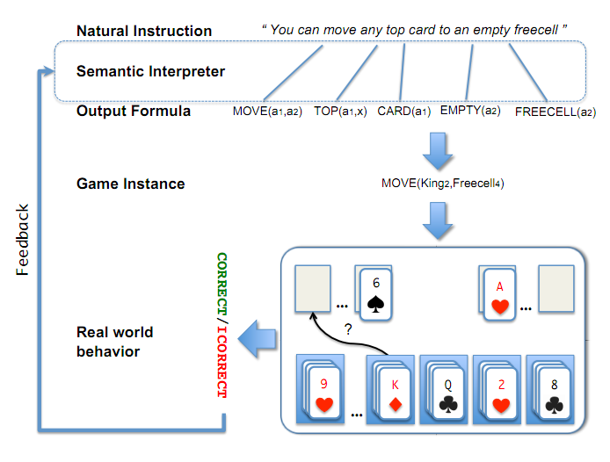
A Response based Learning Scenario
We want to learn a model to transform a natural language sentence to some meaning representation.
English Sentence
Model
Meaning Representation
A top card can be moved to the tableau if it has a different color than the color of the top tableau card, and the cards have successive values.
Move (a1,a2) top(a1,x1) card(a1) tableau(a2) top(x2,a2) color(a1,x3) color(x2,x4) not-equal(x3,x4) value(a1,x5) value(x2,x6) successor(x5,x6)
Play Freecell (solitaire)
Simple derivatives of the models outputs: game API
  Supervise the derivative and Propagate it to learn the transformation model

Slide 35
Response Based Learning
We want to learn a model that transforms a natural language sentence to some meaning representation.
Instead of training with (Sentence, Meaning Representation) pairs
Think about/invent simple derivatives of the models outputs,
  Supervise the derivative (easy!) and
  Propagate it to learn the complex, structured, transformation model
LEARNING:
Train a structured predictor (semantic parse) with this binary supervision
  Many challenges: e.g., how to make a better use of a negative response?
Learning with a constrained latent representation, use inference to expectations to exploit knowledge (e.g., on the structure of the meaning representation).
[Clarke, Goldwasser, Chang, Roth CoNLL’10; Goldwasser, Roth IJCAI’11, MLJ’14]
If the response is “no”, the semantic parse must be wrong; how to supervise?
English Sentence
Model
Meaning Representation
If the response is “yes”, it could still be so for the wrong reason, despite the semantic parse being wrong.

Slide 36
De-compositions for Reasoning about Text [Gupta et al. 18’, 19’ 20’]
In the first quarter, the Bears Cutler fired a 7-yard TD pass to tight end Greg Olsen. … In the third quarter, the … back Adrian Peterson's 1-yard touchdown run. The Bears increased their lead over the Vikings with Cutler's 2-yard TD pass to tight end Desmond Clark. The Vikings … with Favre firing a 6-yard TD pass to tight end Visanthe Shiancoe. The Vikings … with Adrian Peterson's second 1-yard TD run. The Bears then responded with Cutler firing a 20-yard TD pass to wide receiver Earl Bennett. The Bears then won on Jay Cutler's game-winning 39-yard TD pass to wide receiver Devin Aromashodu.
Who scored the longest touchdown pass of the game?
Text Comprehension challenges:
  Understand the text
    Identify and contextualize events, entities, quantities (and their scope), relations, etc.
  Understand questions about the text
    Often, requires decomposing the question in a way that depends on the text
  Reason about the text
    Combine and manipulate the identified information to accomplish information needs (e.g., answering questions)
How can we supervise to support this level of understanding?
  Too many (ill-defined) latent decisions
    Annotating text for all is not scalable
  End-task supervision is the only realistic approach [Clarke et. al.’10] but it is too loose – how can we learn all the latent decisions from end-to-end supervision?
She reports worsened seizure frequency, seizures now occurring up to 10/week, in clusters about 2-3 day/week. Previously reported seizures occurring about 2-3 times per month, often around the time of menses,…
What is her seizure frequency?
Mayor Rahm Emanuel has raised more than $10 million toward his bid for a third term – more than five times the total raised by his 10 challengers combined, campaign finance records show.
How much did his challengers raise?
The COVID-19 pandemic in the United States is part of the worldwide pandemic of coronavirus disease 2019 (COVID-19). As of October 2020, there were more than 9,000,000 cases and 230,000 COVID-19-related deaths in the U.S., representing 20% of the world's known COVID-19 deaths, and the most deaths of any country.
Notes:
We are interested in developing a question answering system that given as input a question and a relevant paragraph of context, produces the correct answer
For example, given the question “Who scored the longest touchdown pass of the game?” and a summary of an American Football game, the model should be able to produce the correct answer

Slide 37
Knowledge as Supervision

Slide 38
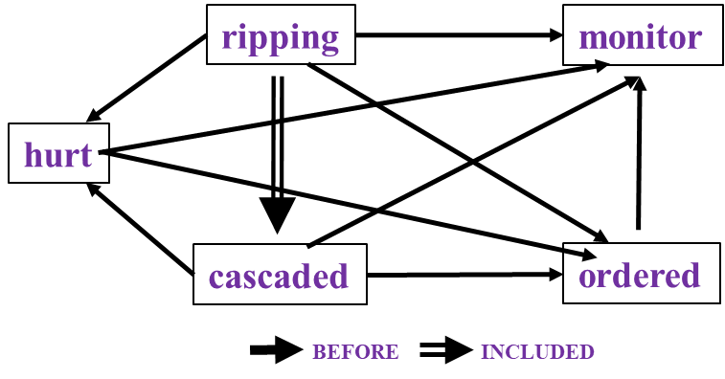
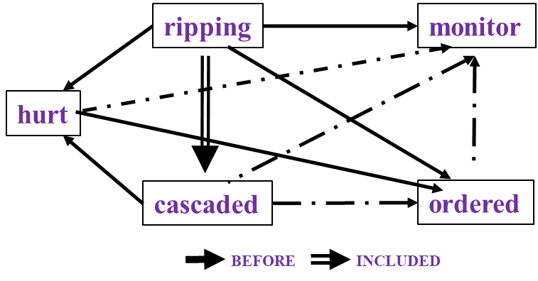

Time and Events [Ning et al. *SEM’2018; ACL’18, EMNLP’18, EMNLP’19; Wang et al. EMNLP’20]
In Los Angeles that lesson was brought home today when tons of earth cascaded down a hillside, ripping two houses from their foundations. No one was hurt, but firefighters ordered the evacuation of nearby homes and said they'll monitor the shifting ground until March 23rd.
Very difficult task— hinders exhaustive annotation (O(N²) edges)
But, it’s rather easy to get partial annotation – some relations.
And, we have strong expectations from the output
  Transitivity
  Some events tend to precede others, or follow others
Reasoning: How to exploit these [declarative & statistical] “expectations”?
How/why does it impact generalization & supervision?
cascaded
ordered
Time
ripping
Must be before

Slide 39
Event distributions Support Temporal Relations
Notes:
We also plotted the distribution of events that usually precede or follow specific events, of course, in terms of time. Although we only have the verbs here, we can still get some intuitive answers.

Slide 40
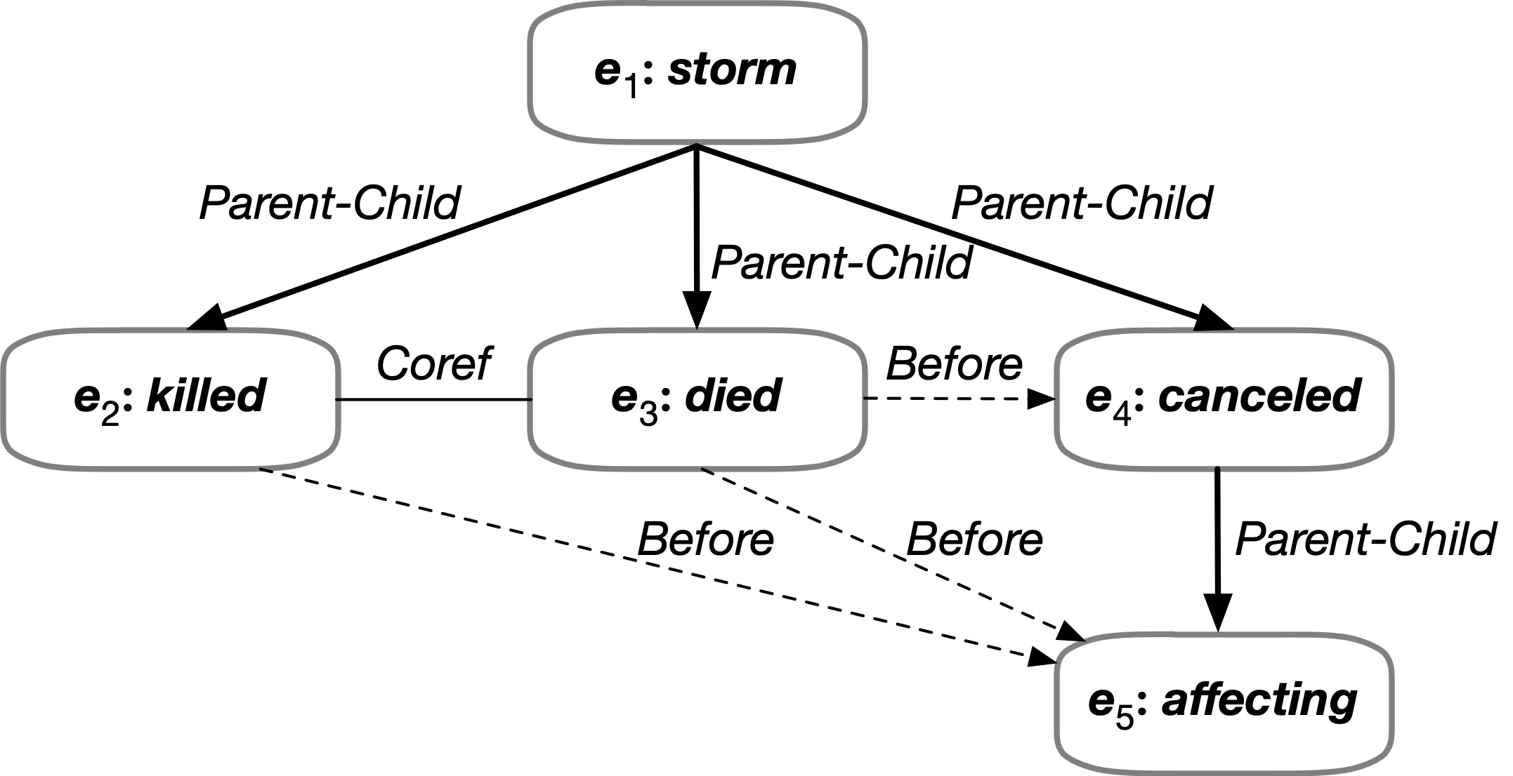

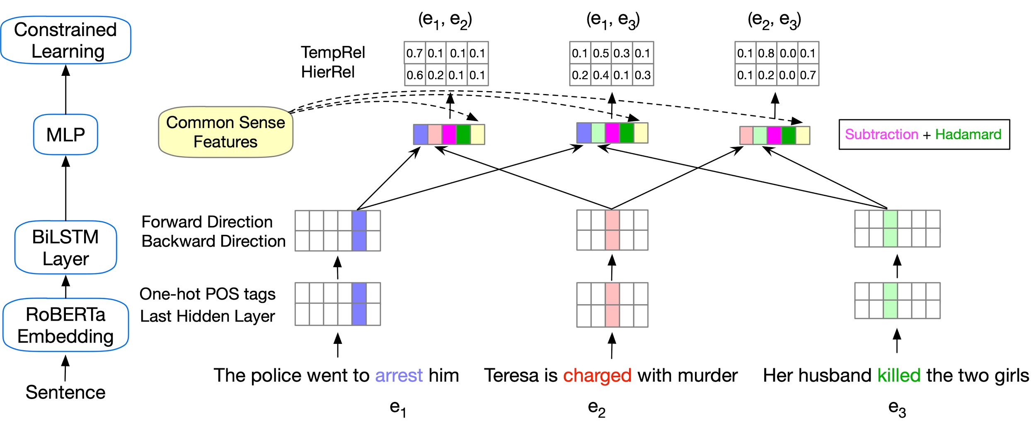
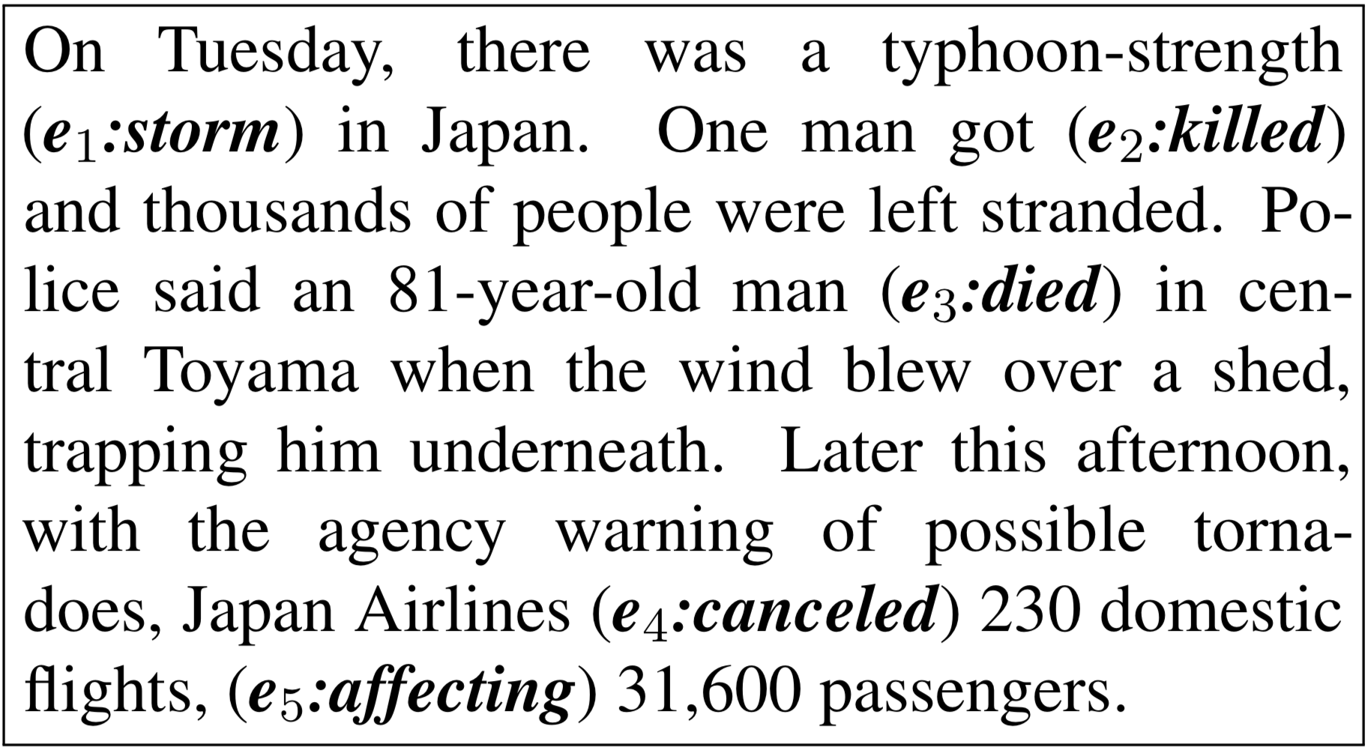
More Reasoning: Event Complexes [Wang et al. EMNLP’20]
Enforcing more logical constraints: Temporal, Symmetry, and Conjunctive by converting declarative constraints into differentiable learning objectives [Li & Srikumar ACL’19]
Temporal Relations
Subevent Relations
Event Coreference

Slide 41
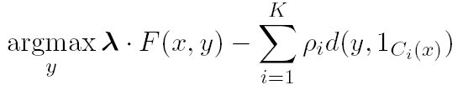
Information extraction
Lars Ole Andersen . Program analysis and specialization for the C Programming language. PhD thesis. DIKU , University of Copenhagen, May 1994 .
Prediction result of a trained HMM
Lars Ole Andersen . Program analysis and
specialization for the
C
Programming language
. PhD thesis .
DIKU , University of Copenhagen , May
1994 .
[AUTHOR]
[TITLE]
[EDITOR]
[BOOKTITLE]
[TECH-REPORT]
[INSTITUTION]
[DATE]
Violates lots of natural constraints!
Notes:
41
41

Slide 42
Strategies for Improving the Results
Increasing the model complexity
Increase difficulty of Learning
Can we keep the learned model simple and still make expressive decisions?
(Pure) Machine Learning Approaches
  Higher Order HMM/CRF?
  Increasing the window size?
  Adding a lot of new features
    Requires a lot of labeled examples
  What if we only have a few labeled examples?
Other options?
  Constrain the output to make sense
  Push the (simple) model in a direction that makes sense
Notes:
42

Slide 43
Examples of Constraints
Each field must be a consecutive list of words and can appear at most once in a citation.
State transitions must occur on punctuation marks.
The citation can only start with AUTHOR or EDITOR.
The words pp., pages correspond to PAGE.
Four digits starting with 20xx and 19xx are DATE.
Quotations can appear only in TITLE
…….
Easy to express pieces of “knowledge”
Non Propositional; May use Quantifiers

Slide 44
Information Extraction with Constraints
Adding constraints, we get correct results!
  Without changing the model
[AUTHOR] Lars Ole Andersen .
[TITLE] Program analysis and specialization for the
C Programming language .
[TECH-REPORT] PhD thesis .
[INSTITUTION] DIKU , University of Copenhagen ,
[DATE] May, 1994 .
Notes:
44

Slide 45
Guiding (Semi-Supervised) Learning with Constraints
In traditional Semi-Supervised learning the model can drift away from the correct one.
Constraints can be used to generate better training data
  At training to improve labeling of un-labeled data (and thus improve the model)
  At decision time, to bias the objective function towards favoring constraint satisfaction.
Seed examples
Model
Constraints
Better Predictions
Better model-based labeled data
Un-labeled Data
Decision Time
Constraints

Slide 46

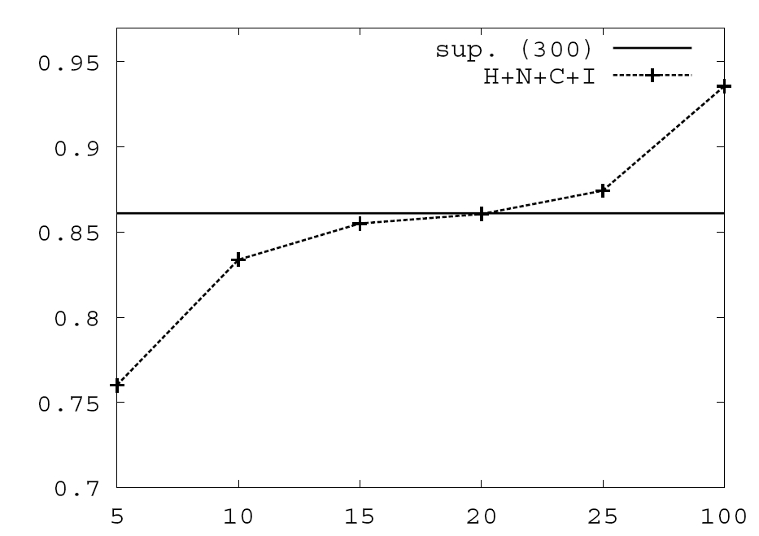
Value of Constraints in Semi-Supervised Learning
Objective function:
Learning w/o Constraints: 300 examples.
Constraints are used to Bootstrap a semi-supervised learner
Poor model + constraints used to annotate unlabeled data, which in turn is used to keep training the model.
Learning w 10 Constraints
# of available labeled examples

Slide 47
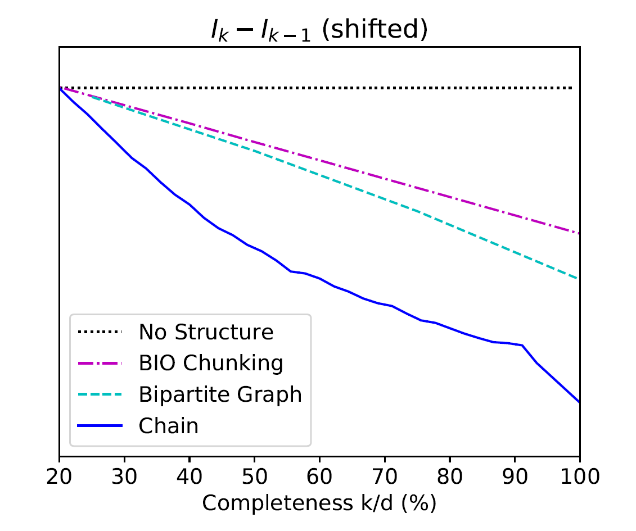
Why Does Structure Help? [Ning et al. NAACL’19]
$$Δ_{k}=I_{k}−I_{k−1} \text{: }\text{The} \text{benefit} \text{of} \text{a} \text{new} \text{label}$$
Chain:
Temporal Relation Extraction
Information-theoretic considerations support quantifying the benefit of additional labels
The tighter the structure is, the smaller the benefit of an additional label is.
Consequently, better generalization even with a partial set of supervision signals.
+: p<5%
++: p<1%
++
++
++
++
++
++
++
++
+
more concave
Bipartite Graph:
Semantic Role Classification
Seq Tagging
Shallow Parsing
++
++
++
++
++
++
Notes:
When we think about it from the supervision perspective, we can ask: what is the benefit of getting a new label. And the observation, that we make using some information theoretic tools that I will not detail here is what you expect – the tighter the structure is, the smaller the benefit of a new labels is.
Consider for example this graph, and let’s think about two extreme cases. I want to label the edges, and I have the constraint that all the edges have the same label. Or, the edges’ labels are completely independent.
And indeed, we can also show experimentally, on a range of NLP problems, that this holds – the tighter the structure is, the smaller the number of examples you need…
Given that we are using constraints – structure, as an indirect supervision signal we can also think about – what kind of signals are needed to actually support learnability.

Slide 48
Theory

Slide 49
What can we Say about our ability to learn?
Assume that instead of the “perfect” supervision signal you get:
  Noisy signals
  Partial Signals
  Constraints
  Supervision from other (related tasks)
Is it possible to learn the target task from these signals?

Slide 50
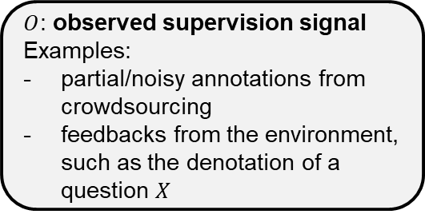





Learnability with Indirect Supervision Signals
(Wang, Ning, Roth, NeurIPS 2020)
Framework
We studied the problem of learning with general forms of supervision signals ($O$), any signals that contain (partial) information about the true label.
  Examples: noisy/partial labels, constraints, or indirect feedback from the environment.
We proposed a general learning scheme, which uses the predicted label to induce predictions about $O.$ The prediction is evaluated by the observed signals (fig. 1).
Question: Under what conditions on the indirect supervision can we guarantee learnability of the original classification problem?
update parameters
$\hat{Y}$: predicted label
(the gold label is not observed)
$P(\hat{O})$:
induced prediction of the supervision signal
$O$: observed supervision signal
Examples:
partial/noisy annotations from crowdsourcing
feedbacks from the environment, such as the denotation of a question $X$
$X$: input instance
$L$: loss
task
induce
Figure 1: Learning Scheme
Notes:
The fundamental goal here is the ability to replace standard supervised learning with the use of indirect, weak, and cheap supervision signals.
To understand this we study a general learning scheme where the supervision comes from any signal that contains partial information abut the true label.

Slide 51
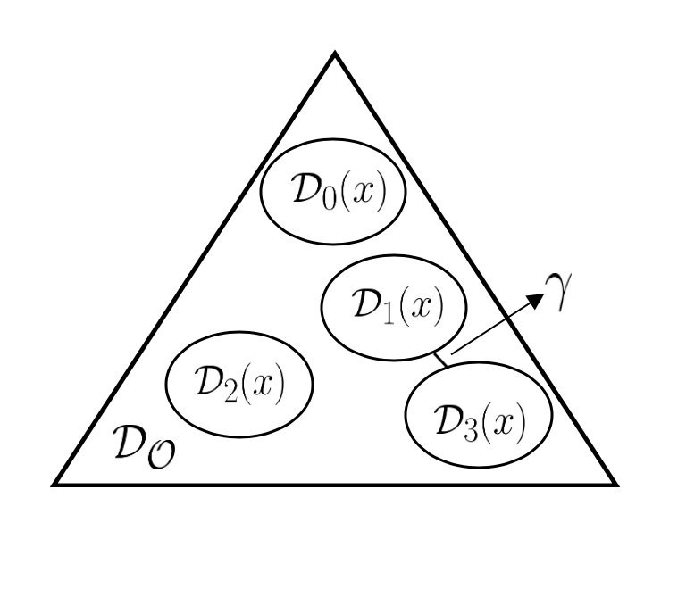




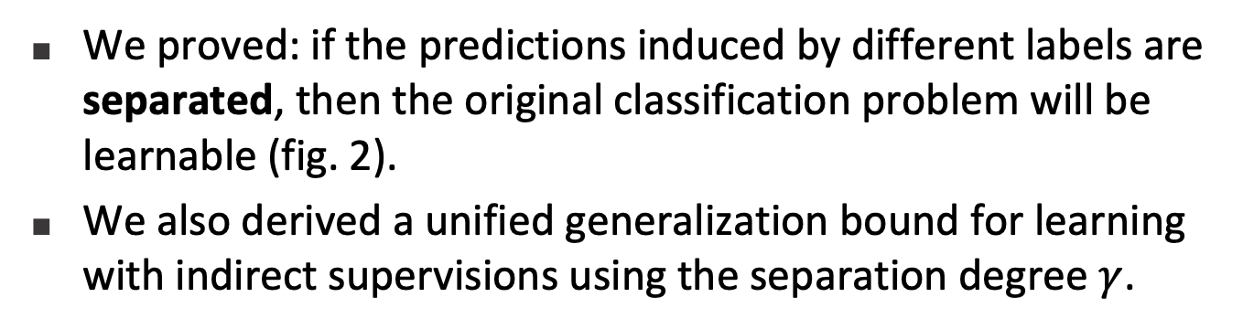
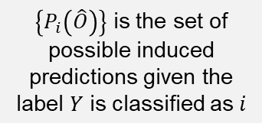
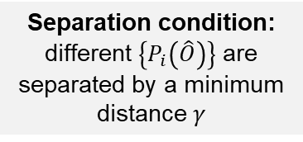
Learnability with Indirect Supervision Signals
(Wang, Ning, Roth,
To appear in NeurIPS 2020)
$\left\{P_{i}\left(\hat{O}\right)\right\}$ is the set of possible induced predictions given the label $Y$ is classified as $i$
Theory
We proved: if the predictions induced by different labels are separated, then the original classification problem will be learnable (fig. 2).
We also derived a unified generalization bound for learning with indirect supervisions using the separation degree $γ$.
$$\{P_{1}\left(\hat{O}\right)\}$$
$$\{P_{2}\left(\hat{O}\right)\}$$
$$\{P_{3}\left(\hat{O}\right)\}$$
$$\{P_{4}\left(\hat{O}\right)\}$$
Applications
Our result can be applied to recover the previous results about learnability with noisy and partial labels.
It will also help us to find and combine supervision signals that is easier to collect and ensures learnability.
Separation condition: different $\left\{P_{i}\left(\hat{O}\right)\right\}$ are separated by a minimum distance $γ$
Figure 2: Separation
(4-class Classification Example)

