Slide 1
Learnability with Indirect Supervision Signals (NeurIPS 2020)
Kaifu Wang, Qiang Ning and Dan Roth

Slide 2
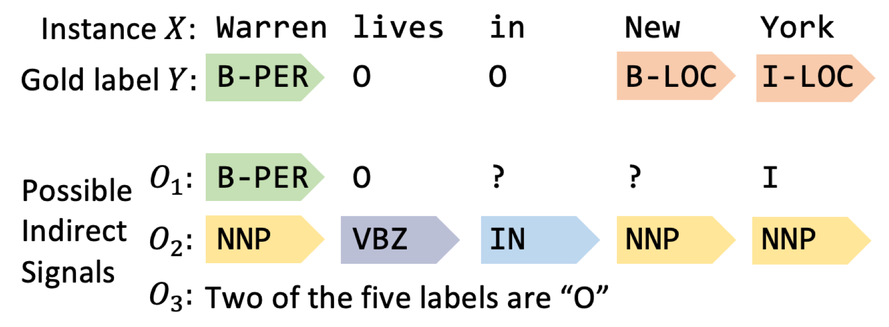
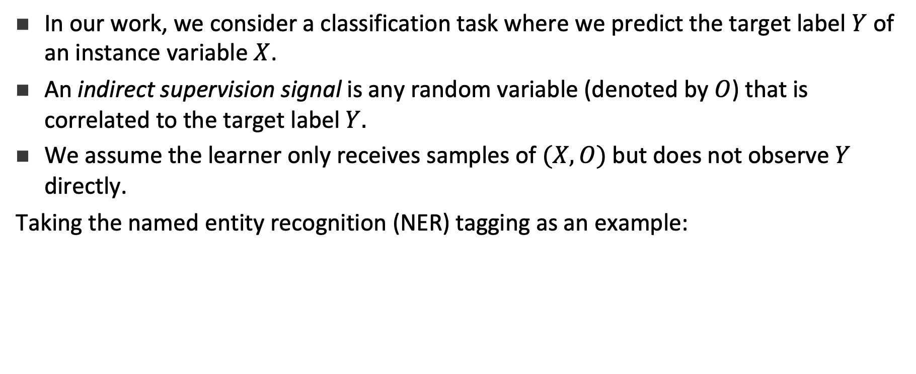
Motivation
In our work, we consider a classification task where we predict the target label $Y$ of an instance variable $X$.
An indirect supervision signal is any random variable (denoted by $O$) that is correlated to the target label$Y.$
We assume the learner only receives samples of $(X,O)$but does not observe $Y$ directly.
Taking the named entity recognition (NER) tagging as an example:

Slide 3
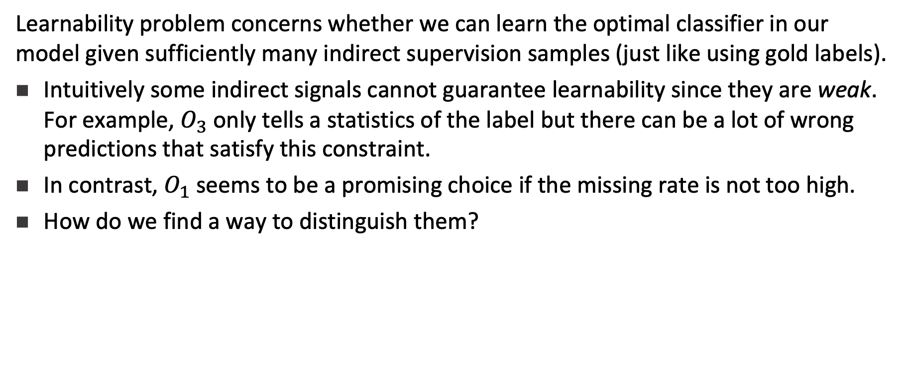
Problems
Learnability problem concerns whether we can learn the optimal classifier in our model given sufficiently many indirect supervision samples (just like using gold labels).
Intuitively some indirect signals cannot guarantee learnability since they are weak. For example, $O_{3}$ only tells a statistics of the label but there can be a lot of wrong predictions that satisfy this constraint.
In contrast, $O_{1}$ seems to be a promising choice if the missing rate is not too high.
How do we find a way to distinguish them?

Slide 4
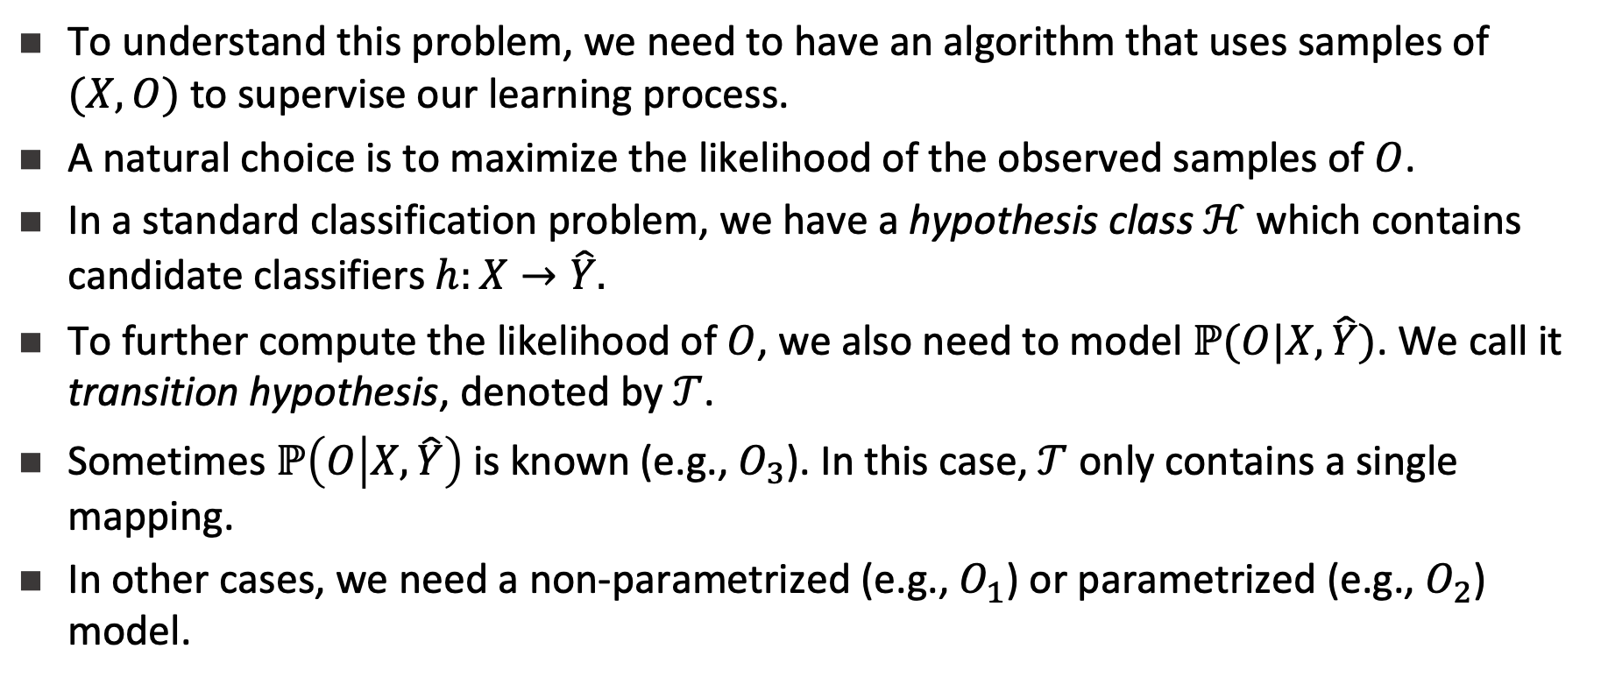
Learning
To understand this problem, we need to have an algorithm that uses samples of $(X,O)$to supervise our learning process.
A natural choice is to maximize the likelihood of the observed samples of $O$.
In a standard classification problem, we have a hypothesis class $ℋ$which contains candidate classifiers $h:X→\hat{Y}.$
To further compute the likelihood of $O$, we also need to model $ℙ(O|X,\hat{Y})$. We call it transition hypothesis, denoted by $𝒯$.
Sometimes $ℙ\left(O | X,\hat{Y}\right)$is known (e.g., $O_{3}$). In this case,$𝒯$ only contains a single mapping.
In other cases, we need a non-parametrized (e.g., $O_{1}$) or parametrized (e.g., $O_{2}$) model.

Slide 5

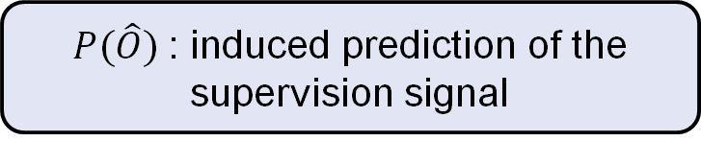

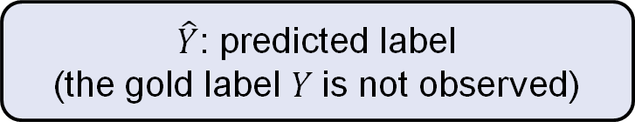
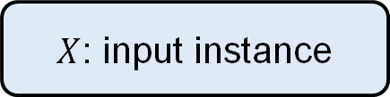
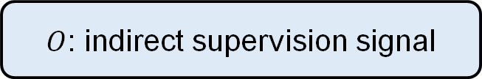
Learning (contd.)
Our learning framework is shown in the figure. The learner uses the prediction of $Y$ to induce predictions about $O.$This prediction is then evaluated by the observed dataset. The annotation loss is used to update the classifier and the transition hypothesis.
Dataset
$X$: input instance
$O$: indirect supervision signal
Classification
Hypothesis
Update
$\hat{Y}$: predicted label
(the gold label $Y$is not observed)
Transition
Hypothesis
Update
$P(\hat{O})$: induced prediction of the supervision signal
$ℓ_{𝒪}$: annotation loss

Slide 6
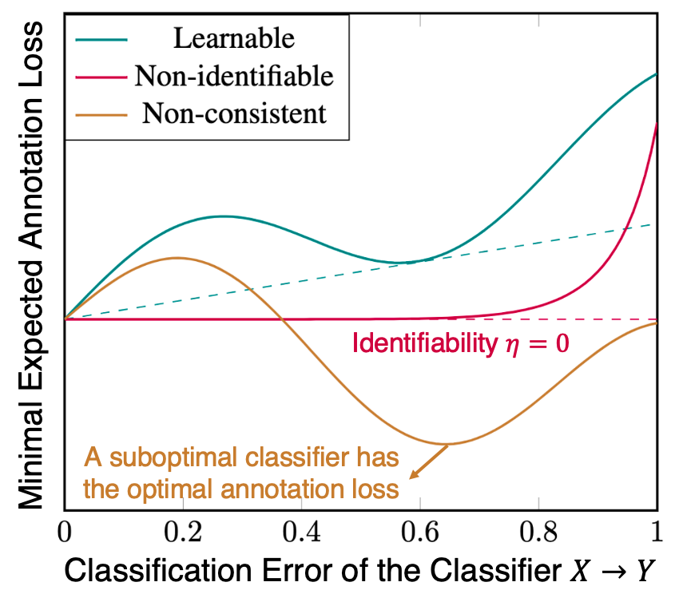

Learnability Condition: Overview
To illustrate the learnability condition, we plot the the relationship between the classification error of a hypothesis $h$ and the minimum annotation loss (risk) it can have (over choices of transition hypotheses).

Slide 7
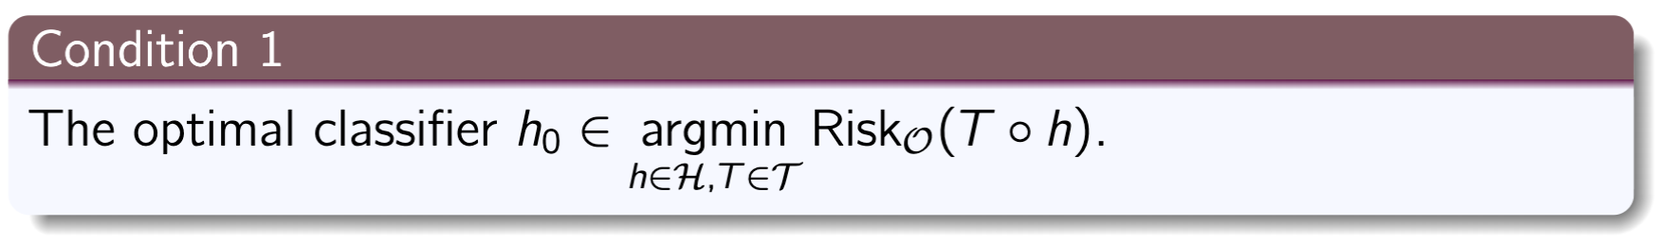
Learnability Condition 1: Consistency
The optimal classifier should be able to induce an optimal prediction of the indirect signal. Formally, we require:
Remark: When the consistency condition does not hold (this can happen when our signal is very noisy), maximizing the likelihood of the observable will contradict our goal of maximizing the likelihood of the true label.

Slide 8
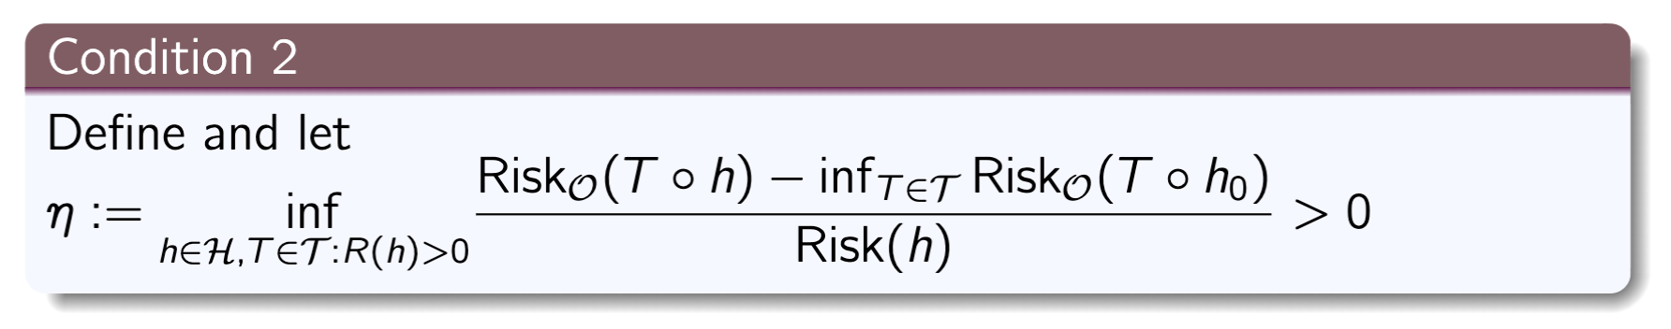

Learnability Condition 2: Identifiability
A suboptimal classifier should induce higher annotation loss than the lowest annotation loss on average. Formally, we require
Remark: $O_{2}$may fail to satisfy this condition (with some models) because it is possible that we can predict PoS tagging well without the knowledge of NER.

Slide 9
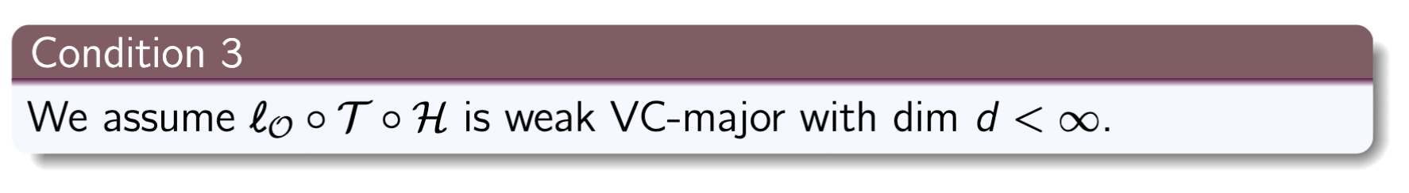
Learnability Condition 3: Complexity
Our model should not be too complex. Complexity of a model can be described by (a generalized) VC-dimension. Formally, we require:

Slide 10
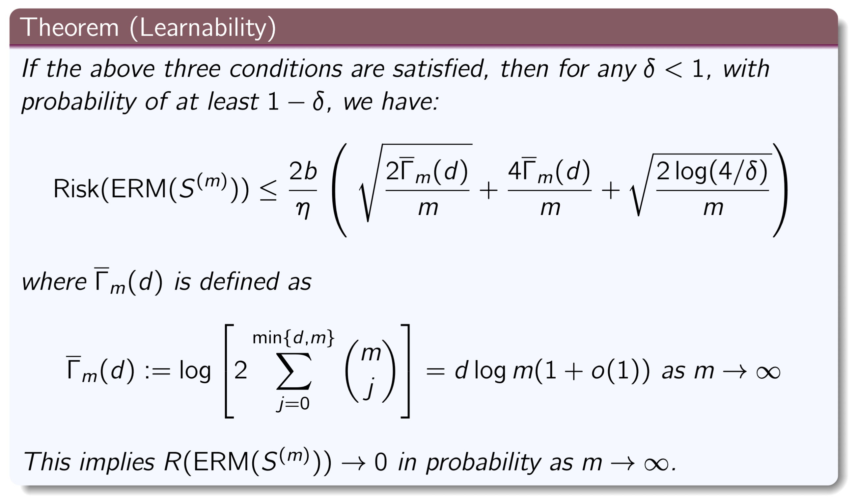
Learning Bound
Now we are able to state the first main result:
In words, we can find the optimal classifier as we have a large training set.

Slide 11
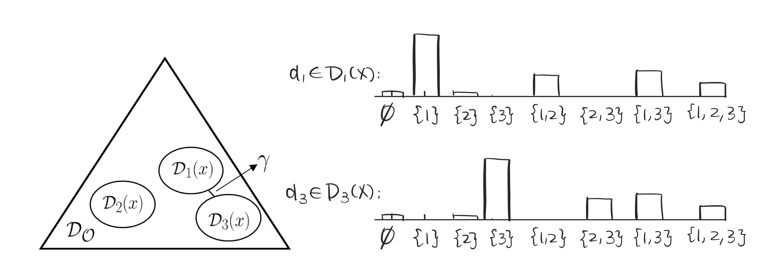


Separation: Illustration
To check the first two conditions with the learner's prior knowledge, we further propose the separation condition. We illustrate the definition using the example of partial label $O$ for a 3-class classification problem where $O$is identified as a subset of the label space {1,2,3}.
A (predicted) label $y_{i}$will induce a distribution family on the annotation space$𝒪$, denoted as $𝒟_{i}(x)$. Separation condition requires different families are separated by a minimal distance $γ>0$.

Slide 12
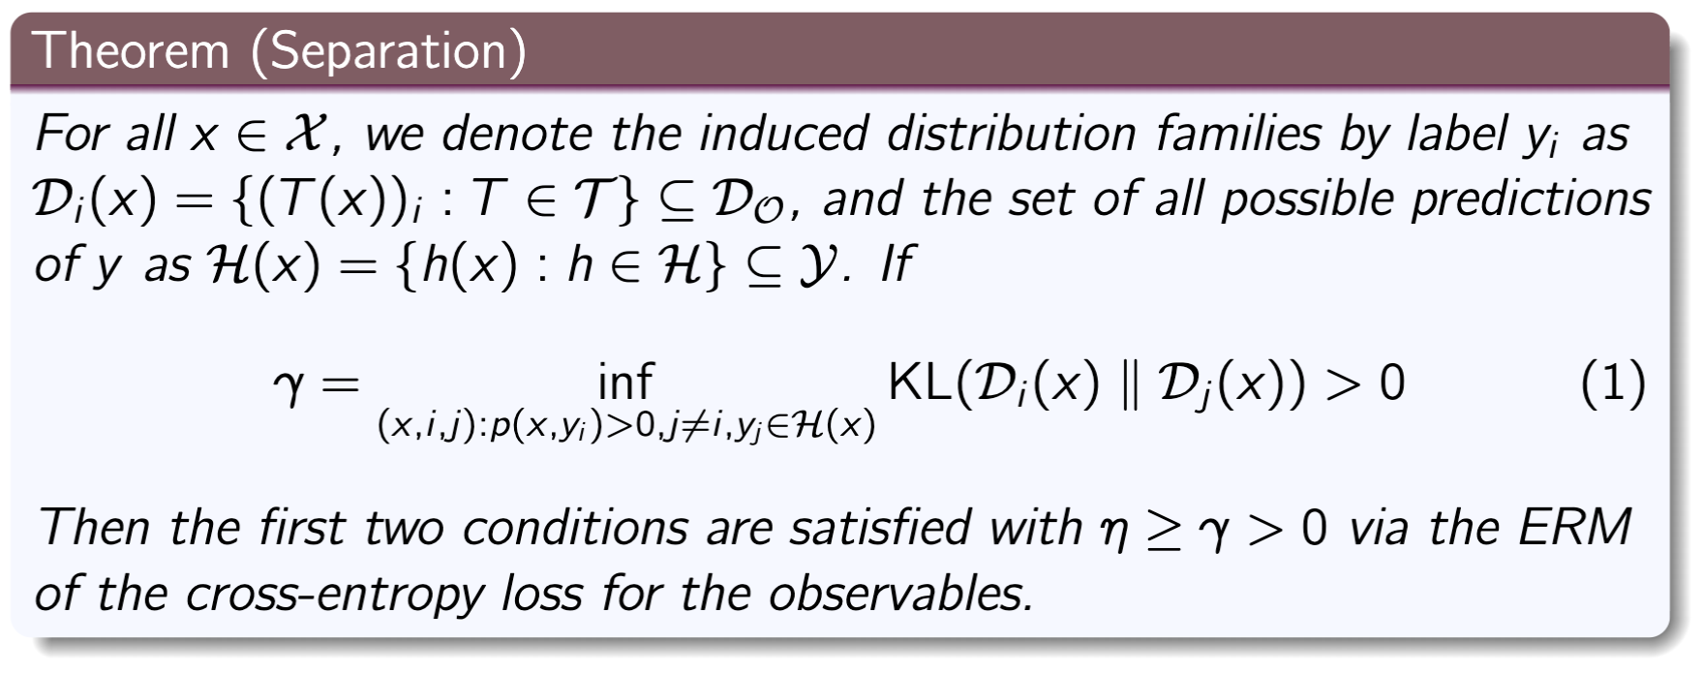
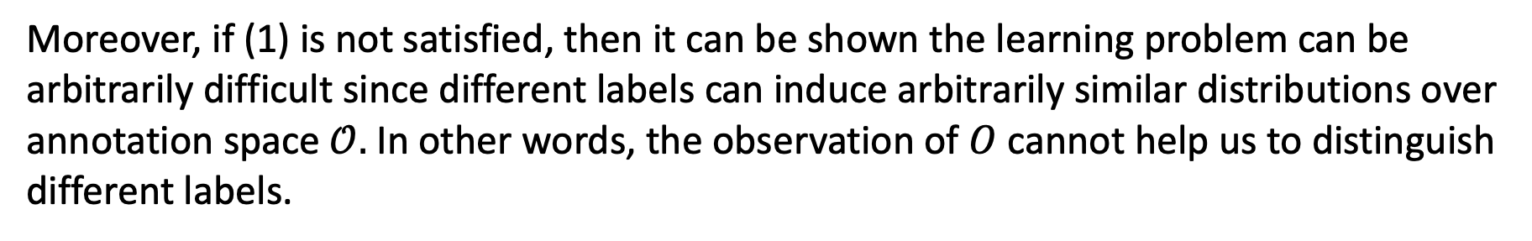
Separation: Formal Definition
Moreover, if (1) is not satisfied, then it can be shown the learning problem can be arbitrarily difficult since different labels can induce arbitrarily similar distributions over annotation space$𝒪.$In other words, the observation of $O$ cannot help us to distinguish different labels.

Slide 13
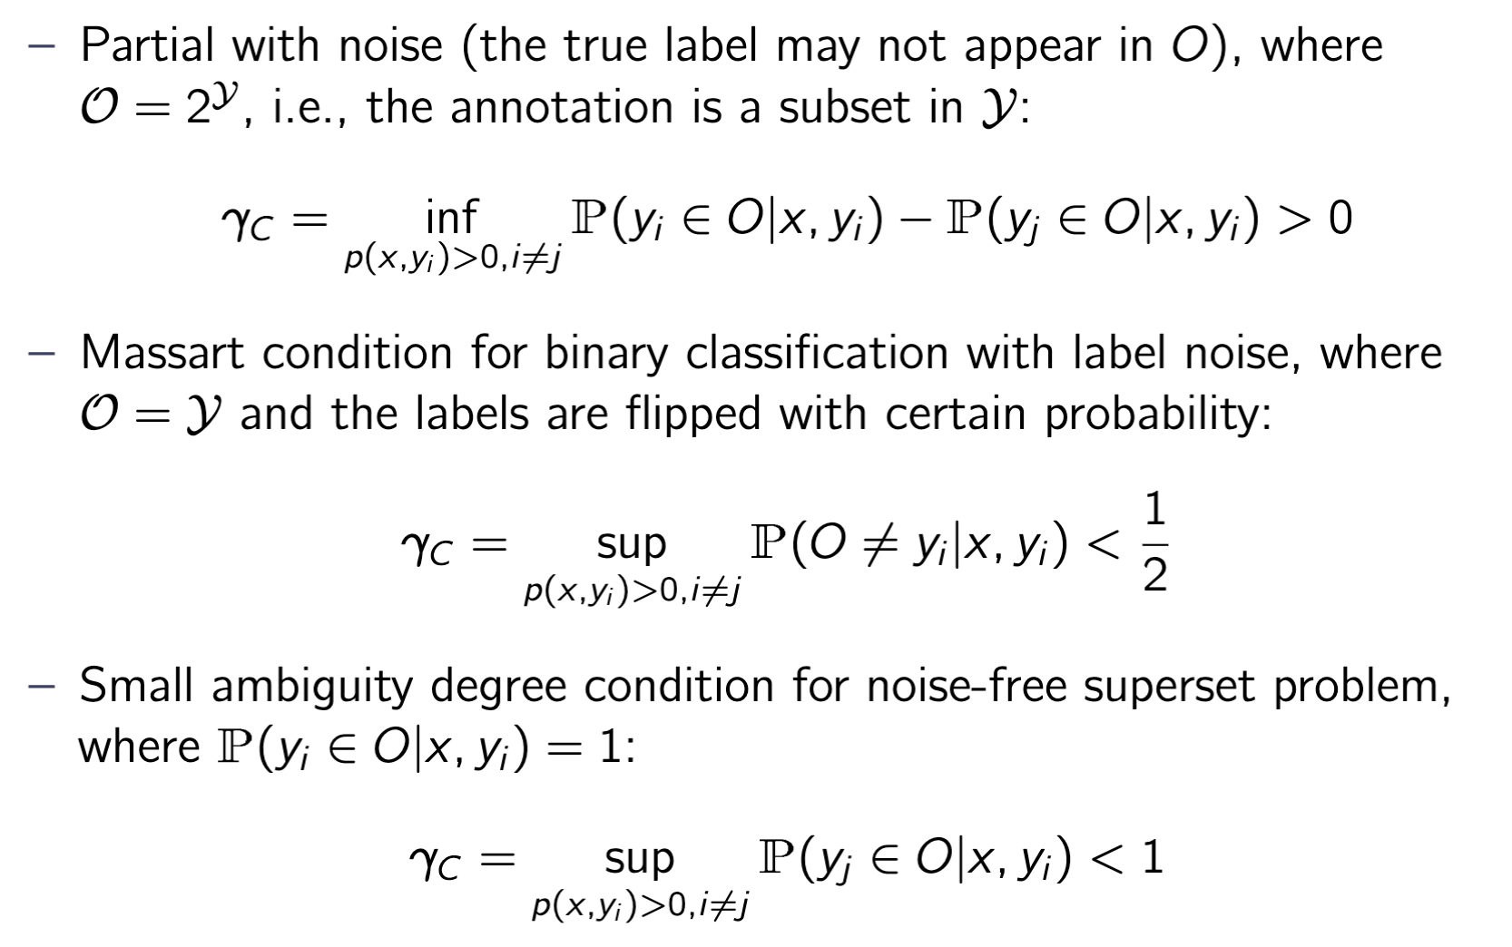
Application: Partial Annotation with Noise
In this way, we can include many learning conditions for specific scenarios proposed in literature as special cases of separation:

Slide 14
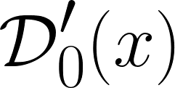
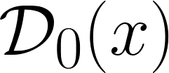
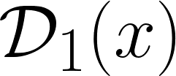
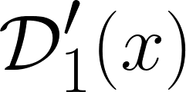
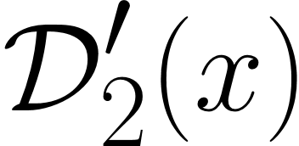
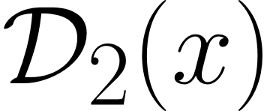

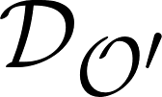
Application: Joint Supervision
If a single source of supervision signal cannot ensure learnability, it should be used jointly with other signals. We show that a joint supervision can:
Harm the separation if supervision signals are simply mixed. This is due to the convexity of the KL-divergence.
Preserve the pairwise separation if modelled properly. This effect is visualized in the following figure, where each signal cannot separate one pair of labels, but can be combined to ensure global separation.
Create new separation: If there are constraints between different signals, these constraints can be utilized to supervise the learning.
+
=

Slide 15
Thank you

